Slide 1
Receptive Fields of Single Neurones in the Cat’s Striate Cortex D.H. Hubel and T.N. Wiesel
Presentation:
Bradley Hughes

Slide 2
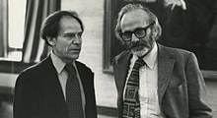
Wiesel & Hubel
Notes:
Hubel and Wiesel received the Nobel Prize for two major contributions: firstly, their work on development of the visual system, which involved a description of ocular dominance columns in the 1960s and 1970s; and secondly, their work establishing a foundation for visual neurophysiology, describing how signals from the eye are processed by visual parcels in the neo-cortex

Slide 3
Vocabulary
The receptive field of an individual sensory neuron is the particular region of the sensory space (e.g., the body surface, or the visual field) in which a stimulus will modify the firing of that neuron.
Acute preparation – the animal is anesthetized and restrained
Contralateral: opposite side.
Iposilateral - the same side.
Inhibitory response – does not fire during stimulus (off)
Excitatory response – fires during stimulus
Notes:
I found parts some of the language foreign as I read this so I thought I’d share what I discovered.

Slide 4
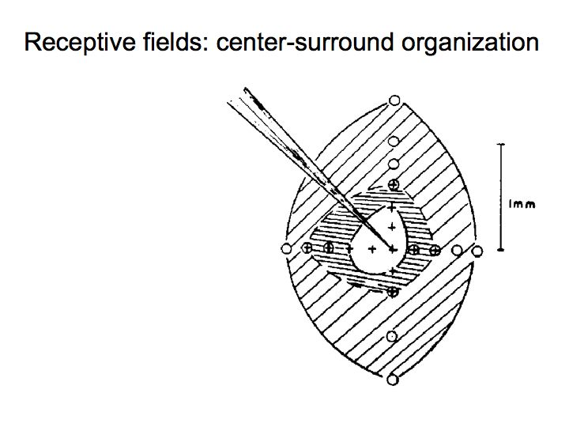
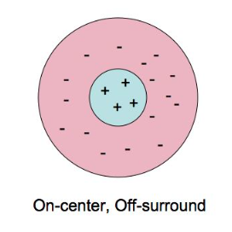
Background
Kuffler (1953) – showed cat retinal ganglion cells have concentric receptive fields
“on” in the center and “off” periphery
Barlow, FitzHugh, Kuffler (1957) – showed that a smaller spot in the center of field more response than covering entire field
Notes:
This work looked to extend the work of Kuffler, which showed, by inserting an electrode into the cats retina and shining spots of light in the visual field, the receptive fields of a single ganglion cell

Slide 5
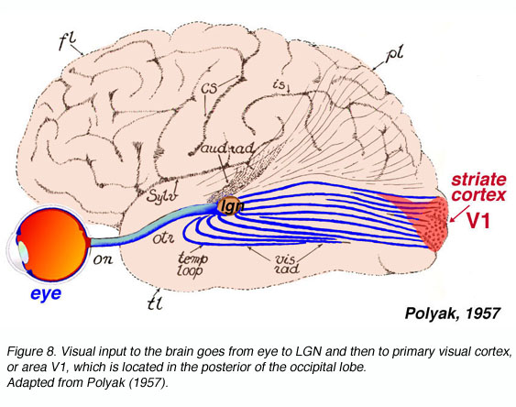
Present Research
Notes:
Hubel and Wiesel identified the visual pathway as a particularly interesting part of the brain because it enabled research to examine single cell responses at multiple levels. Kuffler had looked at the retina and now they wanted to see if the receptive fields in the striate cells matched those in the retina when stimulated.
Warning: The next slide has a graphic, but blurry photo of a cat in acute preparation.

Slide 6
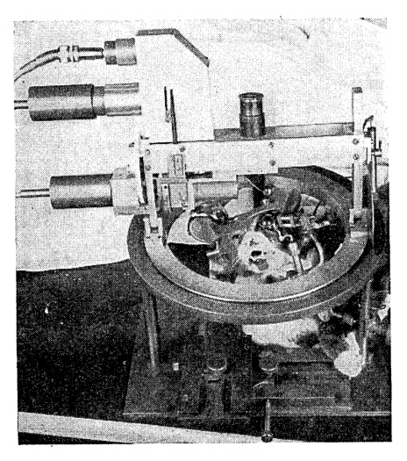
Methods
Acute preparation
Multibeam Opthalmascope
Single cell activity recorded
extracellularly via electrode
Electrode in lateral gyrus
Notes:
Basically, they anesthetized the cat, put it into this restraint, and used a machine to systematically shine light on the retina and recorded the response in a neuron in the striate cortex.
Does anyone have questions about the methods before I get into the results?

Slide 7
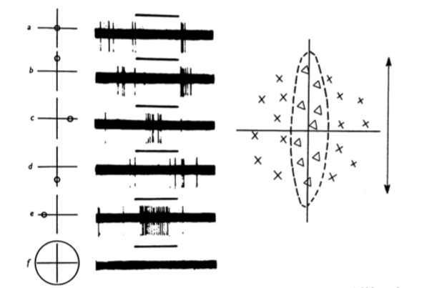
Results
Most cells had restricted area of retina that when light was shined on caused them to fire
Figure 1. Hubbel and Wiesel (1959)
Notes:
Explain the figure.
First, they identified the cells receptive field, finding that most had a an alternating pattern of elongated excitatory and inhibitory regions
The excitatory regions fired when light was shown on them and the inhibitory showed decreased activity followed by a burst of impulses when the light was turned off.
Here, the triangles indicate off areas and the crosses on areas during stimulus
When both excitatory and inhibitory regions stimulated at the same time the cells showed a weaker response. A large spot shone on the entirety of the receptive field resulted in no response

Slide 8
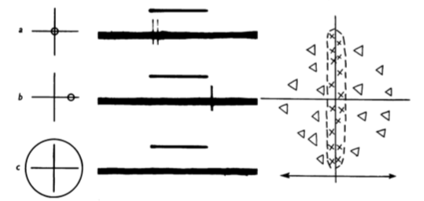
Results
Figure 2. Hubbel and Wiesel (1959)
Notes:
Another cell with the opposite pattern of excitatory and inhibitory areas

Slide 9
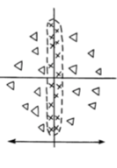
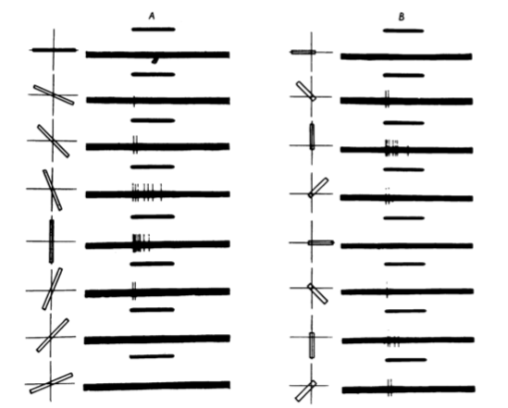
Results
Figure 3. Hubbel and Wiesel (1959)
Notes:
This is the same cell as figure 2. They rotated a bar of light and found that when it overlapped too much of the inhibitory regions the stimulus elicited no response. A is a bar across the whole field and B is rotated like the hand of a clock, so it only crosses into one inhibitory field as it rotates from vertical.

Slide 10
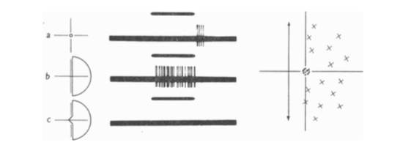
Results
Figure 4. Hubbel and Wiesel (1959)
Notes:
Although most of the cells displayed the side by side alternating fields, some were different. This cell with a small inhibitory area in the middle and a large excitatory field to the left displays similar activation. In row a with a small dot of light in the inhibitory region there is slight activation. In b there is activation when light is shown only on the large excitatory region, but in c when the small inhibitory region is included there is no response

Slide 11
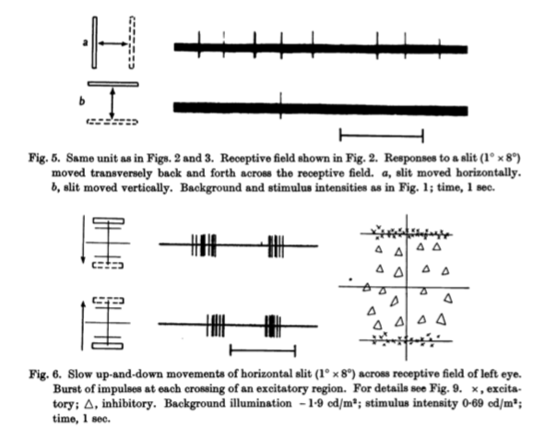
Results - Movement
Notes:
Most cells showed activation when the light crossed the boundaries of the on, off regions.
To figure the same neuron as figure 2.
There are more examples of this in the paper.

Slide 12
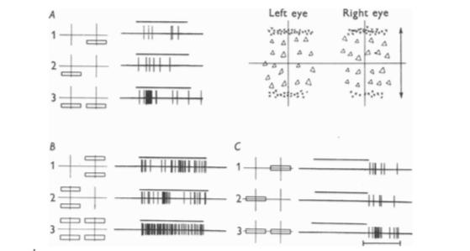
Results - Binocular
Figure 9. Hubbel and Wiesel (1959)
Notes:
They studied 45 neurons. 36 cells could be activated from only one eye, 15 from only the ipsolateral eye and 21 from the contralateral.
9 could be activated from both eyes independently. Here they show activation from one and then both eyes while stimulating either one or both of the excitatory regions of this cell.

Slide 13
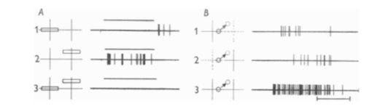
Results - Binocular
Figure 10. Hubbel and Wiesel (1959)
Notes:
Here they show that with binocular vision moving from an inhibitory to an excitatory greatly increases response, surprisingly as all other combinations of inhibitory and excitatory cells led to no response.

Slide 14
Discussion
Showed at another level of the vision system that cells had both inhibitory and excitatory regions
Identified the receptive fields of single cells in the striate cortex, whcih and showed side by side elongated pattern of inhibitory and excitatory areas.
Demonstrated that activation in antagonistic areas leads to lesser or no response
Identified the importance of movement in the activation of striate cortex cells
Notes:
1. IN addition to the retinal ganglions

Slide 15
Discussion
Identified cells that were activated by the ipsolateral, contrlateral, and both eyes.
Receptive fields in binocularly driven cells similar.
Interaction between excitatory and inhibitory cells in binocular cell

Slide 16
References
Barlow, H. B., FitzHugh, R., & Kuffler, S. W. (1957). Change of organization in the receptive fields of the cat's retina during dark adaptation. J.Physiol.137,338-354.
Hubel, D. H., & Wiesel, T. N. (1959). Receptive fields of single neurones in the cat’s striate cortex. The Journal of Physiology, 148(3), 574–591.
Kuffler, S. W. (1953). Discharge patterns and functional organization of mammalian retina. J.Neurophysiol.16,37-68.

