Slide 1
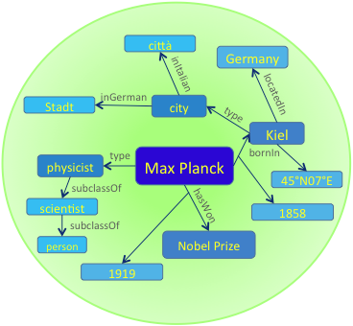
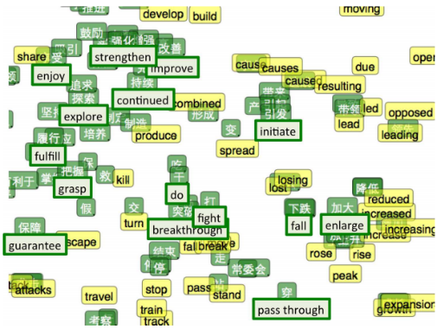
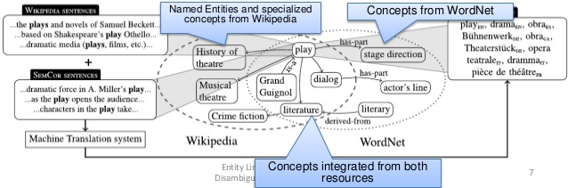

Latent Cross-Lingual Concepts
(Vulić et al.)
Multilingual Knowledge
bases
Yago
(Suchanek et al.)
Universal Syntactic Processing
(Petrov et al.)
Multilingual representation spaces
Multilingual linguistic
processing
(Navigli et al.)
BilBOWA (Gouws et al.)

