Slide 1
Customer Buying Patterns
BLACKWELL ELECTRONICS
Customer Data Analysis

Slide 2
OVERVIEW
Blackwell Electronics is developing 2016 sales and marketing plans. The goal of this report is to inform these plans by analyzing recent in-store and online customer data.
Specific questions asked of the data team:
Do customers in different regions spend more per transaction? Which regions spend the most/least?
Are there differences in the age of customers between regions? If so, can we predict the age of a customer in a region based on other demographic data?
Can we predict the amount a customer will spend per transaction based on other data we have collected about that customer?
Is there any correlation between age of a customer and if the transaction was made online or in the store?
Do any other factors predict if a customer will buy online or in our stores?

Slide 3
SOURCE DATA
Demographic data with following attributes were collected and analyzed for 80000 customers:
Type of purchase
In-store or online
Customer’s age
Range from 18 to 85
Number of items purchased
Amount per purchase
Range from $5 to $3000
Region of purchase
East
West
South
Central

Slide 4
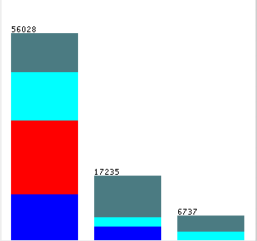
SPENDING BY REGION
East
West
South
Question: Do customers in different regions spend more per transaction?
Answer: Yes
Observations:
West region spends least; averaging about $ 253 per transaction
South and Central regions spend the most; up to $3000 per purchase
Central region made the most number of purchases
Central
Under $1000
$1000 - $2000
$2000-$3000
Notes:
All transactions in West region are under $1000.

Slide 5
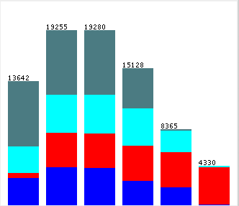
AGE BY REGION
Question: Are there differences in the age of customers between regions? If so, can we predict the age of a customer in a region based on other demographic data?
Answer: Correlation between age and region is poor except for West region
Observations:
Can predict customers in age group 74-85 years old to be in West region
Likewise, can predict customers in Central region are under 74
Very small minority in age group 18 – 28 is in the West region
Age:
18 -28
29-39
40-50
51-61
62-73
74-85
West
Central
East
South

Slide 6
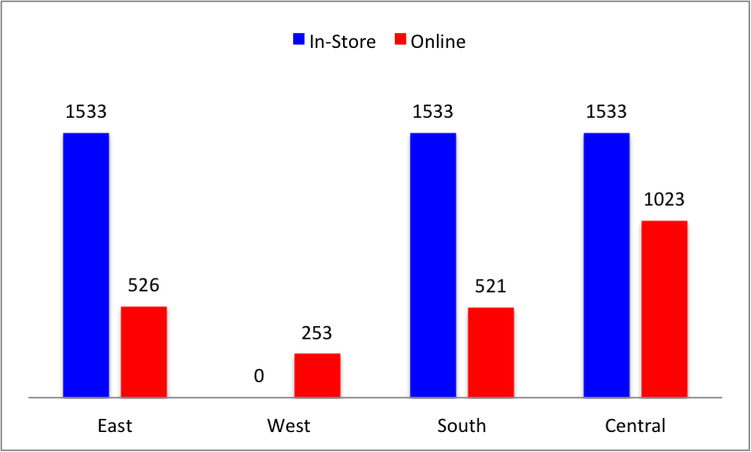
SPENDING PER TRANSACTION
Question: Can we predict the amount per transaction a customer will spend based on other data we have collected about that customer?
Answer: Yes
Observations:
Region, In-store, and Age attributes help with prediction
Model predicted the spending per transaction values 67% of the time
Western region only shops online.
Notes:
Use graph from Xcel worksheet
The entire West region shops online only. Why? Lack of brick-and-mortar stores?

Slide 7
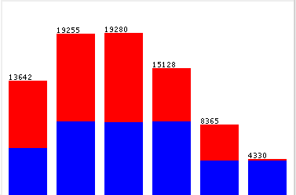
AGE: ONLINE vs. IN-STORE
Question: Is there any correlation between customer’s age and online or in-store transaction?
Answer: Correlation for 74-85 age group is strong, but poor for the rest of the age groups
Observations:
Predict correctly about 90% of the time for age group 74-85 to make online purchase
Even split for online vs. in-store purchase for all regions combined.
18 -28
29-39
40-50
51-61
62-73
74-85
In-store
Online

Slide 8
PREDICTION: ONLINE vs. IN-STORE
Rules:
East region: shop in-store
West region: shop online
South region:
If amount <= $1000, shop in-store
If amount > $1000, shop online
Central region:
If amount <= $2000, and
If age is 18 – 51, shop in-store
If age is 73 – 85, shop in-store
If age is 52 – 63, and
If amount <= $100, shop in-store
If amount > $100, shop online
If amount > $2000, shop online
Question: Do any other factors predict if a customer will buy online or in our stores?
Answer: Yes
Observations:
Rules (on right) have 88% accuracy
Region and Amount, coupled with Age, are strong predictors for shopping in-store vs. online

Slide 9
CONCLUSIONS
Blackwell Electronics data team should consider the following when developing 2016 sales and marketing plan:
Western region spends the least because lack of physical stores in this area. Should consider:
Adding brick and mortar stores in this region to capture the predicted $1533 per transaction as seen by the East, South and Central regions
Most of the 73-85 year olds are from the West region, who did all of their shopping online. Target this group with more online specials
East, West, and South regions may benefit from online marketing campaign. Learn from Central region
West region has the smallest group of customer aged 18-28. Target this age group in Western region with new marketing campaign to increase market share
Notes:
West region has the highest population of 74-85 yr olds. All of purchases done online and each transaction is about $253 on the average. We need to encourage this age group to spend more by getting them into the stores.
This region also has the smallest population of 18-28 yr olds. Should encourage more of this age group to shop either online or in-store. Should target marketing campaign here, too.

Slide 10
Next Steps
Are we targeting the right customer groups?
Age group 18-28 in the West for online purchases
Is the 18-28 group representative of the general population for the West region
Adding brick and mortar stores in West region to capture the predicted $1533 per transaction as seen by the East, South and Central regions
In general, most of the age group 74-85 shop in-store. And the West region has the highest population of 74-85 yr olds, all of whom shop online. This highlights the need for brick-and-mortar store in West region.
In-store purchases drop significantly after age 50. Why? Need to investigate so we can properly target ad campaign.
West region also has the smallest population of 18-28 yr olds. Should encourage more of this age group to shop either online or in-store. Should target marketing campaign here, too.
Notes:
Will need more data (general population, in addition to what’s provided) to understand age group 18-28 in the West region as well as age group older-than-61 in Central region
In-Store purchases drop after age 50, any significance? Need to do more study to investigate why …

