Slide 1
DISPLIB TRAIN DISPATCHING
comparison spine
Mathematical model
mapped to code
01
Data objects
Operation graph, resources, objective components
02
Path logic
Flow constraints choose one route per train
Formula screenshots on the left; baseline Gurobi MIP in the middle; extended OR-Tools CP-SAT on the right.
03
Safety logic
Resource exclusivity and anti-swapping order
04
Cost logic
Weighted delay objective and implementation gap
Eq(1)
Route feasibility and running times
Eq(2)
Pairwise shared-resource precedence
Eq(3)
Global event order against swapping
Output: editable PowerPoint deck for the optimization lab report.
01

Slide 2
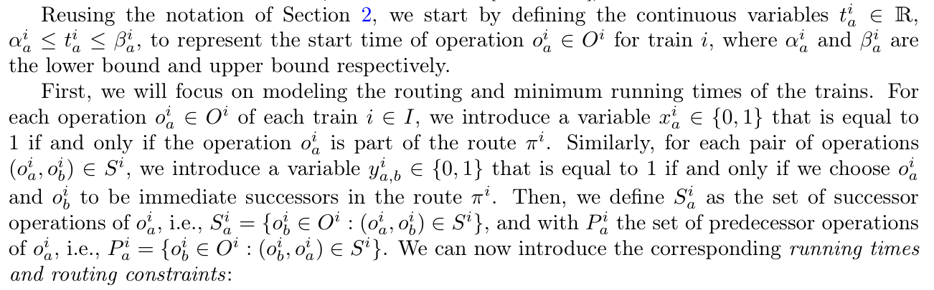
MODEL MAP 02
Both solvers start from the same DISPLIB objects.
The formulation changes, but the parsed problem vocabulary is shared.
Mathematical expression
Baseline MIP
Extended CP-SAT
phase1_baseline/src/data_parser.py
phase2_extend/src/data_parser.py
class Operation:
id: int
min_duration: int
successors: List[int]
start_lb: int = 0
start_ub: Optional[float] = None
resources: List[ResourceRequirement]
class ObjectiveComponent:
train: int
operation: int
threshold: int
coeff: float
class Operation:
id: int
min_duration: int
successors: List[int]
start_lb: int = 0
start_ub: Optional[float] = None
resources: List[ResourceRequirement]
find_conflict_pairs()
-> (train_i, op_a, train_j,
op_b, resource, lambda_i,
lambda_j)
Paper: variable and routing vocabulary
O_i
train.operations
S_i
op.successors
op.resources + release_time
BASELINE ROLE
EXTENDED ROLE
Psi
The parser turns the DISPLIB JSON into the objects that the Gurobi MIP loops over.
CP-SAT uses the same data objects, so the comparison isolates the modeling layer.
Data parser: phase1_baseline/src/data_parser.py:5 and phase2_extend/src/data_parser.py:5.
02

Slide 3
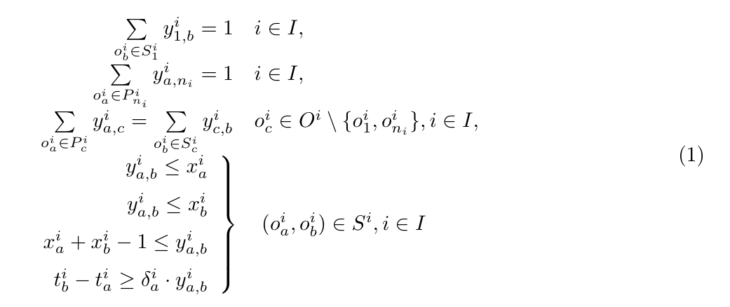
MODEL MAP 03
Route feasibility is the same path problem in two languages.
A train must select one path from entry operation to exit operation.
Mathematical expression
Baseline MIP
Extended CP-SAT
mip_model.py:70-102
cp_model.py:156-188
# Entry and exit
sum(y[entry, succ]) == 1
x[entry] == 1
sum(y[pred, exit]) == 1
x[exit] == 1
# Intermediate operations
sum_in = sum(y[pred, op])
sum_out = sum(y[op, succ])
sum_in == sum_out
sum_in == x[op]
# Link y to x
y[op, succ] <= x[op]
y[op, succ] <= x[succ]
x[op] + x[succ] - 1 <= y[op, succ]
# Entry and exit
Add(x[start] == 1)
Add(x[end] == 1)
# Flow out
Add(sum(y[op, succ])
== x[op])
# Flow in
Add(sum(y[pred, op])
== x[op])
# Same route variable names
x = active operation
y = selected successor arc
Paper Eq. (1): routing and running-time constraints
MATH MEANING
The first three lines choose a path. The next three link selected arcs y to selected operations x. The last line enforces the minimum duration.
Baseline uses Gurobi linear constraints; extension uses CP-SAT Boolean constraints.
03

Slide 4
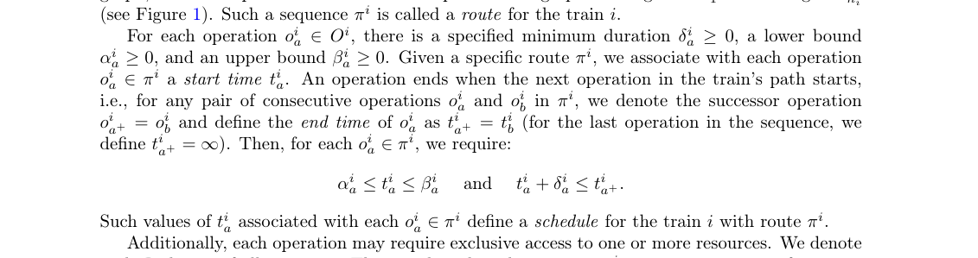
MODEL MAP 04
Time feasibility becomes variable bounds and interval timing.
The CP-SAT version turns the same start-time logic into interval variables.
Mathematical expression
Baseline MIP
Extended CP-SAT
mip_model.py:32-34, 101-102
cp_model.py:50-67, 190-197
# Start-time variable
ub = op.start_ub if finite else GRB.INFINITY
t[train, op] = addVar(
lb=op.start_lb,
ub=ub,
vtype=GRB.CONTINUOUS
)
# Minimum duration
addConstr(
t[train, succ] - t[train, op]
>= op.min_duration * y[train, op, succ]
)
# Start, duration, end
starts = NewIntVar(lb, ub)
durations = NewIntVar(
op.min_duration, horizon
)
ends = NewIntVar(
lb + op.min_duration,
horizon * 2
)
# Optional interval
NewOptionalIntervalVar(
starts, durations, ends, x
)
# Successor timing
Add(starts[succ] == ends[op])
.OnlyEnforceIf(y)
Problem definition: time window and minimum duration
MATH MEANING
Each selected operation starts within its lower and upper bound. The next operation may start only after the minimum duration has elapsed.
The CP-SAT model expresses scheduling through optional intervals rather than only start-time inequalities.
04

Slide 5
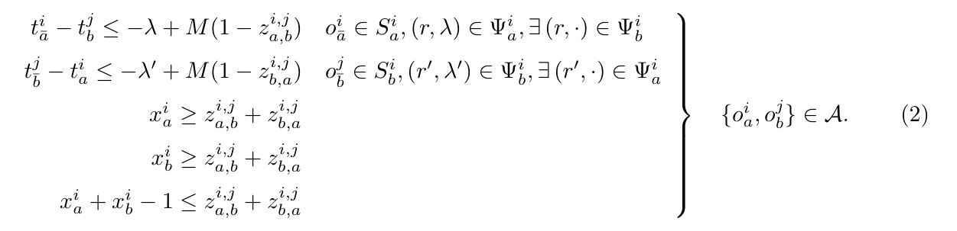
MODEL MAP 05
Resource safety is pairwise precedence in MIP and no-overlap in CP-SAT.
Both prevent two trains from occupying the same resource before release time has passed.
Mathematical expression
Baseline MIP
Extended CP-SAT
mip_model.py:43-53, 106-148
cp_model.py:69-119
conflicts = find_conflict_pairs()
z_ab = addVar(BINARY)
z_ba = addVar(BINARY)
# If both ops selected, one order
x_a + x_b - 1 <= z_ab + z_ba
x_a >= z_ab + z_ba
x_b >= z_ab + z_ba
# If a before b
(z_ab == 1) >>
(t[succ_a] - t[o2] <= -lambda_a)
# If b before a
(z_ba == 1) >>
(t[succ_b] - t[o1] <= -lambda_b)
# Build an optional interval
iv = NewOptionalIntervalVar(
starts, durations, ends, x
)
# Include release time by extending
# the resource occupation interval
ext_dur = durations + release_time
ext_end = ends + release_time
ext_iv = NewOptionalIntervalVar(
starts, ext_dur, ext_end, x
)
resource_intervals[res].append(ext_iv)
# Native scheduling constraint
AddNoOverlap(resource_intervals[res])
Paper Eq. (2): pairwise resource constraints
Conflict set A
MATH MEANING
For every shared resource pair, decide which operation goes first and separate their times by the release headway.
Baseline mirrors the paper's z variables; extension uses CP-SAT's interval scheduling primitive.
05

Slide 6
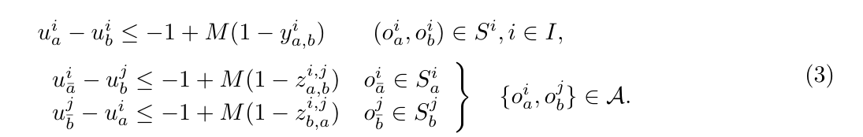
MODEL MAP 06
Global ordering prevents unrealistic same-time swapping.
The u variable gives simultaneous events a physically valid sequence.
Mathematical expression
Baseline MIP
Extended CP-SAT
mip_model.py:36-37, 132-164
cp_model.py:47-49, 146-153, 268-273
u[train, op] = addVar(lb=0)
# Same-train order
(y[op, succ] == 1) >>
(u[op] - u[succ] <= -1)
# Cross-train conflict order
(z_ab == 1) >>
(u[succ_a] - u[o2] <= -1)
(z_ba == 1) >>
(u[succ_b] - u[o1] <= -1)
# Export order
events.sort(key=(time, u))
u[train, op] = NewIntVar(
0, number_of_operations
)
# Same-train order
Add(u[succ] >= u[op] + 1)
.OnlyEnforceIf(y)
# Cross-train conflict order
Add(u[o2] >= u[succ_a] + 1)
.OnlyEnforceIf([z_ab, y])
# Export order
events.sort(key=(time, Value(u)))
Paper Eq. (3): ordering constraints
MATH MEANING
The paper needs a global event order Pi, not just sorted times. This matters when operations or release times can be zero.
REPORT PHRASE
We use u as a topological rank to make the exported event list verifier-compatible.
Implementation note: MIP u is continuous in the current code; CP-SAT u is integer.
06

Slide 7
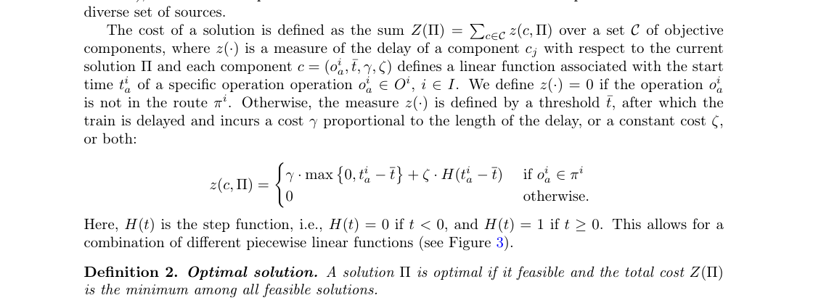
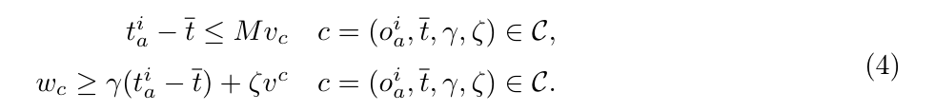
MODEL MAP 07
The objective minimizes weighted delay of selected operations.
Both implementations calculate the linear delay term; the fixed step term is a current limitation.
Mathematical expression
Baseline MIP
Extended CP-SAT
mip_model.py:55-58, 166-183
cp_model.py:200-229
v[c] = addVar(BINARY)
w[c] = addVar(lb=0)
t_a = t[comp.train, comp.operation]
x_a = x[comp.train, comp.operation]
(x_a == 1) >>
(t_a - threshold <= M * v[c])
(x_a == 1) >>
(w[c] >= coeff * (t_a - threshold))
Minimize(sum(w))
over_time = NewIntVar(0, horizon * 2)
Add(over_time >= starts[op] - threshold)
.OnlyEnforceIf(x_a)
cost = NewIntVar(0, max_cost)
Add(cost == over_time * scaled_coeff)
.OnlyEnforceIf(x_a)
Add(cost == 0)
.OnlyEnforceIf(x_a.Not())
Minimize(sum(costs))
Problem definition: delay cost z(c, Pi)
Paper Eq. (4): MILP objective constraints
MATH MEANING
Cost activates when a selected objective operation starts after its threshold. The paper allows both linear delay and a fixed step penalty.
LIMITATION
Current code implements coeff * max(0, delay). DISPLIB's fixed increment / zeta step penalty is not fully implemented.
Objective exports as objective_value in the DISPLIB solution JSON.
07

Slide 8
MODEL MAP 08
The extension preserves the problem definition, but changes the scheduling engine.
Use this slide as the closing comparison in the report.
Concept
Baseline MIP
Extended CP-SAT
Route choice
Binary x and y variables with linear flow constraints
Same Boolean x and y route logic in CP-SAT
Timing
Continuous start-time variables and duration inequalities
Integer starts, durations, ends, and optional intervals
Resource safety
Pairwise z precedence variables for every shared resource conflict
Resource occupation intervals with AddNoOverlap
Anti-swapping
Topological u rank and indicator constraints
Integer u rank enforced with OnlyEnforceIf conditions
Objective
Auxiliary v and w variables minimize weighted delay
Scaled integer cost variables minimize weighted delay
PRESENTATION SENTENCE
HONEST CAVEAT
Baseline = close implementation of the reference MILP. Extended = same DISPLIB feasibility logic, but resource conflicts are handled through CP-SAT scheduling primitives.
Mention two implementation details: fixed step penalty is missing, and MIP u is continuous while the paper defines it as integer.
Deck source: formula screenshots plus repository code in phase1_baseline/src and phase2_extend/src.
08

