Slide 1
DISPLIB TRAIN DISPATCHING
was ich hier zeige
Mathematisches Modell
im echten Code
01
Kein Pseudocode
Die Code-Boxen kommen direkt aus den .py-Dateien.
02
Genaue Stellen
Jeder Ausschnitt hat Datei und Zeilennummer.
Links: Formel. Mitte: Baseline mit Gurobi. Rechts: Extended Modell mit CP-SAT.
03
Zwei Solver
Gurobi schreibt man als MIP; CP-SAT als Scheduling-Modell.
04
Warum anders?
Andere Solverlogik: LP/Branch-and-Cut vs. Propagation/SAT-Suche.
Alle Code-Ausschnitte sind unveränderte Auszüge aus phase1_baseline/src und phase2_extend/src.
01

Slide 2
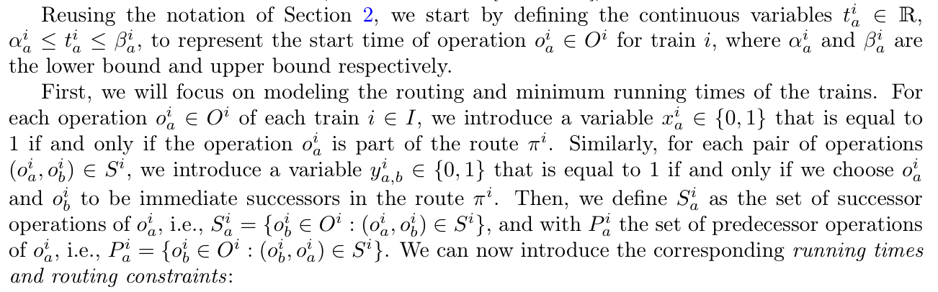
VERBATIM CODE MAP 02
Entscheidungsvariablen werden als echte Solver-Variablen angelegt.
Die Variablen heißen ähnlich, aber die Solver-Sprache ist unterschiedlich.
Mathematische Formulierung
Baseline-Code (Gurobi/MIP)
Extended-Code (CP-SAT)
phase1_baseline/src/mip_model.py:13-41
phase2_extend/src/cp_model.py:16-67
# Variables
self.x = {} # x[train.id, op.id]
self.y = {} # y[train.id, op_a.id, op_b.id]
self.t = {} # t[train.id, op.id]
self.u = {} # u[train.id, op.id]
self.z = {} # z[t1, o1, t2, o2]
self.z_ba = {} # z_ba tracking
self.v = {} # v[c_idx]
self.w = {} # w[c_idx]
self._build_model()
def _build_model(self):
# 1. Variables
for train in self.instance.trains:
for op in train.operations:
# Variable x_i,a (1 if operation is selected)
self.x[train.id, op.id] = self.model.addVar(vtype=GRB.BINARY, name=f"x_{train.id}_{op.id}")
# Variable t_i,a (start time)
ub = op.start_ub if op.start_ub is not None and op.start_ub < float('inf') else GRB.INFINITY
self.t[train.id, op.id] = self.model.addVar(lb=op.start_lb, ub=ub, vtype=GRB.CONTINUOUS, name=f"t_{train.id}_{op.id}")
# Variable u_i,a (ordering logic)
self.u[train.id, op.id] = self.model.addVar(lb=0, vtype=GRB.CONTINUOUS, name=f"u_{train.id}_{op.id}")
# Variable y_i,a,b (1 if operation b immediately follows a)
for succ in op.successors:
self.y[train.id, op.id, succ] = self.model.addVar(vtype=GRB.BINARY, name=f"y_{train.id}_{op.id}_{succ}")
# Core CP Variables
self.x = {} # x[train_id, op_id]: Boolean, 1 if operation is selected
self.y = {} # y[train_id, op_a, op_b]: Boolean, 1 if sequence A -> B is taken
self.u = {} # u[train_id, op_id]: Integer, topological sequence rank
self.starts = {} # starts[train_id, op_id]: Integer, start time
self.durations = {} # durations[train_id, op_id]: Integer, duration
self.ends = {} # ends[train_id, op_id]: Integer, end time
self.status = None
self.obj_val = float('inf')
# Use a scaling factor since CP-SAT only supports integers, but cost coefficients might be floats
self.COEFF_SCALE = 1000
self._build_model()
def _build_model(self):
resource_intervals = {} # {resource_name: [list of extended IntervalVars]}
obj_costs = [] # List of integer cost variables
# -----------------------------------------------------
# 1. Variables & Interval Construction
# -----------------------------------------------------
for train in self.instance.trains:
for op in train.operations:
t_id = train.id
o_id = op.id
# Active boolean var
self.x[t_id, o_id] = self.model.NewBoolVar(f"x_{t_id}_{o_id}")
self.u[t_id, o_id] = self.model.NewIntVar(0, sum(len(tr.operations) for tr in self.instance.trains), f"u_{t_id}_{o_id}")
# Time bounds mapping
lb = max(0, int(op.start_lb))
ub_val = op.start_ub
ub = self.horizon if (ub_val is None or ub_val == float('inf')) else min(self.horizon, int(ub_val))
if ub < lb: ub = lb # Safety fallback
self.starts[t_id, o_id] = self.model.NewIntVar(lb, ub, f"st_{t_id}_{o_id}")
self.durations[t_id, o_id] = self.model.NewIntVar(int(op.min_duration), self.horizon, f"dur_{t_id}_{o_id}")
self.ends[t_id, o_id] = self.model.NewIntVar(lb + int(op.min_duration), self.horizon + self.horizon, f"end_{t_id}_{o_id}")
# The heart of CP: Optional Interval Variable
iv = self.model.NewOptionalIntervalVar(
self.starts[t_id, o_id],
self.durations[t_id, o_id],
self.ends[t_id, o_id],
self.x[t_id, o_id],
f"iv_{t_id}_{o_id}"
)
Paper: Variablendefinitionen
SPRECHPUNKT
`x` wählt Operationen, `y` wählt direkte Nachfolger, `t` ist die Startzeit und `u` hilft später bei der Reihenfolge.
Gurobi nutzt addVar; CP-SAT nutzt BoolVar, IntVar und optionale Intervalle.
02

Slide 3
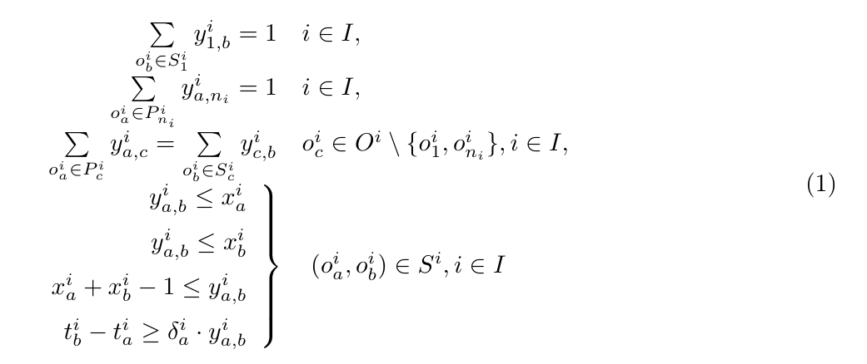
VERBATIM CODE MAP 03
Die Routenlogik steckt direkt in den Flow-Constraints.
Ein Zug muss vom Eingang zum Ausgang laufen, ohne in Zwischenknoten zu verschwinden.
Mathematische Formulierung
Baseline-Code (Gurobi/MIP)
Extended-Code (CP-SAT)
phase1_baseline/src/mip_model.py:70-102
phase2_extend/src/cp_model.py:156-188
# A) Flow constraints
for train in self.instance.trains:
entries = [op.id for op in train.operations if len(predecessors[train.id][op.id]) == 0]
exits = [op.id for op in train.operations if len(op.successors) == 0]
# Flow leaving entry
for entry in entries:
op = train.get_operation(entry)
self.model.addConstr(gp.quicksum(self.y[train.id, entry, succ] for succ in op.successors) == 1)
self.model.addConstr(self.x[train.id, entry] == 1)
# Flow entering exit
for exit in exits:
self.model.addConstr(gp.quicksum(self.y[train.id, pred, exit] for pred in predecessors[train.id][exit]) == 1)
self.model.addConstr(self.x[train.id, exit] == 1)
# Flow conservation for intermediate
for op in train.operations:
if op.id not in entries and op.id not in exits:
sum_in = gp.quicksum(self.y[train.id, pred, op.id] for pred in predecessors[train.id][op.id])
sum_out = gp.quicksum(self.y[train.id, op.id, succ] for succ in op.successors)
self.model.addConstr(sum_in == sum_out)
self.model.addConstr(sum_in == self.x[train.id, op.id])
# Logical y relates to x
for op in train.operations:
for succ in op.successors:
self.model.addConstr(self.y[train.id, op.id, succ] <= self.x[train.id, op.id])
self.model.addConstr(self.y[train.id, op.id, succ] <= self.x[train.id, succ])
self.model.addConstr(self.x[train.id, op.id] + self.x[train.id, succ] - 1 <= self.y[train.id, op.id, succ])
# Duration minimum
self.model.addConstr(self.t[train.id, succ] - self.t[train.id, op.id] >= op.min_duration * self.y[train.id, op.id, succ])
# 3. Flow Constraints (Entering & Leaving)
# -----------------------------------------------------
predecessors = {train.id: {op.id: [] for op in train.operations} for train in self.instance.trains}
for train in self.instance.trains:
for op in train.operations:
for succ in op.successors:
predecessors[train.id][succ].append(op.id)
for train in self.instance.trains:
t_id = train.id
starts_idx = [op.id for op in train.operations if len(predecessors[t_id][op.id]) == 0]
ends_idx = [op.id for op in train.operations if len(op.successors) == 0]
# Start Ops must be active (usually only 1 start)
for o_idx in starts_idx:
self.model.Add(self.x[t_id, o_idx] == 1)
# End Ops must be active (usually only 1 end)
for o_idx in ends_idx:
self.model.Add(self.x[t_id, o_idx] == 1)
for op in train.operations:
o_id = op.id
# Flow OUT: sum_out == x
if o_id not in ends_idx:
self.model.Add(sum(self.y[t_id, o_id, succ] for succ in op.successors) == self.x[t_id, o_id])
# Flow IN: sum_in == x
if o_id not in starts_idx:
preds = predecessors[t_id][o_id]
self.model.Add(sum(self.y[t_id, p, o_id] for p in preds) == self.x[t_id, o_id])
Paper Gl. (1): Routing-Constraints
SPRECHPUNKT
Am Eingang geht genau ein Weg raus. Am Ausgang kommt genau ein Weg rein. In der Mitte gilt: rein gleich raus.
Diese Folie ist der direkte Code-Gegenpart zu Gleichung (1).
03

Slide 4
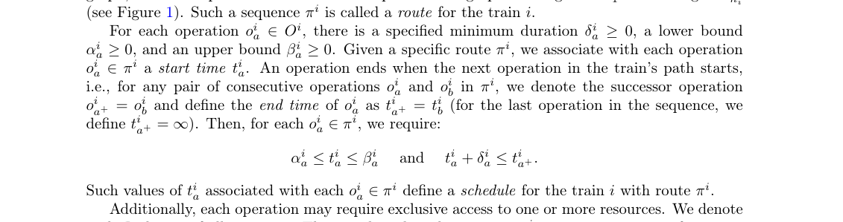
VERBATIM CODE MAP 04
Zeitfenster und Mindestdauern stehen an zwei Code-Stellen.
Im MIP gibt es Startzeiten; im CP-SAT Modell gibt es Start, Dauer, Ende und Intervalle.
Mathematische Formulierung
Baseline-Code (Gurobi/MIP)
Extended-Code (CP-SAT)
mip_model.py:32-34
cp_model.py:50-67
# Variable t_i,a (start time)
ub = op.start_ub if op.start_ub is not None and op.start_ub < float('inf') else GRB.INFINITY
self.t[train.id, op.id] = self.model.addVar(lb=op.start_lb, ub=ub, vtype=GRB.CONTINUOUS, name=f"t_{train.id}_{op.id}")
# Time bounds mapping
lb = max(0, int(op.start_lb))
ub_val = op.start_ub
ub = self.horizon if (ub_val is None or ub_val == float('inf')) else min(self.horizon, int(ub_val))
if ub < lb: ub = lb # Safety fallback
self.starts[t_id, o_id] = self.model.NewIntVar(lb, ub, f"st_{t_id}_{o_id}")
self.durations[t_id, o_id] = self.model.NewIntVar(int(op.min_duration), self.horizon, f"dur_{t_id}_{o_id}")
self.ends[t_id, o_id] = self.model.NewIntVar(lb + int(op.min_duration), self.horizon + self.horizon, f"end_{t_id}_{o_id}")
# The heart of CP: Optional Interval Variable
iv = self.model.NewOptionalIntervalVar(
self.starts[t_id, o_id],
self.durations[t_id, o_id],
self.ends[t_id, o_id],
self.x[t_id, o_id],
f"iv_{t_id}_{o_id}"
)
mip_model.py:101-102
Problemdefinition: Zeitfenster und Dauer
# Duration minimum
self.model.addConstr(self.t[train.id, succ] - self.t[train.id, op.id] >= op.min_duration * self.y[train.id, op.id, succ])
SPRECHPUNKT
cp_model.py:190-197
Die untere und obere Schranke kommen beim Erzeugen von `t`. Die Mindestdauer kommt später als Constraint zwischen Vorgänger und Nachfolger.
# Precedences Time Logic
for succ in op.successors:
# IF y[op->succ] is true => start(succ) == end(op)
# This is critical: the train occupies the resource until it physically starts the next operation!
self.model.Add(self.starts[t_id, succ] == self.ends[t_id, o_id]).OnlyEnforceIf(self.y[t_id, o_id, succ])
# Strict topological rank progression
self.model.Add(self.u[t_id, succ] >= self.u[t_id, o_id] + 1).OnlyEnforceIf(self.y[t_id, o_id, succ])
Die Code-Boxen sind bewusst nicht gekürzt oder in Pseudocode umgeschrieben.
04

Slide 5
VERBATIM CODE MAP 05
Die Konfliktmenge A wird im Parser aus gemeinsamen Ressourcen gebaut.
Das Modell bekommt die Konfliktpaare also schon vorbereitet.
Mathematische Formulierung
Baseline-Code (Gurobi/MIP)
Extended-Code (CP-SAT)
phase1_baseline/src/data_parser.py:85-113
phase2_extend/src/data_parser.py:85-113
def find_conflict_pairs(self) -> List[Tuple[int, int, int, int, str, int, int]]:
"""
Returns pairs of operations from different trains that require the same resource.
Returns tuples of (train_i, op_a, train_j, op_b, resource, lambda_i, lambda_j)
for i < j to avoid duplicate symmetric pairs.
"""
# Map resource -> list of (train_idx, op_idx, release_time)
res_map = {}
for t in self.trains:
for op in t.operations:
for req in op.resources:
if req.resource not in res_map:
res_map[req.resource] = []
res_map[req.resource].append((t.id, op.id, req.release_time))
conflicts = []
for res, usage_list in res_map.items():
for idx1 in range(len(usage_list)):
for idx2 in range(idx1 + 1, len(usage_list)):
t1, op1, l1 = usage_list[idx1]
t2, op2, l2 = usage_list[idx2]
if t1 != t2:
# ensure t1 < t2 for consistent ordering
if t1 > t2:
conflicts.append((t2, op2, t1, op1, res, l2, l1))
else:
conflicts.append((t1, op1, t2, op2, res, l1, l2))
return list(set(conflicts))
def find_conflict_pairs(self) -> List[Tuple[int, int, int, int, str, int, int]]:
"""
Returns pairs of operations from different trains that require the same resource.
Returns tuples of (train_i, op_a, train_j, op_b, resource, lambda_i, lambda_j)
for i < j to avoid duplicate symmetric pairs.
"""
# Map resource -> list of (train_idx, op_idx, release_time)
res_map = {}
for t in self.trains:
for op in t.operations:
for req in op.resources:
if req.resource not in res_map:
res_map[req.resource] = []
res_map[req.resource].append((t.id, op.id, req.release_time))
conflicts = []
for res, usage_list in res_map.items():
for idx1 in range(len(usage_list)):
for idx2 in range(idx1 + 1, len(usage_list)):
t1, op1, l1 = usage_list[idx1]
t2, op2, l2 = usage_list[idx2]
if t1 != t2:
# ensure t1 < t2 for consistent ordering
if t1 > t2:
conflicts.append((t2, op2, t1, op1, res, l2, l1))
else:
conflicts.append((t1, op1, t2, op2, res, l1, l2))
return list(set(conflicts))
Paper: Konfliktmenge A
SPRECHPUNKT
Zwei Operationen stehen im Konflikt, wenn sie zu verschiedenen Zügen gehören, aber dieselbe Ressource benutzen.
Die Parser-Logik ist in beiden Phasen gleich: Ressource scannen, Konfliktpaar erzeugen.
05

Slide 6
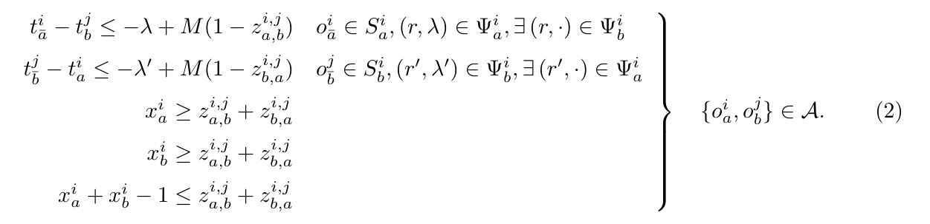
VERBATIM CODE MAP 06
Ressourcenkonflikte: Gurobi braucht Paarlogik, CP-SAT nutzt NoOverlap.
Das ist der wichtigste Grund, warum die beiden Codeblöcke so unterschiedlich aussehen.
Mathematische Formulierung
Baseline-Code (Gurobi/MIP)
Extended-Code (CP-SAT)
mip_model.py:43-53
cp_model.py:69-90
# Resource Precedence z variables
conflicts = self.instance.find_conflict_pairs()
for c in conflicts:
t1, o1, t2, o2, res, l1, l2 = c
# z_ab (1 if t1_o1 precedes t2_o2)
z_ab = self.model.addVar(vtype=GRB.BINARY, name=f"z_{t1}_{o1}_{t2}_{o2}_r_{res}")
# z_ba (1 if t2_o2 precedes t1_o1)
z_ba = self.model.addVar(vtype=GRB.BINARY, name=f"z_{t2}_{o2}_{t1}_{o1}_r_{res}")
self.z[t1, o1, t2, o2, res] = z_ab
self.z_ba[t1, o1, t2, o2, res] = z_ba
# Process resources for AddNoOverlap
for r_data in op.resources:
res_name = r_data.resource
rel_time = int(r_data.release_time)
if res_name not in resource_intervals:
resource_intervals[res_name] = []
# If there's a headway (release_time), we must artificially extend the block's end.
if rel_time > 0:
ext_dur = self.model.NewIntVar(int(op.min_duration) + rel_time, self.horizon + rel_time, f"ext_dur_{t_id}_{o_id}_{res_name}")
self.model.Add(ext_dur == self.durations[t_id, o_id] + rel_time)
ext_end = self.model.NewIntVar(lb + int(op.min_duration) + rel_time, self.horizon * 2 + rel_time, f"ext_end_{t_id}_{o_id}_{res_name}")
self.model.Add(ext_end == self.ends[t_id, o_id] + rel_time)
ext_iv = self.model.NewOptionalIntervalVar(
self.starts[t_id, o_id], ext_dur, ext_end, self.x[t_id, o_id], f"ext_iv_{t_id}_{o_id}_{res_name}"
)
resource_intervals[res_name].append(ext_iv)
else:
resource_intervals[res_name].append(iv)
Paper Gl. (2): Ressourcenreihenfolge
mip_model.py:125-148
self.model.addConstr(x_a >= z_ab + z_ba)
self.model.addConstr(x_b >= z_ab + z_ba)
self.model.addConstr(x_a + x_b - 1 <= z_ab + z_ba)
op_a = self.instance.trains[t1].get_operation(o1)
op_b = self.instance.trains[t2].get_operation(o2)
for succ_a in op_a.successors:
# 1. Physical time-blocking: If Train 1 goes before Train 2 (z_ab==1), Train 1 must fully
# reach its next step (succ_a) before Train 2's timeline is allowed to start.
self.model.addConstr((z_ab == 1) >> (self.t[t1, succ_a] - self.t[t2, o2] <= -l1))
# 2. Cycle-crushing sequence: If Train 1 goes before Train 2, the topological rank (u-value)
# assigned to Train 1's next step must be strictly smaller than Train 2's start. This breaks cyclic swapping.
# --> Corresponds to DISPLIB Paper Eq (3) lower part: u_{a_bar}^i - u_b^j <= -1 + M(1 - z_{a,b}^{i,j})
# (u_{a_bar}^i <==> self.u[t1, succ_a], u_b^j <==> self.u[t2, o2], z_{a,b}^{i,j} <==> z_ab)
self.model.addConstr((z_ab == 1) >> (self.u[t1, succ_a] - self.u[t2, o2] <= -1))
for succ_b in op_b.successors:
# Same blocking logic mirrored if Train 2 goes before Train 1 (z_ba==1).
# --> Corresponds to DISPLIB Paper Eq (3) lower part: u_{b_bar}^j - u_a^i <= -1 + M(1 - z_{b,a}^{i,j})
# (u_{b_bar}^j <==> self.u[t2, succ_b], u_a^i <==> self.u[t1, o1], z_{b,a}^{i,j} <==> z_ba)
self.model.addConstr((z_ba == 1) >> (self.t[t2, succ_b] - self.t[t1, o1] <= -l2))
self.model.addConstr((z_ba == 1) >> (self.u[t2, succ_b] - self.u[t1, o1] <= -1))
WARUM ANDERS?
Gurobi löst ein MIP: dafür formulieren wir lineare und indicator constraints mit `z_ab` und `z_ba`. CP-SAT hat Scheduling-Intervalle und kann mit `AddNoOverlap` direkt sagen: nicht gleichzeitig.
cp_model.py:117-119
# This absolutely annihilates the logic of Big-M!
for res_name, intervals in resource_intervals.items():
self.model.AddNoOverlap(intervals)
Gleiches Ziel, andere Modellierungssprache: paarweise Vorrangvariablen versus globale NoOverlap-Constraint.
06

Slide 7
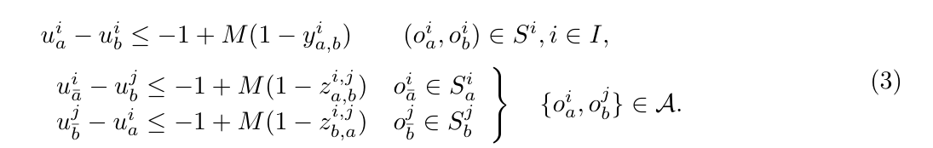
VERBATIM CODE MAP 07
Die Variable `u` macht die Ereignisreihenfolge eindeutig.
Sie hilft besonders dann, wenn Zeiten nah beieinander liegen oder gleich wirken.
Mathematische Formulierung
Baseline-Code (Gurobi/MIP)
Extended-Code (CP-SAT)
mip_model.py:132-148
cp_model.py:146-153
for succ_a in op_a.successors:
# 1. Physical time-blocking: If Train 1 goes before Train 2 (z_ab==1), Train 1 must fully
# reach its next step (succ_a) before Train 2's timeline is allowed to start.
self.model.addConstr((z_ab == 1) >> (self.t[t1, succ_a] - self.t[t2, o2] <= -l1))
# 2. Cycle-crushing sequence: If Train 1 goes before Train 2, the topological rank (u-value)
# assigned to Train 1's next step must be strictly smaller than Train 2's start. This breaks cyclic swapping.
# --> Corresponds to DISPLIB Paper Eq (3) lower part: u_{a_bar}^i - u_b^j <= -1 + M(1 - z_{a,b}^{i,j})
# (u_{a_bar}^i <==> self.u[t1, succ_a], u_b^j <==> self.u[t2, o2], z_{a,b}^{i,j} <==> z_ab)
self.model.addConstr((z_ab == 1) >> (self.u[t1, succ_a] - self.u[t2, o2] <= -1))
for succ_b in op_b.successors:
# Same blocking logic mirrored if Train 2 goes before Train 1 (z_ba==1).
# --> Corresponds to DISPLIB Paper Eq (3) lower part: u_{b_bar}^j - u_a^i <= -1 + M(1 - z_{b,a}^{i,j})
# (u_{b_bar}^j <==> self.u[t2, succ_b], u_a^i <==> self.u[t1, o1], z_{b,a}^{i,j} <==> z_ba)
self.model.addConstr((z_ba == 1) >> (self.t[t2, succ_b] - self.t[t1, o1] <= -l2))
self.model.addConstr((z_ba == 1) >> (self.u[t2, succ_b] - self.u[t1, o1] <= -1))
for succ_a in op_a.successors:
# If Train 1 goes before Train 2 (z_ab==1), Train 1 must reach succ_a before Train 2 starts o2.
self.model.Add(self.starts[t2, o2] >= self.starts[t1, succ_a] + l1).OnlyEnforceIf([z_ab, self.y[t1, o1, succ_a]])
self.model.Add(self.u[t2, o2] >= self.u[t1, succ_a] + 1).OnlyEnforceIf([z_ab, self.y[t1, o1, succ_a]])
for succ_b in op_b.successors:
self.model.Add(self.starts[t1, o1] >= self.starts[t2, succ_b] + l2).OnlyEnforceIf([z_ba, self.y[t2, o2, succ_b]])
self.model.Add(self.u[t1, o1] >= self.u[t2, succ_b] + 1).OnlyEnforceIf([z_ba, self.y[t2, o2, succ_b]])
Paper Gl. (3): Ordnungsbedingungen
SPRECHPUNKT
cp_model.py:190-197
`u` ist wie ein Rang in der Ereignisliste. Wenn A vor B liegt, muss der Rang von A kleiner sein als der Rang von B.
# Precedences Time Logic
for succ in op.successors:
# IF y[op->succ] is true => start(succ) == end(op)
# This is critical: the train occupies the resource until it physically starts the next operation!
self.model.Add(self.starts[t_id, succ] == self.ends[t_id, o_id]).OnlyEnforceIf(self.y[t_id, o_id, succ])
# Strict topological rank progression
self.model.Add(self.u[t_id, succ] >= self.u[t_id, o_id] + 1).OnlyEnforceIf(self.y[t_id, o_id, succ])
mip_model.py:157-164
for train in self.instance.trains:
for op in train.operations:
for succ in op.successors:
# Enforce strictly increasing topological sequence (u-values)
# as the train progresses forward through its route.
# --> Corresponds to DISPLIB Paper Eq (3) upper part: u_a^i - u_b^i <= -1 + M(1 - y_{a,b}^i)
# (u_a^i <==> self.u[..op.id], u_b^i <==> self.u[..succ])
self.model.addConstr((self.y[train.id, op.id, succ] == 1) >> (self.u[train.id, op.id] - self.u[train.id, succ] <= -1))
Ehrlicher Hinweis: Im Paper ist `u` ganzzahlig; im Baseline-Code ist `u` kontinuierlich.
07

Slide 8
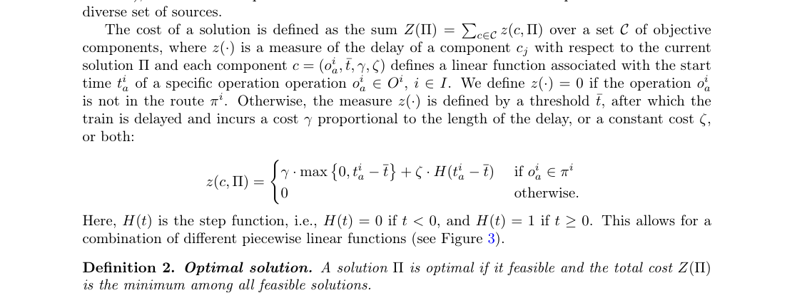
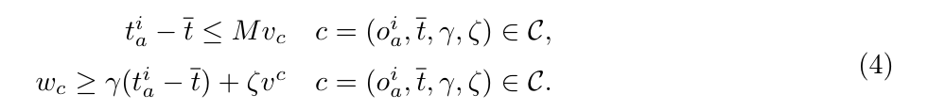
VERBATIM CODE MAP 08
Die Zielfunktion minimiert die gewichtete Verspätung.
Die aktuelle Implementierung bildet vor allem den linearen Verspätungsteil ab.
Mathematische Formulierung
Baseline-Code (Gurobi/MIP)
Extended-Code (CP-SAT)
mip_model.py:55-58
cp_model.py:200-229
# Objective variables
for c_idx, comp in enumerate(self.instance.objective):
self.v[c_idx] = self.model.addVar(vtype=GRB.BINARY, name=f"v_{c_idx}")
self.w[c_idx] = self.model.addVar(lb=0, vtype=GRB.CONTINUOUS, name=f"w_{c_idx}")
# 4. Objective Costs Calculation (Penalty)
# -----------------------------------------------------
for c_idx, comp in enumerate(self.instance.objective):
if comp.train == -1 or comp.operation == -1:
continue
t_id = comp.train
o_id = comp.operation
th = int(comp.threshold)
cf = comp.coeff
scaled_cf = int(cf * self.COEFF_SCALE)
x_a = self.x.get((t_id, o_id))
if x_a is None:
continue
over_time = self.model.NewIntVar(0, self.horizon * 2, f"ov_{c_idx}")
self.model.Add(over_time >= self.starts[t_id, o_id] - th).OnlyEnforceIf(x_a)
cost_var = self.model.NewIntVar(0, int(self.horizon * 2 * max(1, scaled_cf)), f"cost_{c_idx}")
self.model.Add(cost_var == over_time * scaled_cf).OnlyEnforceIf(x_a)
self.model.Add(cost_var == 0).OnlyEnforceIf(x_a.Not())
obj_costs.append(cost_var)
# -----------------------------------------------------
# 5. Set Objective
# -----------------------------------------------------
if len(obj_costs) > 0:
self.model.Minimize(sum(obj_costs))
Problemdefinition: Verspätungskosten
mip_model.py:166-183
# D) Objective Cost Component
obj_expr = gp.LinExpr()
for c_idx, comp in enumerate(self.instance.objective):
if comp.train == -1 or comp.operation == -1:
continue
w_c = self.w[c_idx]
v_c = self.v[c_idx]
t_a = self.t[comp.train, comp.operation]
x_a = self.x[comp.train, comp.operation]
# Indicators for computing penalty exactly when x_a == 1
self.model.addConstr((x_a == 1) >> (t_a - comp.threshold <= self.M * v_c))
self.model.addConstr((x_a == 1) >> (w_c >= comp.coeff * (t_a - comp.threshold)))
obj_expr += w_c
self.model.setObjective(obj_expr, GRB.MINIMIZE)
Paper Gl. (4): Objective-Constraints
EHRLICHER HINWEIS
Der Code zeigt `coeff * delay`. Die feste Step-Penalty aus der vollen DISPLIB-Definition ist hier nicht vollständig umgesetzt.
Für den Bericht ist diese Einschränkung wichtig, weil sie direkt im Code sichtbar ist.
08

Slide 9
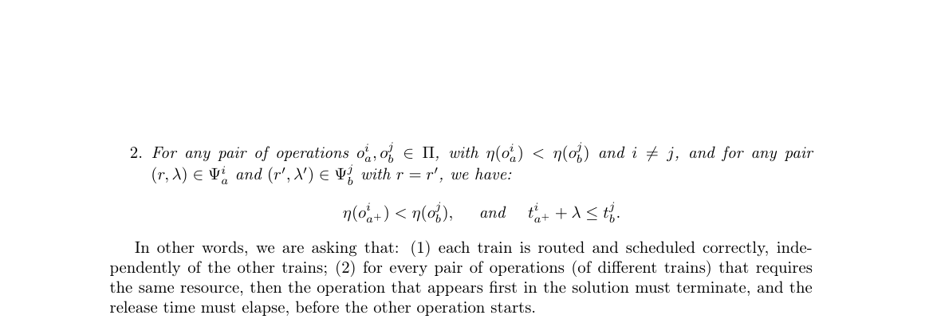
VERBATIM CODE MAP 09
Am Ende wird eine geordnete Event-Liste exportiert.
Das Ergebnis ist nicht nur ein Zielfunktionswert, sondern eine Lösung im DISPLIB-Format.
Mathematische Formulierung
Baseline-Code (Gurobi/MIP)
Extended-Code (CP-SAT)
mip_model.py:189-218
cp_model.py:250-282
def export_solution(self, filename: str):
if self.model.status not in (GRB.OPTIMAL, GRB.TIME_LIMIT, GRB.SUBOPTIMAL):
print("No valid solution to export!")
return
events = []
for train in self.instance.trains:
for op in train.operations:
val_x = self.x[train.id, op.id].X
if val_x > 0.5: # Operation is selected
val_t = self.t[train.id, op.id].X
events.append({
"operation": op.id,
"time": int(round(val_t)),
"train": train.id
})
# ---------------------------------------------------------
# ROBUST TOPOLOGICAL SORT FOR VERIFIER
# ---------------------------------------------------------
# We can directly use the topological rank `u` calculated by the Gurobi solver!
# This completely guarantees no cyclic dependencies and matches the physical causality.
events.sort(key=lambda x: (x["time"], self.u[x["train"], x["operation"]].X))
final_events = events
# ---------------------------------------------------------
output = {
"events": events,
"objective_value": int(round(self.model.ObjVal))
def export_solution(self, filename: str):
if self.status not in ["OPTIMAL", "FEASIBLE"]:
print("Cannot export: No feasible solution available.")
return
events = []
for train in self.instance.trains:
t_id = train.id
for op in train.operations:
o_id = op.id
if self.solver.BooleanValue(self.x[t_id, o_id]):
st = self.solver.Value(self.starts[t_id, o_id])
events.append({
"operation": o_id,
"time": int(st),
"train": t_id
})
# ---------------------------------------------------------
# ROBUST TOPOLOGICAL SORT FOR VERIFIER
# ---------------------------------------------------------
# We can directly use the topological rank `u` calculated by the CP-SAT solver!
# This completely guarantees no cyclic dependencies and matches the physical causality.
events.sort(key=lambda x: (x["time"], self.solver.Value(self.u[x["train"], x["operation"]])))
final_events = events
events = final_events
# ---------------------------------------------------------
output = {
"events": events,
"objective_value": int(round(self.obj_val))
Problemdefinition: geordnete Events und Freigabezeiten
SPRECHPUNKT
Beide Solver sammeln die gewählten Operationen und sortieren sie nach Zeit und `u`, bevor die JSON-Lösung geschrieben wird.
Hier werden auch objective_value und events in die DISPLIB-Lösungsdatei geschrieben.
09

Slide 10
VERBATIM CODE MAP 10
Kurz gesagt: gleiche Dispatching-Logik, aber zwei verschiedene Solver-Welten.
Für die Präsentation ist genau dieser Unterschied der rote Faden.
Aspekt
Gurobi / Baseline MIP
CP-SAT / Extended Modell
Modelltyp
gemischt-ganzzahliges lineares Modell
Constraint Programming + SAT-basierte Suche
Typische Syntax
`addVar`, `quicksum`, lineare Constraints, indicator constraints
`NewBoolVar`, `NewIntVar`, `OnlyEnforceIf`, `IntervalVar`, `AddNoOverlap`
Ressourcen
paarweise Reihenfolge mit `z_ab` und `z_ba`
Intervalle pro Ressource, globale NoOverlap-Constraint
Suchidee
LP-Relaxationen, Branch-and-Bound/Branch-and-Cut
Constraint Propagation, SAT-Lernen und kombinatorische Suche
Merksatz
mathematisch nah an der MILP-Formulierung
modelliert Scheduling-Konflikte direkter
GUTER SATZ ZUM SAGEN
EHRLICHE EINSCHRÄNKUNG
Die beiden Codes sehen nicht deshalb anders aus, weil sie etwas anderes lösen, sondern weil die Solver unterschiedliche Modellierungssprachen haben.
Die Step-Penalty ist nicht vollständig abgebildet, und `u` ist im Baseline-Code kontinuierlich, obwohl das Paper `u` ganzzahlig definiert.
Alle Code-Ausschnitte in dieser Präsentation sind echte Auszüge aus dem Repository.
10

