Slide 1
DISPLIB TRAIN DISPATCHING
what changed from the previous draft
Mathematical model
mapped to actual code
01
No pseudo-code
Code boxes are read from .py files at build time.
02
Exact locations
Every excerpt has file name and line range.
Every code panel is a verbatim excerpt from the repository, selected by file and line range.
03
Same comparison
Math, baseline MIP, and CP-SAT remain side-by-side.
04
Honest caveats
Objective and u-variable implementation details are explicit.
Deck rebuilt with verbatim code excerpts from phase1_baseline/src and phase2_extend/src.
01

Slide 2
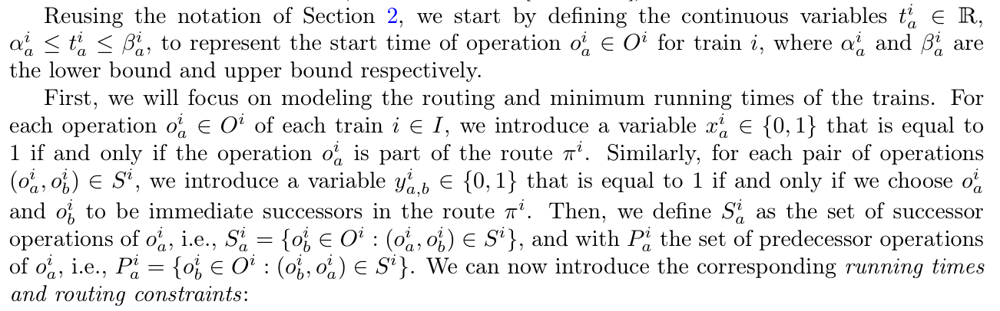
VERBATIM CODE MAP 02
Decision variables are implemented as real solver variables.
This slide shows the actual variable dictionaries and addVar/NewIntVar calls.
Mathematical expression
Baseline code
Extended code
phase1_baseline/src/mip_model.py:13-41
phase2_extend/src/cp_model.py:16-67
# Variables
self.x = {} # x[train.id, op.id]
self.y = {} # y[train.id, op_a.id, op_b.id]
self.t = {} # t[train.id, op.id]
self.u = {} # u[train.id, op.id]
self.z = {} # z[t1, o1, t2, o2]
self.z_ba = {} # z_ba tracking
self.v = {} # v[c_idx]
self.w = {} # w[c_idx]
self._build_model()
def _build_model(self):
# 1. Variables
for train in self.instance.trains:
for op in train.operations:
# Variable x_i,a (1 if operation is selected)
self.x[train.id, op.id] = self.model.addVar(vtype=GRB.BINARY, name=f"x_{train.id}_{op.id}")
# Variable t_i,a (start time)
ub = op.start_ub if op.start_ub is not None and op.start_ub < float('inf') else GRB.INFINITY
self.t[train.id, op.id] = self.model.addVar(lb=op.start_lb, ub=ub, vtype=GRB.CONTINUOUS, name=f"t_{train.id}_{op.id}")
# Variable u_i,a (ordering logic)
self.u[train.id, op.id] = self.model.addVar(lb=0, vtype=GRB.CONTINUOUS, name=f"u_{train.id}_{op.id}")
# Variable y_i,a,b (1 if operation b immediately follows a)
for succ in op.successors:
self.y[train.id, op.id, succ] = self.model.addVar(vtype=GRB.BINARY, name=f"y_{train.id}_{op.id}_{succ}")
# Core CP Variables
self.x = {} # x[train_id, op_id]: Boolean, 1 if operation is selected
self.y = {} # y[train_id, op_a, op_b]: Boolean, 1 if sequence A -> B is taken
self.u = {} # u[train_id, op_id]: Integer, topological sequence rank
self.starts = {} # starts[train_id, op_id]: Integer, start time
self.durations = {} # durations[train_id, op_id]: Integer, duration
self.ends = {} # ends[train_id, op_id]: Integer, end time
self.status = None
self.obj_val = float('inf')
# Use a scaling factor since CP-SAT only supports integers, but cost coefficients might be floats
self.COEFF_SCALE = 1000
self._build_model()
def _build_model(self):
resource_intervals = {} # {resource_name: [list of extended IntervalVars]}
obj_costs = [] # List of integer cost variables
# -----------------------------------------------------
# 1. Variables & Interval Construction
# -----------------------------------------------------
for train in self.instance.trains:
for op in train.operations:
t_id = train.id
o_id = op.id
# Active boolean var
self.x[t_id, o_id] = self.model.NewBoolVar(f"x_{t_id}_{o_id}")
self.u[t_id, o_id] = self.model.NewIntVar(0, sum(len(tr.operations) for tr in self.instance.trains), f"u_{t_id}_{o_id}")
# Time bounds mapping
lb = max(0, int(op.start_lb))
ub_val = op.start_ub
ub = self.horizon if (ub_val is None or ub_val == float('inf')) else min(self.horizon, int(ub_val))
if ub < lb: ub = lb # Safety fallback
self.starts[t_id, o_id] = self.model.NewIntVar(lb, ub, f"st_{t_id}_{o_id}")
self.durations[t_id, o_id] = self.model.NewIntVar(int(op.min_duration), self.horizon, f"dur_{t_id}_{o_id}")
self.ends[t_id, o_id] = self.model.NewIntVar(lb + int(op.min_duration), self.horizon + self.horizon, f"end_{t_id}_{o_id}")
# The heart of CP: Optional Interval Variable
iv = self.model.NewOptionalIntervalVar(
self.starts[t_id, o_id],
self.durations[t_id, o_id],
self.ends[t_id, o_id],
self.x[t_id, o_id],
f"iv_{t_id}_{o_id}"
)
Paper: variable definitions
MAPPING
x, y, t and u are created inside _build_model(). z, v and w appear on the resource and objective slides.
The displayed code is verbatim from the current repository files.
02

Slide 3
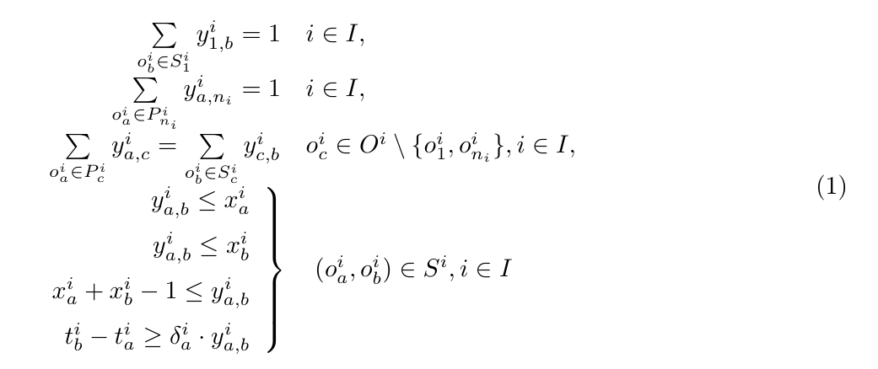
VERBATIM CODE MAP 03
Route feasibility is encoded by the actual flow constraints.
The baseline block is exactly the code section you are reviewing.
Mathematical expression
Baseline code
Extended code
phase1_baseline/src/mip_model.py:70-102
phase2_extend/src/cp_model.py:156-188
# A) Flow constraints
for train in self.instance.trains:
entries = [op.id for op in train.operations if len(predecessors[train.id][op.id]) == 0]
exits = [op.id for op in train.operations if len(op.successors) == 0]
# Flow leaving entry
for entry in entries:
op = train.get_operation(entry)
self.model.addConstr(gp.quicksum(self.y[train.id, entry, succ] for succ in op.successors) == 1)
self.model.addConstr(self.x[train.id, entry] == 1)
# Flow entering exit
for exit in exits:
self.model.addConstr(gp.quicksum(self.y[train.id, pred, exit] for pred in predecessors[train.id][exit]) == 1)
self.model.addConstr(self.x[train.id, exit] == 1)
# Flow conservation for intermediate
for op in train.operations:
if op.id not in entries and op.id not in exits:
sum_in = gp.quicksum(self.y[train.id, pred, op.id] for pred in predecessors[train.id][op.id])
sum_out = gp.quicksum(self.y[train.id, op.id, succ] for succ in op.successors)
self.model.addConstr(sum_in == sum_out)
self.model.addConstr(sum_in == self.x[train.id, op.id])
# Logical y relates to x
for op in train.operations:
for succ in op.successors:
self.model.addConstr(self.y[train.id, op.id, succ] <= self.x[train.id, op.id])
self.model.addConstr(self.y[train.id, op.id, succ] <= self.x[train.id, succ])
self.model.addConstr(self.x[train.id, op.id] + self.x[train.id, succ] - 1 <= self.y[train.id, op.id, succ])
# Duration minimum
self.model.addConstr(self.t[train.id, succ] - self.t[train.id, op.id] >= op.min_duration * self.y[train.id, op.id, succ])
# 3. Flow Constraints (Entering & Leaving)
# -----------------------------------------------------
predecessors = {train.id: {op.id: [] for op in train.operations} for train in self.instance.trains}
for train in self.instance.trains:
for op in train.operations:
for succ in op.successors:
predecessors[train.id][succ].append(op.id)
for train in self.instance.trains:
t_id = train.id
starts_idx = [op.id for op in train.operations if len(predecessors[t_id][op.id]) == 0]
ends_idx = [op.id for op in train.operations if len(op.successors) == 0]
# Start Ops must be active (usually only 1 start)
for o_idx in starts_idx:
self.model.Add(self.x[t_id, o_idx] == 1)
# End Ops must be active (usually only 1 end)
for o_idx in ends_idx:
self.model.Add(self.x[t_id, o_idx] == 1)
for op in train.operations:
o_id = op.id
# Flow OUT: sum_out == x
if o_id not in ends_idx:
self.model.Add(sum(self.y[t_id, o_id, succ] for succ in op.successors) == self.x[t_id, o_id])
# Flow IN: sum_in == x
if o_id not in starts_idx:
preds = predecessors[t_id][o_id]
self.model.Add(sum(self.y[t_id, p, o_id] for p in preds) == self.x[t_id, o_id])
Paper Eq. (1): routing constraints
MATH MEANING
Entry leaves once, exit is reached once, intermediate operations conserve flow, and y is linked to x.
Eq. (1) is the direct counterpart of the flow-constraint loops.
03

Slide 4
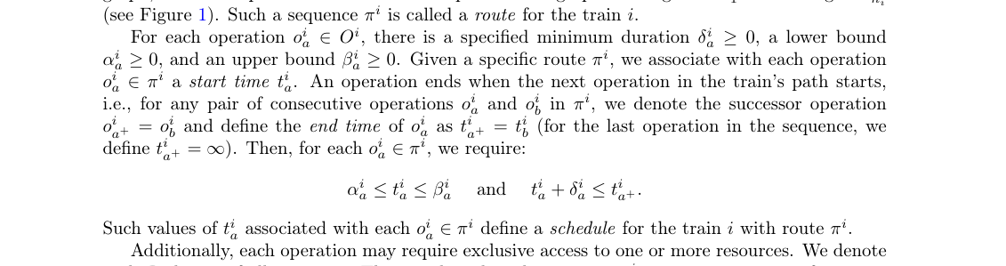
VERBATIM CODE MAP 04
Time windows and durations are implemented in separate exact snippets.
The baseline uses t variables; the extension uses start-duration-end intervals.
Mathematical expression
Baseline code
Extended code
mip_model.py:32-34
cp_model.py:50-67
# Variable t_i,a (start time)
ub = op.start_ub if op.start_ub is not None and op.start_ub < float('inf') else GRB.INFINITY
self.t[train.id, op.id] = self.model.addVar(lb=op.start_lb, ub=ub, vtype=GRB.CONTINUOUS, name=f"t_{train.id}_{op.id}")
# Time bounds mapping
lb = max(0, int(op.start_lb))
ub_val = op.start_ub
ub = self.horizon if (ub_val is None or ub_val == float('inf')) else min(self.horizon, int(ub_val))
if ub < lb: ub = lb # Safety fallback
self.starts[t_id, o_id] = self.model.NewIntVar(lb, ub, f"st_{t_id}_{o_id}")
self.durations[t_id, o_id] = self.model.NewIntVar(int(op.min_duration), self.horizon, f"dur_{t_id}_{o_id}")
self.ends[t_id, o_id] = self.model.NewIntVar(lb + int(op.min_duration), self.horizon + self.horizon, f"end_{t_id}_{o_id}")
# The heart of CP: Optional Interval Variable
iv = self.model.NewOptionalIntervalVar(
self.starts[t_id, o_id],
self.durations[t_id, o_id],
self.ends[t_id, o_id],
self.x[t_id, o_id],
f"iv_{t_id}_{o_id}"
)
mip_model.py:101-102
Problem definition: time bounds and minimum duration
# Duration minimum
self.model.addConstr(self.t[train.id, succ] - self.t[train.id, op.id] >= op.min_duration * self.y[train.id, op.id, succ])
MATH MEANING
cp_model.py:190-197
The displayed snippets are exact line ranges, but split because the code creates time variables and duration constraints in different parts of _build_model().
# Precedences Time Logic
for succ in op.successors:
# IF y[op->succ] is true => start(succ) == end(op)
# This is critical: the train occupies the resource until it physically starts the next operation!
self.model.Add(self.starts[t_id, succ] == self.ends[t_id, o_id]).OnlyEnforceIf(self.y[t_id, o_id, succ])
# Strict topological rank progression
self.model.Add(self.u[t_id, succ] >= self.u[t_id, o_id] + 1).OnlyEnforceIf(self.y[t_id, o_id, succ])
No synthetic abbreviations are used inside the code boxes.
04

Slide 5
VERBATIM CODE MAP 05
The conflict set A is built by scanning shared resources.
Both phases use the same parser logic for conflict-pair generation.
Mathematical expression
Baseline code
Extended code
phase1_baseline/src/data_parser.py:85-113
phase2_extend/src/data_parser.py:85-113
def find_conflict_pairs(self) -> List[Tuple[int, int, int, int, str, int, int]]:
"""
Returns pairs of operations from different trains that require the same resource.
Returns tuples of (train_i, op_a, train_j, op_b, resource, lambda_i, lambda_j)
for i < j to avoid duplicate symmetric pairs.
"""
# Map resource -> list of (train_idx, op_idx, release_time)
res_map = {}
for t in self.trains:
for op in t.operations:
for req in op.resources:
if req.resource not in res_map:
res_map[req.resource] = []
res_map[req.resource].append((t.id, op.id, req.release_time))
conflicts = []
for res, usage_list in res_map.items():
for idx1 in range(len(usage_list)):
for idx2 in range(idx1 + 1, len(usage_list)):
t1, op1, l1 = usage_list[idx1]
t2, op2, l2 = usage_list[idx2]
if t1 != t2:
# ensure t1 < t2 for consistent ordering
if t1 > t2:
conflicts.append((t2, op2, t1, op1, res, l2, l1))
else:
conflicts.append((t1, op1, t2, op2, res, l1, l2))
return list(set(conflicts))
def find_conflict_pairs(self) -> List[Tuple[int, int, int, int, str, int, int]]:
"""
Returns pairs of operations from different trains that require the same resource.
Returns tuples of (train_i, op_a, train_j, op_b, resource, lambda_i, lambda_j)
for i < j to avoid duplicate symmetric pairs.
"""
# Map resource -> list of (train_idx, op_idx, release_time)
res_map = {}
for t in self.trains:
for op in t.operations:
for req in op.resources:
if req.resource not in res_map:
res_map[req.resource] = []
res_map[req.resource].append((t.id, op.id, req.release_time))
conflicts = []
for res, usage_list in res_map.items():
for idx1 in range(len(usage_list)):
for idx2 in range(idx1 + 1, len(usage_list)):
t1, op1, l1 = usage_list[idx1]
t2, op2, l2 = usage_list[idx2]
if t1 != t2:
# ensure t1 < t2 for consistent ordering
if t1 > t2:
conflicts.append((t2, op2, t1, op1, res, l2, l1))
else:
conflicts.append((t1, op1, t2, op2, res, l1, l2))
return list(set(conflicts))
Paper: conflict set A
MATH MEANING
A contains operation pairs from different trains that require the same resource. The code returns train ids, operation ids, resource name and both release times.
The two parser files currently contain the same conflict-pair implementation.
05

Slide 6
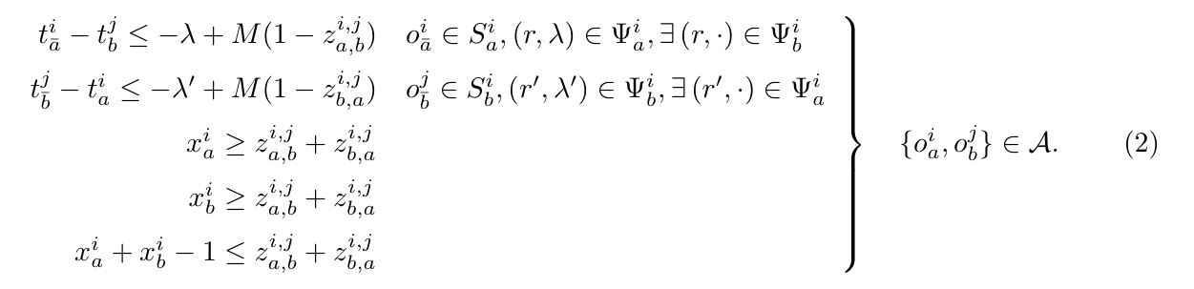
VERBATIM CODE MAP 06
Resource exclusivity is actual z-precedence code versus actual interval code.
This is the code-level counterpart of Eq. (2).
Mathematical expression
Baseline code
Extended code
mip_model.py:43-53
cp_model.py:69-90
# Resource Precedence z variables
conflicts = self.instance.find_conflict_pairs()
for c in conflicts:
t1, o1, t2, o2, res, l1, l2 = c
# z_ab (1 if t1_o1 precedes t2_o2)
z_ab = self.model.addVar(vtype=GRB.BINARY, name=f"z_{t1}_{o1}_{t2}_{o2}_r_{res}")
# z_ba (1 if t2_o2 precedes t1_o1)
z_ba = self.model.addVar(vtype=GRB.BINARY, name=f"z_{t2}_{o2}_{t1}_{o1}_r_{res}")
self.z[t1, o1, t2, o2, res] = z_ab
self.z_ba[t1, o1, t2, o2, res] = z_ba
# Process resources for AddNoOverlap
for r_data in op.resources:
res_name = r_data.resource
rel_time = int(r_data.release_time)
if res_name not in resource_intervals:
resource_intervals[res_name] = []
# If there's a headway (release_time), we must artificially extend the block's end.
if rel_time > 0:
ext_dur = self.model.NewIntVar(int(op.min_duration) + rel_time, self.horizon + rel_time, f"ext_dur_{t_id}_{o_id}_{res_name}")
self.model.Add(ext_dur == self.durations[t_id, o_id] + rel_time)
ext_end = self.model.NewIntVar(lb + int(op.min_duration) + rel_time, self.horizon * 2 + rel_time, f"ext_end_{t_id}_{o_id}_{res_name}")
self.model.Add(ext_end == self.ends[t_id, o_id] + rel_time)
ext_iv = self.model.NewOptionalIntervalVar(
self.starts[t_id, o_id], ext_dur, ext_end, self.x[t_id, o_id], f"ext_iv_{t_id}_{o_id}_{res_name}"
)
resource_intervals[res_name].append(ext_iv)
else:
resource_intervals[res_name].append(iv)
Paper Eq. (2): resource precedence
mip_model.py:125-148
self.model.addConstr(x_a >= z_ab + z_ba)
self.model.addConstr(x_b >= z_ab + z_ba)
self.model.addConstr(x_a + x_b - 1 <= z_ab + z_ba)
op_a = self.instance.trains[t1].get_operation(o1)
op_b = self.instance.trains[t2].get_operation(o2)
for succ_a in op_a.successors:
# 1. Physical time-blocking: If Train 1 goes before Train 2 (z_ab==1), Train 1 must fully
# reach its next step (succ_a) before Train 2's timeline is allowed to start.
self.model.addConstr((z_ab == 1) >> (self.t[t1, succ_a] - self.t[t2, o2] <= -l1))
# 2. Cycle-crushing sequence: If Train 1 goes before Train 2, the topological rank (u-value)
# assigned to Train 1's next step must be strictly smaller than Train 2's start. This breaks cyclic swapping.
# --> Corresponds to DISPLIB Paper Eq (3) lower part: u_{a_bar}^i - u_b^j <= -1 + M(1 - z_{a,b}^{i,j})
# (u_{a_bar}^i <==> self.u[t1, succ_a], u_b^j <==> self.u[t2, o2], z_{a,b}^{i,j} <==> z_ab)
self.model.addConstr((z_ab == 1) >> (self.u[t1, succ_a] - self.u[t2, o2] <= -1))
for succ_b in op_b.successors:
# Same blocking logic mirrored if Train 2 goes before Train 1 (z_ba==1).
# --> Corresponds to DISPLIB Paper Eq (3) lower part: u_{b_bar}^j - u_a^i <= -1 + M(1 - z_{b,a}^{i,j})
# (u_{b_bar}^j <==> self.u[t2, succ_b], u_a^i <==> self.u[t1, o1], z_{b,a}^{i,j} <==> z_ba)
self.model.addConstr((z_ba == 1) >> (self.t[t2, succ_b] - self.t[t1, o1] <= -l2))
self.model.addConstr((z_ba == 1) >> (self.u[t2, succ_b] - self.u[t1, o1] <= -1))
MATH MEANING
Baseline creates z_ab/z_ba and adds indicator constraints. CP-SAT extends intervals by release_time and applies AddNoOverlap.
cp_model.py:117-119
# This absolutely annihilates the logic of Big-M!
for res_name, intervals in resource_intervals.items():
self.model.AddNoOverlap(intervals)
The baseline and extension use different modeling primitives for the same safety condition.
06

Slide 7
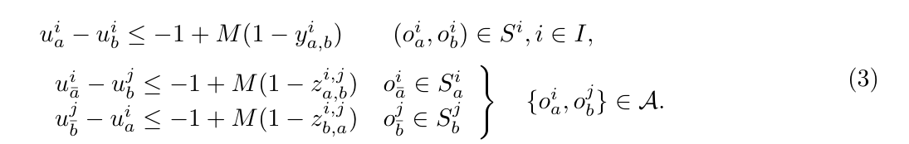
VERBATIM CODE MAP 07
Global ordering is implemented by the actual u-rank constraints.
This prevents same-time resource swapping and supports verifier-compatible event order.
Mathematical expression
Baseline code
Extended code
mip_model.py:132-148
cp_model.py:146-153
for succ_a in op_a.successors:
# 1. Physical time-blocking: If Train 1 goes before Train 2 (z_ab==1), Train 1 must fully
# reach its next step (succ_a) before Train 2's timeline is allowed to start.
self.model.addConstr((z_ab == 1) >> (self.t[t1, succ_a] - self.t[t2, o2] <= -l1))
# 2. Cycle-crushing sequence: If Train 1 goes before Train 2, the topological rank (u-value)
# assigned to Train 1's next step must be strictly smaller than Train 2's start. This breaks cyclic swapping.
# --> Corresponds to DISPLIB Paper Eq (3) lower part: u_{a_bar}^i - u_b^j <= -1 + M(1 - z_{a,b}^{i,j})
# (u_{a_bar}^i <==> self.u[t1, succ_a], u_b^j <==> self.u[t2, o2], z_{a,b}^{i,j} <==> z_ab)
self.model.addConstr((z_ab == 1) >> (self.u[t1, succ_a] - self.u[t2, o2] <= -1))
for succ_b in op_b.successors:
# Same blocking logic mirrored if Train 2 goes before Train 1 (z_ba==1).
# --> Corresponds to DISPLIB Paper Eq (3) lower part: u_{b_bar}^j - u_a^i <= -1 + M(1 - z_{b,a}^{i,j})
# (u_{b_bar}^j <==> self.u[t2, succ_b], u_a^i <==> self.u[t1, o1], z_{b,a}^{i,j} <==> z_ba)
self.model.addConstr((z_ba == 1) >> (self.t[t2, succ_b] - self.t[t1, o1] <= -l2))
self.model.addConstr((z_ba == 1) >> (self.u[t2, succ_b] - self.u[t1, o1] <= -1))
for succ_a in op_a.successors:
# If Train 1 goes before Train 2 (z_ab==1), Train 1 must reach succ_a before Train 2 starts o2.
self.model.Add(self.starts[t2, o2] >= self.starts[t1, succ_a] + l1).OnlyEnforceIf([z_ab, self.y[t1, o1, succ_a]])
self.model.Add(self.u[t2, o2] >= self.u[t1, succ_a] + 1).OnlyEnforceIf([z_ab, self.y[t1, o1, succ_a]])
for succ_b in op_b.successors:
self.model.Add(self.starts[t1, o1] >= self.starts[t2, succ_b] + l2).OnlyEnforceIf([z_ba, self.y[t2, o2, succ_b]])
self.model.Add(self.u[t1, o1] >= self.u[t2, succ_b] + 1).OnlyEnforceIf([z_ba, self.y[t2, o2, succ_b]])
Paper Eq. (3): ordering constraints
MATH MEANING
cp_model.py:190-197
u is used as a topological rank. Same-train and cross-train precedence relationships push successor events later in the rank order.
# Precedences Time Logic
for succ in op.successors:
# IF y[op->succ] is true => start(succ) == end(op)
# This is critical: the train occupies the resource until it physically starts the next operation!
self.model.Add(self.starts[t_id, succ] == self.ends[t_id, o_id]).OnlyEnforceIf(self.y[t_id, o_id, succ])
# Strict topological rank progression
self.model.Add(self.u[t_id, succ] >= self.u[t_id, o_id] + 1).OnlyEnforceIf(self.y[t_id, o_id, succ])
mip_model.py:157-164
for train in self.instance.trains:
for op in train.operations:
for succ in op.successors:
# Enforce strictly increasing topological sequence (u-values)
# as the train progresses forward through its route.
# --> Corresponds to DISPLIB Paper Eq (3) upper part: u_a^i - u_b^i <= -1 + M(1 - y_{a,b}^i)
# (u_a^i <==> self.u[..op.id], u_b^i <==> self.u[..succ])
self.model.addConstr((self.y[train.id, op.id, succ] == 1) >> (self.u[train.id, op.id] - self.u[train.id, succ] <= -1))
Implementation caveat: baseline u is continuous in code, while the paper defines u as integer.
07

Slide 8
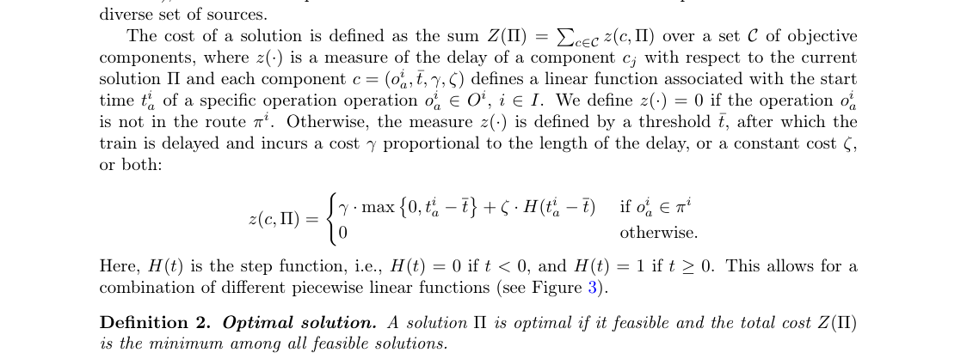
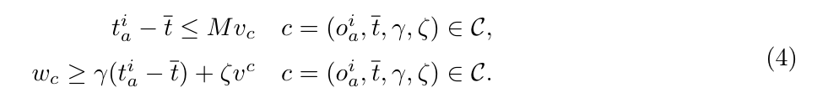
VERBATIM CODE MAP 08
The objective code is the actual implementation of weighted delay.
The formula allows a step term; the current code implements the linear delay term.
Mathematical expression
Baseline code
Extended code
mip_model.py:55-58
cp_model.py:200-229
# Objective variables
for c_idx, comp in enumerate(self.instance.objective):
self.v[c_idx] = self.model.addVar(vtype=GRB.BINARY, name=f"v_{c_idx}")
self.w[c_idx] = self.model.addVar(lb=0, vtype=GRB.CONTINUOUS, name=f"w_{c_idx}")
# 4. Objective Costs Calculation (Penalty)
# -----------------------------------------------------
for c_idx, comp in enumerate(self.instance.objective):
if comp.train == -1 or comp.operation == -1:
continue
t_id = comp.train
o_id = comp.operation
th = int(comp.threshold)
cf = comp.coeff
scaled_cf = int(cf * self.COEFF_SCALE)
x_a = self.x.get((t_id, o_id))
if x_a is None:
continue
over_time = self.model.NewIntVar(0, self.horizon * 2, f"ov_{c_idx}")
self.model.Add(over_time >= self.starts[t_id, o_id] - th).OnlyEnforceIf(x_a)
cost_var = self.model.NewIntVar(0, int(self.horizon * 2 * max(1, scaled_cf)), f"cost_{c_idx}")
self.model.Add(cost_var == over_time * scaled_cf).OnlyEnforceIf(x_a)
self.model.Add(cost_var == 0).OnlyEnforceIf(x_a.Not())
obj_costs.append(cost_var)
# -----------------------------------------------------
# 5. Set Objective
# -----------------------------------------------------
if len(obj_costs) > 0:
self.model.Minimize(sum(obj_costs))
Problem definition: delay cost
mip_model.py:166-183
# D) Objective Cost Component
obj_expr = gp.LinExpr()
for c_idx, comp in enumerate(self.instance.objective):
if comp.train == -1 or comp.operation == -1:
continue
w_c = self.w[c_idx]
v_c = self.v[c_idx]
t_a = self.t[comp.train, comp.operation]
x_a = self.x[comp.train, comp.operation]
# Indicators for computing penalty exactly when x_a == 1
self.model.addConstr((x_a == 1) >> (t_a - comp.threshold <= self.M * v_c))
self.model.addConstr((x_a == 1) >> (w_c >= comp.coeff * (t_a - comp.threshold)))
obj_expr += w_c
self.model.setObjective(obj_expr, GRB.MINIMIZE)
Paper Eq. (4): objective constraints
IMPLEMENTATION NOTE
The code boxes are exact. They show coeff-based delay, but not the fixed increment/zeta step penalty from the full DISPLIB definition.
Objective limitation is useful to mention in the report because it is visible in the real code.
08

Slide 9
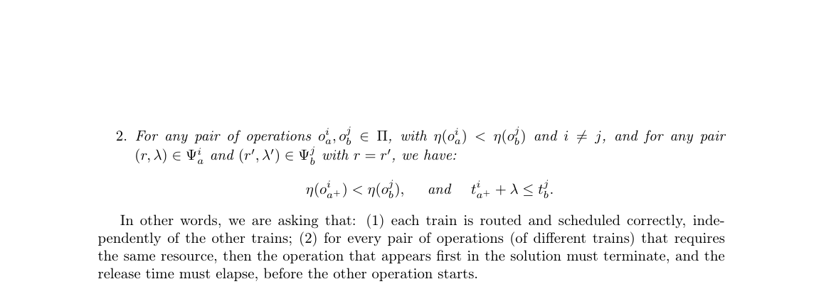
VERBATIM CODE MAP 09
The exported solution is the code-level form of the ordered event sequence.
This maps DISPLIB's Pi sequence to the final JSON events list.
Mathematical expression
Baseline code
Extended code
mip_model.py:189-218
cp_model.py:250-282
def export_solution(self, filename: str):
if self.model.status not in (GRB.OPTIMAL, GRB.TIME_LIMIT, GRB.SUBOPTIMAL):
print("No valid solution to export!")
return
events = []
for train in self.instance.trains:
for op in train.operations:
val_x = self.x[train.id, op.id].X
if val_x > 0.5: # Operation is selected
val_t = self.t[train.id, op.id].X
events.append({
"operation": op.id,
"time": int(round(val_t)),
"train": train.id
})
# ---------------------------------------------------------
# ROBUST TOPOLOGICAL SORT FOR VERIFIER
# ---------------------------------------------------------
# We can directly use the topological rank `u` calculated by the Gurobi solver!
# This completely guarantees no cyclic dependencies and matches the physical causality.
events.sort(key=lambda x: (x["time"], self.u[x["train"], x["operation"]].X))
final_events = events
# ---------------------------------------------------------
output = {
"events": events,
"objective_value": int(round(self.model.ObjVal))
def export_solution(self, filename: str):
if self.status not in ["OPTIMAL", "FEASIBLE"]:
print("Cannot export: No feasible solution available.")
return
events = []
for train in self.instance.trains:
t_id = train.id
for op in train.operations:
o_id = op.id
if self.solver.BooleanValue(self.x[t_id, o_id]):
st = self.solver.Value(self.starts[t_id, o_id])
events.append({
"operation": o_id,
"time": int(st),
"train": t_id
})
# ---------------------------------------------------------
# ROBUST TOPOLOGICAL SORT FOR VERIFIER
# ---------------------------------------------------------
# We can directly use the topological rank `u` calculated by the CP-SAT solver!
# This completely guarantees no cyclic dependencies and matches the physical causality.
events.sort(key=lambda x: (x["time"], self.solver.Value(self.u[x["train"], x["operation"]])))
final_events = events
events = final_events
# ---------------------------------------------------------
output = {
"events": events,
"objective_value": int(round(self.obj_val))
Problem definition: ordered event sequence and resource release
MATH MEANING
The solution is not just a set of times. It is an ordered event list. Both solvers sort by time and u before writing JSON.
These snippets are also where objective_value and events are written to the DISPLIB solution file.
09

Slide 10
VERBATIM CODE MAP 10
What to say in the report: baseline is the reference MILP, extension is a CP-SAT reformulation.
The important point is not that the code text is short; it is that every line maps to a mathematical role.
Concept
Baseline
Extended
Variables
Gurobi addVar dictionaries x, y, t, u, z, v, w
CP-SAT Bool/Int variables and optional intervals
Route
Flow constraints over predecessors and successors
Same x/y route logic with Add(...) constraints
Time
Continuous t with lower/upper bounds and duration inequalities
Integer starts/durations/ends plus optional intervals
Resources
Pairwise z_ab/z_ba precedence constraints
AddNoOverlap on resource occupation intervals
Ordering
u-rank indicator constraints and export sorting
u-rank OnlyEnforceIf constraints and export sorting
Objective
w_c minimizes coeff * delay
scaled integer cost_var minimizes coeff * delay
STRONG SENTENCE
HONEST CAVEAT
The baseline follows the paper's MILP structure closely; the extended model keeps the same DISPLIB feasibility logic but replaces pairwise resource modeling with interval scheduling.
For strict accuracy, say that the current implementation does not fully model DISPLIB's fixed step penalty and that baseline u is continuous in code.
All code excerpts in this deck are verbatim selections from the repository.
10

