Slide 1
Master of Science in Data Science - Capstone Projects
Author: Blake Tindol
Date: 5/11/2024
Contact Information: Email: blaketindol@gmail.com | Phone: 269-578-3791
Notes:
Good [morning/afternoon/evening], everyone. My name is Blake Tindol, and I'm excited to present my capstone projects for my Master of Science in Data Science program at Syracuse University

Slide 2
Introduction
Overview: My academic journey in the Data Science program at Syracuse University has equipped me with skills to tackle complex data-driven challenges.
Goals: This portfolio showcases my projects, demonstrating my capability to apply data science theories and techniques to real-world problems.
Notes:
"Good [morning/afternoon/evening], everyone. My name is Blake Tindol, and I work for Stryker Medical, a leading medical technology company. When I first started my Masters in Data Science program at Syracuse University, I was working as a data analyst. My responsibilities primarily involved basic data visualization tasks using Power BI.
However, as I progressed through the program, I gained a deeper understanding and a broad set of skills in data science. This journey has equipped me with the knowledge to tackle complex data-driven challenges. By applying data science theories and techniques, I have transitioned from a data analyst to a data scientist within my organization.
The goal of this portfolio is to showcase the projects I've worked on during my studies, demonstrating my capability to apply these new skills to real-world problems. Through these projects, I have been able to contribute significantly to my work at Stryker Medical, enhancing our data analysis capabilities and driving more informed decision-making.
In this presentation, I will walk you through some of the key projects from my capstone, illustrating how the skills and techniques I've learned have been applied to solve real-world challenges."

Slide 3
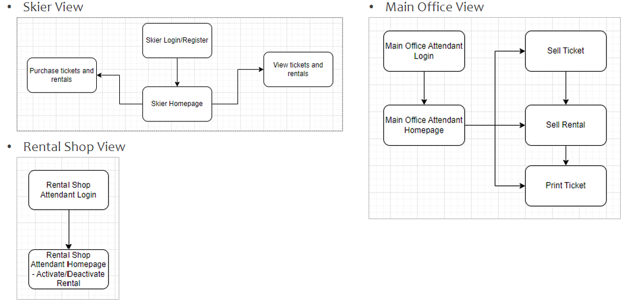
Project 1 - Ski Resort Management System
Abstract: This project involved designing and implementing a database system for managing a ski resort. It tracks skier rentals, lift tickets, and provides functionalities for various users.
Objectives:
Develop a comprehensive database system for a ski resort.
Support complex data management and retrieval operations.
Methods:
SQL for database creation and advanced SQL scripts for data manipulation.
Technologies: Microsoft SQL Server, Python, Faker.
Results:
Successfully implemented a relational database supporting transactional operations.
Developed a user interface for different stakeholders.
Notes:
"Let's begin with Project 1, the Ski Resort Management System.
Abstract: This project involved designing and implementing a database system for managing a ski resort. The system tracks skier rentals, lift tickets, and provides functionalities for various users, including skiers, attendants, and management, through a web application interface.
Objectives: Our main objectives were to develop a comprehensive database system that supports complex data management and retrieval operations tailored for a ski resort environment.
Methods:
We used SQL for database creation, including tables for skiers, tickets, rentals, and ticket types.
Advanced SQL scripts were used for data manipulation, ensuring data integrity with constraints, and automating data processes with triggers.
We used Microsoft SQL Server for the database backend and Python, along with libraries like Faker, for data generation and testing.
For example, we created SQL scripts to set up the initial database schema, including tables such as skiers, tickets, rentals, and ticket_types. We also implemented triggers to handle business logic, such as automatically calculating ticket validity periods based on the type of ticket purchased.
Results:
We successfully implemented a relational database that supports transactional operations for the ski resort.
We developed a user interface that allows different stakeholders to interact with the system effectively. This includes functionality for skiers to purchase tickets and rentals, attendants to manage sales and equipment distribution, and management to oversee operations.
For instance, the v_attendant view was created to allow office attendants to see current and upcoming tickets and rentals, and the p_sign_up stored procedure was created to handle new skier registrations.
In summary, this project showcased our ability to design and implement a functional database system that meets the operational requirements of a ski resort."

Slide 4
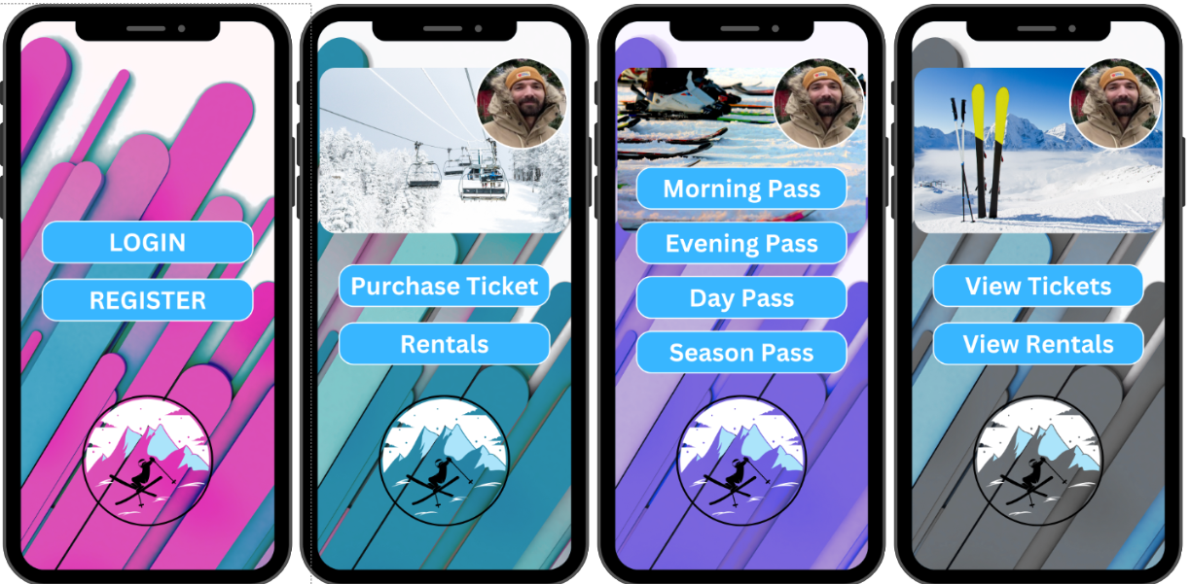
Ski Resort Management System - Learning Objectives
Statistical Analysis and Probabilistic Modeling:
Utilized statistical data to predict usage trends and customer behavior, optimizing operations and resource management.
Machine Learning:
Although not directly applied, the project laid the groundwork for future machine learning applications by establishing a strong database management system.
Data Management and Processing:
Demonstrated extensive skills in SQL database management, including setup, management, and querying.
Data Visualization and Communication:
Developed a user interface to effectively communicate data to different users.
Advanced Computational Techniques:
Employed advanced SQL techniques like triggers and stored procedures.
Ethics and Privacy:
Implemented security measures to protect personal information.
Research Methods:
Applied thorough research methods in system design, data modeling, and testing.
Notes:
"Now, let’s get into the learning objectives that this project helped us achieve.
Statistical Analysis and Probabilistic Modeling:
We utilized statistical data from the system to predict usage trends and customer behavior, optimizing operations and resource management. For example, by analyzing patterns in ticket purchases and rentals, we could forecast peak times and manage resources more effectively.
Machine Learning:
Although we did not directly apply machine learning algorithms in this project, the foundational work in data management and processing lays the groundwork for future machine learning applications. This could include predictive maintenance of ski lifts or personalized marketing campaigns based on customer behavior data.
Data Management and Processing:
This project demonstrated extensive skills in SQL database management, including setting up, managing, and querying databases efficiently. We used advanced SQL scripts for data manipulation, ensuring data integrity with constraints, and automating processes with triggers.
For instance, we used triggers to automatically set the start and end times for half-day, full-day, and multi-day tickets based on the purchase date.
Data Visualization and Communication:
We developed a user interface that effectively communicates data to different users, making it easy to interact with the system and make informed decisions based on the data presented.
The interface allowed skiers to view their tickets and rentals, office attendants to sell tickets and rentals, and rental shop attendants to manage equipment distribution and returns.
Advanced Computational Techniques:
We employed advanced SQL techniques like triggers and stored procedures to manage data and automate processes within the database, ensuring efficient and effective data operations.
For example, the t_ticket_datetimes trigger ensures that ticket start and end times are correctly set based on the type of ticket purchased.
Ethics and Privacy:
The project addressed data privacy by implementing security measures to protect the personal information of the resort guests. Ensuring that only authorized personnel can access sensitive data is a key aspect of ethical data handling.
Research Methods:
We applied thorough research methods in the planning and execution of the database system, including requirement gathering, system design, data modeling, and testing, to ensure the project met all specified requirements.
Through this project, we demonstrated our ability to apply a wide range of data science skills to solve real-world problems, ensuring a comprehensive and reliable database management system for the ski resort."

Slide 5
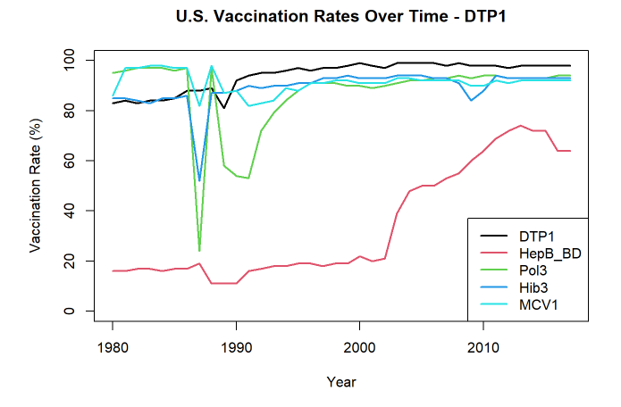
Project 2 - Analysis of Vaccination Rates in the U.S. Over Time
Abstract: Explored trends in vaccination rates across the United States, identifying vaccines with the highest and lowest rates.
Objectives:
Understand changes in vaccination rates over time.
Identify vaccines with the highest and lowest rates.
Evaluate vaccine volatility.
Methods:
Descriptive statistics for trend analysis and volatility assessment.
Chi-squared test to compare vaccination data reporting rates.
Results:
Most vaccination rates increased over time, with DTP1 ending the highest and HepB_BD the lowest and most volatile.
Significant difference in reporting rates between public and private schools.
Notes:
"Let's move on to Project 2, which focuses on the Analysis of Vaccination Rates in the U.S. Over Time.
Abstract: This analysis explored trends in vaccination rates across the United States, identifying vaccines with the highest and lowest rates at the end of the observed period and assessing the volatility of these rates.
Objectives: Our primary objectives were to understand how vaccination rates have changed over time in the U.S., identify which vaccines have the highest and lowest rates at the end of the observed period, and evaluate which vaccine exhibits the greatest volatility in rates.
Methods:
Descriptive Statistics: We conducted a trend analysis by computing the initial and final vaccination rates for each vaccine to observe overall trends. For example, DTP1 increased from 83% to 98%, while Pol3 slightly decreased from 95% to 94%.
Volatility Assessment: To evaluate the volatility of vaccination rates, we calculated the standard deviation and variance for each vaccine. HepB_BD exhibited the highest volatility, with a standard deviation of 22.539 and a variance of 508.008.
Chi-Squared Test: We compared vaccination data reporting rates between public and private schools using a chi-squared test to test for statistical significance. We found that public schools reported vaccination data at a significantly higher rate (97.42%) compared to private schools (84.72%), with a p-value of less than 0.001 indicating a highly significant difference.
Results:
Our analysis showed that while most vaccination rates increased over time, Polio showed a slight decrease.
DTP1 ended with the highest vaccination rate at 98%, whereas HepB_BD had the lowest rate at 64% and was also the most volatile.
The chi-squared test revealed a significant difference in reporting rates between public and private schools, with public schools being more likely to report vaccination data.
In summary, this project demonstrated our ability to analyze trends and volatility in vaccination rates, as well as the significant differences in reporting compliance between public and private schools."

Slide 6
Analysis of Vaccination Rates - Learning Objectives
Statistical Analysis and Probabilistic Modeling:
Applied descriptive statistics and chi-squared tests to analyze trends and volatility in vaccination rates.
Data Management and Processing:
Extensive data manipulation and processing using R, ensuring data accuracy for in-depth analysis.
Data Visualization and Communication:
Created visualizations to illustrate vaccination trends and differences.
Research Methods:
Applied systematic research methods, including data analysis and hypothesis testing, using both frequentist and Bayesian models.
Notes:
Now, let's discuss how this project aligns with our learning objectives.
Statistical Analysis and Probabilistic Modeling:
We applied a range of statistical techniques to analyze trends in U.S. vaccination rates over time. Specifically, we employed descriptive statistics to assess the volatility of vaccination rates and conducted a chi-squared test to compare reporting rates between public and private schools.
For example, we identified that HepB_BD had the greatest volatility with a standard deviation of 22.539 and a variance of 508.008. Additionally, we found that public schools had a higher reporting rate (97.42%) compared to private schools (84.72%).
Data Management and Processing:
This project involved extensive data manipulation and processing using R. We cleaned and organized datasets, derived initial and final vaccination rates, and structured data for statistical analysis and visualization.
Specific tasks included calculating the increase in DTP1 vaccination rate from 83% to 98% and normalizing data to ensure consistency.
Data Visualization and Communication:
We created visualizations to effectively communicate our findings. Line plots were used to illustrate trends in vaccination rates over time, making it easier to compare rates across different vaccines.
For example, line plots depicted the vaccination rates of DTP1, HepB_BD, Pol3, Hib3, and MCV1 over the years, highlighting key findings such as DTP1 having the highest rate at the end of the time series and HepB_BD having the lowest.
Research Methods:
We applied systematic research methods, including thorough data analysis, hypothesis testing, and the use of both frequentist and Bayesian models.
For instance, we used frequentist logistic regression to identify factors predicting reporting compliance and Bayesian logistic regression to validate these findings. The comparison of frequentist and Bayesian results provided robustness to our conclusions.
Overall, this project showcased our ability to apply a wide range of data science skills to analyze public health data, providing insights into vaccination trends and highlighting significant differences in reporting compliance between public and private schools."

Slide 7
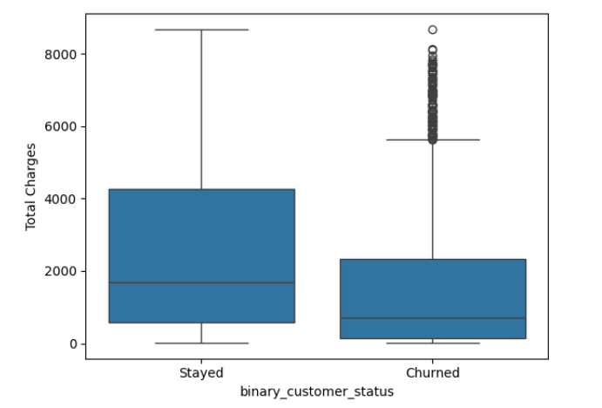
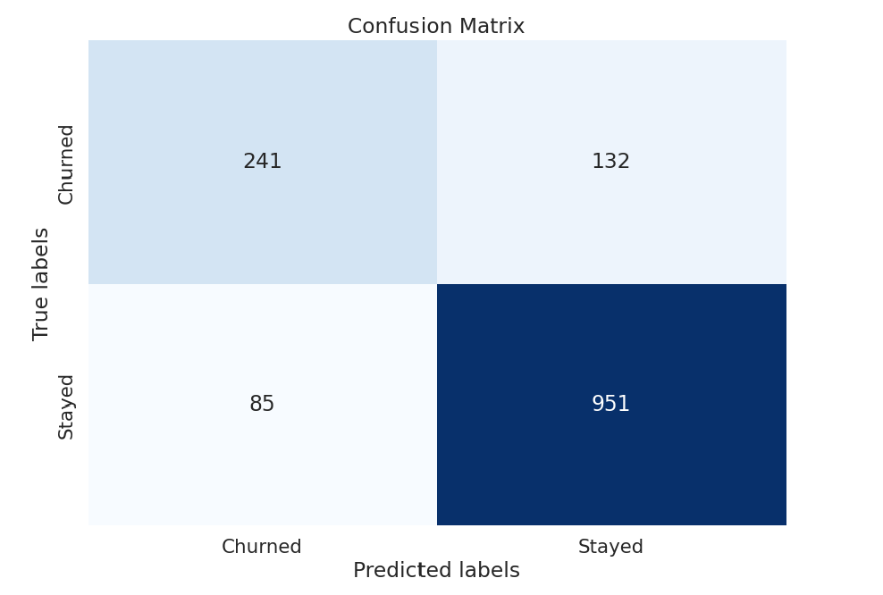
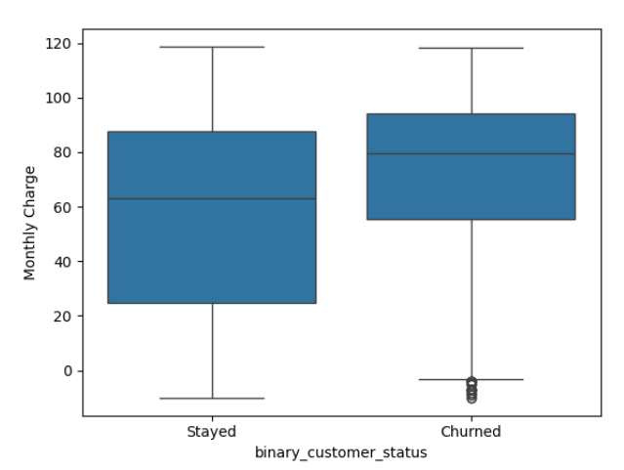
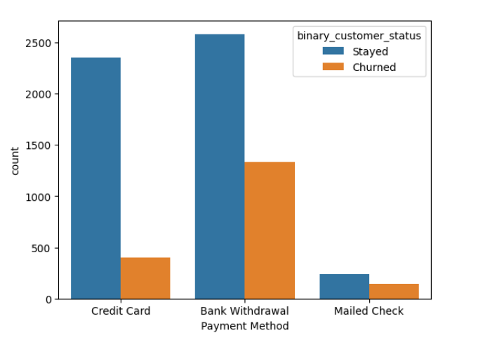
Project 3 - Predictive Analysis of Customer Churn in the Telecom Sector
Abstract: Used Big Data analytics to understand and predict customer churn, developing models to help craft effective retention strategies.
Objectives:
Analyze customer data to identify drivers of churn.
Develop predictive models to forecast churn.
Propose data-driven retention strategies.
Methods:
Data preparation, EDA, and predictive modeling using Logistic Regression, Random Forest, and SVM.
Evaluation using accuracy metrics and confusion matrices.
Results:
Identified key churn drivers.
Achieved best model performance with Random Forest and SVM, both reaching 84.6% accuracy.
Notes:
Our project focused on predicting customer churn in the telecom sector using Big Data analytics. We aimed to identify key factors leading to churn and develop predictive models to forecast future churn, thereby aiding telecom companies in crafting effective retention strategies.
Abstract:
We utilized Big Data analytics to understand and predict customer churn. Our goal was to analyze customer data, identify churn drivers, and develop predictive models to inform retention strategies.
Objectives:
Analyze customer data to identify drivers of churn.
Develop predictive models capable of forecasting customer churn.
Propose data-driven strategies for improving customer retention.
Methods:
Data Preparation: We cleaned and preprocessed a dataset containing details on demographics, service usage, and churn status.
Exploratory Data Analysis (EDA): Analyzed various customer attributes to understand their impact on churn.
Top Left Chart (Box Plot of Total Charges by Customer Status): Customers who churned generally have lower total charges compared to those who stayed.
Predictive Modeling: Implemented Logistic Regression, Random Forest, and Support Vector Machine models to predict churn.
Top Right Chart (Confusion Matrix): The model performs well in predicting customers who will stay but has some false positives and false negatives.
Evaluation: Assessed model performance using accuracy metrics and confusion matrices.
Bottom Left Chart (Box Plot of Monthly Charges by Customer Status): Customers who churned tend to have slightly higher monthly charges compared to those who stayed.
Bottom Right Chart (Bar Chart of Payment Method by Customer Status): Customers using credit cards are more likely to stay compared to those using bank withdrawals or mailed checks.
Results:
Identified key churn drivers including service quality, pricing, and competitive offers.
Achieved the best model performance with Random Forest and Support Vector Machine, both reaching 84.6% accuracy.
Conclusion:
By applying data science techniques to a real-world problem, we provided actionable insights for improving customer retention in the telecom sector.

Slide 8
Predictive Analysis of Customer Churn - Learning Objectives
Statistical Analysis and Probabilistic Modeling:
Leveraged statistical tests and predictive modeling techniques to analyze churn data.
Machine Learning:
Developed and implemented machine learning models, including logistic regression, random forest, and SVM.
Data Management and Processing:
Managed a large dataset, handling missing values and normalizing data for modeling.
Data Visualization and Communication:
Used visual tools to illustrate data analysis results and model performance.
Advanced Computational Techniques:
Applied PCA and machine learning models to handle high-dimensional data.
Ethics and Privacy:
Addressed ethical considerations in data handling and predictive modeling.
Research Methods:
Conducted thorough exploratory and predictive analysis using systematic research methods.
Notes:
"Now, let's discuss how this project aligns with our learning objectives.
Statistical Analysis and Probabilistic Modeling:
We leveraged statistical tests and predictive modeling techniques to analyze churn data. Logistic regression provided insights into churn likelihood based on customer attributes, while Random Forest and SVM handled complex, nonlinear relationships.
Machine Learning:
We developed and implemented machine learning models, including Logistic Regression, Random Forest, and SVM. Principal Component Analysis (PCA) was used for feature reduction, simplifying the dataset and improving model performance.
Data Management and Processing:
This project involved managing a large dataset with over 7,000 rows and 38 columns. We performed data cleaning, handled missing values, normalized data, and merged datasets based on zip codes to add population data. These preprocessing steps ensured that our data was suitable for modeling.
Data Visualization and Communication:
We used various visual tools to illustrate the results of our data analysis and predictive modeling. Count plots, boxplots, and confusion matrices helped visualize the distribution of customer attributes, the impact of different factors on churn, and the performance of our models. These visualizations made it easier for stakeholders to understand the key findings.
Advanced Computational Techniques:
We applied advanced algorithms such as PCA and machine learning models to solve a practical business problem. PCA reduced the dimensionality of the dataset, while the machine learning models predicted customer churn, uncovering patterns and making accurate predictions.
Ethics and Privacy:
We addressed ethical considerations by responsibly managing customer data and focusing on the implications of predictive modeling. Ensuring that customer data was anonymized and used solely for improving service quality aligns with ethical standards in data science.
Research Methods:
We conducted thorough exploratory and predictive analysis using systematic research methods. This included requirement gathering, data modeling, hypothesis testing, and rigorous statistical analysis. Both frequentist and Bayesian methods were used to validate our findings, ensuring robustness and reliability.
This project encapsulates the comprehensive application of data science knowledge to a practical issue, integrating various aspects of the data science curriculum. It not only demonstrates our technical skills but also highlights the importance of ethical considerations and effective communication in data science."

Slide 9
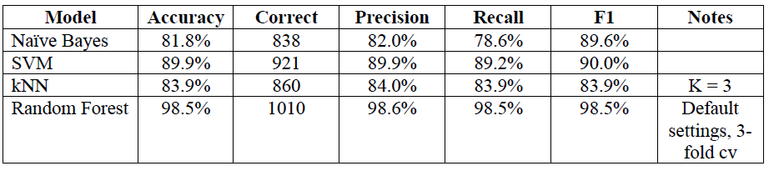
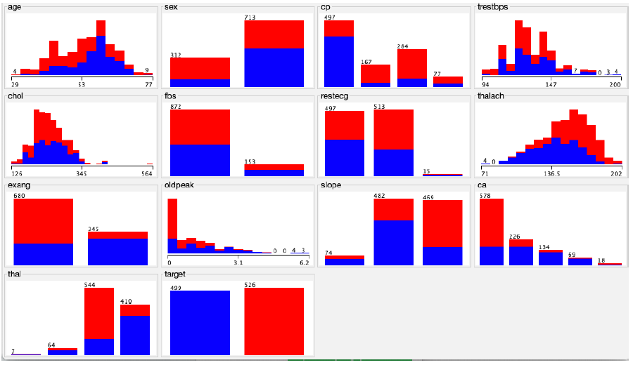
Project 4 - Heart Disease Prediction Using Machine Learning
Abstract: Utilized data mining and machine learning techniques to predict heart disease using the Cleveland Clinic Heart Disease Dataset.
Objectives:
Apply machine learning models to predict heart disease.
Evaluate and compare model performance.
Identify key predictors for early diagnosis.
Methods:
Data preprocessing, EDA, and model development using Random Forest, Naive Bayes, kNN, and SVM.
Model evaluation using accuracy, precision, recall, and F1-score.
Results:
Random Forest achieved the highest accuracy (98.5%).
Key predictors included chest pain type and maximum heart rate.
Notes:
Abstract:
Our project focused on leveraging data mining and machine learning techniques to predict heart disease using the Cleveland Clinic Heart Disease Dataset.
We aimed to utilize various predictive models to enhance early detection and improve health outcomes for patients.
Objectives:
Apply machine learning models to predict heart disease:
We implemented and compared several machine learning models to determine their effectiveness in predicting heart disease.
Evaluate and compare model performance:
We assessed the models using metrics such as accuracy, precision, recall, and F1-score to ensure a comprehensive evaluation.
Identify key predictors for early diagnosis:
By identifying the most influential features, we aimed to aid clinicians in focusing on critical predictors for early diagnosis and treatment.
Methods:
Data Preprocessing:
Cleaned and prepared the Cleveland dataset, including handling missing values and encoding categorical variables.
Ensured data quality and readiness for analysis.
Exploratory Data Analysis (EDA):
Investigated the dataset to identify patterns and important predictors of heart disease.
Used visualizations to better understand the data distribution and relationships.
Model Development:
Developed several machine learning models including Random Forest, Naive Bayes, kNN, and Support Vector Machines (SVM).
These models were chosen based on their ability to handle classification tasks effectively.
Model Evaluation:
Assessed model performance using accuracy, precision, recall, and F1-score.
Utilized cross-validation to ensure the robustness of the models.
Results:
The Random Forest model achieved the highest accuracy at 98.5%, demonstrating its effectiveness in predicting heart disease.
Key predictors identified included chest pain type, number of major vessels colored by fluoroscopy, and maximum heart rate achieved.
These findings have significant implications for clinical practice, providing valuable insights for early diagnosis and treatment.
Model Performance Chart:
The chart compares the performance of four machine learning models: Naive Bayes, SVM, kNN, and Random Forest.
Naive Bayes: Accuracy 81.8%, Precision 82.0%, Recall 78.6%, F1-score 89.6%.
SVM: Accuracy 89.9%, Precision 89.9%, Recall 89.2%, F1-score 90.0%.
kNN: Accuracy 83.9%, Precision 84.0%, Recall 83.9%, F1-score 83.9% (with k=3).
Random Forest: Accuracy 98.5%, Precision 98.6%, Recall 98.5%, F1-score 98.5% (default settings with 3-fold cross-validation).
The Random Forest model outperformed the others across all metrics, highlighting its robustness and reliability in predicting heart disease.
"Our project leveraged machine learning to predict heart disease using the Cleveland Clinic Heart Disease Dataset. The primary objective was to develop and evaluate models to enhance early detection. We meticulously prepared the data, conducted extensive exploratory data analysis, and implemented multiple machine learning models. Our Random Forest model achieved an impressive 98.5% accuracy, with key predictors such as chest pain type and maximum heart rate achieved being identified as significant. These findings provide valuable insights for clinical practice, aiding in early diagnosis and improving patient outcomes.
Now, let's look at the performance of the different models we evaluated. The chart here compares four models: Naive Bayes, SVM, kNN, and Random Forest. As you can see, the Random Forest model stands out with the highest accuracy at 98.5%, as well as high precision, recall, and F1-score. This demonstrates the model's effectiveness and reliability in predicting heart disease, making it a valuable tool for early diagnosis in a clinical setting."

Slide 10
Heart Disease Prediction - Learning Objectives
Statistical Analysis and Probabilistic Modeling:
Applied Naive Bayes algorithm for probabilistic modeling.
Machine Learning:
Implemented and evaluated several machine learning models for prediction.
Data Management and Processing:
Meticulously cleaned and prepared the Cleveland dataset for analysis.
Data Visualization and Communication:
Used visual tools to illustrate key predictors and model performance.
Advanced Computational Techniques:
Employed advanced algorithms like Random Forest and SVM.
Ethics and Privacy:
Focused on accuracy and reliability of predictive modeling in healthcare.
Research Methods:
Conducted a thorough review of literature and robust model evaluation.
Notes:
"Let's now discuss how this project aligns with our learning objectives.
**Statistical Analysis and Probabilistic Modeling:**
In our project, we utilized the Naive Bayes algorithm for probabilistic modeling. This method allowed us to handle categorical data effectively and compute probabilities, crucial for predicting the presence of heart disease based on multiple factors. By applying Naive Bayes, we demonstrated our ability to use statistical models to derive meaningful insights from clinical data, which is essential for understanding the likelihood of disease presence.
**Machine Learning:**
We implemented several machine learning models, including Random Forest, Support Vector Machines (SVM), and k-Nearest Neighbors (kNN). The Random Forest model emerged as the most accurate, with a success rate of 98.5%. This part of the project showcased our deep understanding of different algorithmic approaches and their application in solving real-world problems, enhancing the predictive power and reliability of our analyses.
**Data Management and Processing:**
Effective data management and processing were central to our project. We meticulously cleaned and prepared the Cleveland dataset, handling missing values and encoding categorical variables to ensure the data was ready for analysis. This thorough approach to data handling is crucial for building reliable models and obtaining valid results, emphasizing the importance of data management in achieving high-quality outcomes.
**Data Visualization and Communication:**
We employed various data visualization techniques to interpret model results and communicate findings effectively. Visual tools such as charts and graphs were used to illustrate key predictors of heart disease and model performance metrics. By using these visualizations, we were able to make complex data insights accessible to both technical and non-technical audiences, which is essential for ensuring that stakeholders can grasp the significance of the findings and make informed decisions based on the data.
**Advanced Computational Techniques:**
Our project utilized advanced machine learning algorithms like Random Forest and SVM to analyze and predict clinical outcomes. Additionally, we used Principal Component Analysis (PCA) to reduce the dimensionality of the dataset, retaining the most significant information while simplifying the data structure. This application of advanced methods demonstrated our ability to handle complex datasets and extract meaningful patterns, which is crucial for tackling real-world challenges in data science.
**Ethics and Privacy:**
Throughout the project, we prioritized the accuracy and reliability of our predictive modeling, especially since we were dealing with sensitive healthcare data. Ensuring the integrity of the data and the models' predictions was paramount, reflecting our commitment to ethical standards in data science. This focus on ethics and privacy ensured that our analyses were trustworthy and aligned with best practices in the field.
**Research Methods:**
We conducted a thorough review of existing literature, designed robust models, and critically evaluated their performance in a real-world healthcare setting. This comprehensive approach ensured that our methodologies were grounded in current research and best practices. The systematic approach we employed ensured that the conclusions drawn were well-supported by the data, demonstrating the importance of research methods in producing credible and impactful results.
Overall, this project integrated comprehensive data science knowledge and machine learning techniques to address a critical real-world problem in healthcare, demonstrating the practical application of our curriculum."

Slide 11
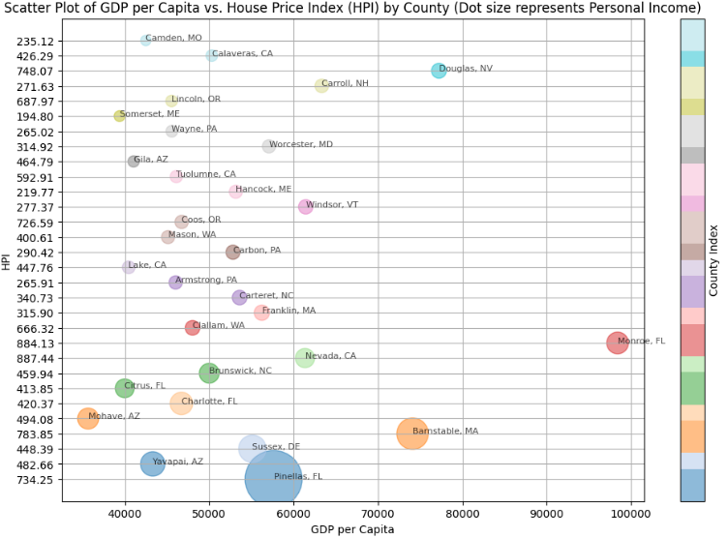
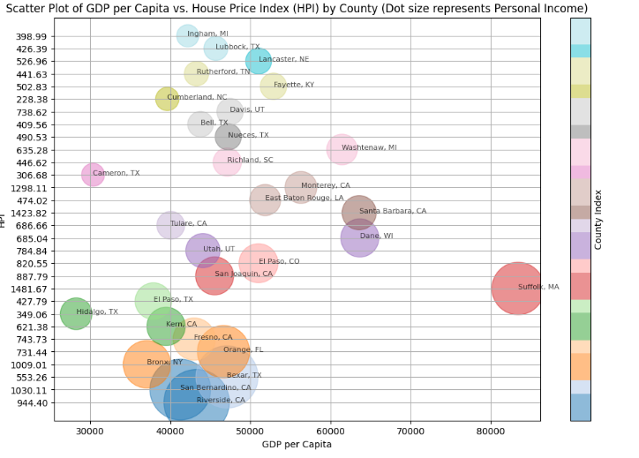
Project 5 - Data-Driven Insights into US County Demographics and Economic Trends
Abstract: Analyzed demographic and economic data across US counties to uncover trends influencing relocation, policy-making, and business strategy.
Objectives:
Apply statistical analysis to interpret demographic and economic data.
Use Python scripting for data manipulation and automation.
Generate actionable insights through graphical representation.
Methods:
Data retrieval using Python's requests library.
Data processing with pandas.
Statistical analysis and visualization using matplotlib and seaborn.
Applied basic predictive models for future trends.
Results:
Identified counties with aging populations and their economic implications.
Highlighted regions with potential for economic growth.
Notes:
### Slide 1: Project Overview
**Introduction:**
"In this project, we analyzed various datasets to gain insights into demographic and economic trends in US counties. We used data from the US Census Bureau and the Bureau of Economic Analysis to provide valuable information on population, age distribution, and economic indicators."
**Abstract:**
"Our project involved the analysis of demographic and economic data across US counties to uncover trends that influence decisions related to relocation, policy-making, and business strategy. By leveraging Python scripting, we synthesized data from multiple sources to provide a comprehensive view of the factors that characterize each county."
**Objectives:**
"The primary objectives of our project were to:
1. Apply statistical analysis to interpret complex datasets concerning US demographics and economics.
2. Utilize Python scripting for data manipulation, integration, and automation of data retrieval processes.
3. Generate actionable insights through the graphical representation of data."
**Methods:**
"We employed several methods to achieve these objectives:
- Data Retrieval: We used automated scripts with Python's `requests` library to fetch data from the US Census Bureau and Bureau of Economic Analysis APIs.
- Data Processing: Utilizing `pandas`, we cleaned, merged, and transformed the datasets to prepare them for analysis.
- Statistical Analysis and Visualization: We used Python's `matplotlib` and `seaborn` libraries to visualize data trends and distributions.
- Machine Learning: Basic predictive models were applied to assess potential future trends based on historical data."
**Results:**
"Our analysis led to several key findings:
- We identified counties with an aging population and explored their economic implications.
- We highlighted regions with a youthful demographic, suggesting potential for economic growth and labor market expansion.
- We developed interactive plots and charts that allow for easy visualization of complex economic and demographic relationships."
**Conclusion:**
"This project significantly enhanced my understanding and application of data science principles in a real-world context. It reinforced my skills in data manipulation and visualization and provided practical experience in interpreting and communicating data-driven insights effectively."
**Scatter Plot Analysis:**
"In our results, we generated scatter plots to visualize the relationship between GDP per capita and the House Price Index (HPI) for counties with a high proportion of individuals retiring and those with a low proportion of individuals retiring. In the scatter plots displayed here:
1. **Retiring Counties (Top Plot):**
- Counties such as Pinellas, FL and Barnstable, MA have high GDP per capita and high HPI, indicating affluent areas with significant retiring populations.
- The dot sizes represent personal income, highlighting areas with substantial economic resources despite the aging population.
- Notable counties such as Yavapai, AZ and Sussex, DE also show similar trends but with varying GDP per capita levels.
2. **Counties with Young Demographics (Bottom Plot):**
- Regions such as Riverside, CA and San Bernardino, CA exhibit lower GDP per capita but higher HPI, indicating potential for economic growth driven by a youthful demographic.
- These regions have large dot sizes, showing higher personal income levels, suggesting robust economic activity and potential for labor market expansion.
- Counties like Bexar, TX and Bronx, NY further illustrate regions with significant youthful populations and corresponding economic indicators.
By comparing these plots, we can observe how demographic composition affects economic indicators across different counties, providing actionable insights for businesses and policymakers."
**Age Distribution Analysis:**
"Additionally, we examined the population distribution by age group in selected counties to understand their demographic profiles better. Here are the bar charts for Riverside, CA, and Pinellas, FL:
1. **Riverside, CA (Top Chart):**
- Riverside has a relatively balanced age distribution, with noticeable peaks in the younger age groups (0-24 years) and middle-aged groups (30-44 years).
- This distribution indicates a stable workforce and potential for economic growth, supported by a substantial working-age population.
2. **Pinellas, FL (Bottom Chart):**
- Pinellas shows a higher proportion of older age groups, especially in the 55-64 years and 65+ years categories.
- The significant elderly population in Pinellas highlights the need for services and amenities catering to retirees, such as healthcare and recreational facilities.
By analyzing these age distributions, we gain insights into the economic and social needs of different counties, aiding in targeted policy-making and business strategies."
Use these notes to guide your presentation, ensuring you highlight specific details from your project to illustrate how you met each objective and achieved your results. #############################################################################

Slide 12
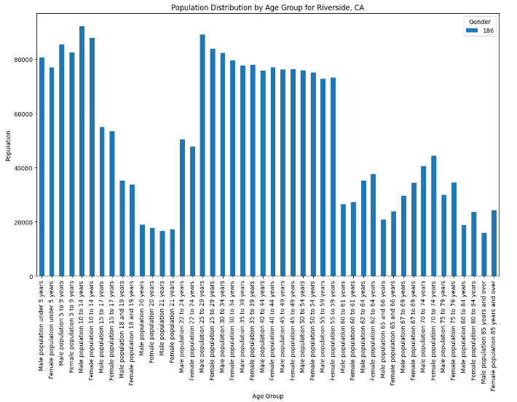
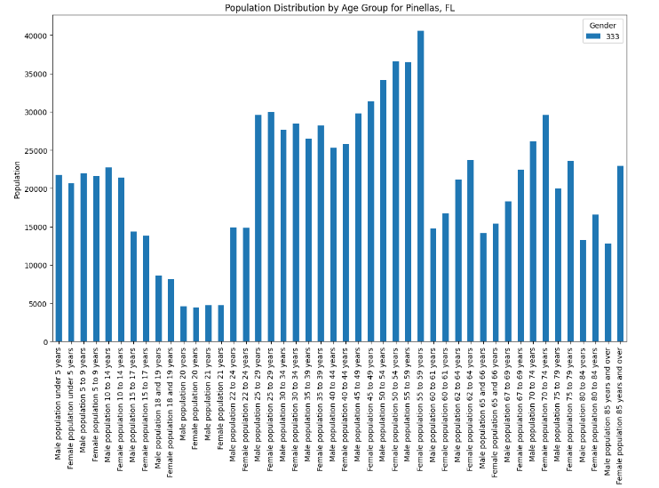
Data-Driven Insights - Learning Objectives
Statistical Analysis and Probabilistic Modeling:
Applied statistical methods to interpret complex datasets.
Machine Learning:
Used predictive models to assess potential future trends.
Data Management and Processing:
Efficiently managed and processed large datasets using Python libraries.
Data Visualization and Communication:
Created interactive plots and charts for easy data visualization.
Advanced Computational Techniques:
Utilized advanced data structures and algorithms for efficient data processing.
Ethics and Privacy:
Ensured data was sourced responsibly and analyzed with privacy considerations.
Research Methods:
Applied systematic research methods from data collection to evaluation.
Notes:
Introduction: "Let's now discuss how this project aligns with our learning objectives."
Statistical Analysis and Probabilistic Modeling: "We applied statistical methods to interpret complex datasets. For example, we calculated the proportions of individuals in specific age groups and analyzed their economic implications. This helped us identify demographic shifts and their impacts on regional economic health."
Machine Learning: "We incorporated basic predictive models to assess potential future trends based on historical data. These models helped predict economic outcomes like GDP per capita and personal income, highlighting regions with potential for economic growth or decline."
Data Management and Processing: "Our project showcased extensive use of Python libraries like pandas for cleaning, merging, and transforming large datasets efficiently. Automating data retrieval from multiple sources and integrating them into a cohesive dataset was crucial for our analysis."
Data Visualization and Communication: "Using Python libraries like matplotlib and seaborn, we translated complex data sets into comprehensible visual formats. Interactive plots and charts made it easier to visualize and interpret economic and demographic relationships."
Advanced Computational Techniques: "We utilized advanced data structures and algorithms for efficient data processing. This included Python scripting for automation and handling large volumes of data."
Ethics and Privacy: "Ethics and privacy were paramount in our project. We ensured that all data was sourced responsibly and analyzed with consideration for privacy concerns, using data from reputable sources like the US Census Bureau and Bureau of Economic Analysis."
Research Methods: "We applied a systematic approach from data collection to evaluation. This involved a thorough review of existing data sources, careful data integration, and rigorous analysis to derive meaningful insights."
Capstone Project: "Overall, this project synthesized all aspects of the data science curriculum to solve practical problems with real-world data, meeting the educational objectives and providing valuable insights for decision-making."

Slide 13
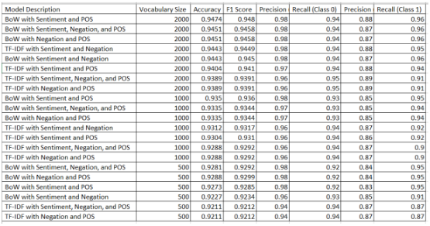
Project 6 - Email Spam Classification Using NLP Techniques
Abstract: Classified emails into "spam" or "ham" using machine learning and NLP techniques.
Objectives:
Apply various preprocessing methods and feature extraction techniques.
Utilize a Naive Bayes classifier for accurate classification.
Methods:
Data preprocessing: lowercasing, URL removal, HTML tag removal, etc.
Feature extraction: Bag-of-Words (BoW) and TF-IDF.
Sentiment analysis to enhance classification accuracy.
Model training with Naive Bayes and other classifiers.
Results:
High precision and recall for both spam and ham classifications using BoW.
Improved accuracy with sentiment scores.
Notes:
Email Spam Classification Using NLP Techniques'. The goal of this project was to classify emails into 'spam' or 'ham' categories using machine learning and NLP techniques.
We started with data preprocessing, applying steps like lowercasing, URL removal, HTML tag removal, non-alphabetic character removal, tokenization, stopword removal, and lemmatization. These steps were crucial in cleaning and preparing the data for analysis.
For feature extraction, we used Bag-of-Words (BoW) and Term Frequency-Inverse Document Frequency (TF-IDF). While BoW captured the frequency of words, TF-IDF weighed their importance. We also incorporated sentiment analysis to enhance classification accuracy.
We trained our models using a Naive Bayes classifier, known for its effectiveness in text classification. Our base model showed high precision and recall for both spam and ham classifications using BoW. Interestingly, the incorporation of sentiment scores significantly improved accuracy to 0.9466, highlighting the value of sentiment analysis.
To provide a comprehensive comparison of our models, we tested various combinations of models, vocabulary sizes, and feature sets. As shown in the table, models using BoW with sentiment and POS tagging achieved the highest accuracy of 0.9474 and an F1 score of 0.9480. In contrast, models using TF-IDF showed slightly lower performance.
Our conclusion was that the combination of traditional feature extraction methods with advanced NLP techniques, like sentiment analysis, can significantly enhance model performance."

Slide 14
Email Spam Classification - Learning Objectives
Statistical Analysis and Probabilistic Modeling:
Applied statistical methods to interpret complex email datasets.
Machine Learning:
Implemented supervised learning with a Naive Bayes classifier.
Data Management and Processing:
Managed and preprocessed a large dataset of emails using Python libraries.
Data Visualization and Communication:
Created visualizations to present data insights through EDA.
Advanced Computational Techniques:
Applied complex NLP techniques for feature extraction.
Ethics and Privacy:
Addressed ethical considerations in handling email data.
Research Methods:
Employed rigorous data collection and evaluation techniques.
Notes:
"Now, let's discuss how this project aligns with our learning objectives.
First, for Statistical Analysis and Probabilistic Modeling, we applied statistical methods to interpret complex email datasets. For instance, we calculated word frequencies and employed probabilistic modeling to predict whether an email is spam or ham. This step was crucial for understanding patterns in the data.
In Machine Learning, we implemented supervised learning using a Naive Bayes classifier. This choice was due to its known effectiveness in text classification, ensuring high accuracy and reliability in our results.
Regarding Data Management and Processing, we managed and preprocessed a large dataset of emails using Python libraries like pandas. This included cleaning, merging, and transforming data, which was essential for preparing the dataset for analysis.
For Data Visualization and Communication, we created visualizations using matplotlib to present insights from the data through exploratory data analysis. These visualizations highlighted key patterns and trends, facilitating better understanding and decision-making.
In Advanced Computational Techniques, we applied complex NLP techniques such as tokenization, lemmatization, and part-of-speech tagging. These techniques enhanced the feature extraction process, improving our model's performance.
We also addressed Ethics and Privacy by handling email data responsibly and ensuring that the classification process respected privacy concerns.
Finally, in Research Methods, we employed rigorous data collection and evaluation techniques. This structured approach ensured the validity and reliability of our findings, from data collection to final evaluation.
Overall, this project demonstrated our ability to apply comprehensive data science skills to a practical, real-world problem."

Slide 15
Conclusion
Summary: My projects demonstrate a comprehensive application of data science knowledge and skills to real-world problems. They reflect my growth as a data scientist and my readiness to contribute effectively in a professional setting.
Future Work: Explore more advanced NLP techniques and deep learning models to further enhance predictive capabilities in various domains.

Slide 16
Resources
Link: https://github.com/btindol/Syracuse_Data_Science_Master_Portfolio
Description: Contains all the code and documentation for the projects discussed.

