Slide 1
Self Stabilizing Distributed Queuing
by Srikanta Tirthapura, Member, IEEE, and Maurice Herlihy, Member, IEEE
presenter: Lucas Rosa

Slide 2
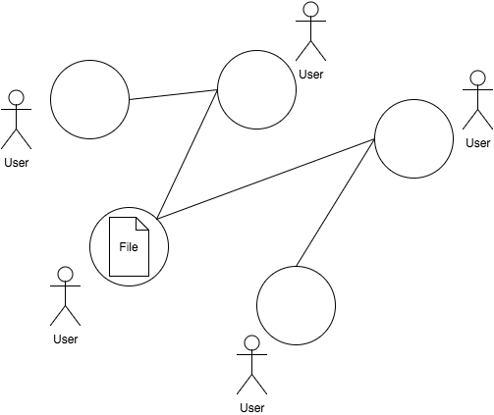
Motivation
Synchronizing accesses to a mobile object in a computer network

Slide 3
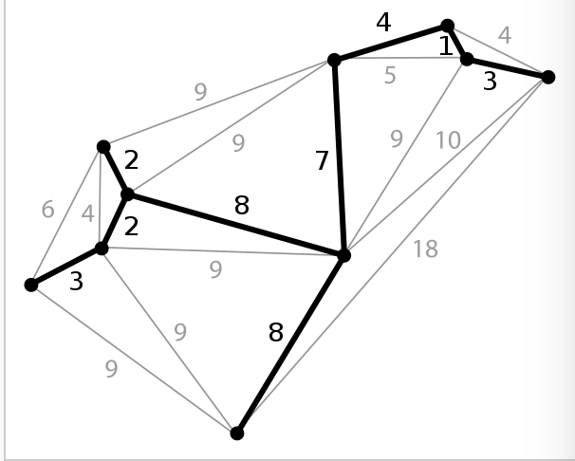
Spanning Tree
A subgraph that is a tree which includes all the vertices of a graph
A graph may have many spanning trees, but an unconnected graph will not contain a spanning tree
Minimum spanning tree
Connects all the vertices together with the minimal total weighting for its edges
Prim’s algorithm

Slide 4
Arrow Protocol
Simple distributed queuing protocol based on path reversal on a network spanning tree
Used to manage mobile objects and has outperformed conventional directory schemes under high contention
Not fault tolerant because it assumes that nodes and links never fail
Lost messages
Edge failures
Node failures

Slide 5
Self Stabilization
A unified approach to fault tolerance of the arrow protocol
If starting from an arbitrary initial global state, it eventually reaches a legal global state
A general correctness condition
Stable and local

