Slide 1
Oral Tobramycin
From BCS III to a Viable Oral Formulation
A bibliographic study with PBPK modeling in PK-Sim
and multi-objective formulation optimization
Khaled Ben Taieb — Personal research — September 2026
repository: oral-tobramycin-pbpk

Slide 2
The Problem
An essential antibiotic locked out of the oral route
Tobramycin: WHO-essential aminoglycoside — first-line against Pseudomonas aeruginosa (CF, HAP, UTI)
Available only IV and inhaled — no oral formulation exists
Oral bioavailability ≈ 1–2 % — assumed BCS class IV for decades
Clinical burden: hospitalization, catheters, access inequity in low-resource settings
The wrong assumption ("low solubility AND low permeability") drives the wrong toolbox
Research question: can a validated computational path unlock oral tobramycin?
oral-tobramycin-pbpk
2

Slide 3
Finding 1 — It is BCS Class III, not IV
Solubility is never the limiting factor
Property | Value | Criterion
Solubility (water) | 94–100 mg/mL | highest dose soluble in ≤250 mL
Dose margin | 20–200× | BCS 'high' threshold
Papp | < 1×10⁻⁶ cm/s | class III boundary
Oral F | ≈ 1–2 % | clinical evidence
Explicit statement — Asad 2023 (PLoS ONE):
“Tobramycin (TOB) is a BCS class III drug”
Consequence: a permeability-only problem → solubility technologies are unnecessary → the toolbox is permeability enhancement.
oral-tobramycin-pbpk
3

Slide 4
The Permeability Toolbox
Five validated levers, one 10-gene chromosome
Strategy | Evidence | GA lever
HIP — hydrophobic ion pairing | 1500× logP shift (Asad 2023) | gene 1
SEDDS | spontaneous emulsification | genes 3–5
Nanoparticles (PLGA/chitosan) | MIC maintained (Hill 2019) | genes 2, 7, 8
PE — sodium caprate C₁₀ | clinical safety record | gene 6
Enteric coating | standard technology | gene 9
The optimization question: which combination, at what dose, attains antibacterial exposure targets?
oral-tobramycin-pbpk
4

Slide 5
The Enhancement Model — Cited, Bounded, Emergent
No free multiplier: 7 factors × 2 anchors
Component | Form | Max | Grade
HIP logP' (Asad 2023) | 10^((logP+2.9)·K), gene capped +1.6 | 20x | B
SEDDS fraction (Muhammad 2022) | min(1.6, sum/100) | 1.6x | B
Nanoparticle size (Hill 2019) | 1+0.5·exp(-(size-50)/150) | 1.5x | C
C10 loading (Maher 2009) | 1+0.6·(pe/50) | 1.6x | B
Polymer (Bohley 2024) | 1+0.3·(pl/30) | 1.3x | C
Chitosan / enteric | x1.15 / x1.10 if on | 1.27x | C
Anchors: native P_int0 = 3e-9 (F = 1.75 %) · nominal x20 platform — emergent maximum x126.3, optimizer attains x125
oral-tobramycin-pbpk
5

Slide 6
Two-Phase Computational Design
One optimization logic, two engines
Phase I — Exploratory engine (pure R, Chapters 3 & 5)
2-compartment PK + GI transit + Hill PD + 8-factor bioavailability model
GA (100×200) + NSGA-II (200×300); MC n=200, CV n=26, OAT
Result: 34 % platform, top-10 formulations, manufacturing $4.30/dose (grade B)
Phase II — PK-Sim platform (Chapters 4, 6, 7)
Whole-body PBPK built from the validated amikacin model (OSP Library)
Gate-validated vs clinical data — 6/6; calibrated oral transfer function
In-the-loop NSGA-II: ~6,100 native evaluations (pop 100, converged gen 60)
Cross-validation between engines: 34.0 % vs 34.6 % at the same multiplier (Δ 1.9 % relative) — hypothesis H5 supported
oral-tobramycin-pbpk
6

Slide 7
Phase II — Building the PK-Sim Platform
The engineering story: crash → root cause → fix → validated model

Slide 8
The macOS Crash — OSPSuite-R issue #1622
Symptom → crash report → root cause → fix
Symptom: loadProjectFromSnapshot() → SIGSEGV on macOS (wrapper hard-blocks Darwin)
Crash report (.ips, faulting thread):
SQLite.Interop.dylib:
sqlite3_log ← lookupName ← resolveExprStep
← sqlite3ViewGetColumnNames ↔ selectExpander
(~90 inlined frames — stack overflow)
Root cause: SQLite view-name resolution overflows the .NET worker-thread stack while emitting a warning
Fix: materialize all 91 views into tables (static template data; content preserved) — patch_pksimdb.py
Result: PK-Sim runs natively on macOS — conversion, simulations, PKML export, populations
Upstream: issue #1622, fix scheduled v13; workaround reusable by the community
oral-tobramycin-pbpk
8

Slide 9
Model Build — Amikacin → Tobramycin
No published tobramycin PK-Sim model exists (structured search: 0 results)
Parameter | Value | Note
Molecular weight | 467.515 g/mol | PubChem
logP | −2.9 | native drug
Fraction unbound | 0.95 | minimal binding
Solubility | 94 mg/mL | never limiting (BCS III)
pKa (bases) | 7.7, 7.8, 9.1 | 3 of 5 amines — platform limit
Renal process | GFR fraction 1.0 | purely renal clearance
Silent traps found & fixed (Ch. 4):
renal process matched by name — renaming breaks clearance silently
simulation-level altered parameters override building blocks (infusion 4→30 min)
formulation type = Formulation_Dissolved, linked in the simulation's protocol selection
units are base units: dose in kg, gastric emptying in minutes
oral-tobramycin-pbpk
9

Slide 10
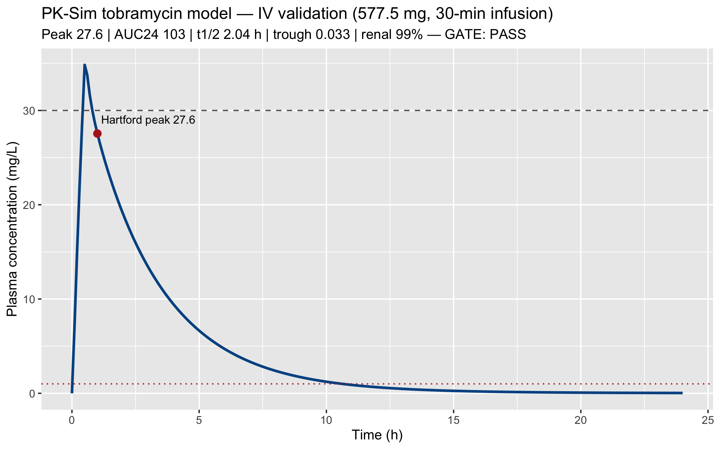
IV Validation Gate — 6/6 PASS
577.5 mg (7 mg/kg), 30-min infusion, 82.5-kg volunteer
Metric | PK-Sim | Published target | Verdict
Hartford peak (30 min post-inf) | 25.3 mg/L | 20–30 mg/L | PASS
Cmax end of infusion | 34.8 mg/L | 20–35 (V1 envelope) | PASS
AUC24 → implied CL | 102.5 → 5.63 L/h | CL 3.27–6.03 (Li 2021) | PASS
Trough 24 h | 0.033 mg/L | < 1 mg/L | PASS
t½ NCA effective | 2.29 h | 2.0–3.0 h | PASS
Renal excretion 24 h | 99.4 % | > 90 % | PASS
The model reproduces the published clinical envelope — validated substrate for the oral program.
oral-tobramycin-pbpk
10

Slide 11
Two Windows, One Truth — F24 vs F96
Flip-flop kinetics forces the distinction
 | 24-h window (F24) | 96-h window (F96)
Native (x1) | 1.75 % — calibration to clinical 1-2 % | 3.5 % — extent incl. flip-flop tail
Nominal platform (x20) | 34.6 % (legacy cross-check 34.0 %) | ~49 %
Winner (x125) | 91.6 % | 97.1 %
Clinical 1–2 % is a 24-h-era estimate: calibration uses F24, extent claims use F96
Both conventions reported side by side throughout — no hidden window switches
oral-tobramycin-pbpk
11

Slide 12
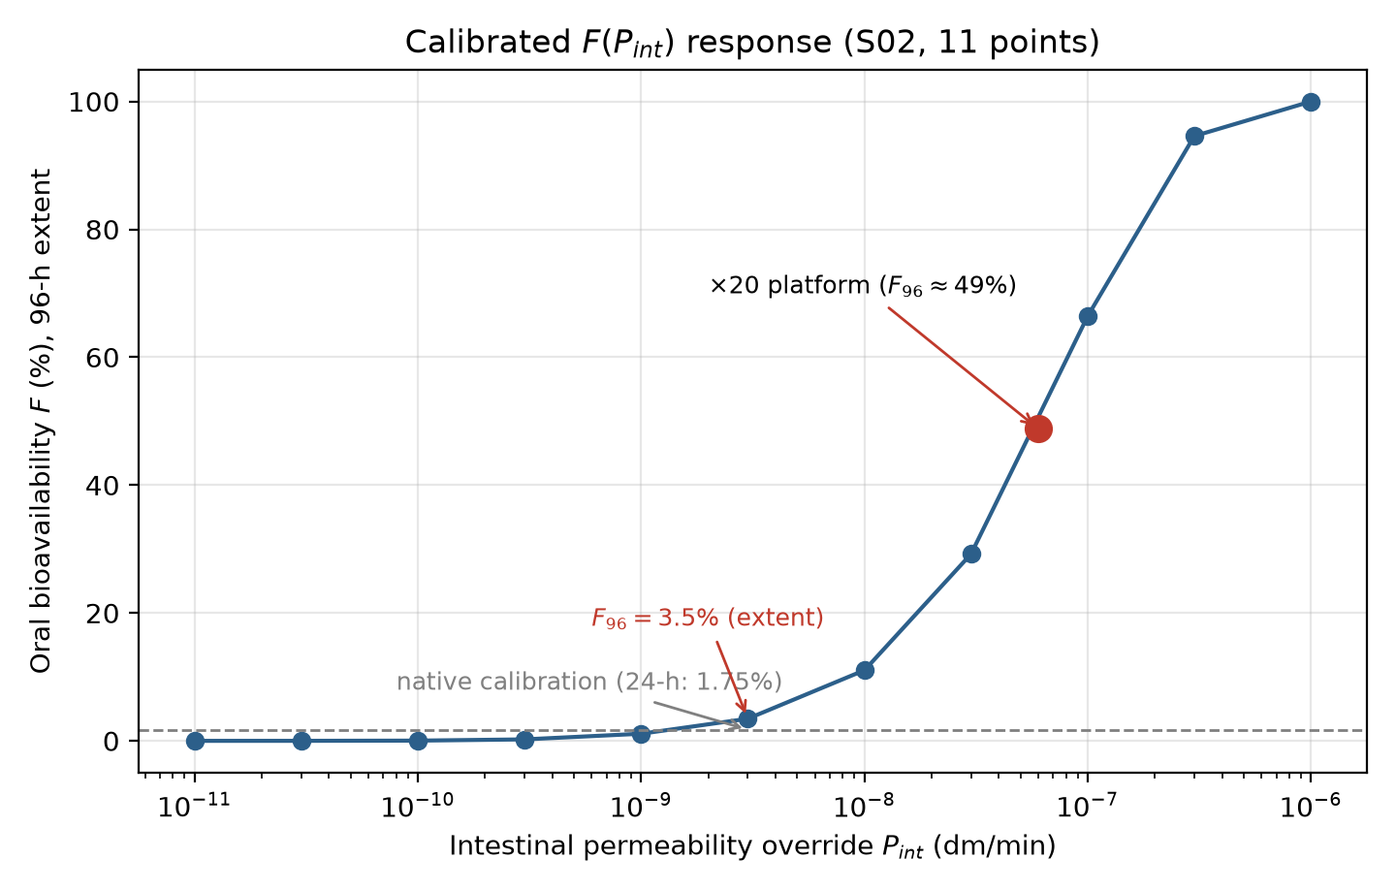
The Oral Transfer Function F(P_int)
Calibrated, not fitted silently
Native PK-Sim P_int for logP −2.9: ~0 (correlation saturates; paracellular off by default)
Calibrated baseline: P_int₀ = 3×10⁻⁹ dm/min → F₀ = 1.75 % (clinical 1–2 %)
Extent curve (96 h) saturates past ×100; 24-h window saturates earlier — both conventions reported
Every GA candidate = an emergent multiplier on P_int₀ — 7 cited factors, max ×125 (measured logP cap)
oral-tobramycin-pbpk
12

Slide 13
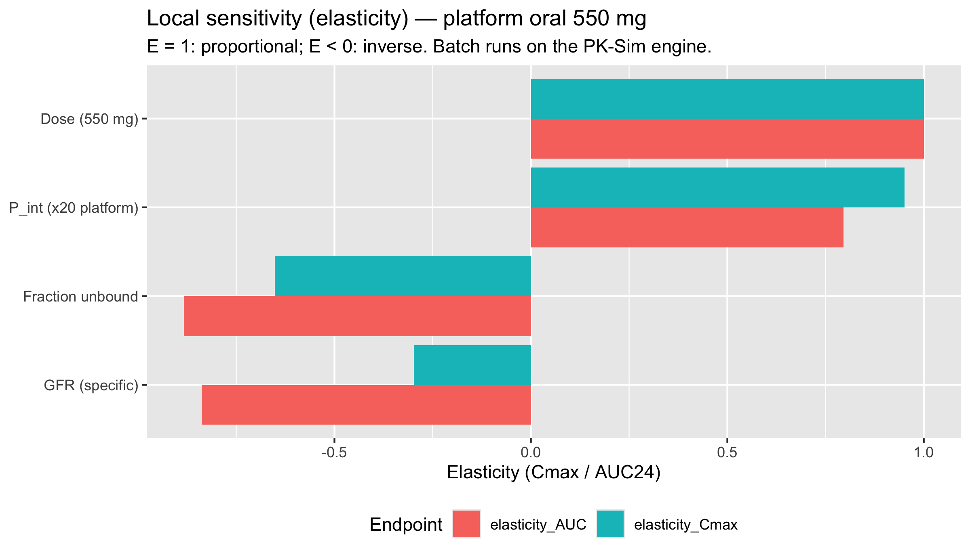
Physiological Studies — S01…S05
All PK-Sim-native, batch-executed
Study | Design | Key result
S01 — IV × renal (20 scenarios) | doses × CLCR 30–150 mL/min | CL 1.83 → 7.18 L/h; trough 3.0 at CLCR 30
S03 — Virtual population (n=100) | ICRP 2002, nominal ×20 platform | Cmax/MIC median 4.5 [1.4–13.2]
S04 — Elasticities (±20 %) | P_int, dose, GFR, f_u | P_int +0.95 Cmax; GFR −0.84 AUC; f_u −0.88
S05 — Food effect | GET 15 vs 60 min | Cmax −20 %, extent unchanged (BCS III)
oral-tobramycin-pbpk
13

Slide 14
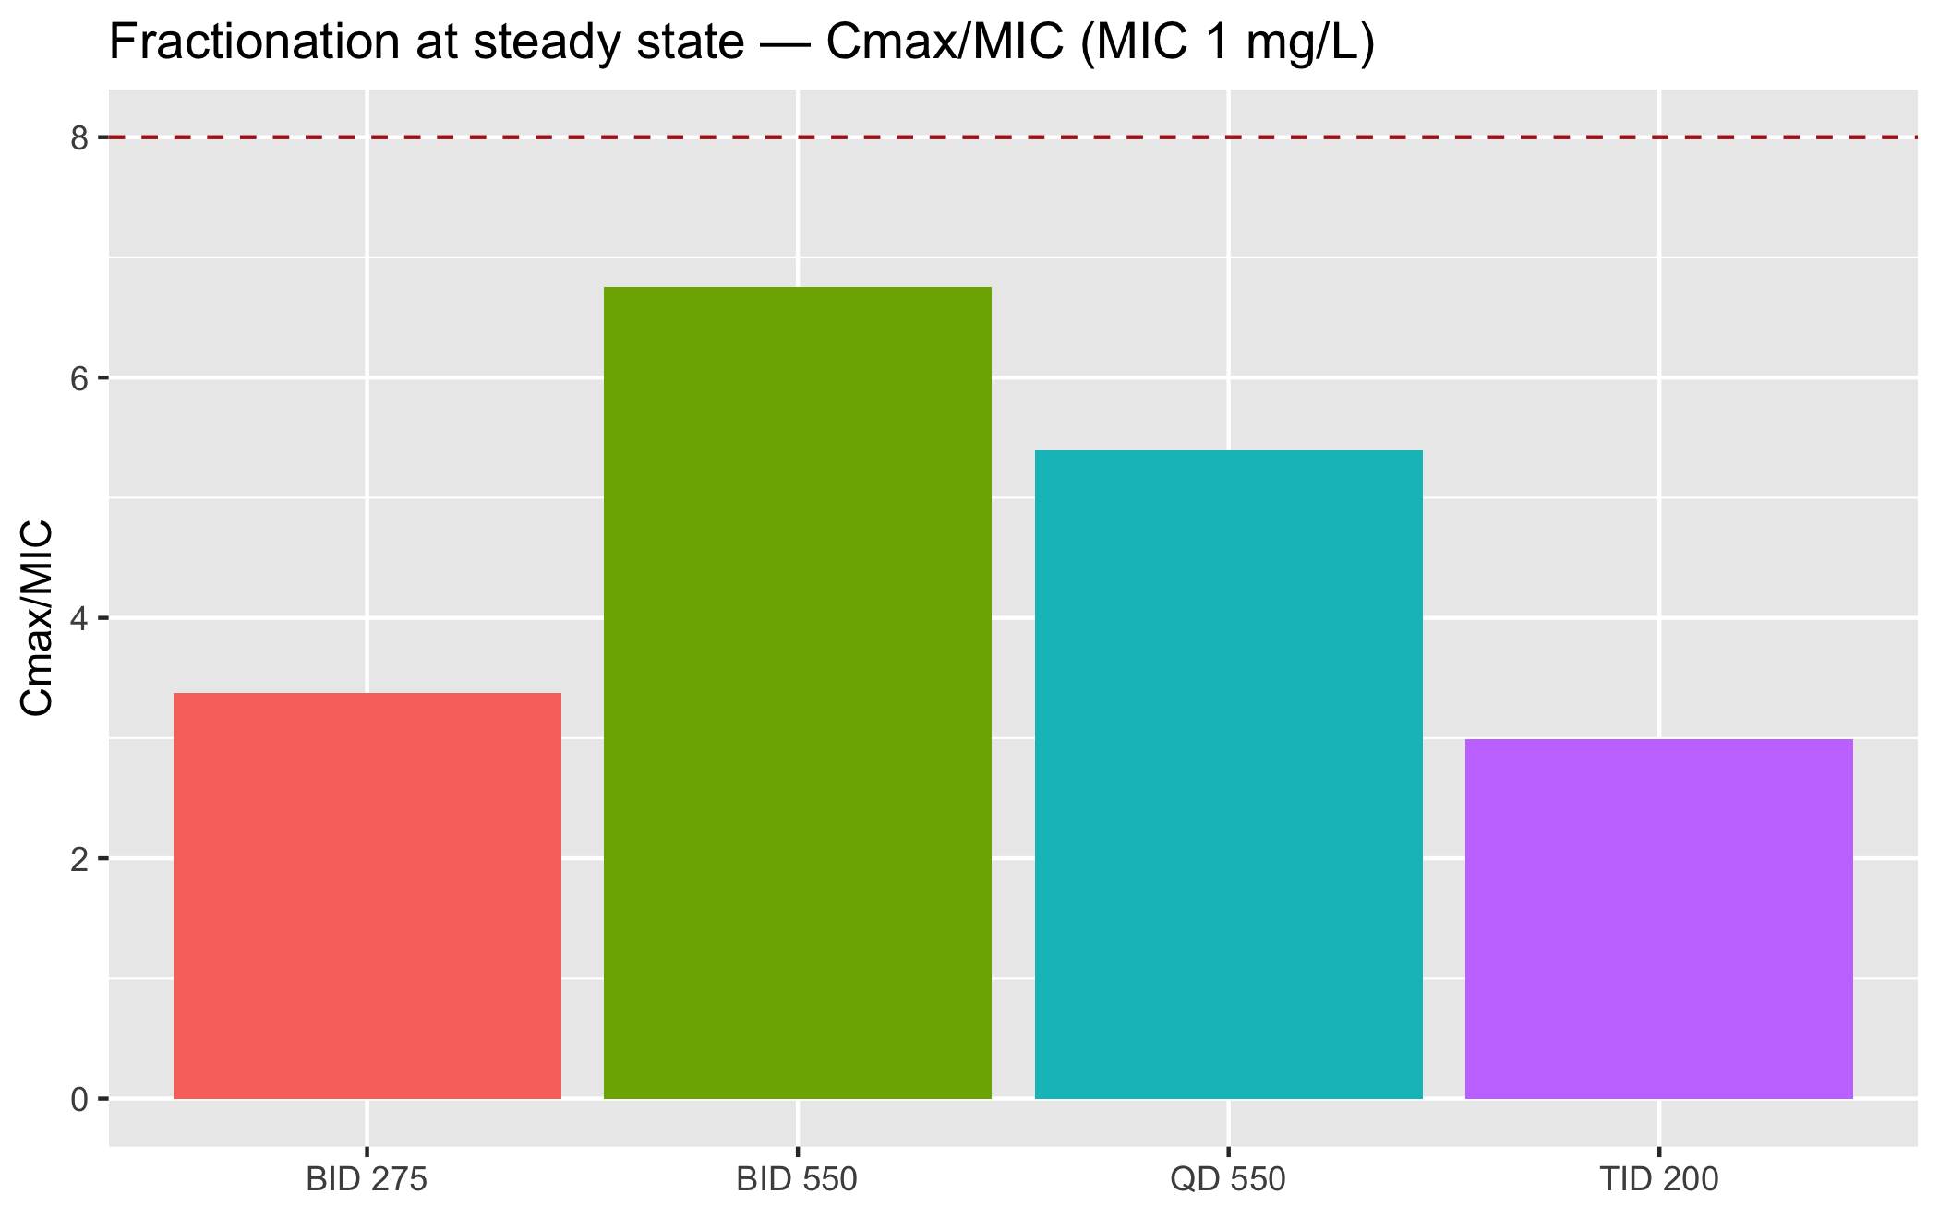
S06 — Flip-Flop Kinetics & the Nominal Limit
A genuine kinetic discovery
Single oral dose: terminal decline is absorption-rate-limited — C(24 h) = 0.72 mg/L
→ steady-state superposition requires a 96 h window (flip-flop kinetics)
Nominal platform (×20) at 550–600 mg: AUC_ss/MIC ≤ 50 — map shows attainment from 993 mg
QD 550: Cmax_ss 5.4, AUC_ss 49.6 — BID 275: 3.4 / 24.2
Conclusion: the optimization must push the platform further
oral-tobramycin-pbpk
14

Slide 15
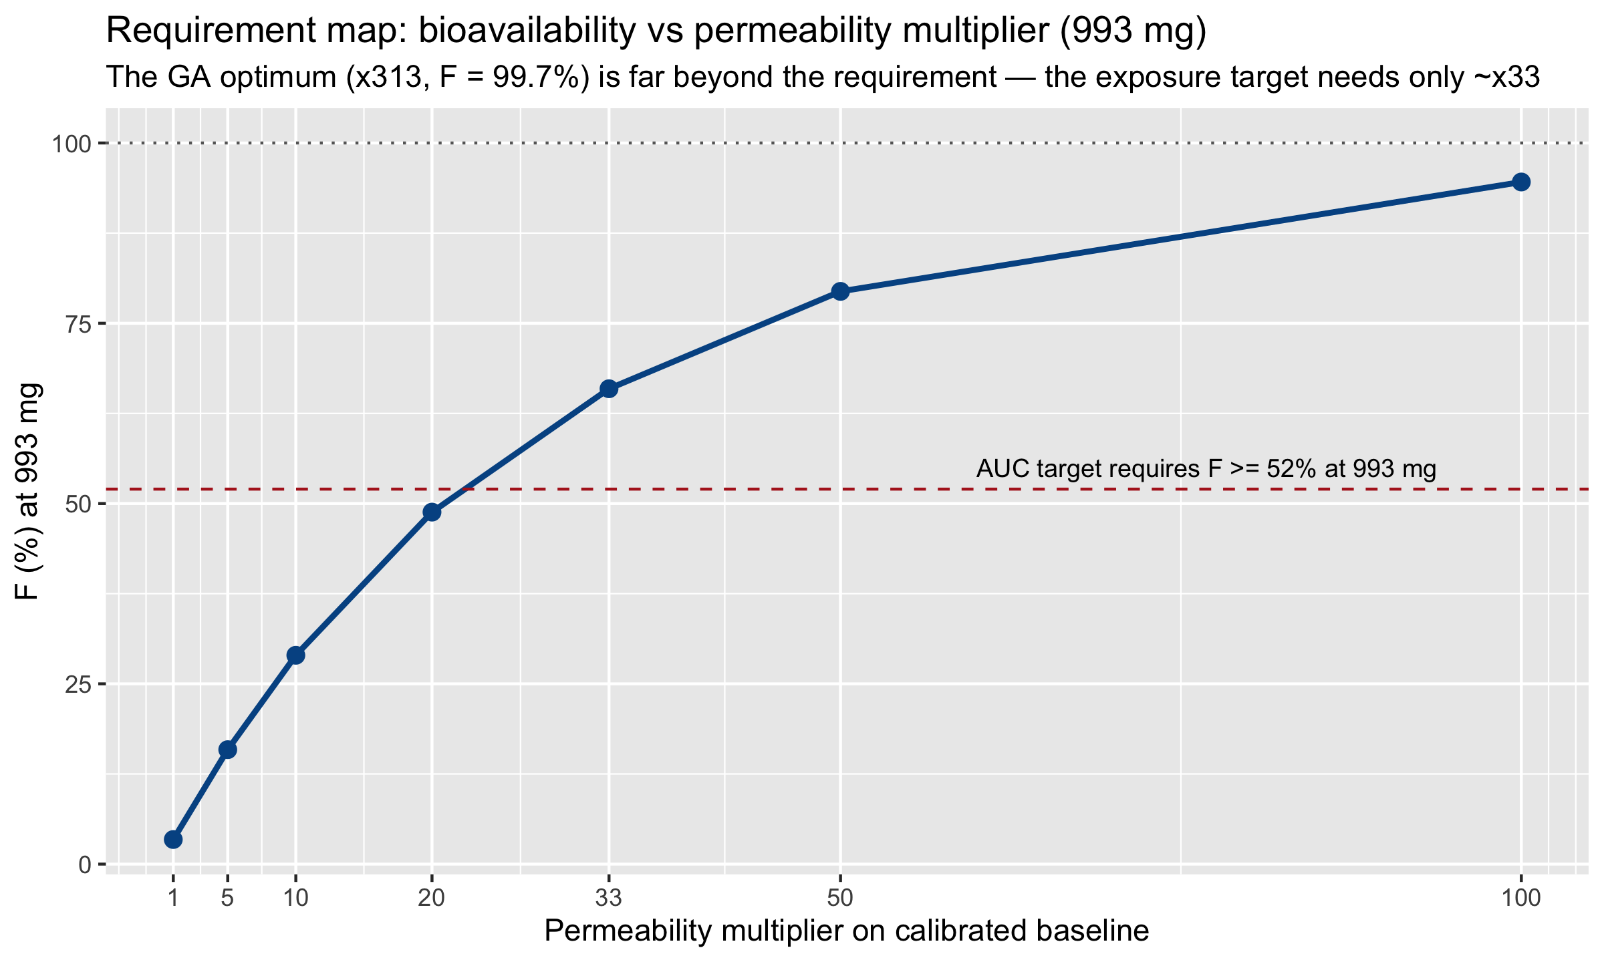
The Requirement Map — S08
What a real formulation must deliver, dose by dose
x20 at 993 mg: BOTH targets met (9.7 / 93.5) — the nominal multiplier suffices
Beyond x33: buys dose reduction, not new attainment
x125 ceiling: same targets at 467 mg — troughs at the line
Tiered, falsifiable: >=x20 for targets · x125 max
oral-tobramycin-pbpk
15

Slide 16
In-the-Loop NSGA-II — Converged at Generation 60
One SimulationBatch per generation; seed 42; cited-bounds enhancement model
Gen | best F96 | best Cmax/MIC | median dose
1 | 92.2 % | 20.4 | 834 mg
10 | 96.6 % | 30.2 | 1000 mg
60 | 97.1 % | 31.2 | 1000 mg
The front degenerates to the corner — exposure objectives are synergistic; only dose opposes
The finding: the optimum sits at the cited-bounds corner (×125) — the best the evidence supports
The clinically relevant question shifts: what is the minimal dose that still attains the targets?
The degeneracy is itself a finding — answered by the winner's dose scan (next).
oral-tobramycin-pbpk
16

Slide 17
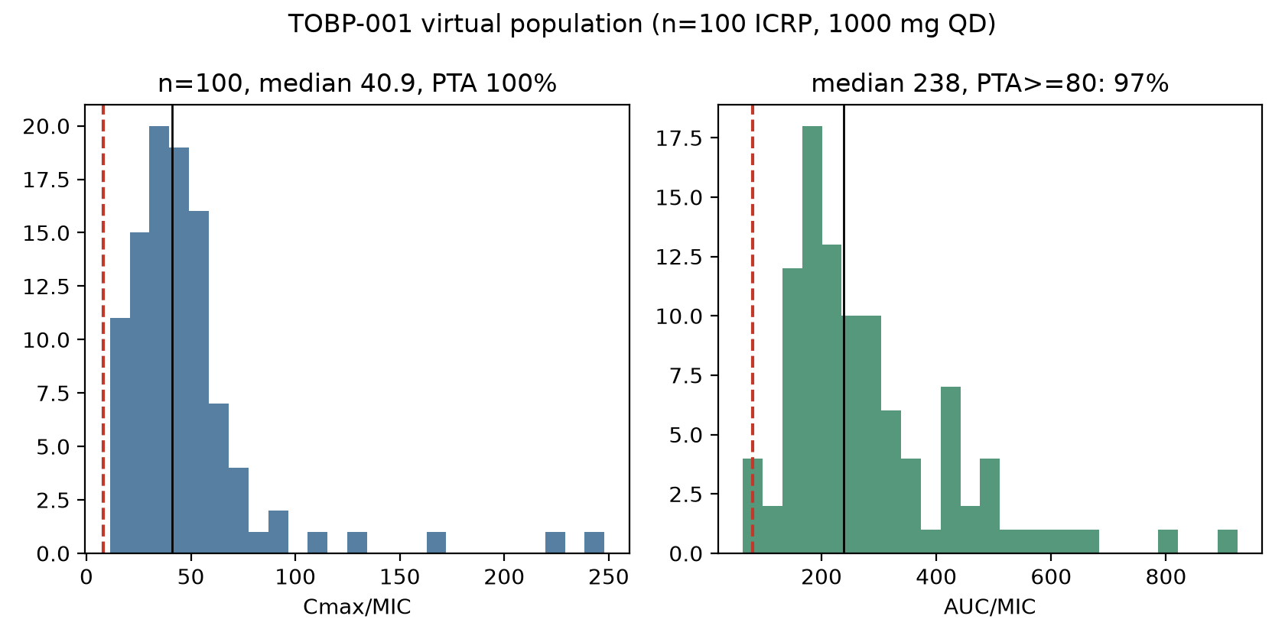
The Winner — TOBP-001
1000 mg once daily · P_int ×125 (cited max) · F96 = 97.1 %
Regimen | Cmax_ss/MIC | AUC_ss/MIC | Cmin_ss (mg/L)
QD 250 (minimal peak dose) | 8.0 | ~43 | ~0.4
QD 1000 (winner) | 32.2 | 172.3 | 1.21
BID 500 | 17.6 | 172.2 | 2.34
AUC/MIC = 172 — ABOVE the 80–120 IV target band (in-band from 467 mg)
Minimal target-attaining dose: 250 mg QD (Cmax/MIC = 8.0)
Population (n=100): Cmax/MIC 40.9 [15.8–88.8] PTA 100 % · AUC/MIC 238, PTA≥80: 97 %
Virtual population — 100 % peak attainment
oral-tobramycin-pbpk
17

Slide 18
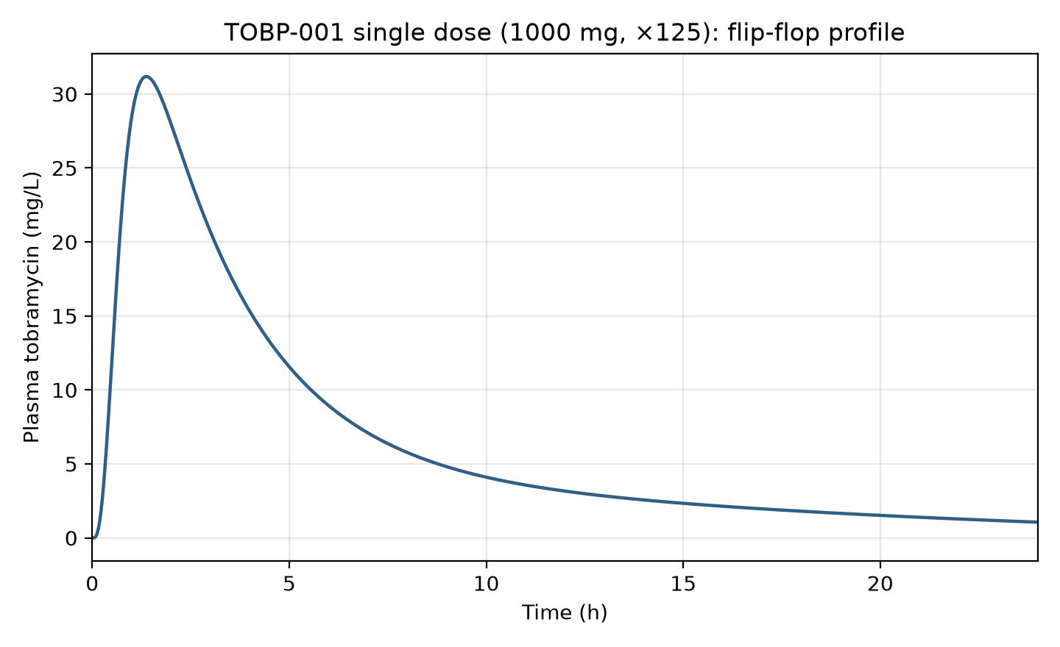
Formulation Identity Card — TOBP-001
Decoded chromosome: what the pharmacist must manufacture
Component | Specification
HIP complex (ion pairing) | apparent logP' = +1.6 (measured complex; lit. 1500x shift)
Nanoparticle platform | polymer NPs, particle size ≈ 50 nm
SEDDS system | surfactant-rich ceiling: 60% / 29% co / 70% oil
Permeation enhancer | sodium caprate (C10) 50 mM
Mucoadhesive polymer | 29.3% loading
Coatings | chitosan (TJ modulation) + enteric HPMC-AS
Dose | 1000 mg once daily
PK-Sim implementation | P_int override 3.75e-7 dm/min = ×125 (cited max)
Single dose: F96 97.1% | Cmax 31.2 mg/L | AUC96 172.3 — flip-flop tail visible
oral-tobramycin-pbpk
18

Slide 19
One Platform, Three Operating Points
Identity-card comparison (steady state, MIC 1 mg/L)
Card | Dose (mg) | P_int mult | F96 (%) | Cmax_ss/MIC | AUC_ss/MIC | Cmin_ss (mg/L)
TOBP-001 (winner) | 1000 | ×125 | 97.1 | 32.2 | 172.3 | 1.21
TOBP-250 (sparing) | 250 | ×125 | ~96 | 8.0 | ~43 | ~0.4
TOB-161-A (legacy) | 550 | ×73.9 | 89.3 | 13.6 | 87.3 | 1.05
Card 1 answers "what is the ceiling" — near-IV exposure (AUC/MIC 172 > 80–120)
Card 2 answers "what is the minimum" — a quarter of the dose still guards the peak (Cmax/MIC = 8)
Card 3 is the conservative platform the physiological studies characterized in depth
TDM selects the operating point per patient and per local MIC (PTA tables, Appendix N)
oral-tobramycin-pbpk
19

Slide 20
Two Candidates, One Battery — A vs B
Same model, same enhancement mapping, same 10-block protocol
 | TOB-161-A (legacy GA) | TOBP-001 (PK-Sim GA)
Multiplier | x73.9 | x125.0 (cited max)
Dose QD | 550.6 mg | 1000 mg
F96 / F24 | 89.3 % / 77.9 % | 97.1 % / 91.6 %
AUC_ss/MIC | 87.3 (IN BAND) | 172.3 (above; in-band from 467 mg)
Cmin_ss | 1.05 mg/L | 1.21 mg/L
Population PTA | 95 % peak / 79 % AUC | 100 % peak / 97 % AUC
Food effect | extent same, Cmax -31 % | extent same, Cmax -32 %
TOB-161-A: the conservative in-band option · TOBP-001: the upper design point — the space between is the experimental search interval
oral-tobramycin-pbpk
20

Slide 21
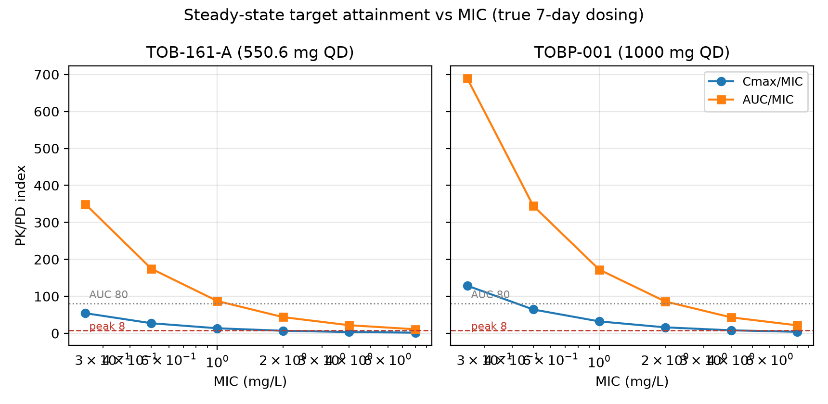
Target Attainment vs MIC — True 7-Day Dosing
Battery B5 block, both candidates
fT>MIC 99.6 % at MIC 1 for both · TOBP-001 holds the peak to MIC 2, TOB-161-A to MIC 1
oral-tobramycin-pbpk
21

Slide 22
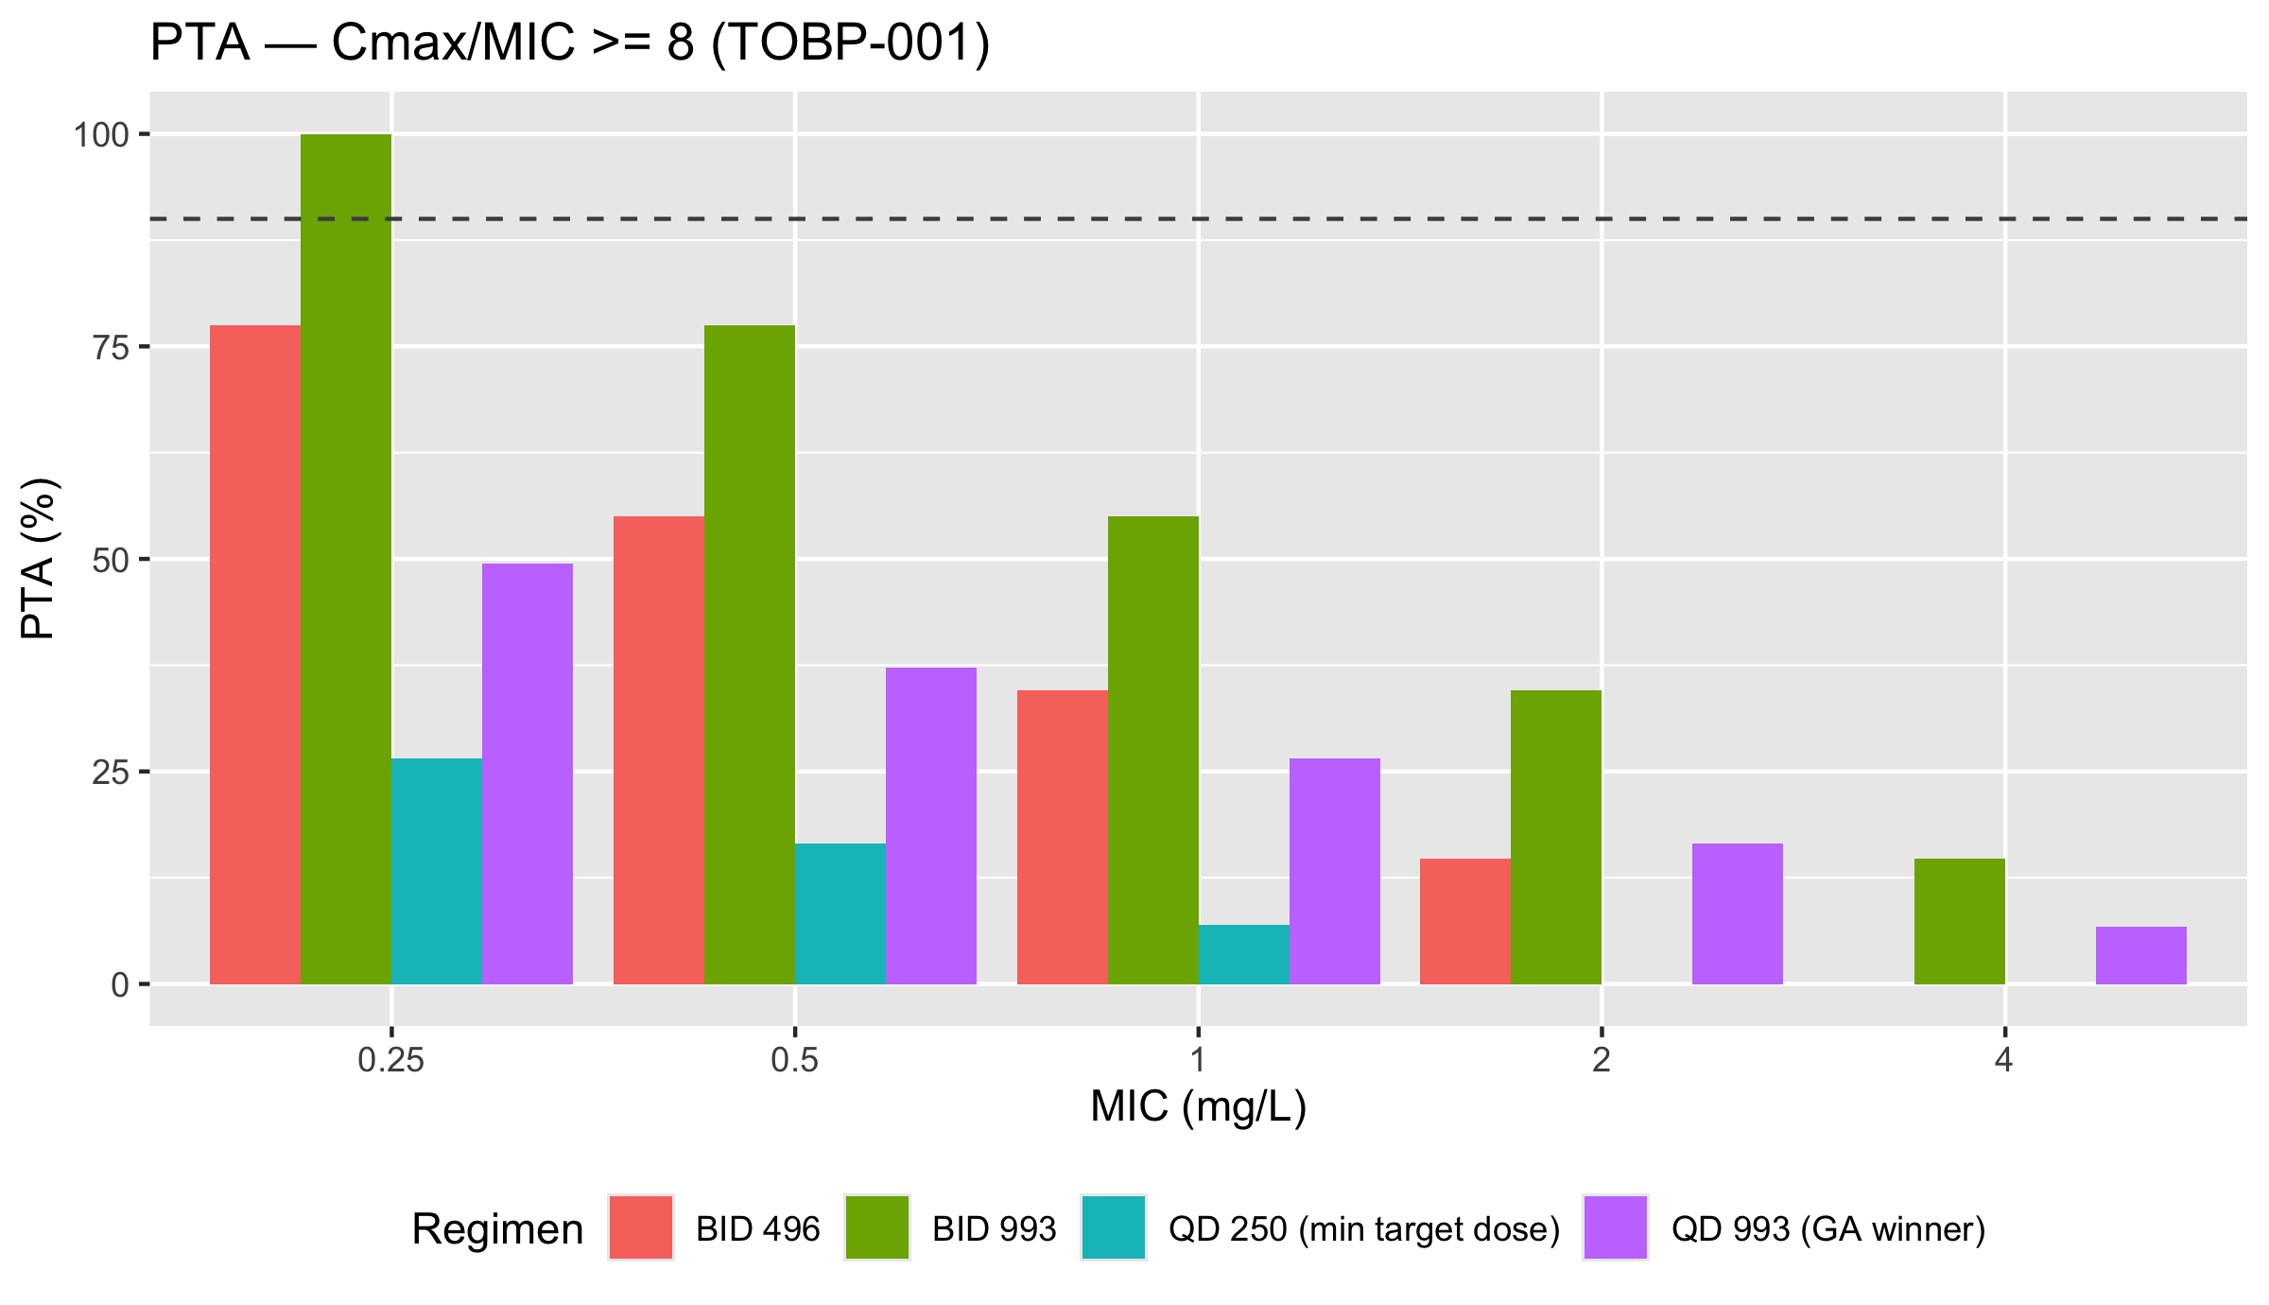
The Trade-Off — Trough Liability
The optimization inverts the clinical question
Both candidates sit AT the 1 mg/L line (QD troughs 1.05–1.21) — BID pushes above it (2.34)
The problem flips from "can we absorb enough?" to "how do we safely dose what we can now absorb?"
Clinical answer: QD regimens for trough safety; BID 500 for fT>MIC 100% with TDM
Bayesian TDM is structural, not optional — the virtual population provides the prior
Food effect on the winner: Cmax −32 %, extent unchanged (F96 97.1/97.2 %) — dose away from meals
oral-tobramycin-pbpk
22

Slide 23
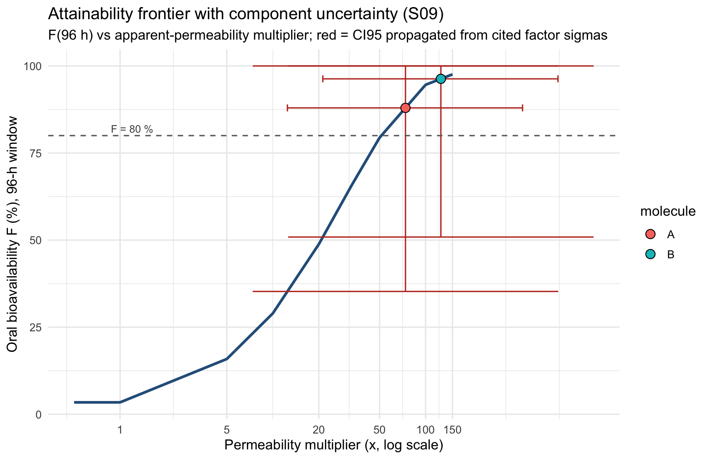
Uncertainty, Propagated — S09 Frontier
20,000 draws through the validated response curve
Per-component lognormal sigmas by evidence grade (A 0.10 · B 0.25 · C 0.40)
TOBP-001: F96 96 % [51–100] · AUC/MIC 172 [97–179] — robust
TOB-161-A: F96 88 % [35–100] · AUC 87 [39–99] — dose-limited
Not assumed away — quantified
oral-tobramycin-pbpk
23

Slide 24
Trust, Verified — Mass Balance & True Dosing
The engine checks its own arithmetic
Check | Predicted | Simulated | Verdict
AUC_tau = F·D/CL (TOB-161-A) | 87.38 mg·h/L | 87.25 (true 7-day QD) | 0.15 % OK
AUC_tau = F·D/CL (TOBP-001) | 172.20 mg·h/L | 172.28 (true 7-day QD) | 0.05 % OK
Superposition vs true dosing | 49.6 (screening) | 48.0 (true QD 550, x20) | ~3 % OK
Repeated dosing = PKML Application replication (one Application_k per dose — exactly how PK-Sim represents it)
Screening sweeps may use superposition; headline values use true dosing
oral-tobramycin-pbpk
24

Slide 25
Cross-Platform Validation — Two Engines, One Answer
Hypothesis H5
 | Legacy custom engine (Phase I) | PK-Sim 12.4 (Phase II)
Structure | 2-ct ODEs + transit + Hill (RK4) | Whole-body PBPK (ACAT + GFR)
Baseline F₀ | 1.5–2.8 % | 1.75 % (calibrated)
Platform F at ×20 | 34.0 % | 34.6 %
Agreement | Δ = 0.6 pp — 1.9 % relative
Phase I was not discarded work — it was the hypothesis generator whose central number the definitive platform confirmed.
oral-tobramycin-pbpk
25

Slide 26
Clinical Regimens — From the Battery
QD for trough safety · BID for interval coverage · TDM structural
Regimen | Cmax_ss/MIC | AUC_ss/MIC | Cmin_ss | Role
QD 250 (TOBP-001 platform) | 8.0 | ~43 | ~0.4 | peak guard, safest trough
QD 550.6 (TOB-161-A) | 13.6 | 87.3 | 1.05 | in-band, trough at line
QD 1000 (TOBP-001) | 32.2 | 172.3 | 1.21 | full exposure, TDM mandatory
BID 500 (TOBP-001) | 17.6 | 172.2 | 2.34 | fT 100%, trough above line
Renal impairment CLCR 100 to 20: AUC x3.4–3.5 — dose adaptation mandatory, as with IV
oral-tobramycin-pbpk
26

Slide 27
Roadmap — Experimental De-Risking
505(b)(2) · ~7 years · ~$4.8 M · manufacturing grade B ≈ $4.30/dose
Phase | Action
0–6 months | Caco-2/Ussing permeability of the HIP complex — the direct ×20/×125 test; prototype capsule + release
6–12 months | Rat/dog oral PK with model refinement; GLP toxicology of the full platform
1–3 years | Phase I SAD/food-effect → Phase II CF outpatients under Bayesian TDM
Regulatory | FDA 505(b)(2); precedent: oral SNAC platforms
The ×125 ceiling is what the evidence permits, not what it guarantees — each tier is falsifiable.
oral-tobramycin-pbpk
27

Slide 28
Bottom Line
An IV-only essential antibiotic now has a validated computational path
to oral administration — with named regimens, quantified exposure,
honest trade-offs, and a costed de-risking program.
250 mg — the dose that guards the peak
1000 mg — the dose that rivals the intravenous bag (AUC/MIC 172)
TDM — the driver's seat (troughs at the line, managed by monitoring)
Thank you — Questions

