Slide 1


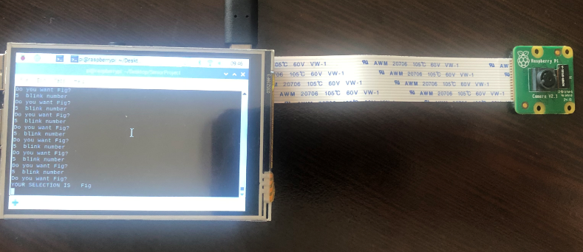

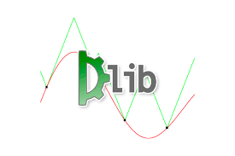


EYE BLINKING DETECTION SYSTEM
Batu Kaan Özen
Department of Electrical and Electronics Engineering
TOBB University of Economics and Technology
ABSTRACT
Amyotrophic Lateral Sclerosis (ALS), known as motor neuron disease, is a disease that does not impair the mental functions of the patient, but gradually loses muscle control. However, the eyelids of the patient do not lose their function for a long time. For this reason, blink communication is a recommended solution for ALS patients. Our aim in this project is making one system, which can detect ten words from the number of blinking. Our system uses the facial landmarks and their distance between each other and detects eye blinking after that it decide the meaning of eye command from the number of blinks. As a example, when the user blinks 4 times in 10 seconds. It means that the user wants banana. The technicall process is mainly based on Image Processing.
CONCULUSİON
The detecting eye blinking , understanding amount of blicks and offering desired foods are successfully completed.
TECHNICAL SPECIFICATION
Raspberry Pi 4B 4 GB RAM
Raspberry Pi Camera V2.1
3.5inch RPİ LCD(A)
Libraries
OpenCV
Dlib
Numpy
Project Price List
Product | Price
Raspberry Pi 4 B 4 GB RAM | 464,44 TL
Raspberry Pi Camera V2 | 229.82 TL
Type C charger | 29.90 TL
SanDisk Ultra 32 GB | 41.85 TL
3.5 Inch Lcd Ekran(A) 320x480 | 154.13 TL
ALGORİTHM
Taking Image via OpenCV from Raspberry Pi Camera.
Applying pre trained DLİB Library for detecting facial Landmarks.
Finding whether eye is open or not via calculating distance of spesific landmarks.
Counting blink amount in 10 seconds and understanding desired food from the number of blink.
REFRENCES
https://hackernoon.com/a-brief-history-of-computer-vision-and-convolutional-neural-networks-8fe8aacc79f3
https://ieeexplore.ieee.org/document/6746811?section=abstract
https://www.raspberrypi.org/products/raspberry-pi-4-model-b/specifications/
https://www.raspberrypi.org/documentation/hardware/camera/
https://www.pyimagesearch.com/2017/04/03/facial-landmarks-dlib-opencv-python/
http://vision.fe.uni-lj.si/cvww2016/proceedings/papers/05.pdf

