Slide 1
Predicting Wine Quality From Chemical Test Results
Applying Feature Selection to the UCI Wine Quality Dataset
Rohit Garg, Anshul Jain, Brian Lewis, Gabriel Moraes, Vijay Tummala
SCI 101: An Introduction to Data Science

Slide 2
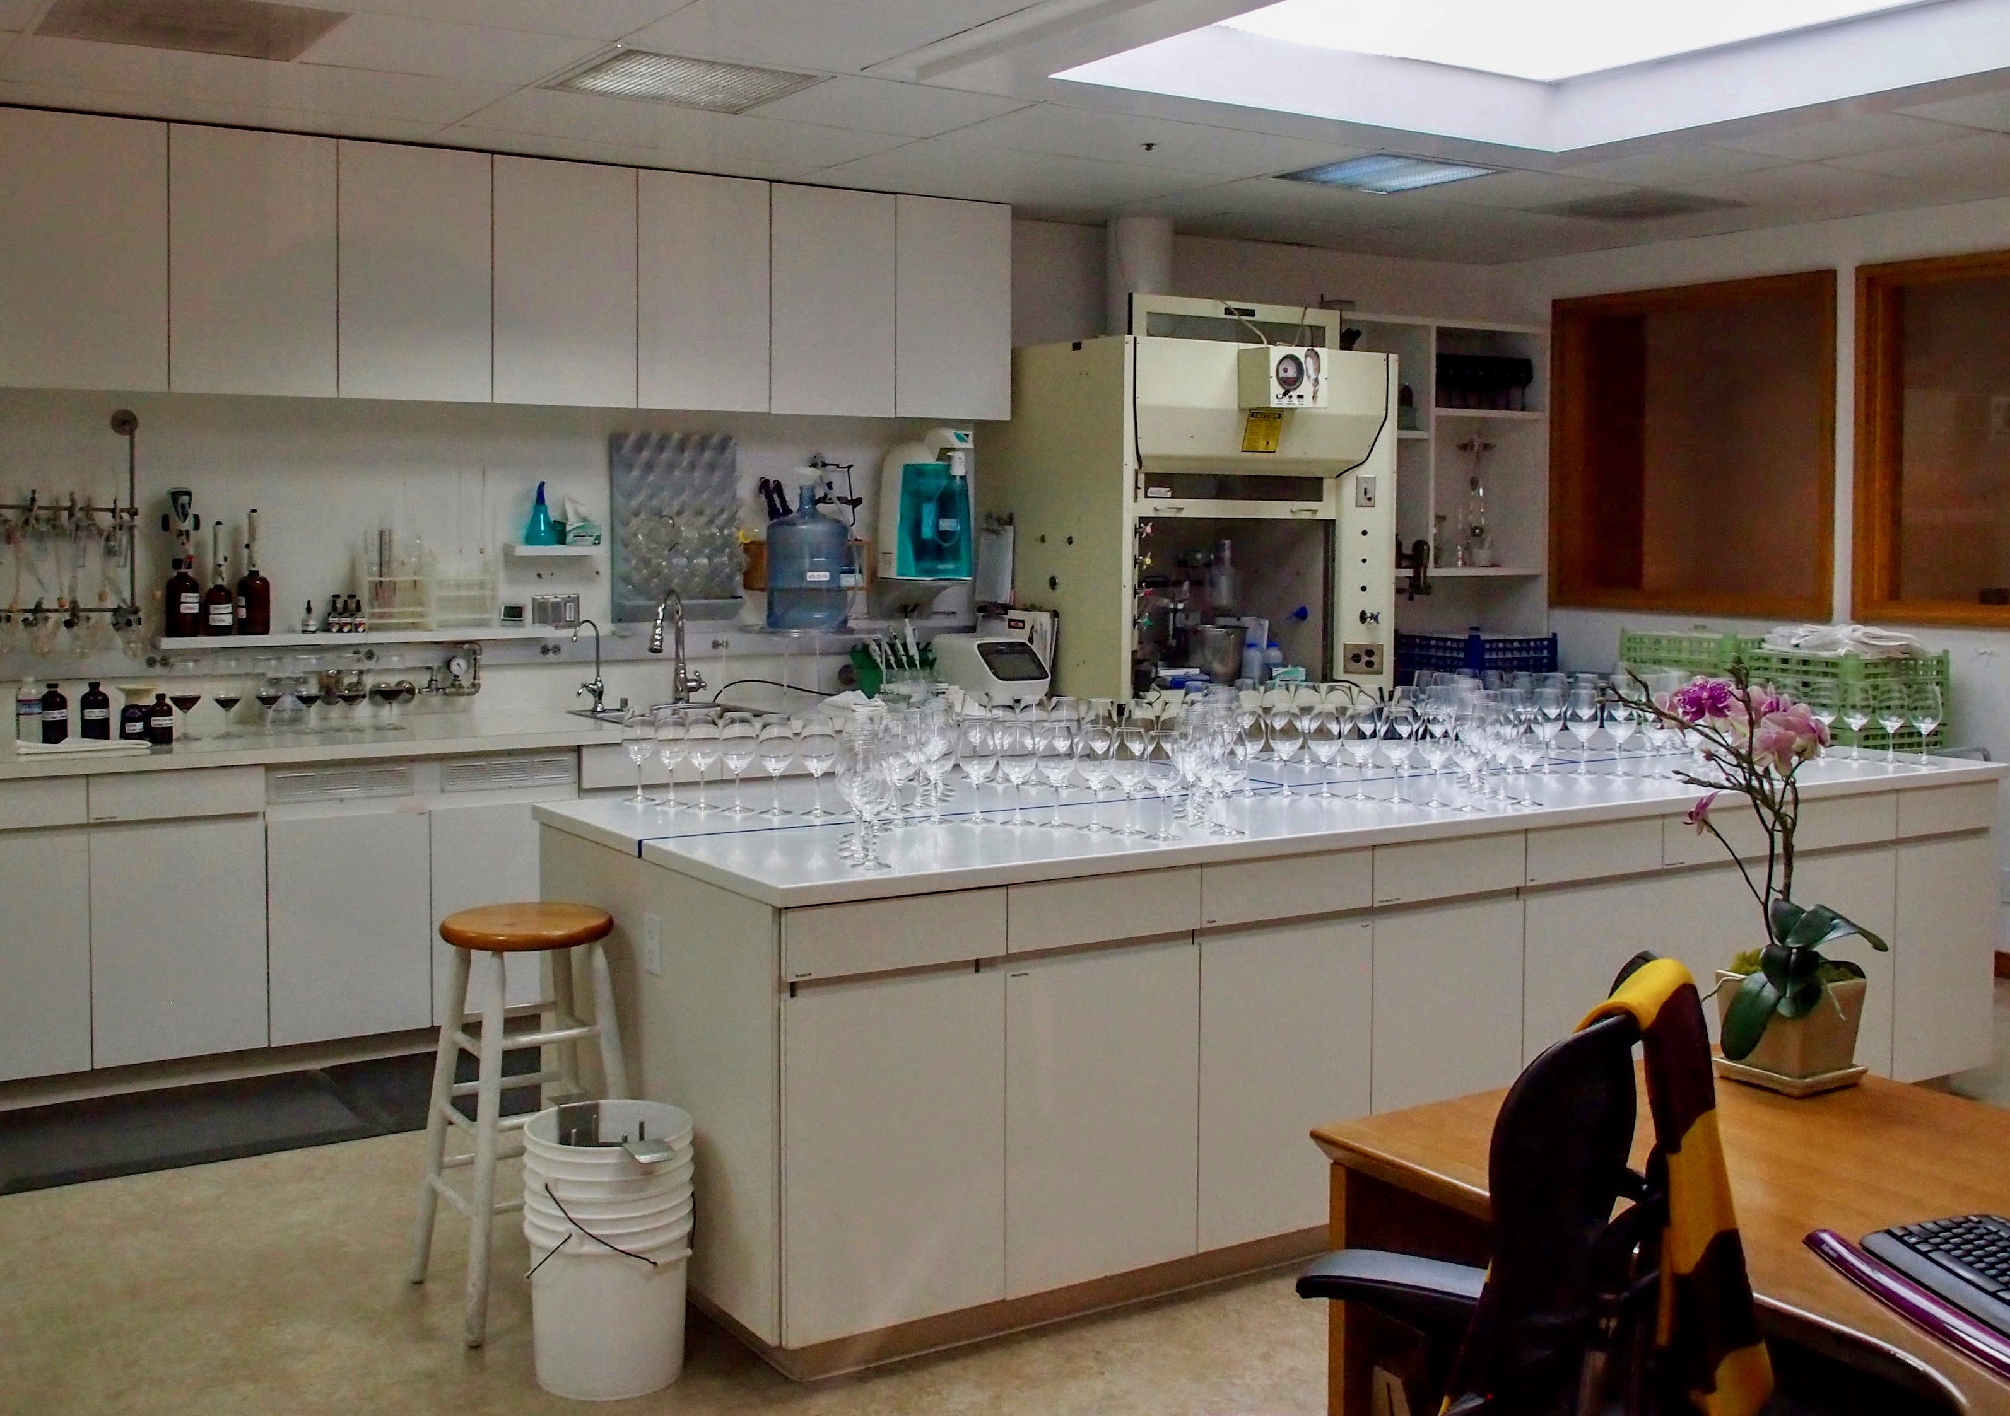
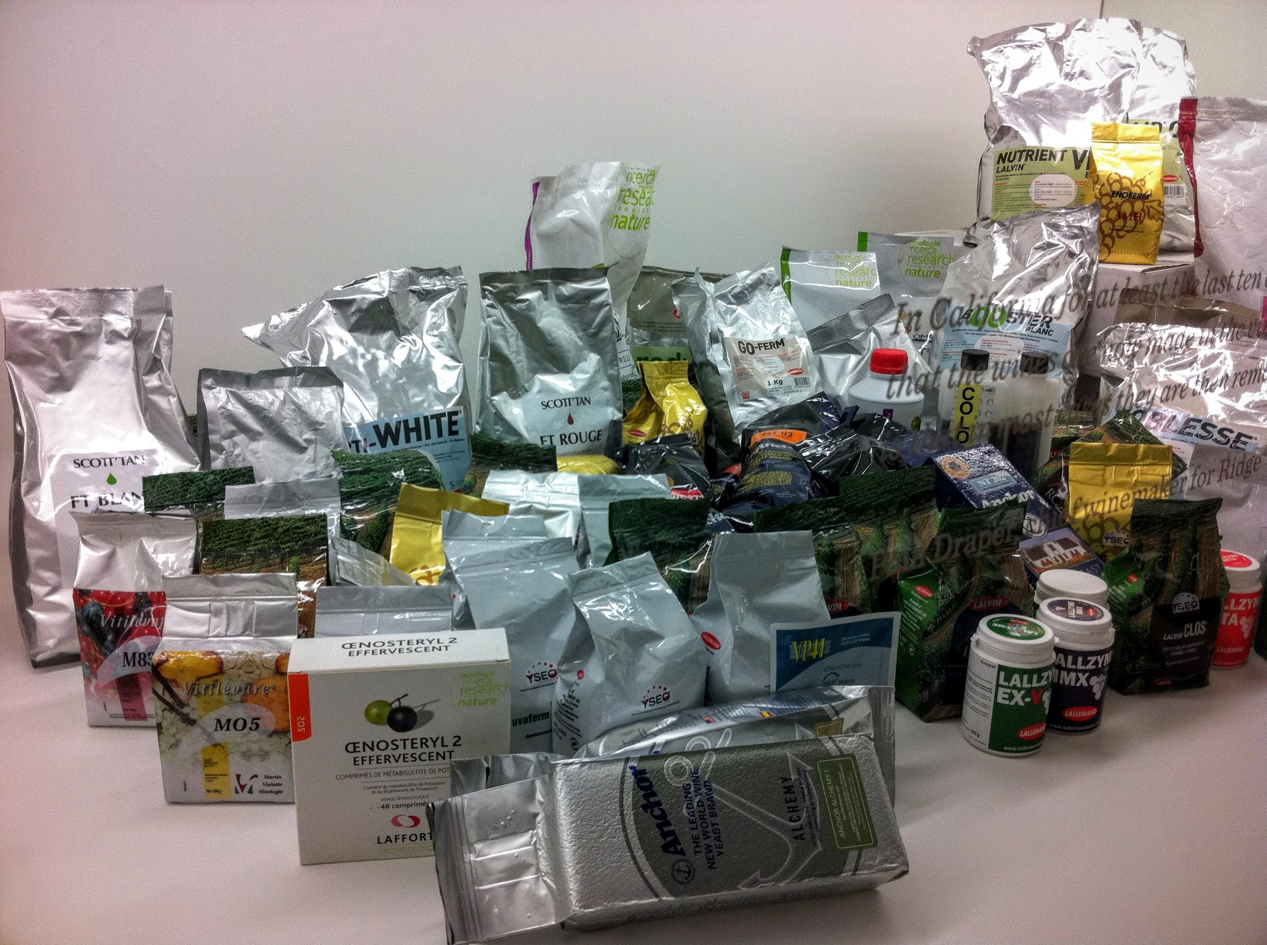
Evaluating Wine Quality
Done to improve wine
Can vary varieties, growing conditions, chemistry
Today: combine lab results & expert reviews
Goal: automatically predict reviews from lab results
Wine Quality datasets
Lab results + reviews for red & white Portuguese Vinho Verde wines
We used the red wine data: 1599 samples, 12 variables
Experiments
Greedy feature selection, exhaustive search
Notes:
Sensory reviews from experts are expensive & “noisy”
- want to automatically predict reviews from easy-to-get lab results
Here are some chemicals to doctor wine chemistry(!)

