Slide 1
PUBLIC-INTEREST INVESTIGATION · TIER-GRADED LEGAL EXPOSURE
UK Government Data-Linkage: Where has it actually been ruled unlawful?
A primary-source hunt for Tier-1 adjudications — an ICO enforcement notice, penalty or reprimand, or a court ruling of unlawful processing — against Data First, Splink, ONS IDS and ADR UK, with everything else graded down to regulator concern or criticism.
Brandon Myers · brandonmyers.net · June 2026 · 3 research passes · ~300 verification agents
brandonmyers.net
1 / 14

Slide 2
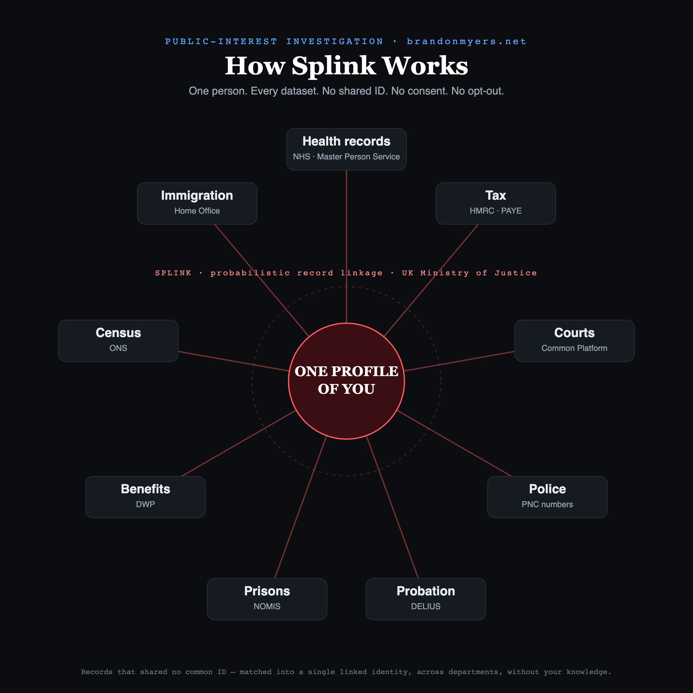
HOW THE MACHINE WORKS · THE PICTURE
One person. Every dataset. No shared ID.
ONE PROFILE OF YOU at the centre; separate records splinter off across departments — Health, Tax, Courts, Police, Probation, Prisons, Benefits, Census, Immigration — matched by Splink (UK MoJ) with no shared ID, no consent, no opt-out.
brandonmyers.net
2 / 14

Slide 3
THE BOTTOM LINE
No Tier-1 adjudication exists against any named target.
Every genuine ruling of unlawfulness sits ADJACENT — in Home Office immigration data — not on the data-linkage systems themselves.
The honest, defensible frame: the same shortcut — keeping citizens' data-protection safeguards in policy instead of law — has been struck down by the courts three times. Not an asserted violation against Data First, which has never been adjudicated.
brandonmyers.net
3 / 14

Slide 4
HOW THIS WAS BUILT
Evidence standard
Three independent deep-research passes. Each claim extracted from fetched primary sources, then put through adversarial verification — a claim is killed unless it survives skeptical refutation. Tiering applied strictly; my own overreach killed too.
3 independent passes · 99 sources fetched · ~300 verification agents · 4 claims killed for overreach
[ T1 ] Enforcement notice / penalty / reprimand, or court ruling of unlawfulness
[ T2 ] Regulator concern short of enforcement, or settled / withdrawn JR
[ T3 ] Criticism, no adjudication
brandonmyers.net
4 / 14

Slide 5
PER-TARGET VERDICT
The four named systems
[ NONE ] MoJ Data First — NONE. No legal challenge, ICO action, or court ruling. Only DPIA + Five Safes + panel oversight on record.
[ NONE ] Splink — NONE. The open-source record-linkage tool built for Data First; nothing adjudicated against it.
[ NONE ] ONS IDS / IDP — NONE, now searched directly, not inferred. Highest adverse material is Tier 3 only.
[ NONE ] ADR UK — NONE. Statutory safeguards; the ICO has endorsed the Five Safes model.
Sources: GOV.UK MoJ Data First/Splink ATR · ADR UK governance · OSR follow-up · PAC Mar 2026 · ICO enforcement register
brandonmyers.net
5 / 14

Slide 6
GAP CLOSED · ONS IDS
ONS IDS: searched directly — still nothing above Tier 3
An earlier pass only inferred 'none' from absence. A dedicated sweep of the ICO register, NSDEC minutes, OSR reports and the March 2026 PAC report confirms it.
[ T3 ] PAC 'Government use of data' (Mar 2026): criticism is value-for-money and adoption only. Zero references to ICO, GDPR, or unlawful processing.
[ T3 ] OSR (statistics regulator): engaged with IDS only at recommendation level. No enforcement power.
[ T3 ] NSDEC ethics committee: names IDS positively as a strategic project to prioritise for ethics review. Prospective assurance, not censure.
[ NONE ] ICO / Courts: no enforcement notice, penalty, reprimand, audit or opinion; no JR touching IDS/IDP linkage.
brandonmyers.net
6 / 14

Slide 7
ADJACENT TIER-1 · RULED UNLAWFUL THREE TIMES
The immigration exemption — 2021, 2023, 2023
• R1 · 26 May 2021 · Court of Appeal · [2021] EWCA Civ 800 — original exemption unlawful, an 'unauthorised derogation from the GDPR'.
• R2 · 29 Mar 2023 · High Court (Saini J) · [2023] EWHC 713 (Admin) — revised exemption STILL unlawful; safeguards can't live in policy.
• R3 · 11 Dec 2023 · Court of Appeal · [2023] EWCA Civ 1474 — confirmed breach of Art 23(2). The ruling the 2024 fix answered.
“Safeguards must appear on the face of the legislation or in a binding code (approved by Parliament) and with statutory force.”
BAILII / caselaw.nationalarchives.gov.uk [2023] EWHC 713 (Admin) · House of Lords Library · Open Rights Group
brandonmyers.net
7 / 14

Slide 8
CURRENT STATUS · 2026
Struck down three times — then legislated back into force
The exemption was never struck down outright: each ruling used a suspended declaration, then the government re-legislated.
Operative text today: SI 2024/342 — Data Protection Act 2018 (Amendment of Schedule 2 Exemptions) Regulations 2024 — made 7 Mar 2024, in force 8 Mar 2024. It finally put case-by-case decision-making, a necessity/proportionality test, and vulnerability + Convention-rights safeguards on the face of the statute.
The successor statute, the Data (Use and Access) Act 2025 (Royal Assent 19 Jun 2025), left the immigration exemption untouched — it amends only the separate crime exemption. A dedicated search found no fourth round of litigation as of mid-2026.
Confirmed verbatim: legislation.gov.uk SI 2024/342 + EM · Data (Use and Access) Act 2025 (c.18) · gov.uk DUAA summary
brandonmyers.net
8 / 14

Slide 9
THE DECISIVE POINT · READ BEFORE USING
Does the immigration ruling touch data-linkage?
Not directly. The unlawfulness is about an exemption from individuals' OWN data-subject rights — not about linking or sharing datasets. The defect was procedural: Art 23(2) safeguards must live in legislation, not policy. The judgments contain no discussion of inter-departmental sharing, record linkage, or bulk matching.
• FAIR: the same department, the same trick of keeping safeguards out of the statute, ruled unlawful three times.
• OVERREACH (do not make this claim): that the courts have condemned government data-linkage. They have not.
Basis: [2023] EWHC 713 (Admin) ratio · D. Erdos, UKCLA — 'focuses on data-subject rights, not inter-departmental data sharing or bulk matching.'
brandonmyers.net
9 / 14

Slide 10
CLOSEST TO THE LINKAGE MACHINERY
The National Fraud Initiative — a Tier-2 warning
[ T2 ] Regulator concern, on the record — a consultation response, not enforcement.
On 26 March 2021 the ICO formally responded to the Cabinet Office's plan to expand the National Fraud Initiative's data-matching purposes. The most on-point item in the whole investigation.
“…could potentially allow participants to conduct disproportionate searches for information about particular individuals across a wide range of sources without lawful cause.”
The ICO also warned the Cabinet Office 'has not yet undertaken a DPIA' and should do so before any processing. No Tier-1 enforcement or court ruling on inter-departmental data-matching was found.
ICO consultation response on the NFI (26 Mar 2021), full PDF · related: ICO response on the Eligibility Verification Measure
brandonmyers.net
10 / 14

Slide 11
HANDLE WITH CARE
Four items that look stronger than they are
• Royal Free–DeepMind (3 Jul 2017): ICO FOUND DPA 1998 non-compliance over ~1.6M records — but via a voluntary undertaking. No fine, no notice. Cite as 'finding via undertaking,' never a penalty.
• Visa-streaming algorithm (2020): withdrawn before any hearing after the JCWI/Foxglove JR. Tier 2 — no ruling, no admission. 'Successful JR' is press shorthand.
• DWP Universal Credit [2020] EWCA Civ 778: real ruling against DWP — but irrationality over salary timing. Zero data-protection holding. Irrelevant.
• Home Office GPS tagging (1 Mar 2024): genuine ICO enforcement notice + warning — but DPIA/surveillance failure, NOT data-matching.
brandonmyers.net
11 / 14

Slide 12
HOW TO DEPLOY THIS HONESTLY
Positioning
• Lead with the adjacency, not a fabricated violation. The Tier-1 facts are next door, named and dated — the spine, not a claim that Data First was condemned.
• The pattern is the argument. Three times the Home Office put safeguards in policy not law; three times the courts ruled that unlawful. The same posture runs through Data First / ONS IDS.
• Be precise on Royal Free and the visa tool. An opponent who catches 'fine' (it was an undertaking) or 'struck down' (it was a withdrawal) discredits the whole brief. Accuracy is the weapon.
• State plainly the on-target verdict is 'none found.' That is a strength — the honest, searched result — and it pre-empts the 'you're exaggerating' rebuttal.
brandonmyers.net
12 / 14

Slide 13
CAVEATS & OPEN QUESTIONS
What still needs nailing down
• Whether the Cabinet Office ever completed the DPIA the ICO demanded in 2021, and whether the ICO followed up once expanded NFI matching went live.
• Any Tier-1 action on the other big sharing regimes — DWP fraud matching, HMRC bulk sharing, Digital Economy Act 2017 powers — beyond the NFI consultation. Not yet searched to exhaustion.
• The ICO enforcement register renders dynamically; the ONS 'none found' rests on converging searches, not a single authoritative query.
• An unreported or very recent filing against SI 2024/342 cannot be fully excluded.
brandonmyers.net
13 / 14

Slide 14
PRIMARY SOURCES · FULL SERIES
Citations
• caselaw.nationalarchives.gov.uk / BAILII — [2023] EWHC 713 (Admin); [2020] EWCA Civ 778; [2021] EWCA Civ 800; [2023] EWCA Civ 1474
• legislation.gov.uk — SI 2024/342 + Explanatory Memorandum; Data (Use and Access) Act 2025 (c.18)
• gov.uk — Data First / Splink ATR · DUAA summary | adruk.org governance | committees.parliament.uk/52403 (PAC 2026)
• ico.org.uk — Royal Free; GPS tagging; immigration-exemption guide; National Fraud Initiative consultation (2021) | osr.statisticsauthority.gov.uk | foxglove.org.uk
Full series at brandonmyers.net/writing — The Quiet Joining-Up (with archived evidence locker), Statistics or Operations?, and this report. Repository: github.com/btmaffiliate/uk-data-linkage-disclosure
brandonmyers.net
14 / 14

