Slide 2
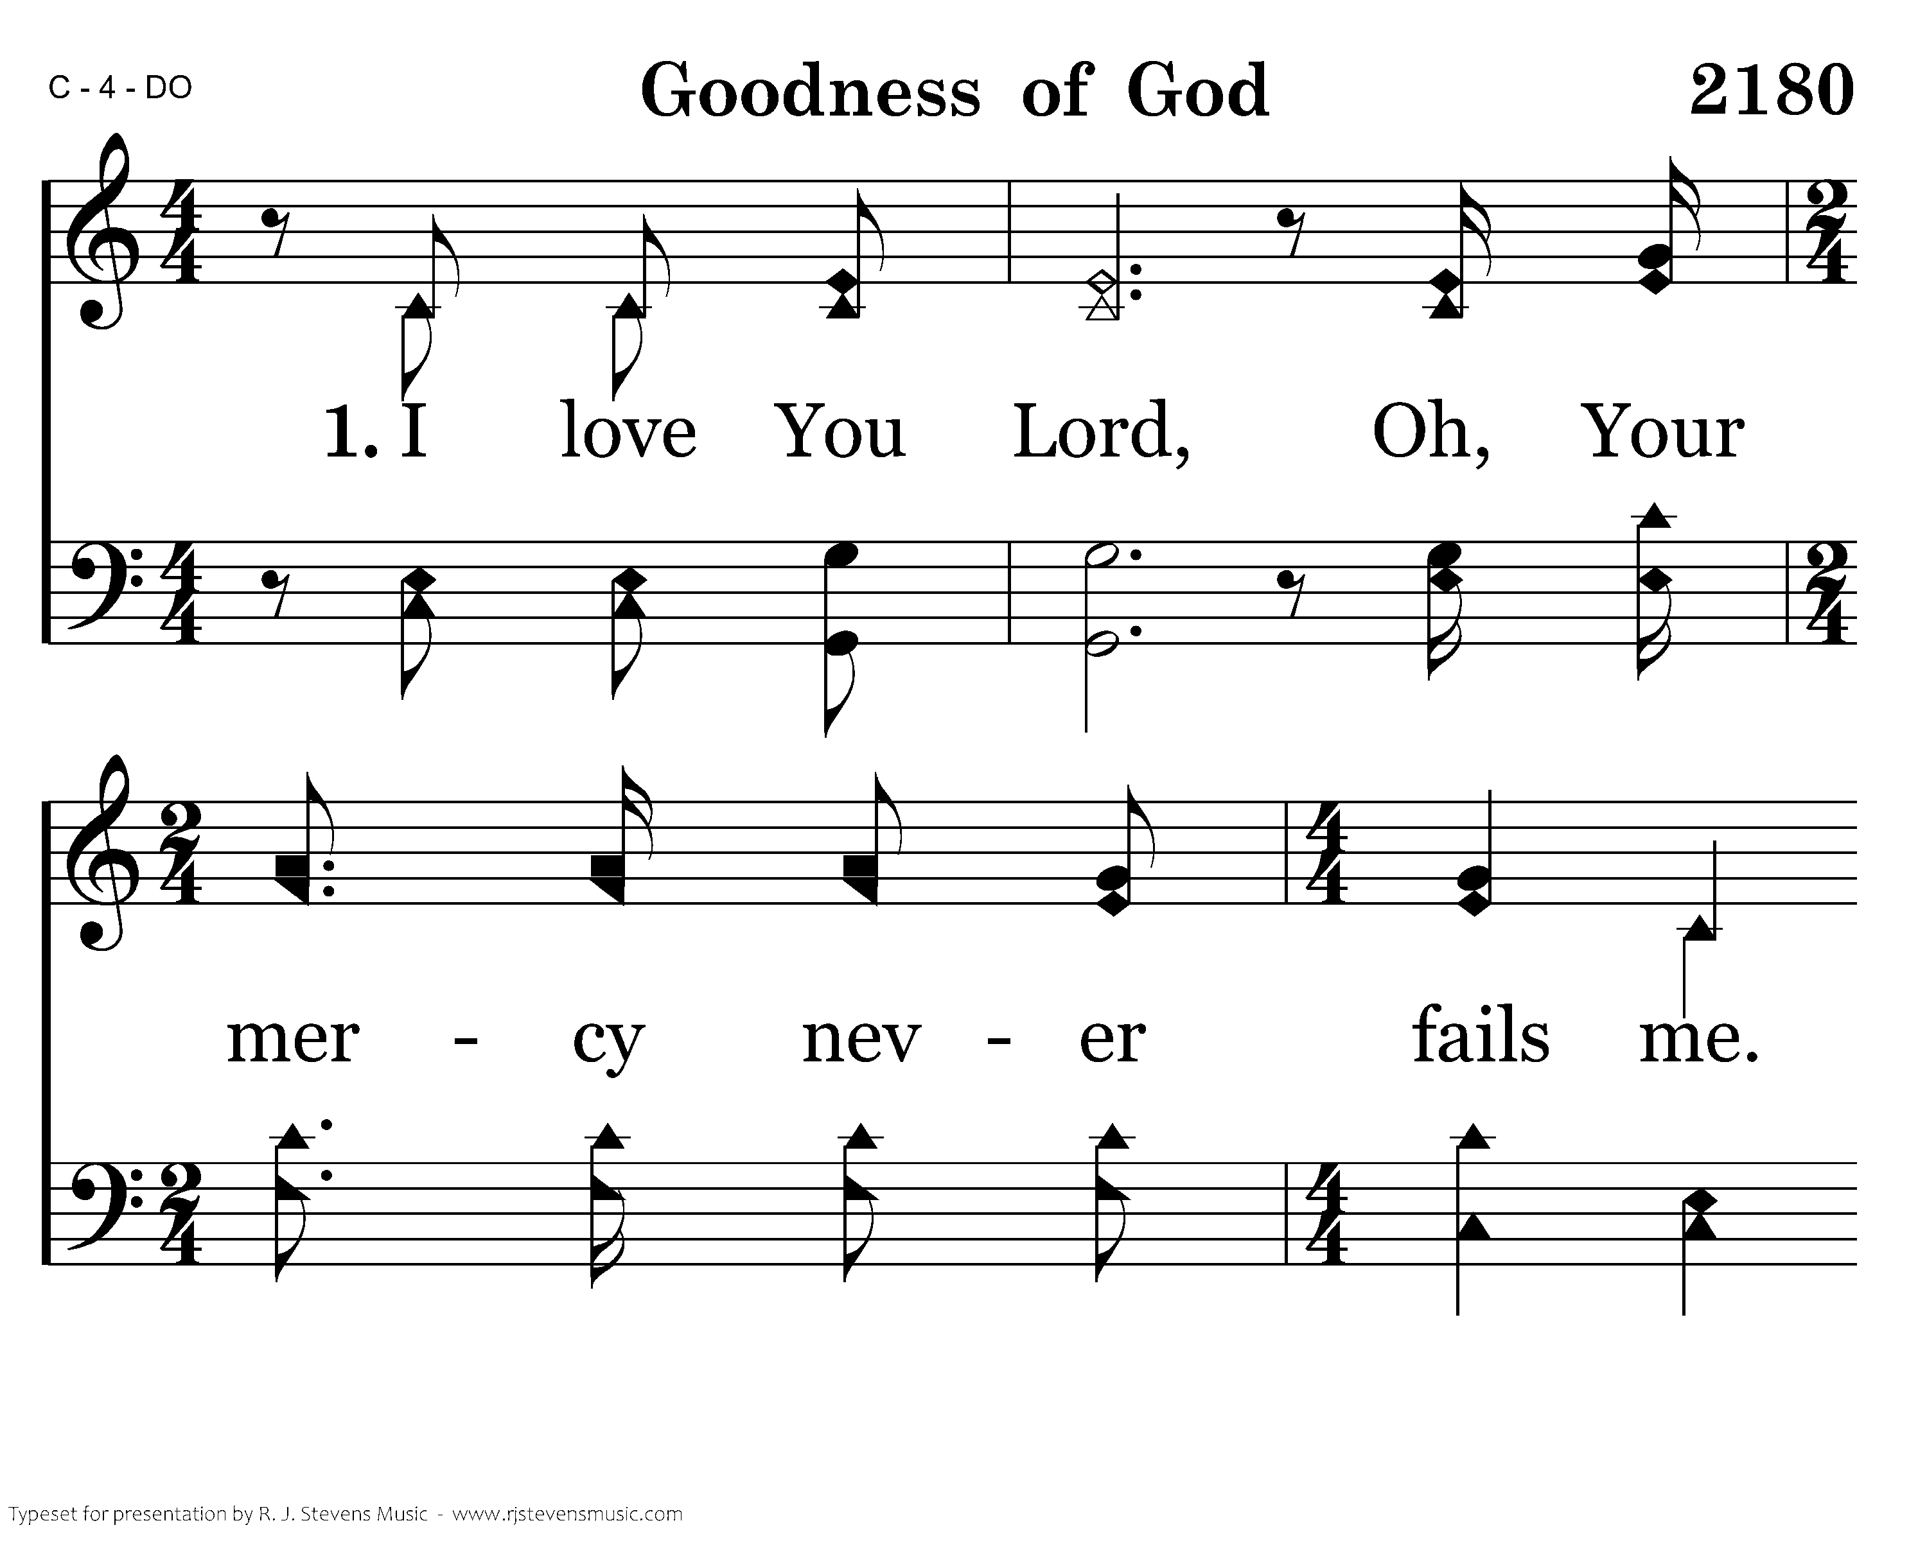
Notes:
3198x2400xeh-202-001.png

Slide 3
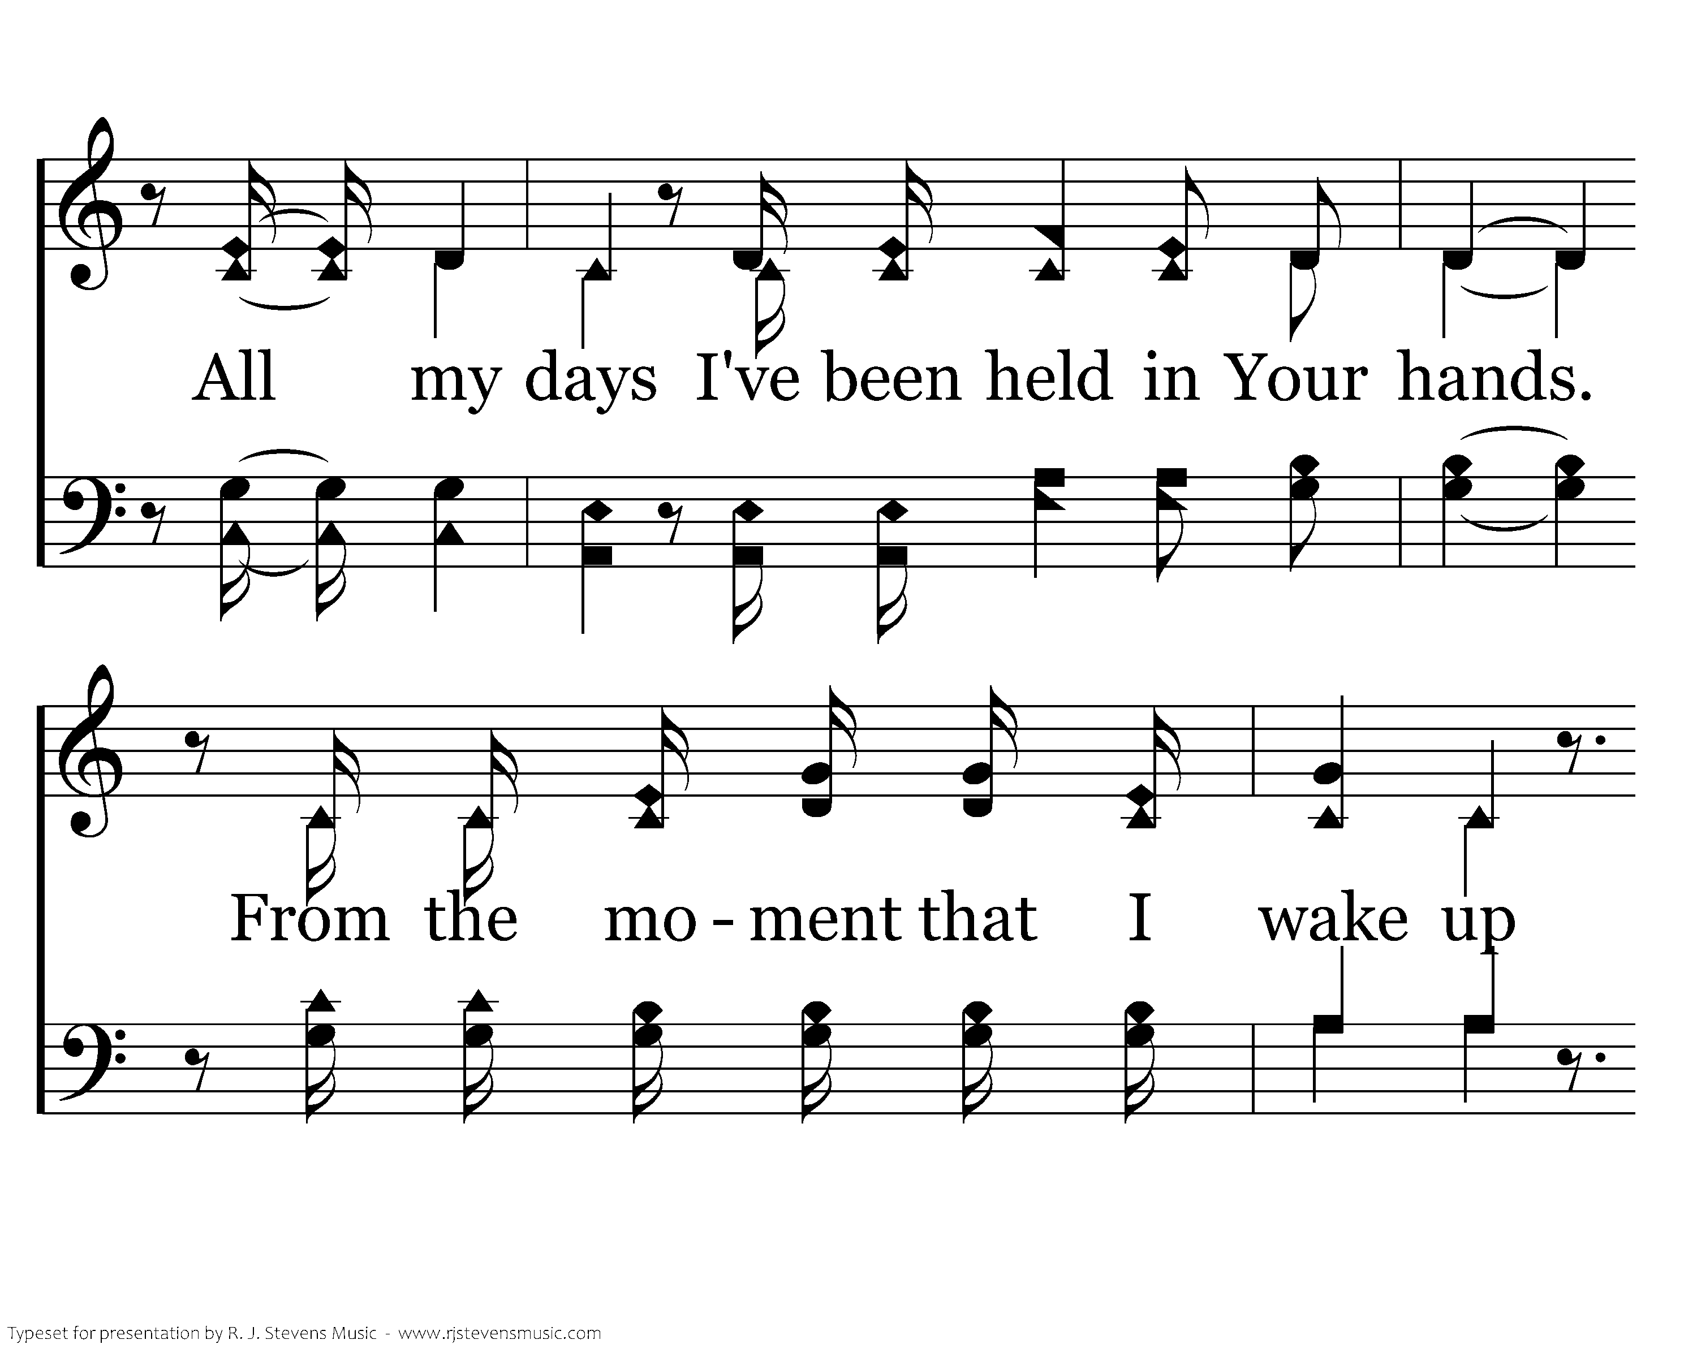
Notes:
3198x2400xeh-202-002.png

Slide 4
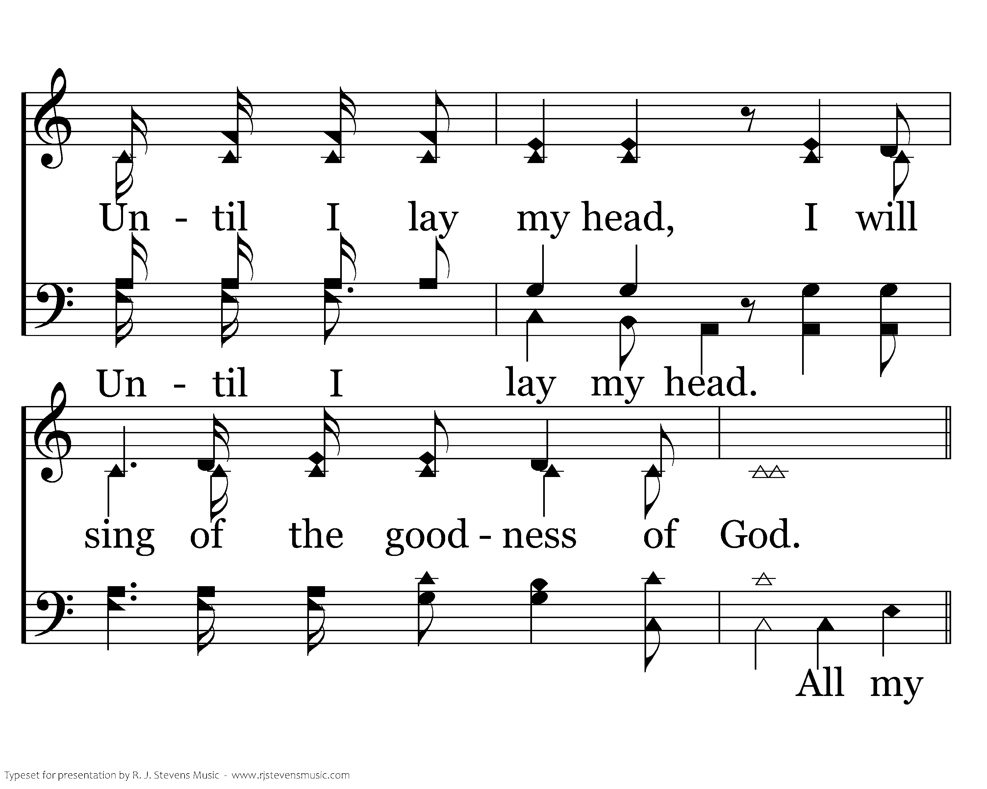
Notes:
3198x2400xeh-202-003.png

Slide 5
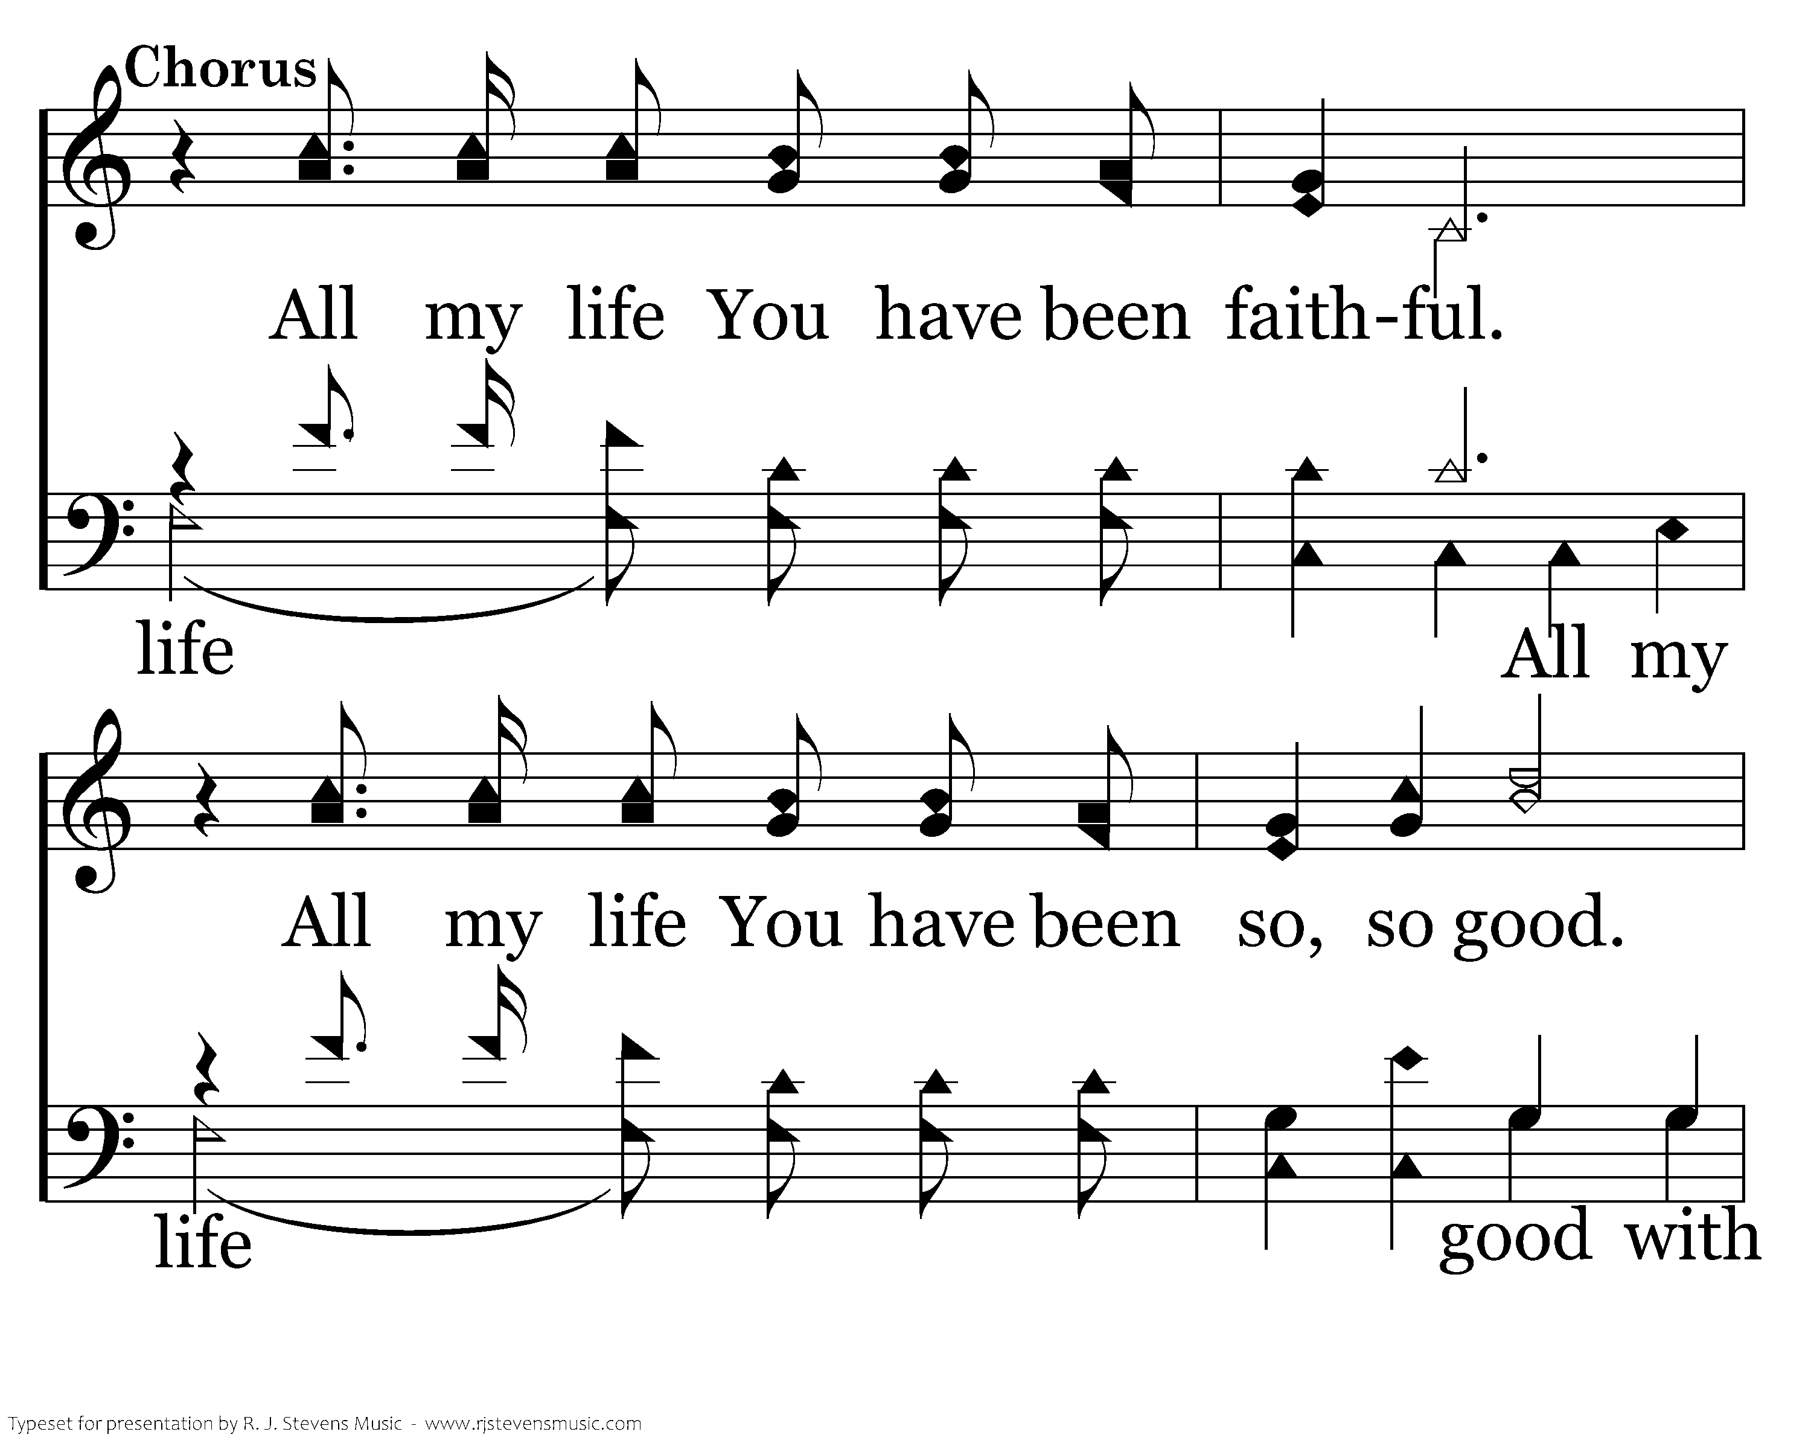
Notes:
3198x2400xeh-202-004.png

Slide 6
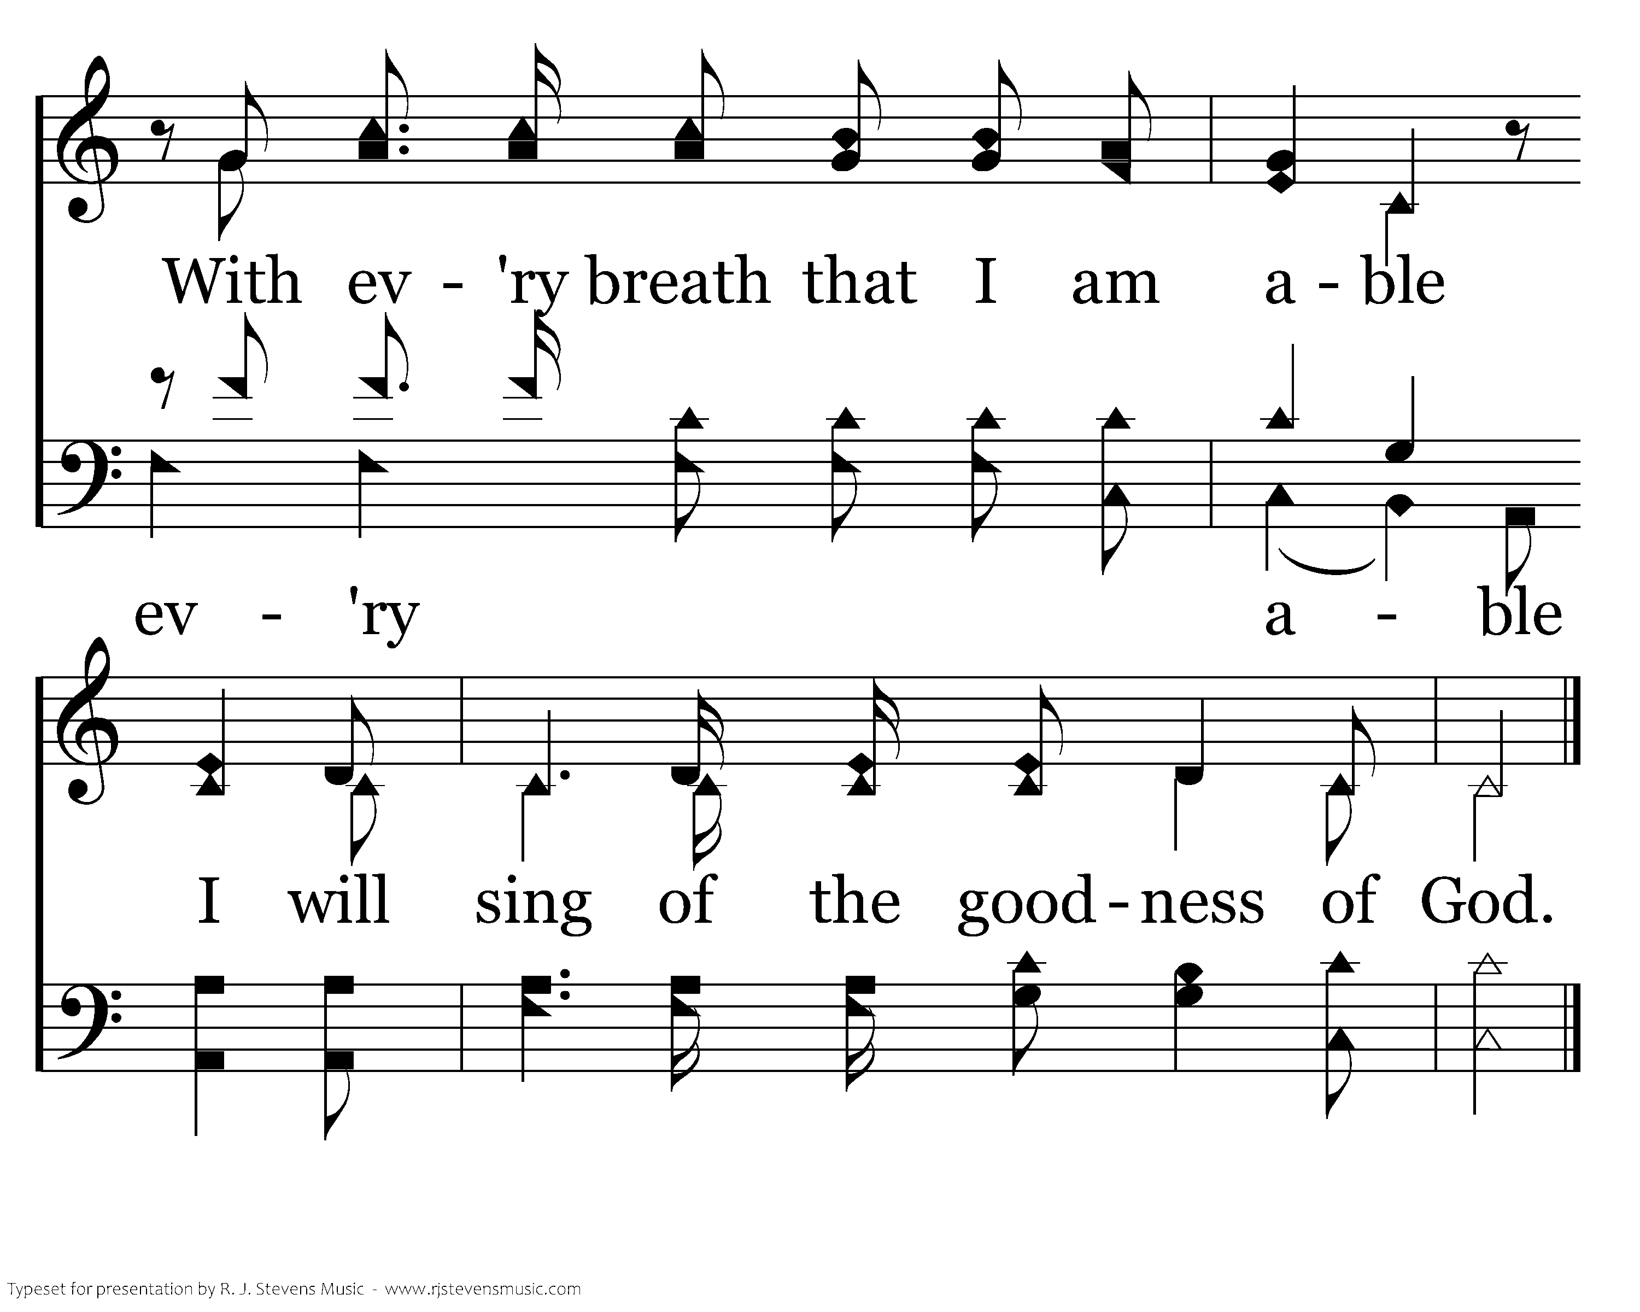
Notes:
3198x2400xeh-202-005.png

Slide 7
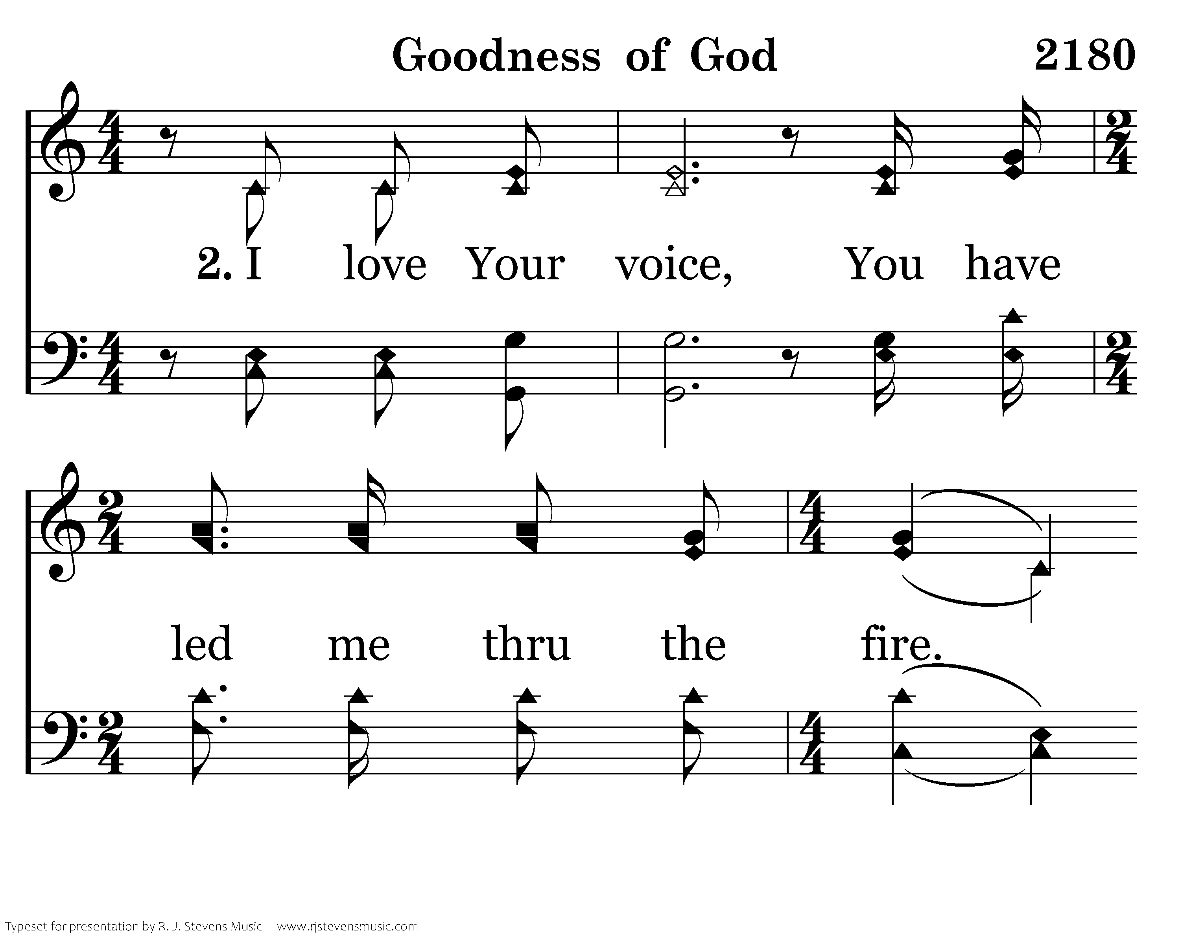
Notes:
3198x2400xeh-202-006.png

Slide 8
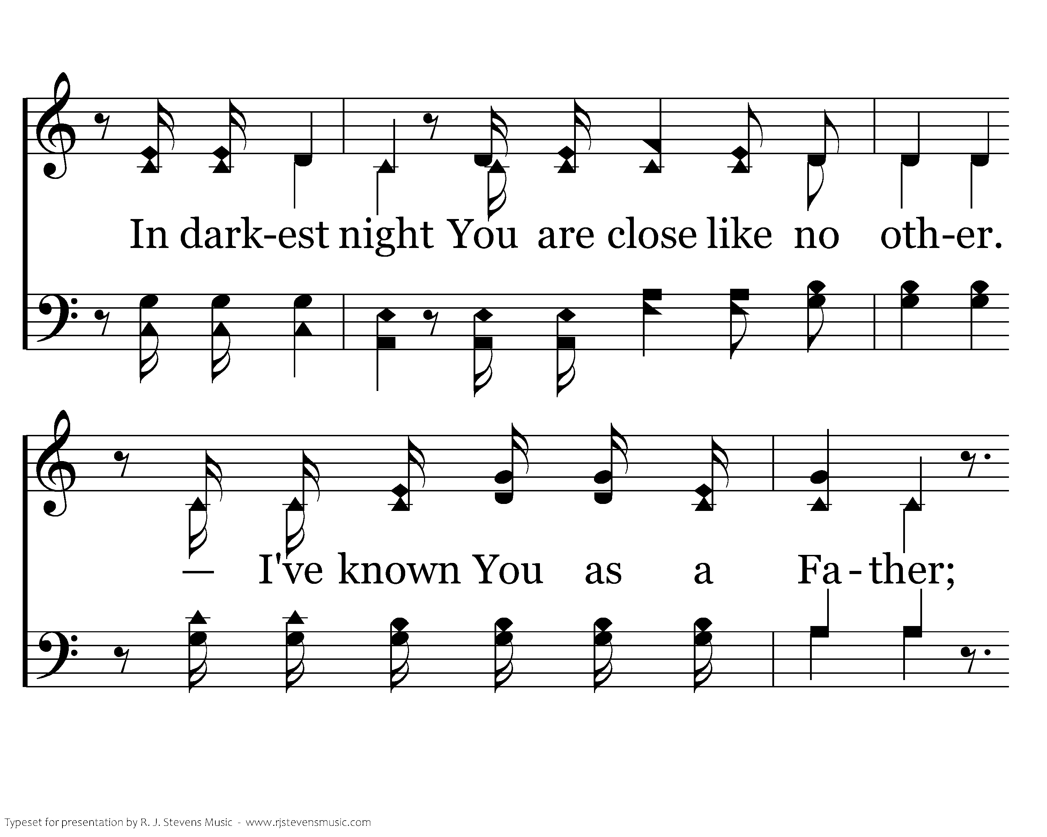
Notes:
3198x2400xeh-202-007.png

Slide 9
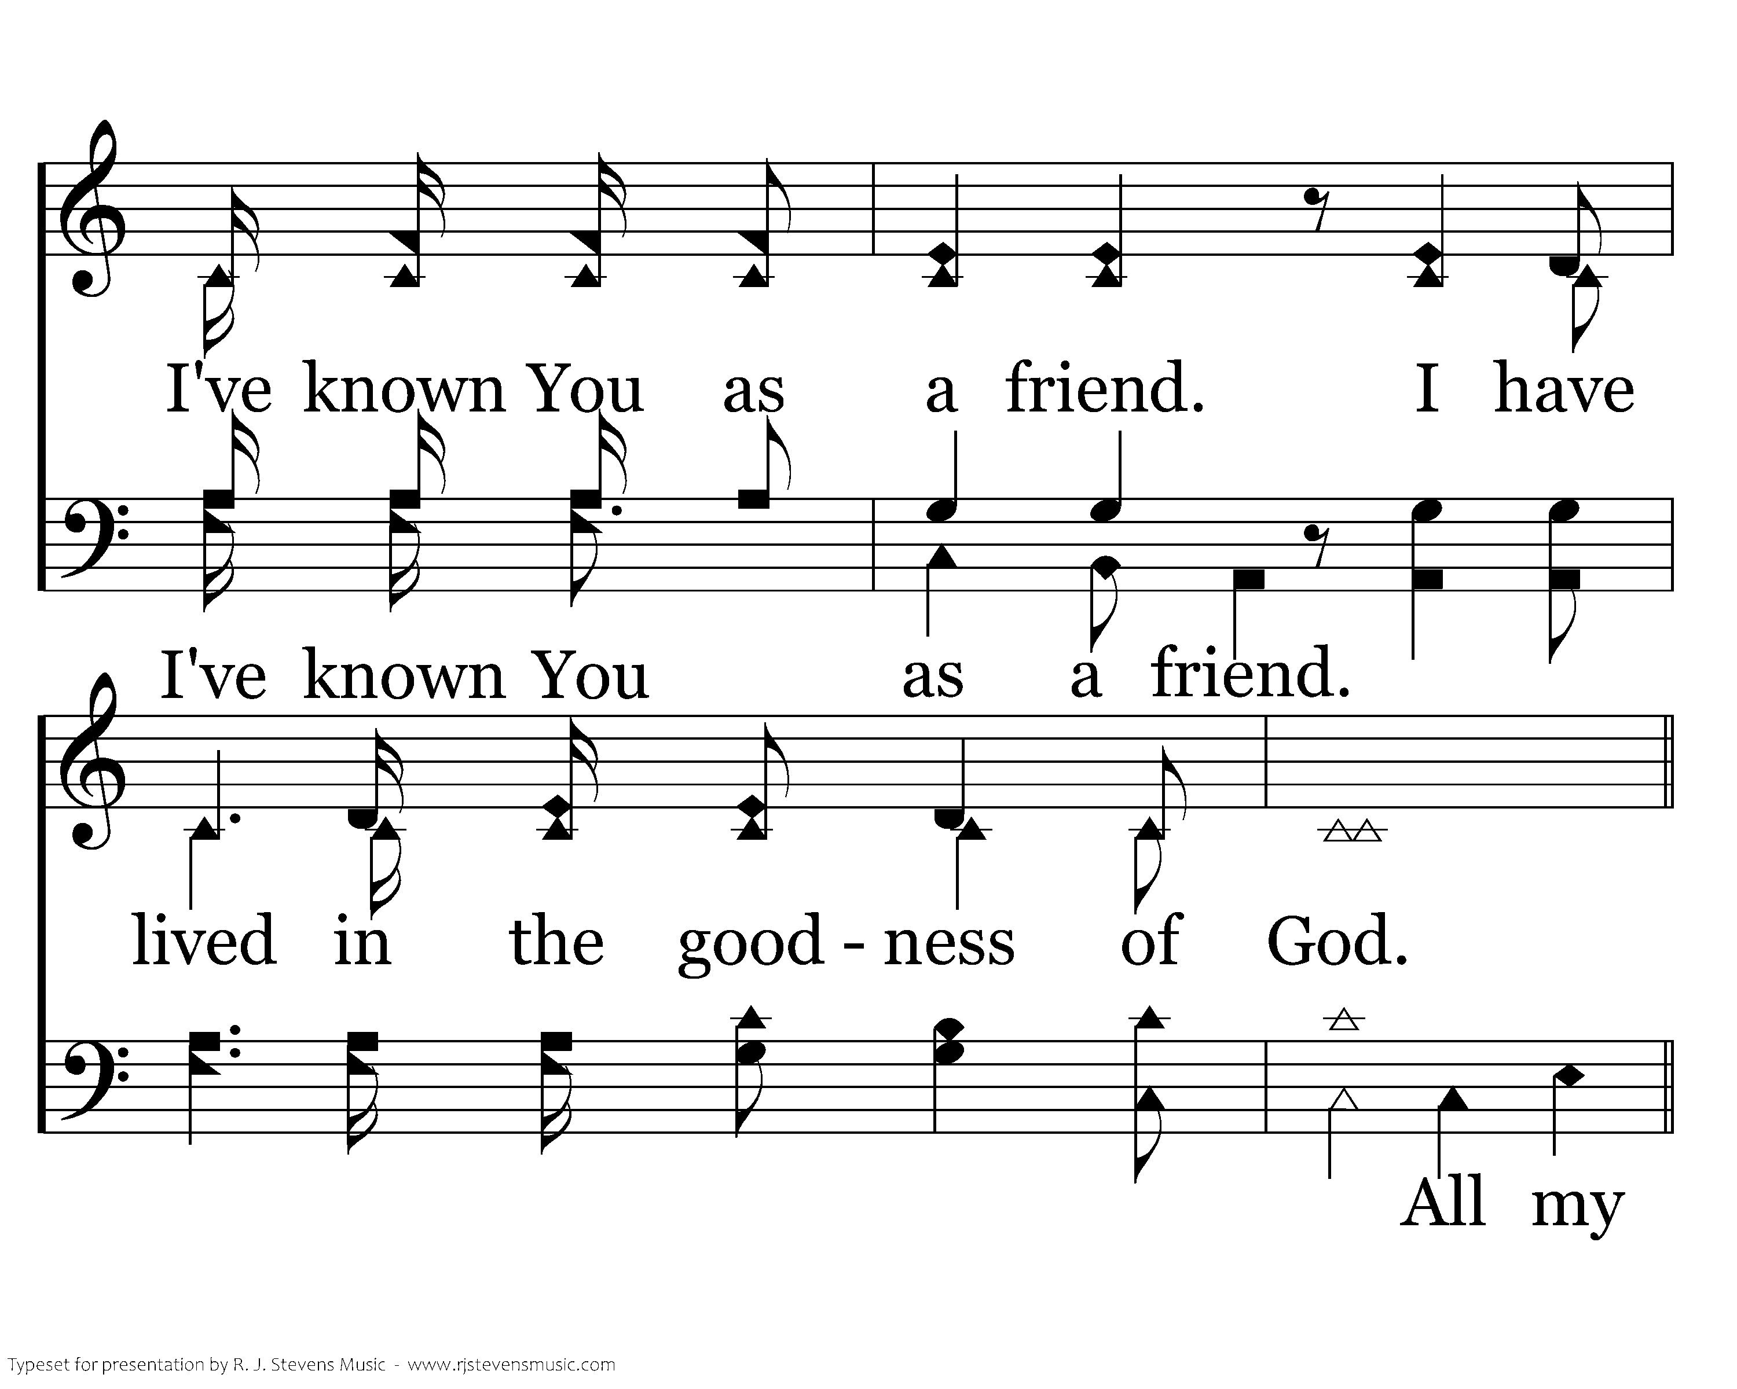
Notes:
3198x2400xeh-202-008.png

Slide 10
Notes:
3198x2400xeh-202-009.png

Slide 11
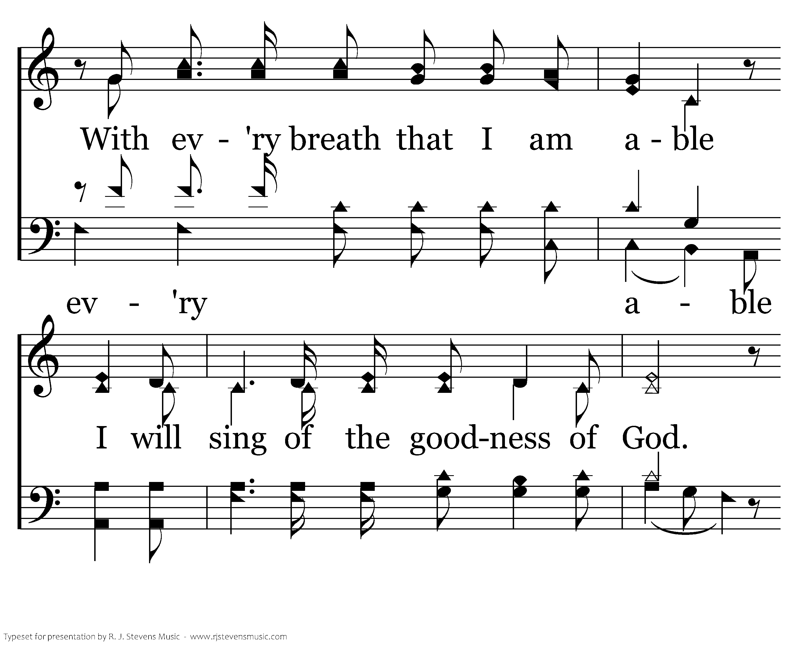
Notes:
3198x2400xeh-202-010.png

Slide 12
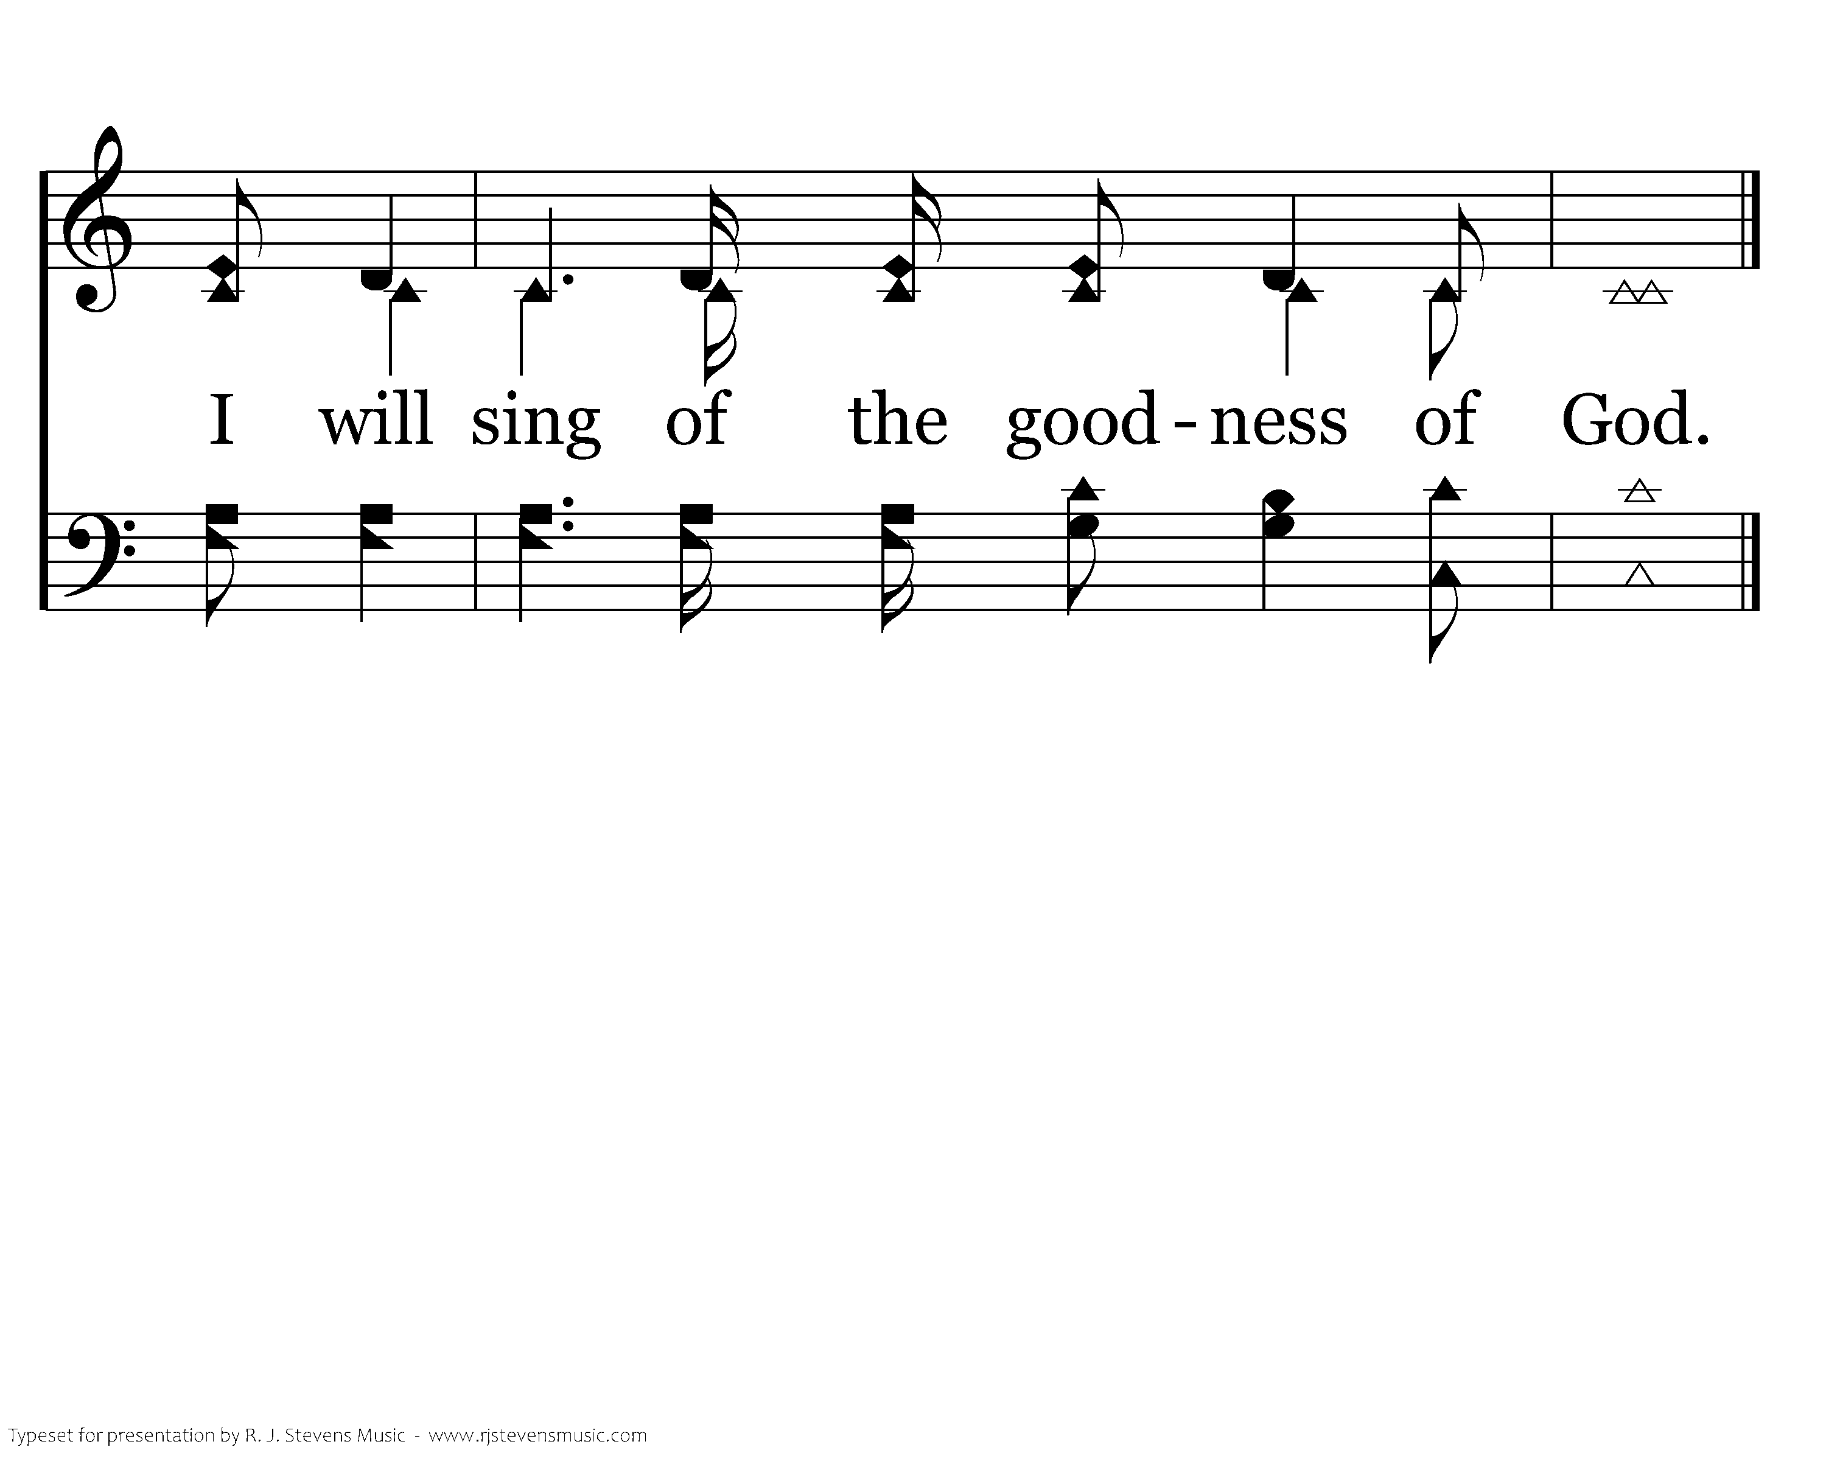
Notes:
3198x2400xeh-202-011.png

