Slide 1

238
Words by: Reginald Heber
Music by: John B. Dykes
Holy, Holy Holy!

Slide 2
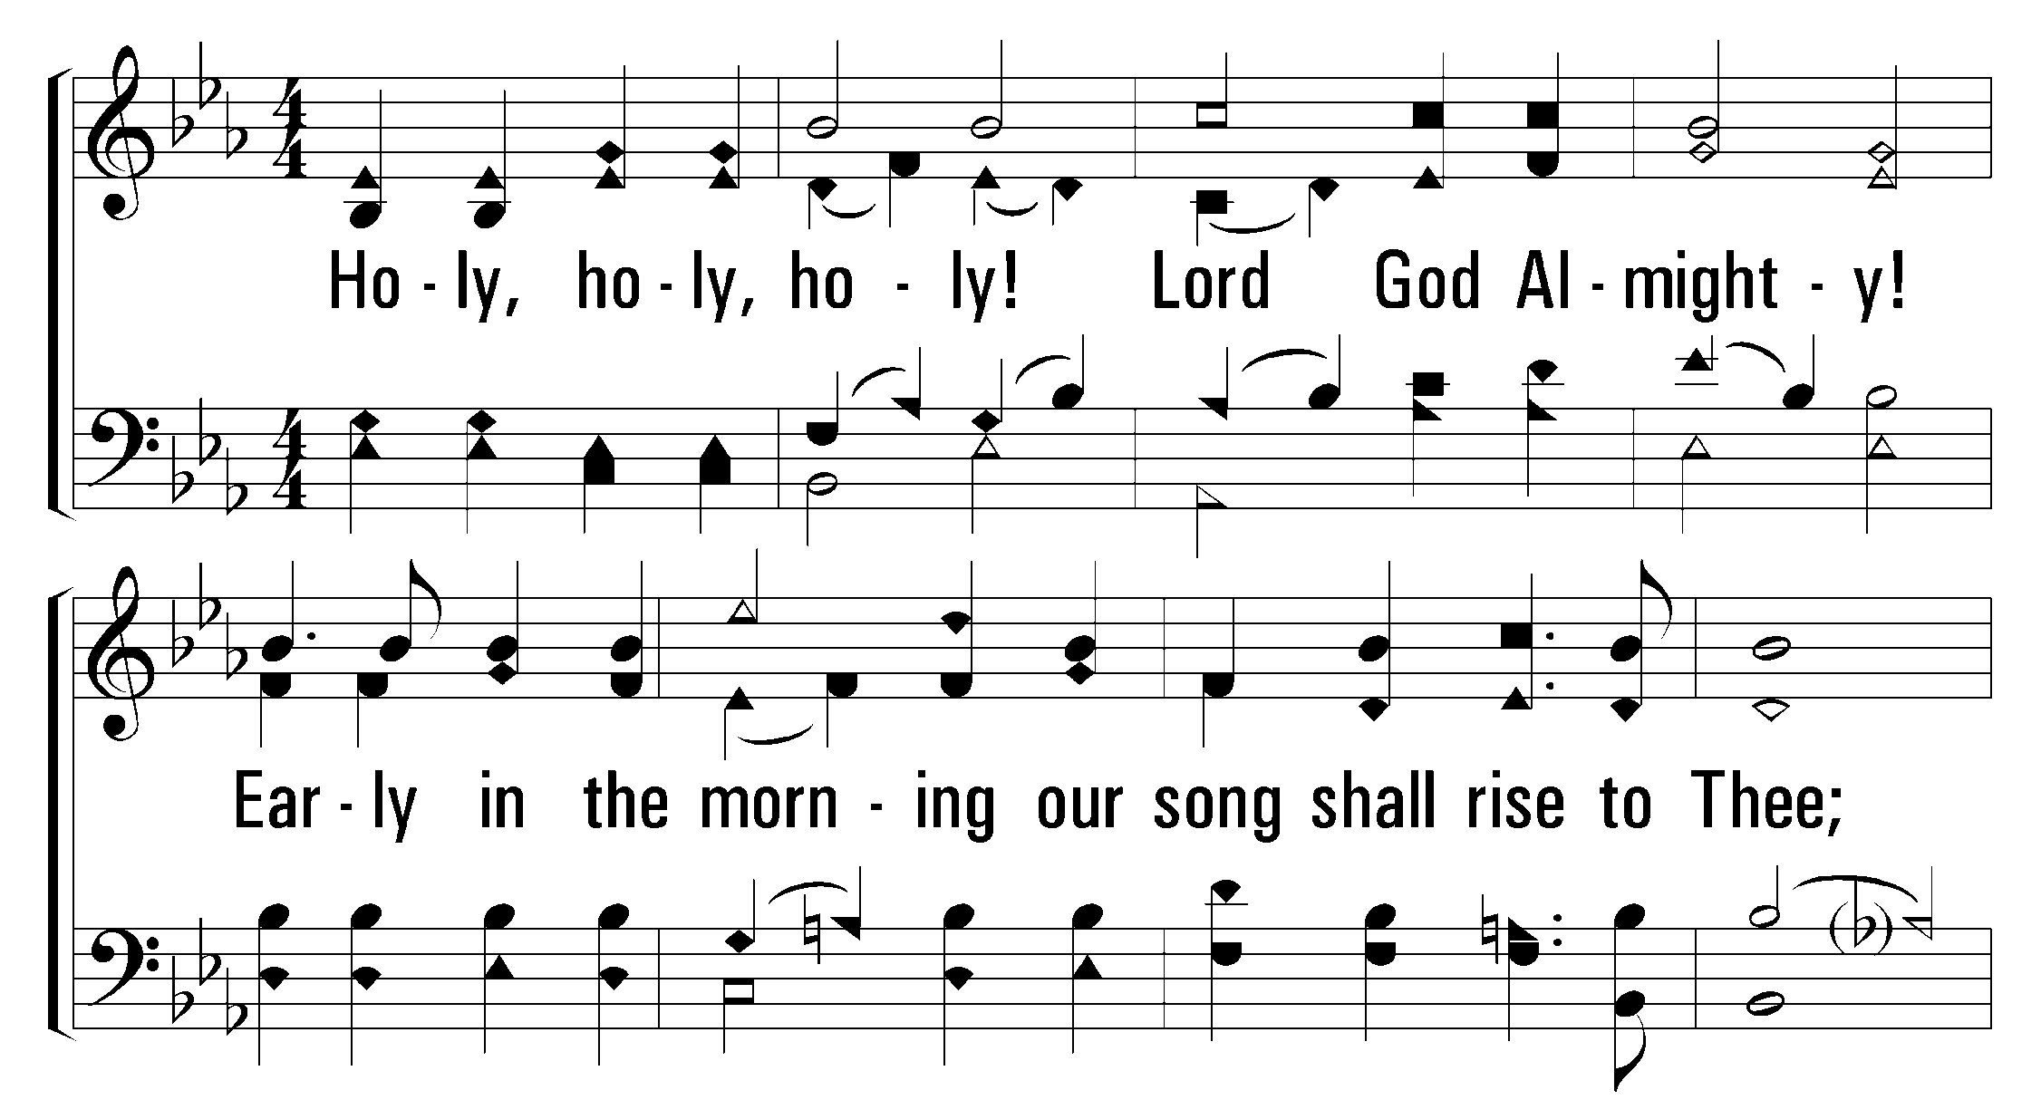


1
2
3
4
238
Holy, Holy Holy!
© 2001 The Paperless Hymnal™

Slide 3
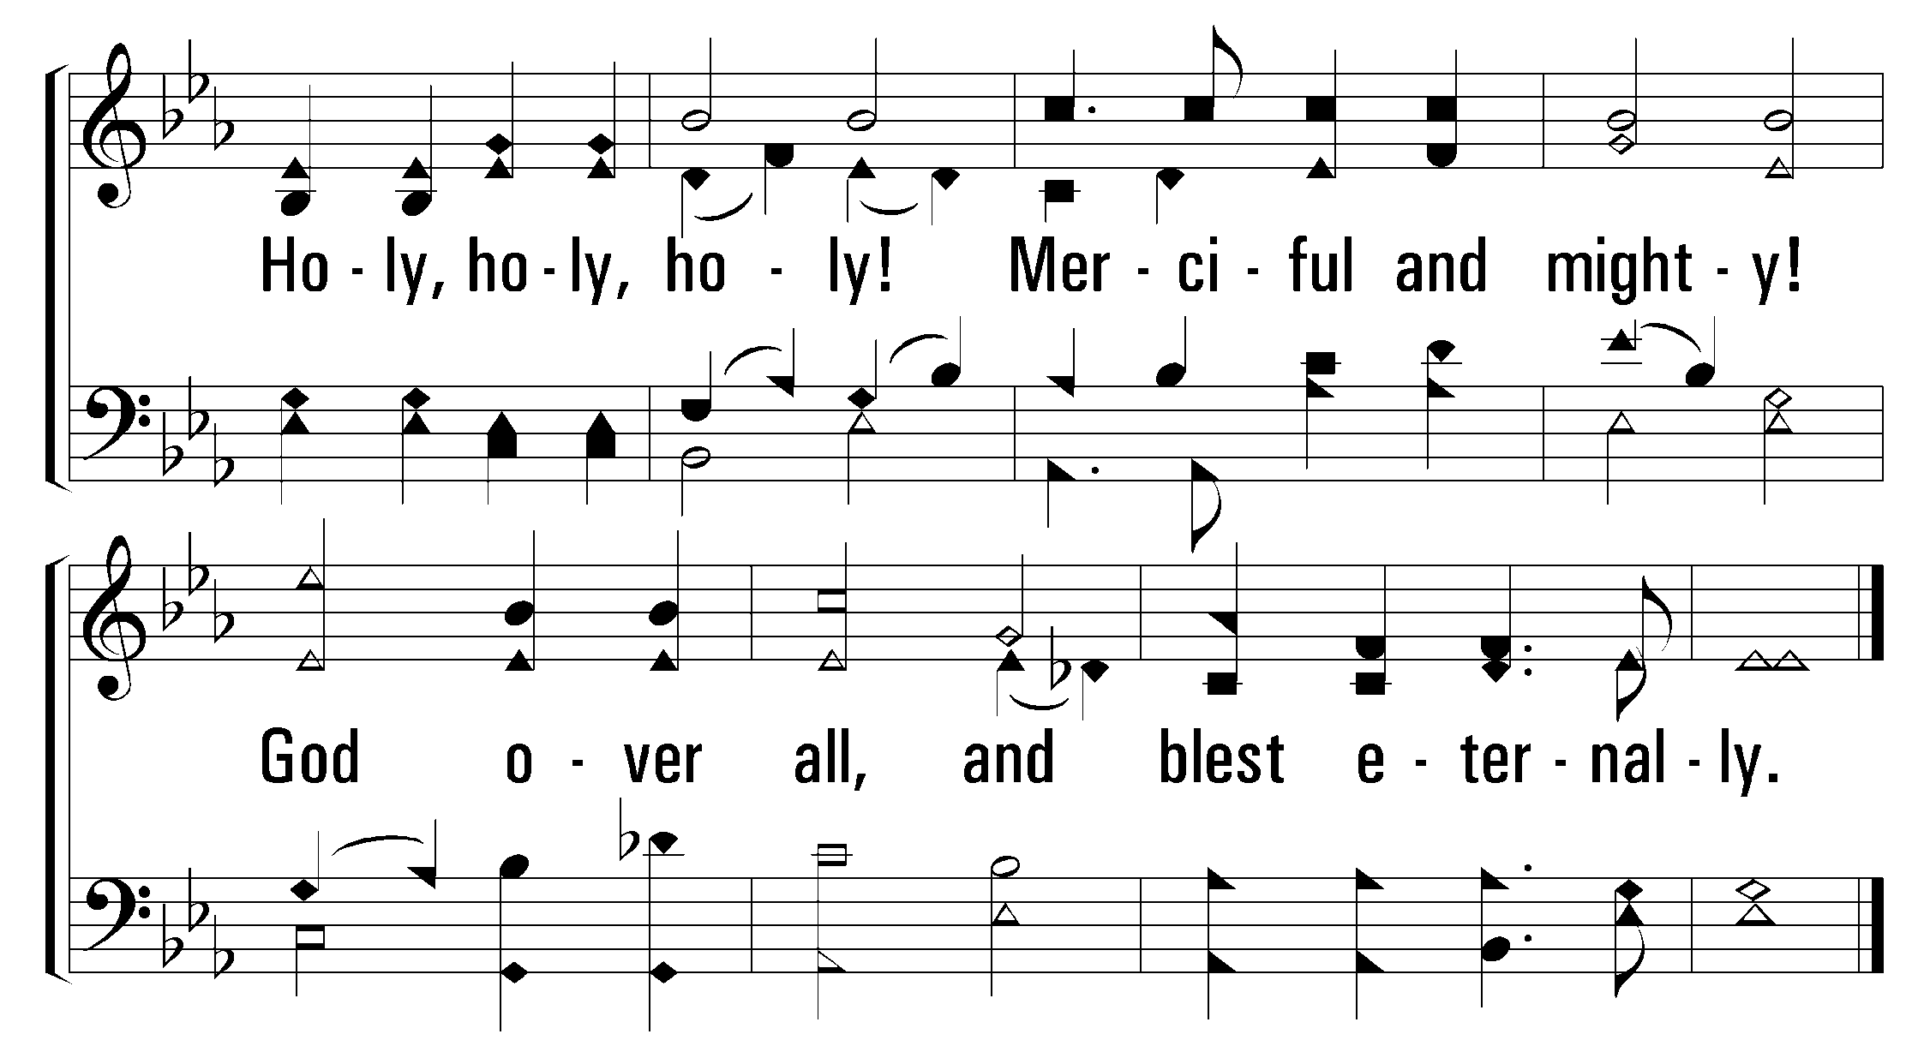
1
2
3
4
238
Holy, Holy Holy!
© 2001 The Paperless Hymnal™

Slide 4
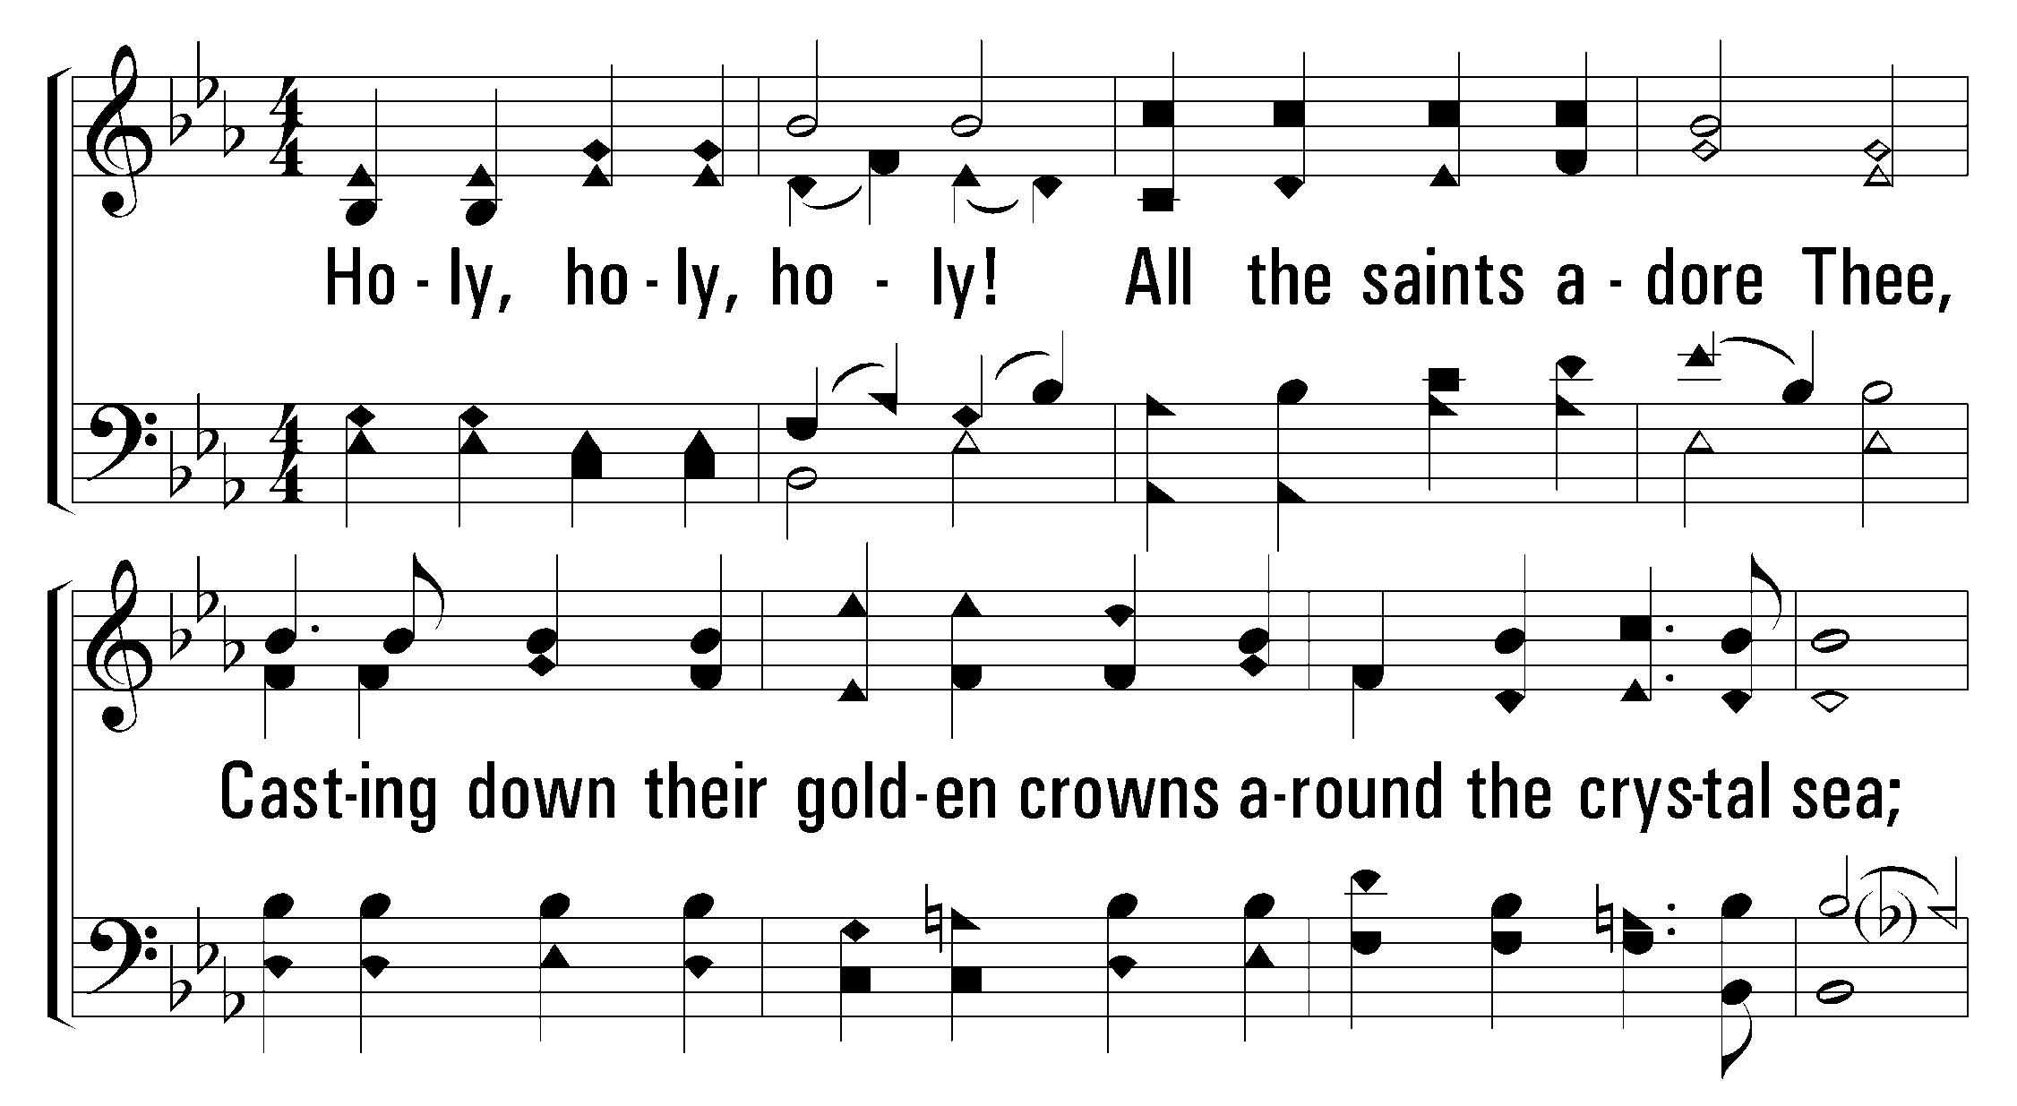
1
2
3
4
238
Holy, Holy Holy!
© 2001 The Paperless Hymnal™

Slide 5
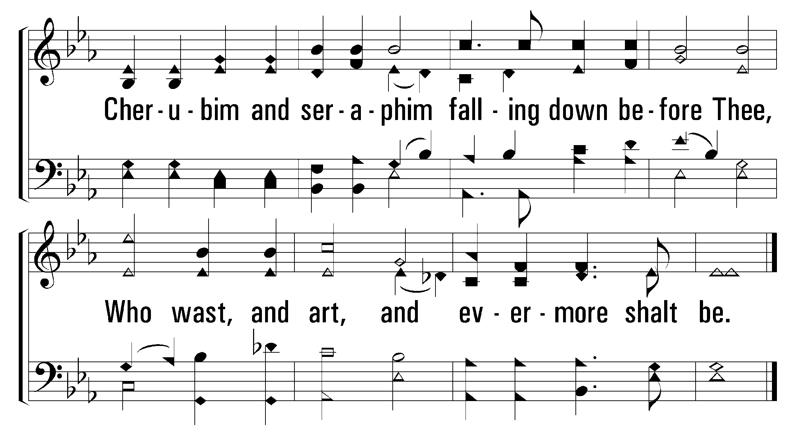
1
2
3
4
238
Holy, Holy Holy!
© 2001 The Paperless Hymnal™

Slide 6
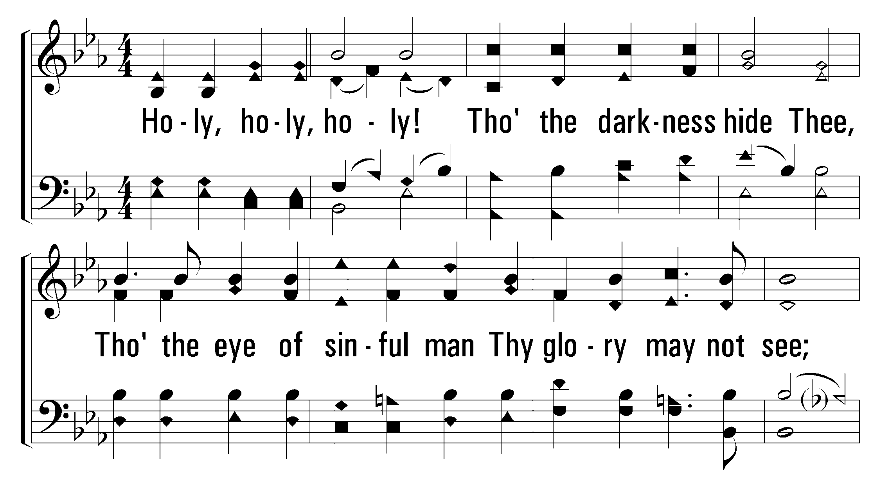
1
2
3
4
238
Holy, Holy Holy!
© 2001 The Paperless Hymnal™

Slide 7
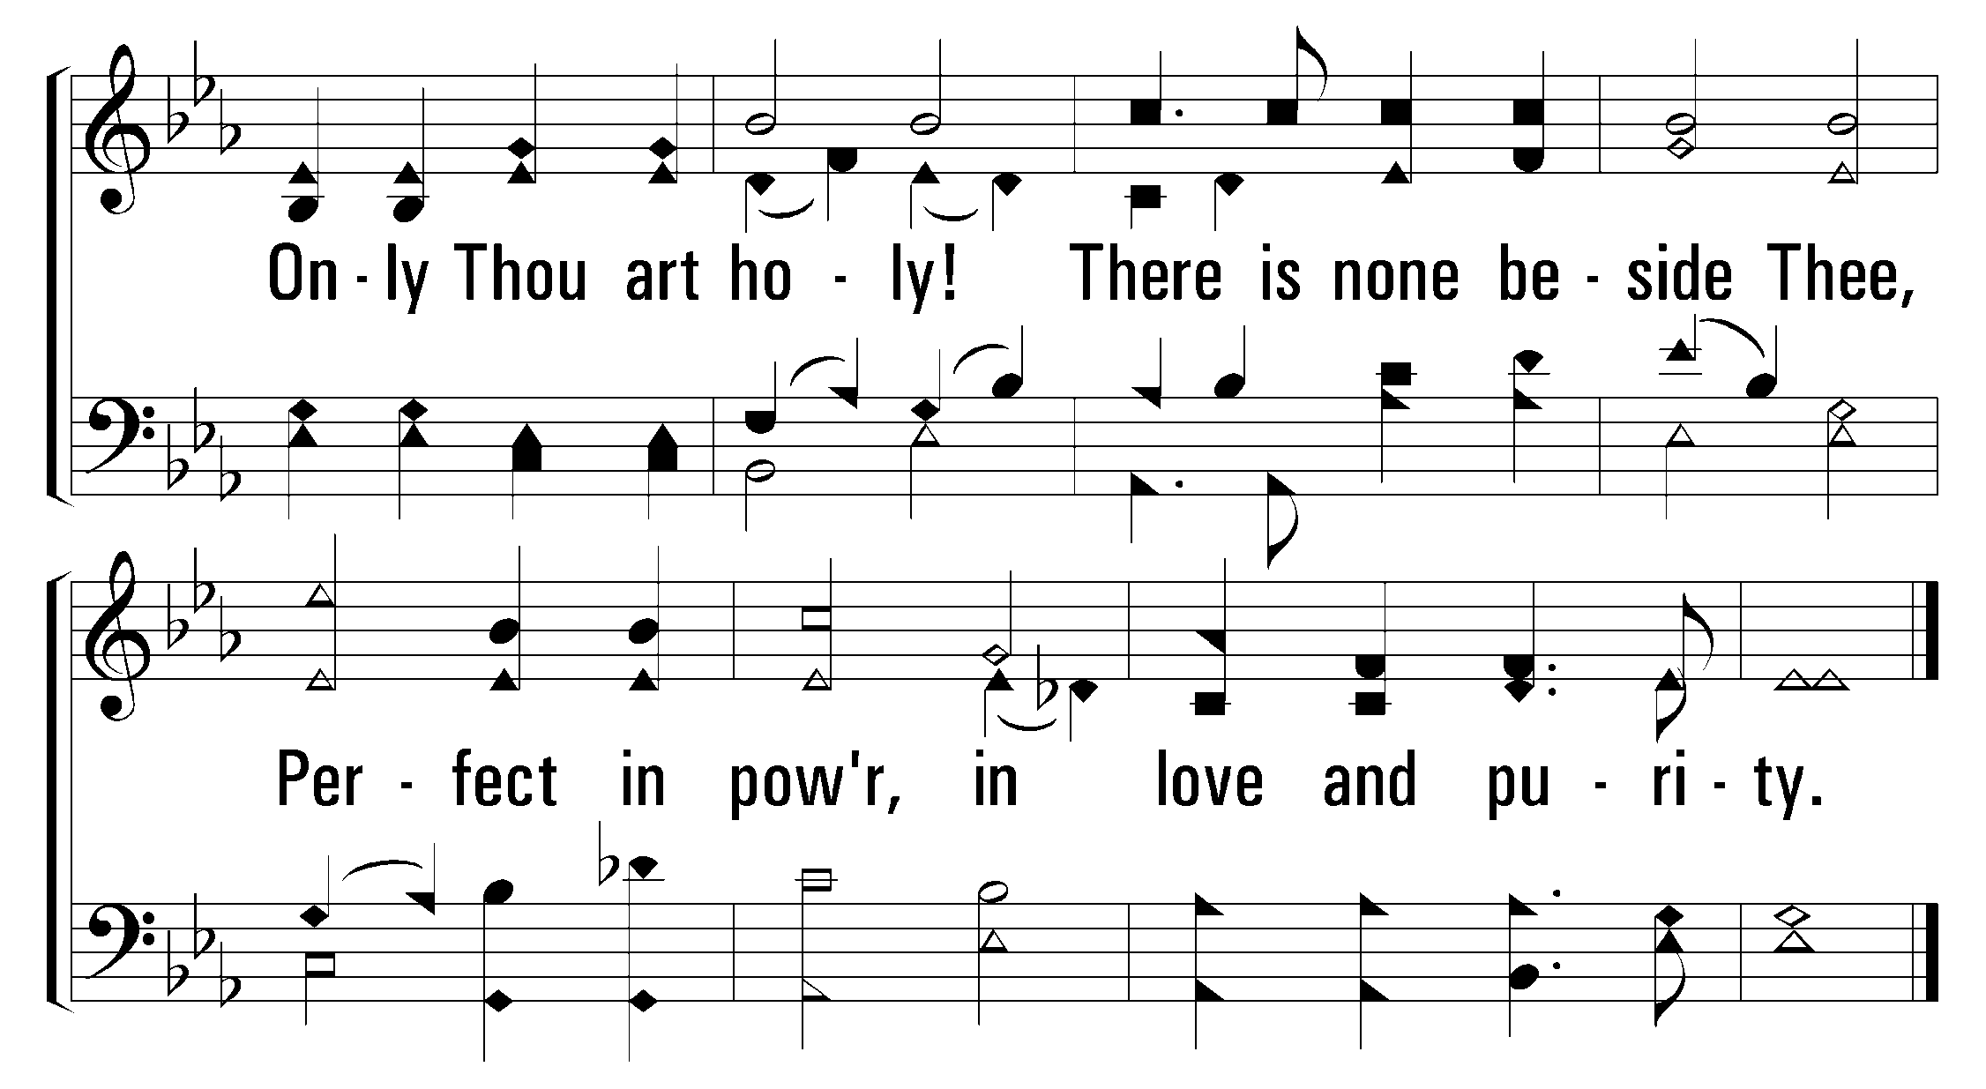
1
2
3
4
238
Holy, Holy Holy!
© 2001 The Paperless Hymnal™

Slide 8
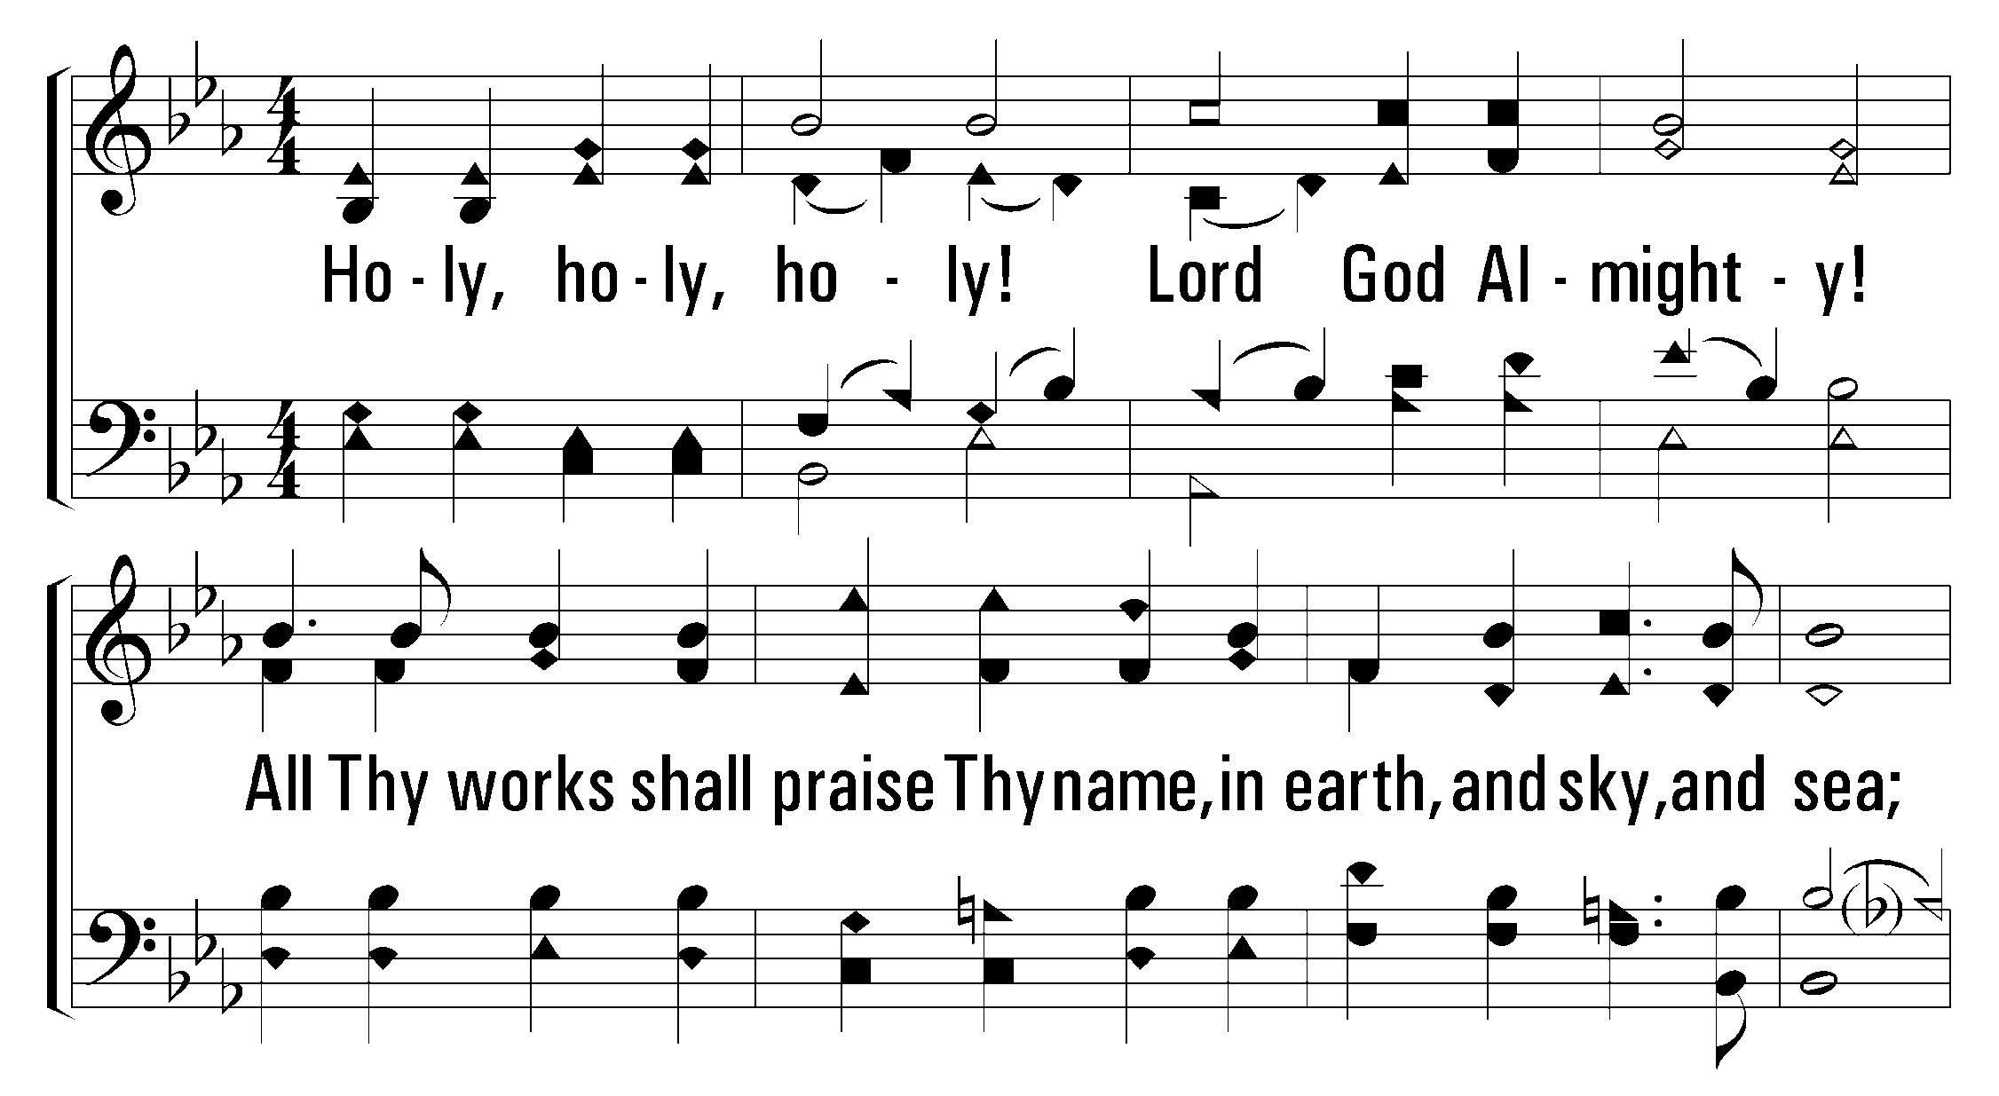
1
2
3
4
238
Holy, Holy Holy!
© 2001 The Paperless Hymnal™

Slide 9
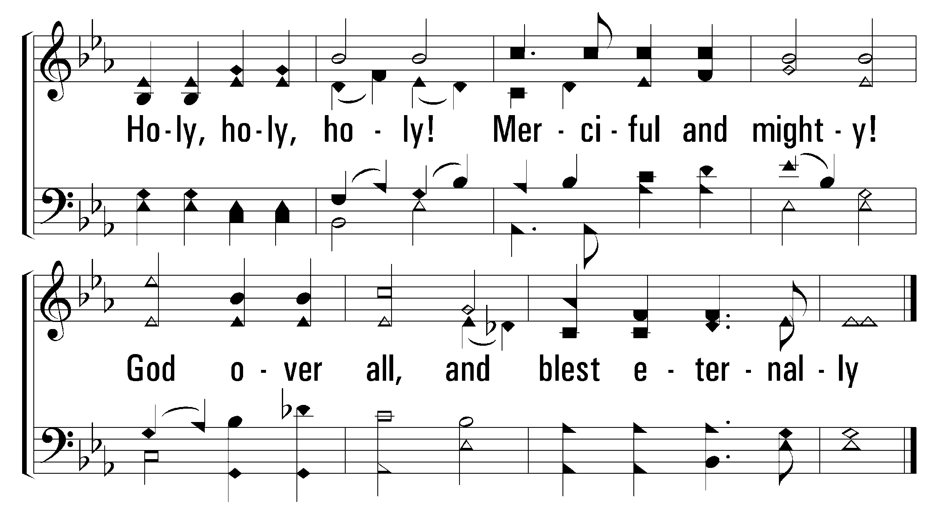
1
2
3
4
238
Holy, Holy Holy!
© 2001 The Paperless Hymnal™

Slide 11
408
pp Slowly
Low in the Grave He Lay

Slide 12
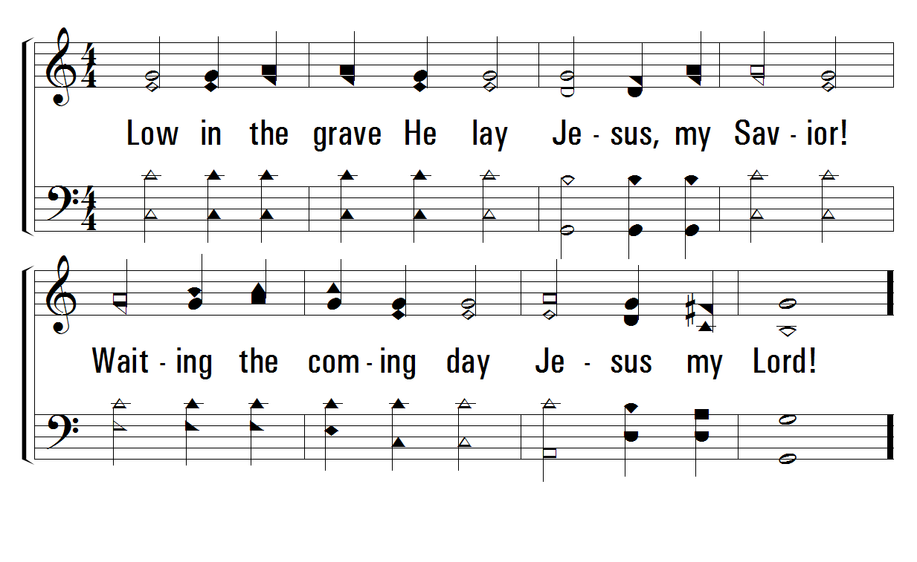
1
C
2
C
3
C
408
Low in the Grave He Lay
© 2001 The Paperless Hymnal™

Slide 13
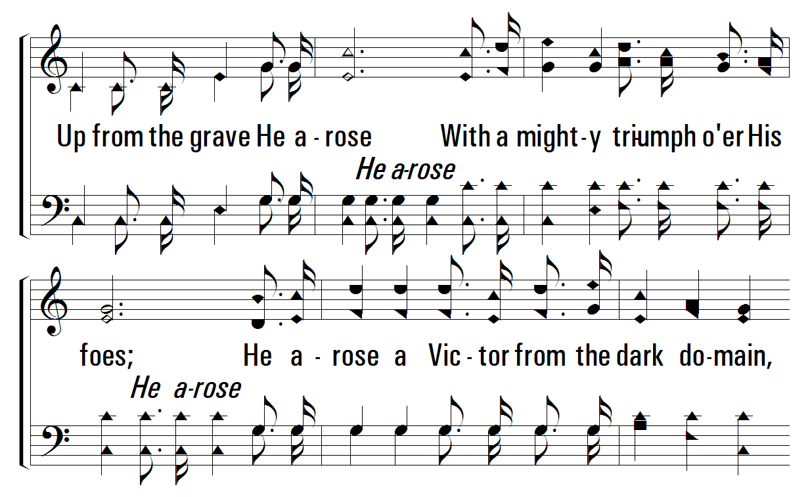
1
C
2
C
3
C
408
Low in the Grave He Lay
© 2001 The Paperless Hymnal™

Slide 14
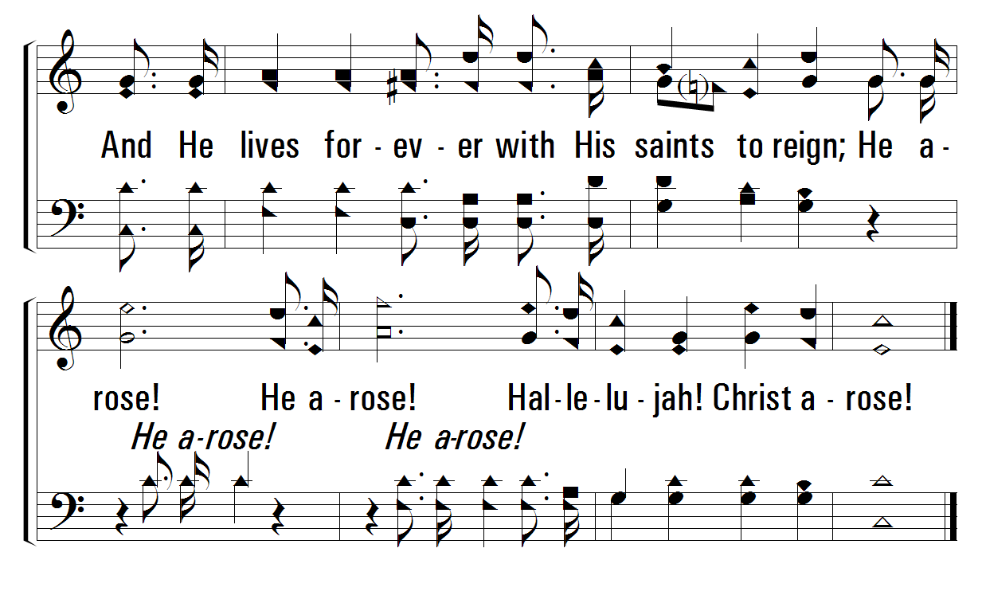
1
C
2
C
3
C
408
Low in the Grave He Lay
© 2001 The Paperless Hymnal™

Slide 15
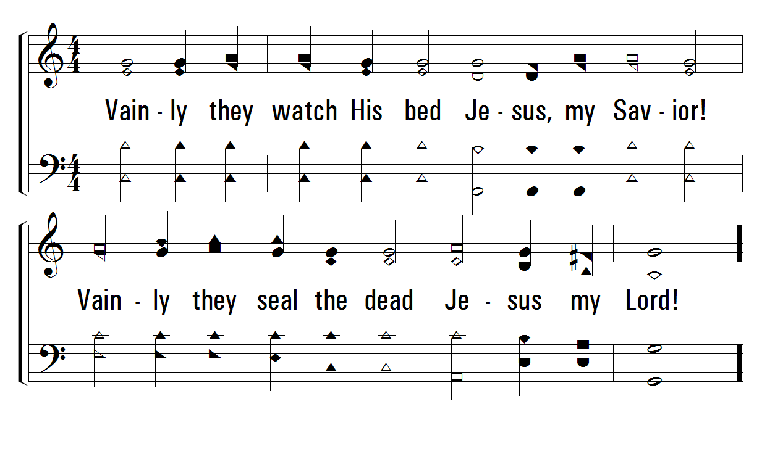
1
C
2
C
3
C
408
Low in the Grave He Lay
© 2001 The Paperless Hymnal™

Slide 16
1
C
2
C
3
C
408
Low in the Grave He Lay
© 2001 The Paperless Hymnal™

Slide 17
1
C
2
C
3
C
408
Low in the Grave He Lay
© 2001 The Paperless Hymnal™

Slide 18
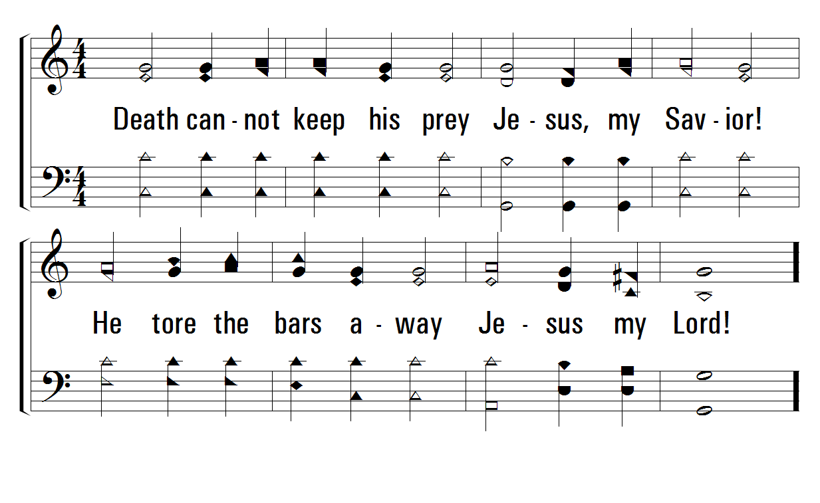
1
C
2
C
3
C
408
Low in the Grave He Lay
© 2001 The Paperless Hymnal™

Slide 19
1
C
2
C
3
C
408
Low in the Grave He Lay
© 2001 The Paperless Hymnal™

Slide 20
1
C
2
C
3
C
408
Low in the Grave He Lay
© 2001 The Paperless Hymnal™

Slide 22
120
Words: Carolina Sandell Berg / tr. Andrew L. Skoog
Music: Oscar Ahnfelt
Day by Day

Slide 23
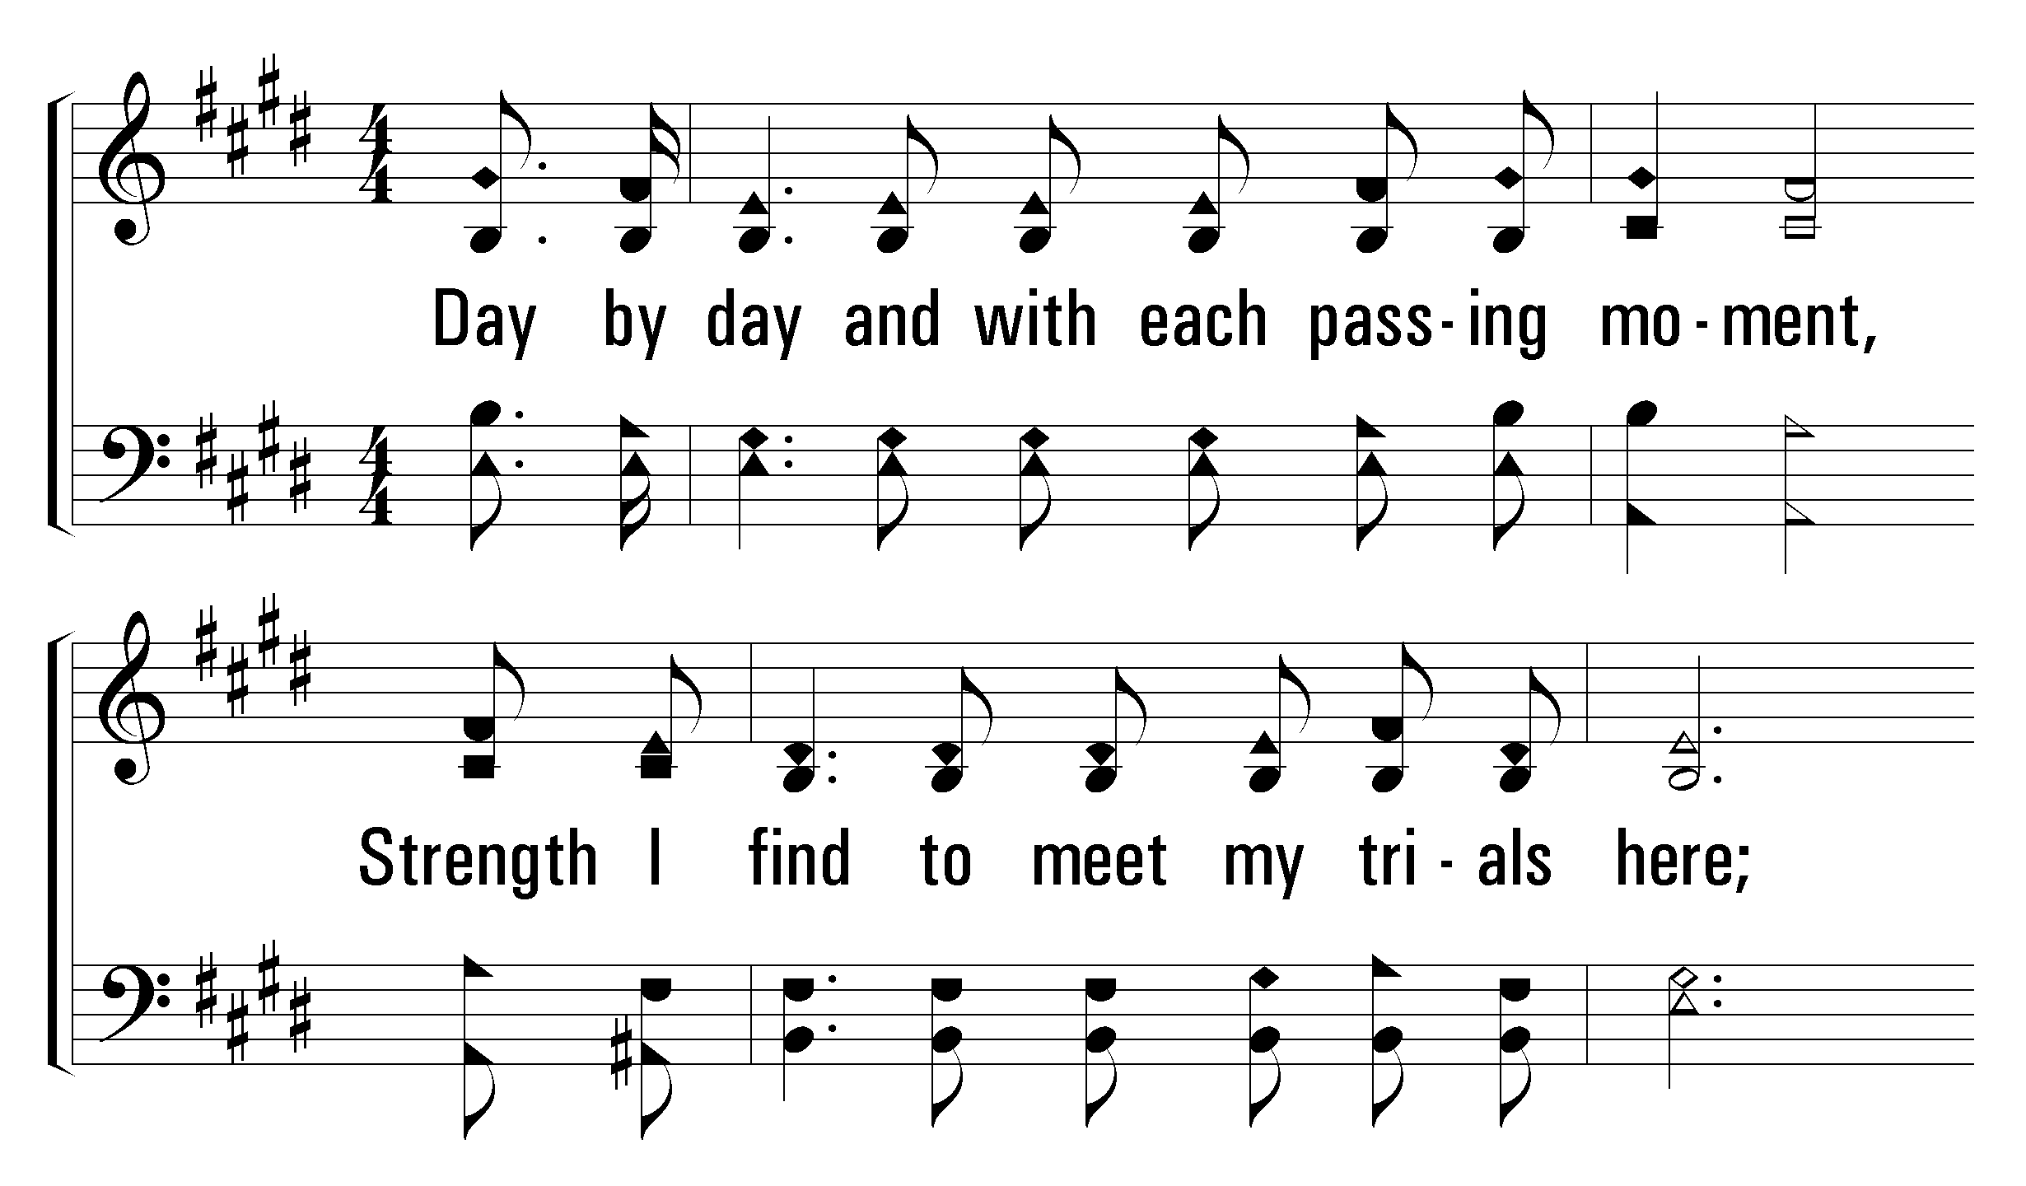
1
2
3
120
Day by Day
© 2004 The Paperless Hymnal™

Slide 24
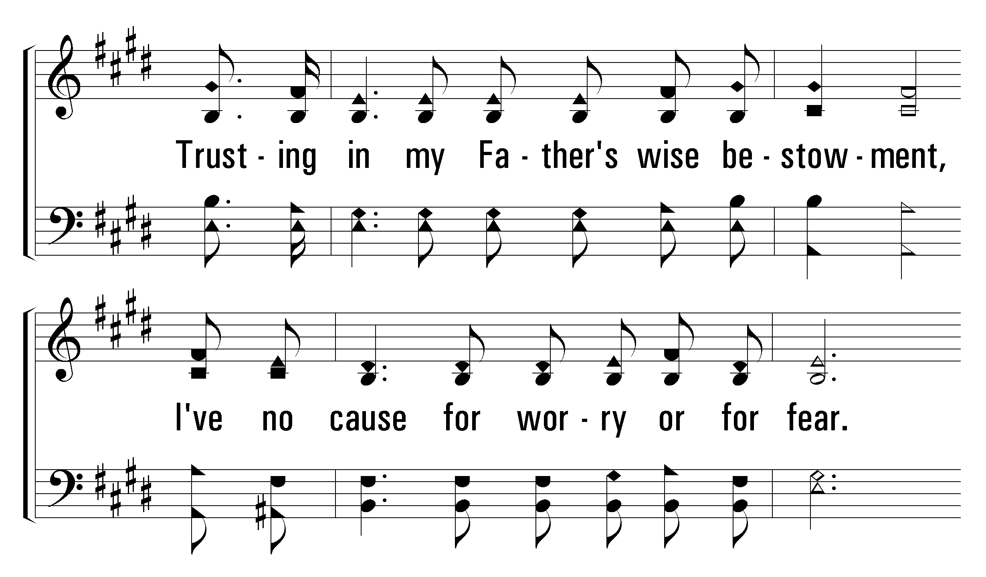
1
2
3
120
Day by Day
© 2004 The Paperless Hymnal™

Slide 25
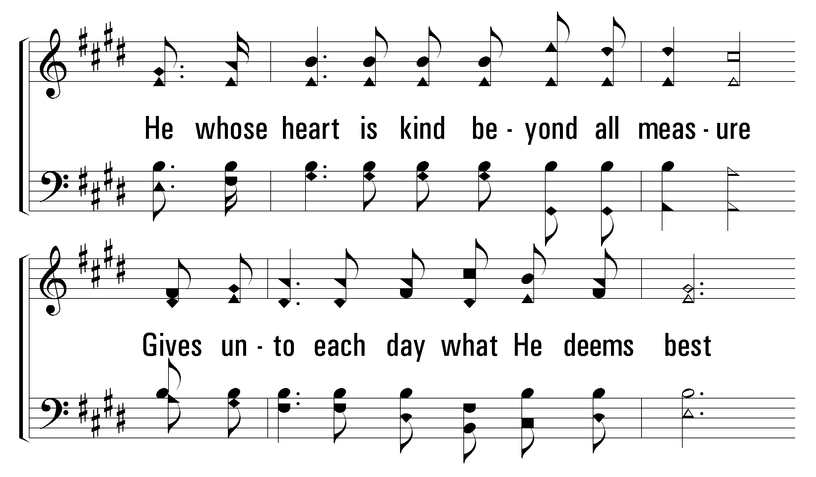
1
2
3
120
Day by Day
© 2004 The Paperless Hymnal™

Slide 26
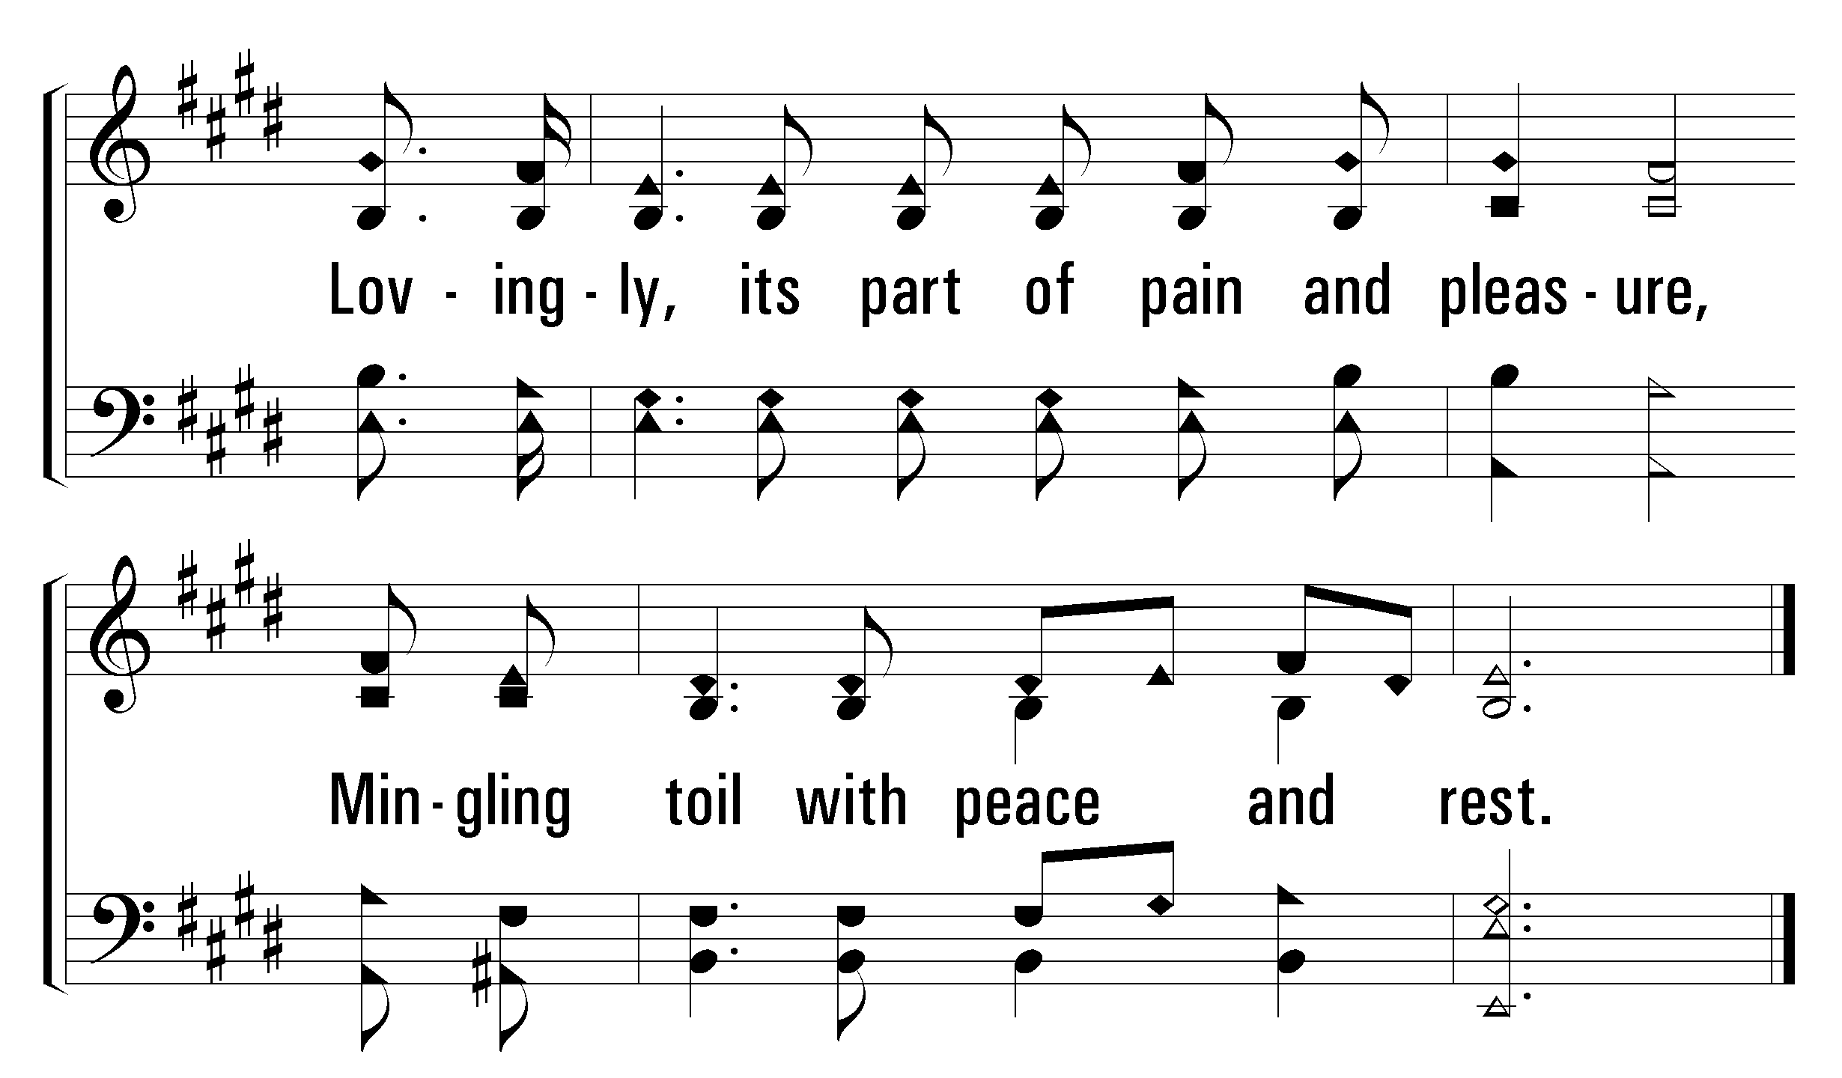
1
2
3
120
Day by Day
© 2004 The Paperless Hymnal™

Slide 27
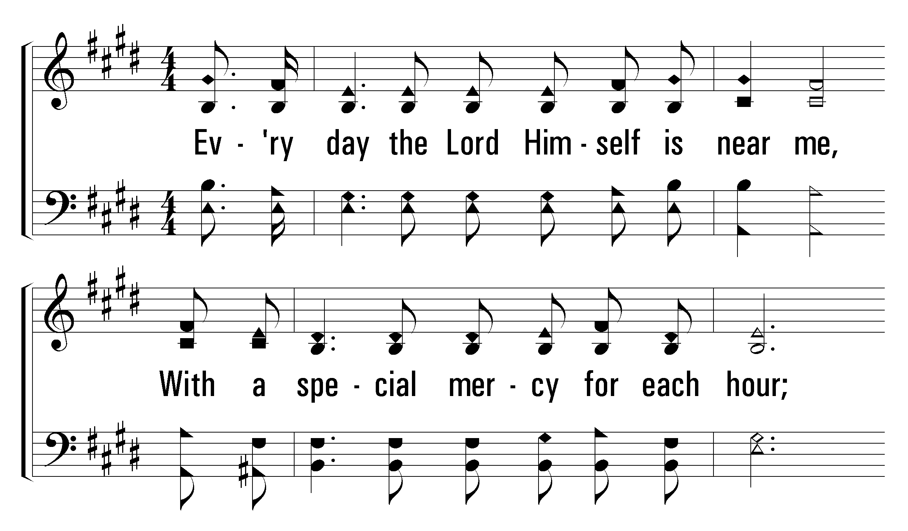
1
2
3
120
Day by Day
© 2004 The Paperless Hymnal™

Slide 28
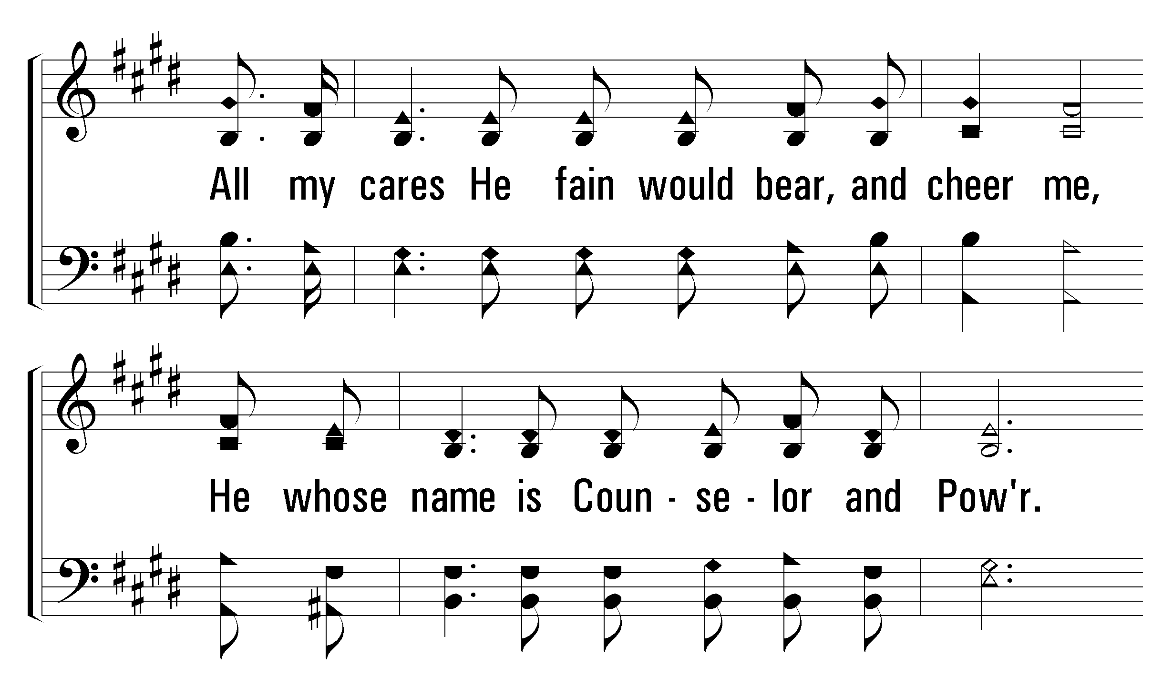
1
2
3
120
Day by Day
© 2004 The Paperless Hymnal™

Slide 29
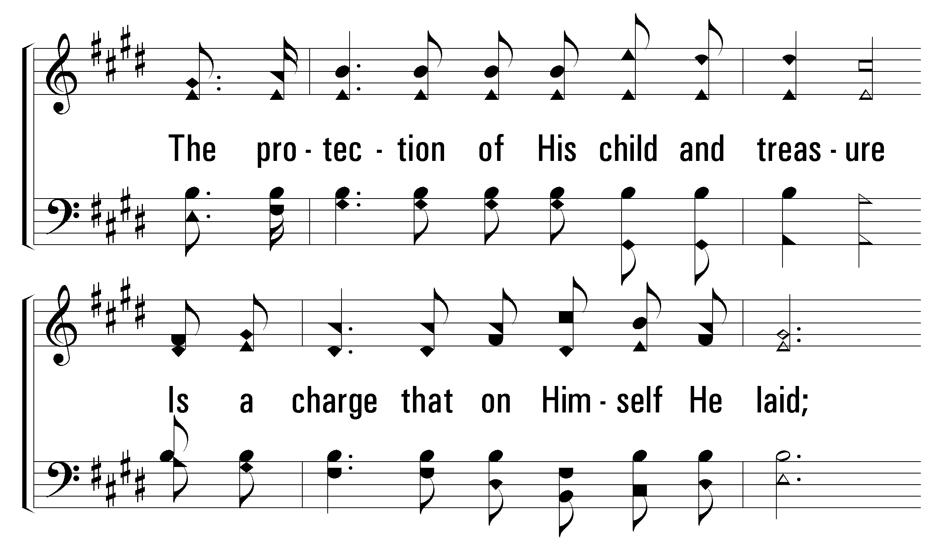
1
2
3
120
Day by Day
© 2004 The Paperless Hymnal™

Slide 30
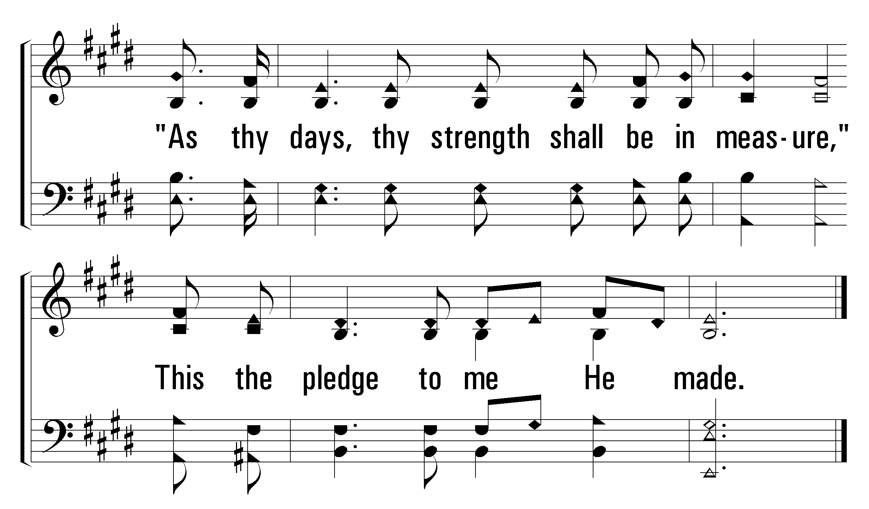
1
2
3
120
Day by Day
© 2004 The Paperless Hymnal™

Slide 31
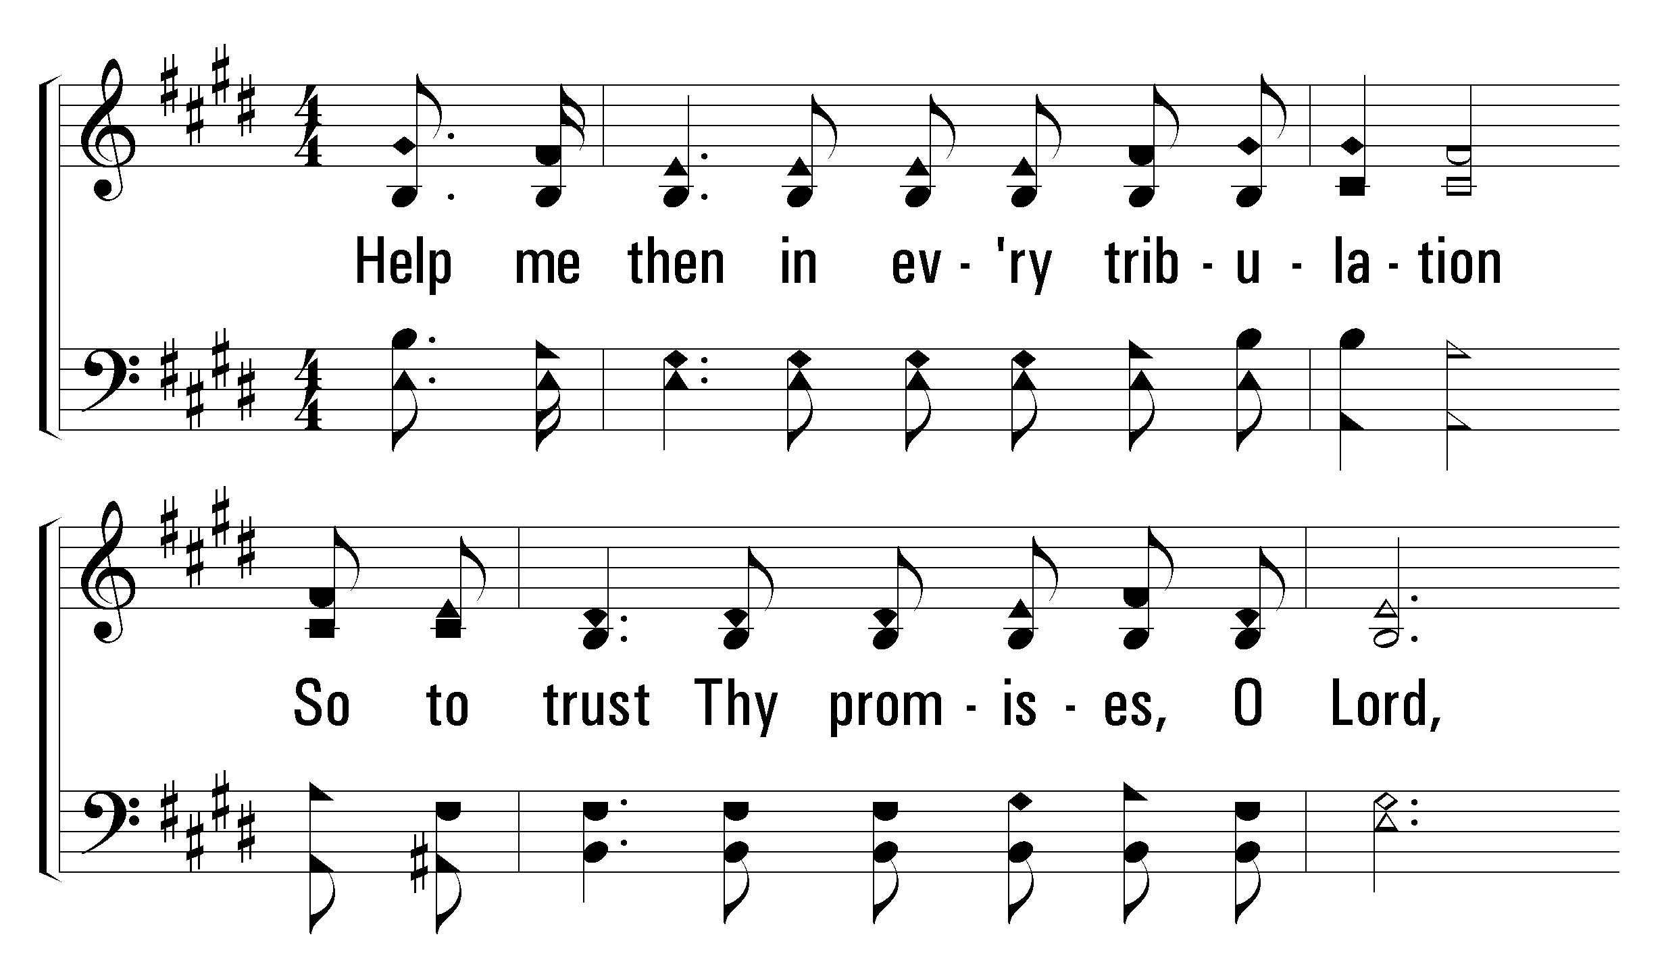
1
2
3
120
Day by Day
© 2004 The Paperless Hymnal™

Slide 32
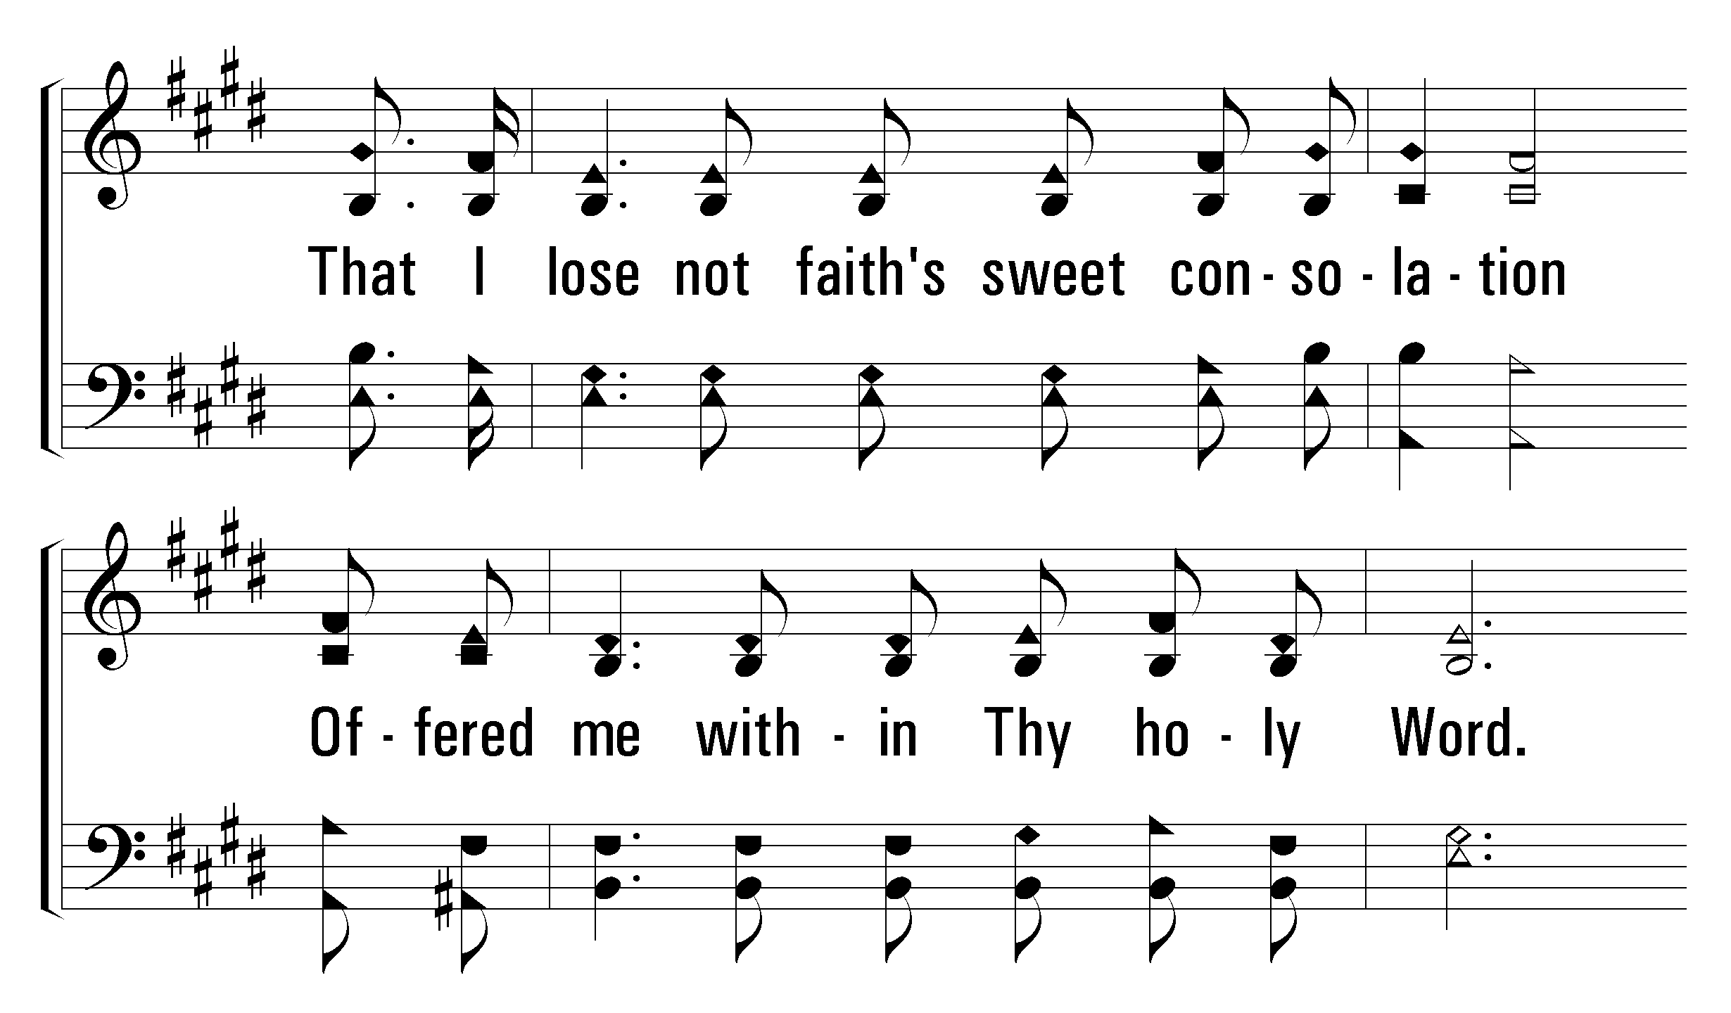
1
2
3
120
Day by Day
© 2004 The Paperless Hymnal™

Slide 33
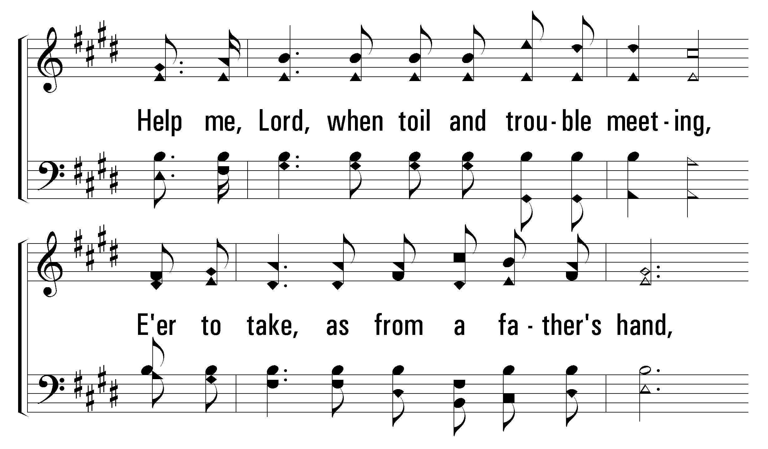
1
2
3
120
Day by Day
© 2004 The Paperless Hymnal™

Slide 34
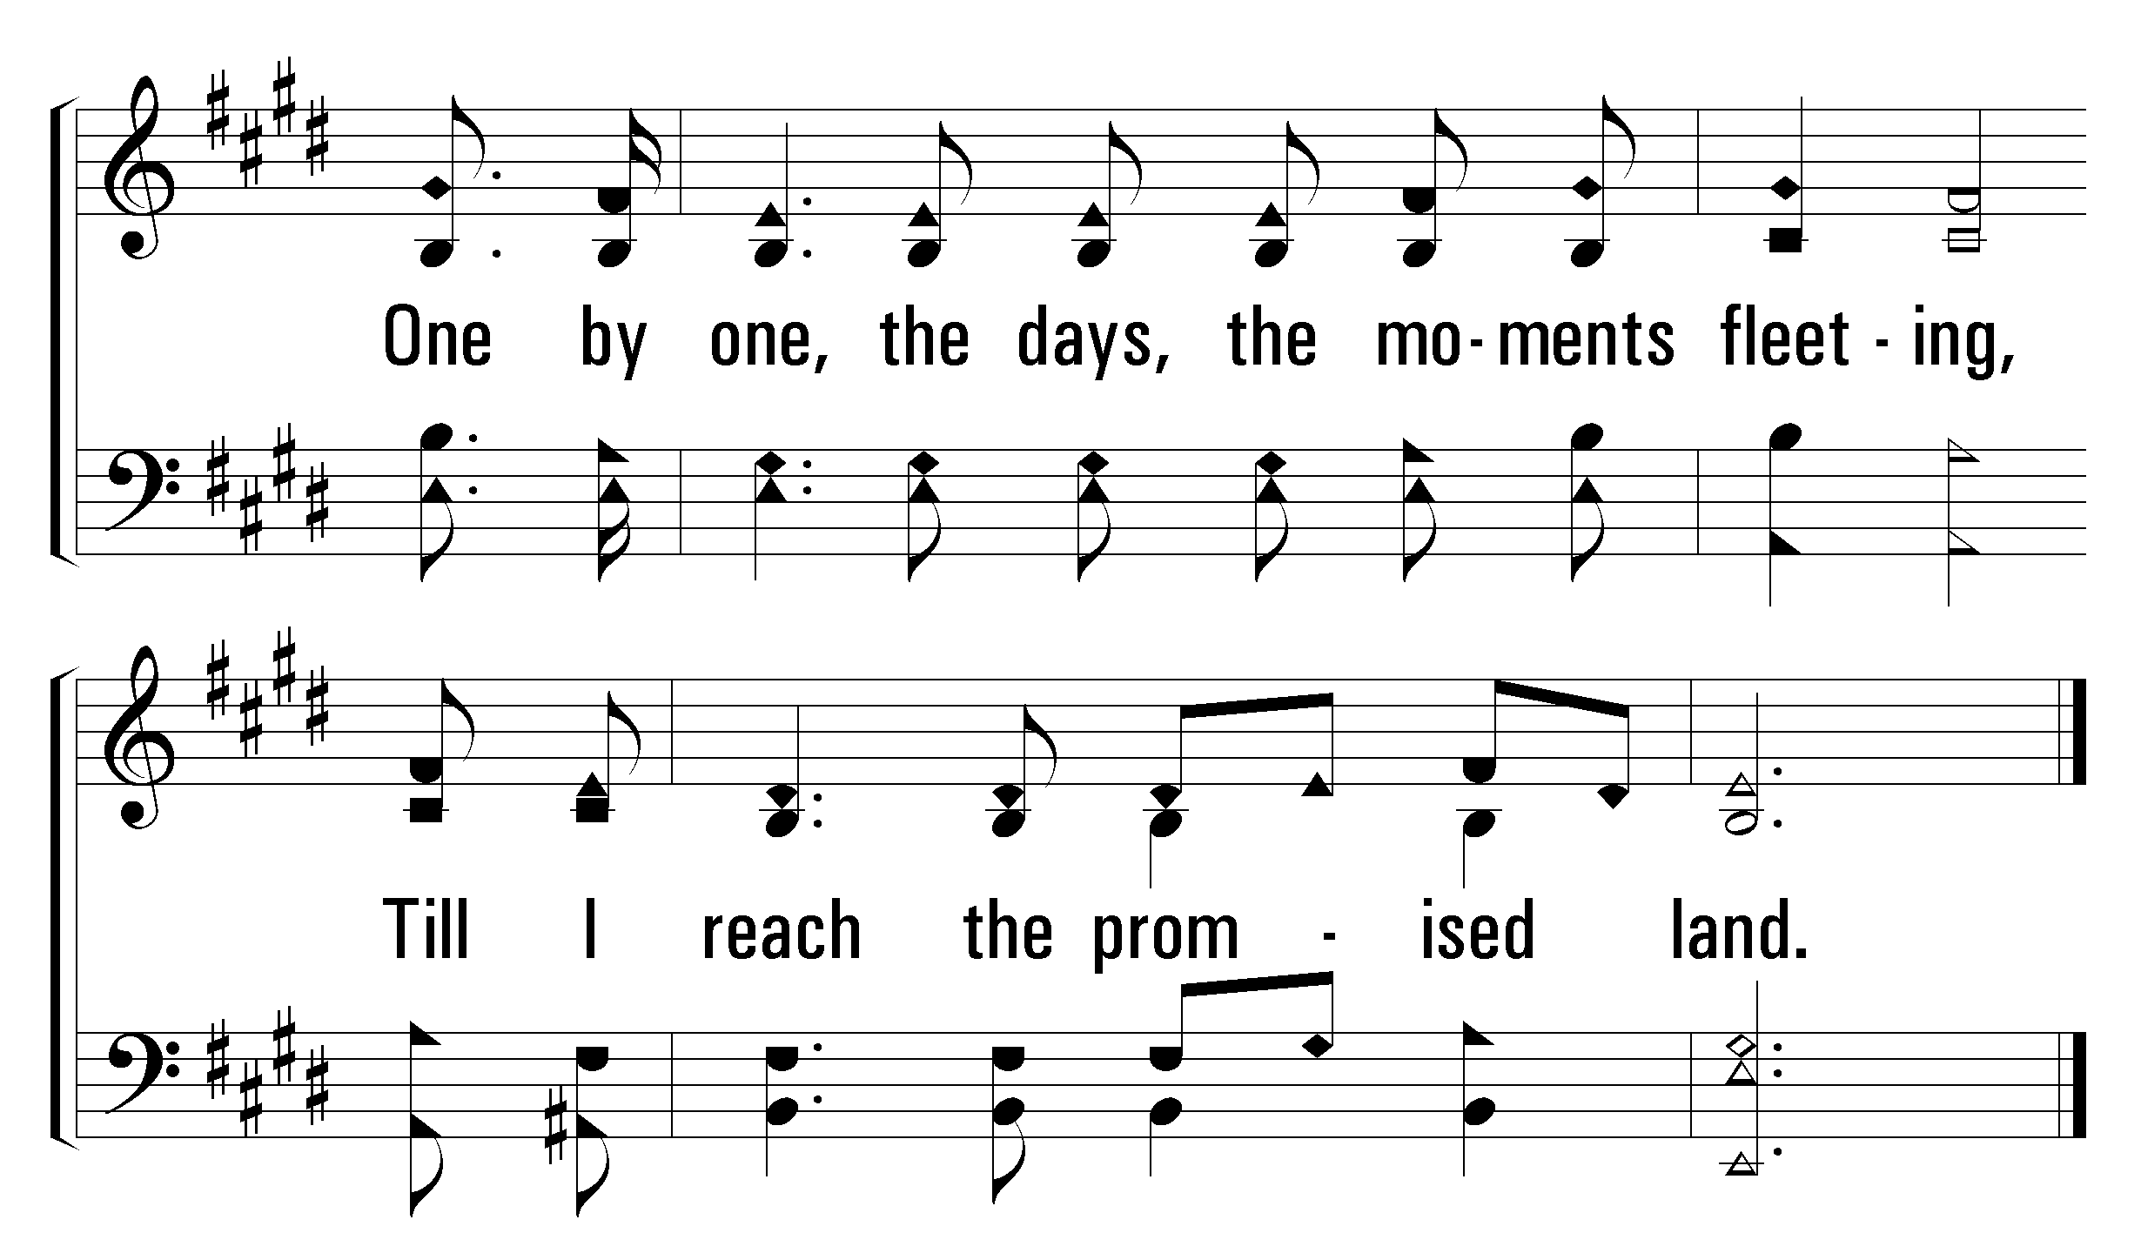
1
2
3
120
Day by Day
© 2004 The Paperless Hymnal™

Slide 36
500
Words: Robert Robinson
Music: Wyeth’s Repository of Sacred Music
O Thou Fount of Every Blessing

Slide 37
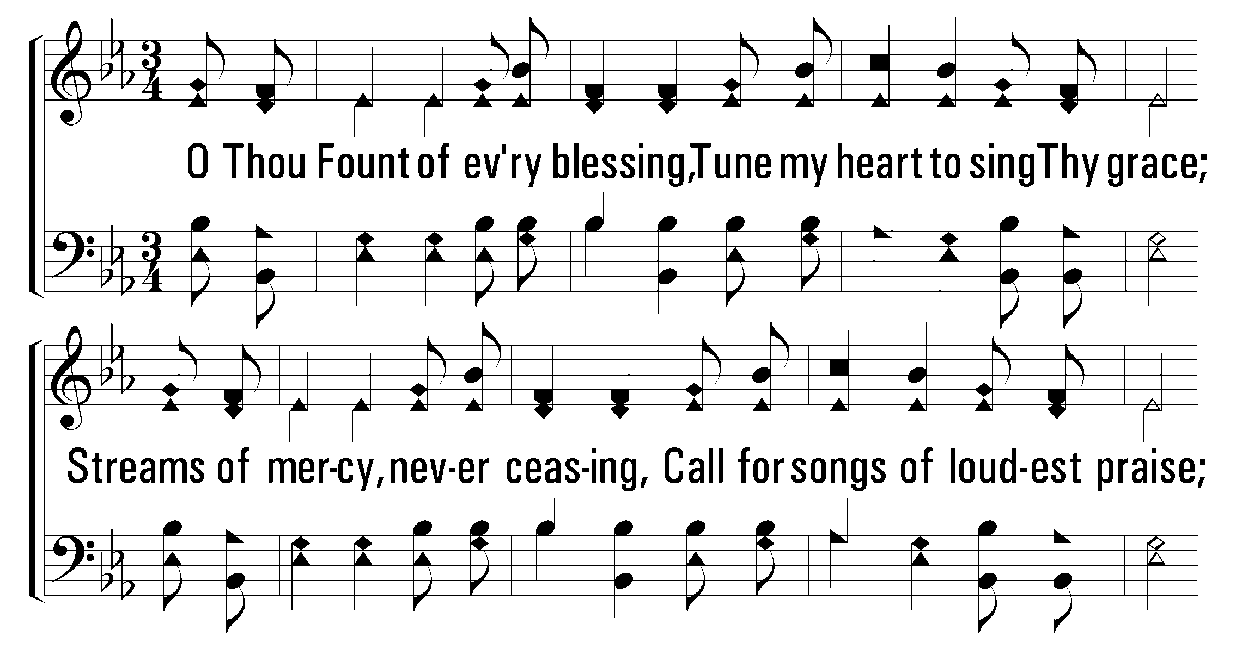
1
2
3
500
O Thou Fount of Every Blessing
© 2001 The Paperless Hymnal™

Slide 38
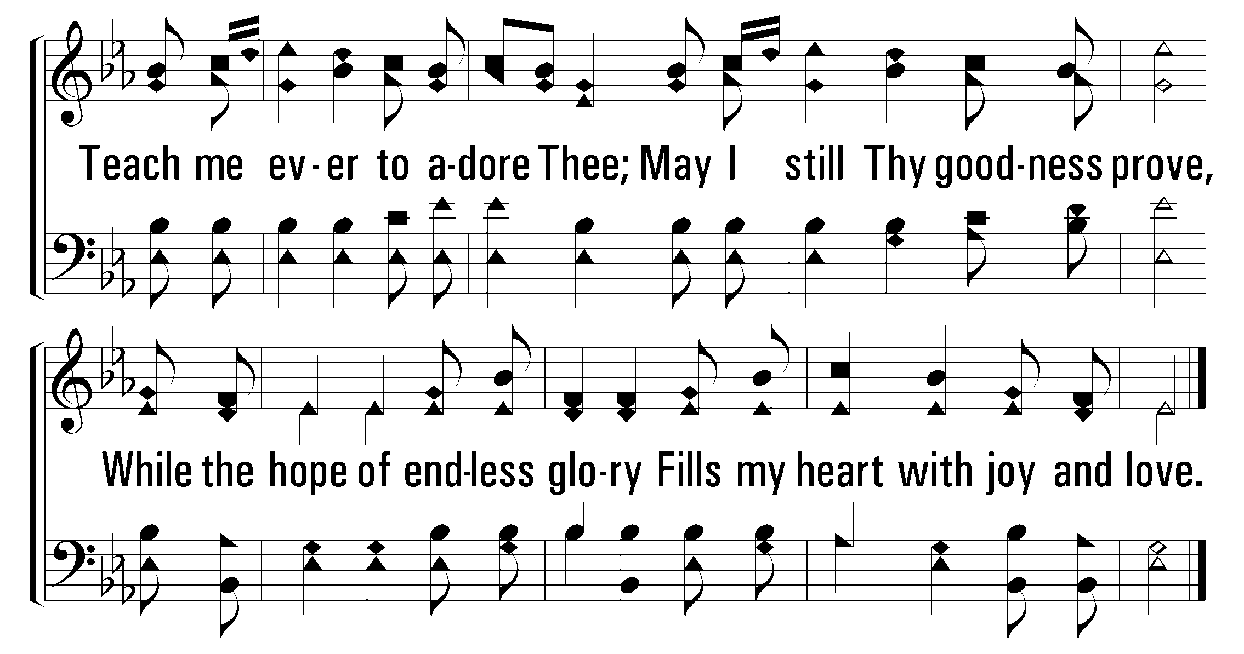
1
2
3
500
O Thou Fount of Every Blessing
© 2001 The Paperless Hymnal™

Slide 39
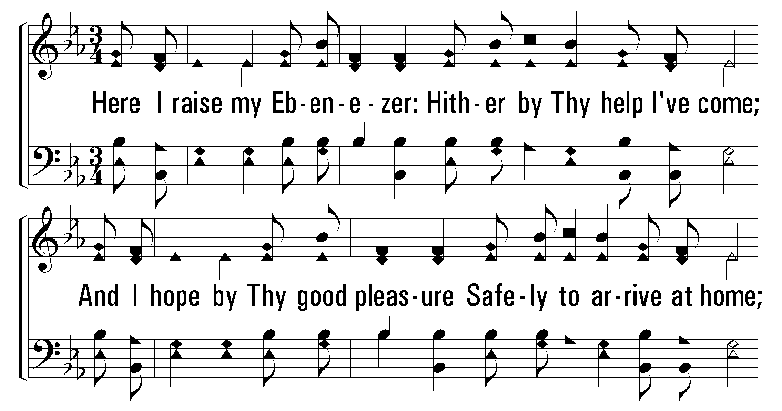
1
2
3
500
O Thou Fount of Every Blessing
© 2001 The Paperless Hymnal™

Slide 40
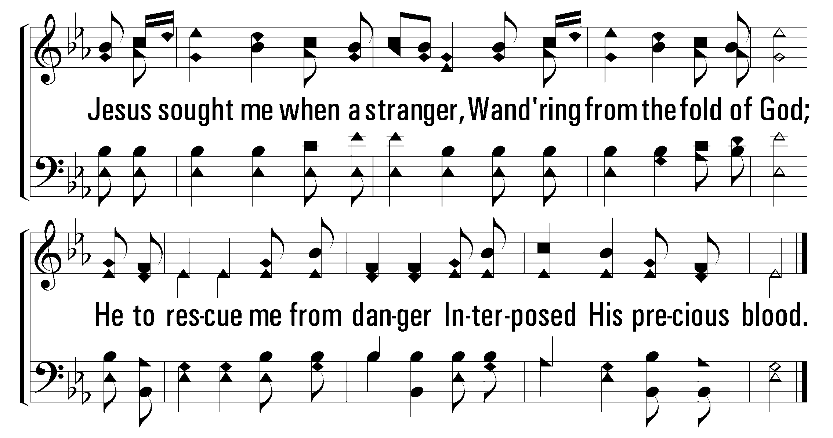
1
2
3
500
O Thou Fount of Every Blessing
© 2001 The Paperless Hymnal™

Slide 41
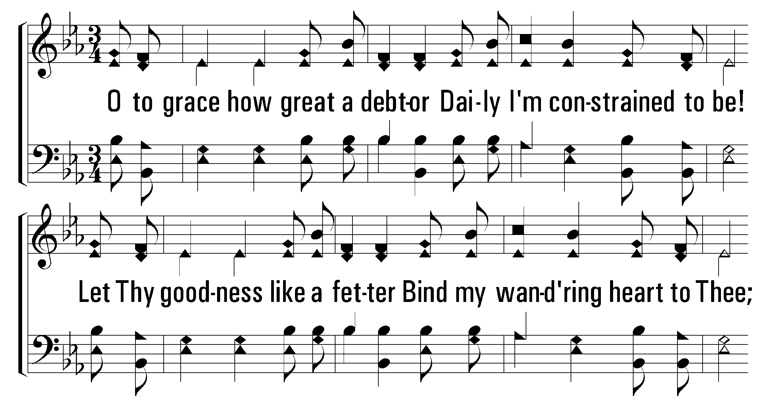
1
2
3
500
O Thou Fount of Every Blessing
© 2001 The Paperless Hymnal™

Slide 42
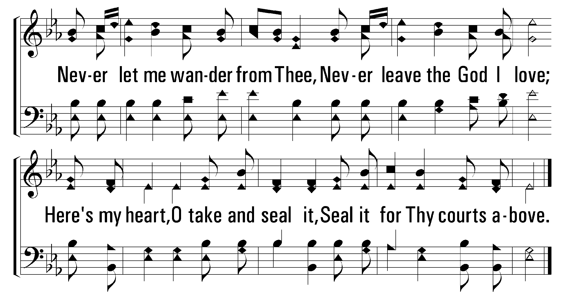
1
2
3
500
O Thou Fount of Every Blessing
© 2001 The Paperless Hymnal™

