Slide 1
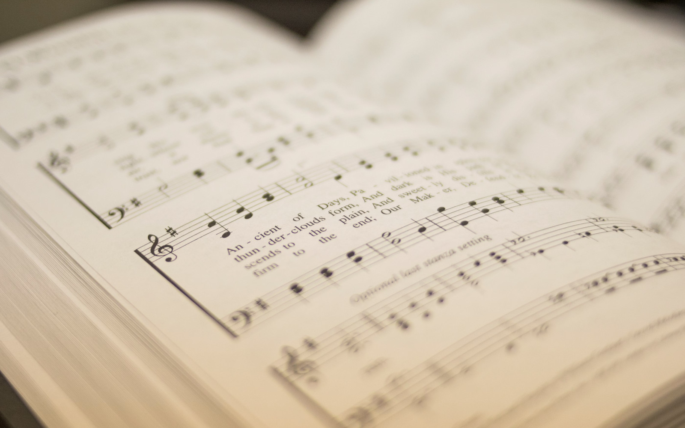

77
LOOK, YE SAINTS! THE SIGHT IS GLORIOUS
1
2
3
“SINGING...TO THE LORD”
COLOSSIANS 3:16
Tune: CWM RHONDDA • John Hughes (1907)
Hymn: Thomas Kelly (1809)

Slide 2
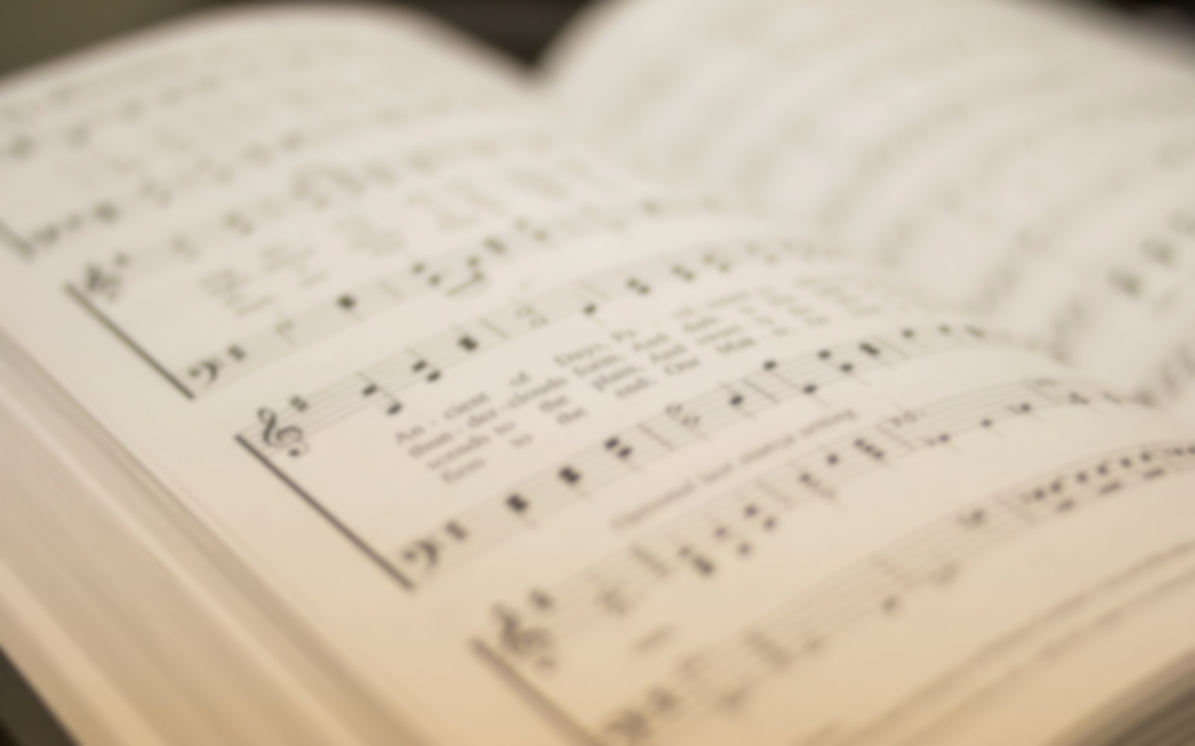
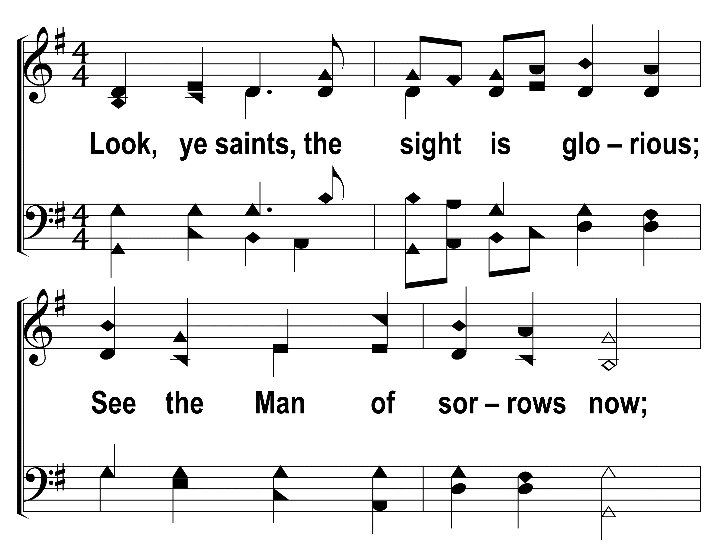

77
1
LOOK, YE SAINTS! THE SIGHT IS GLORIOUS
2
3
© 2014 Sumphonia Productions, LLC

Slide 3
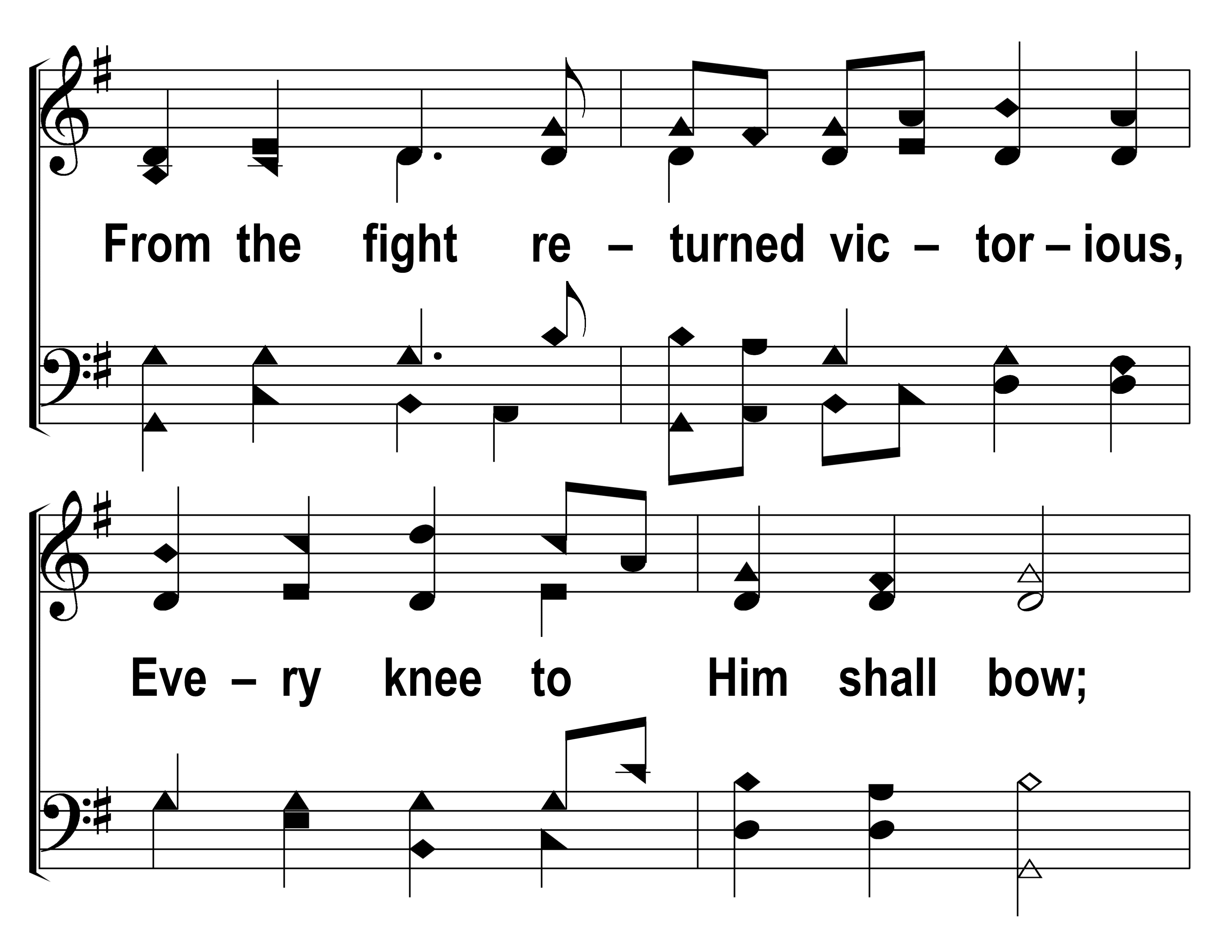
77
1
LOOK, YE SAINTS! THE SIGHT IS GLORIOUS
2
3
© 2014 Sumphonia Productions, LLC

Slide 4
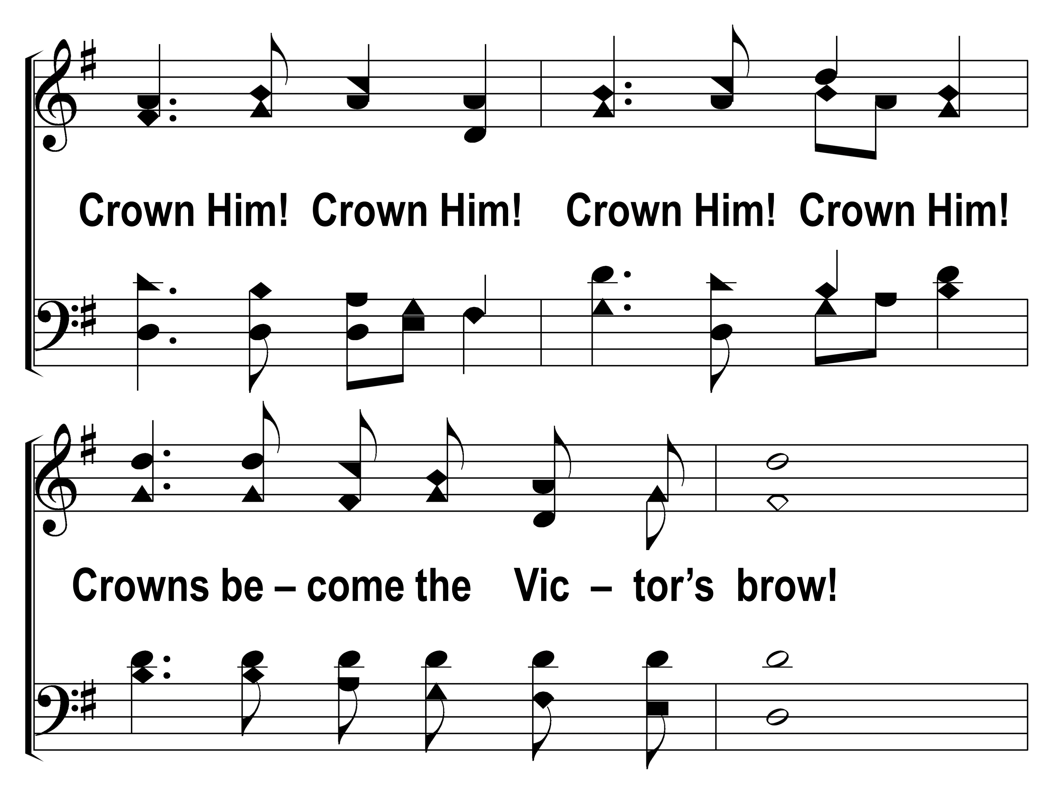
77
1
LOOK, YE SAINTS! THE SIGHT IS GLORIOUS
2
3
© 2014 Sumphonia Productions, LLC

Slide 5
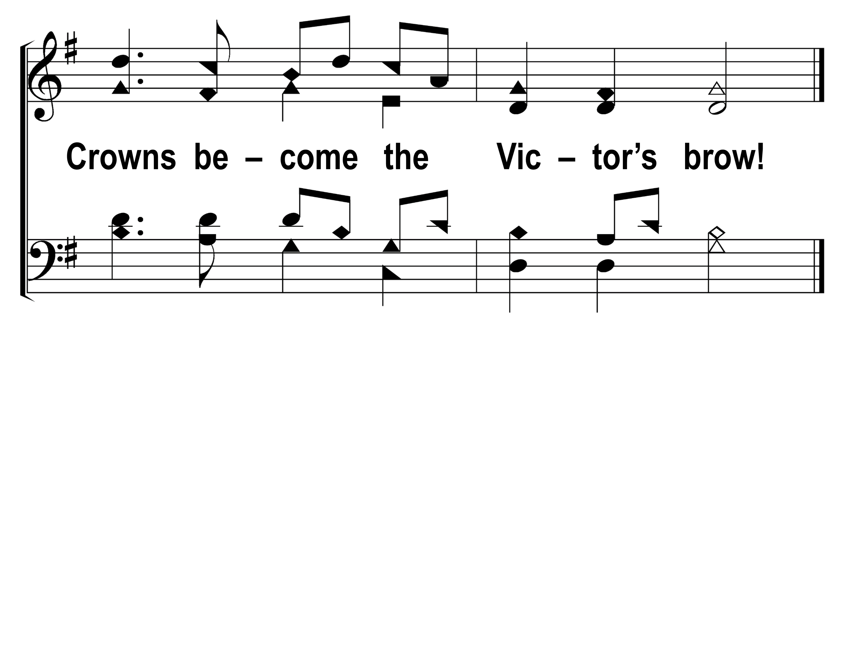
77
1
LOOK, YE SAINTS! THE SIGHT IS GLORIOUS
2
3
© 2014 Sumphonia Productions, LLC

Slide 6
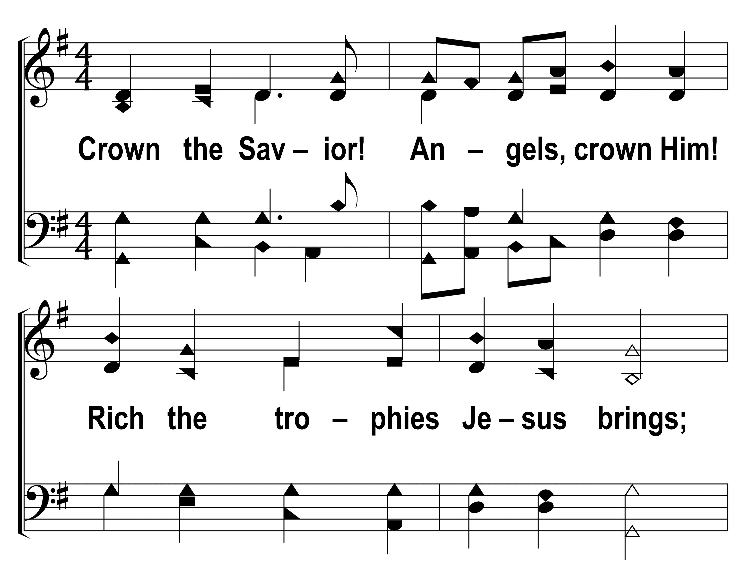
77
1
LOOK, YE SAINTS! THE SIGHT IS GLORIOUS
2
3
© 2014 Sumphonia Productions, LLC

Slide 7
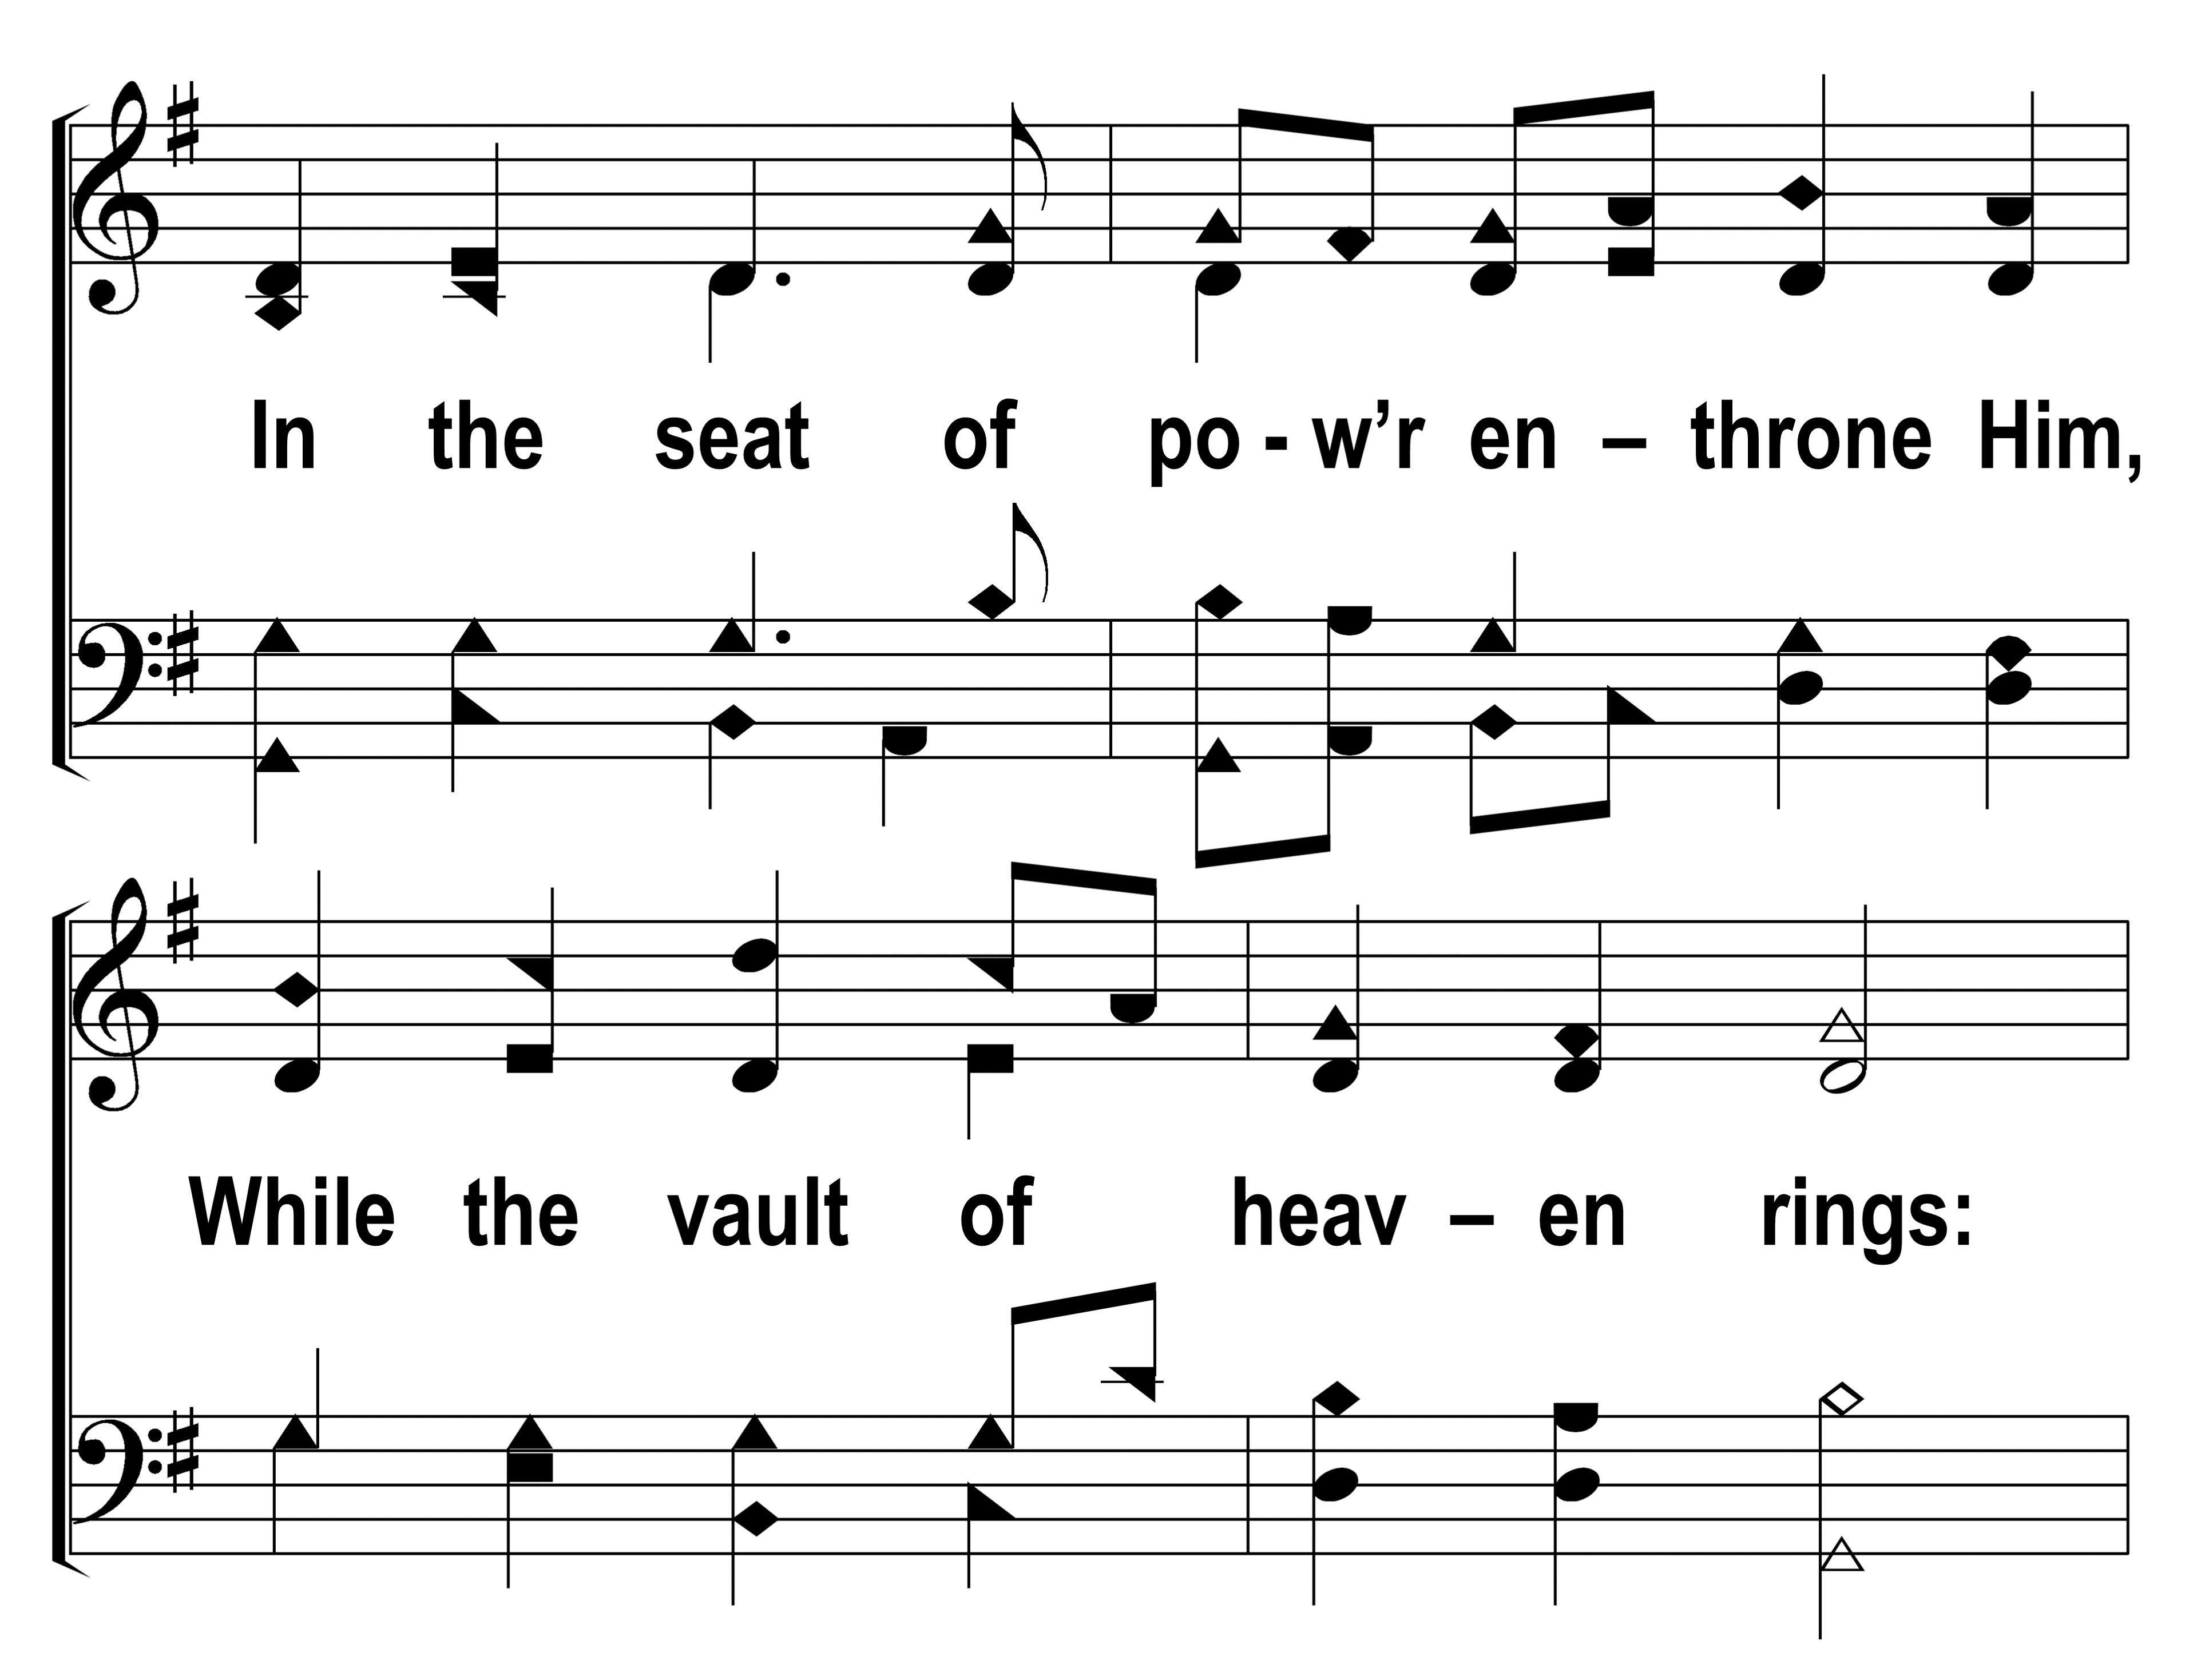
77
1
LOOK, YE SAINTS! THE SIGHT IS GLORIOUS
2
3
© 2014 Sumphonia Productions, LLC

Slide 8

77
1
LOOK, YE SAINTS! THE SIGHT IS GLORIOUS
2
3
© 2014 Sumphonia Productions, LLC

Slide 9
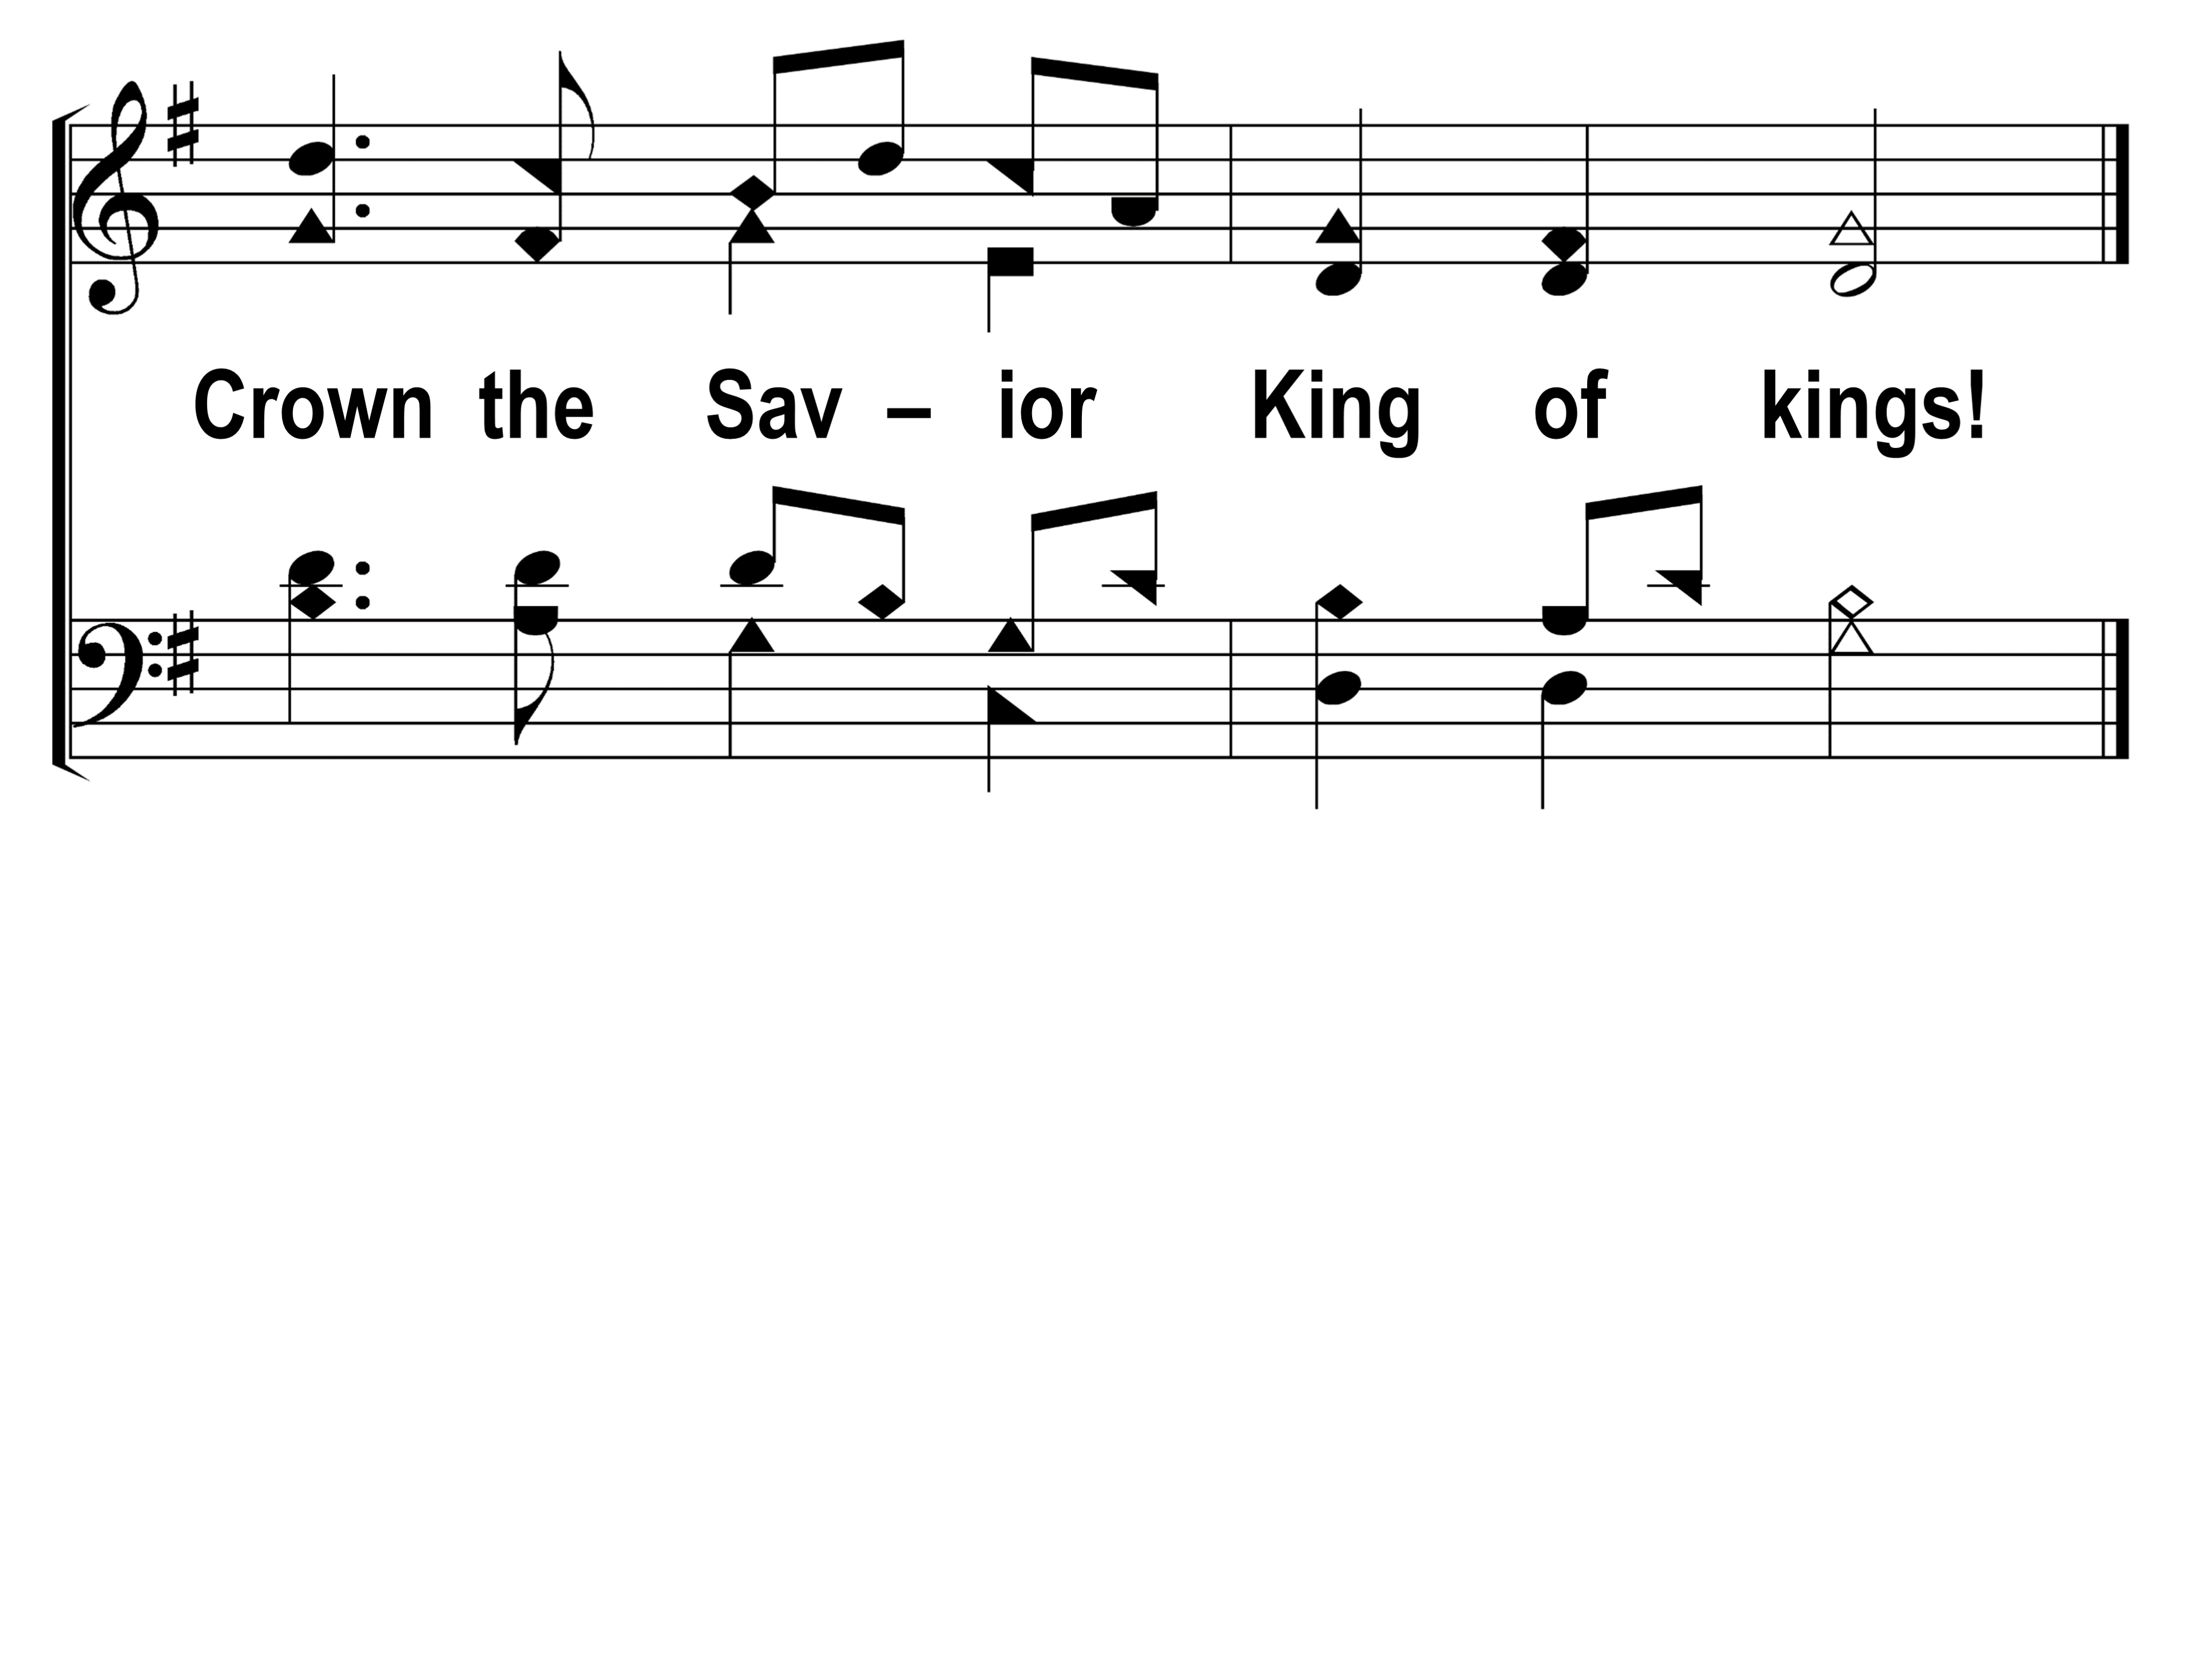
77
1
LOOK, YE SAINTS! THE SIGHT IS GLORIOUS
2
3
© 2014 Sumphonia Productions, LLC

Slide 10
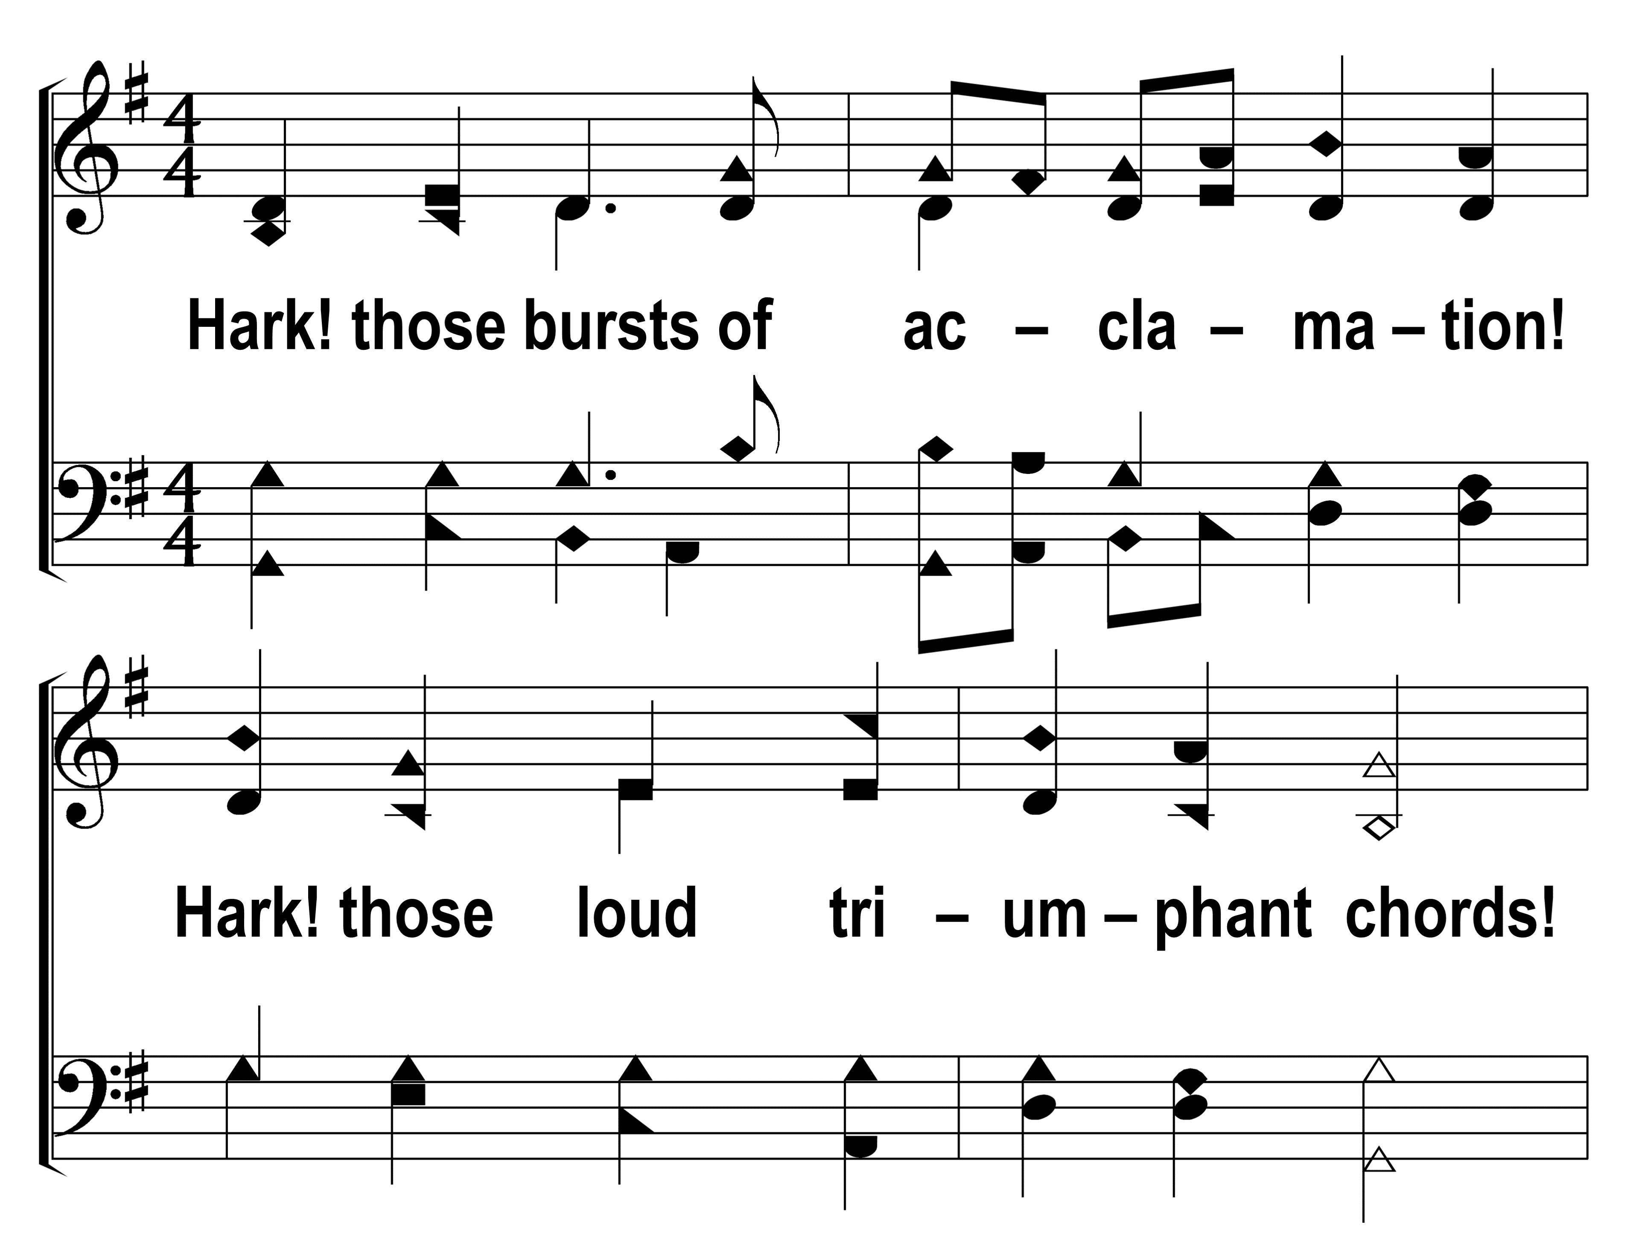
77
1
LOOK, YE SAINTS! THE SIGHT IS GLORIOUS
2
3
© 2014 Sumphonia Productions, LLC

Slide 11
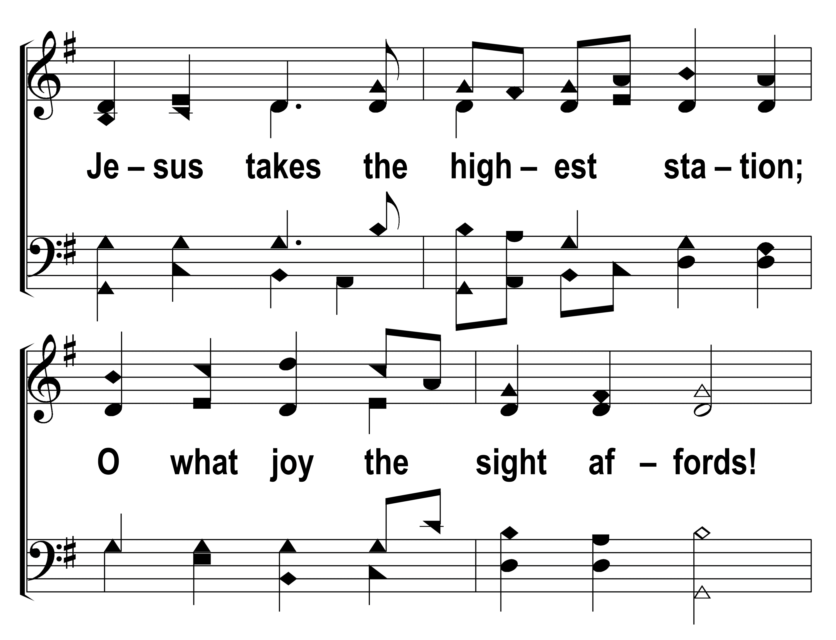
77
1
LOOK, YE SAINTS! THE SIGHT IS GLORIOUS
2
3
© 2014 Sumphonia Productions, LLC

Slide 12
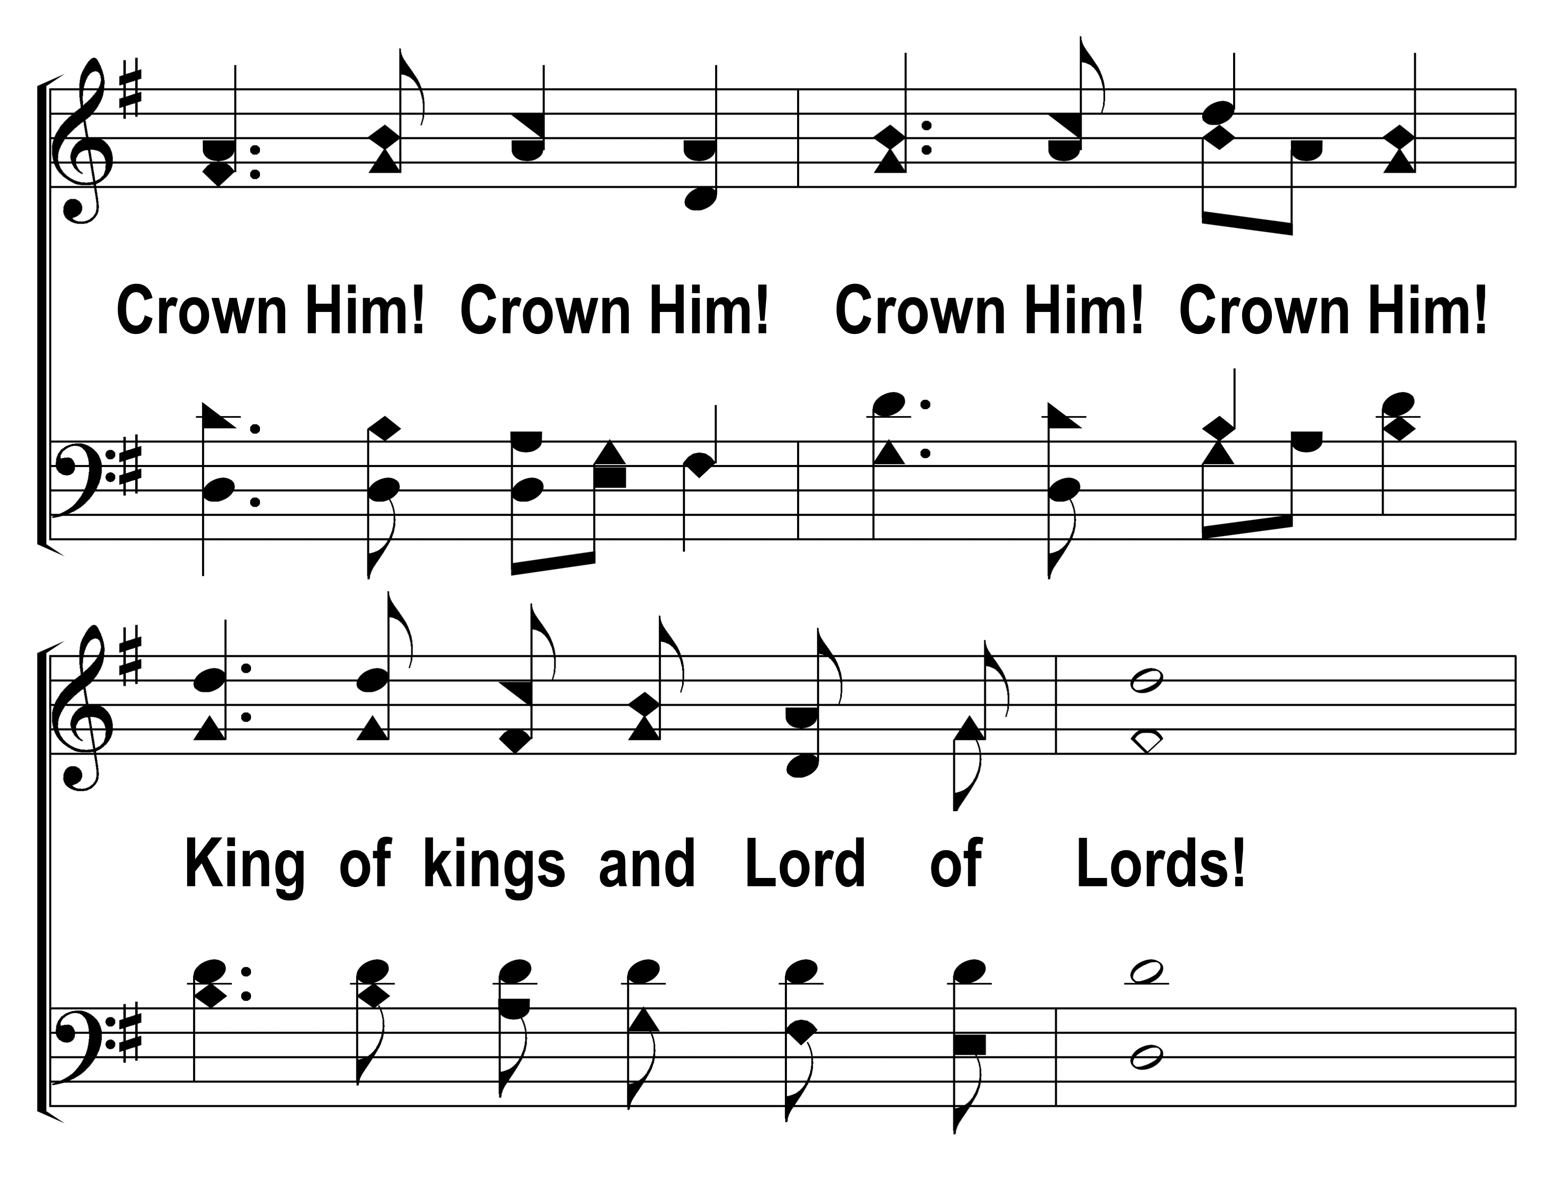
77
1
LOOK, YE SAINTS! THE SIGHT IS GLORIOUS
2
3
© 2014 Sumphonia Productions, LLC

Slide 13
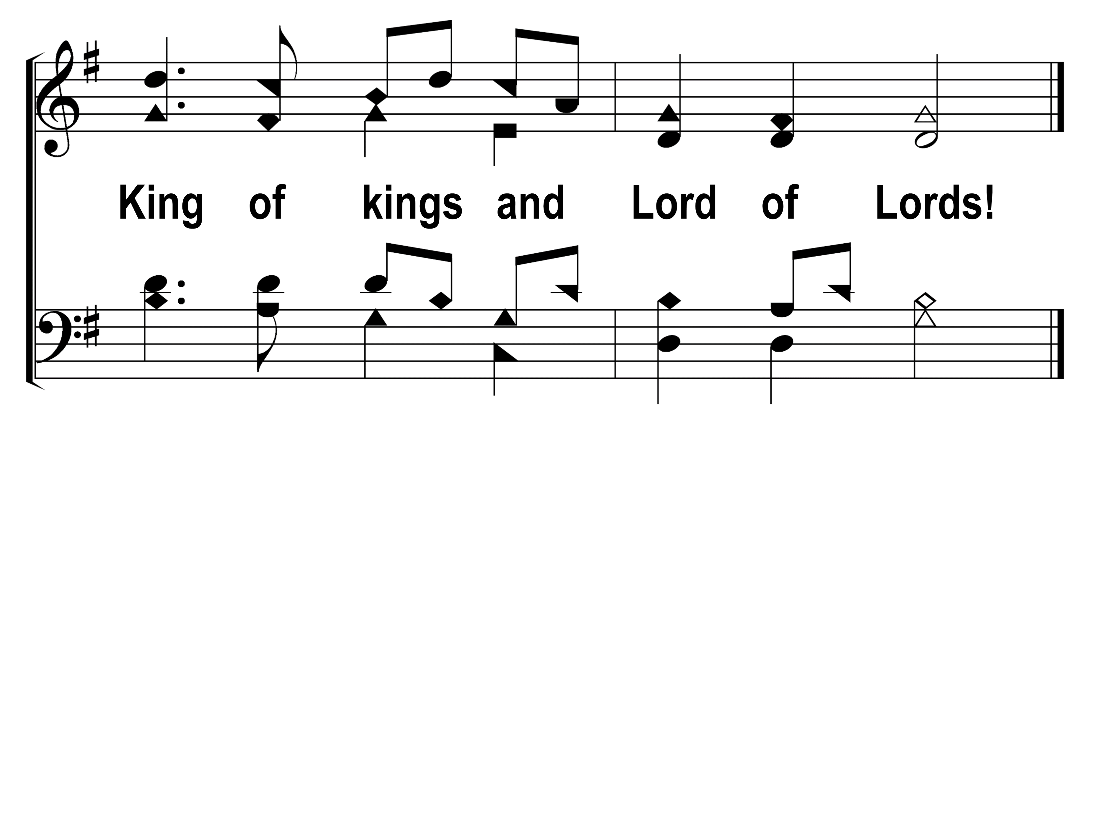
77
1
LOOK, YE SAINTS! THE SIGHT IS GLORIOUS
2
3
© 2014 Sumphonia Productions, LLC

