Slide 1
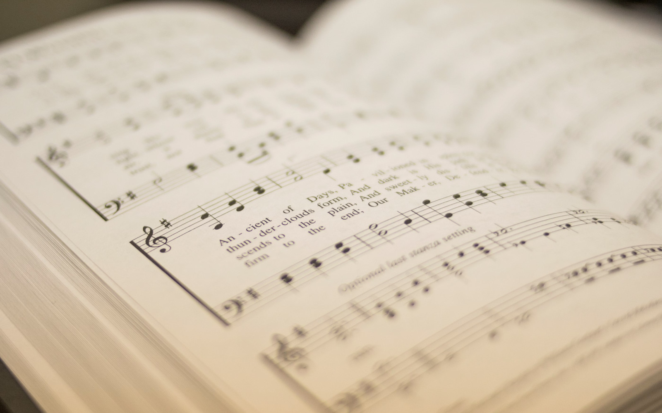

494
WE WALK BY FAITH
1
2
3
4
“SINGING...TO THE LORD”
COLOSSIANS 3:16
Music by: Carl Gläser / Arr. Lowell Mason
Hymn: Henry Alford (1844)

Slide 2
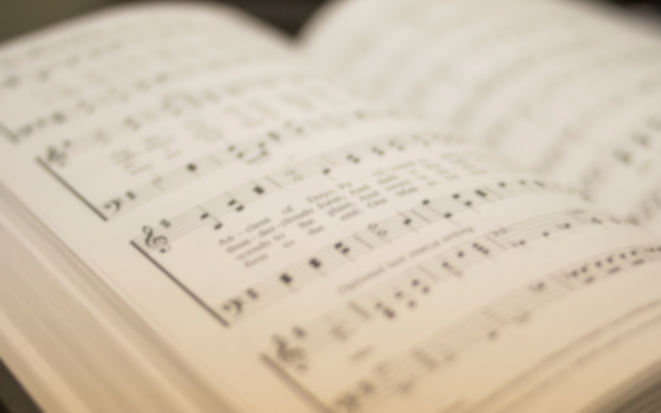
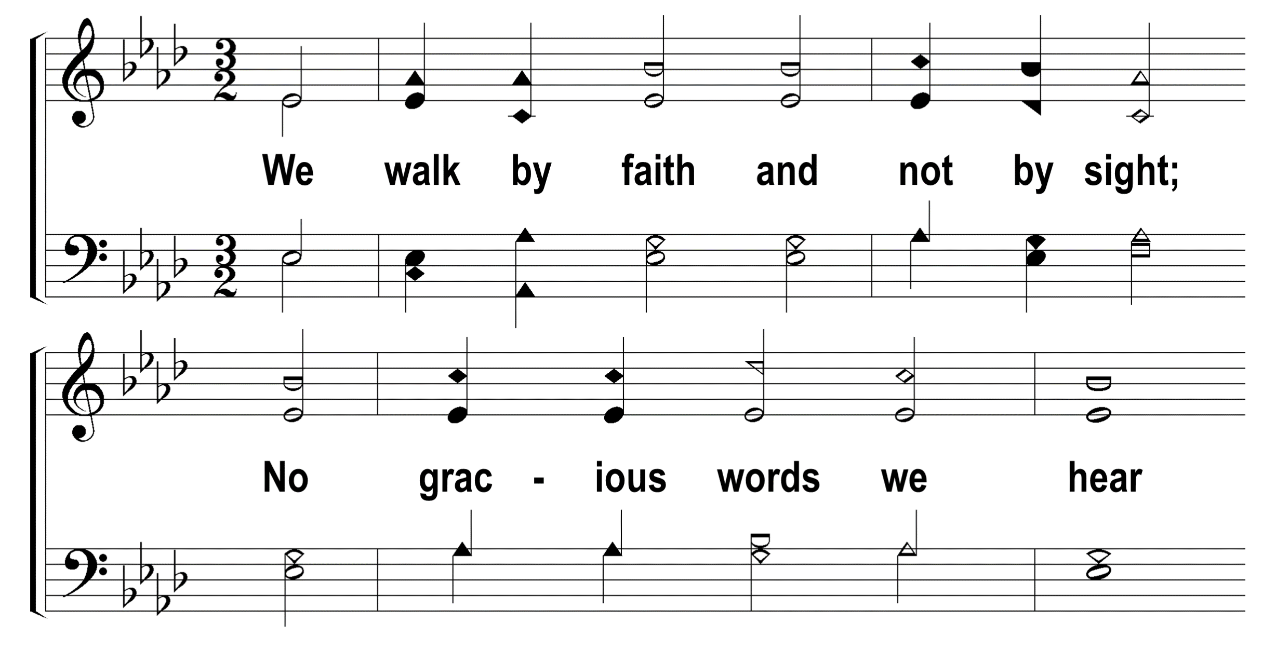

1
2
3
4
494
WE WALK BY FAITH
© 2014 Sumphonia Productions, LLC

Slide 3
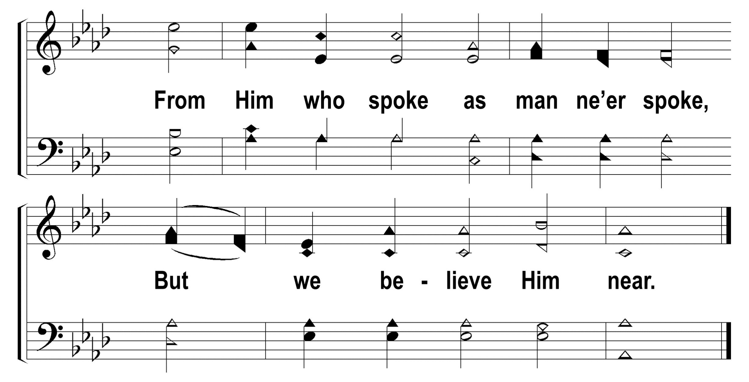
1
2
3
4
494
WE WALK BY FAITH
© 2014 Sumphonia Productions, LLC

Slide 4
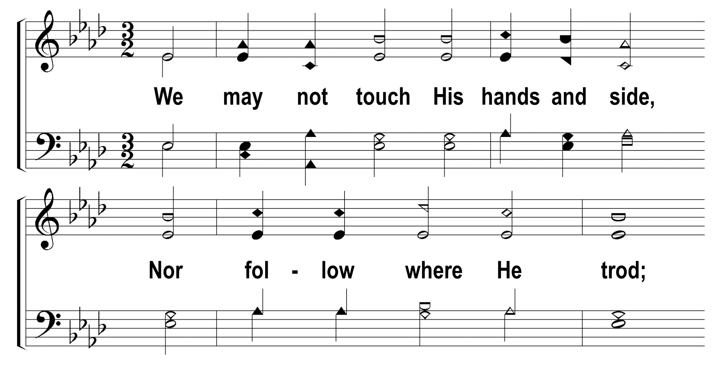
1
2
3
4
494
WE WALK BY FAITH
© 2014 Sumphonia Productions, LLC

Slide 5
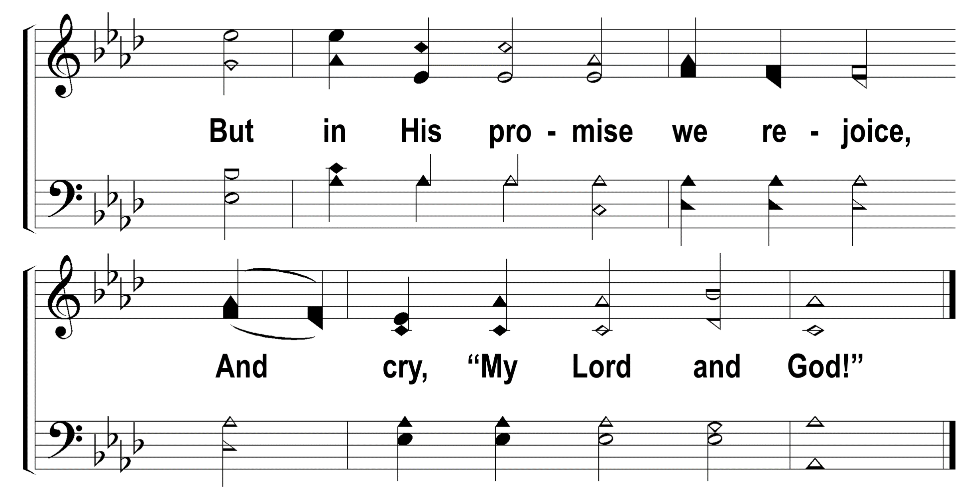
1
2
3
4
494
WE WALK BY FAITH
© 2014 Sumphonia Productions, LLC

Slide 6
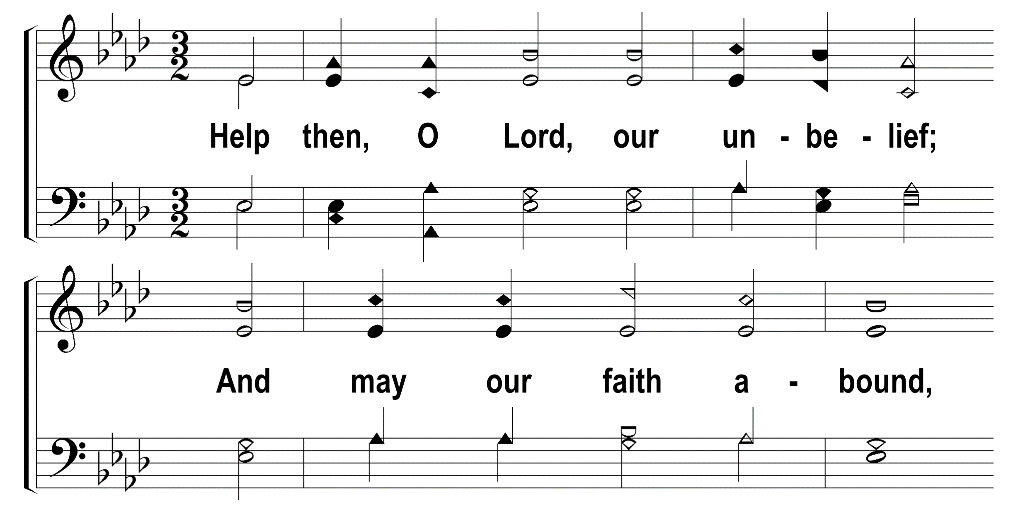
1
2
3
4
494
WE WALK BY FAITH
© 2014 Sumphonia Productions, LLC

Slide 7
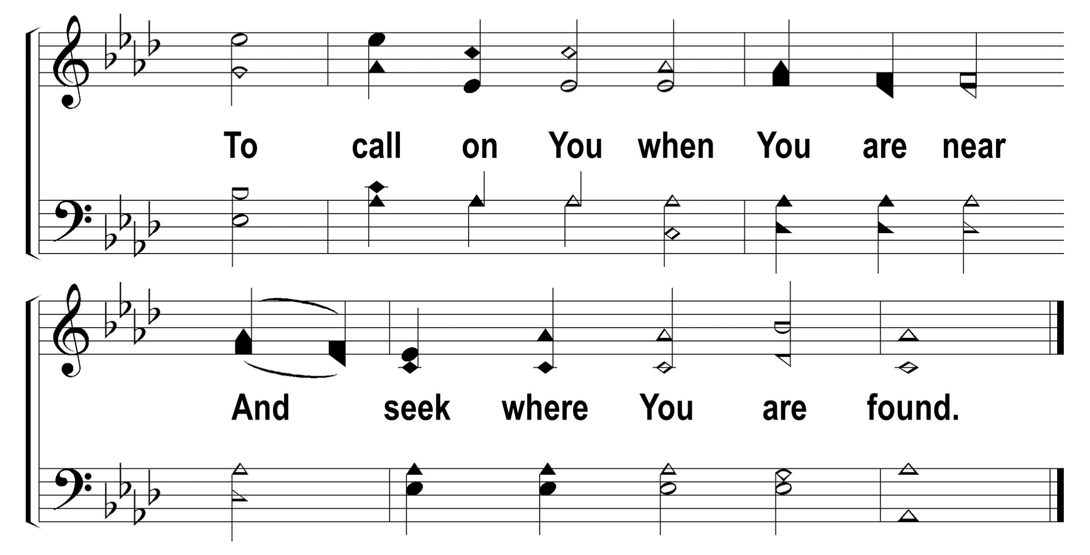
1
2
3
4
494
WE WALK BY FAITH
© 2014 Sumphonia Productions, LLC

Slide 8
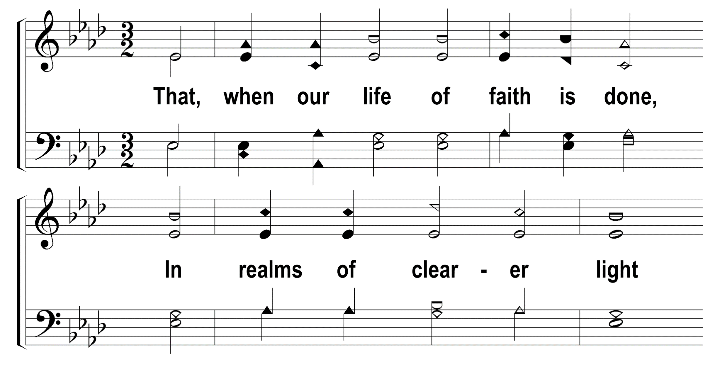
1
2
3
4
494
WE WALK BY FAITH
© 2014 Sumphonia Productions, LLC

Slide 9
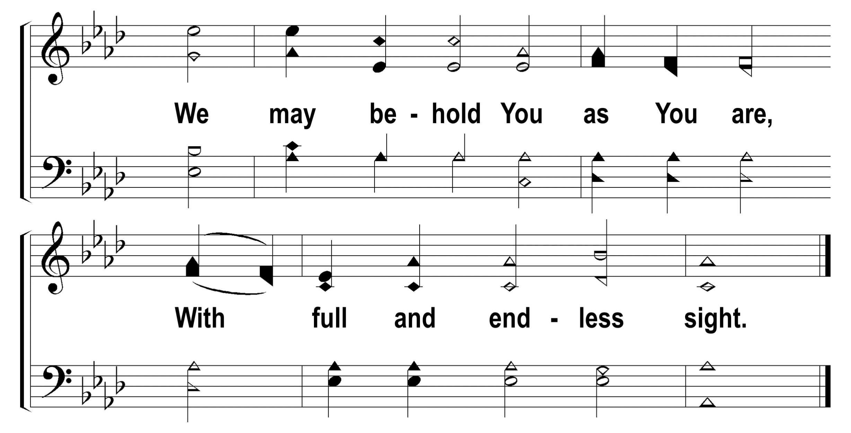
1
2
3
4
494
WE WALK BY FAITH
© 2014 Sumphonia Productions, LLC

