Slide 1



Welcome
Reading
Prayer
32
168
Lord’s Supper
Collection
519
Sermon
380
Prayer
James Newman
Blaine Mellor, Jr.
Stuart Shannon
Larry Brown
Marty Broadwell
Marty Broadwell
Bill Sanchez
Maurice Norman
Welcome & Announcements
John 8:1-11
Theophany
Go to Dark Gethsemane
2 Corinthians 5:14-19
Only in Thee
Immovable Against Temptations
Just As I Am
Please silence your phone
February 21, 2021
Sunday • 8:30am
Notes:
Song Leader: Larry Brown

Slide 2

Welcome
Reading
Prayer
32
168
Lord’s Supper
Collection
519
Sermon
380
Prayer
READING
JOHN 8:1-11
Pew Bible: Page 720
“HAVE THIS LETTER READ TO ALL”
1 THESSALONIANS 5:27
Blaine Mellor, Jr.

Slide 3
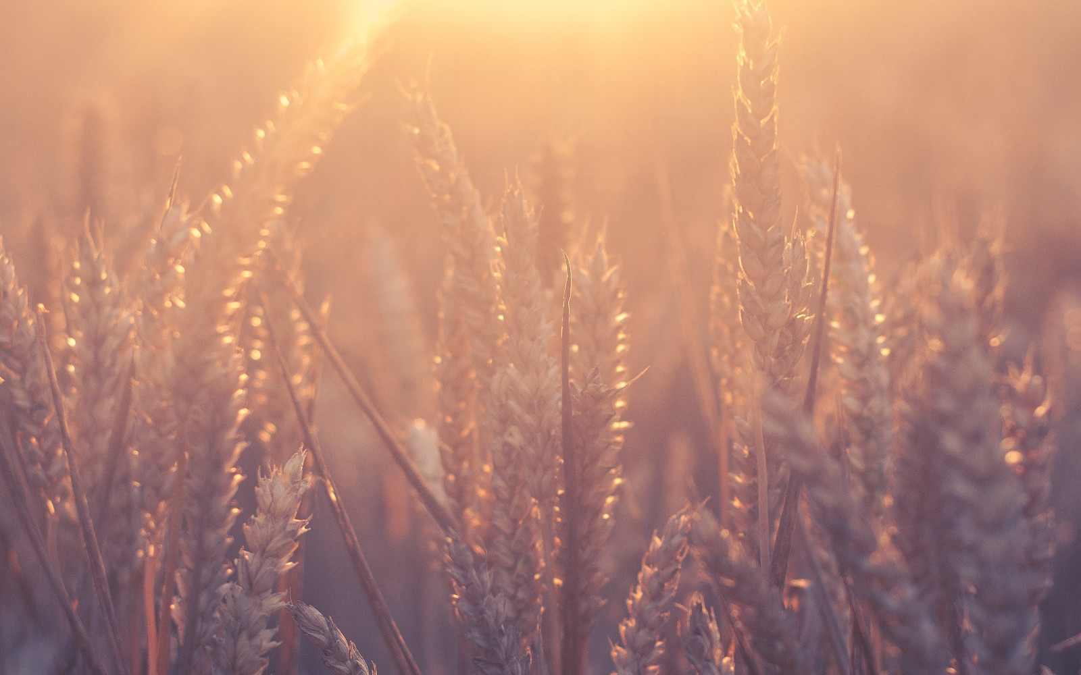
Welcome
Reading
Prayer
32
168
Lord’s Supper
Collection
519
Sermon
380
Prayer
PRAYER
“DEVOTE YOURSELVES TO PRAYER”
COLOSSIANS 4:2
Stuart Shannon

Slide 4
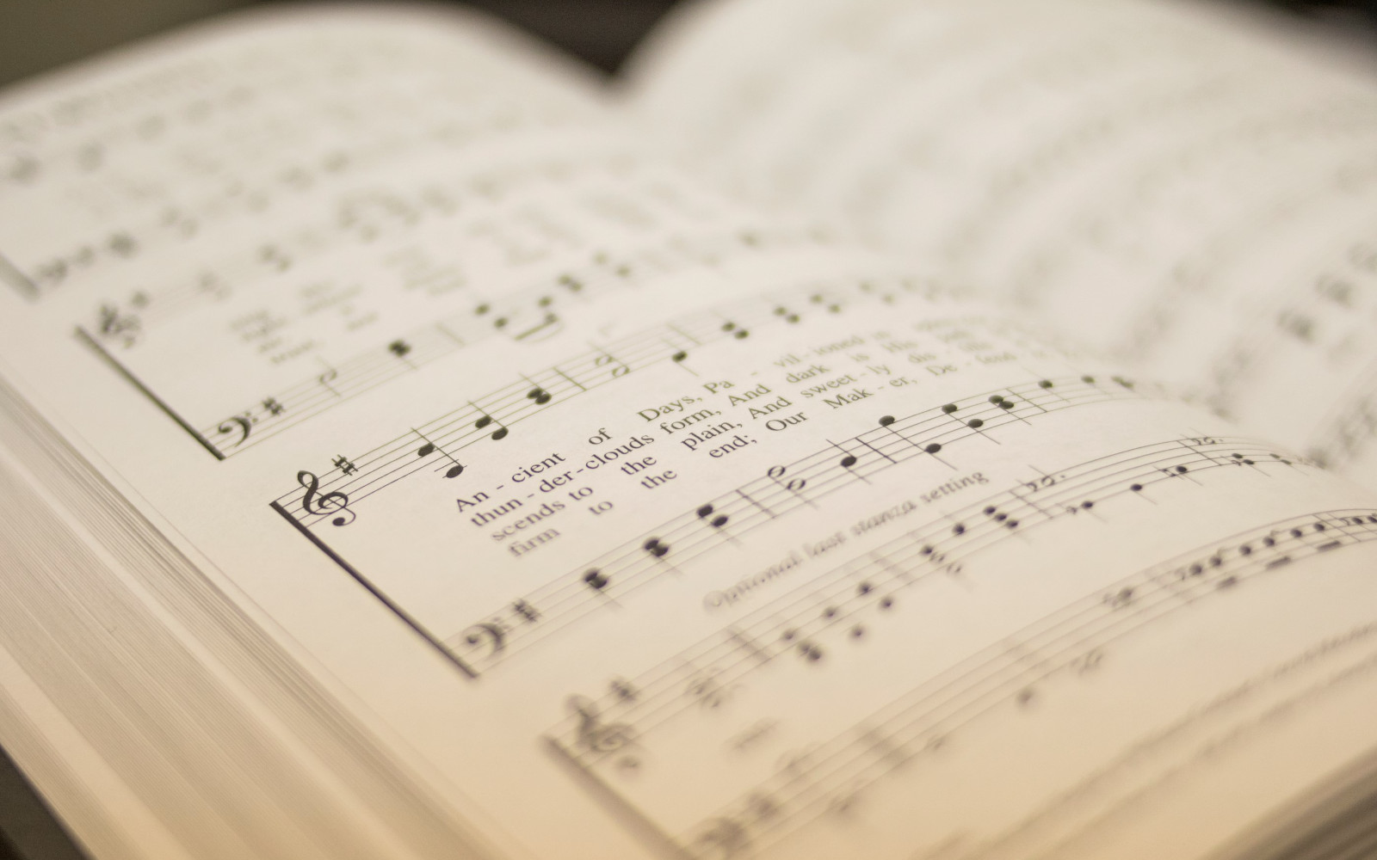
Welcome
Reading
Prayer
32
168
Lord’s Supper
Collection
519
Sermon
380
Prayer
32
THEOPHANY (HIGH ABOVE THE SERAPHIM)
1
2
3
“SINGING...TO THE LORD”
COLOSSIANS 3:16
Theophany
© 2001 David and Jimona Maravilla
Tune: MAZURKA • Frederic Chopin (1829); arr. C. A. Roberts (2001)
Hymn: C. A. Roberts (2001)

Slide 5
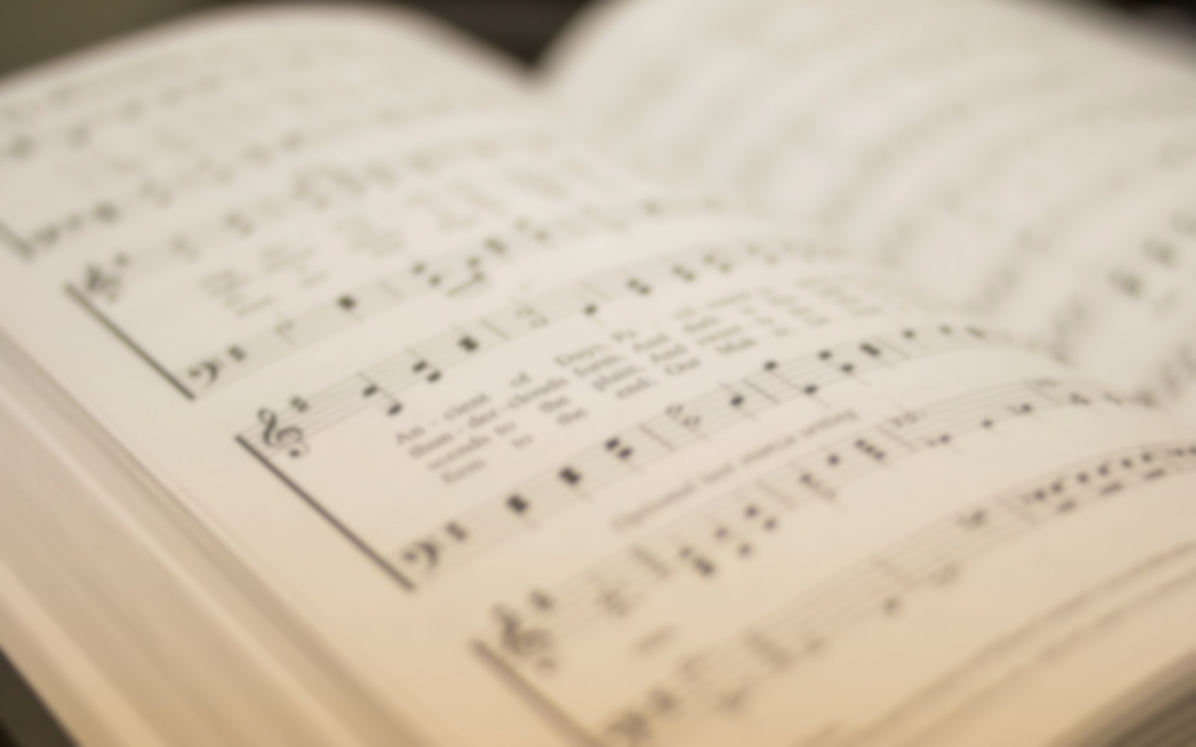
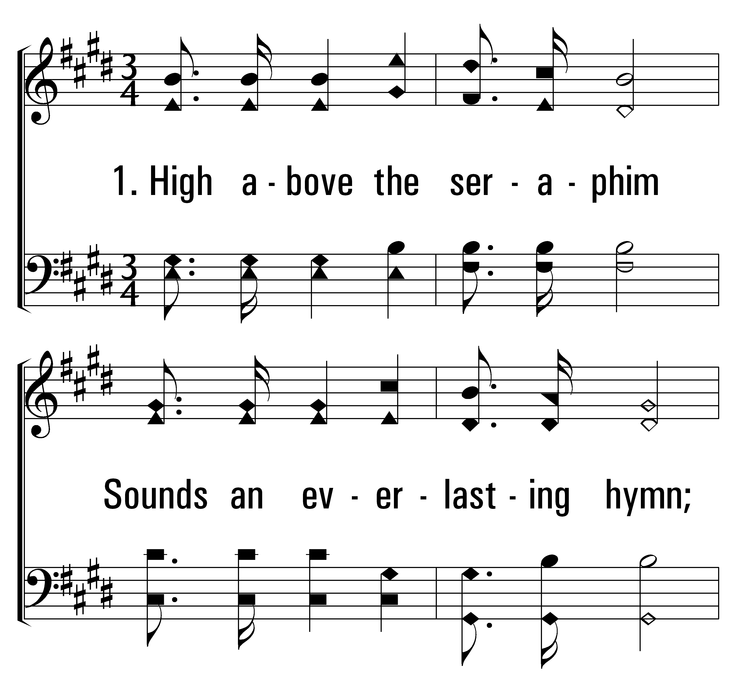


32
1
THEOPHANY (HIGH ABOVE THE SERAPHIM)
3
© 2014 Sumphonia Productions, LLC

Slide 6
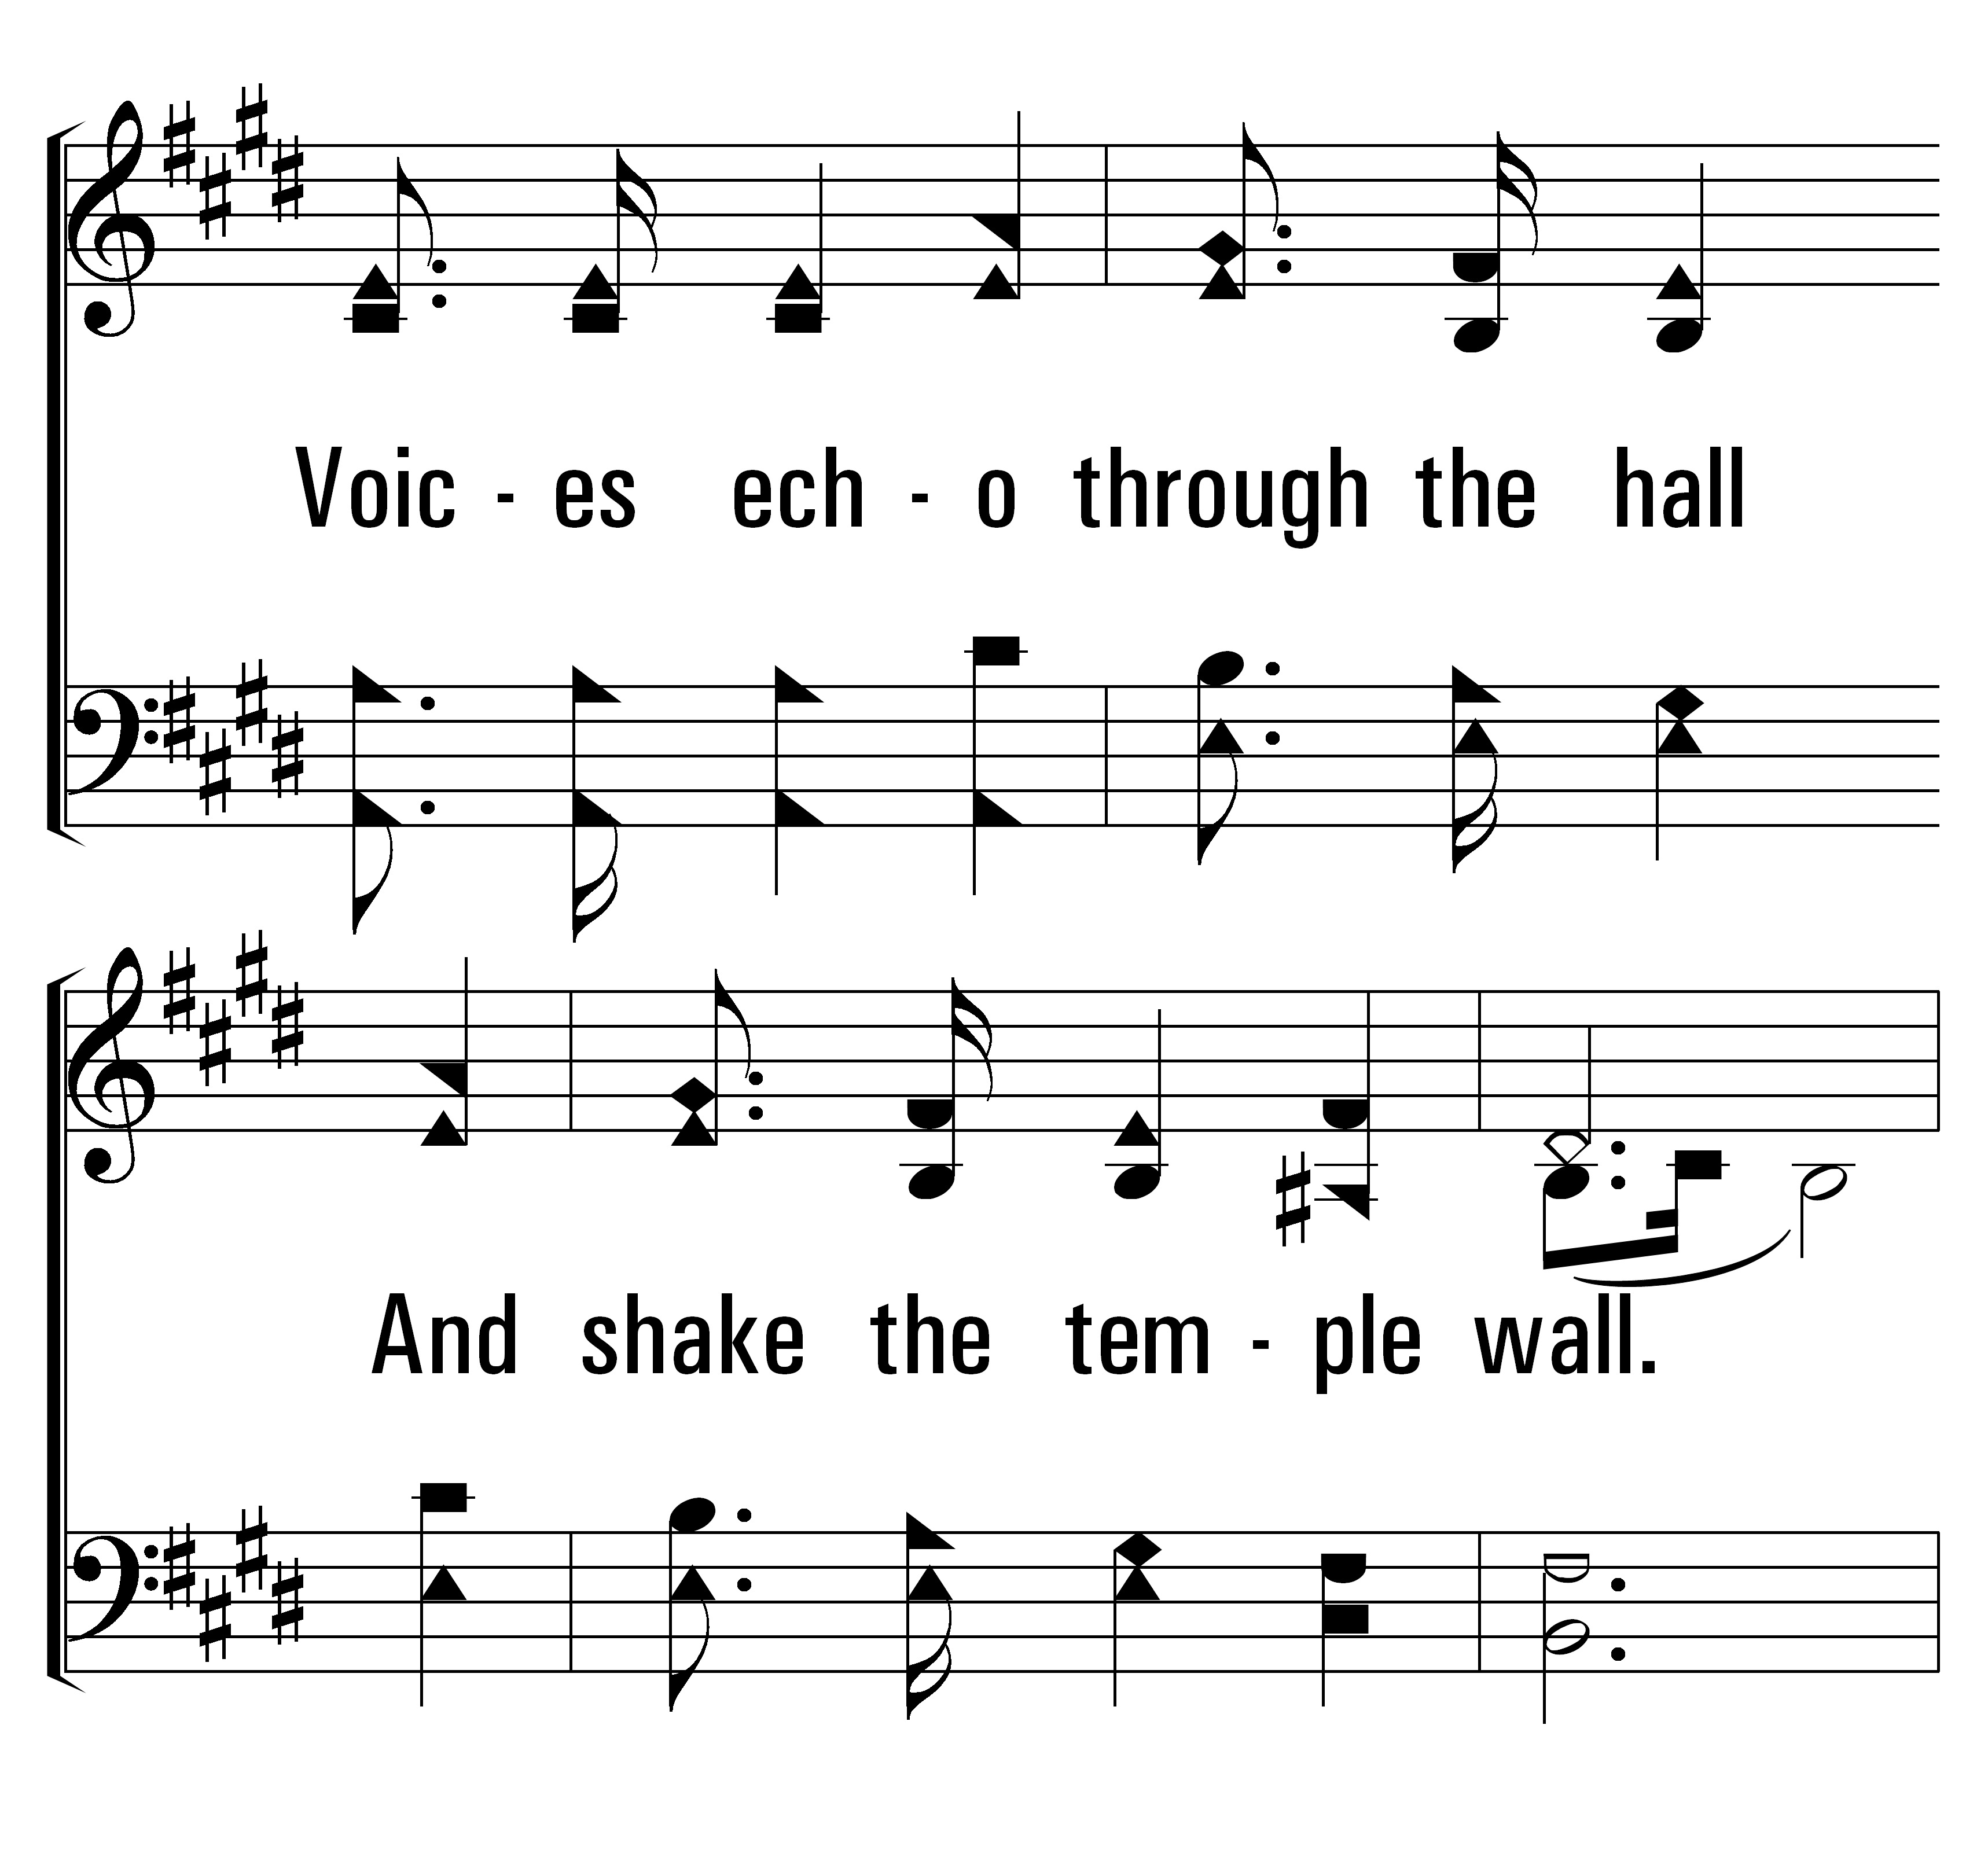
32
1
THEOPHANY (HIGH ABOVE THE SERAPHIM)
3
© 2014 Sumphonia Productions, LLC

Slide 7
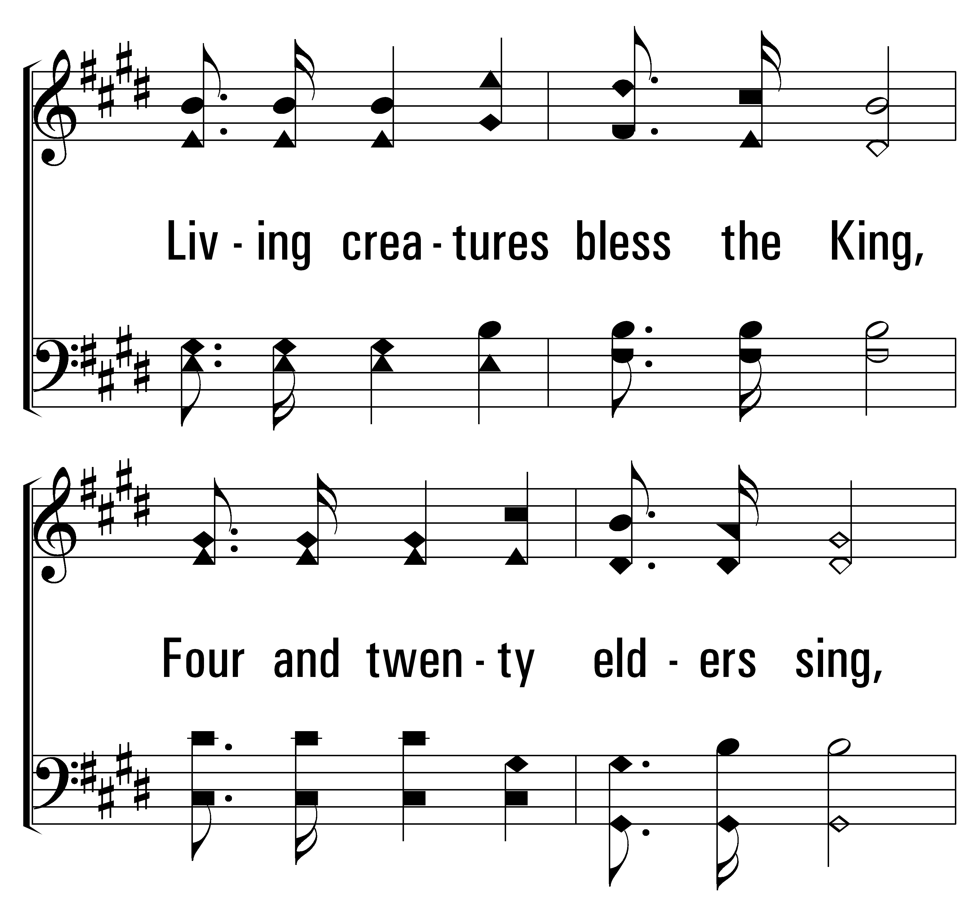
32
1
THEOPHANY (HIGH ABOVE THE SERAPHIM)
3
© 2014 Sumphonia Productions, LLC

Slide 8
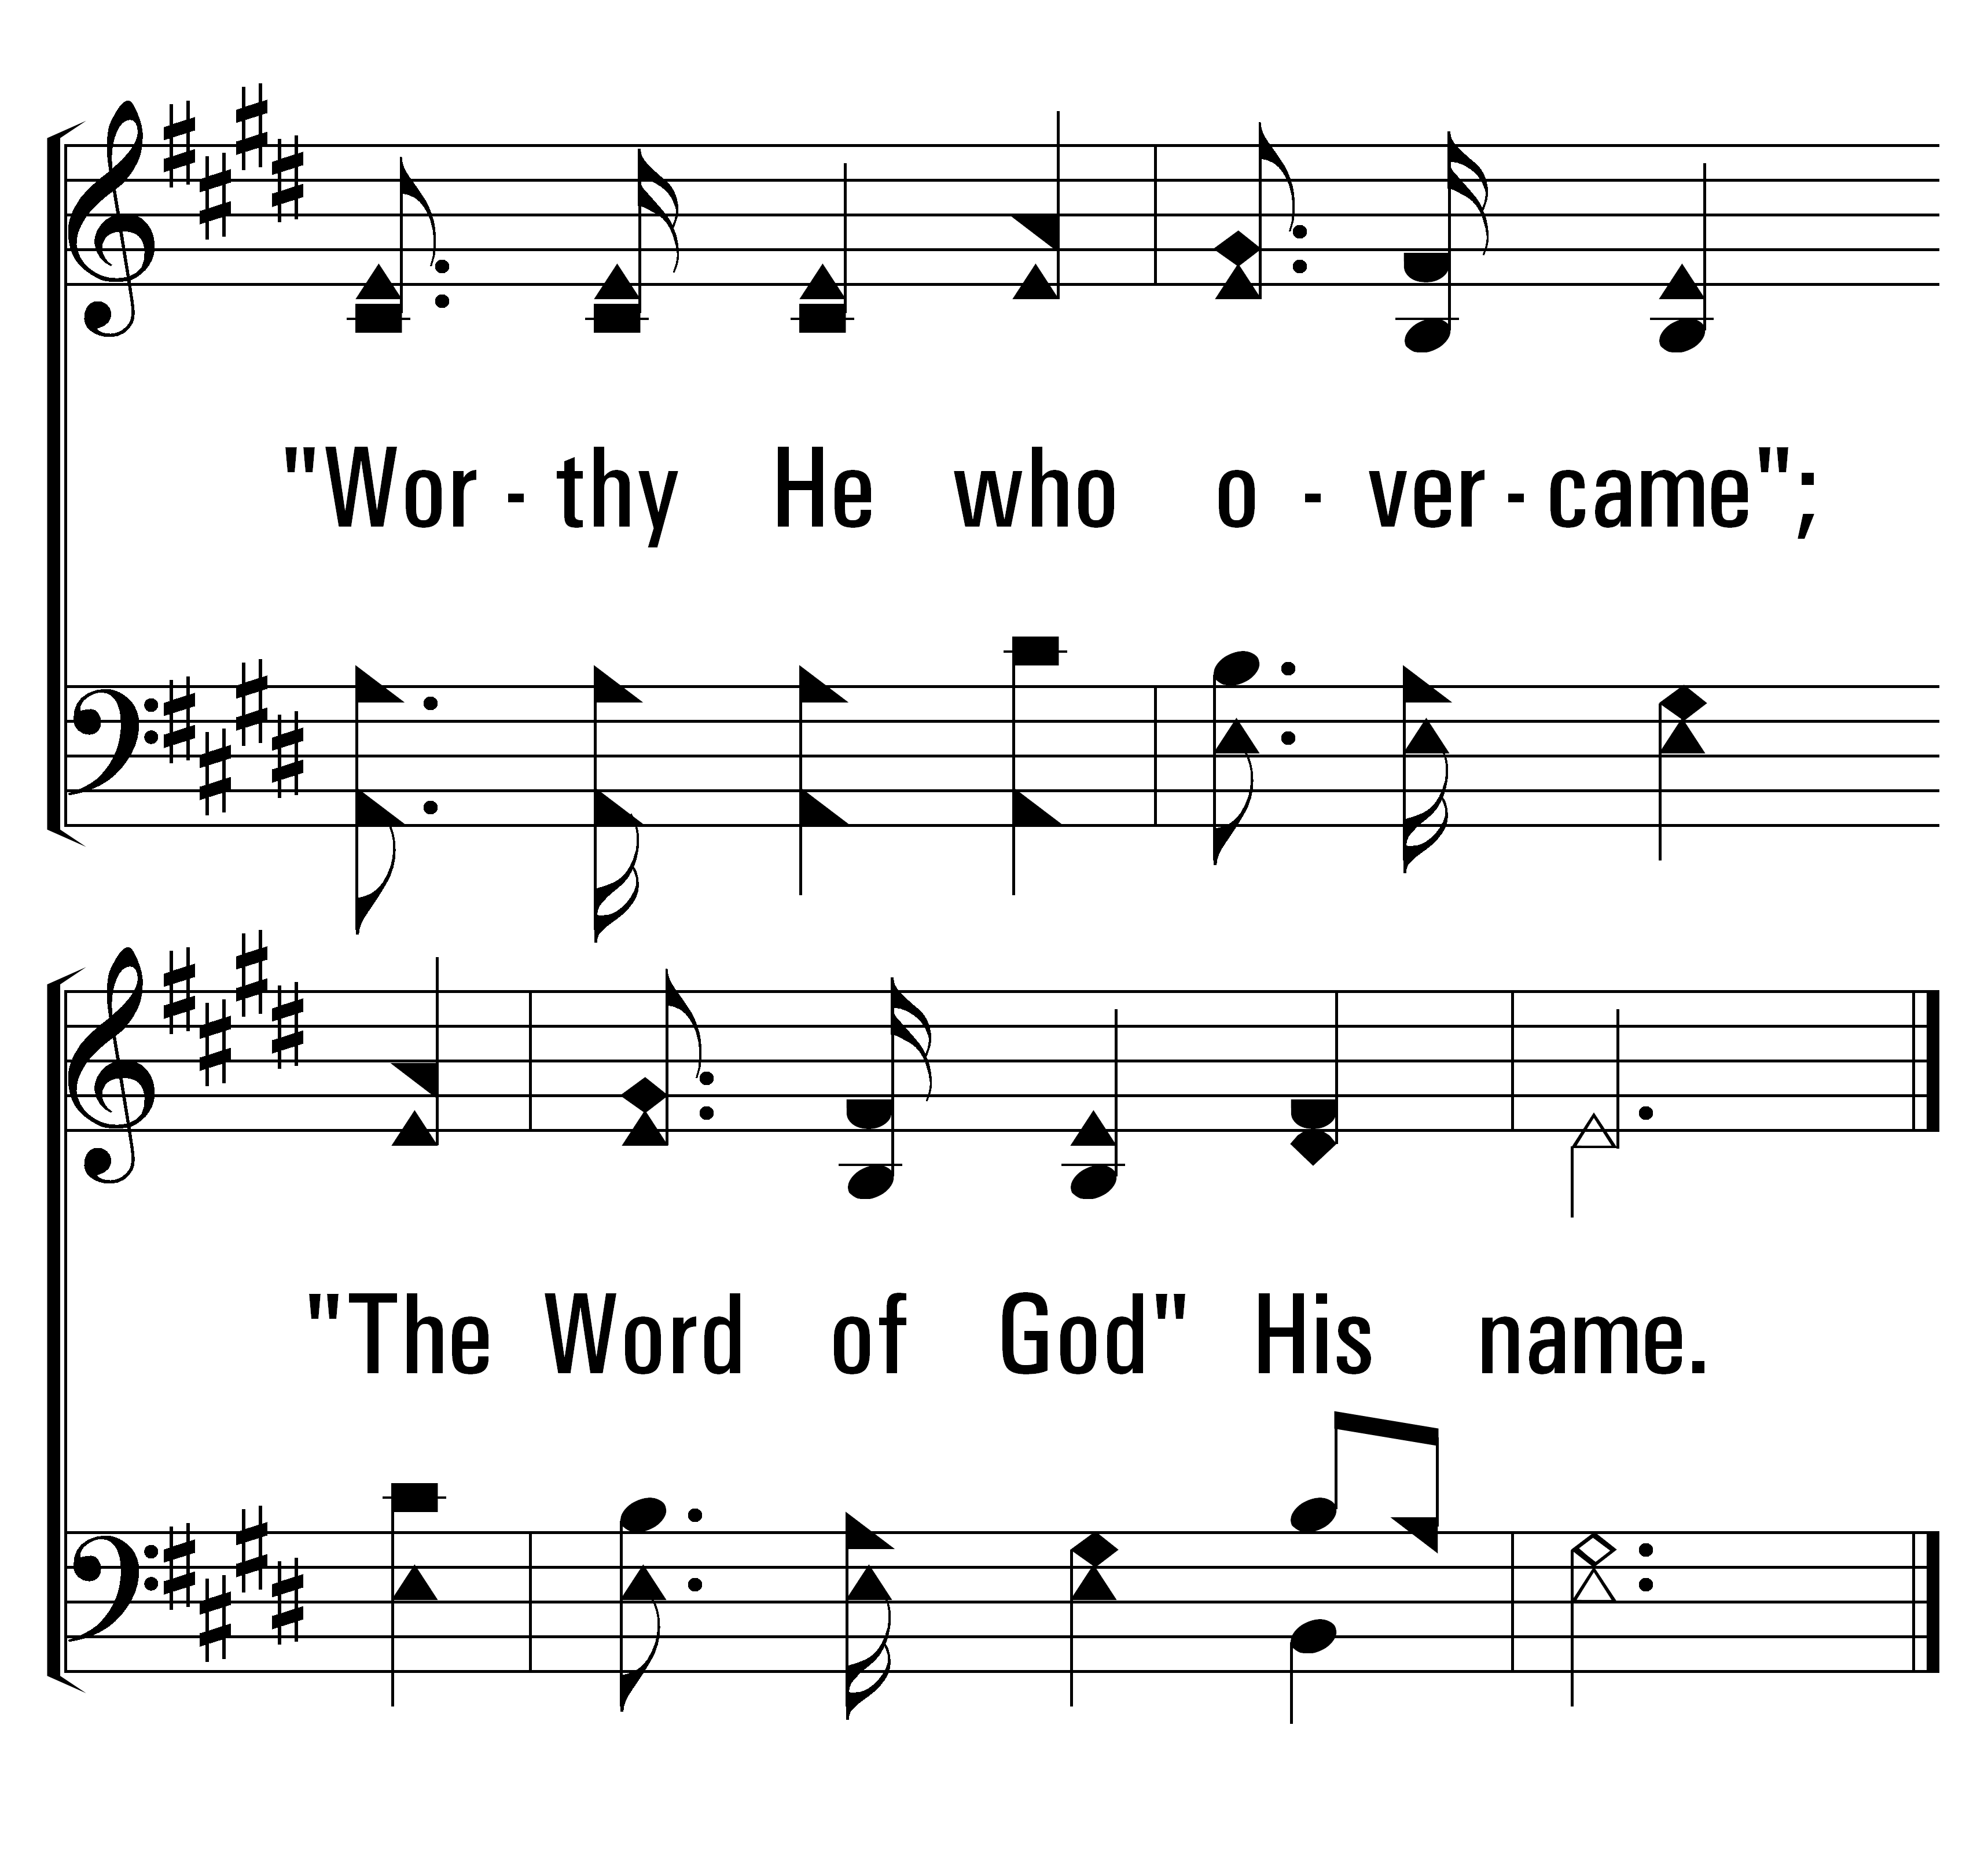
32
1
THEOPHANY (HIGH ABOVE THE SERAPHIM)
3
© 2014 Sumphonia Productions, LLC

Slide 9
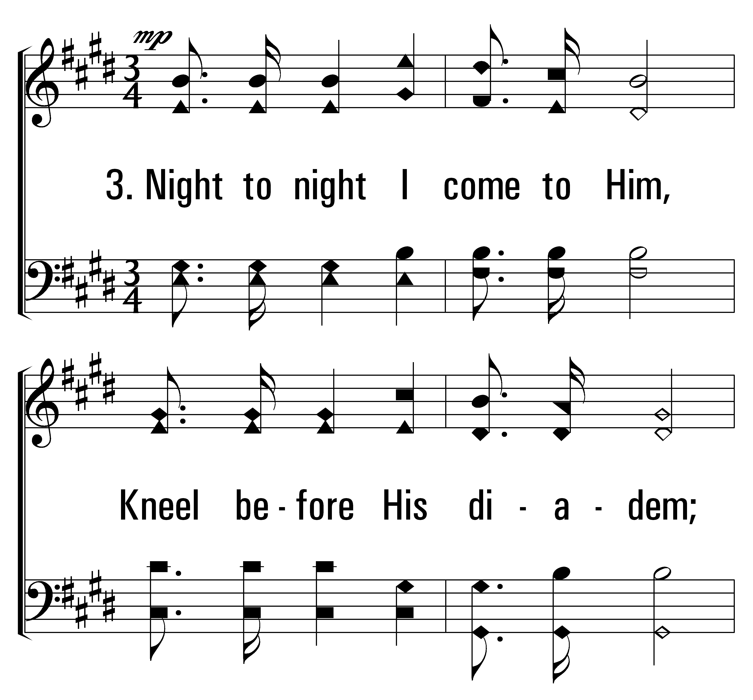
32
1
THEOPHANY (HIGH ABOVE THE SERAPHIM)
3
© 2014 Sumphonia Productions, LLC

Slide 10
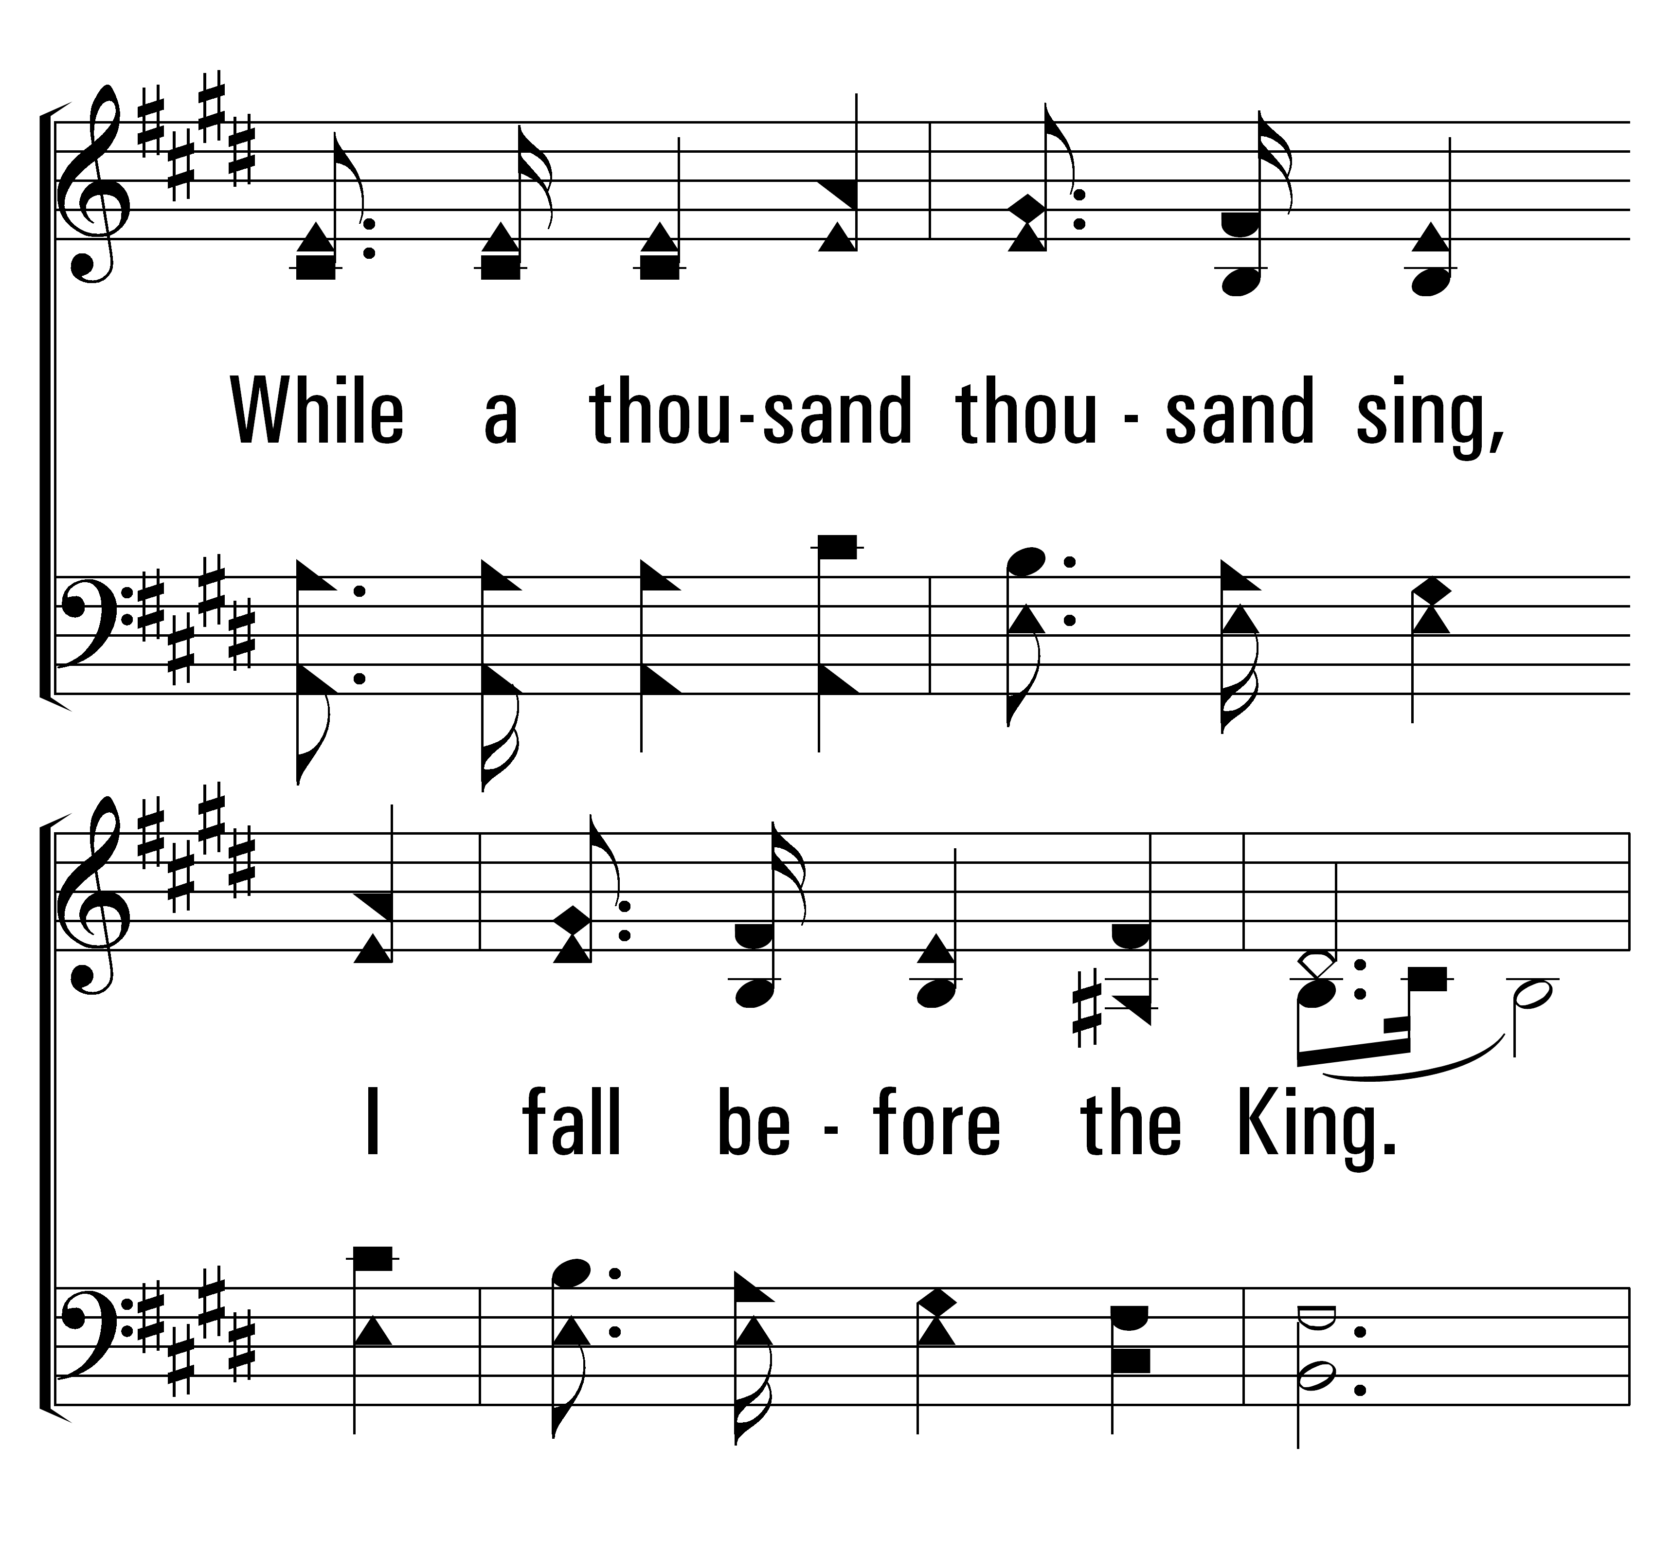
32
1
THEOPHANY (HIGH ABOVE THE SERAPHIM)
3
© 2014 Sumphonia Productions, LLC

Slide 11
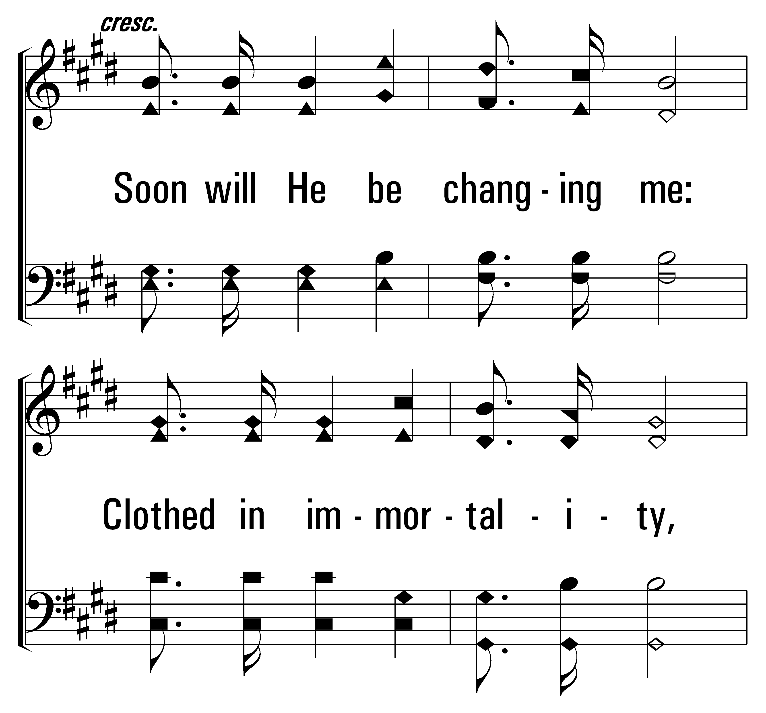
32
1
THEOPHANY (HIGH ABOVE THE SERAPHIM)
3
© 2014 Sumphonia Productions, LLC

Slide 12
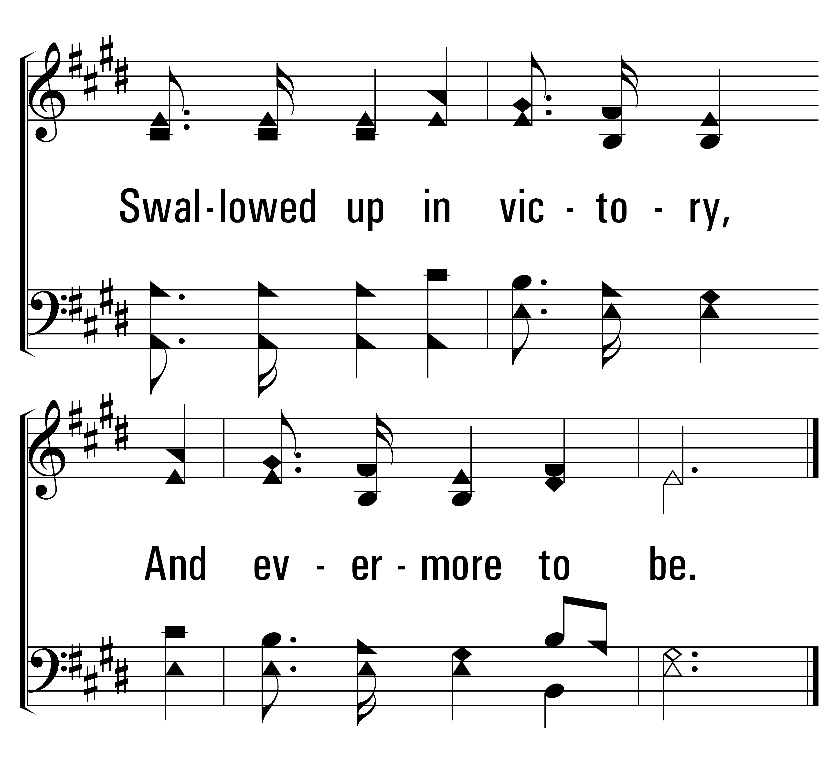
32
1
THEOPHANY (HIGH ABOVE THE SERAPHIM)
3
© 2014 Sumphonia Productions, LLC

Slide 13
Welcome
Reading
Prayer
32
168
Lord’s Supper
Collection
519
Sermon
380
Prayer
168
GO TO DARK GETHSEMANE
1
2
3
4
“SINGING...TO THE LORD”
COLOSSIANS 3:16
Words: James Montgomery
Music: Richard Redhead

Slide 14
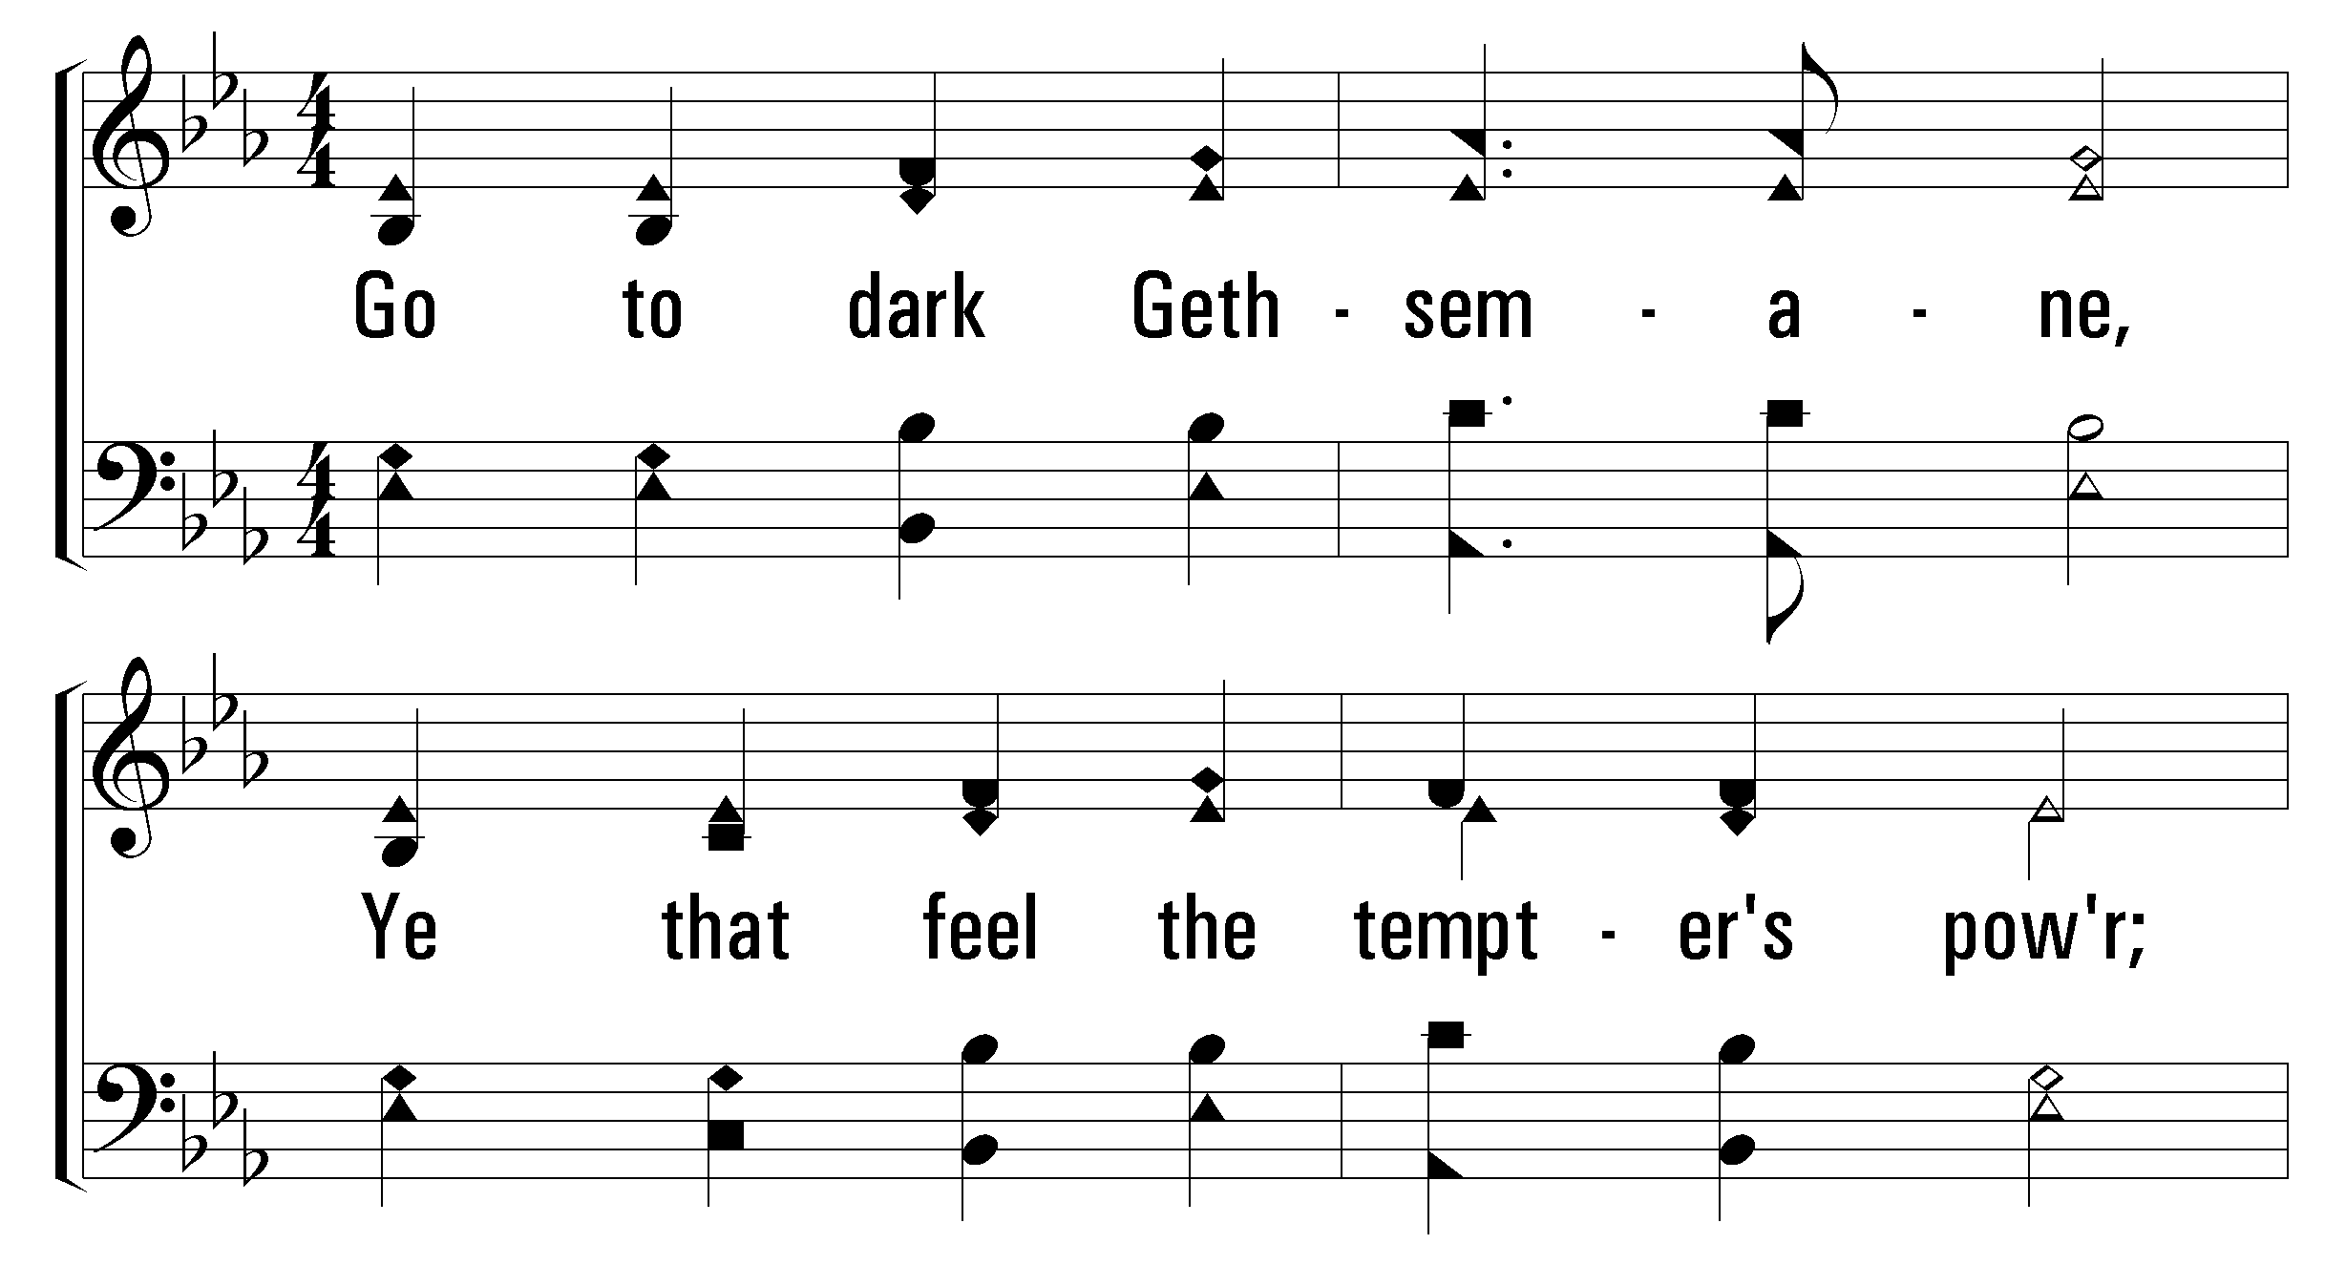

1
2
4
168
GO TO DARK GETHSEMANE
© 2010 The Paperless Hymnal®

Slide 15
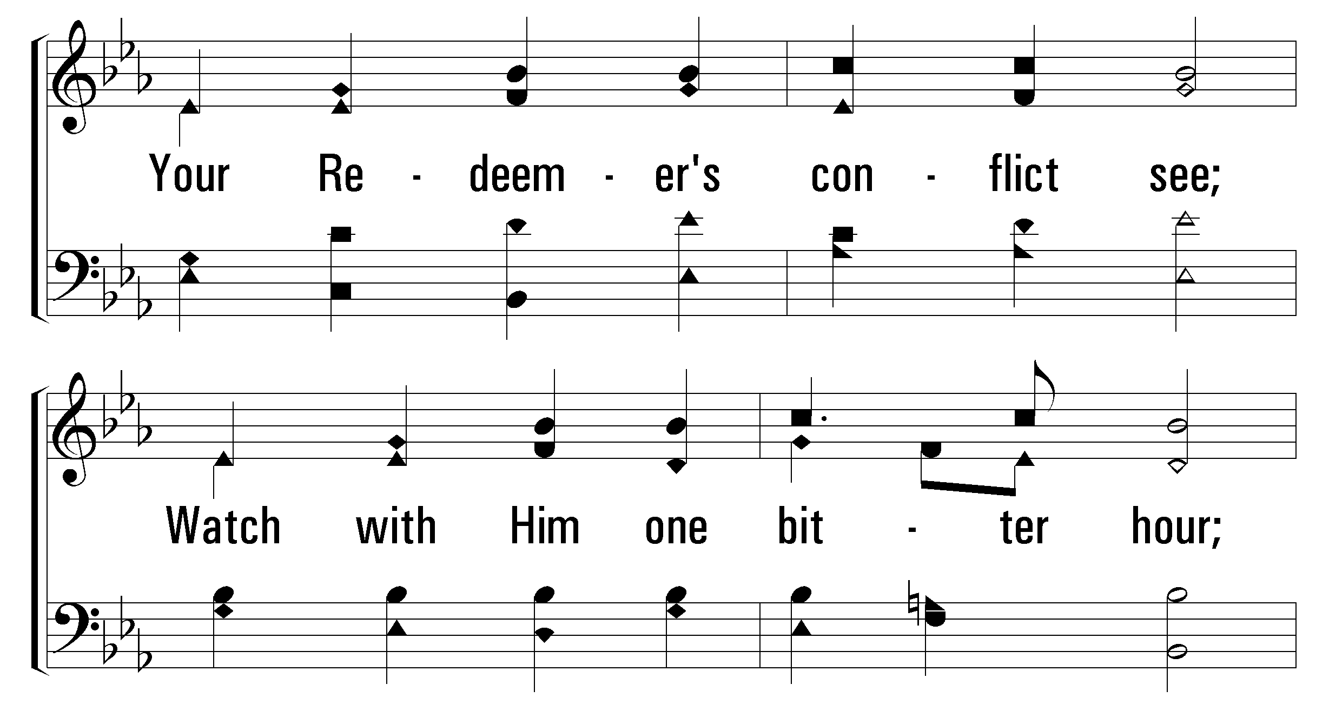
1
2
4
168
GO TO DARK GETHSEMANE
© 2010 The Paperless Hymnal®

Slide 16
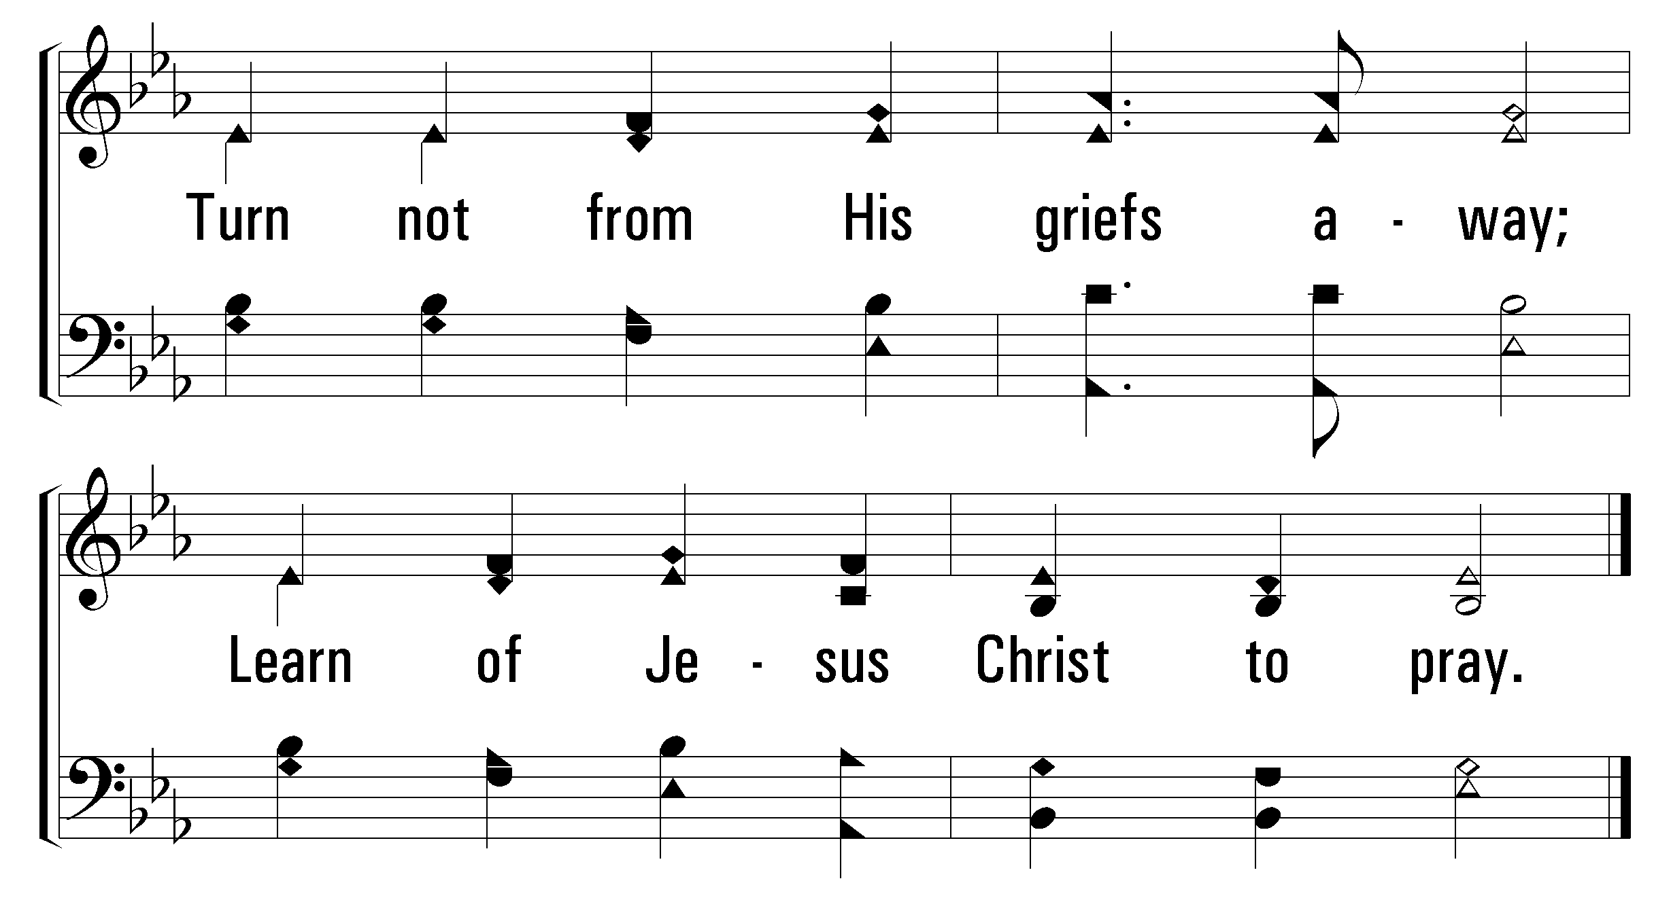
1
2
4
168
GO TO DARK GETHSEMANE
© 2010 The Paperless Hymnal®

Slide 17
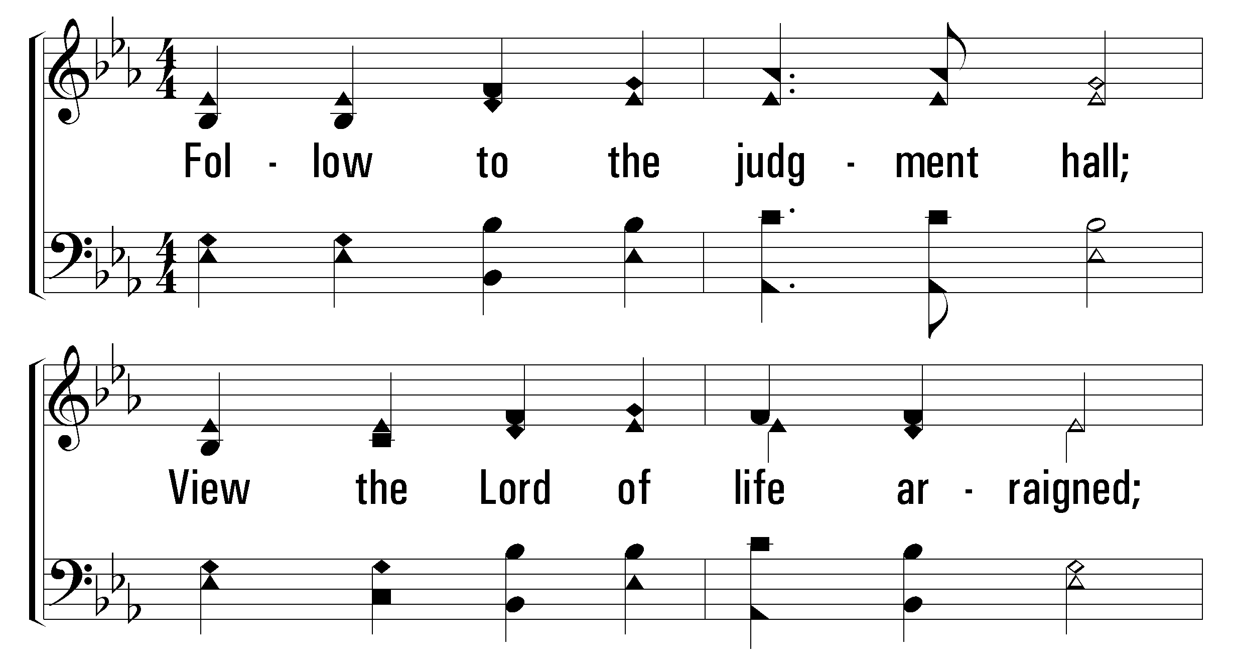
1
2
4
168
GO TO DARK GETHSEMANE
© 2010 The Paperless Hymnal®

Slide 18
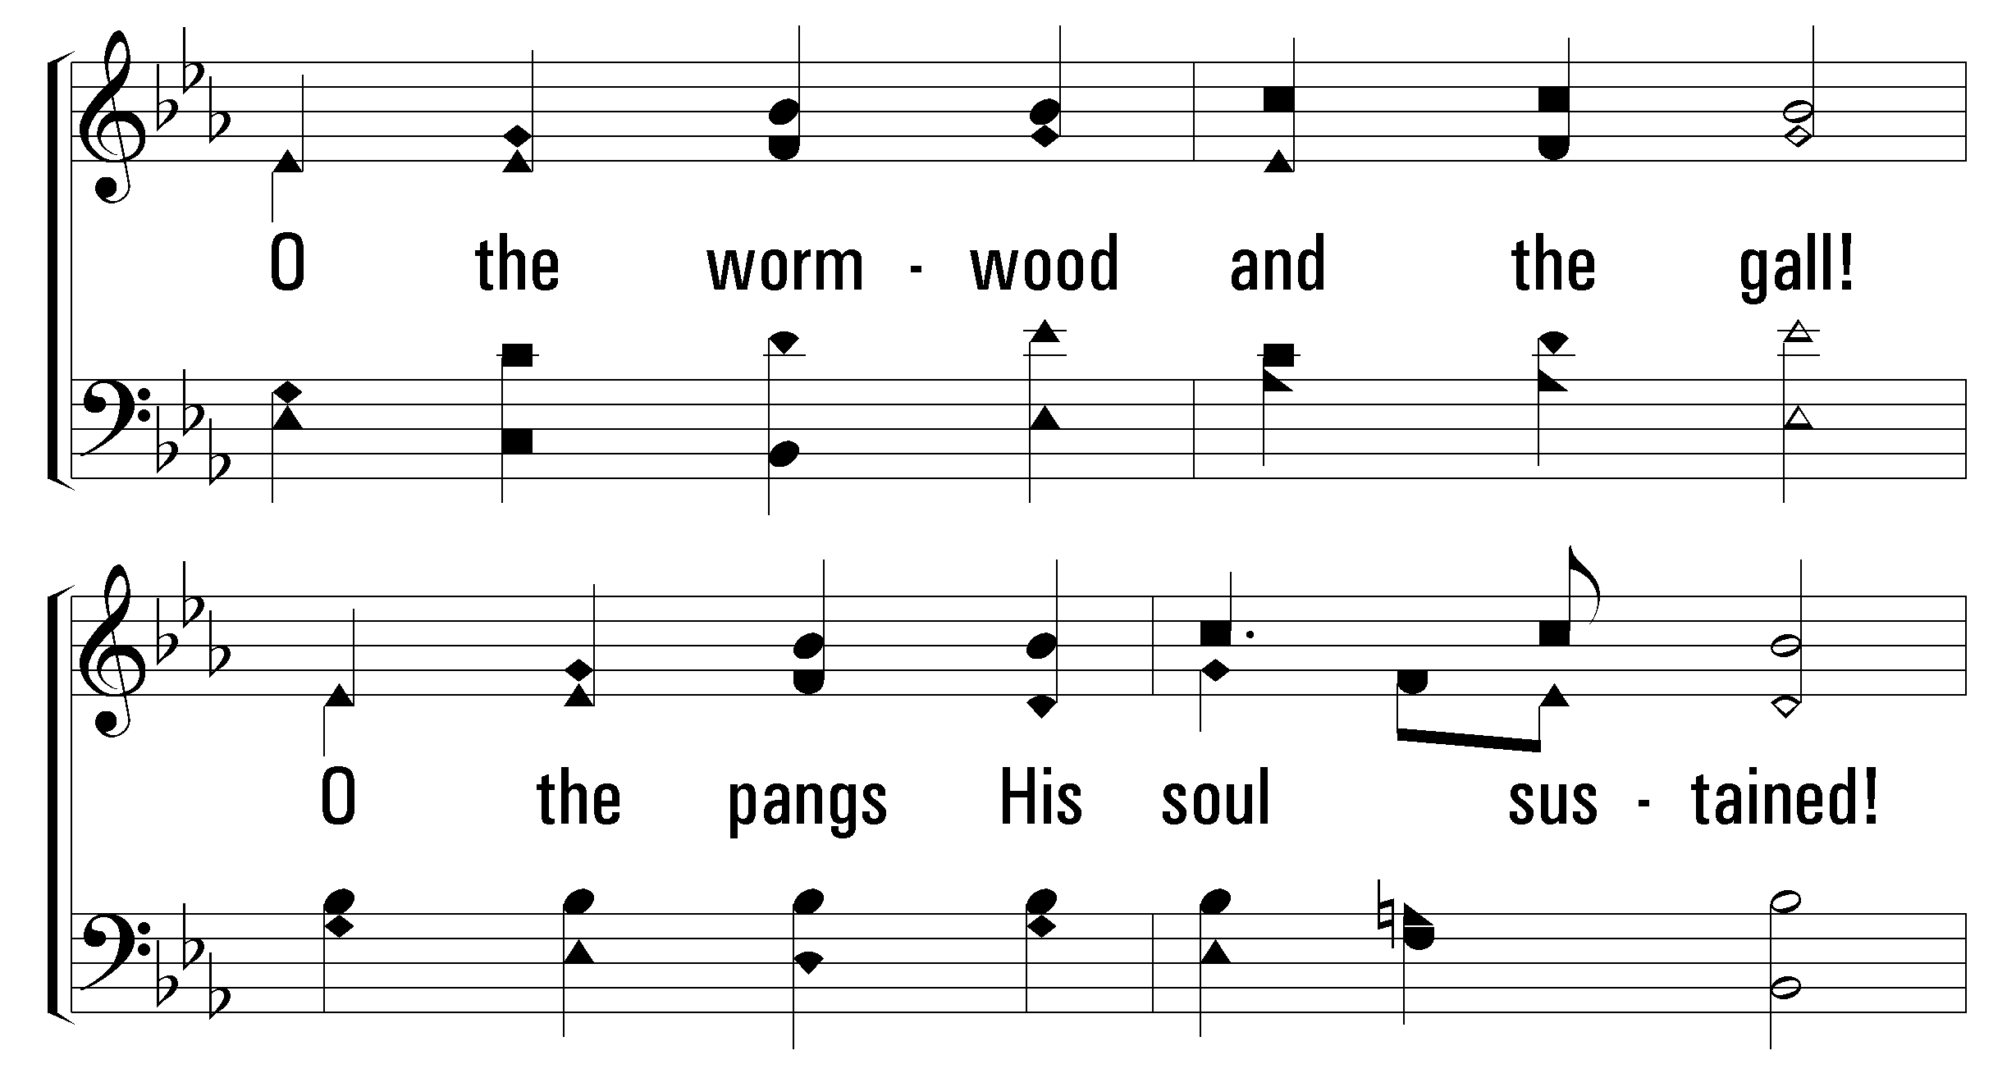
1
2
4
168
GO TO DARK GETHSEMANE
© 2010 The Paperless Hymnal®

Slide 19
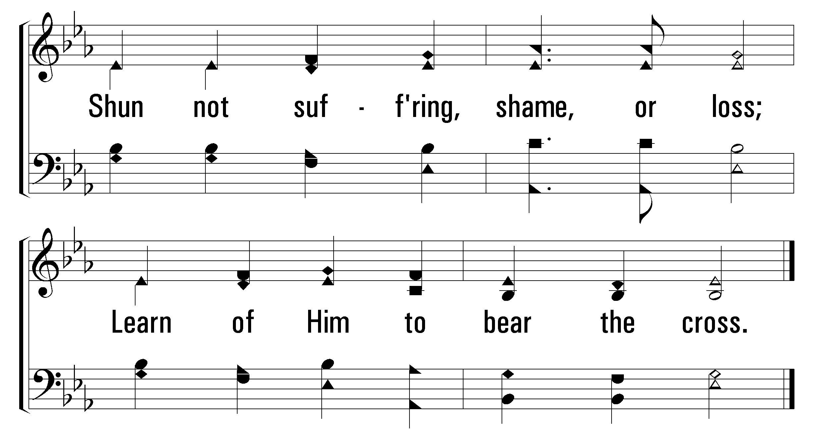
1
2
4
168
GO TO DARK GETHSEMANE
© 2010 The Paperless Hymnal®

Slide 20
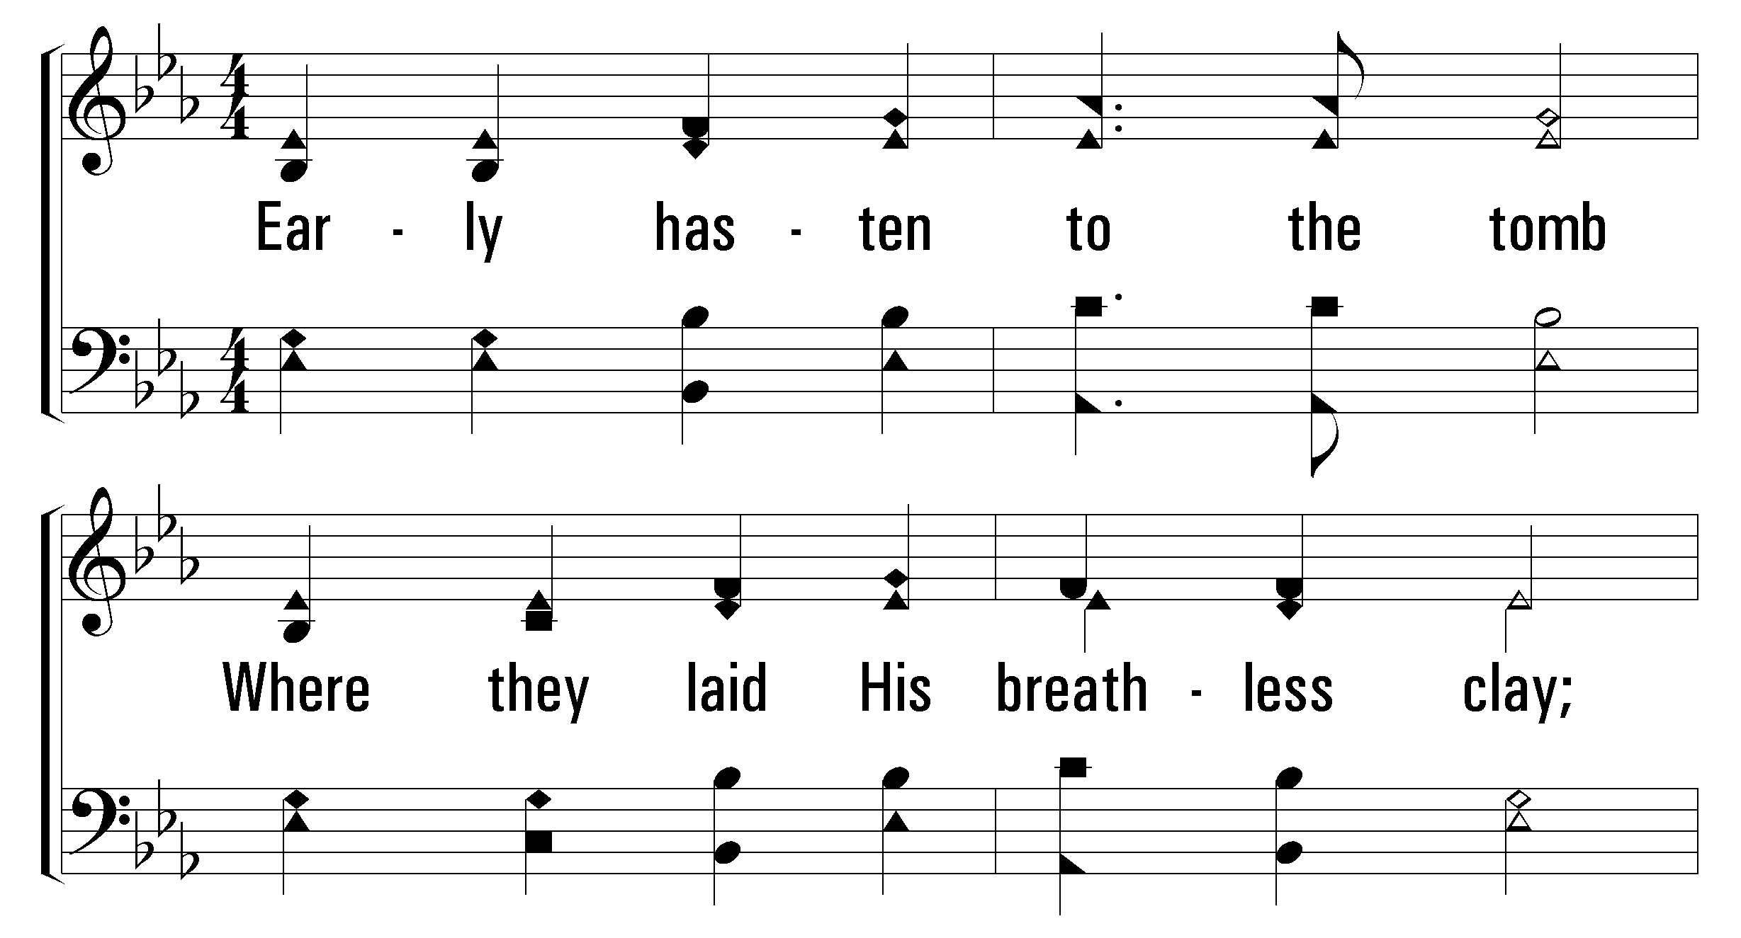
1
2
4
168
GO TO DARK GETHSEMANE
© 2010 The Paperless Hymnal®

Slide 21
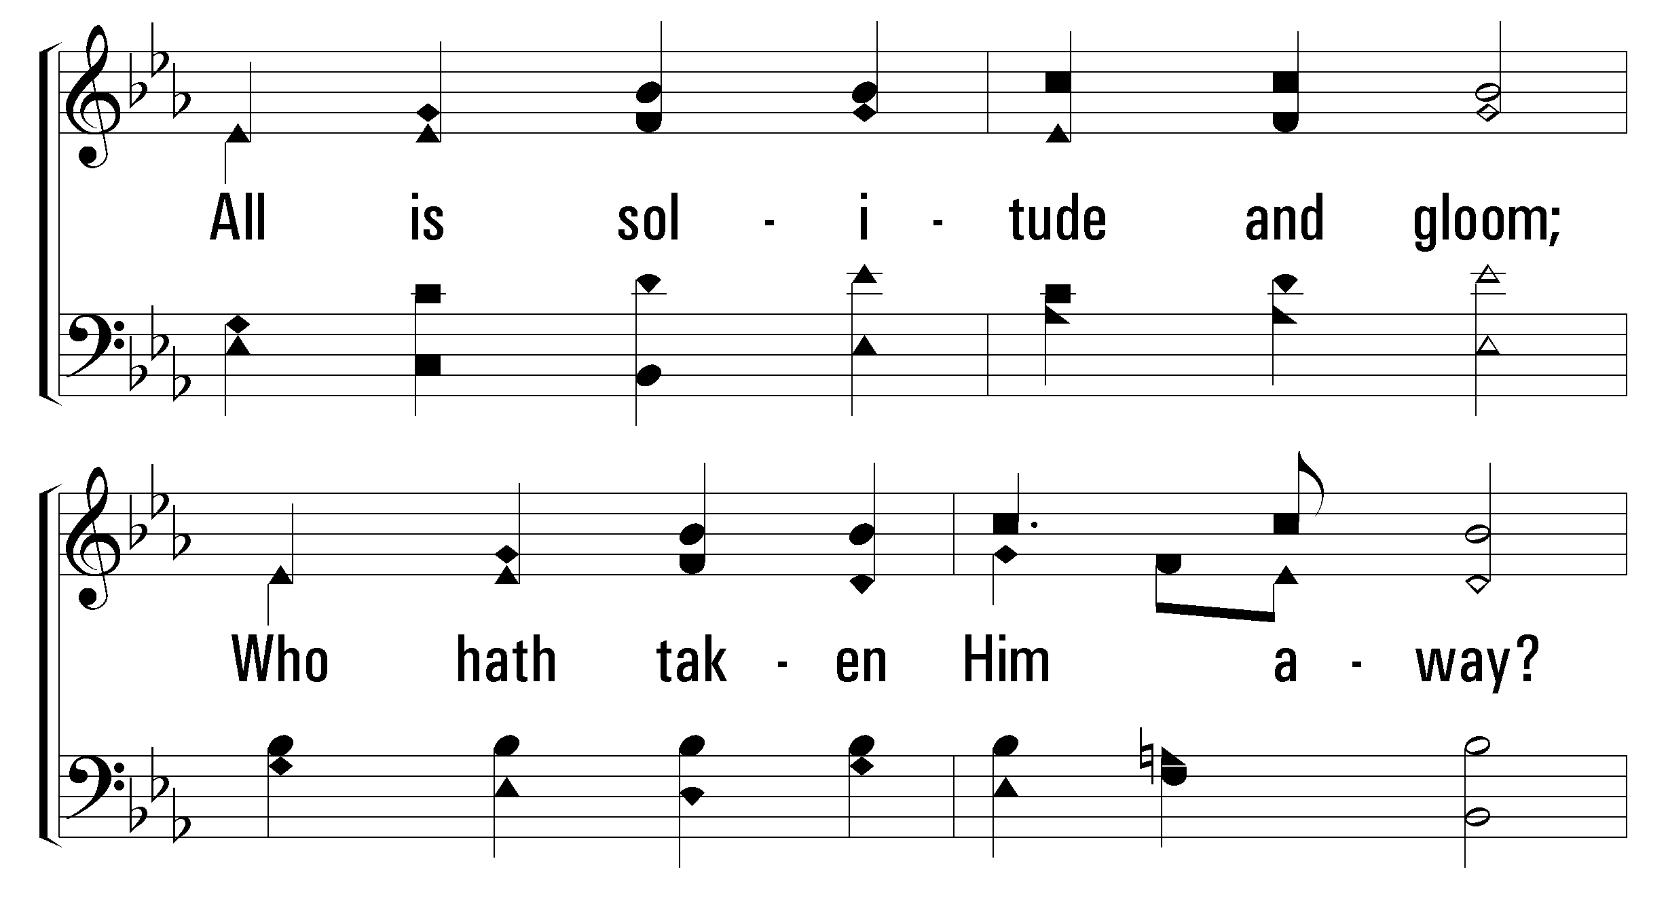
1
2
4
168
GO TO DARK GETHSEMANE
© 2010 The Paperless Hymnal®

Slide 22
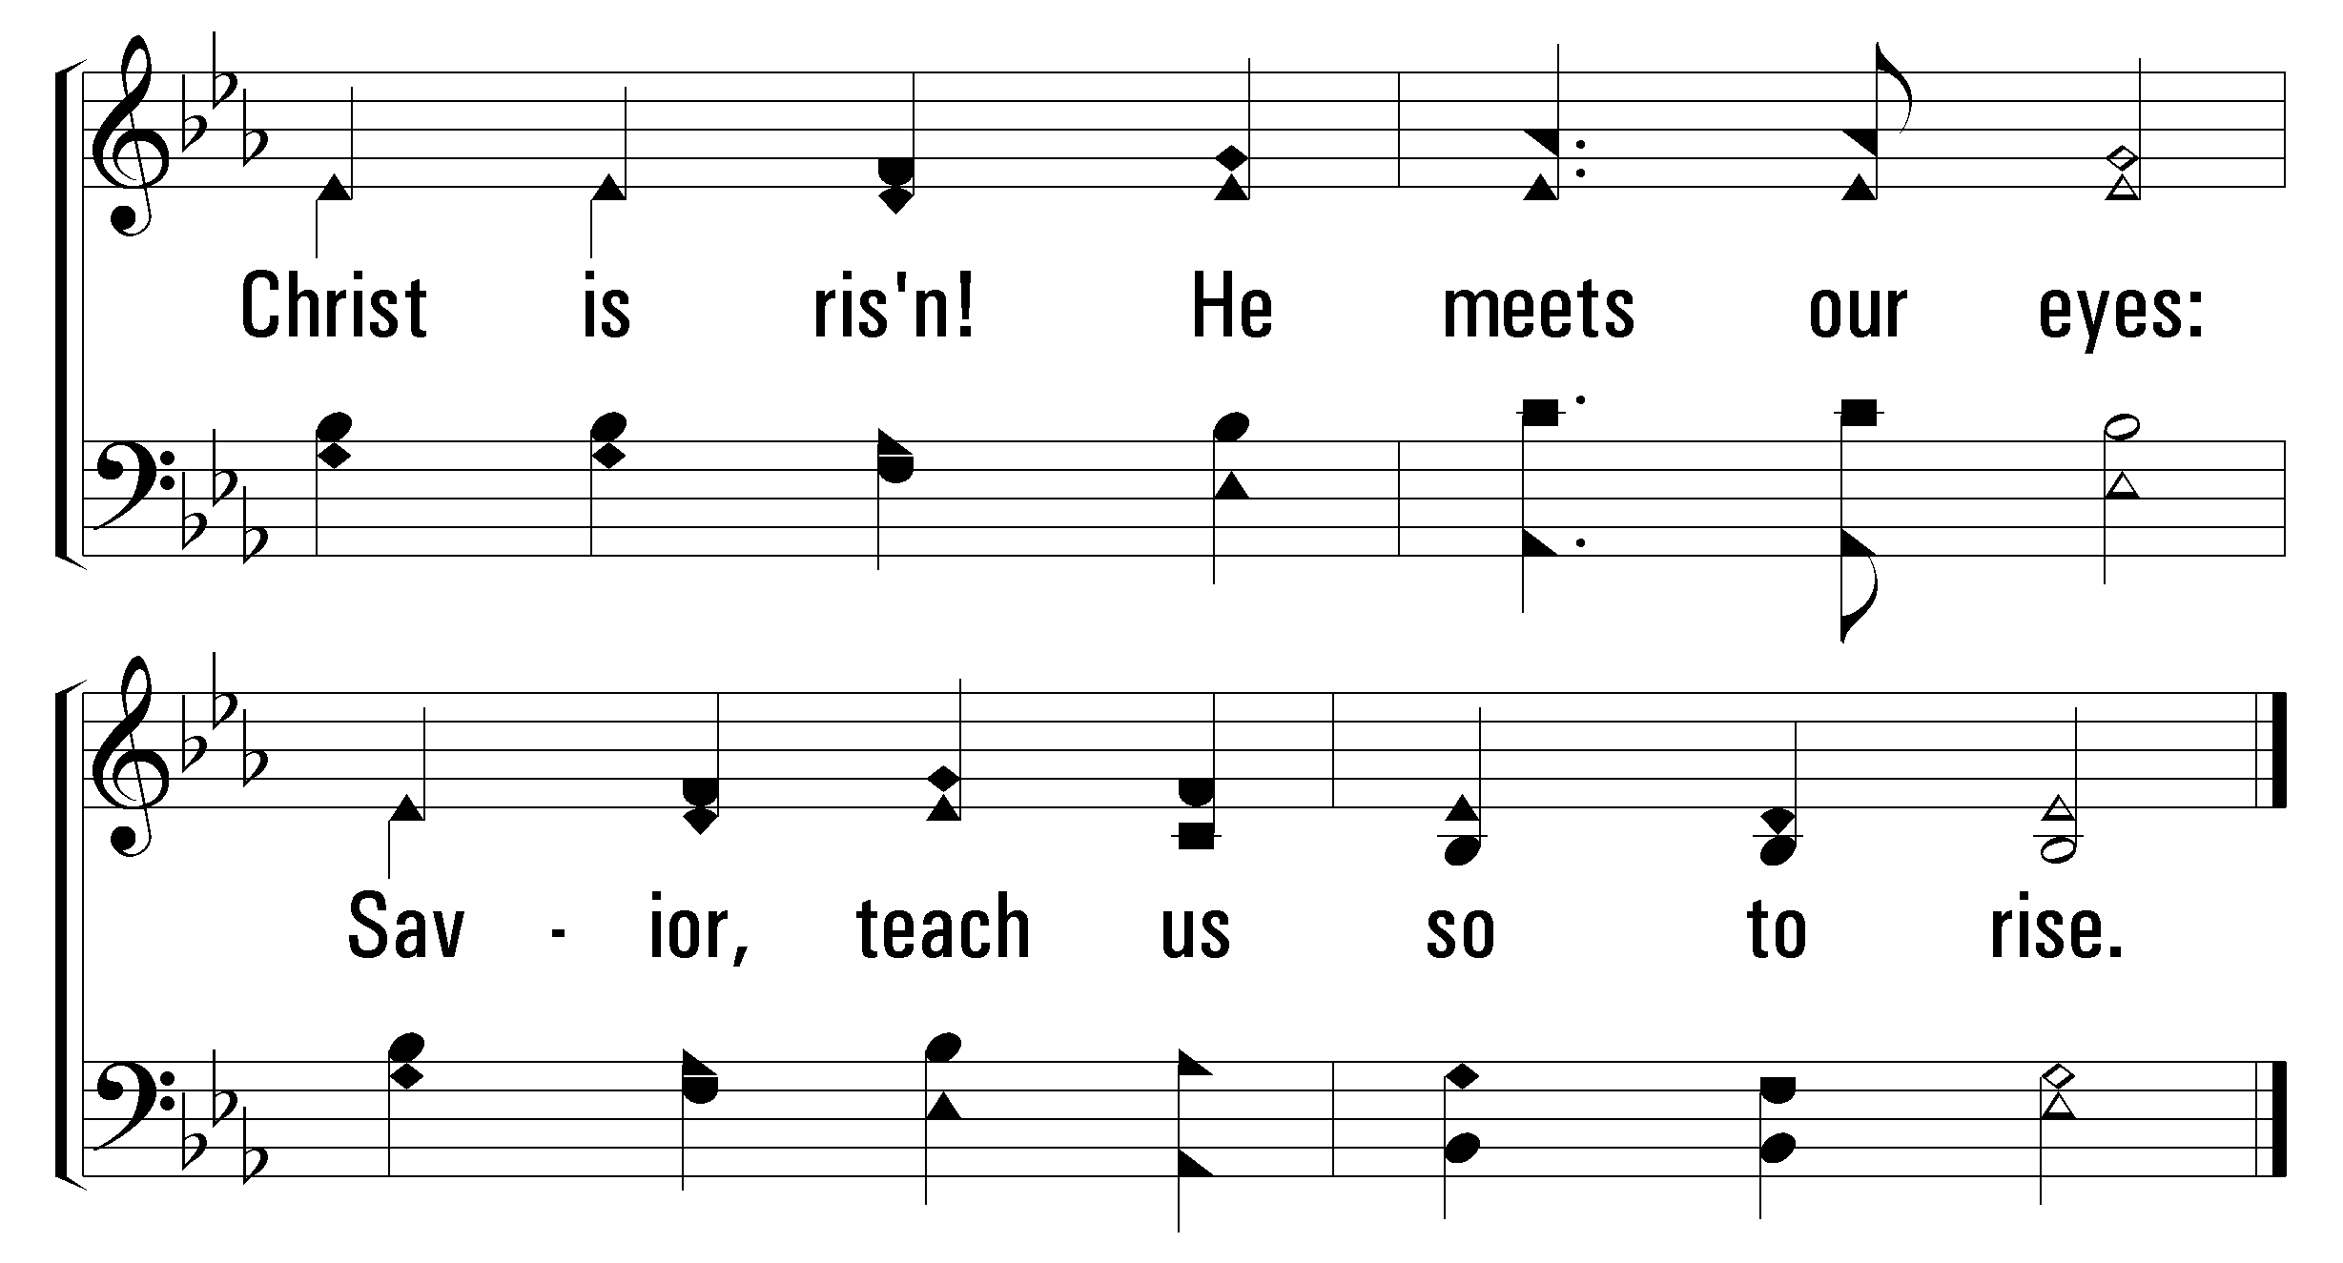
1
2
4
168
GO TO DARK GETHSEMANE
© 2010 The Paperless Hymnal®

Slide 23

Welcome
Reading
Prayer
32
168
Lord’s Supper
Collection
519
Sermon
380
Prayer
LORD’S
SUPPER
“DO THIS IN REMEMBRANCE OF ME” LUKE 22:19
Marty Broadwell

Slide 25

Welcome
Reading
Prayer
32
168
Lord’s Supper
Collection
519
Sermon
380
Prayer
For the love of Christ compels us, because we judge thus: that if One died for all, then all died; and He died for all, that those who live should live no longer for themselves, but for Him who died for them and rose again. Therefore, from now on, we regard no one according to the flesh. Even though we have known Christ according to the flesh, yet now we know Him thus no longer. Therefore, if anyone is in Christ, he is a new creation; old things have passed away; behold, all things have become new. Now all things are of God, who has reconciled us to Himself through Jesus Christ, and has given us the ministry of reconciliation, that is, that God was in Christ reconciling the world to Himself, not imputing their trespasses to them, and has committed to us the word of reconciliation.
2 Corinthians 5:14-19

Slide 26

Welcome
Reading
Prayer
32
168
Lord’s Supper
Collection
519
Sermon
380
Prayer
GIVING
THE COLLECTION FOR THE SAINTS
“FOR GOD LOVES A CHEERFUL GIVER” 2 CORINTHIANS 9:7
Marty Broadwell

Slide 27
Welcome
Reading
Prayer
32
168
Lord’s Supper
Collection
519
Sermon
380
Prayer
INVITATION SONG
380
JUST AS I AM
1
2
3
4
5
6
“SINGING...TO THE LORD”
COLOSSIANS 3:16
Words by: Charlotte Elliott / Music by: William Bradbury

Slide 28

Welcome
Reading
Prayer
32
168
Lord’s Supper
Collection
519
Sermon
380
Prayer
519
ONLY IN THEE
1
2
3
4
“SINGING...TO THE LORD”
COLOSSIANS 3:16
Words: T. O. Chisholm
Music: Charles H. Gabriel

Slide 29

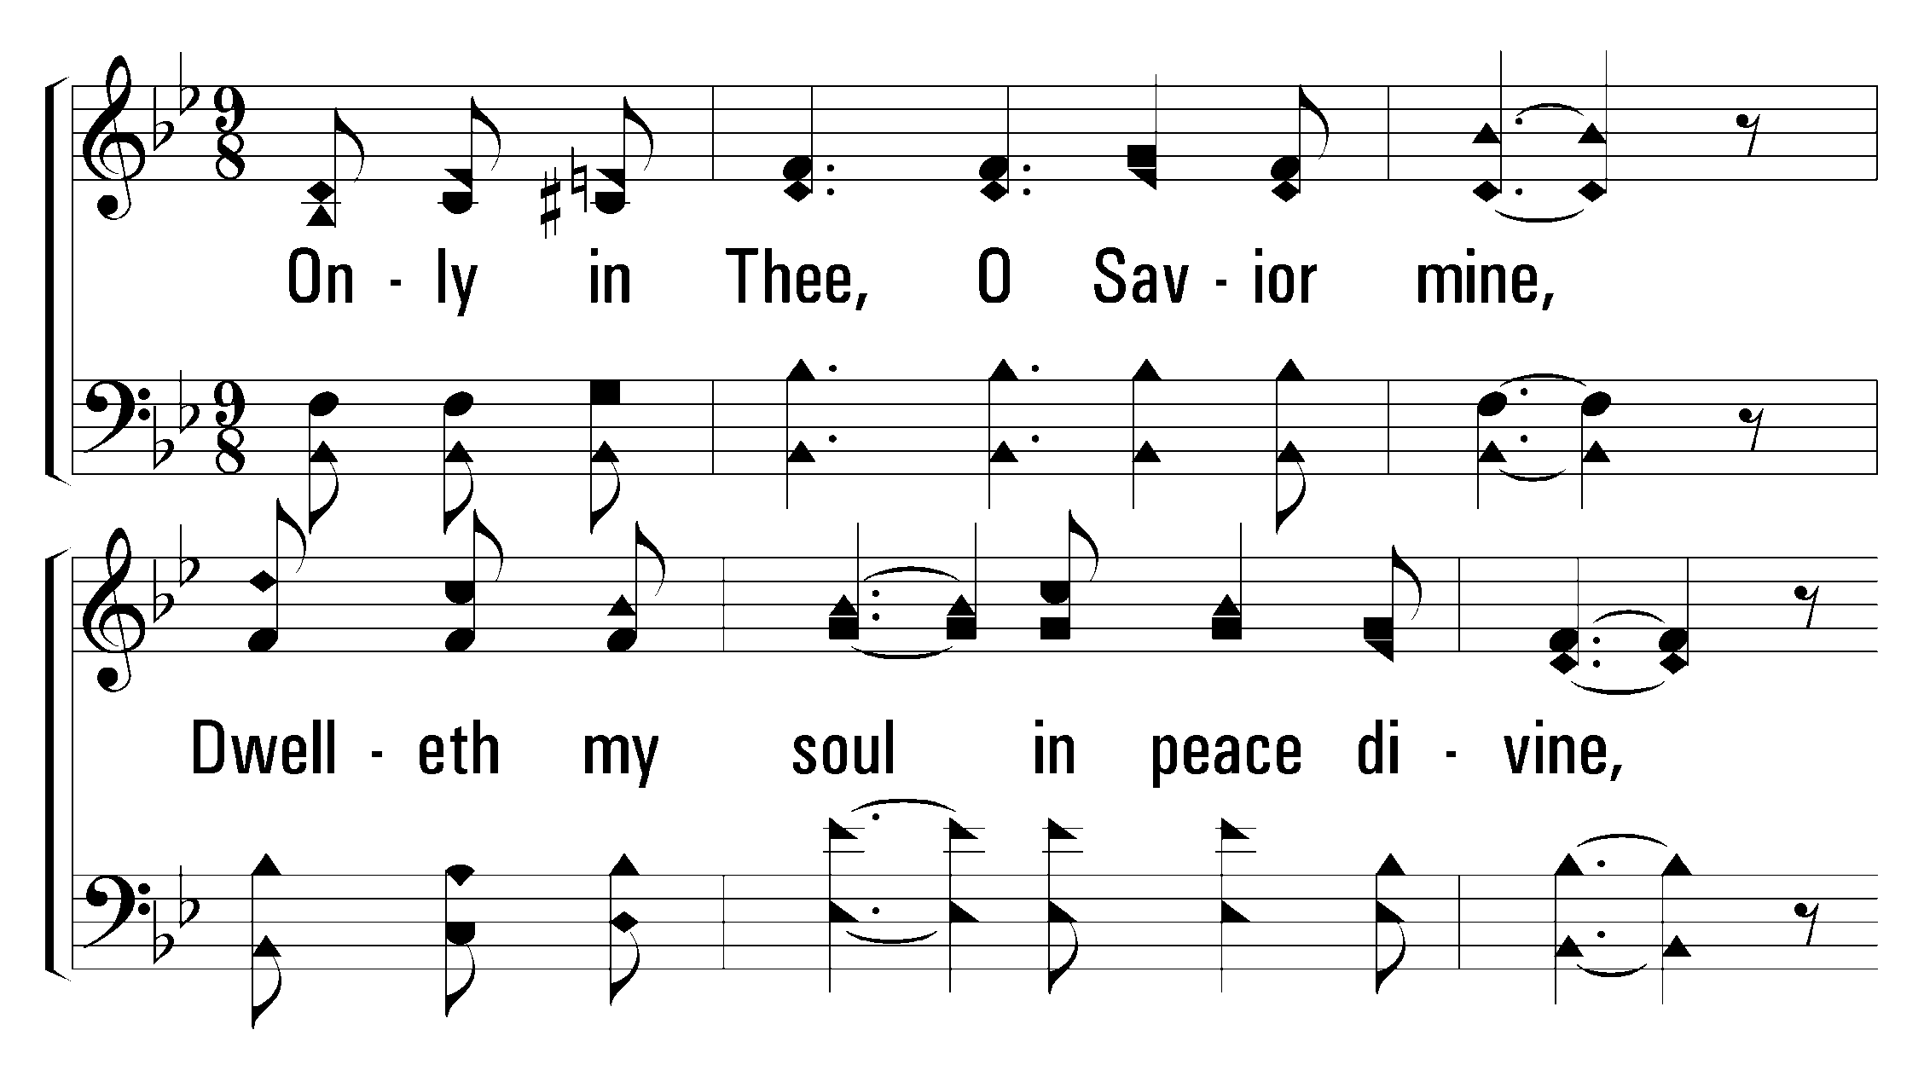
1
2
4
519
ONLY IN THEE
© 2001 The Paperless Hymnal™

Slide 30
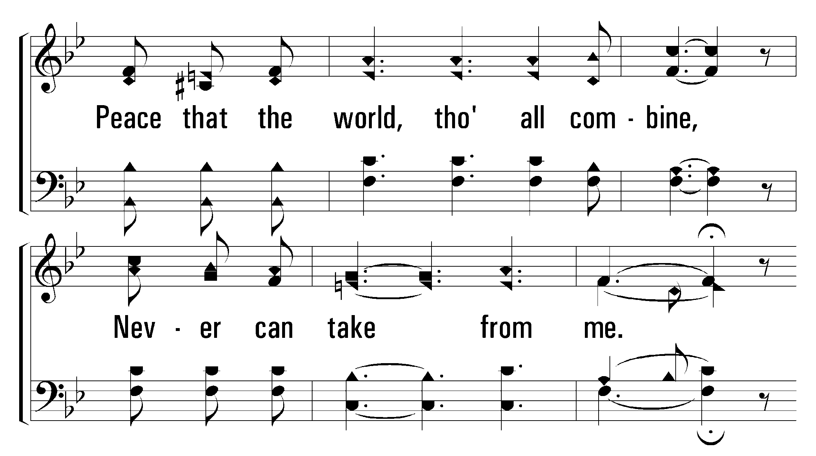
1
2
4
519
ONLY IN THEE
© 2001 The Paperless Hymnal™

Slide 31
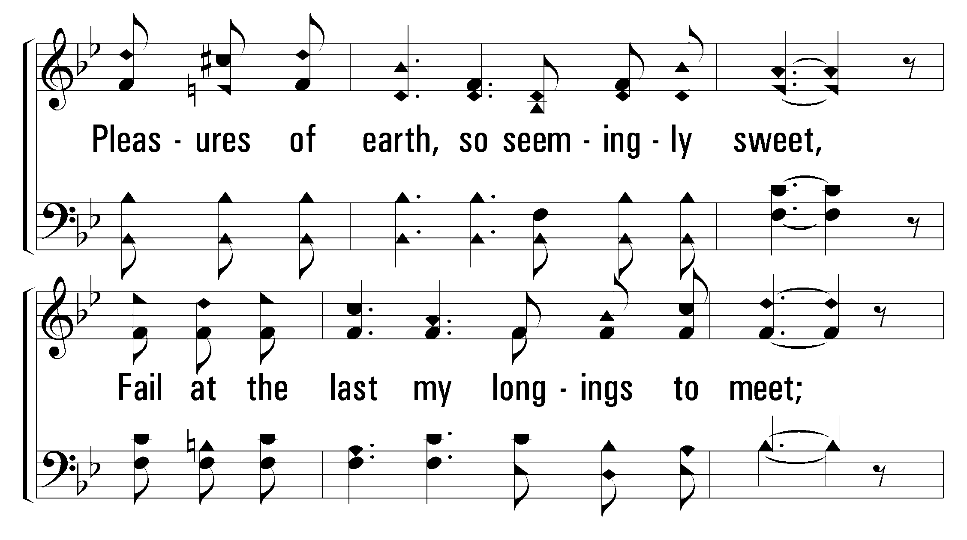
1
2
4
519
ONLY IN THEE
© 2001 The Paperless Hymnal™

Slide 32
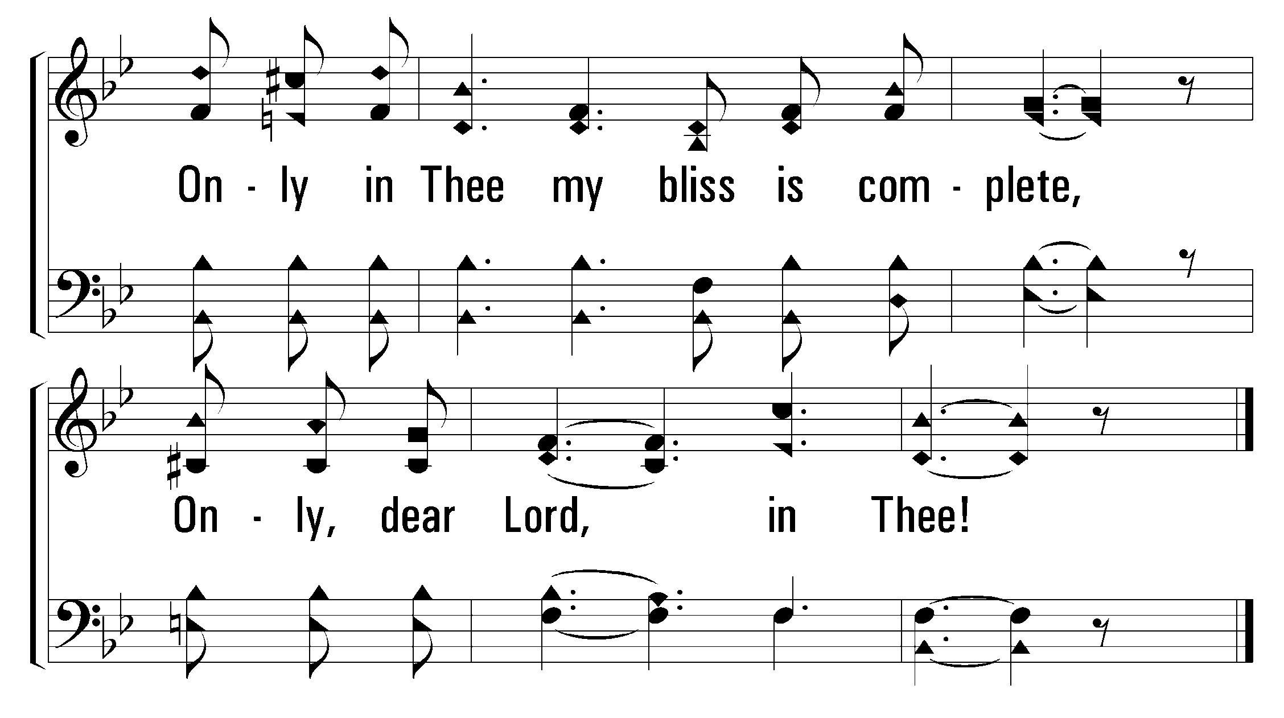
1
2
4
519
ONLY IN THEE
© 2001 The Paperless Hymnal™

Slide 33
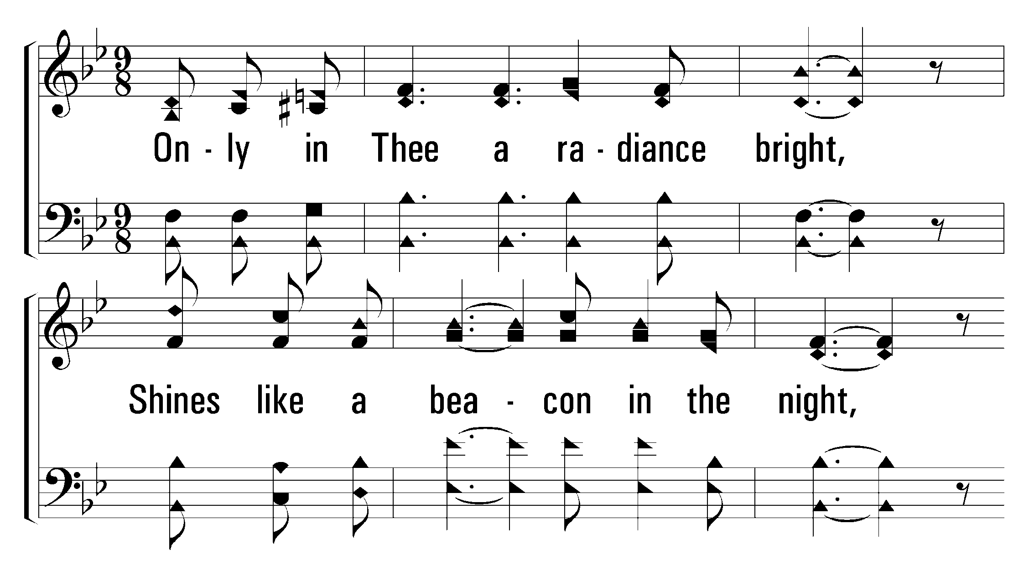
1
2
4
519
ONLY IN THEE
© 2001 The Paperless Hymnal™

Slide 34
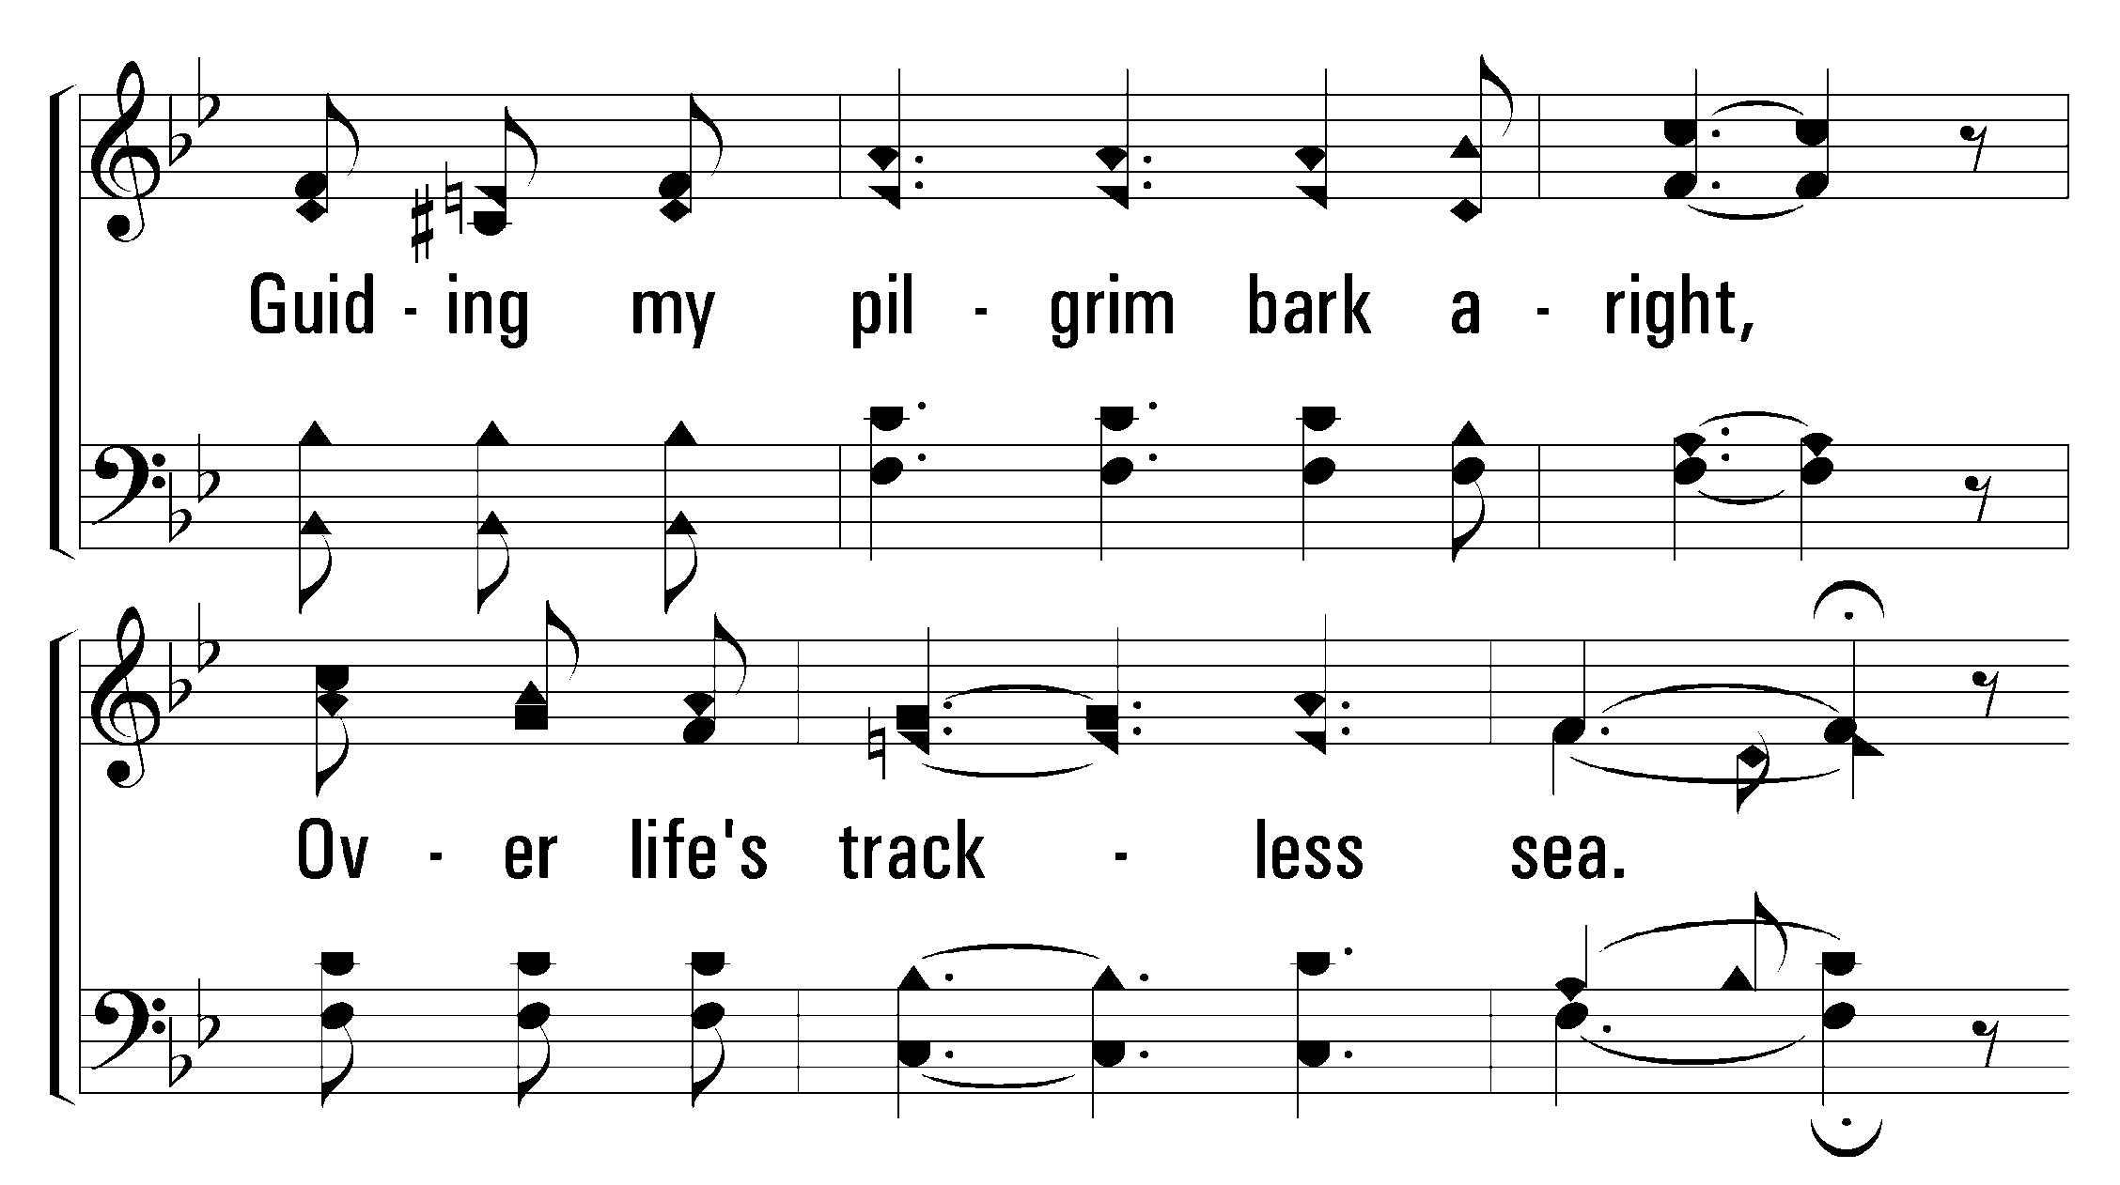
1
2
4
519
ONLY IN THEE
© 2001 The Paperless Hymnal™

Slide 35
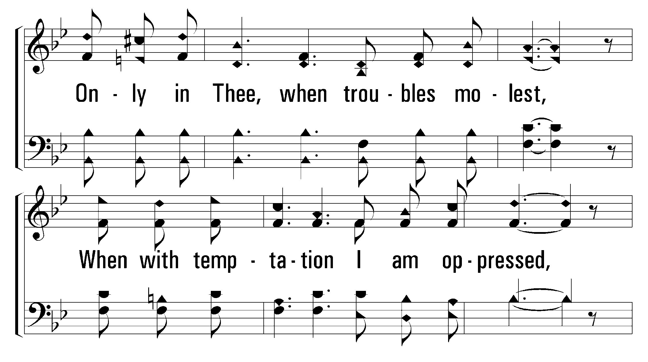
1
2
4
519
ONLY IN THEE
© 2001 The Paperless Hymnal™

Slide 36
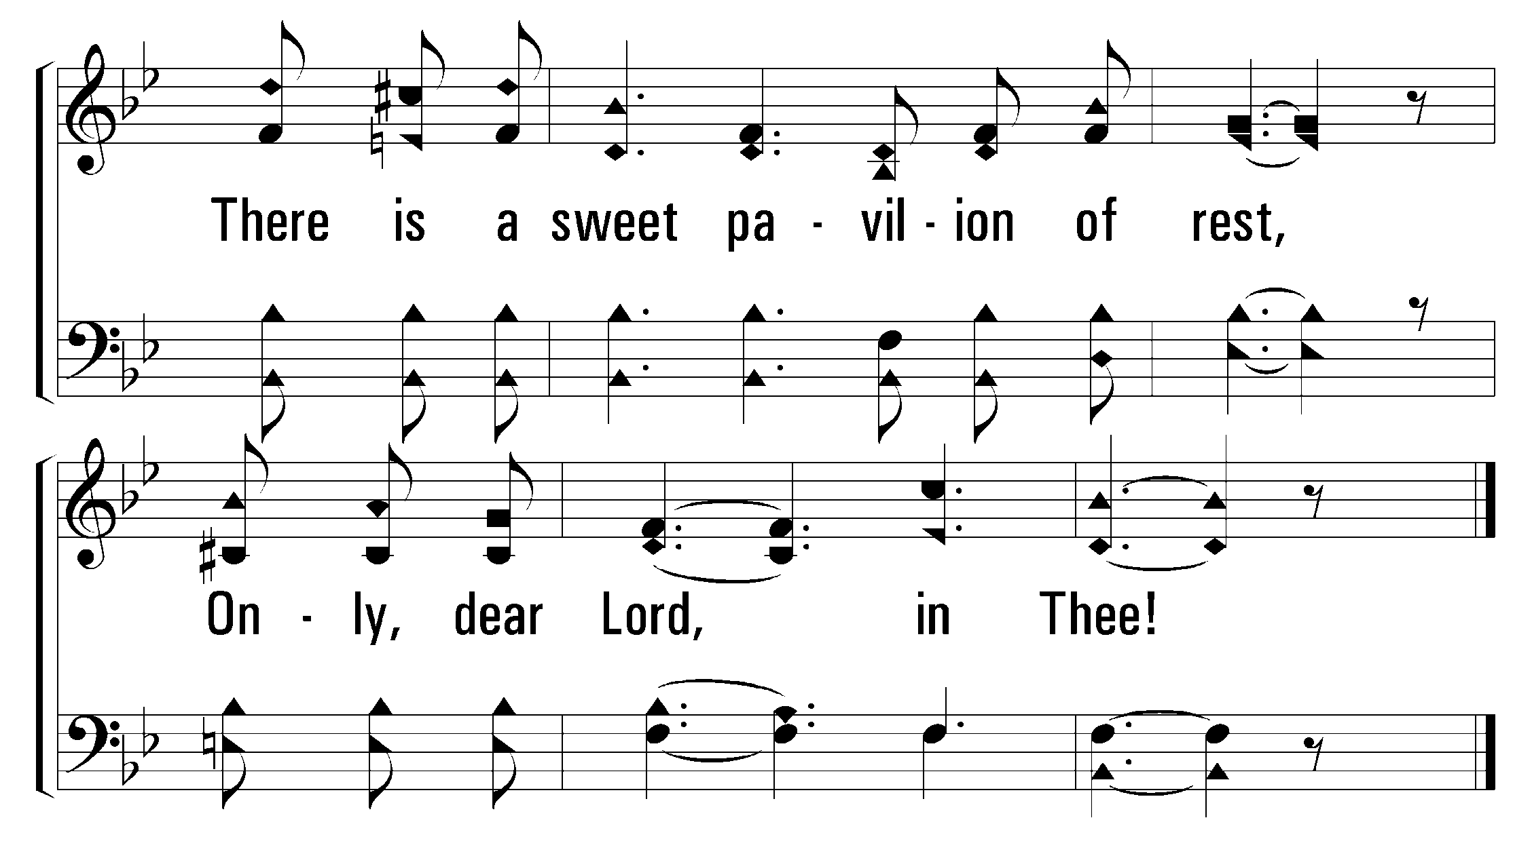
1
2
4
519
ONLY IN THEE
© 2001 The Paperless Hymnal™

Slide 37
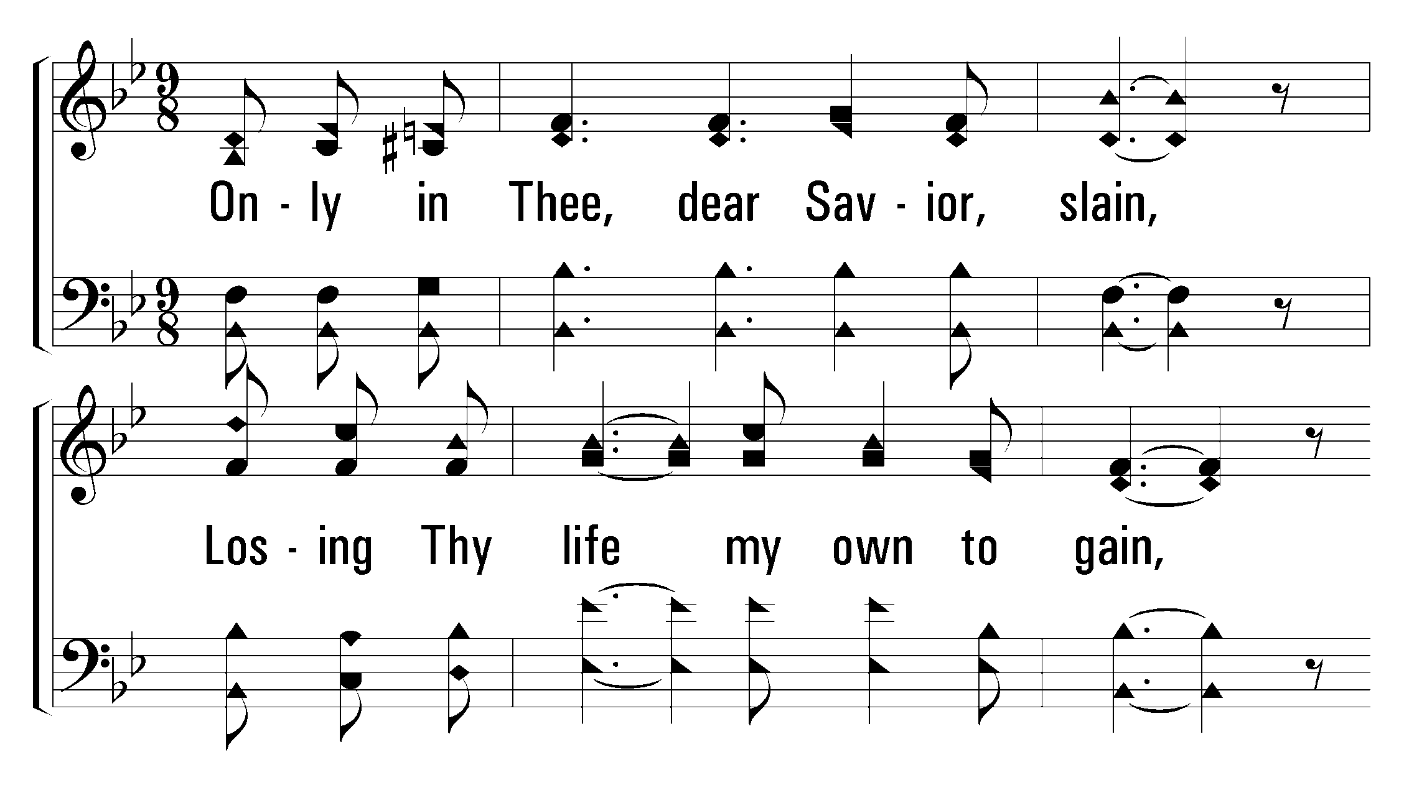
1
2
4
519
ONLY IN THEE
© 2001 The Paperless Hymnal™

Slide 38
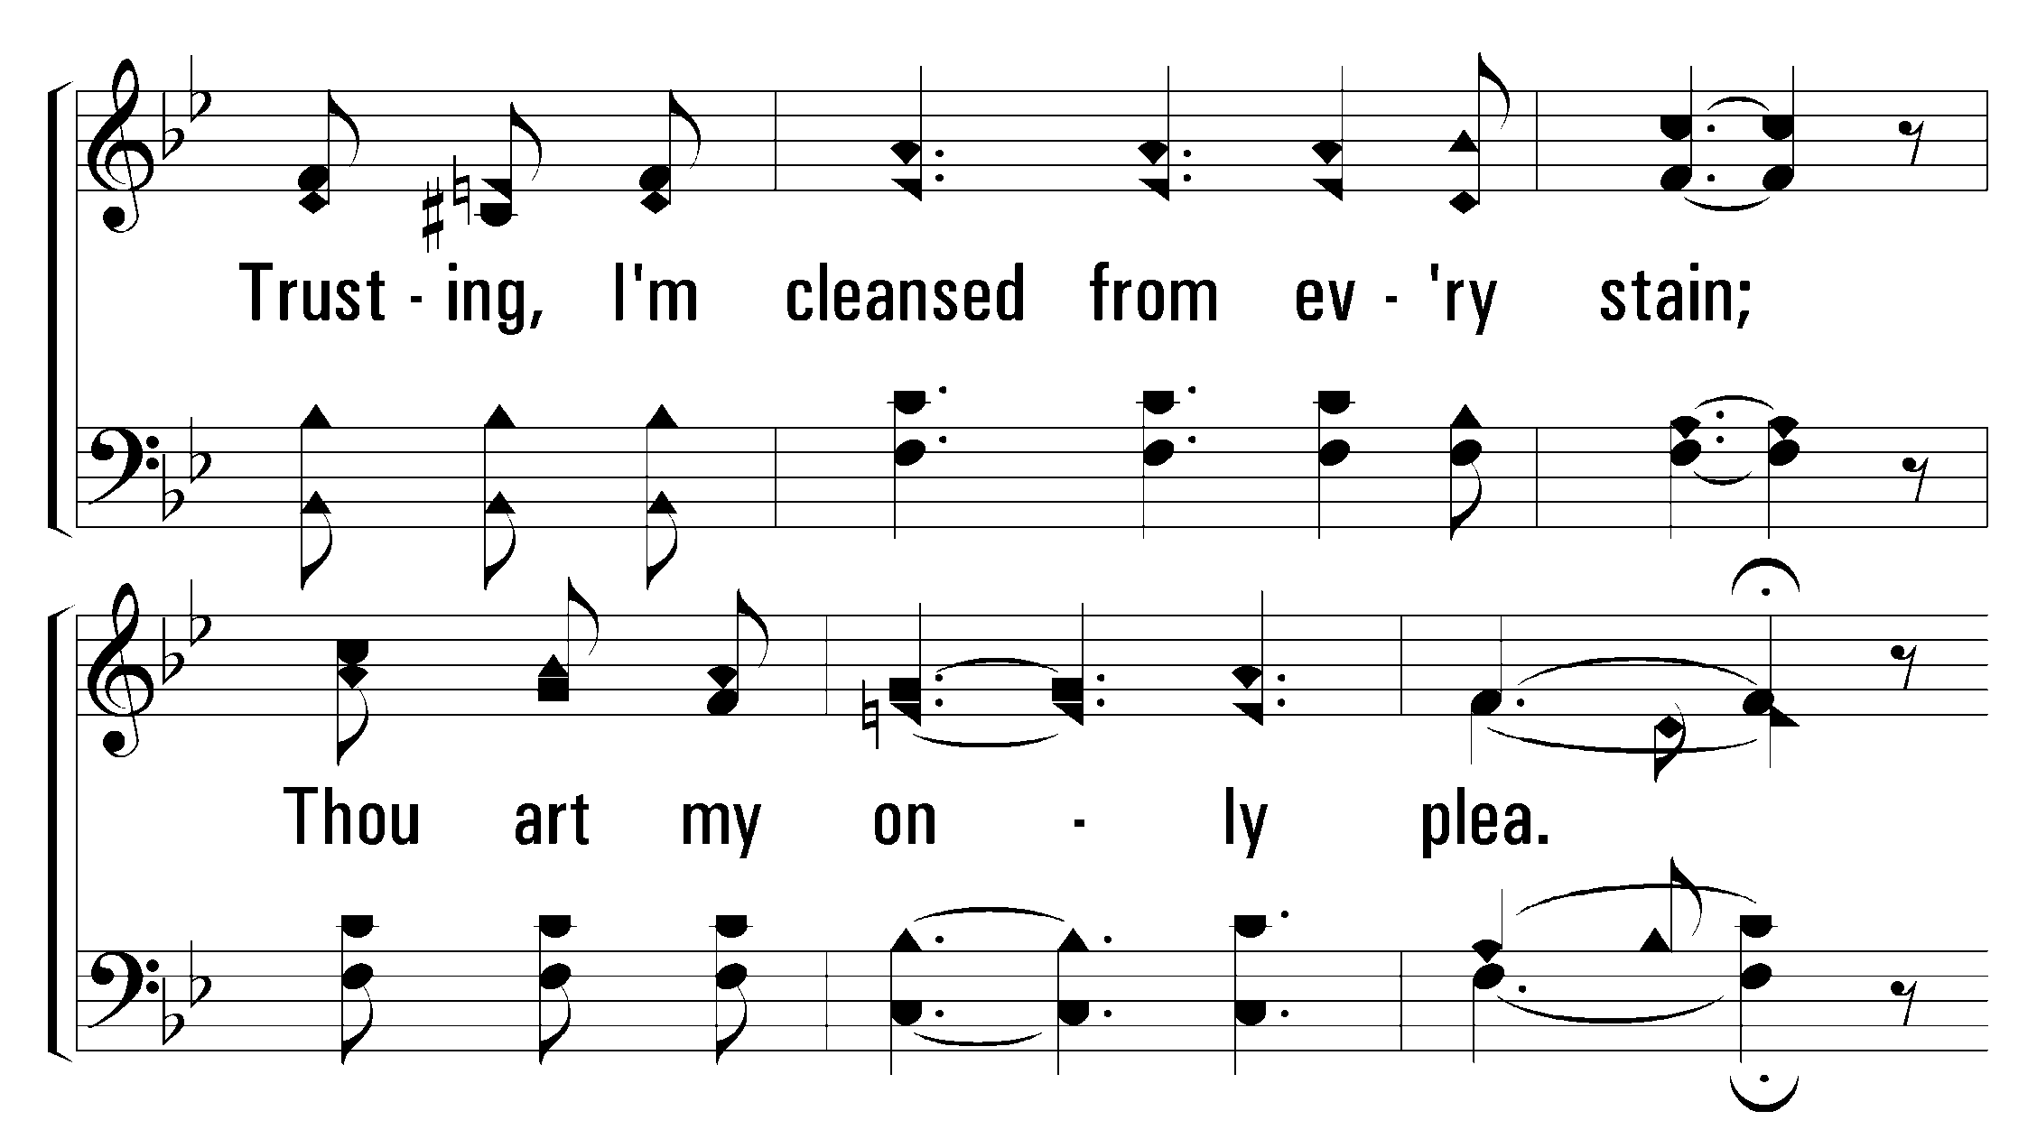
1
2
4
519
ONLY IN THEE
© 2001 The Paperless Hymnal™

Slide 39
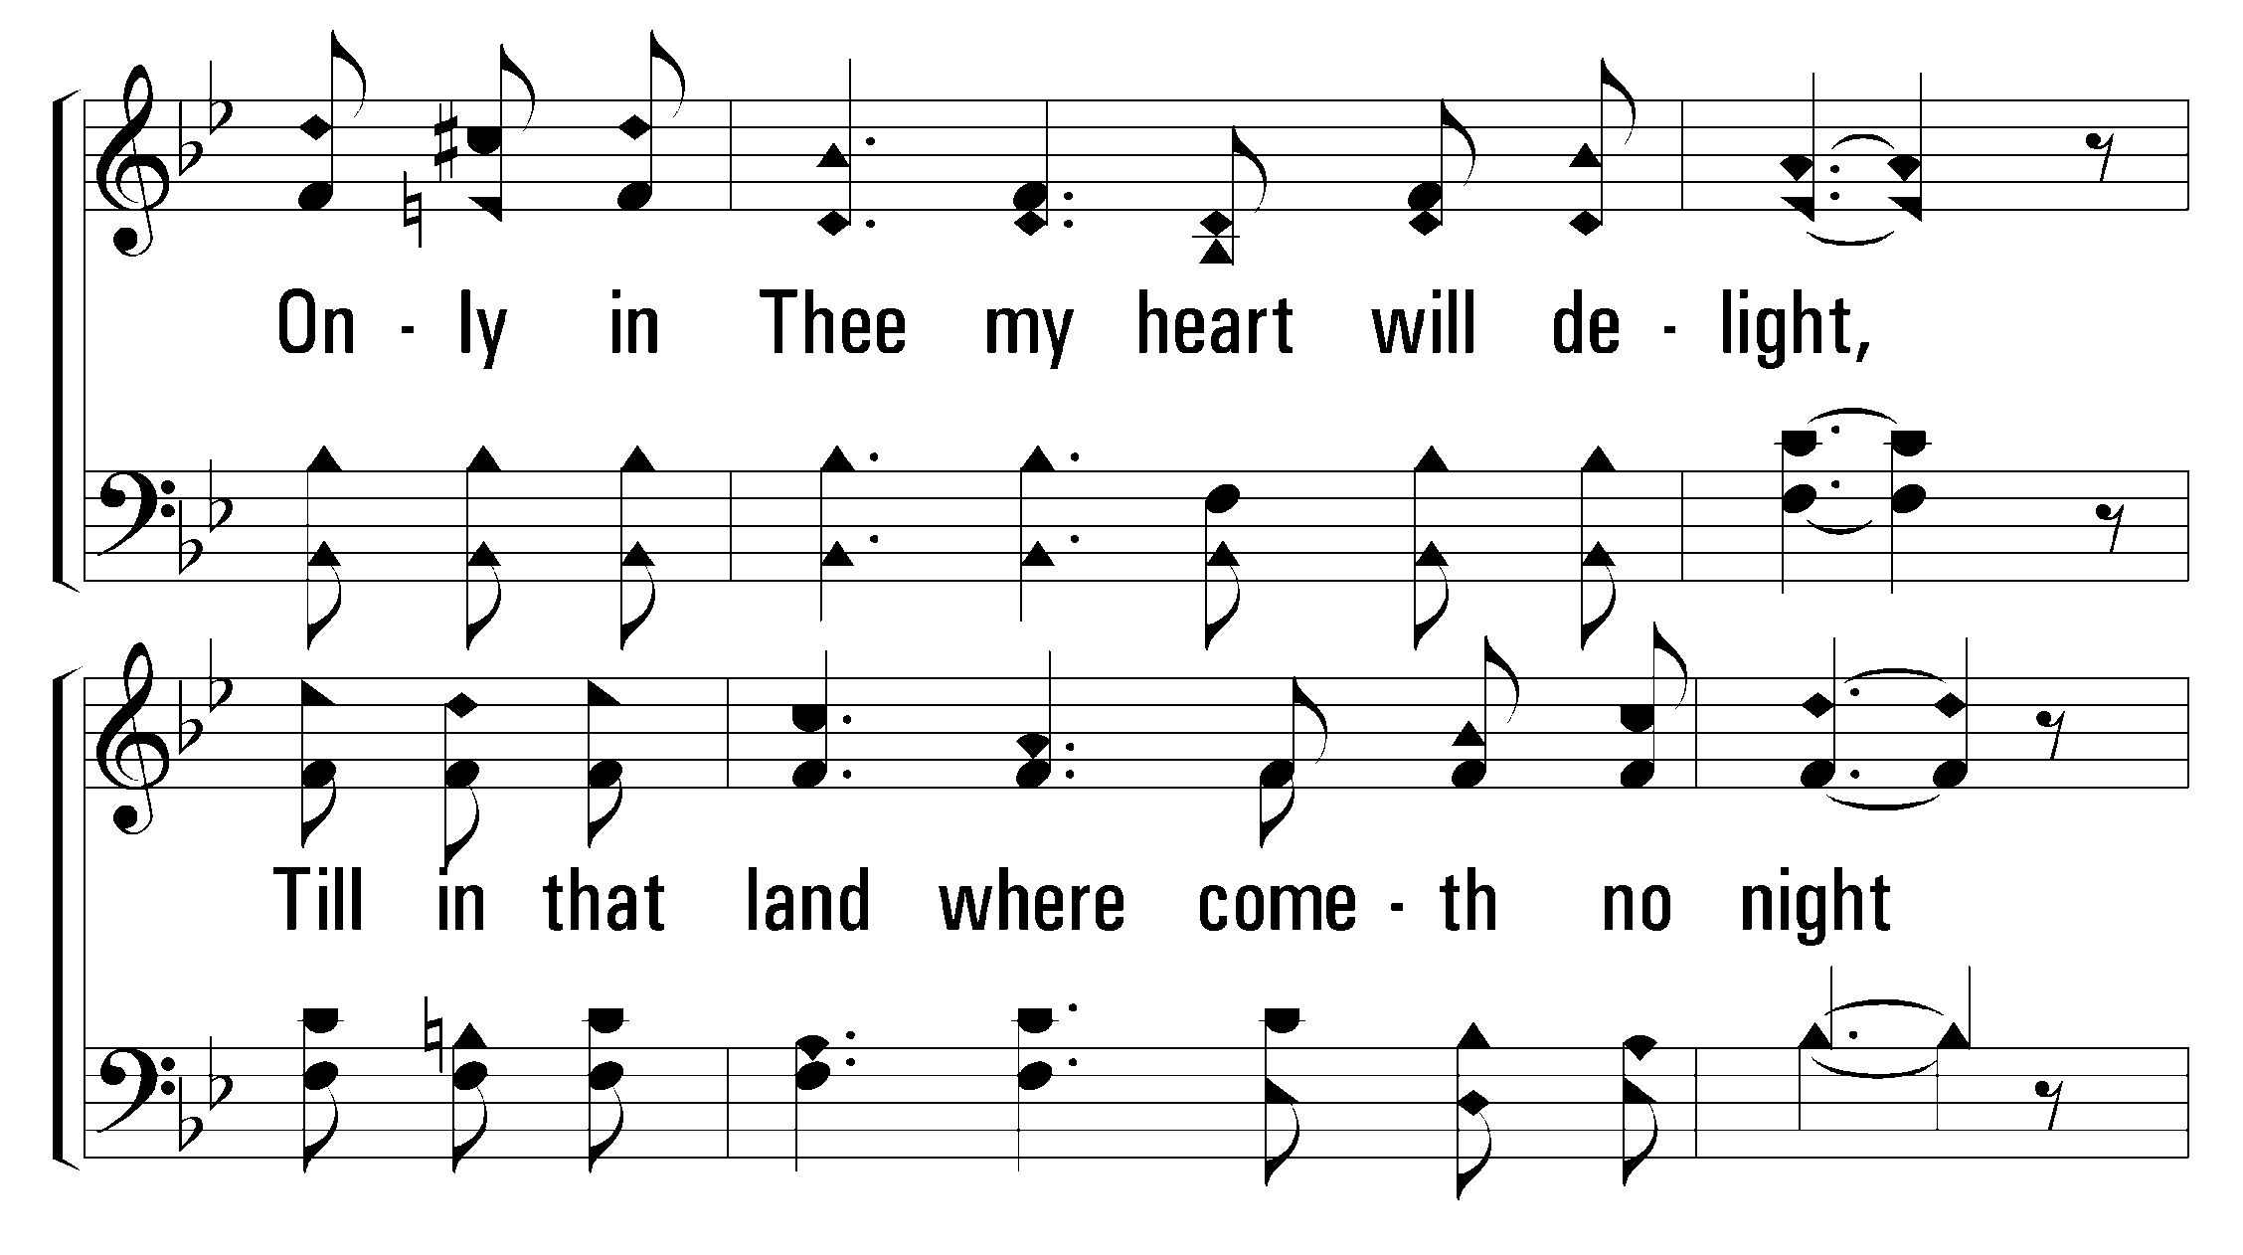
1
2
4
519
ONLY IN THEE
© 2001 The Paperless Hymnal™

Slide 40
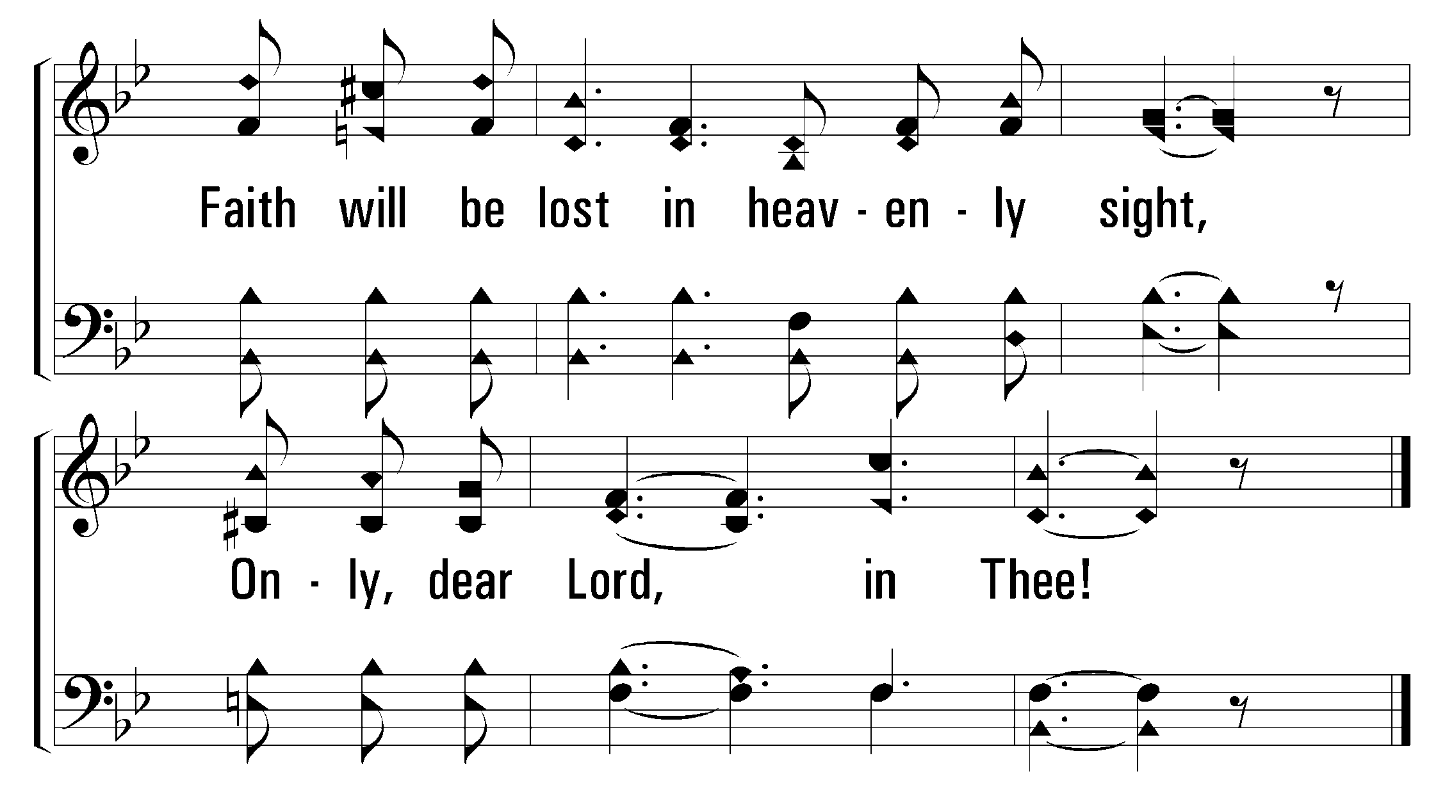
1
2
4
519
ONLY IN THEE
© 2001 The Paperless Hymnal™

Slide 41

Welcome
Reading
Prayer
32
168
Lord’s Supper
Collection
519
Sermon
380
Prayer
SERMON
“HE COMMANDED US TO PREACH TO THE PEOPLE”
ACTS 10:42
Bill Sanchez

Slide 43
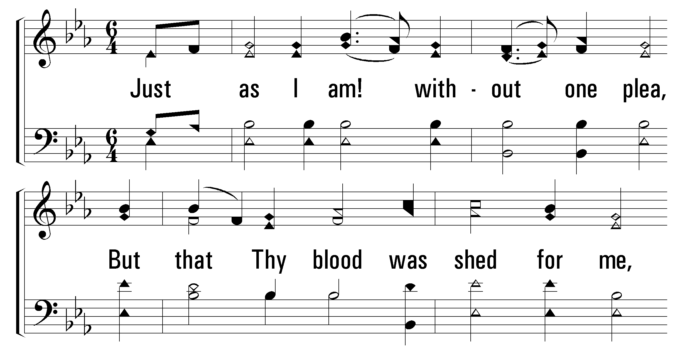
1
2
5
380
JUST AS I AM
© 2001 The Paperless Hymnal™

Slide 44
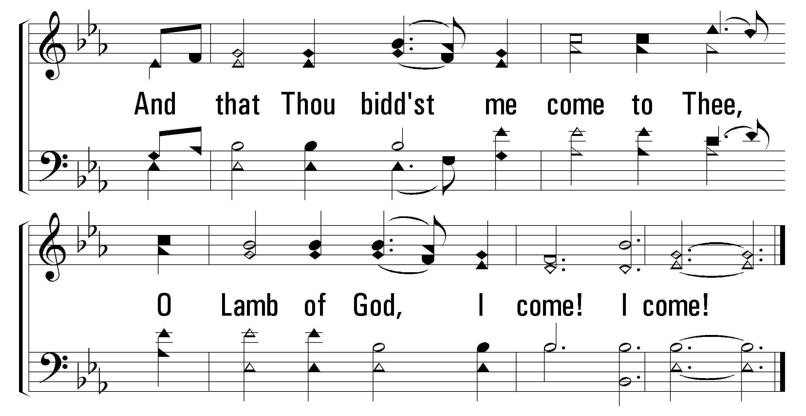
1
2
5
380
JUST AS I AM
© 2001 The Paperless Hymnal™

Slide 45
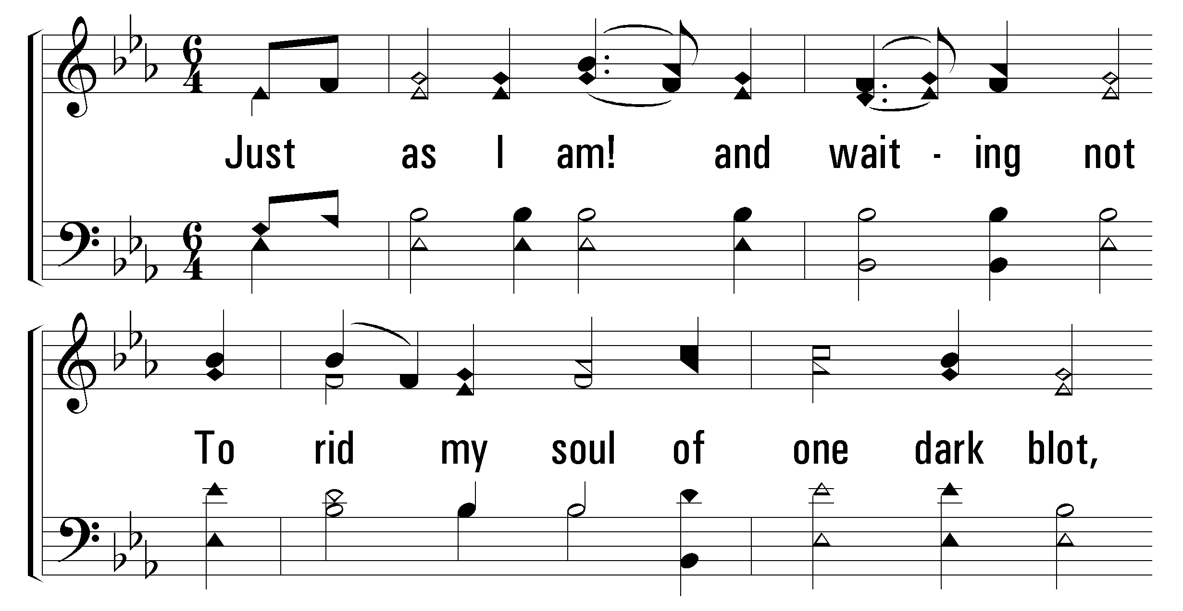
1
2
5
380
JUST AS I AM
© 2001 The Paperless Hymnal™

Slide 46
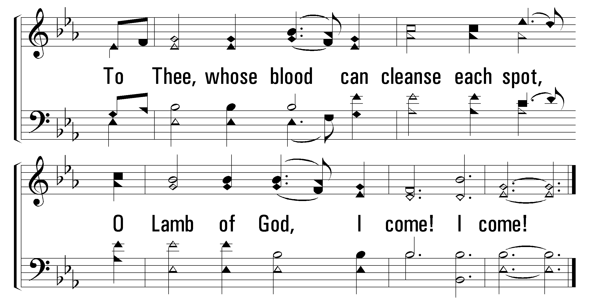
1
2
5
380
JUST AS I AM
© 2001 The Paperless Hymnal™

Slide 47
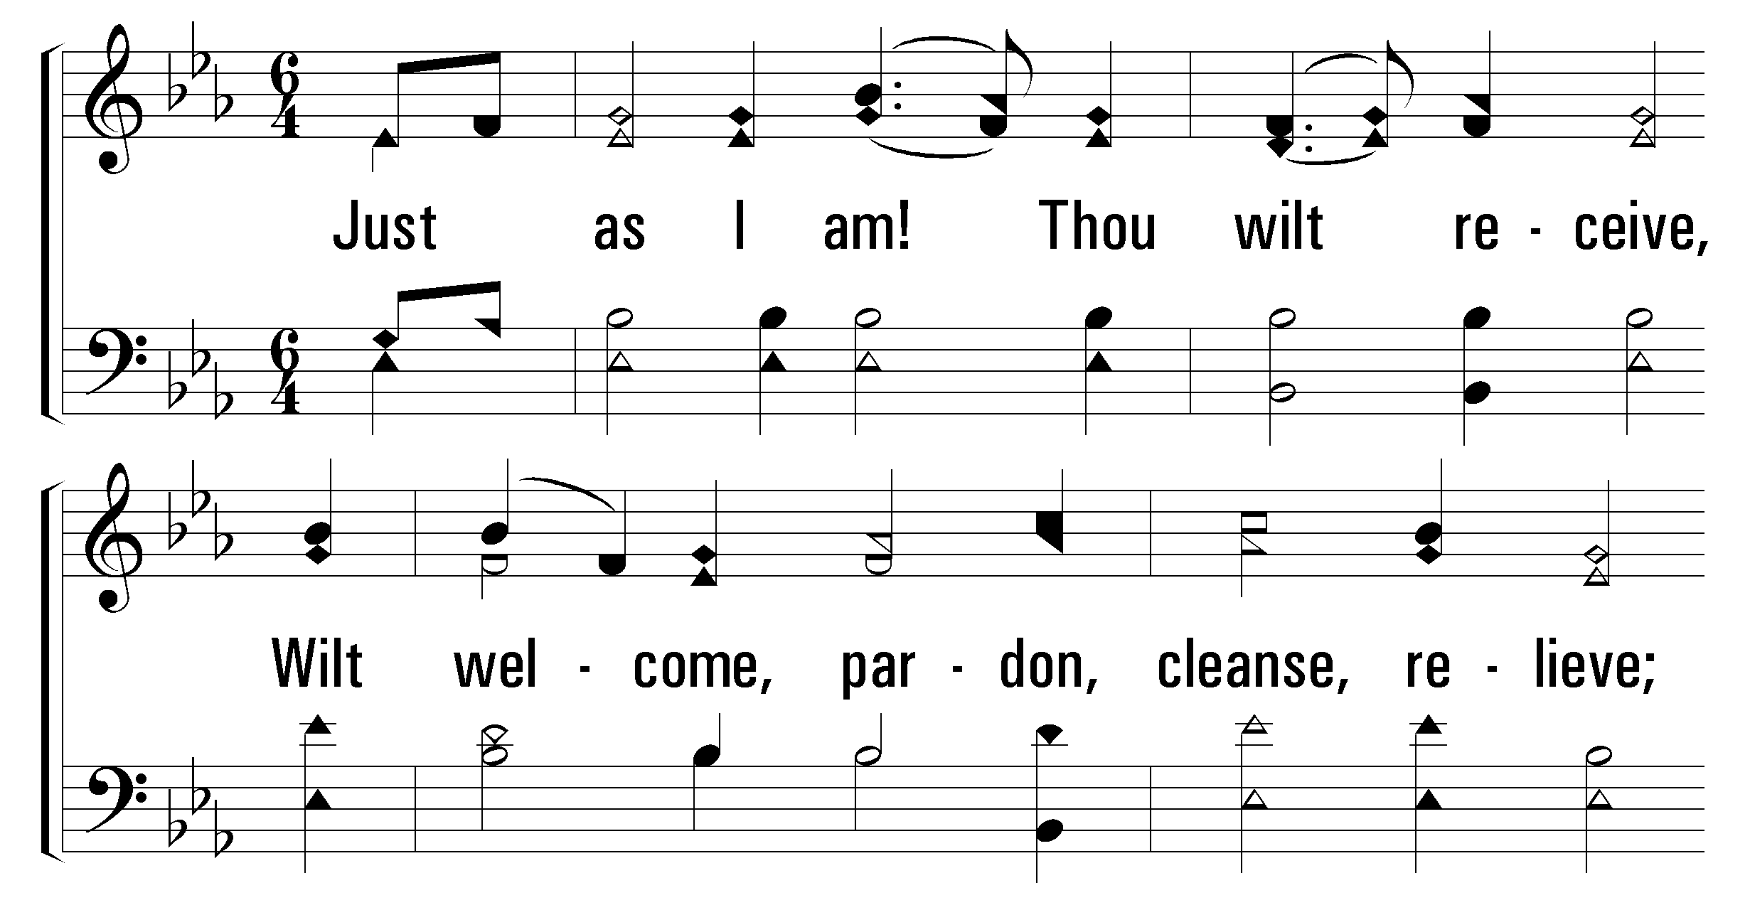
1
2
5
380
JUST AS I AM
© 2001 The Paperless Hymnal™

Slide 48
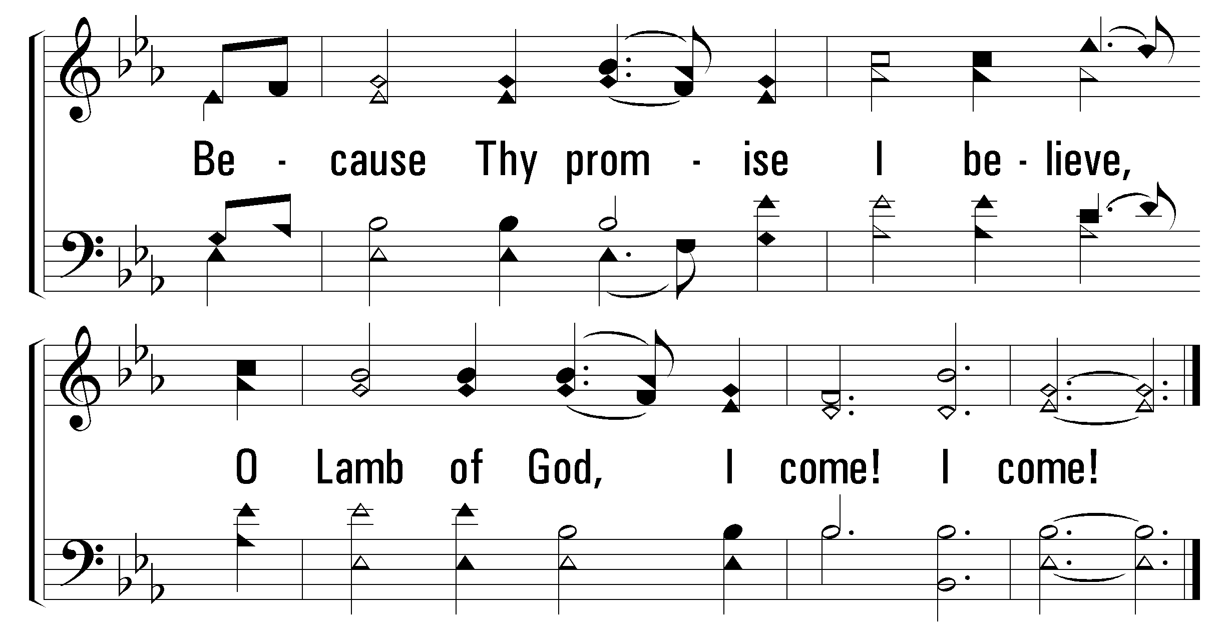
1
2
5
380
JUST AS I AM
© 2001 The Paperless Hymnal™

Slide 50

Welcome
Reading
Prayer
32
168
Lord’s Supper
Collection
519
Sermon
380
Prayer
PRAYER
“DEVOTE YOURSELVES TO PRAYER”
COLOSSIANS 4:2
Maurice Norman

