Slide 1




• Welcome
Reading
Prayer
115 .
615 .
Lord’s Supper
32 .
Collection
500 .
Sermon
739 .
Prayer
Welcome & Announcements
Isaiah 40:1-11
Crown Him with Many Crowns
That Dreadful Night
Theophany
O Thou Fount of Every Blessing
The Goal of our Instruction is Love
What Will You Do with Jesus?
Notes:
Song Leader: David Williams

Slide 2

Welcome
• Reading
Prayer
115 .
615 .
Lord’s Supper
32 .
Collection
500 .
Sermon
739 .
Prayer
READING
ISAIAH 40:1-11
Pew Bible: Page 485
“HAVE THIS LETTER READ TO ALL”
1 THESSALONIANS 5:27

Slide 3

Welcome
Reading
• Prayer
115 .
615 .
Lord’s Supper
32 .
Collection
500 .
Sermon
739 .
Prayer
PRAYER
“DEVOTE YOURSELVES TO PRAYER”
COLOSSIANS 4:2

Slide 4

Welcome
Reading
Prayer
• 115 .
615 .
Lord’s Supper
32 .
Collection
500 .
Sermon
739 .
Prayer
115
CROWN HIM WITH MANY CROWNS
1
2
3
4
“SINGING...TO THE LORD”
COLOSSIANS 3:16
Words by: Matthew Bridges, st.2: Godfrey Thring
Music by: George J. Elvey

Slide 5

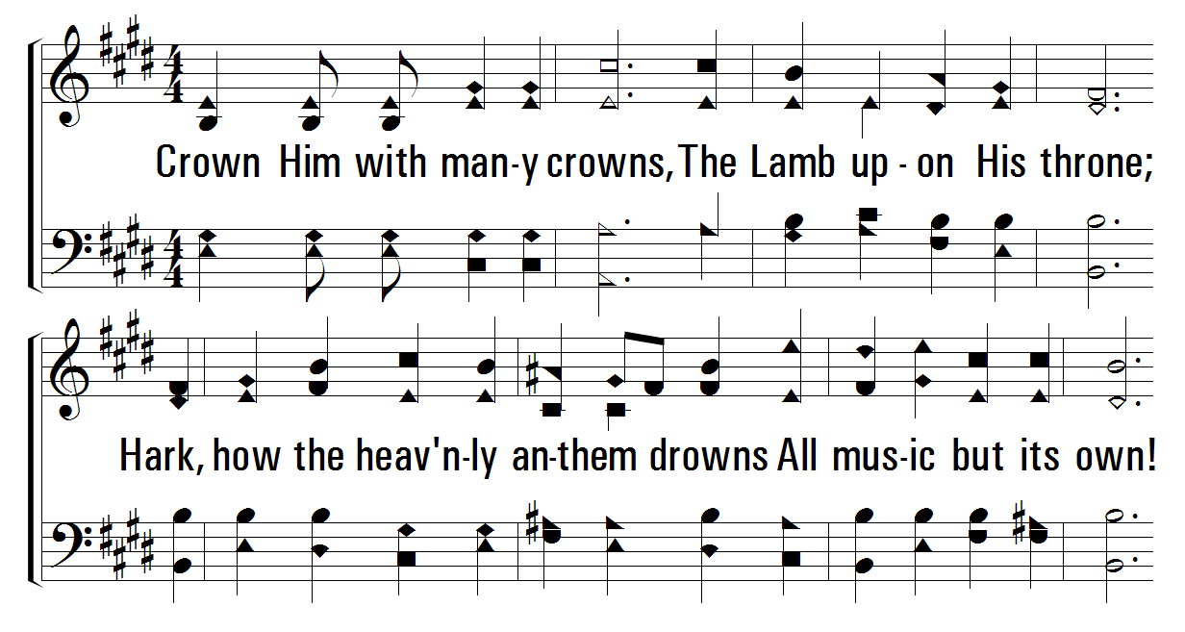


1
2
4
115
CROWN HIM WITH MANY CROWNS
© 2001 The Paperless Hymnal™

Slide 6
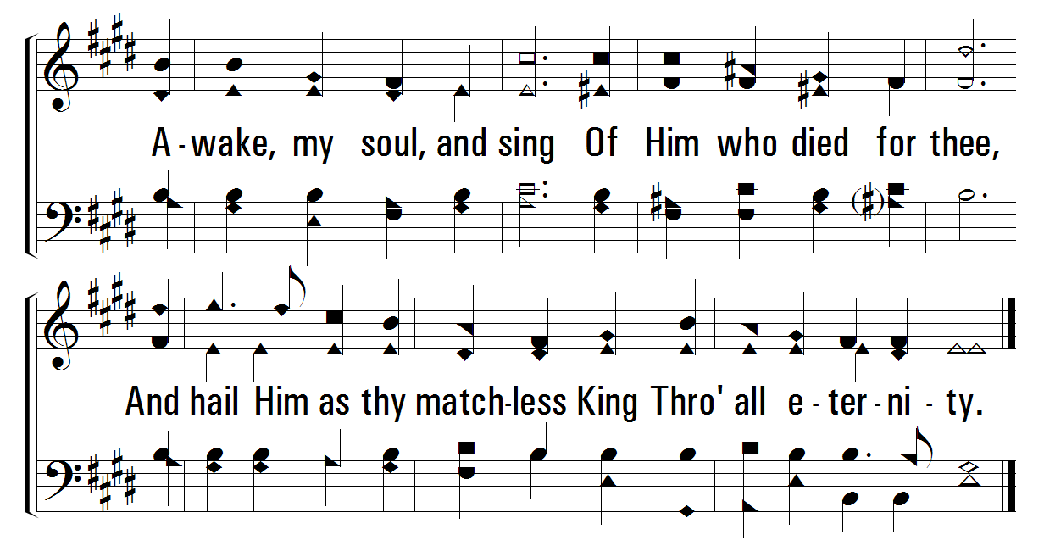
1
2
4
115
CROWN HIM WITH MANY CROWNS
© 2001 The Paperless Hymnal™

Slide 7
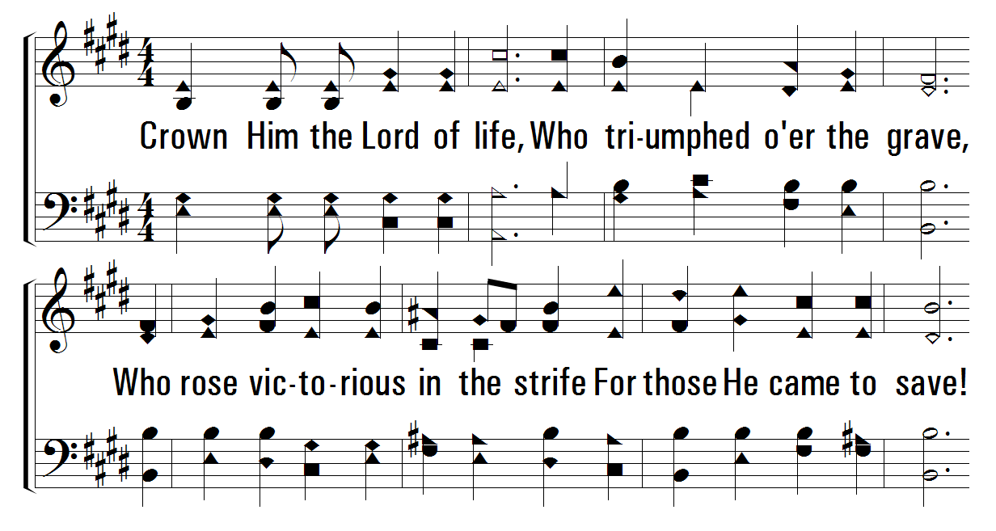
1
2
4
115
CROWN HIM WITH MANY CROWNS
© 2001 The Paperless Hymnal™

Slide 8
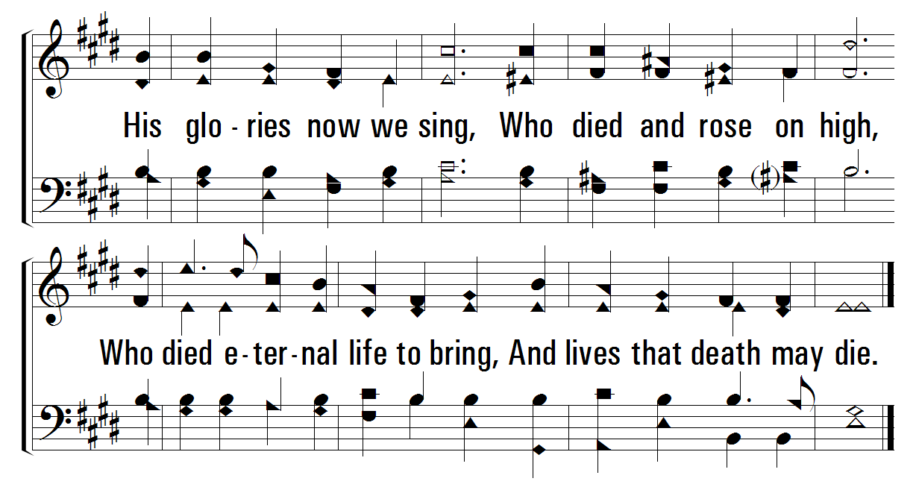
1
2
4
115
CROWN HIM WITH MANY CROWNS
© 2001 The Paperless Hymnal™

Slide 9
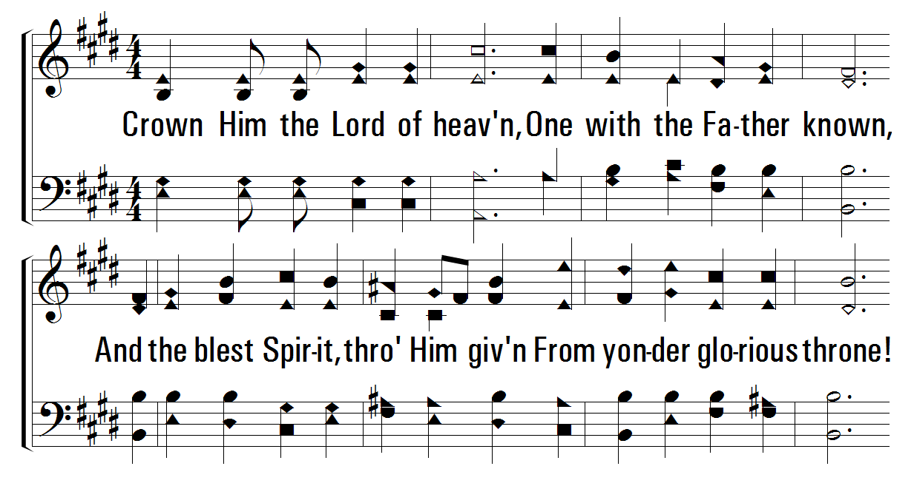
1
2
4
115
CROWN HIM WITH MANY CROWNS
© 2001 The Paperless Hymnal™

Slide 10
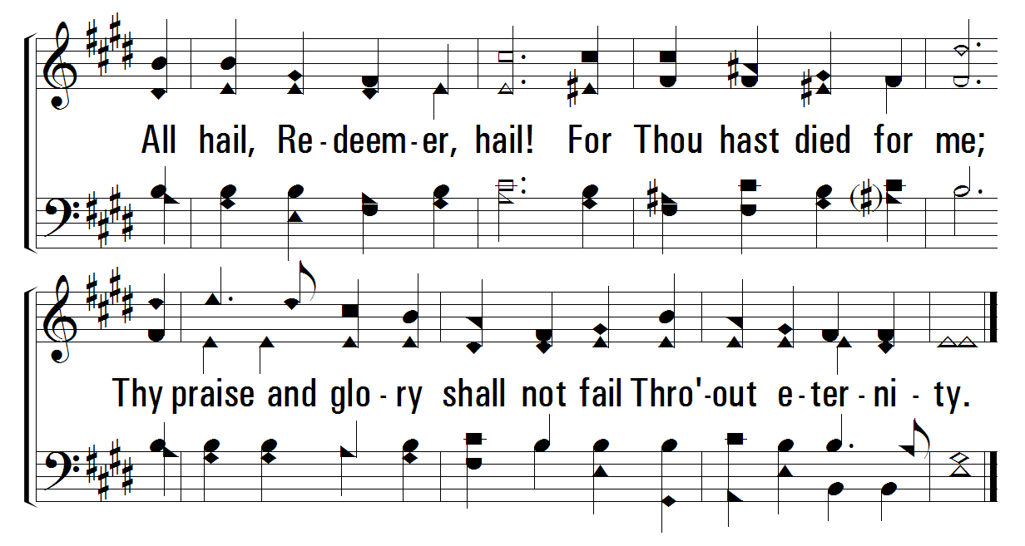
1
2
4
115
CROWN HIM WITH MANY CROWNS
© 2001 The Paperless Hymnal™

Slide 11
Welcome
Reading
Prayer
115 .
• 615 .
Lord’s Supper
32 .
Collection
500 .
Sermon
739 .
Prayer
615
THAT DREADFUL NIGHT
1
2
“SINGING...TO THE LORD”
COLOSSIANS 3:16
Regular Voices

Slide 12
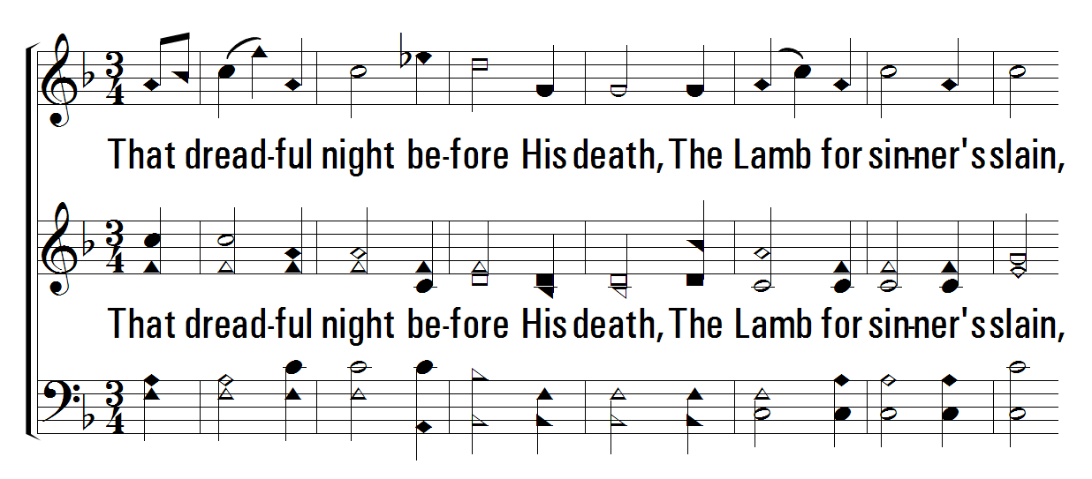
1
2
615
THAT DREADFUL NIGHT
© 2006 The Paperless Hymnal®

Slide 13
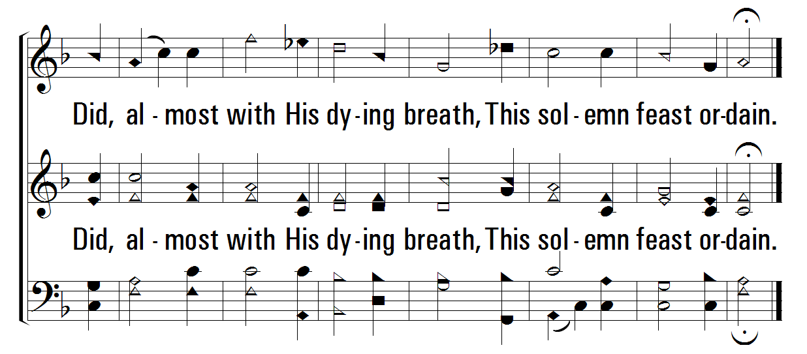
1
2
615
THAT DREADFUL NIGHT
© 2006 The Paperless Hymnal®

Slide 14
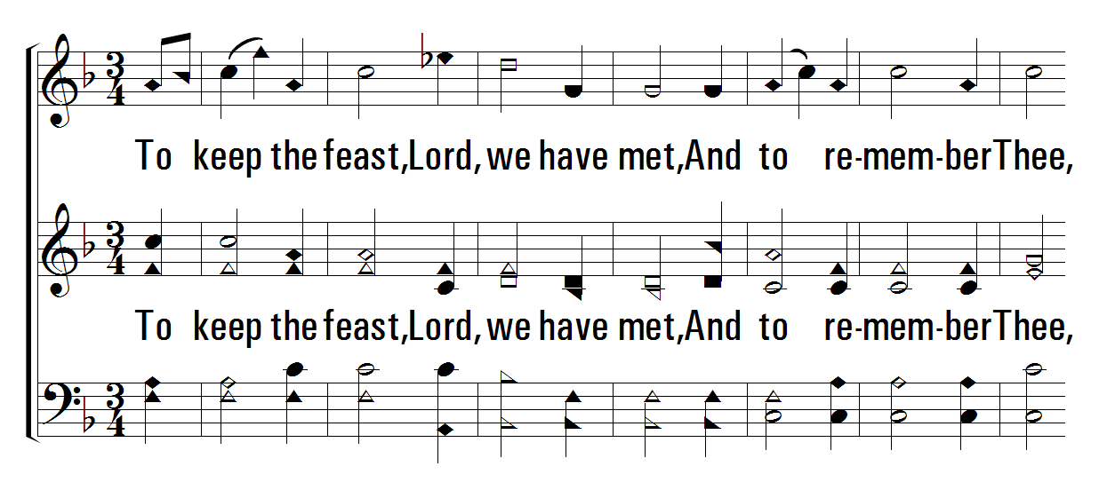
1
2
615
THAT DREADFUL NIGHT
© 2006 The Paperless Hymnal®

Slide 15
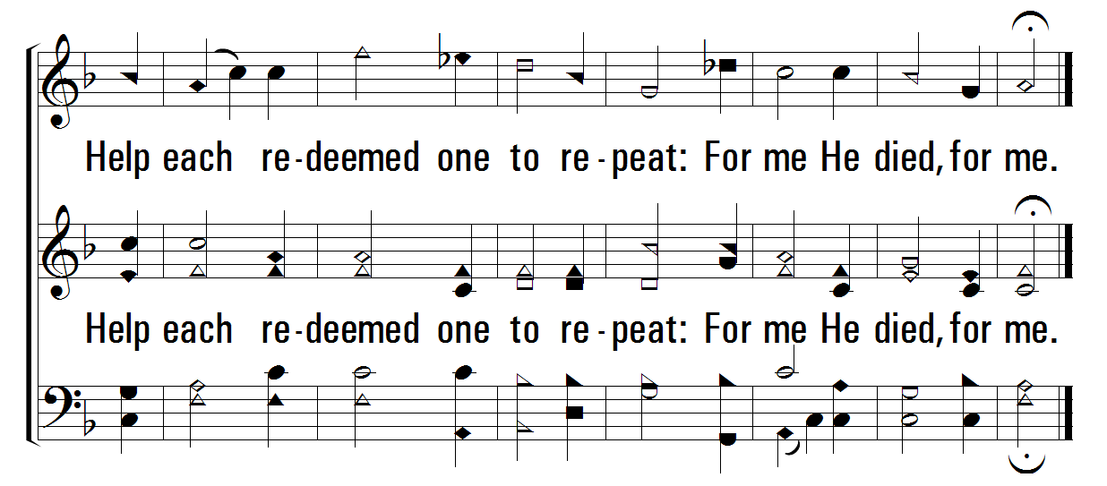
1
2
615
THAT DREADFUL NIGHT
© 2006 The Paperless Hymnal®

Slide 16

Welcome
Reading
Prayer
115 .
615 .
• Lord’s Supper
32 .
Collection
500 .
Sermon
739 .
Prayer
LORD’S
SUPPER
“DO THIS IN REMEMBRANCE OF ME” LUKE 22:19

Slide 17
Welcome
Reading
Prayer
115 .
615 .
Lord’s Supper
• 32 .
Collection
500 .
Sermon
739 .
Prayer
32
THEOPHANY (HIGH ABOVE THE SERAPHIM)
1
2
3
“SINGING...TO THE LORD”
COLOSSIANS 3:16
Theophany
© 2001 David and Jimona Maravilla
Tune: MAZURKA • Frederic Chopin (1829); arr. C. A. Roberts (2001)
Hymn: C. A. Roberts (2001)

Slide 18
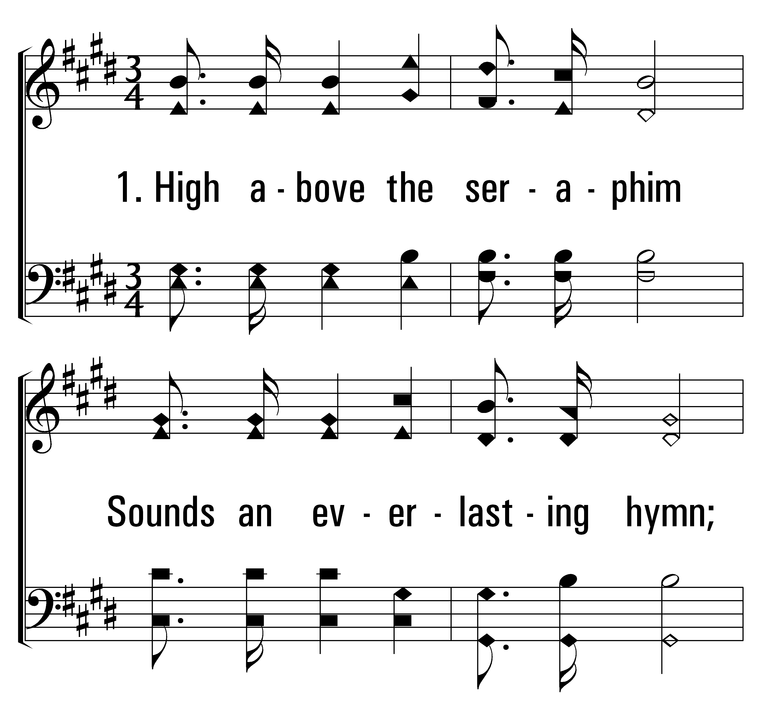

1
32
2
3
THEOPHANY (HIGH ABOVE THE SERAPHIM)
© 2014 Sumphonia Productions, LLC

Slide 19
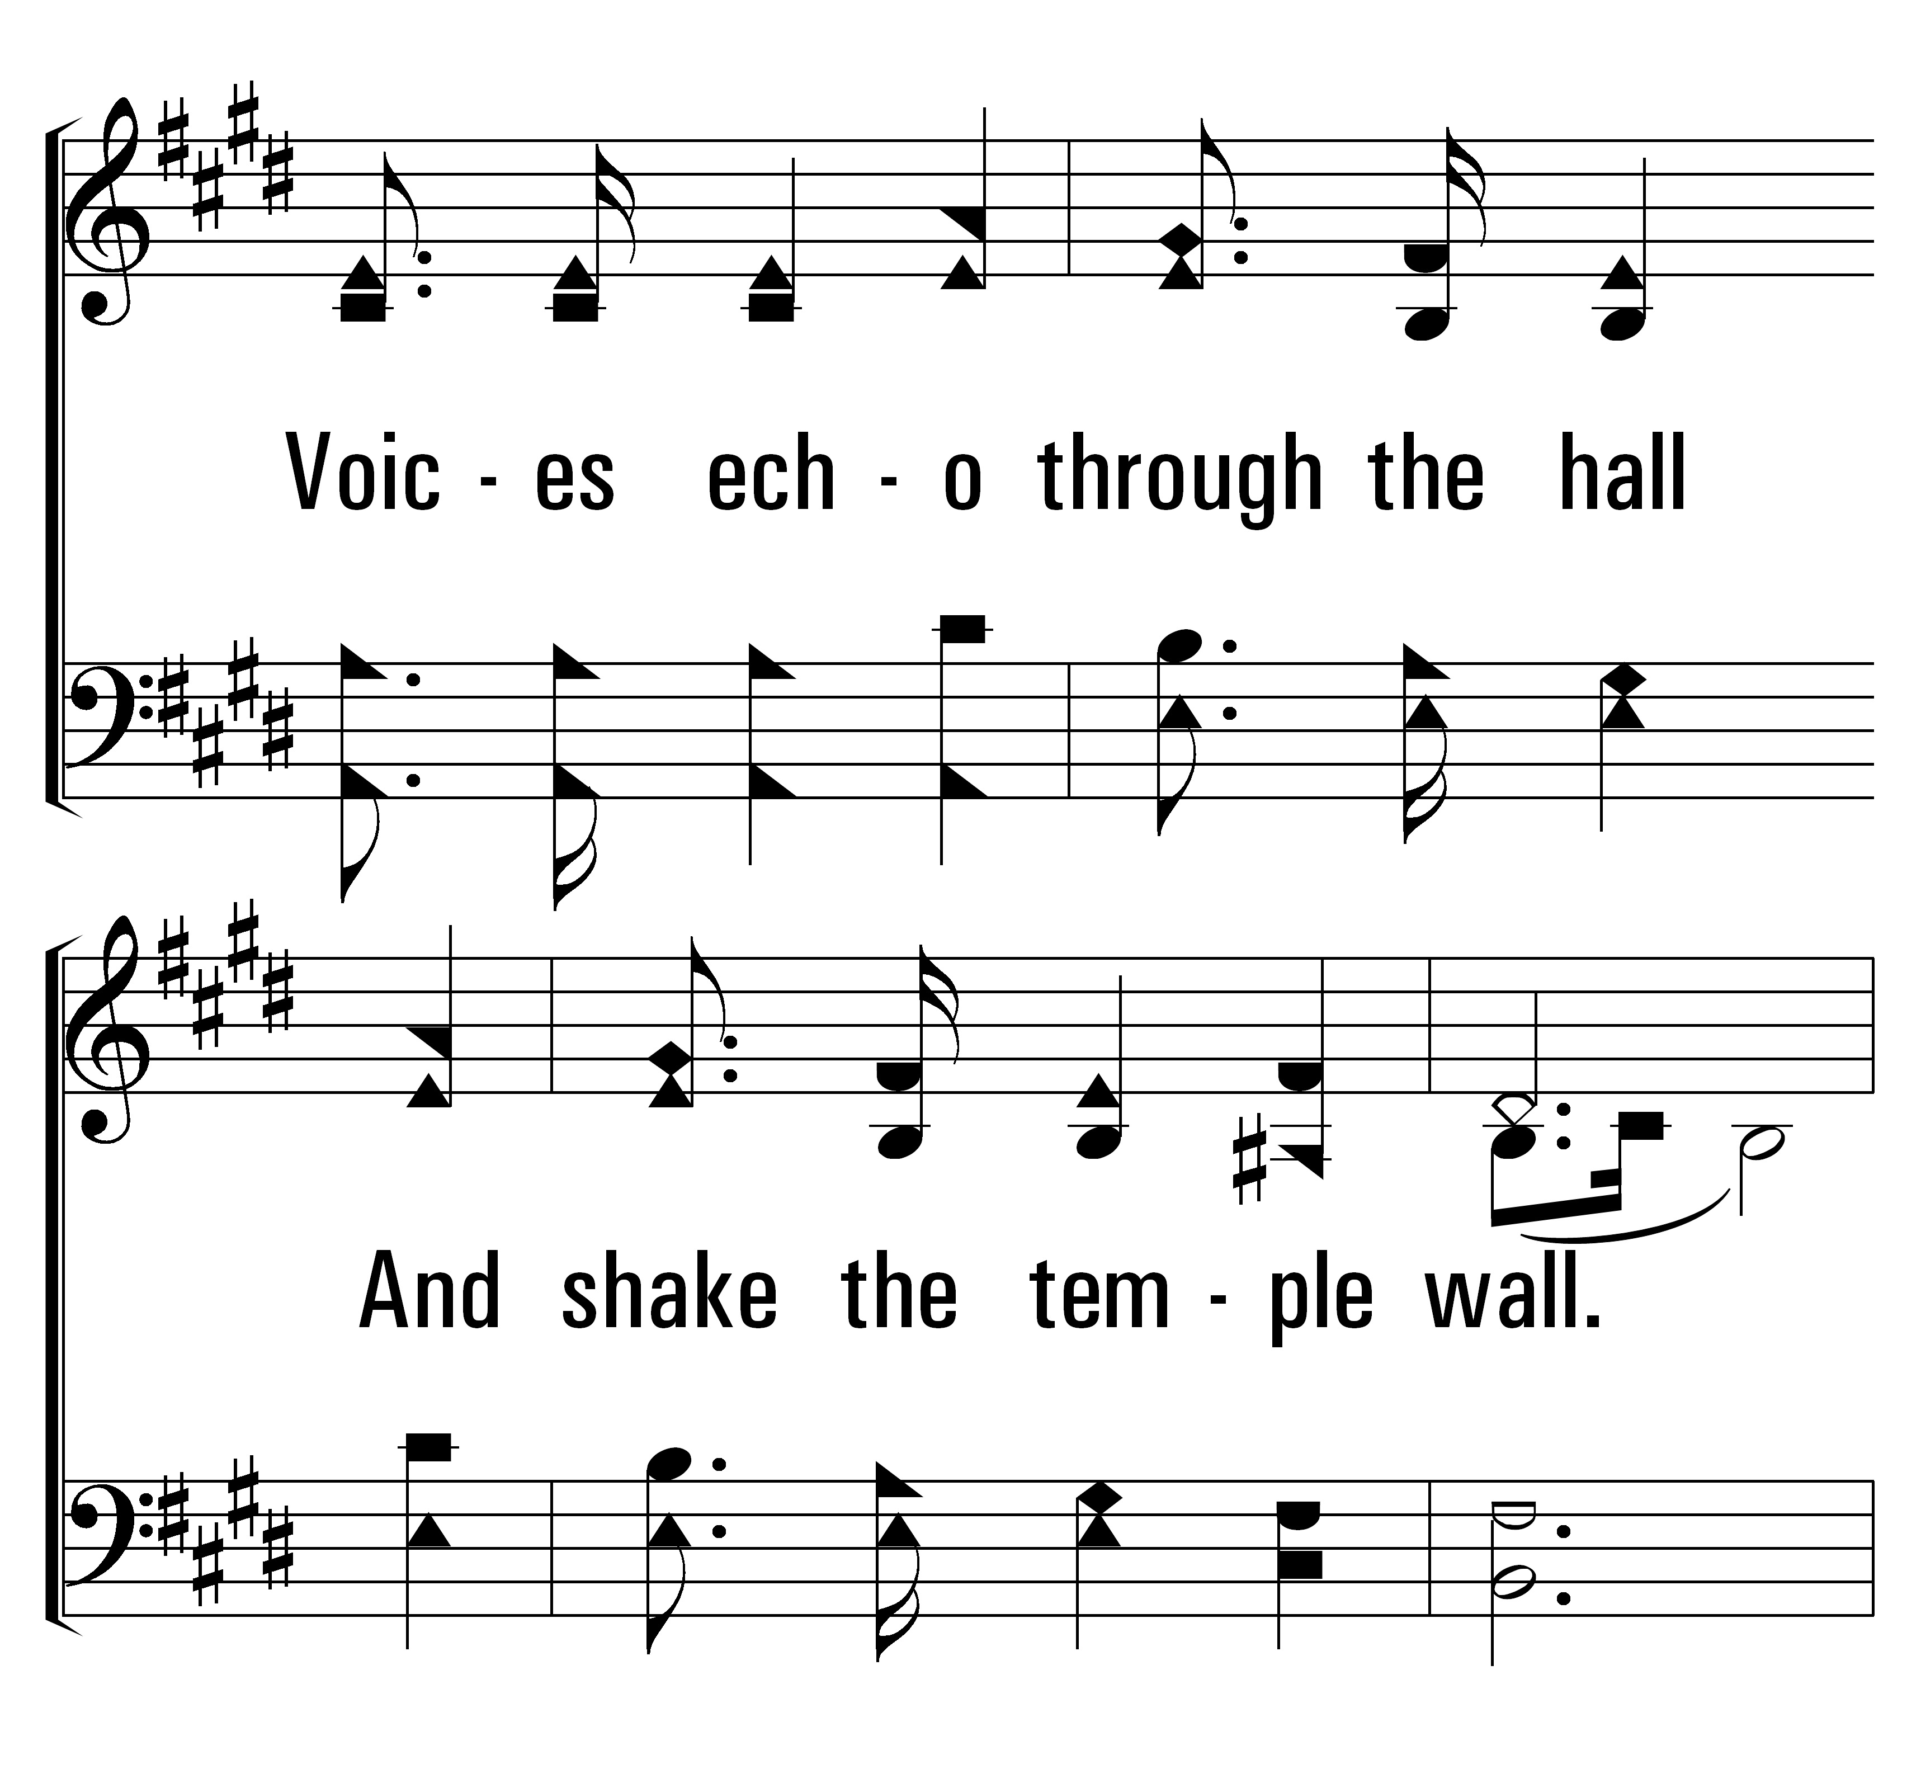
1
32
2
3
THEOPHANY (HIGH ABOVE THE SERAPHIM)
© 2014 Sumphonia Productions, LLC

Slide 20
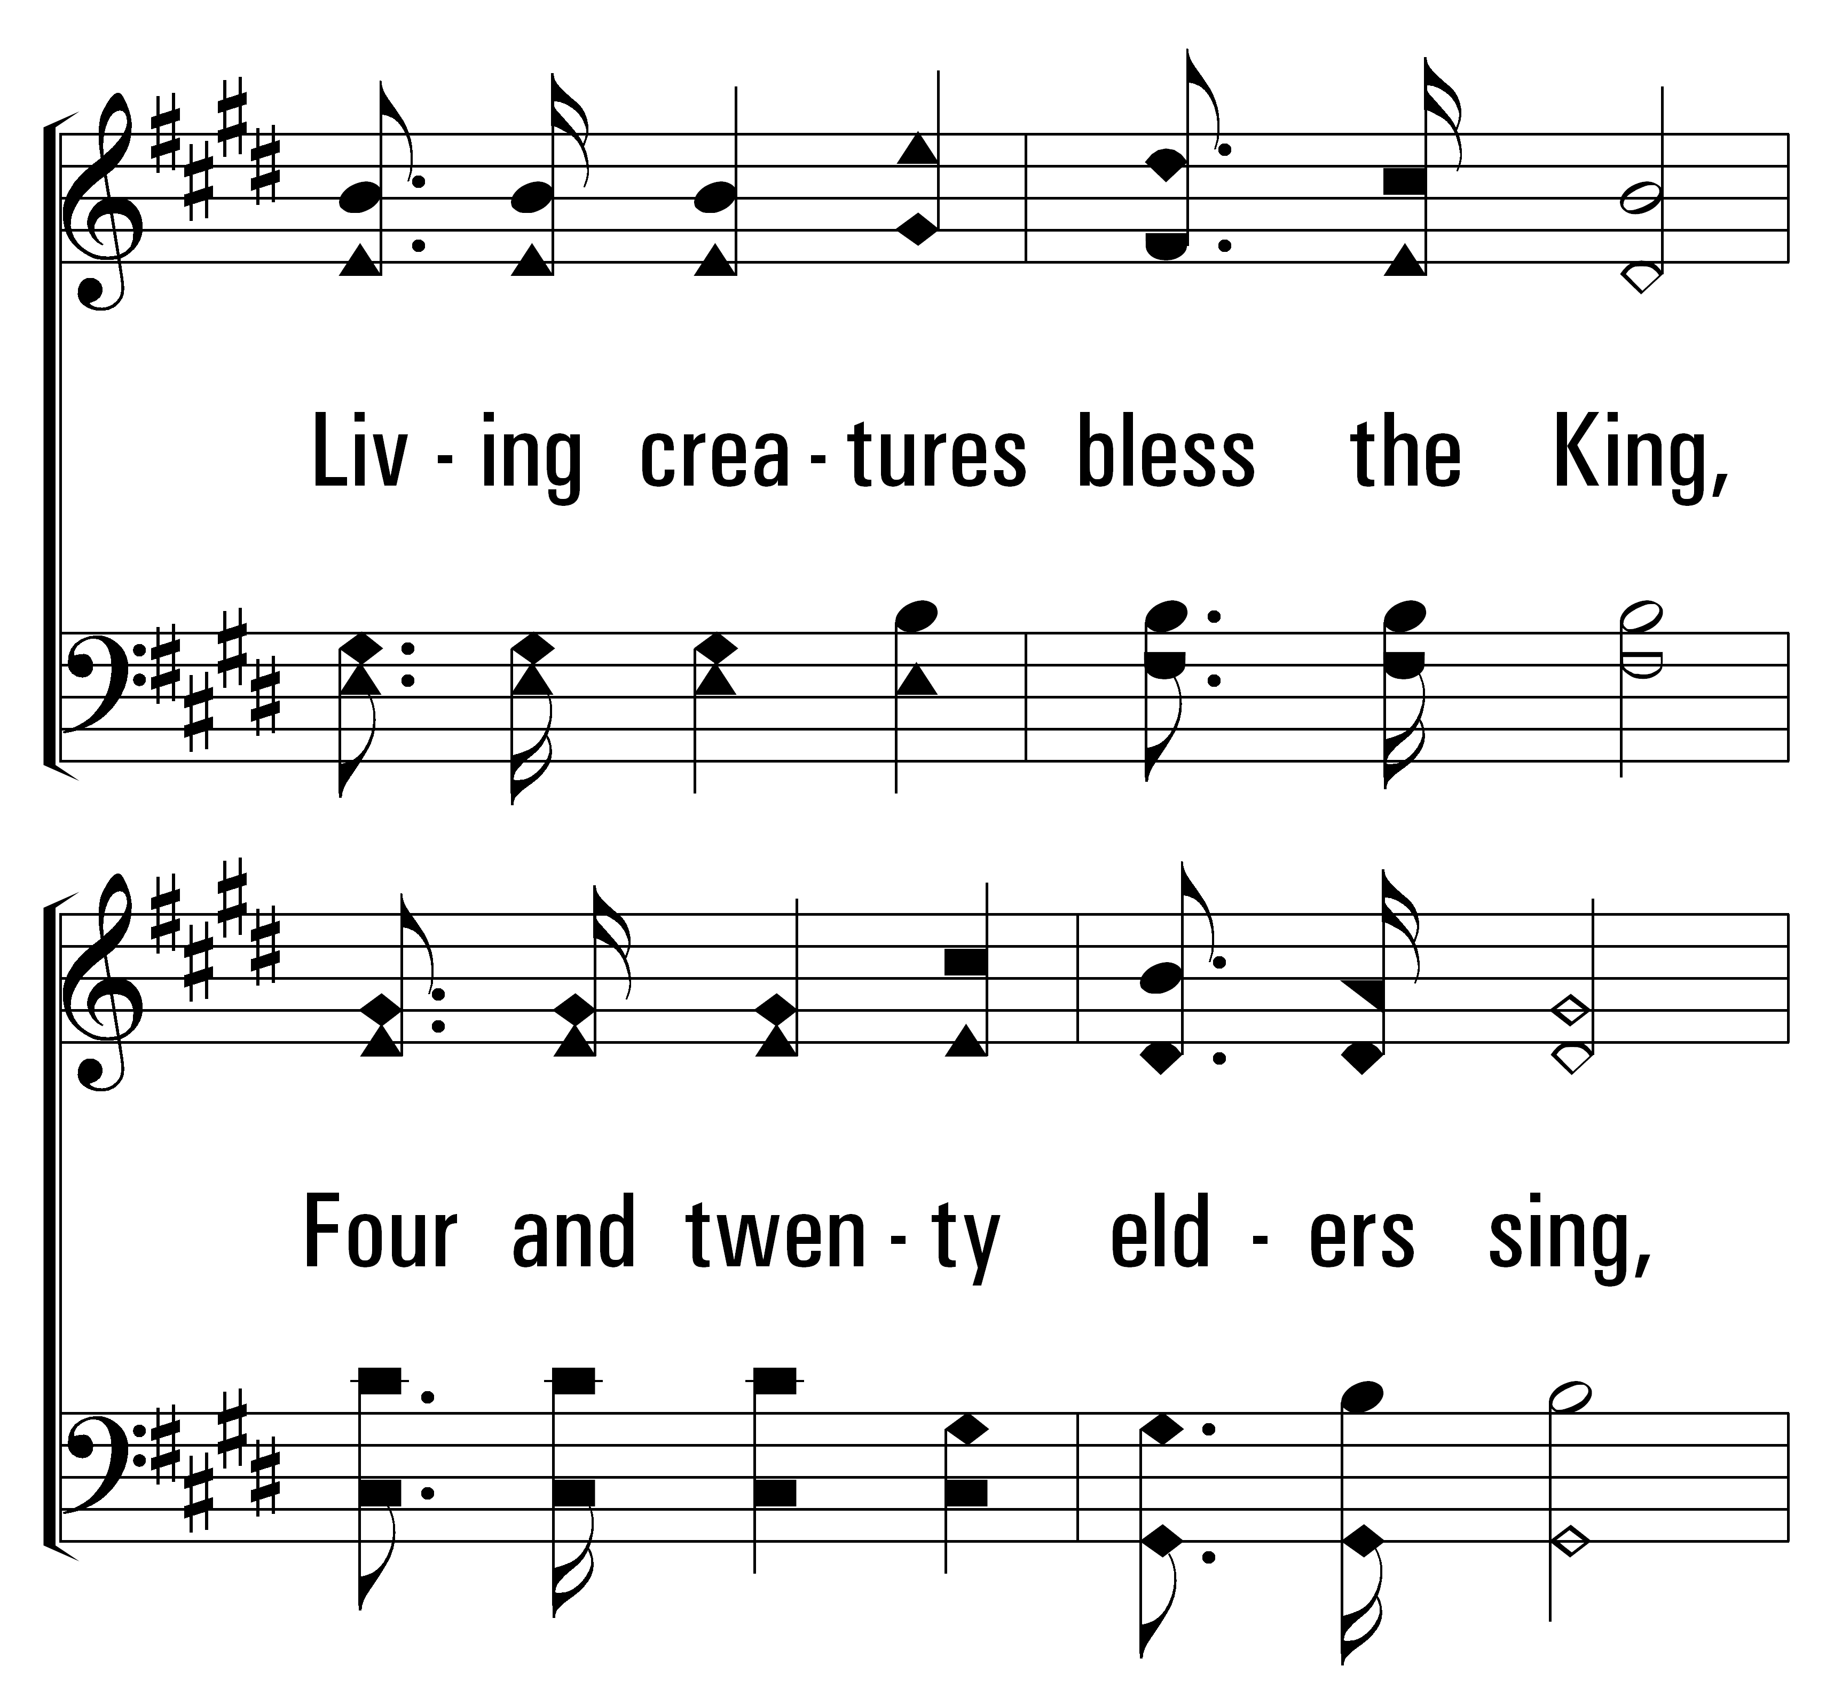
1
32
2
3
THEOPHANY (HIGH ABOVE THE SERAPHIM)
© 2014 Sumphonia Productions, LLC

Slide 21
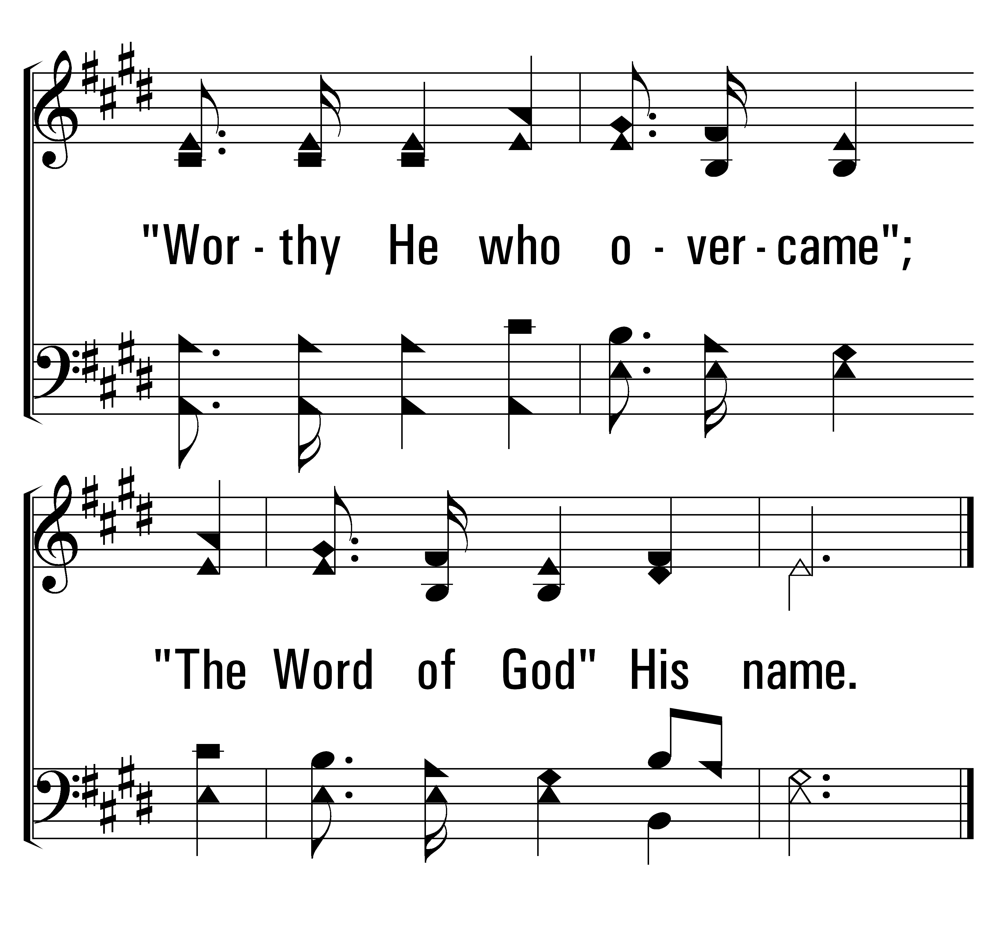
1
32
2
3
THEOPHANY (HIGH ABOVE THE SERAPHIM)
© 2014 Sumphonia Productions, LLC

Slide 22
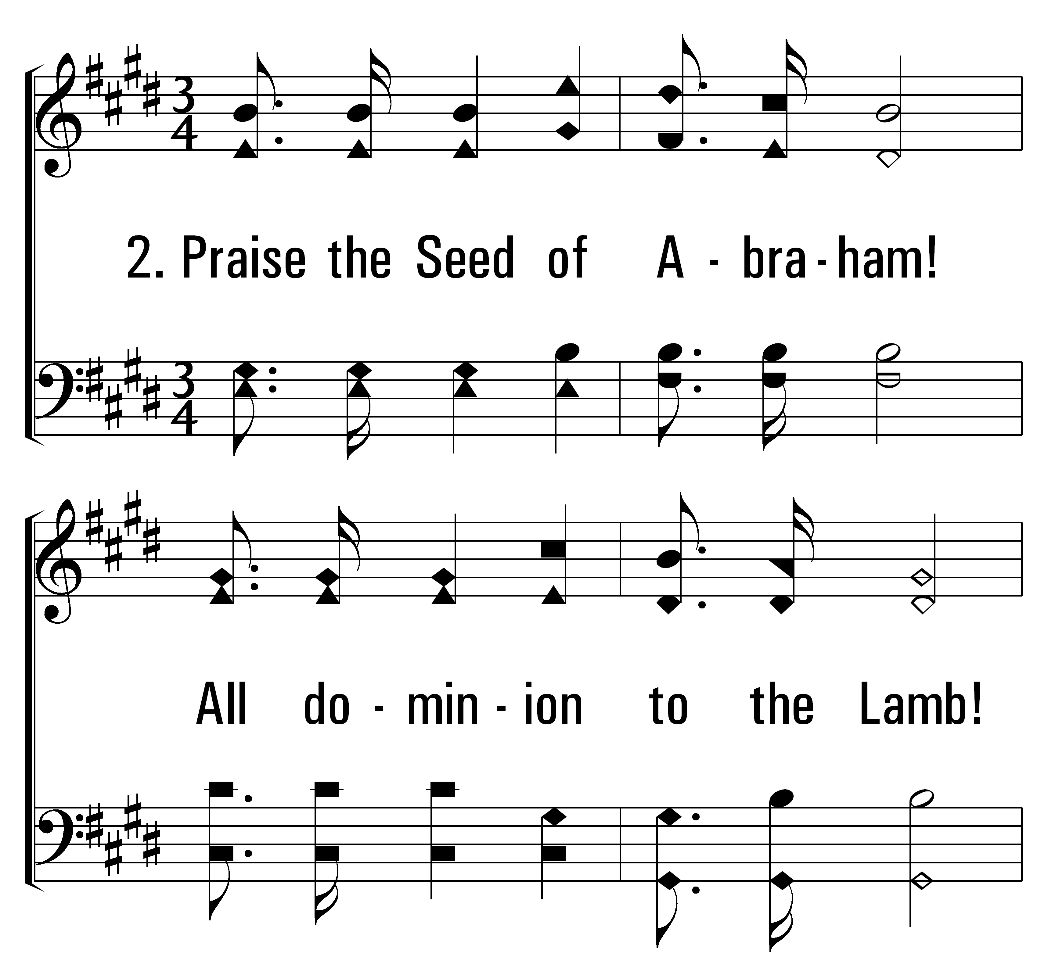
1
32
2
3
THEOPHANY (HIGH ABOVE THE SERAPHIM)
© 2014 Sumphonia Productions, LLC

Slide 23
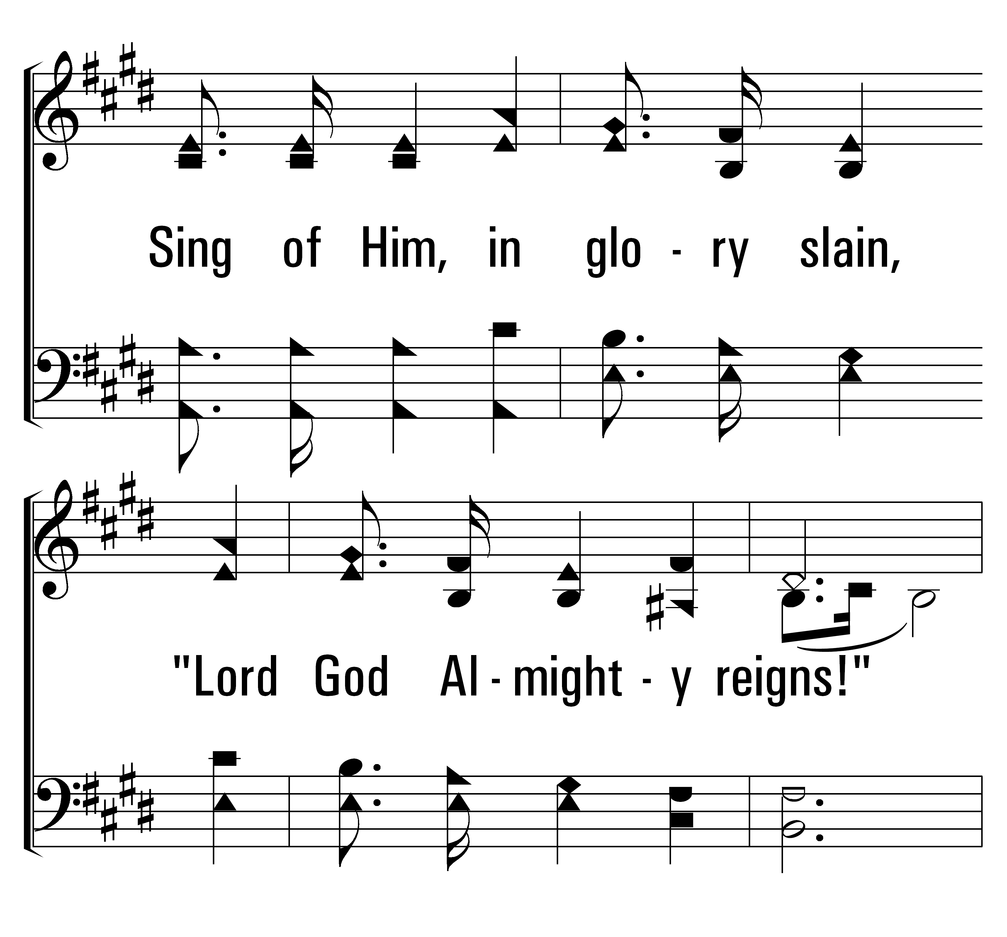
1
32
2
3
THEOPHANY (HIGH ABOVE THE SERAPHIM)
© 2014 Sumphonia Productions, LLC

Slide 24
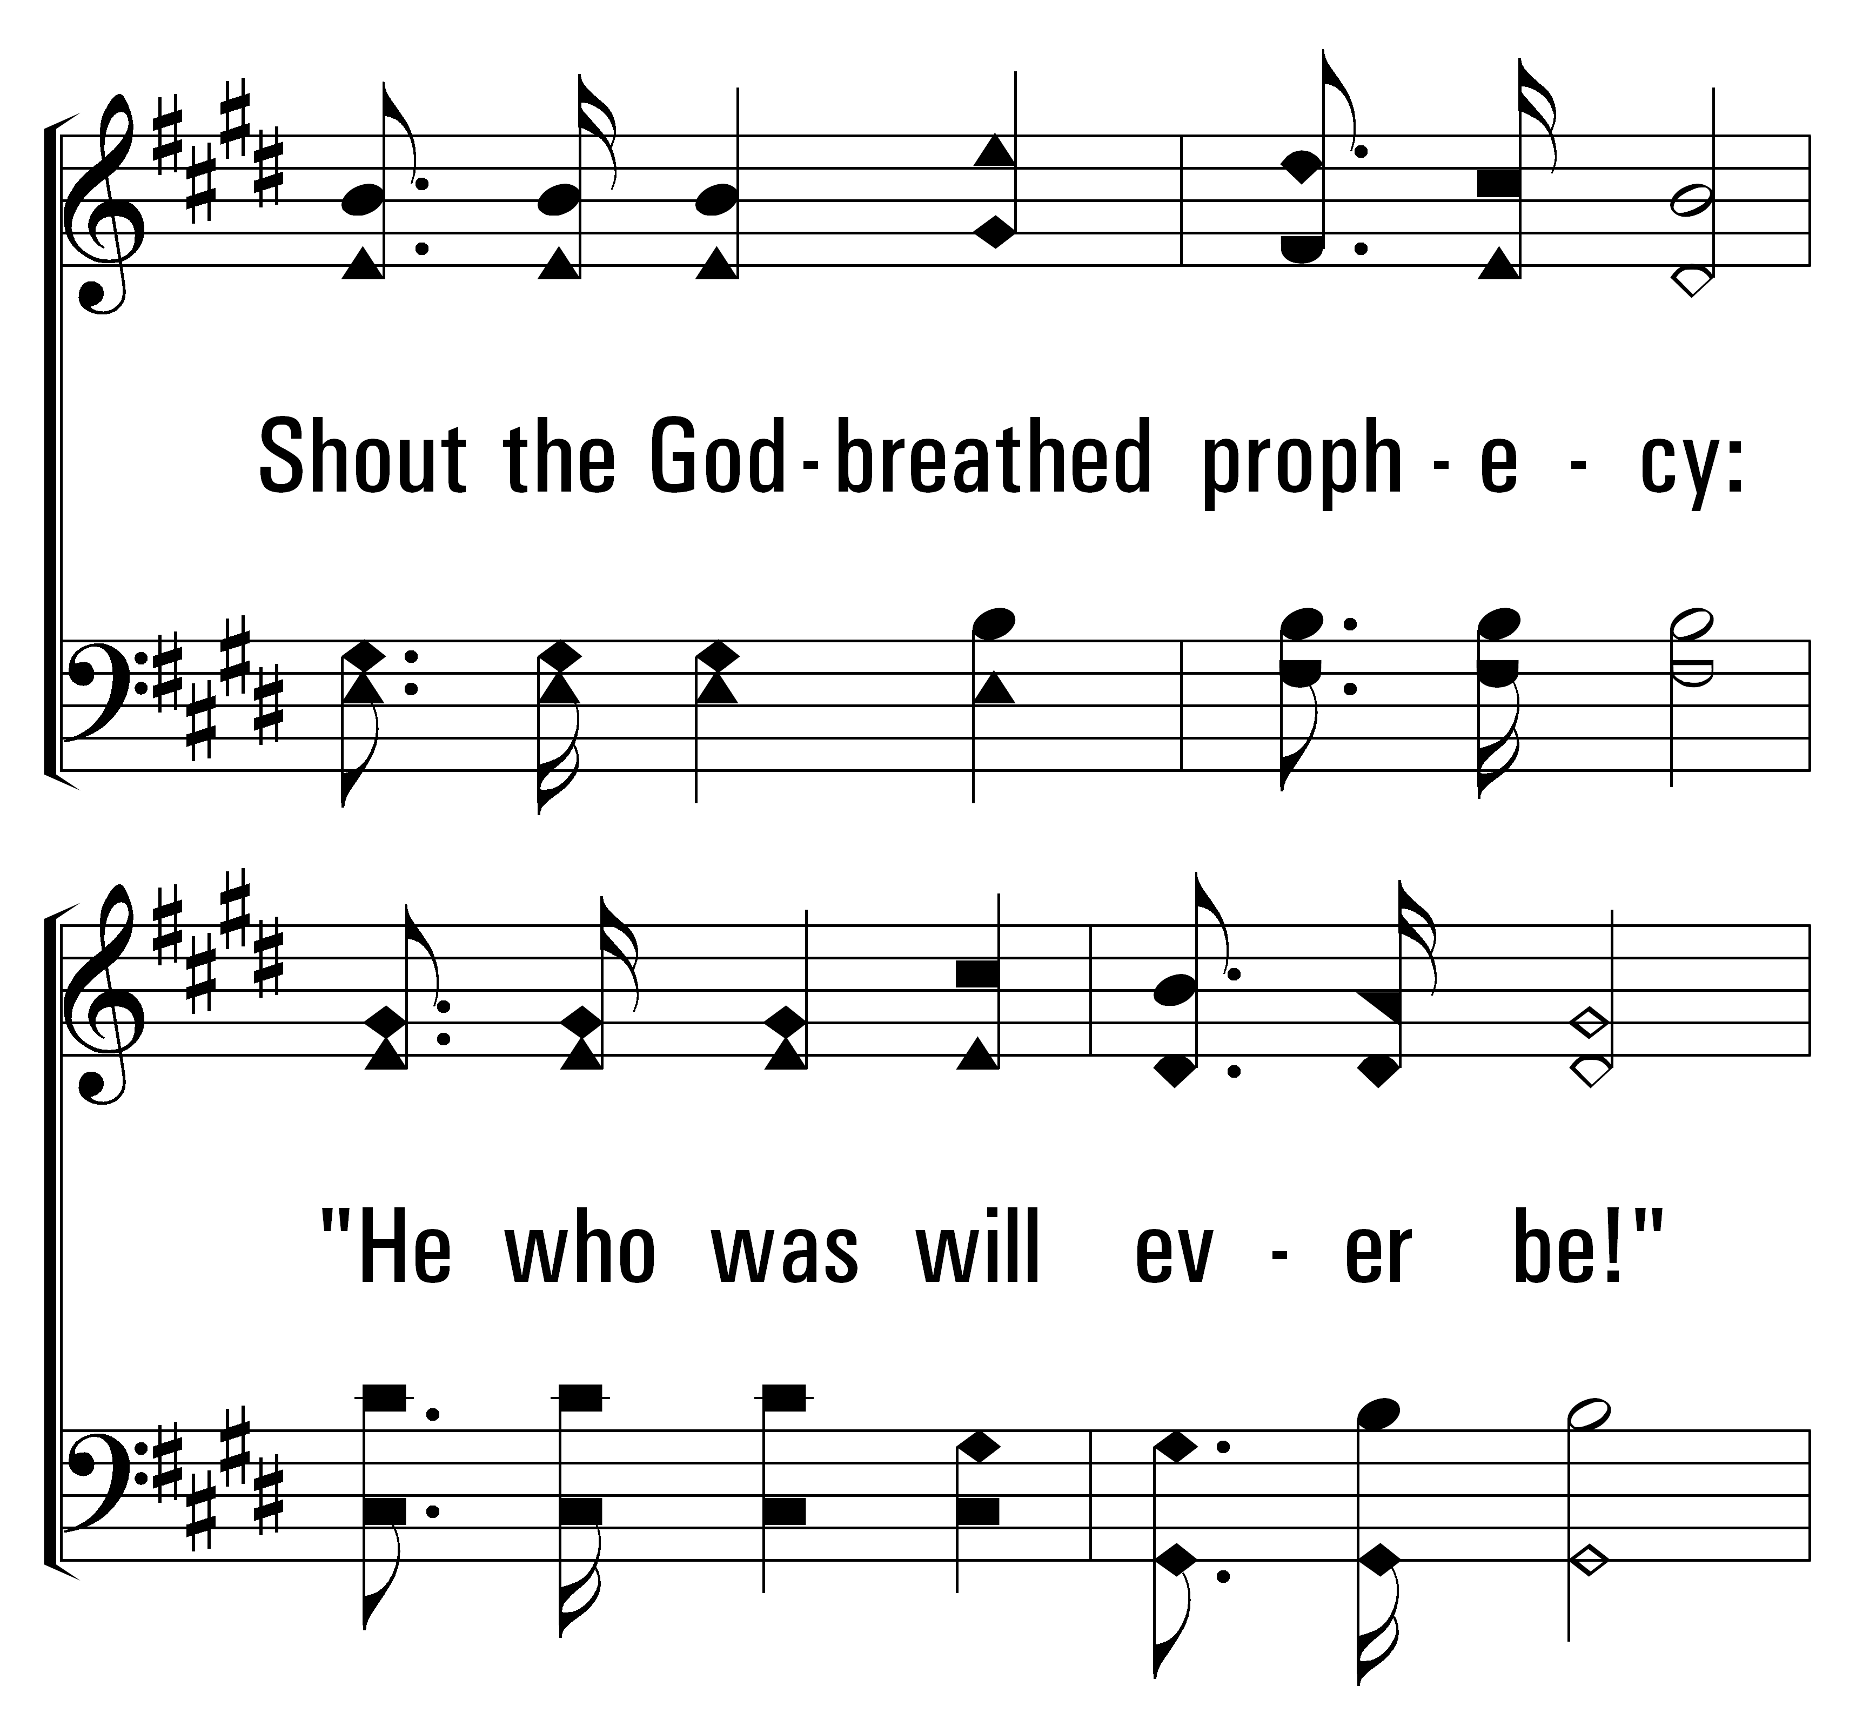
1
32
2
3
THEOPHANY (HIGH ABOVE THE SERAPHIM)
© 2014 Sumphonia Productions, LLC

Slide 25
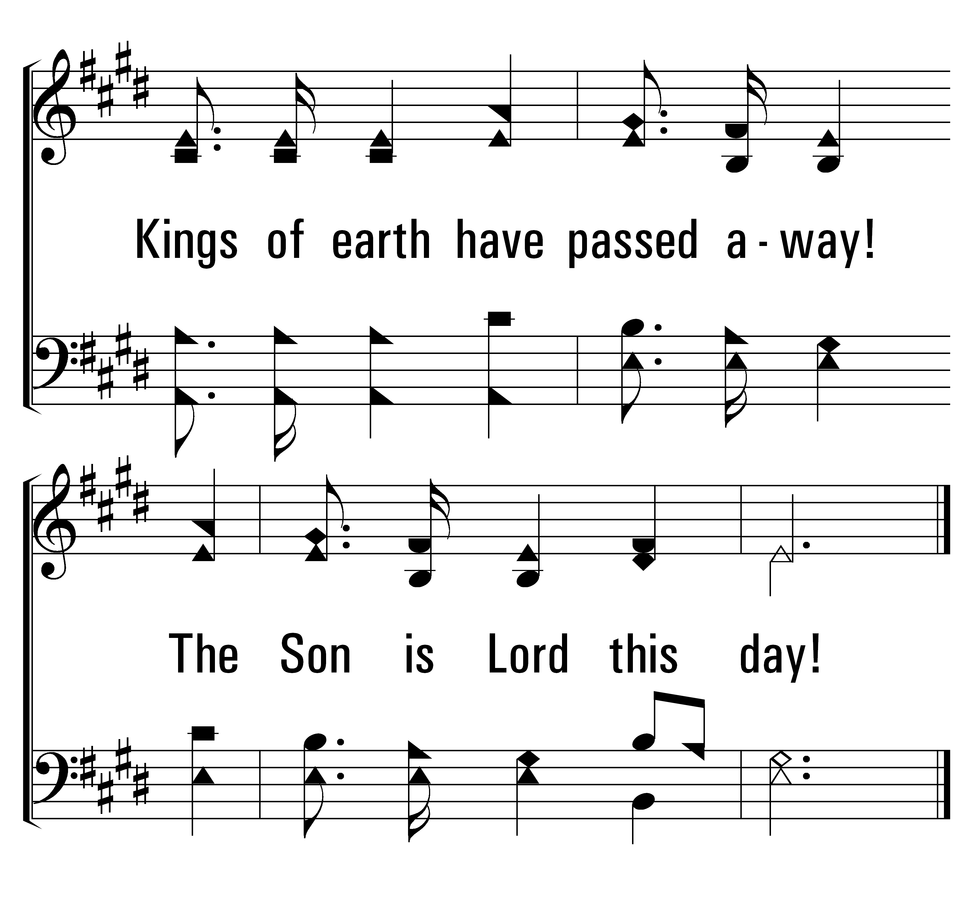
1
32
2
3
THEOPHANY (HIGH ABOVE THE SERAPHIM)
© 2014 Sumphonia Productions, LLC

Slide 26
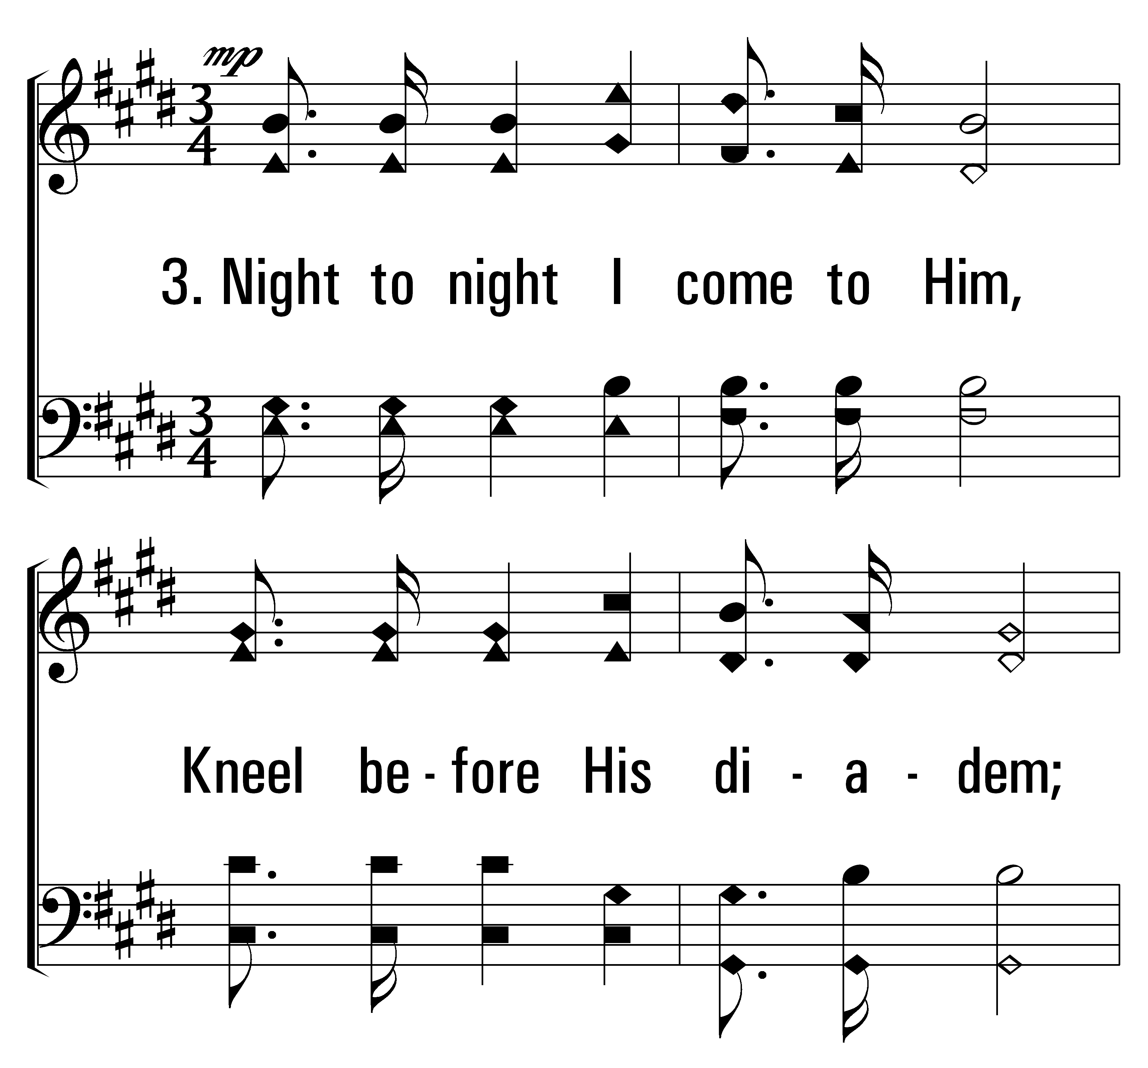
1
32
2
3
THEOPHANY (HIGH ABOVE THE SERAPHIM)
© 2014 Sumphonia Productions, LLC

Slide 27
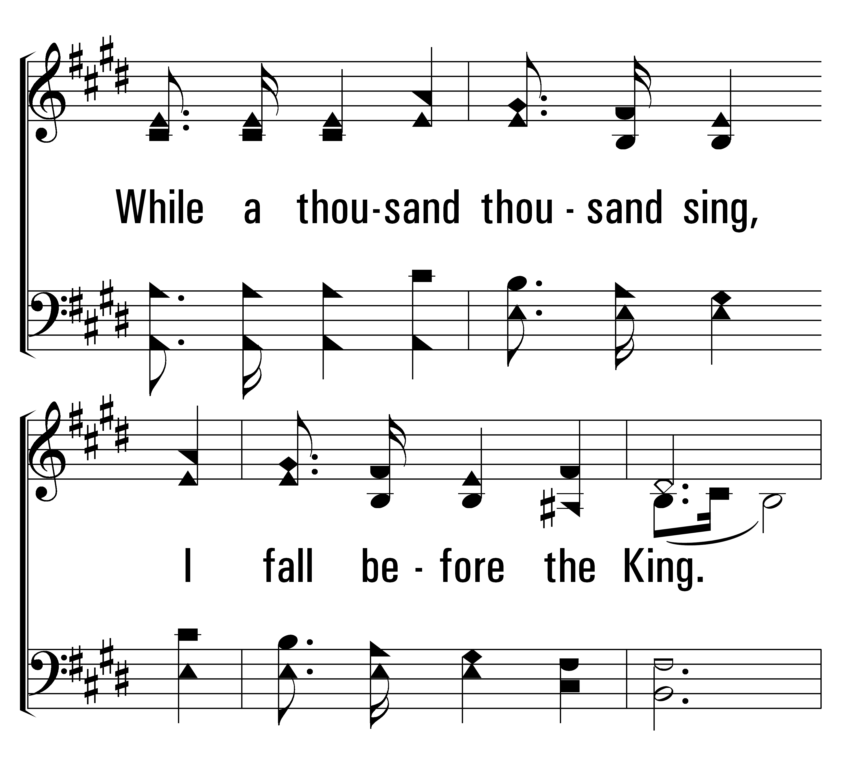
1
32
2
3
THEOPHANY (HIGH ABOVE THE SERAPHIM)
© 2014 Sumphonia Productions, LLC

Slide 28
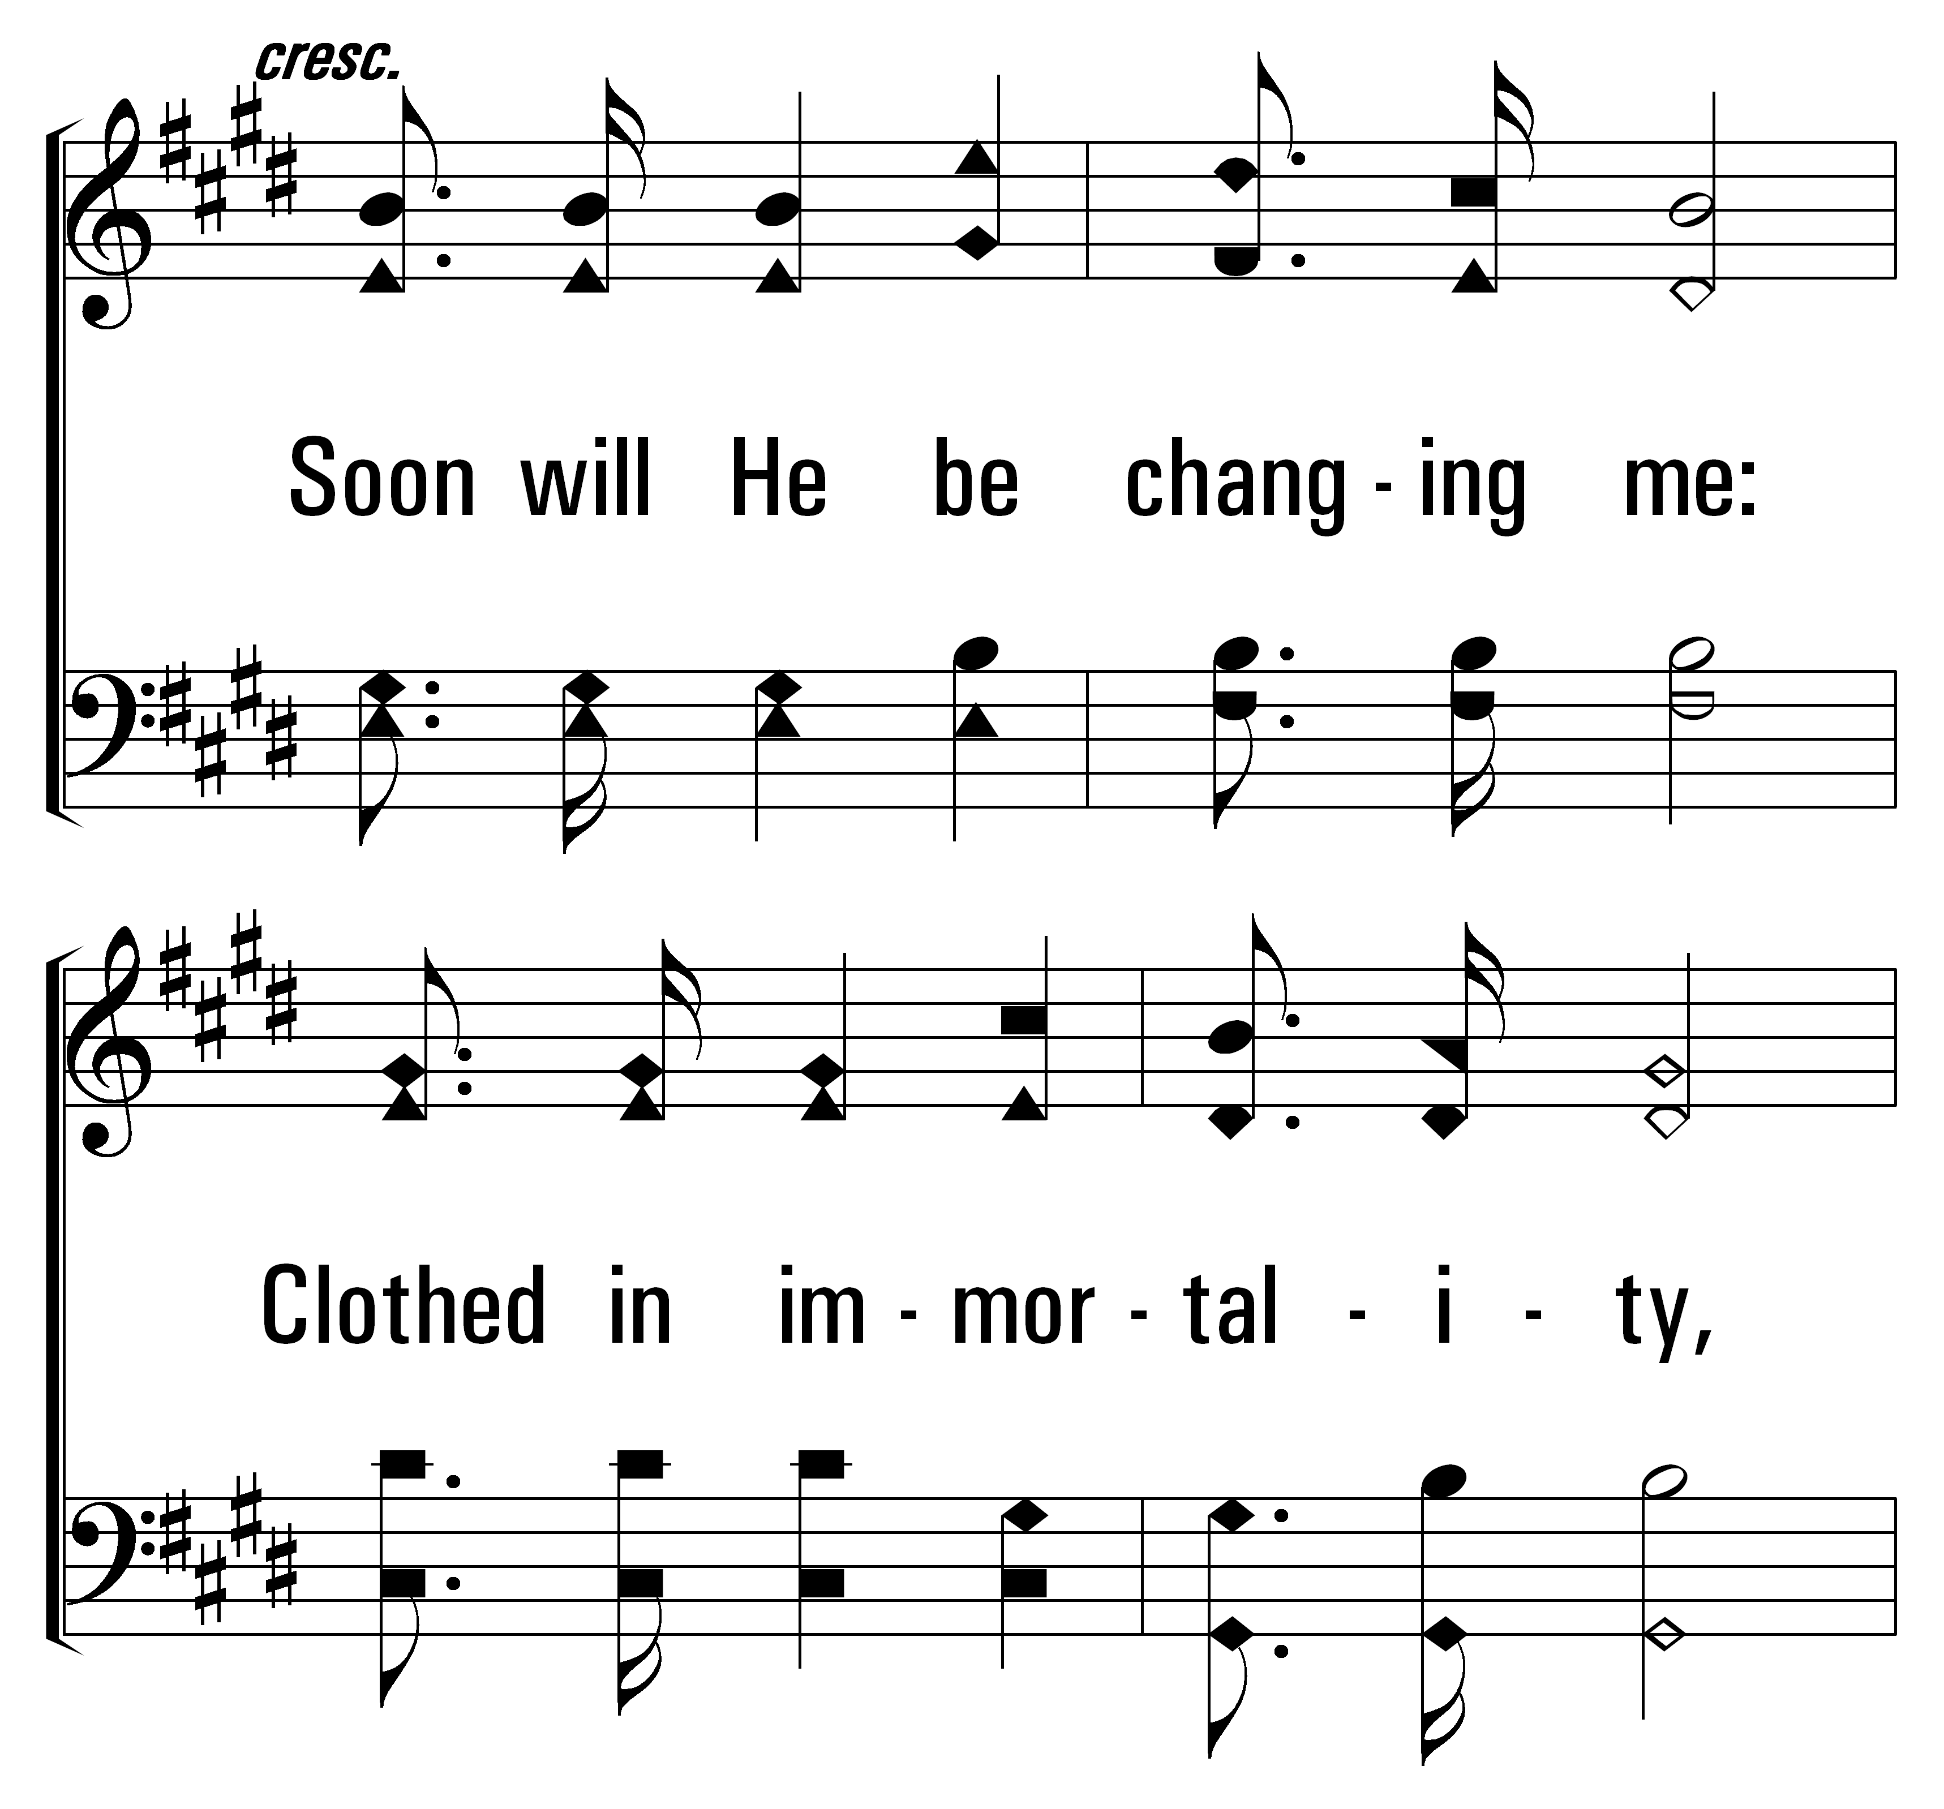
1
32
2
3
THEOPHANY (HIGH ABOVE THE SERAPHIM)
© 2014 Sumphonia Productions, LLC

Slide 29
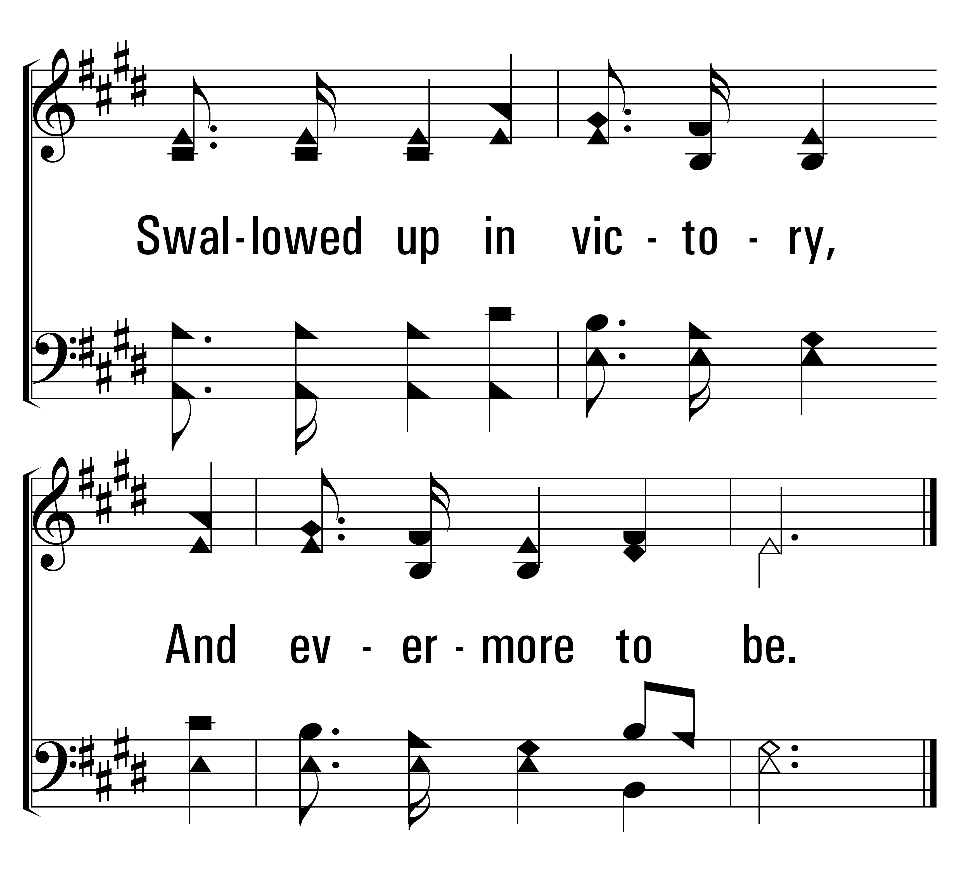
1
32
2
3
THEOPHANY (HIGH ABOVE THE SERAPHIM)
© 2014 Sumphonia Productions, LLC

Slide 30

Welcome
Reading
Prayer
115 .
615 .
Lord’s Supper
32 .
• Collection
500 .
Sermon
739 .
Prayer
GIVING
THE COLLECTION FOR THE SAINTS
“FOR GOD LOVES A CHEERFUL GIVER” 2 CORINTHIANS 9:7

Slide 31
Welcome
Reading
Prayer
115 .
615 .
Lord’s Supper
32 .
Collection
500 .
Sermon
• 739 .
Prayer
739
WHAT WILL YOU DO WITH JESUS?
1
2
3
“SINGING...TO THE LORD”
COLOSSIANS 3:16
Words: James Robinson
Music: Bentley D. Ackley

Slide 32


Welcome
Reading
Prayer
115 .
615 .
Lord’s Supper
32 .
Collection
• 500 .
Sermon
739 .
Prayer
500
O THOU FOUNT OF EVERY BLESSING
1
2
3
“SINGING...TO THE LORD”
COLOSSIANS 3:16
Words: Robert Robinson
Music: Wyeth’s Repository of Sacred Music

Slide 33

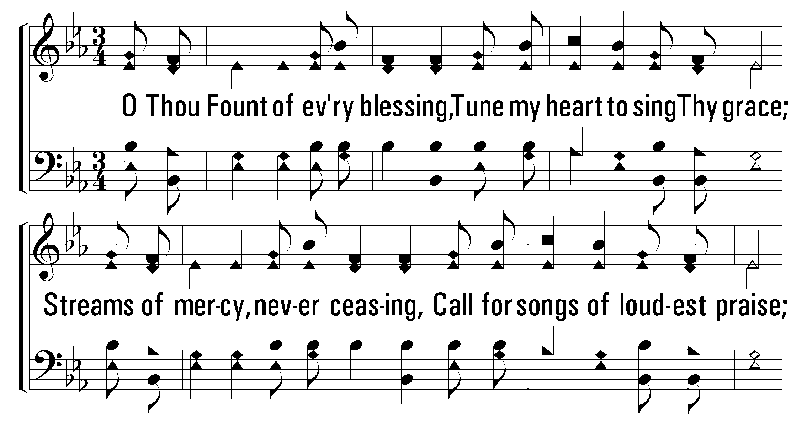
1
2
3
500
O THOU FOUNT OF EVERY BLESSING
© 2001 The Paperless Hymnal™

Slide 34
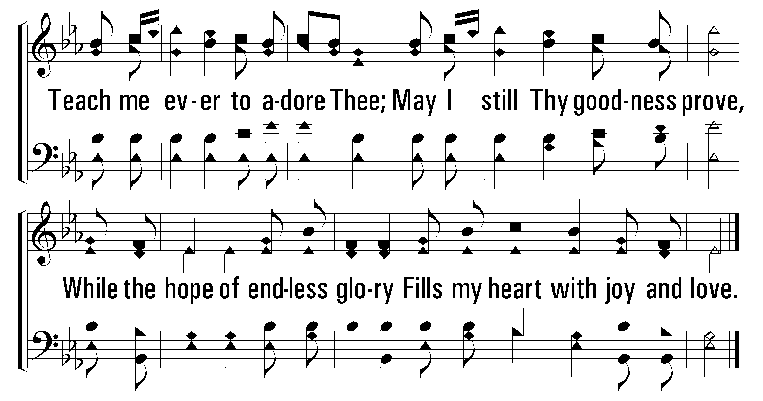
1
2
3
500
O THOU FOUNT OF EVERY BLESSING
© 2001 The Paperless Hymnal™

Slide 35
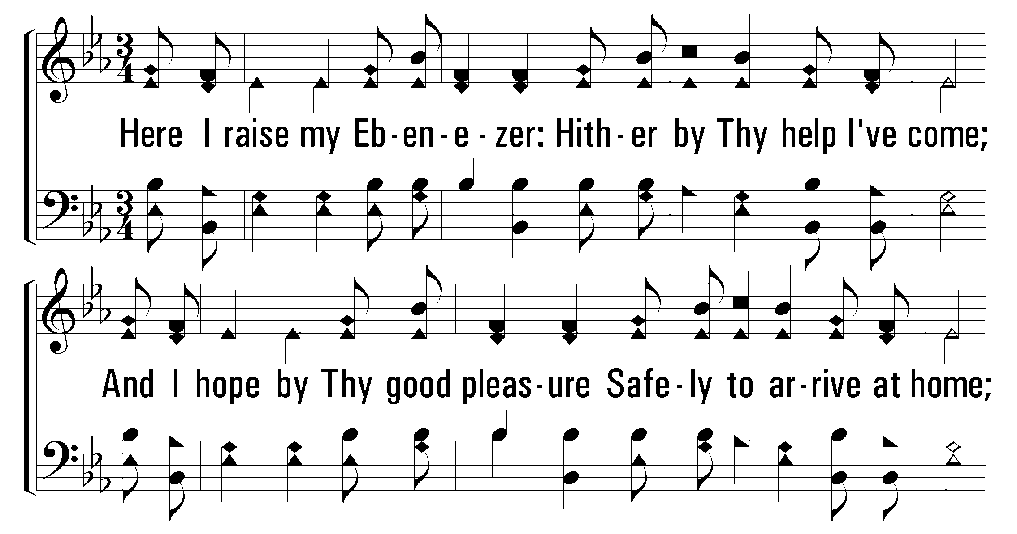
1
2
3
500
O THOU FOUNT OF EVERY BLESSING
© 2001 The Paperless Hymnal™

Slide 36
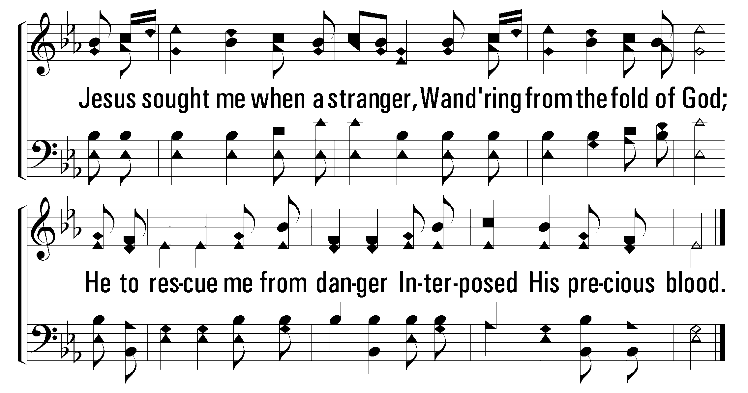
1
2
3
500
O THOU FOUNT OF EVERY BLESSING
© 2001 The Paperless Hymnal™

Slide 37
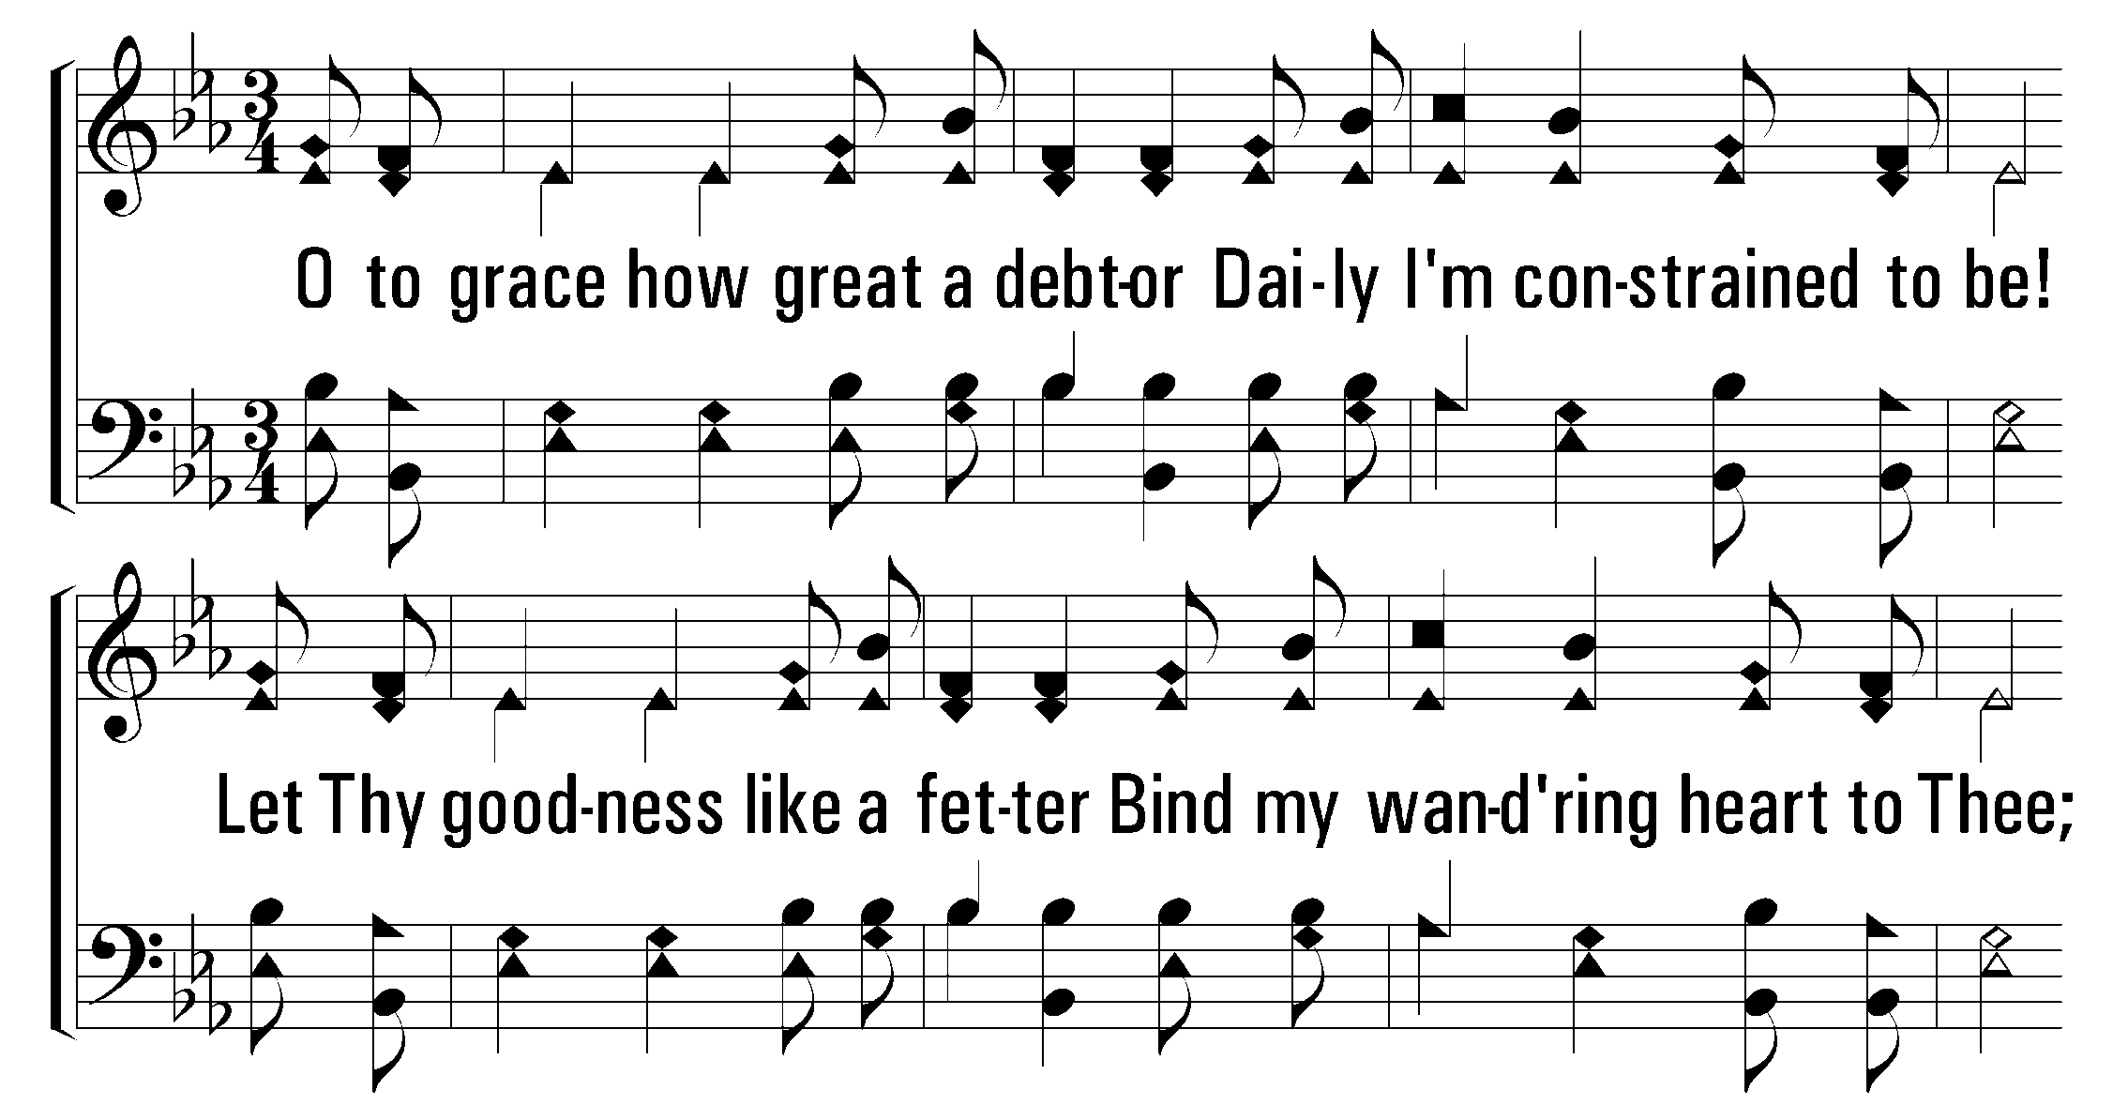
1
2
3
500
O THOU FOUNT OF EVERY BLESSING
© 2001 The Paperless Hymnal™

Slide 38
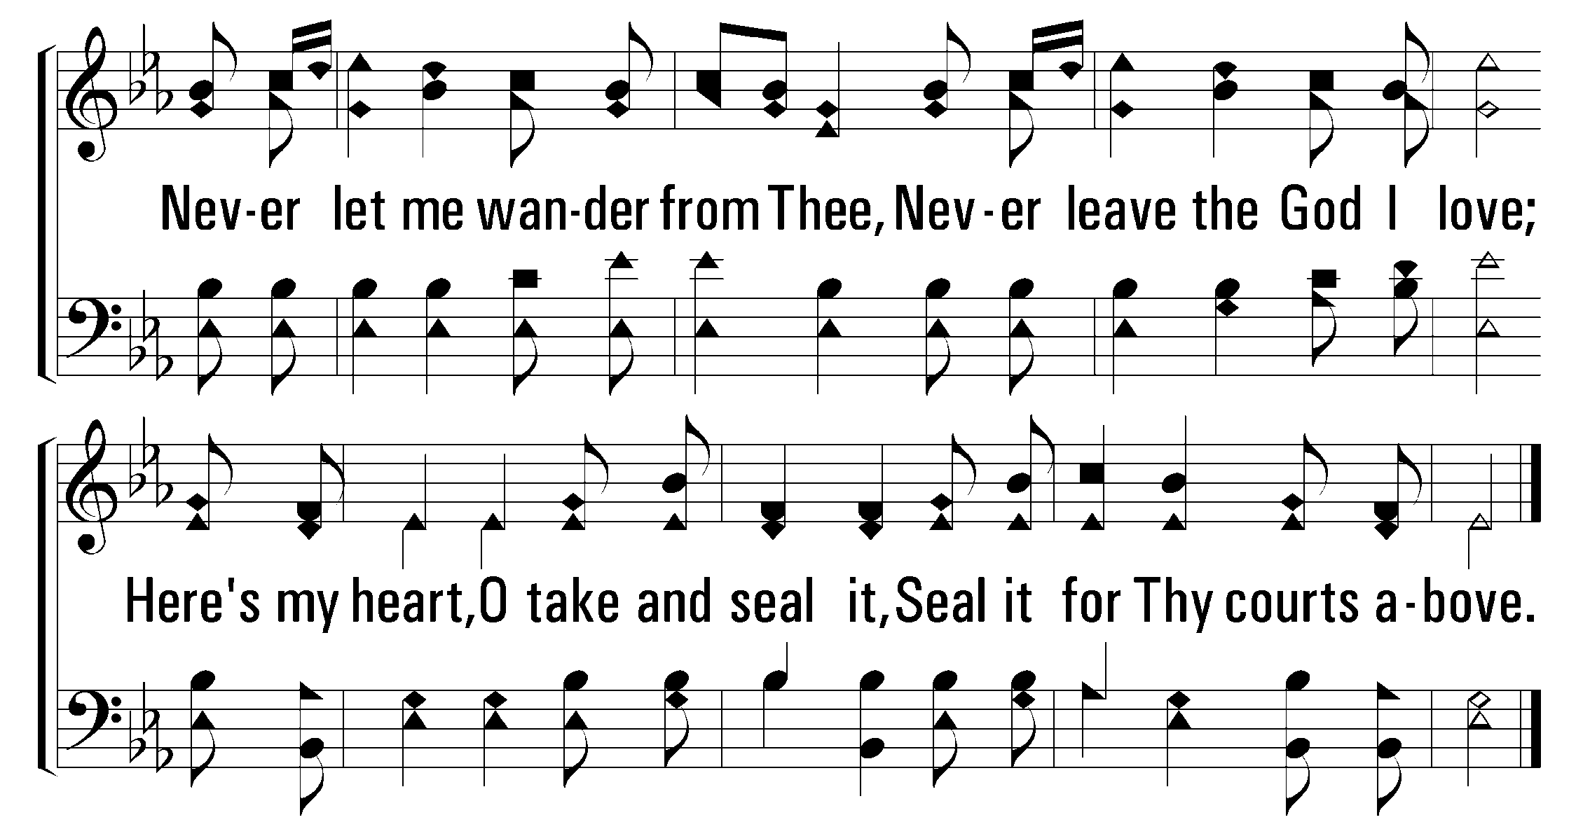
1
2
3
500
O THOU FOUNT OF EVERY BLESSING
© 2001 The Paperless Hymnal™

Slide 40
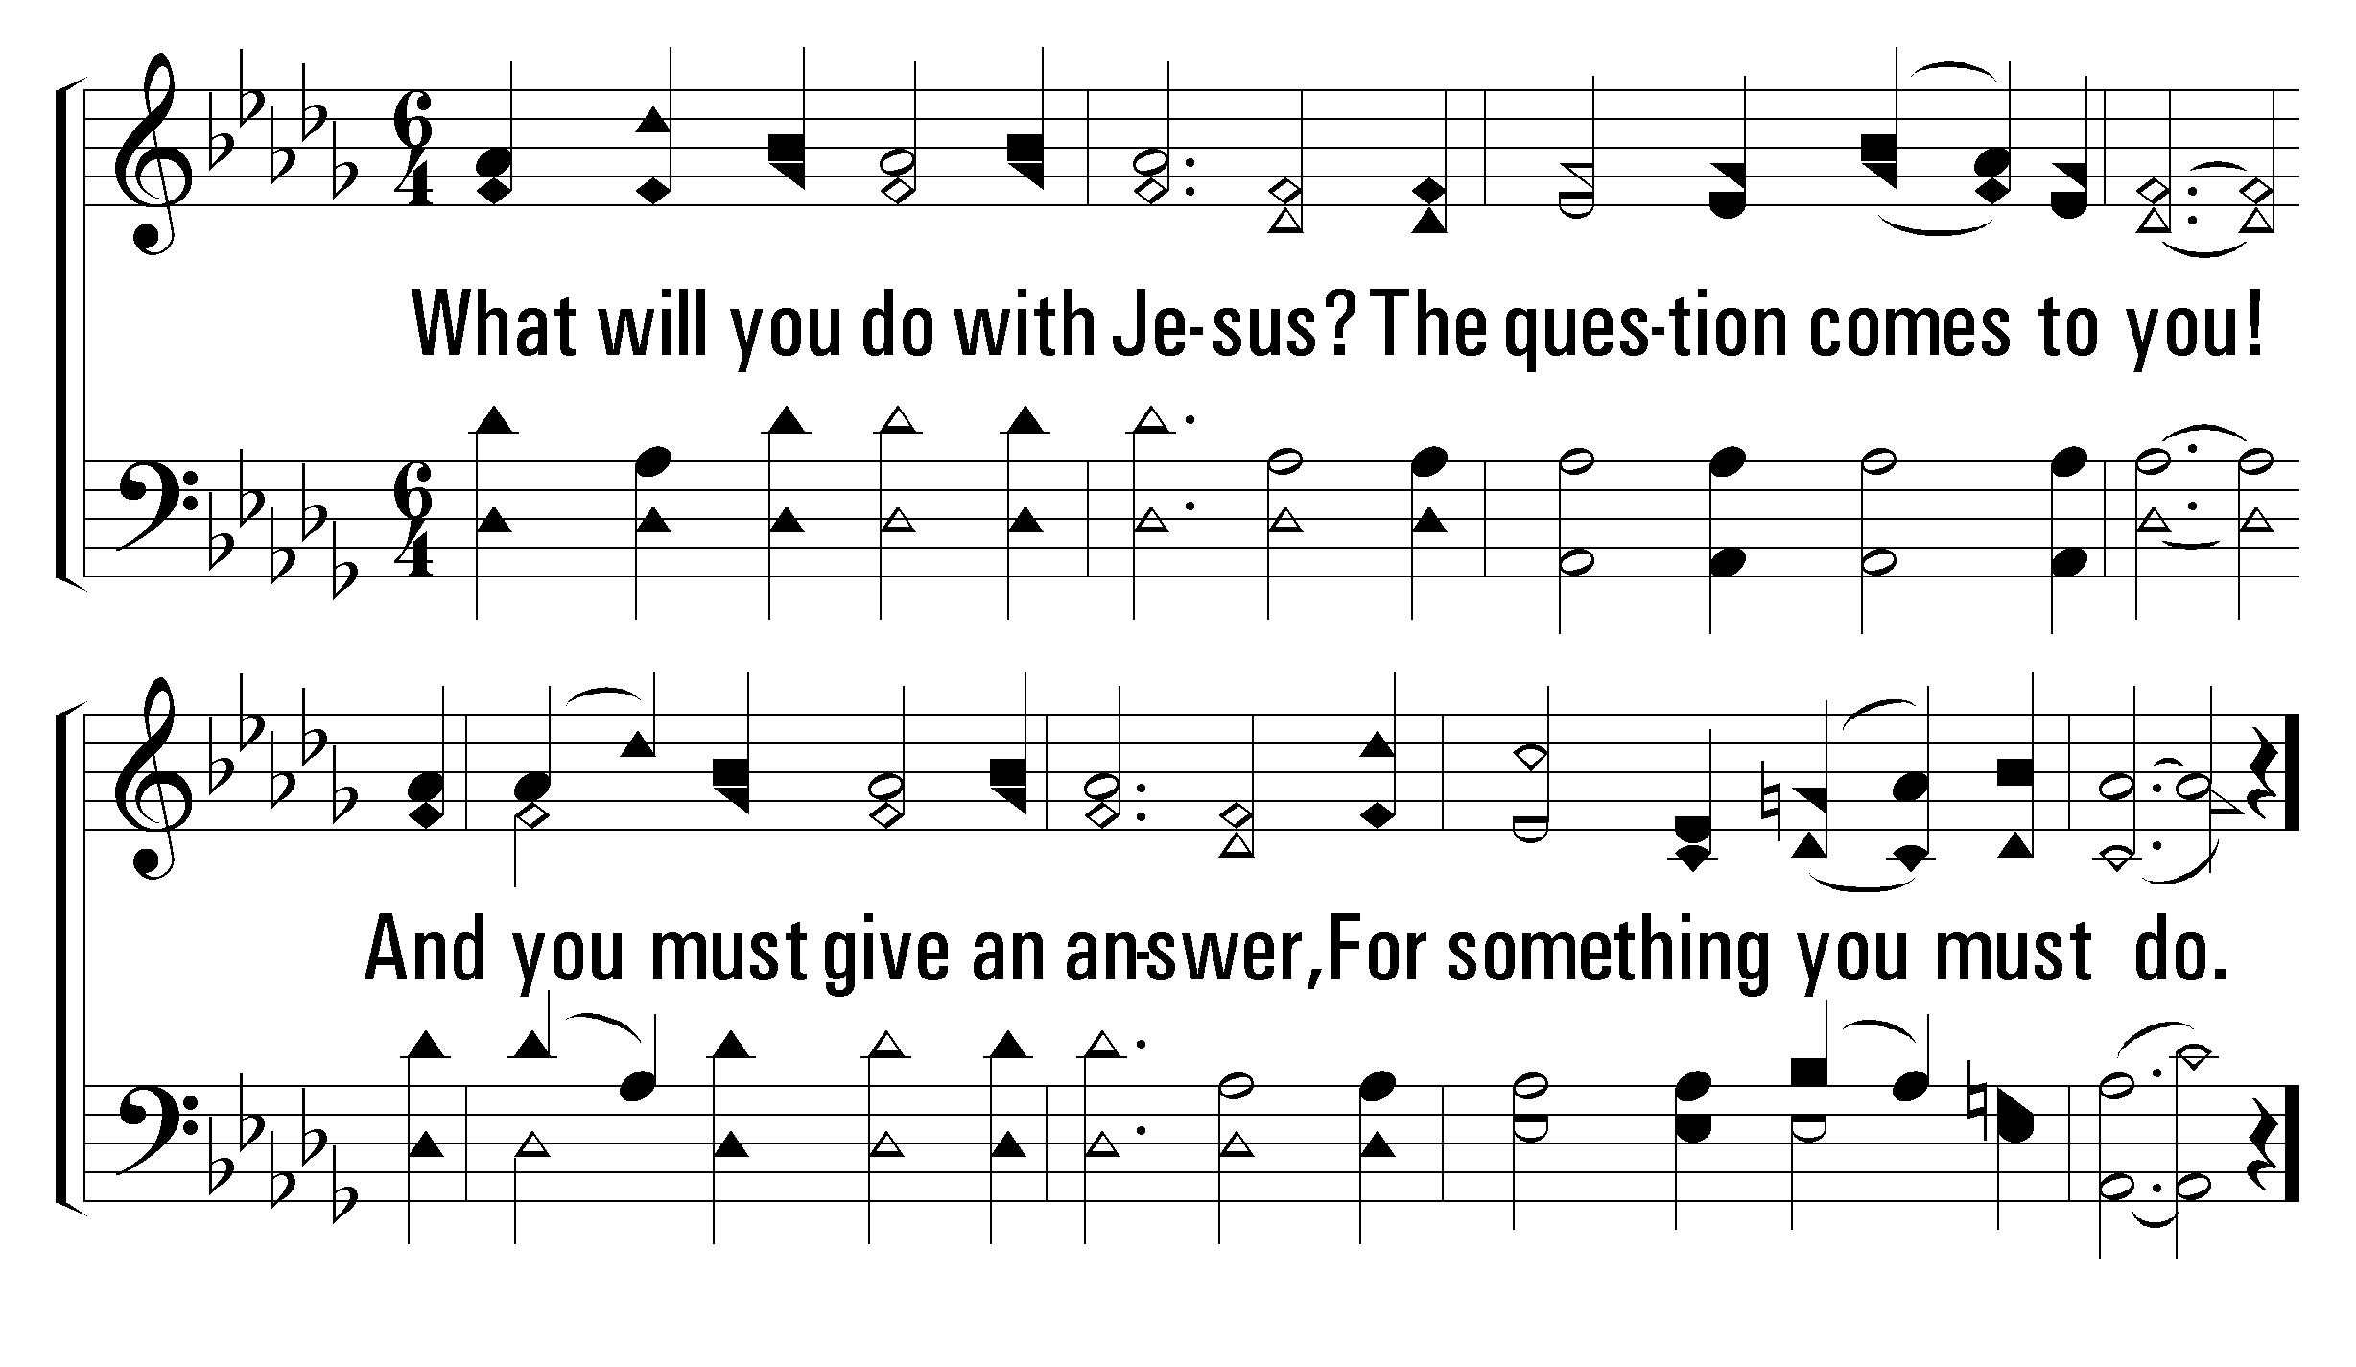
1
C
2
C
3
C
739
WHAT WILL YOU DO WITH JESUS?
© 2004 The Paperless Hymnal™

Slide 41
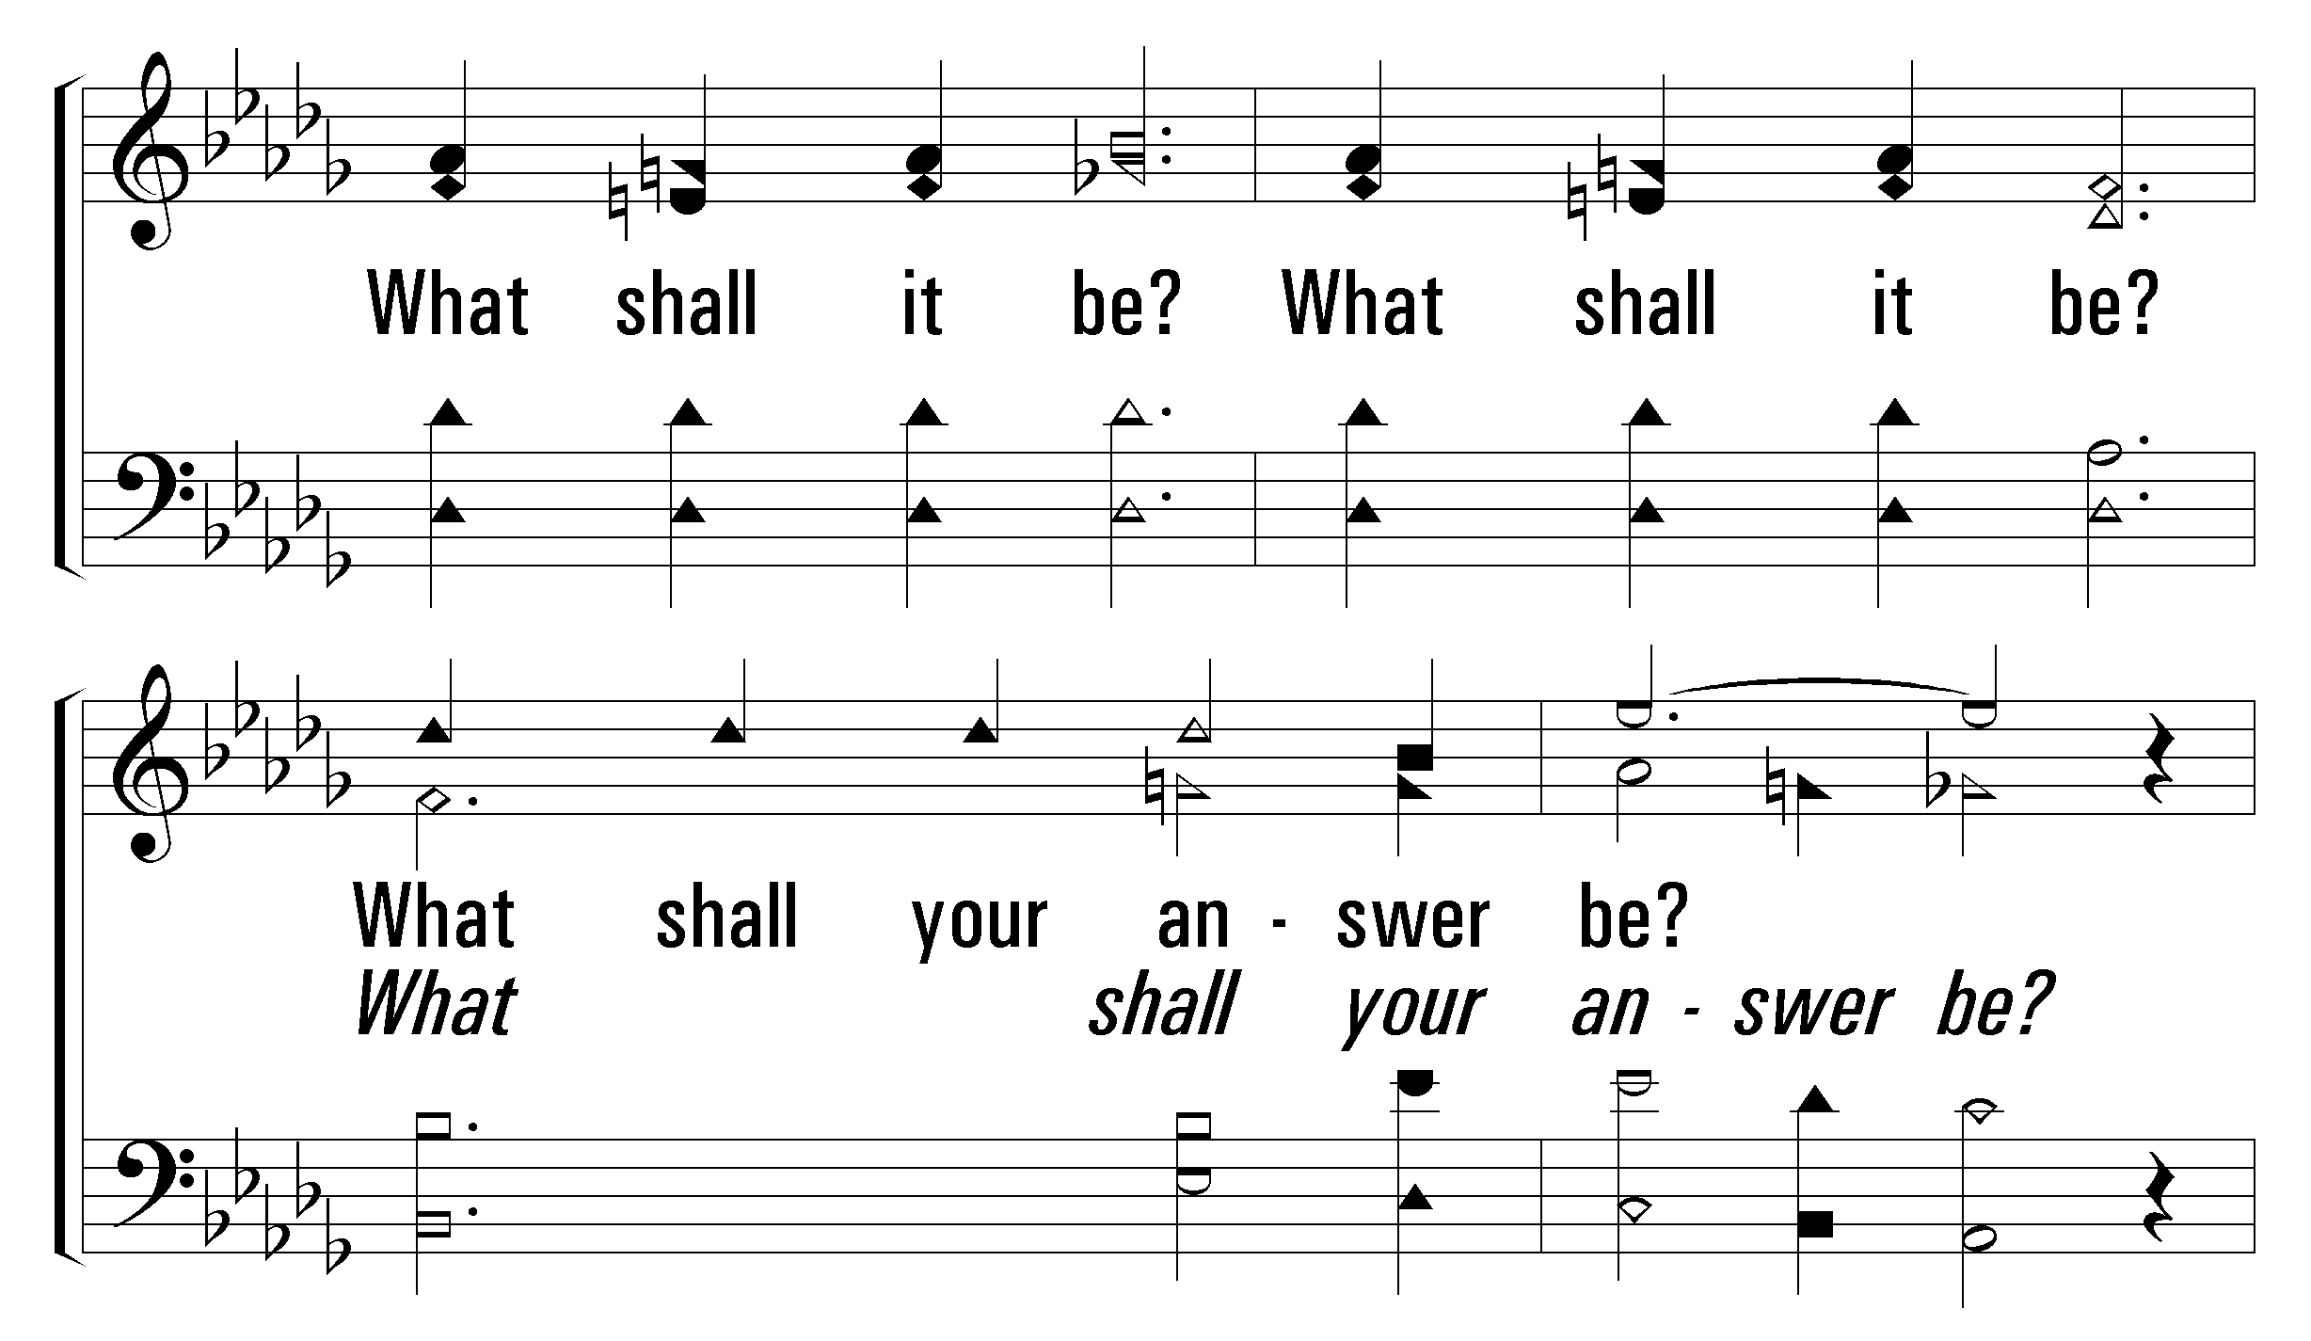
1
C
2
C
3
C
739
WHAT WILL YOU DO WITH JESUS?
© 2004 The Paperless Hymnal™

Slide 42
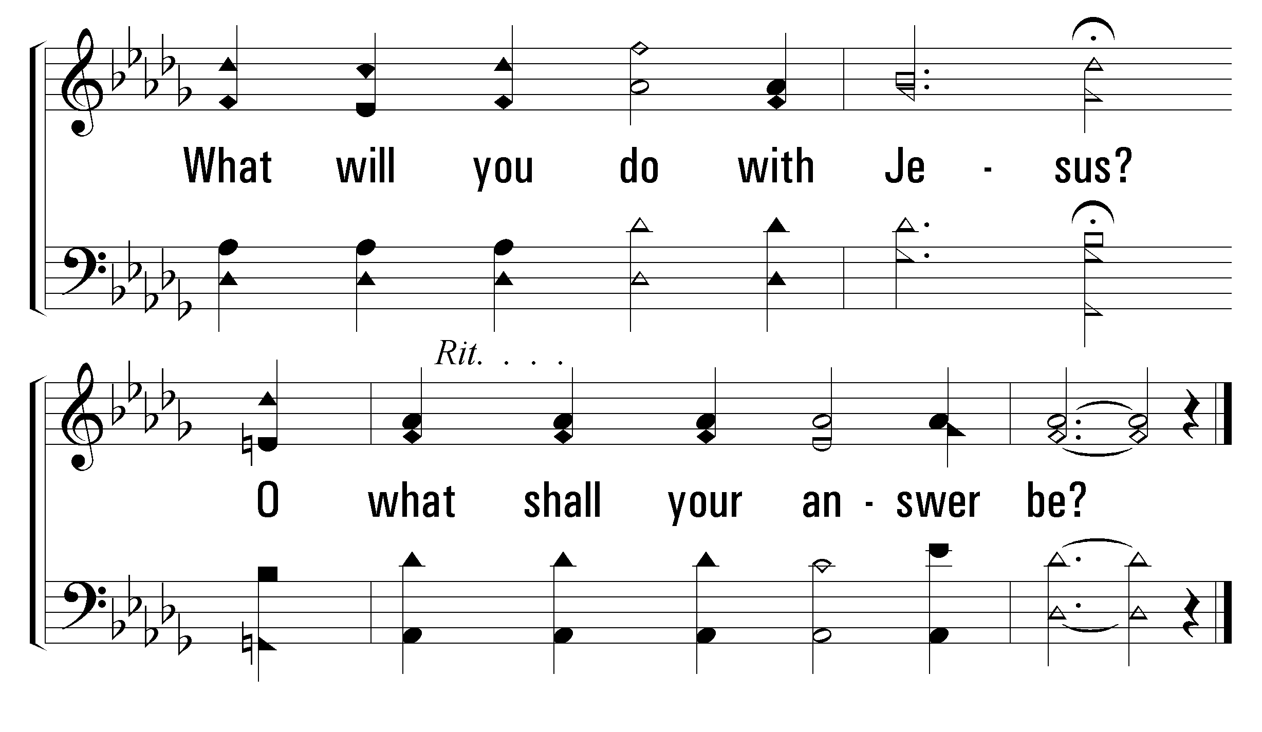
1
C
2
C
3
C
739
WHAT WILL YOU DO WITH JESUS?
© 2004 The Paperless Hymnal™

Slide 43
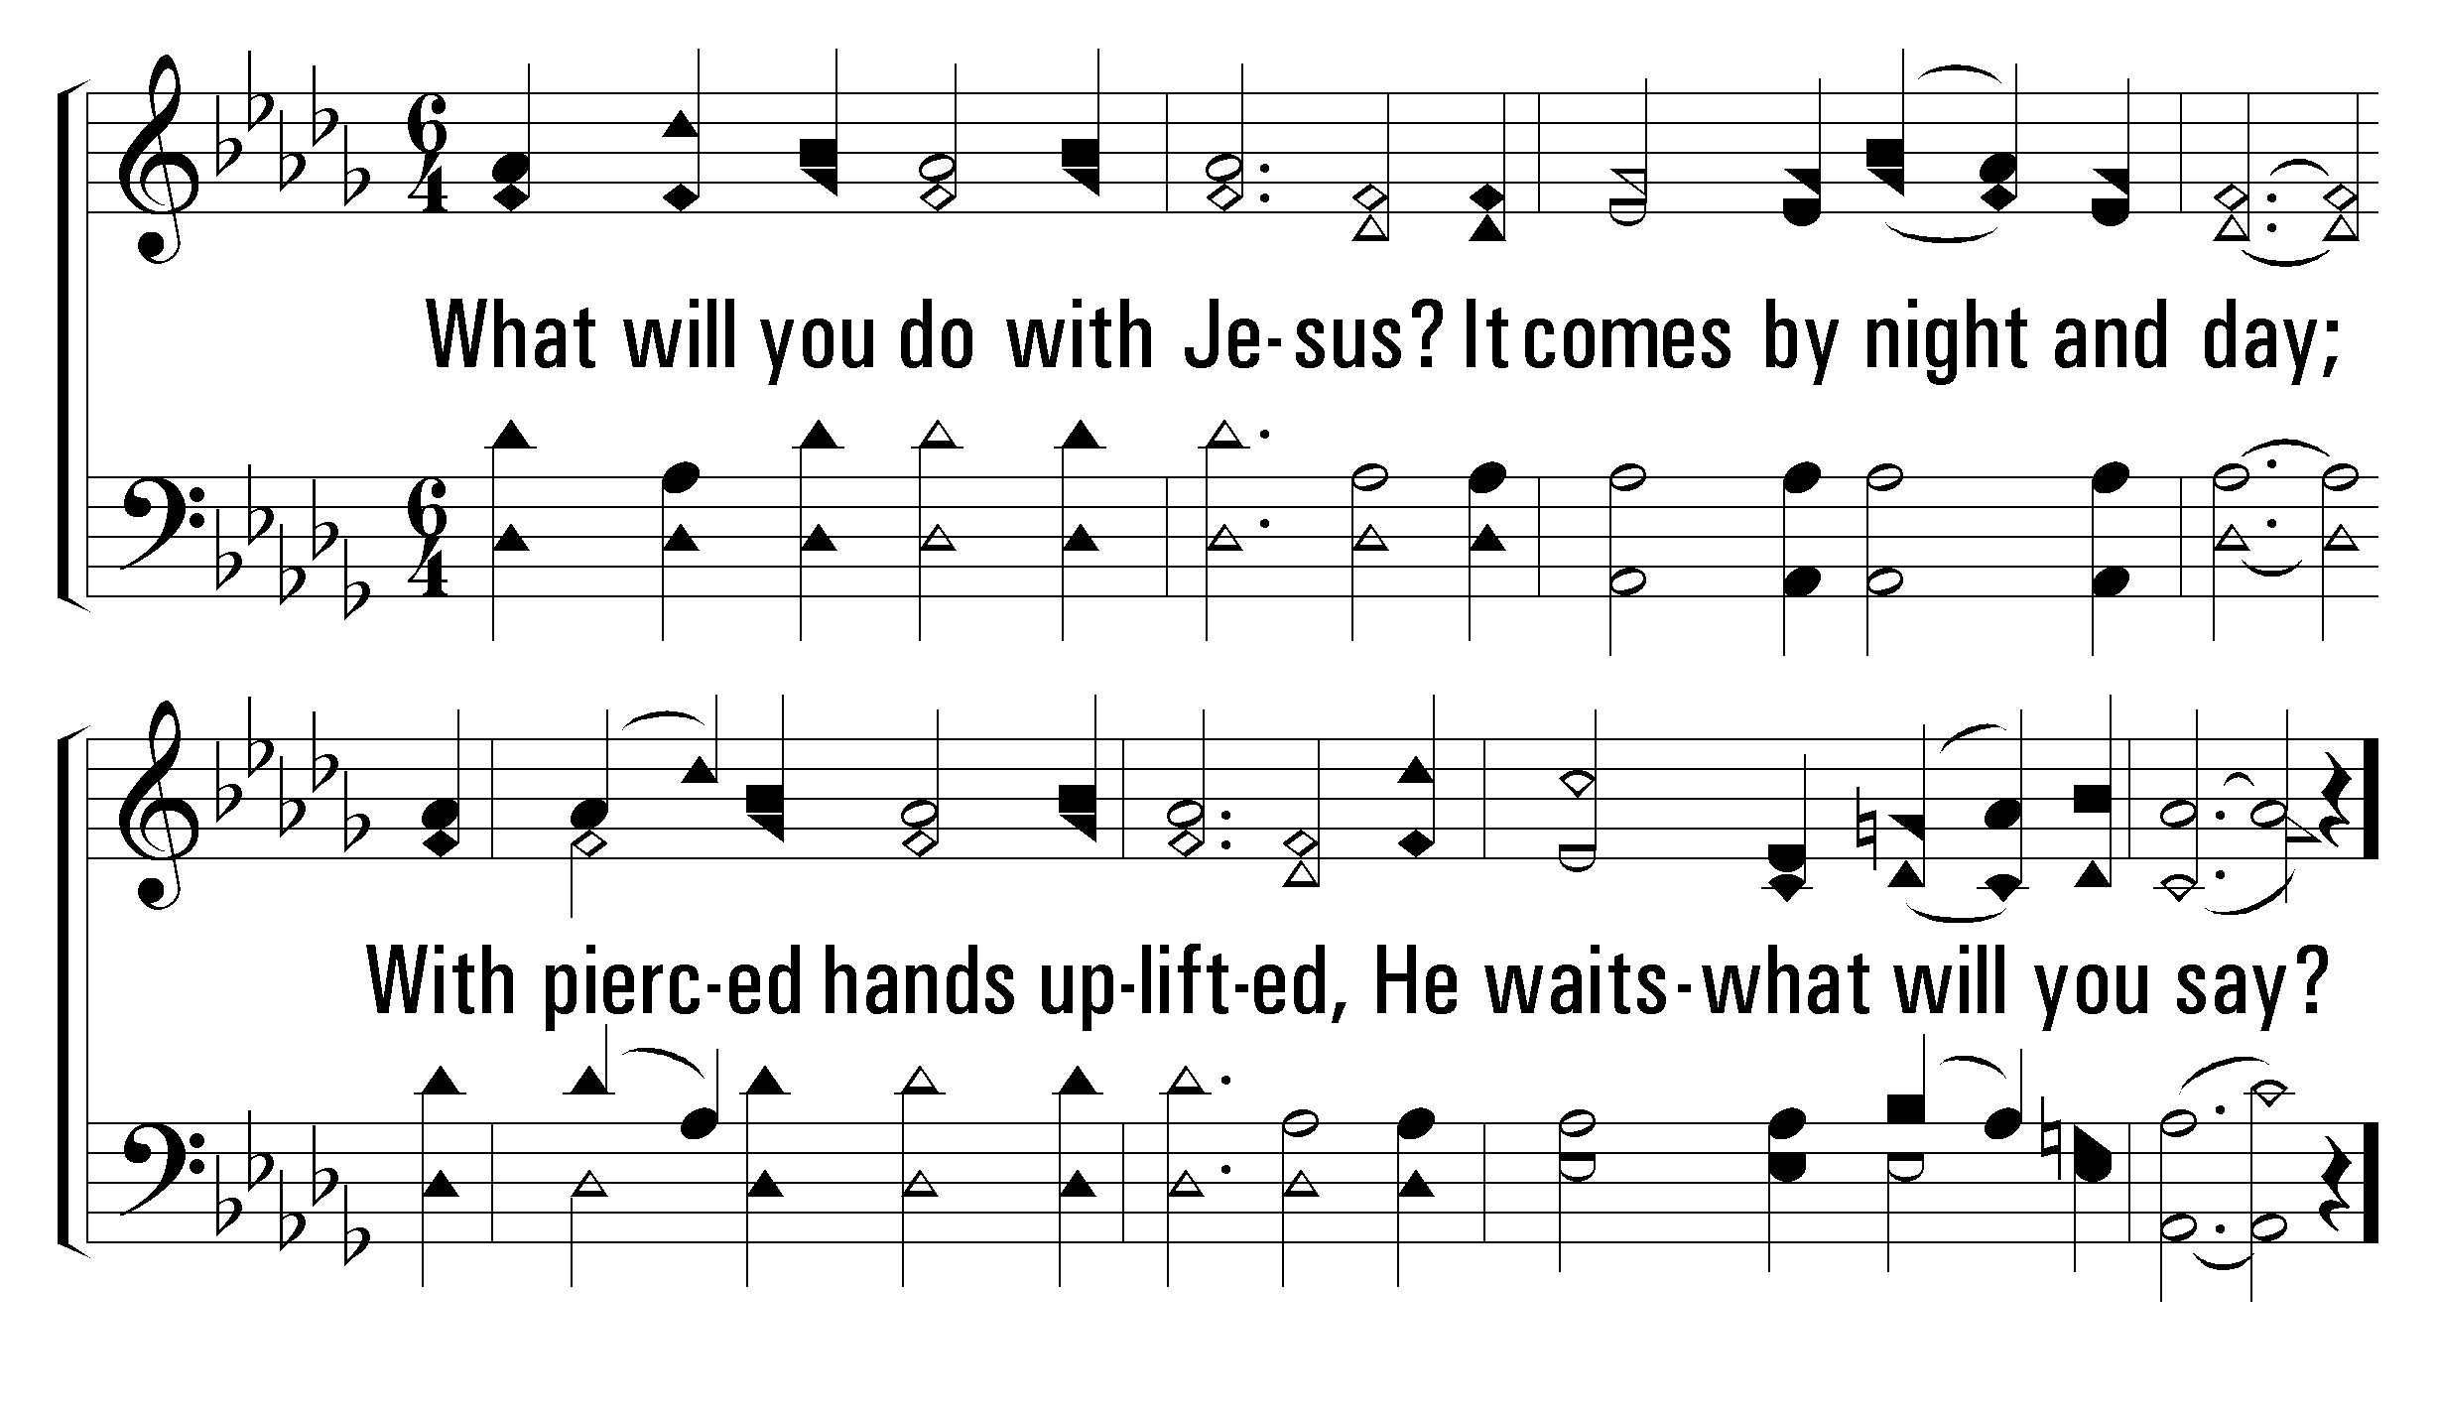
1
C
2
C
3
C
739
WHAT WILL YOU DO WITH JESUS?
© 2004 The Paperless Hymnal™

Slide 44
1
C
2
C
3
C
739
WHAT WILL YOU DO WITH JESUS?
© 2004 The Paperless Hymnal™

Slide 45
1
C
2
C
3
C
739
WHAT WILL YOU DO WITH JESUS?
© 2004 The Paperless Hymnal™

Slide 46
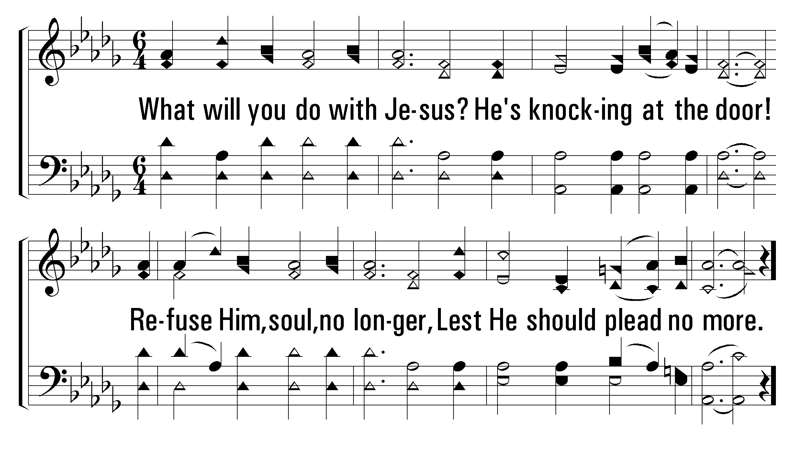
1
C
2
C
3
C
739
WHAT WILL YOU DO WITH JESUS?
© 2004 The Paperless Hymnal™

Slide 47
1
C
2
C
3
C
739
WHAT WILL YOU DO WITH JESUS?
© 2004 The Paperless Hymnal™

Slide 48
1
C
2
C
3
C
739
WHAT WILL YOU DO WITH JESUS?
© 2004 The Paperless Hymnal™

Slide 50
Welcome
Reading
Prayer
115 .
615 .
Lord’s Supper
32 .
Collection
500 .
Sermon
739 .
• Prayer
PRAYER
“DEVOTE YOURSELVES TO PRAYER”
COLOSSIANS 4:2

Slide 51

embryhills.com

