Slide 1
Scripture Reading: Colossians 2:1-15
I Stand Amazed (299)
My Jesus As Thou Wilt (433)
Prayer
If Jesus Goes with Me (321)
Sermon: The Will of God
At Calvary (53)
Announcements
Lord’s Supper
Closing Prayer
Sunday Evening
June 2, 2019

Slide 2
Colossians 2:1-15
Pew Bible: Page 793
Alive in Christ

Slide 3

299
I Stand Amazed
Words and Music by: Charles H. Gabriel
Chorus After Last Verse

Slide 4

Song Medley
299
433
I Stand Amazed
My Jesus, As Thou Wilt
Words and Music by: E. M. Bartlett
Copyright © 1939 by E.M. Bartlett. Copyright 1967 by Mrs. E.M. Bartlett, renewal.
Assigned to Albert E. Brumley & Sons/SESAC (admin. By ICG).
All rights reserved. Used by permission.
Words and Music by: Charles H. Gabriel

Slide 5
Welcome
Reading
Prayer
299
Song Medley
433
329
I Stand Amazed
My Jesus, As Thou Wilt
Medley
Lord’s Supper
500
Collection
PHSS-123
Sermon
53
Words and Music by: E. M. Bartlett
Copyright © 1939 by E.M. Bartlett. Copyright 1967 by Mrs. E.M. Bartlett, renewal.
Assigned to Albert E. Brumley & Sons/SESAC (admin. By ICG).
All rights reserved. Used by permission.
Words and Music by: Charles H. Gabriel
Prayer

Slide 6
Welcome
299
Reading
I Stand Amazed
Prayer
Words and Music by: E. M. Bartlett
Copyright © 1939 by E.M. Bartlett. Copyright 1967 by Mrs. E.M. Bartlett, renewal.
Assigned to Albert E. Brumley & Sons/SESAC (admin. By ICG).
All rights reserved. Used by permission.
329
Medley
Lord’s Supper
500
433
Collection
Words and Music by: Charles H. Gabriel
PHSS-123
My Jesus, As Thou Wilt
Sermon
53
Prayer

Slide 7
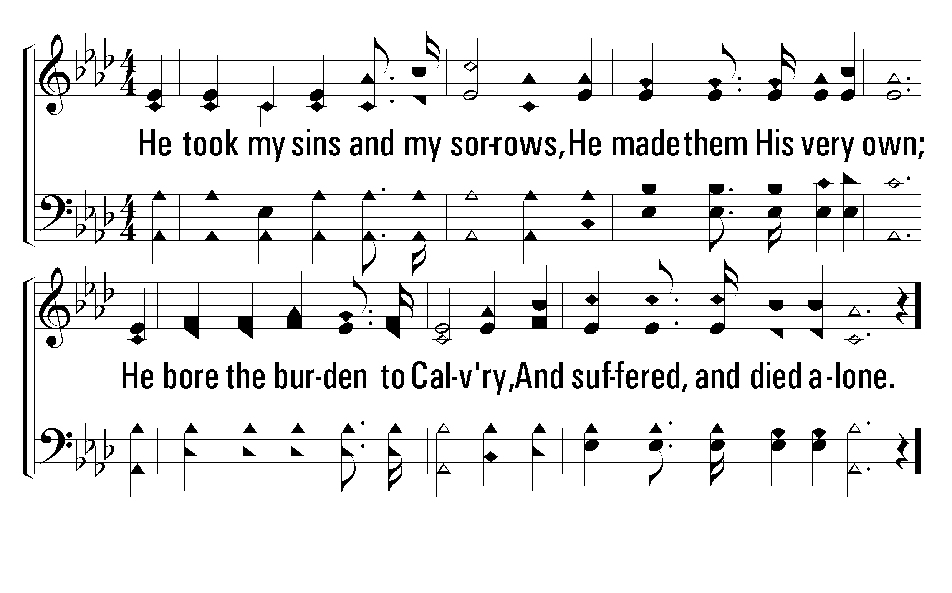
299
I Stand Amazed
1
2
3
4
5
C
© 2001 The Paperless Hymnal™

Slide 8
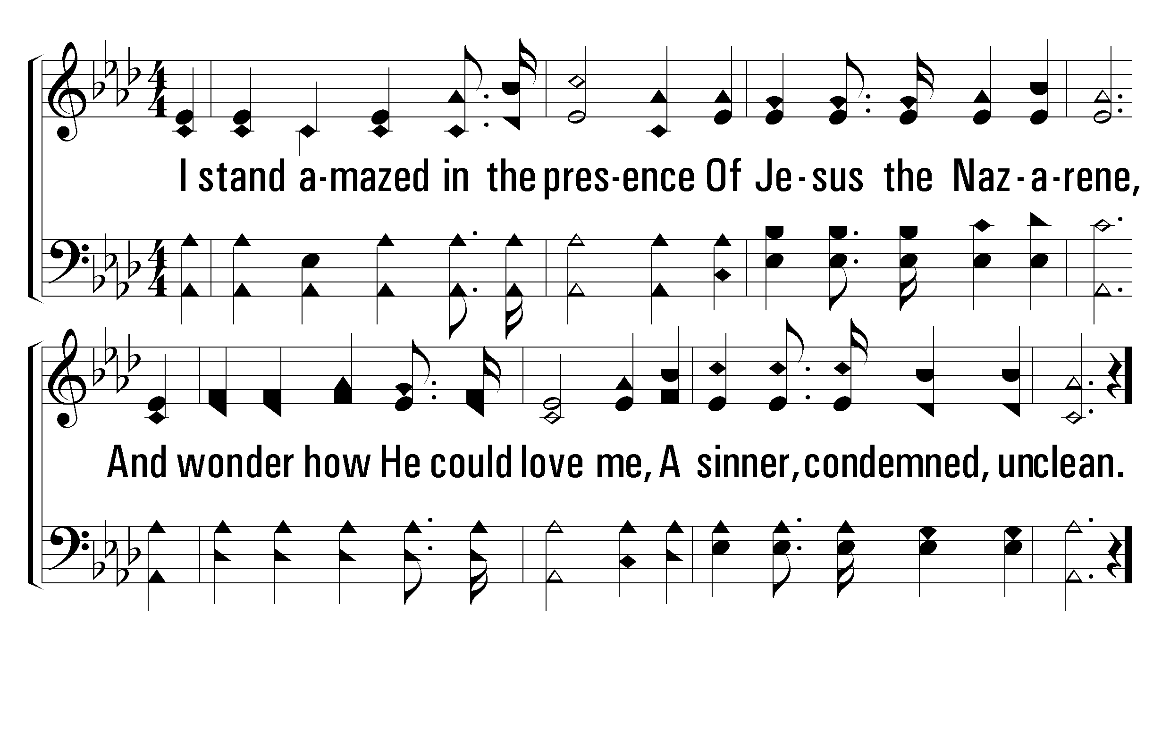
299
I Stand Amazed
1
2
3
4
5
C
© 2001 The Paperless Hymnal™

Slide 9
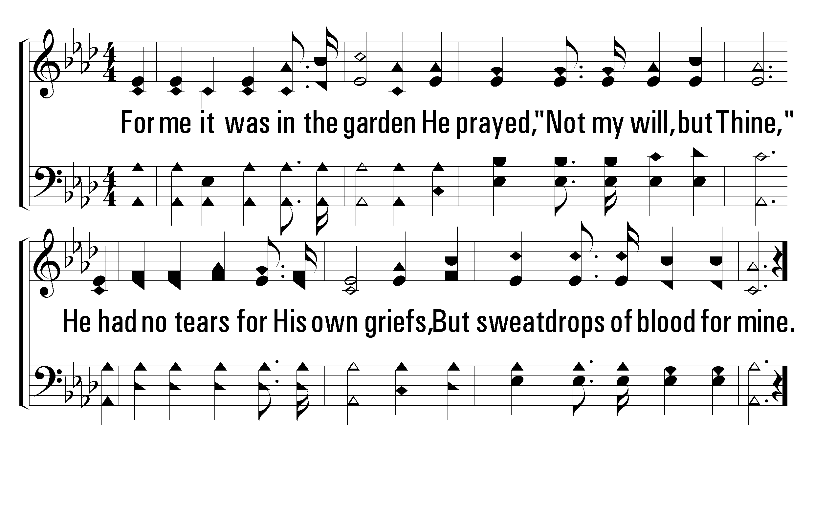
299
I Stand Amazed
1
2
3
4
5
C
© 2001 The Paperless Hymnal™

Slide 10
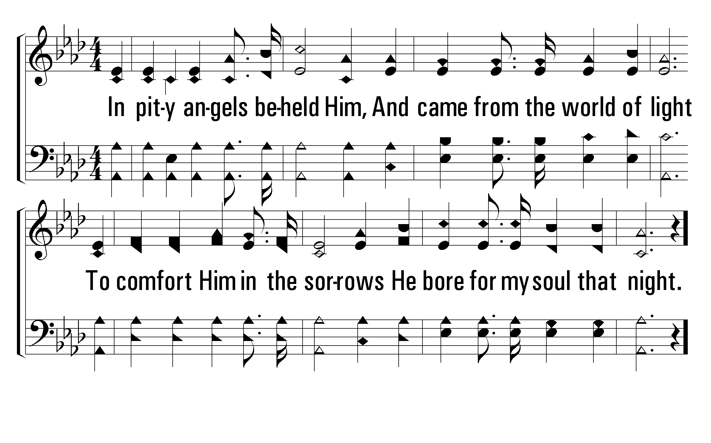
299
I Stand Amazed
1
2
3
4
5
C
© 2001 The Paperless Hymnal™

Slide 11
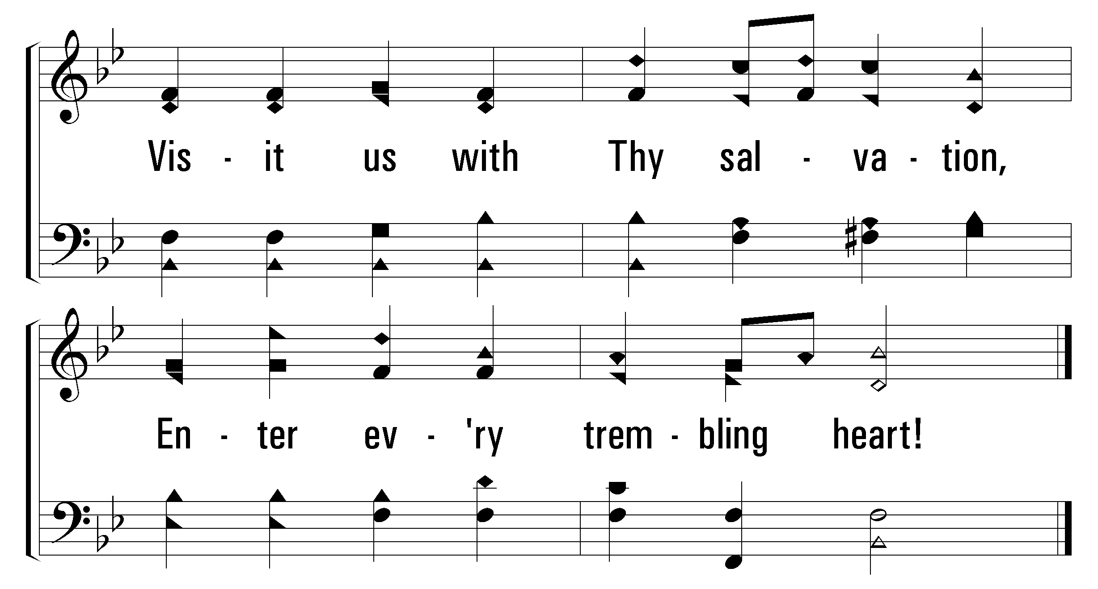
405
Love Divine
1
3
4
© 2002 The Paperless Hymnal™

Slide 12
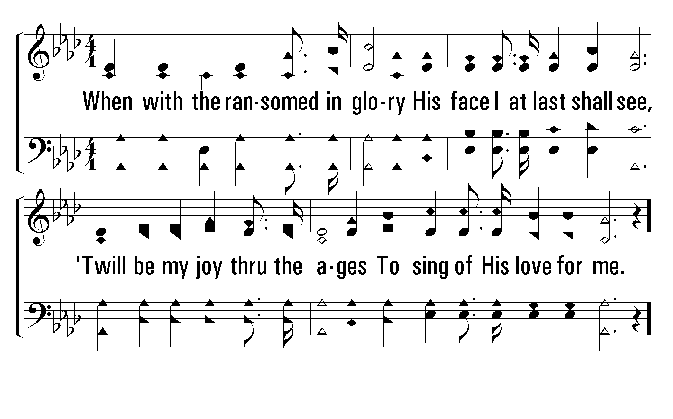
299
I Stand Amazed
1
2
3
4
5
C
© 2001 The Paperless Hymnal™

Slide 13
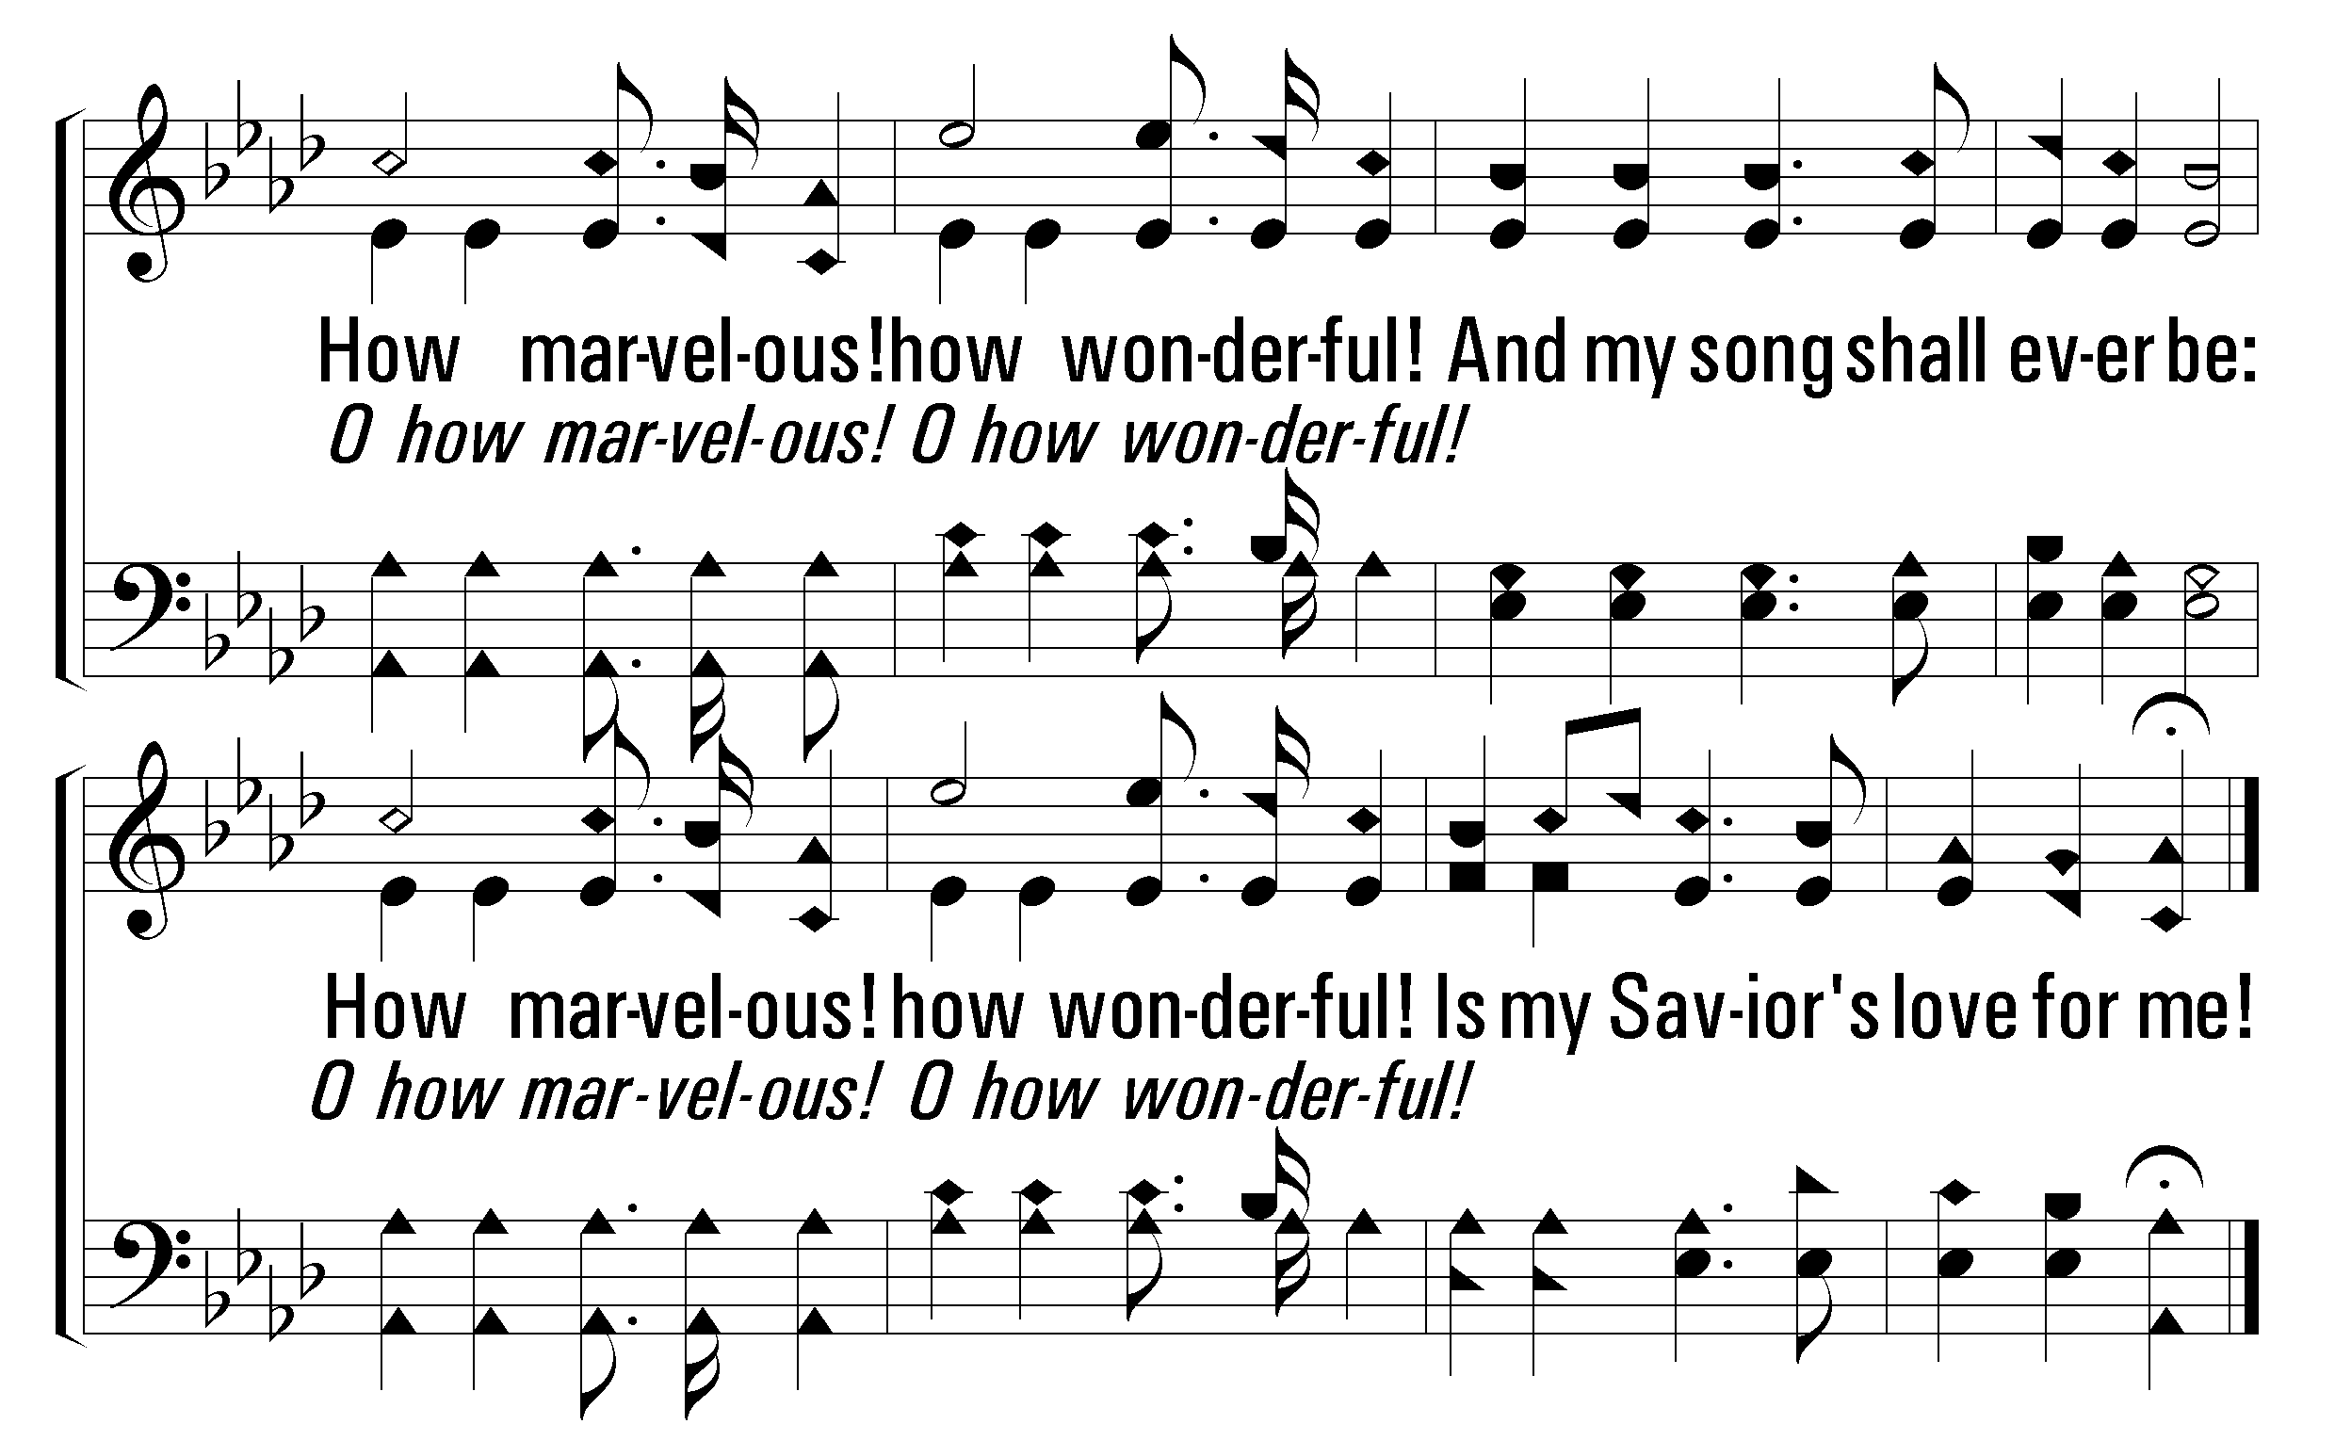
299
I Stand Amazed
1
2
3
4
5
C
© 2001 The Paperless Hymnal™

Slide 14
433
My Jesus As Thou Wilt
Words: Benjamin Schmolke, tr. Jane Borthwick
Music: Carl von Weber

Slide 15
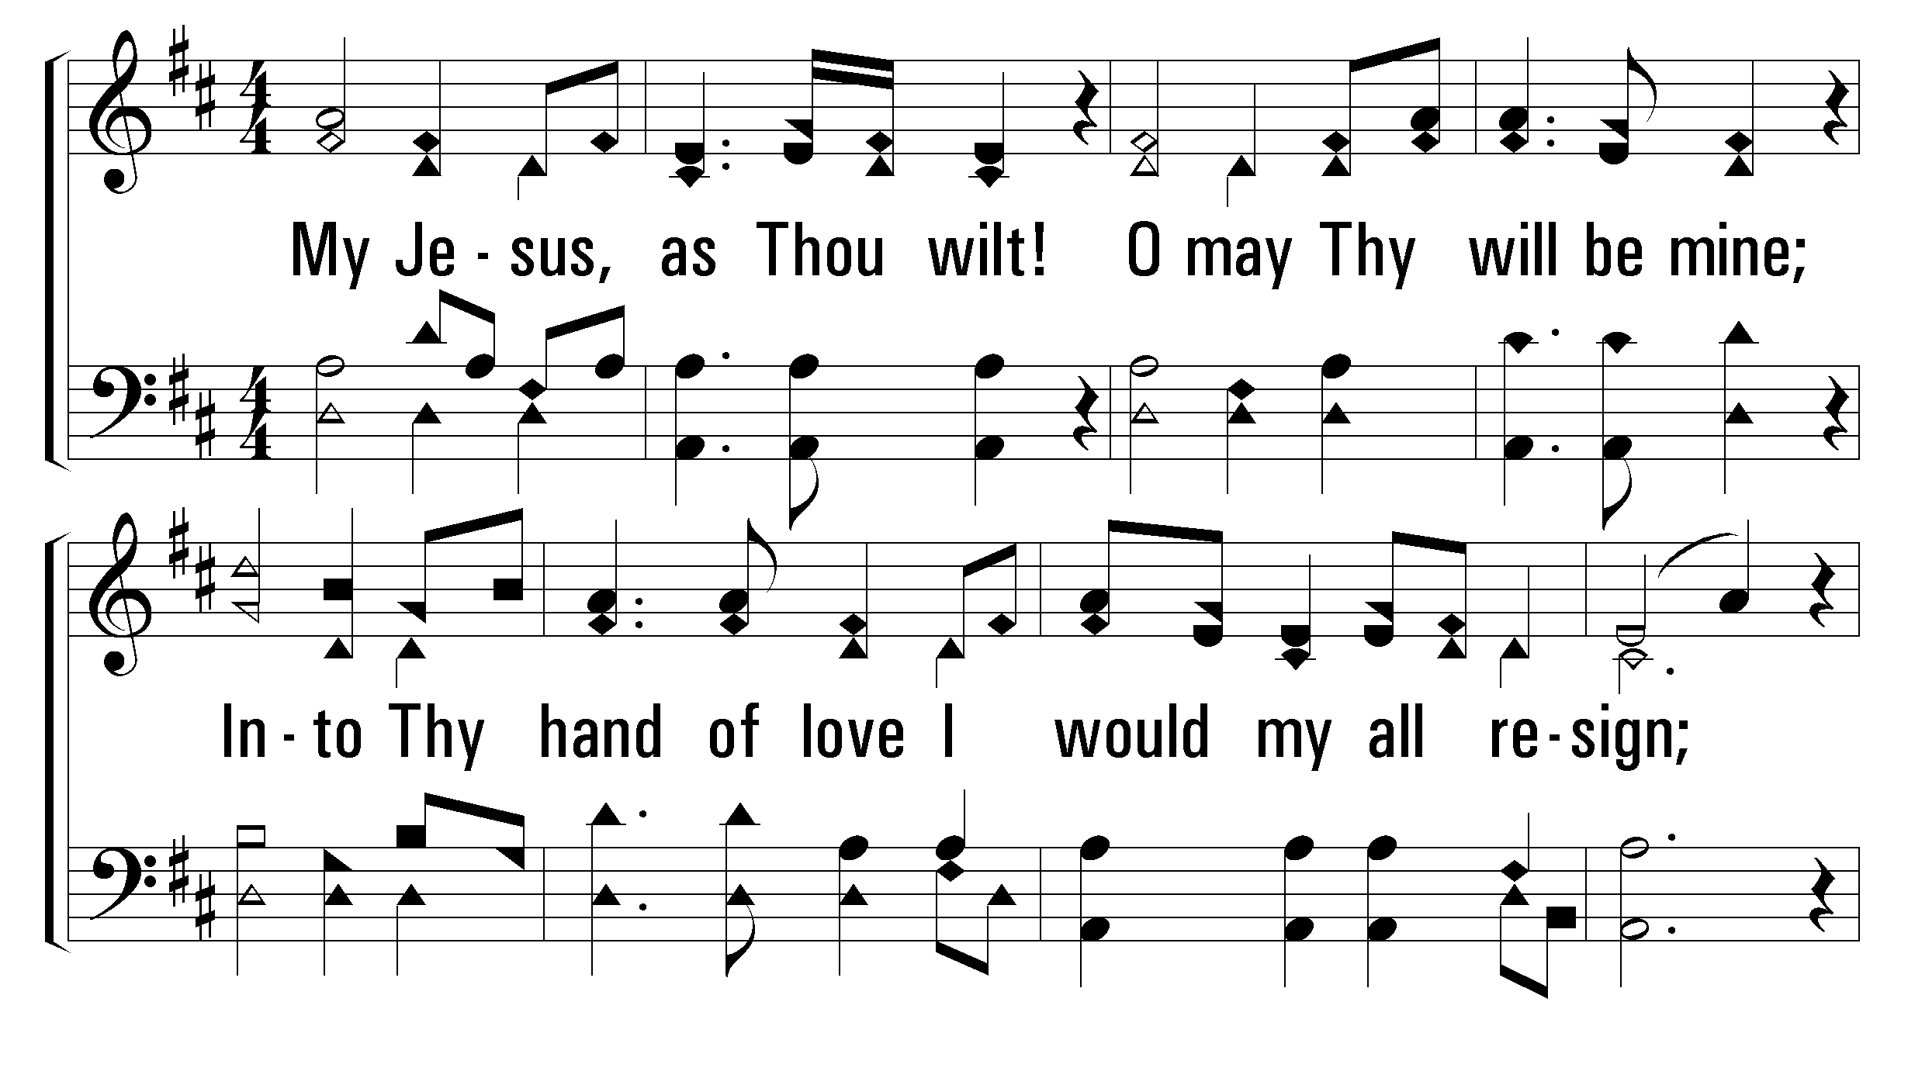
433
My Jesus As Thou Wilt
1
2
3
4
© 2002 The Paperless Hymnal™

Slide 16
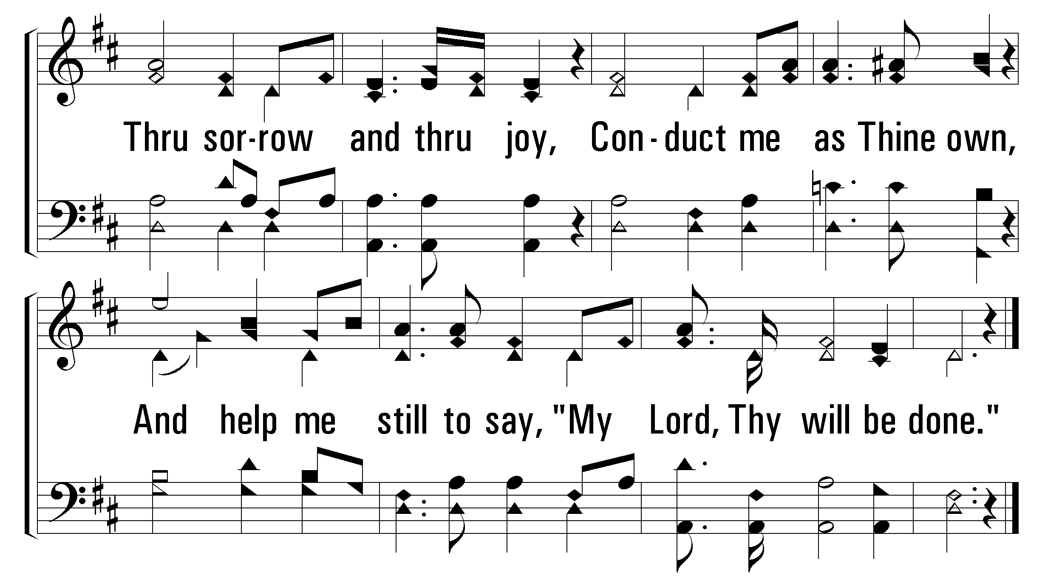
433
My Jesus As Thou Wilt
1
2
3
4
© 2002 The Paperless Hymnal™

Slide 17
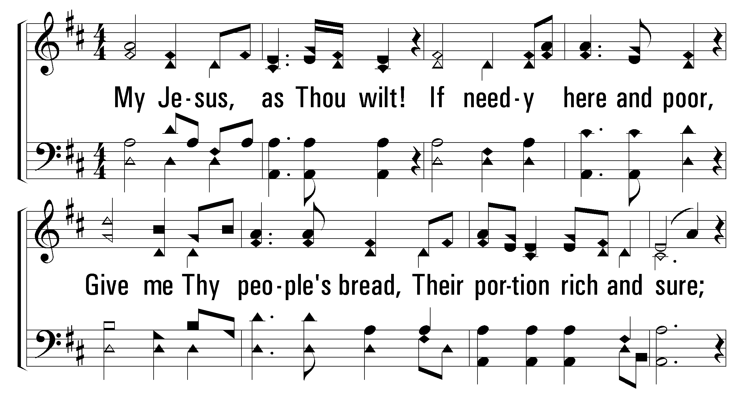
433
My Jesus As Thou Wilt
1
2
3
4
© 2002 The Paperless Hymnal™

Slide 18
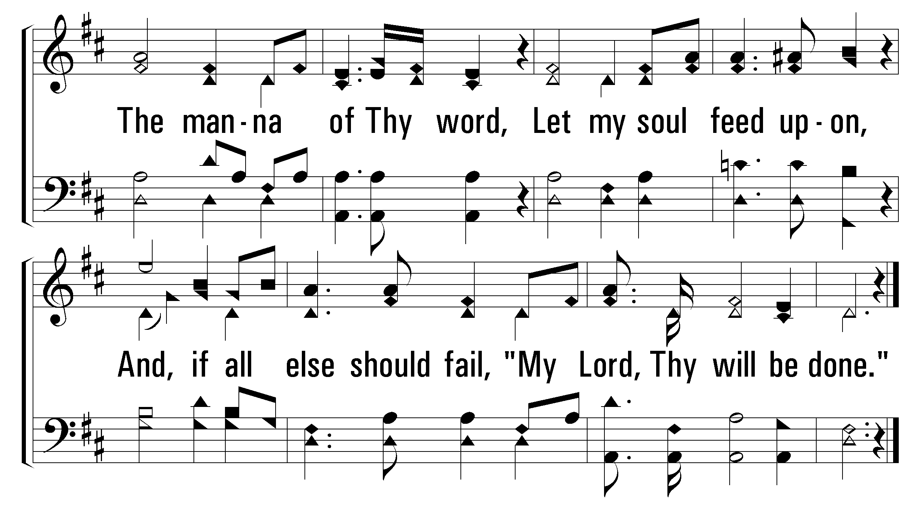
433
My Jesus As Thou Wilt
1
2
3
4
© 2002 The Paperless Hymnal™

Slide 19
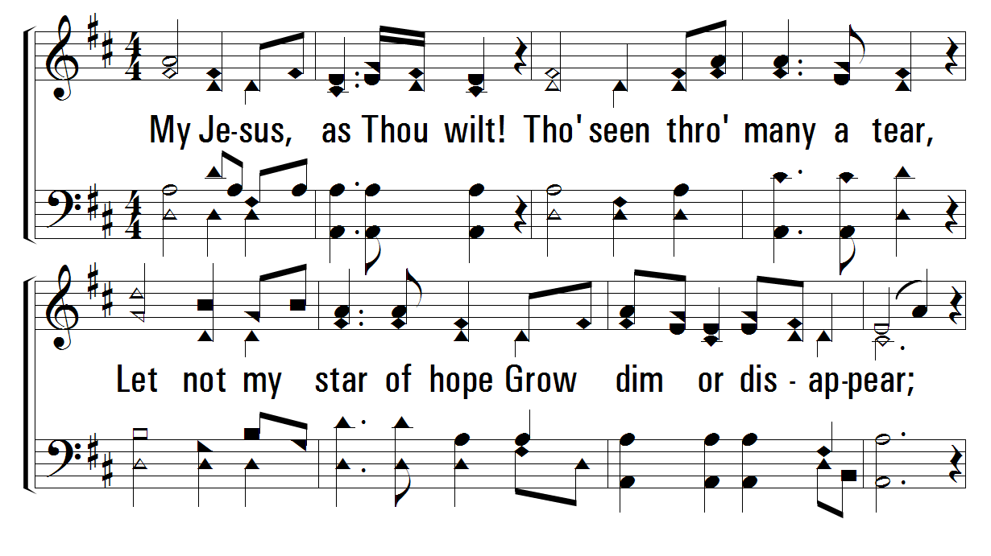
433
My Jesus As Thou Wilt
1
2
3
4
© 2002 The Paperless Hymnal™

Slide 20
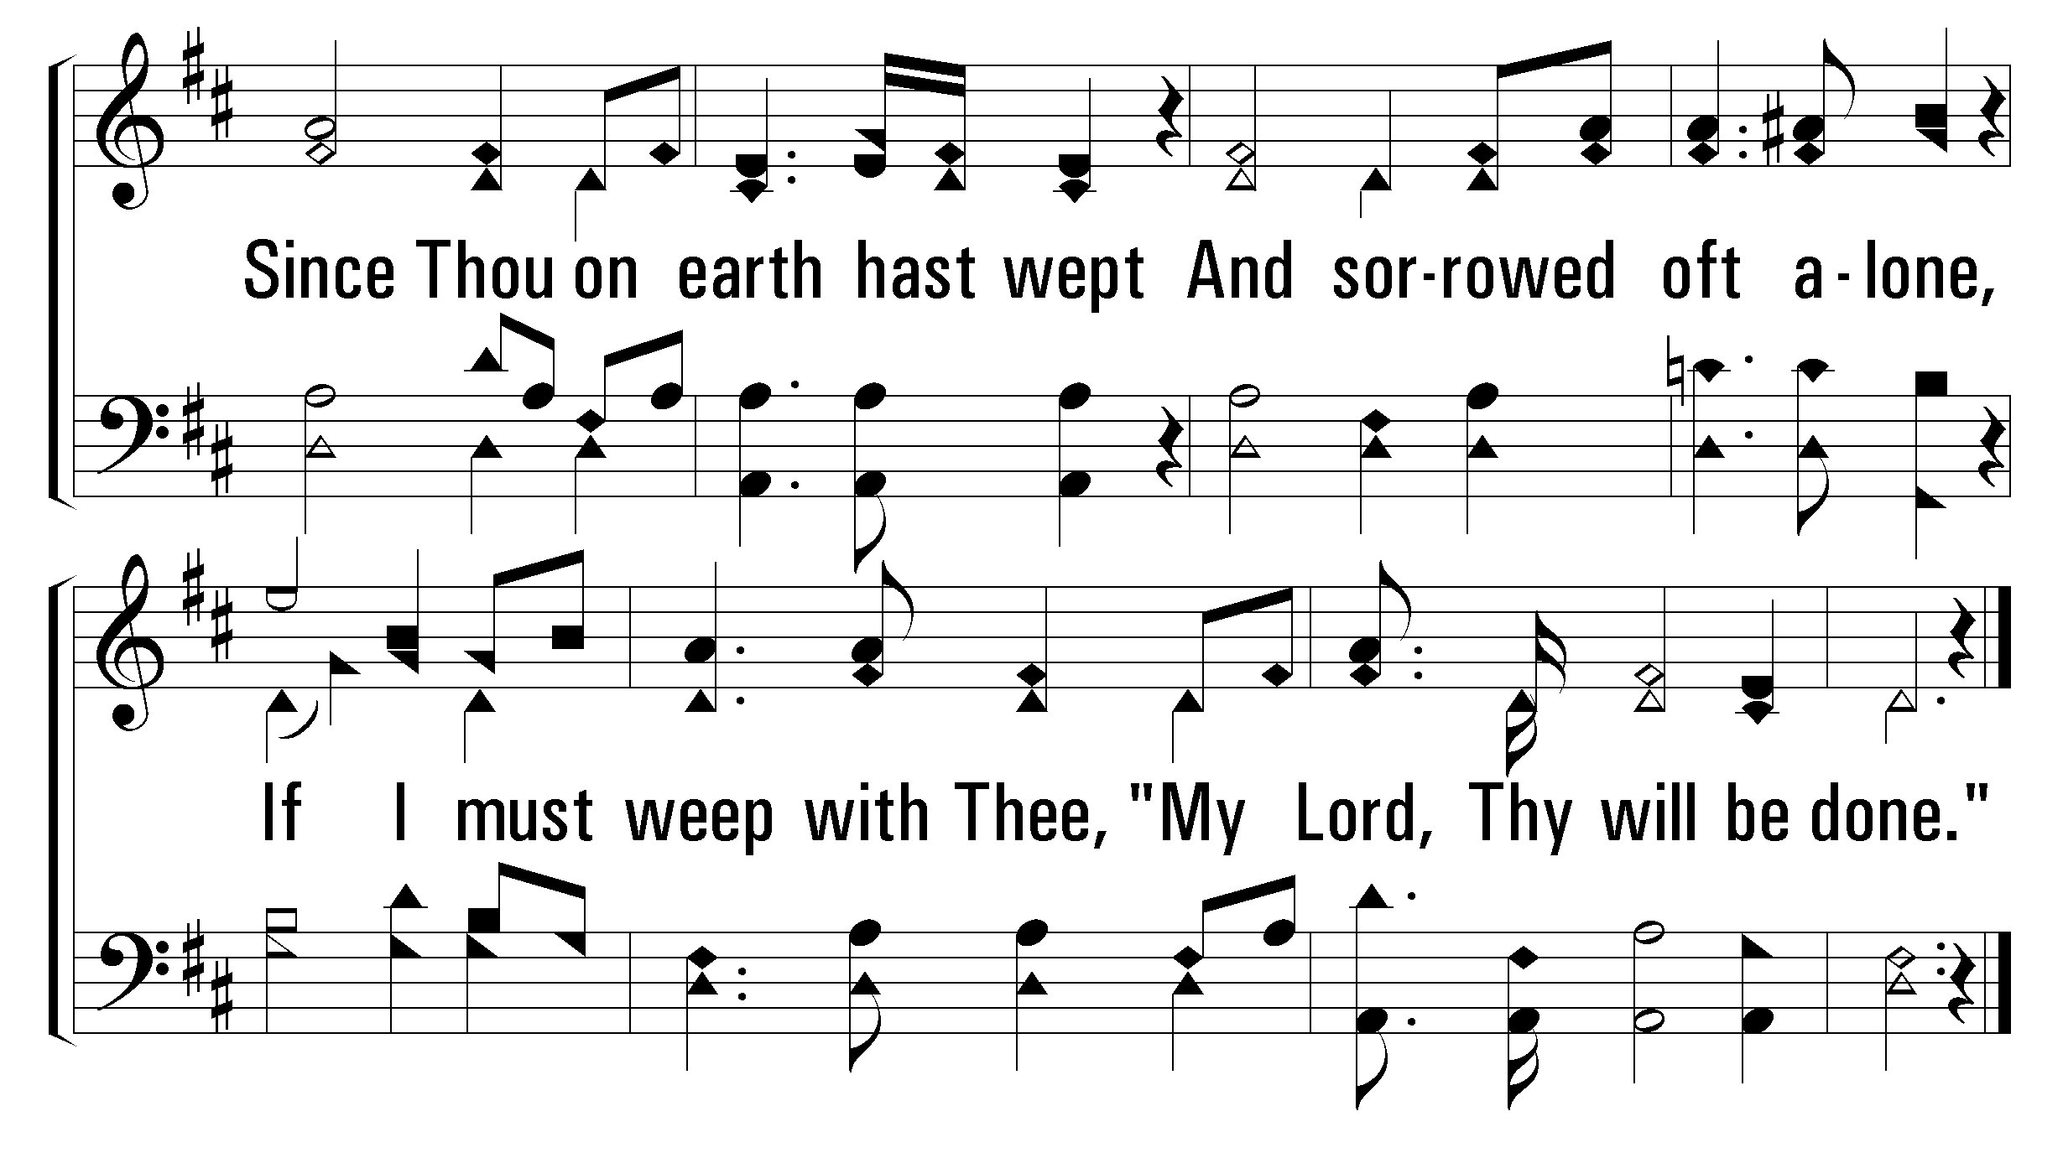
433
My Jesus As Thou Wilt
1
2
3
4
© 2002 The Paperless Hymnal™

Slide 21
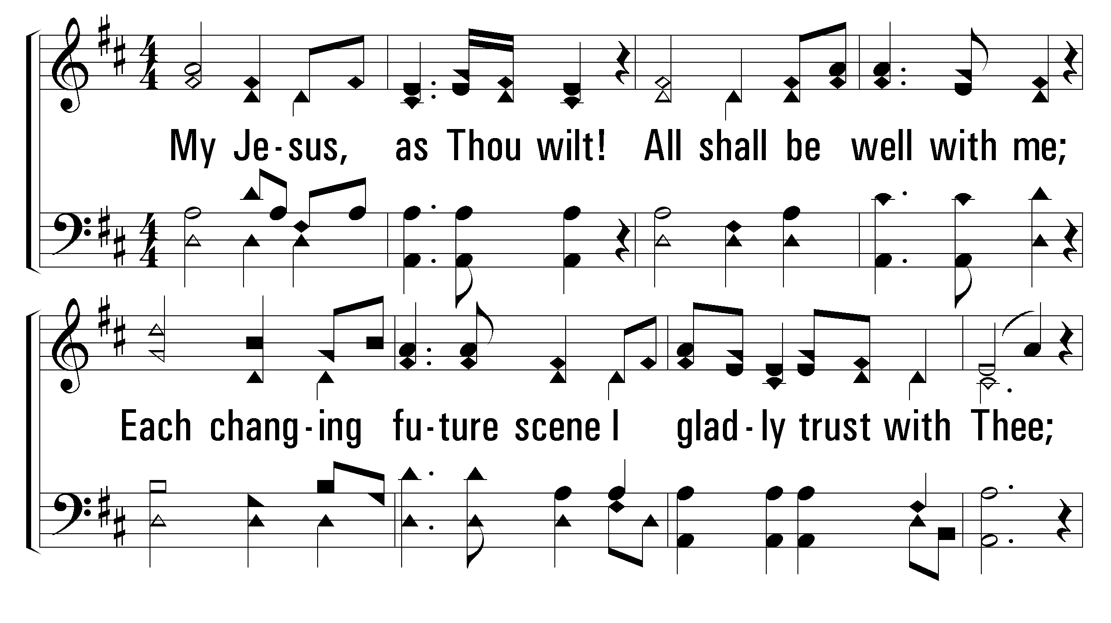
433
My Jesus As Thou Wilt
1
2
3
4
© 2002 The Paperless Hymnal™

Slide 22
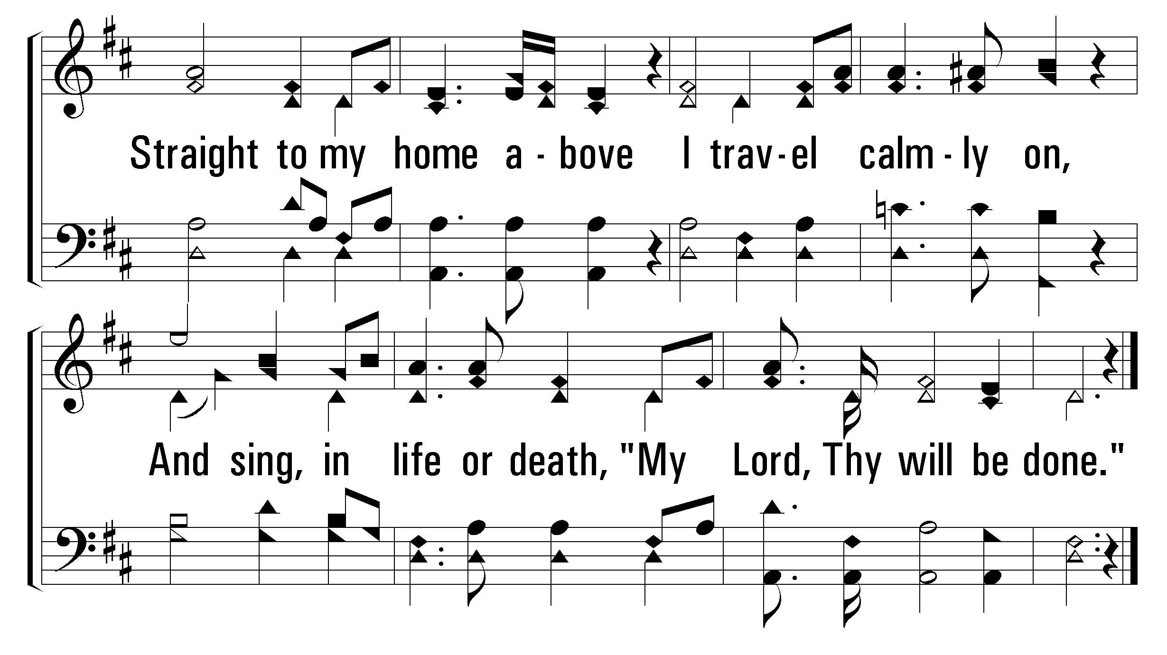
433
My Jesus As Thou Wilt
1
2
3
4
© 2002 The Paperless Hymnal™

Slide 24
Invitation Song
53
At Calvary
Words by: William R. Newell
Music by: Daniel B. Towner
Omit Verse 4

Slide 25
321
If Jesus Goes with Me
Words & Music: C. Austin Miles

Slide 26
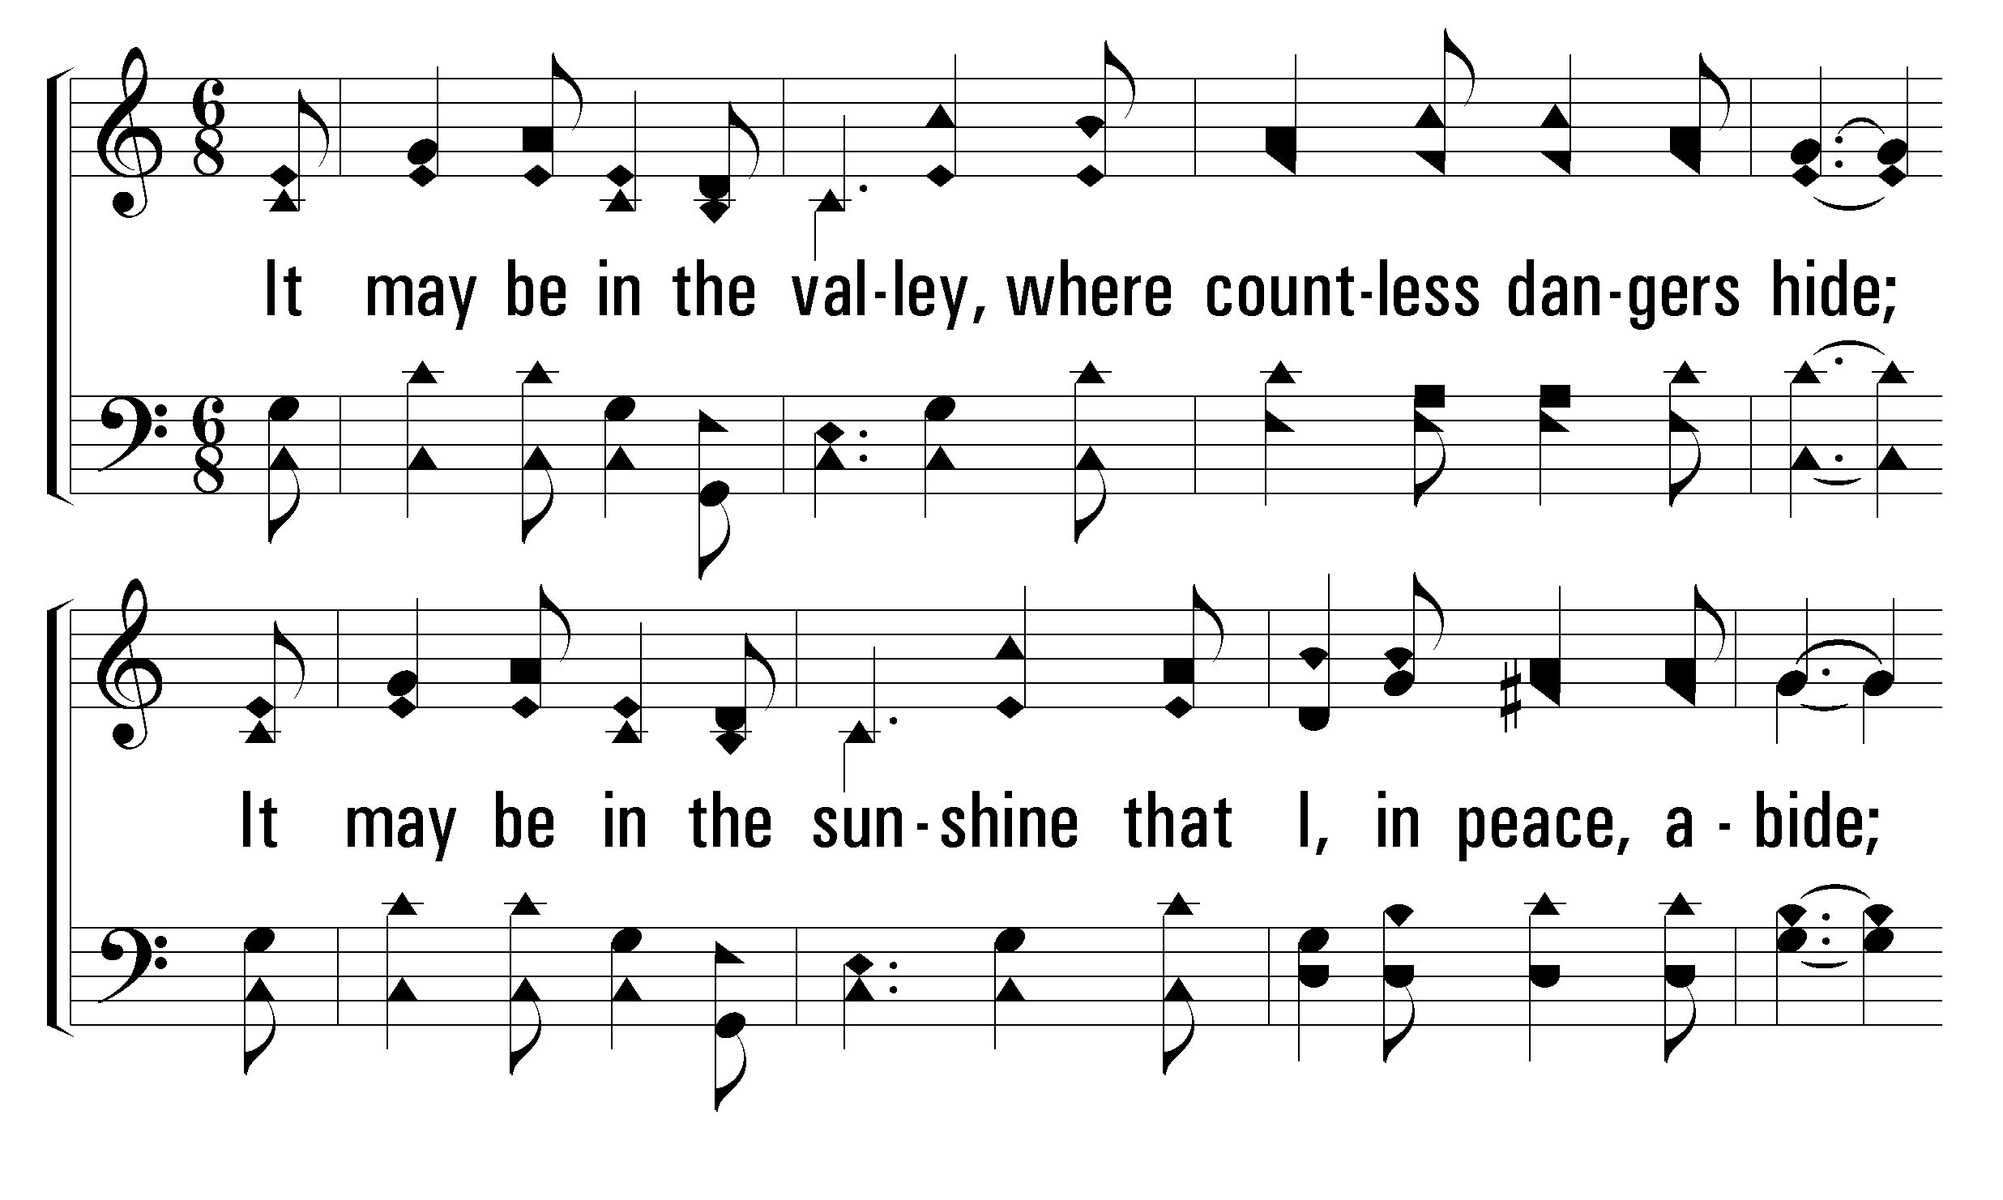
321
If Jesus Goes with Me
1
C
2
C
3
C
4
C
© 2009 The Paperless Hymnal®

Slide 27
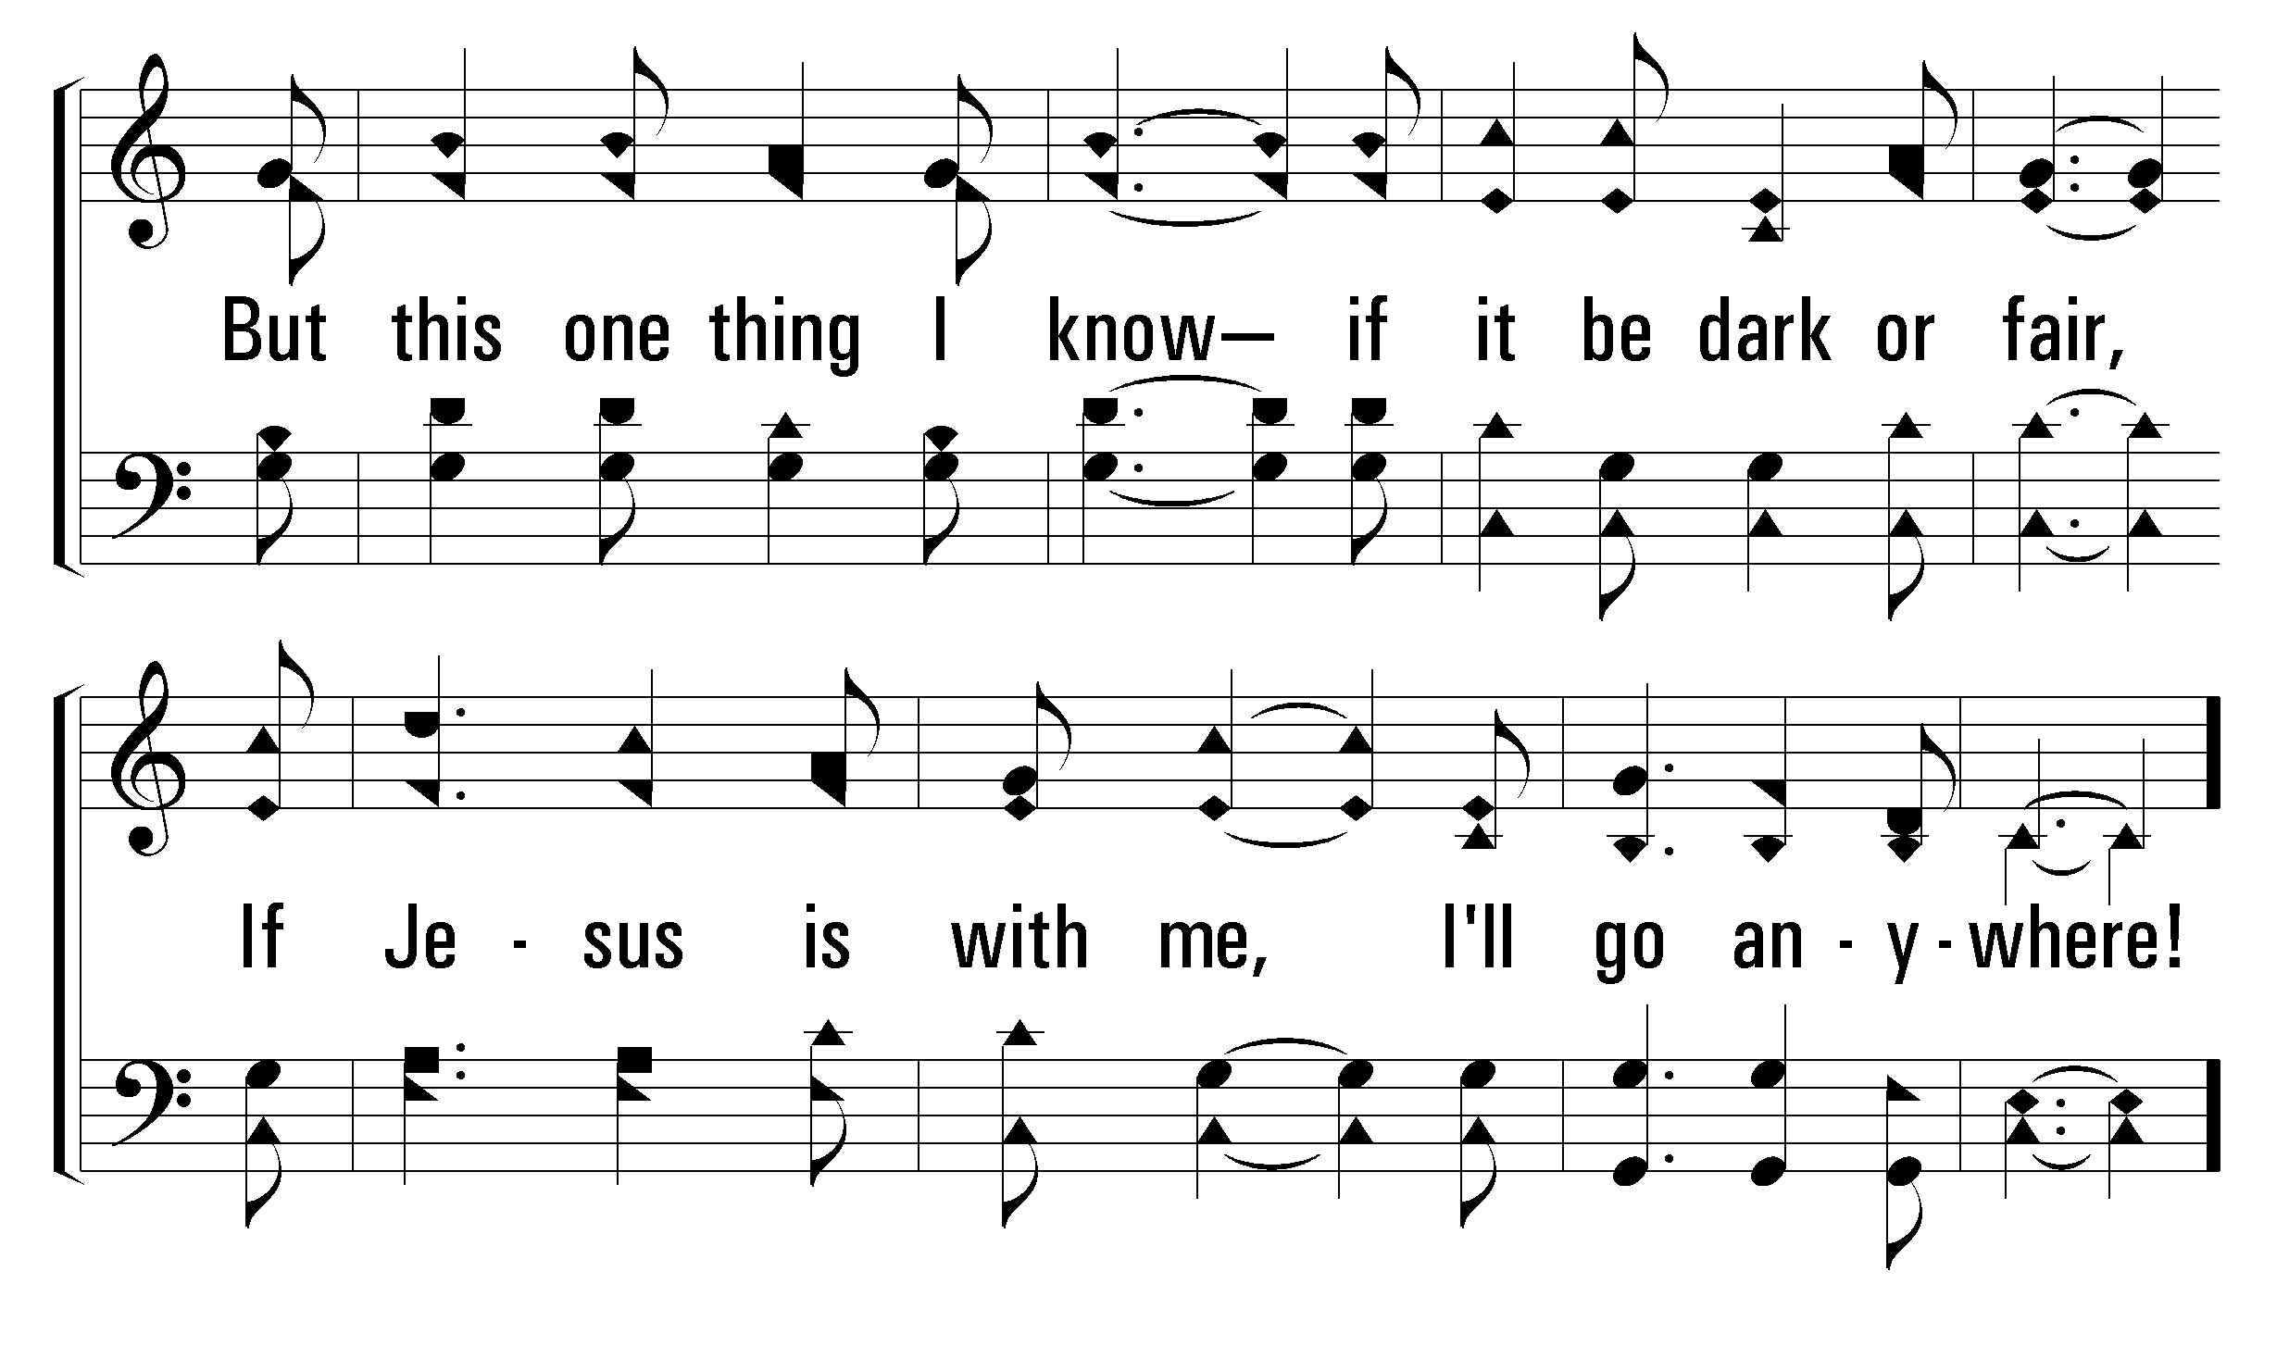
321
If Jesus Goes with Me
1
C
2
C
3
C
4
C
© 2009 The Paperless Hymnal®

Slide 28
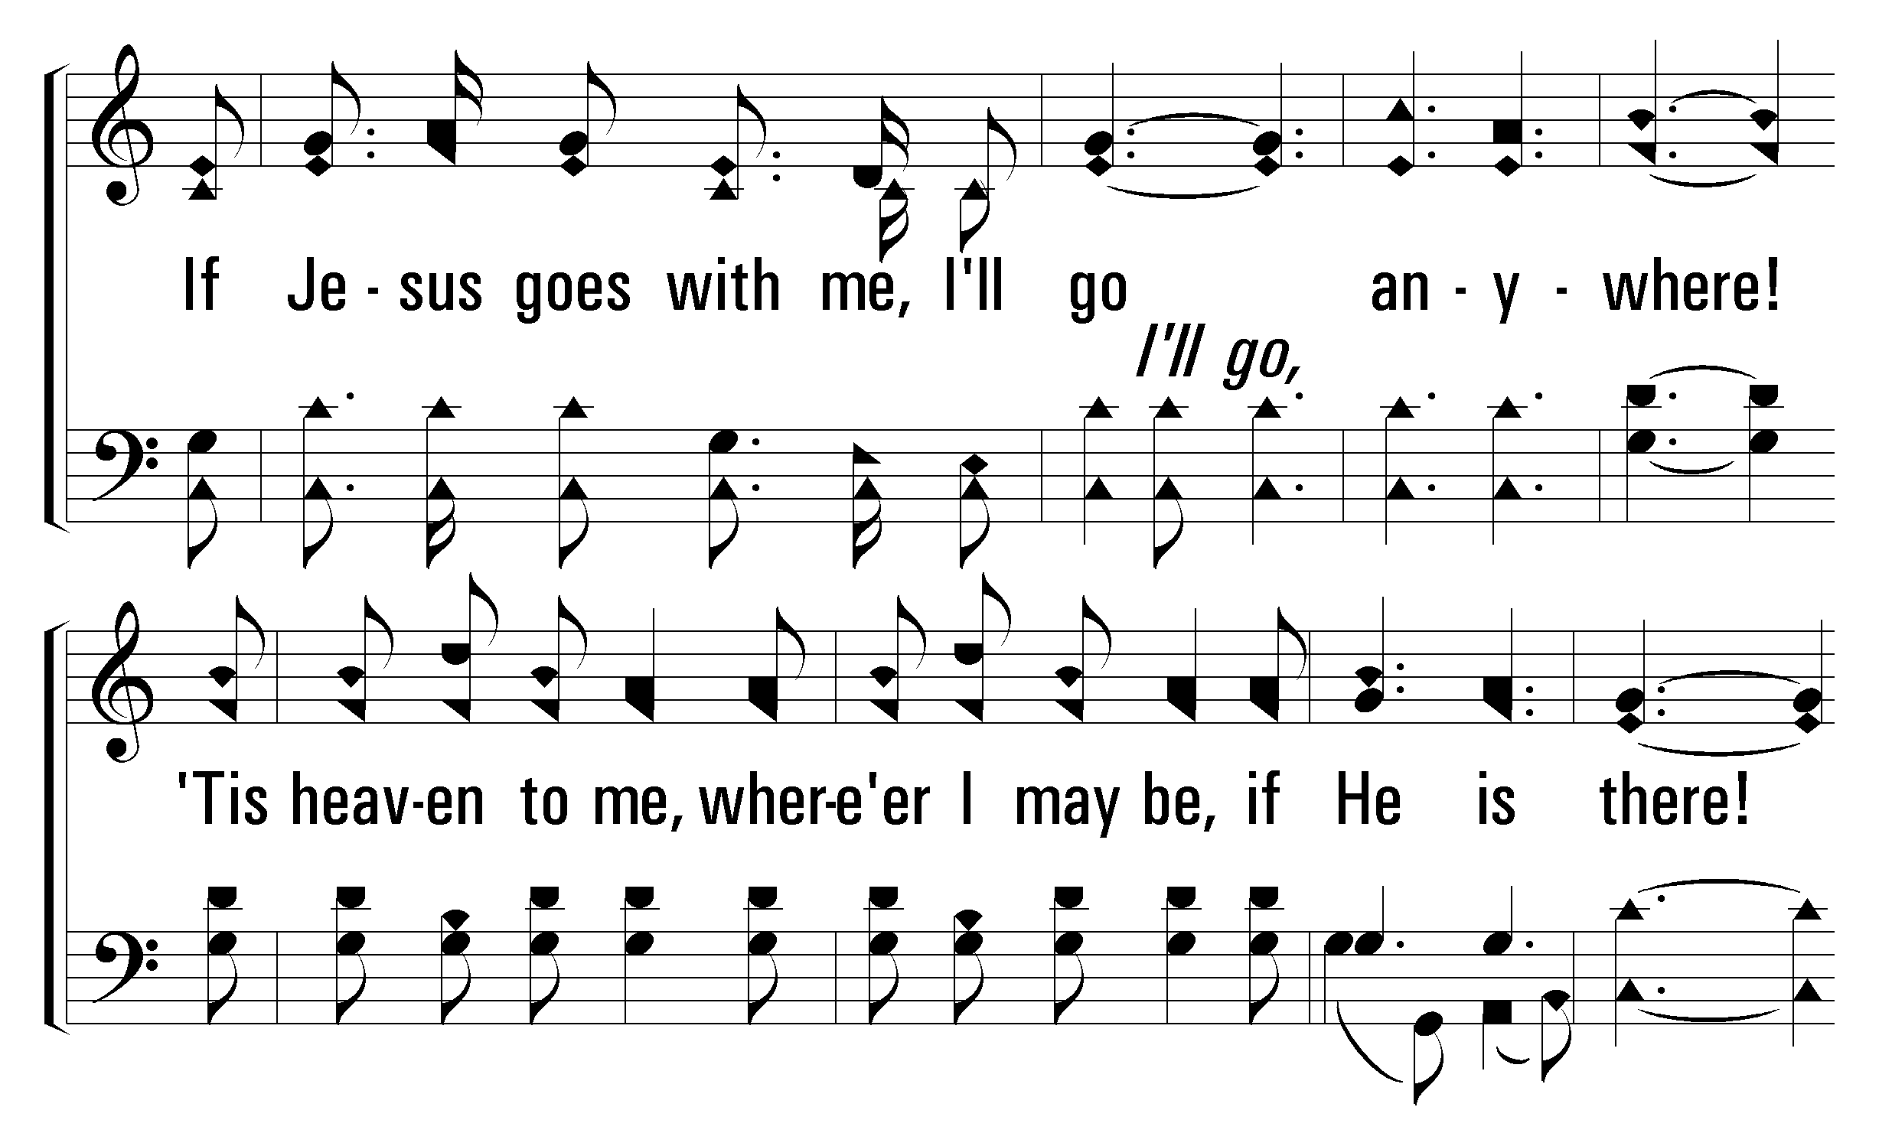
321
If Jesus Goes with Me
1
C
2
C
3
C
4
C
© 2009 The Paperless Hymnal®

Slide 29
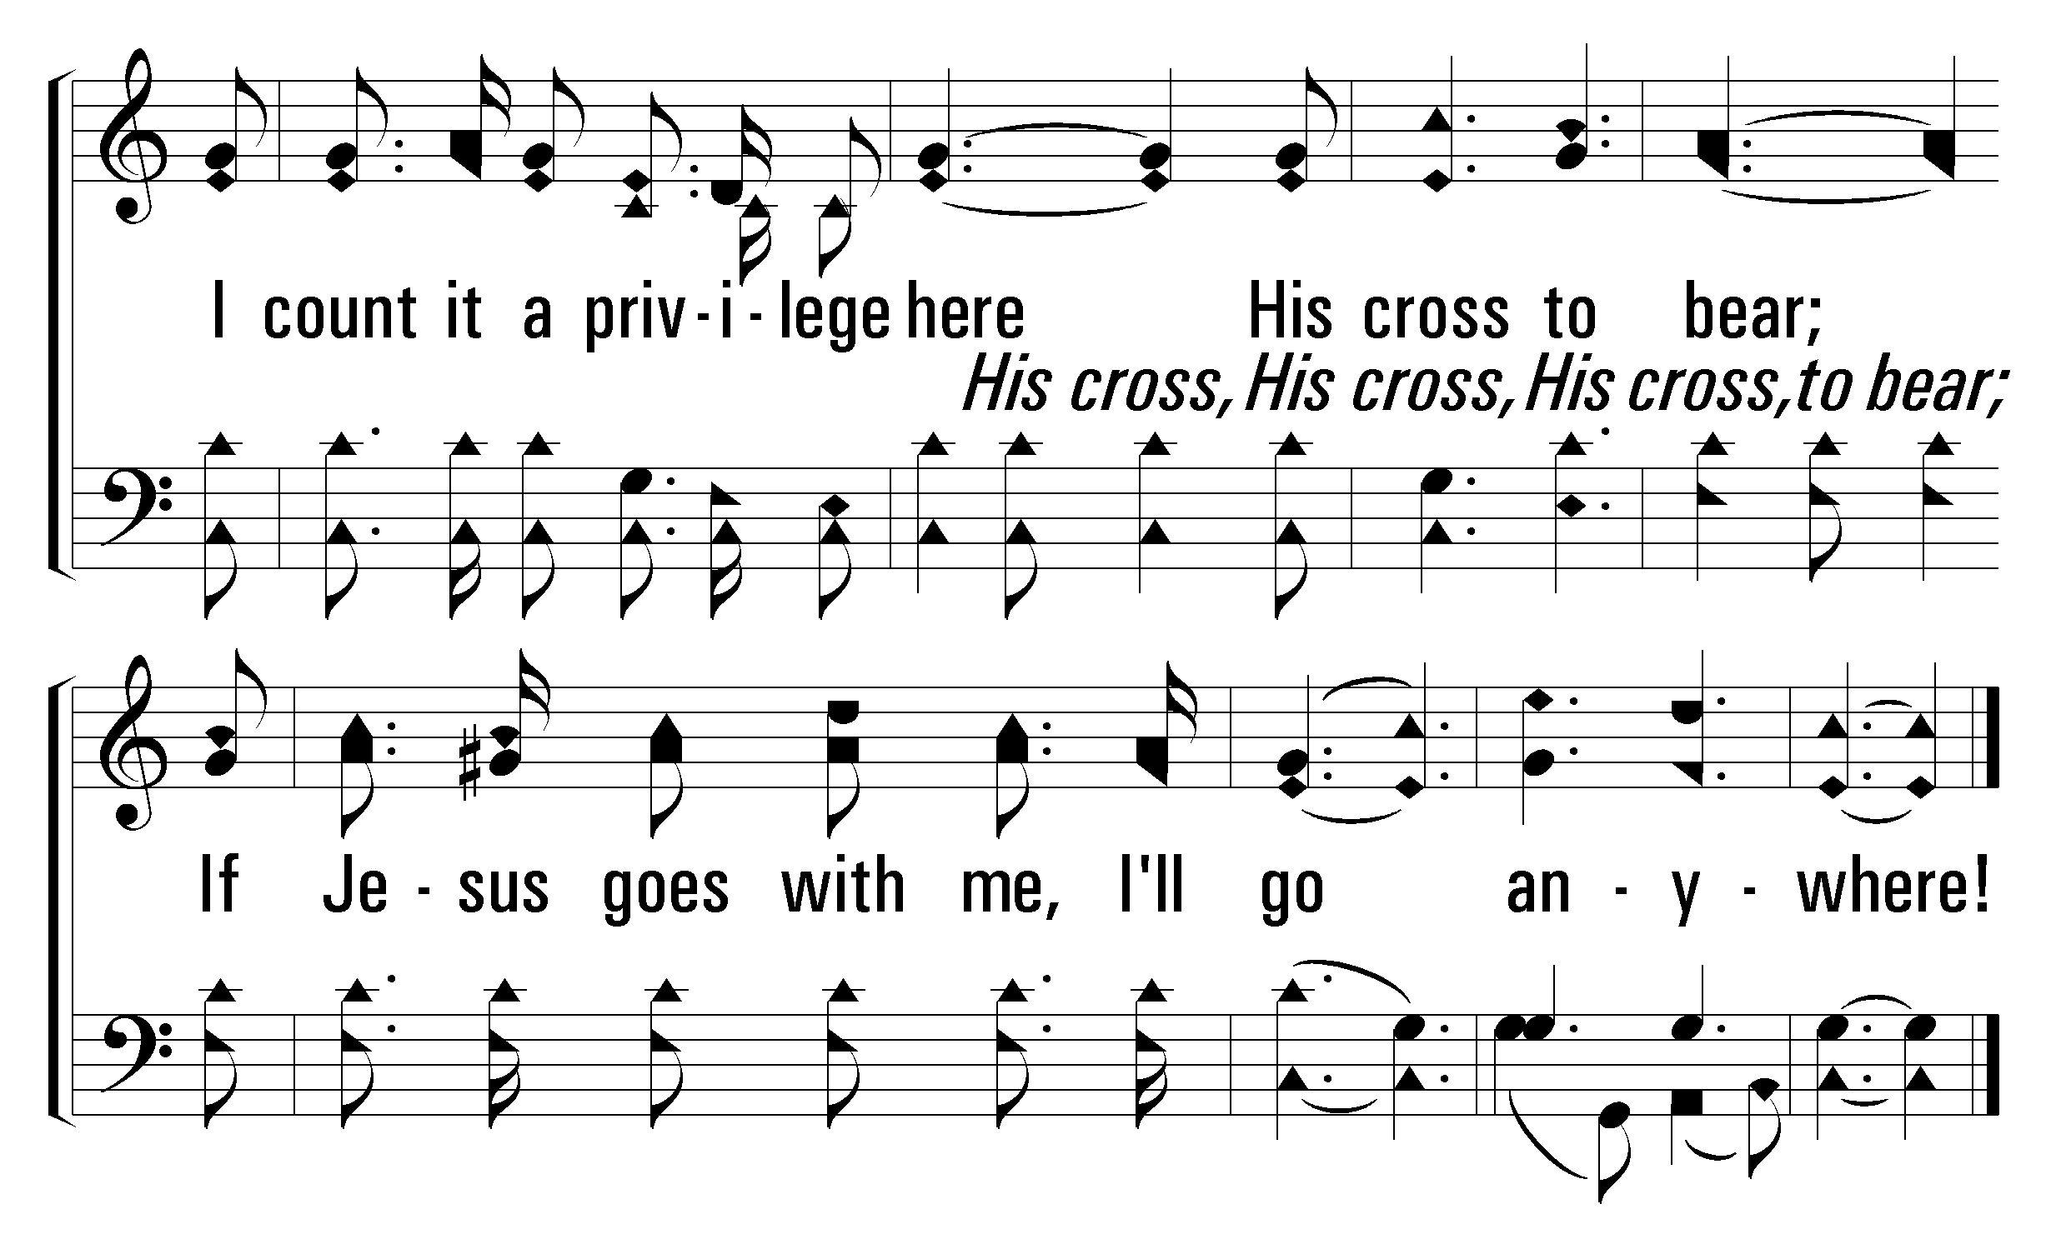
321
If Jesus Goes with Me
1
C
2
C
3
C
4
C
© 2009 The Paperless Hymnal®

Slide 30
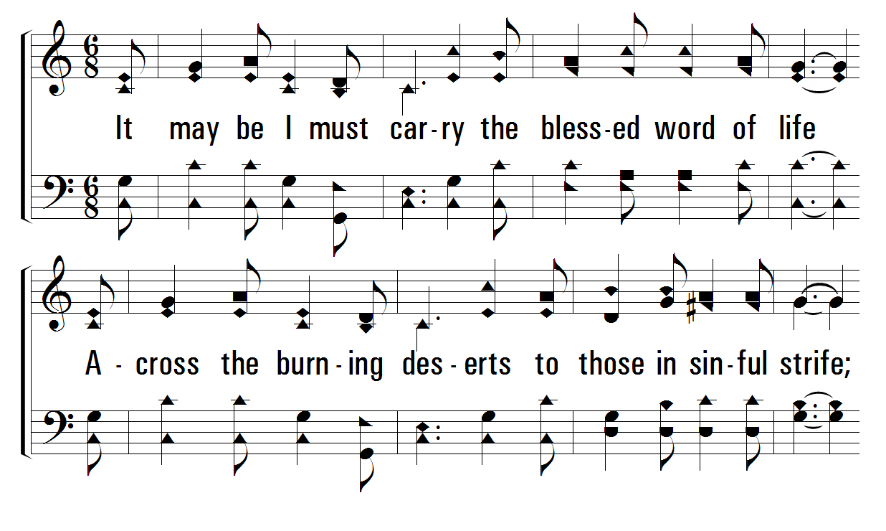
321
If Jesus Goes with Me
1
C
2
C
3
C
4
C
© 2009 The Paperless Hymnal®

Slide 31
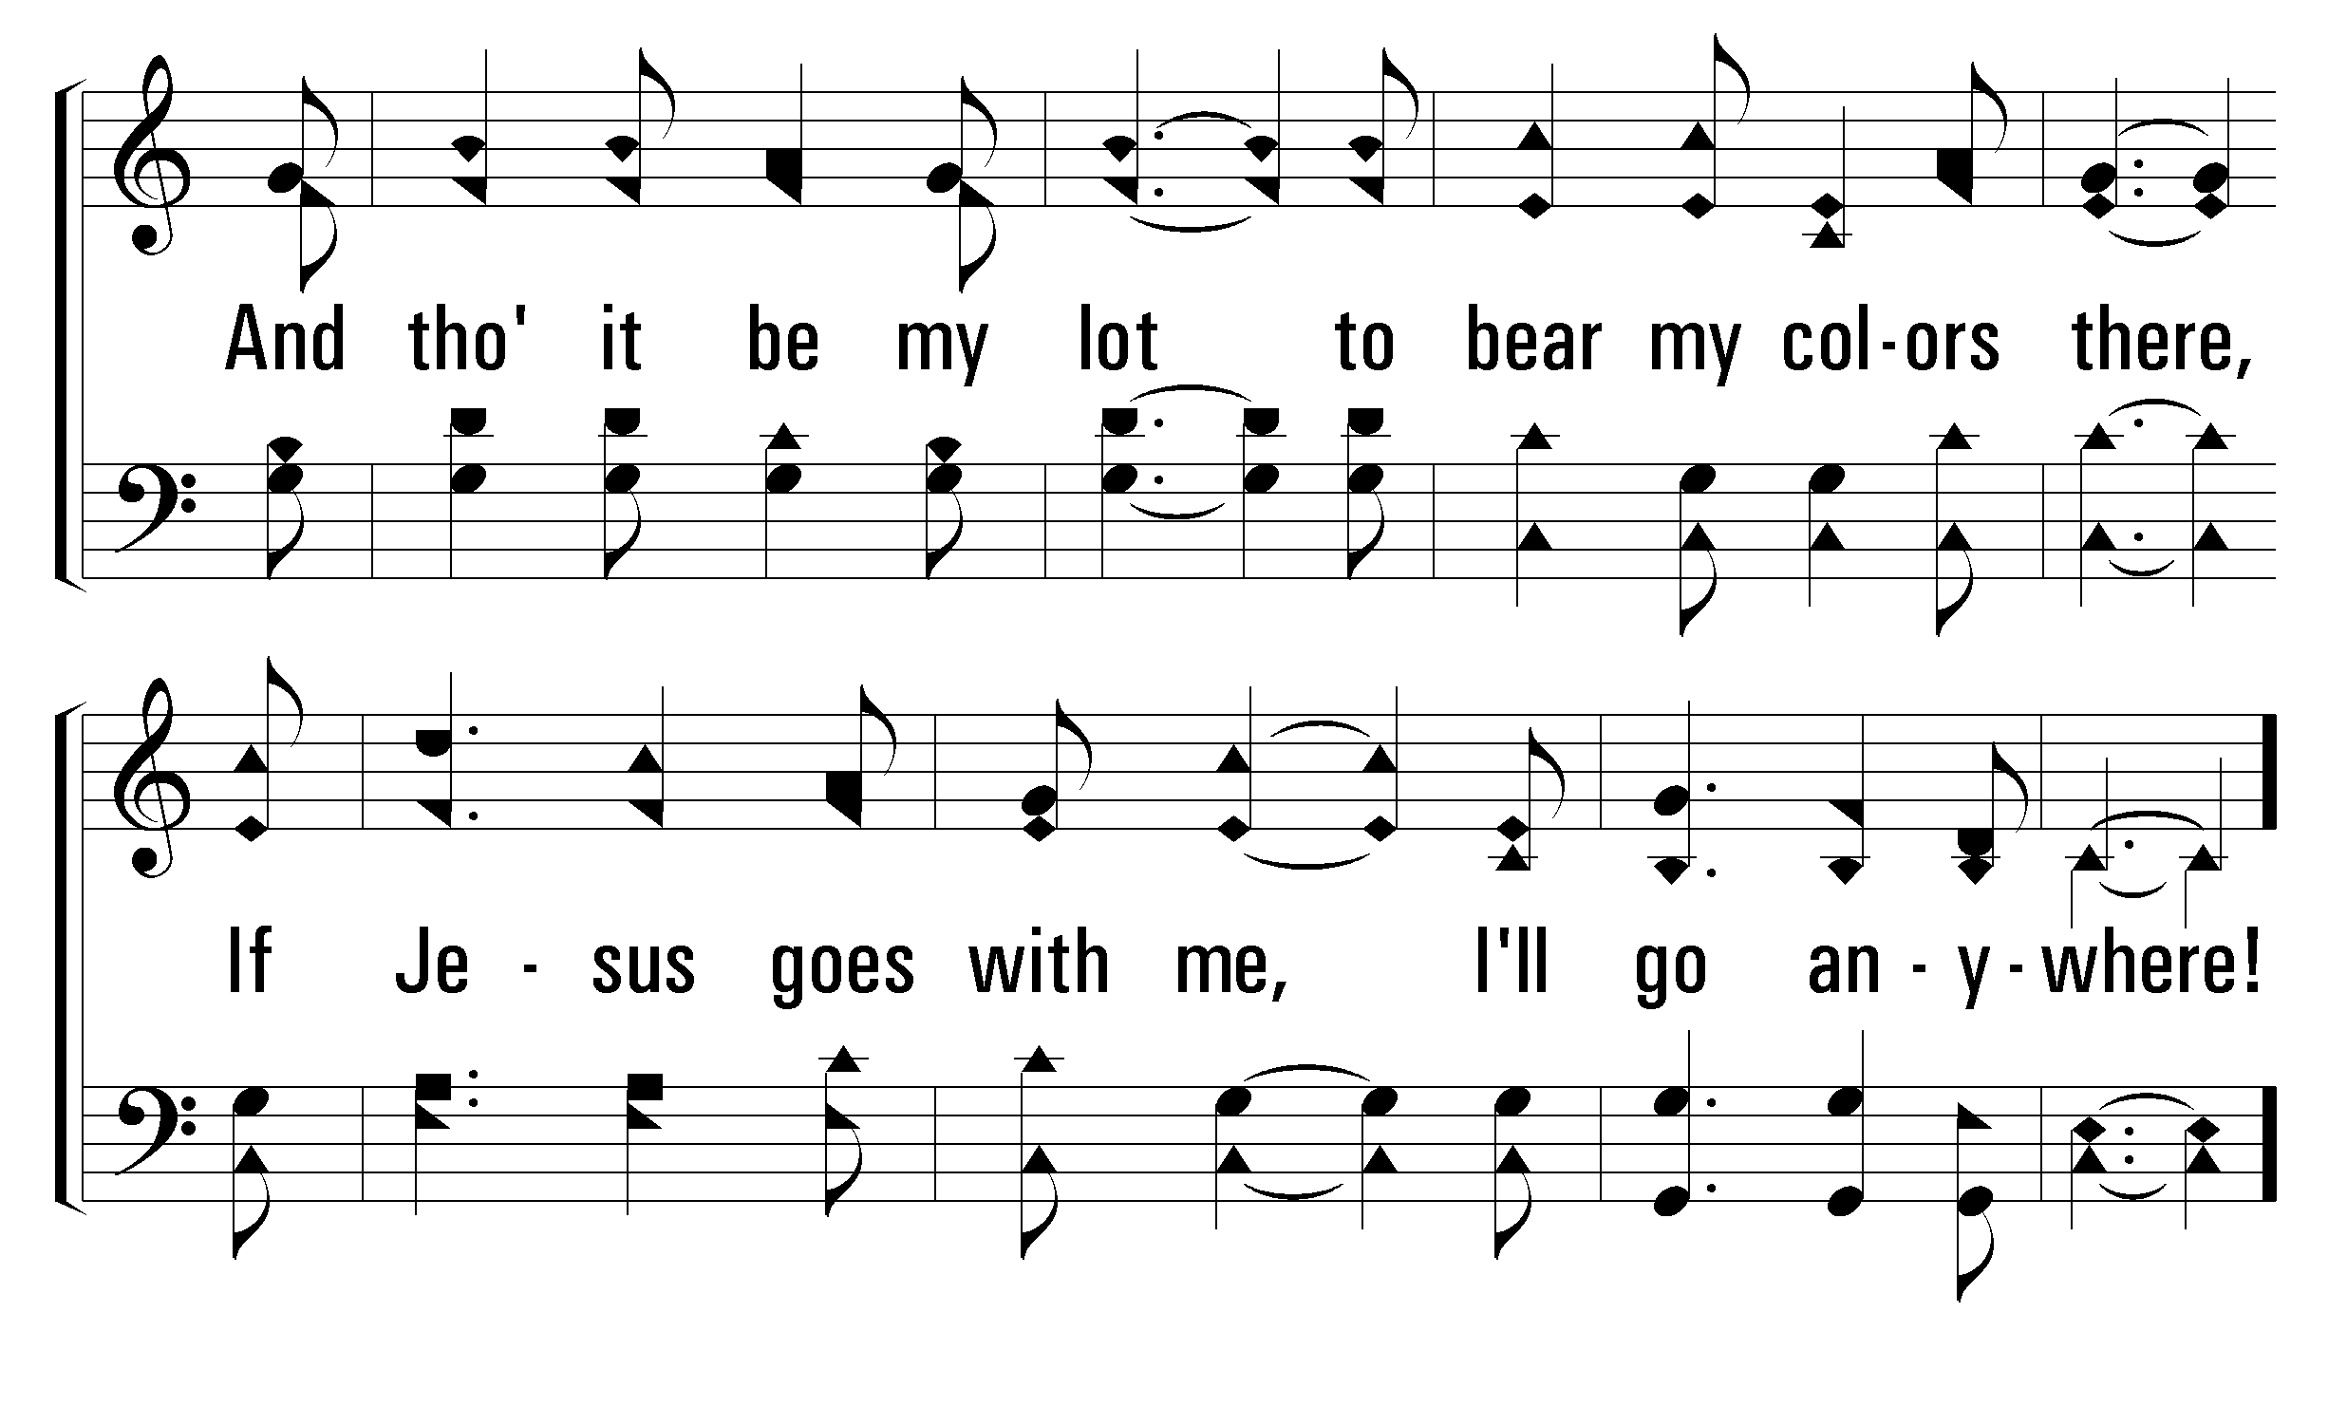
321
If Jesus Goes with Me
1
C
2
C
3
C
4
C
© 2009 The Paperless Hymnal®

Slide 32
321
If Jesus Goes with Me
1
C
2
C
3
C
4
C
© 2009 The Paperless Hymnal®

Slide 33
321
If Jesus Goes with Me
1
C
2
C
3
C
4
C
© 2009 The Paperless Hymnal®

Slide 34
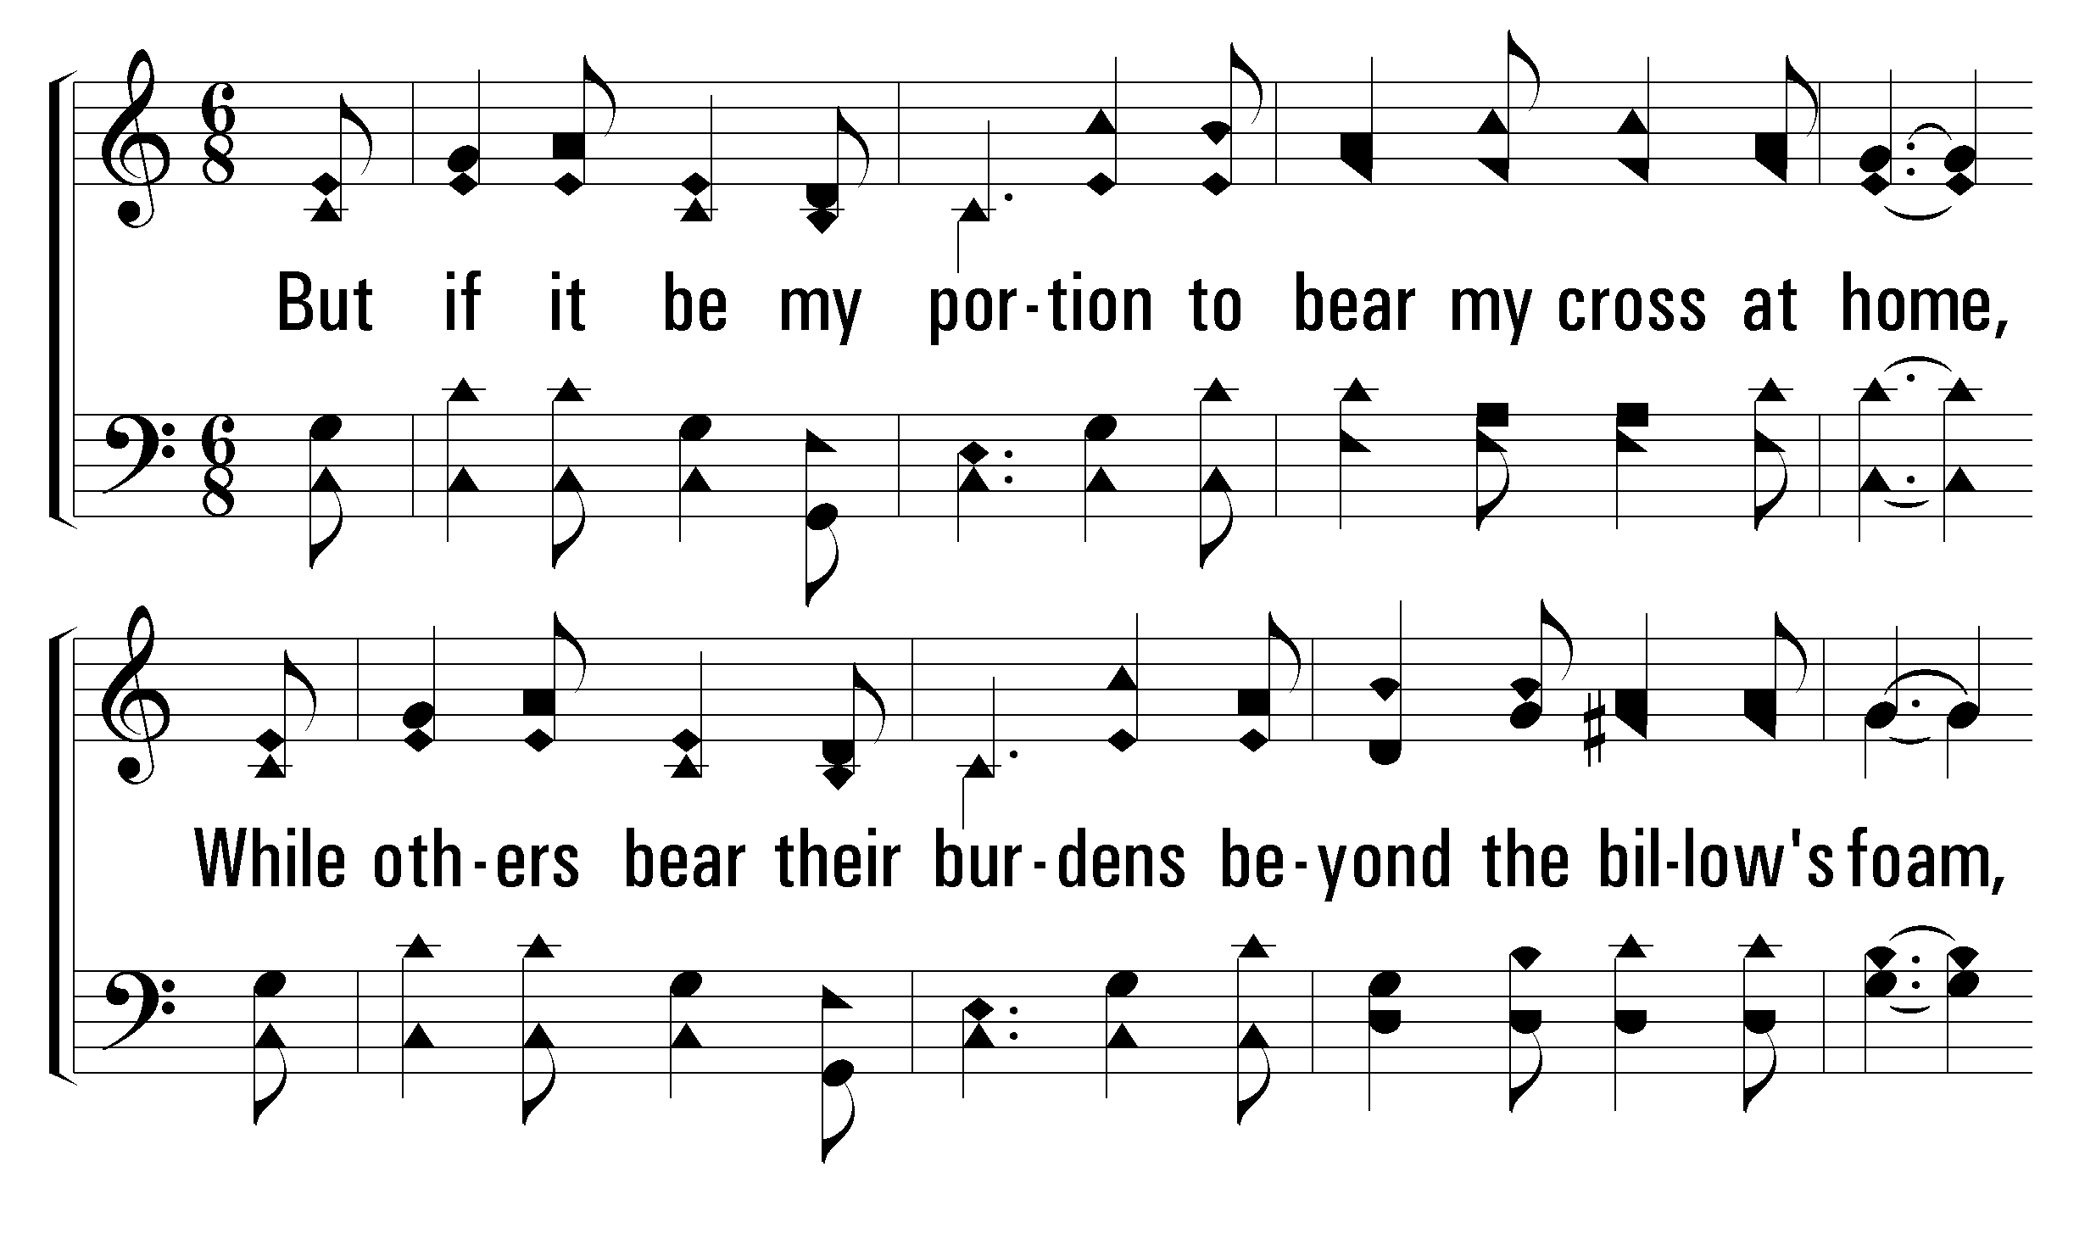
321
If Jesus Goes with Me
1
C
2
C
3
C
4
C
© 2009 The Paperless Hymnal®

Slide 35
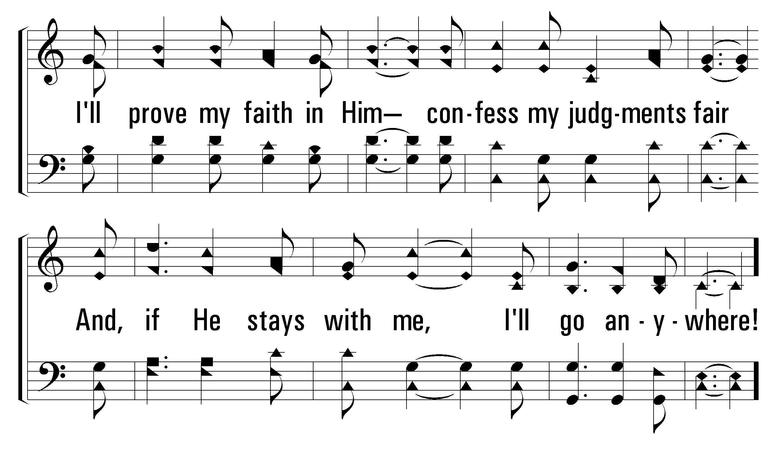
321
If Jesus Goes with Me
1
C
2
C
3
C
4
C
© 2009 The Paperless Hymnal®

Slide 36
321
If Jesus Goes with Me
1
C
2
C
3
C
4
C
© 2009 The Paperless Hymnal®

Slide 37
321
If Jesus Goes with Me
1
C
2
C
3
C
4
C
© 2009 The Paperless Hymnal®

Slide 38
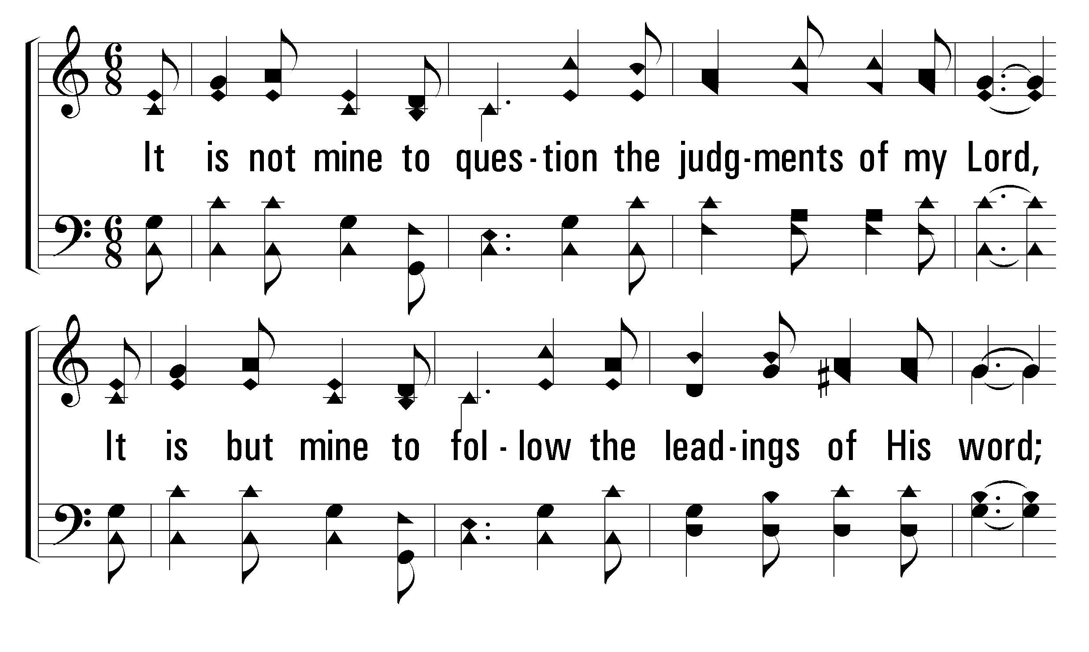
321
If Jesus Goes with Me
1
C
2
C
3
C
4
C
© 2009 The Paperless Hymnal®

Slide 39
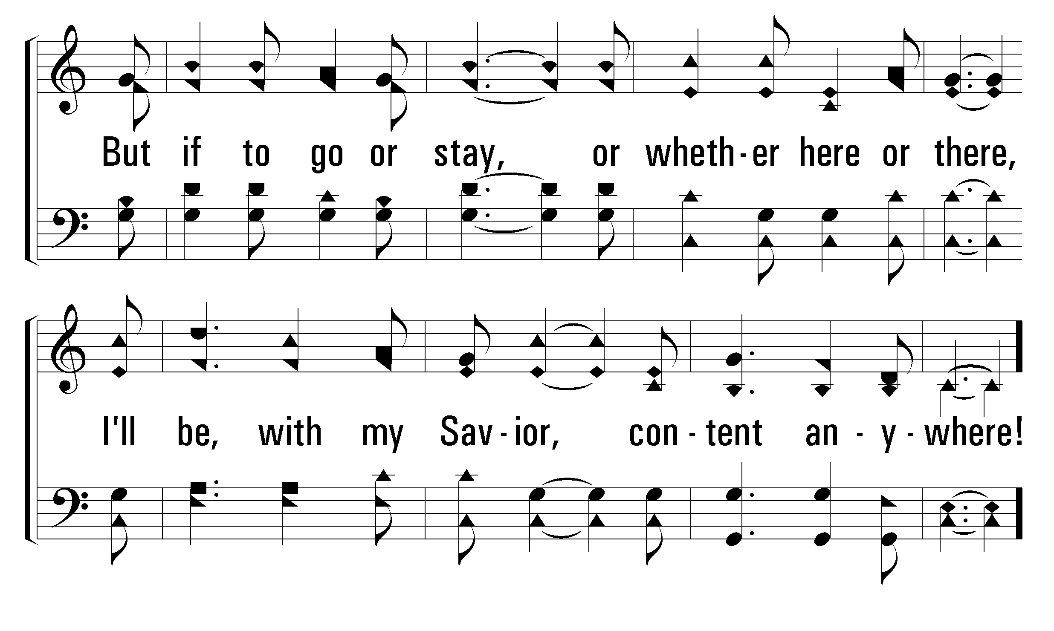
321
If Jesus Goes with Me
1
C
2
C
3
C
4
C
© 2009 The Paperless Hymnal®

Slide 40
321
If Jesus Goes with Me
1
C
2
C
3
C
4
C
© 2009 The Paperless Hymnal®

Slide 41
321
If Jesus Goes with Me
1
C
2
C
3
C
4
C
© 2009 The Paperless Hymnal®

Slide 43
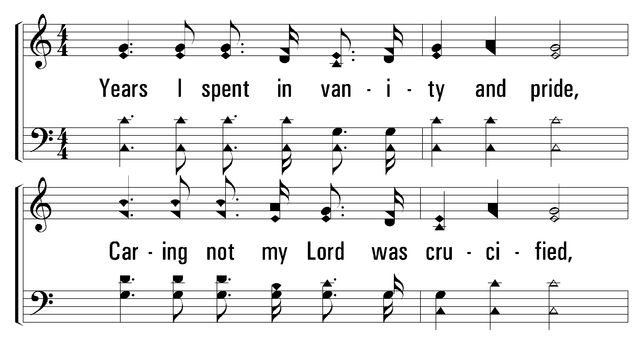
53
At Calvary
1
C
2
C
3
C
© 2001 The Paperless Hymnal™

Slide 44
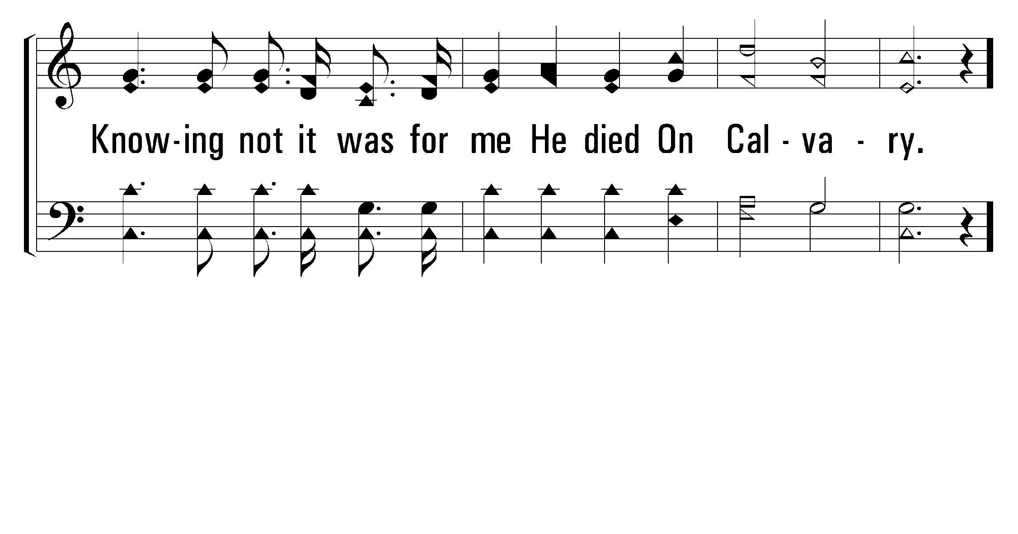
53
At Calvary
1
C
2
C
3
C
© 2001 The Paperless Hymnal™

Slide 45
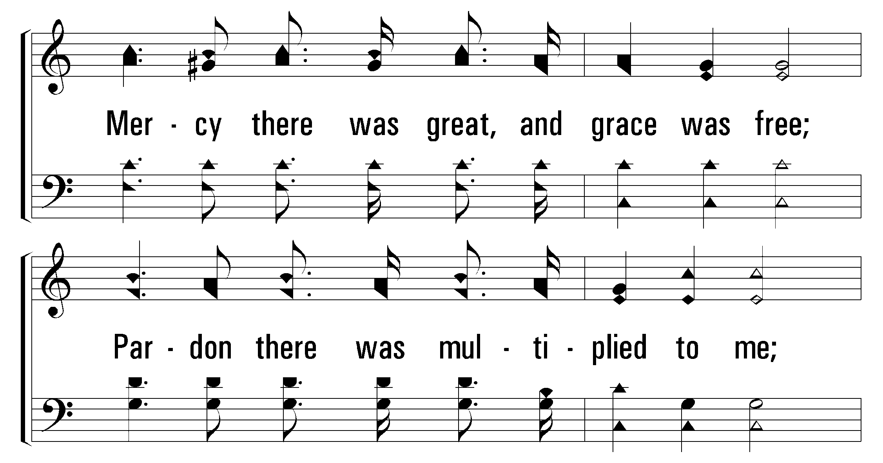
53
At Calvary
1
C
2
C
3
C
© 2001 The Paperless Hymnal™

Slide 46
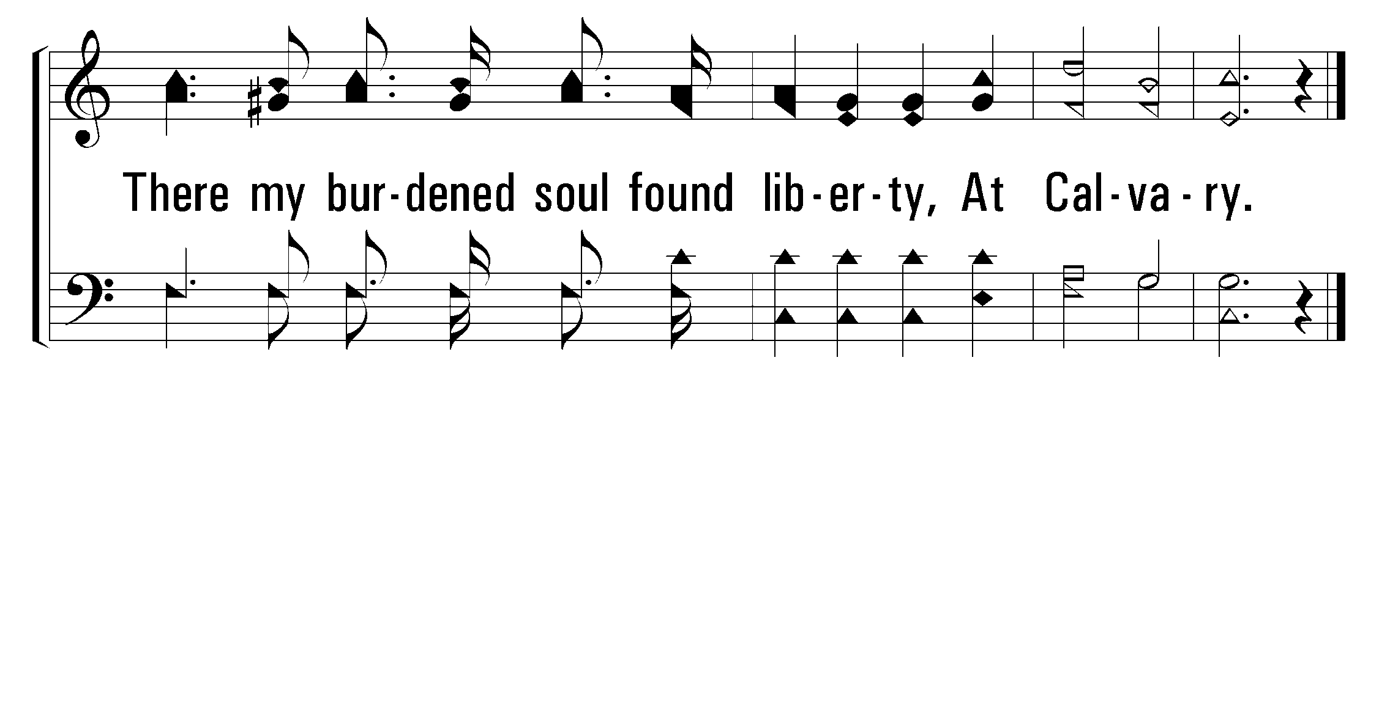
53
At Calvary
1
C
2
C
3
C
© 2001 The Paperless Hymnal™

Slide 47
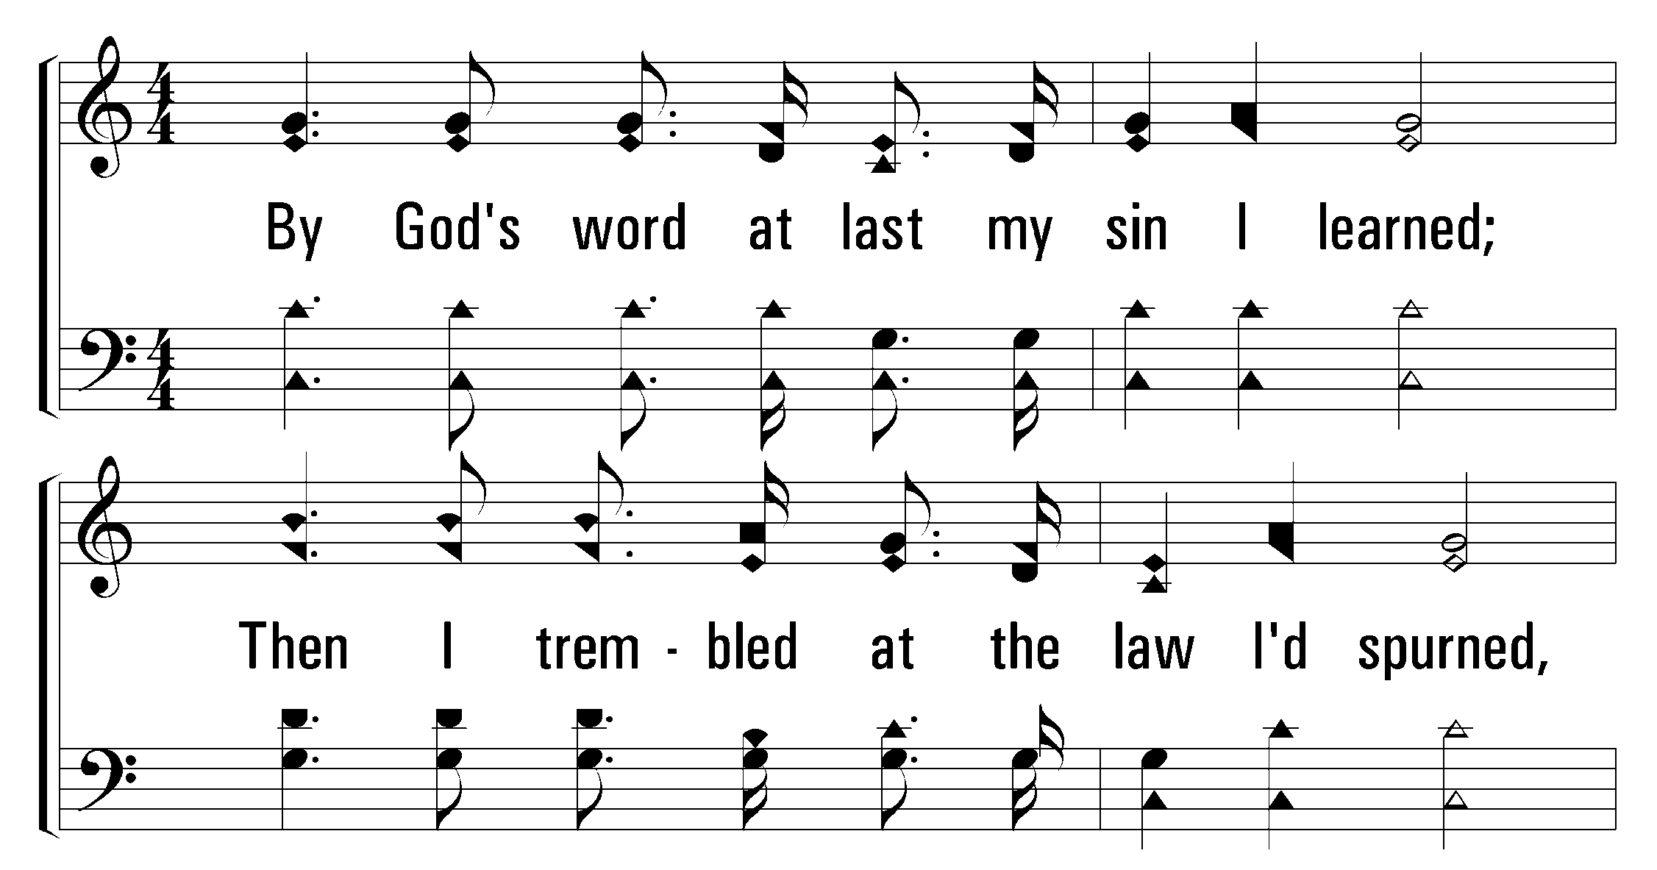
53
At Calvary
1
C
2
C
3
C
© 2001 The Paperless Hymnal™

Slide 48
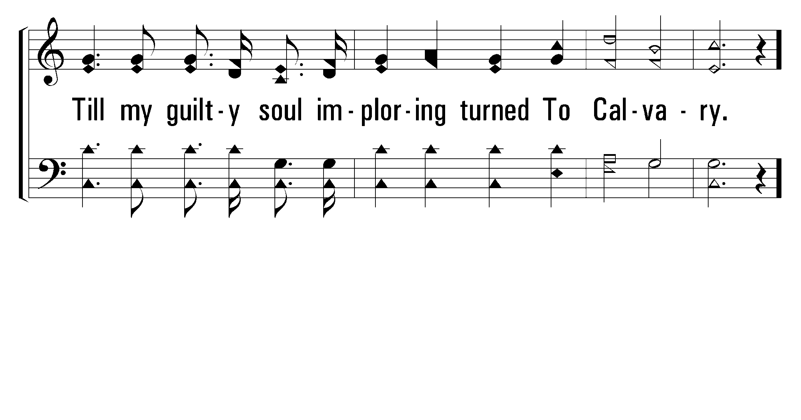
53
At Calvary
1
C
2
C
3
C
© 2001 The Paperless Hymnal™

Slide 49
53
At Calvary
1
C
2
C
3
C
© 2001 The Paperless Hymnal™

Slide 50
53
At Calvary
1
C
2
C
3
C
© 2001 The Paperless Hymnal™

Slide 51
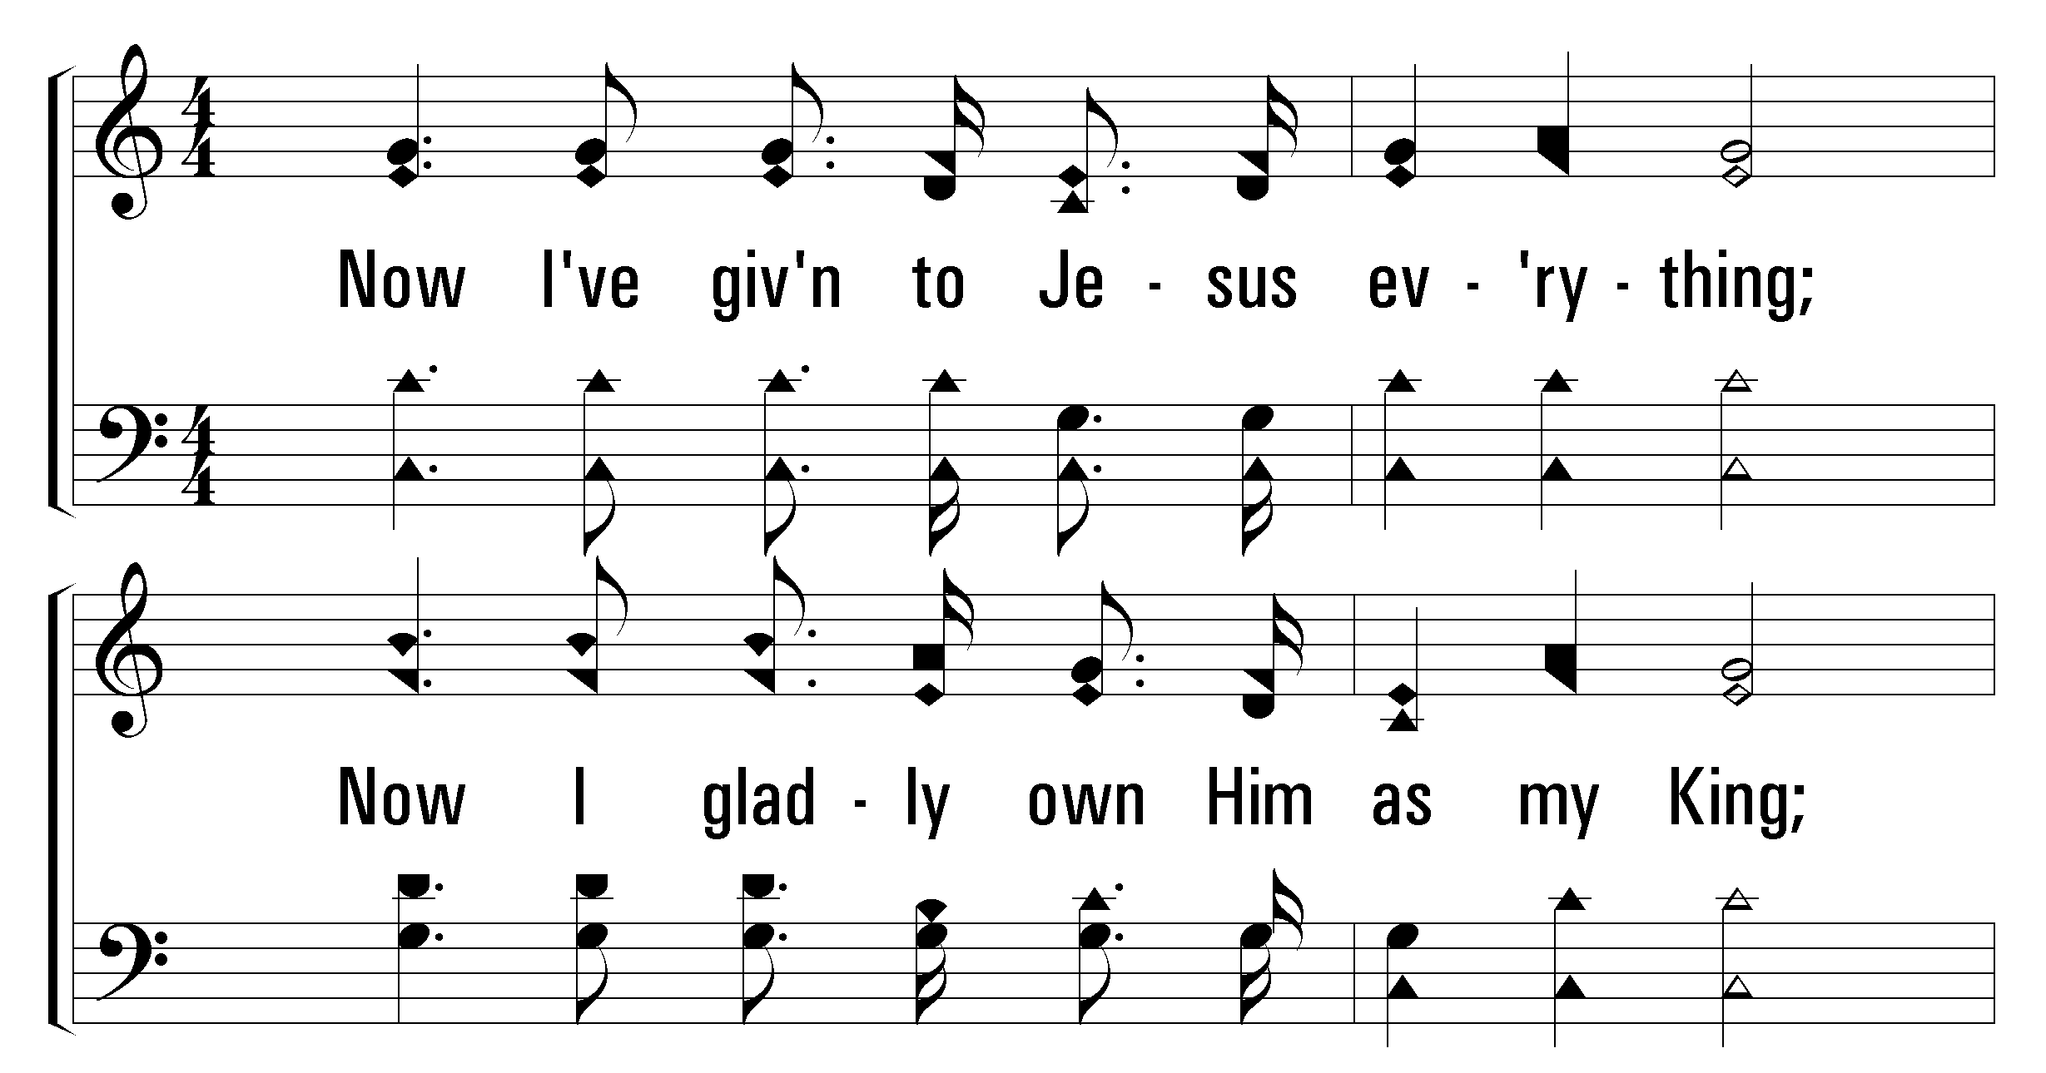
53
At Calvary
1
C
2
C
3
C
© 2001 The Paperless Hymnal™

Slide 52
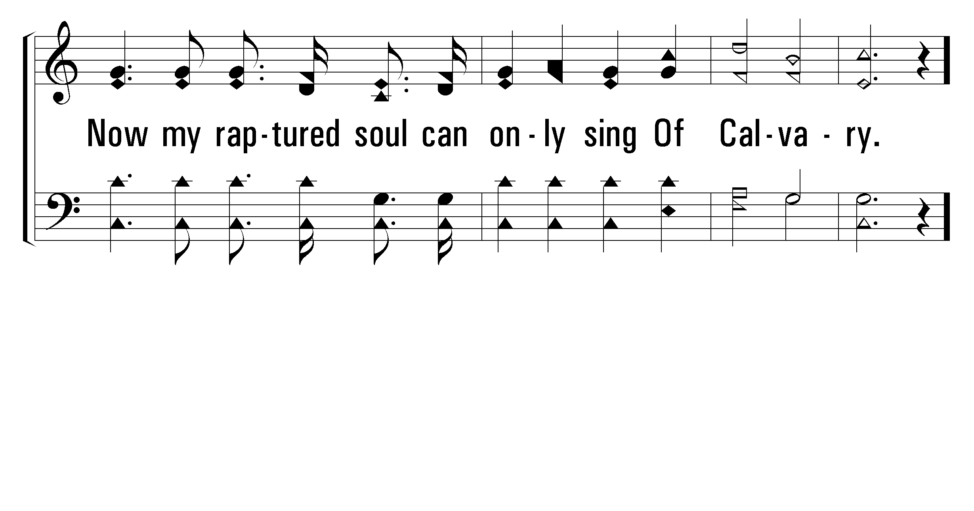
53
At Calvary
1
C
2
C
3
C
© 2001 The Paperless Hymnal™

Slide 53
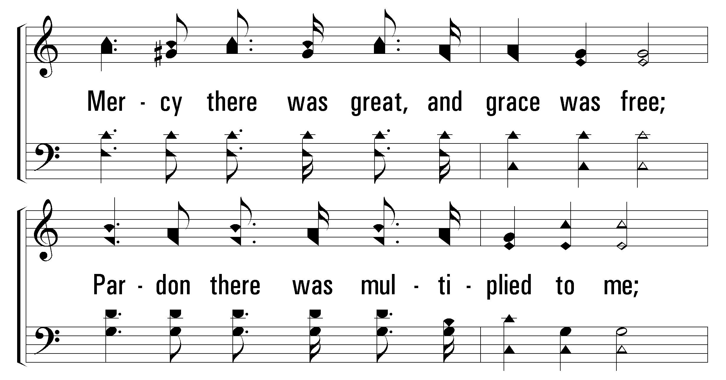
53
At Calvary
1
C
2
C
3
C
© 2001 The Paperless Hymnal™

Slide 54

53
At Calvary
1
C
2
C
3
C
© 2001 The Paperless Hymnal™

