Slide 1
Wednesday Night, August 8, 2019
Higher Ground (234)
Invitation
Hark! The Gentle Voice (207)
Announcements
Closing Prayer

Slide 2

Invitation Song
207
Hark! The Gentle Voice
Words: Mary B. C. Slade
Music: Asa B. Everett

Slide 3
234
Higher Ground
Words by: Johnson Oatman
Music by: Charles H. Gabriel
Omit Verse 3

Slide 4
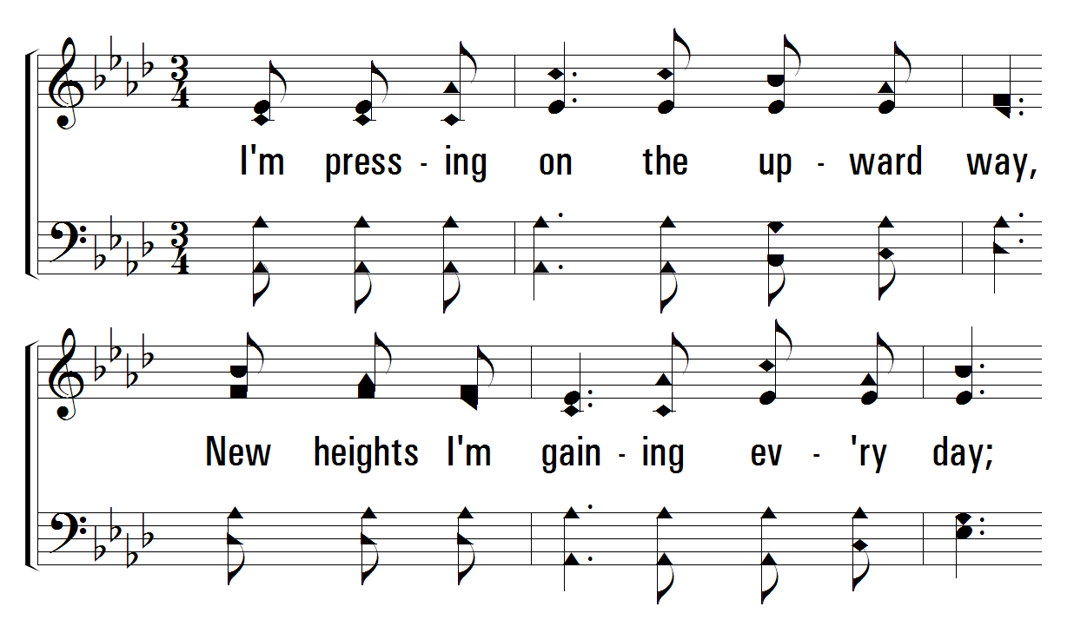
234
Higher Ground
1
C
2
C
4
C
© 2001 The Paperless Hymnal™

Slide 5
234
Higher Ground
Words by: Johnson Oatman
Music by: Charles H. Gabriel
Omit Verse 3

Slide 6
Estoy presionando hacia arriba
presio - nando
hacia arriba
nuevas alturas que estoy ganando todos los días
234
Higher Ground
1
C
2
C
4
C
© 2001 The Paperless Hymnal™

Slide 7
Estoy presionando hacia arriba
nuevas alturas que estoy ganando todos los días
234
Higher Ground
1
C
2
C
4
C
© 2001 The Paperless Hymnal™

Slide 8
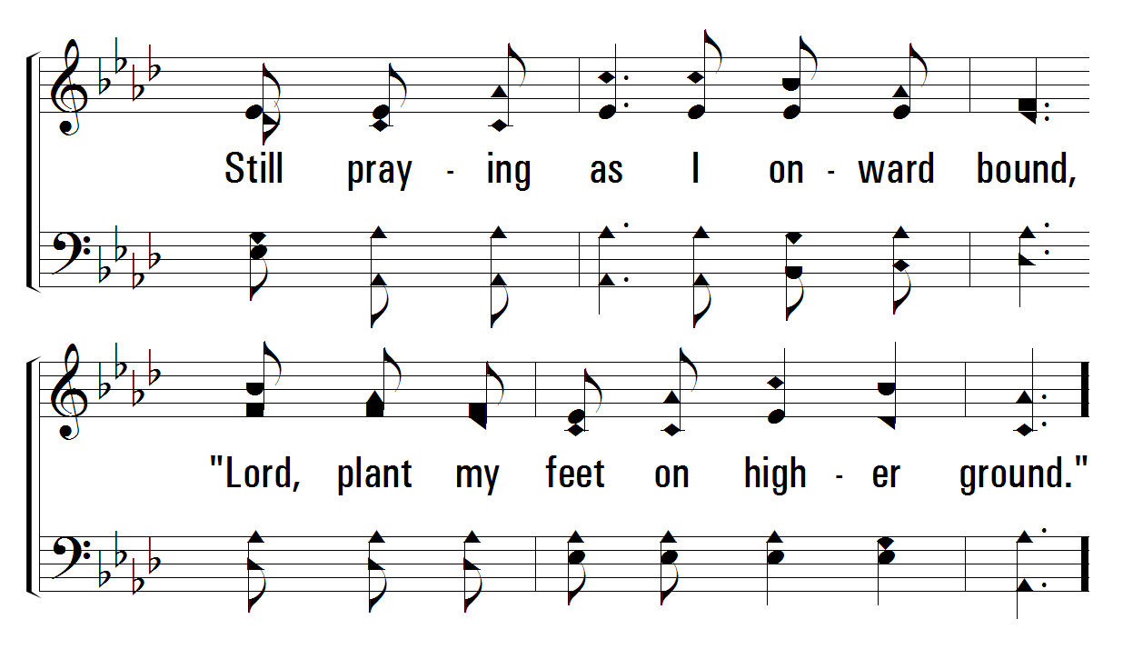
234
Higher Ground
1
C
2
C
4
C
© 2001 The Paperless Hymnal™

Slide 9
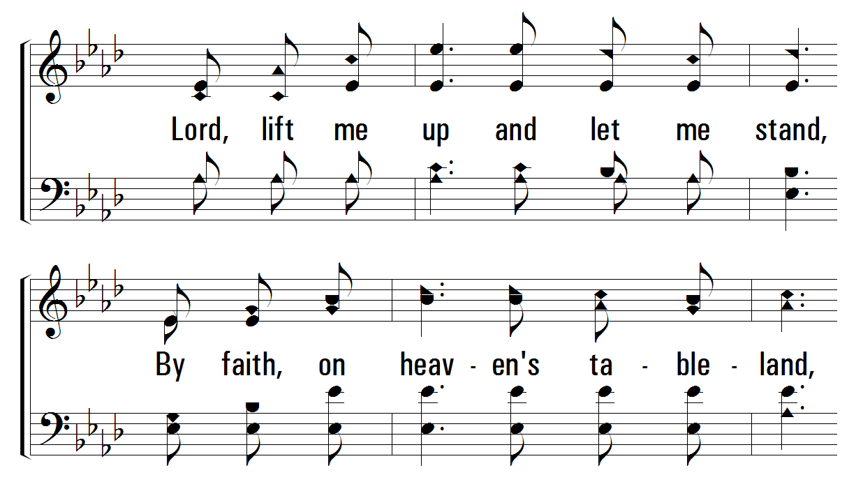
234
Higher Ground
1
C
2
C
4
C
© 2001 The Paperless Hymnal™

Slide 10
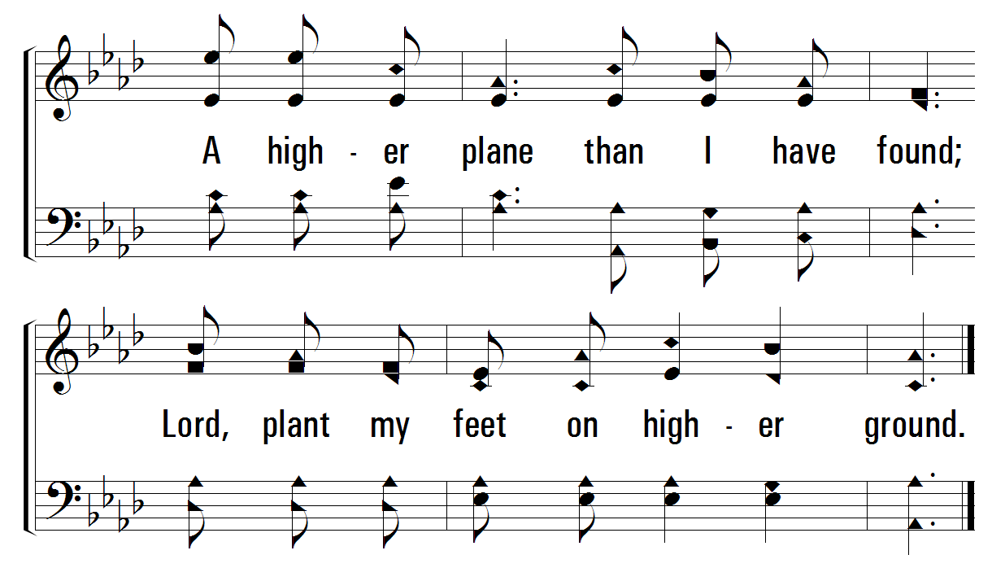
234
Higher Ground
1
C
2
C
4
C
© 2001 The Paperless Hymnal™

Slide 11
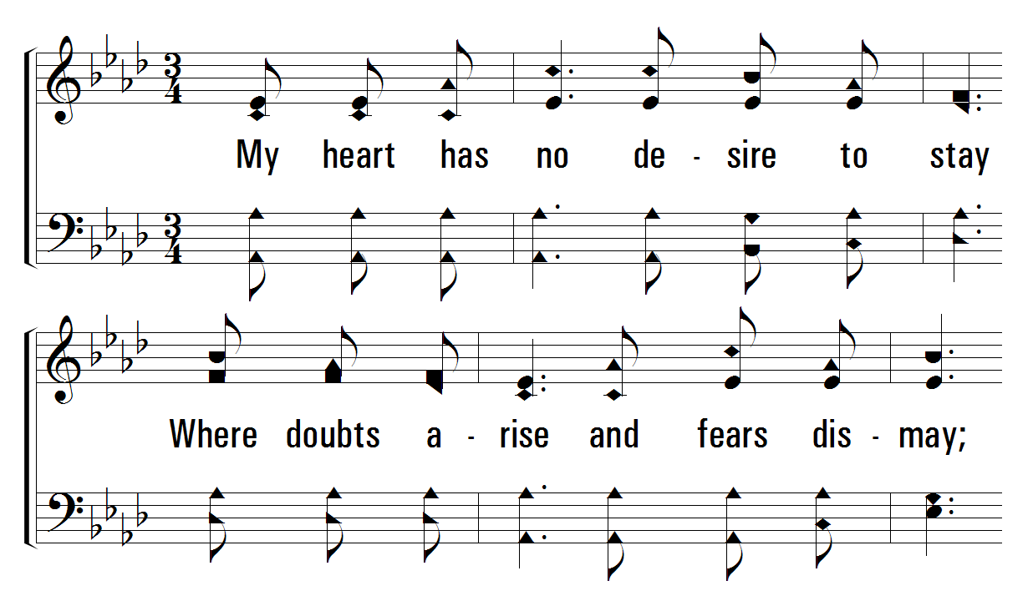
234
Higher Ground
1
C
2
C
4
C
© 2001 The Paperless Hymnal™

Slide 12
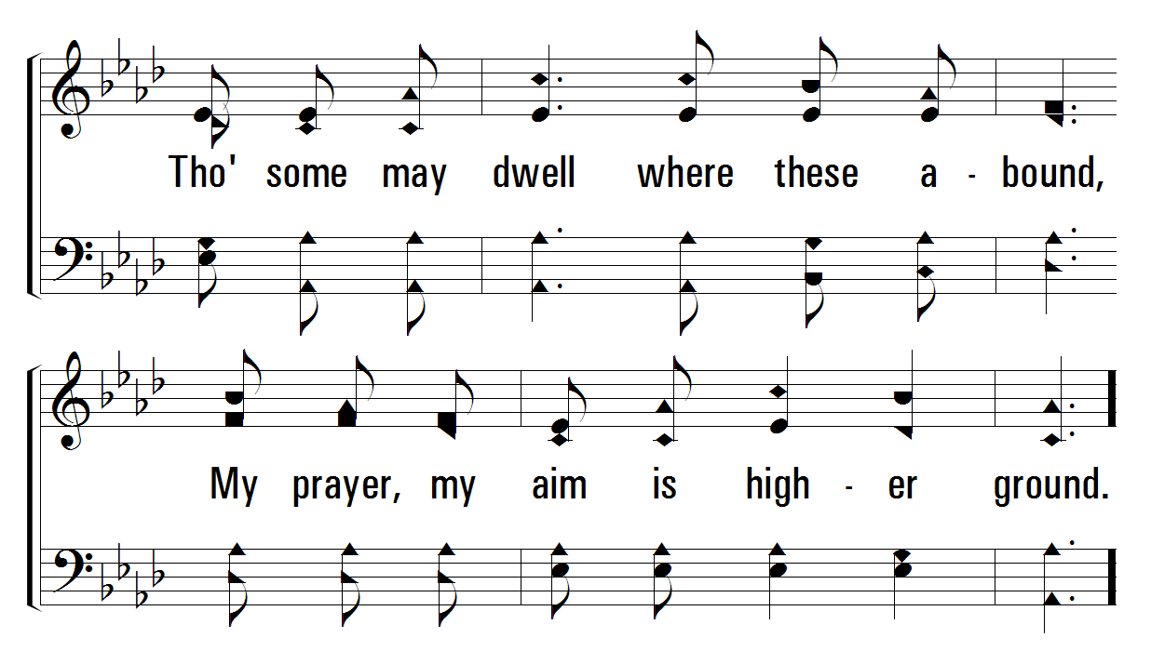
234
Higher Ground
1
C
2
C
4
C
© 2001 The Paperless Hymnal™

Slide 13
234
Higher Ground
1
C
2
C
4
C
© 2001 The Paperless Hymnal™

Slide 14
234
Higher Ground
1
C
2
C
4
C
© 2001 The Paperless Hymnal™

Slide 15
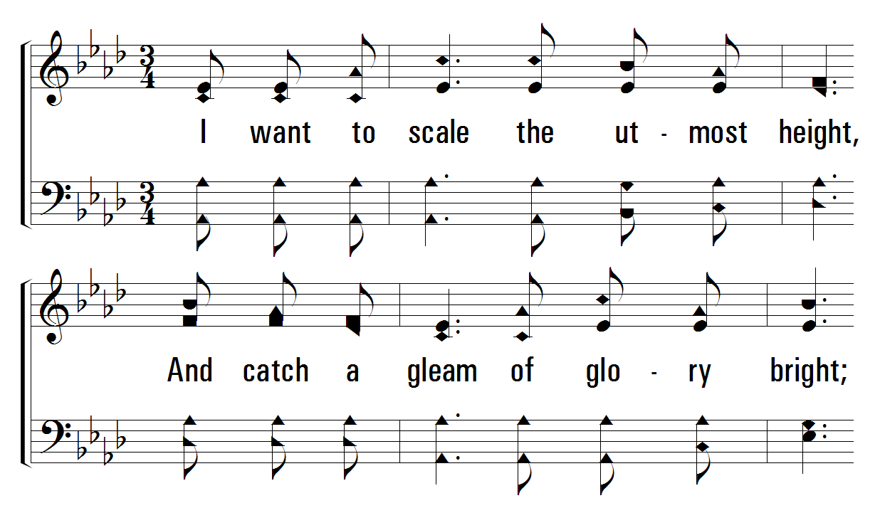
234
Higher Ground
1
C
2
C
4
C
© 2001 The Paperless Hymnal™

Slide 16
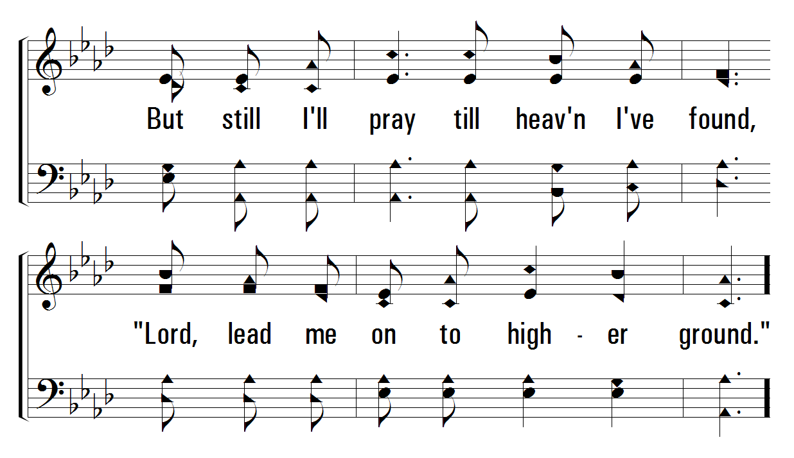
234
Higher Ground
1
C
2
C
4
C
© 2001 The Paperless Hymnal™

Slide 17
234
Higher Ground
1
C
2
C
4
C
© 2001 The Paperless Hymnal™

Slide 18
234
Higher Ground
1
C
2
C
4
C
© 2001 The Paperless Hymnal™

Slide 19

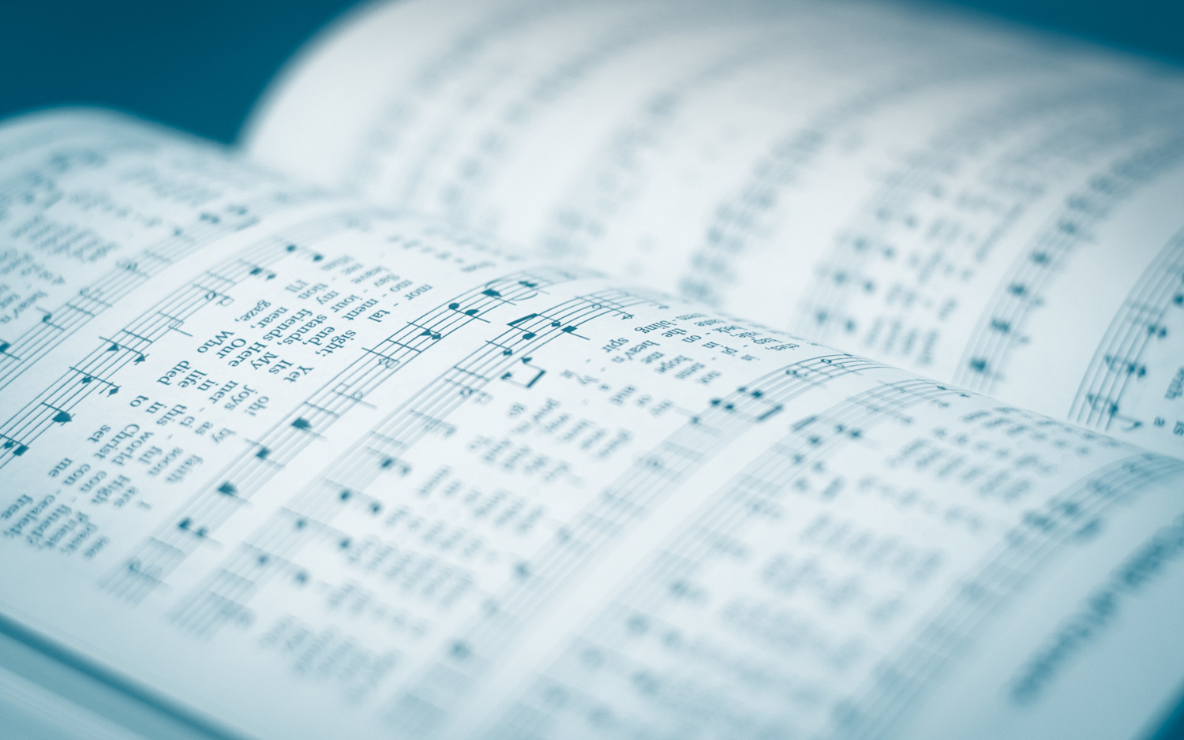

Invitation

Slide 21
234
Higher Ground
1
C
2
C
4
C
© 2001 The Paperless Hymnal™

Slide 23
Invitation

Slide 25
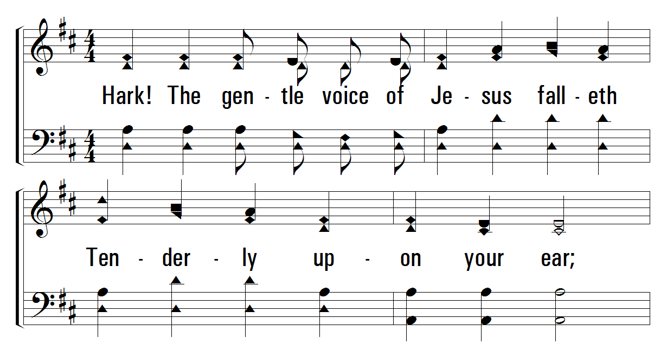
207
Hark! The Gentle Voice
1
C
2
C
3
C
© 2001 The Paperless Hymnal™

Slide 26
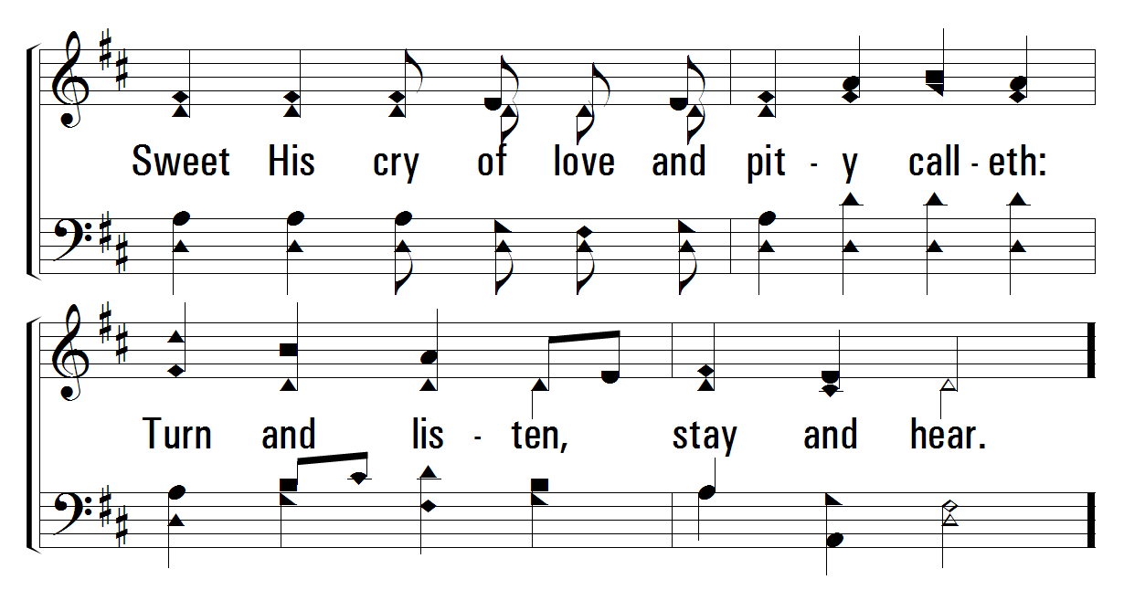
207
Hark! The Gentle Voice
1
C
2
C
3
C
© 2001 The Paperless Hymnal™

Slide 27
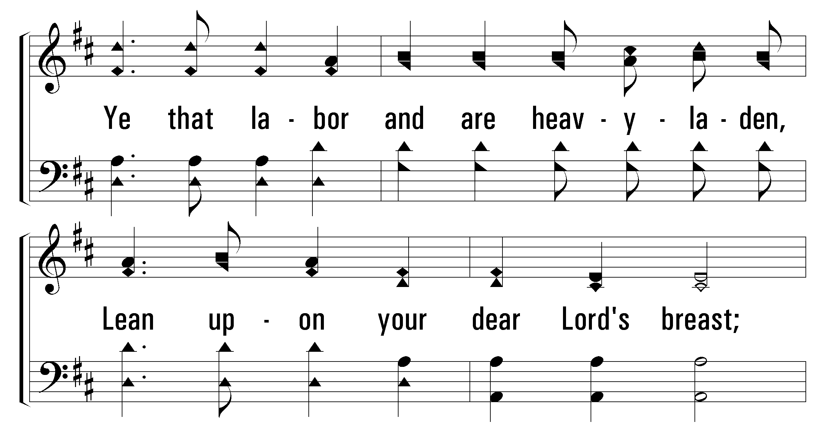
207
Hark! The Gentle Voice
1
C
2
C
3
C
© 2001 The Paperless Hymnal™

Slide 28
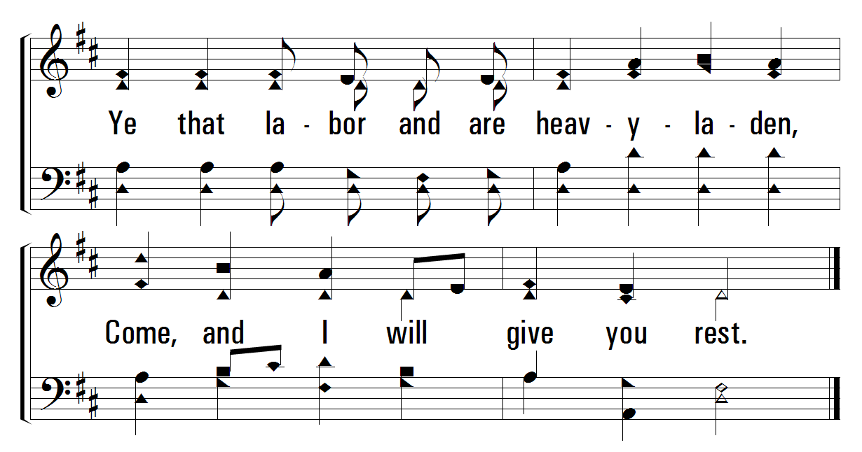
207
Hark! The Gentle Voice
1
C
2
C
3
C
© 2001 The Paperless Hymnal™

Slide 29
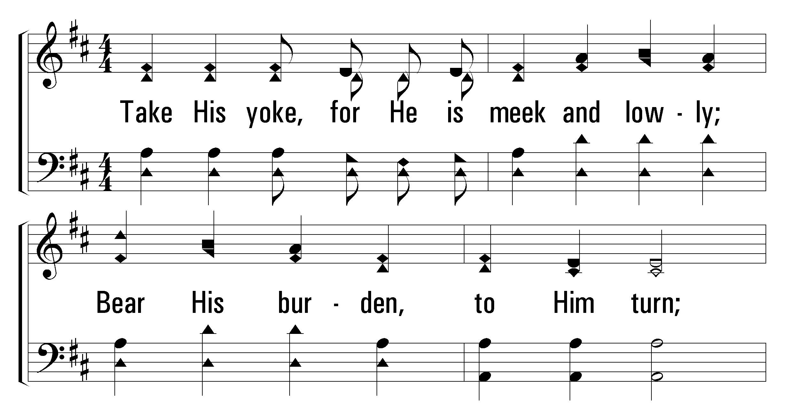
207
Hark! The Gentle Voice
1
C
2
C
3
C
© 2001 The Paperless Hymnal™

Slide 30
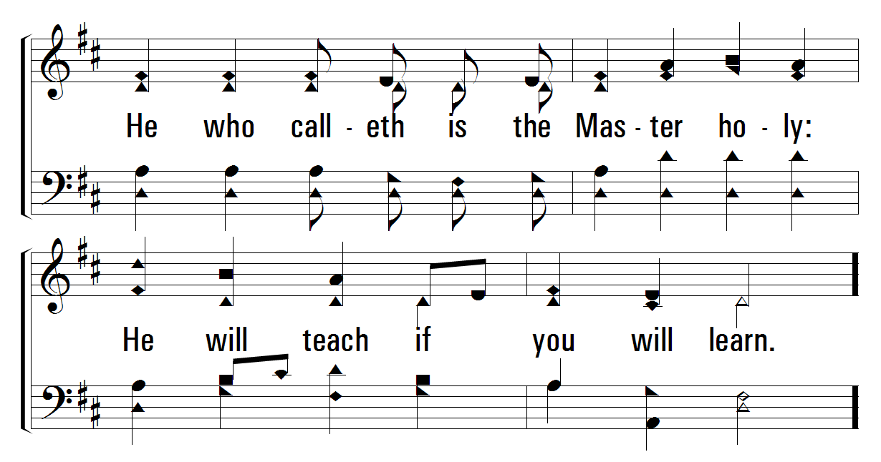
207
Hark! The Gentle Voice
1
C
2
C
3
C
© 2001 The Paperless Hymnal™

Slide 31
207
Hark! The Gentle Voice
1
C
2
C
3
C
© 2001 The Paperless Hymnal™

Slide 32
207
Hark! The Gentle Voice
1
C
2
C
3
C
© 2001 The Paperless Hymnal™

Slide 33
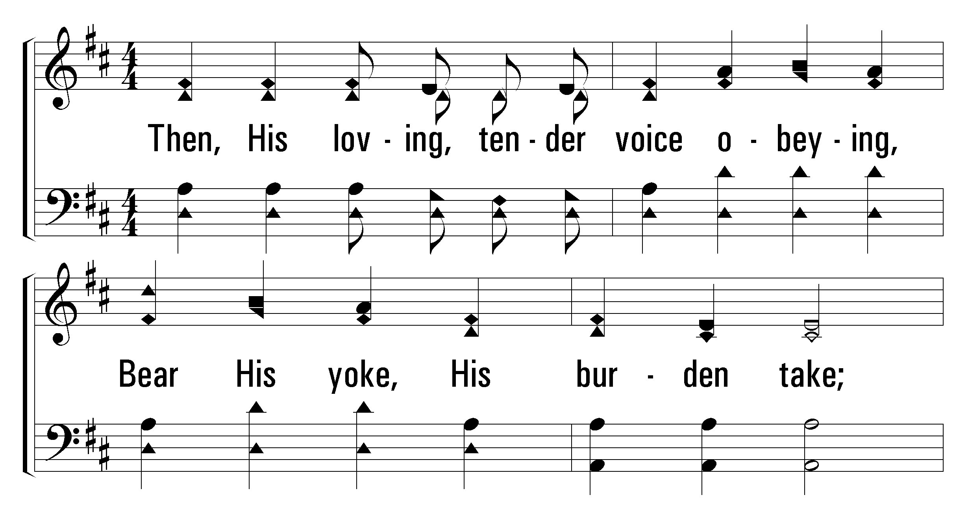
207
Hark! The Gentle Voice
1
C
2
C
3
C
© 2001 The Paperless Hymnal™

Slide 34
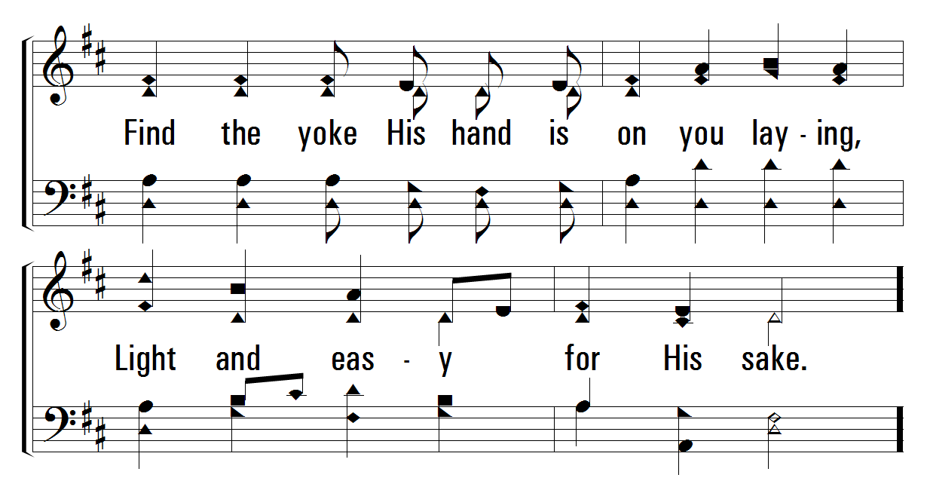
207
Hark! The Gentle Voice
1
C
2
C
3
C
© 2001 The Paperless Hymnal™

Slide 35
207
Hark! The Gentle Voice
1
C
2
C
3
C
© 2001 The Paperless Hymnal™

Slide 36
207
Hark! The Gentle Voice
1
C
2
C
3
C
© 2001 The Paperless Hymnal™

Slide 38



Slide 39


Thanks for being with us tonight.
Please join us again this Sunday!
9:00
am
Bible
Classes
10:00
am
Morning
Worship
6:00
pm
Evening
Worship

Slide 41
embryhills.com

