Slide 1
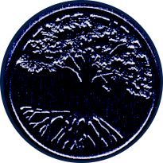

Welcome
He Is in Our Midst
A Common Love
Sheep and Goats
Ye Must Be Born Again
Prayer
Sunday 6:00PM
August 16, 2020
Welcome
105
Larry Brown
842
Sermon
Marty Broadwell
797
Prayer
Dwight Alleyne
Notes:
Song Leader: Larry Brown

