Slide 1
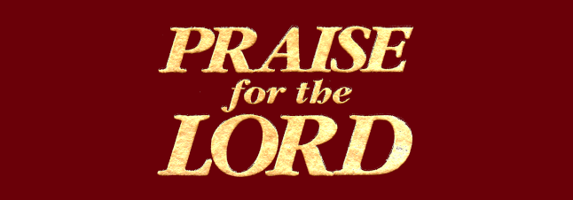
392
Words: vs. 1: Albert W. T. Orsborn
Music: Tom M. Jones
Let the Beauty of Jesus Be Seen

Slide 2
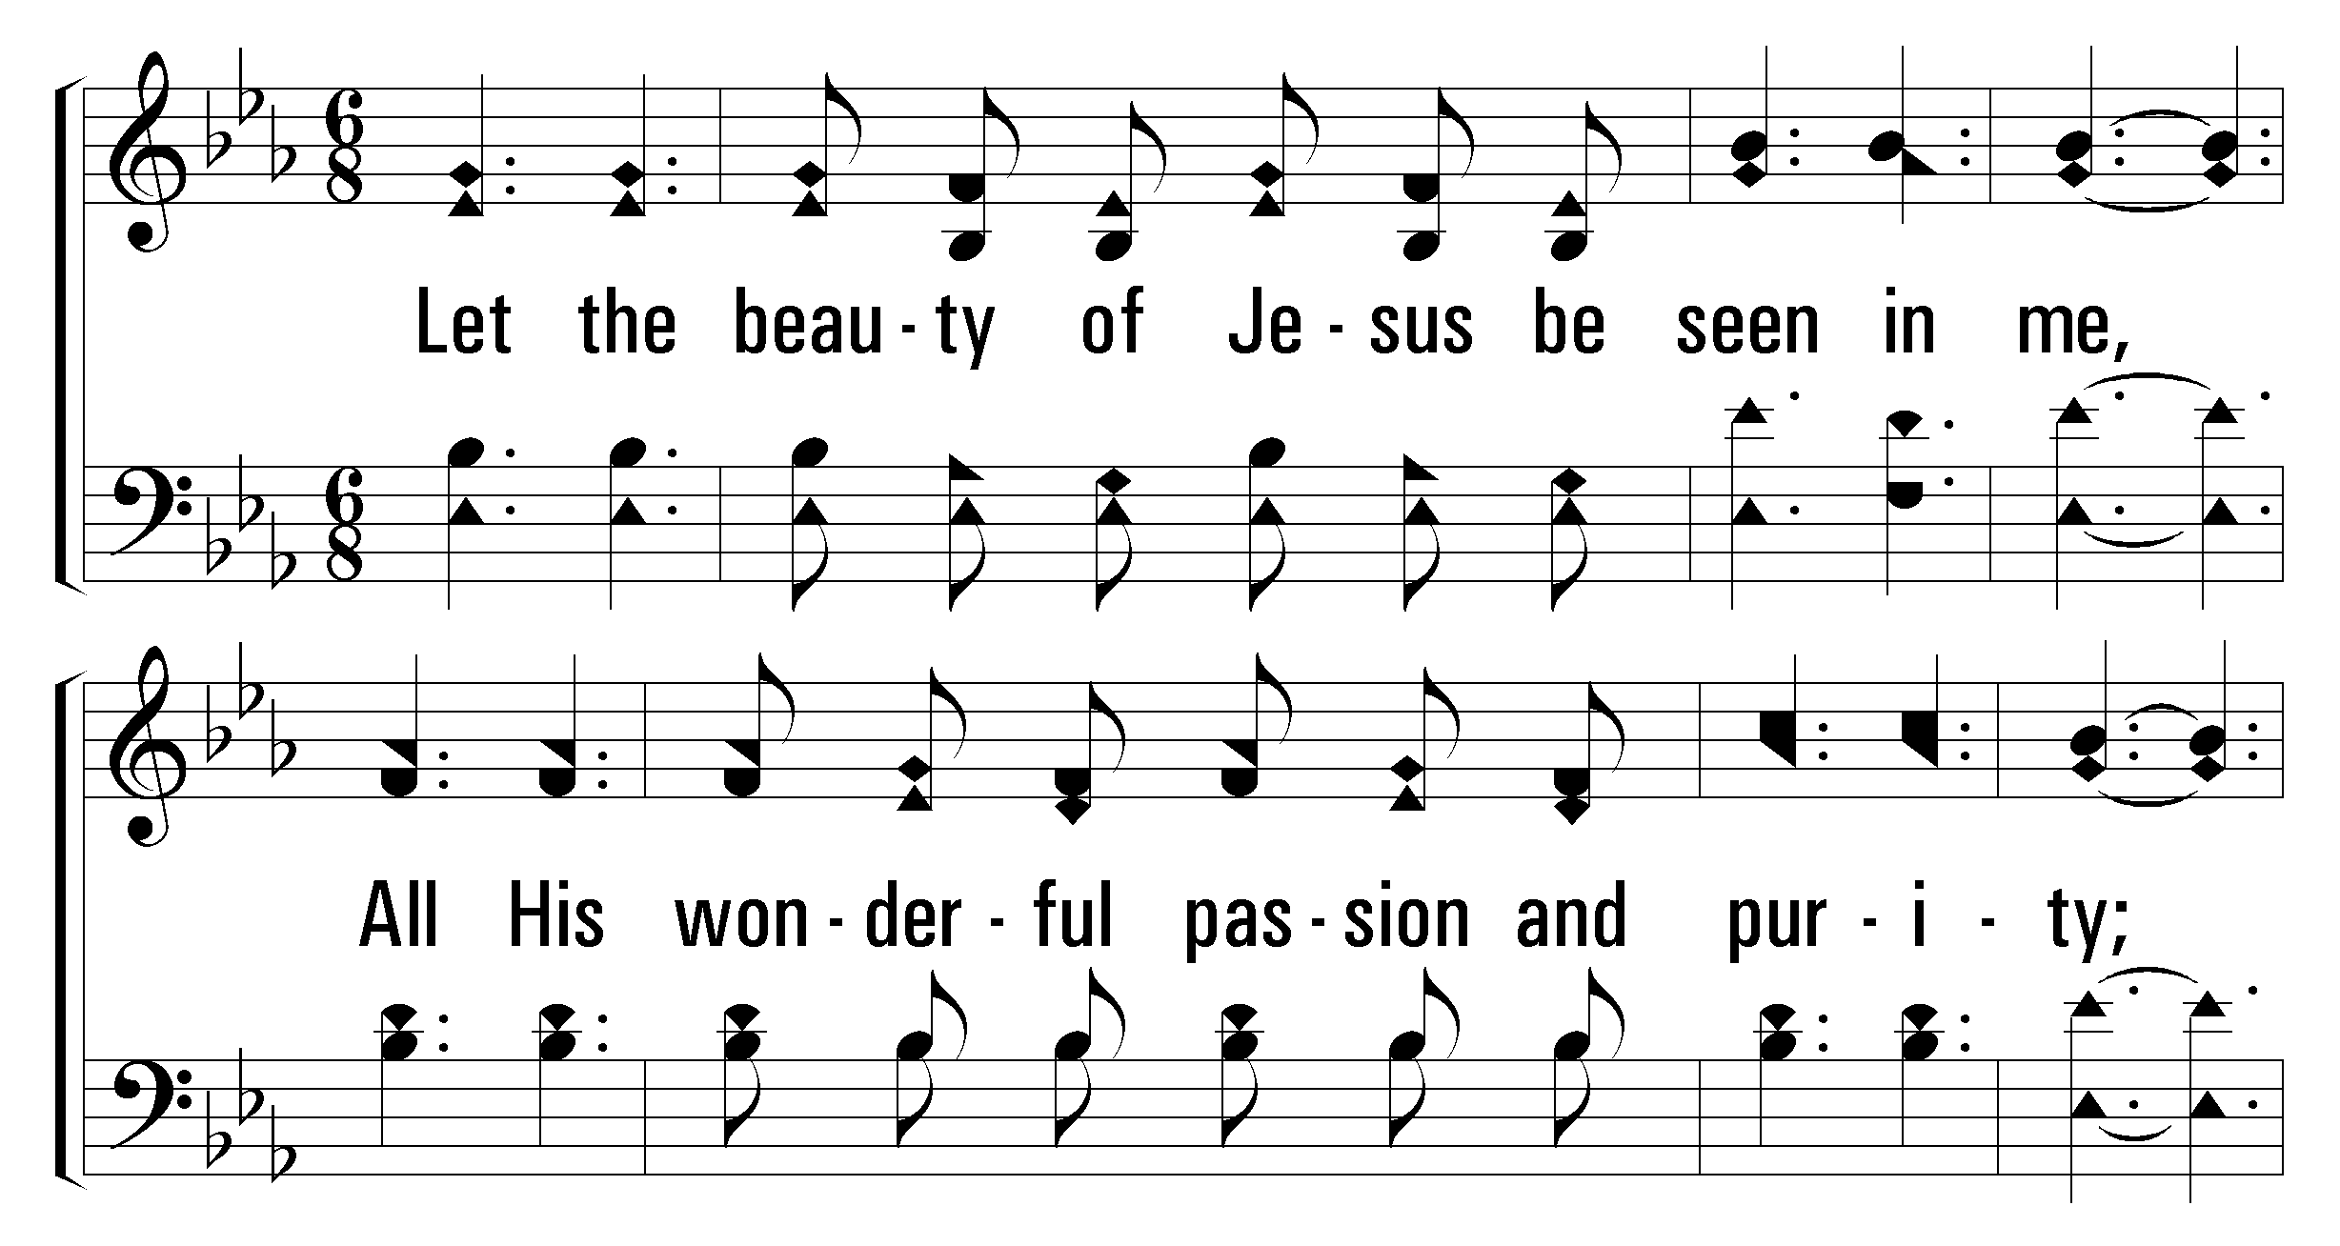


1
2
3
4
392
Let the Beauty of Jesus Be Seen
© 2003 The Paperless Hymnal™

Slide 3
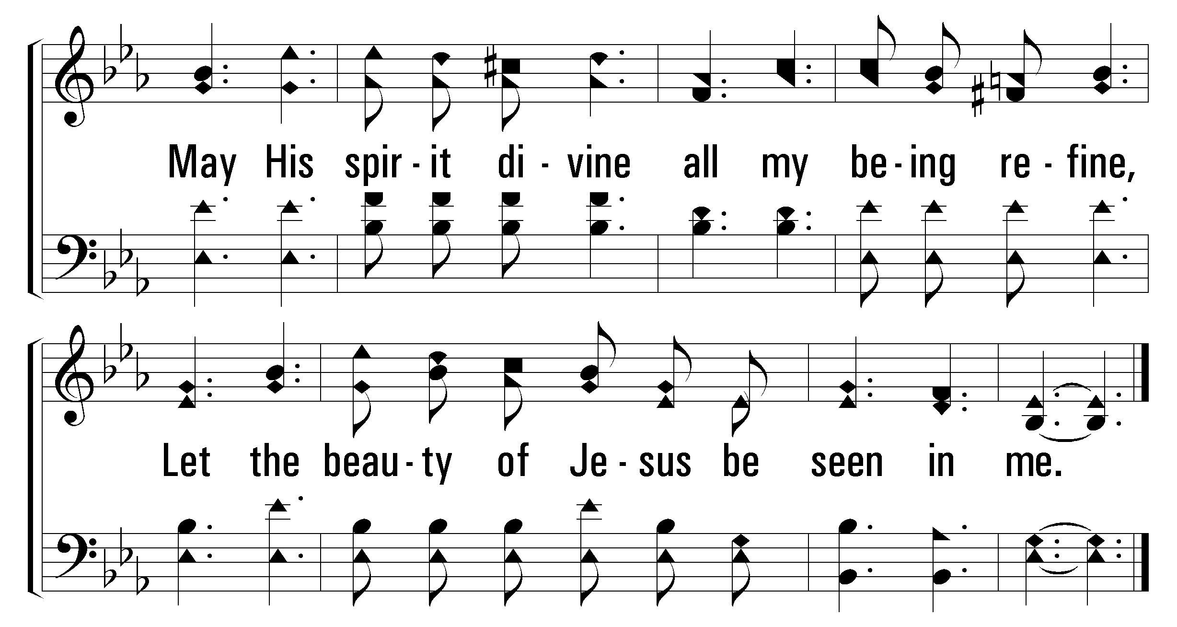
1
2
3
4
392
Let the Beauty of Jesus Be Seen
© 2003 The Paperless Hymnal™

Slide 4
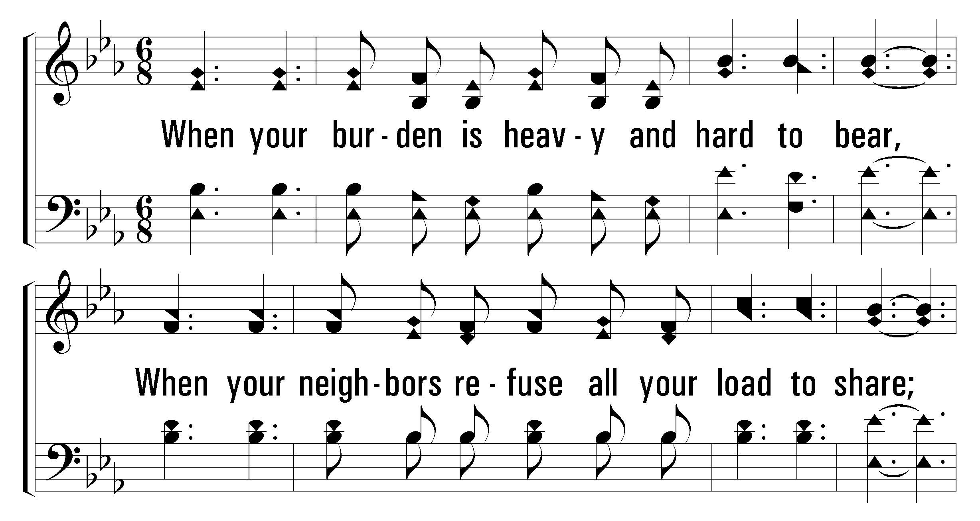
1
2
3
4
392
Let the Beauty of Jesus Be Seen
© 2003 The Paperless Hymnal™

Slide 5
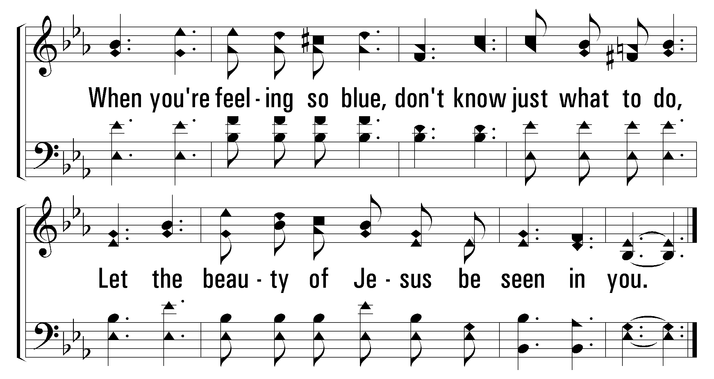
1
2
3
4
392
Let the Beauty of Jesus Be Seen
© 2003 The Paperless Hymnal™

Slide 6
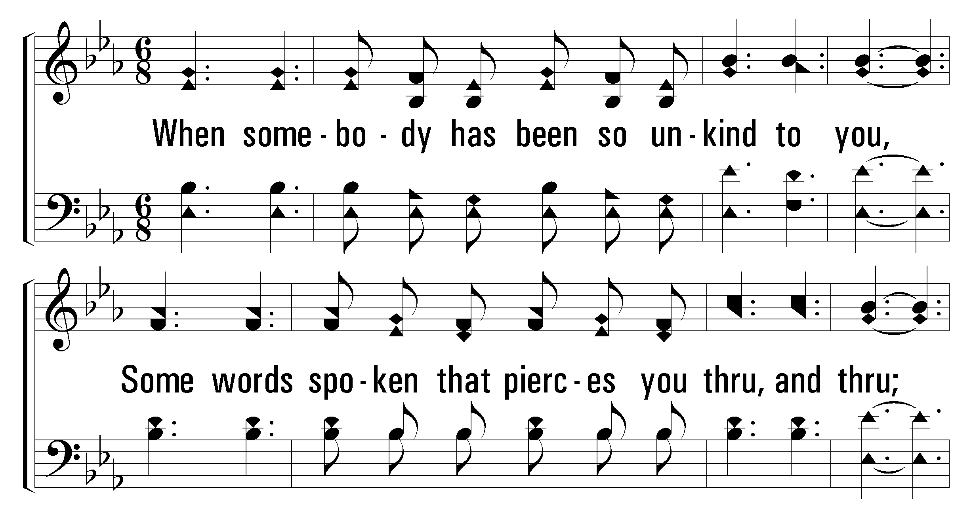
1
2
3
4
392
Let the Beauty of Jesus Be Seen
© 2003 The Paperless Hymnal™

Slide 7
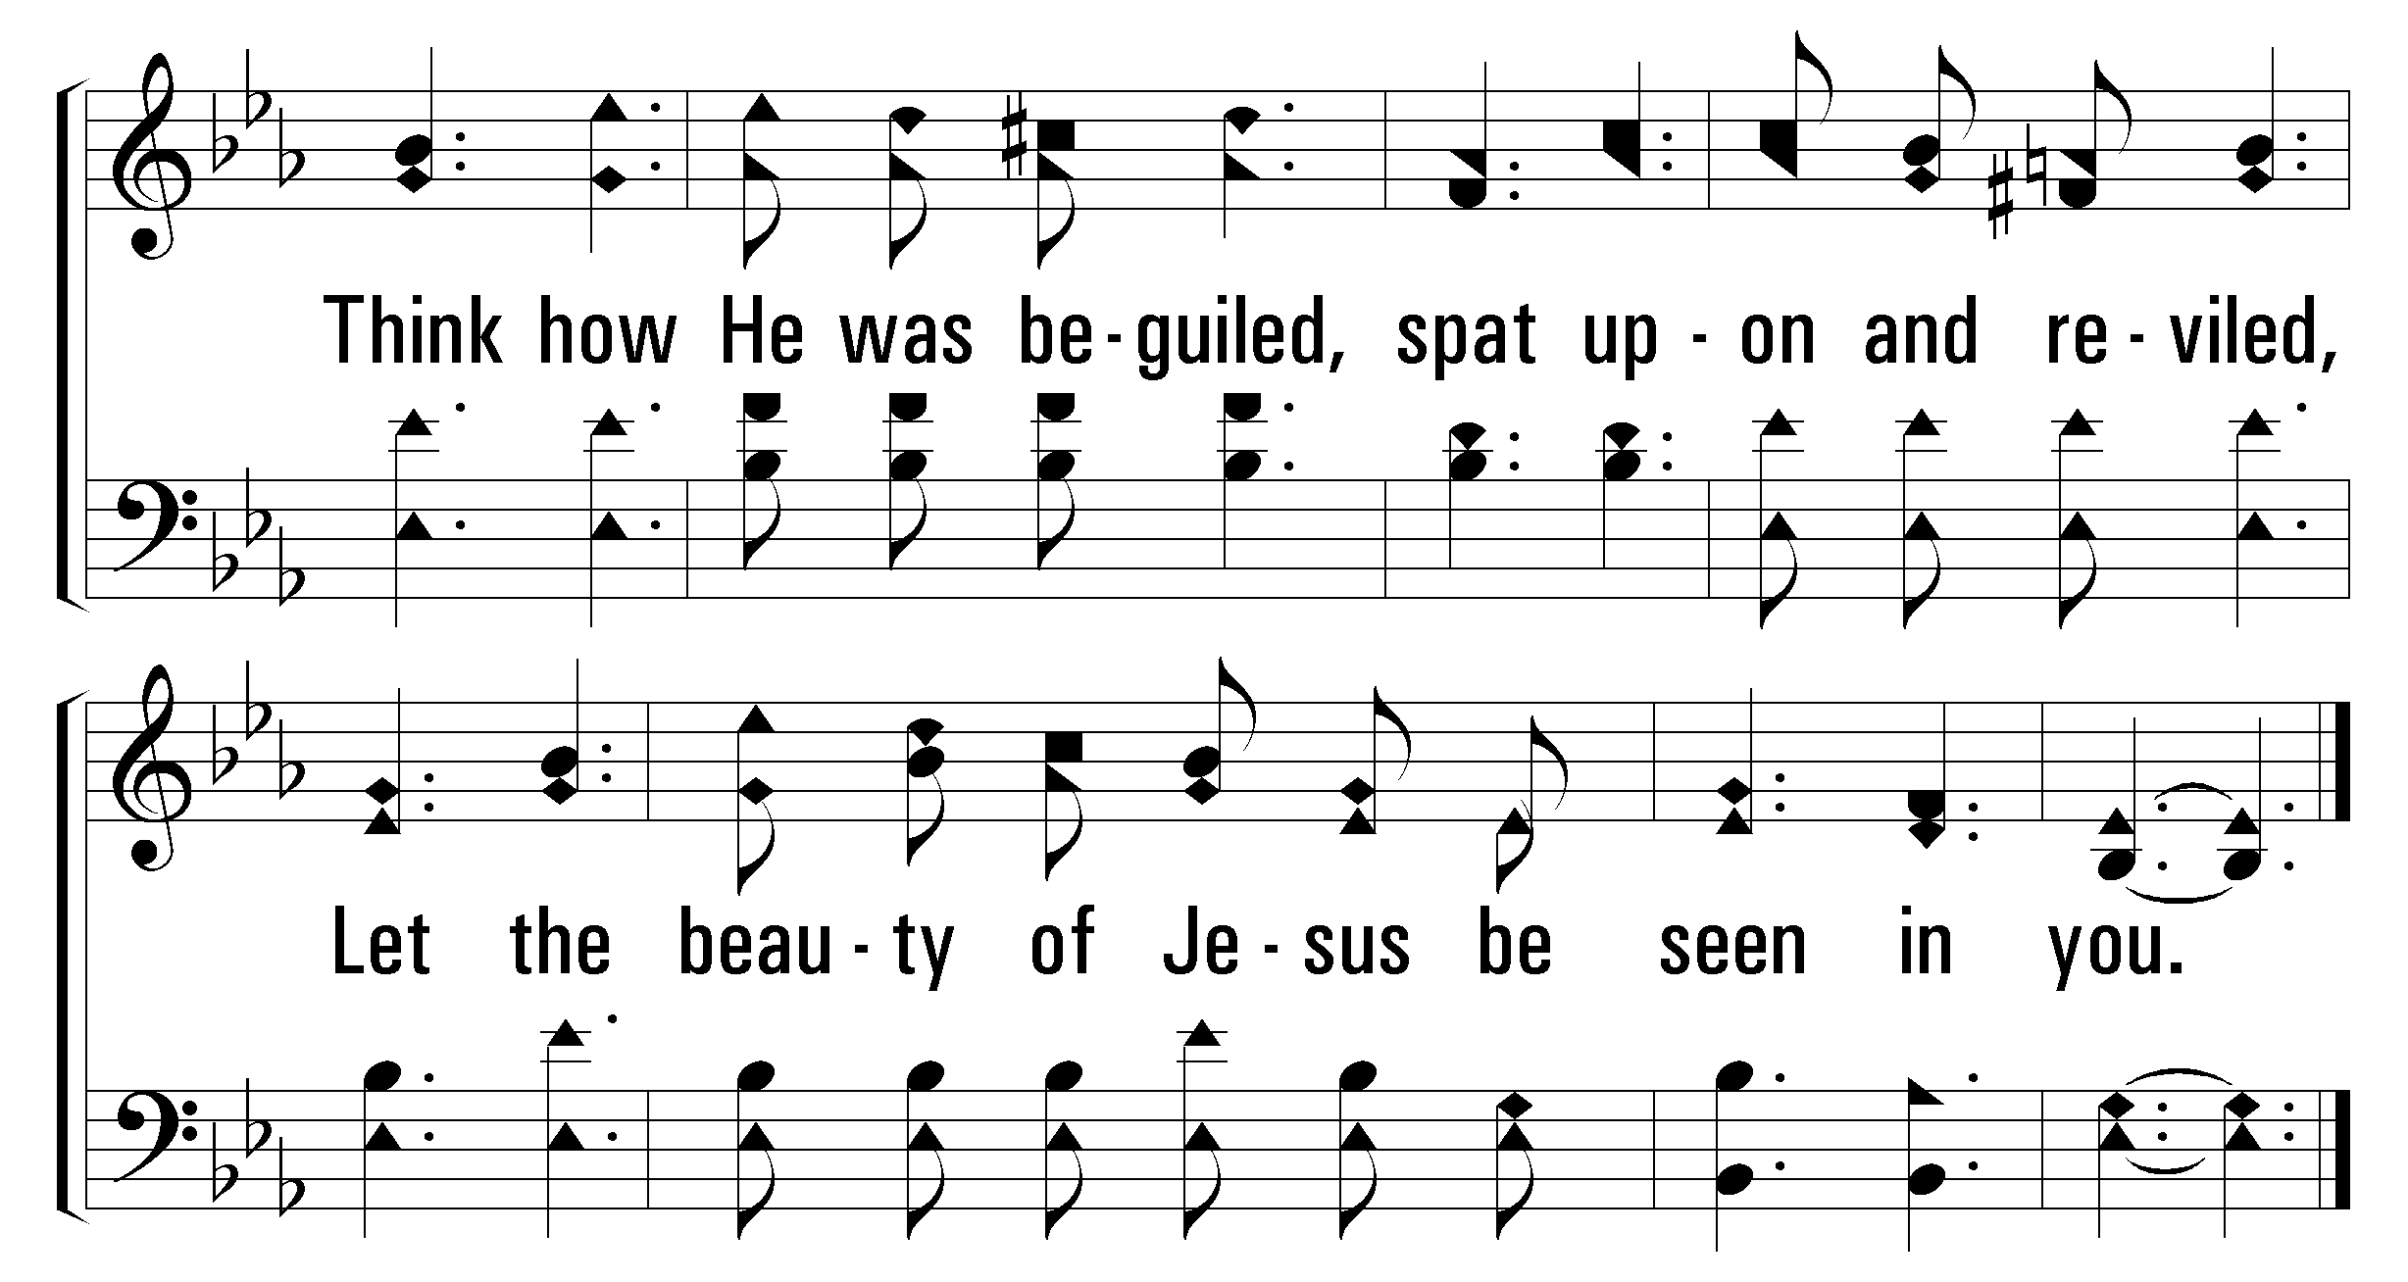
1
2
3
4
392
Let the Beauty of Jesus Be Seen
© 2003 The Paperless Hymnal™

Slide 8
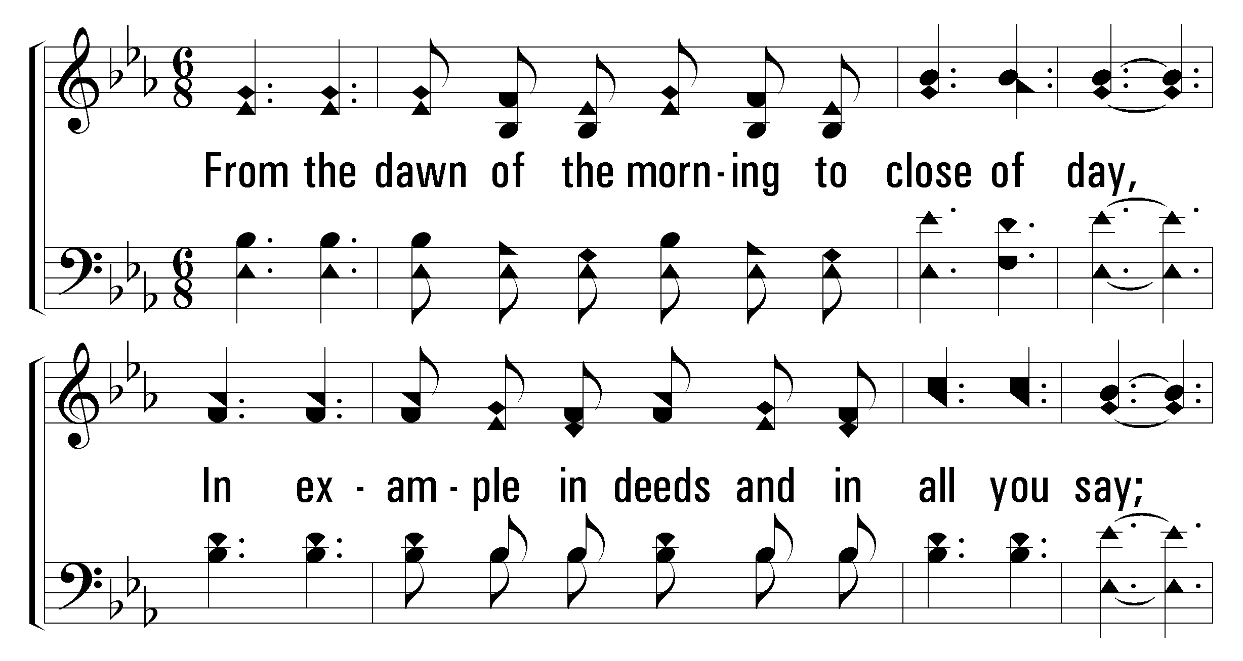
1
2
3
4
392
Let the Beauty of Jesus Be Seen
© 2003 The Paperless Hymnal™

Slide 9
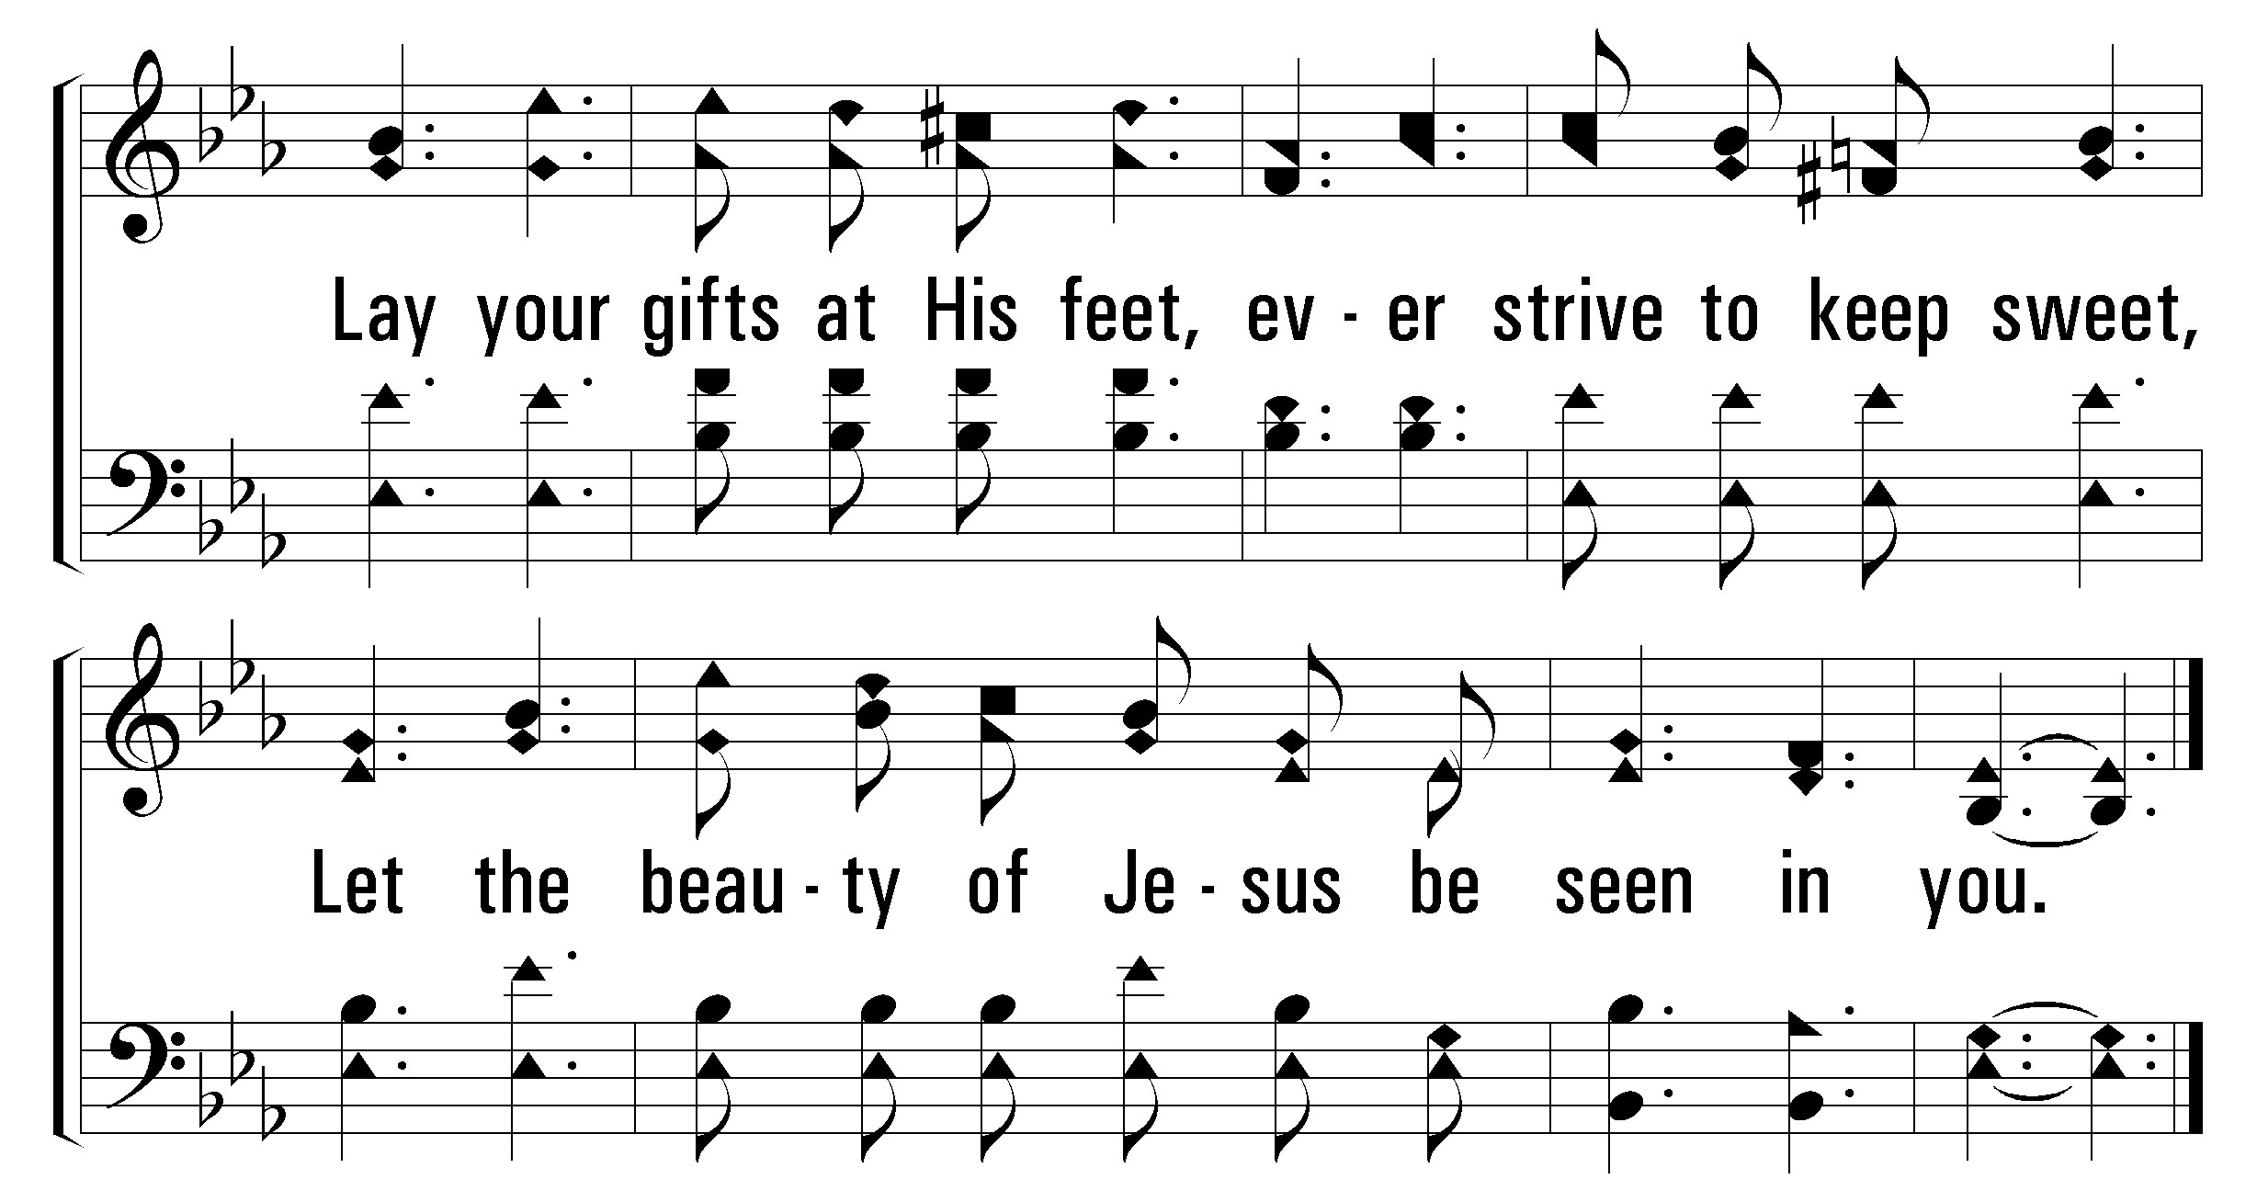
1
2
3
4
392
Let the Beauty of Jesus Be Seen
© 2003 The Paperless Hymnal™

