Slide 1

514
Be Strong and Courageous
Hymn: M. W. Bassford (2001)
Tune: Glenda B. Schales (2001)
© 2001 Glenda B. Schales
Verses 1 & 2

Slide 2
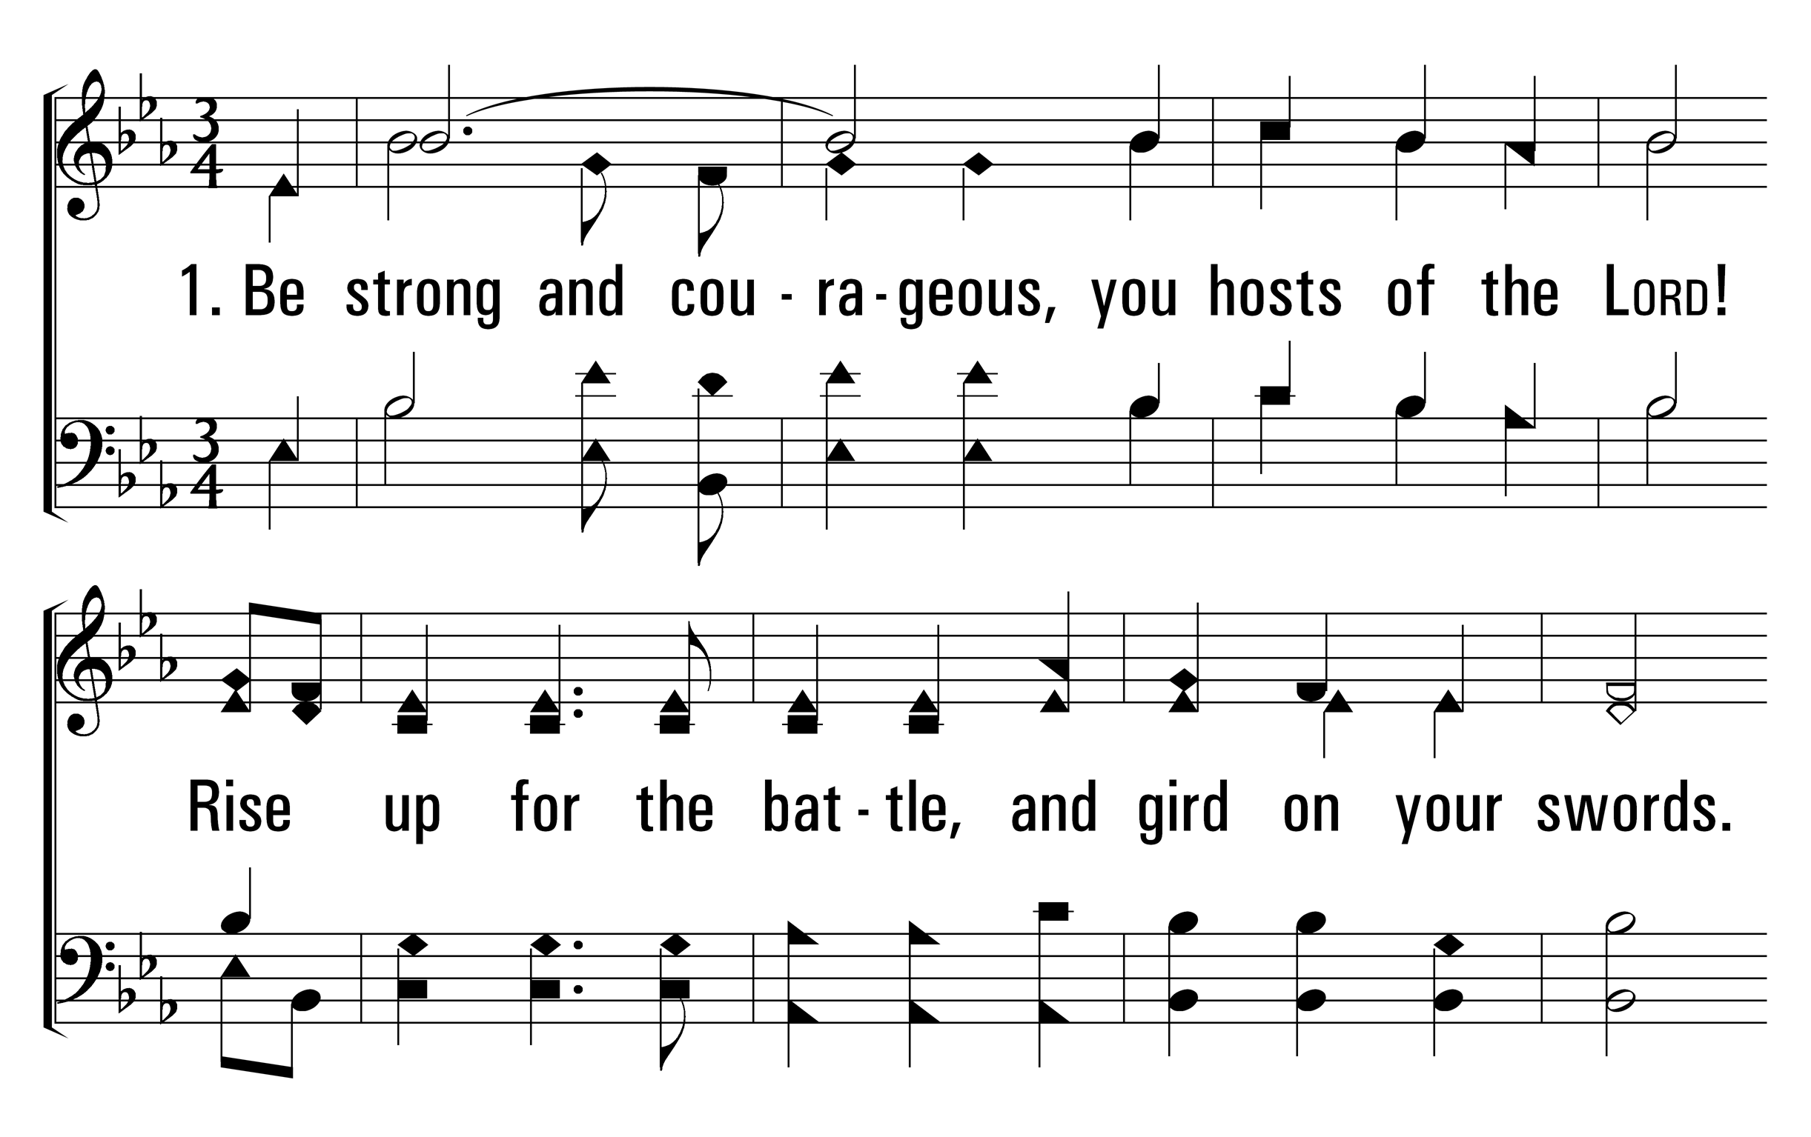

514
Be Strong and Courageous
1
C
3
C
© 2014 Sumphonia Productions, LLC

Slide 3
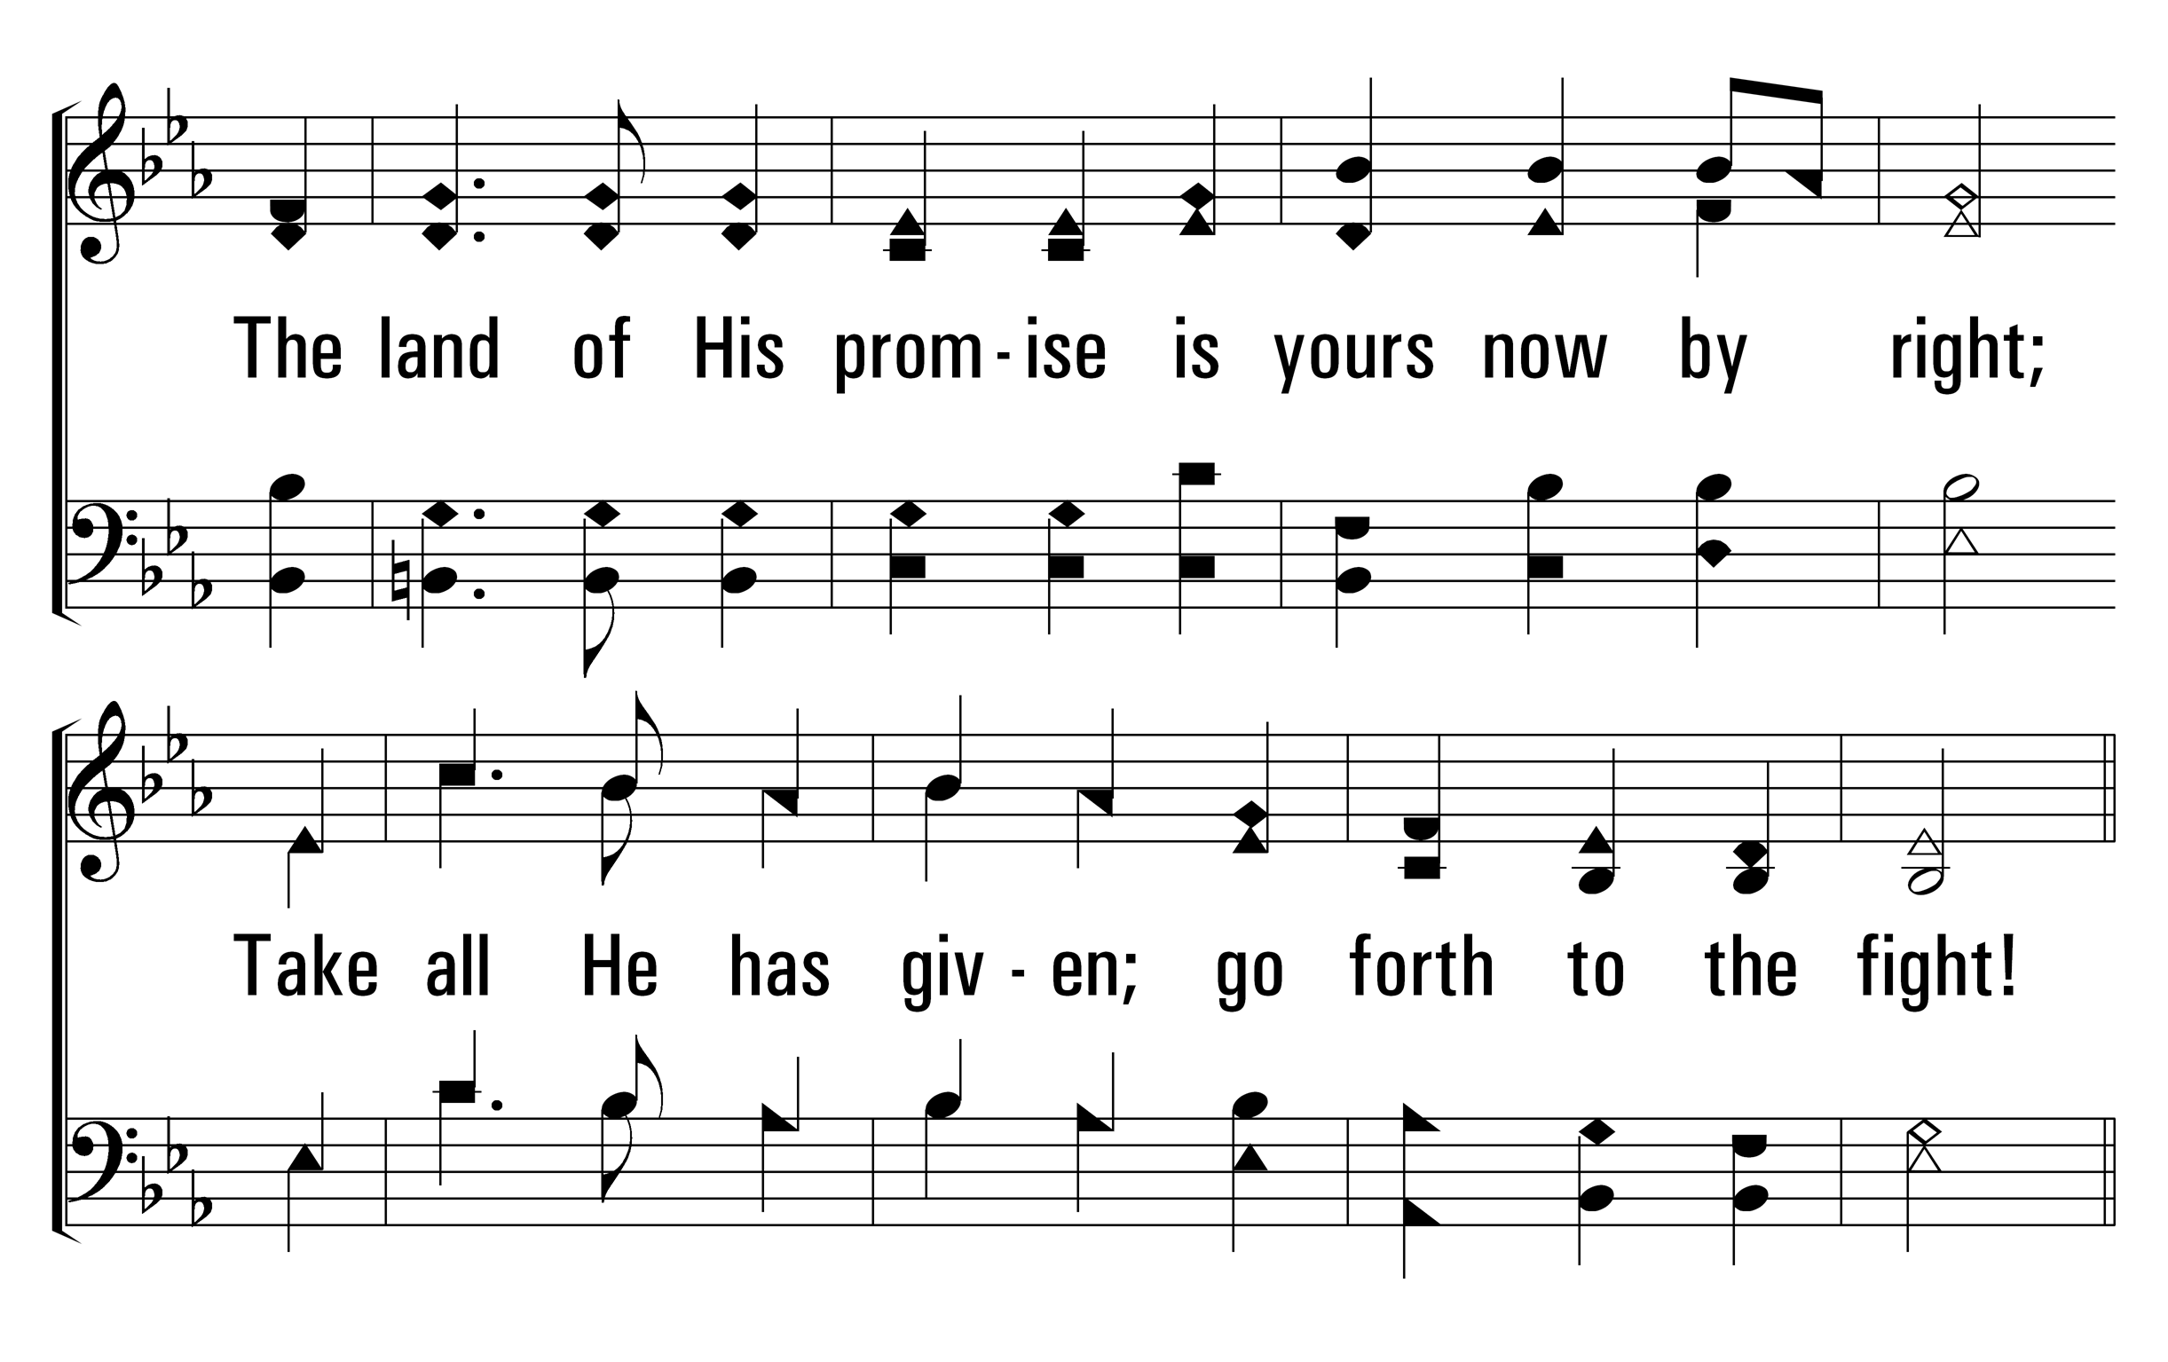
514
Be Strong and Courageous
1
C
3
C
© 2014 Sumphonia Productions, LLC

Slide 4
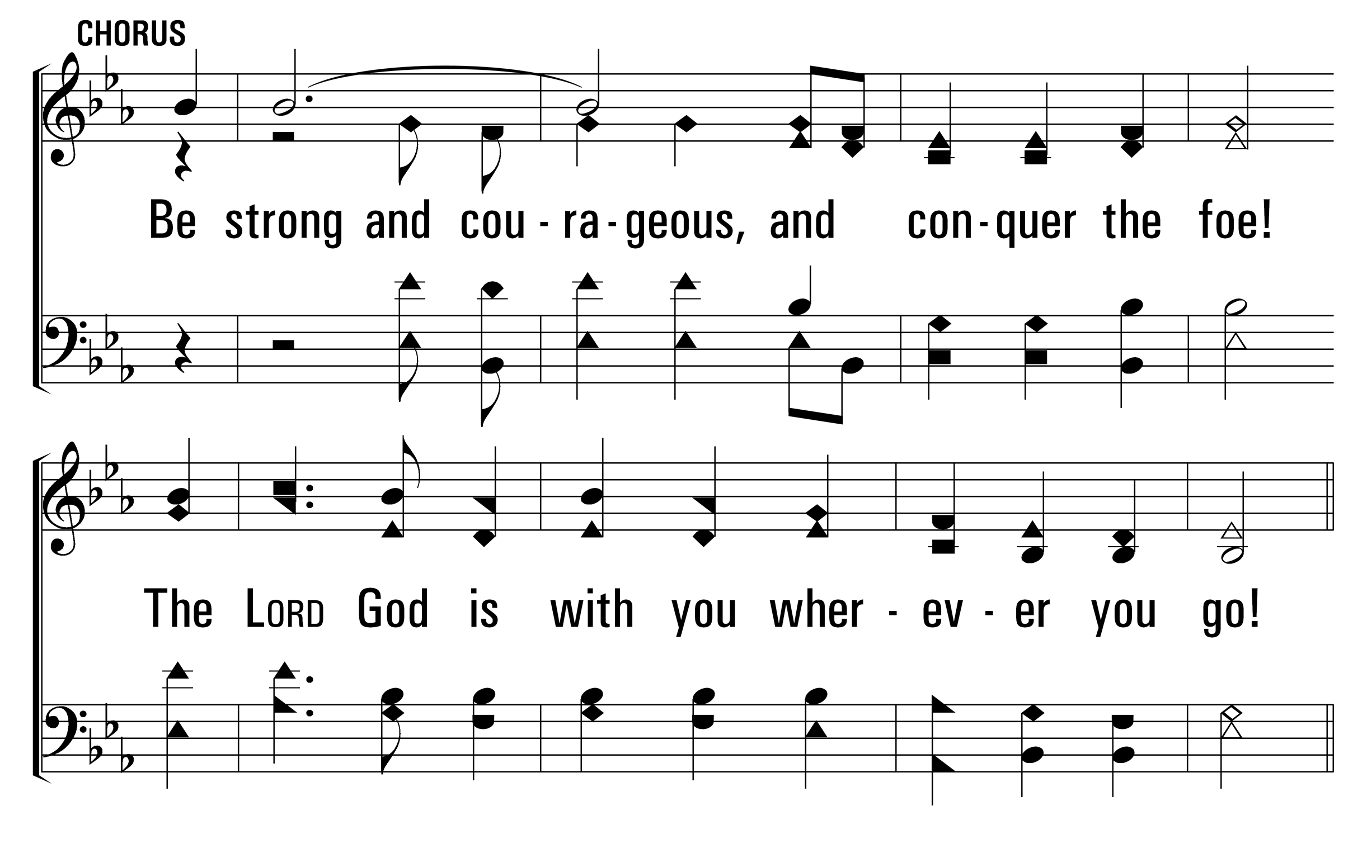
514
Be Strong and Courageous
1
C
3
C
© 2014 Sumphonia Productions, LLC

Slide 5
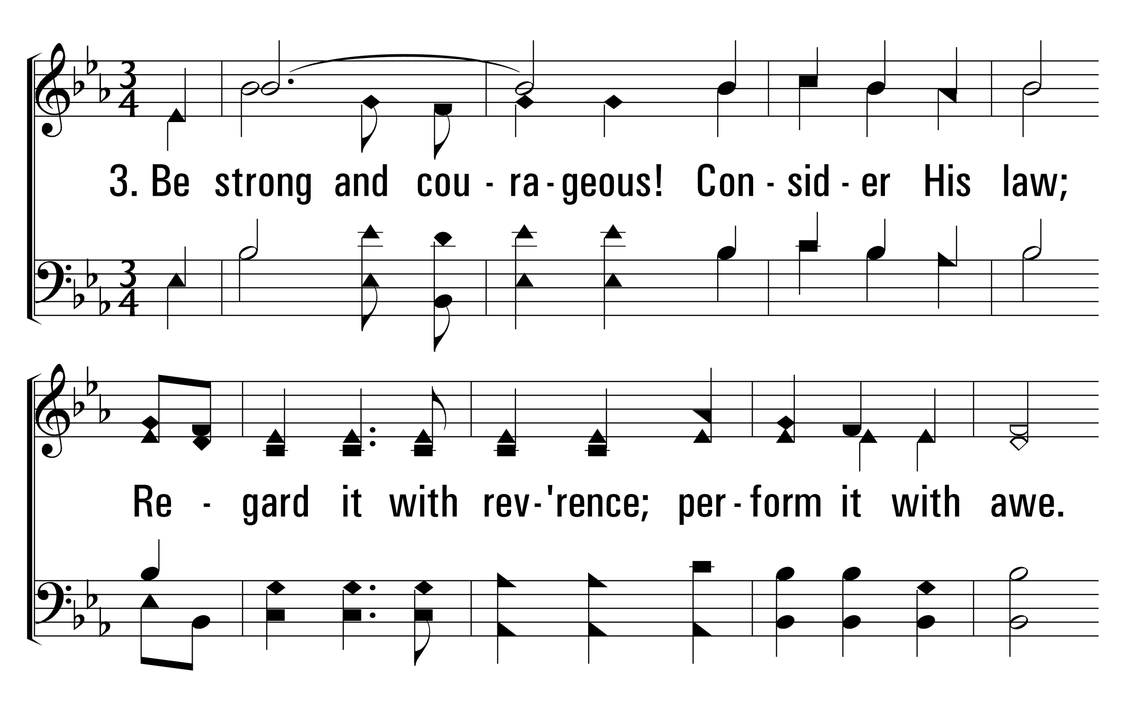
514
Be Strong and Courageous
1
C
3
C
© 2014 Sumphonia Productions, LLC

Slide 6
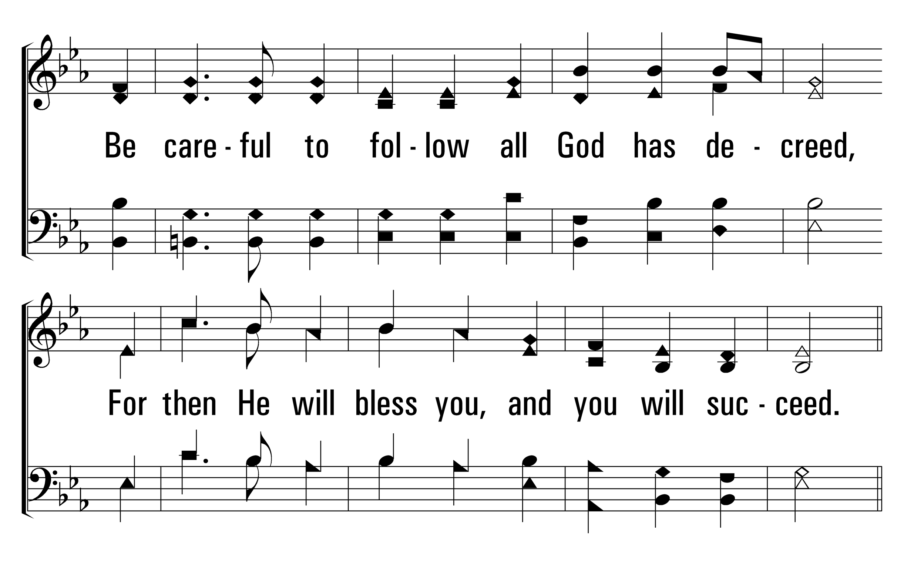
514
Be Strong and Courageous
1
C
3
C
© 2014 Sumphonia Productions, LLC

Slide 7
514
Be Strong and Courageous
1
C
3
C
© 2014 Sumphonia Productions, LLC

Slide 8
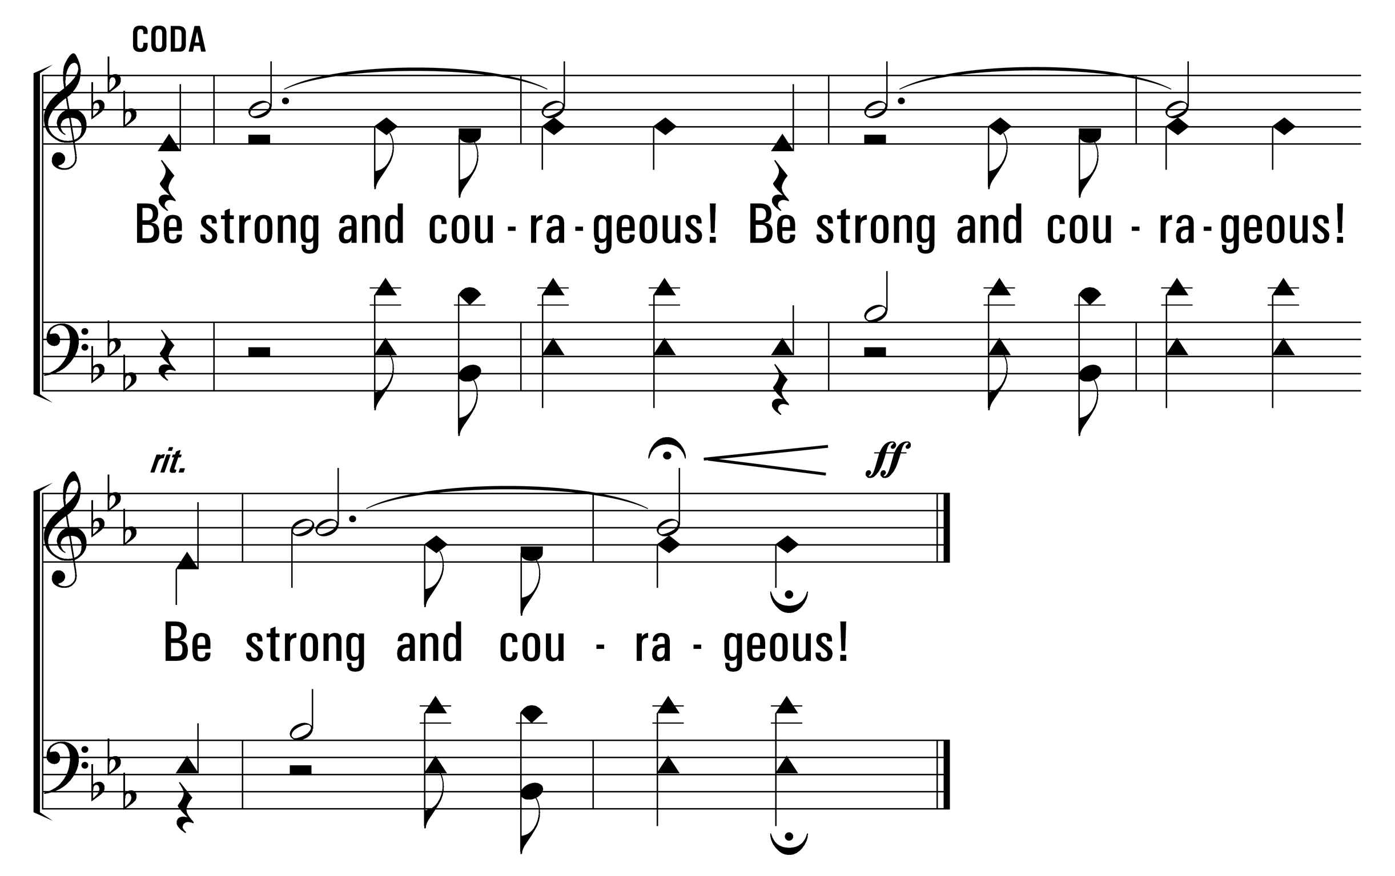
514
Be Strong and Courageous
1
C
3
C
© 2014 Sumphonia Productions, LLC

Slide 9
514
Be Strong and Courageous
Hymn: M. W. Bassford (2001)
Tune: Glenda B. Schales (2001)
© 2001 Glenda B. Schales
Verses 1 & 2

