Slide 1




• Welcome
Reading
Prayer
115 .
950 .
Lord’s Supper
32 .
Collection
500 .
Sermon
739 .
Prayer
Welcome & Announcements
Isaiah 40:1-11
Crown Him with Many Crowns
Lamb of God
Theophany
O Thou Fount of Every Blessing
The Goal of our Instruction is Love
What Will You Do with Jesus?
Notes:
Song Leader: David Williams

Slide 2

Welcome
• Reading
Prayer
115 .
950 .
Lord’s Supper
32 .
Collection
500 .
Sermon
739 .
Prayer
READING
ISAIAH 40:1-11
Pew Bible: Page 485
“HAVE THIS LETTER READ TO ALL”
1 THESSALONIANS 5:27

Slide 3

Welcome
Reading
• Prayer
115 .
950 .
Lord’s Supper
32 .
Collection
500 .
Sermon
739 .
Prayer
PRAYER
“DEVOTE YOURSELVES TO PRAYER”
COLOSSIANS 4:2

Slide 4
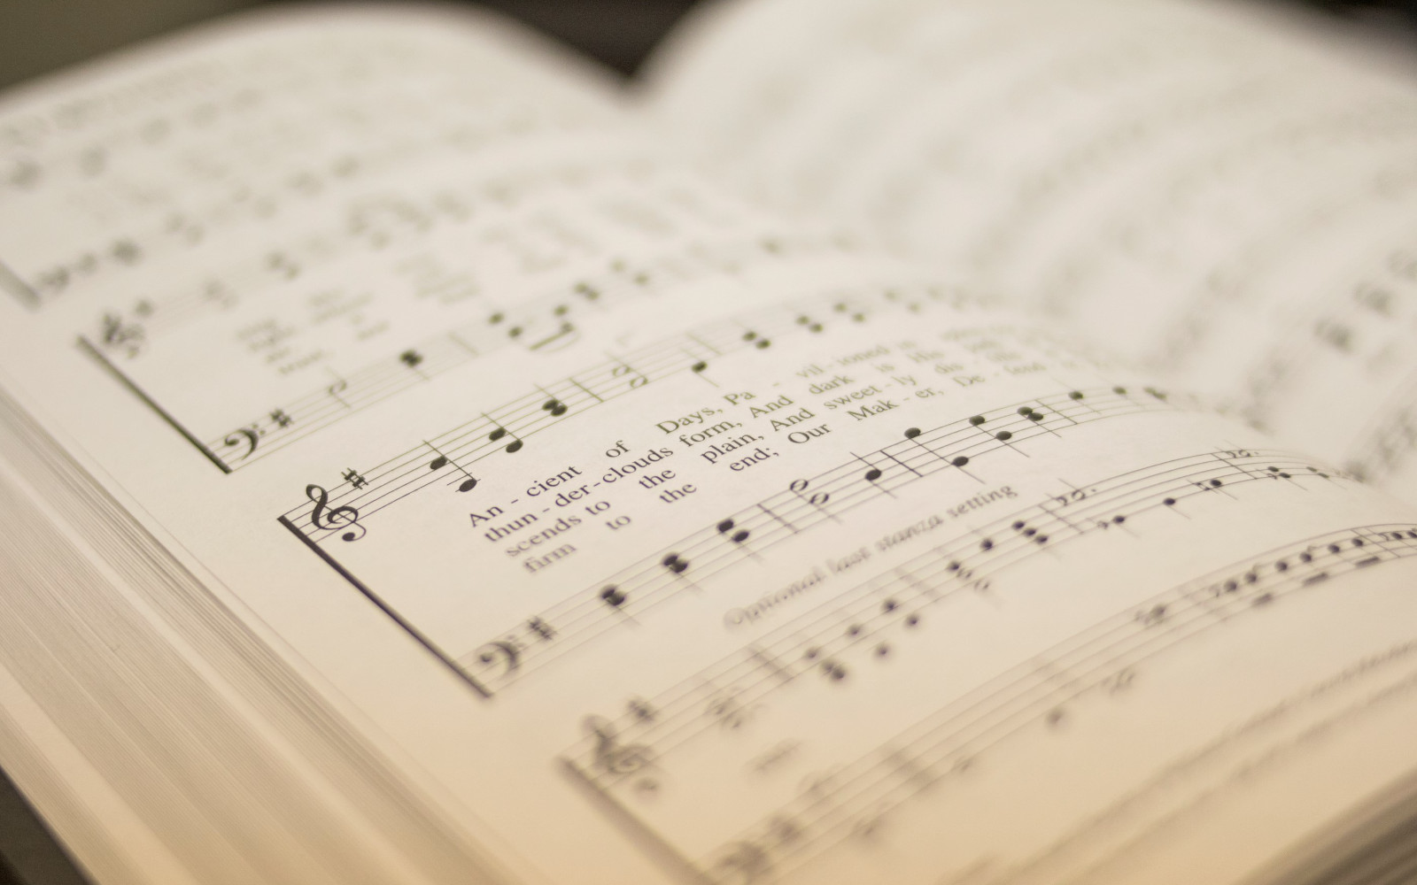
Welcome
Reading
Prayer
• 115 .
950 .
Lord’s Supper
32 .
Collection
500 .
Sermon
739 .
Prayer
115
CROWN HIM WITH MANY CROWNS
1
2
3
4
“SINGING...TO THE LORD”
COLOSSIANS 3:16
Words by: Matthew Bridges, st.2: Godfrey Thring
Music by: George J. Elvey

Slide 5
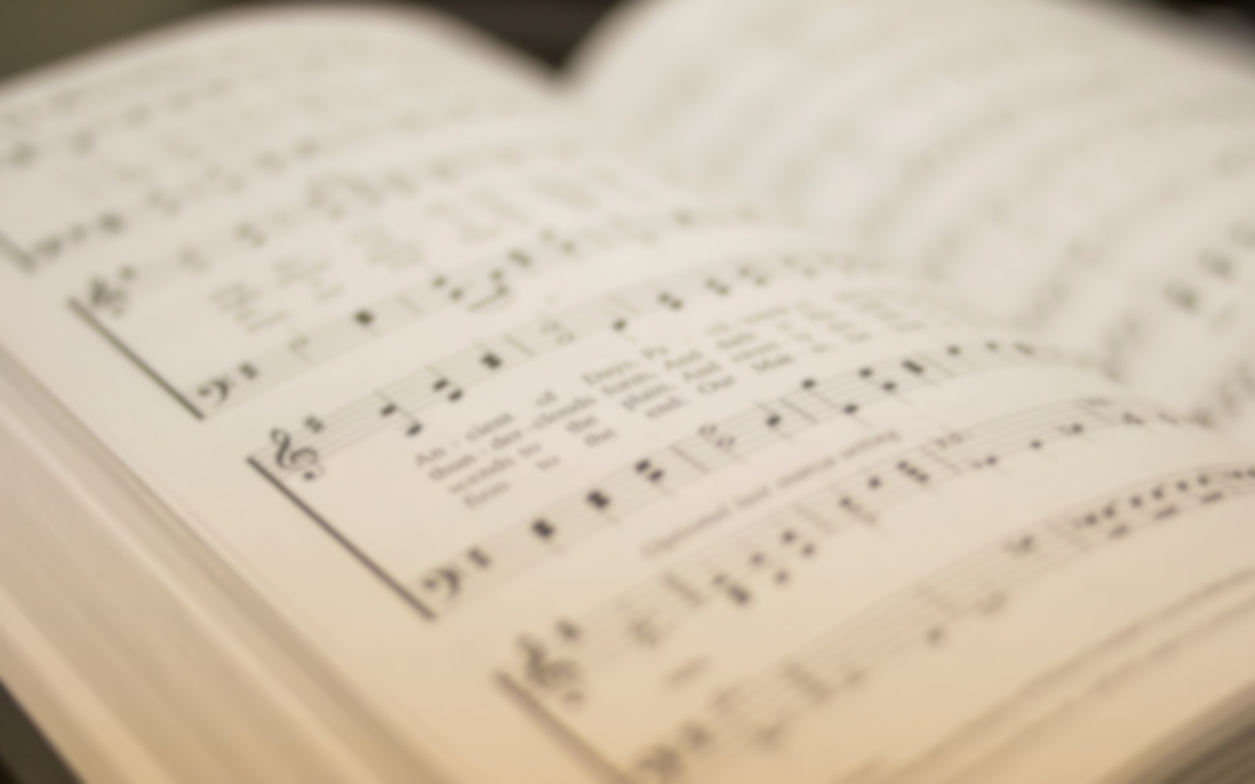
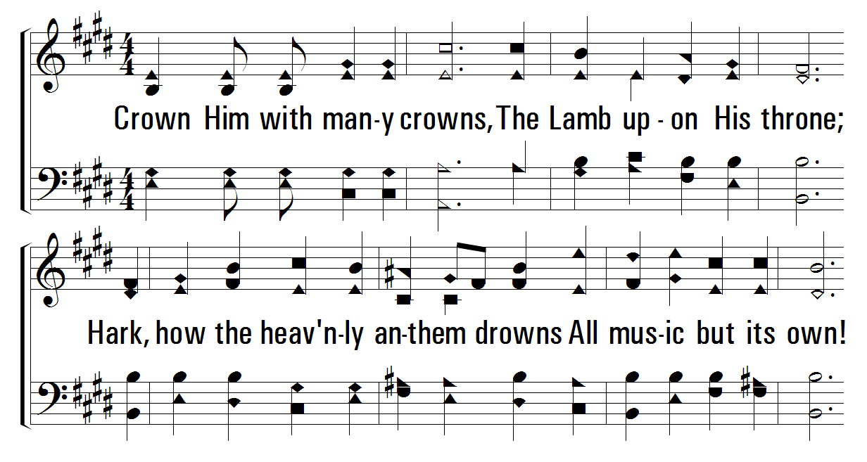


1
2
4
115
CROWN HIM WITH MANY CROWNS
© 2001 The Paperless Hymnal™

Slide 6
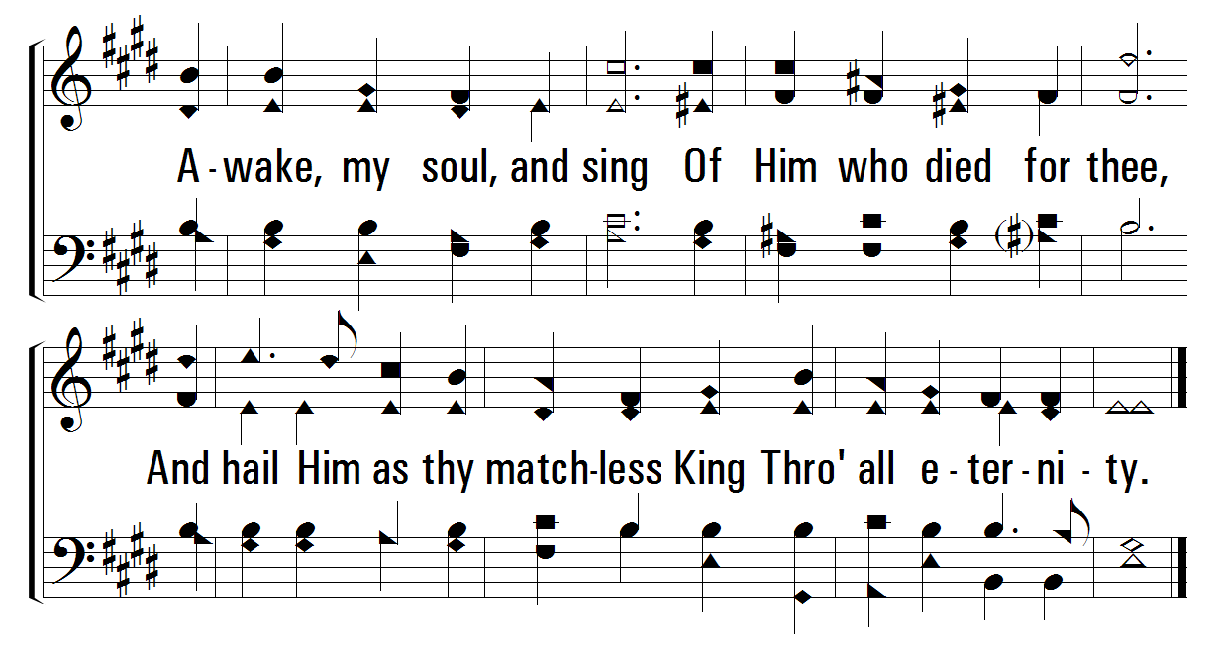
1
2
4
115
CROWN HIM WITH MANY CROWNS
© 2001 The Paperless Hymnal™

Slide 7
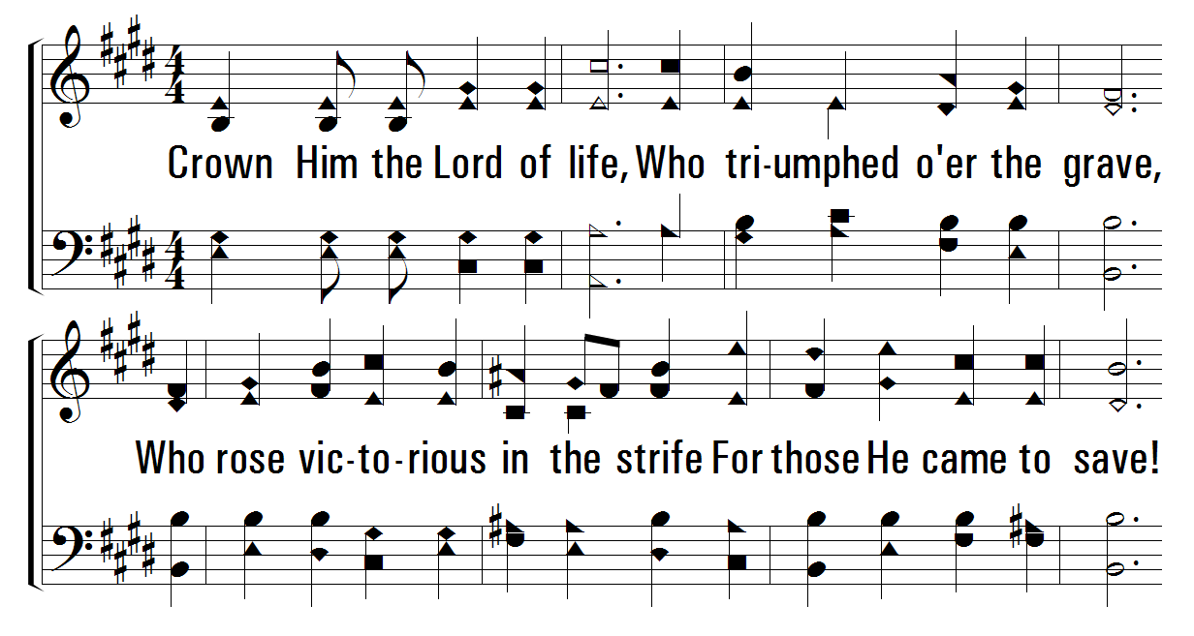
1
2
4
115
CROWN HIM WITH MANY CROWNS
© 2001 The Paperless Hymnal™

Slide 8
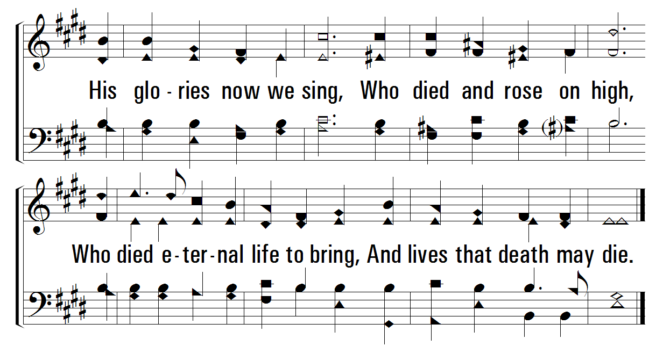
1
2
4
115
CROWN HIM WITH MANY CROWNS
© 2001 The Paperless Hymnal™

Slide 9
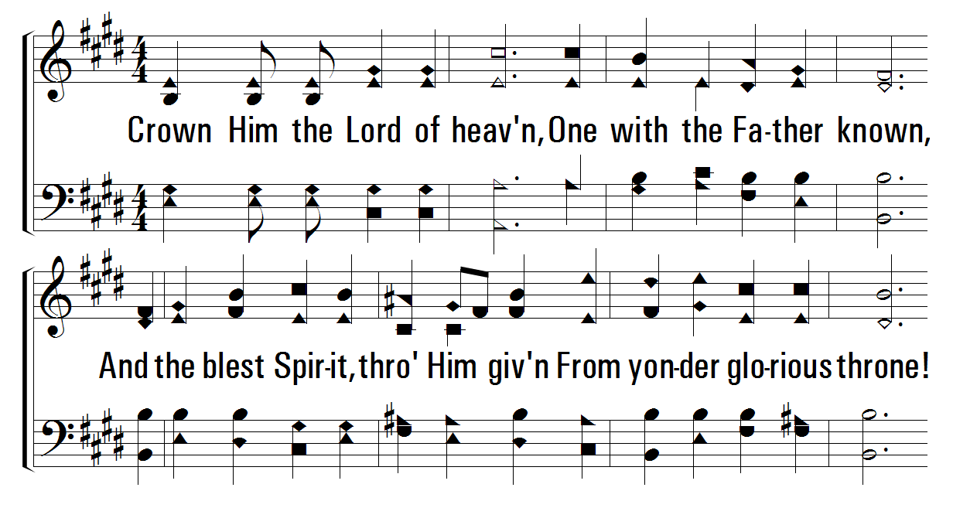
1
2
4
115
CROWN HIM WITH MANY CROWNS
© 2001 The Paperless Hymnal™

Slide 10
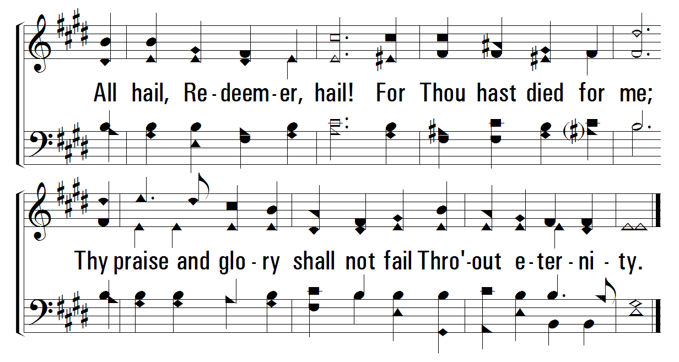
1
2
4
115
CROWN HIM WITH MANY CROWNS
© 2001 The Paperless Hymnal™

Slide 11

Welcome
Reading
Prayer
115 .
• 950 .
Lord’s Supper
32 .
Collection
500 .
Sermon
739 .
Prayer
950
LAMB OF GOD
1
2
3
“SINGING...TO THE LORD”
COLOSSIANS 3:16
Words and Music by: Twila Paris
Copyright © 1985 by StraightWay Music/Mountain Spring Music. All Rights Reserved. Used By Permission.

Slide 12

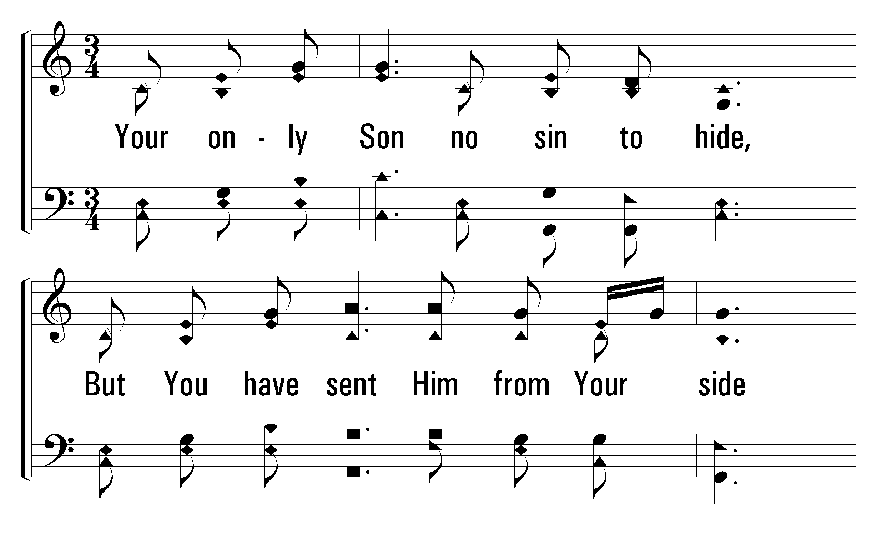
1
C
2
C
3
C
950
LAMB OF GOD
© 2005 The Paperless Hymnal™

Slide 13
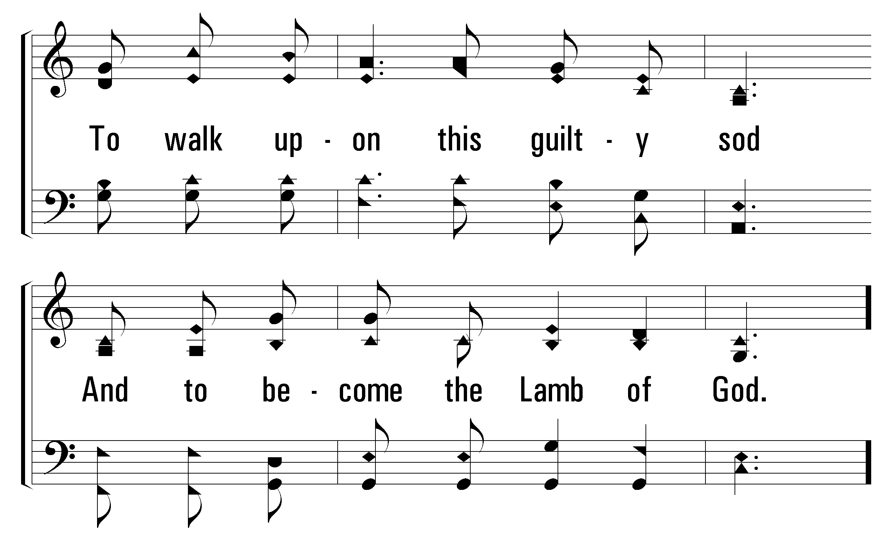
1
C
2
C
3
C
950
LAMB OF GOD
© 2005 The Paperless Hymnal™

Slide 14
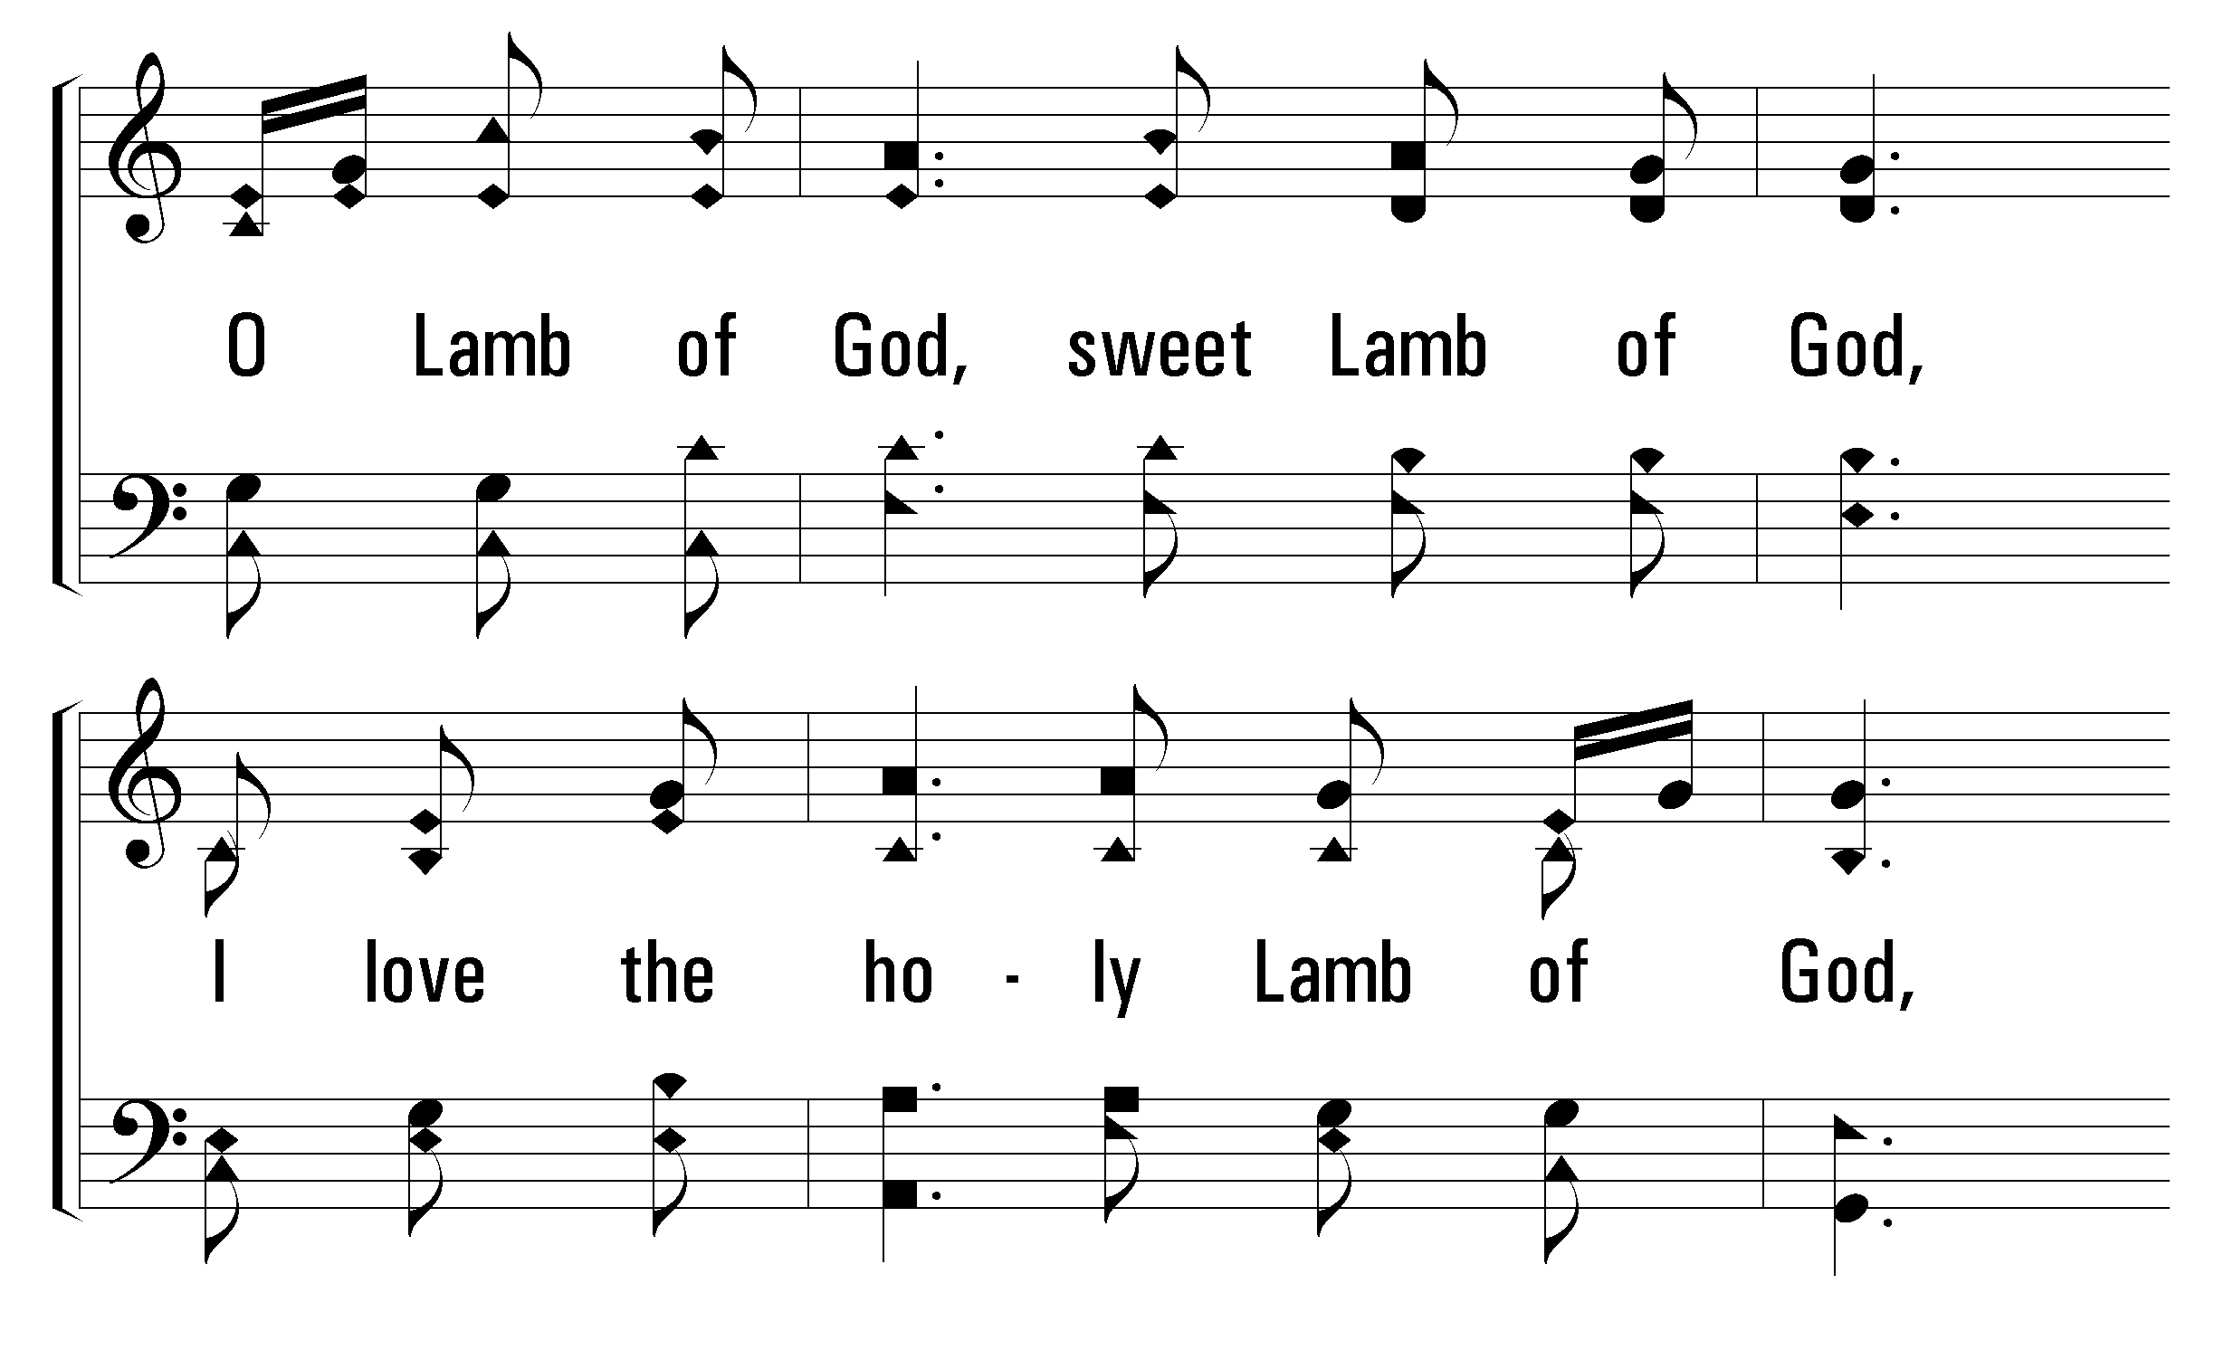
1
C
2
C
3
C
950
LAMB OF GOD
© 2005 The Paperless Hymnal™

Slide 15
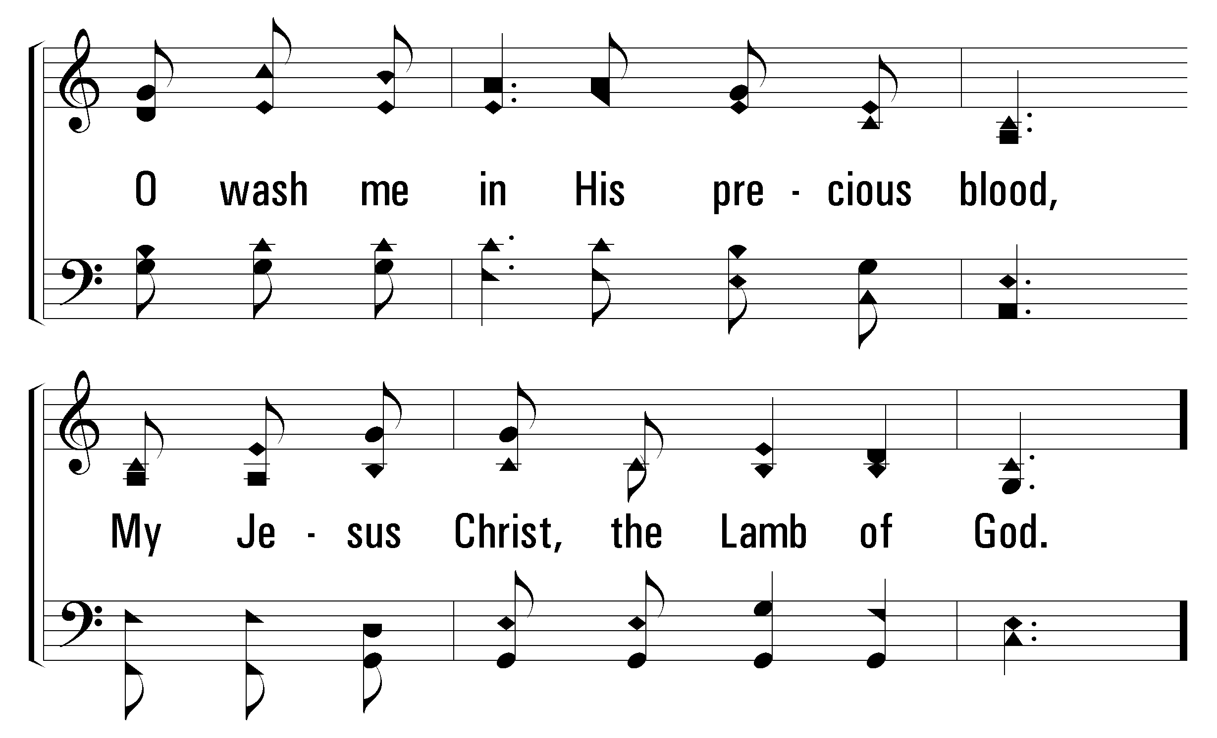
1
C
2
C
3
C
950
LAMB OF GOD
© 2005 The Paperless Hymnal™

Slide 16
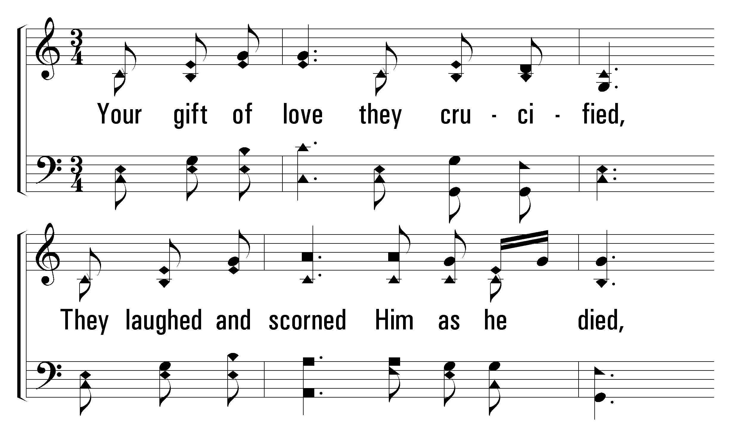
1
C
2
C
3
C
950
LAMB OF GOD
© 2005 The Paperless Hymnal™

Slide 17
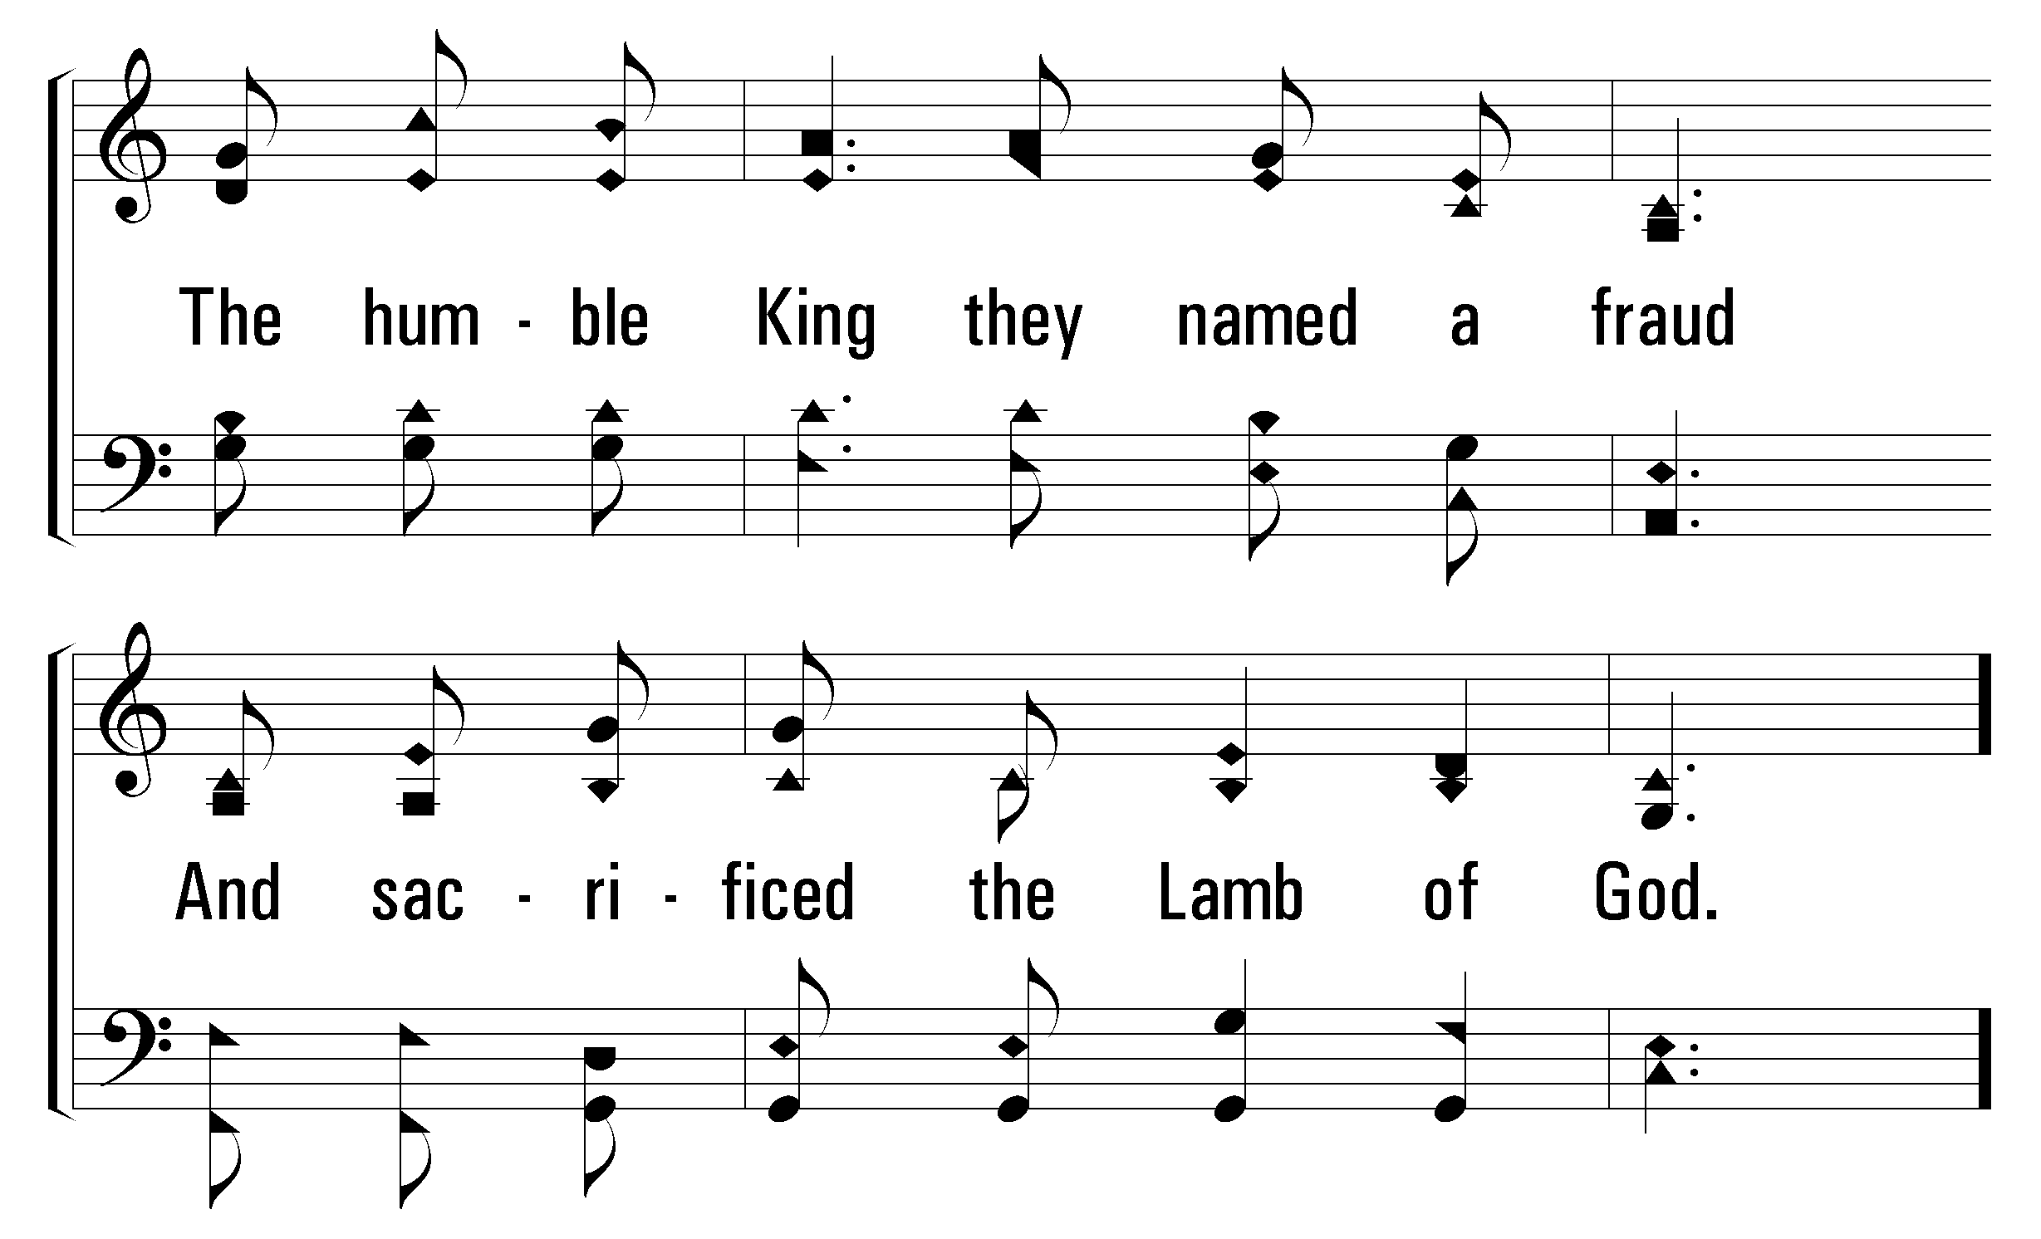
1
C
2
C
3
C
950
LAMB OF GOD
© 2005 The Paperless Hymnal™

Slide 18
1
C
2
C
3
C
950
LAMB OF GOD
© 2005 The Paperless Hymnal™

Slide 19
1
C
2
C
3
C
950
LAMB OF GOD
© 2005 The Paperless Hymnal™

Slide 20
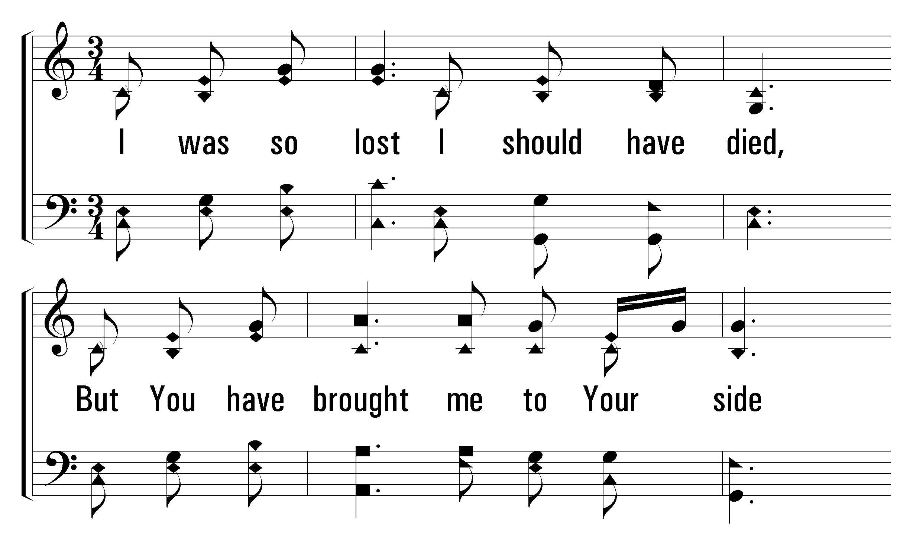
1
C
2
C
3
C
950
LAMB OF GOD
© 2005 The Paperless Hymnal™

Slide 21
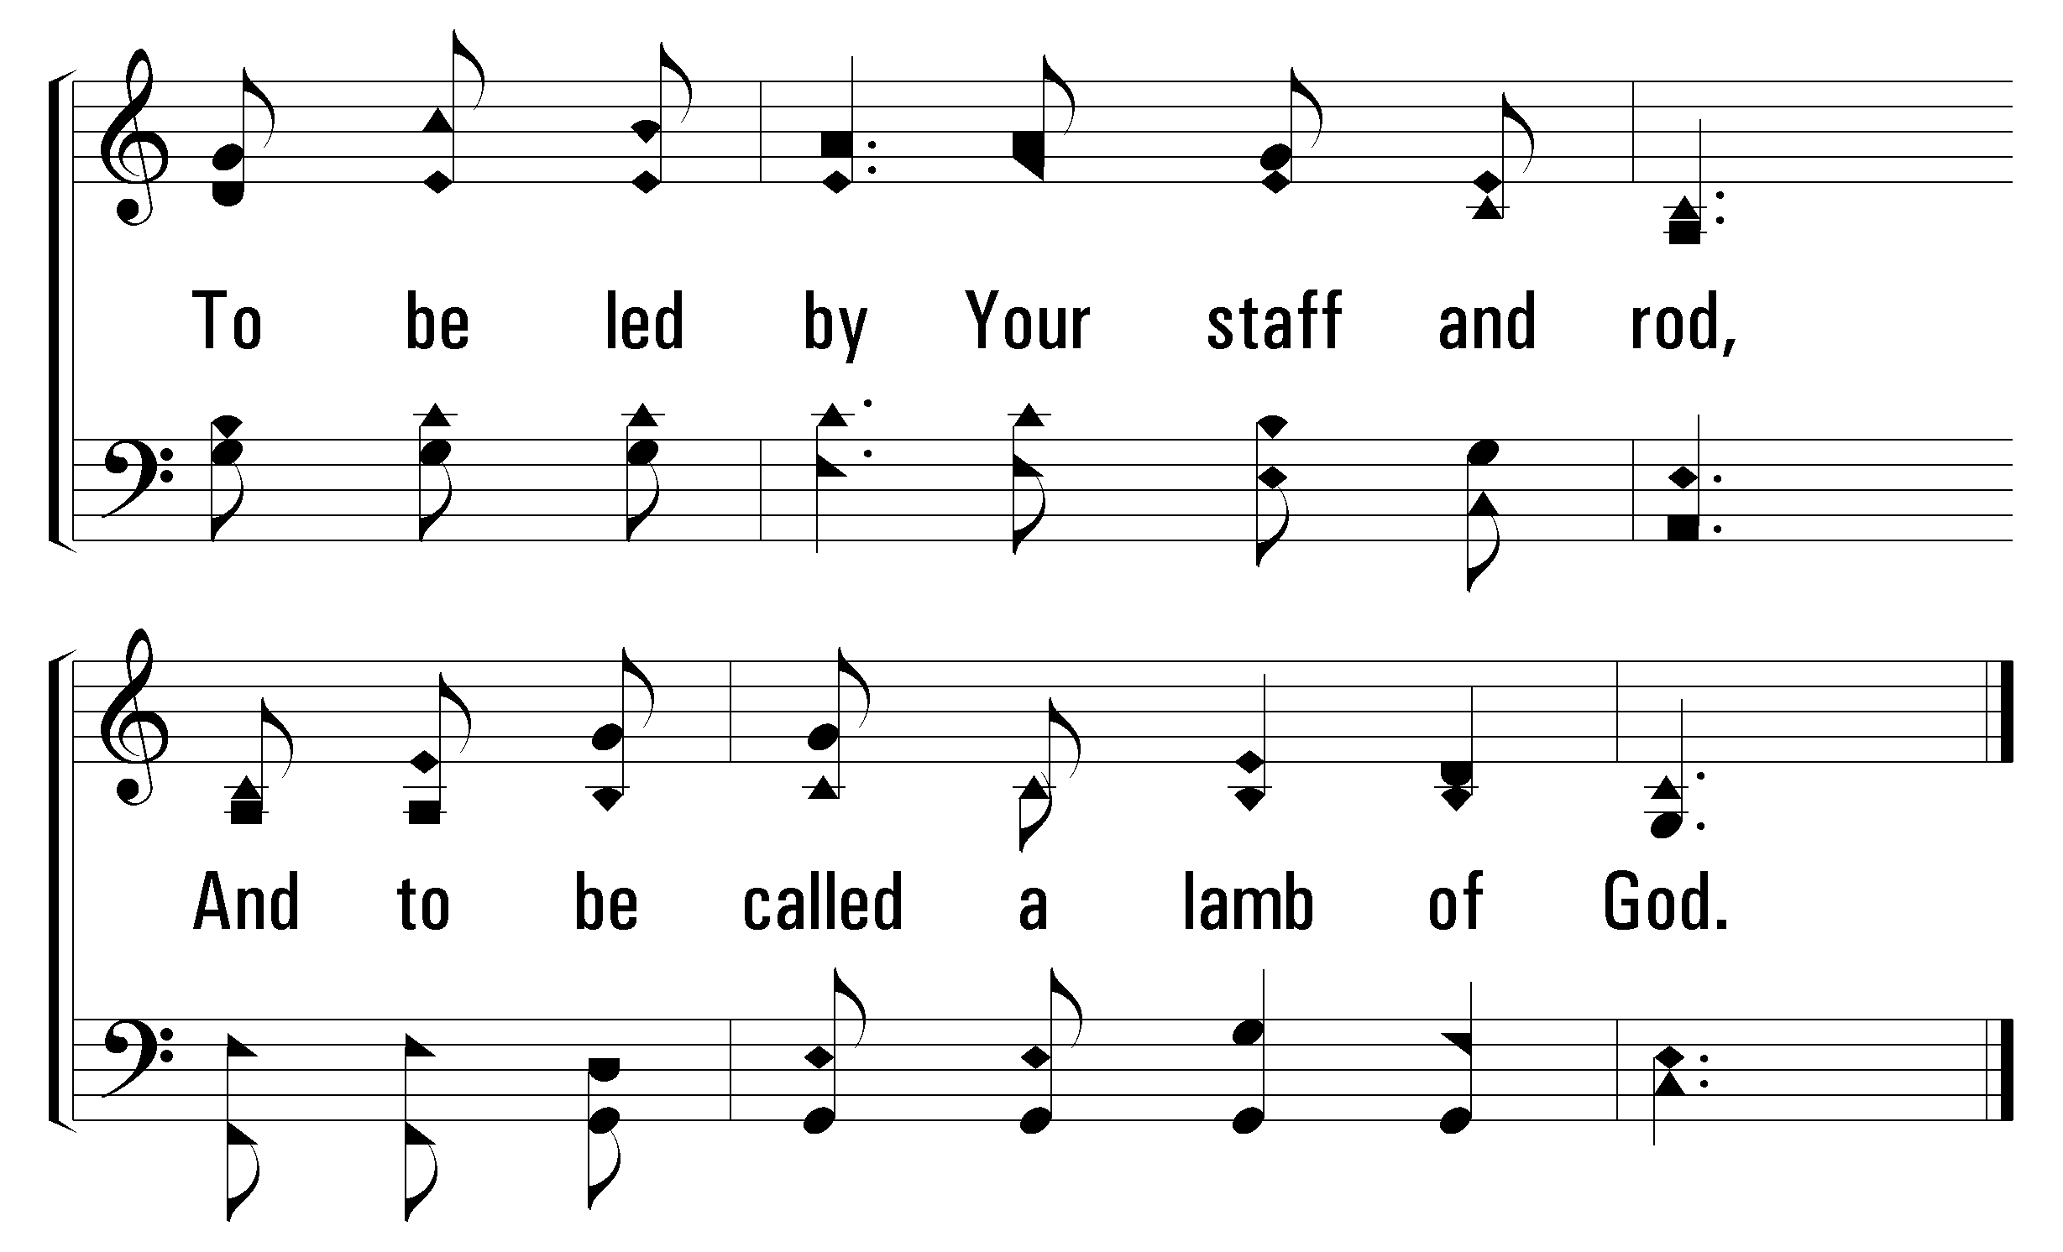
1
C
2
C
3
C
950
LAMB OF GOD
© 2005 The Paperless Hymnal™

Slide 22
1
C
2
C
3
C
950
LAMB OF GOD
© 2005 The Paperless Hymnal™

Slide 23
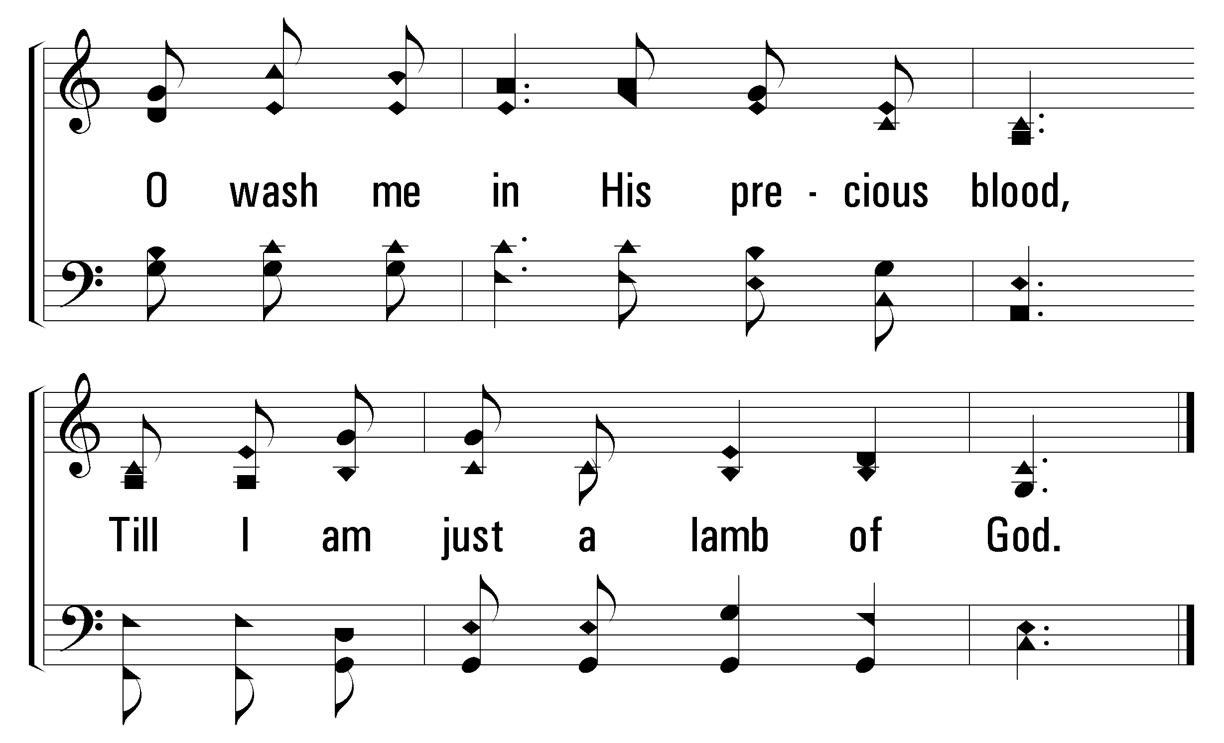
1
C
2
C
3
C
950
LAMB OF GOD
© 2005 The Paperless Hymnal™

Slide 24

Welcome
Reading
Prayer
115 .
950 .
• Lord’s Supper
32 .
Collection
500 .
Sermon
739 .
Prayer
LORD’S
SUPPER
“DO THIS IN REMEMBRANCE OF ME” LUKE 22:19

Slide 26

Welcome
Reading
Prayer
115 .
950 .
• Lord’s Supper
32 .
Collection
500 .
Sermon
739 .
Prayer
I am the bread of life. Your fathers ate the manna in the wilderness, and they died. This is the bread that comes down from heaven, so that one may eat of it and not die. I am the living bread that came down from heaven. If anyone eats of this bread, he will live forever. And the bread that I will give for the life of the world is my flesh.
John 6:48-51

Slide 27
Welcome
Reading
Prayer
115 .
950 .
Lord’s Supper
• 32 .
Collection
500 .
Sermon
739 .
Prayer
32
THEOPHANY (HIGH ABOVE THE SERAPHIM)
1
2
3
“SINGING...TO THE LORD”
COLOSSIANS 3:16
Theophany
© 2001 David and Jimona Maravilla
Tune: MAZURKA • Frederic Chopin (1829); arr. C. A. Roberts (2001)
Hymn: C. A. Roberts (2001)

Slide 28
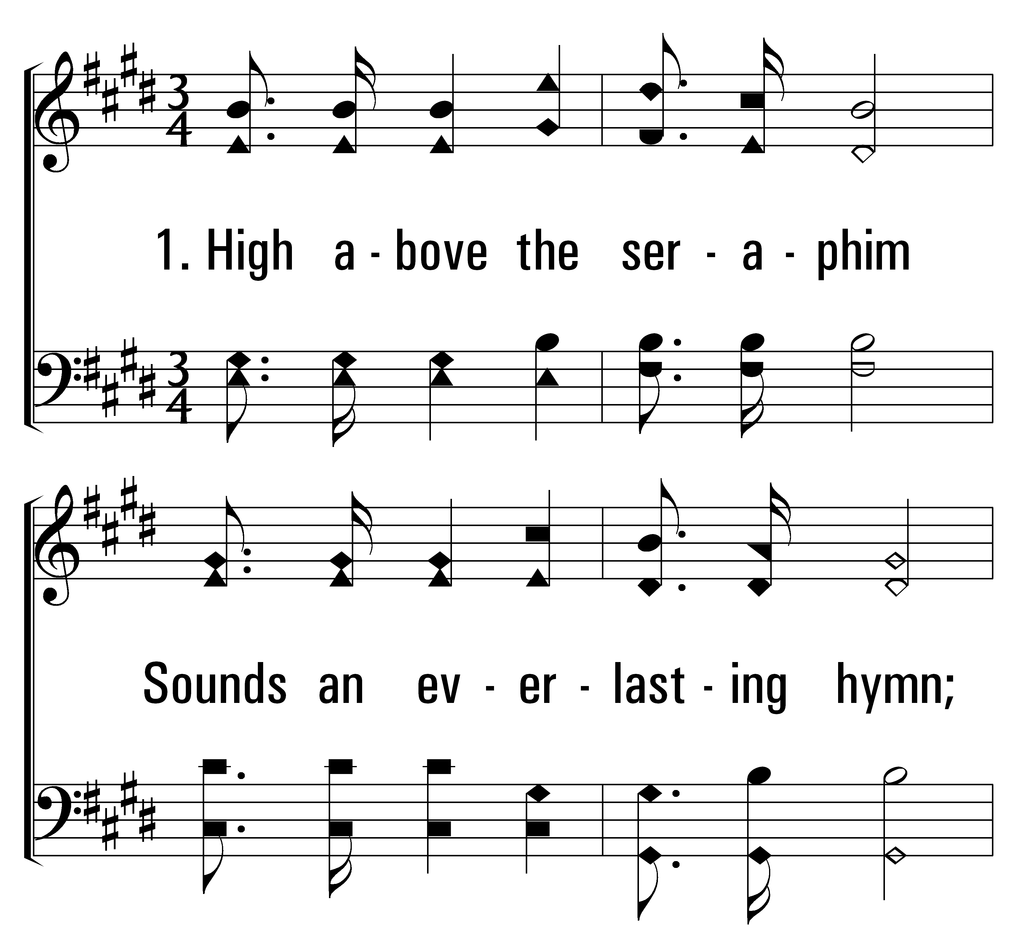

1
32
2
3
THEOPHANY (HIGH ABOVE THE SERAPHIM)
© 2014 Sumphonia Productions, LLC

Slide 29
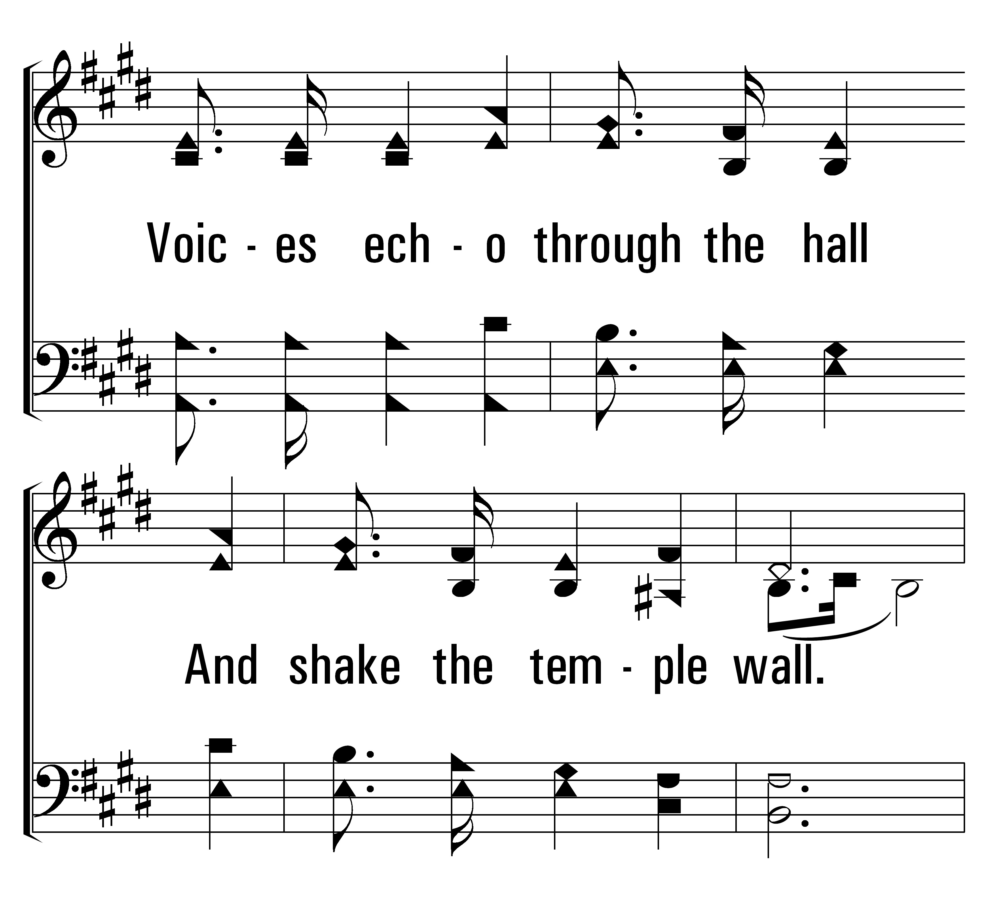
1
32
2
3
THEOPHANY (HIGH ABOVE THE SERAPHIM)
© 2014 Sumphonia Productions, LLC

Slide 30
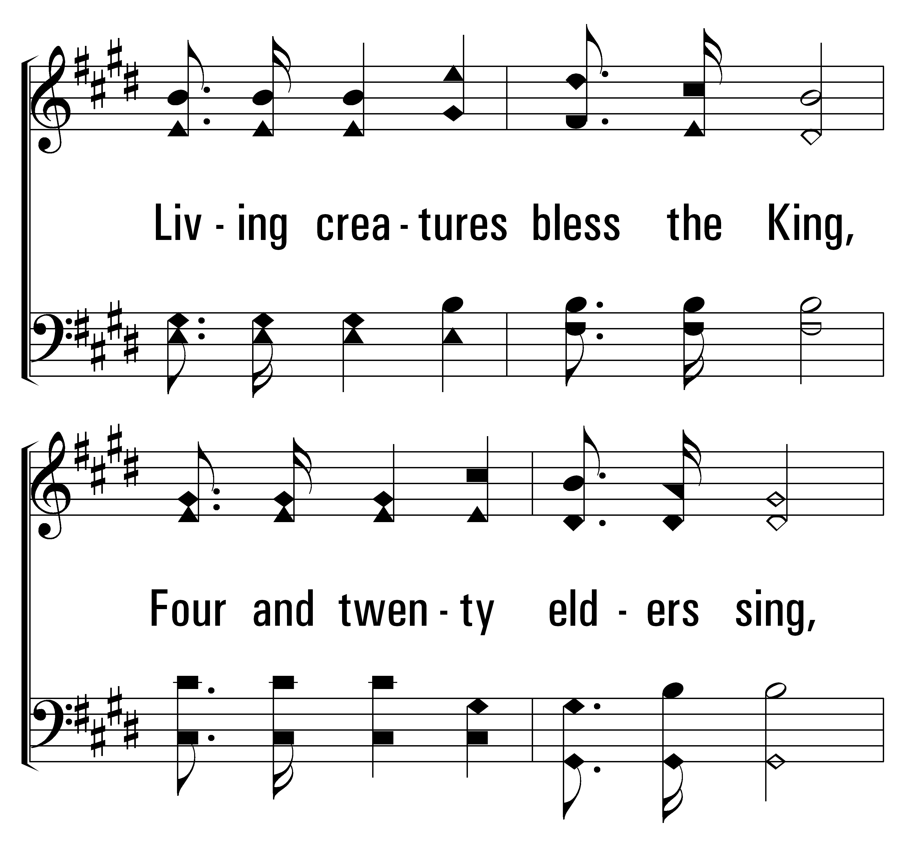
1
32
2
3
THEOPHANY (HIGH ABOVE THE SERAPHIM)
© 2014 Sumphonia Productions, LLC

Slide 31
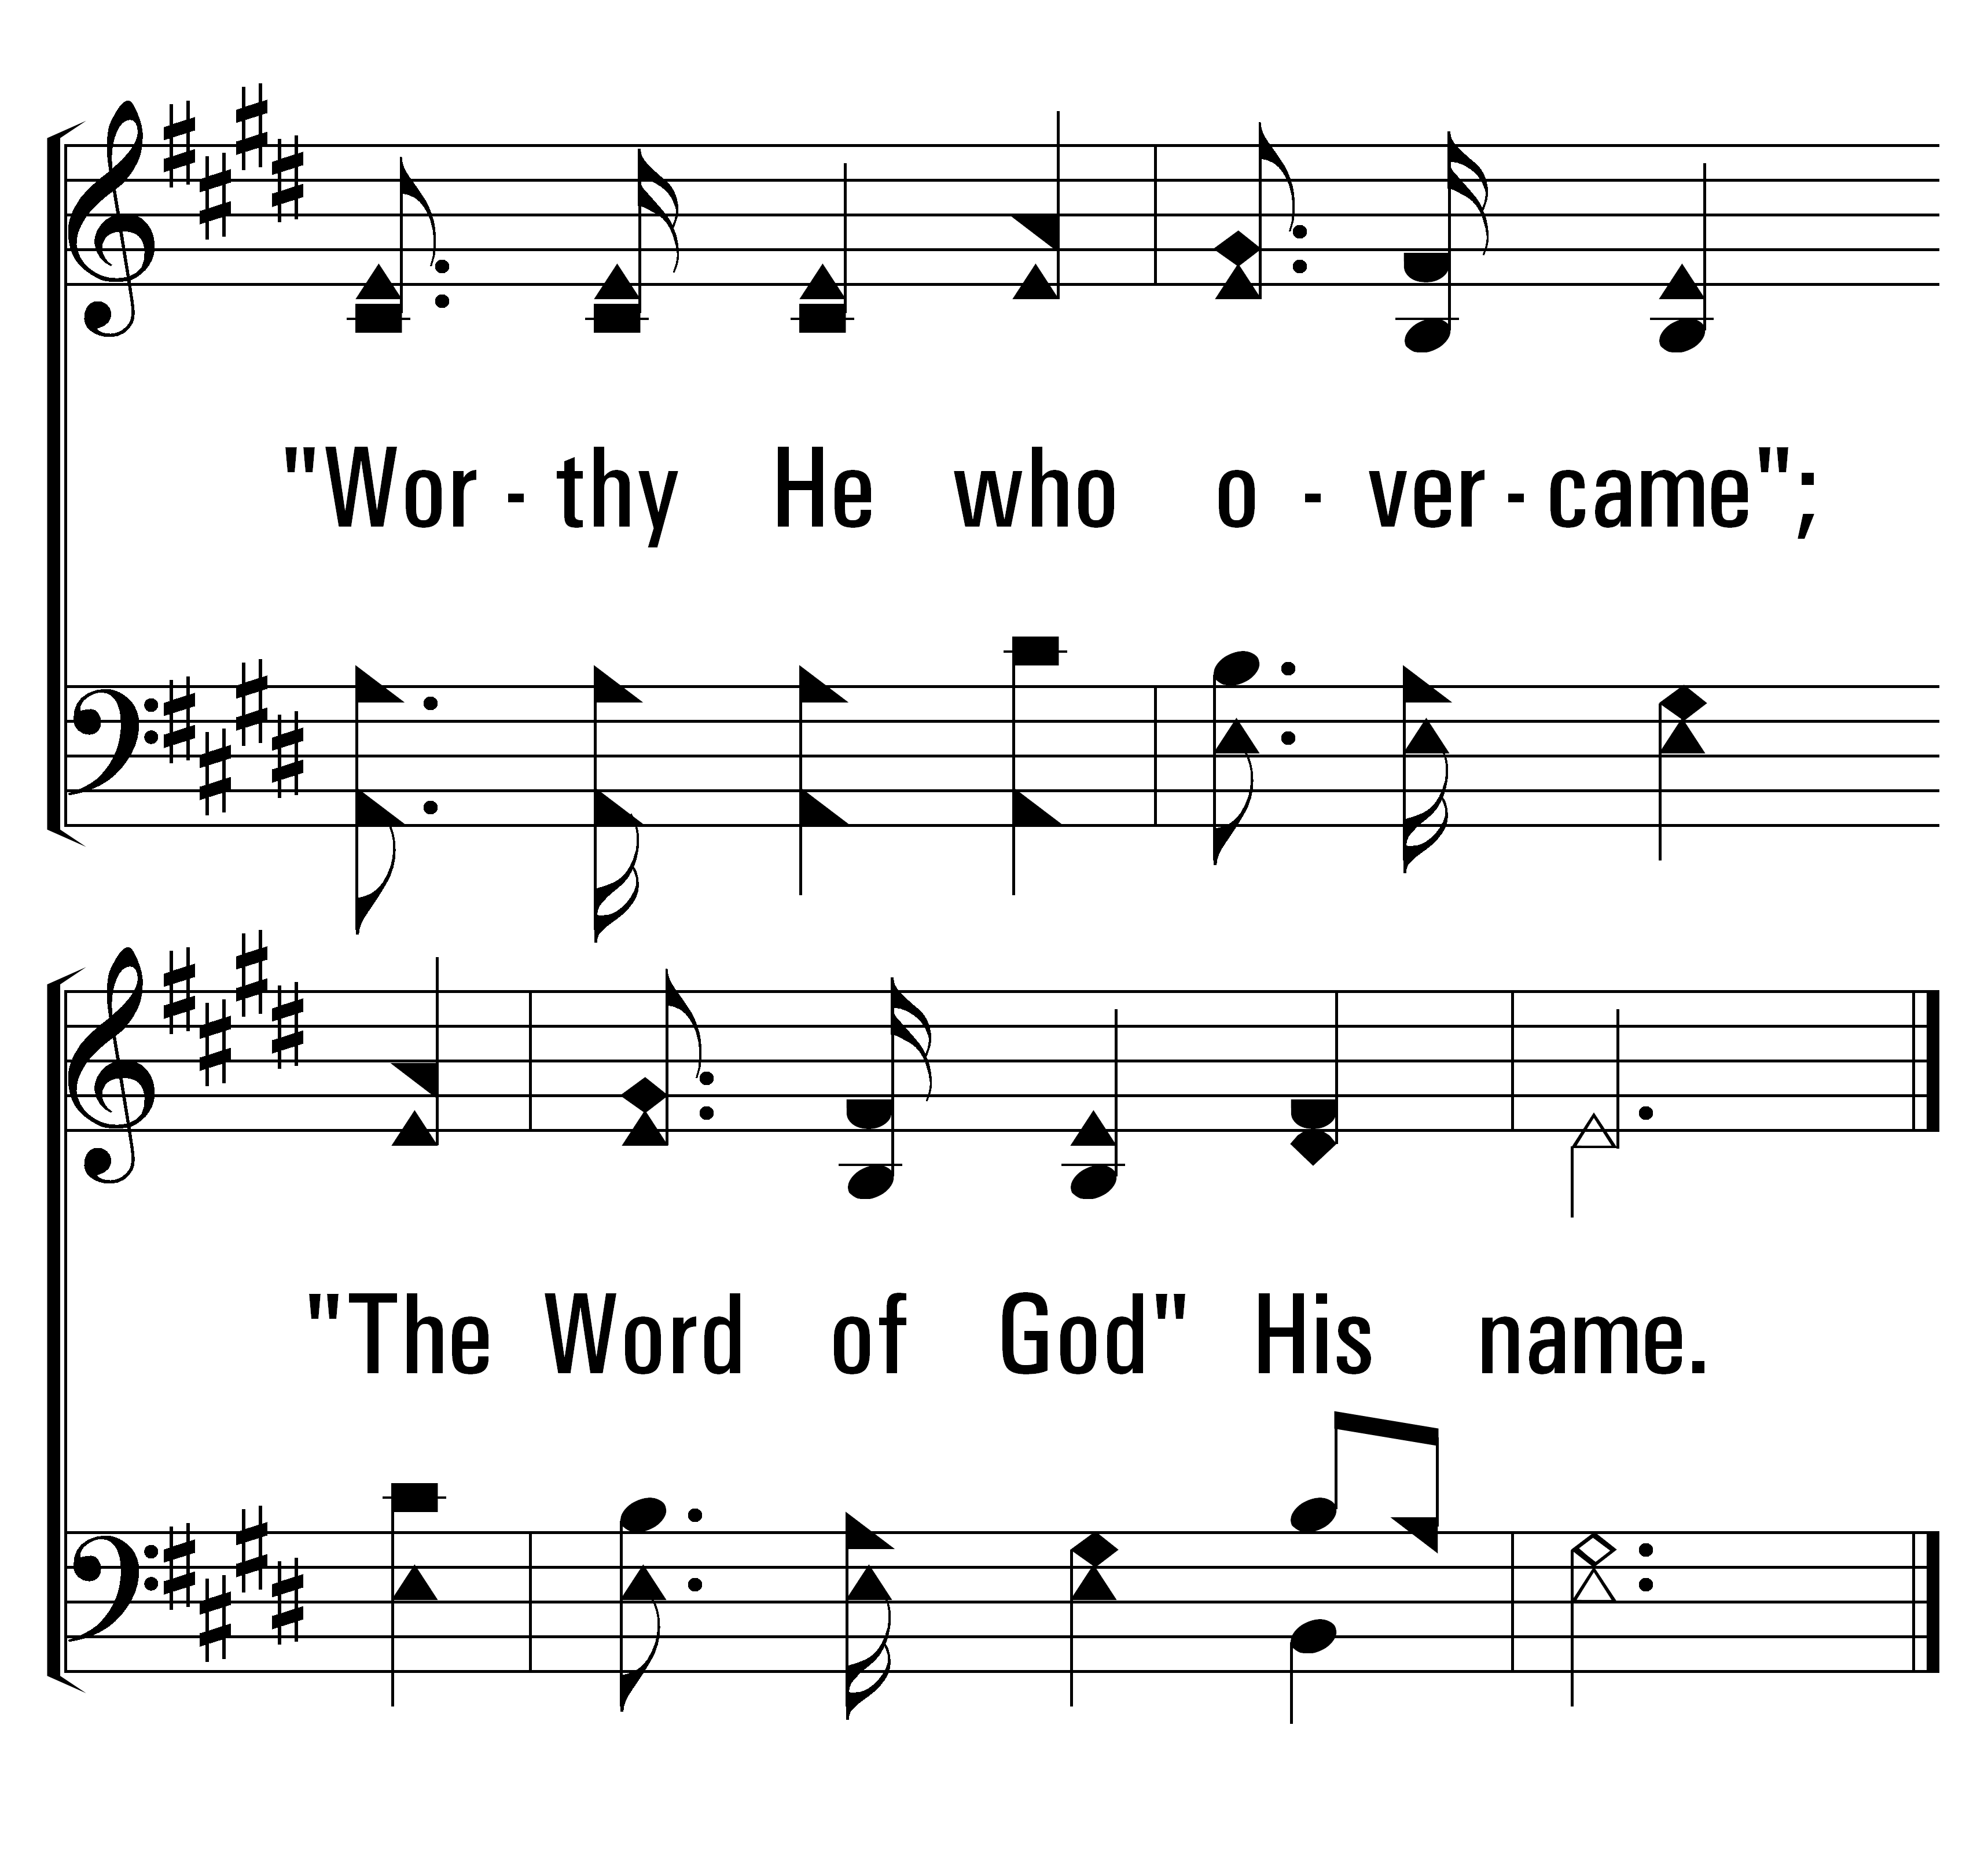
1
32
2
3
THEOPHANY (HIGH ABOVE THE SERAPHIM)
© 2014 Sumphonia Productions, LLC

Slide 32
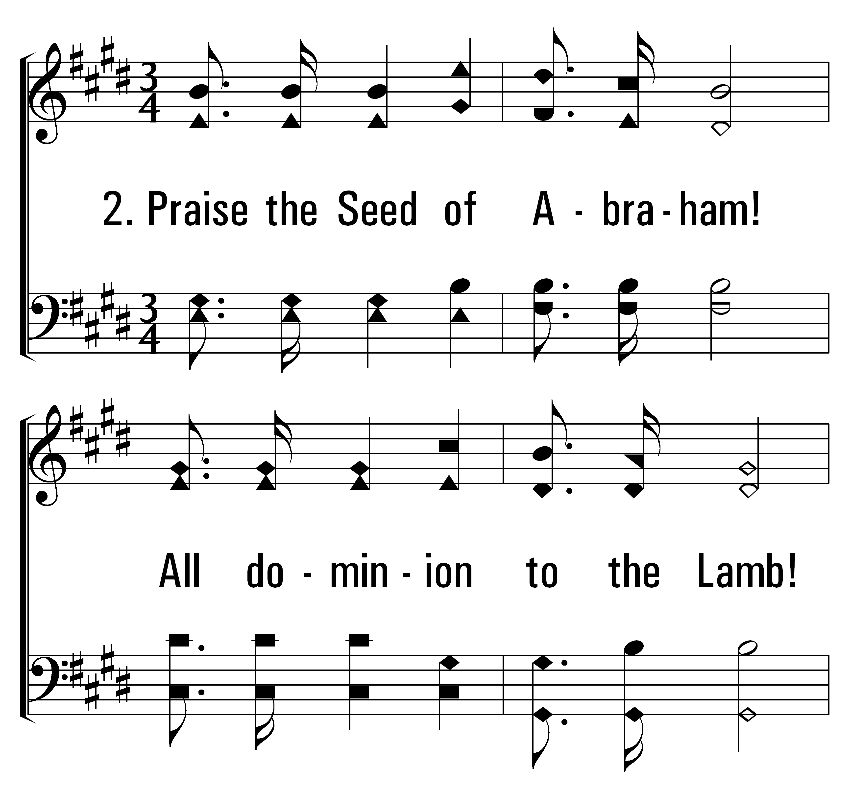
1
32
2
3
THEOPHANY (HIGH ABOVE THE SERAPHIM)
© 2014 Sumphonia Productions, LLC

Slide 33
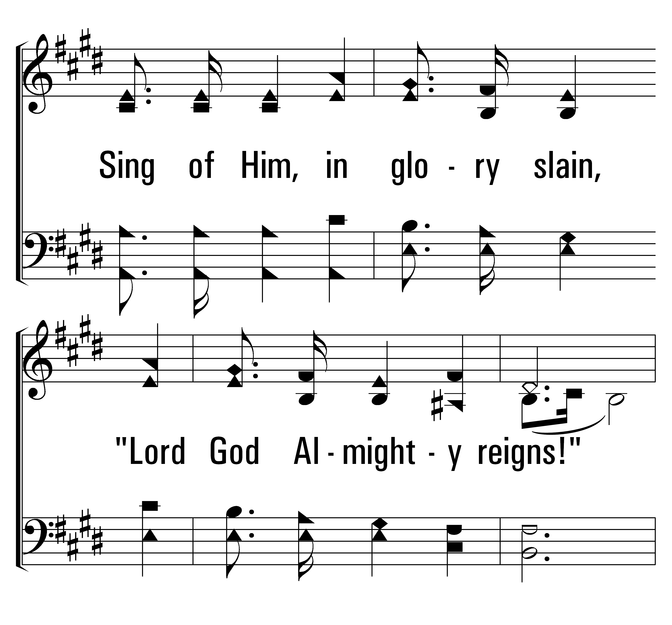
1
32
2
3
THEOPHANY (HIGH ABOVE THE SERAPHIM)
© 2014 Sumphonia Productions, LLC

Slide 34
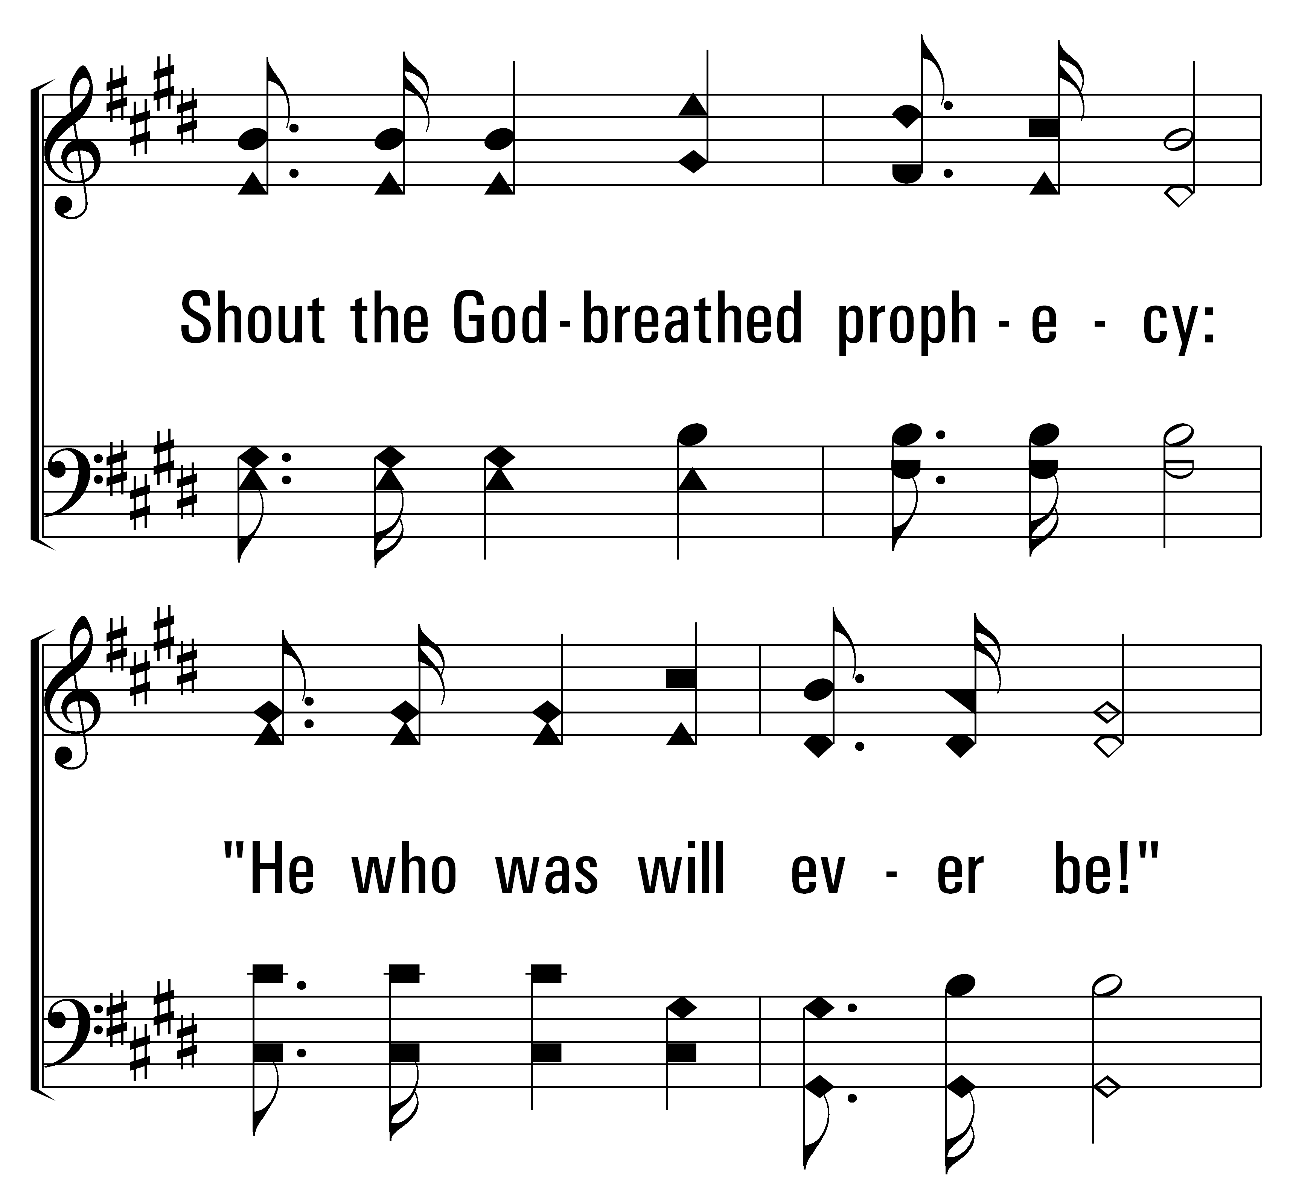
1
32
2
3
THEOPHANY (HIGH ABOVE THE SERAPHIM)
© 2014 Sumphonia Productions, LLC

Slide 35
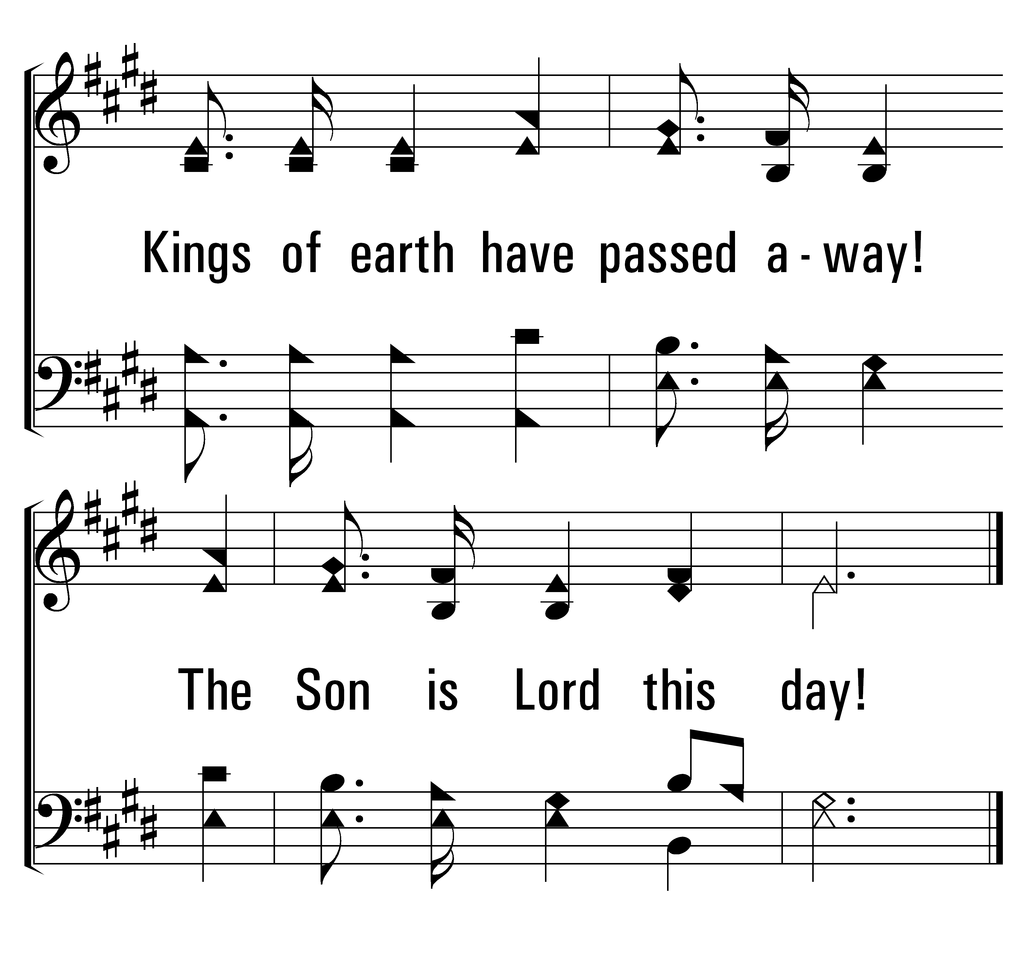
1
32
2
3
THEOPHANY (HIGH ABOVE THE SERAPHIM)
© 2014 Sumphonia Productions, LLC

Slide 36
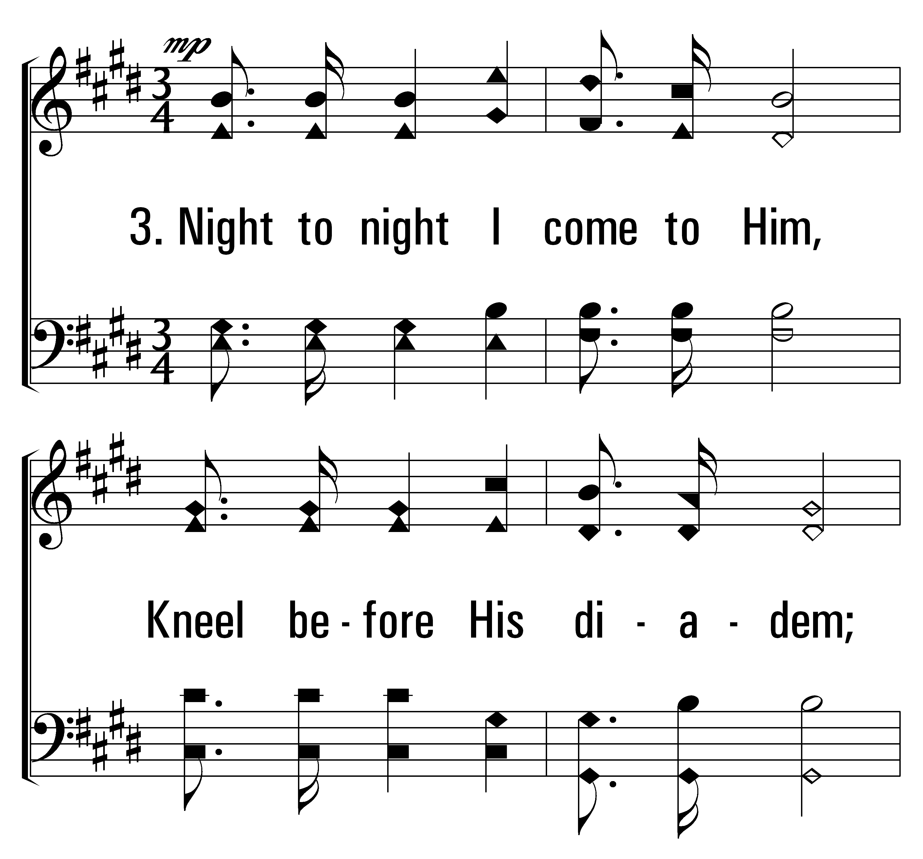
1
32
2
3
THEOPHANY (HIGH ABOVE THE SERAPHIM)
© 2014 Sumphonia Productions, LLC

Slide 37
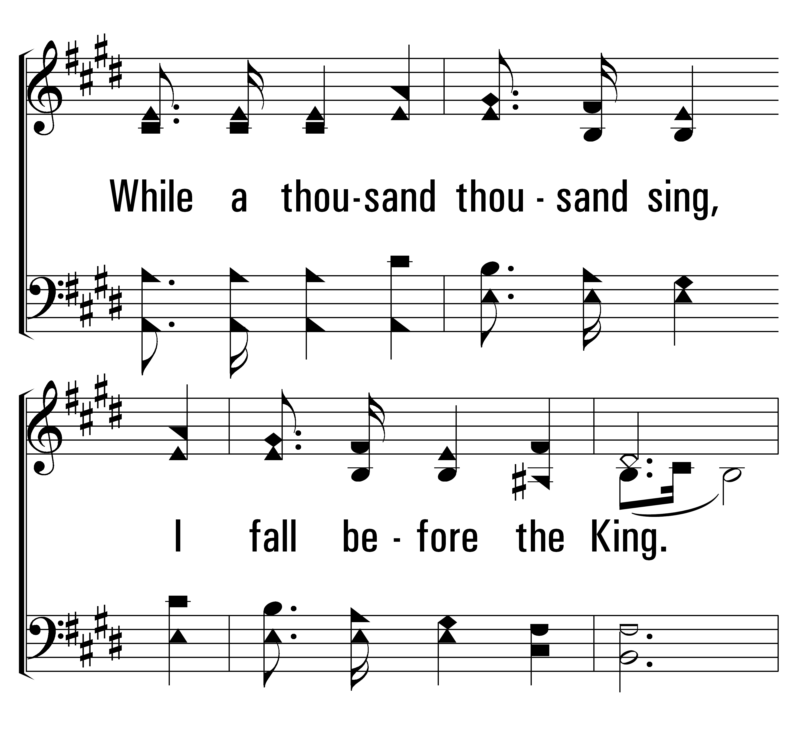
1
32
2
3
THEOPHANY (HIGH ABOVE THE SERAPHIM)
© 2014 Sumphonia Productions, LLC

Slide 38
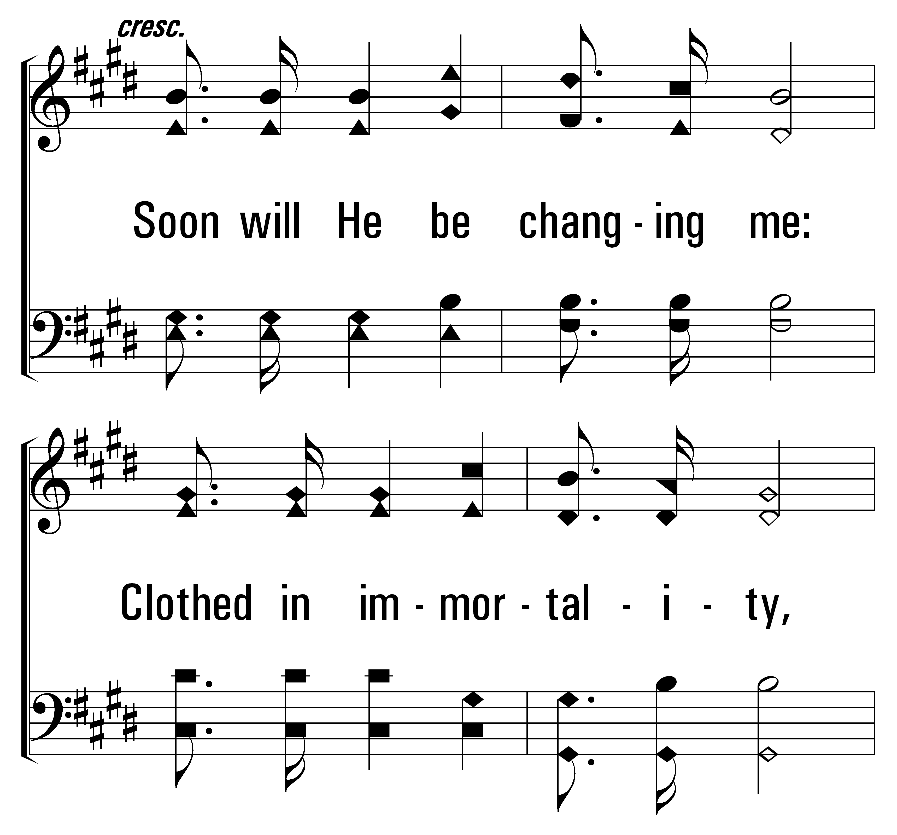
1
32
2
3
THEOPHANY (HIGH ABOVE THE SERAPHIM)
© 2014 Sumphonia Productions, LLC

Slide 39
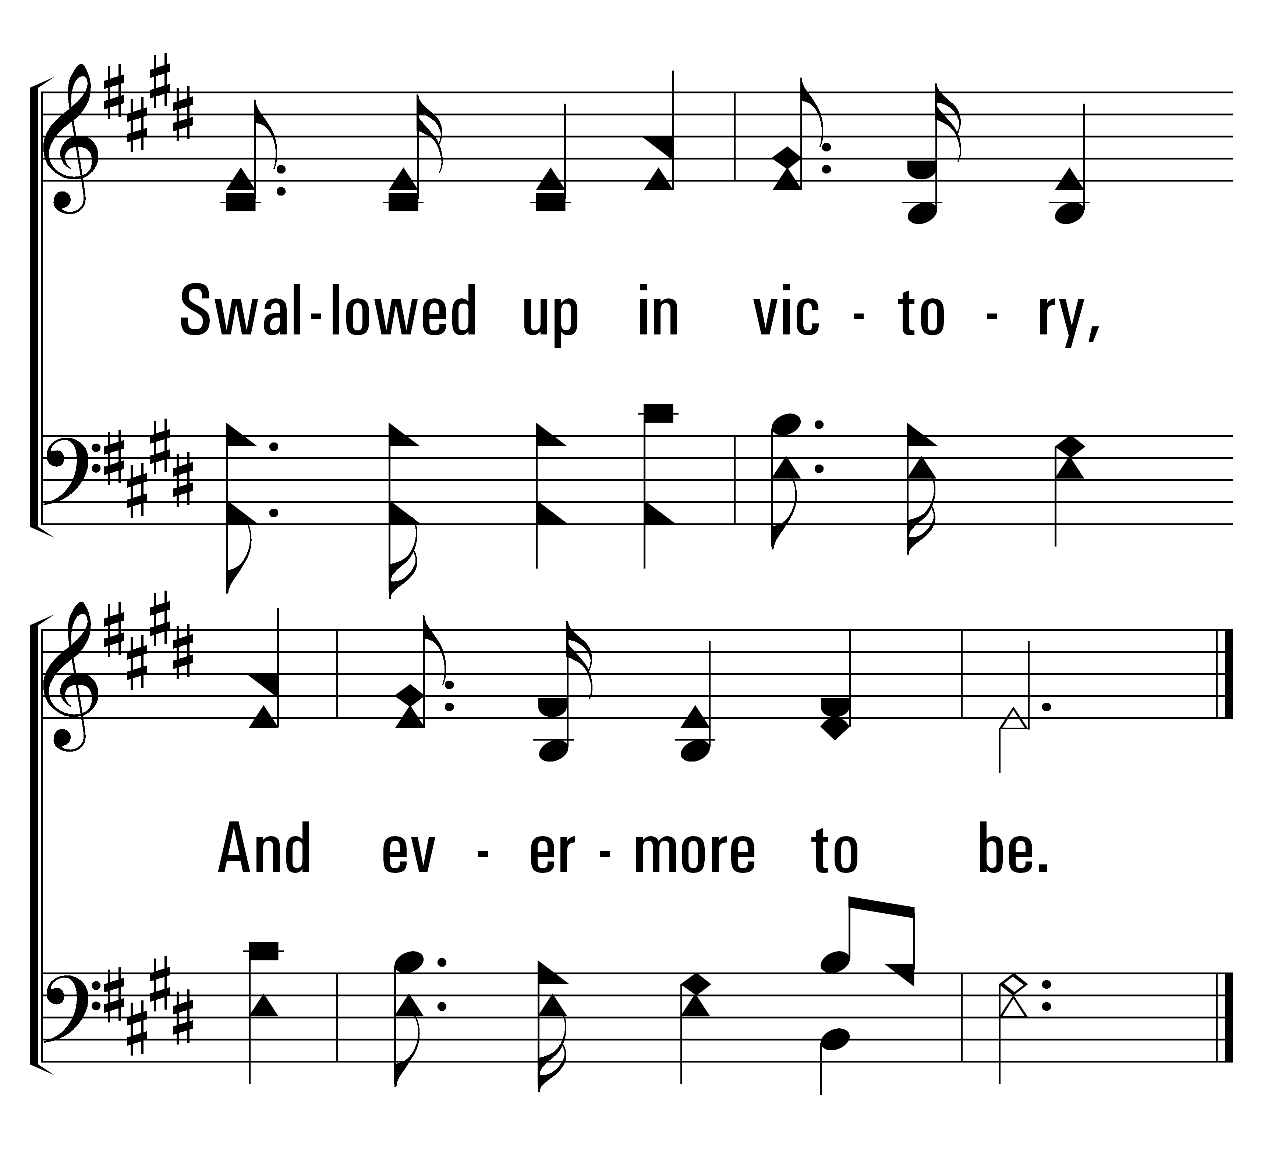
1
32
2
3
THEOPHANY (HIGH ABOVE THE SERAPHIM)
© 2014 Sumphonia Productions, LLC

Slide 40

Welcome
Reading
Prayer
115 .
950 .
Lord’s Supper
32 .
• Collection
500 .
Sermon
739 .
Prayer
GIVING
THE COLLECTION FOR THE SAINTS
“FOR GOD LOVES A CHEERFUL GIVER” 2 CORINTHIANS 9:7

Slide 42

Welcome
Reading
Prayer
115 .
950 .
Lord’s Supper
32 .
• Collection
500 .
Sermon
739 .
Prayer
“I have shown you in every way, by laboring like this, that you must support the weak. And remember the words of the Lord Jesus, that He said, ‘It is more blessed to give than to receive.’”
Acts 20:35

Slide 43
Welcome
Reading
Prayer
115 .
950 .
Lord’s Supper
32 .
Collection
500 .
Sermon
• 739 .
Prayer
INVITATION SONG
739
WHAT WILL YOU DO WITH JESUS?
1
2
3
“SINGING...TO THE LORD”
COLOSSIANS 3:16
Words: James Robinson
Music: Bentley D. Ackley

Slide 44

Welcome
Reading
Prayer
115 .
950 .
Lord’s Supper
32 .
Collection
• 500 .
Sermon
739 .
Prayer
500
O THOU FOUNT OF EVERY BLESSING
1
2
3
“SINGING...TO THE LORD”
COLOSSIANS 3:16
Words: Robert Robinson
Music: Wyeth’s Repository of Sacred Music

Slide 45

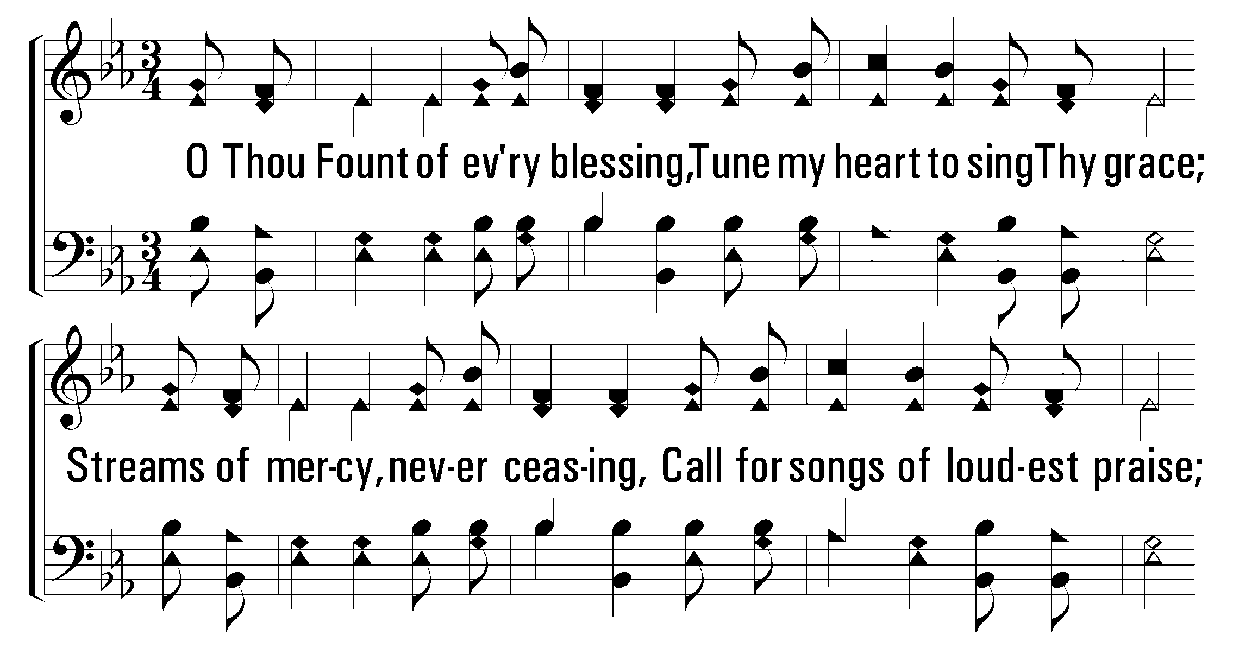
1
2
3
500
O THOU FOUNT OF EVERY BLESSING
© 2001 The Paperless Hymnal™

Slide 46
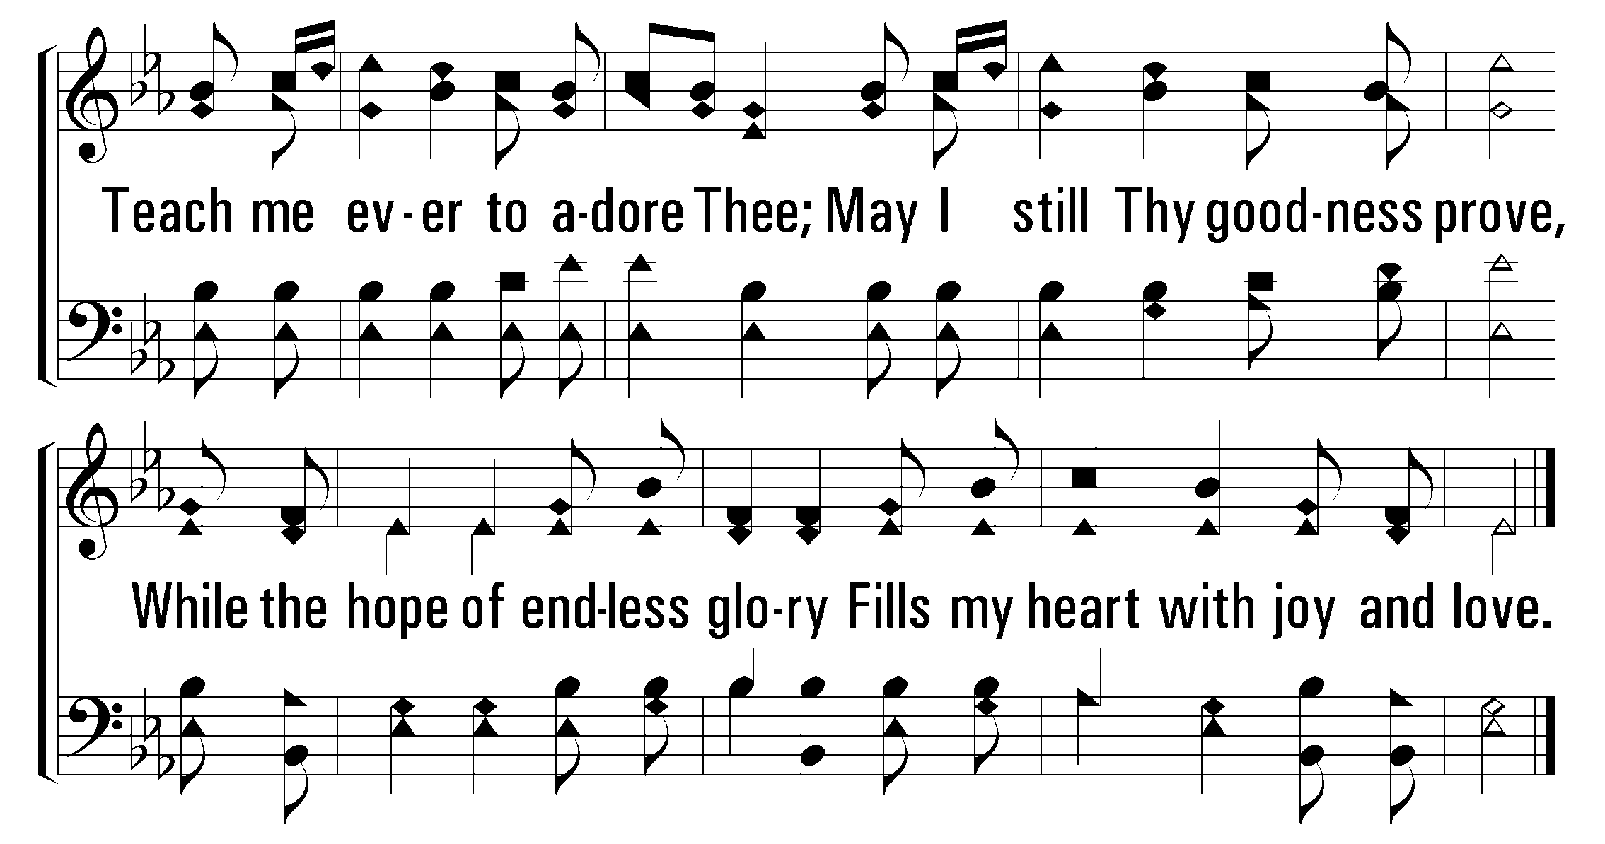
1
2
3
500
O THOU FOUNT OF EVERY BLESSING
© 2001 The Paperless Hymnal™

Slide 47
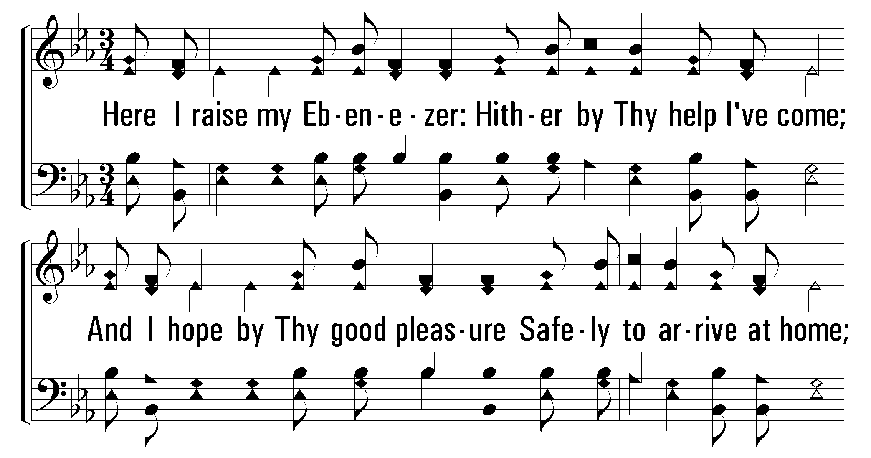
1
2
3
500
O THOU FOUNT OF EVERY BLESSING
© 2001 The Paperless Hymnal™

Slide 48
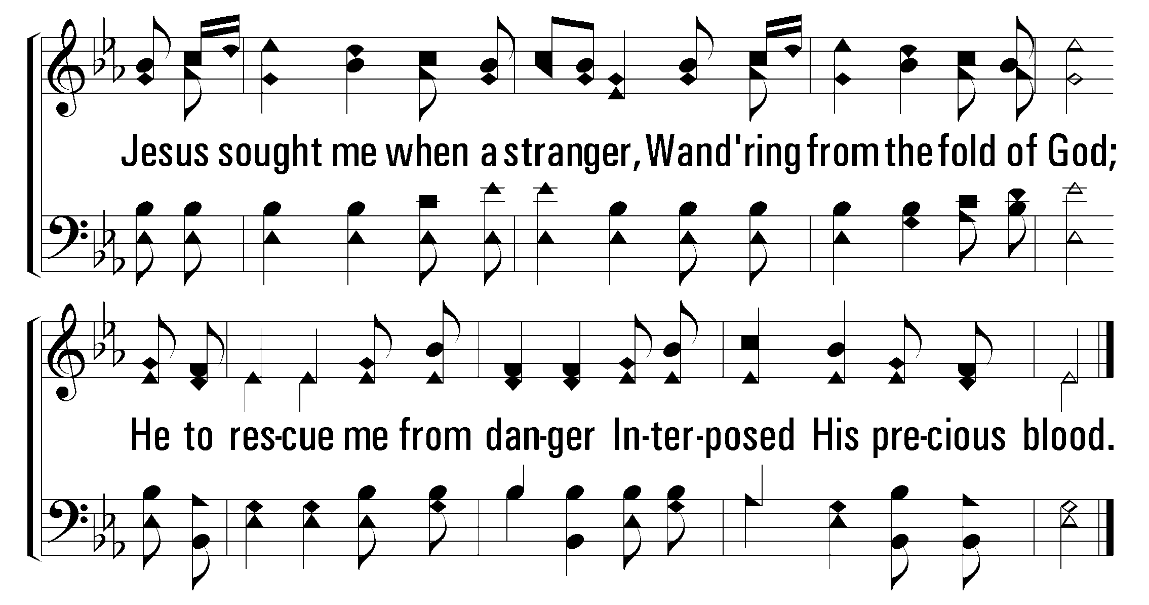
1
2
3
500
O THOU FOUNT OF EVERY BLESSING
© 2001 The Paperless Hymnal™

Slide 49
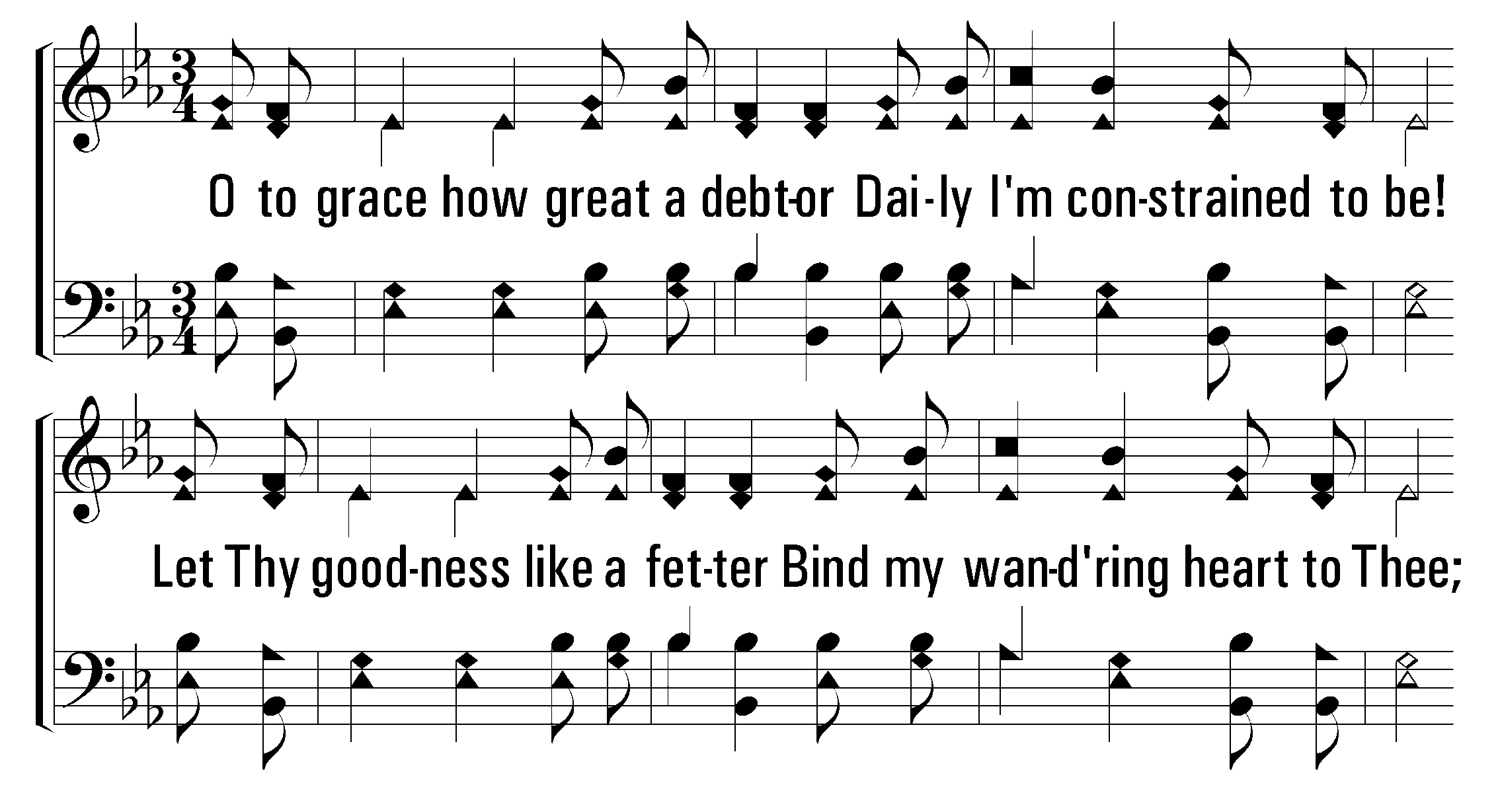
1
2
3
500
O THOU FOUNT OF EVERY BLESSING
© 2001 The Paperless Hymnal™

Slide 50
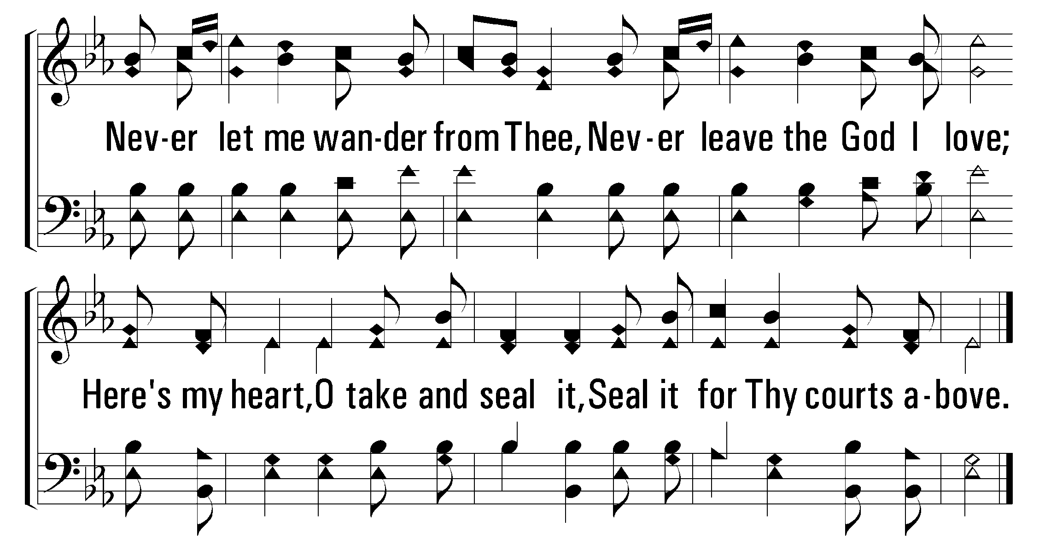
1
2
3
500
O THOU FOUNT OF EVERY BLESSING
© 2001 The Paperless Hymnal™

Slide 52
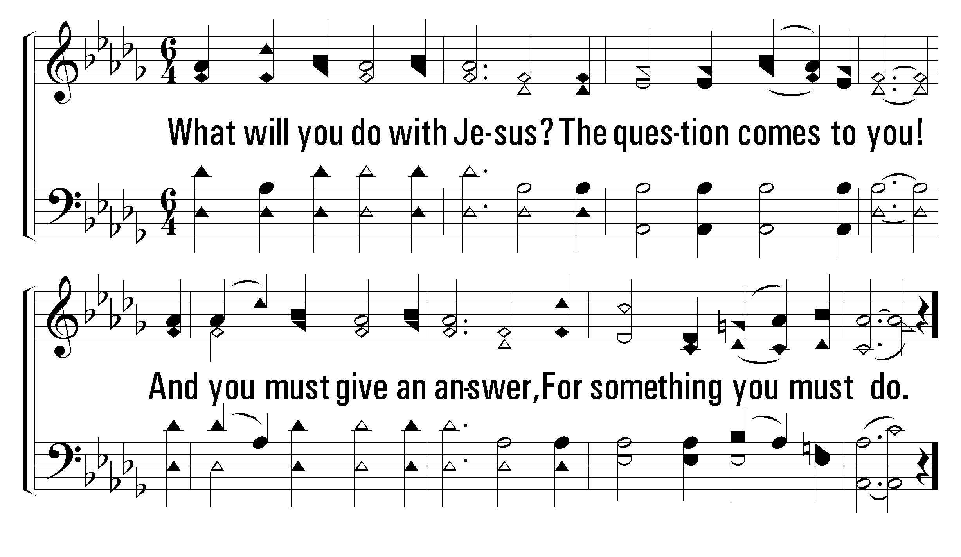
1
C
2
C
3
C
739
WHAT WILL YOU DO WITH JESUS?
© 2004 The Paperless Hymnal™

Slide 53
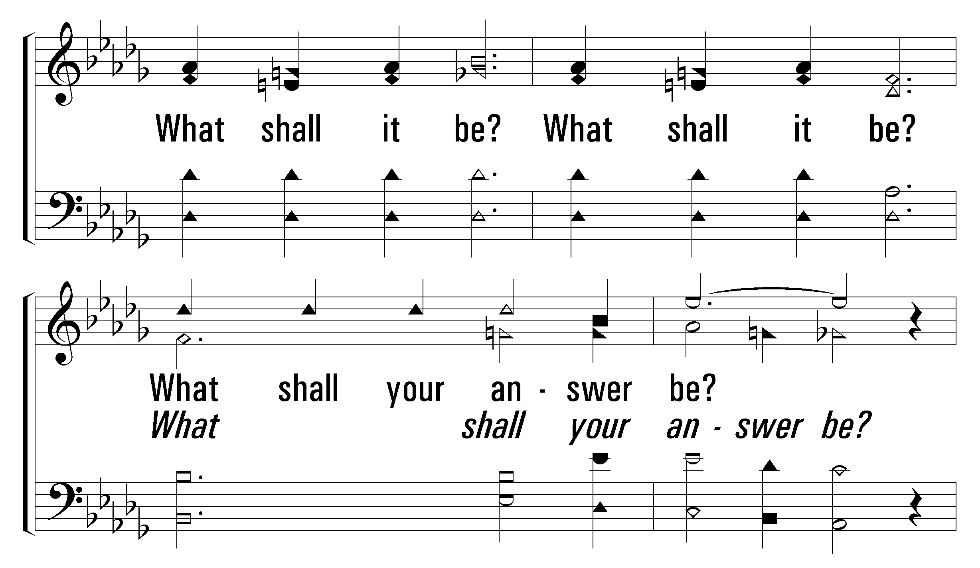
1
C
2
C
3
C
739
WHAT WILL YOU DO WITH JESUS?
© 2004 The Paperless Hymnal™

Slide 54
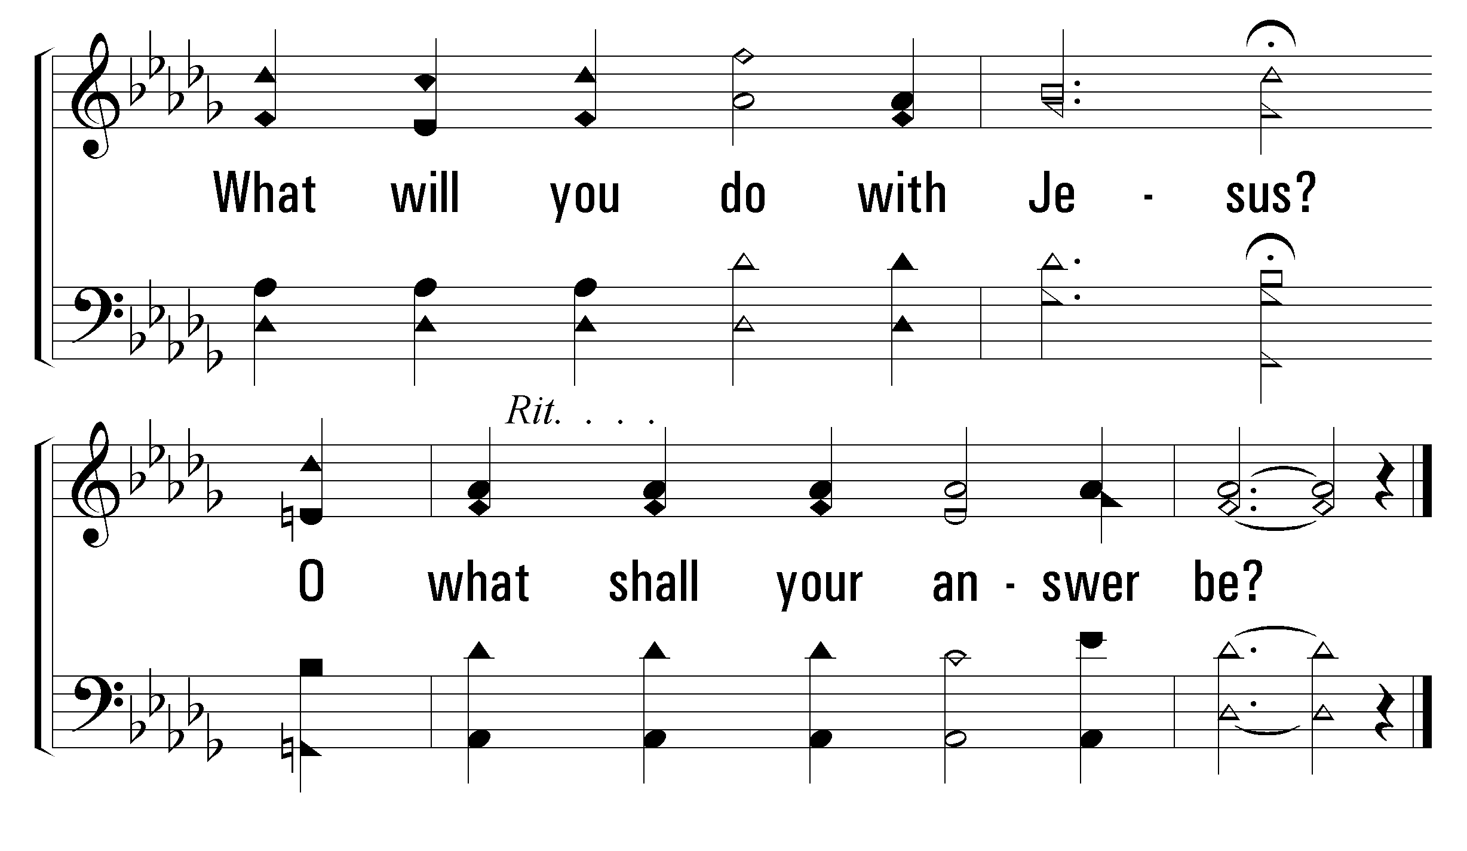
1
C
2
C
3
C
739
WHAT WILL YOU DO WITH JESUS?
© 2004 The Paperless Hymnal™

Slide 55
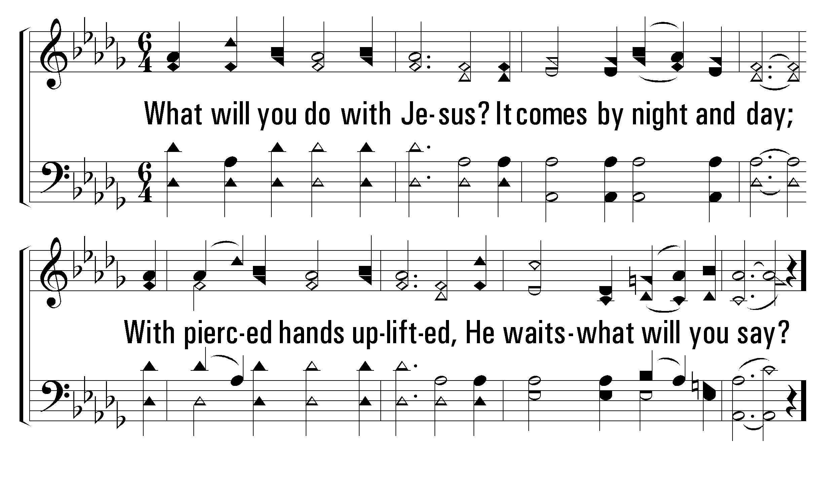
1
C
2
C
3
C
739
WHAT WILL YOU DO WITH JESUS?
© 2004 The Paperless Hymnal™

Slide 56
1
C
2
C
3
C
739
WHAT WILL YOU DO WITH JESUS?
© 2004 The Paperless Hymnal™

Slide 57
1
C
2
C
3
C
739
WHAT WILL YOU DO WITH JESUS?
© 2004 The Paperless Hymnal™

Slide 58
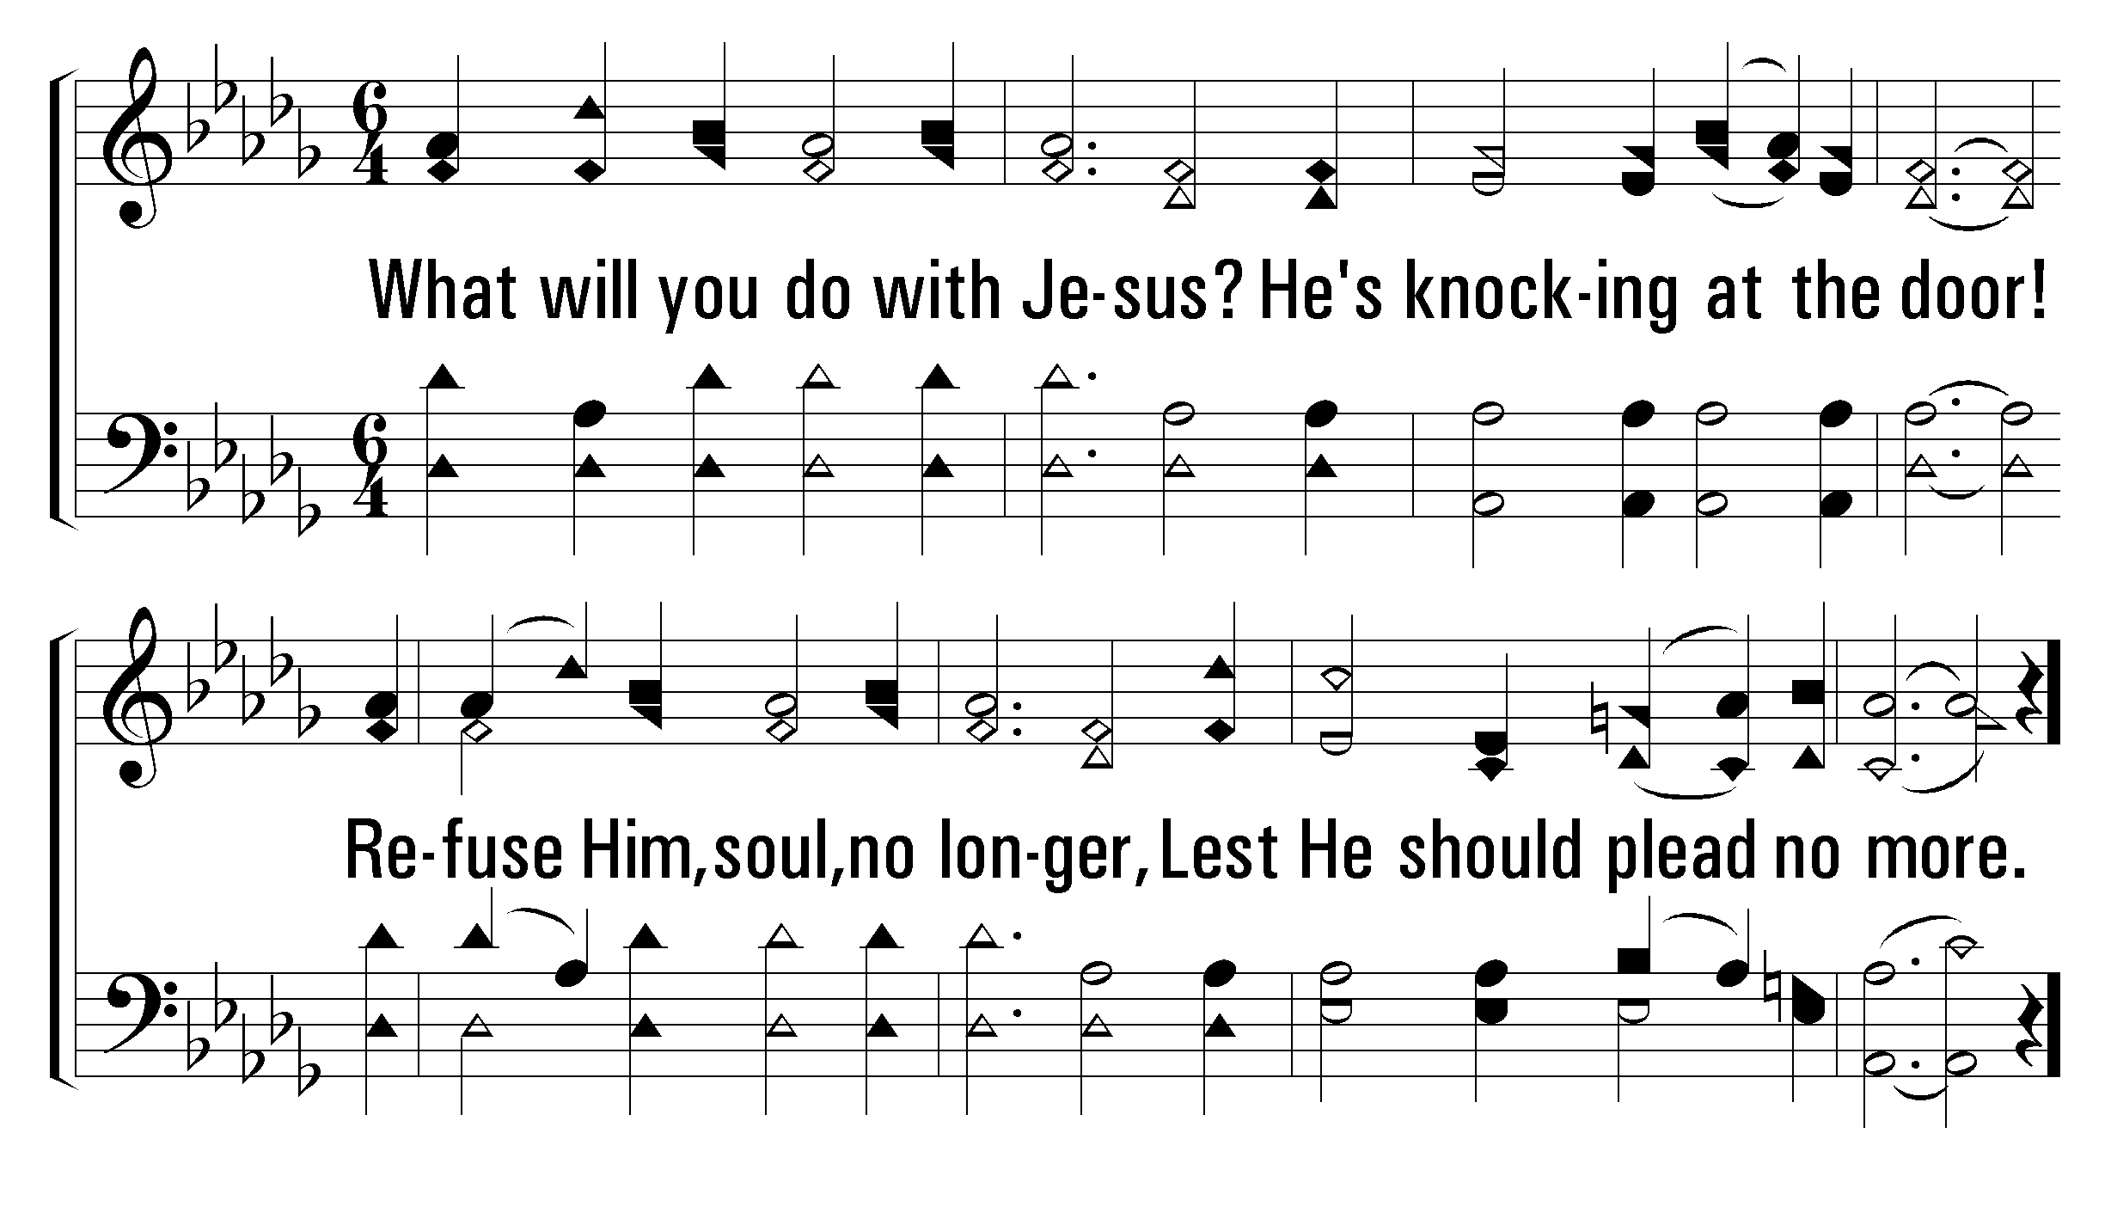
1
C
2
C
3
C
739
WHAT WILL YOU DO WITH JESUS?
© 2004 The Paperless Hymnal™

Slide 59
1
C
2
C
3
C
739
WHAT WILL YOU DO WITH JESUS?
© 2004 The Paperless Hymnal™

Slide 60
1
C
2
C
3
C
739
WHAT WILL YOU DO WITH JESUS?
© 2004 The Paperless Hymnal™

Slide 62
Welcome
Reading
Prayer
115 .
950 .
Lord’s Supper
32 .
Collection
500 .
Sermon
739 .
• Prayer
PRAYER
“DEVOTE YOURSELVES TO PRAYER”
COLOSSIANS 4:2

