Slide 1
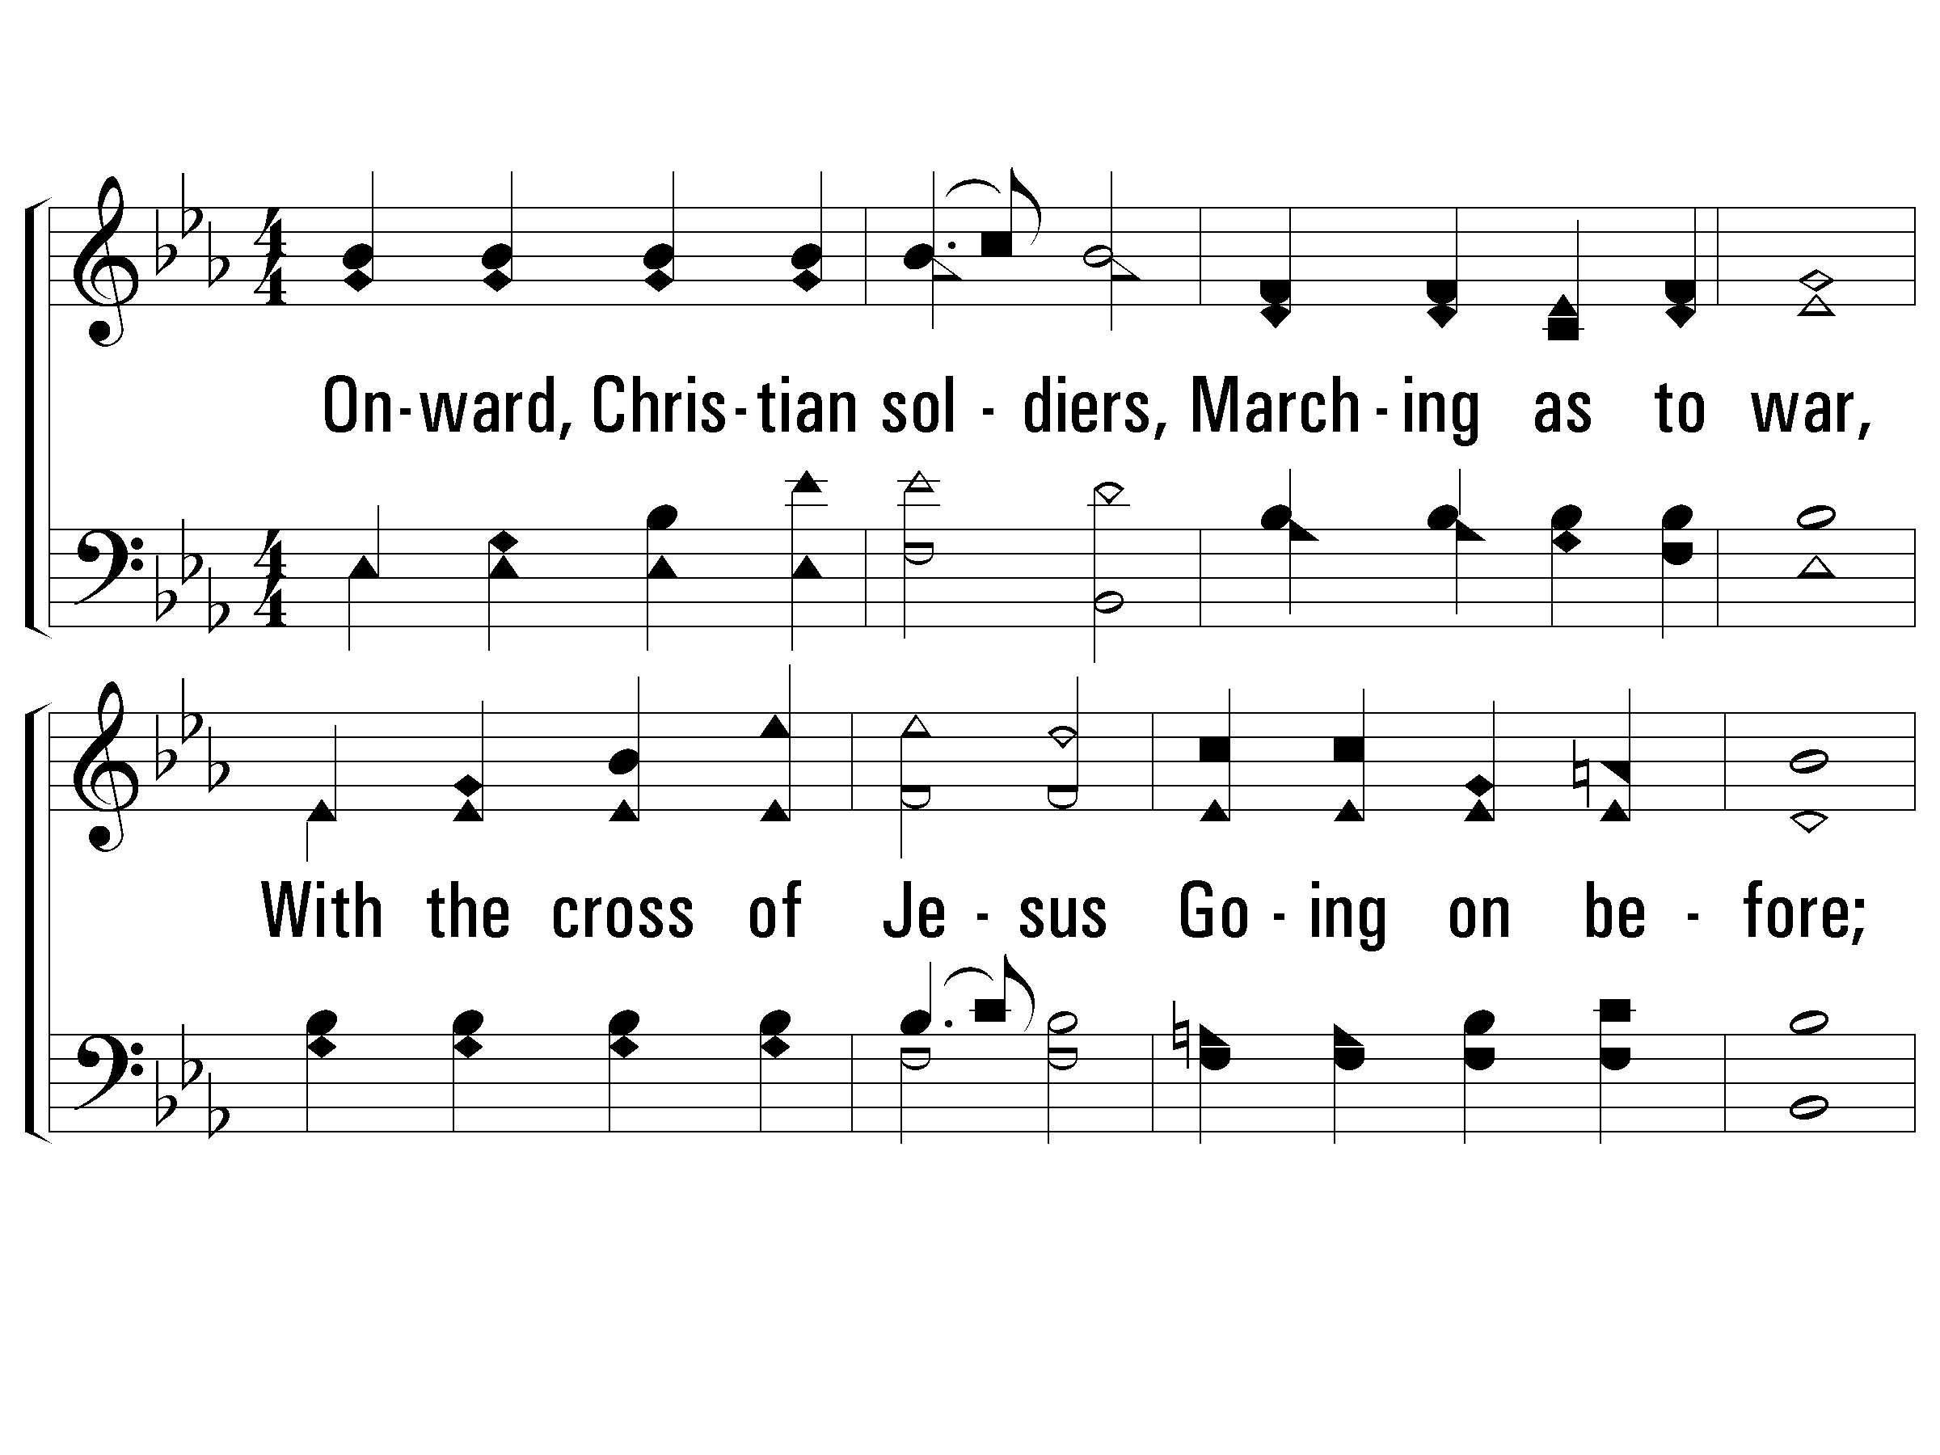
1 - Onward, Christian Soldiers
522
1.
Onward, Christian soldiers,
Marching as to war,
With the cross of Jesus
Going on before;
Christ, the royal Master,
Leads against the foe;
Forward into battle,
See His banners go!
Words by: Sabine Baring-Gould
Music by: Arthur Sullivan
© 2001 The Paperless Hymnal™

Slide 2
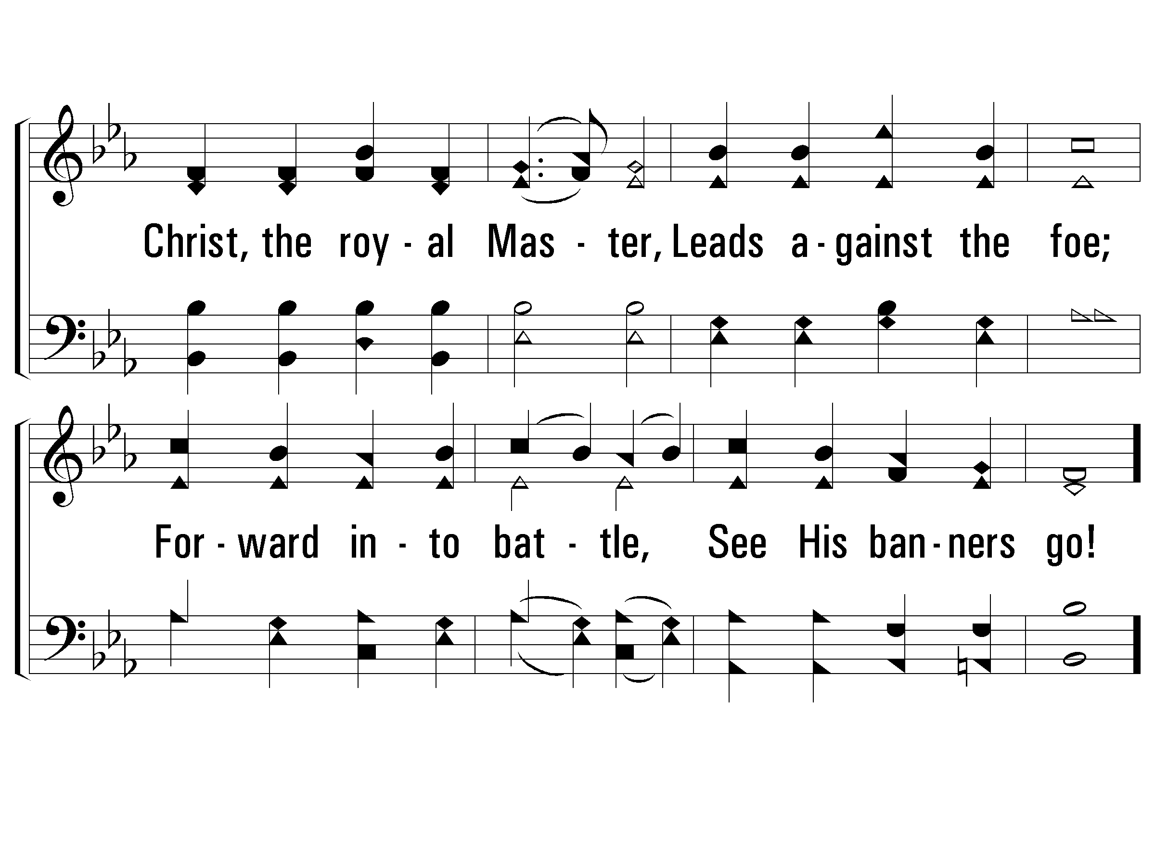
1 - Onward, Christian Soldiers
522
© 2001 The Paperless Hymnal™

Slide 3
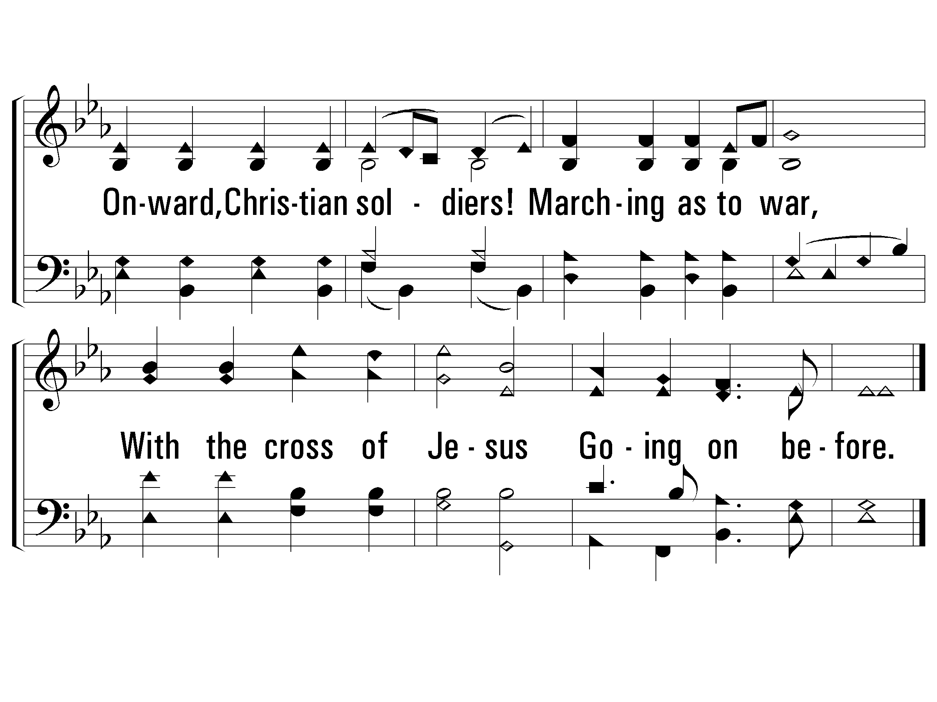
c - Onward, Christian Soldiers
522
Onward, Christian soldiers!
Marching as to war,
With the cross of Jesus
Going on before.
© 2001 The Paperless Hymnal™

Slide 4
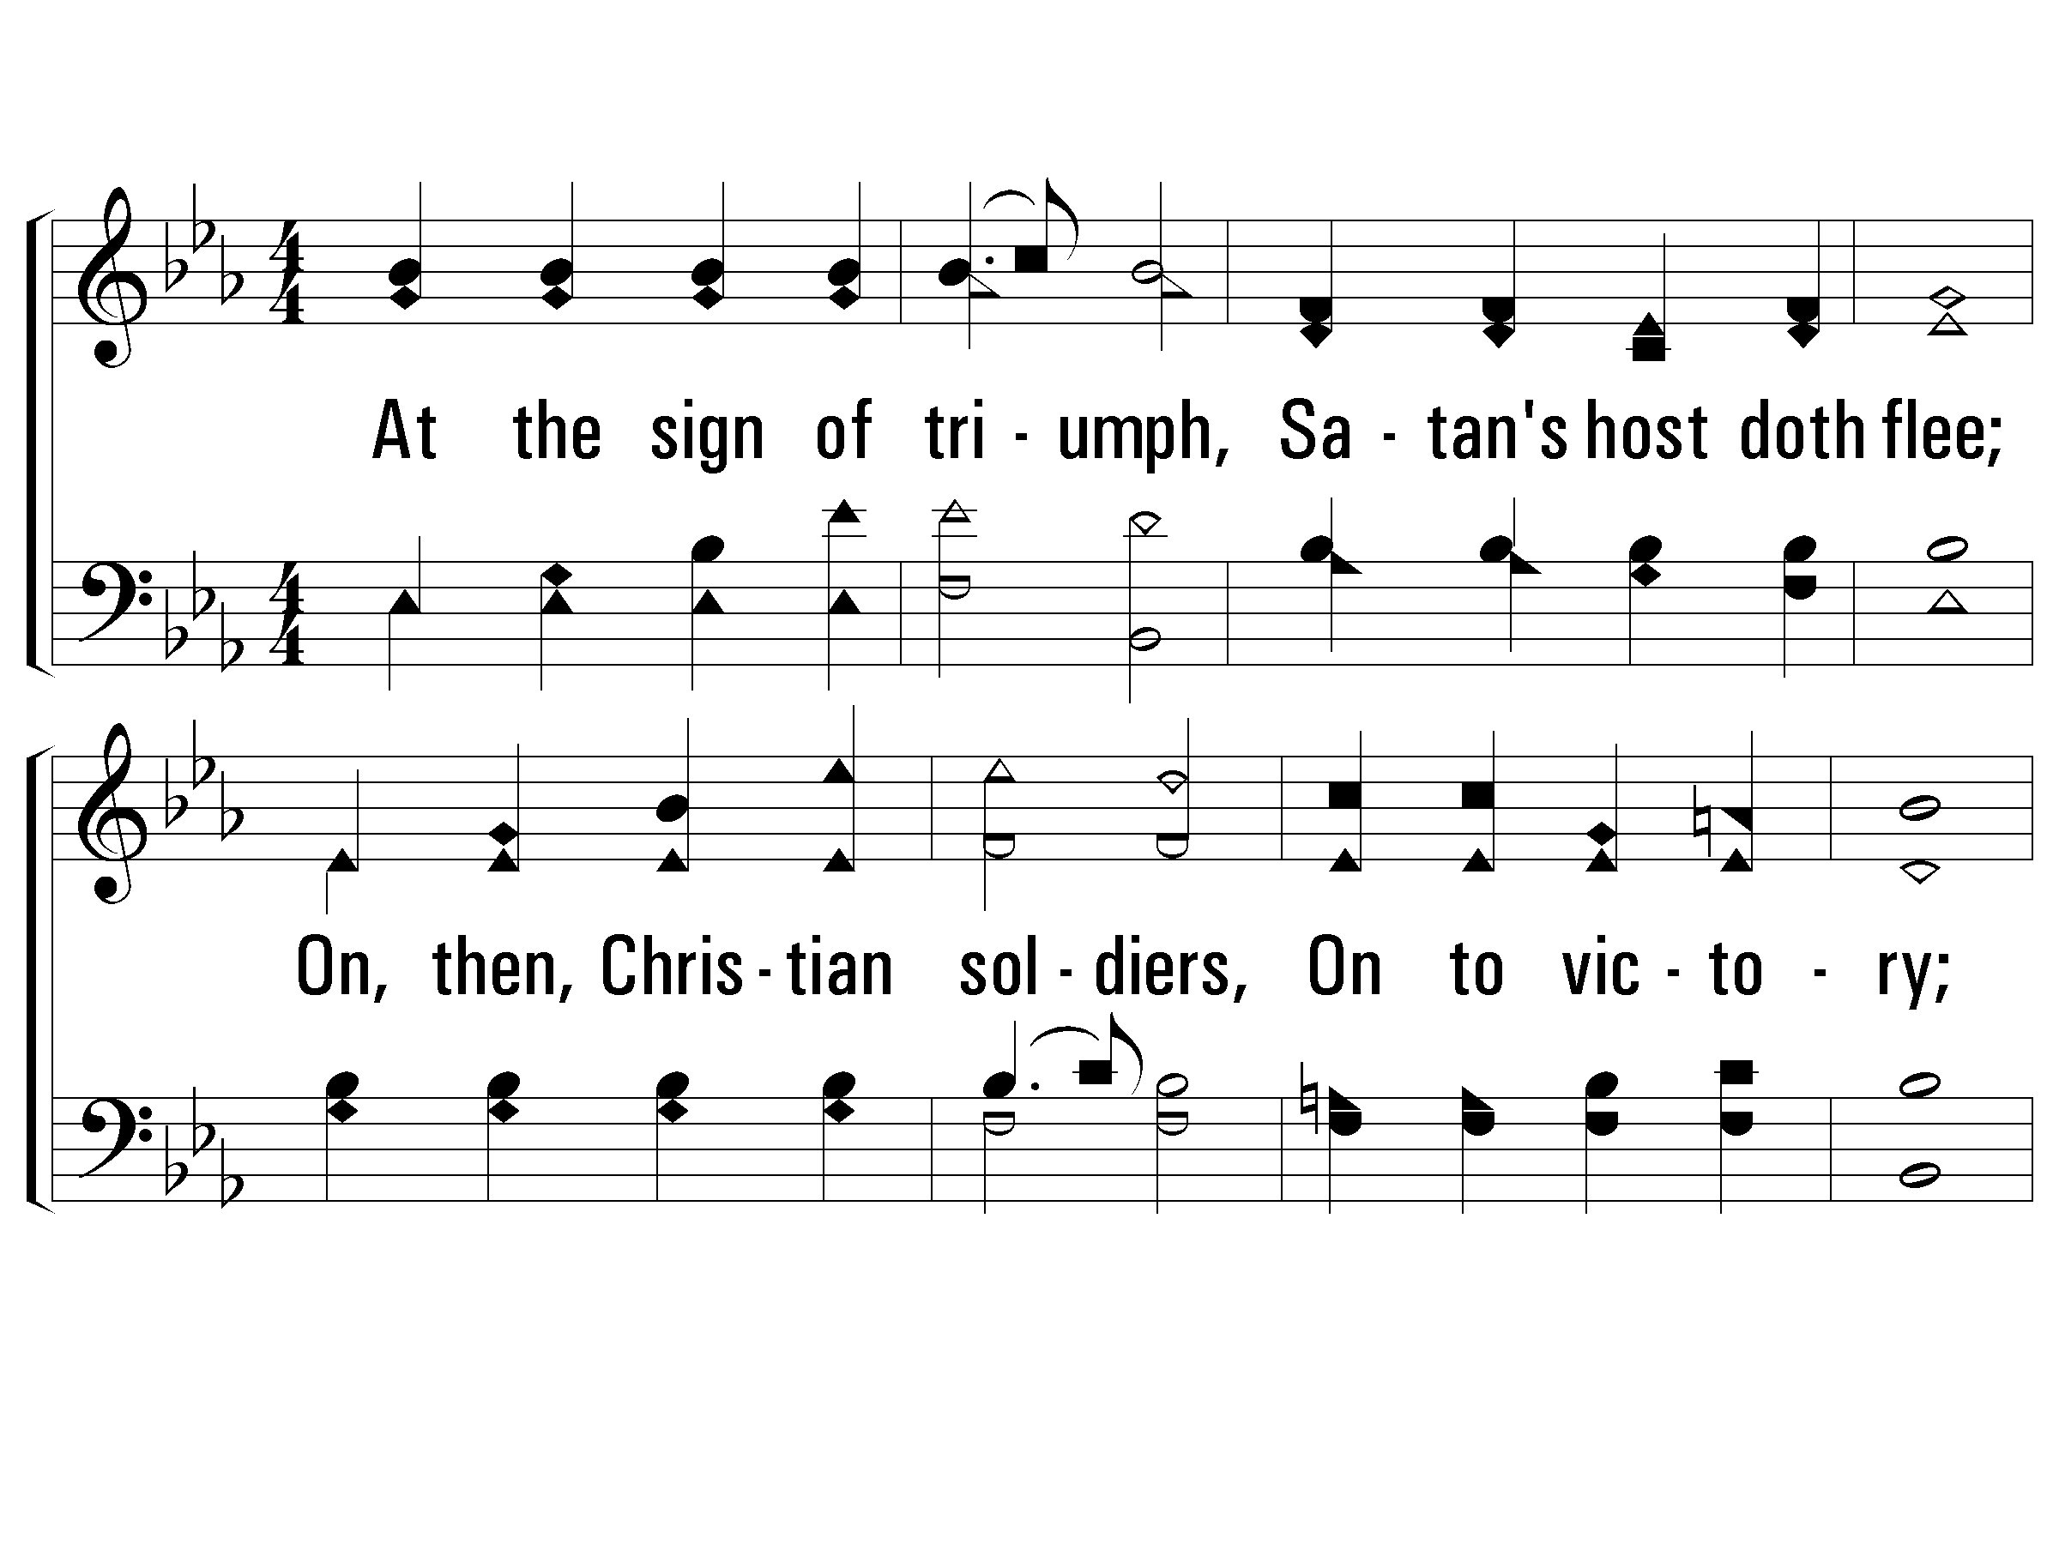
2 - Onward, Christian Soldiers
522
2.
At the sign of triumph,
Satan's host doth flee;
On, then, Christian soldiers,
On to victory;
Hell's foundations quiver
At the shout of praise;
Brothers, lift your voices,
Loud your anthems raise!
Words by: Sabine Baring-Gould
Music by: Arthur Sullivan
© 2001 The Paperless Hymnal™

Slide 5
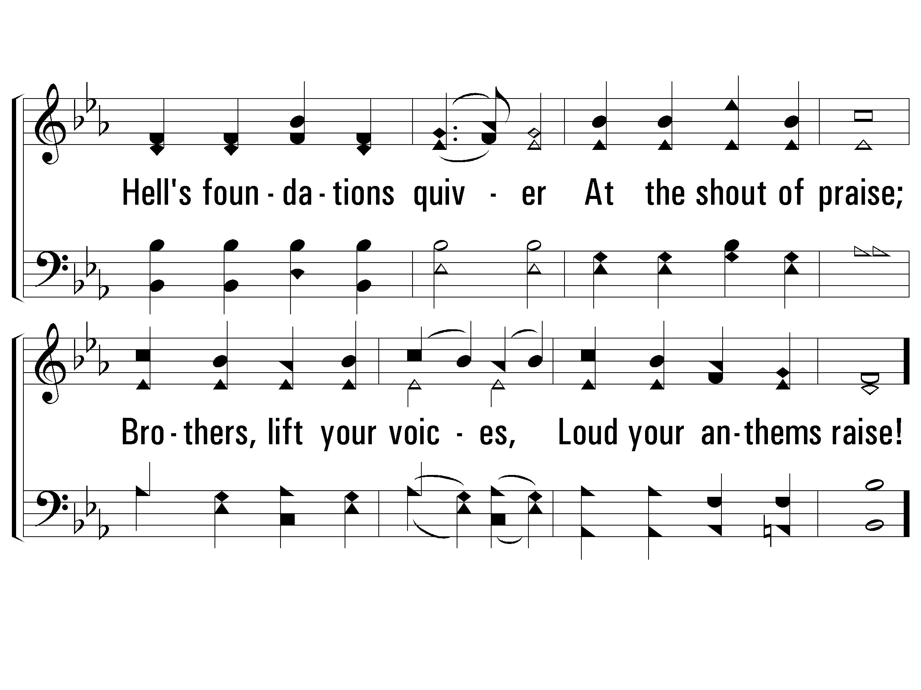
2 - Onward, Christian Soldiers
522
© 2001 The Paperless Hymnal™

Slide 6
c - Onward, Christian Soldiers
522
Onward, Christian soldiers!
Marching as to war,
With the cross of Jesus
Going on before.
© 2001 The Paperless Hymnal™

Slide 7
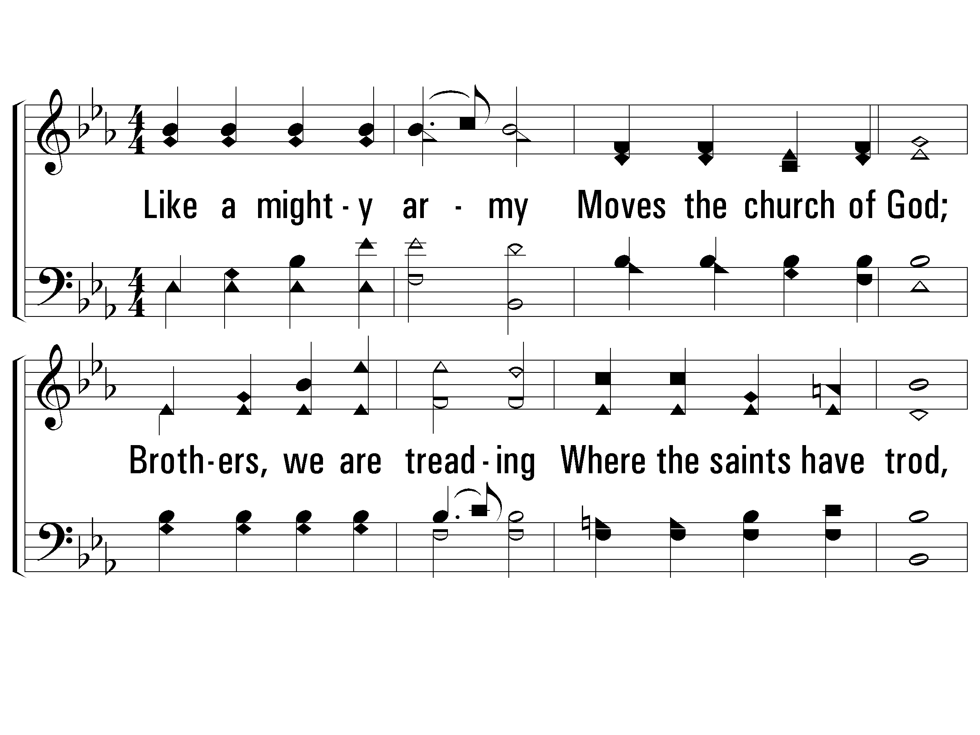
3 - Onward, Christian Soldiers
522
3.
Crowns and thrones may perish,
Kingdoms rise and wane,
But the church of Jesus
Constant will remain;
Gates of hell can never
Against that church prevail;
We have Christ's own promise,
And that cannot fail.
Words by: Sabine Baring-Gould
Music by: Arthur Sullivan
© 2001 The Paperless Hymnal™

Slide 8
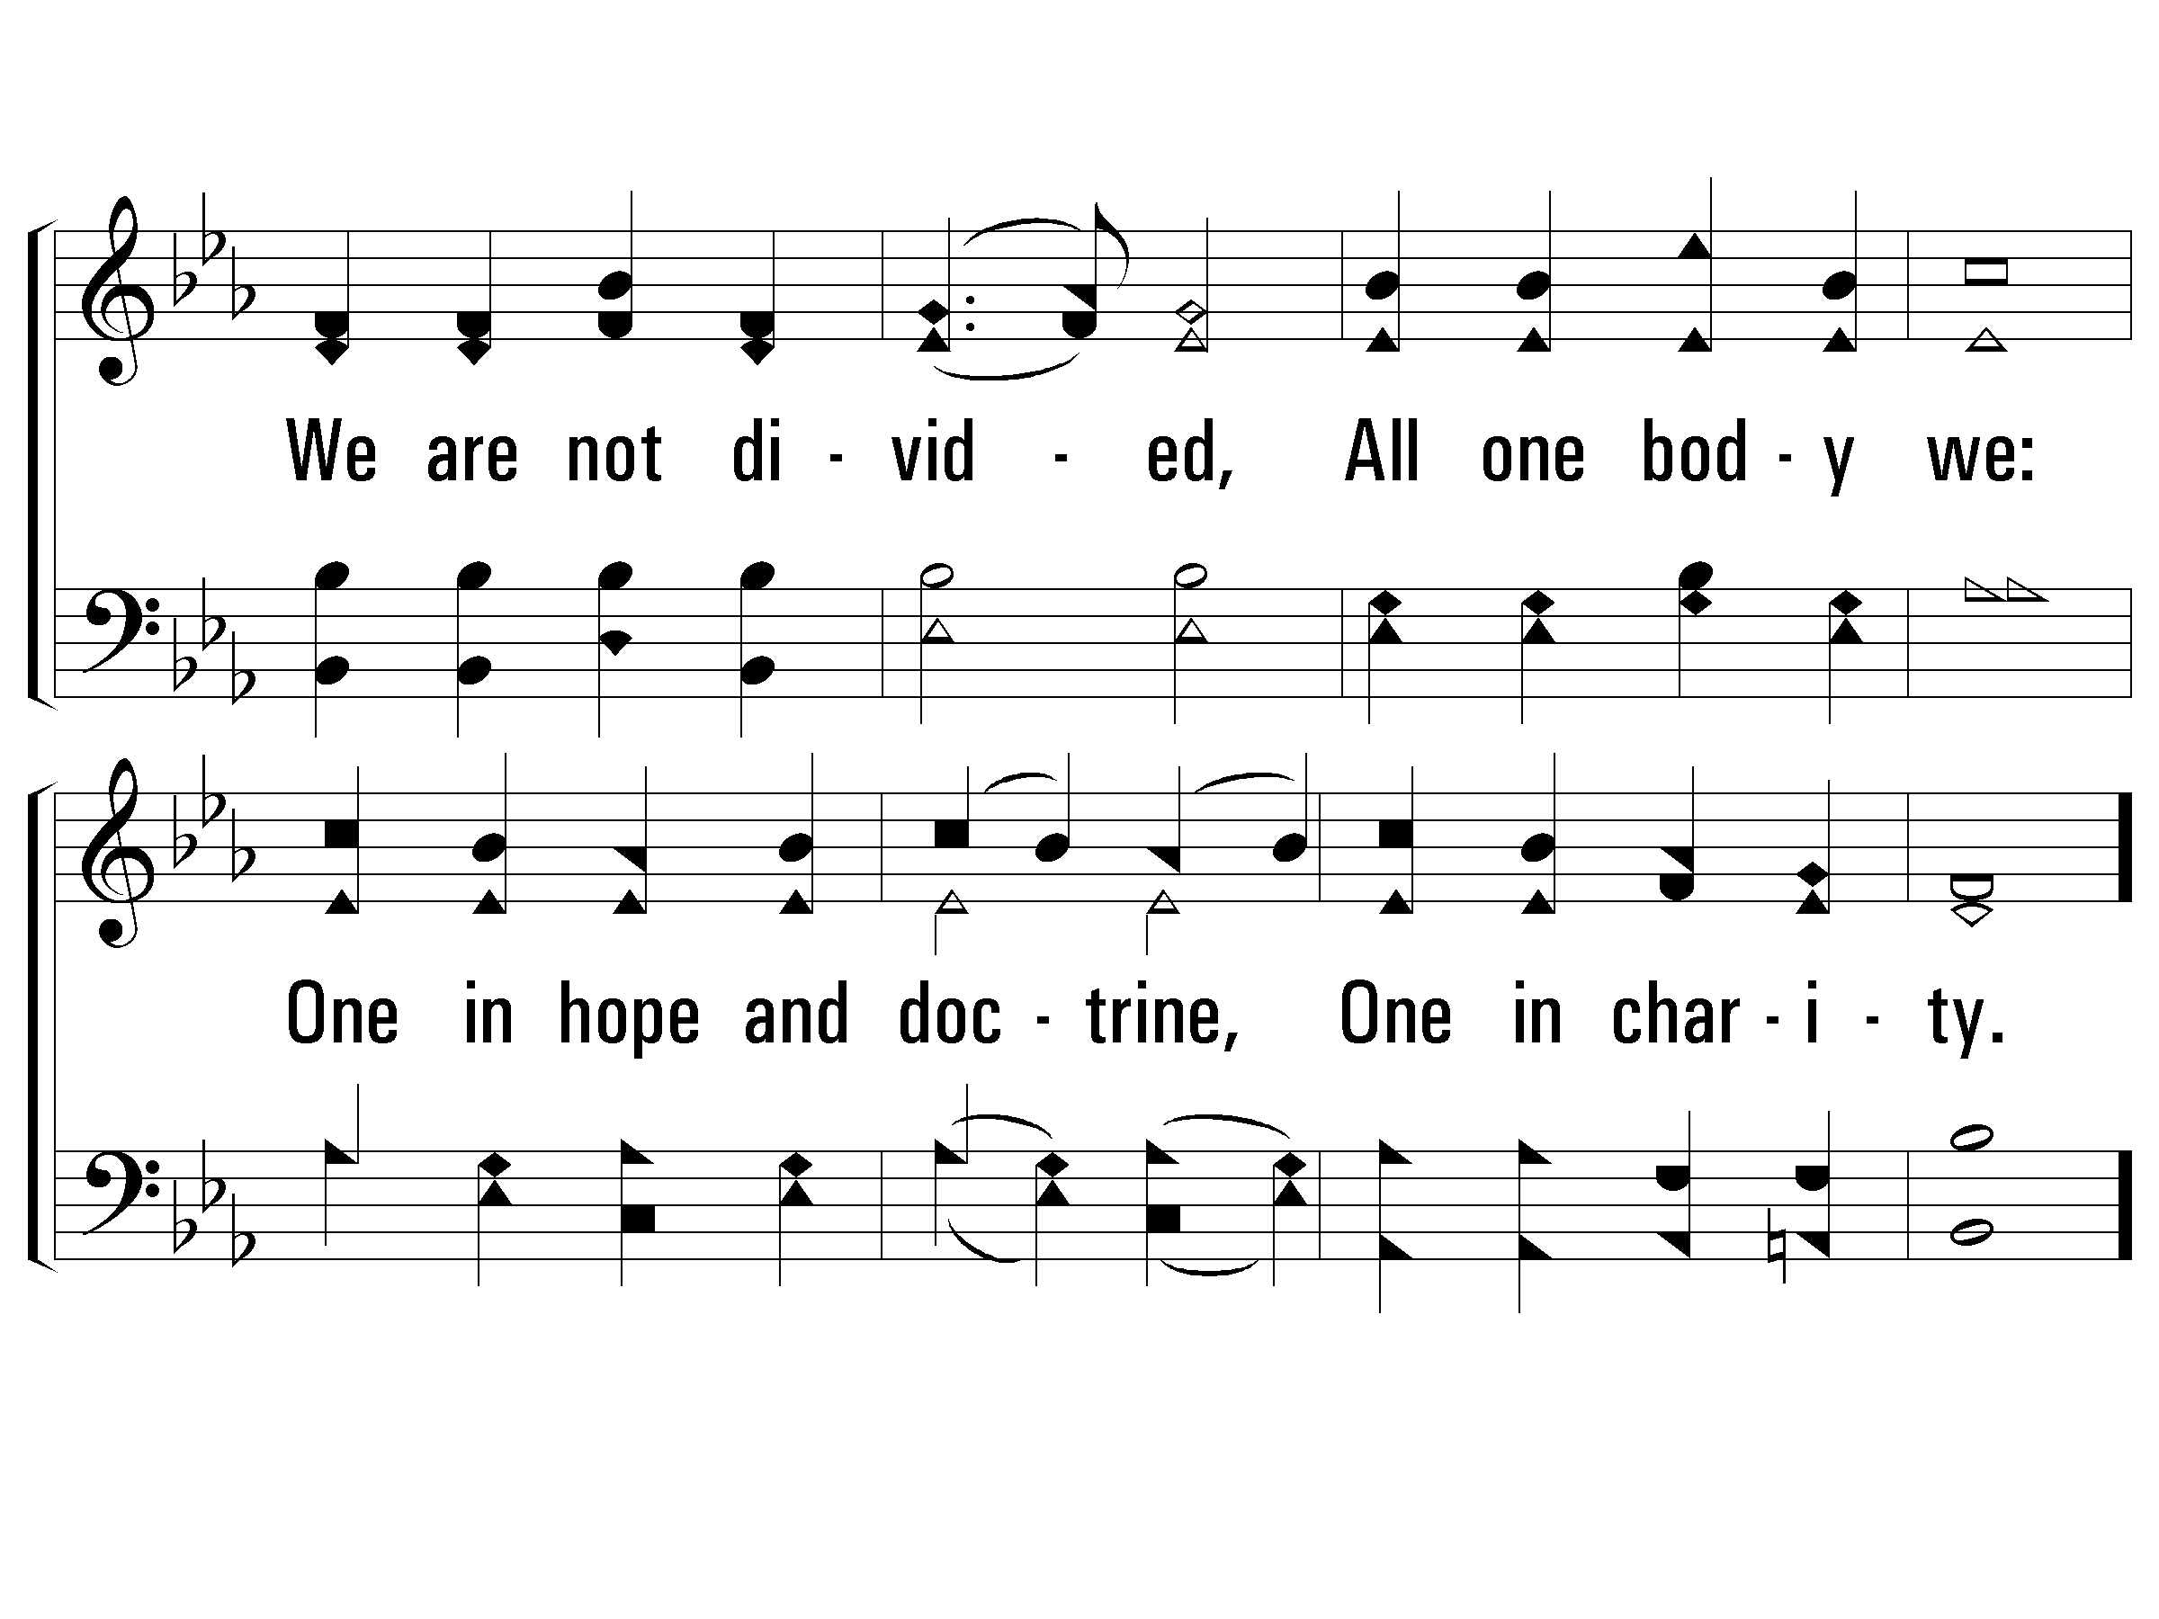
3 - Onward, Christian Soldiers
522
© 2001 The Paperless Hymnal™

Slide 9
c - Onward, Christian Soldiers
522
Onward, Christian soldiers!
Marching as to war,
With the cross of Jesus
Going on before.
© 2001 The Paperless Hymnal™

Slide 10
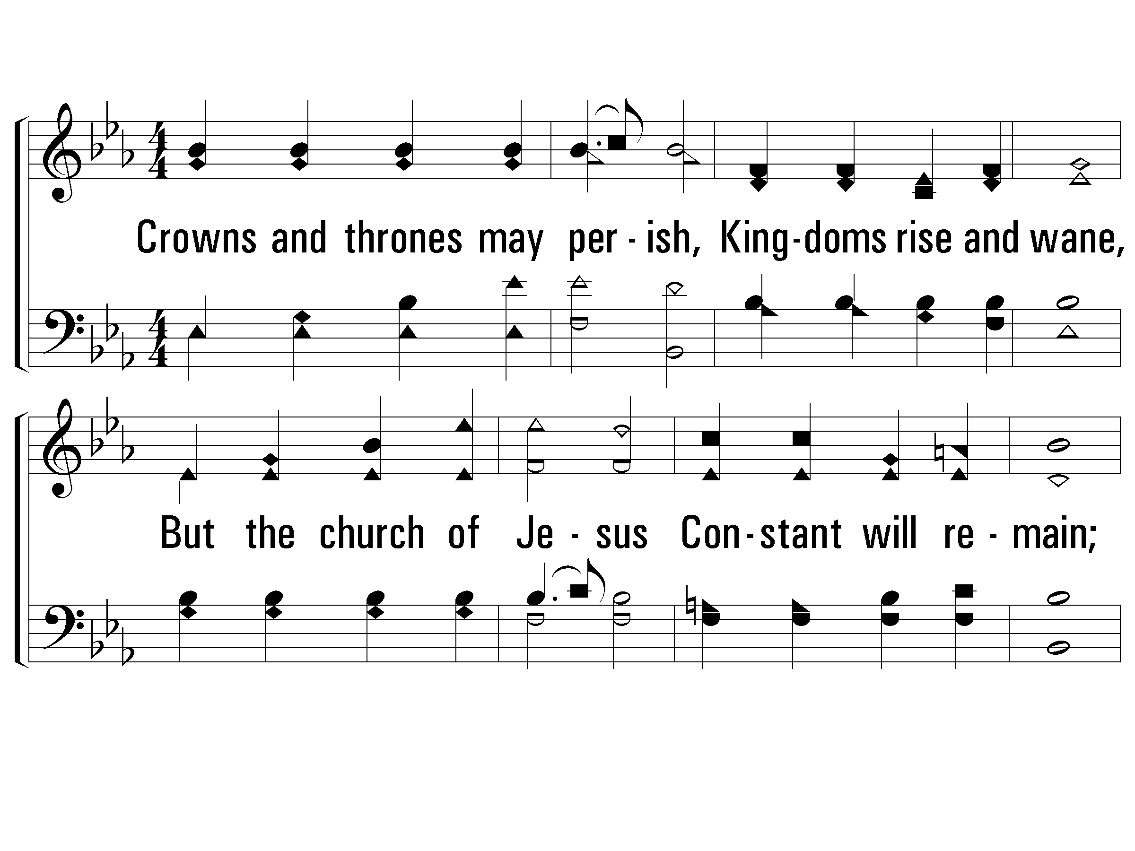
4 - Onward, Christian Soldiers
522
3.
Crowns and thrones may perish,
Kingdoms rise and wane,
But the church of Jesus
Constant will remain;
Gates of hell can never
Against that church prevail;
We have Christ's own promise,
And that cannot fail.
Words by: Sabine Baring-Gould
Music by: Arthur Sullivan
© 2001 The Paperless Hymnal™

Slide 11
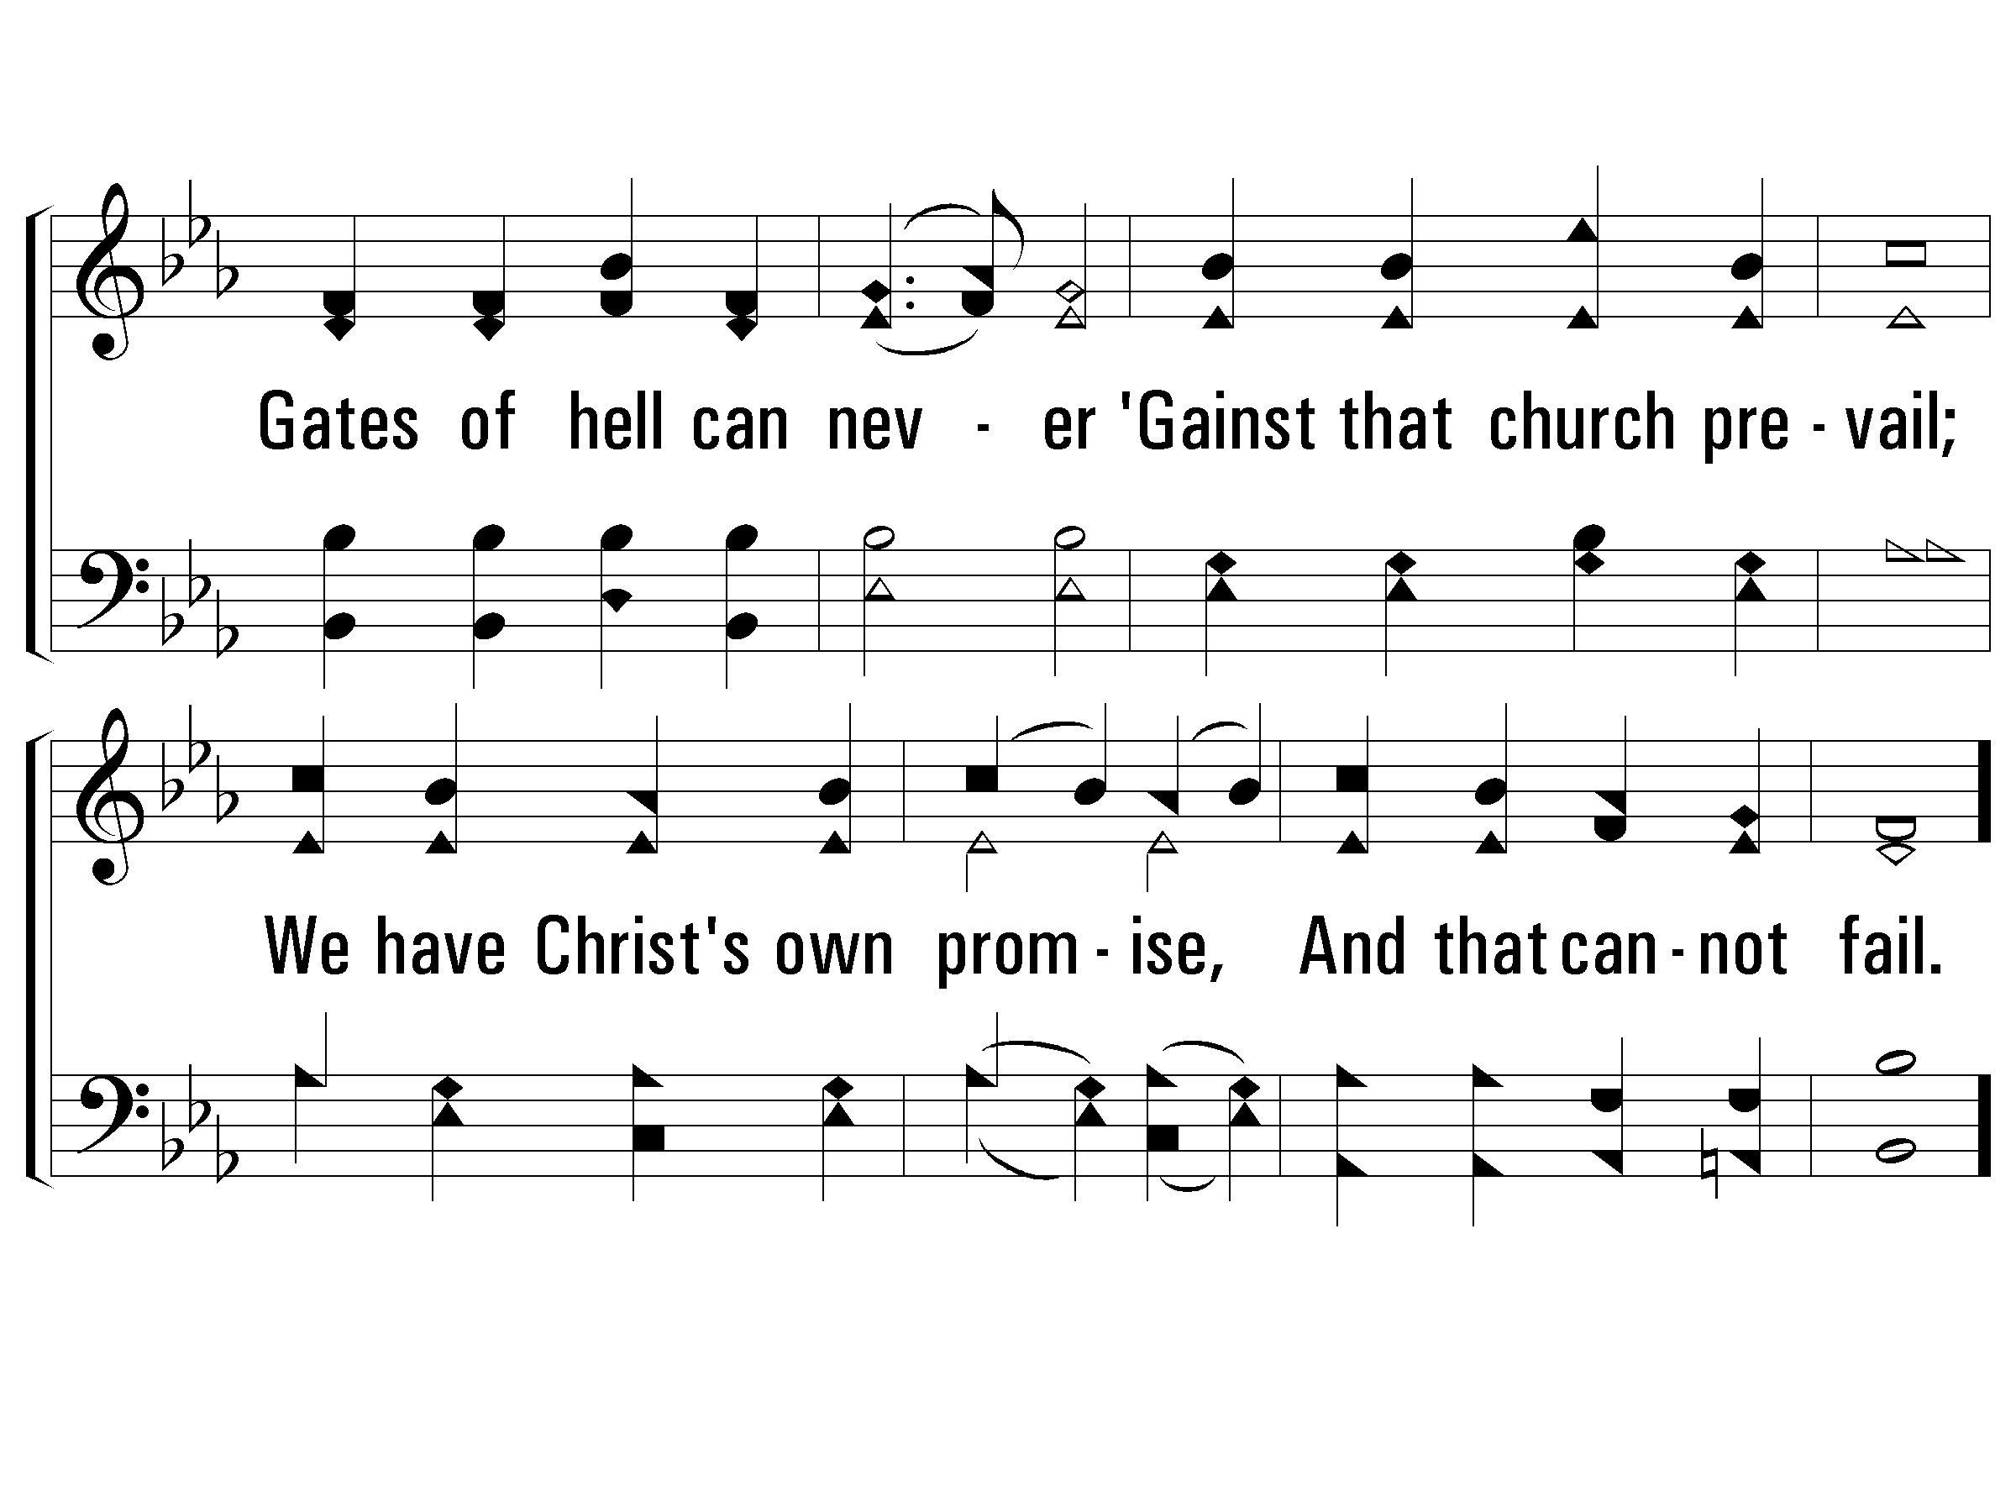
4 - Onward, Christian Soldiers
522
© 2001 The Paperless Hymnal™

Slide 12
c - Onward, Christian Soldiers
522
Onward, Christian soldiers!
Marching as to war,
With the cross of Jesus
Going on before.
© 2001 The Paperless Hymnal™

Slide 13
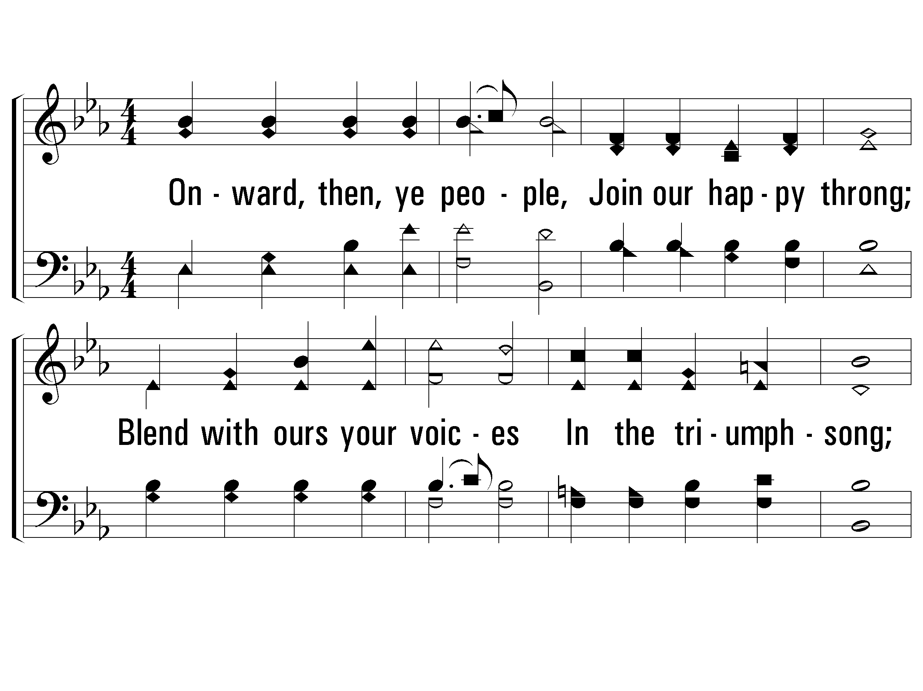
5 - Onward, Christian Soldiers
522
4.
Onward, then, ye people,
Join our happy throng;
Blend with ours your voices
In the triumph-song;
Glory, laud and honor
Unto Christ the King,
This thru countless ages
Men and angels sing.
Words by: Sabine Baring-Gould
Music by: Arthur Sullivan
© 2001 The Paperless Hymnal™

Slide 14
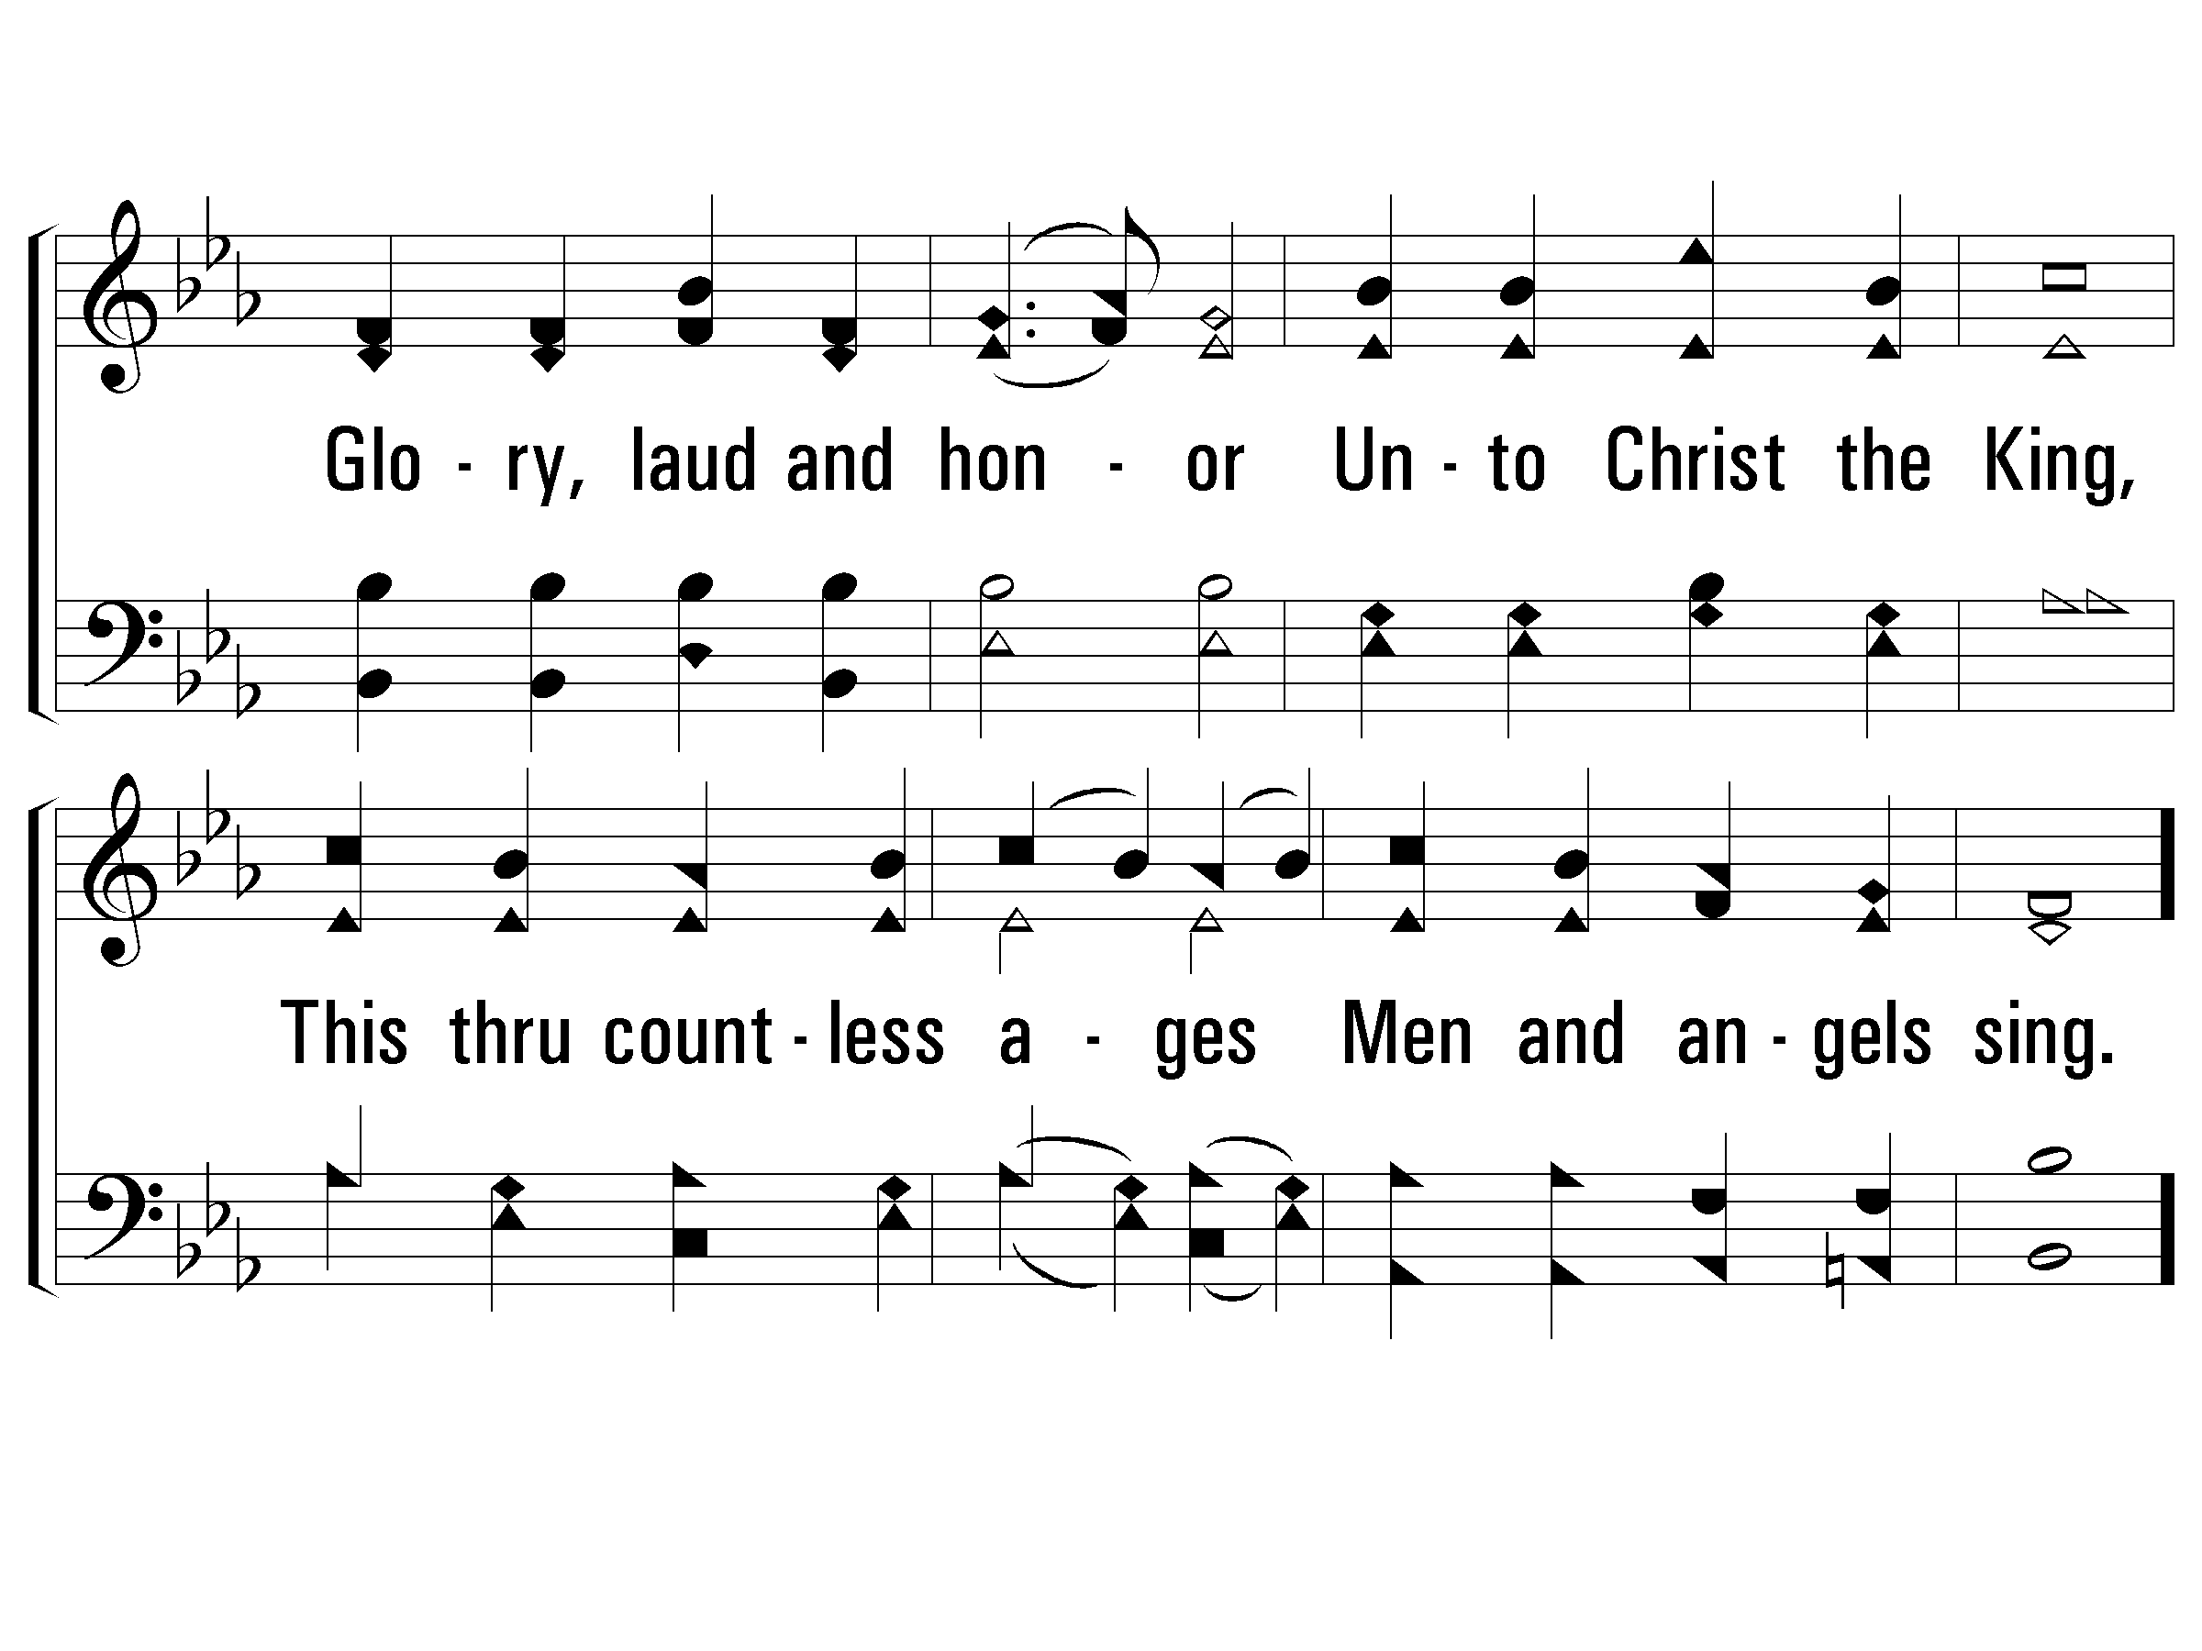
5 - Onward, Christian Soldiers
522
© 2001 The Paperless Hymnal™

Slide 15
c - Onward, Christian Soldiers
522
Onward, Christian soldiers!
Marching as to war,
With the cross of Jesus
Going on before.
© 2001 The Paperless Hymnal™

