Slide 1
Onward, Christian Soldiers
Words by: Sabine Baring-Gould
Music by: Arthur Sullivan

Slide 2
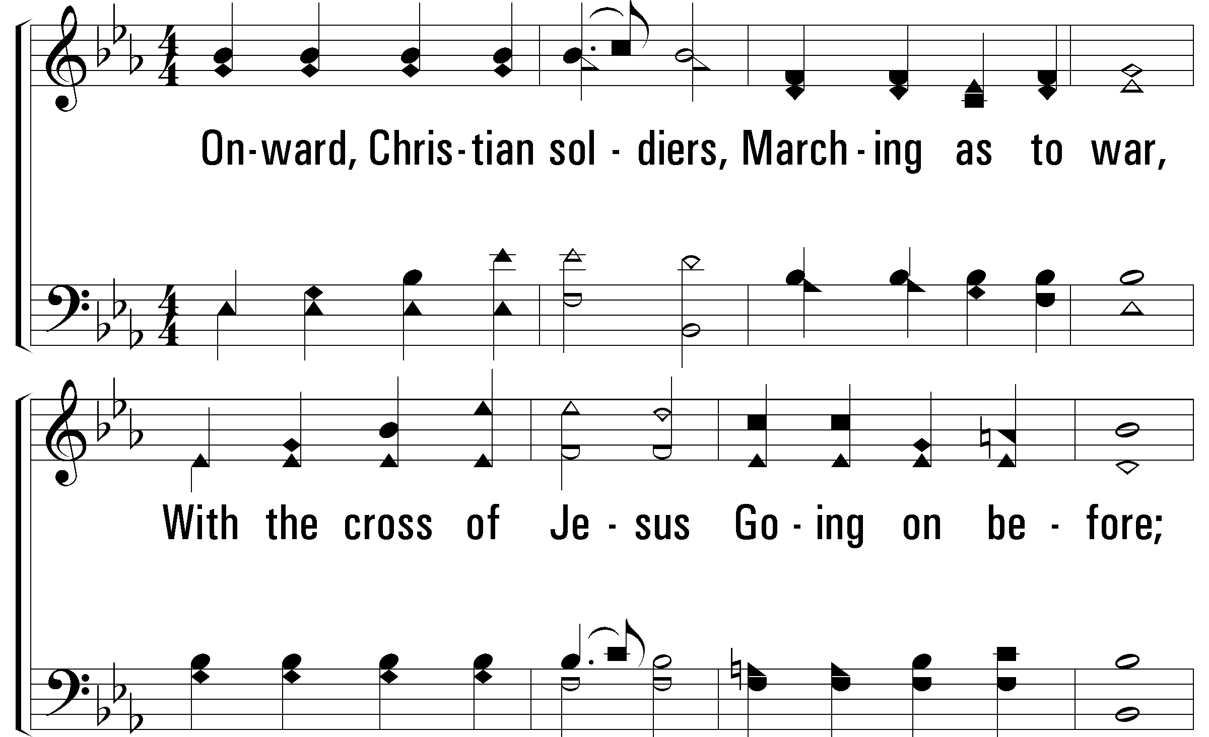
Notes:
2400x1800x522/pftl-522-001.png

Slide 3
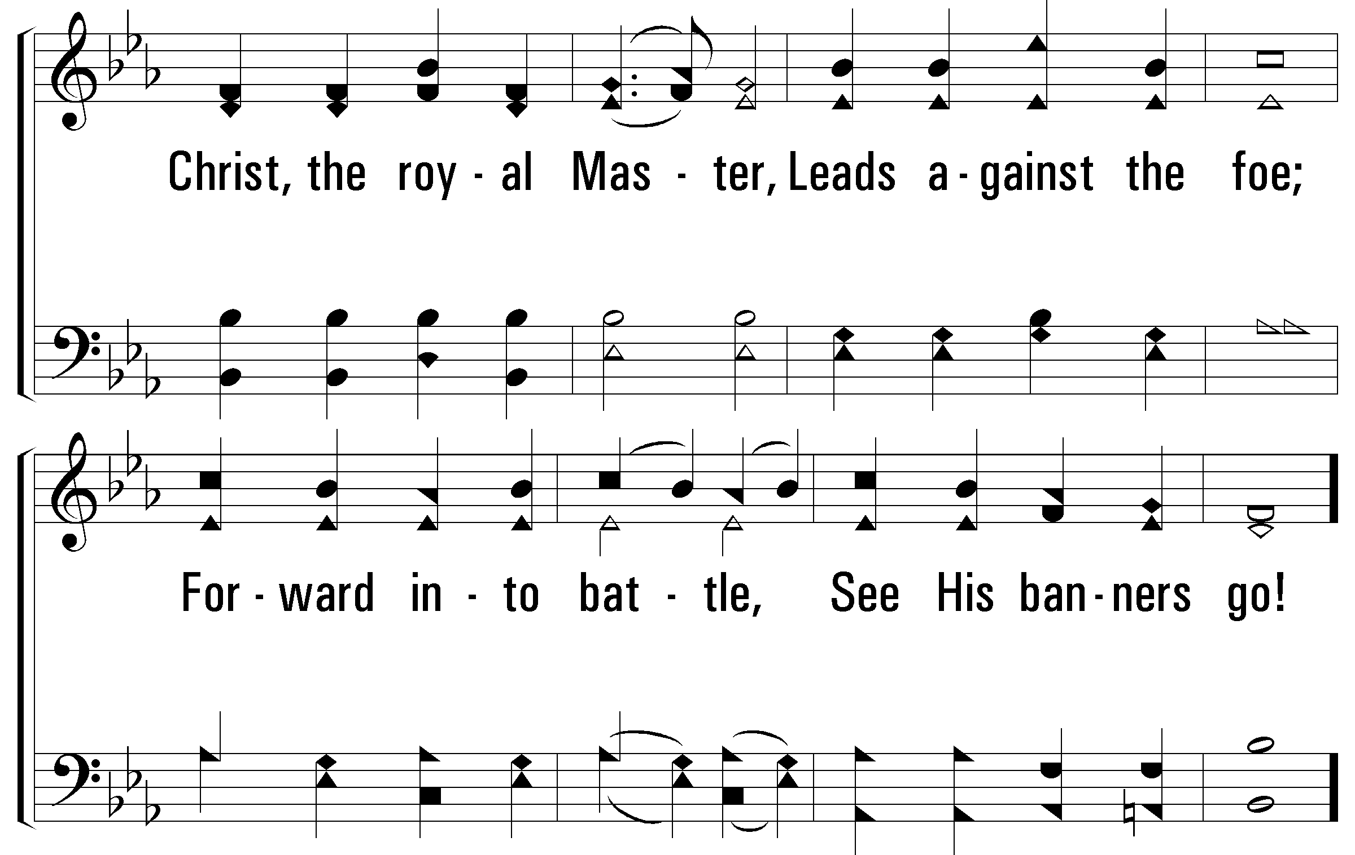
Notes:
2400x1800x522/pftl-522-002.png

Slide 4
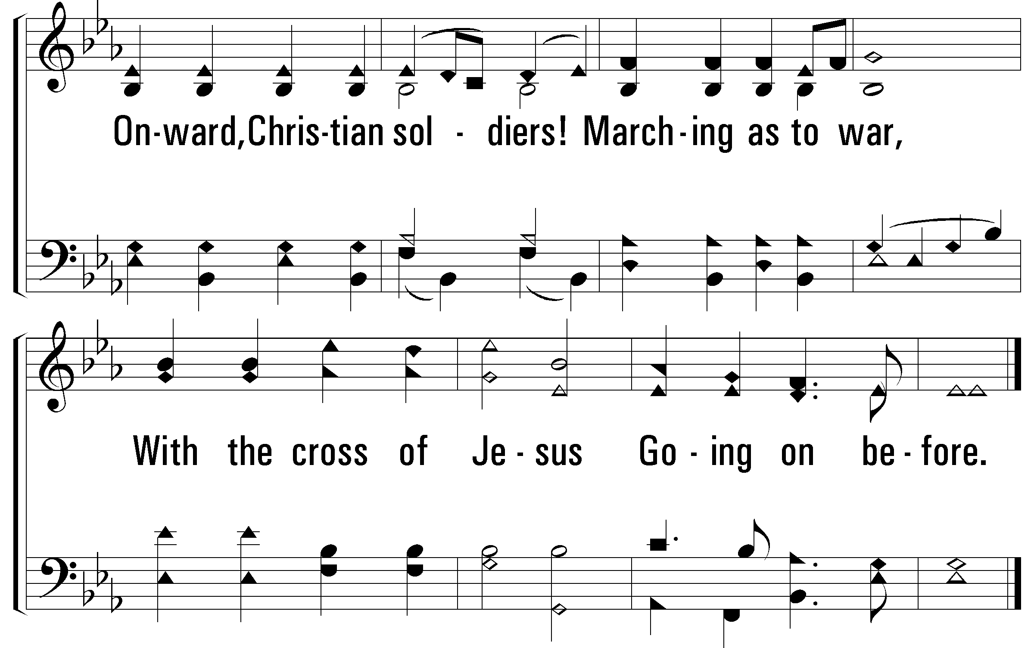
Notes:
2400x1800x522/pftl-522-003.png

Slide 5
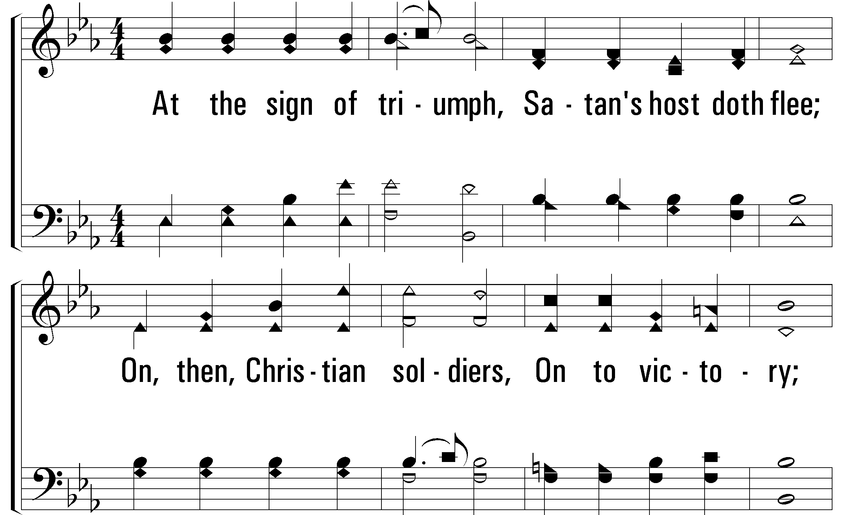
Notes:
2400x1800x522/pftl-522-004.png

Slide 6
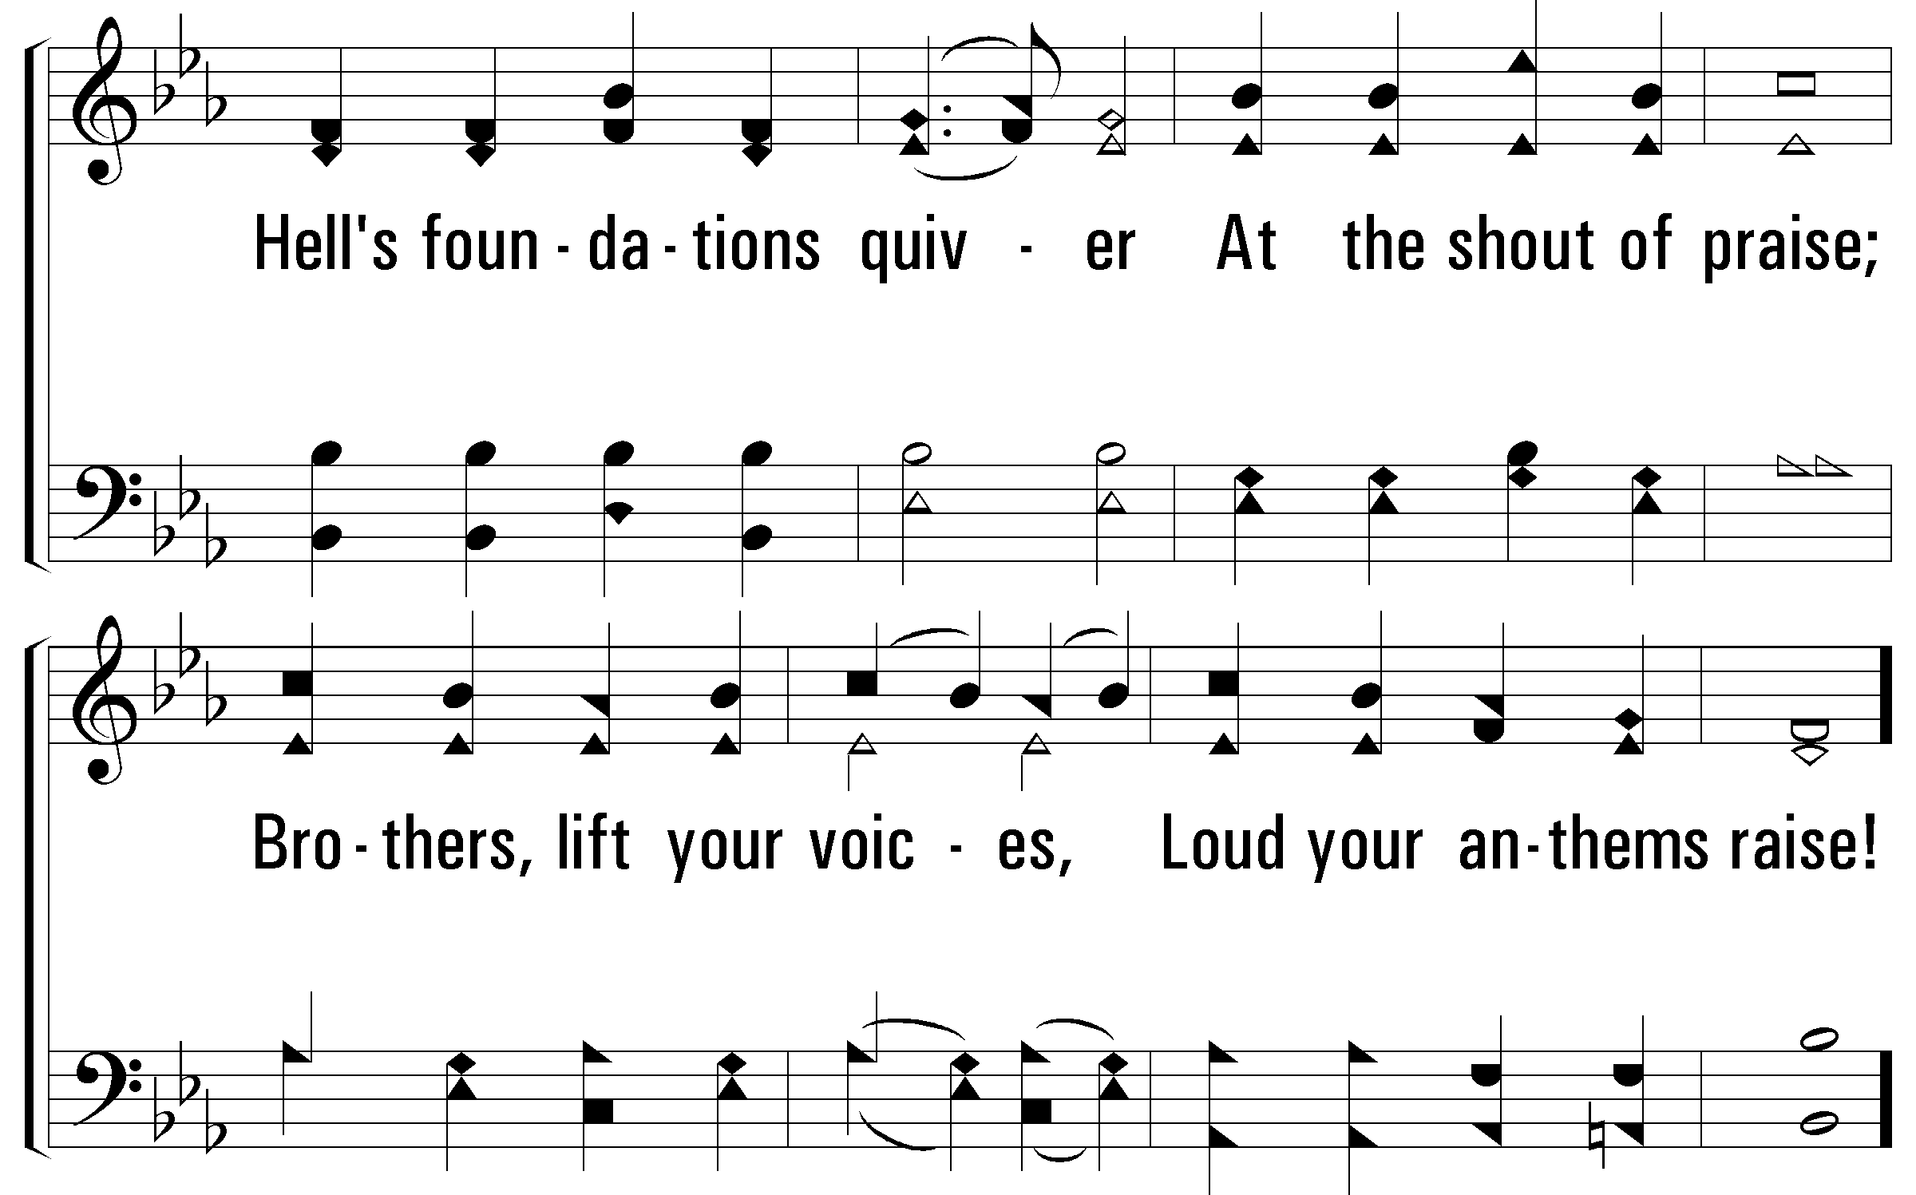
Notes:
2400x1800x522/pftl-522-005.png

Slide 7
Notes:
2400x1800x522/pftl-522-006.png

Slide 8
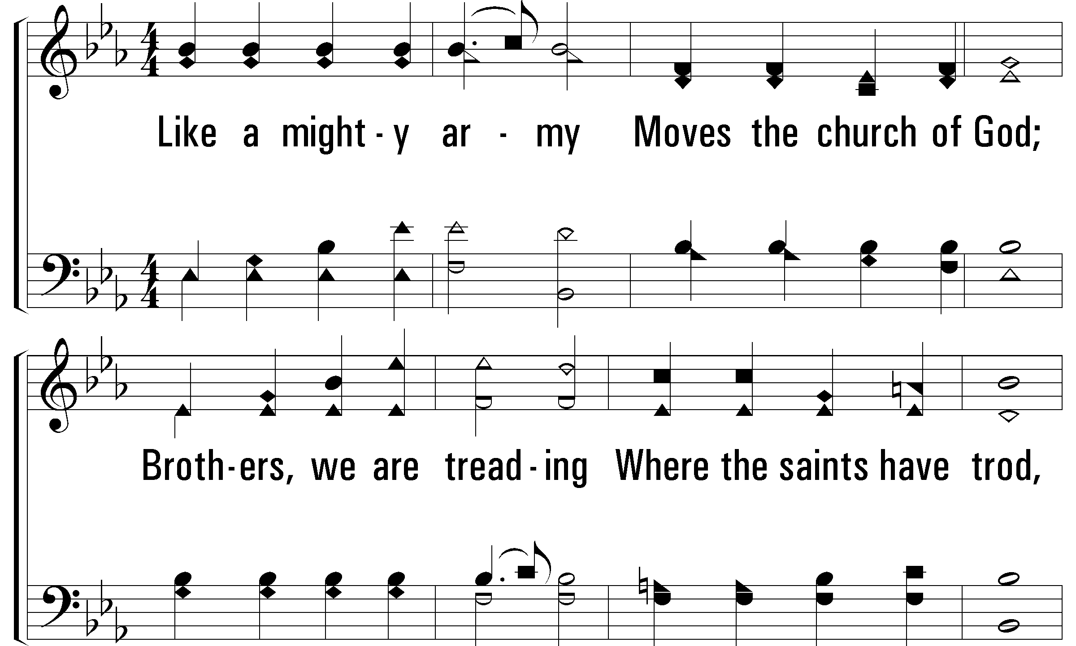
Notes:
2400x1800x522/pftl-522-007.png

Slide 9
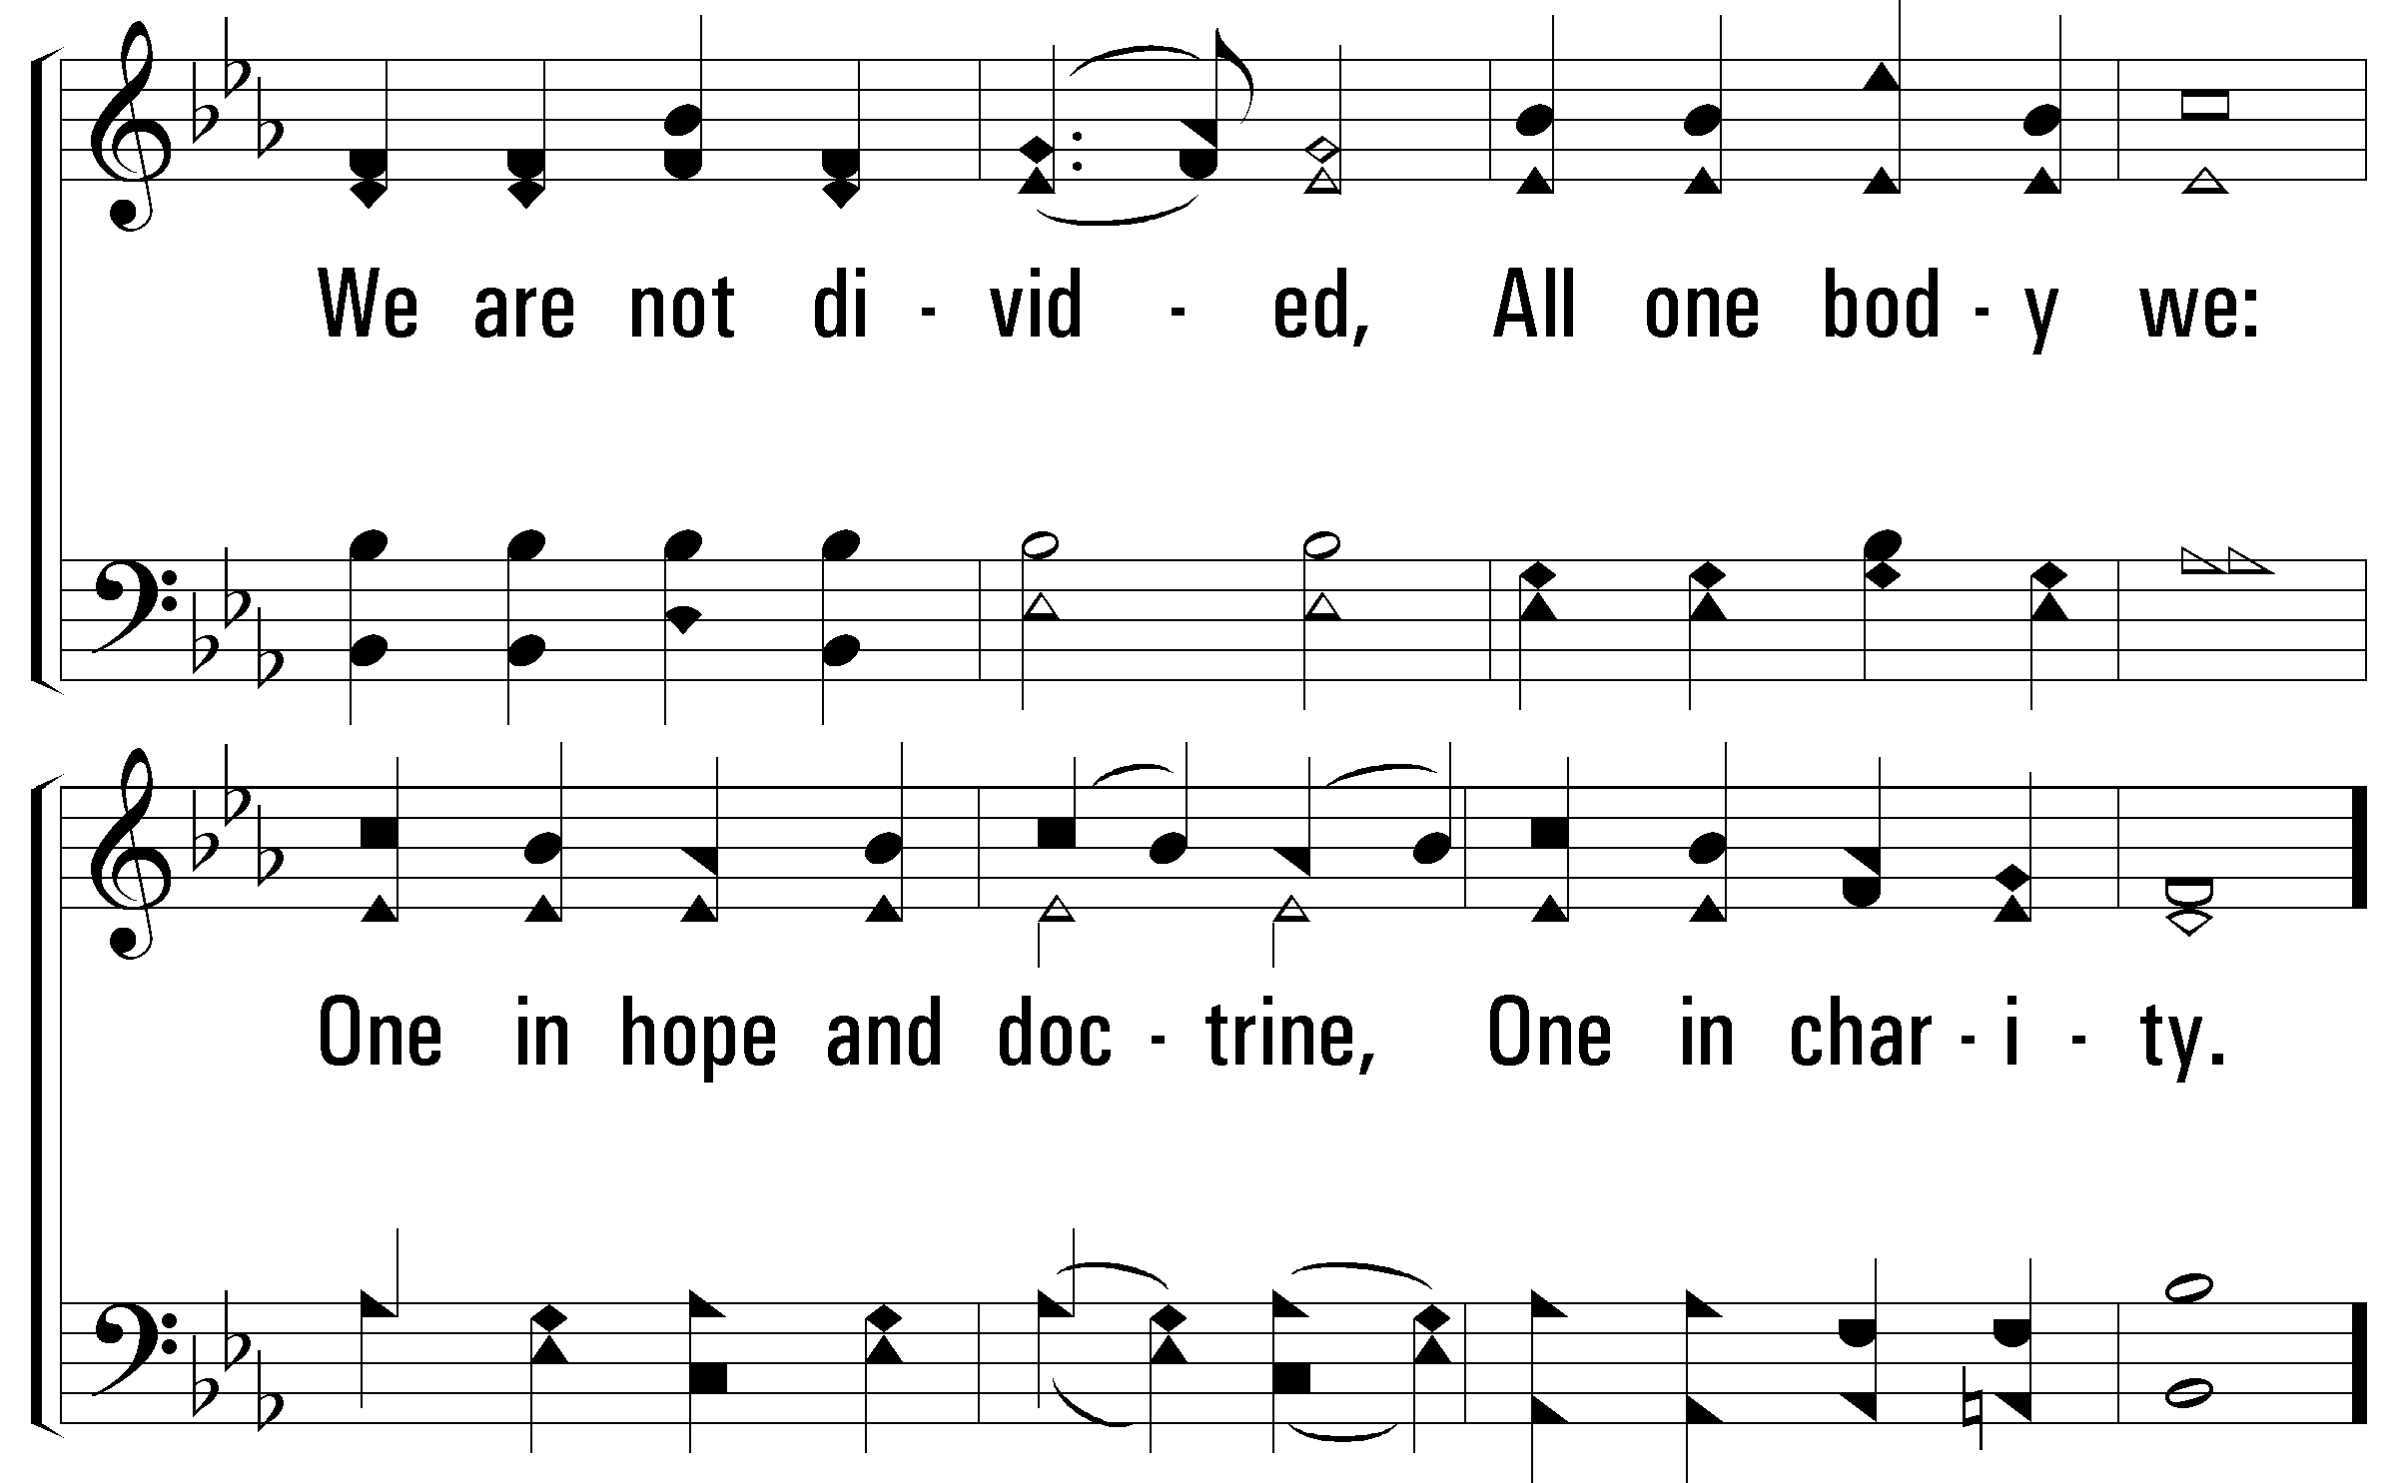
Notes:
2400x1800x522/pftl-522-008.png

Slide 10
Notes:
2400x1800x522/pftl-522-009.png

Slide 11
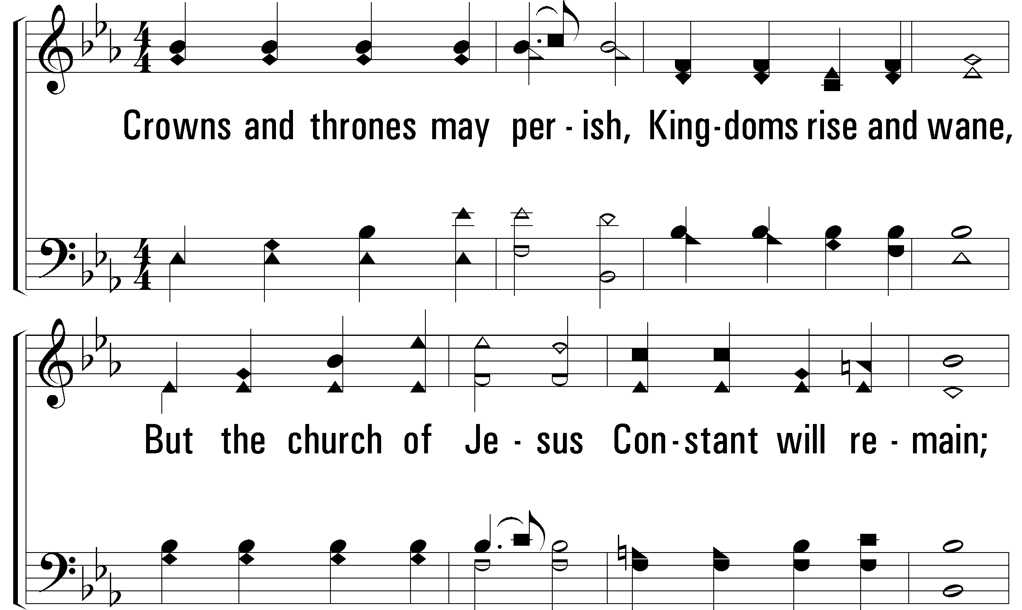
Notes:
2400x1800x522/pftl-522-010.png

Slide 12
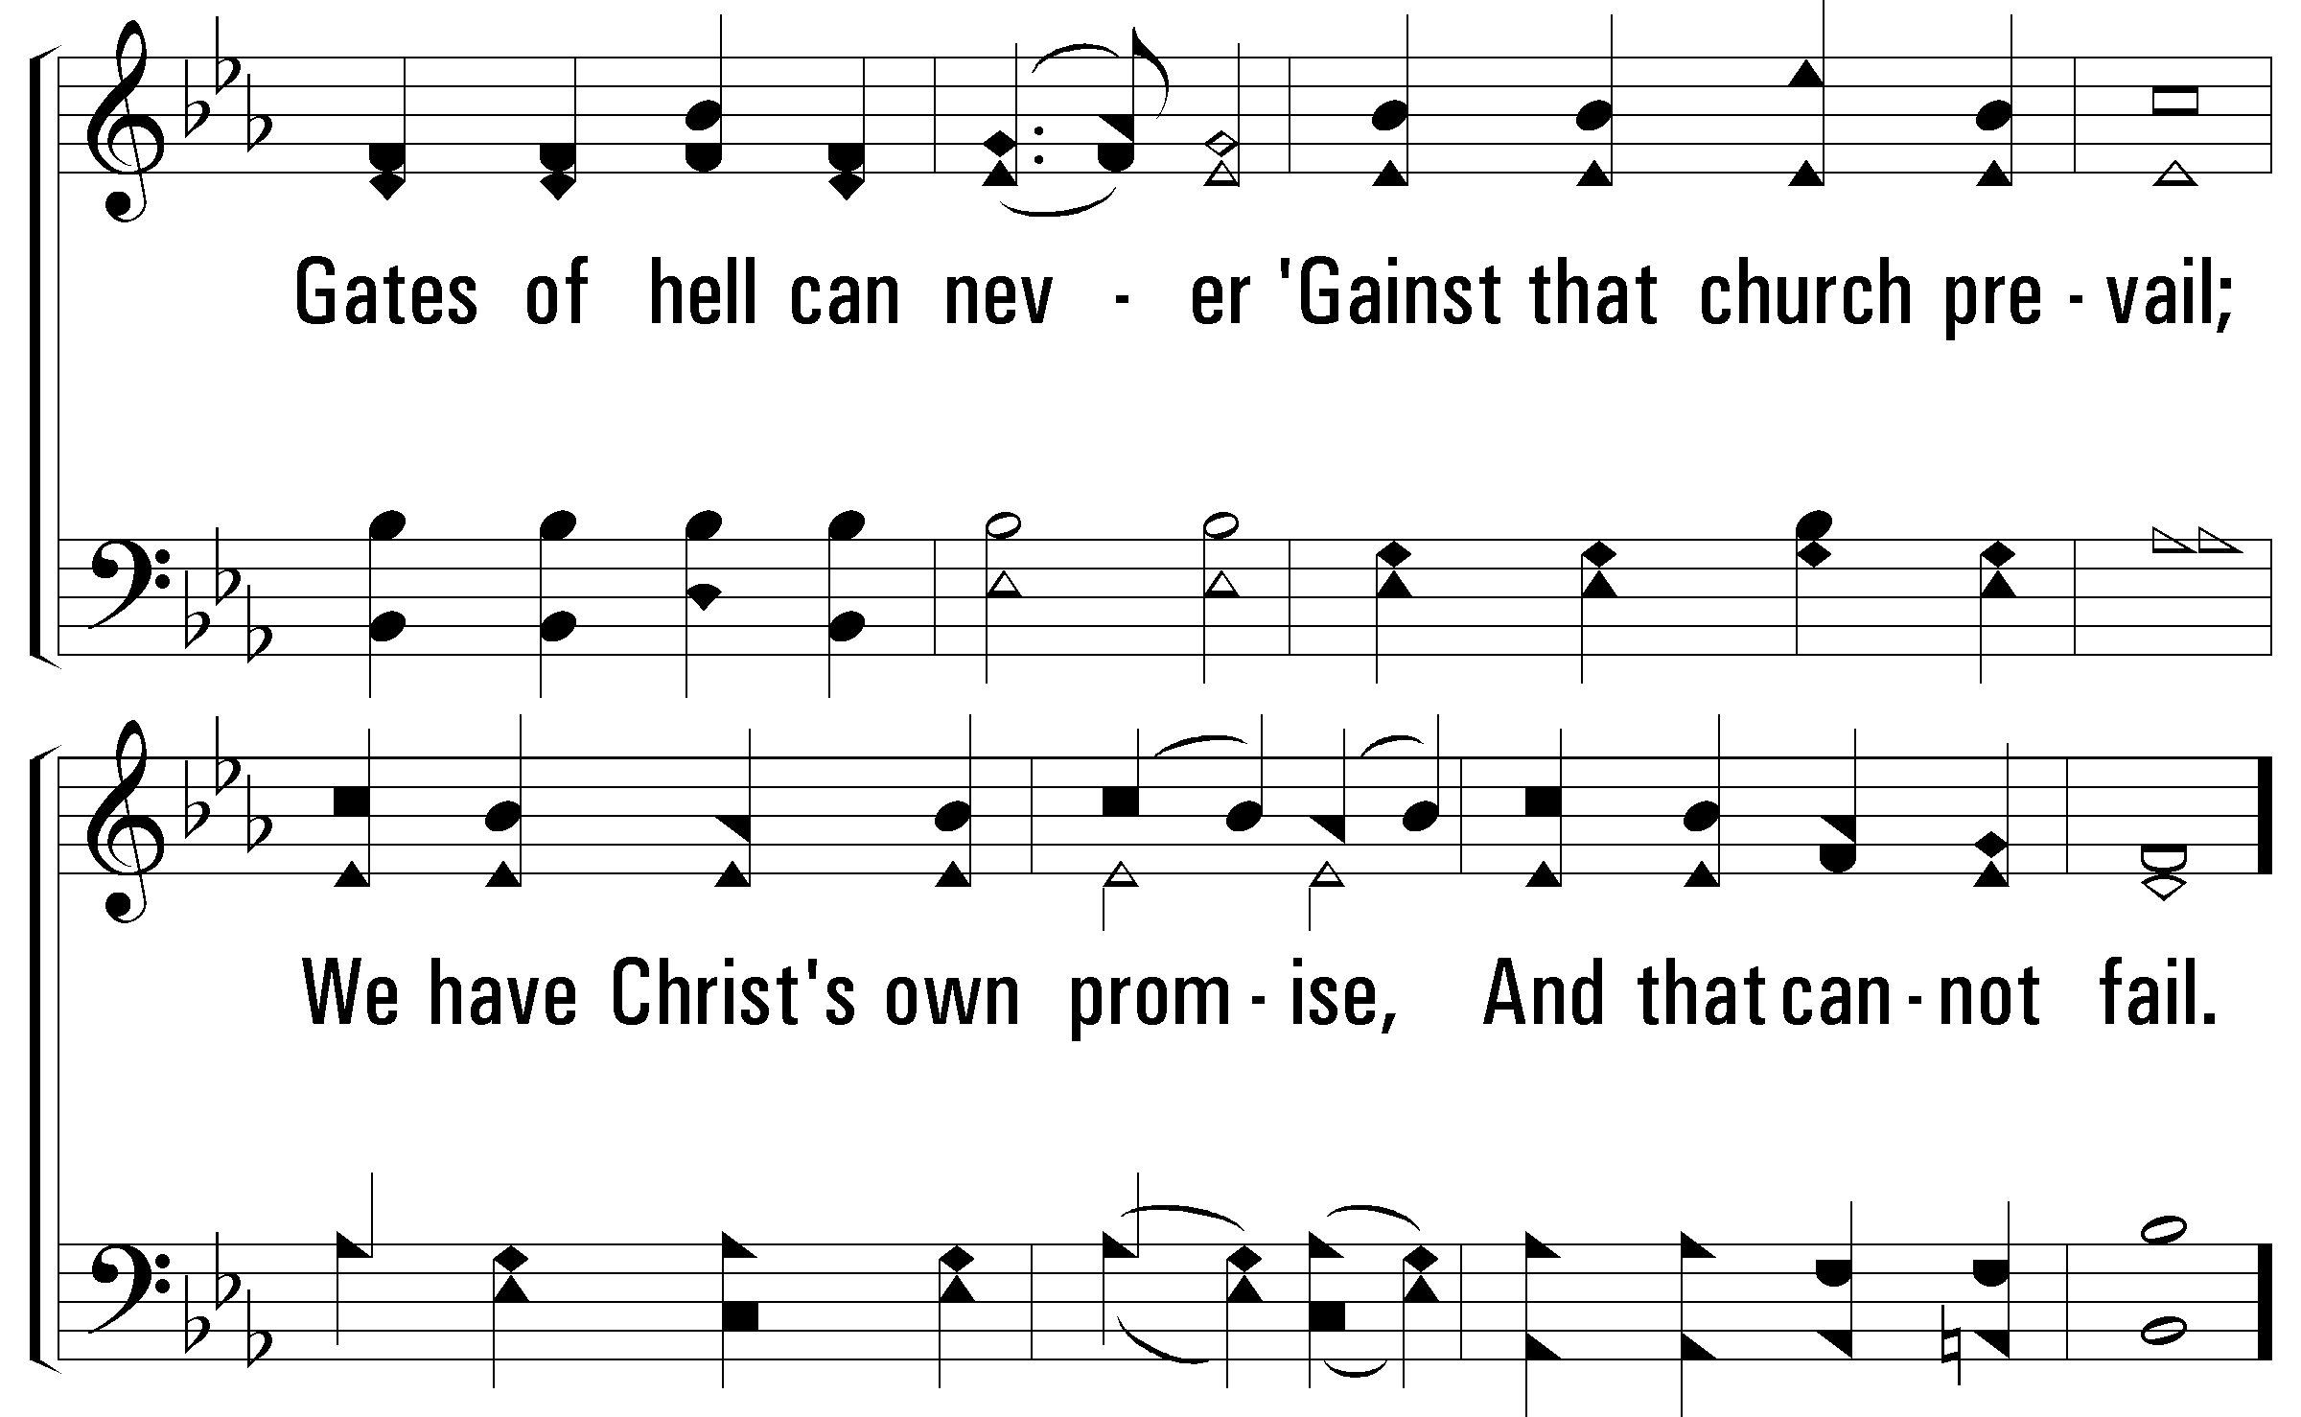
Notes:
2400x1800x522/pftl-522-011.png

Slide 13
Notes:
2400x1800x522/pftl-522-012.png

Slide 14
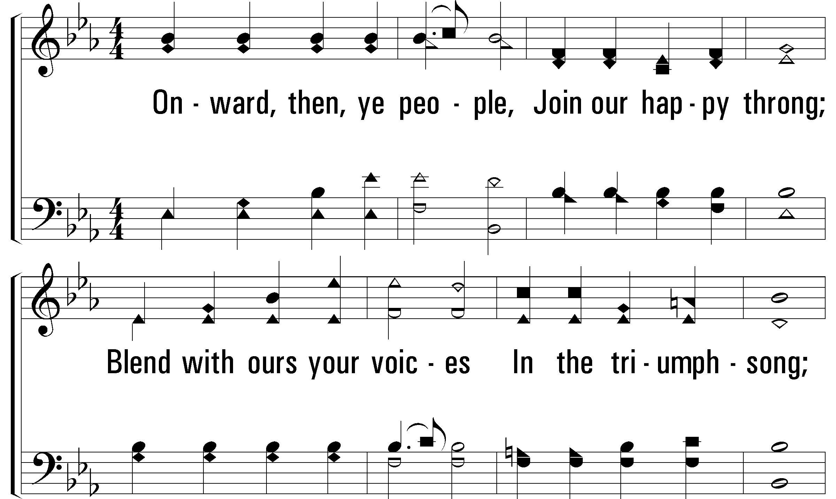
Notes:
2400x1800x522/pftl-522-013.png

Slide 15
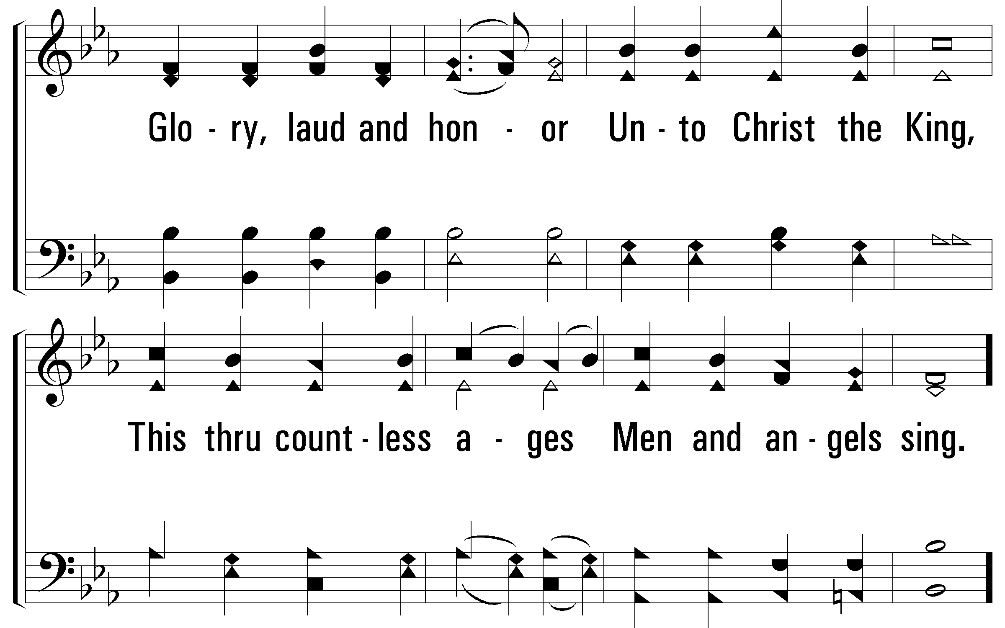
Notes:
2400x1800x522/pftl-522-014.png

Slide 16
Notes:
2400x1800x522/pftl-522-015.png

