Slide 1




Bienvenida
Ofrenda
Lectura
Oración
534
12
Cena del Señor
408
202
Sermón
67
Oración
Welcome
Collection
Reading
Prayer
534
12
Lord’s Supper
408
202
Sermon
67
Prayer
Alex Cruttenden
Matt LaGrone
Phillip Shumake
Announcements
John 17:1-10
Praise to the Lord, The Almighty
Alas! And Did My Savior Bleed
Hebrews 9:24-28
Low in the Grave He Lay
Goodness of God
Life-Giving Generosity
Bring Christ Your Broken Life
Bienvenida
Juan 17:1-10
Gloria al Señor, el Creador
En la cruz
Hebreos 9:24-28
La tumba le encerró
La bondad de Dios
Generosidad que da vida
Tu vida rota trae
Please silence your phone
Favor de apagar los celulares
19 de julio
domingo • 10:00am
July 19, 2026
Sunday • 10:00am
Notes:
Song Leader: Alex Cruttenden

Slide 2

Bienvenida
Ofrenda
Lectura
Oración
534
12
Cena del Señor
408
202
Sermón
67
Oración
Welcome
Collection
Reading
Prayer
534
12
Lord’s Supper
408
202
Sermon
67
Prayer

Slide 3
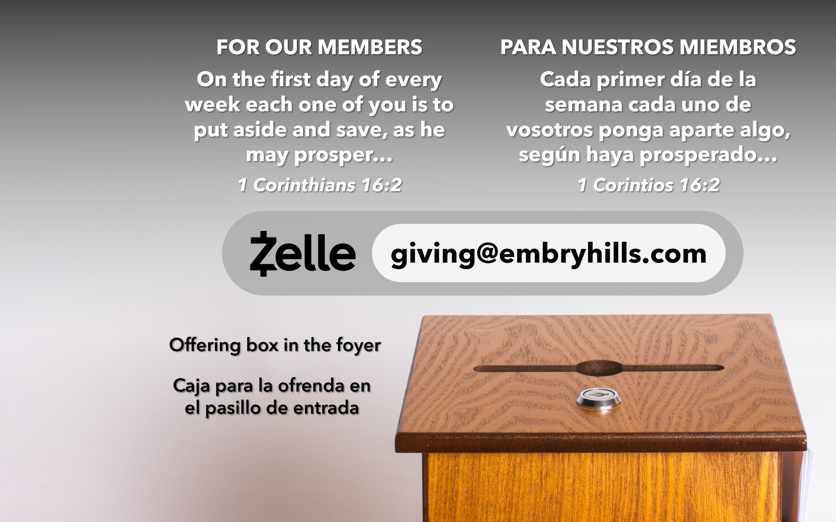
Bienvenida
Ofrenda
Lectura
Oración
534
12
Cena del Señor
408
202
Sermón
67
Oración
Welcome
Collection
Reading
Prayer
534
12
Lord’s Supper
408
202
Sermon
67
Prayer

Slide 4

Bienvenida
Ofrenda
Lectura
Oración
534
12
Cena del Señor
408
202
Sermón
67
Oración
Welcome
Collection
Reading
Prayer
534
12
Lord’s Supper
408
202
Sermon
67
Prayer
LECTURA
READING
JOHN 17:1-10
JUAN 17:1-10
“HAVE THIS LETTER READ TO ALL”
“QUE ESTA CARTA SE LEA A TODOS”
1 THESSALONIANS 5:27
1 TESALONICENSES 5:27

Slide 5

Bienvenida
Ofrenda
Lectura
Oración
534
12
Cena del Señor
408
202
Sermón
67
Oración
Welcome
Collection
Reading
Prayer
534
12
Lord’s Supper
408
202
Sermon
67
Prayer
ORACIÓN
PRAYER
“DEVOTE YOURSELVES TO PRAYER”
“PERSEVERAD EN LA ORACIÓN”
COLOSSIANS 4:2
COLOSENSES 4:2

Slide 6
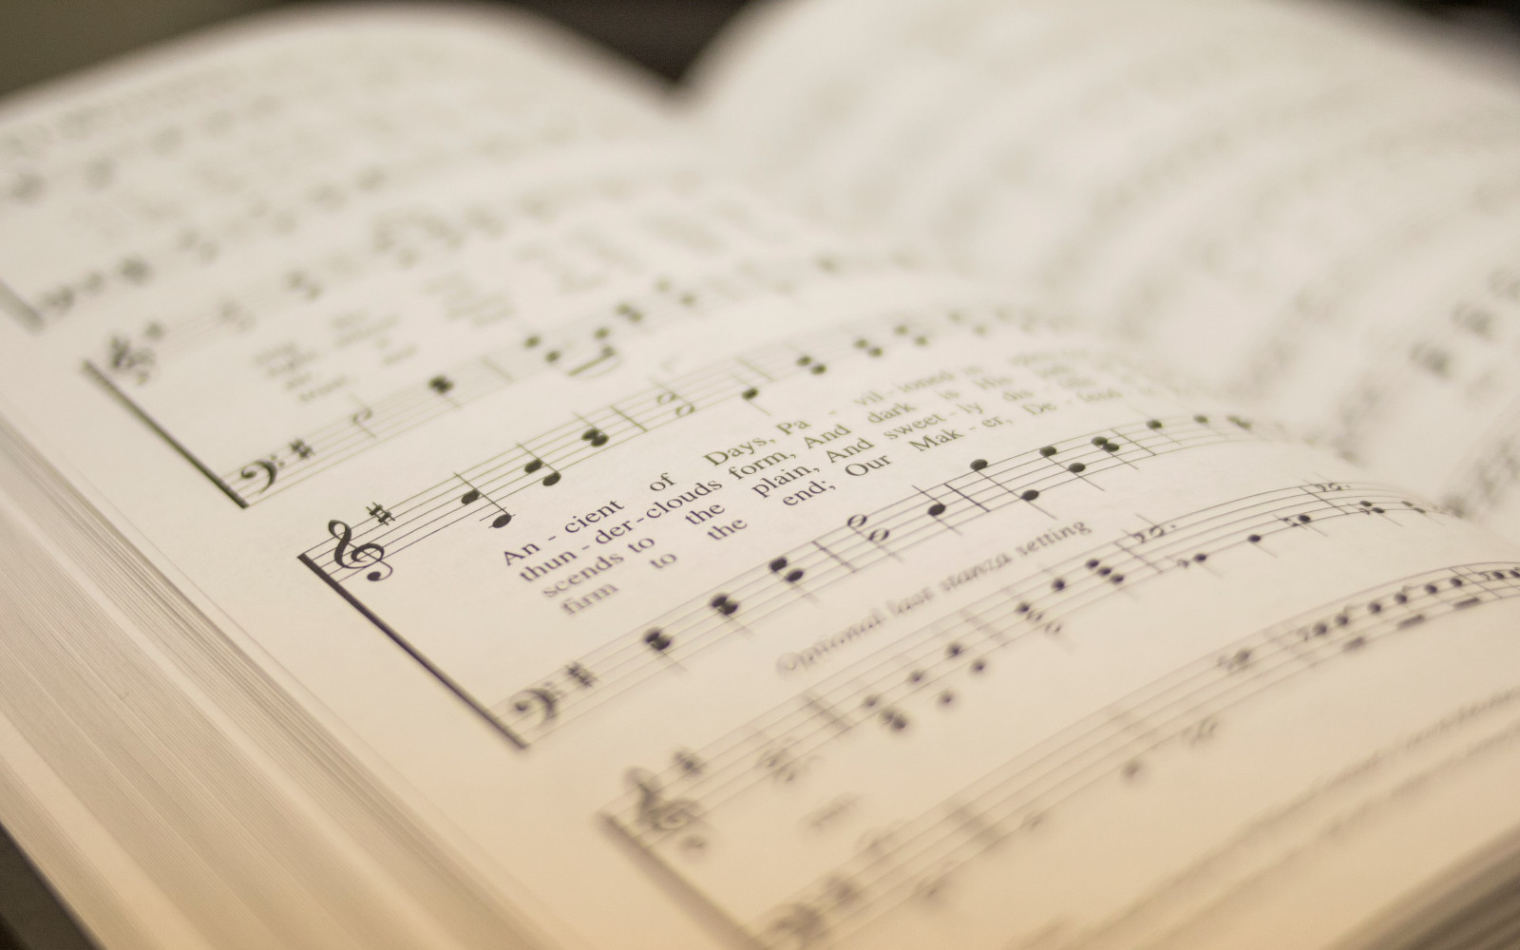
Bienvenida
Ofrenda
Lectura
Oración
534
12
Cena del Señor
408
202
Sermón
67
Oración
Welcome
Collection
Reading
Prayer
534
12
Lord’s Supper
408
202
Sermon
67
Prayer
534
534
GLORIA AL SEÑOR, EL CREADOR
PRAISE TO THE LORD, THE ALMIGHTY
1
2
3
4
“CANTANDO...AL SEÑOR” COLOSENSES 3:16
“SINGING...TO THE LORD” COLOSSIANS 3:16
Words: Joachin Neander / tr. Catherine Winkworth Music: Stralsund Gesangbuch / har. W. Sterndale Bennett
Letra: Joachin Neander / tr. Catherine Winkworth Música: Stralsund Gesangbuch / har. W. Sterndale Bennett

Slide 7
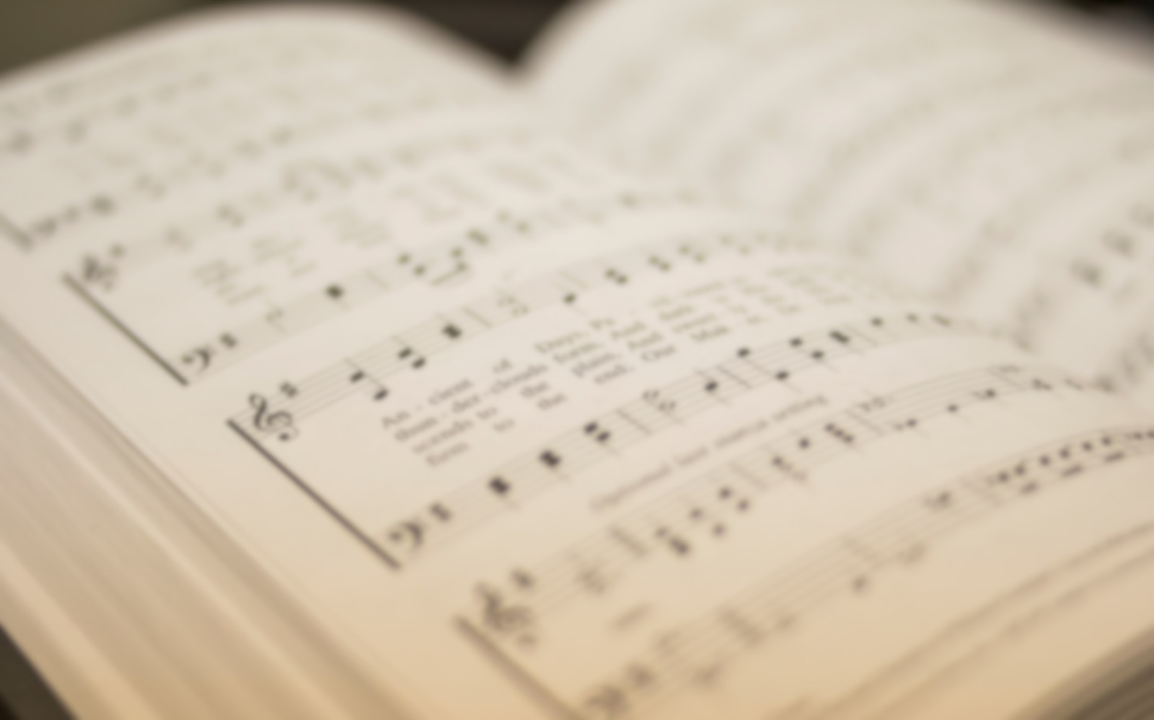
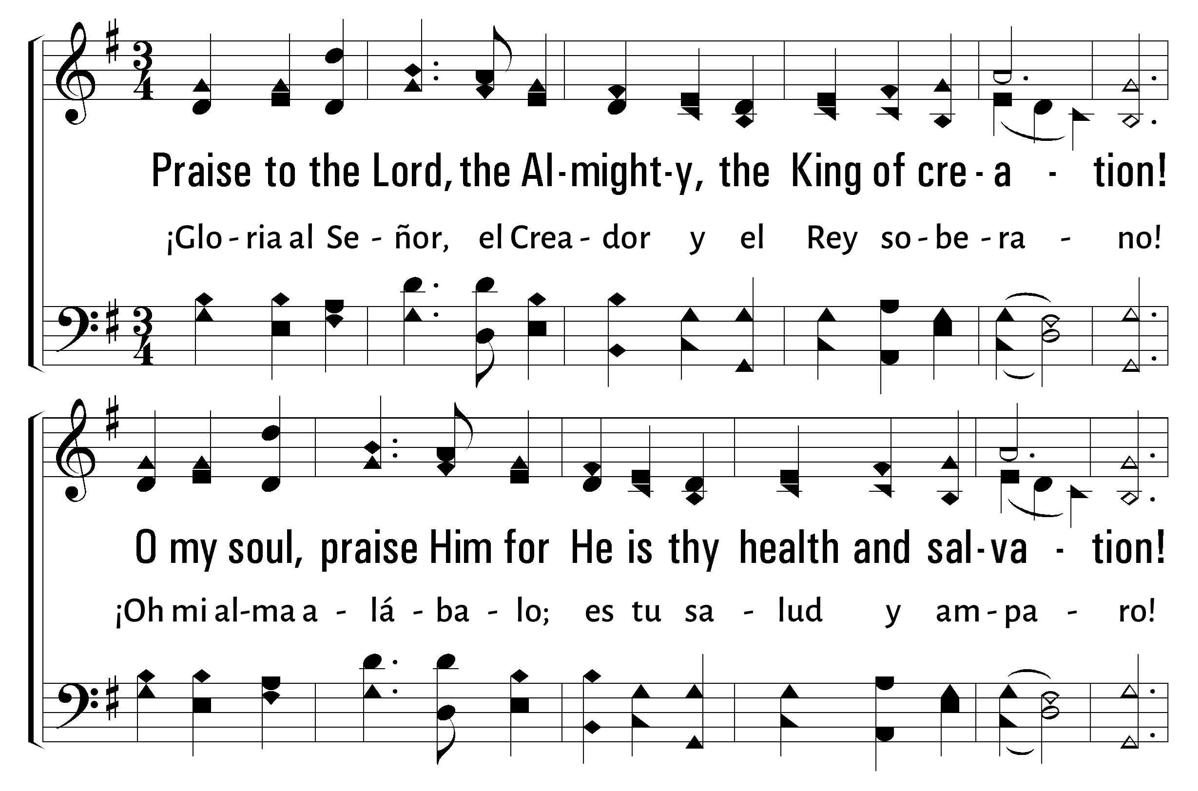


1
2
3
4
534
PRAISE TO THE LORD, THE ALMIGHTY • GLORIA AL SEÑOR, EL CREADOR
© 2003 The Paperless Hymnal™

Slide 8
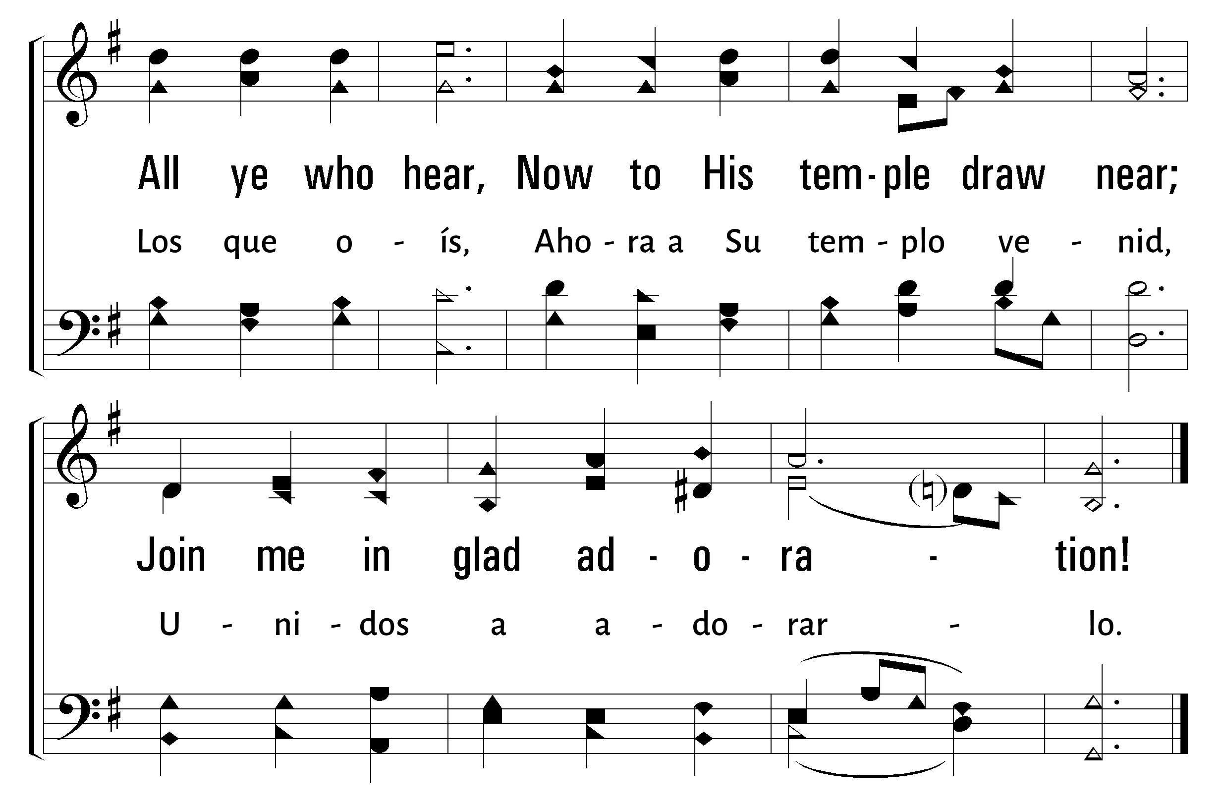
1
2
3
4
534
PRAISE TO THE LORD, THE ALMIGHTY • GLORIA AL SEÑOR, EL CREADOR
© 2003 The Paperless Hymnal™

Slide 9
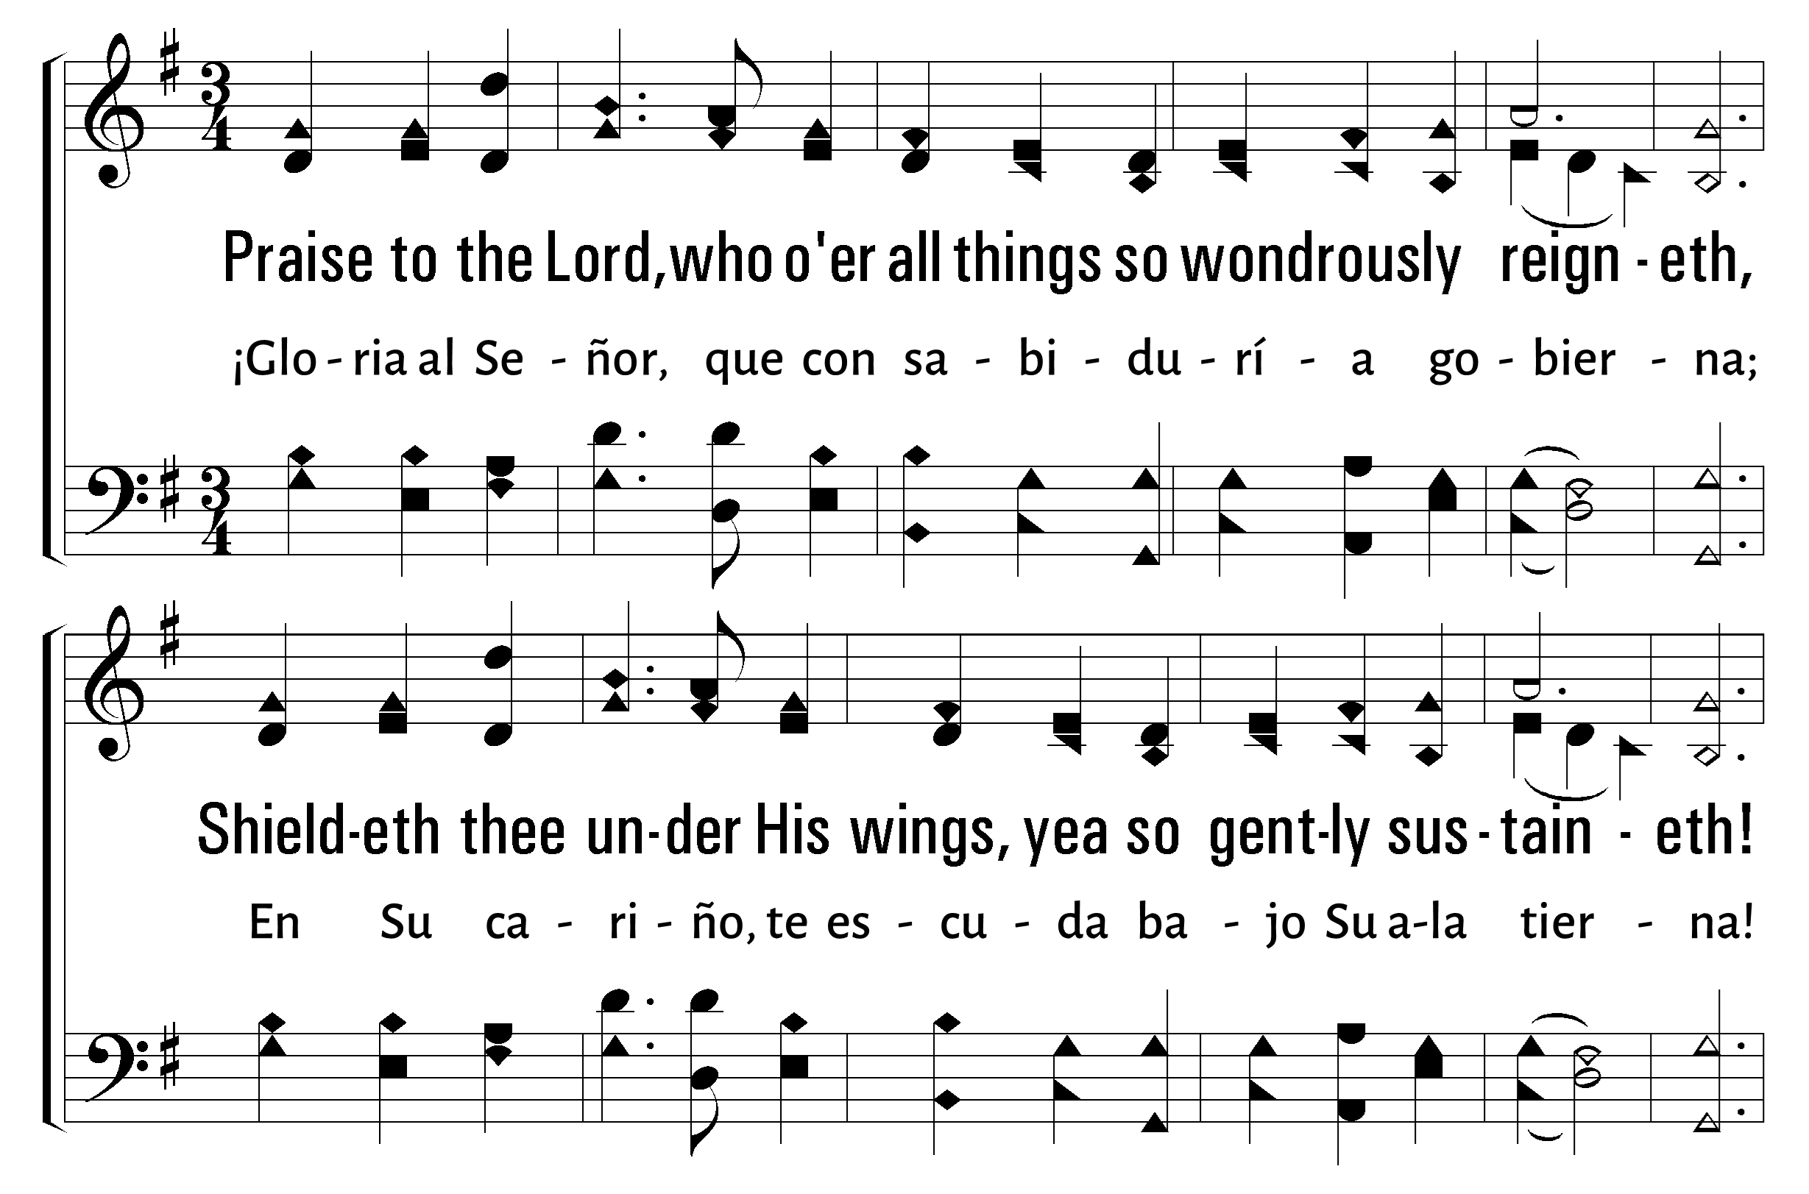
1
2
3
4
534
PRAISE TO THE LORD, THE ALMIGHTY • GLORIA AL SEÑOR, EL CREADOR
© 2003 The Paperless Hymnal™

Slide 10
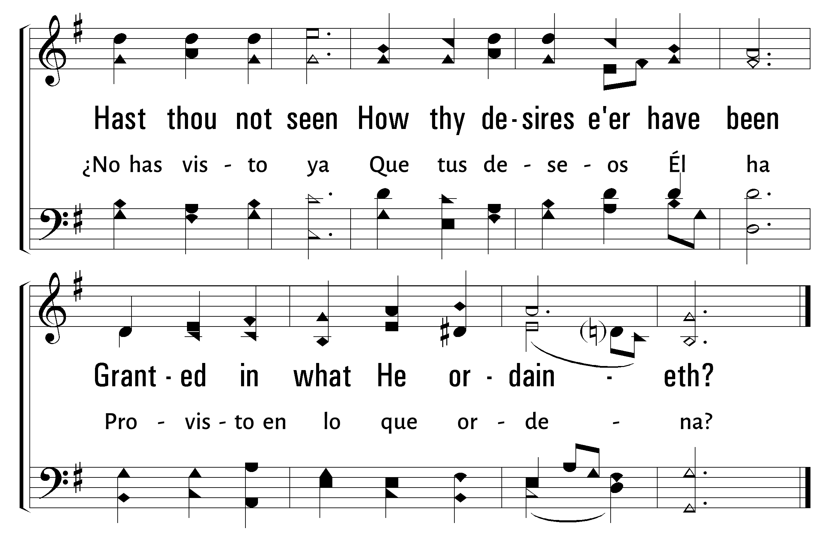
1
2
3
4
534
PRAISE TO THE LORD, THE ALMIGHTY • GLORIA AL SEÑOR, EL CREADOR
© 2003 The Paperless Hymnal™

Slide 11
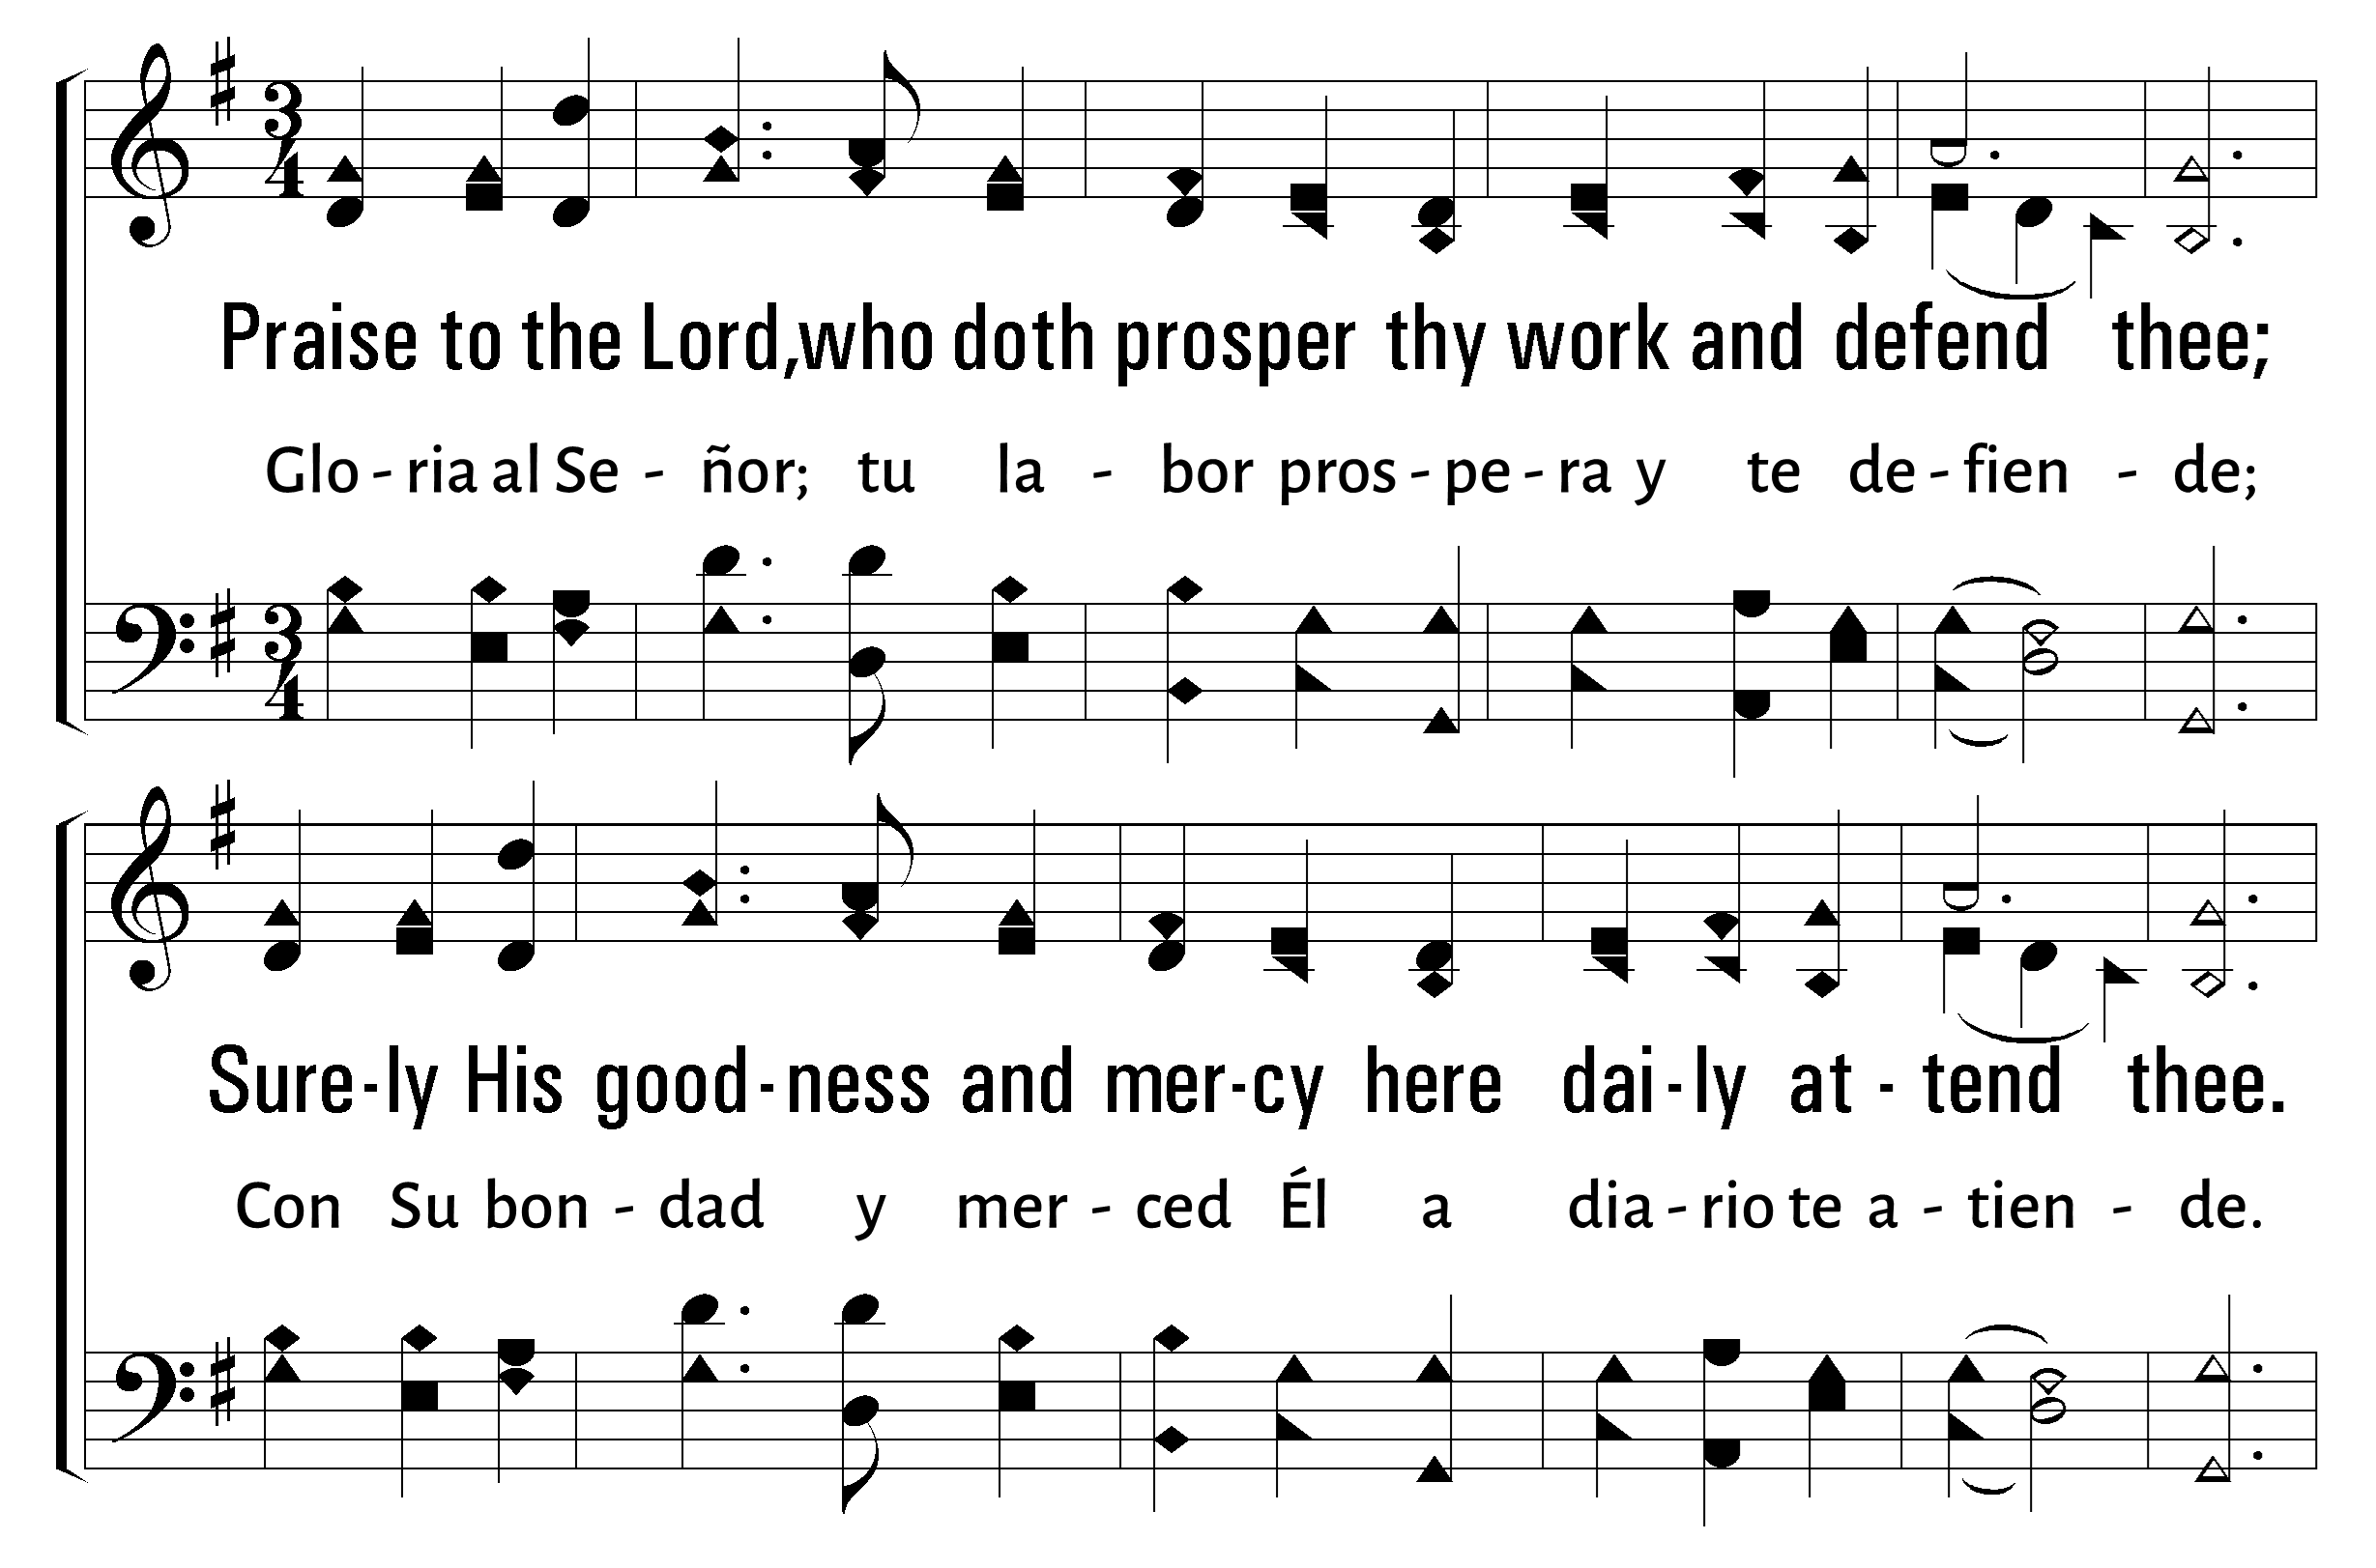
1
2
3
4
534
PRAISE TO THE LORD, THE ALMIGHTY • GLORIA AL SEÑOR, EL CREADOR
© 2003 The Paperless Hymnal™

Slide 12
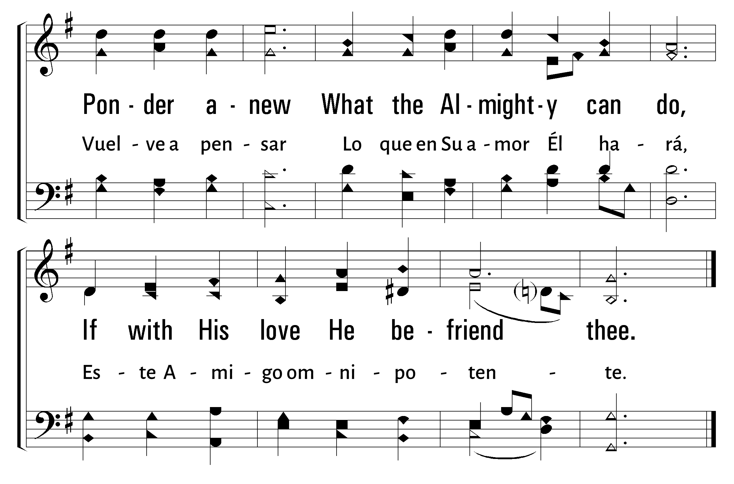
1
2
3
4
534
PRAISE TO THE LORD, THE ALMIGHTY • GLORIA AL SEÑOR, EL CREADOR
© 2003 The Paperless Hymnal™

Slide 13
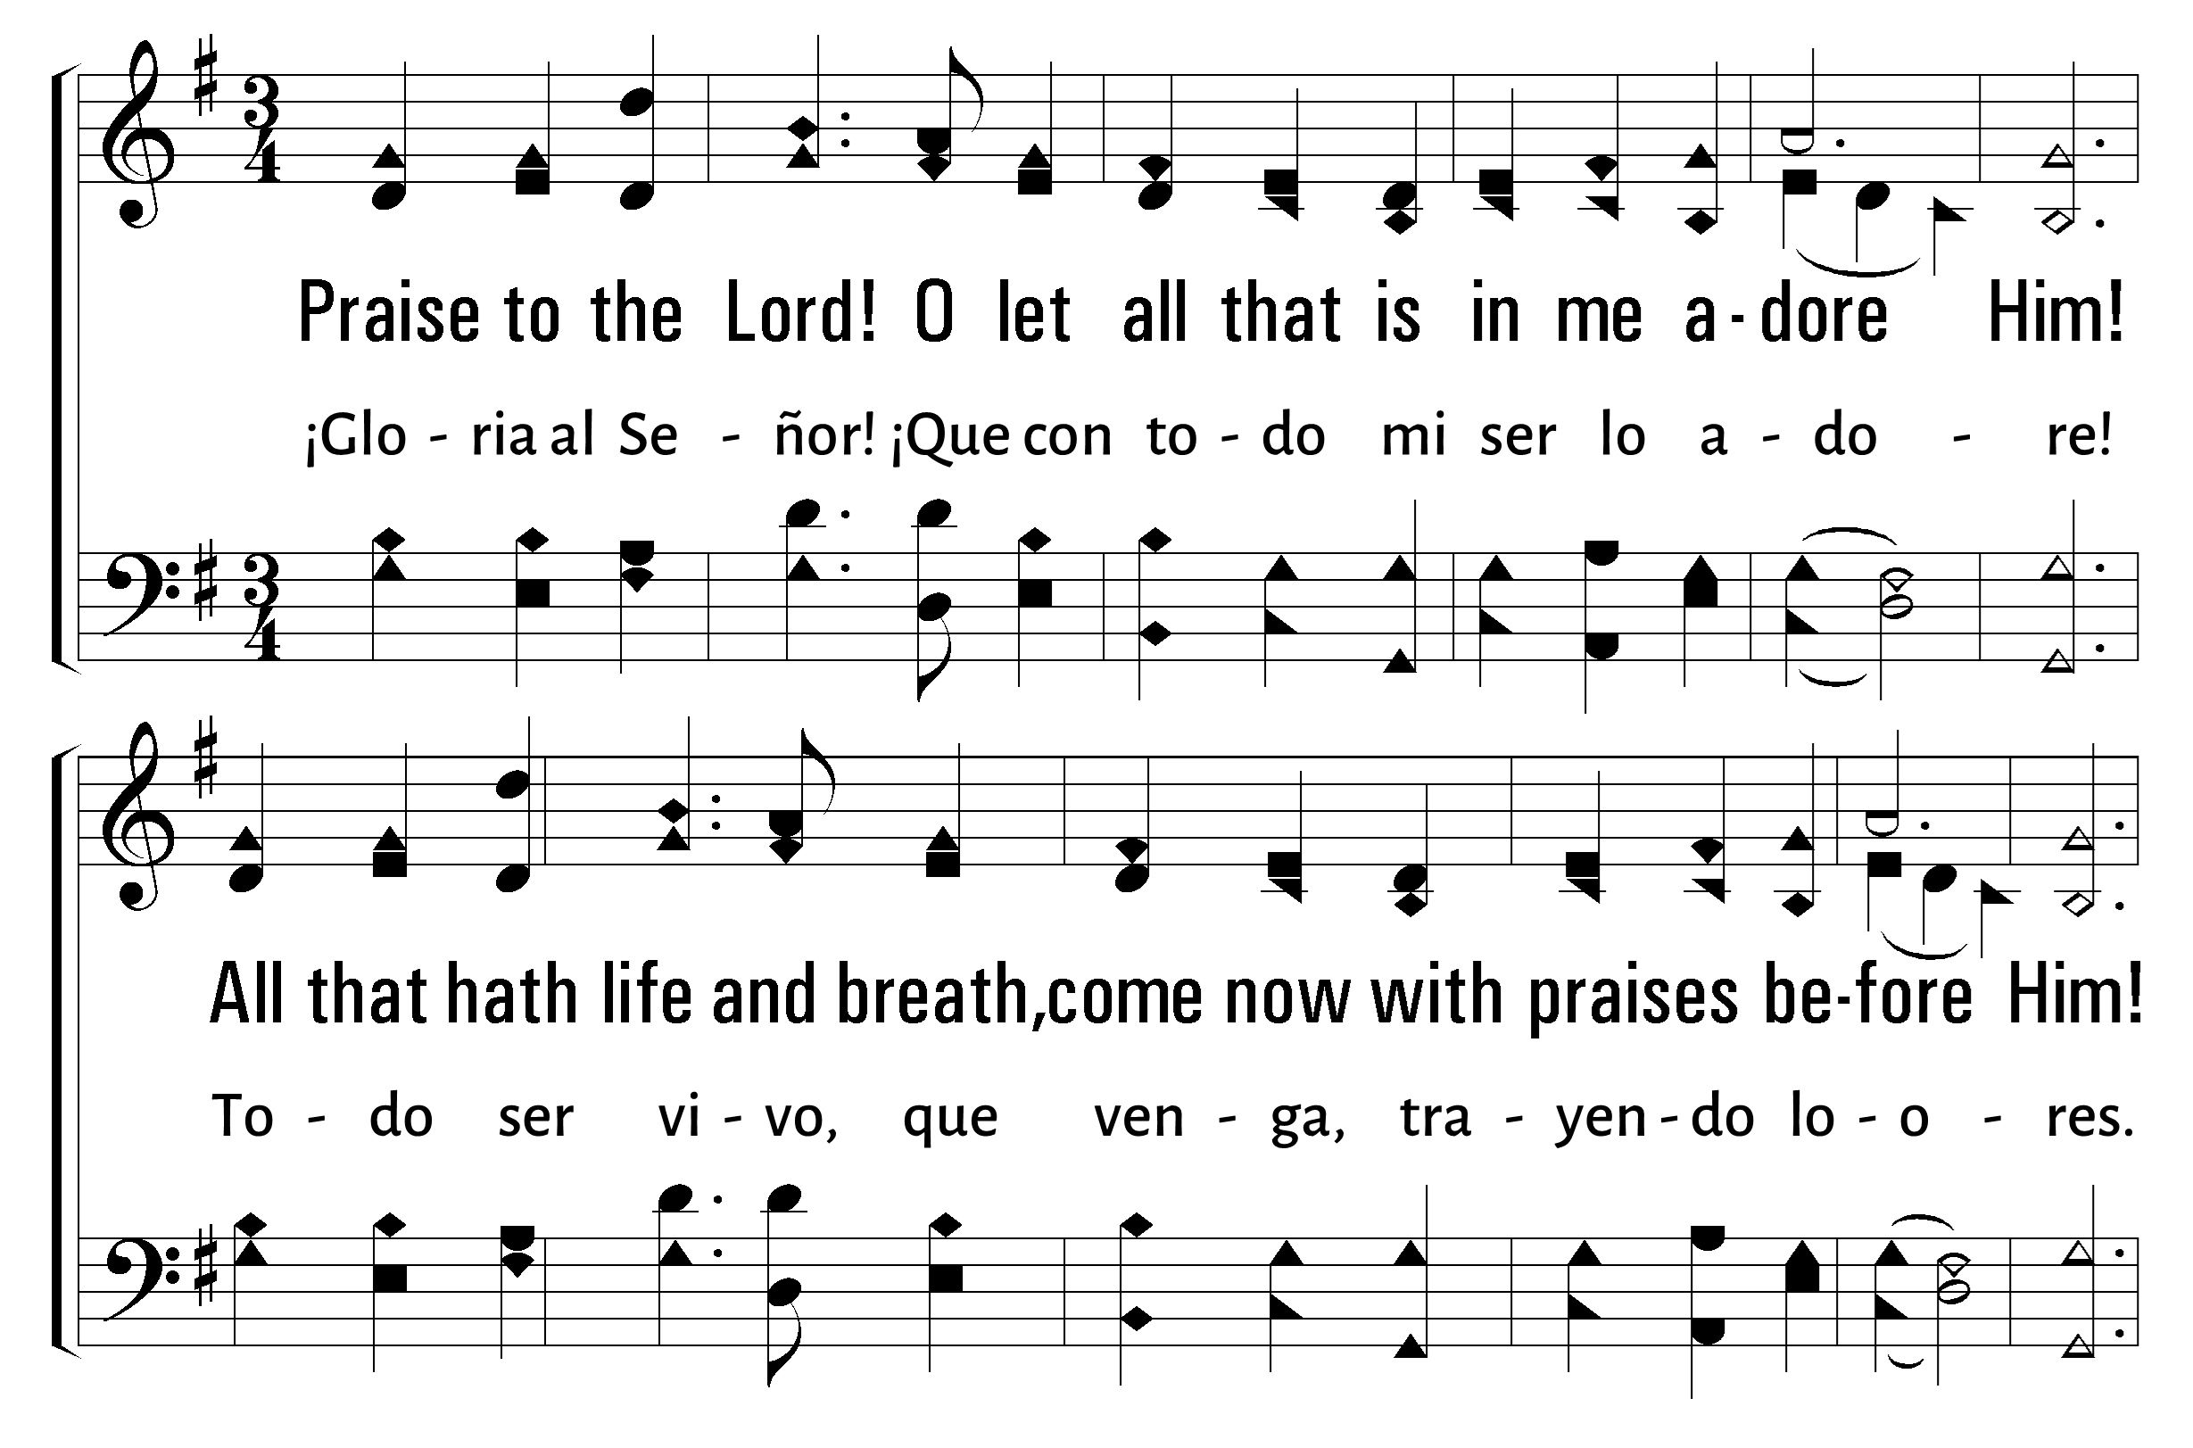
1
2
3
4
534
PRAISE TO THE LORD, THE ALMIGHTY • GLORIA AL SEÑOR, EL CREADOR
© 2003 The Paperless Hymnal™

Slide 14
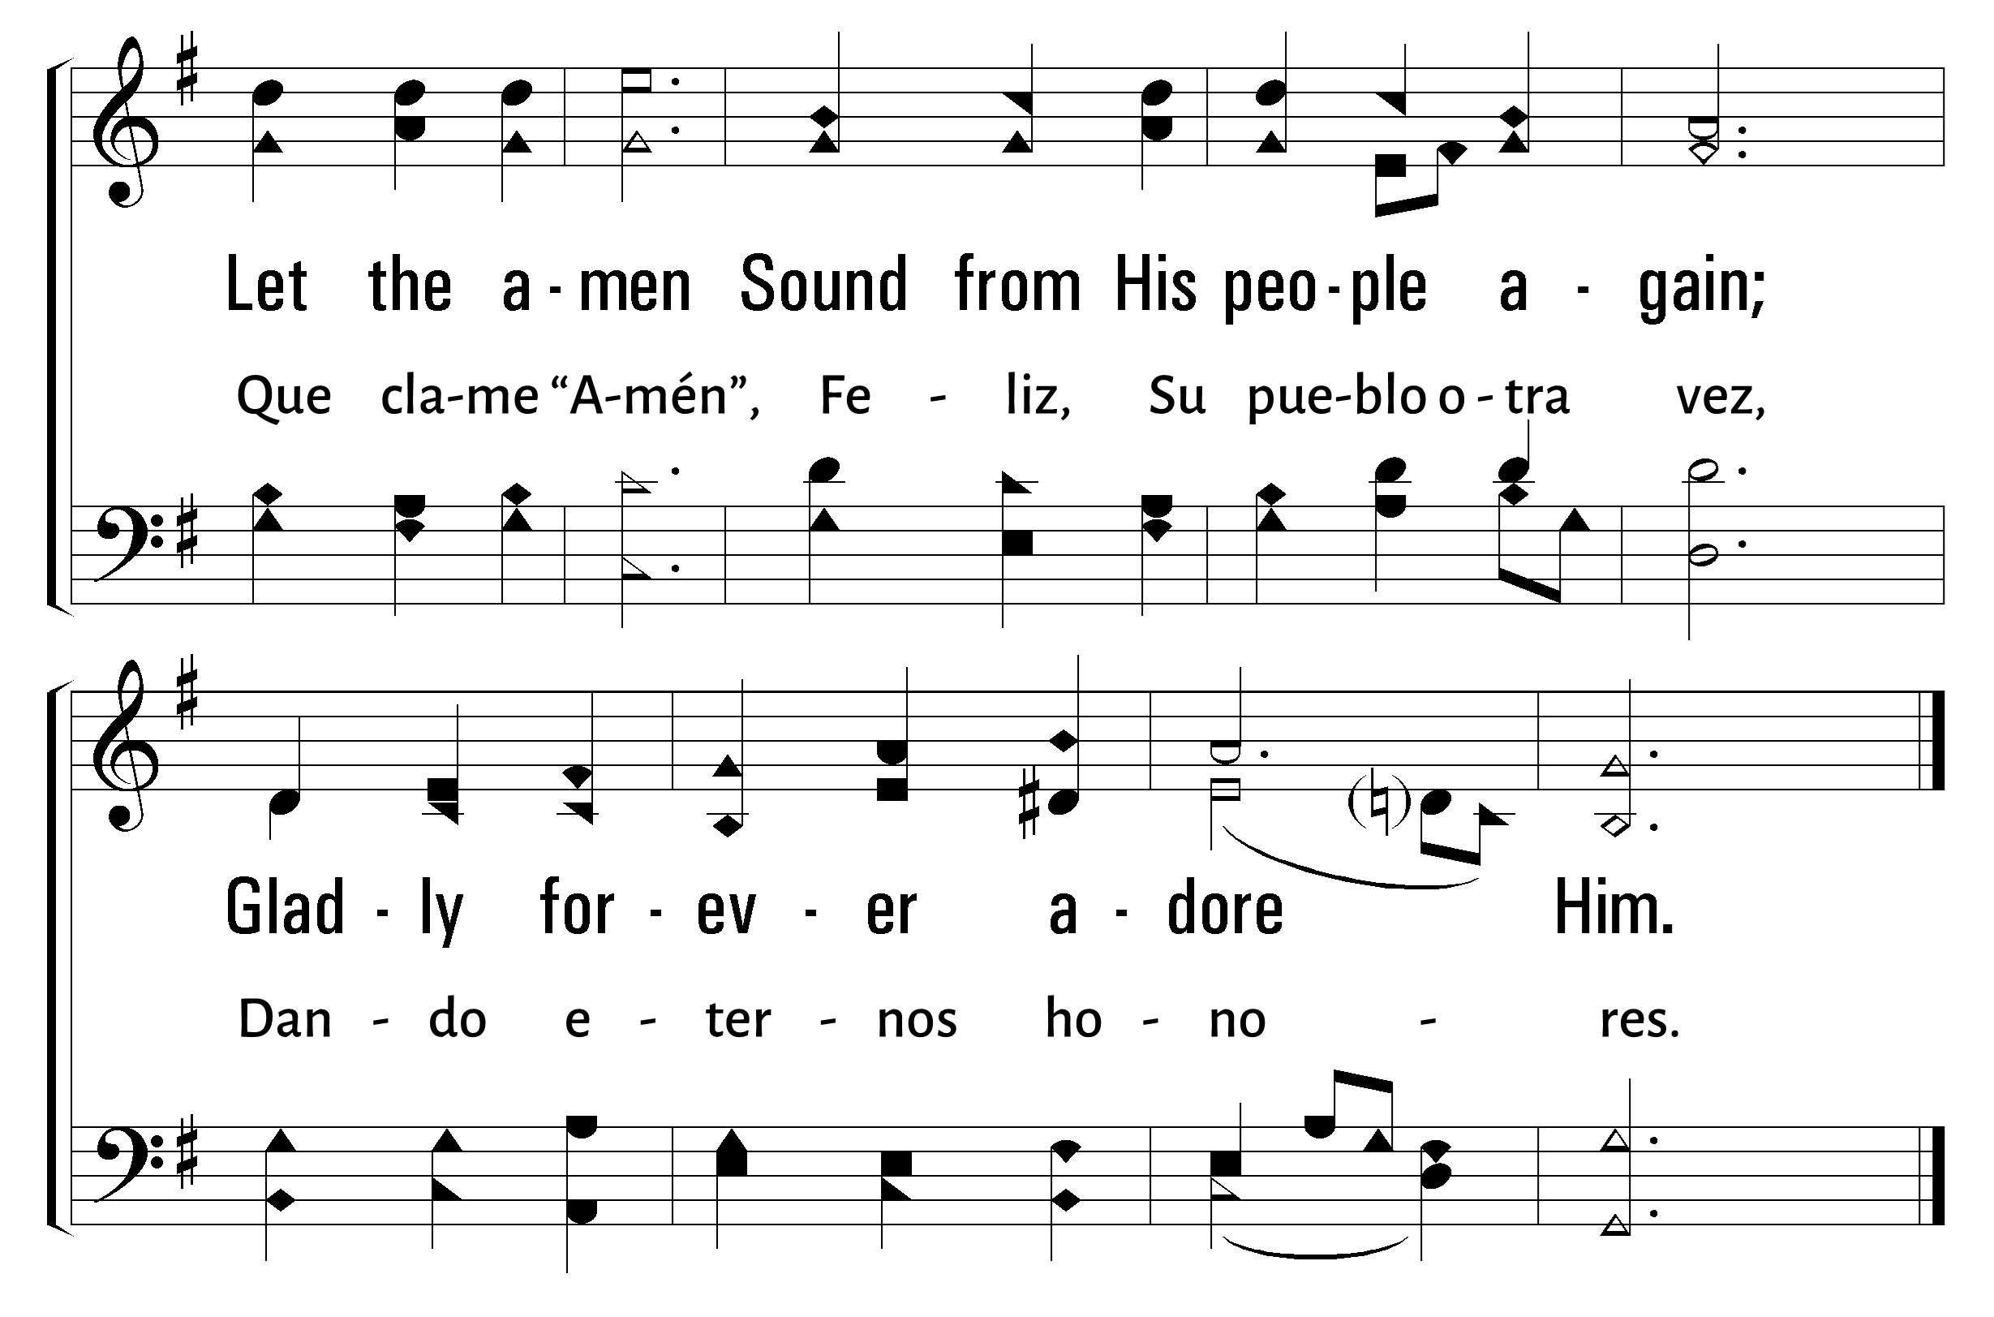
1
2
3
4
534
PRAISE TO THE LORD, THE ALMIGHTY • GLORIA AL SEÑOR, EL CREADOR
© 2003 The Paperless Hymnal™

Slide 15
Bienvenida
Ofrenda
Lectura
Oración
534
12
Cena del Señor
408
202
Sermón
67
Oración
Welcome
Collection
Reading
Prayer
534
12
Lord’s Supper
408
202
Sermon
67
Prayer
12
12
EN LA CRUZ
ALAS! AND DID MY SAVIOR BLEED
1
2
3
4
5
“CANTANDO...AL SEÑOR” COLOSENSES 3:16
“SINGING...TO THE LORD” COLOSSIANS 3:16
Words by: Isaac Watts, chorus by Ralph E. Hudson Music by: Ralph E. Hudson
Palabras por: Isaac Watts, coro por: Ralph E. Hudson Musica por: Ralph E. Hudson

Slide 16
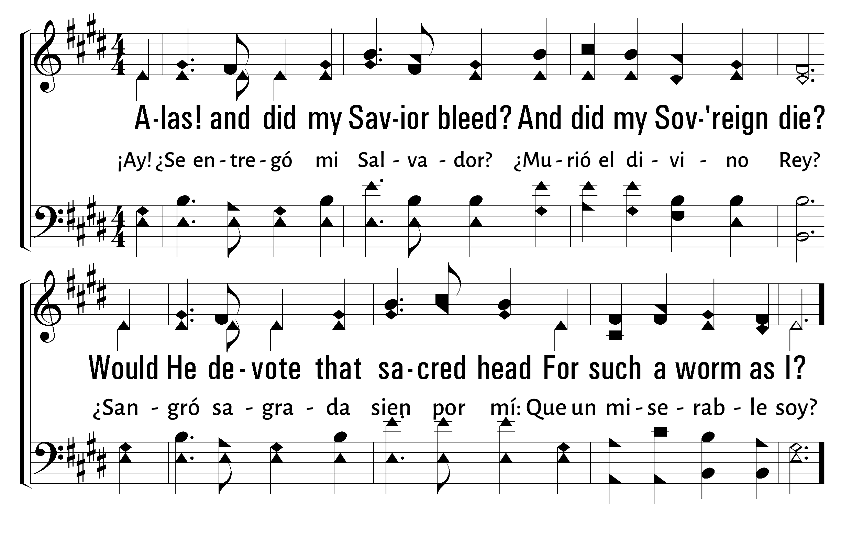
1
2
3
4
5
12
ALAS! AND DID MY SAVIOR BLEED • EN LA CRUZ
© 2001 The Paperless Hymnal™ • Traducción Pedro Grado

Slide 17
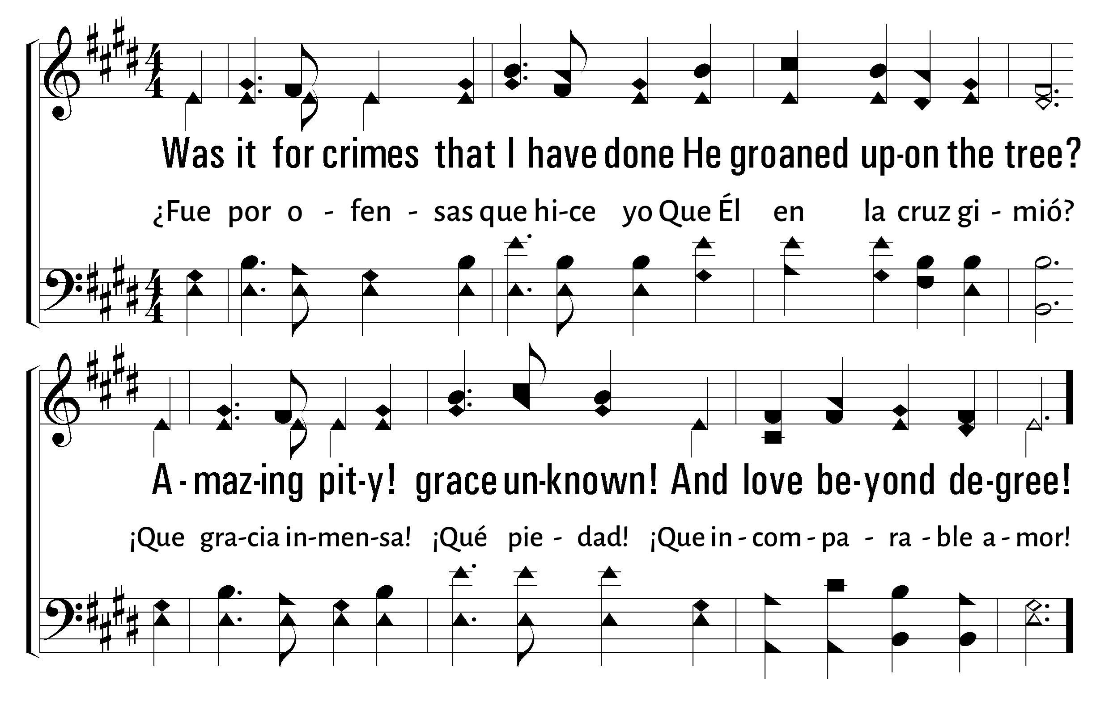
1
2
3
4
5
12
ALAS! AND DID MY SAVIOR BLEED • EN LA CRUZ
© 2001 The Paperless Hymnal™ • Traducción Pedro Grado

Slide 18
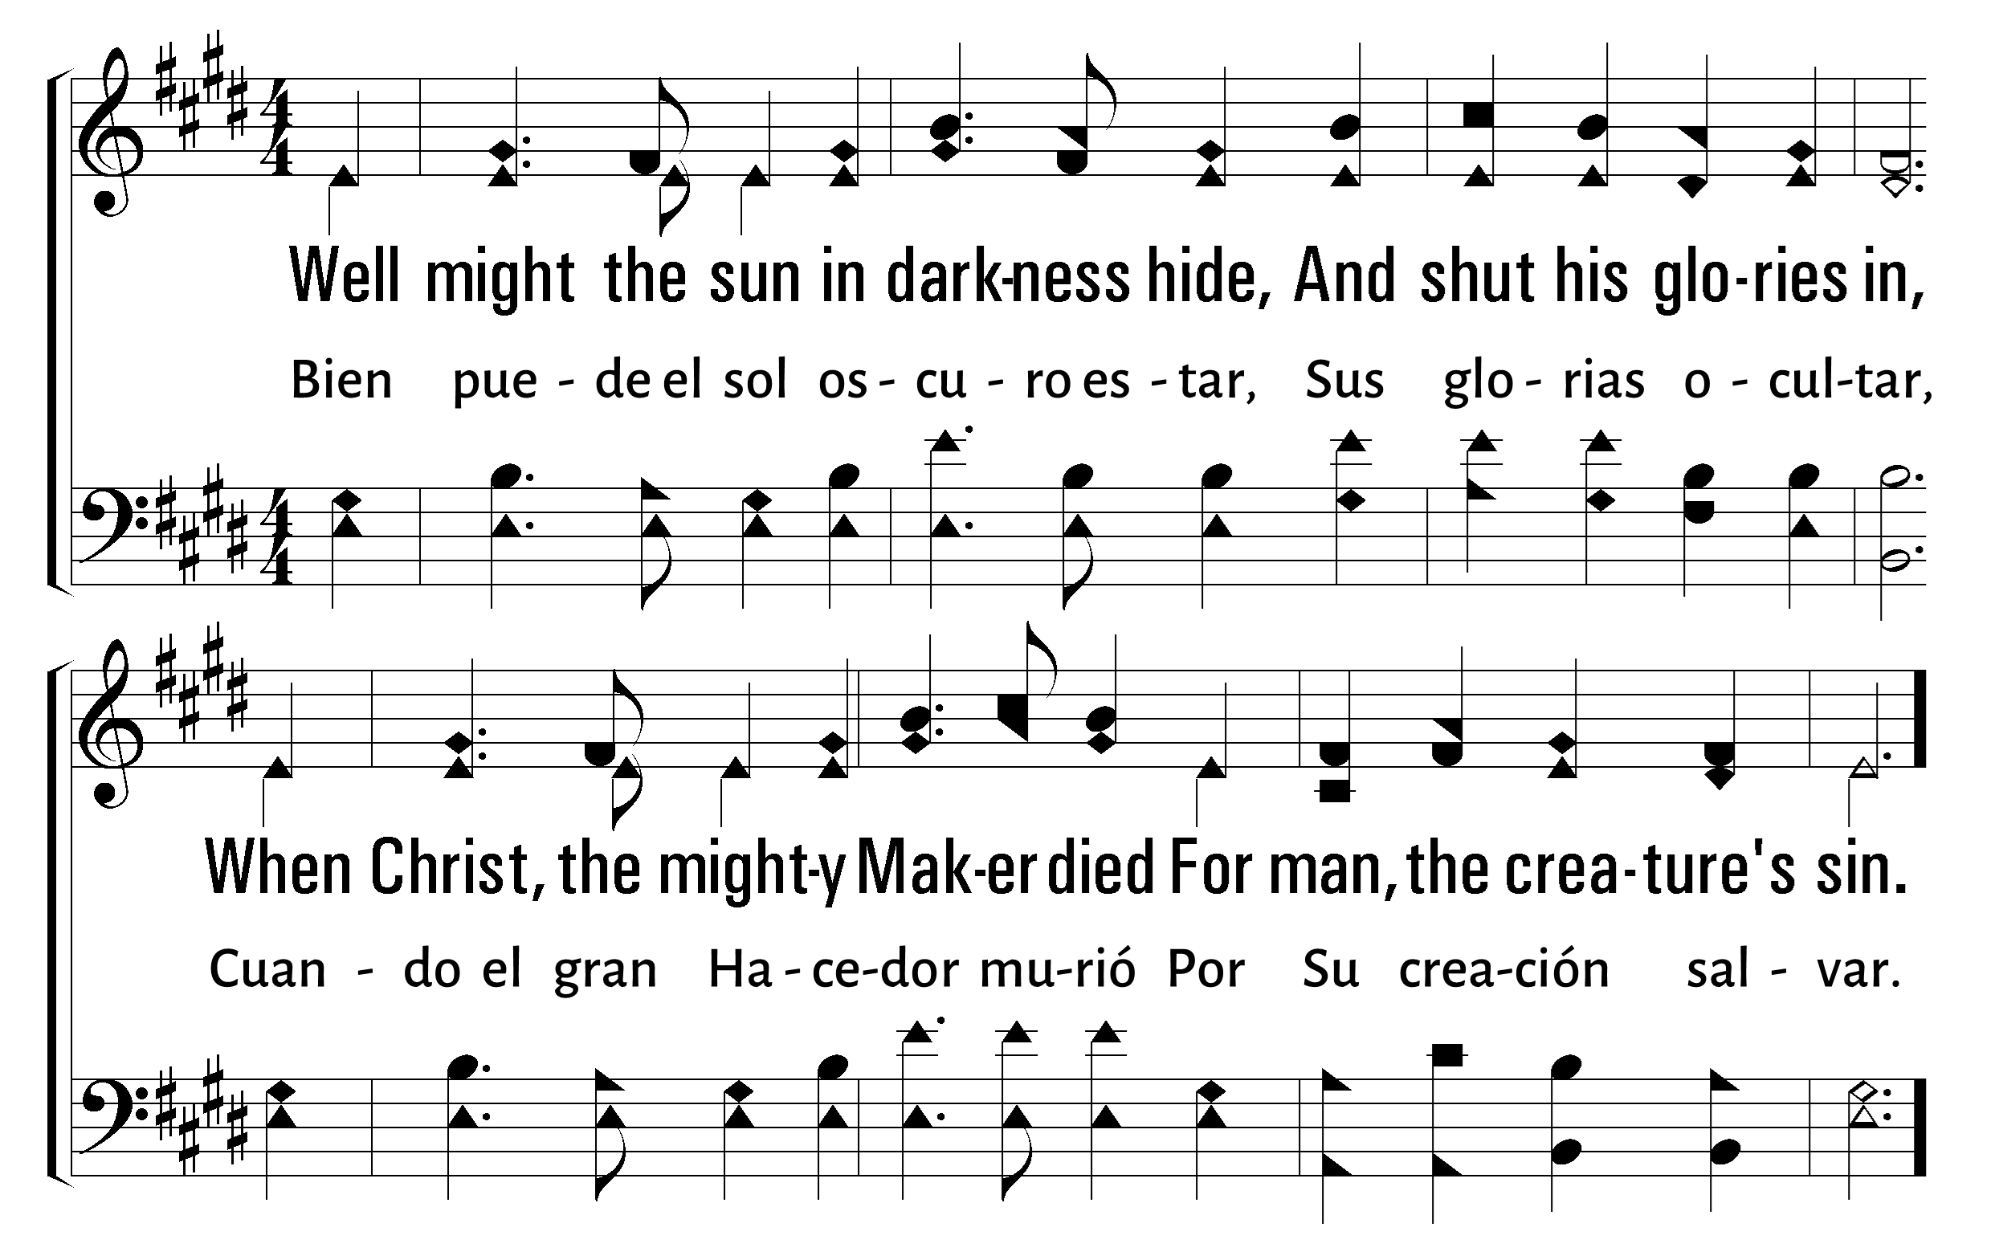
1
2
3
4
5
12
ALAS! AND DID MY SAVIOR BLEED • EN LA CRUZ
© 2001 The Paperless Hymnal™ • Traducción Pedro Grado

Slide 19
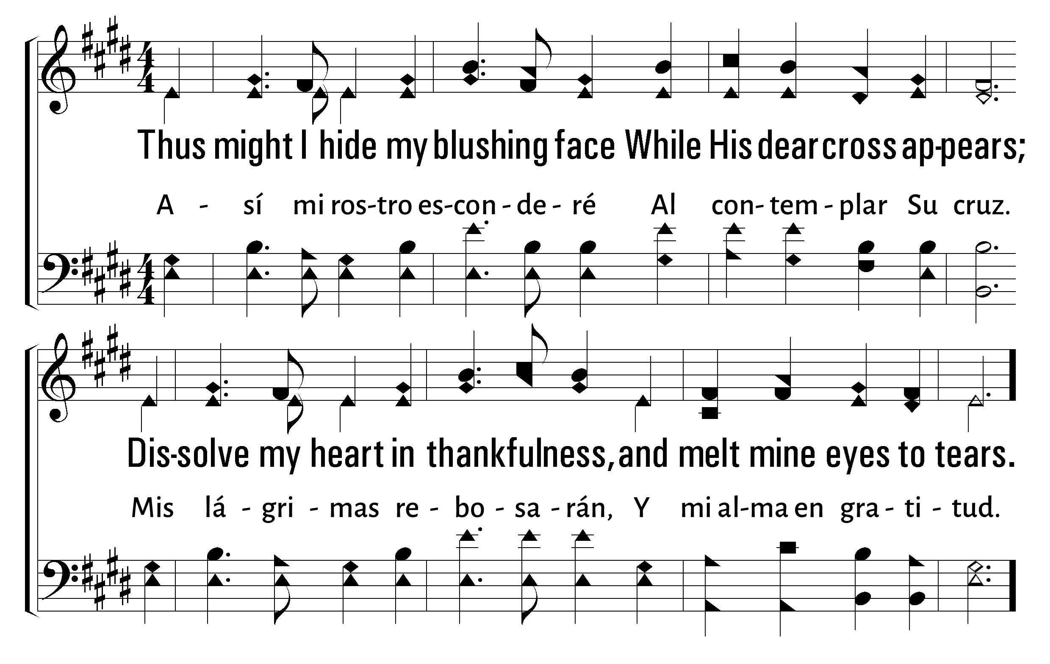
1
2
3
4
5
12
ALAS! AND DID MY SAVIOR BLEED • EN LA CRUZ
© 2001 The Paperless Hymnal™ • Traducción Pedro Grado

Slide 20
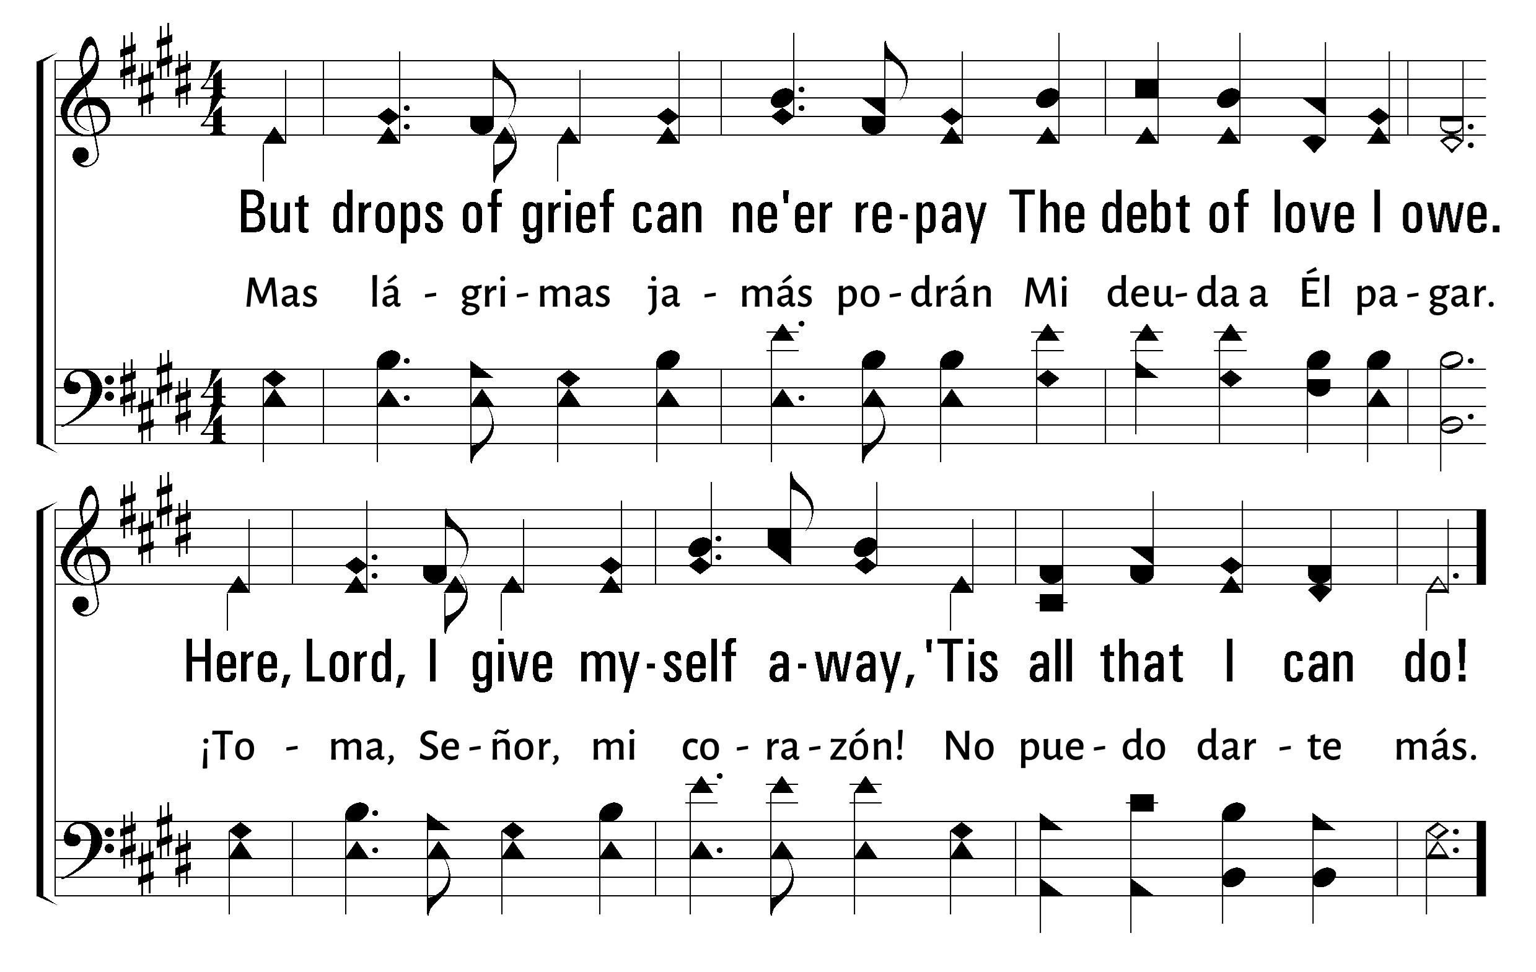
1
2
3
4
5
12
ALAS! AND DID MY SAVIOR BLEED • EN LA CRUZ
© 2001 The Paperless Hymnal™ • Traducción Pedro Grado

Slide 21

Bienvenida
Ofrenda
Lectura
Oración
534
12
Cena del Señor
408
202
Sermón
67
Oración
Welcome
Collection
Reading
Prayer
534
12
Lord’s Supper
408
202
Sermon
67
Prayer
CENA DEL
LORD’S
SUPPER
SEÑOR
“DO THIS IN REMEMBRANCE OF ME” LUKE 22:19
“HACED ESTO EN MEMORIA DE MÍ” LUCAS 22:19
Matt LaGrone

Slide 23

Bienvenida
Ofrenda
Lectura
Oración
534
12
Cena del Señor
408
202
Sermón
67
Oración
Welcome
Collection
Reading
Prayer
534
12
Lord’s Supper
408
202
Sermon
67
Prayer
For Christ has not entered the holy places made with hands, which are copies of the true, but into heaven itself, now to appear in the presence of God for us; not that He should offer Himself often, as the high priest enters the Most Holy Place every year with blood of another-- He then would have had to suffer often since the foundation of the world; but now, once at the end of the ages, He has appeared to put away sin by the sacrifice of Himself. And as it is appointed for men to die once, but after this the judgment, so Christ was offered once to bear the sins of many. To those who eagerly wait for Him He will appear a second time, apart from sin, for salvation.
Porque no entró Cristo en el santuario hecho de mano, figura del verdadero, sino en el cielo mismo para presentarse ahora por nosotros ante Dios; y no para ofrecerse muchas veces, como entra el sumo sacerdote en el Lugar Santísimo cada año con sangre ajena. De otra manera le hubiera sido necesario padecer muchas veces desde el principio del mundo; pero ahora, en la consumación de los siglos, se presentó una vez para siempre por el sacrificio de sí mismo para quitar de en medio el pecado. Y de la manera que está establecido para los hombres que mueran una sola vez, y después de esto el juicio, así también Cristo fue ofrecido una sola vez para llevar los pecados de muchos; y aparecerá por segunda vez, sin relación con el pecado, para salvar a los que le esperan.
Hebrews 9:24-28
Hebreos 9:24-28

Slide 24
Bienvenida
Ofrenda
Lectura
Oración
534
12
Cena del Señor
408
202
Sermón
67
Oración
Welcome
Collection
Reading
Prayer
534
12
Lord’s Supper
408
202
Sermon
67
Prayer
408
408
LA TUMBA LE ENCERRÓ
LOW IN THE GRAVE HE LAY
1
2
3
C
“CANTANDO...AL SEÑOR” COLOSENSES 3:16
“SINGING...TO THE LORD” COLOSSIANS 3:16
Words and Music by: Robert Lowry
Letra y música por: Robert Lowry

Slide 25
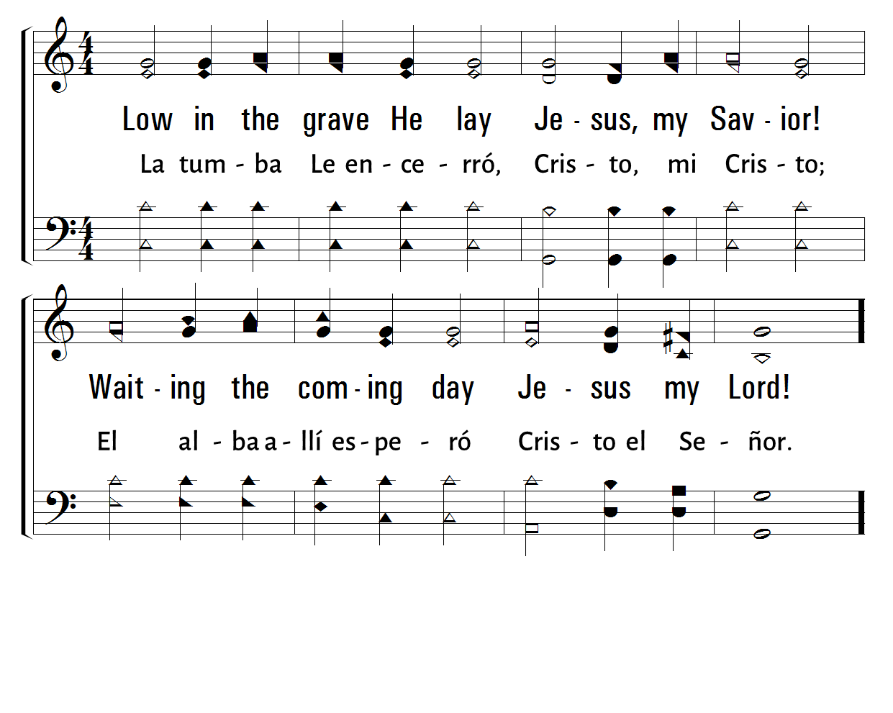
408
1
LOW IN THE GRAVE HE LAY
2
LA TUMBA LE ENCERRÓ
3
C
Traducción G. P. Simmonds
© 2001 The Paperless Hymnal™

Slide 26
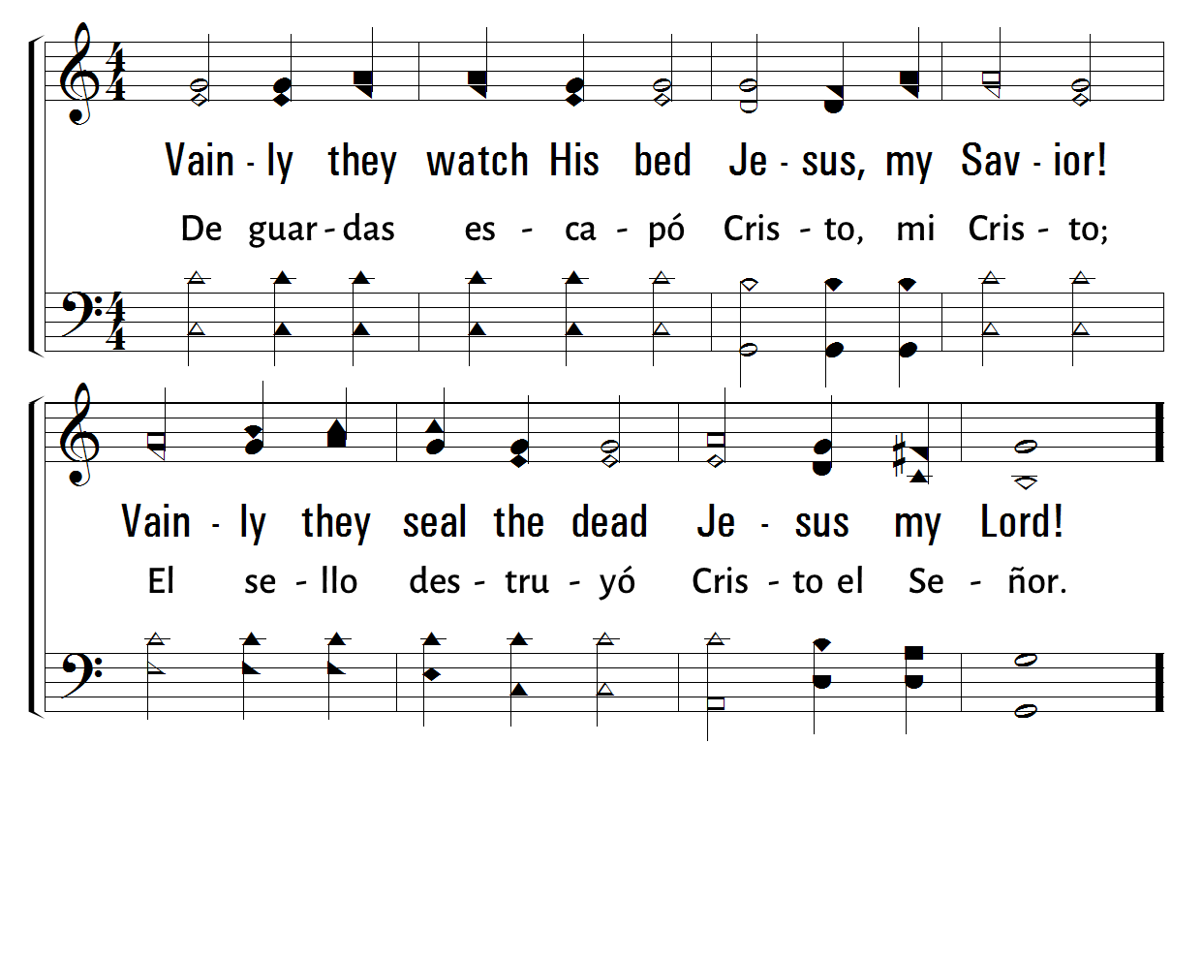
408
1
LOW IN THE GRAVE HE LAY
2
LA TUMBA LE ENCERRÓ
3
C
Traducción G. P. Simmonds
© 2001 The Paperless Hymnal™

Slide 27
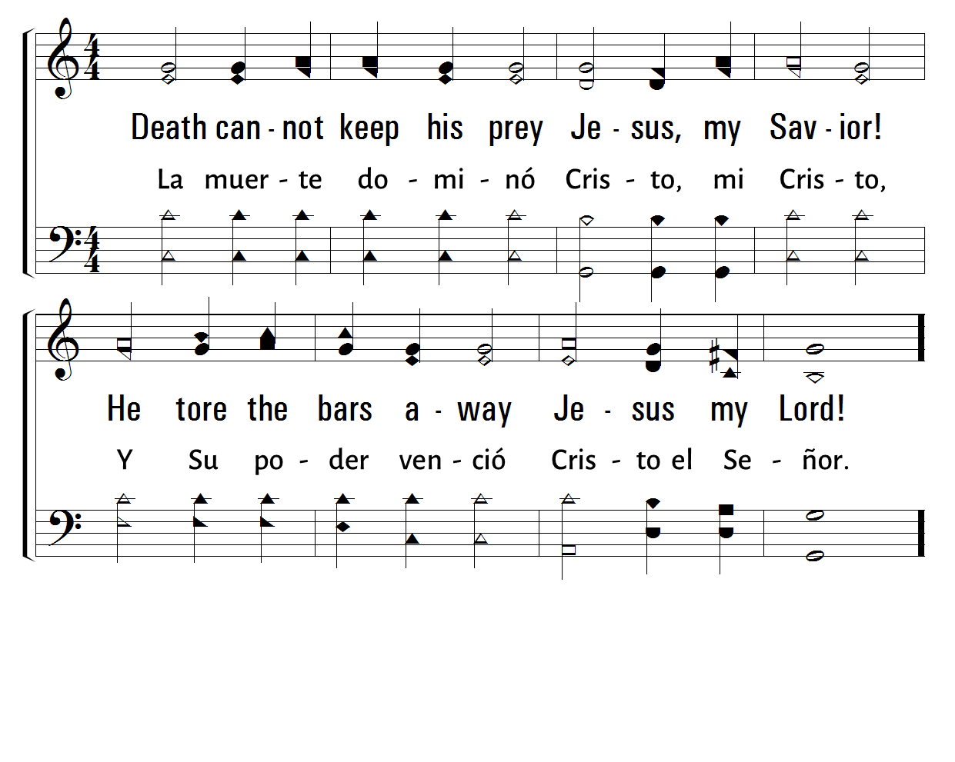
408
1
LOW IN THE GRAVE HE LAY
2
LA TUMBA LE ENCERRÓ
3
C
Traducción G. P. Simmonds
© 2001 The Paperless Hymnal™

Slide 28
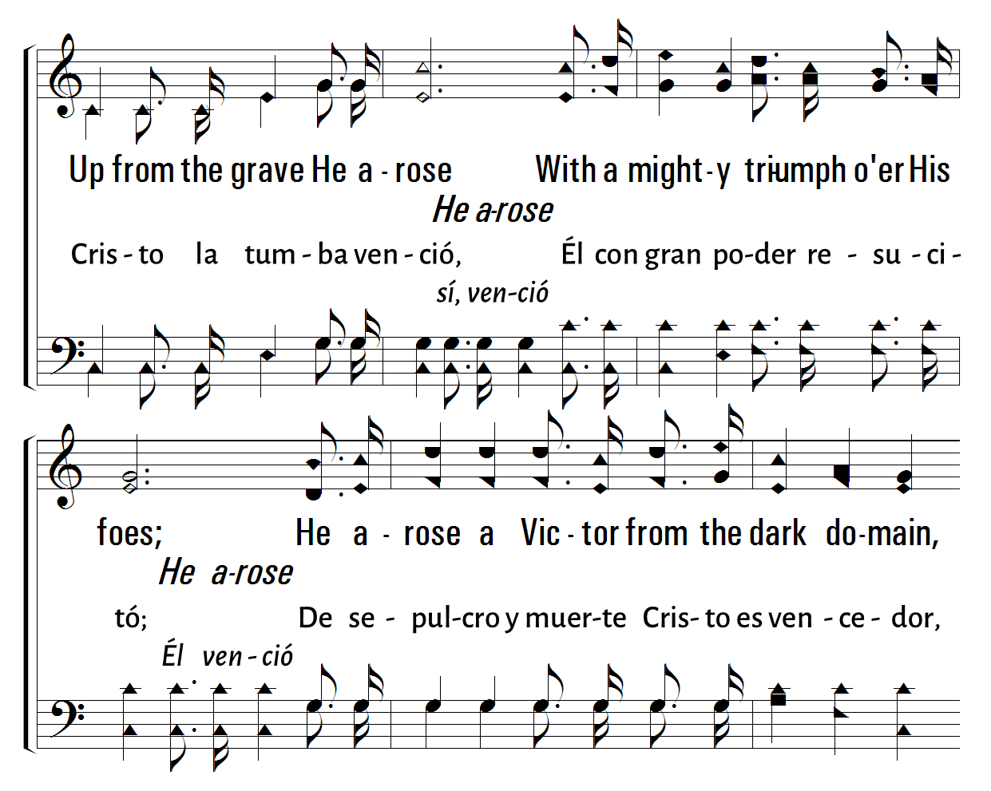
408
1
LOW IN THE GRAVE HE LAY
2
LA TUMBA LE ENCERRÓ
3
C
Traducción G. P. Simmonds
© 2001 The Paperless Hymnal™

Slide 29
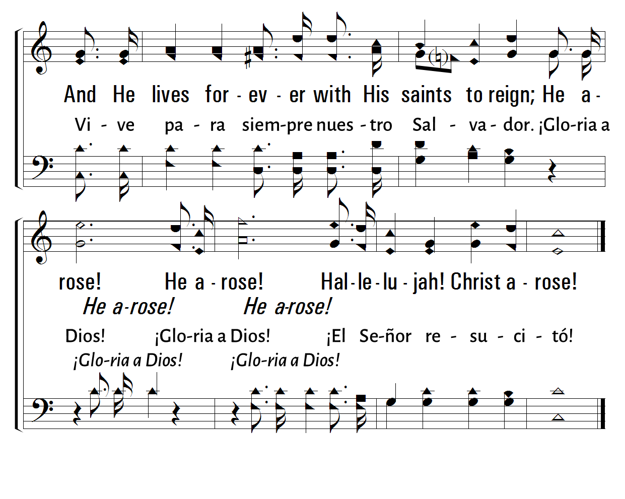
408
1
LOW IN THE GRAVE HE LAY
2
LA TUMBA LE ENCERRÓ
3
C
Traducción G. P. Simmonds
© 2001 The Paperless Hymnal™

Slide 30
Bienvenida
Ofrenda
Lectura
Oración
534
12
Cena del Señor
408
202
Sermón
67
Oración
Welcome
Collection
Reading
Prayer
534
12
Lord’s Supper
408
202
Sermon
67
Prayer
INVITATION SONG
HIMNO DE INVITACIÓN
67
67
TU VIDA ROTA TRAE
BRING CHRIST YOUR BROKEN LIFE
1
2
3
4
“CANTANDO...AL SEÑOR” COLOSENSES 3:16
“SINGING...TO THE LORD” COLOSSIANS 3:16
Words: Thomas O. Chisholm / Music: Lloyd O. Sanderson Copyright © 1935, Renewed 1963 by L. O. Sanderson, Leon B. Sanderson, Owner. All rights reserved. Used by permission.
Palabras: Thomas O. Chisholm / Música: Lloyd O. Sanderson Los Derechos De Autor © 1935, Renovado 1963 por L. O. Sanderson, Leon B. Sanderson, Dueño. Todos Los Derechos Reservados.Utilizado Por Permiso.

Slide 31
Bienvenida
Ofrenda
Lectura
Oración
534
12
Cena del Señor
408
202
Sermón
67
Oración
Welcome
Collection
Reading
Prayer
534
12
Lord’s Supper
408
202
Sermon
67
Prayer
202
202
LA BONDAD DE DIOS
GOODNESS OF GOD
1
2
“CANTANDO...AL SEÑOR” COLOSENSES 3:16
“SINGING...TO THE LORD” COLOSSIANS 3:16
Words and Music by: Jenn Johnson, Ed Cash, Jason Ingram, Ben Fielding, Brian Johnson Arr. Mark Simons, Shane Coffman, Aneva Peirce © Copyright 2019 Fellowship Music. (Admin. by Capitol CMG Publishing.) All Rights Reserved. Used by Permission.
Letra y música: Jenn Johnson, Ed Cash, Jason Ingram, Ben Fielding, Brian Johnson Arr. Mark Simons, Shane Coffman, Aneva Peirce © Derechos del autor 2019 Fellowship Music. (Admin. por Capitol CMG Publishing.) Todos los derechos reservados. Usado con permiso.

Slide 32
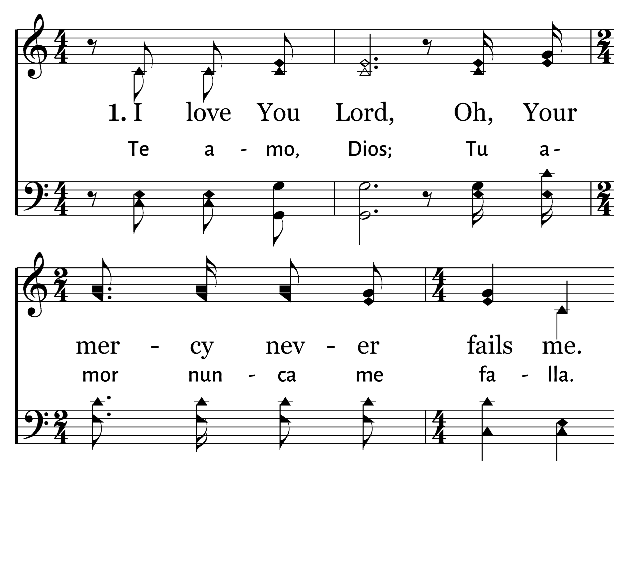
202
1
GOODNESS OF GOD
C
2
C
LA BONDAD DE DIOS
Typeset R. J. Stevens Music

Slide 33
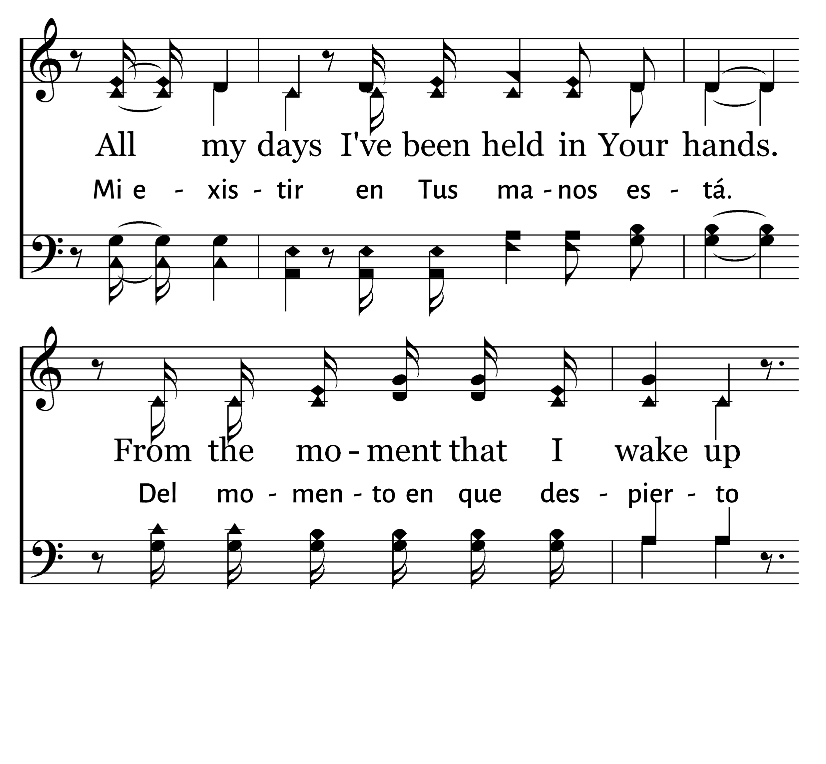
202
1
GOODNESS OF GOD
C
2
C
LA BONDAD DE DIOS
Typeset R. J. Stevens Music

Slide 34
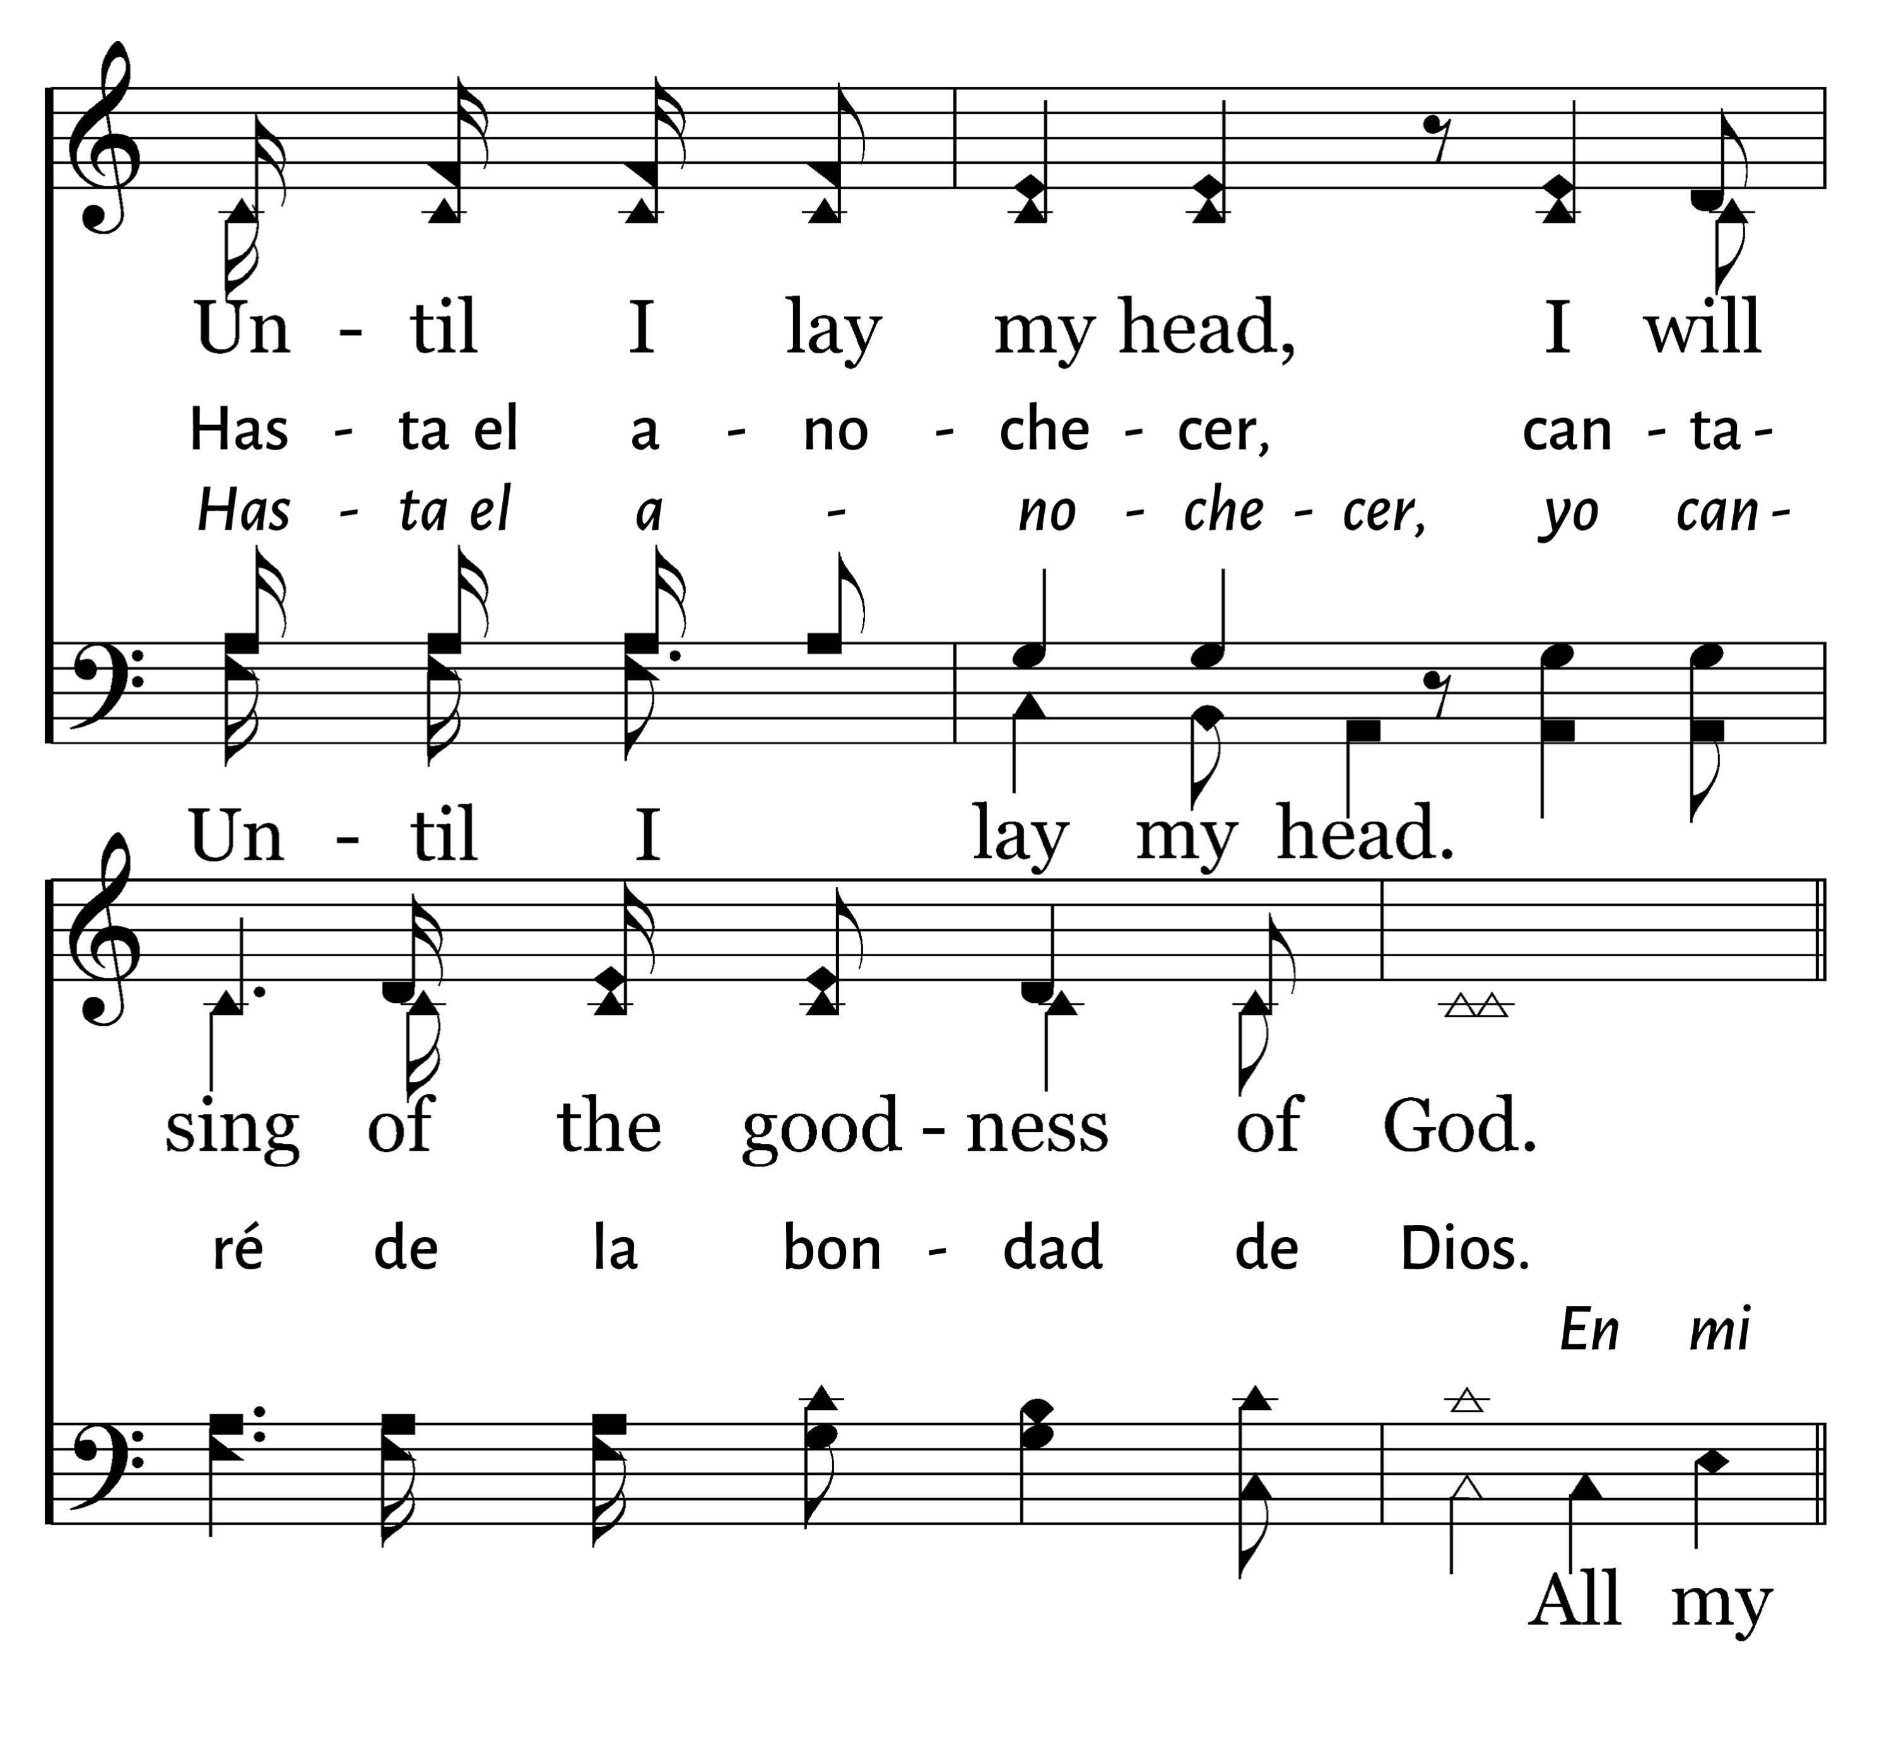
202
1
GOODNESS OF GOD
C
2
C
LA BONDAD DE DIOS
Typeset R. J. Stevens Music

Slide 35
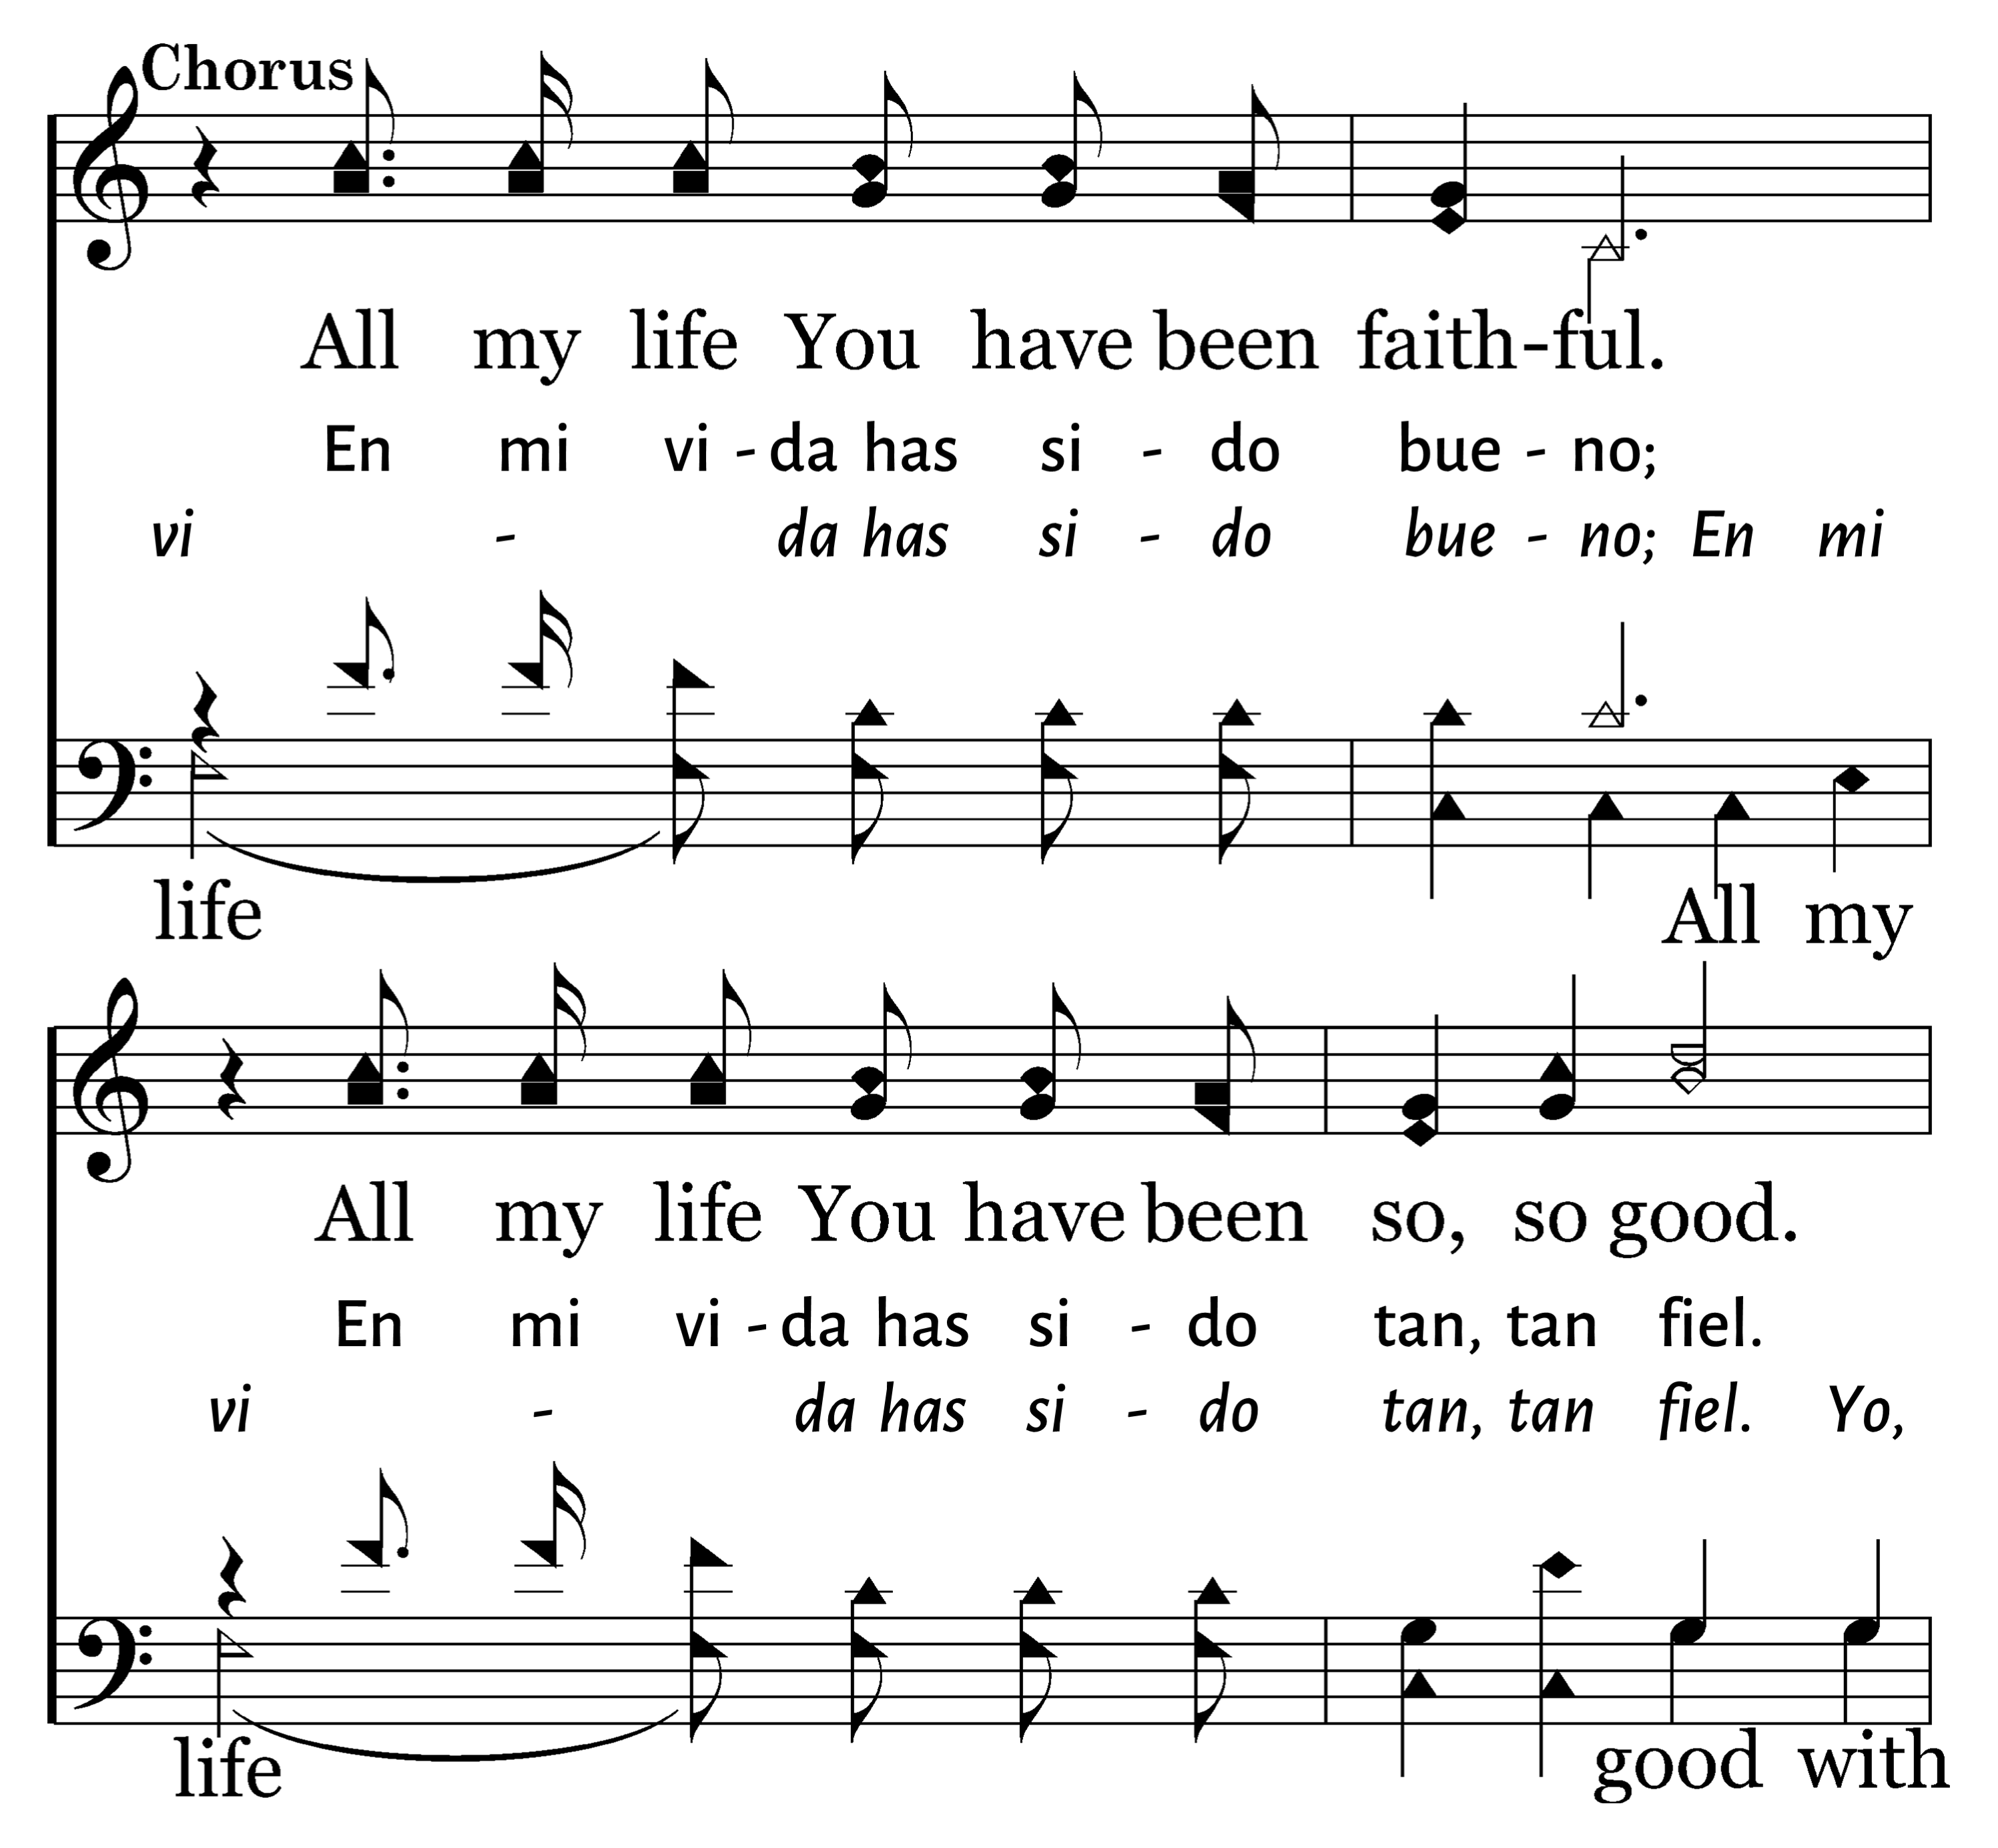
202
1
GOODNESS OF GOD
C
2
C
LA BONDAD DE DIOS
Typeset R. J. Stevens Music

Slide 36
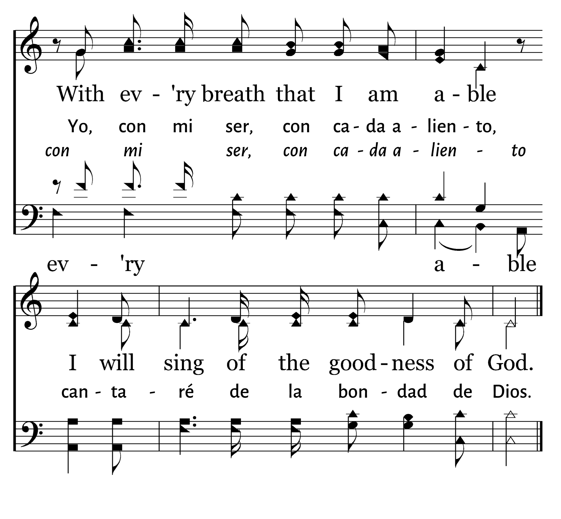
202
1
GOODNESS OF GOD
C
2
C
LA BONDAD DE DIOS
Typeset R. J. Stevens Music

Slide 37
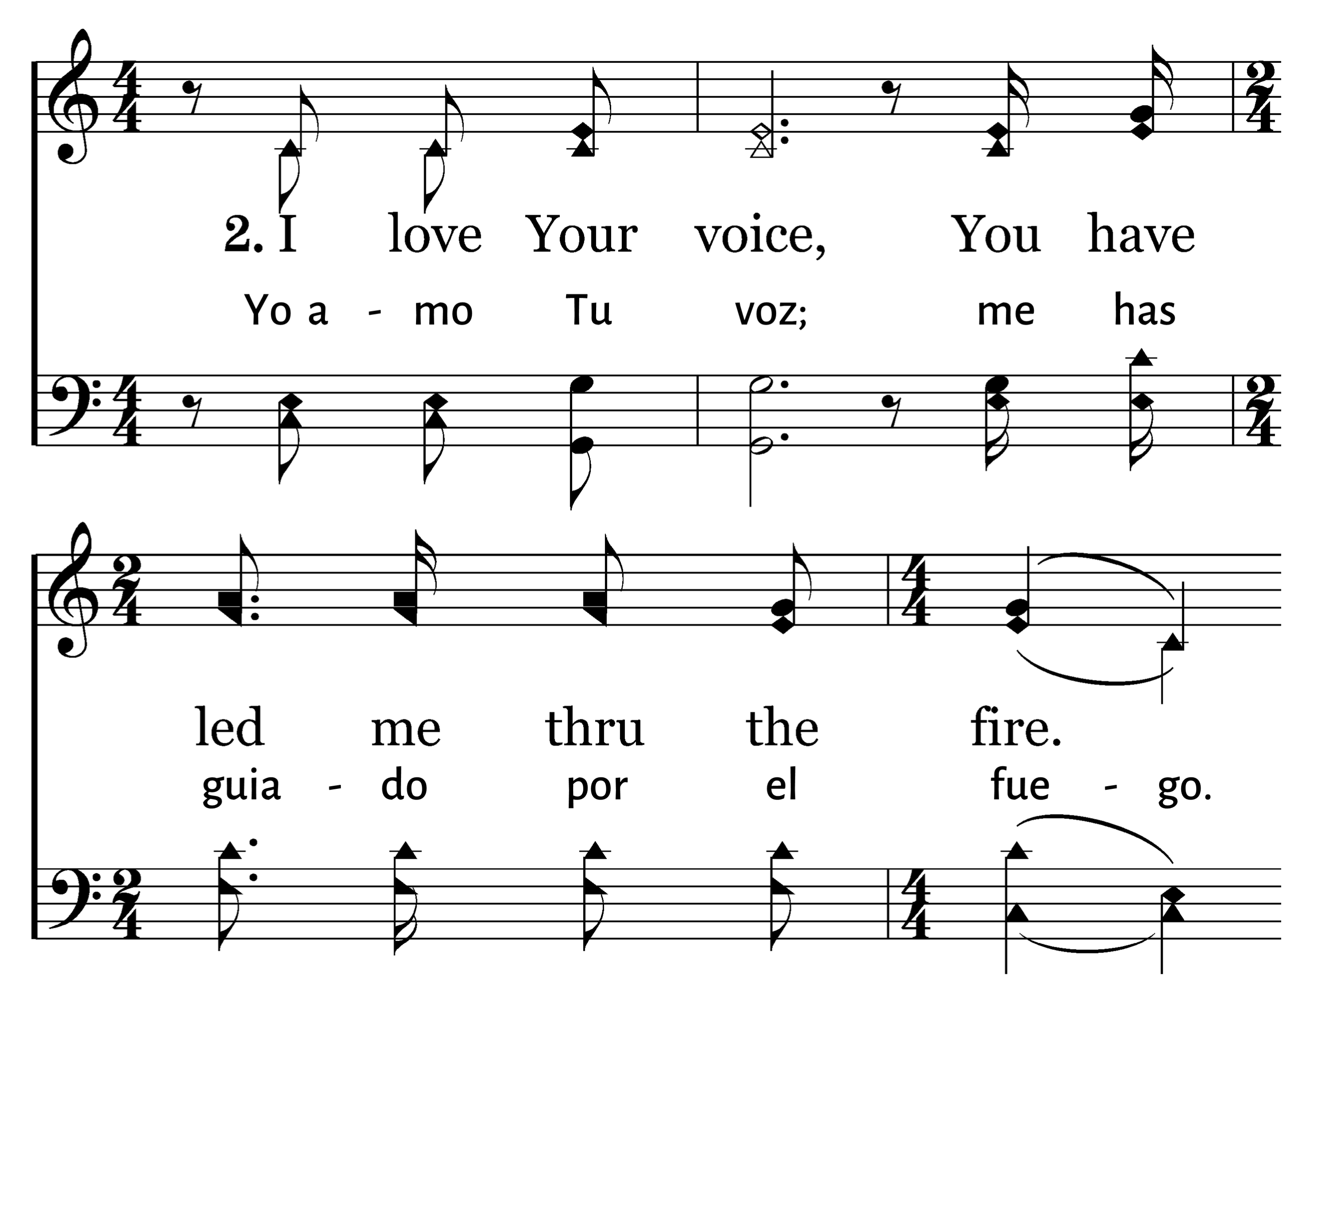
202
1
GOODNESS OF GOD
C
2
C
LA BONDAD DE DIOS
Typeset R. J. Stevens Music

Slide 38
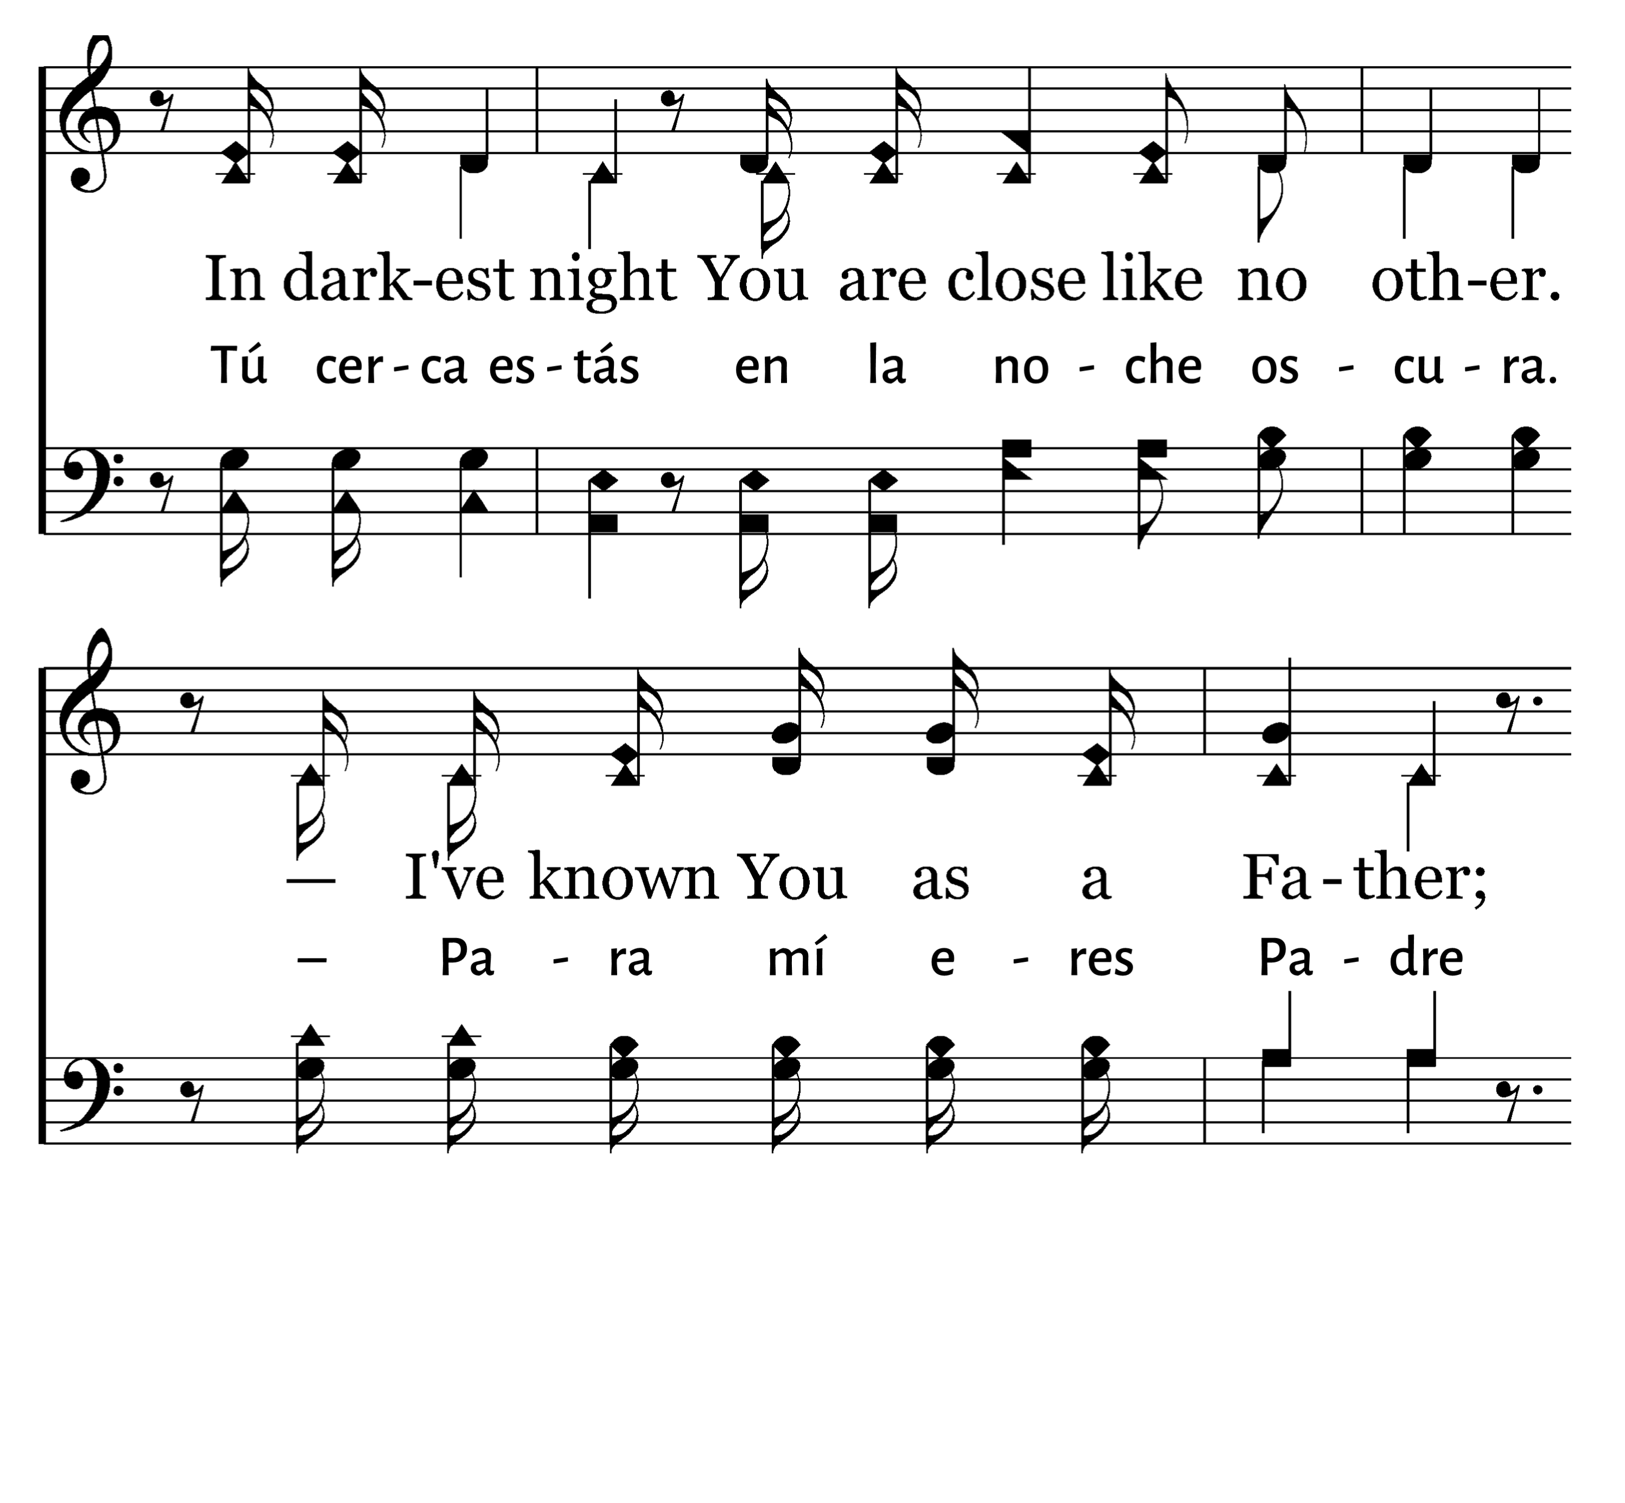
202
1
GOODNESS OF GOD
C
2
C
LA BONDAD DE DIOS
Typeset R. J. Stevens Music

Slide 39
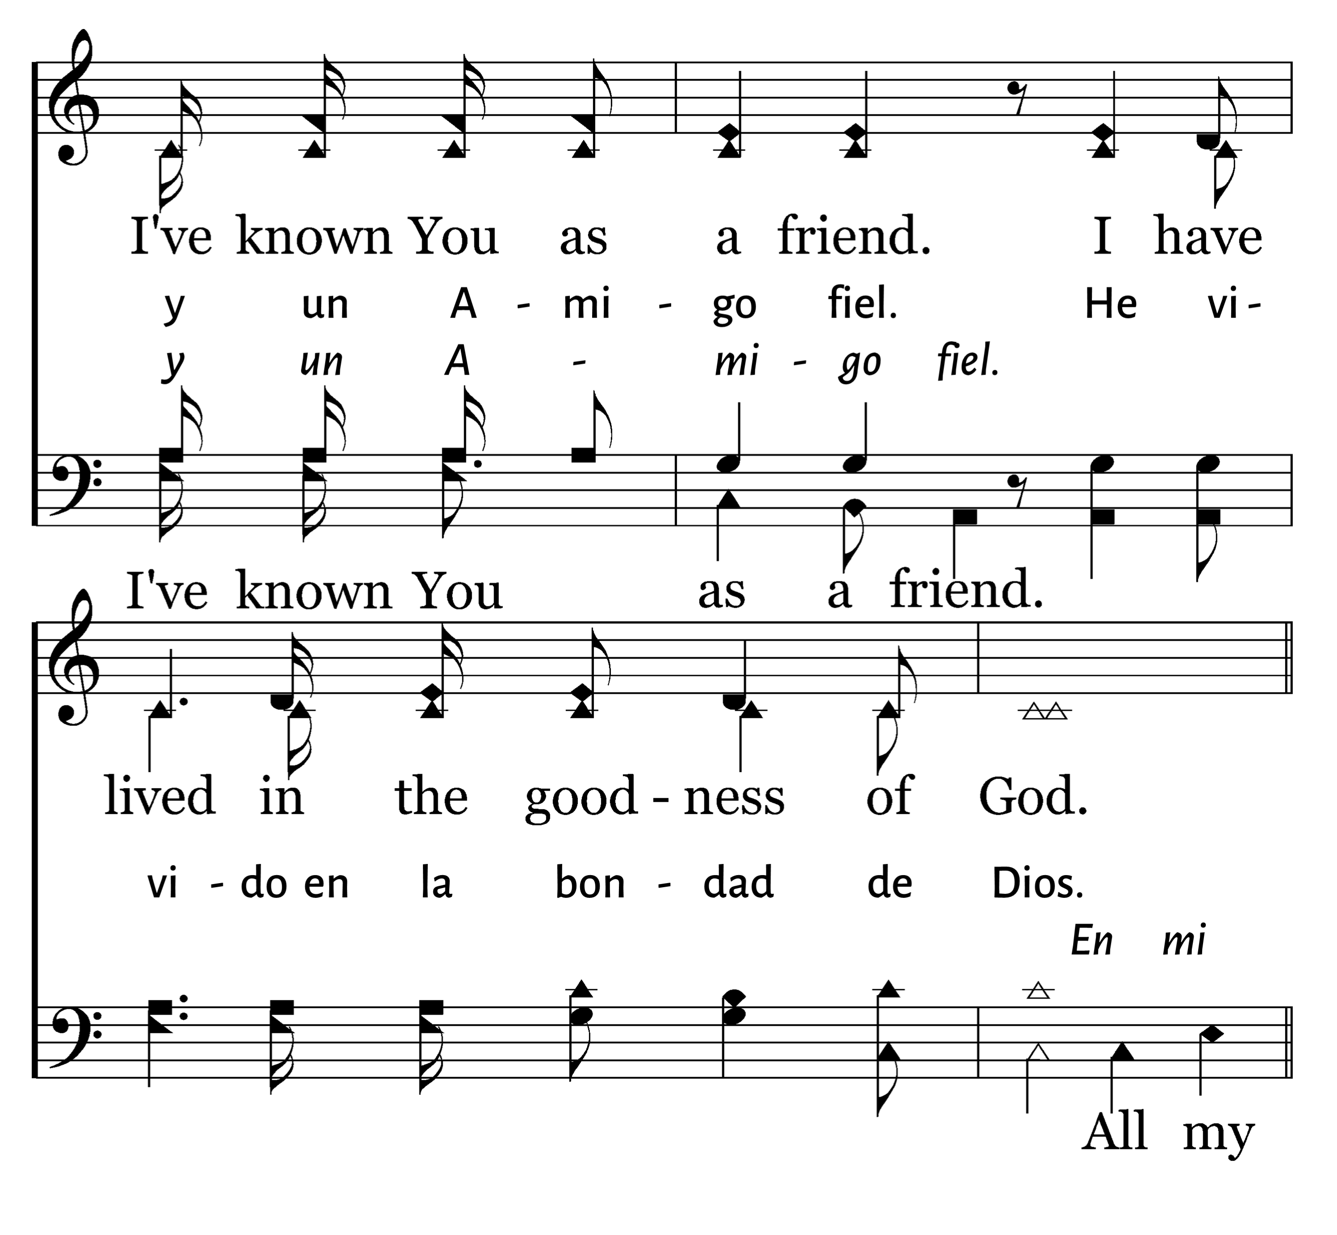
202
1
GOODNESS OF GOD
C
2
C
LA BONDAD DE DIOS
Typeset R. J. Stevens Music

Slide 40
202
1
GOODNESS OF GOD
C
2
C
LA BONDAD DE DIOS
Typeset R. J. Stevens Music

Slide 41
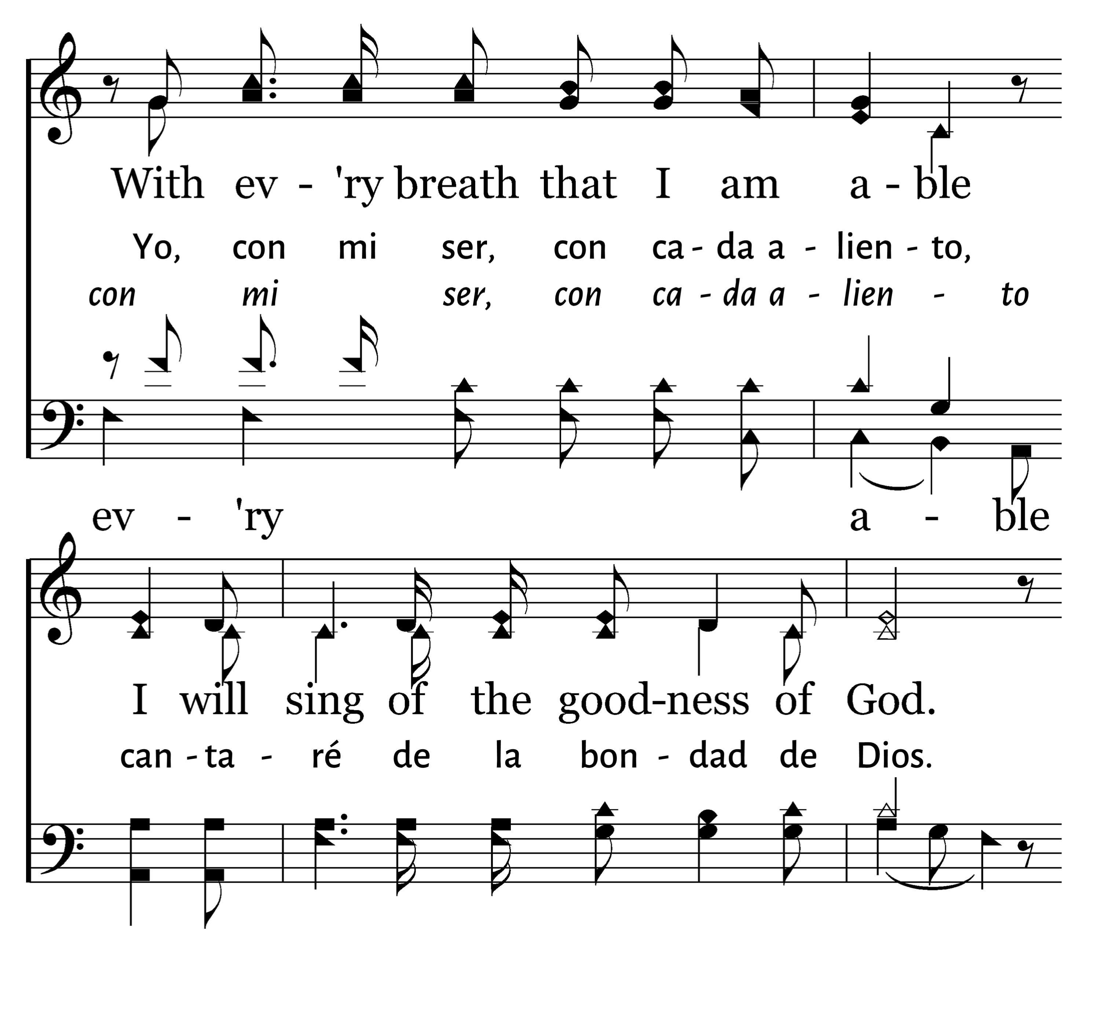
202
1
GOODNESS OF GOD
C
2
C
LA BONDAD DE DIOS
Typeset R. J. Stevens Music

Slide 42
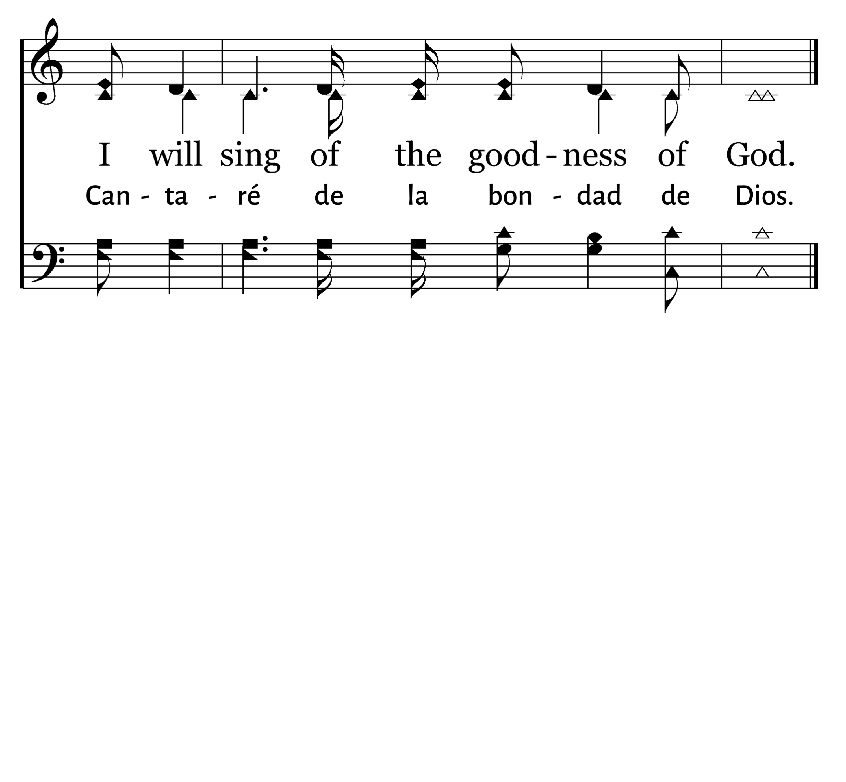
202
1
GOODNESS OF GOD
C
2
C
LA BONDAD DE DIOS
Typeset R. J. Stevens Music

Slide 43

Bienvenida
Ofrenda
Lectura
Oración
534
12
Cena del Señor
408
202
Sermón
67
Oración
Welcome
Collection
Reading
Prayer
534
12
Lord’s Supper
408
202
Sermon
67
Prayer
SERMÓN
SERMON
“NOS MANDÓ QUE PREDICÁSEMOS AL PUEBLO”
“HE COMMANDED US TO PREACH TO THE PEOPLE”
HECHOS 10:42
ACTS 10:42
Phillip Shumake

Slide 45

Notes:
Obviously generosity is a wonderful blessing to others when they have a need – but that’s not what I mean today.
When I say “life-giving” generosity – I mean what JESUS SAYS IN ACTS 20:35
It is more blessed to GIVE than to RECEIVE.
Jesus wants us to understand that of all the things we can do with our finances – ONE OF THE MOST REWARDING is when we choose GENEROSITY.
** So let me say from the outset – I’ve seen tremendous generosity at Embry Hills. For Christians, for the community, for strangers, family, and friends…
** Christians who are generous with their finances of course, but also generous in opening their homes in hospitality – generous in many many ways…
**. We WANT to be a GENEROUS PEOPLE…. So, we want to STUDY passages that HELP us grow in our GENEROSITY.
Ever since COVID, we hear passages about GIVING way less.
We don’t have a weekly giving talk like most of us grew up with – and I am concerned that some of the verses adults know well – are FAR less FAMILIAR to our students.
So today I want to DIVE into the most comprehensive passage on Christian Generosity in 2 Corinthians 8-9.
And I want us to approach this section understanding that when Paul is teaching on this subject – HE’S an UNRIVALED EXPERT…. And this is His Master Class….

Slide 46

Paul’s Master Class
Now, brethren, we wish to make known to you the grace of God which has been given in the churches of Macedonia, ² that in a great ordeal of affliction their abundance of joy and their deep poverty overflowed in the wealth of their liberality. ³ For I testify that according to their ability, and beyond their ability, they gave of their own accord, ⁴ begging us with much urging for the favor of participation in the support of the saints, ⁵ and this, not as we had expected, but they first gave themselves to the Lord and to us by the will of God.
Notes:
** Note first – Stories of Generosity are always moving... I’ve seen Christians help with travel expenses, furniture, and appliances. I’ve seen Christians help with clothes, shoes, and school supplies for children. One of my all time favorites was watching Christians pay around $500 for a small jar of JAM just to raise money for orphans.
Paul begins teaching us by telling us the story of the Macedonians – this is the church at Philippi and Thessolonica and others in that region….
First thing Paul does is call out God’s grace. – Their generosity was not simply because they were “giving” people. Their giving isn’t just a “church tax” the apostles are charging.
Their generosity was an indication that THEY UNDERSTOOD how much was already GIVEN to THEM.
They were helped by Christ when they most needed it.
The were blessed by the gospel that began in Jerusalem.
They have a CLEAR RECOGNITION of how abundantly they have been shown GRACE – greater kindness than they deserve. So they want to pay it forward.
The second thing he does with this story is acknowledge that circumstances can make this HARD!
They had a great ordeal of Affliction. (JFB says “a great testing of affliction” – things are hard enough for them that this is really testing their faith and character.)
We all know when Gas Prices are Crazy. When back to school shopping has us stretched. When the car needs repairs. When… the list goes on…
As hard as the AFFLICTION TESTED THEM – it was no match for the LOVE OF CHRIST that was in their hearts. The JOY they have in Jesus can’t be snuffed out by earthly trials.
BEYOND THEIR ABILITY – they over-performed what anyone expected. They really brought their whole hearts to this!
SUPPORT OF SAINTS – they have in their mind the GOOD these funds are going to. They can imagine the food for the hungry, the clothes for those who had lost everything because of the famine. Etc….
“Not as we had” = BEYOND OUR EXPECTATIONS. Because they are SO committed to Jesus Christ and to God’s people and God’s will.

Slide 47
Everyone Needs Reminders
Reminders To Abound In…
Faith
Knowledge
Love
Utterance
Earnestness
Generosity
Because of Jesus…
“For you know the grace of our Lord Jesus Christ, that though He was rich, yet for your sake He became poor, so that you through His poverty might become rich.”
Notes:
You already abound in…. ** Guys he could be describing Embry Hills. We have strong faith. We have great teaching. We are hard workers, and full of love…. So his point is, we need to not just participate in generosity but ABOUND in generosity.
** The Grace – The Favor – The Undeserved Help

Slide 48
Everyone Needs Reminders
Reminders To Complete…
“the first to begin a year ago...” (8:10)
“now finish doing it...” (8:11)
“the completion of it by your ability...” (8:12)
Understanding What Pleases God…
“For if the readiness is present, it is acceptable according to what a person has, not according to what he does not have.” (8:12)
Notes:
You already abound in…. ** Guys he could be describing Embry Hills. We have strong faith. We have great teaching. We are hard workers, and full of love…. So his point is, we need to not just participate in generosity but ABOUND in generosity.
** The Grace – The Favor – The Undeserved Help
** Pleasing God – God is not asking for the impossible. God is not asking for the Reckless! God is asking for a generous evaluation of what we have available.

Slide 49
Generosity Responds To Needs In Light of Our Abundance
“For this is not for the ease of others and for your affliction, but by way of equality— ¹⁴ at this present time your abundance being a supply for their need, so that their abundance also may become a supply for your need, that there may be equality; ¹⁵ as it is written, “He who gathered much did not have too much, and he who gathered little had no lack.”
GREEDY
NEEDLESS

Slide 50

The Genius of Generosity
God teaches us generosity because it simultaneously redirects our hearts and provides for His people.
Notes:
Jesus wants us to THINK about our HEAVENLY HOME and wants us to LAY UP our treasures with HIM ABOVE…
Kingdom Generosity wants to see care for Saints both Near & Far….
Tell a STORY HERE….

Slide 51

A Generous Heart…
Generous people give thoughtfully.
Generous people give willingly.
Generous people give cheerfully.
Generous people give proportionally.
Generous people give sacrificially.
Notes:
2 COR. 9:6-7a
Thoughtfully – “let me get my thoughts together” – REALLY cool that the Greek for “WORD” – Logos – in John chapter 1, is the same root word for “Collection”
If someone has ever said “I just need a moment to collect my thoughts…” And they take that moment to collect their feelings and ideas and match those with their vocabulary – then they are ready to speak – LOGOS is the collecting and connecting of ideas and words.
This GREEK word in 1 Cor. 16:1-2 the only time it is used is of the ‘Collection’ – I want to collect my financial resources so they can be matched with real world good works!
Thoughtfully – Yes, a generous heart will lead us to some spontaneous giving. But that’s not this context. This context is talking about plans that have been in the works for over a year!!
Reminds us of a truth – we get better at the things we focus on. We don’t just wake up a brain surgeon one day. There’s a TON of thought and practice and education to gain that skill. The same is true of Generosity. We don’t just wake up – ready to think about everyone else instead of ourselves! It requires learning and training and practice. IT requires our attention.
2 COR. 9:7b – Not grudingly or under compulsion.
2 COR. 9:7c – God loves a cheerful giver.
2 COR. 8:11-12 “whatever you give…according to what you HAVE…” *Paul had already taught this idea earlier in 1 Corinthians with similar language…. 1 COR 16:1-2 – Giving “as we may prosper”. In proportion to what they have. One person could give $10 and that could be incredibly generous. Another person could given $1,000 and they wouldn’t even notice. It’s not the specific amount it’s the willingness to consider is this like the Macedonians – from a good heart at the top of my ability… of am I just giving God at the least of my ability?
SACRIFICIALLY - 2 COR 8…. During Testing Affliction . They don’t just give when it’s easy. They give even when they really feel it. HOW? WHY? Because sacrificial giving is an ACT OF FAITH. It is choosing to TRUST in GOD. *And our TRUST in GOD is there because we remember that JESUS GAVE SACRIFICIALLY!
We understand that “You can’t out give God.” HE has already been so good to us, and as 9:8 God “…make all grace abound to you…”
>>> Some of you are SO GENEROUS!!! With your time, with your finances, with your heart!!! THANK YOU!
>>> But for some, if we are honest with ourselves, we know we aren’t giving Sacrificially.

Slide 52
Generous Christians Know…
It’s all from God, so it’s all for God.
Notes:
We want to be people like the Macedonians who ABOUND in generosity. Paul’s master class challenges us – but it reminds us HOW MUCH AMAZING GRACE has been given to us in Jesus Christ!
Kingdom Generosity is INSPIRED BY God’s INDESCRIBIBLE GIFT.

Slide 53
Notes:
Today we’ve been talking about what we GIVE to GOD – and the very first thing we give HIM is our HEART.
We give our lives to FOLLOWING JESUS by accepting the invitation of the Gospel to COME in FAITH and REPENTENCE to have our sins WASHED AWAY….

Slide 54
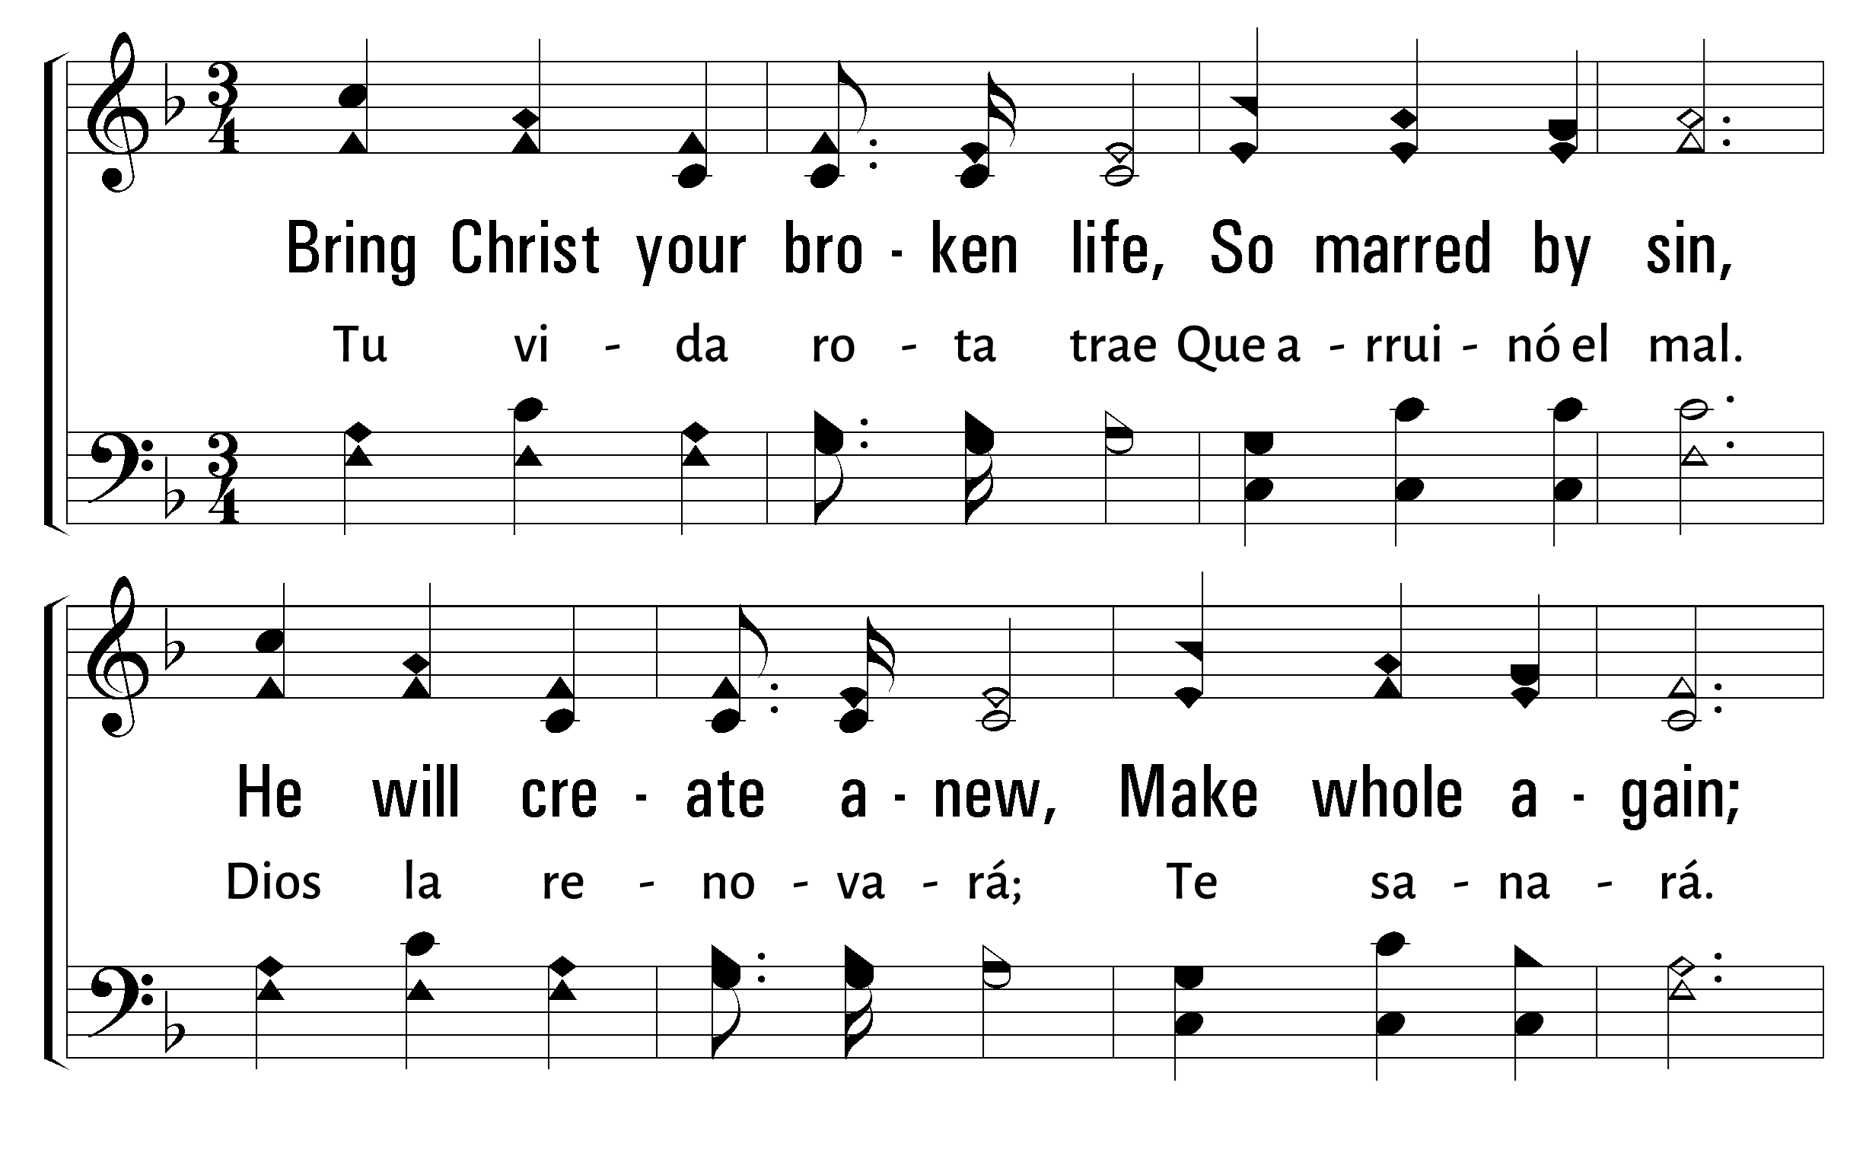
1
2
4
67
BRING CHRIST YOUR BROKEN LIFE • TU VIDA ROTA TRAE
© 2001 The Paperless Hymnal™

Slide 55
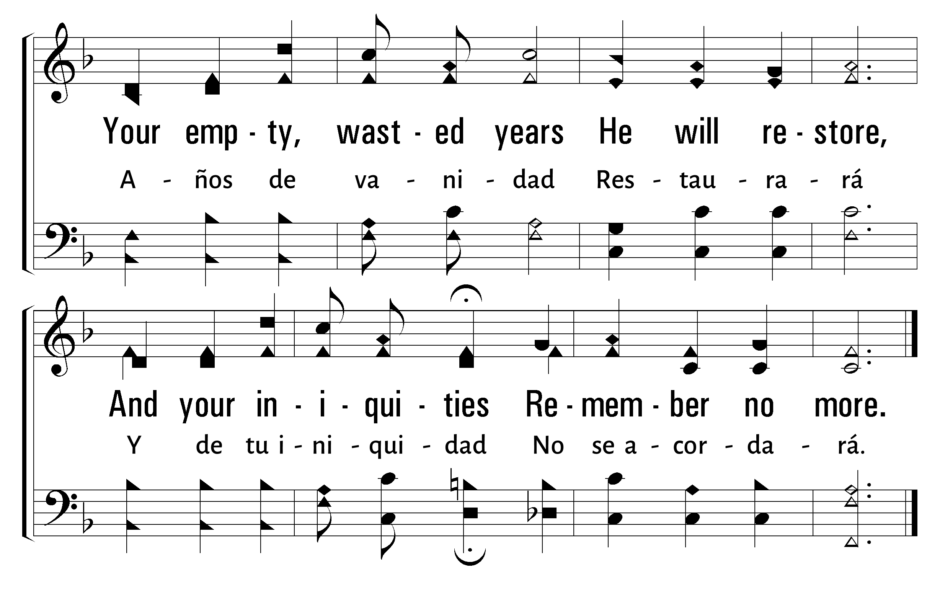
1
2
4
67
BRING CHRIST YOUR BROKEN LIFE • TU VIDA ROTA TRAE
© 2001 The Paperless Hymnal™

Slide 56
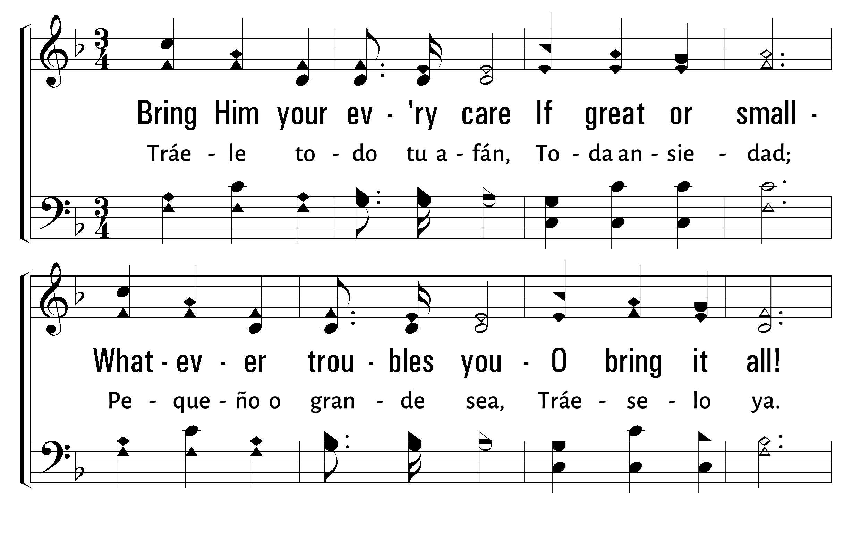
1
2
4
67
BRING CHRIST YOUR BROKEN LIFE • TU VIDA ROTA TRAE
© 2001 The Paperless Hymnal™

Slide 57
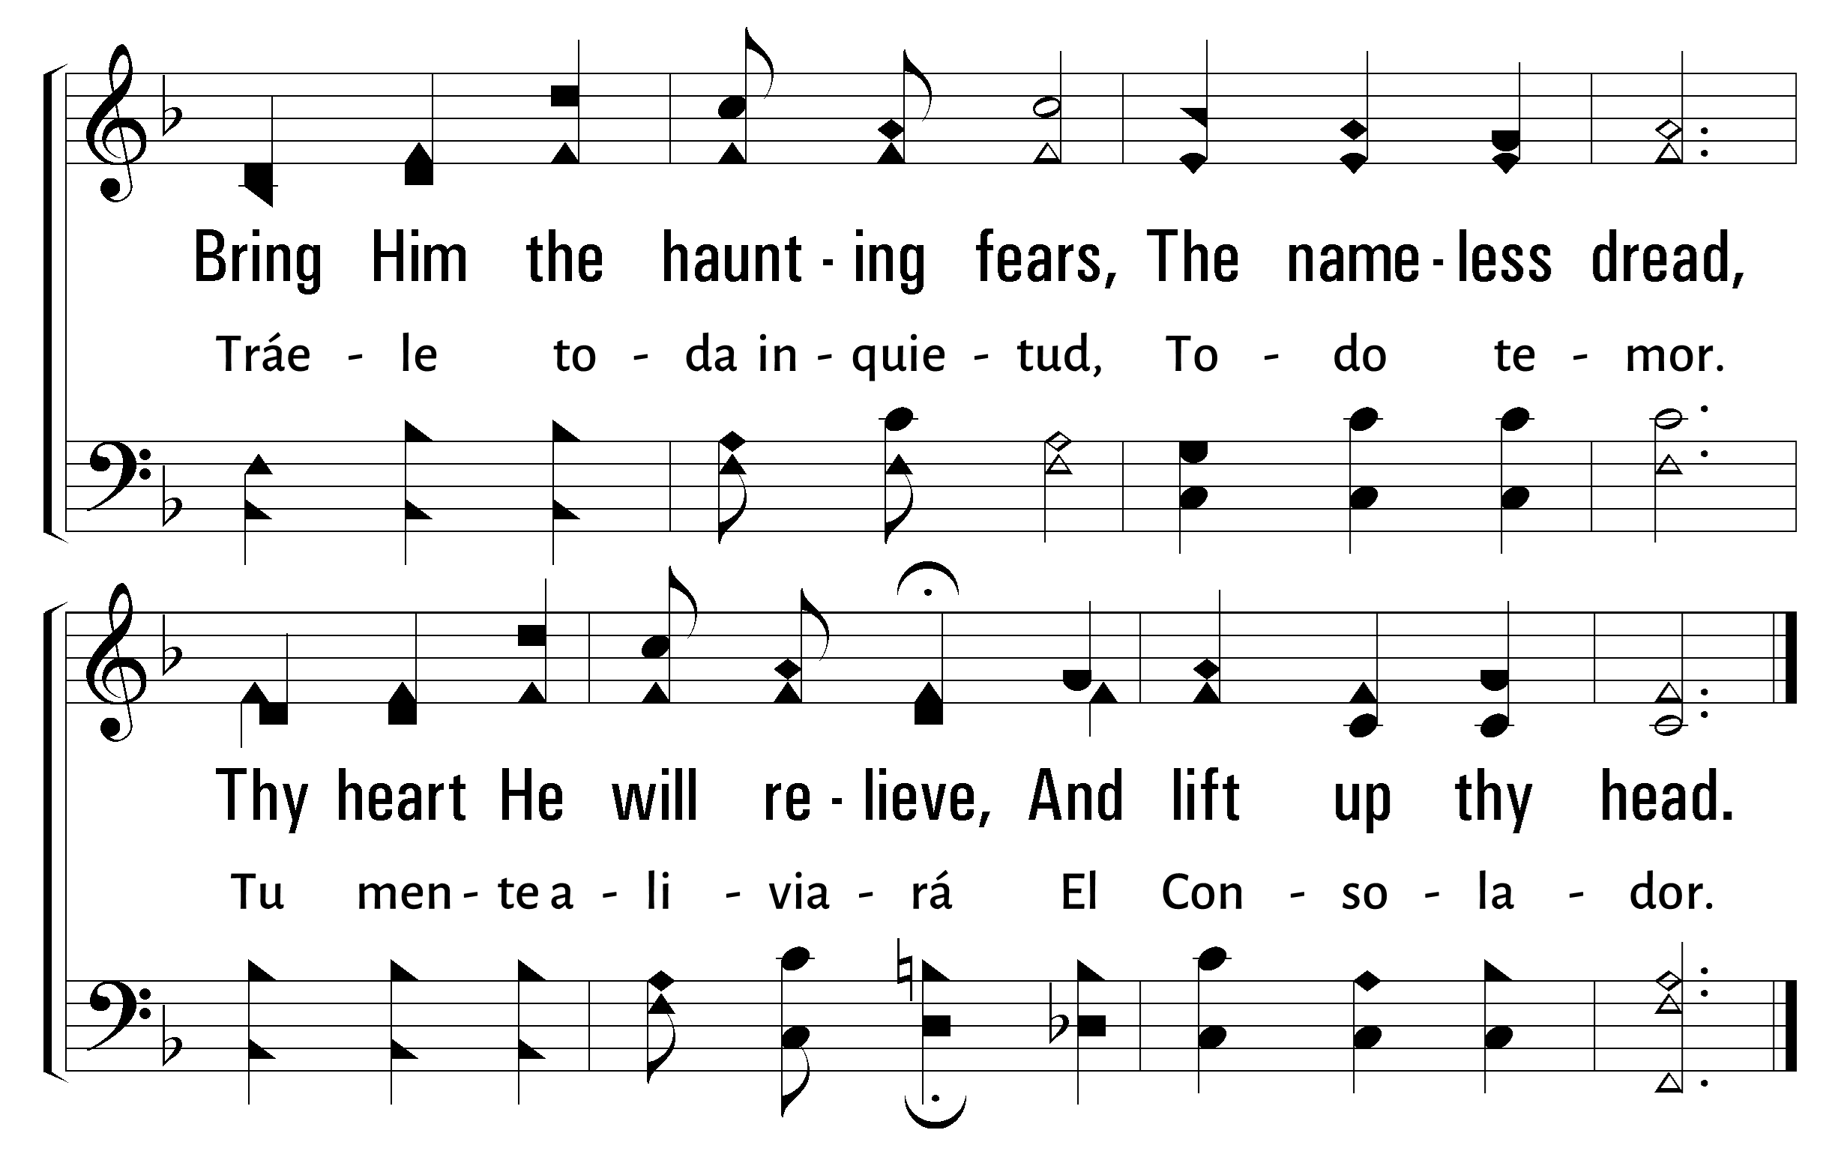
1
2
4
67
BRING CHRIST YOUR BROKEN LIFE • TU VIDA ROTA TRAE
© 2001 The Paperless Hymnal™

Slide 58
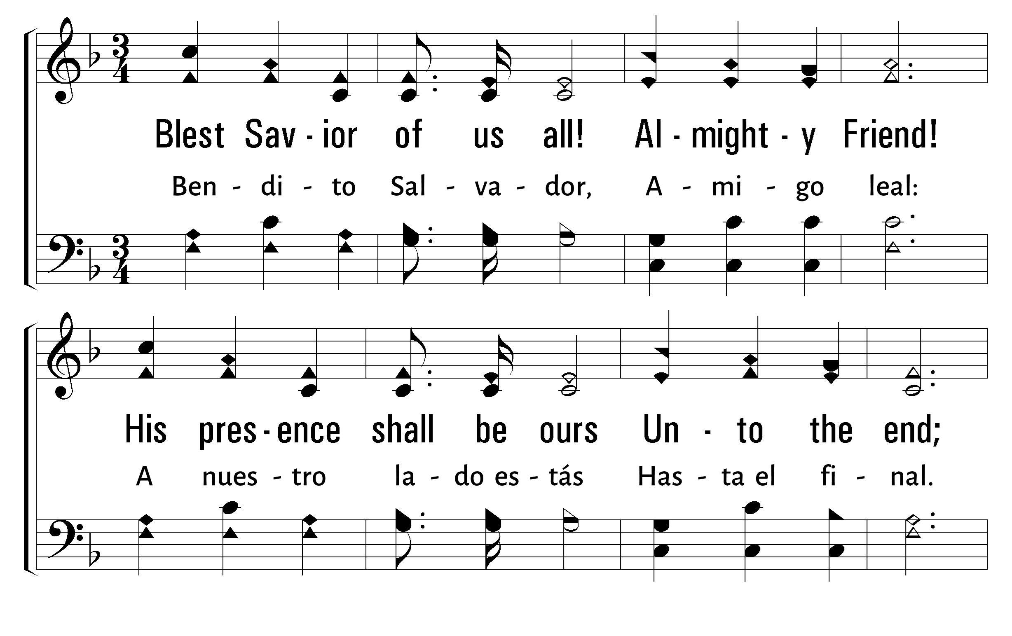
1
2
4
67
BRING CHRIST YOUR BROKEN LIFE • TU VIDA ROTA TRAE
© 2001 The Paperless Hymnal™

Slide 59
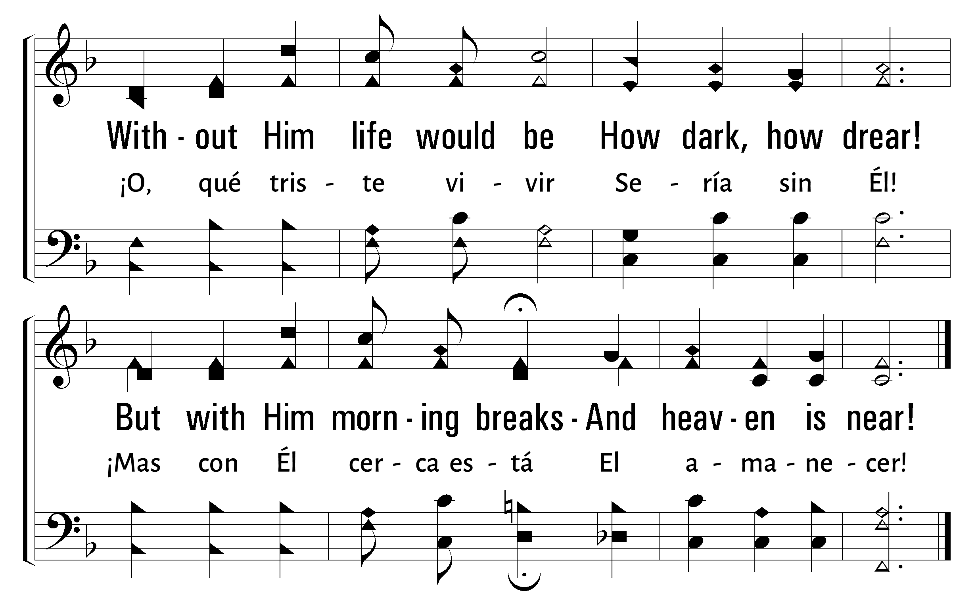
1
2
4
67
BRING CHRIST YOUR BROKEN LIFE • TU VIDA ROTA TRAE
© 2001 The Paperless Hymnal™

Slide 61
Bienvenida
Ofrenda
Lectura
Oración
534
12
Cena del Señor
408
202
Sermón
67
Oración
Welcome
Collection
Reading
Prayer
534
12
Lord’s Supper
408
202
Sermon
67
Prayer
ORACIÓN
PRAYER
“DEVOTE YOURSELVES TO PRAYER”
“PERSEVERAD EN LA ORACIÓN”
COLOSSIANS 4:2
COLOSENSES 4:2

