Slide 1





Bienvenida
Ofrenda
Lectura
Oraciï¿œn
25
742
Cena del Seï¿œor
103
277
Sermï¿œn
613
Oraciï¿œn
Welcome
Collection
Reading
Prayer
25
742
Lord’s Supper
103
277
Sermon
613
Prayer
Alex Cruttenden
Jeff Dutra
Announcements
Luke 1:46-55
All Things Praise Thee
When I Survey the Wondrous Cross
Isaiah 53:9-10a
Behold Our God
Speak, O Lord
Take My Life, and Let It Be
Bienvenida
Lucas 1:46-55
Todo Te alaba
Al contemplar la excelsa cruz
Isaías 53:9-10a
Contempla a Dios
Habla, oh Dios
Sermï¿œn
Que mi vida entera esté
Please silence your phone
Favor de apagar los celulares
28 de junio
domingo • 10:00a.m.
June 28, 2026
Sunday • 10:00am

Slide 2
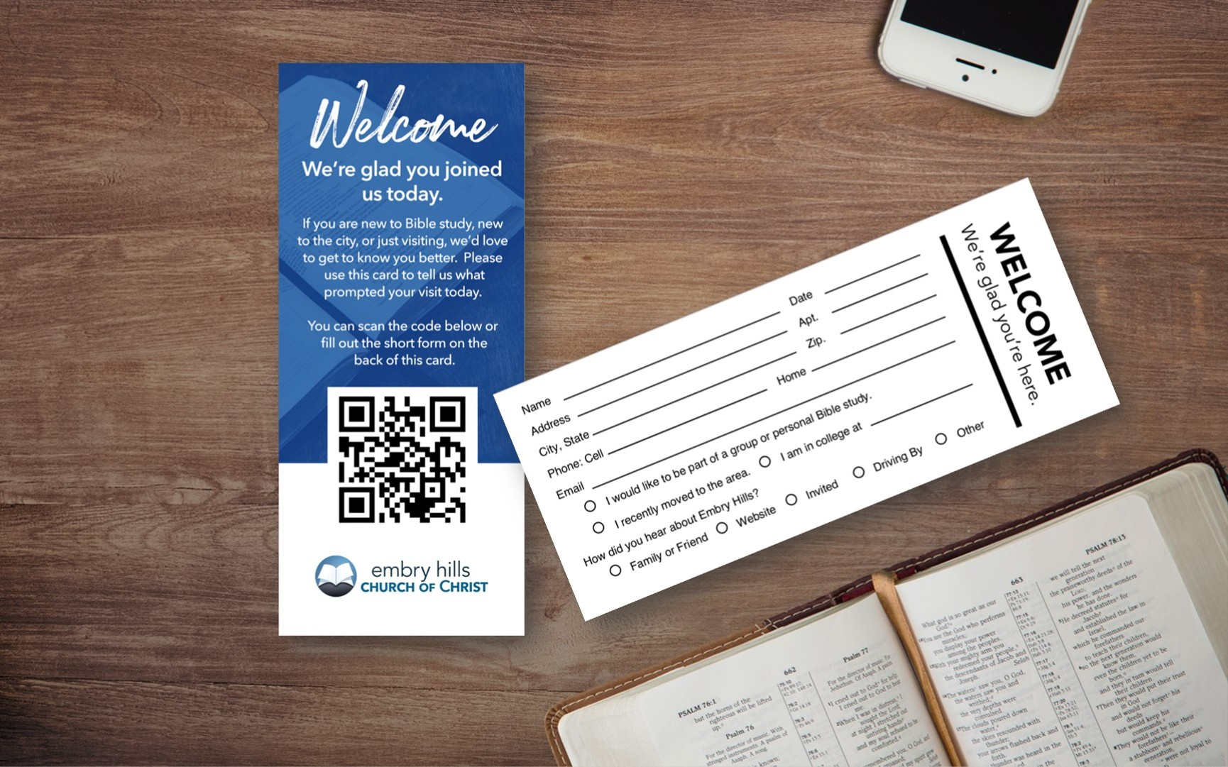
Bienvenida
Ofrenda
Lectura
Oraciï¿œn
25
742
Cena del Seï¿œor
103
277
Sermï¿œn
613
Oraciï¿œn
Welcome
Collection
Reading
Prayer
25
742
Lord’s Supper
103
277
Sermon
613
Prayer

Slide 3
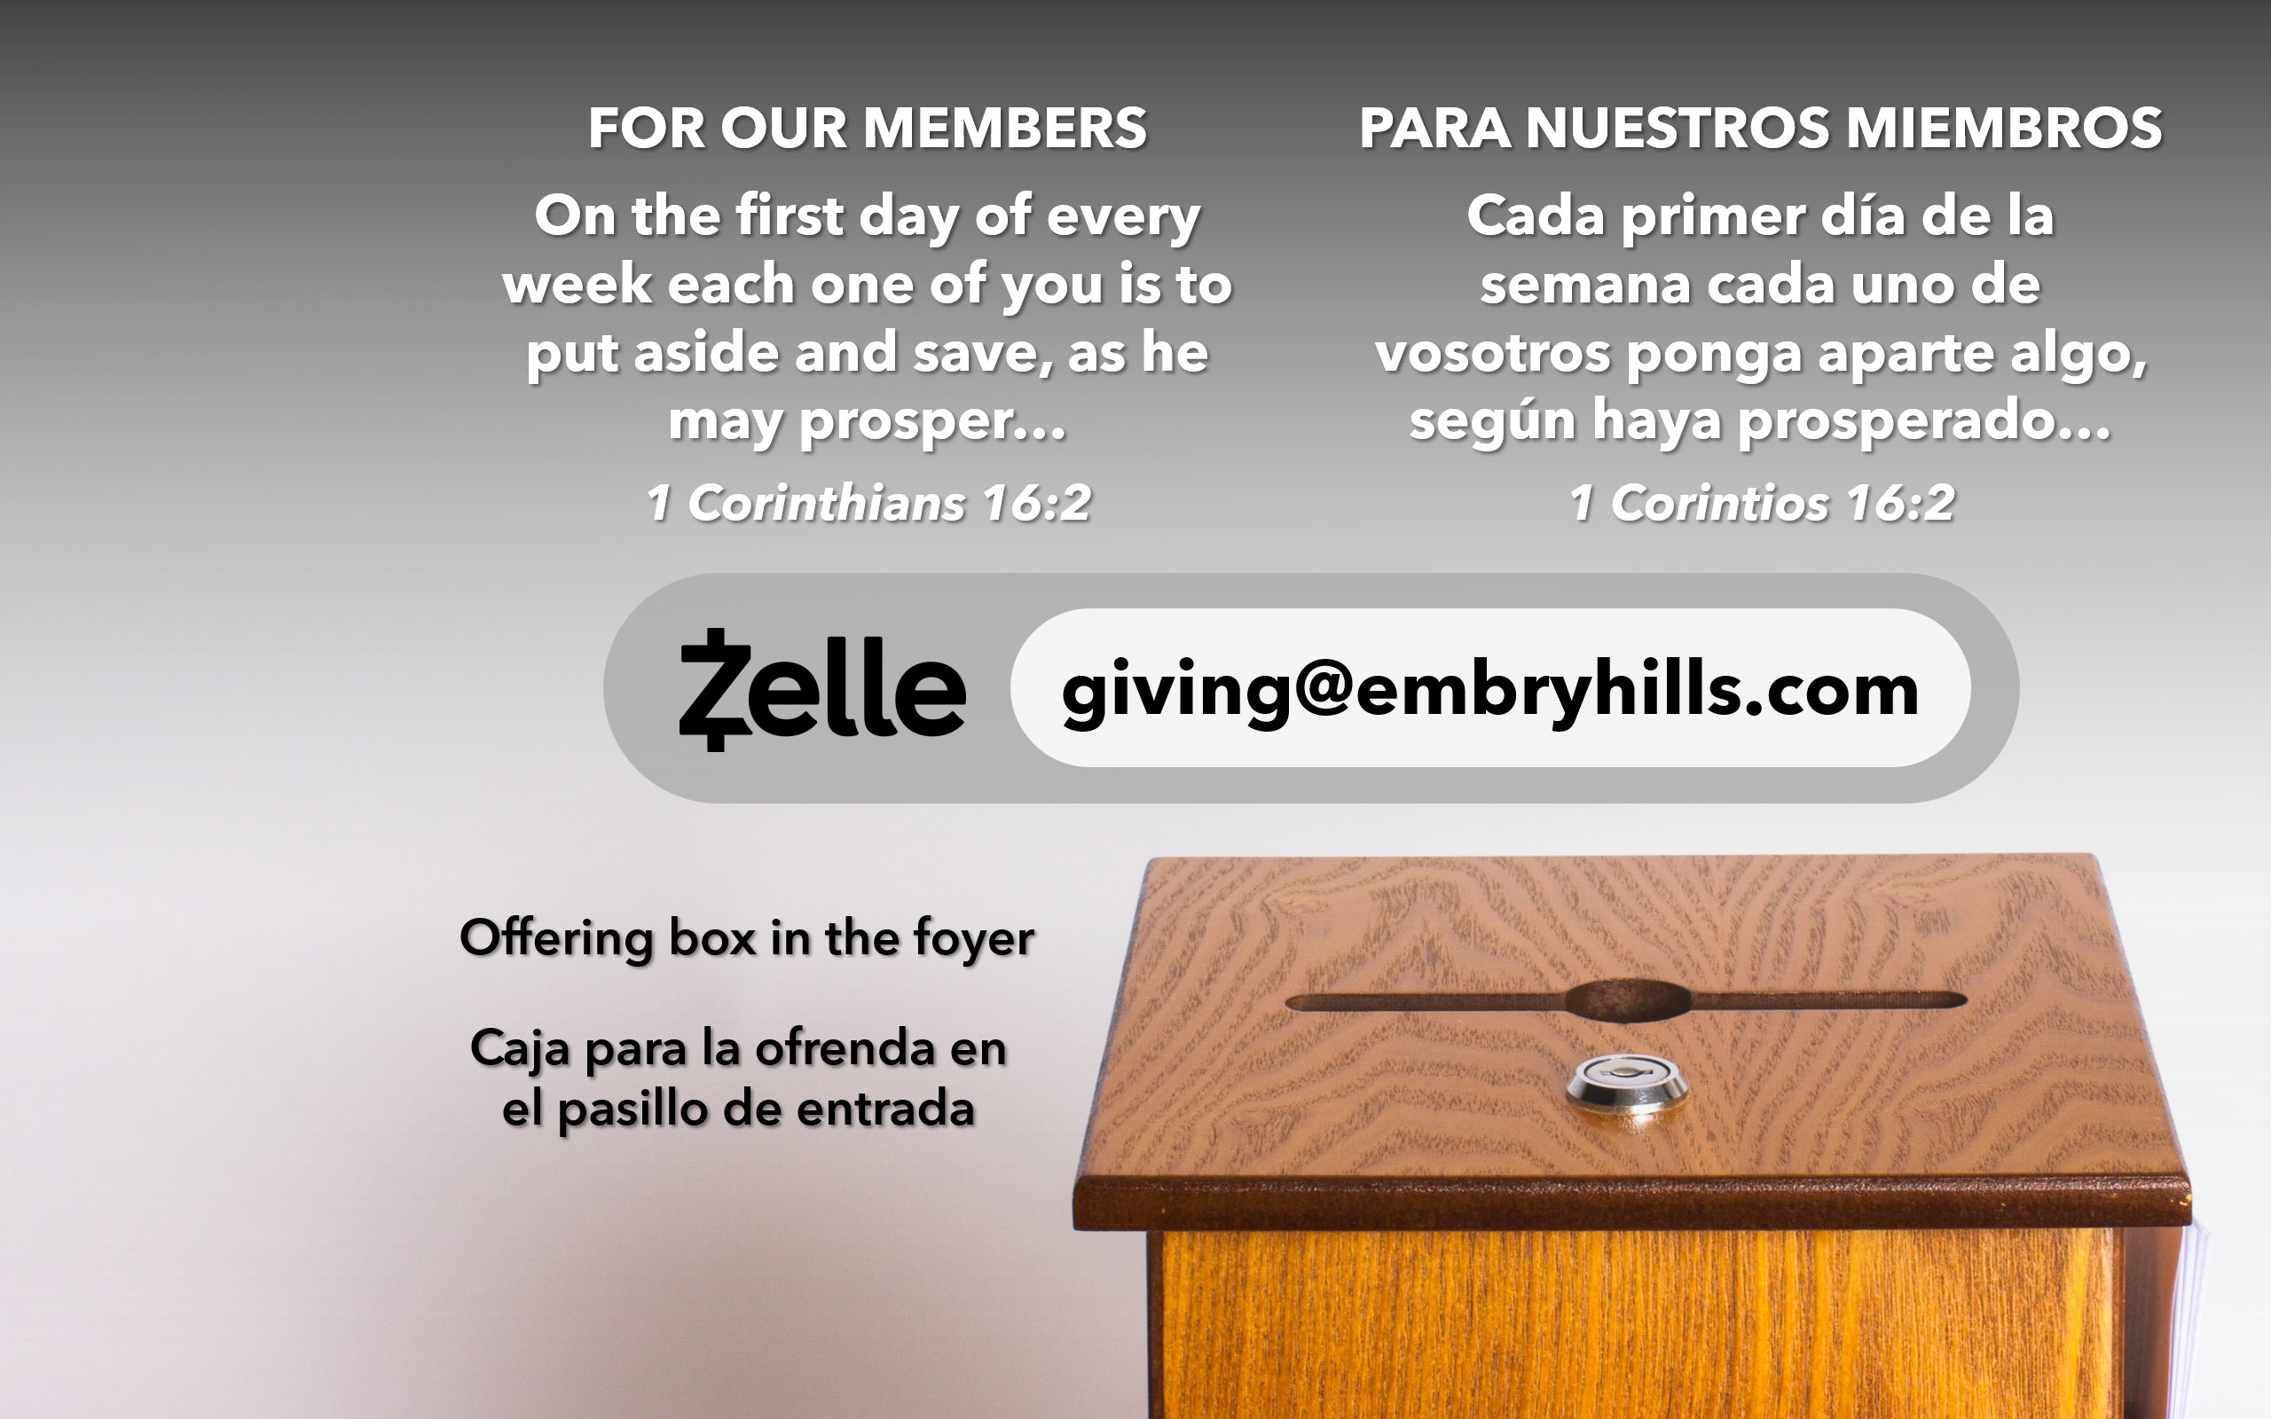
Bienvenida
Ofrenda
Lectura
Oraciï¿œn
25
742
Cena del Seï¿œor
103
277
Sermï¿œn
613
Oraciï¿œn
Welcome
Collection
Reading
Prayer
25
742
Lord’s Supper
103
277
Sermon
613
Prayer

Slide 5

Bienvenida
Ofrenda
Lectura
Oraciï¿œn
25
742
Cena del Seï¿œor
103
277
Sermï¿œn
613
Oraciï¿œn
Welcome
Collection
Reading
Prayer
25
742
Lord’s Supper
103
277
Sermon
613
Prayer
“Repentance and remission of sins should be preached in His name to all nations, beginning at Jerusalem.”
“Y que se predicase en su nombre el arrepentimiento y el perdón de pecados en todas las naciones, comenzando desde Jerusalén.”
Luke 24:47
Lucas 24:47

Slide 6

Bienvenida
Ofrenda
Lectura
Oraciï¿œn
25
742
Cena del Seï¿œor
103
277
Sermï¿œn
613
Oraciï¿œn
Welcome
Collection
Reading
Prayer
25
742
Lord’s Supper
103
277
Sermon
613
Prayer
LECTURA
READING
LUKE 1:46-55
LUCAS 1:46-55
“HAVE THIS LETTER READ TO ALL”
“QUE ESTA CARTA SE LEA A TODOS”
1 THESSALONIANS 5:27
1 TESALONICENSES 5:27

Slide 7

Bienvenida
Ofrenda
Lectura
Oraciï¿œn
25
742
Cena del Seï¿œor
103
277
Sermï¿œn
613
Oraciï¿œn
Welcome
Collection
Reading
Prayer
25
742
Lord’s Supper
103
277
Sermon
613
Prayer
ORACIï¿œN
PRAYER
“DEVOTE YOURSELVES TO PRAYER”
“PERSEVERAD EN LA ORACIï¿œN”
COLOSSIANS 4:2
COLOSENSES 4:2

Slide 8
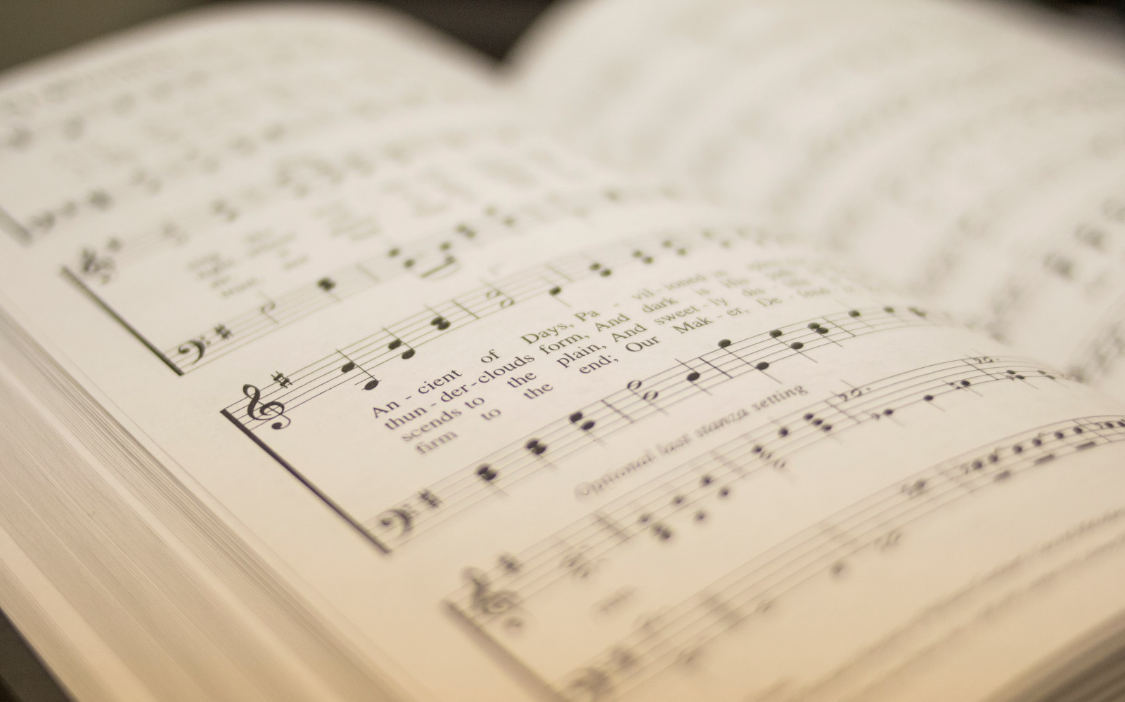
Bienvenida
Ofrenda
Lectura
Oraciï¿œn
25
742
Cena del Seï¿œor
103
277
Sermï¿œn
613
Oraciï¿œn
Welcome
Collection
Reading
Prayer
25
742
Lord’s Supper
103
277
Sermon
613
Prayer
25
25
TODO TE ALABA
ALL THINGS PRAISE THEE
1
2
3
“CANTANDO...AL SEï¿œOR” COLOSENSES 3:16
“SINGING...TO THE LORD” COLOSSIANS 3:16
Words: George W. Conder Music: Conrad Kocher / Arr.: William H. Monk
Letra: George W. Conder Música: Conrad Kocher / Arr.: William H. Monk

Slide 9
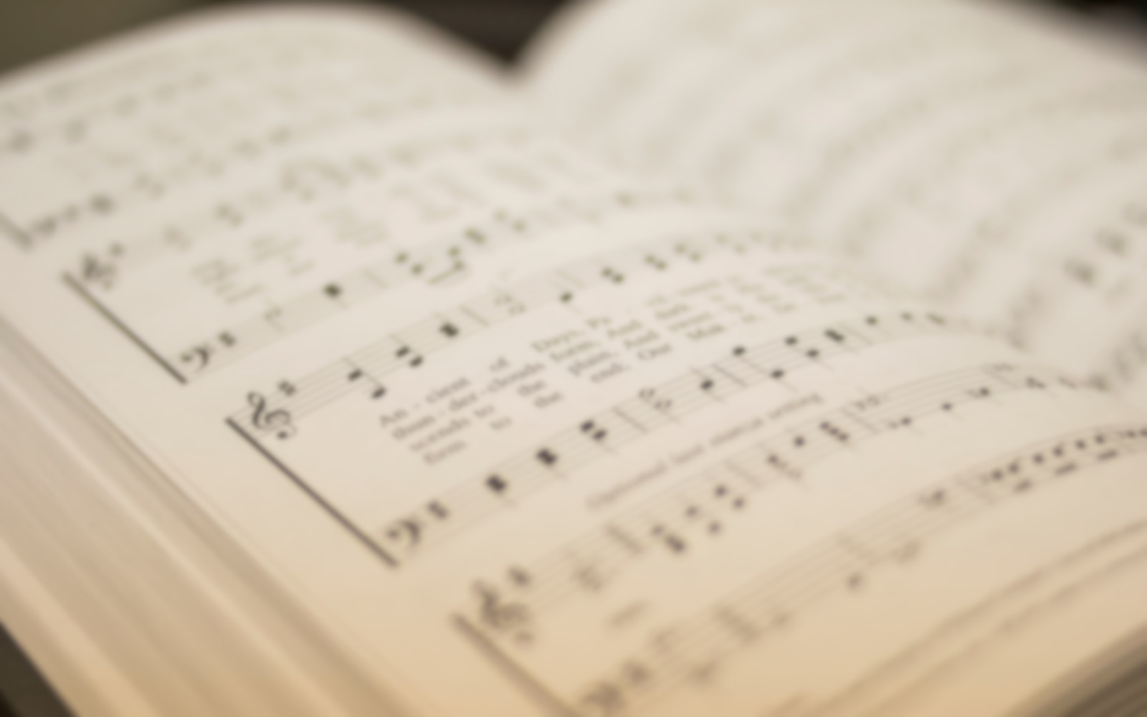
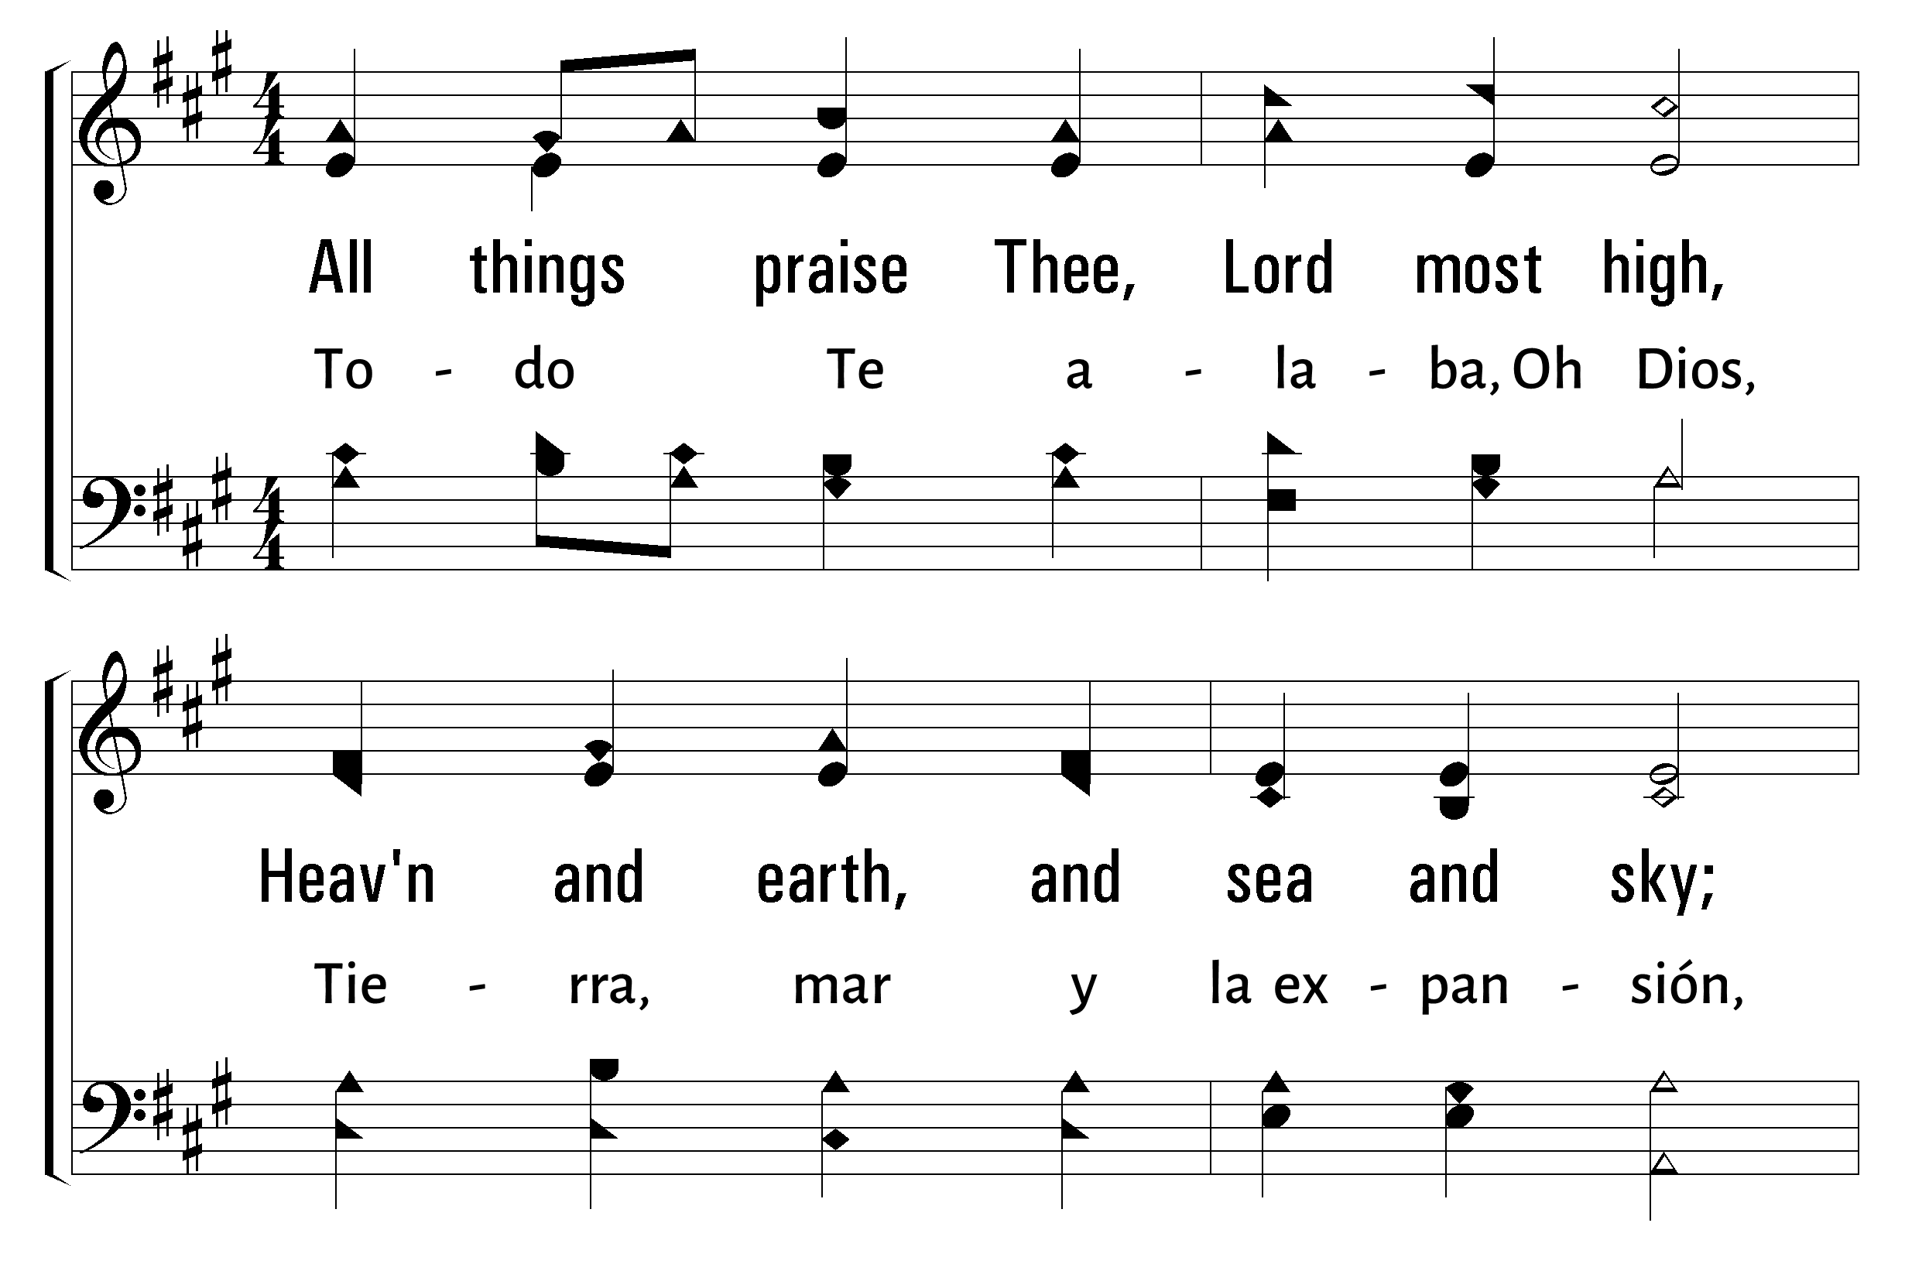


1
2
3
25
ALL THINGS PRAISE THEE • TODO TE ALABA
© 2006 The Paperless Hymnal®

Slide 10
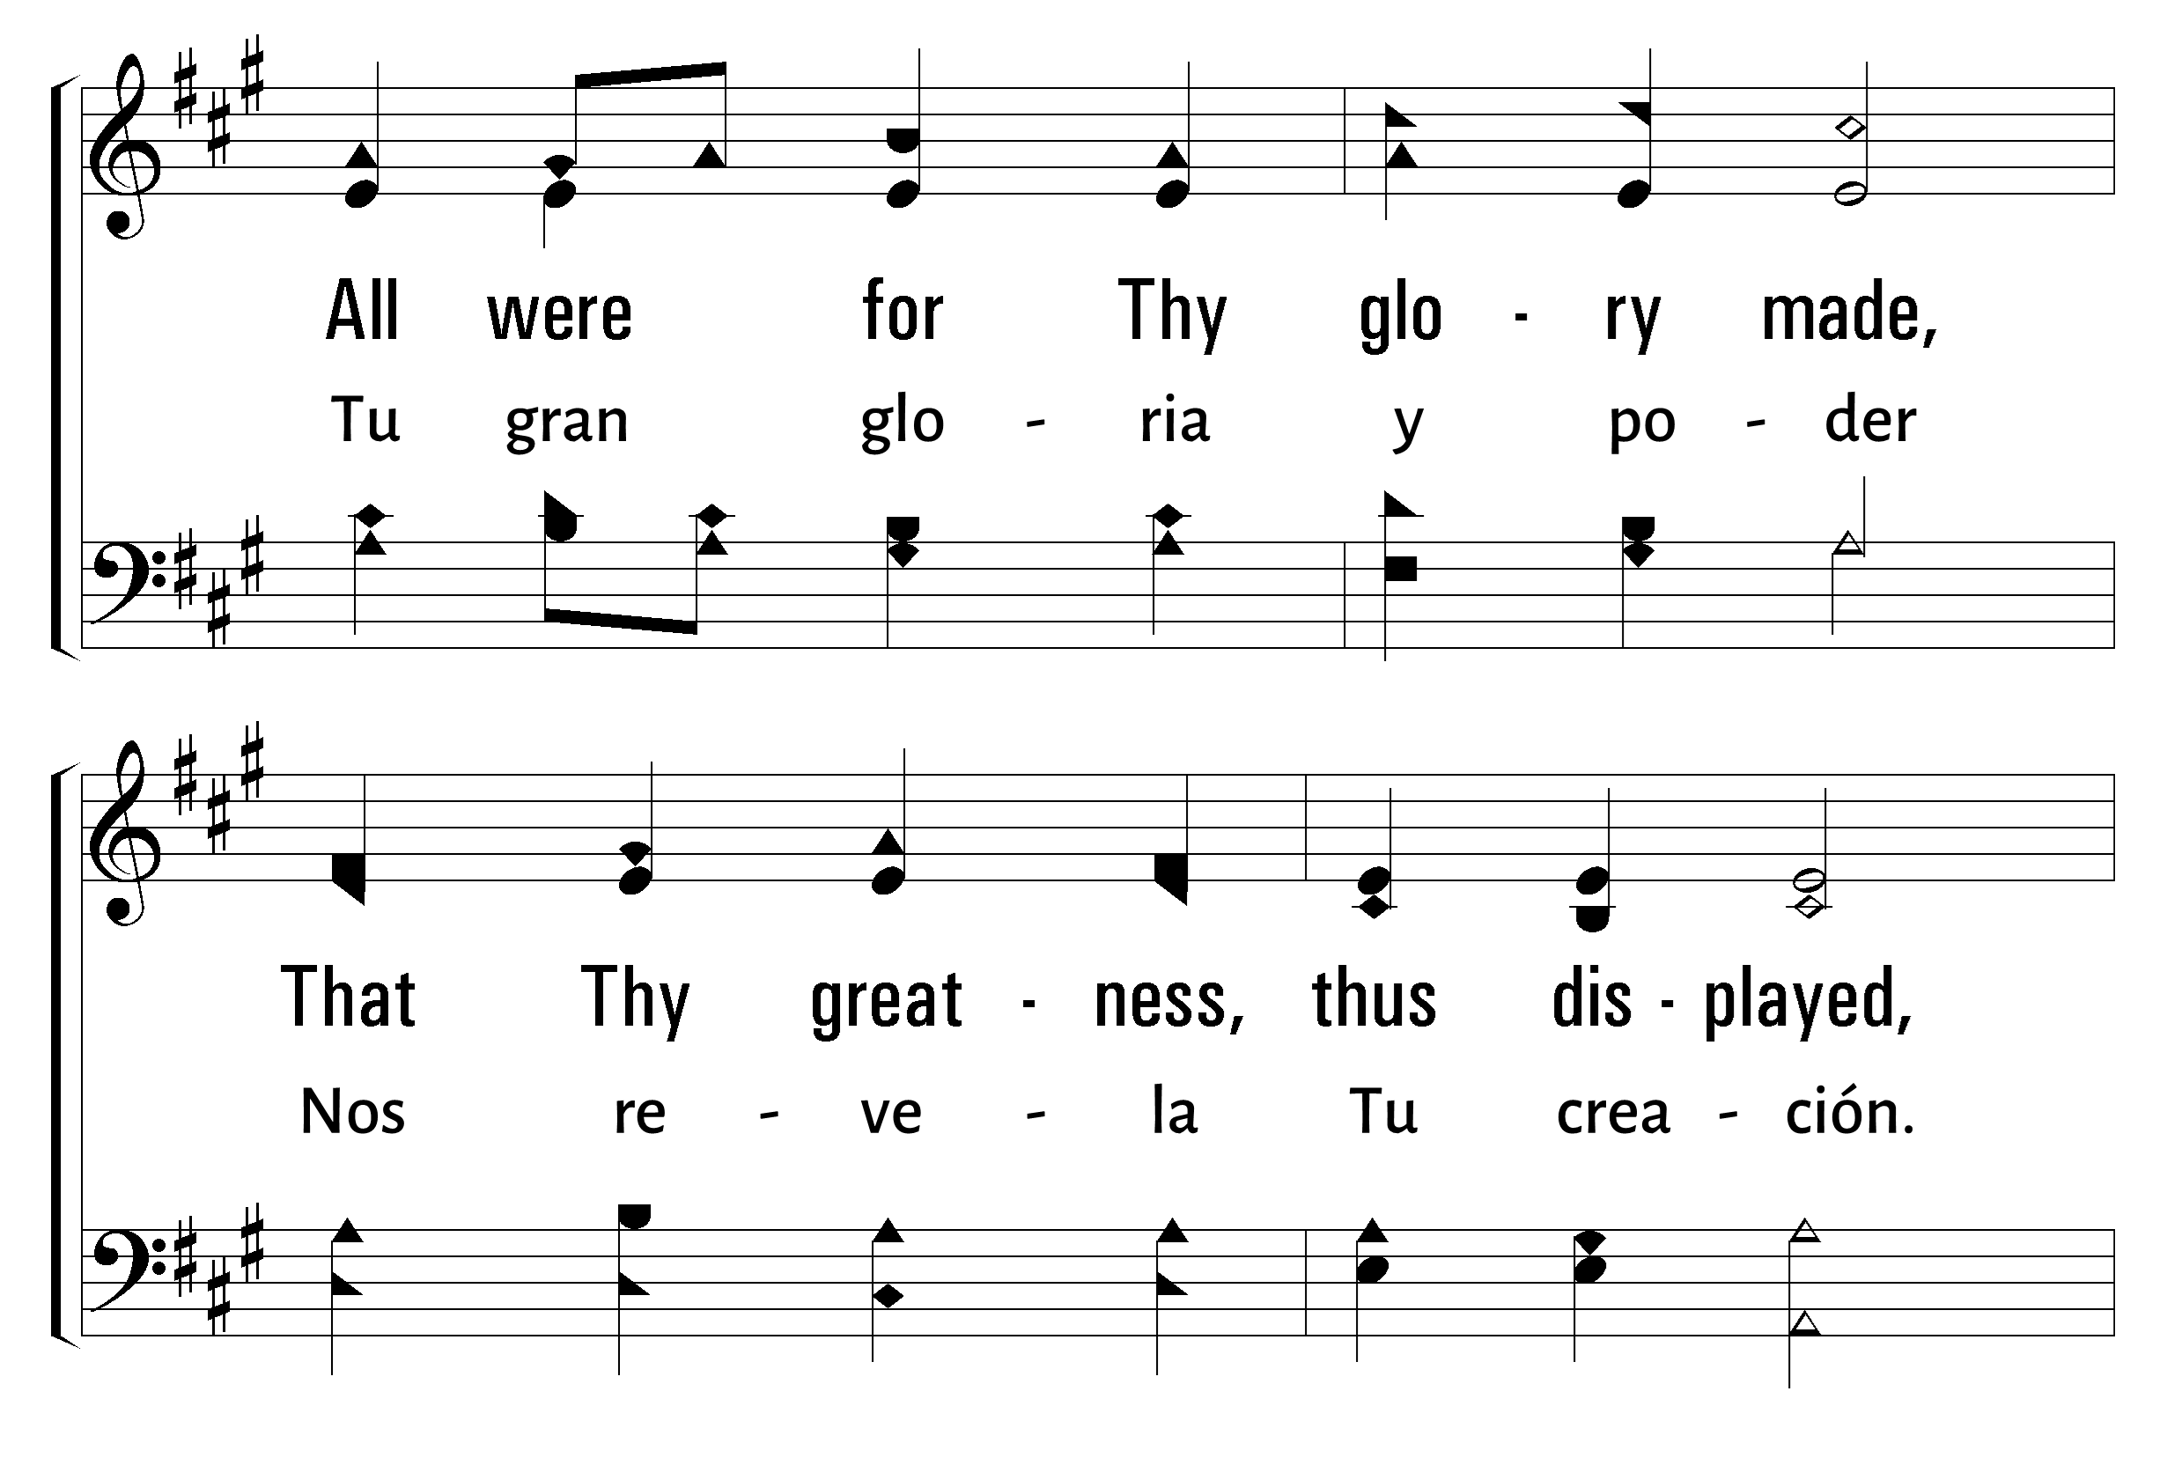
1
2
3
25
ALL THINGS PRAISE THEE • TODO TE ALABA
© 2006 The Paperless Hymnal®

Slide 11
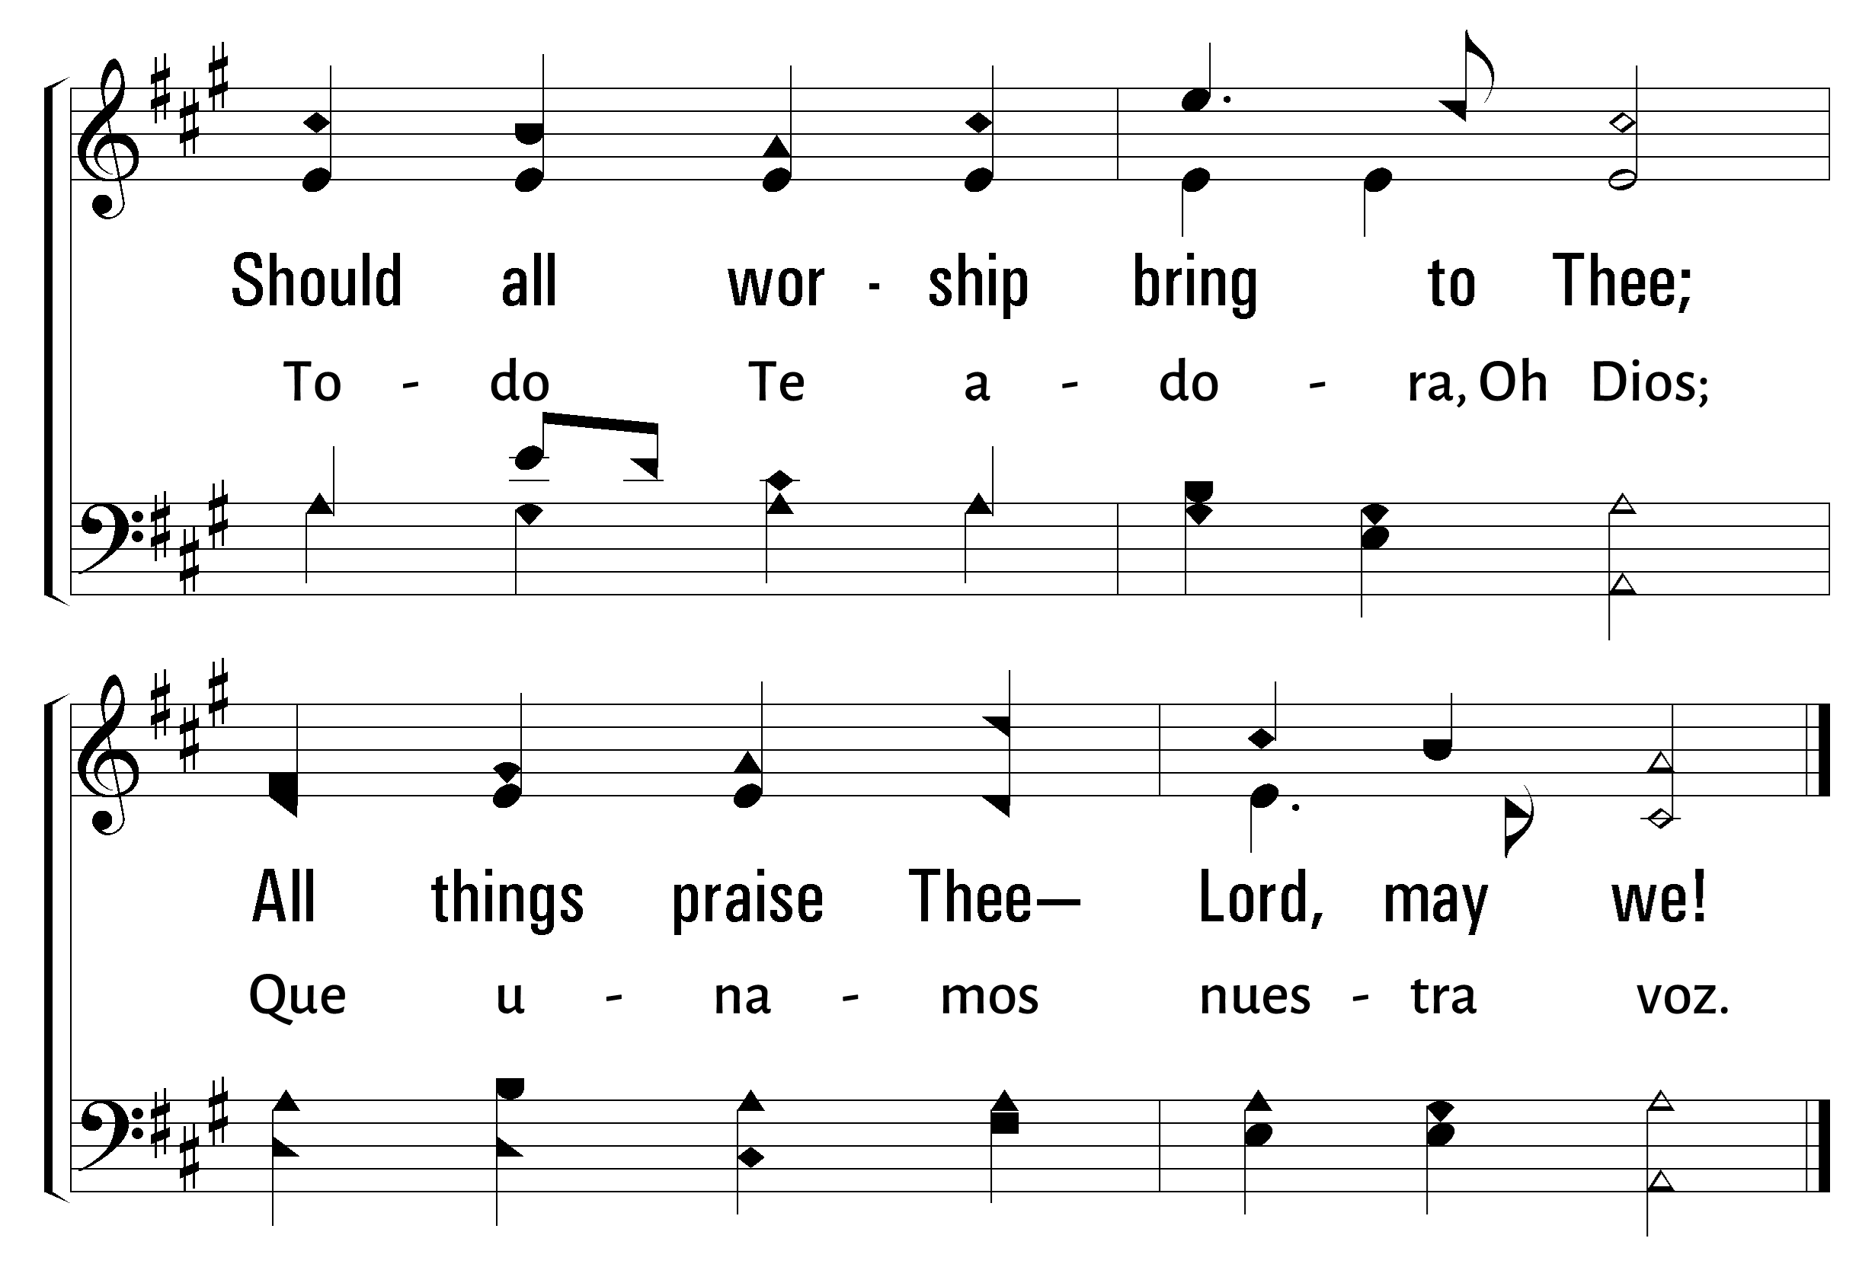
1
2
3
25
ALL THINGS PRAISE THEE • TODO TE ALABA
© 2006 The Paperless Hymnal®

Slide 12
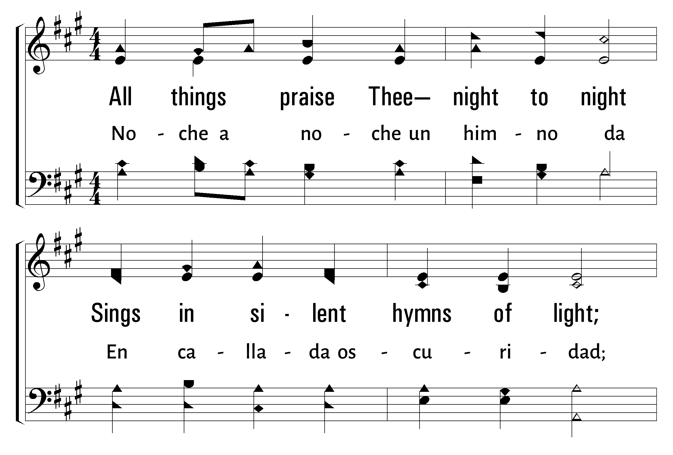
1
2
3
25
ALL THINGS PRAISE THEE • TODO TE ALABA
© 2006 The Paperless Hymnal®

Slide 13
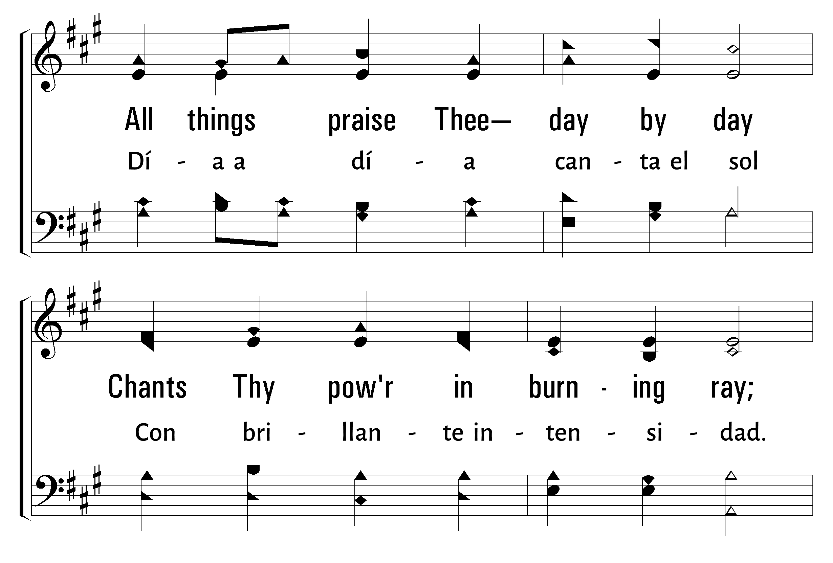
1
2
3
25
ALL THINGS PRAISE THEE • TODO TE ALABA
© 2006 The Paperless Hymnal®

Slide 14
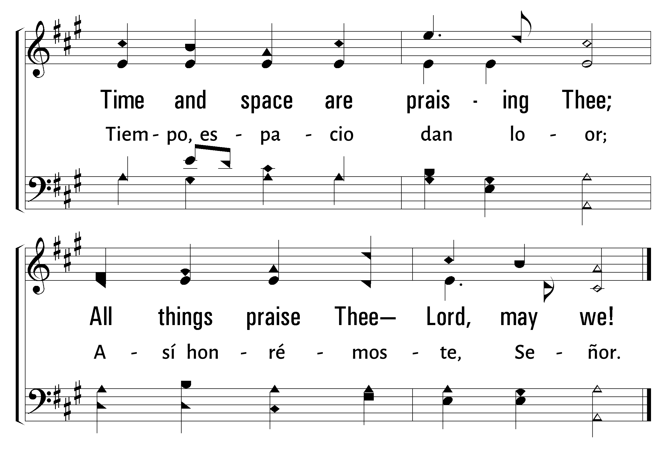
1
2
3
25
ALL THINGS PRAISE THEE • TODO TE ALABA
© 2006 The Paperless Hymnal®

Slide 15
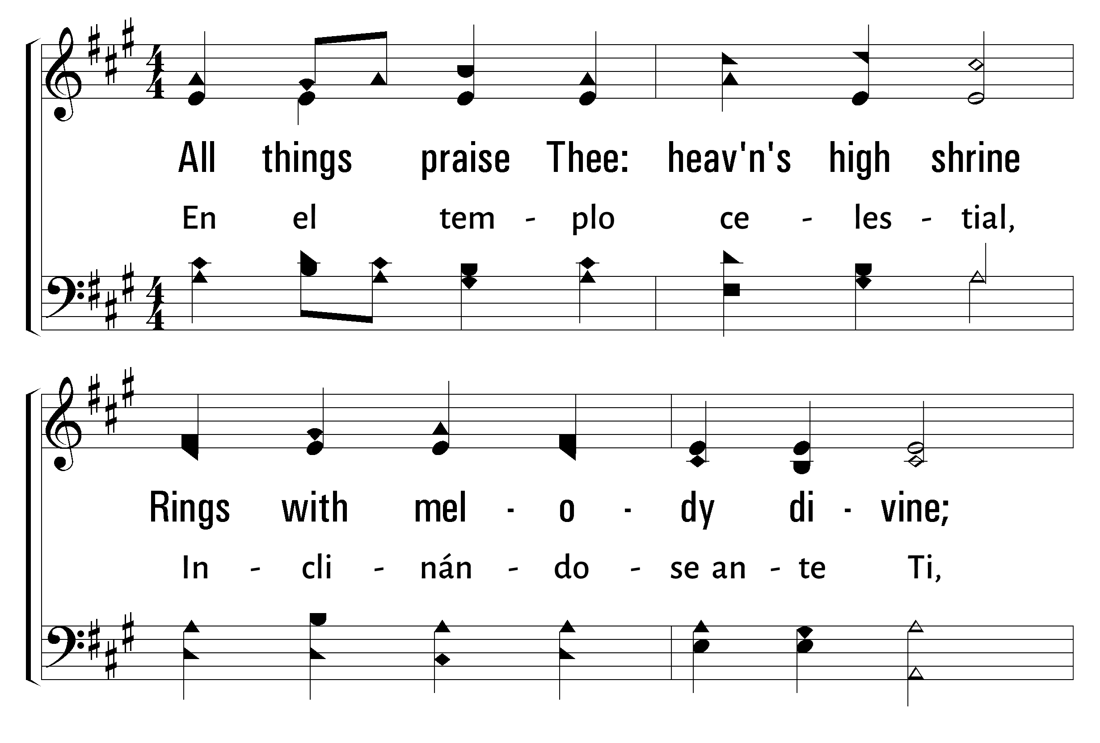
1
2
3
25
ALL THINGS PRAISE THEE • TODO TE ALABA
© 2006 The Paperless Hymnal®

Slide 16
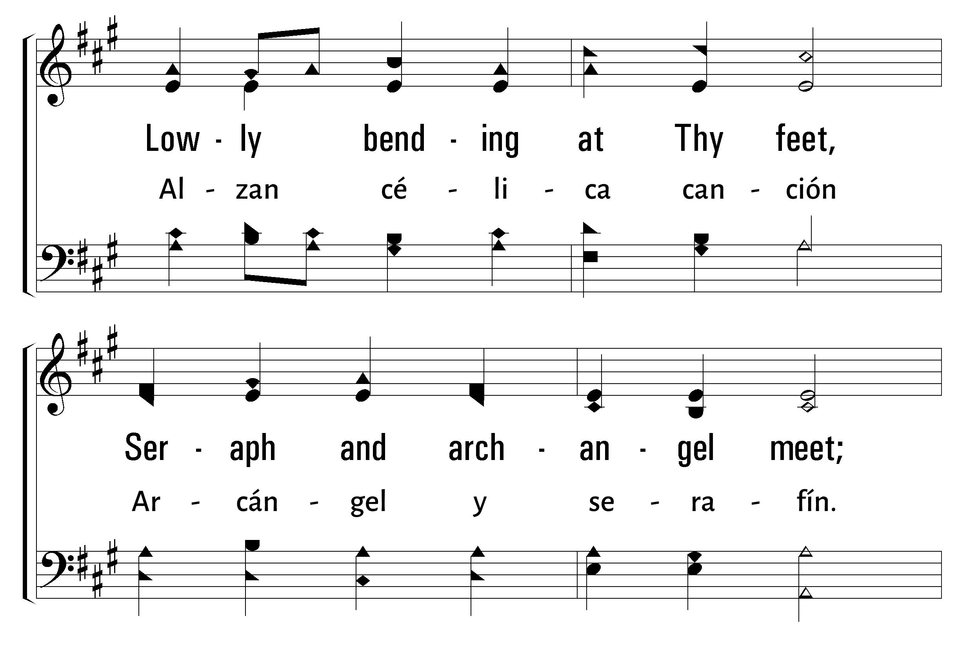
1
2
3
25
ALL THINGS PRAISE THEE • TODO TE ALABA
© 2006 The Paperless Hymnal®

Slide 17
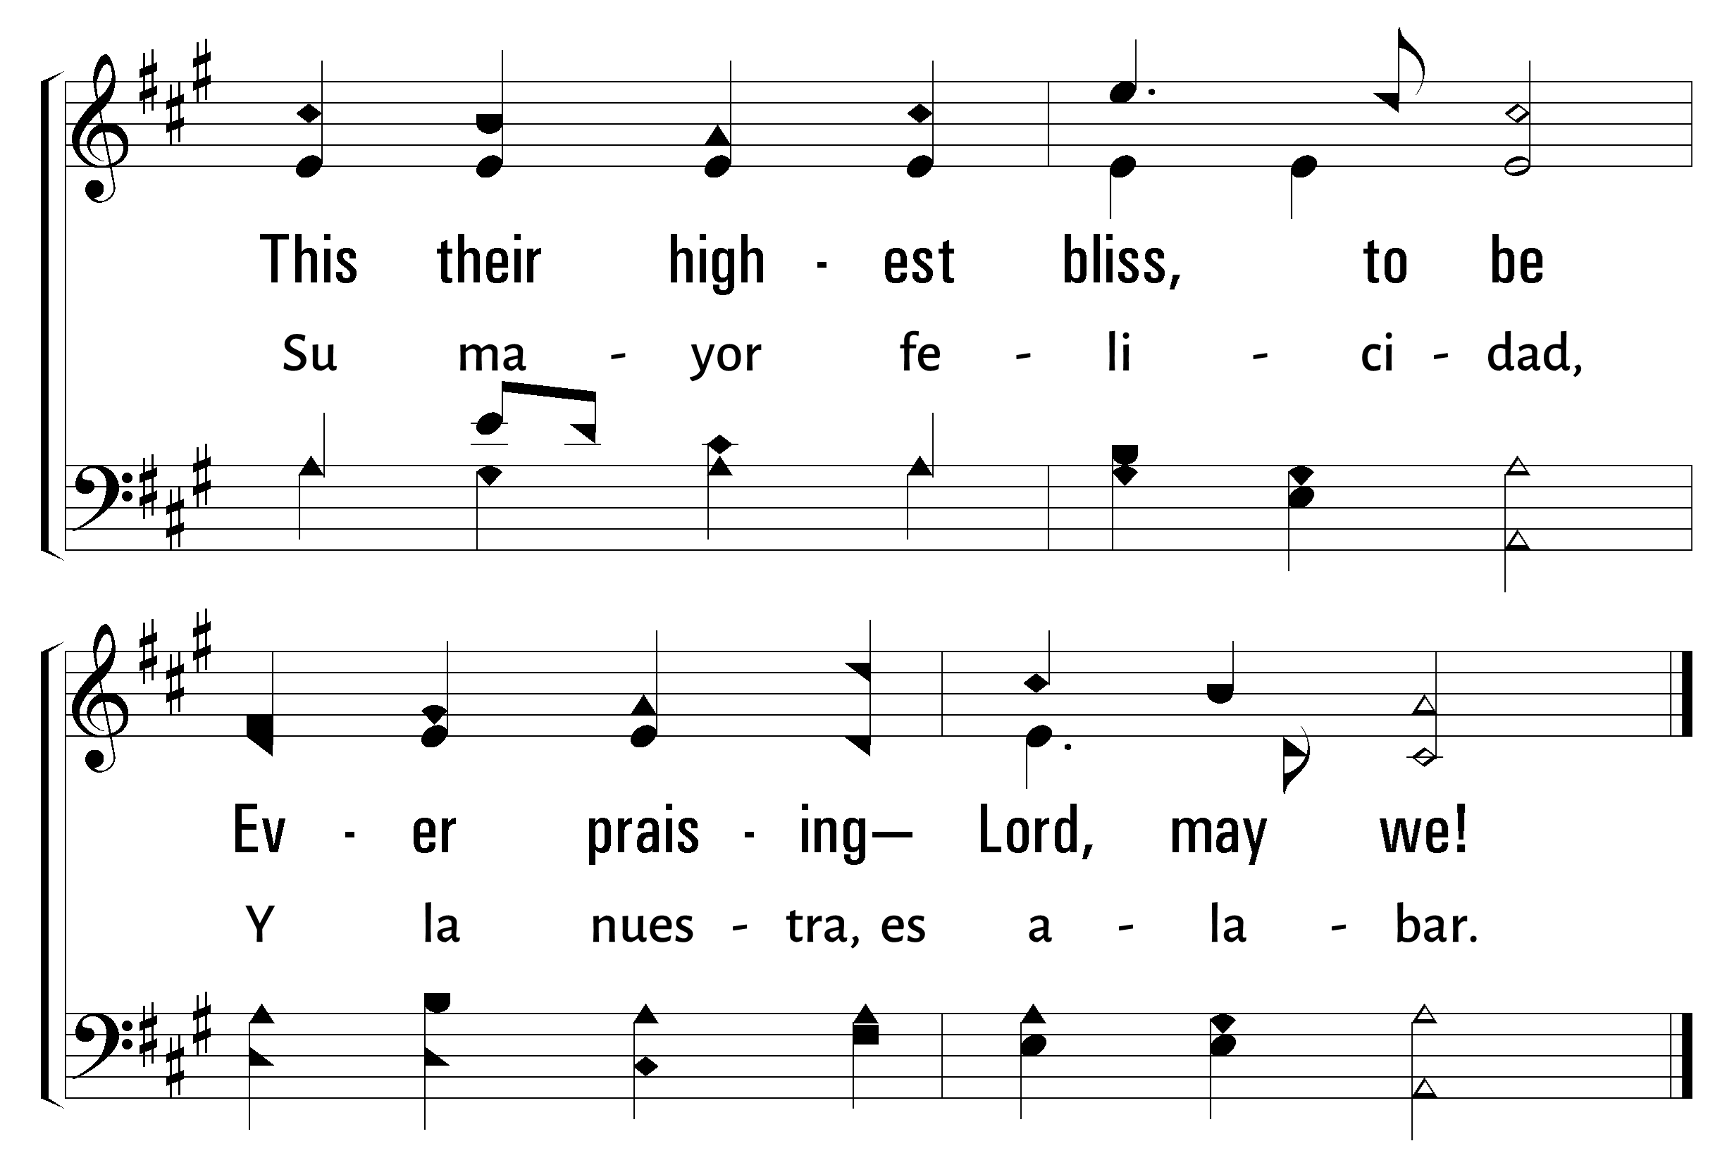
1
2
3
25
ALL THINGS PRAISE THEE • TODO TE ALABA
© 2006 The Paperless Hymnal®

Slide 18
Bienvenida
Ofrenda
Lectura
Oraciï¿œn
25
742
Cena del Seï¿œor
103
277
Sermï¿œn
613
Oraciï¿œn
Welcome
Collection
Reading
Prayer
25
742
Lord’s Supper
103
277
Sermon
613
Prayer
742
742
AL CONTEMPLAR LA EXCELSA CRUZ
WHEN I SURVEY THE WONDROUS CROSS
1
2
3
4
5
“CANTANDO...AL SEï¿œOR” COLOSENSES 3:16
“SINGING...TO THE LORD” COLOSSIANS 3:16
Words by: Isaac Watts Music by: Gregorian Chant, Arrangement by: Lowell Mason
Letra: Isaac Watts Música: Canto gregoriano, arreglo por: Lowell Mason

Slide 19
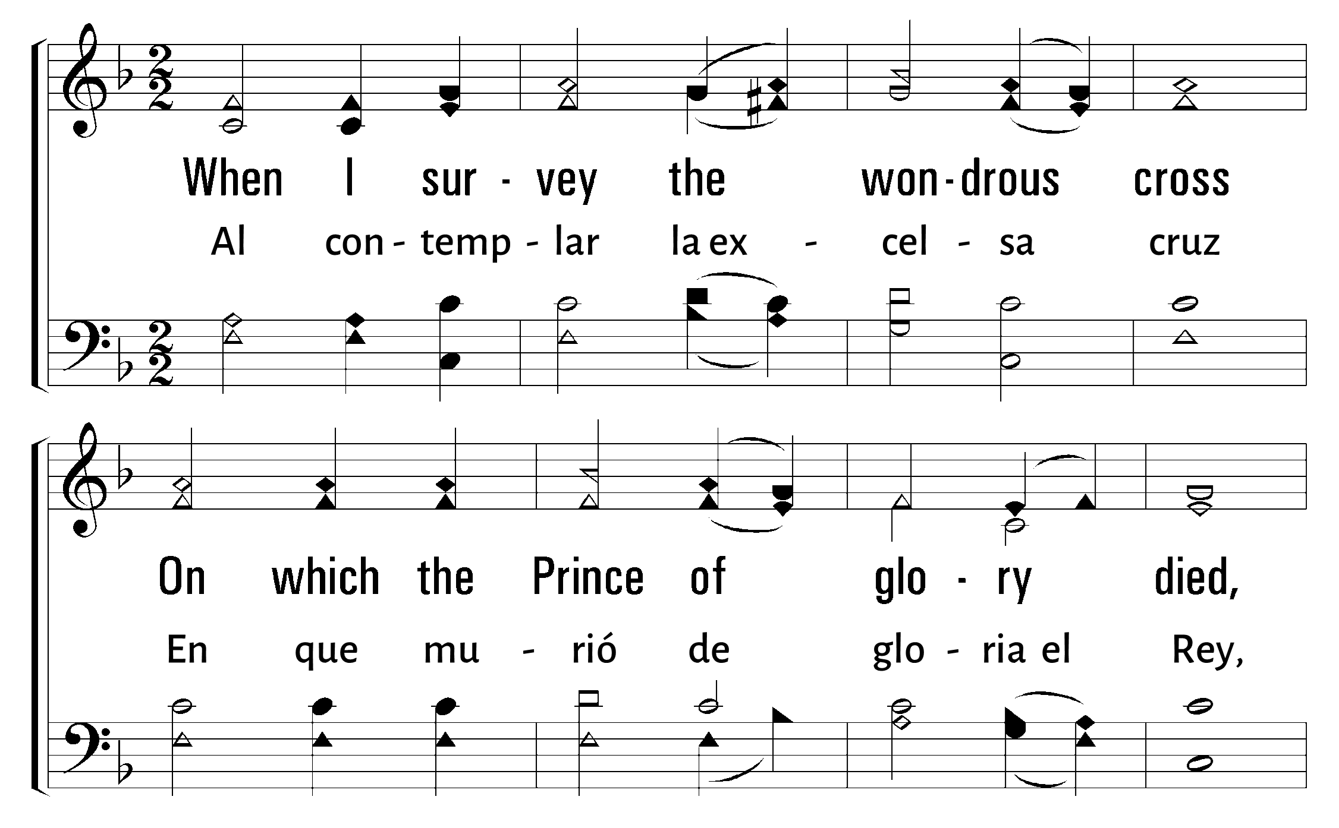
1
2
3
4
5
742
WHEN I SURVEY THE WONDROUS CROSS • AL CONTEMPLAR LA EXCELSA CRUZ
© 2001 The Paperless Hymnal

Slide 20
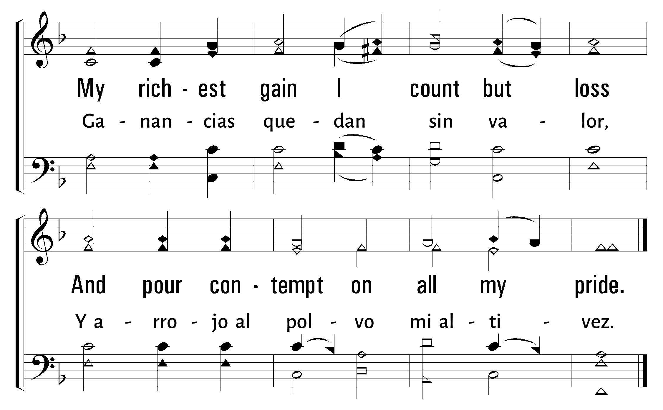
1
2
3
4
5
742
WHEN I SURVEY THE WONDROUS CROSS • AL CONTEMPLAR LA EXCELSA CRUZ
© 2001 The Paperless Hymnal

Slide 21
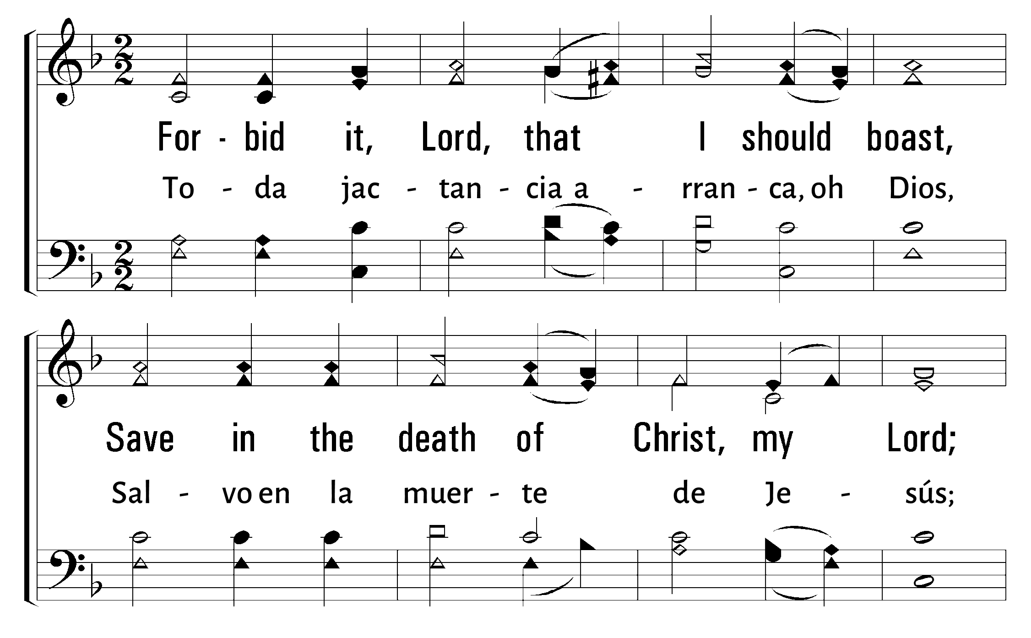
1
2
3
4
5
742
WHEN I SURVEY THE WONDROUS CROSS • AL CONTEMPLAR LA EXCELSA CRUZ
© 2001 The Paperless Hymnal

Slide 22
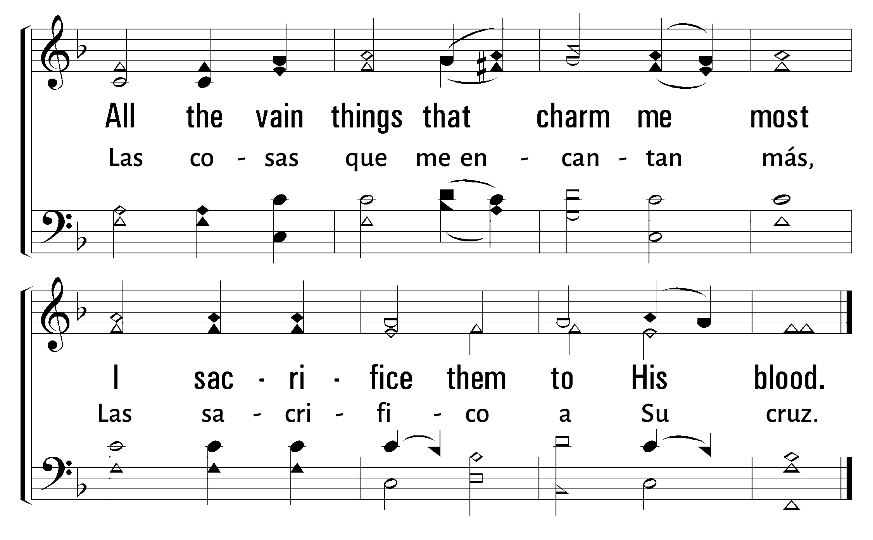
1
2
3
4
5
742
WHEN I SURVEY THE WONDROUS CROSS • AL CONTEMPLAR LA EXCELSA CRUZ
© 2001 The Paperless Hymnal

Slide 23
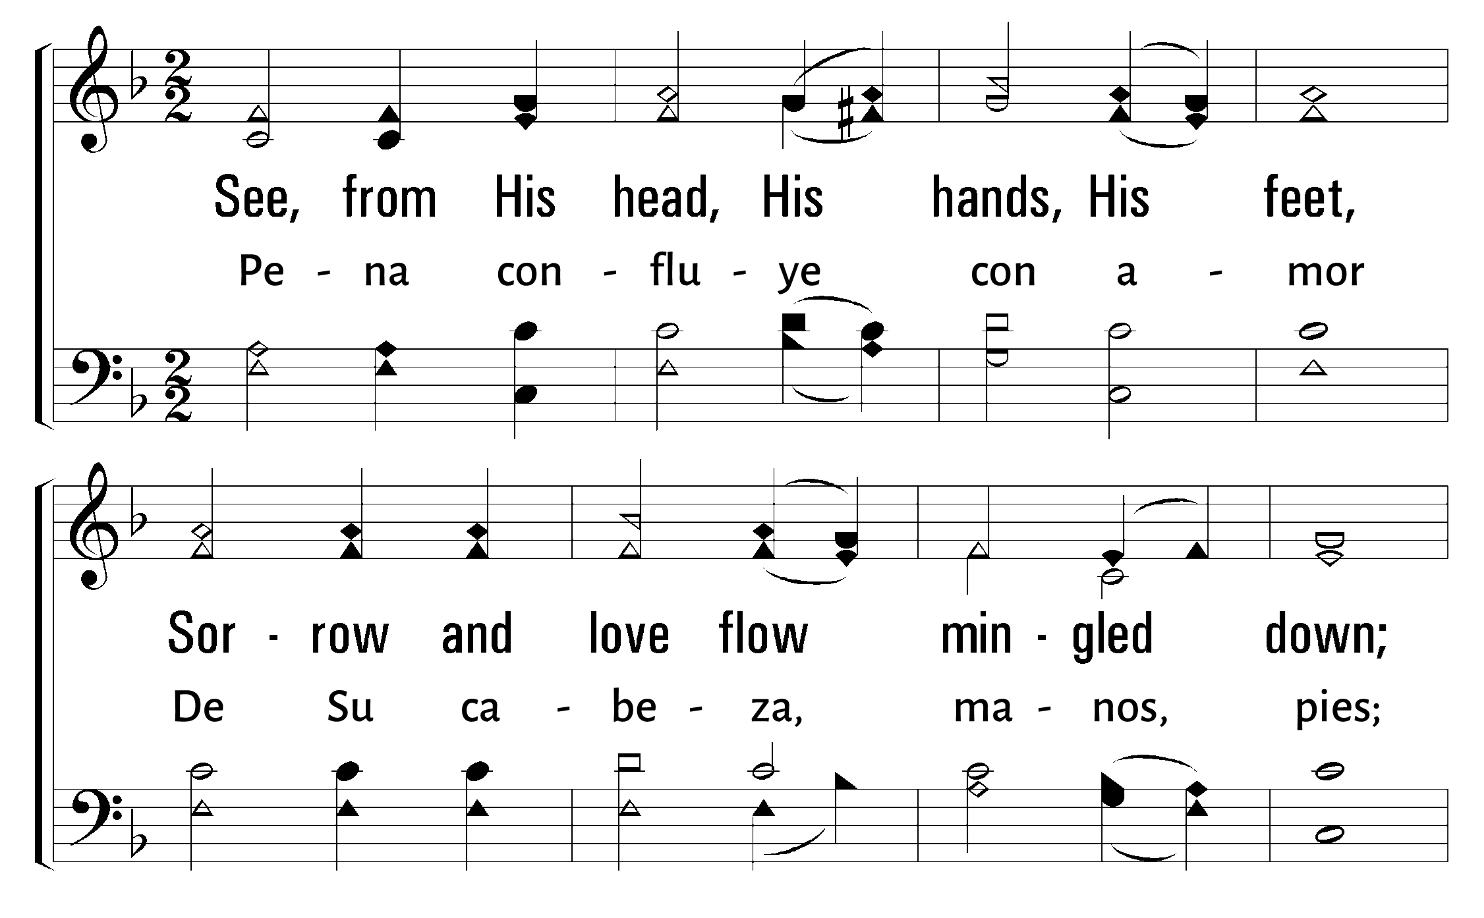
1
2
3
4
5
742
WHEN I SURVEY THE WONDROUS CROSS • AL CONTEMPLAR LA EXCELSA CRUZ
© 2001 The Paperless Hymnal

Slide 24
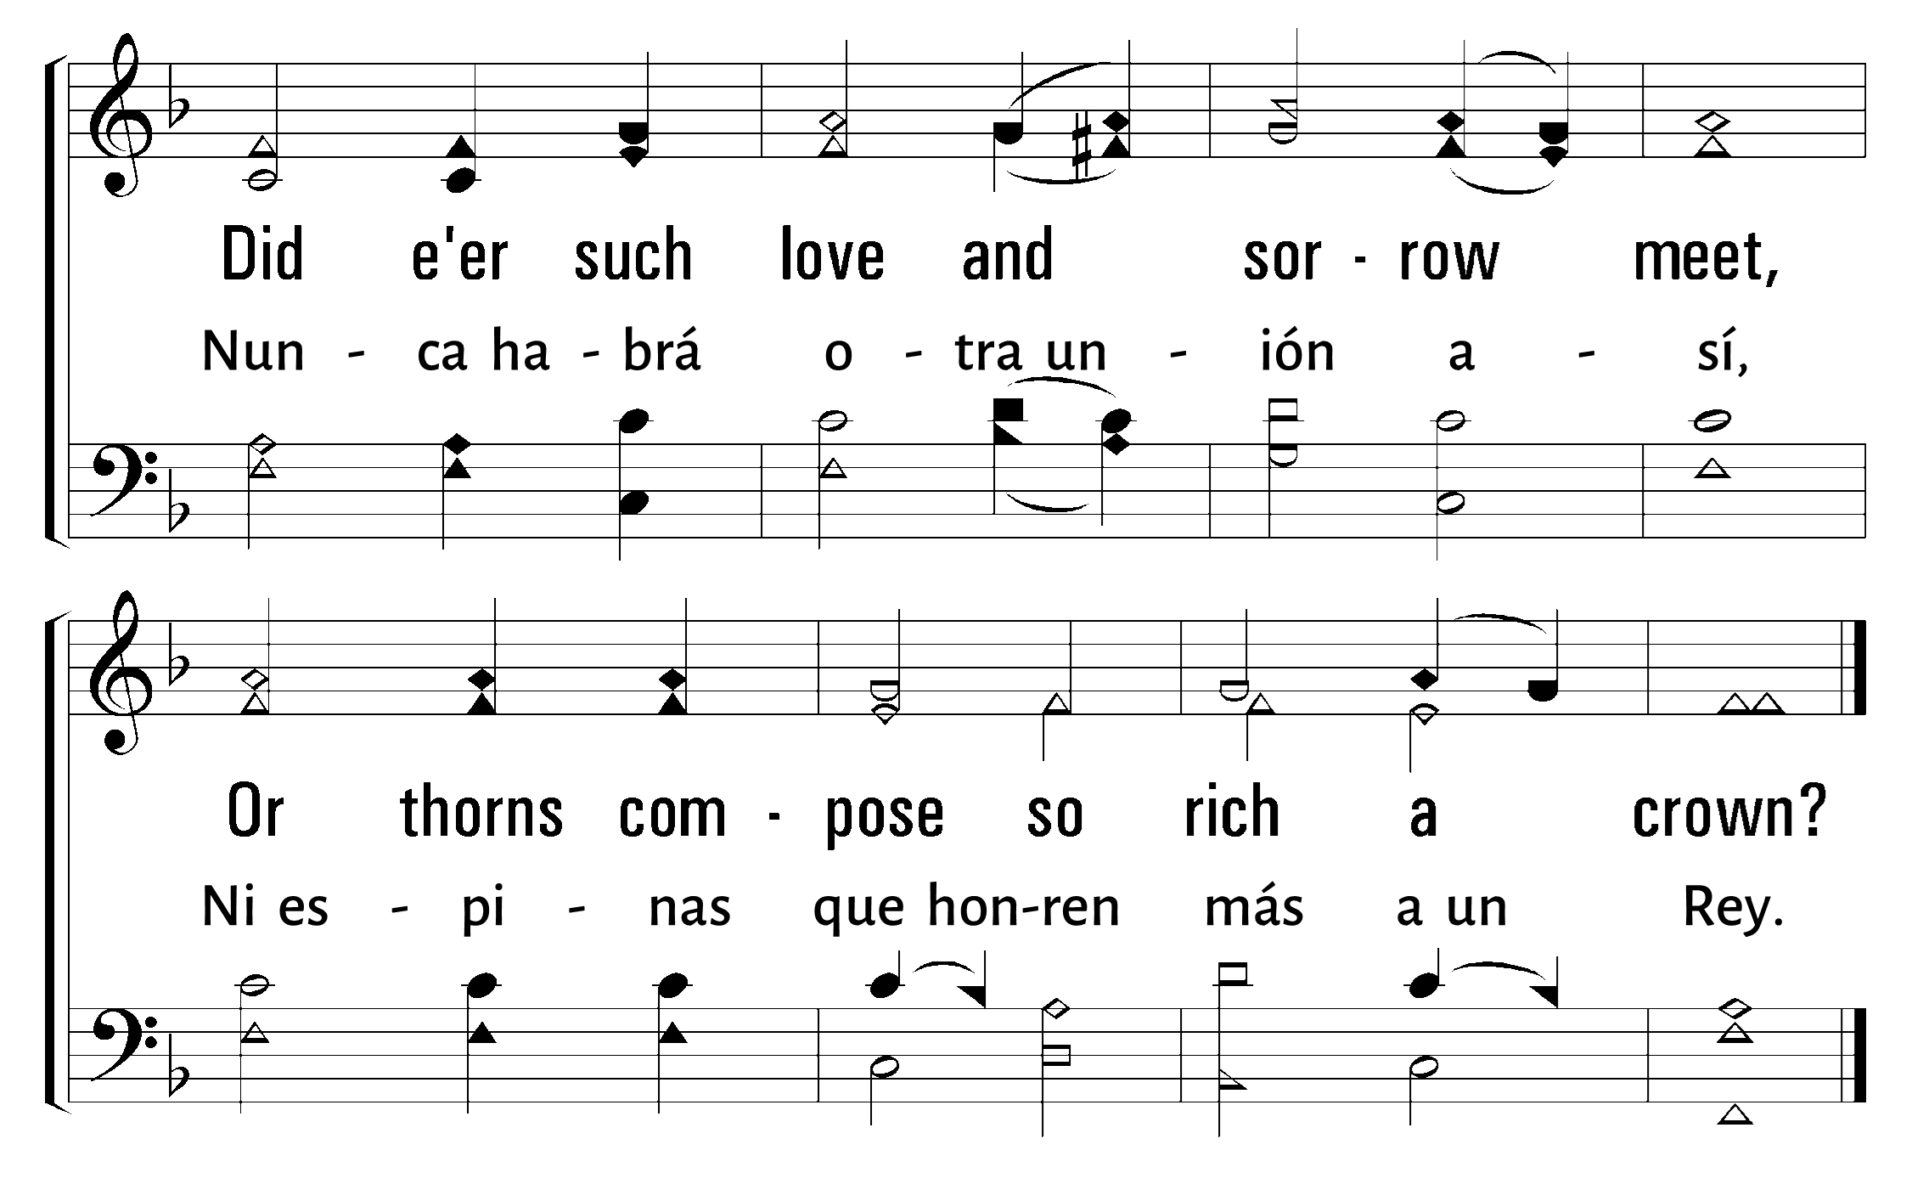
1
2
3
4
5
742
WHEN I SURVEY THE WONDROUS CROSS • AL CONTEMPLAR LA EXCELSA CRUZ
© 2001 The Paperless Hymnal

Slide 25
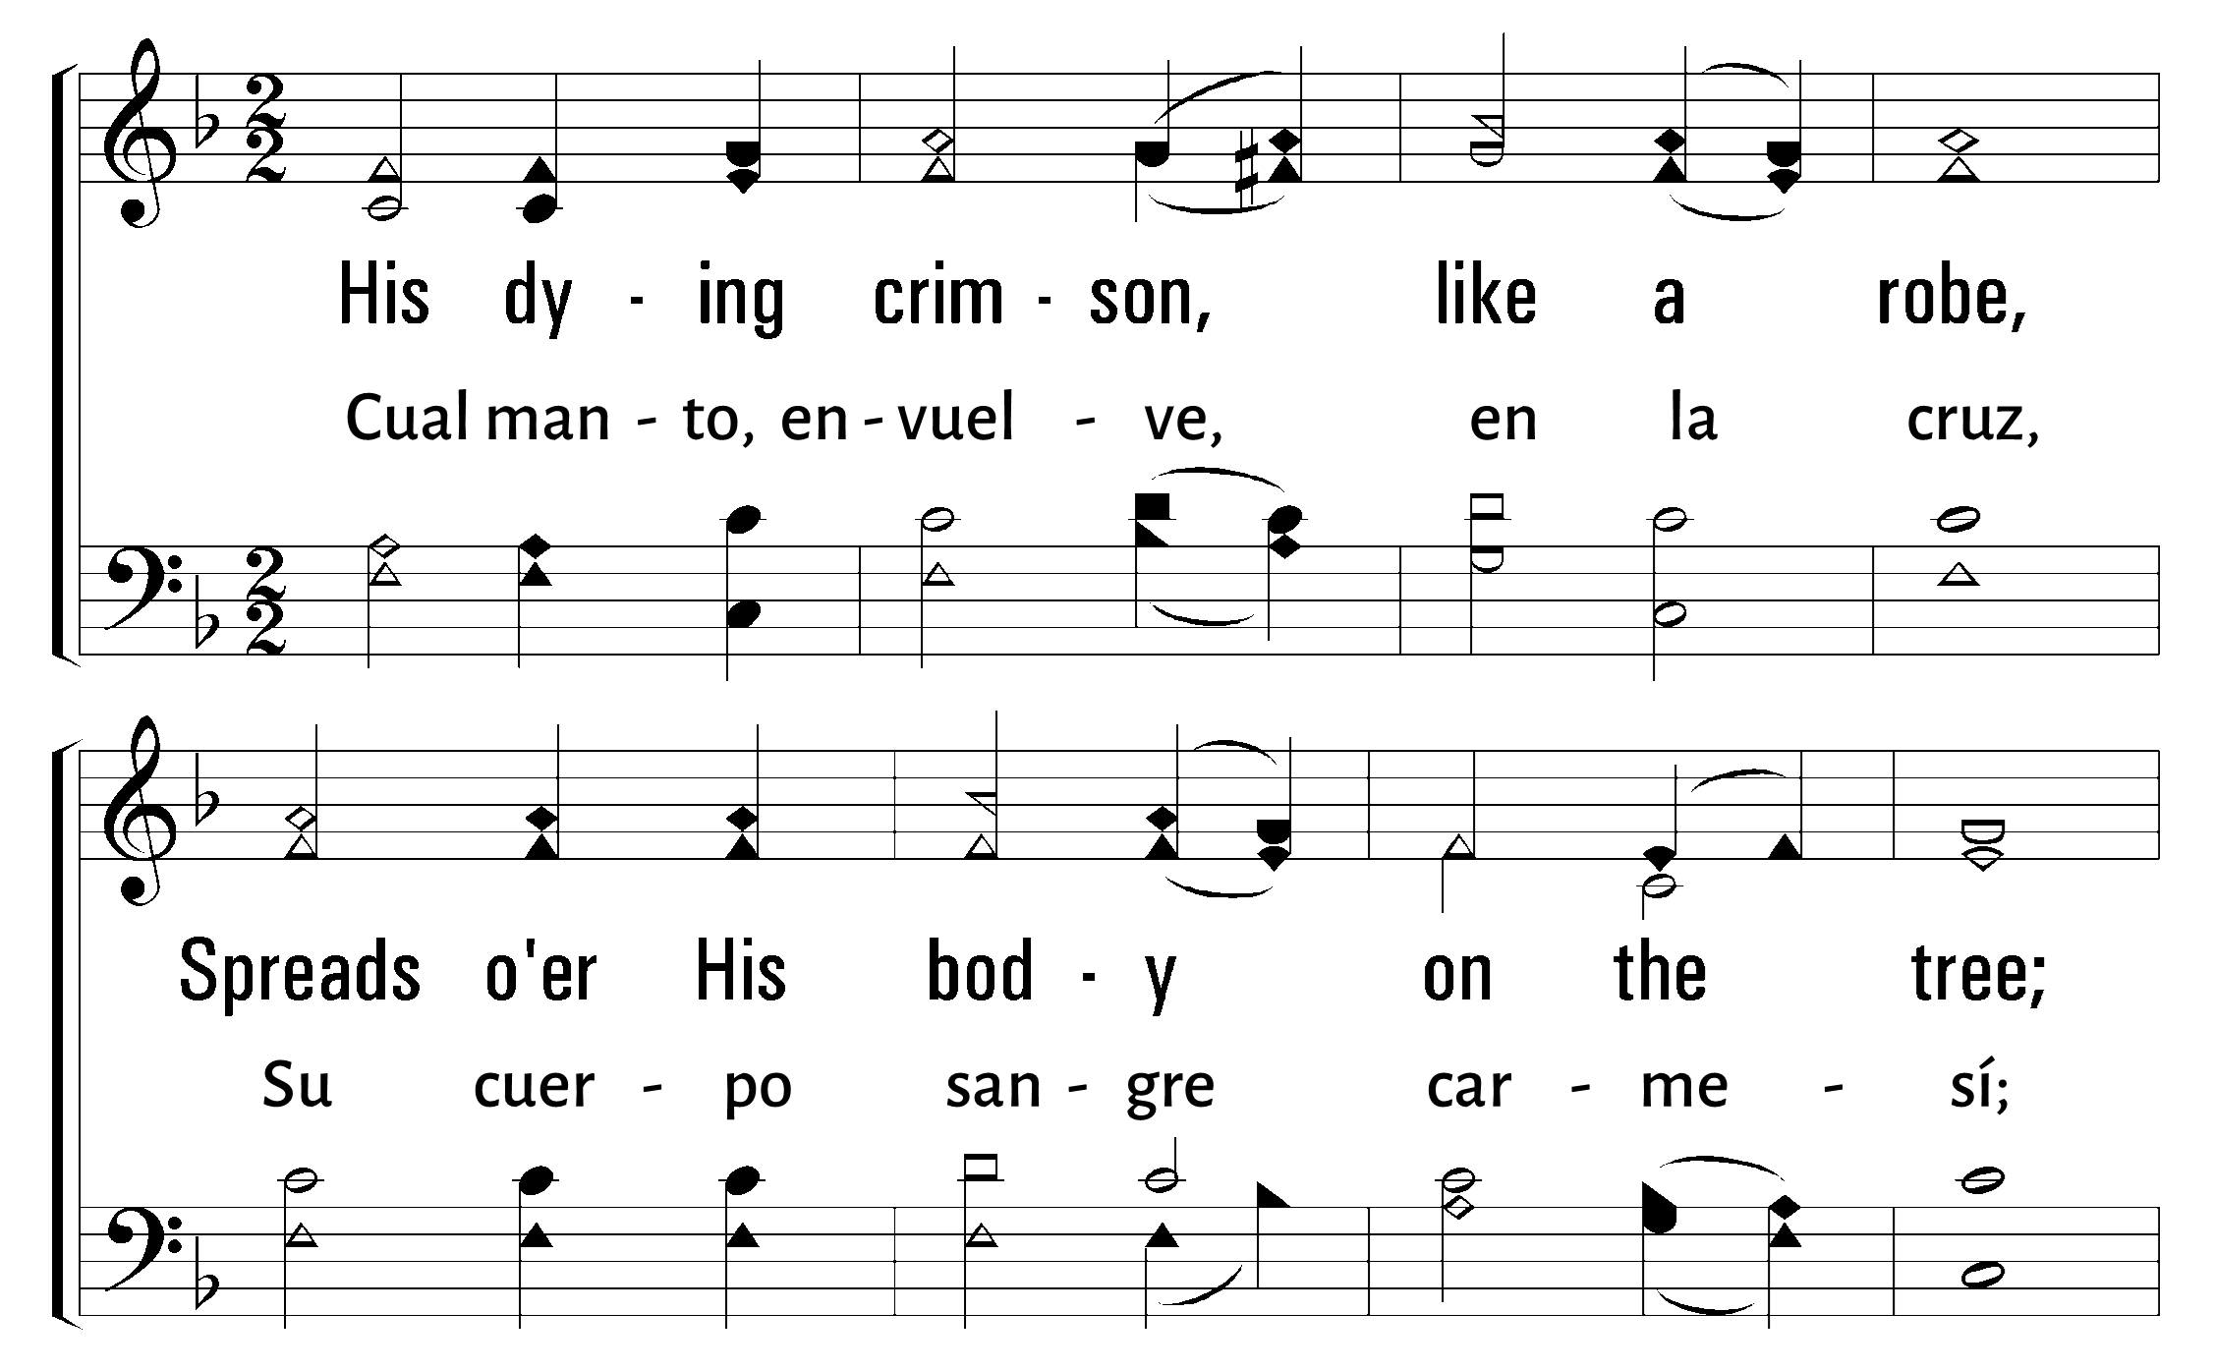
1
2
3
4
5
742
WHEN I SURVEY THE WONDROUS CROSS • AL CONTEMPLAR LA EXCELSA CRUZ
© 2001 The Paperless Hymnal

Slide 26
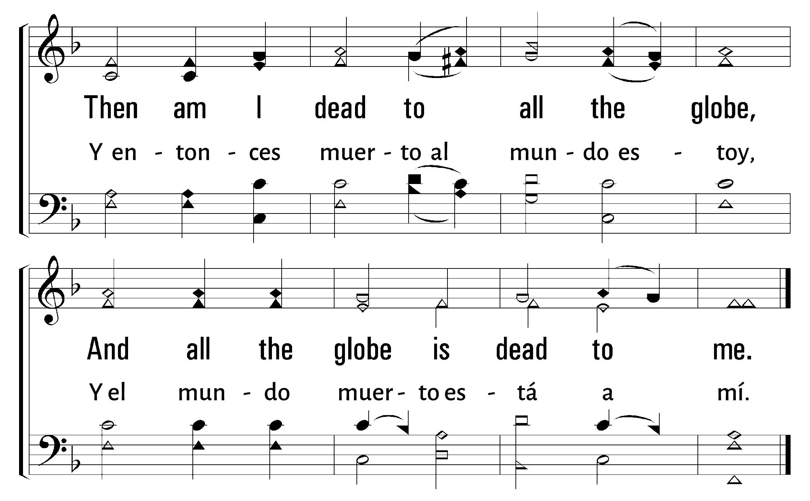
1
2
3
4
5
742
WHEN I SURVEY THE WONDROUS CROSS • AL CONTEMPLAR LA EXCELSA CRUZ
© 2001 The Paperless Hymnal

Slide 27
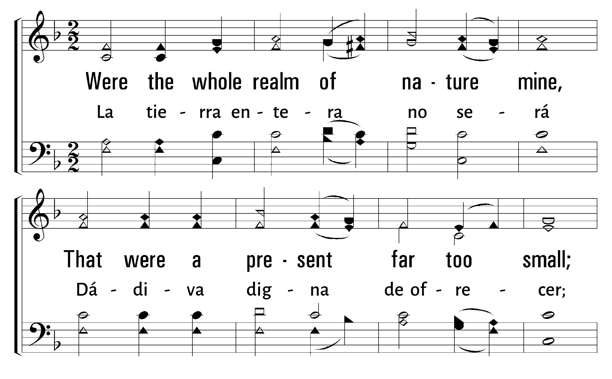
1
2
3
4
5
742
WHEN I SURVEY THE WONDROUS CROSS • AL CONTEMPLAR LA EXCELSA CRUZ
© 2001 The Paperless Hymnal

Slide 28
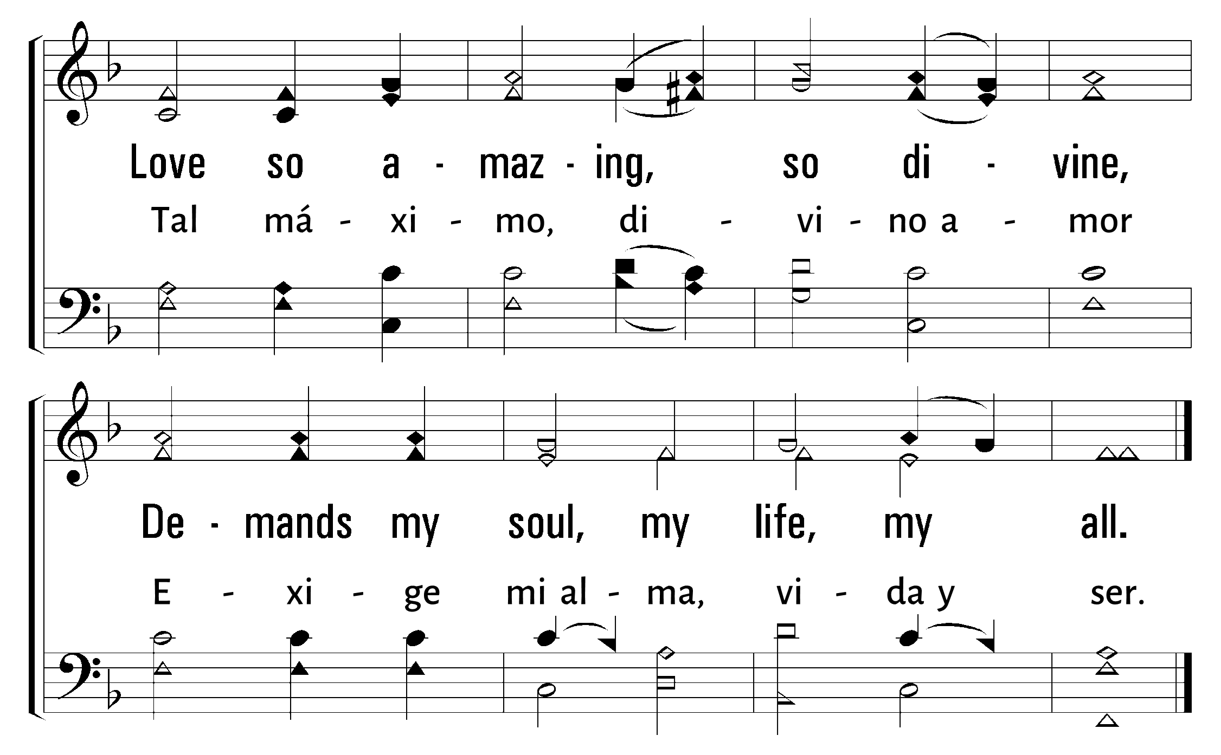
1
2
3
4
5
742
WHEN I SURVEY THE WONDROUS CROSS • AL CONTEMPLAR LA EXCELSA CRUZ
© 2001 The Paperless Hymnal

Slide 29

Bienvenida
Ofrenda
Lectura
Oraciï¿œn
25
742
Cena del Seï¿œor
103
277
Sermï¿œn
613
Oraciï¿œn
Welcome
Collection
Reading
Prayer
25
742
Lord’s Supper
103
277
Sermon
613
Prayer
CENA DEL
LORD’S
SUPPER
SEï¿œOR
“DO THIS IN REMEMBRANCE OF ME” LUKE 22:19
“HACED ESTO EN MEMORIA DE Mï¿œ” LUCAS 22:19
Jeff Dutra

Slide 31

Bienvenida
Ofrenda
Lectura
Oraciï¿œn
25
742
Cena del Seï¿œor
103
277
Sermï¿œn
613
Oraciï¿œn
Welcome
Collection
Reading
Prayer
25
742
Lord’s Supper
103
277
Sermon
613
Prayer
And they made His grave with the wicked— But with the rich at His death, Because He had done no violence, Nor was any deceit in His mouth. When You make His soul an offering for sin,He shall see His seed, He shall prolong His days.
Y se dispuso con los impíos su sepultura, mas con los ricos fue en su muerte; aunque nunca hizo maldad, ni hubo engaño en su boca. 10Con todo eso, Jehová quiso quebrantarlo, sujetándole a padecimiento. Cuando haya puesto su vida en expiación por el pecado, verá linaje, vivirá por largos días.
Isaiah 53:9-10a
Isaías 53:9-10a

Slide 32
Bienvenida
Ofrenda
Lectura
Oraciï¿œn
25
742
Cena del Seï¿œor
103
277
Sermï¿œn
613
Oraciï¿œn
Welcome
Collection
Reading
Prayer
25
742
Lord’s Supper
103
277
Sermon
613
Prayer
103
103
CONTEMPLA A DIOS
BEHOLD OUR GOD
1
2
3
“CANTANDO...AL SEï¿œOR” COLOSENSES 3:16
“SINGING...TO THE LORD” COLOSSIANS 3:16
Words: Jonathan & Meghan Baird Music:Ryan Baird & Stephen Altrogge
Letra: Jonathan y Meghan Baird Música: Ryan Baird y Stephen Altrogge

Slide 33
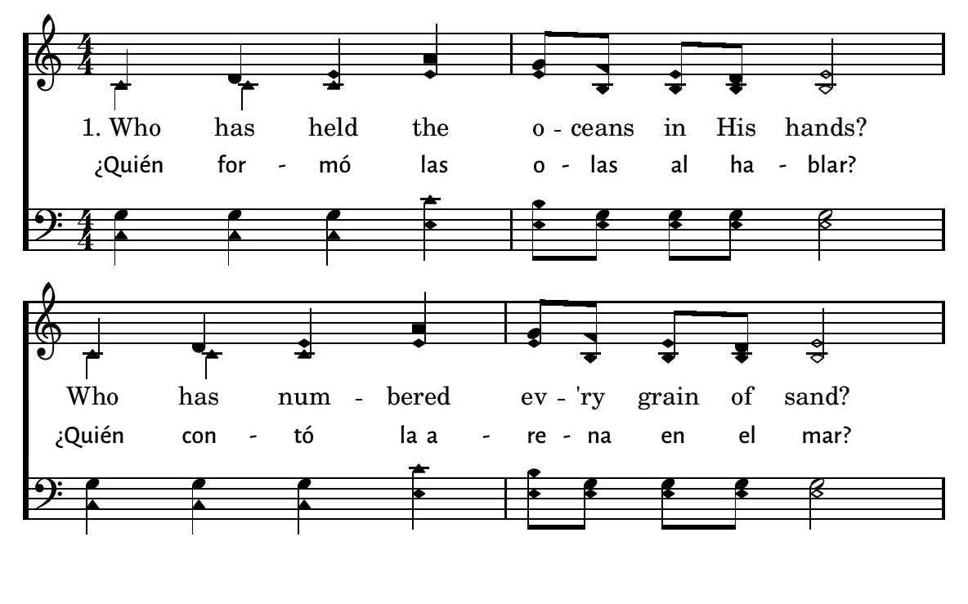
1
2
3
103
BEHOLD OUR GOD • CONTEMPLA A DIOS
© 2015 R.J. Stevens Music, LLC

Slide 34
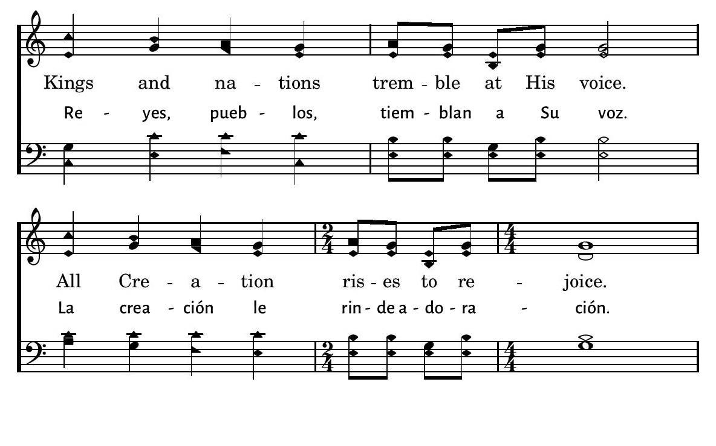
1
2
3
103
BEHOLD OUR GOD • CONTEMPLA A DIOS
© 2015 R.J. Stevens Music, LLC

Slide 35
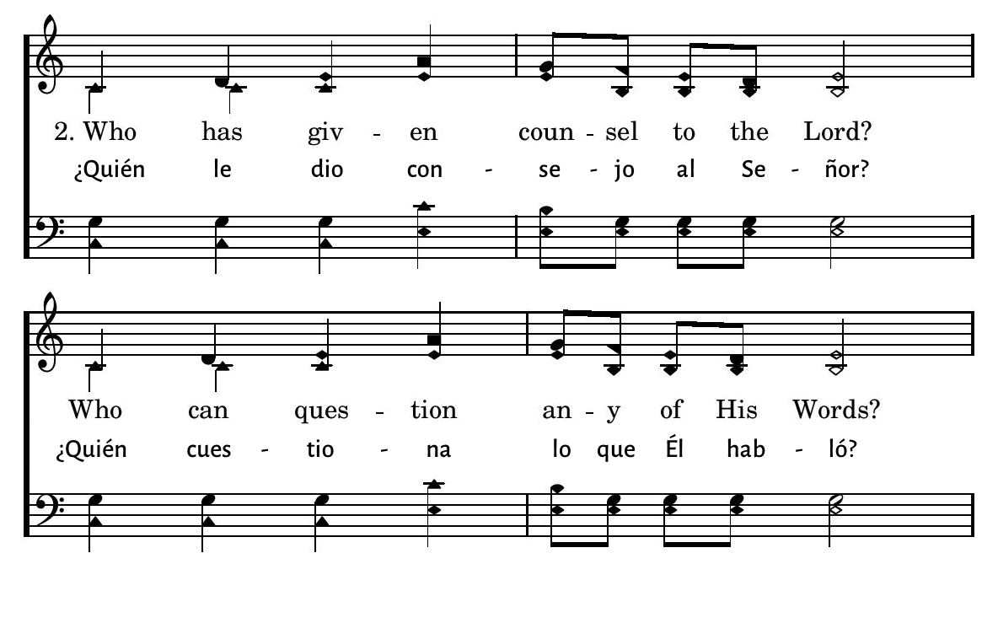
1
2
3
103
BEHOLD OUR GOD • CONTEMPLA A DIOS
© 2015 R.J. Stevens Music, LLC

Slide 36
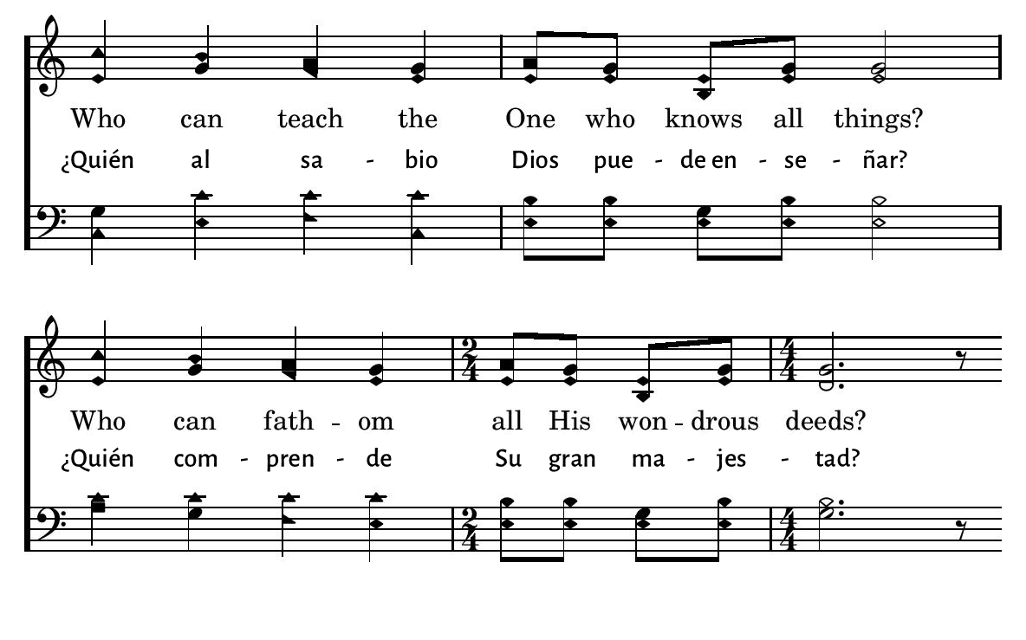
1
2
3
103
BEHOLD OUR GOD • CONTEMPLA A DIOS
© 2015 R.J. Stevens Music, LLC

Slide 37
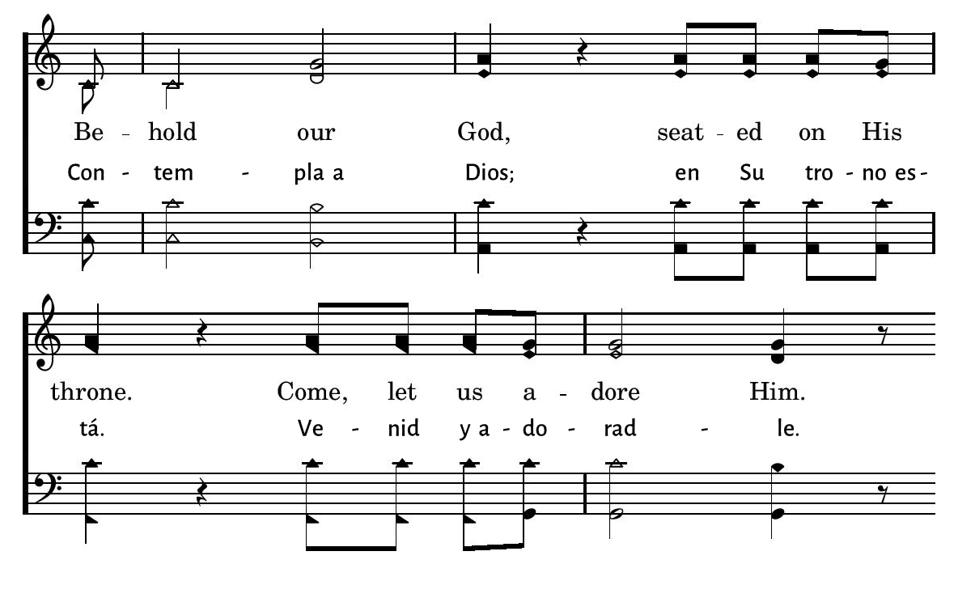
1
2
3
103
BEHOLD OUR GOD • CONTEMPLA A DIOS
© 2015 R.J. Stevens Music, LLC

Slide 38
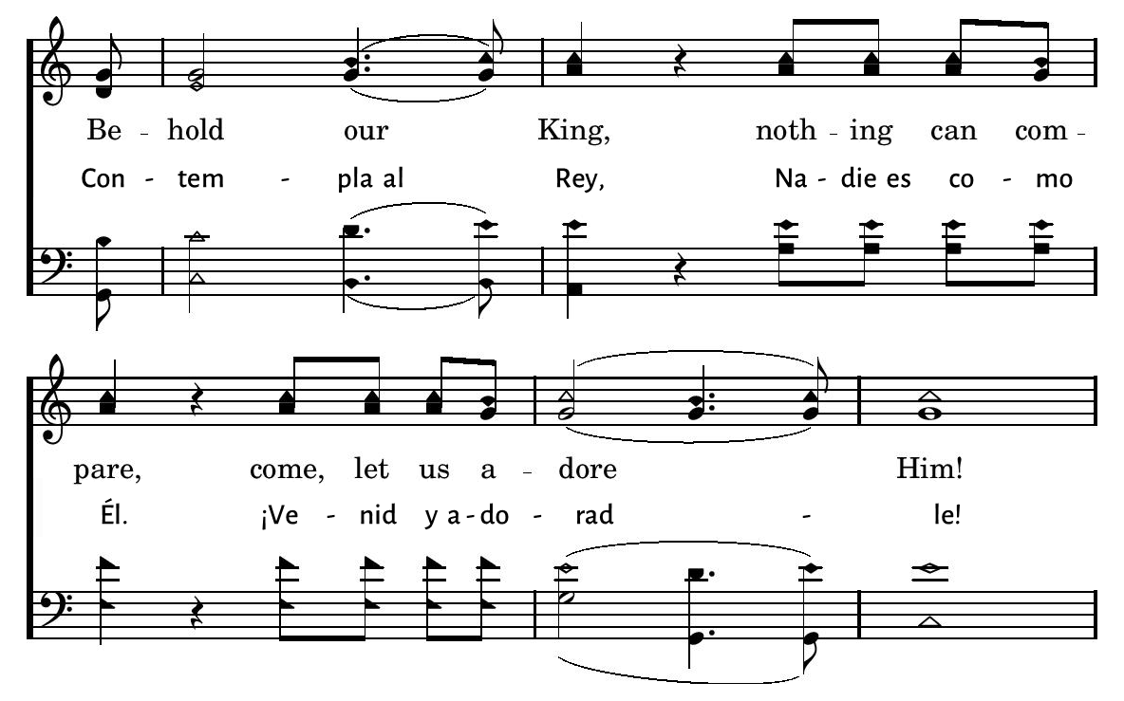
1
2
3
103
BEHOLD OUR GOD • CONTEMPLA A DIOS
© 2015 R.J. Stevens Music, LLC

Slide 39
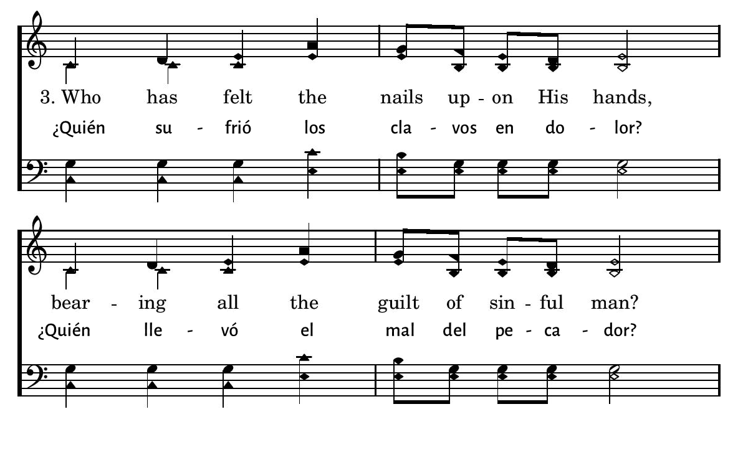
1
2
3
103
BEHOLD OUR GOD • CONTEMPLA A DIOS
© 2015 R.J. Stevens Music, LLC

Slide 40
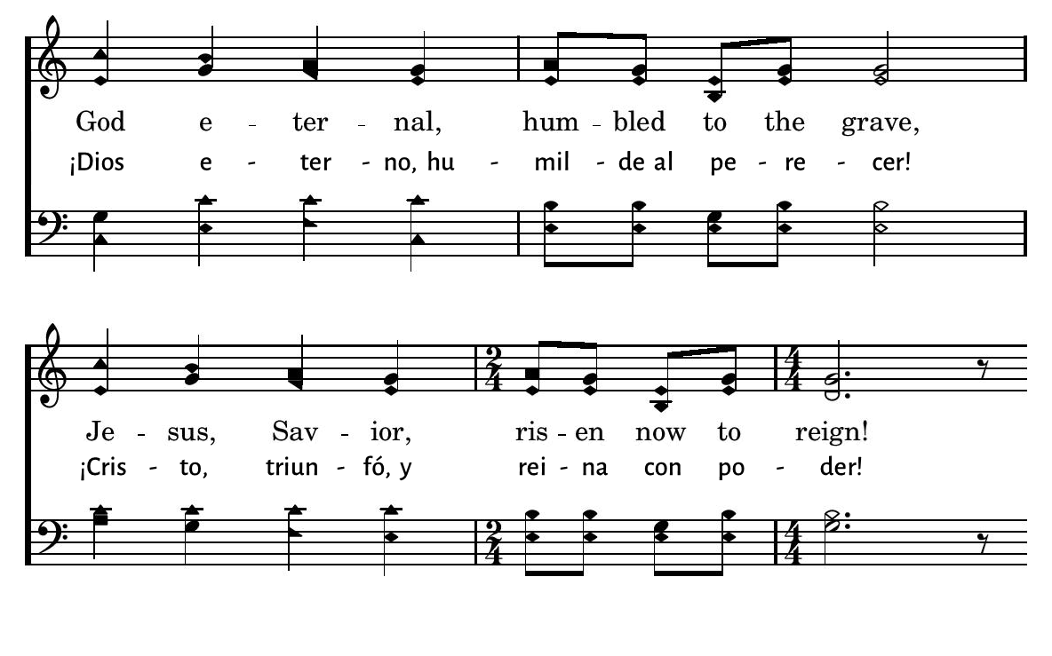
1
2
3
103
BEHOLD OUR GOD • CONTEMPLA A DIOS
© 2015 R.J. Stevens Music, LLC

Slide 41

1
2
3
103
BEHOLD OUR GOD • CONTEMPLA A DIOS
© 2015 R.J. Stevens Music, LLC

Slide 42

1
2
3
103
BEHOLD OUR GOD • CONTEMPLA A DIOS
© 2015 R.J. Stevens Music, LLC

Slide 43
Bienvenida
Ofrenda
Lectura
Oraciï¿œn
25
742
Cena del Seï¿œor
103
277
Sermï¿œn
613
Oraciï¿œn
Welcome
Collection
Reading
Prayer
25
742
Lord’s Supper
103
277
Sermon
613
Prayer
INVITATION SONG
HIMNO DE INVITACIÏ¿ŒN
613
613
QUE MI VIDA ENTERA ESTÉ
TAKE MY LIFE, AND LET IT BE
1
2
3
4
5
6
“CANTANDO...AL SEï¿œOR” COLOSENSES 3:16
“SINGING...TO THE LORD” COLOSSIANS 3:16
Words: Frances R. Havergal Music: McIntoshs & Cunnynghams New Life, Arr.: Rigdon M. McIntosh
Letra: Frances R. Havergal Música: McIntoshs & Cunnynghams New Life, Arr.: Rigdon M. McIntosh

Slide 44
Bienvenida
Ofrenda
Lectura
Oraciï¿œn
25
742
Cena del Seï¿œor
103
277
Sermï¿œn
613
Oraciï¿œn
Welcome
Collection
Reading
Prayer
25
742
Lord’s Supper
103
277
Sermon
613
Prayer
277
277
HABLA, OH DIOS
SPEAK, O LORD
1
2
3
“CANTANDO...AL SEï¿œOR” COLOSENSES 3:16
“SINGING...TO THE LORD” COLOSSIANS 3:16
© 2005 Thankyou Music (admin. by EMI Christian Music Group) Tune: SPEAK O LORD  Keith Getty (2005); Stuart Townend (2005); arr. Charles L. Willis (2011) Hymn: Keith Getty (2005); Stuart Townend (2005) _ _ _
© 2005 Thankyou Music (admin. por EMI Christian Music Group) Música: SPEAK O LORD  Keith Getty (2005); Stuart Townend (2005); arr. Charles L. Willis (2011) Letra: Keith Getty (2005); Stuart Townend (2005)

Slide 45
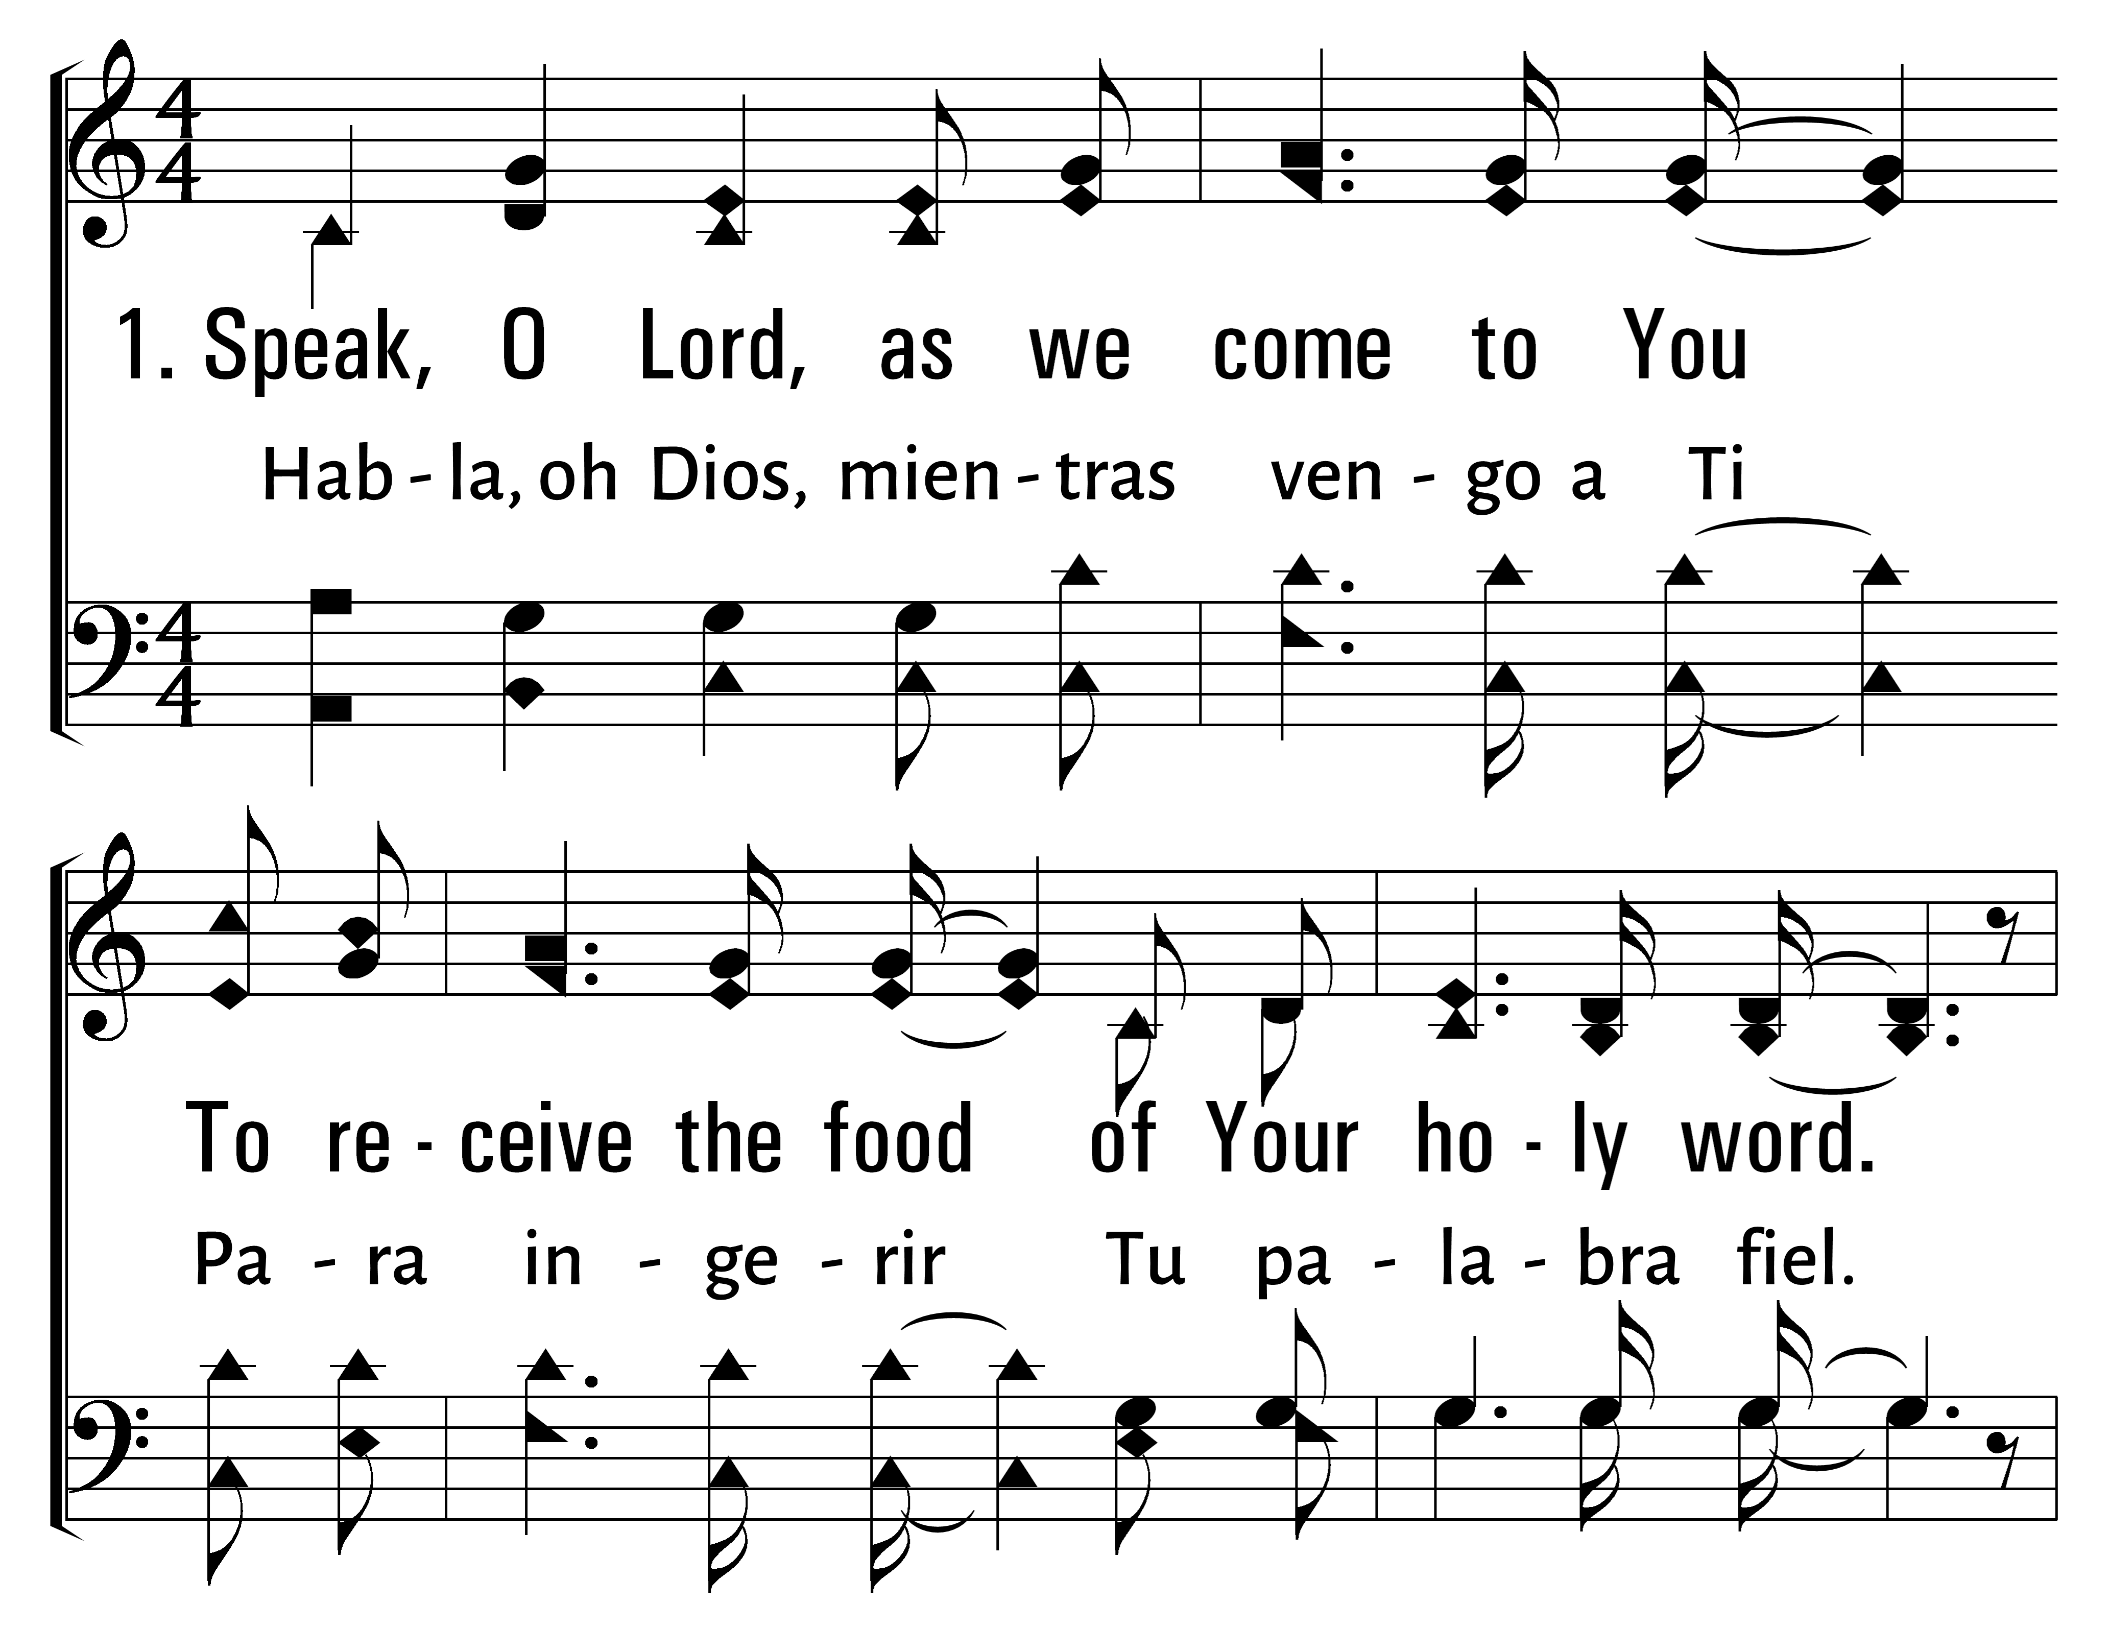

277
1
SPEAK, O LORD
2
3
HABLA, OH DIOS
Traducciï¿œn Jonathan y Sarah Jerez
© 2014 Sumphonia Productions, LLC

Slide 46
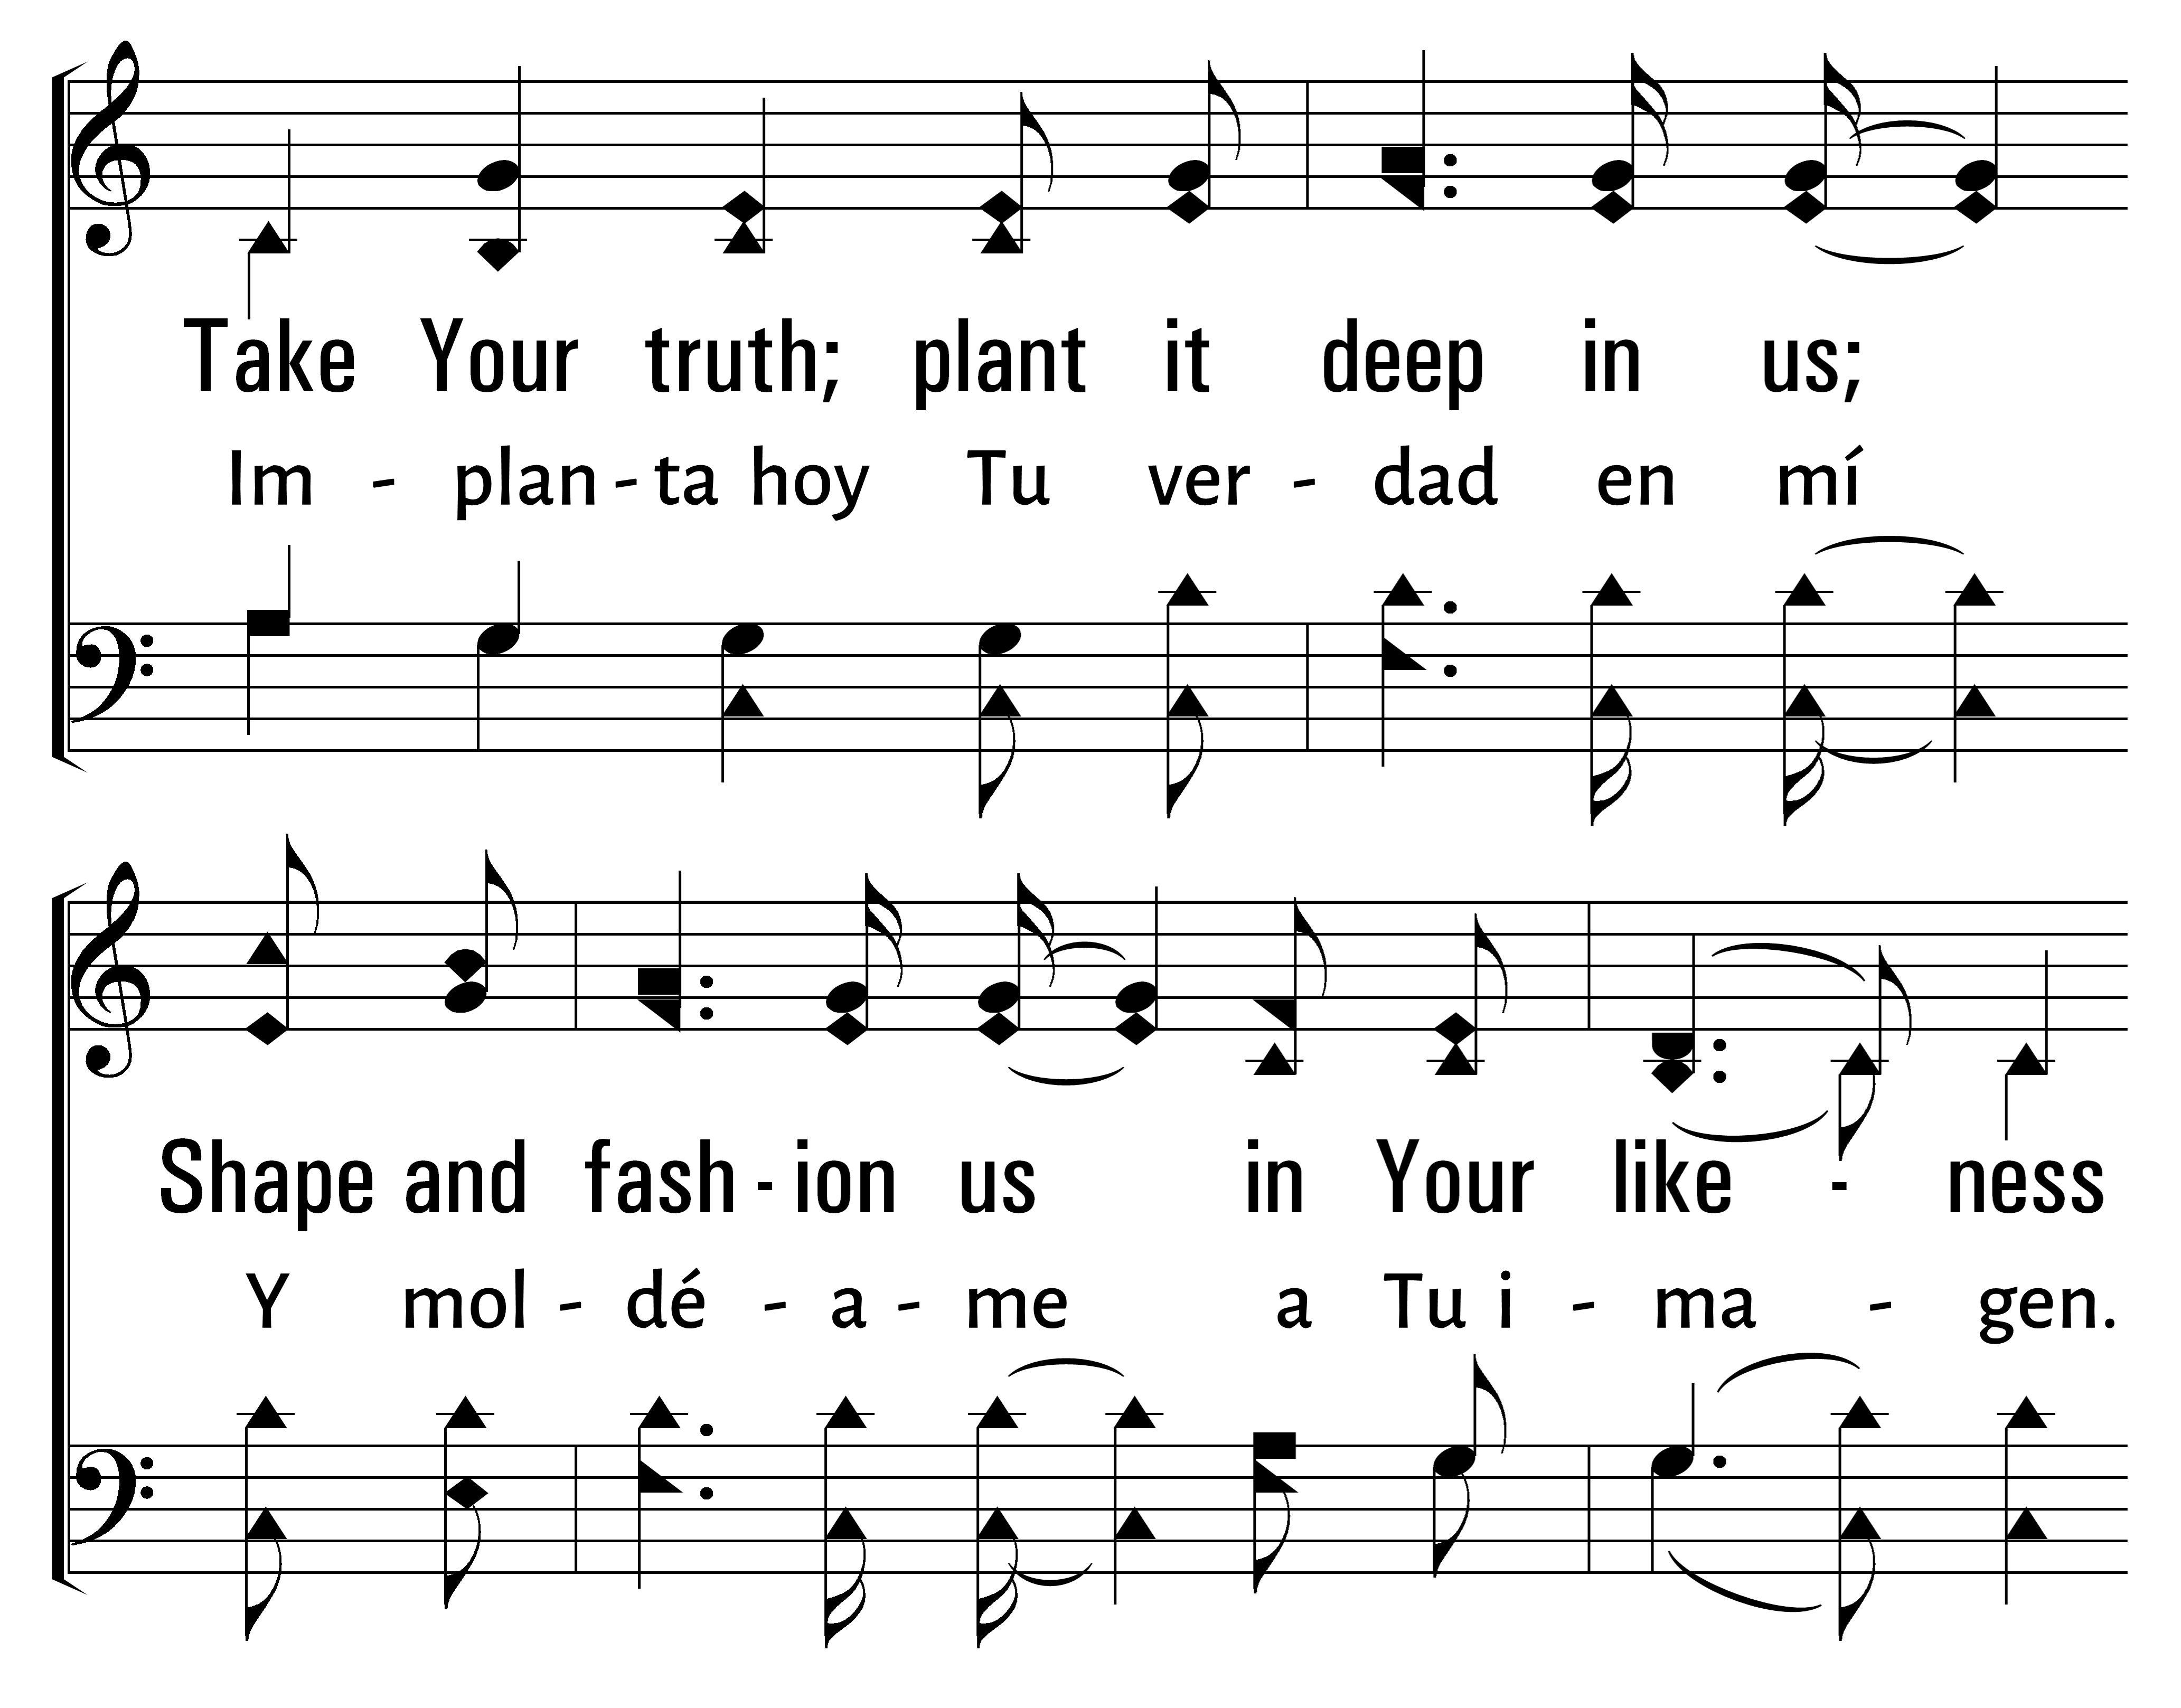
277
1
SPEAK, O LORD
2
3
HABLA, OH DIOS
Traducciï¿œn Jonathan y Sarah Jerez
© 2014 Sumphonia Productions, LLC

Slide 47
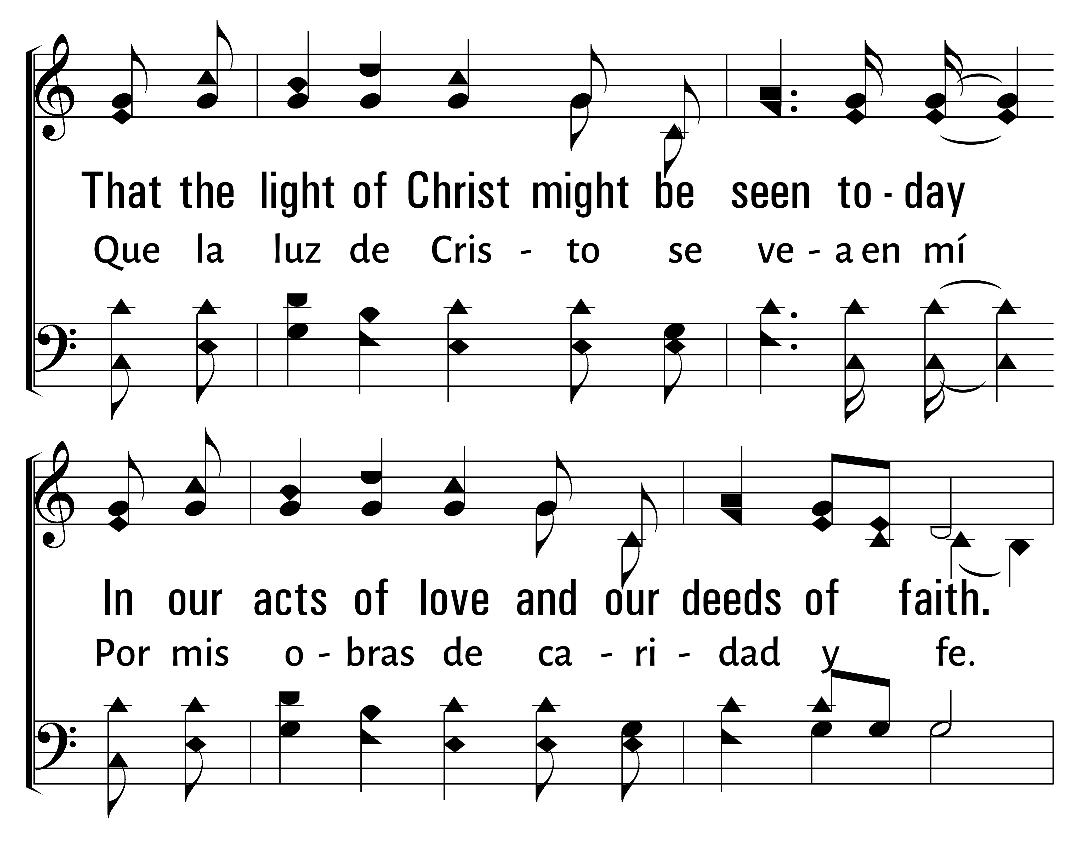
277
1
SPEAK, O LORD
2
3
HABLA, OH DIOS
Traducciï¿œn Jonathan y Sarah Jerez
© 2014 Sumphonia Productions, LLC

Slide 48
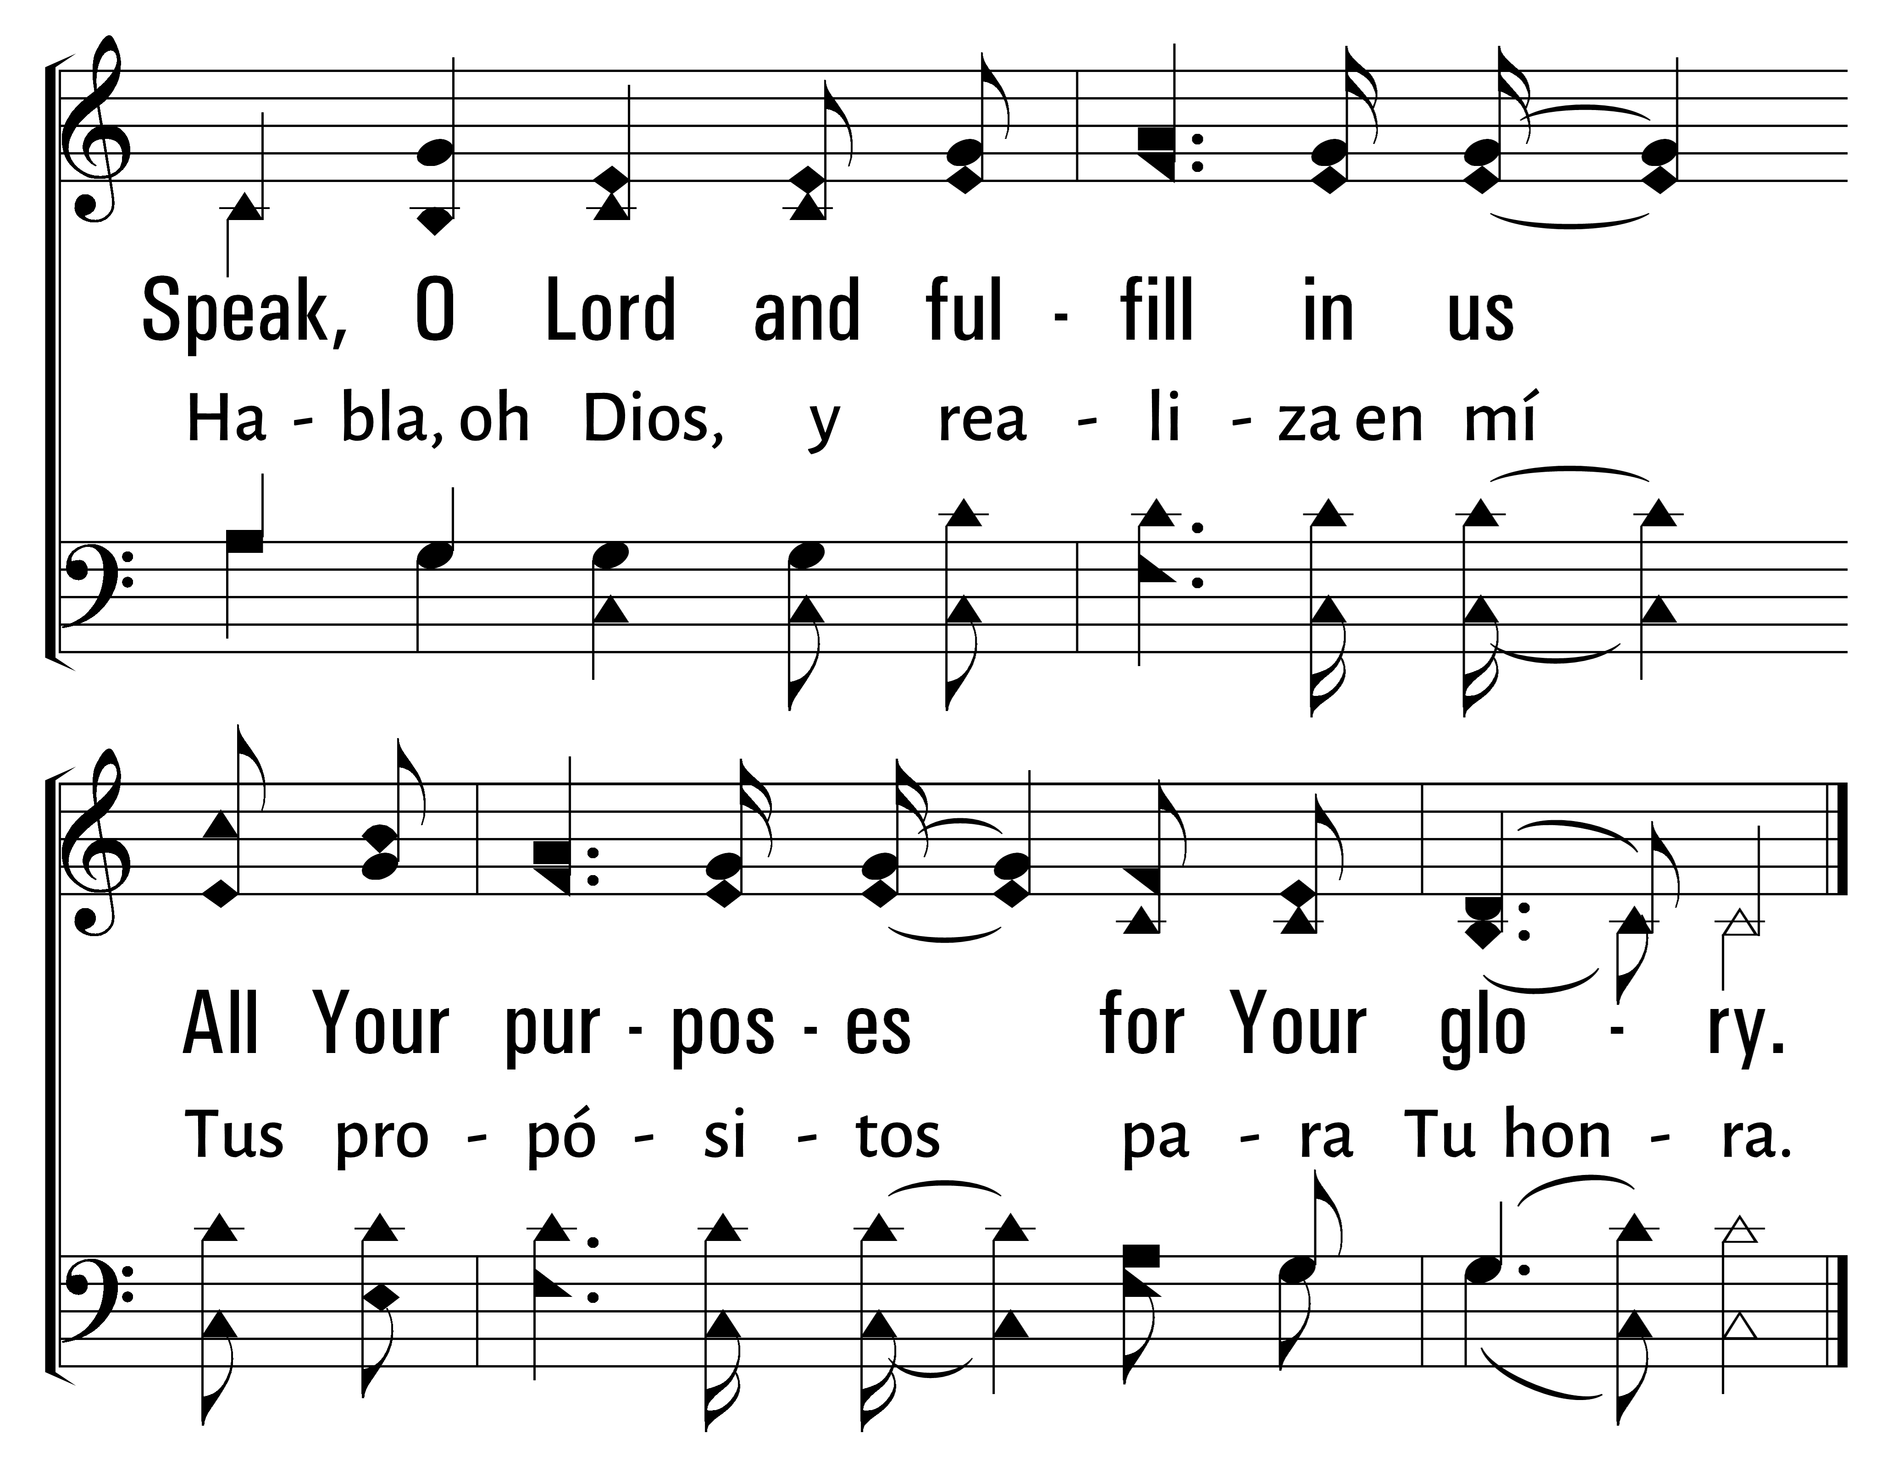
277
1
SPEAK, O LORD
2
3
HABLA, OH DIOS
Traducciï¿œn Jonathan y Sarah Jerez
© 2014 Sumphonia Productions, LLC

Slide 49
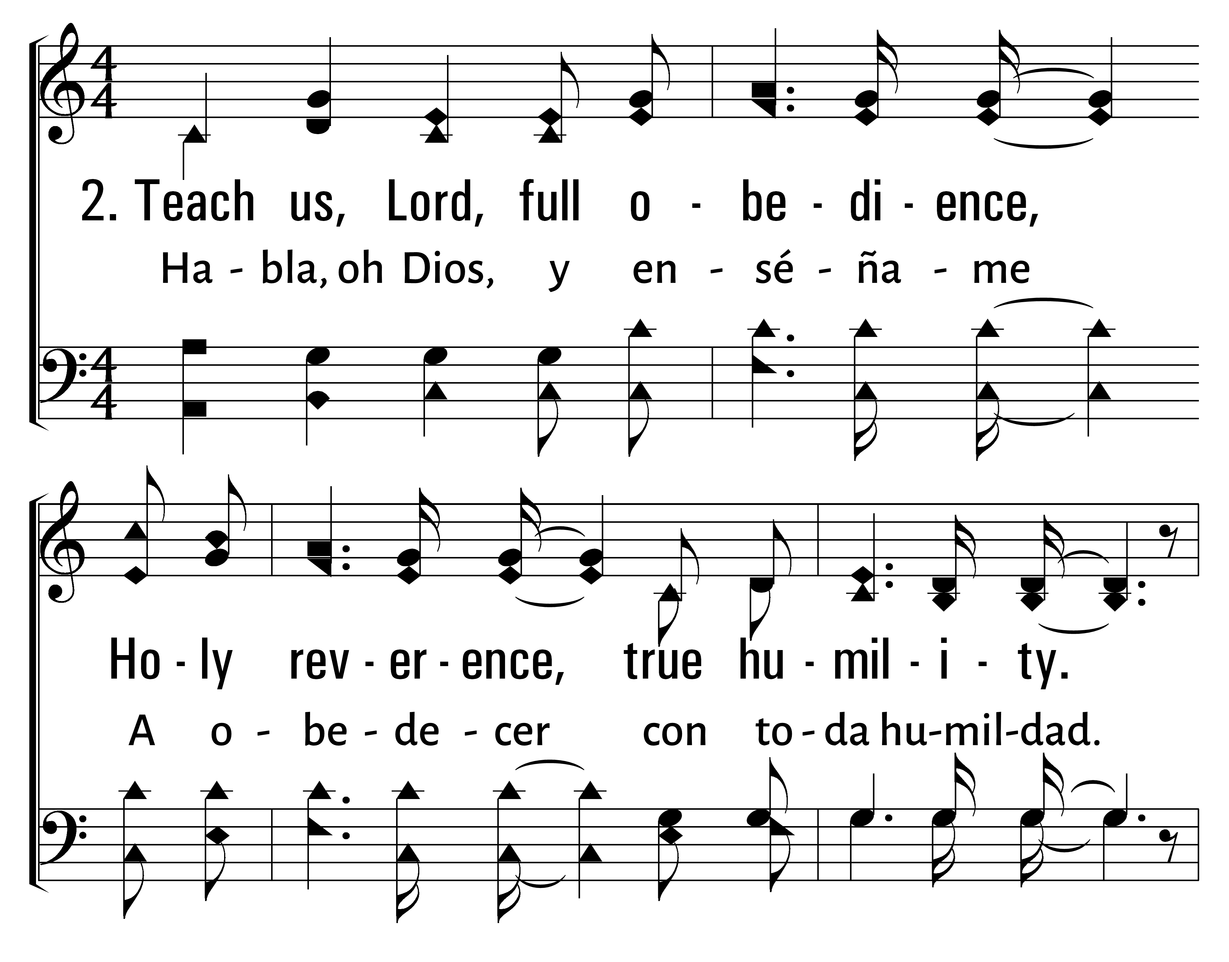
277
1
SPEAK, O LORD
2
3
HABLA, OH DIOS
Traducciï¿œn Jonathan y Sarah Jerez
© 2014 Sumphonia Productions, LLC

Slide 50
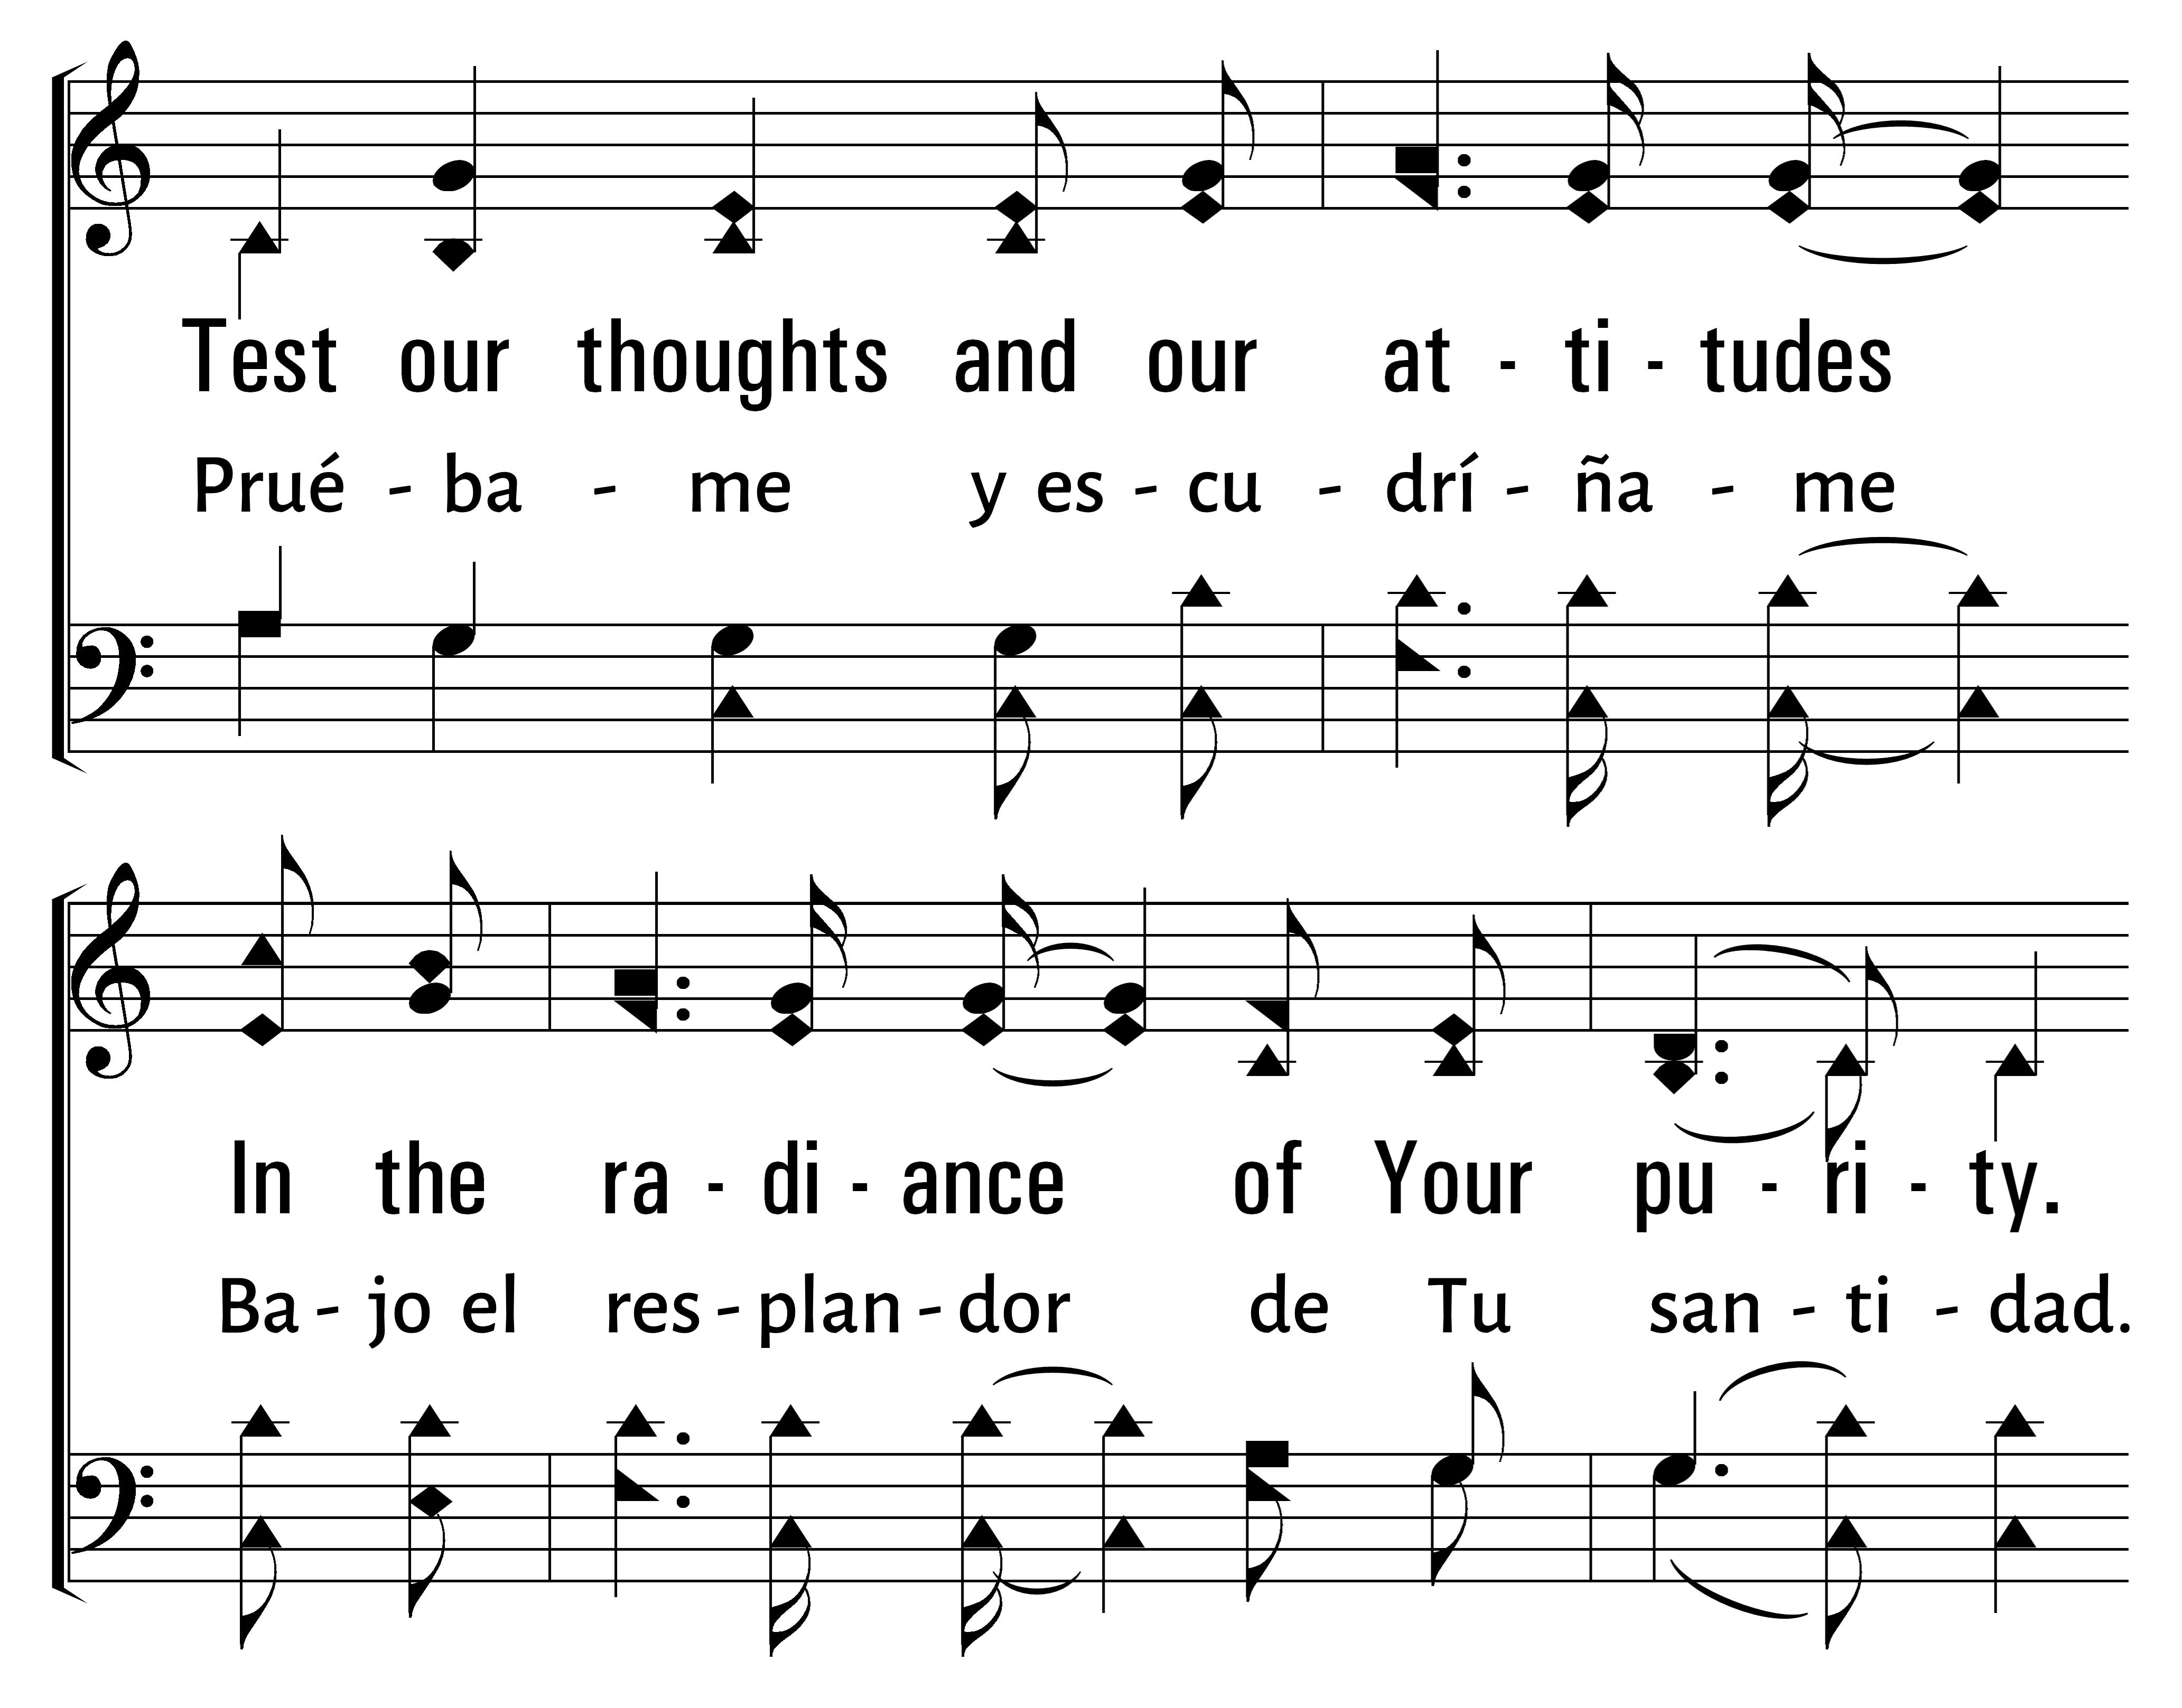
277
1
SPEAK, O LORD
2
3
HABLA, OH DIOS
Traducciï¿œn Jonathan y Sarah Jerez
© 2014 Sumphonia Productions, LLC

Slide 51
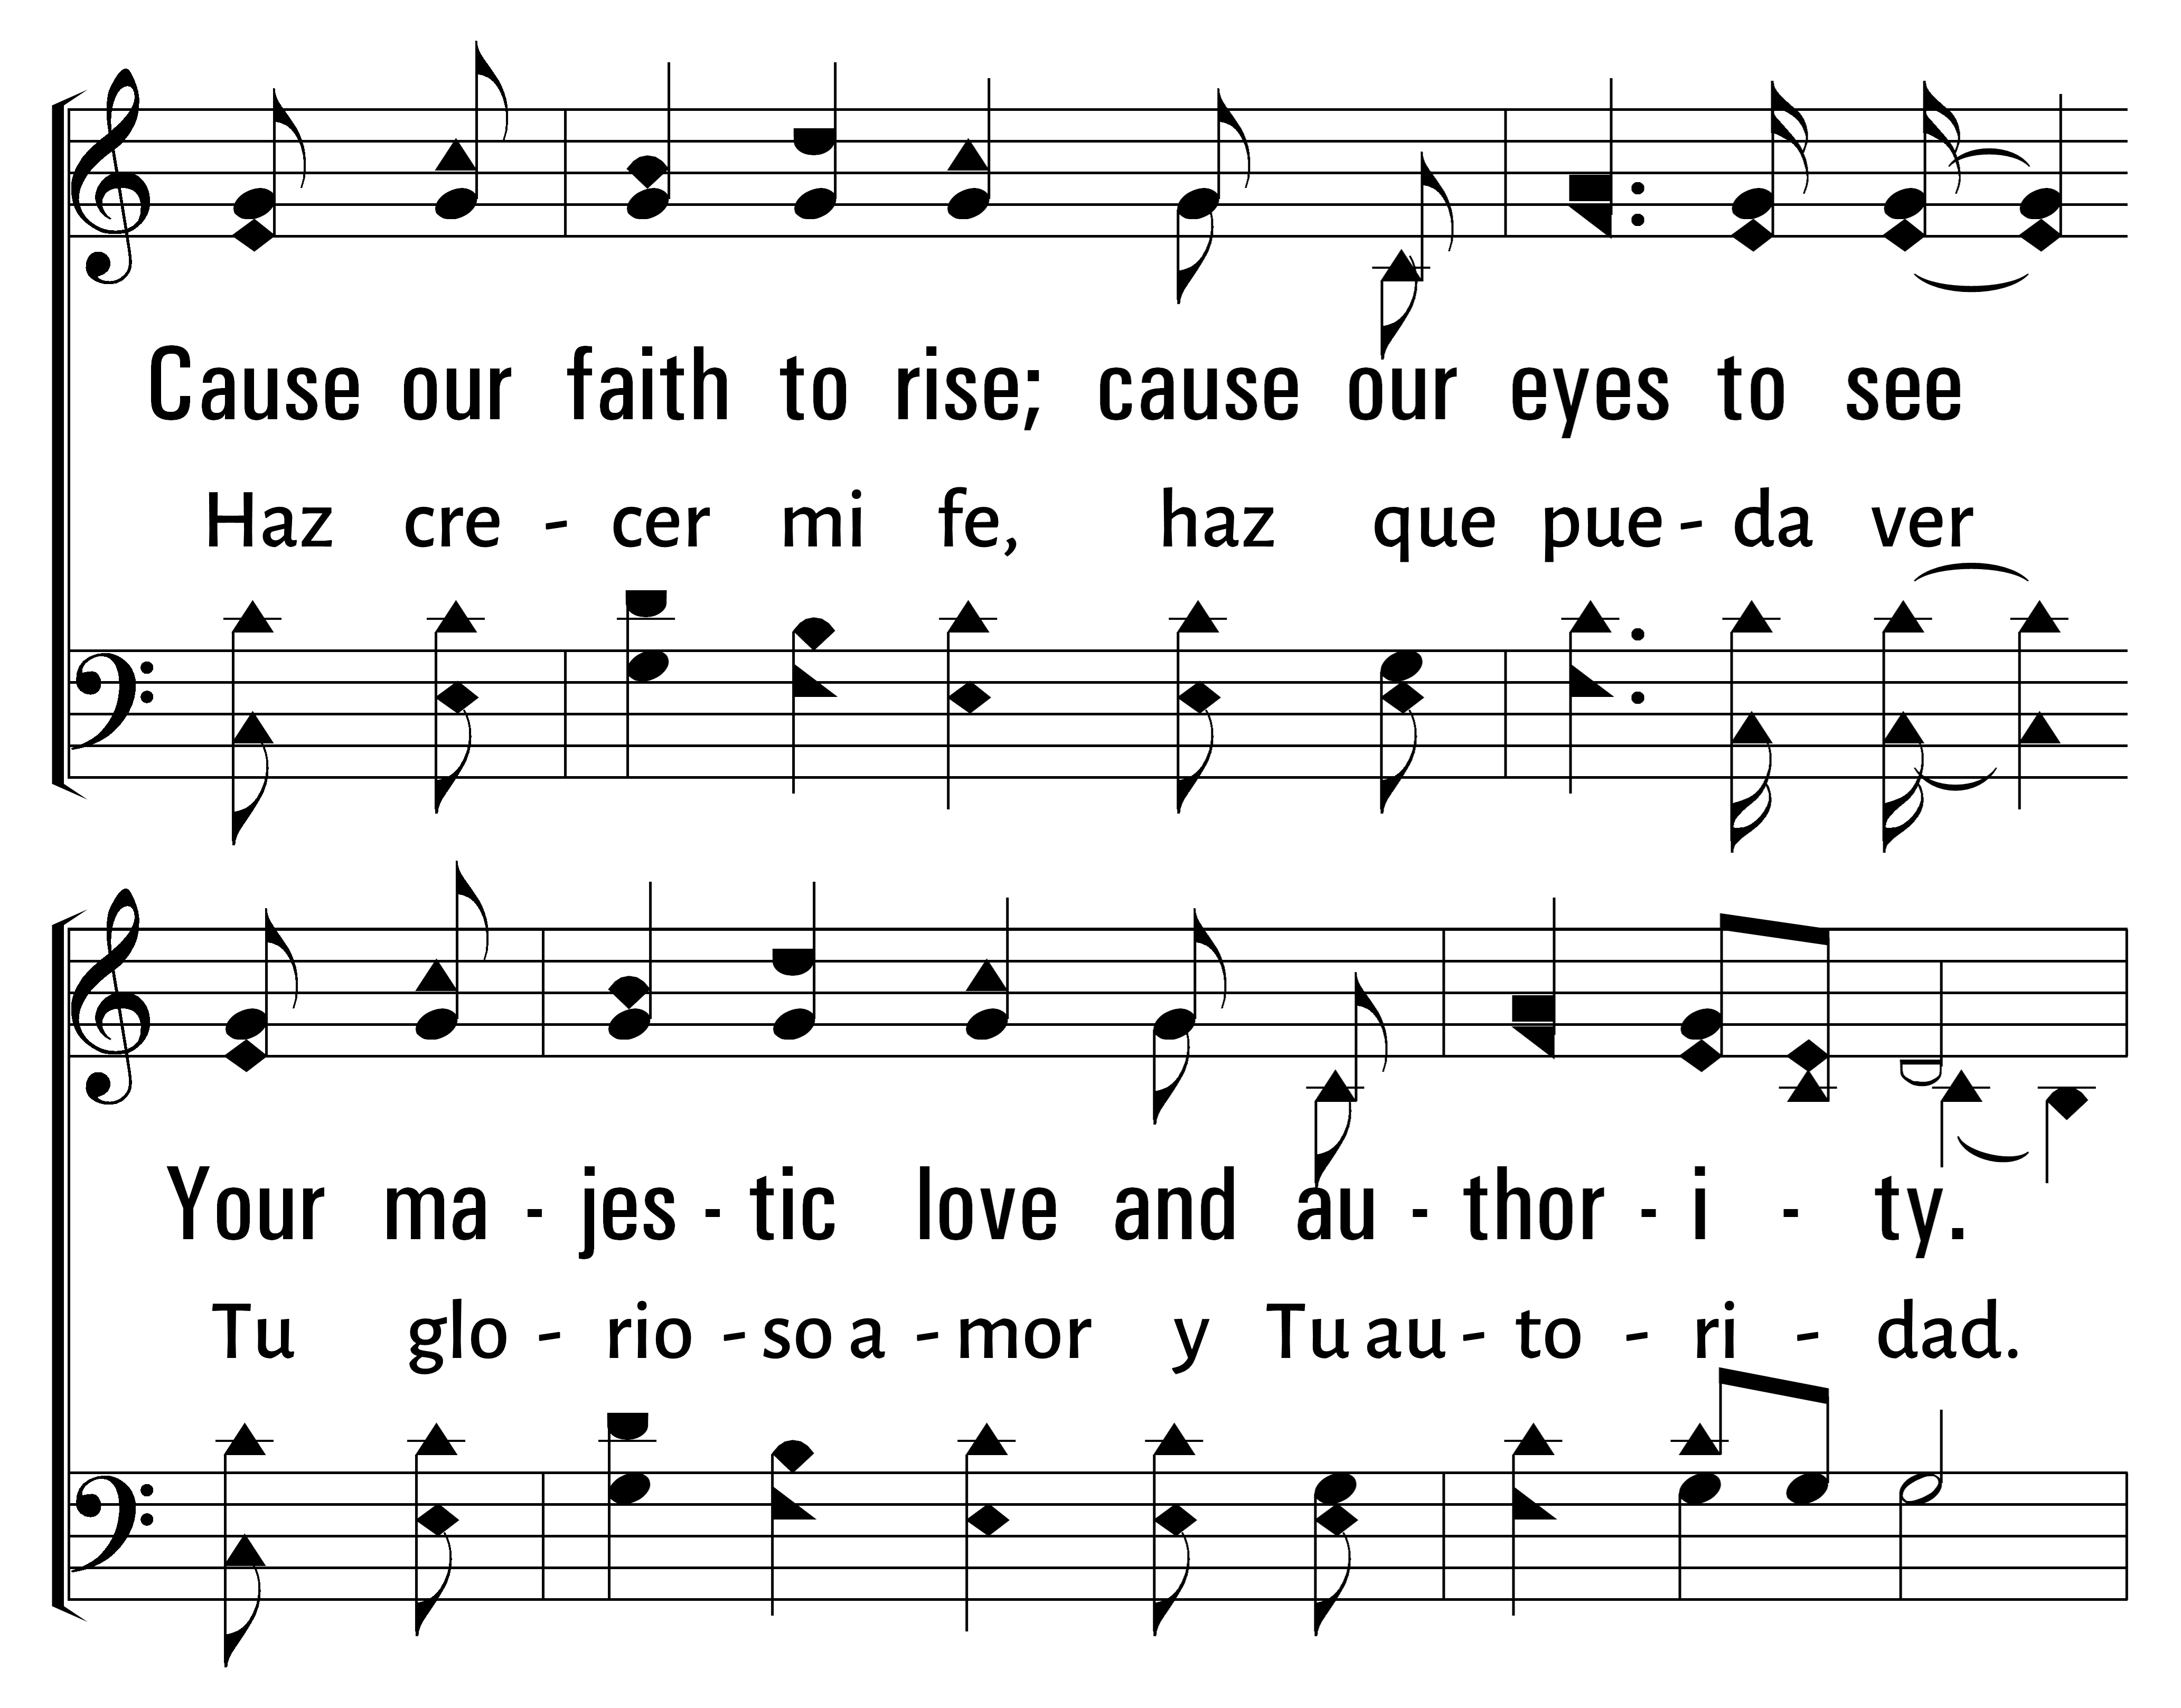
277
1
SPEAK, O LORD
2
3
HABLA, OH DIOS
Traducciï¿œn Jonathan y Sarah Jerez
© 2014 Sumphonia Productions, LLC

Slide 52
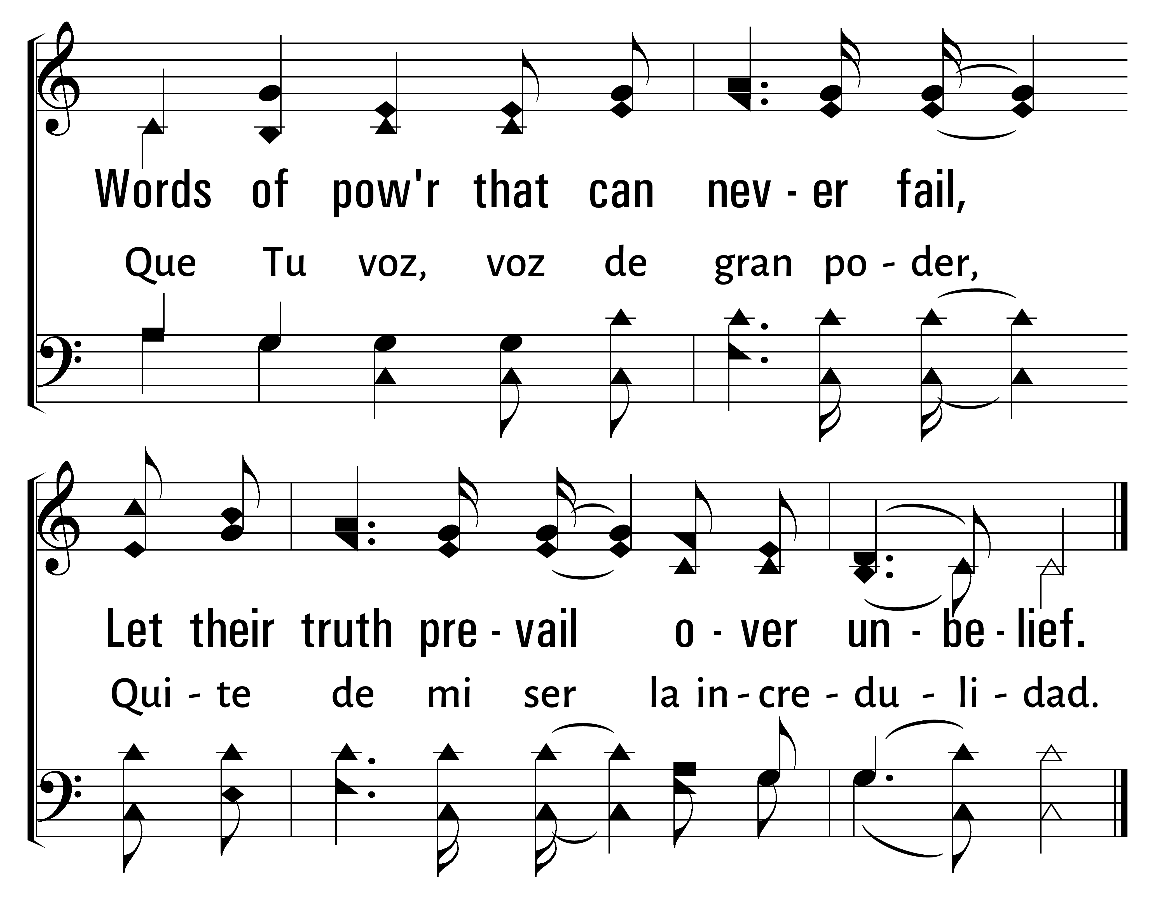
277
1
SPEAK, O LORD
2
3
HABLA, OH DIOS
Traducciï¿œn Jonathan y Sarah Jerez
© 2014 Sumphonia Productions, LLC

Slide 53
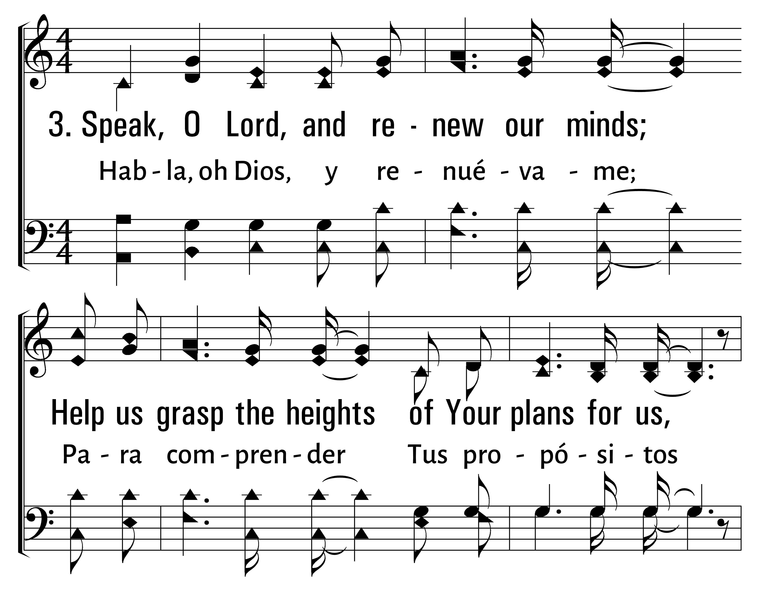
277
1
SPEAK, O LORD
2
3
HABLA, OH DIOS
Traducciï¿œn Jonathan y Sarah Jerez
© 2014 Sumphonia Productions, LLC

Slide 54
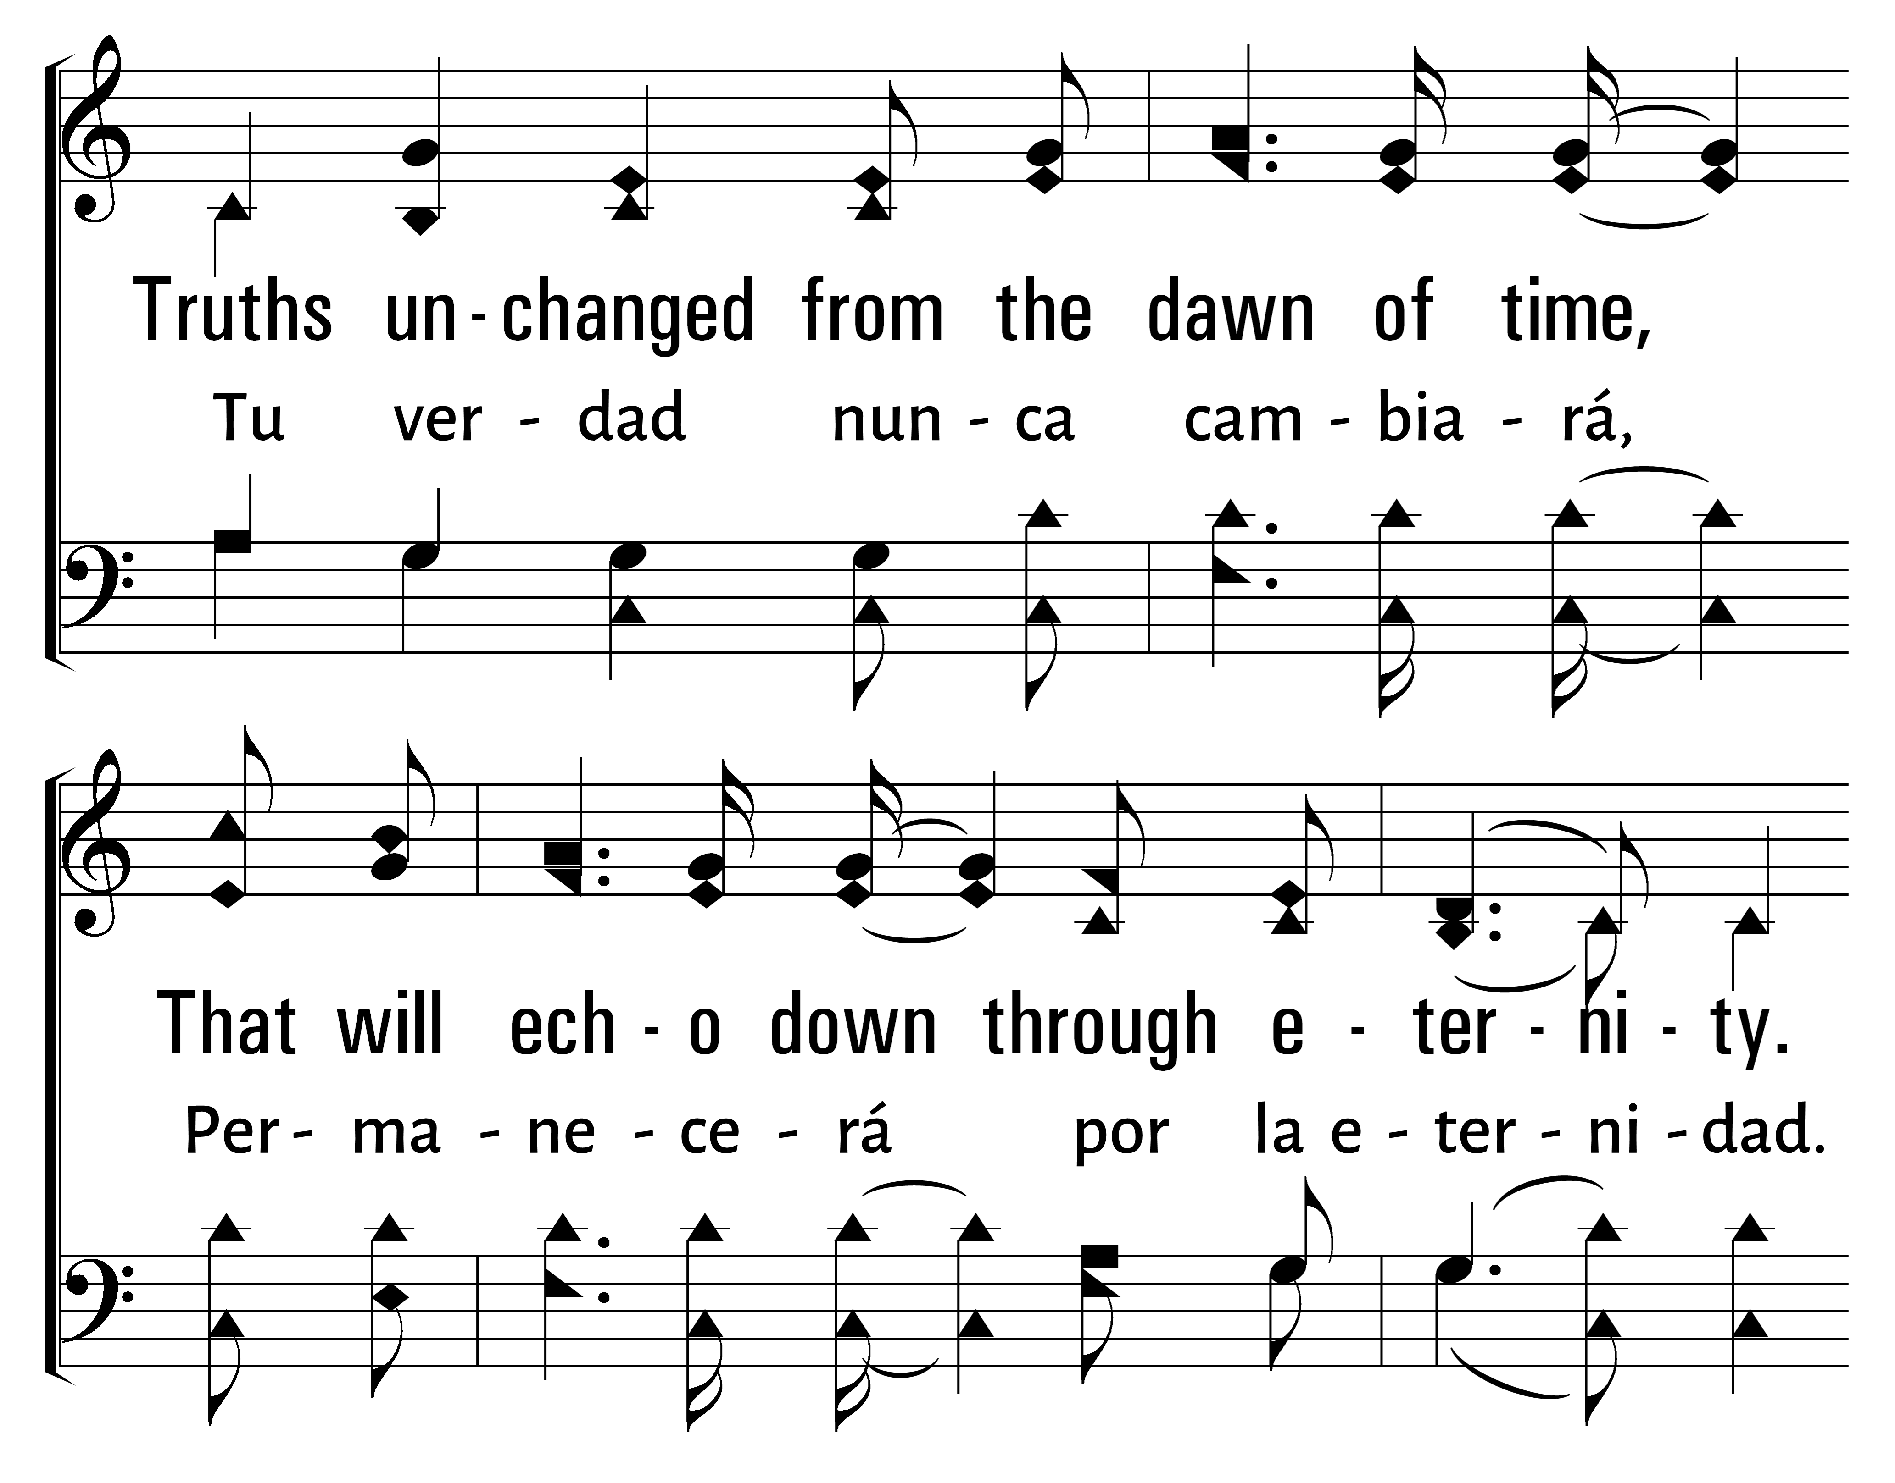
277
1
SPEAK, O LORD
2
3
HABLA, OH DIOS
Traducciï¿œn Jonathan y Sarah Jerez
© 2014 Sumphonia Productions, LLC

Slide 55
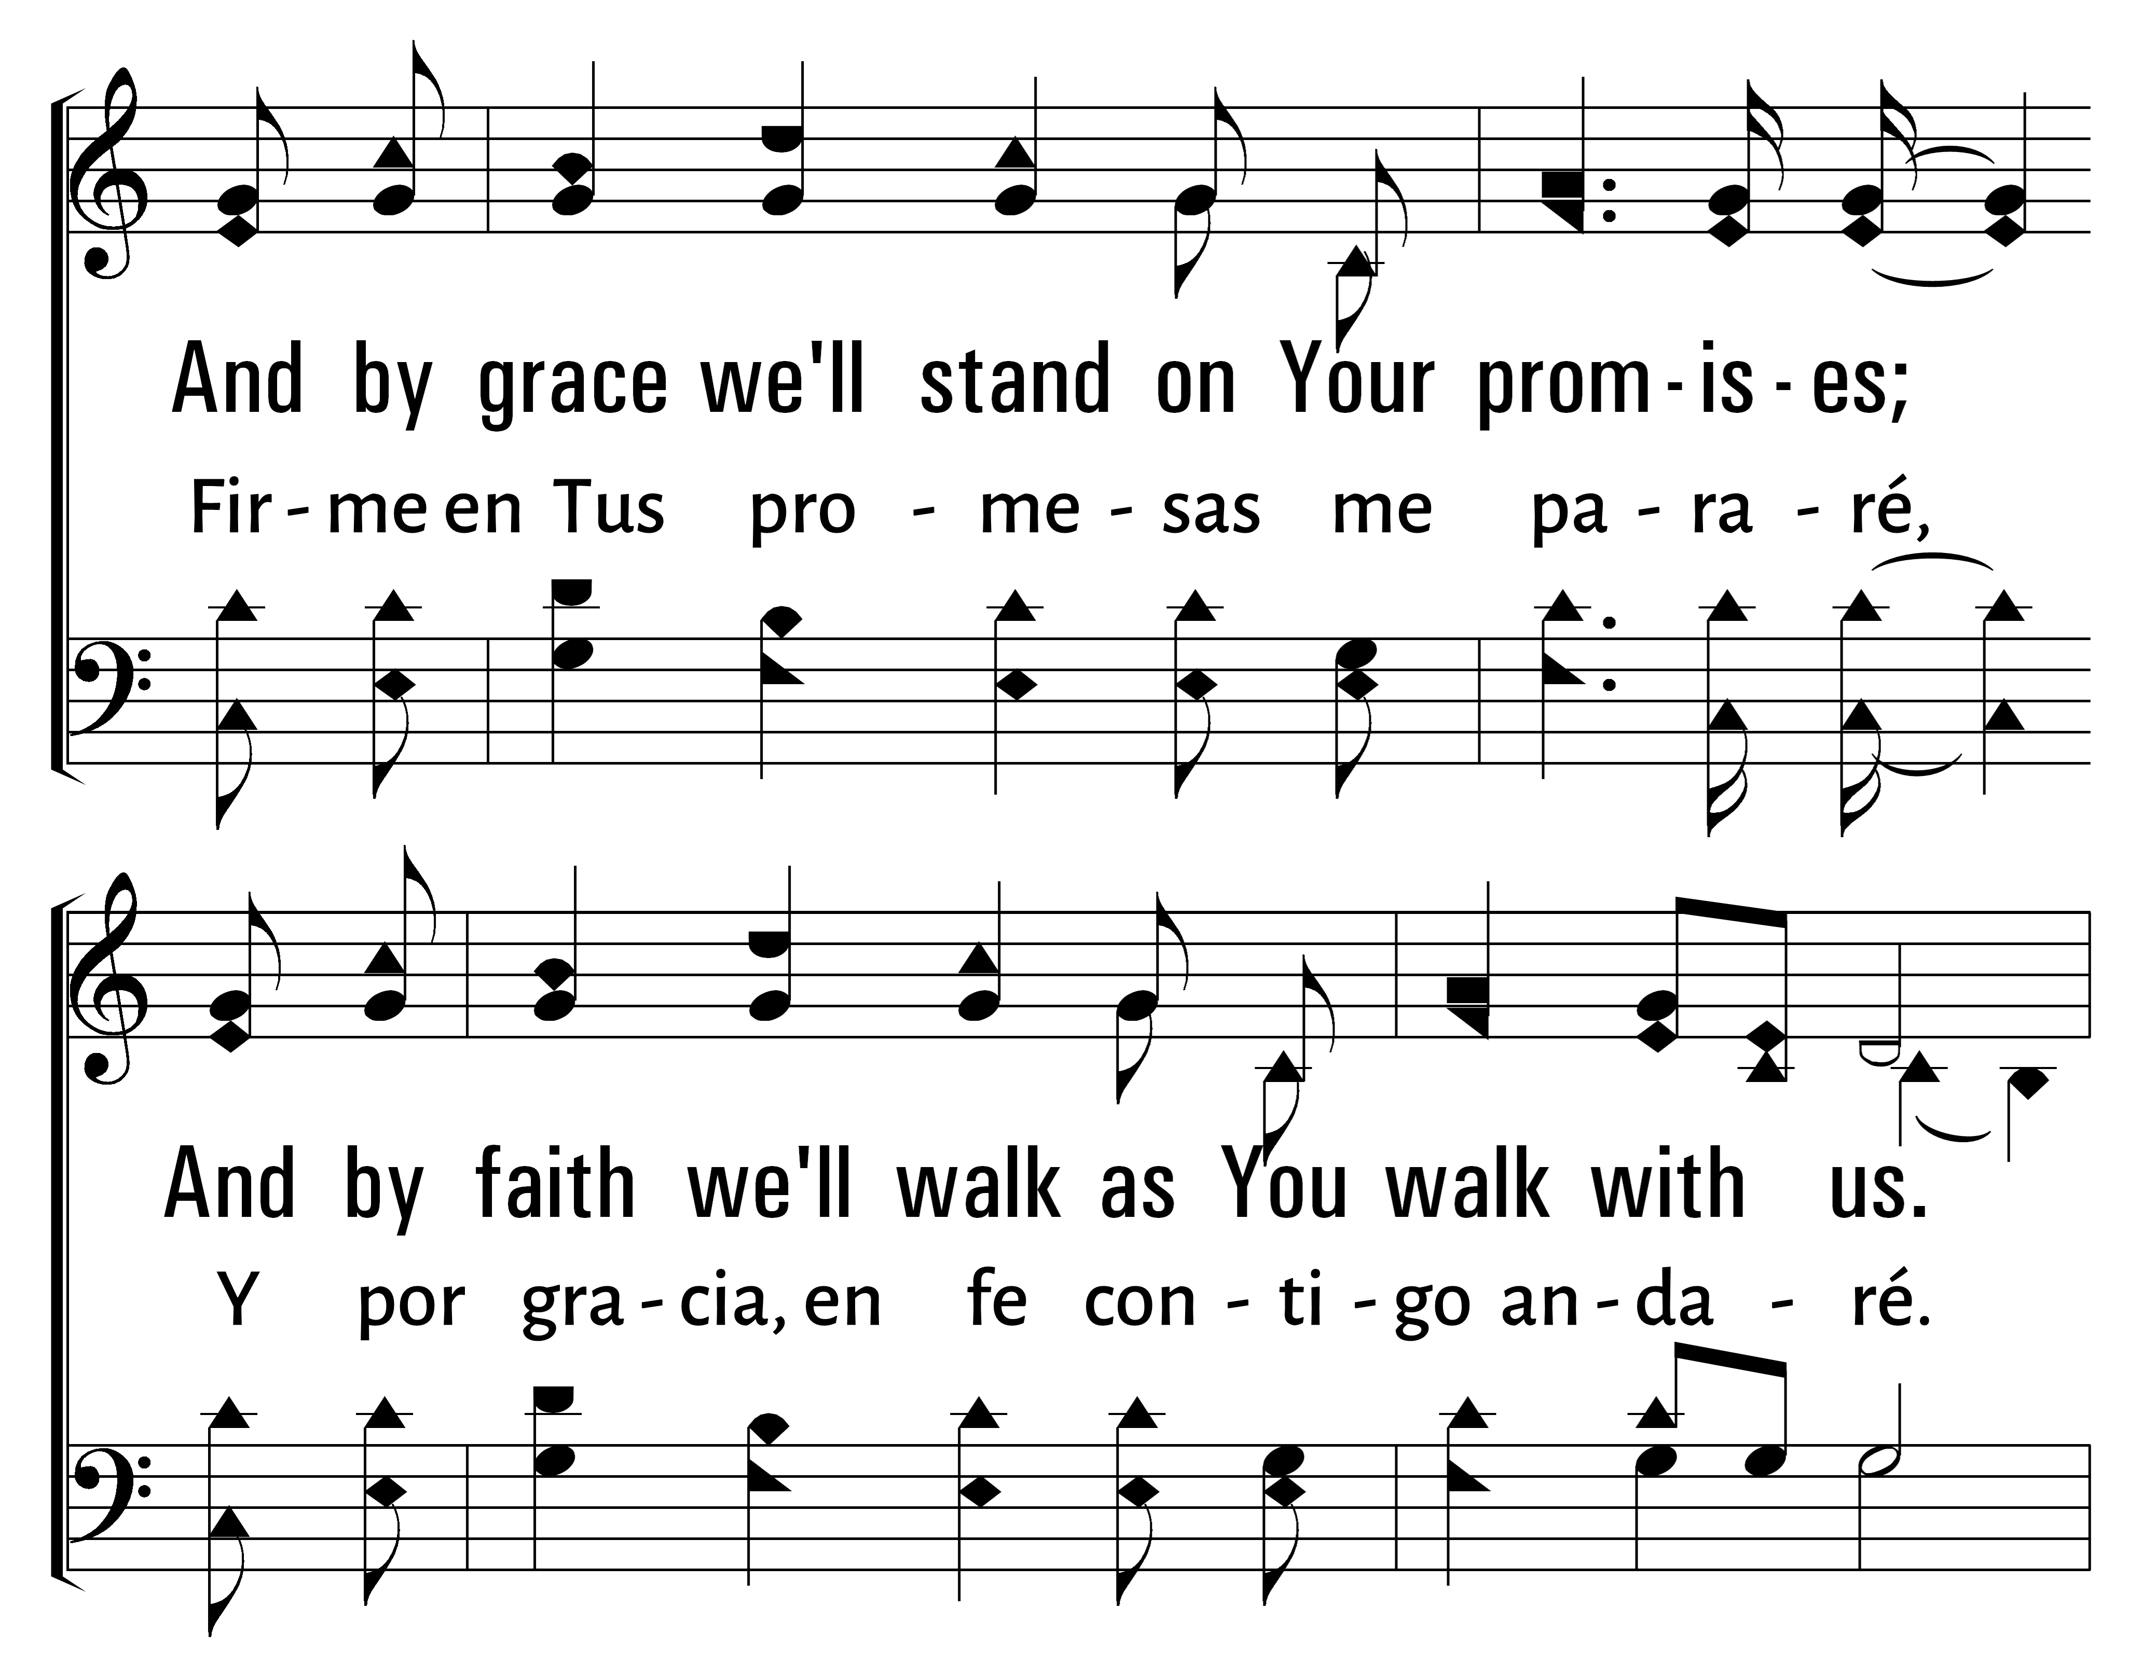
277
1
SPEAK, O LORD
2
3
HABLA, OH DIOS
Traducciï¿œn Jonathan y Sarah Jerez
© 2014 Sumphonia Productions, LLC

Slide 56
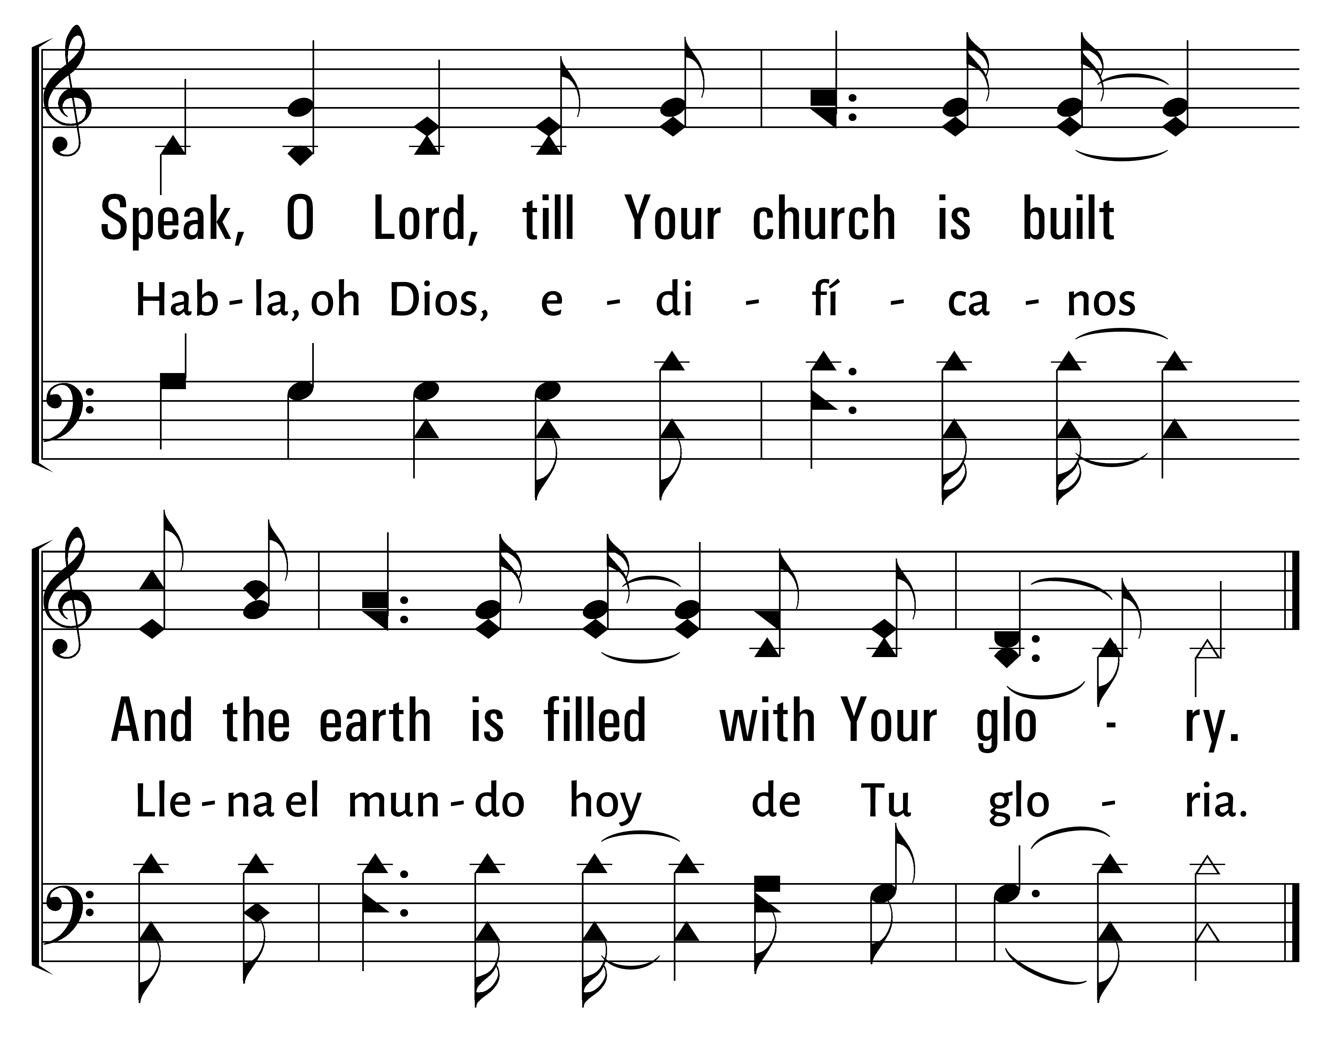
277
1
SPEAK, O LORD
2
3
HABLA, OH DIOS
Traducciï¿œn Jonathan y Sarah Jerez
© 2014 Sumphonia Productions, LLC

Slide 57

Bienvenida
Ofrenda
Lectura
Oraciï¿œn
25
742
Cena del Seï¿œor
103
277
Sermï¿œn
613
Oraciï¿œn
Welcome
Collection
Reading
Prayer
25
742
Lord’s Supper
103
277
Sermon
613
Prayer
SERMï¿œN
SERMON
“NOS MANDï¿œ QUE PREDICï¿œSEMOS AL PUEBLO”
“HE COMMANDED US TO PREACH TO THE PEOPLE”
HECHOS 10:42
ACTS 10:42

Slide 59
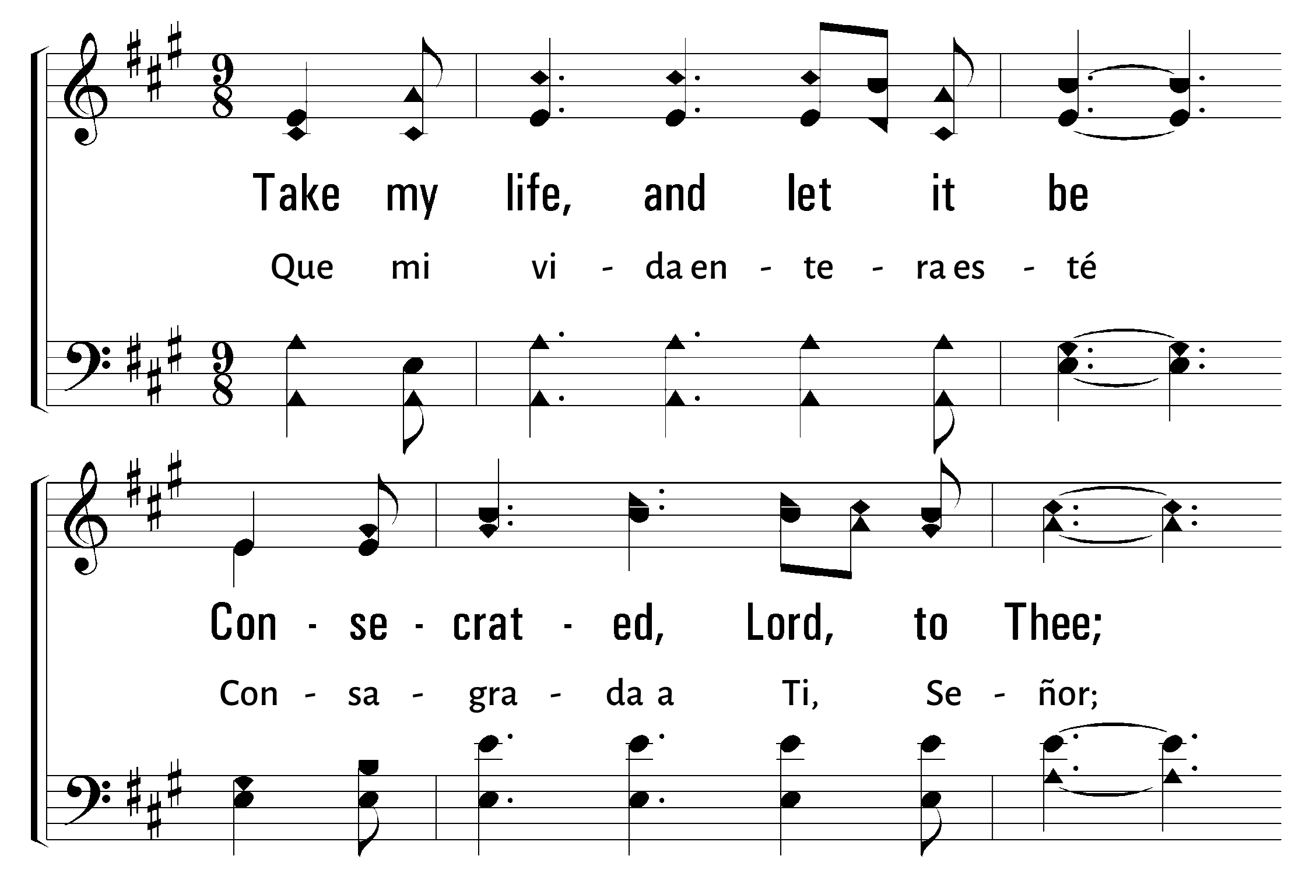
1
2
3
4
5
6
613
TAKE MY LIFE, AND LET IT BE • QUE MI VIDA ENTERA ESTÉ
© 2007 The Paperless Hymnal®

Slide 60
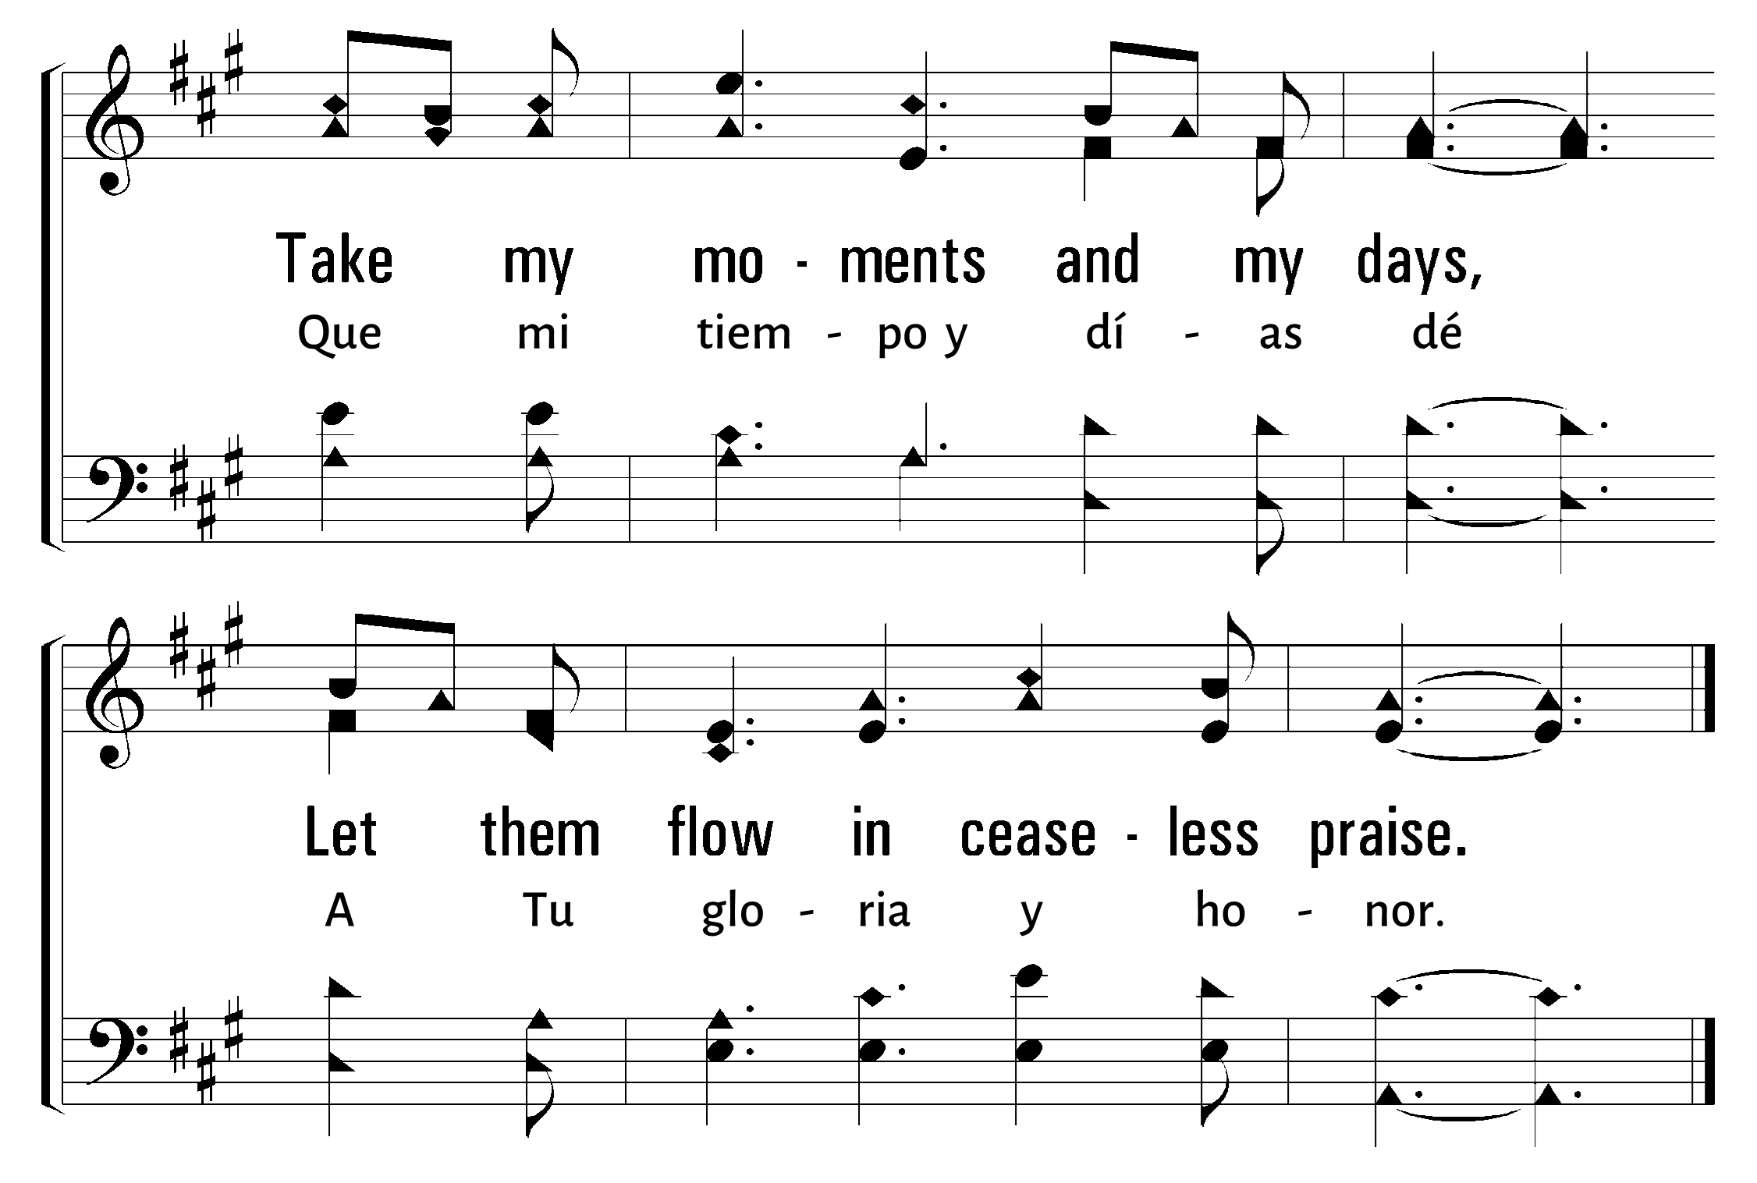
1
2
3
4
5
6
613
TAKE MY LIFE, AND LET IT BE • QUE MI VIDA ENTERA ESTÉ
© 2007 The Paperless Hymnal®

Slide 61
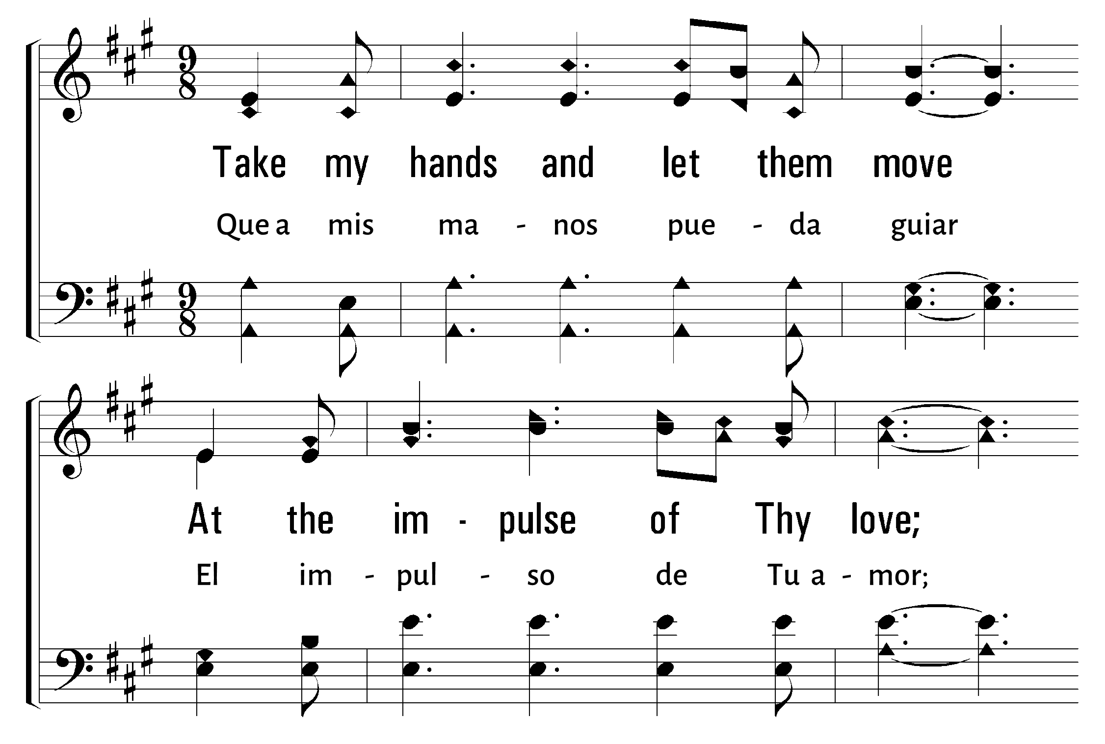
1
2
3
4
5
6
613
TAKE MY LIFE, AND LET IT BE • QUE MI VIDA ENTERA ESTÉ
© 2007 The Paperless Hymnal®

Slide 62
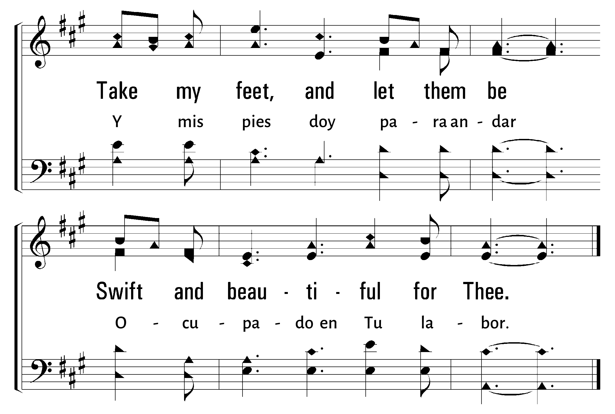
1
2
3
4
5
6
613
TAKE MY LIFE, AND LET IT BE • QUE MI VIDA ENTERA ESTÉ
© 2007 The Paperless Hymnal®

Slide 63
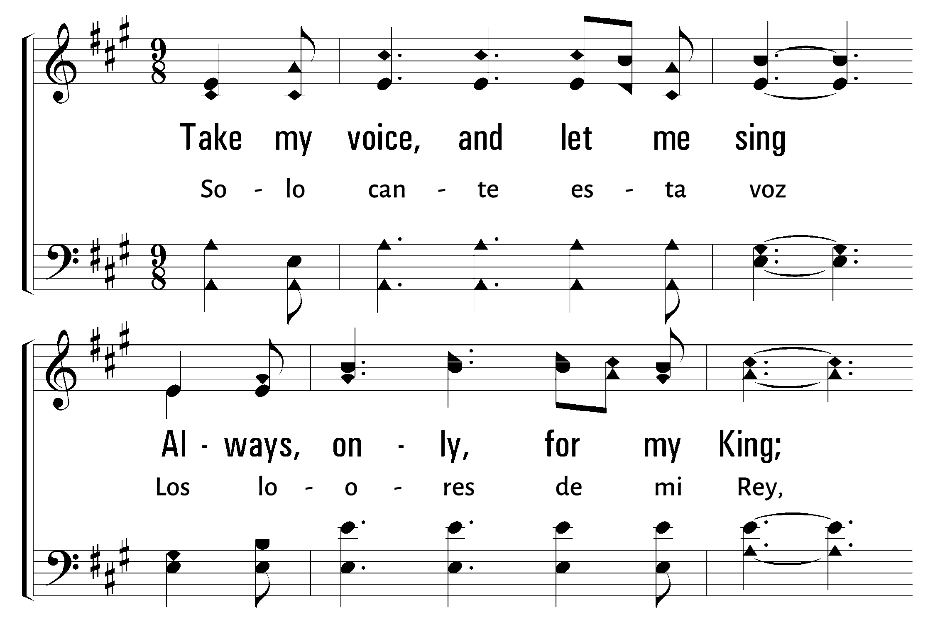
1
2
3
4
5
6
613
TAKE MY LIFE, AND LET IT BE • QUE MI VIDA ENTERA ESTÉ
© 2007 The Paperless Hymnal®

Slide 64
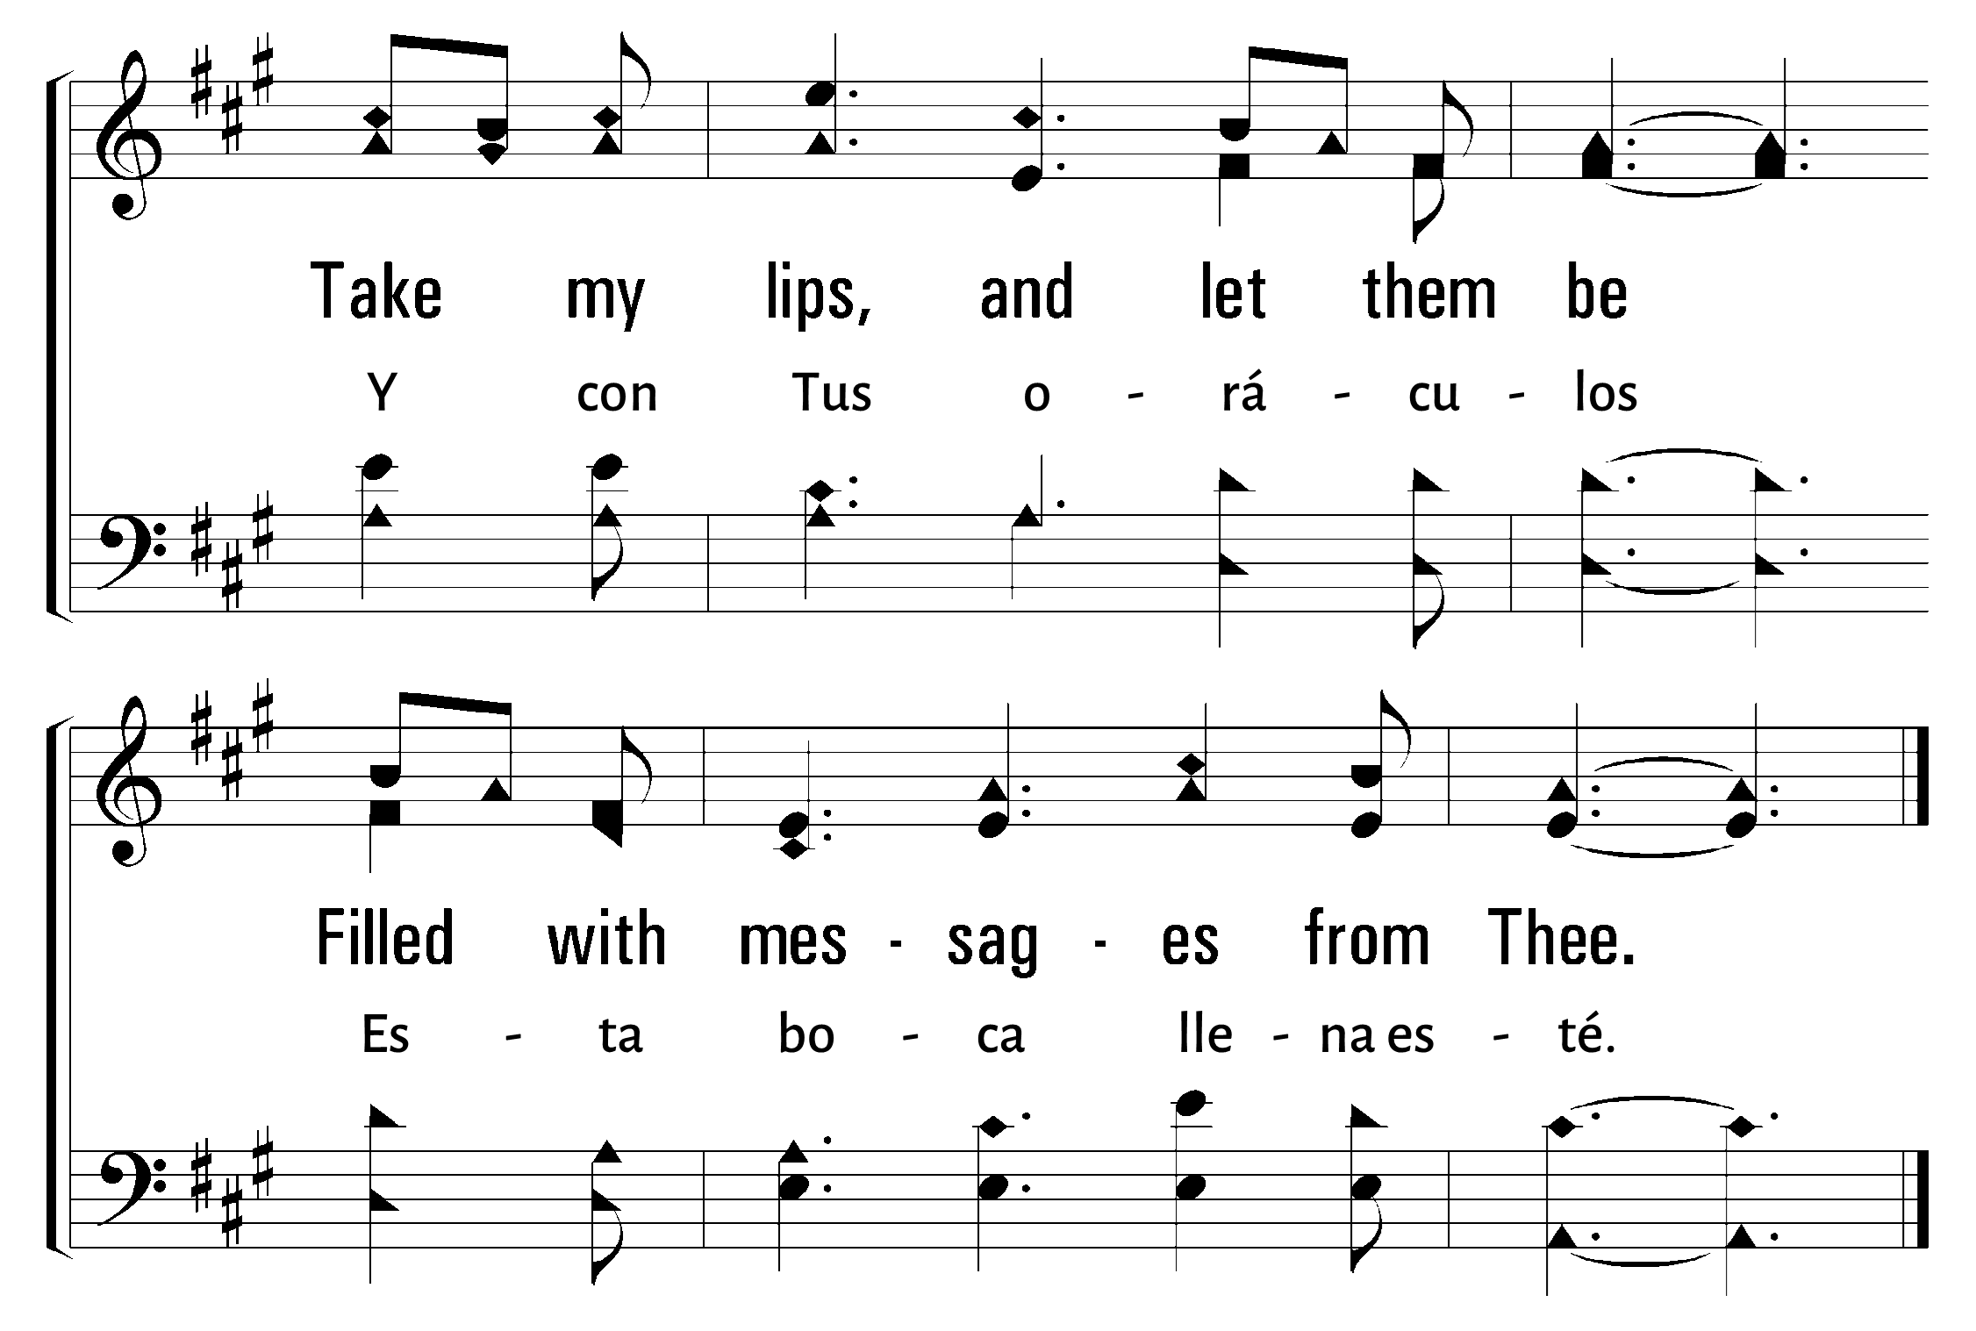
1
2
3
4
5
6
613
TAKE MY LIFE, AND LET IT BE • QUE MI VIDA ENTERA ESTÉ
© 2007 The Paperless Hymnal®

Slide 65
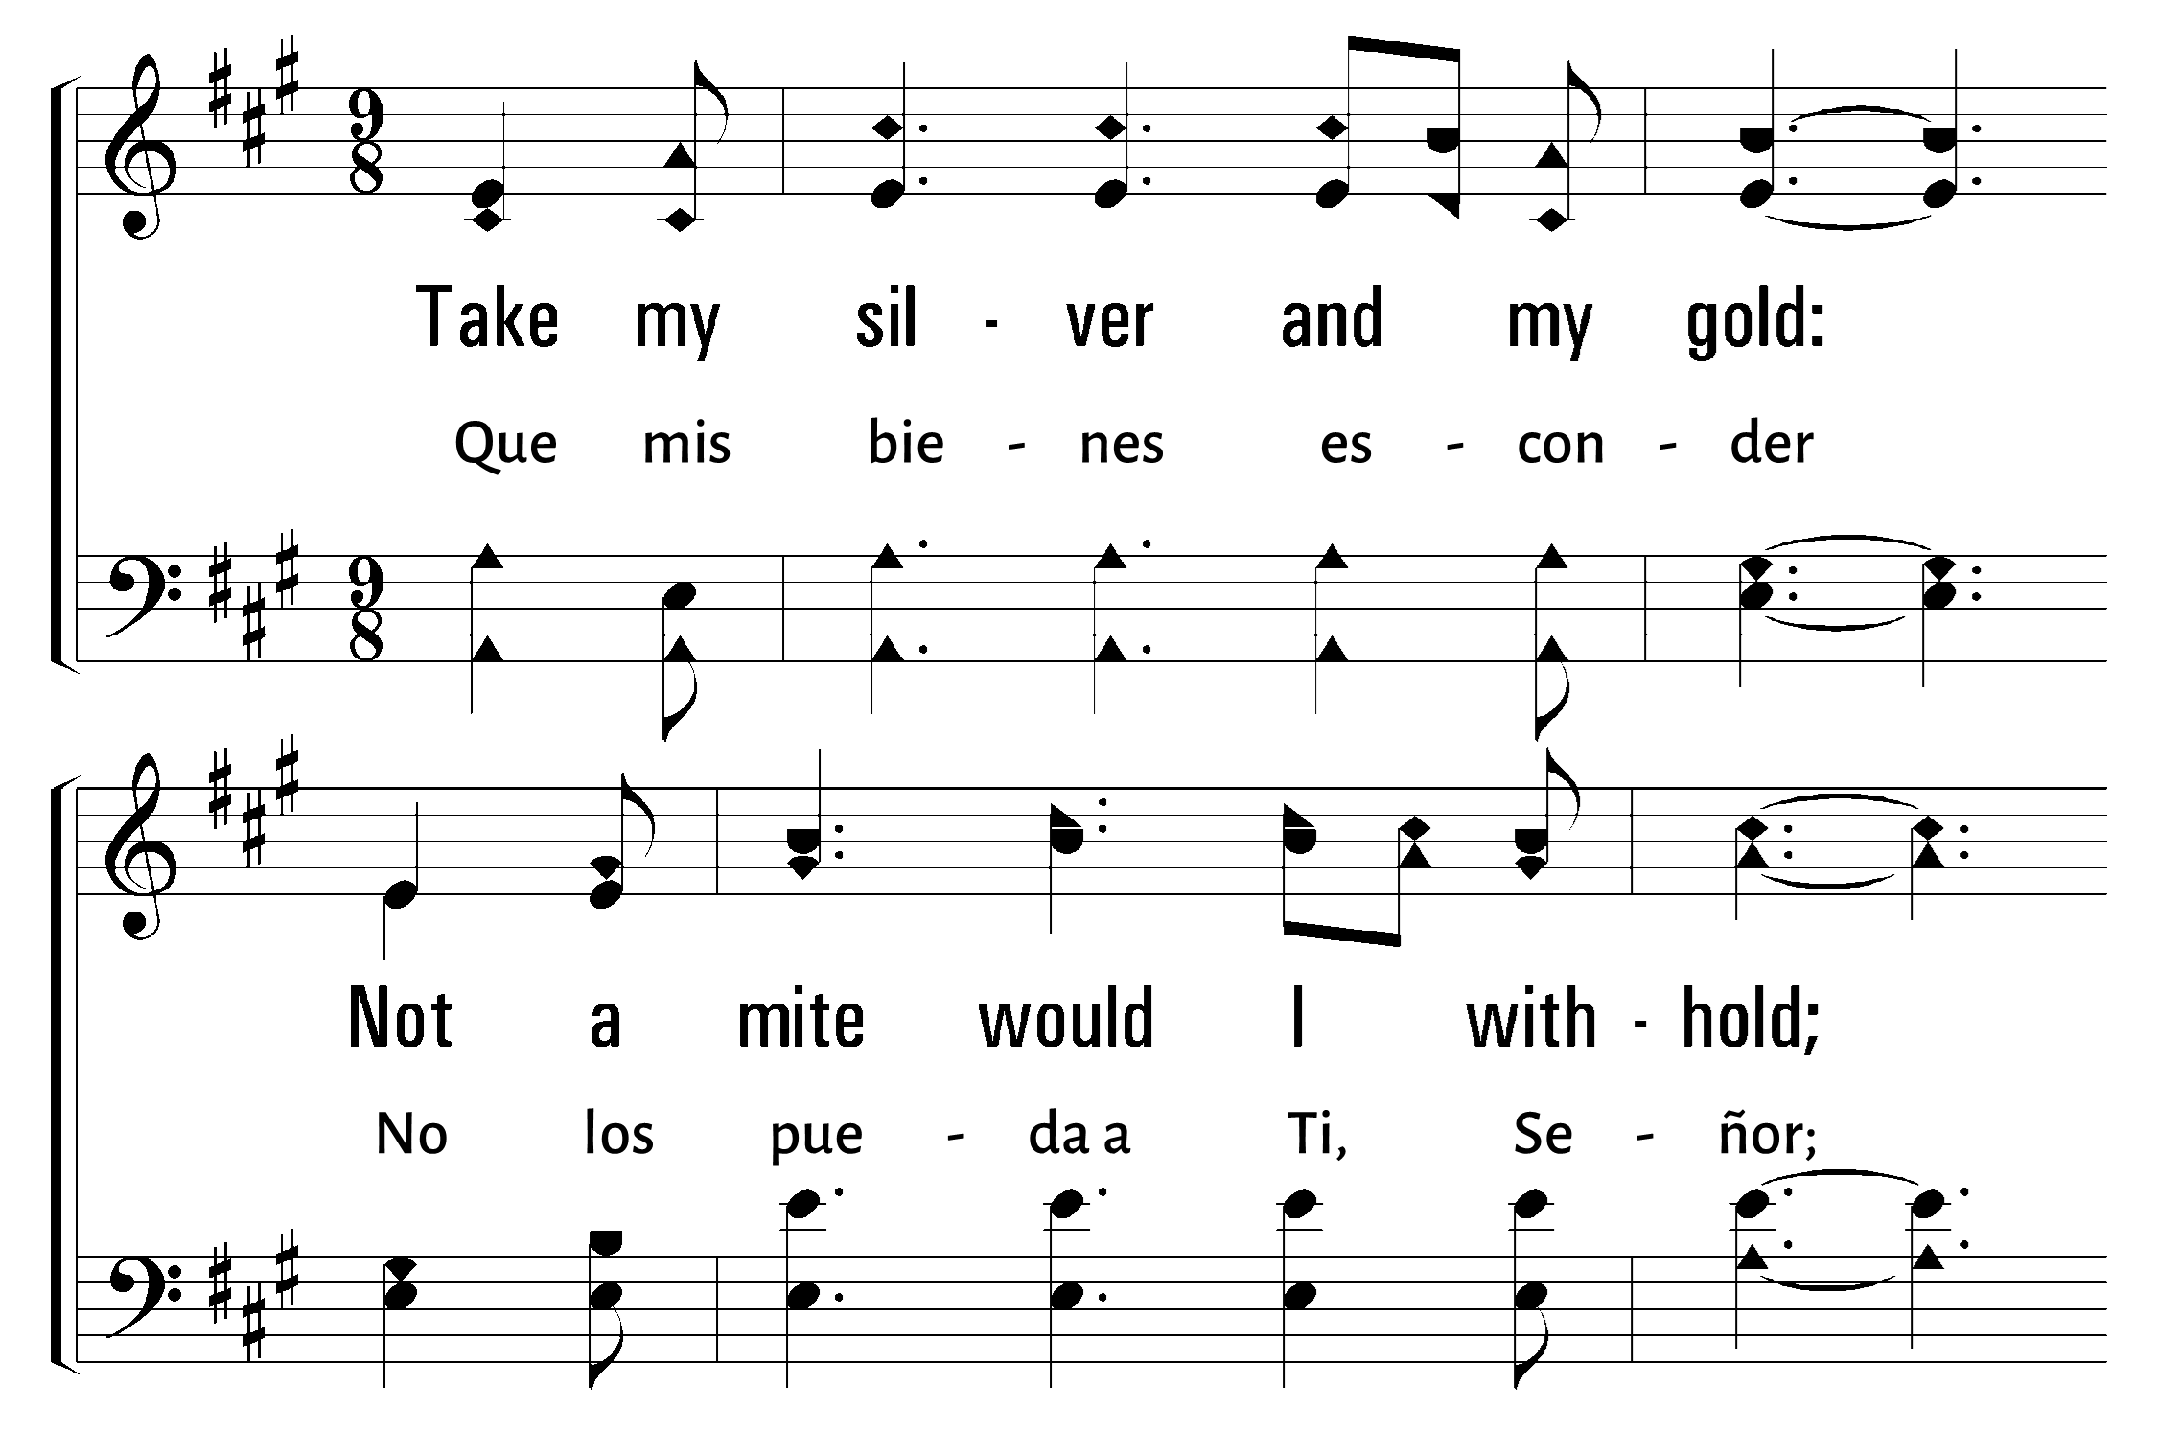
1
2
3
4
5
6
613
TAKE MY LIFE, AND LET IT BE • QUE MI VIDA ENTERA ESTÉ
© 2007 The Paperless Hymnal®

Slide 66

1
2
3
4
5
6
613
TAKE MY LIFE, AND LET IT BE • QUE MI VIDA ENTERA ESTÉ
© 2007 The Paperless Hymnal®

Slide 67

1
2
3
4
5
6
613
TAKE MY LIFE, AND LET IT BE • QUE MI VIDA ENTERA ESTÉ
© 2007 The Paperless Hymnal®

Slide 68

1
2
3
4
5
6
613
TAKE MY LIFE, AND LET IT BE • QUE MI VIDA ENTERA ESTÉ
© 2007 The Paperless Hymnal®

Slide 69

1
2
3
4
5
6
613
TAKE MY LIFE, AND LET IT BE • QUE MI VIDA ENTERA ESTÉ
© 2007 The Paperless Hymnal®

Slide 70

1
2
3
4
5
6
613
TAKE MY LIFE, AND LET IT BE • QUE MI VIDA ENTERA ESTÉ
© 2007 The Paperless Hymnal®

Slide 72
Bienvenida
Ofrenda
Lectura
Oraciï¿œn
25
742
Cena del Seï¿œor
103
277
Sermï¿œn
613
Oraciï¿œn
Welcome
Collection
Reading
Prayer
25
742
Lord’s Supper
103
277
Sermon
613
Prayer
ORACIï¿œN
PRAYER
“DEVOTE YOURSELVES TO PRAYER”
“PERSEVERAD EN LA ORACIï¿œN”
COLOSSIANS 4:2
COLOSENSES 4:2

