Slide 1
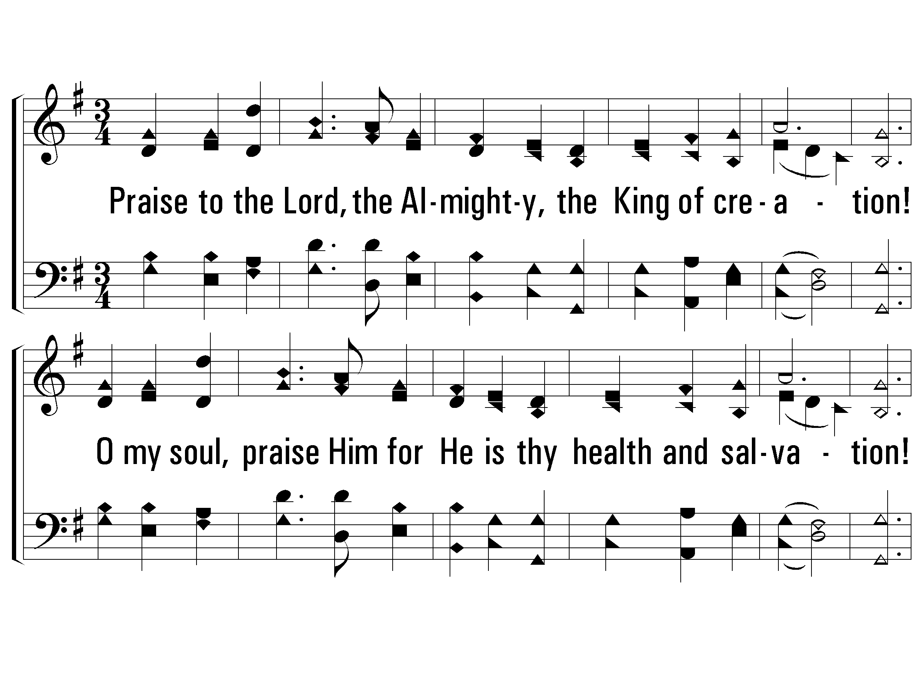
1 – Praise to the Lord, The Almighty
534
1.
Praise to the Lord, the Almighty, the King of creation!
O my soul, praise Him for He is thy health and salvation!
All ye who hear, Now to His temple draw near;
Join me in glad adoration!
Words: Joachin Neander / tr. Catherine Winkworth
Music: Stralsund Gesangbuch / har. W. Sterndale Bennett
© 2003 The Paperless Hymnal™

Slide 2
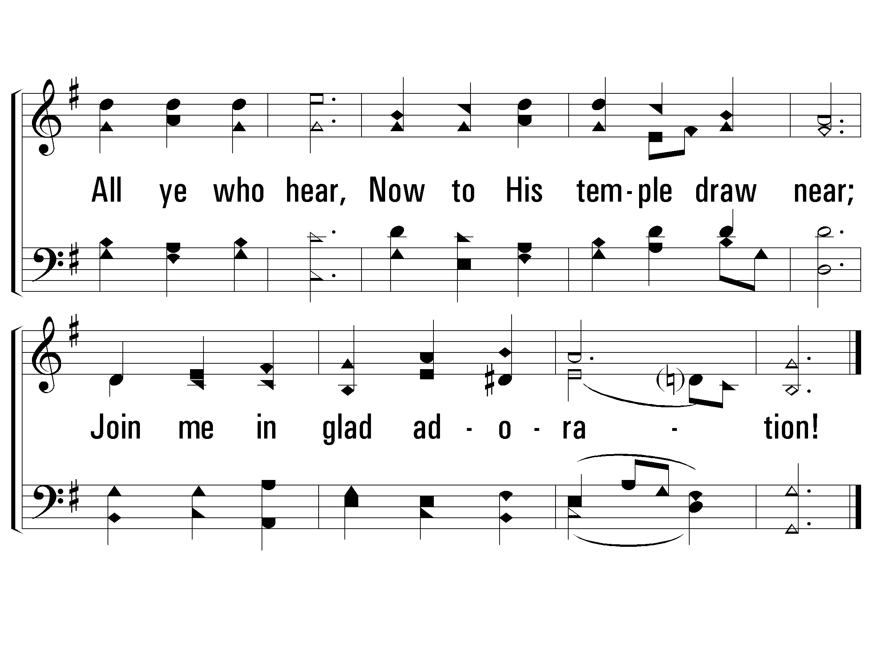
1 – Praise to the Lord, The Almighty
534
© 2003 The Paperless Hymnal™

Slide 3
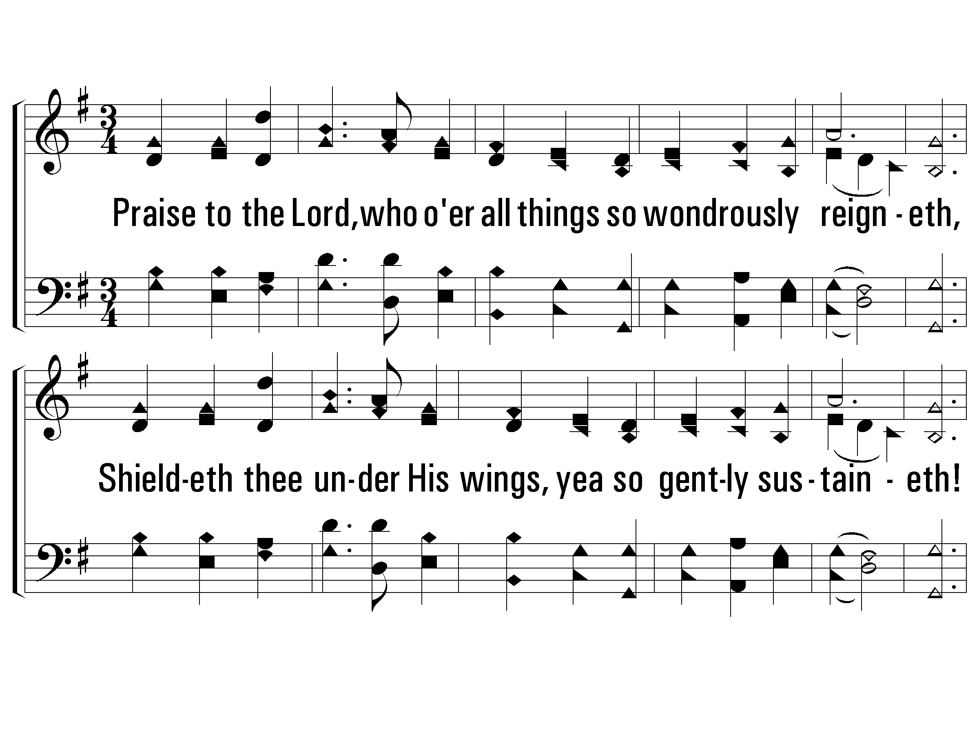
2 – Praise to the Lord, The Almighty
534
2.
Praise to the Lord, who o'er all things so wondrously reigneth,
Shieldeth thee under His wings, yea so gently sustaineth!
Hast thou not seen How thy desires e'er have been
Granted in what He ordaineth?
Words: Joachin Neander / tr. Catherine Winkworth
Music: Stralsund Gesangbuch / har. W. Sterndale Bennett
© 2003 The Paperless Hymnal™

Slide 4
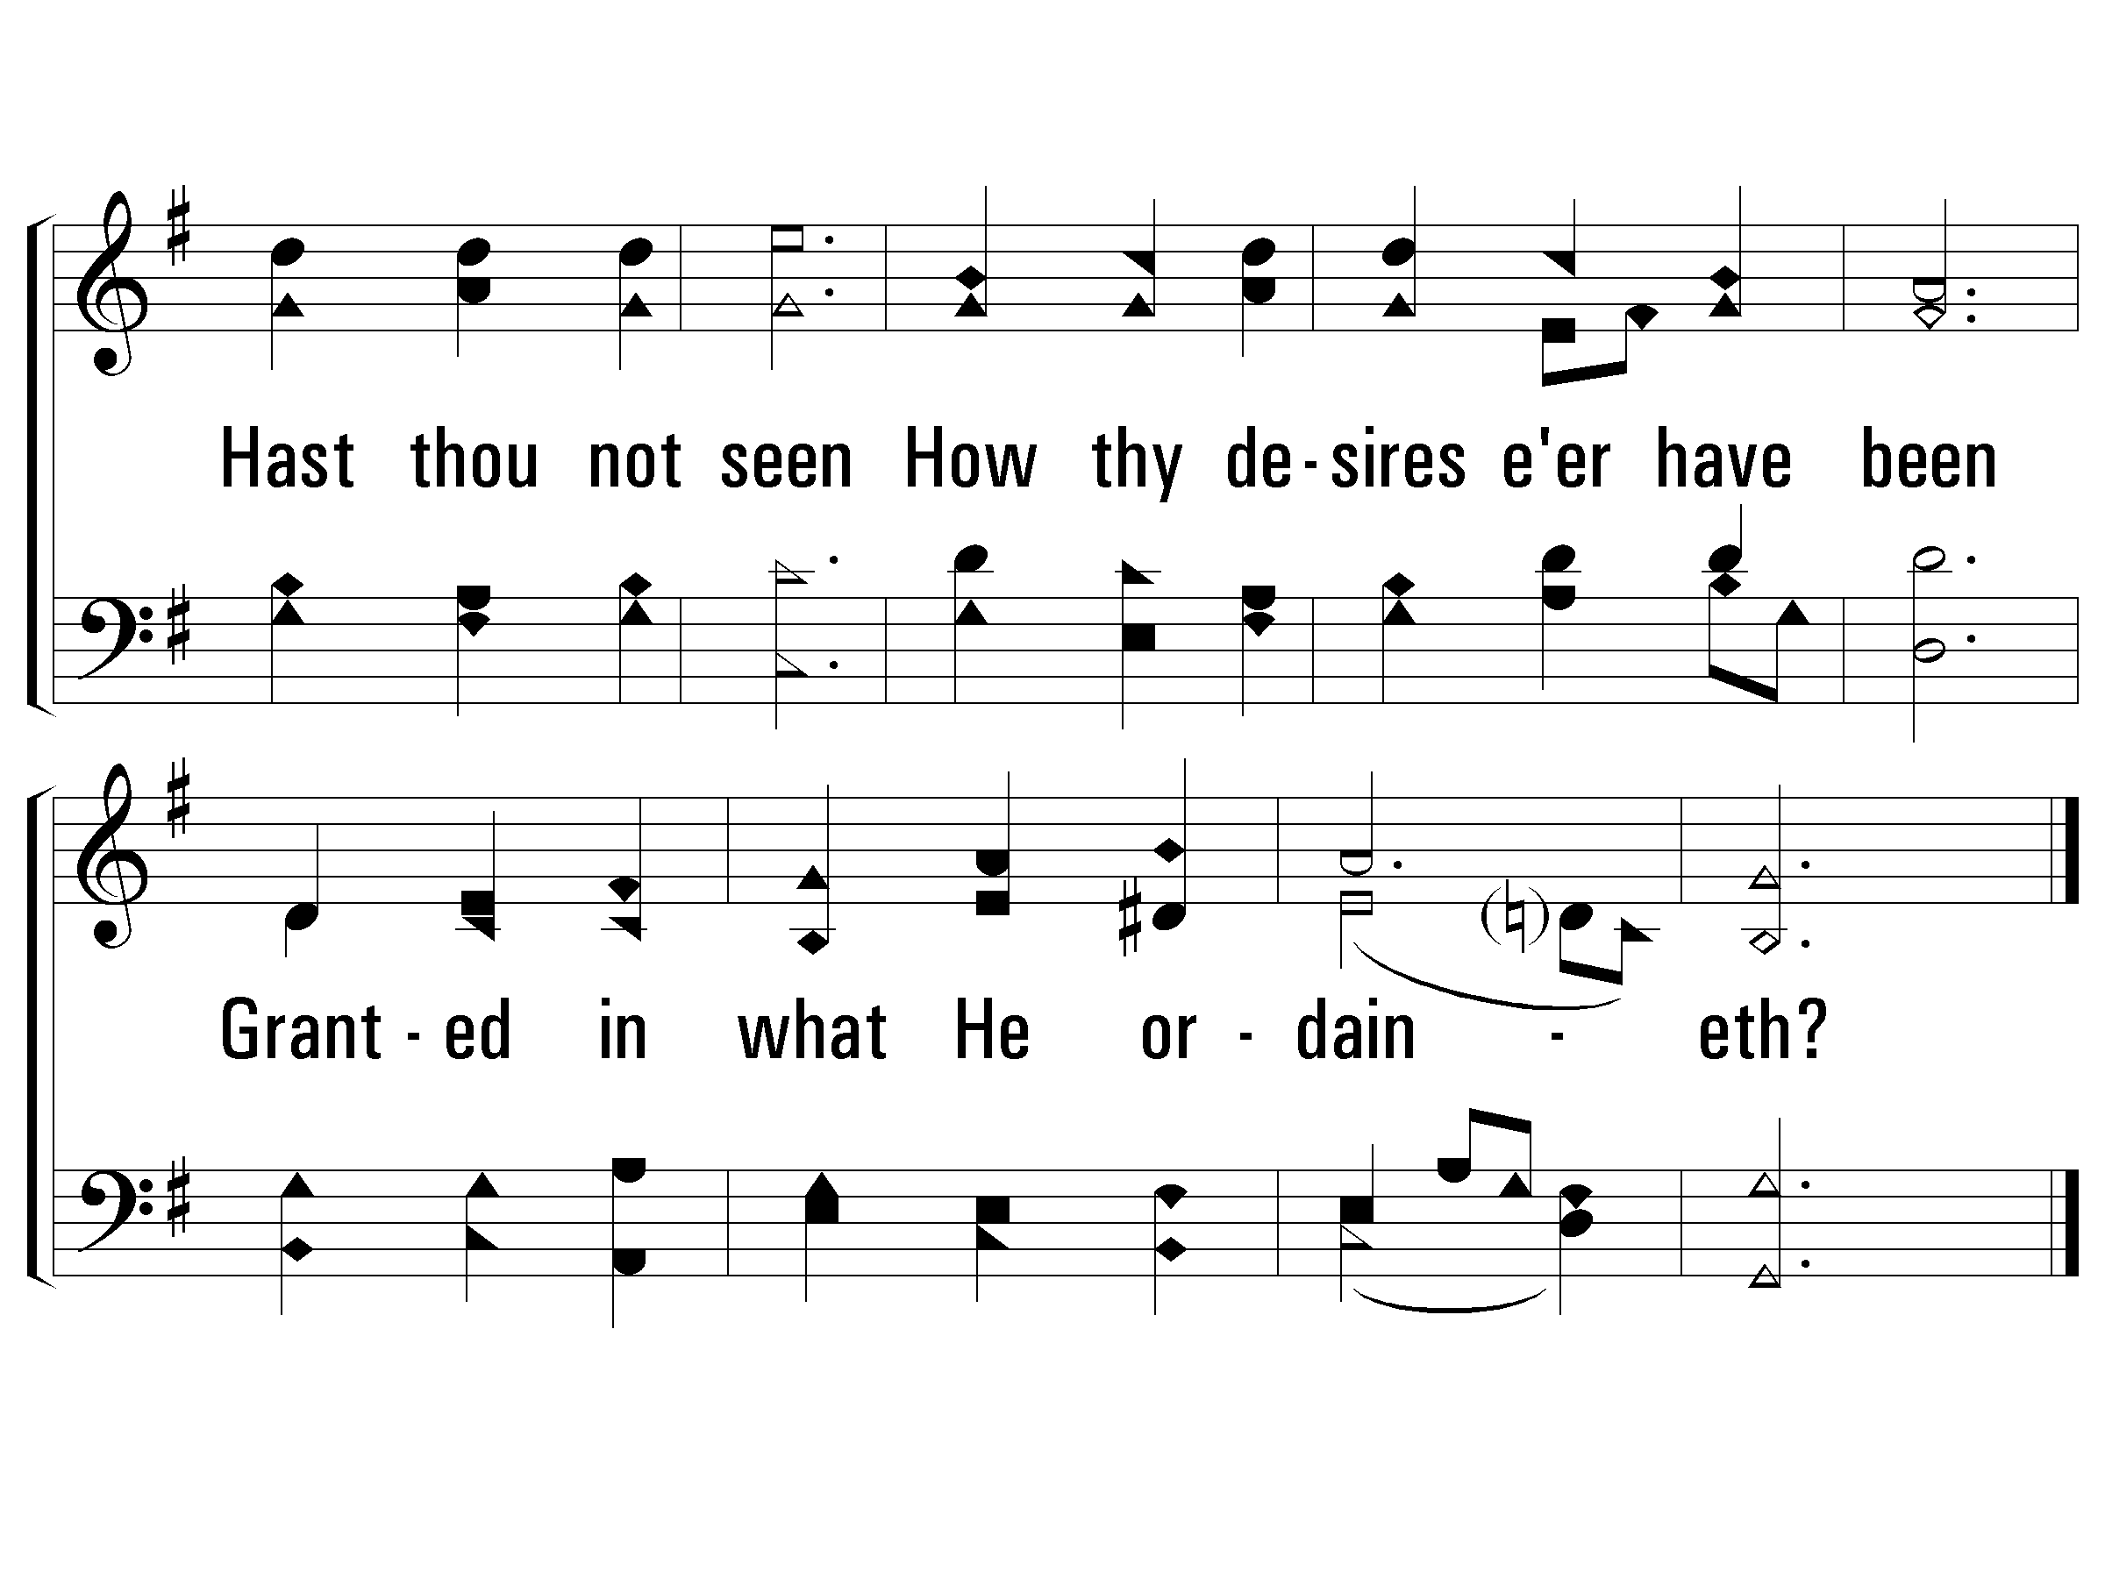
2 – Praise to the Lord, The Almighty
534
© 2003 The Paperless Hymnal™

Slide 5
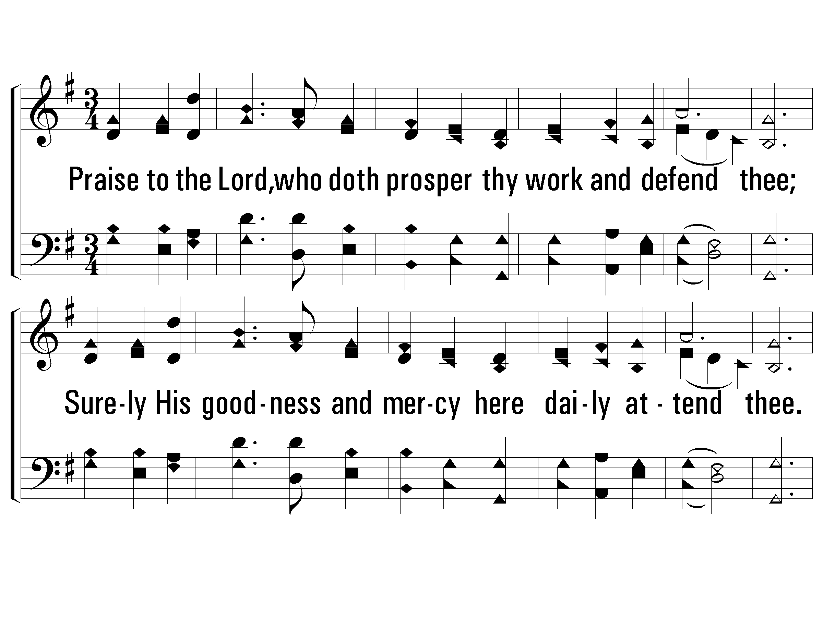
3 – Praise to the Lord, The Almighty
534
3.
Praise to the Lord, who doth prosper thy work and defend thee;
Surely His goodness and mercy here daily attend thee.
Ponder anew What the Almighty can do,
If with His love He befriend thee.
Words: Joachin Neander / tr. Catherine Winkworth
Music: Stralsund Gesangbuch / har. W. Sterndale Bennett
© 2003 The Paperless Hymnal™

Slide 6
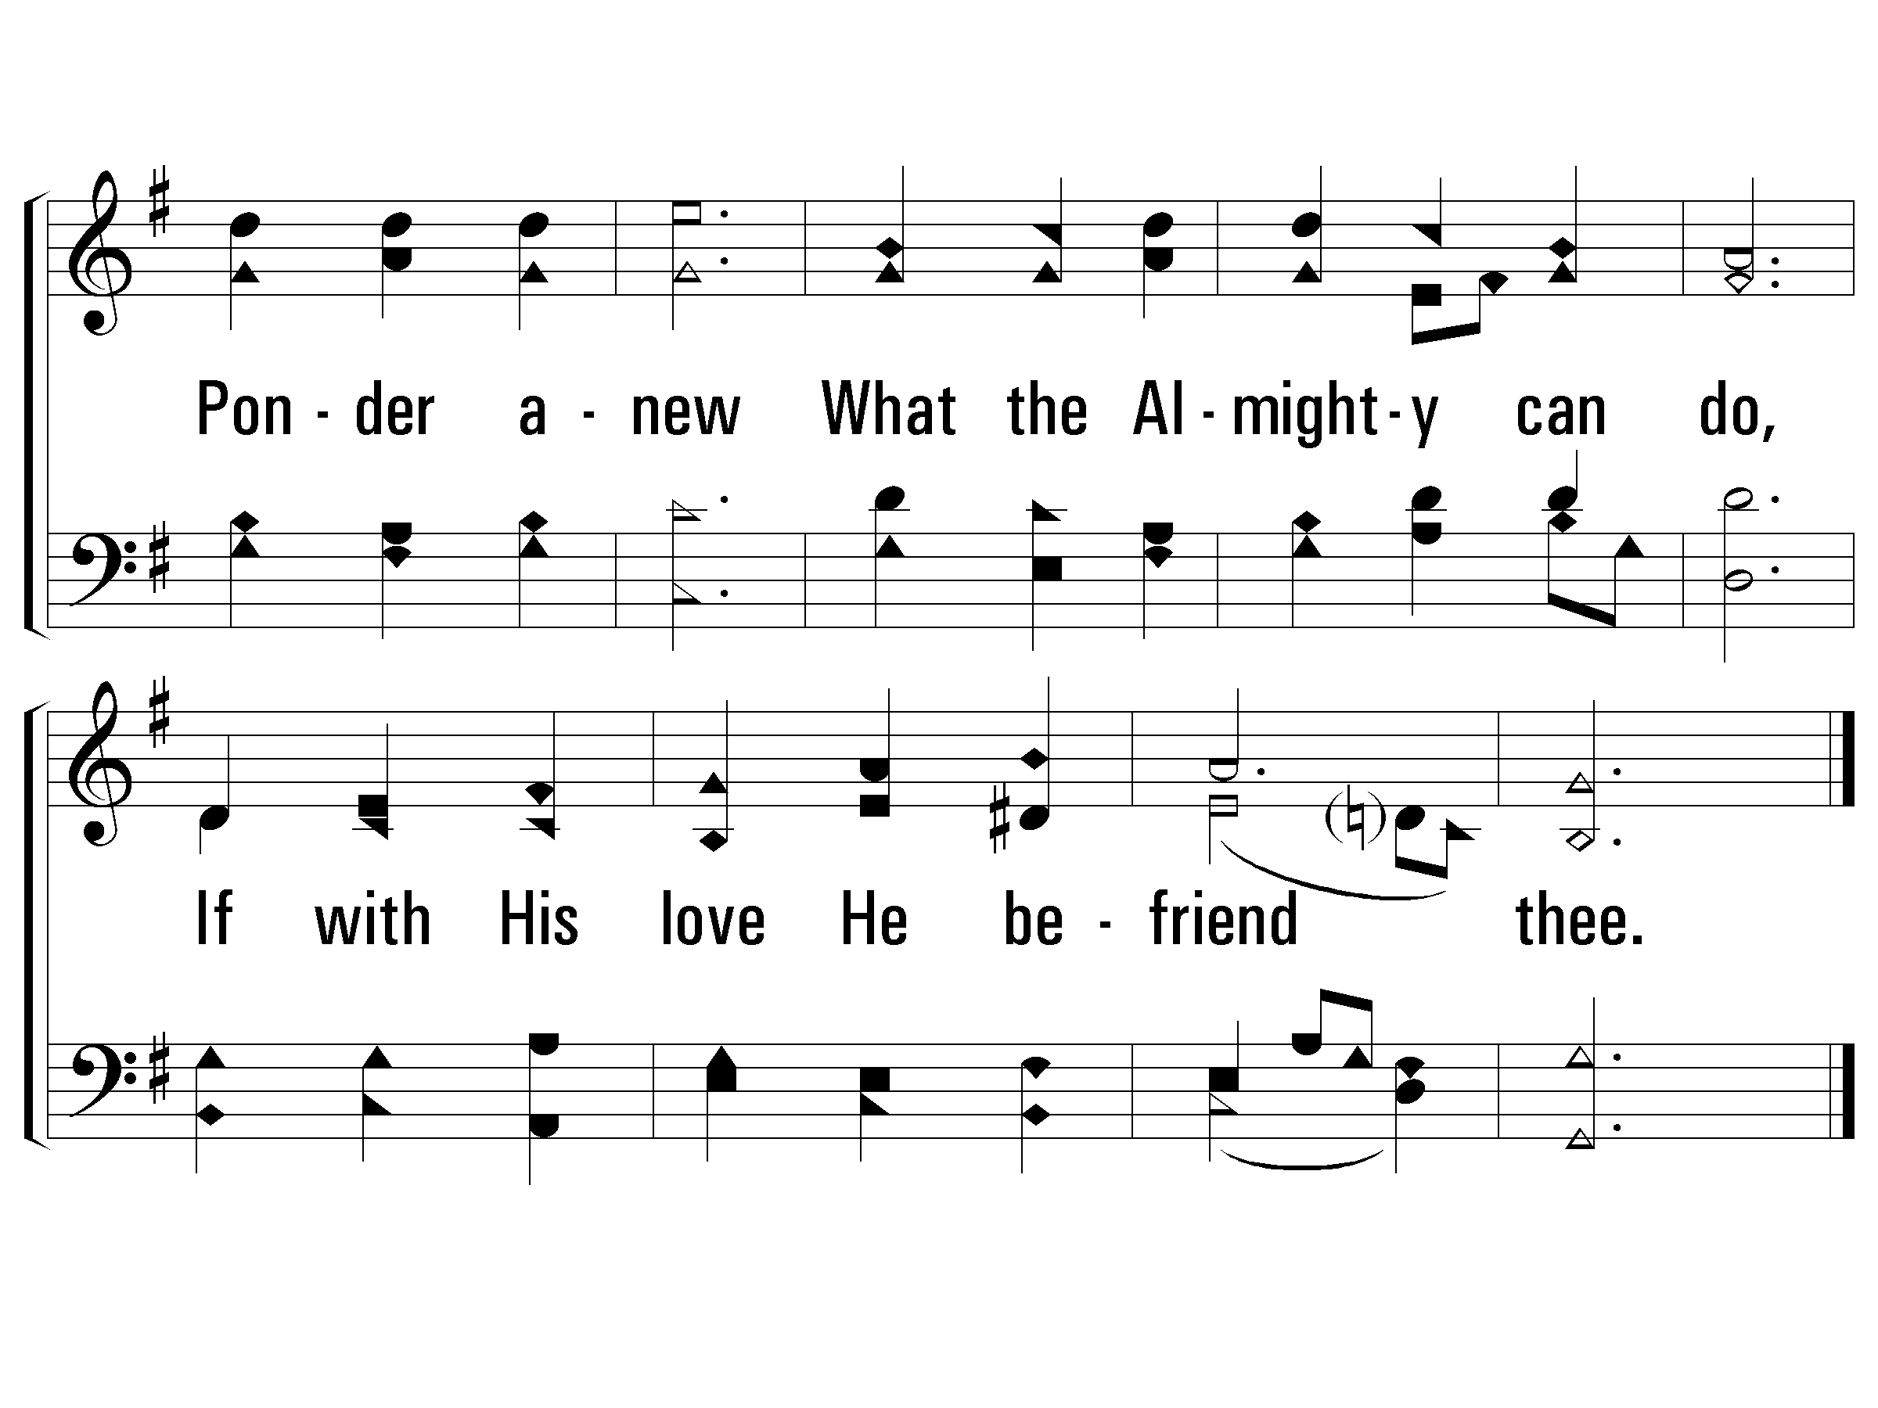
3 – Praise to the Lord, The Almighty
534
© 2003 The Paperless Hymnal™

Slide 7
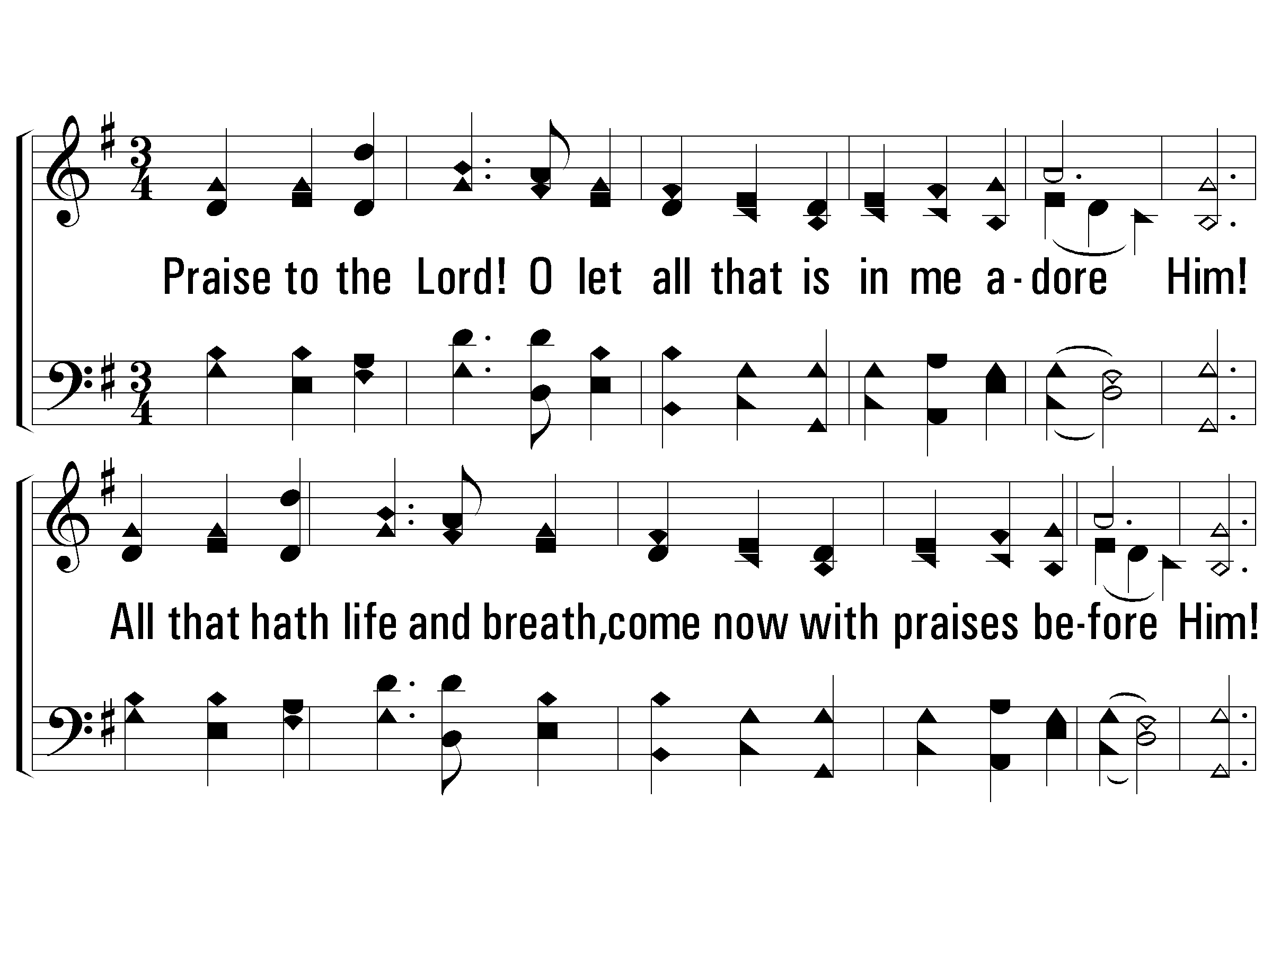
4 – Praise to the Lord, The Almighty
534
4.
Praise to the Lord! O let all that is in me adore Him!
All that hath life and breath, come now with praises before Him!
Let the amen Sound from His people again;
Gladly forever adore Him.
Words: Joachin Neander / tr. Catherine Winkworth
Music: Stralsund Gesangbuch / har. W. Sterndale Bennett
© 2003 The Paperless Hymnal™

Slide 8
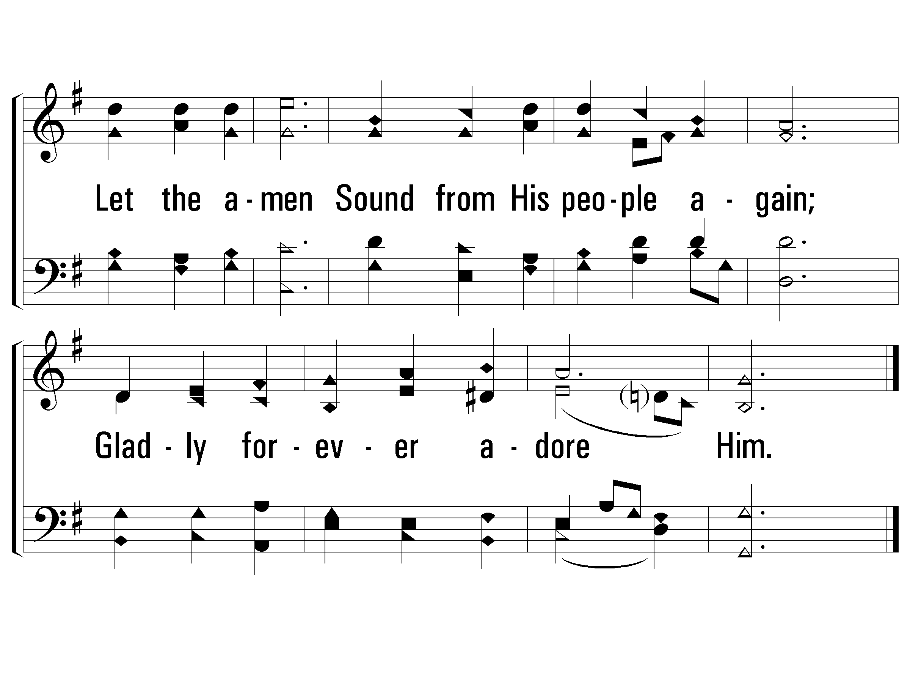
4 – Praise to the Lord, The Almighty
534
© 2003 The Paperless Hymnal™

