Slide 1
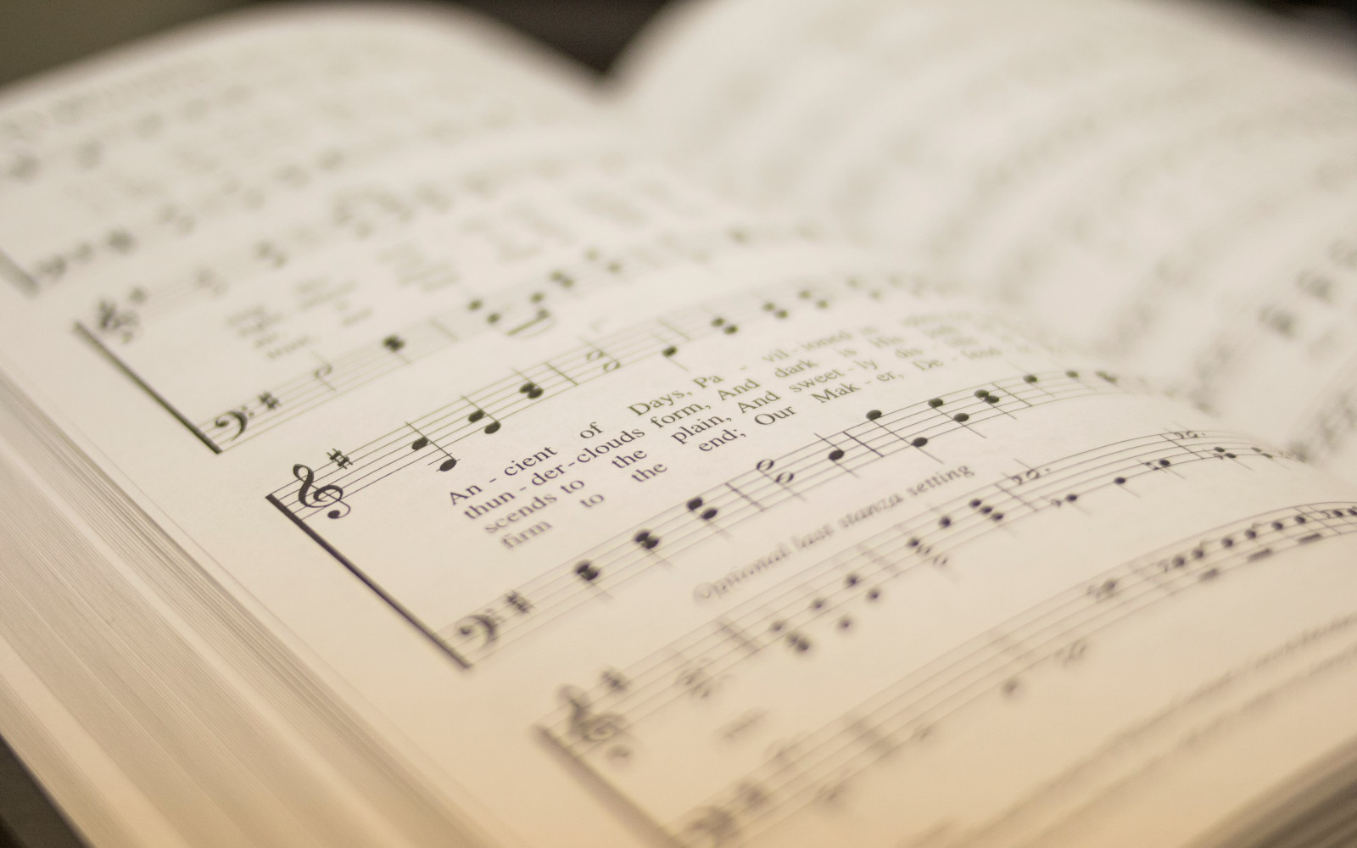

380
JUST AS I AM
1
2
3
4
5
6
“SINGING...TO THE LORD” COLOSSIANS 3:16
Words by: Charlotte Elliott / Music by: William Bradbury

Slide 2
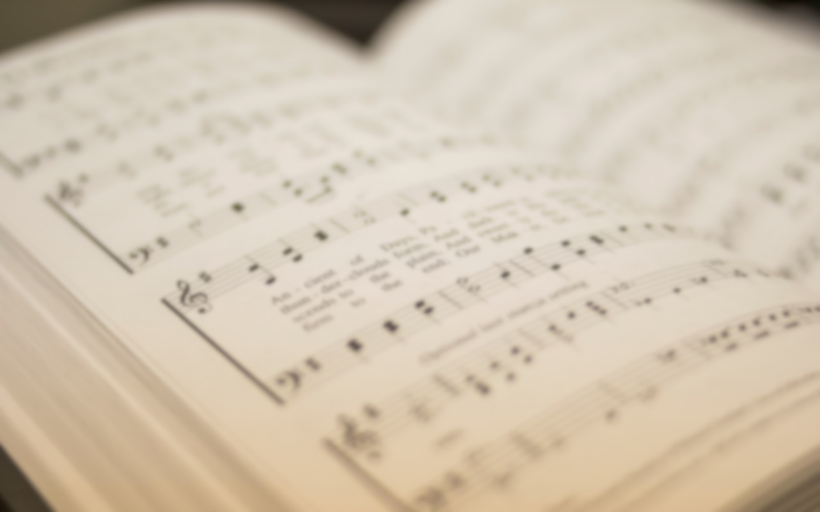
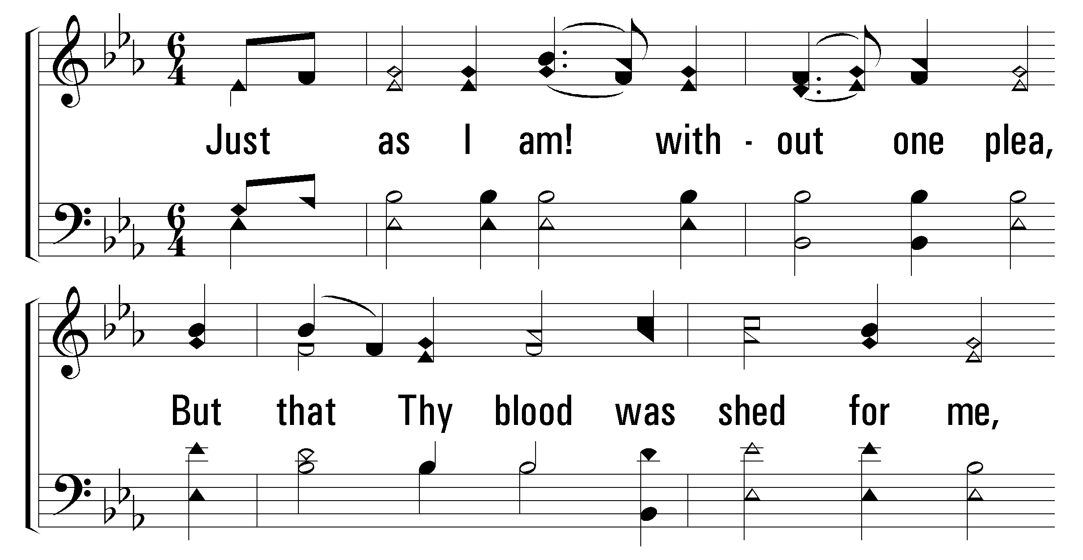


1
2
3
4
5
6
380
JUST AS I AM
© 2001 The Paperless Hymnal™

Slide 3
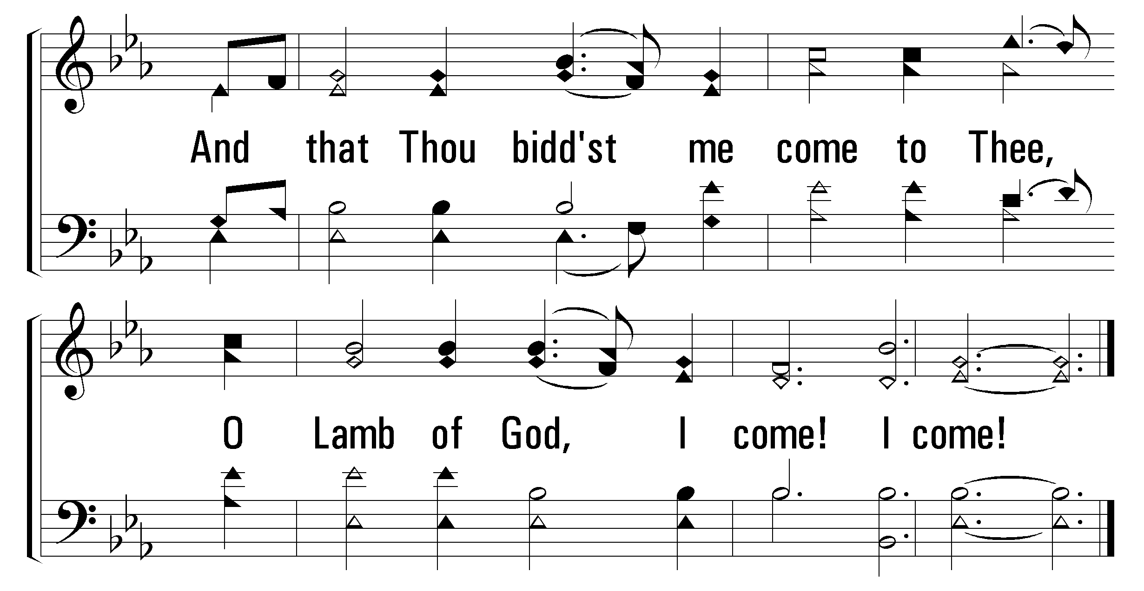
1
2
3
4
5
6
380
JUST AS I AM
© 2001 The Paperless Hymnal™

Slide 4
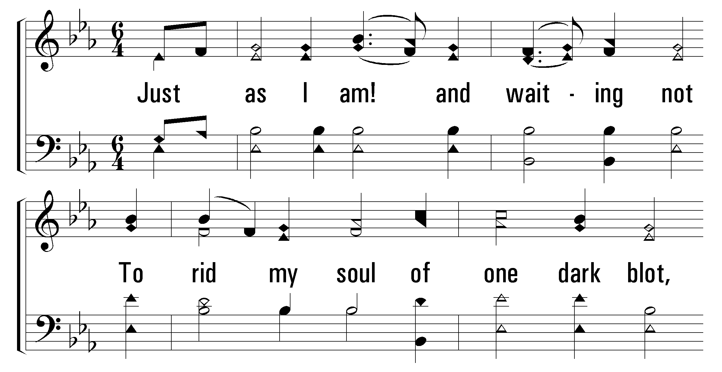
1
2
3
4
5
6
380
JUST AS I AM
© 2001 The Paperless Hymnal™

Slide 5
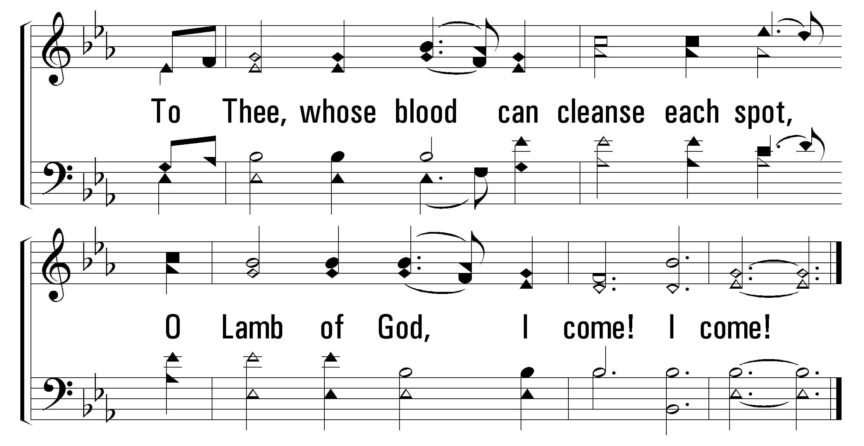
1
2
3
4
5
6
380
JUST AS I AM
© 2001 The Paperless Hymnal™

Slide 6
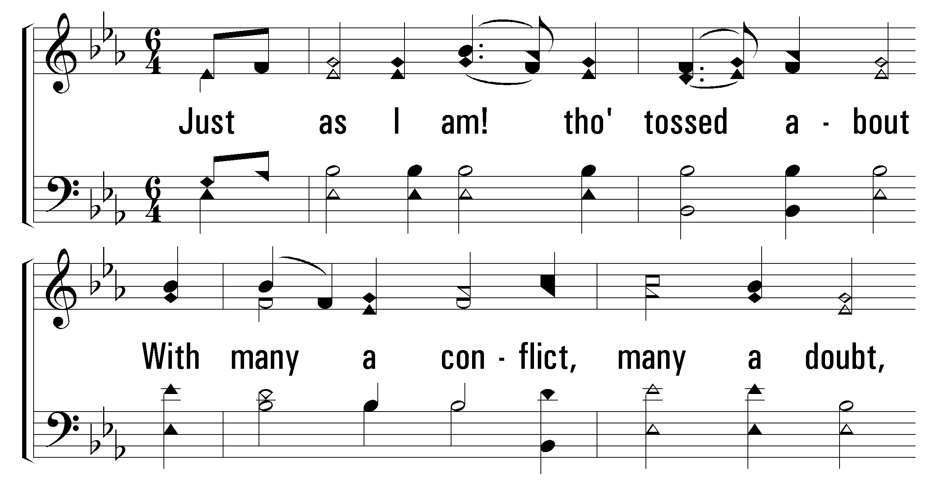
1
2
3
4
5
6
380
JUST AS I AM
© 2001 The Paperless Hymnal™

Slide 7
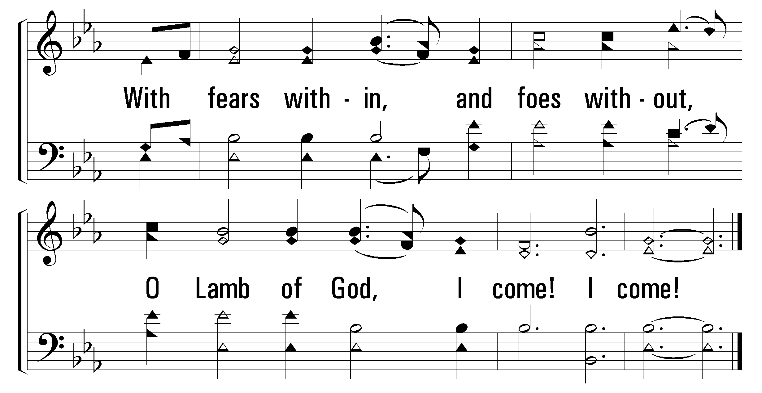
1
2
3
4
5
6
380
JUST AS I AM
© 2001 The Paperless Hymnal™

Slide 8
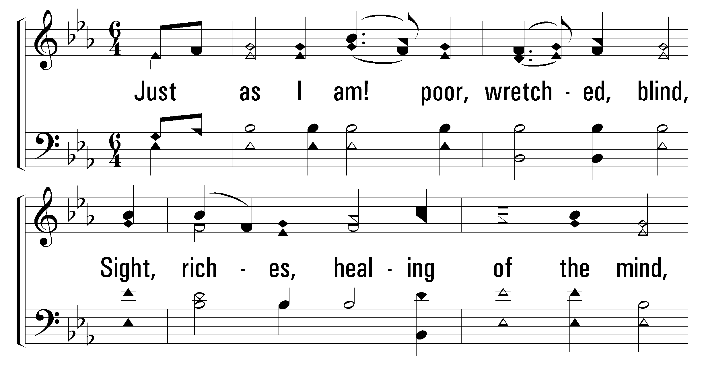
1
2
3
4
5
6
380
JUST AS I AM
© 2001 The Paperless Hymnal™

Slide 9
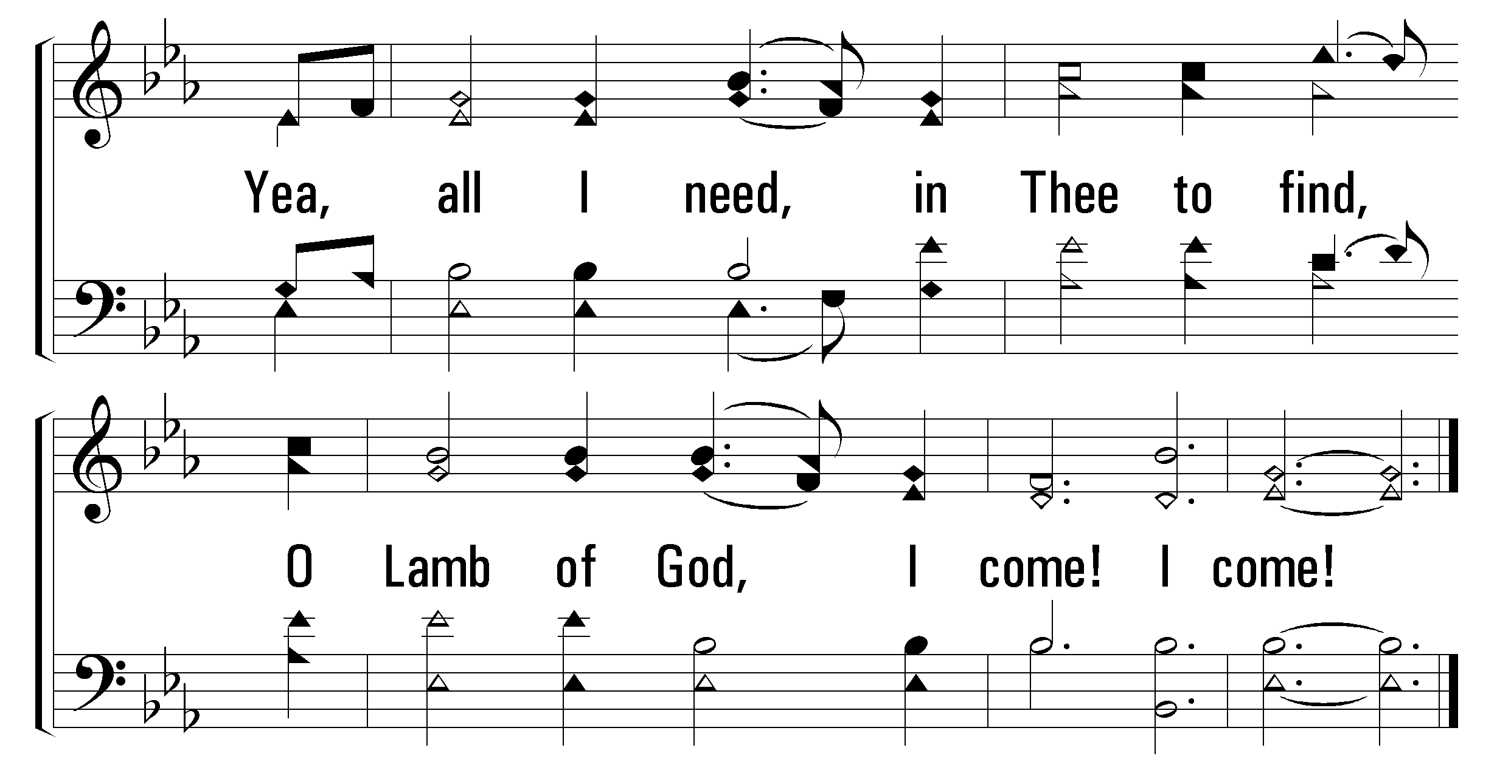
1
2
3
4
5
6
380
JUST AS I AM
© 2001 The Paperless Hymnal™

Slide 10
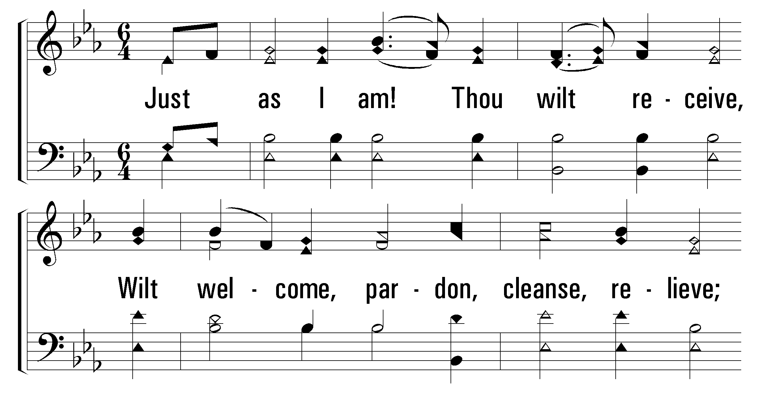
1
2
3
4
5
6
380
JUST AS I AM
© 2001 The Paperless Hymnal™

Slide 11
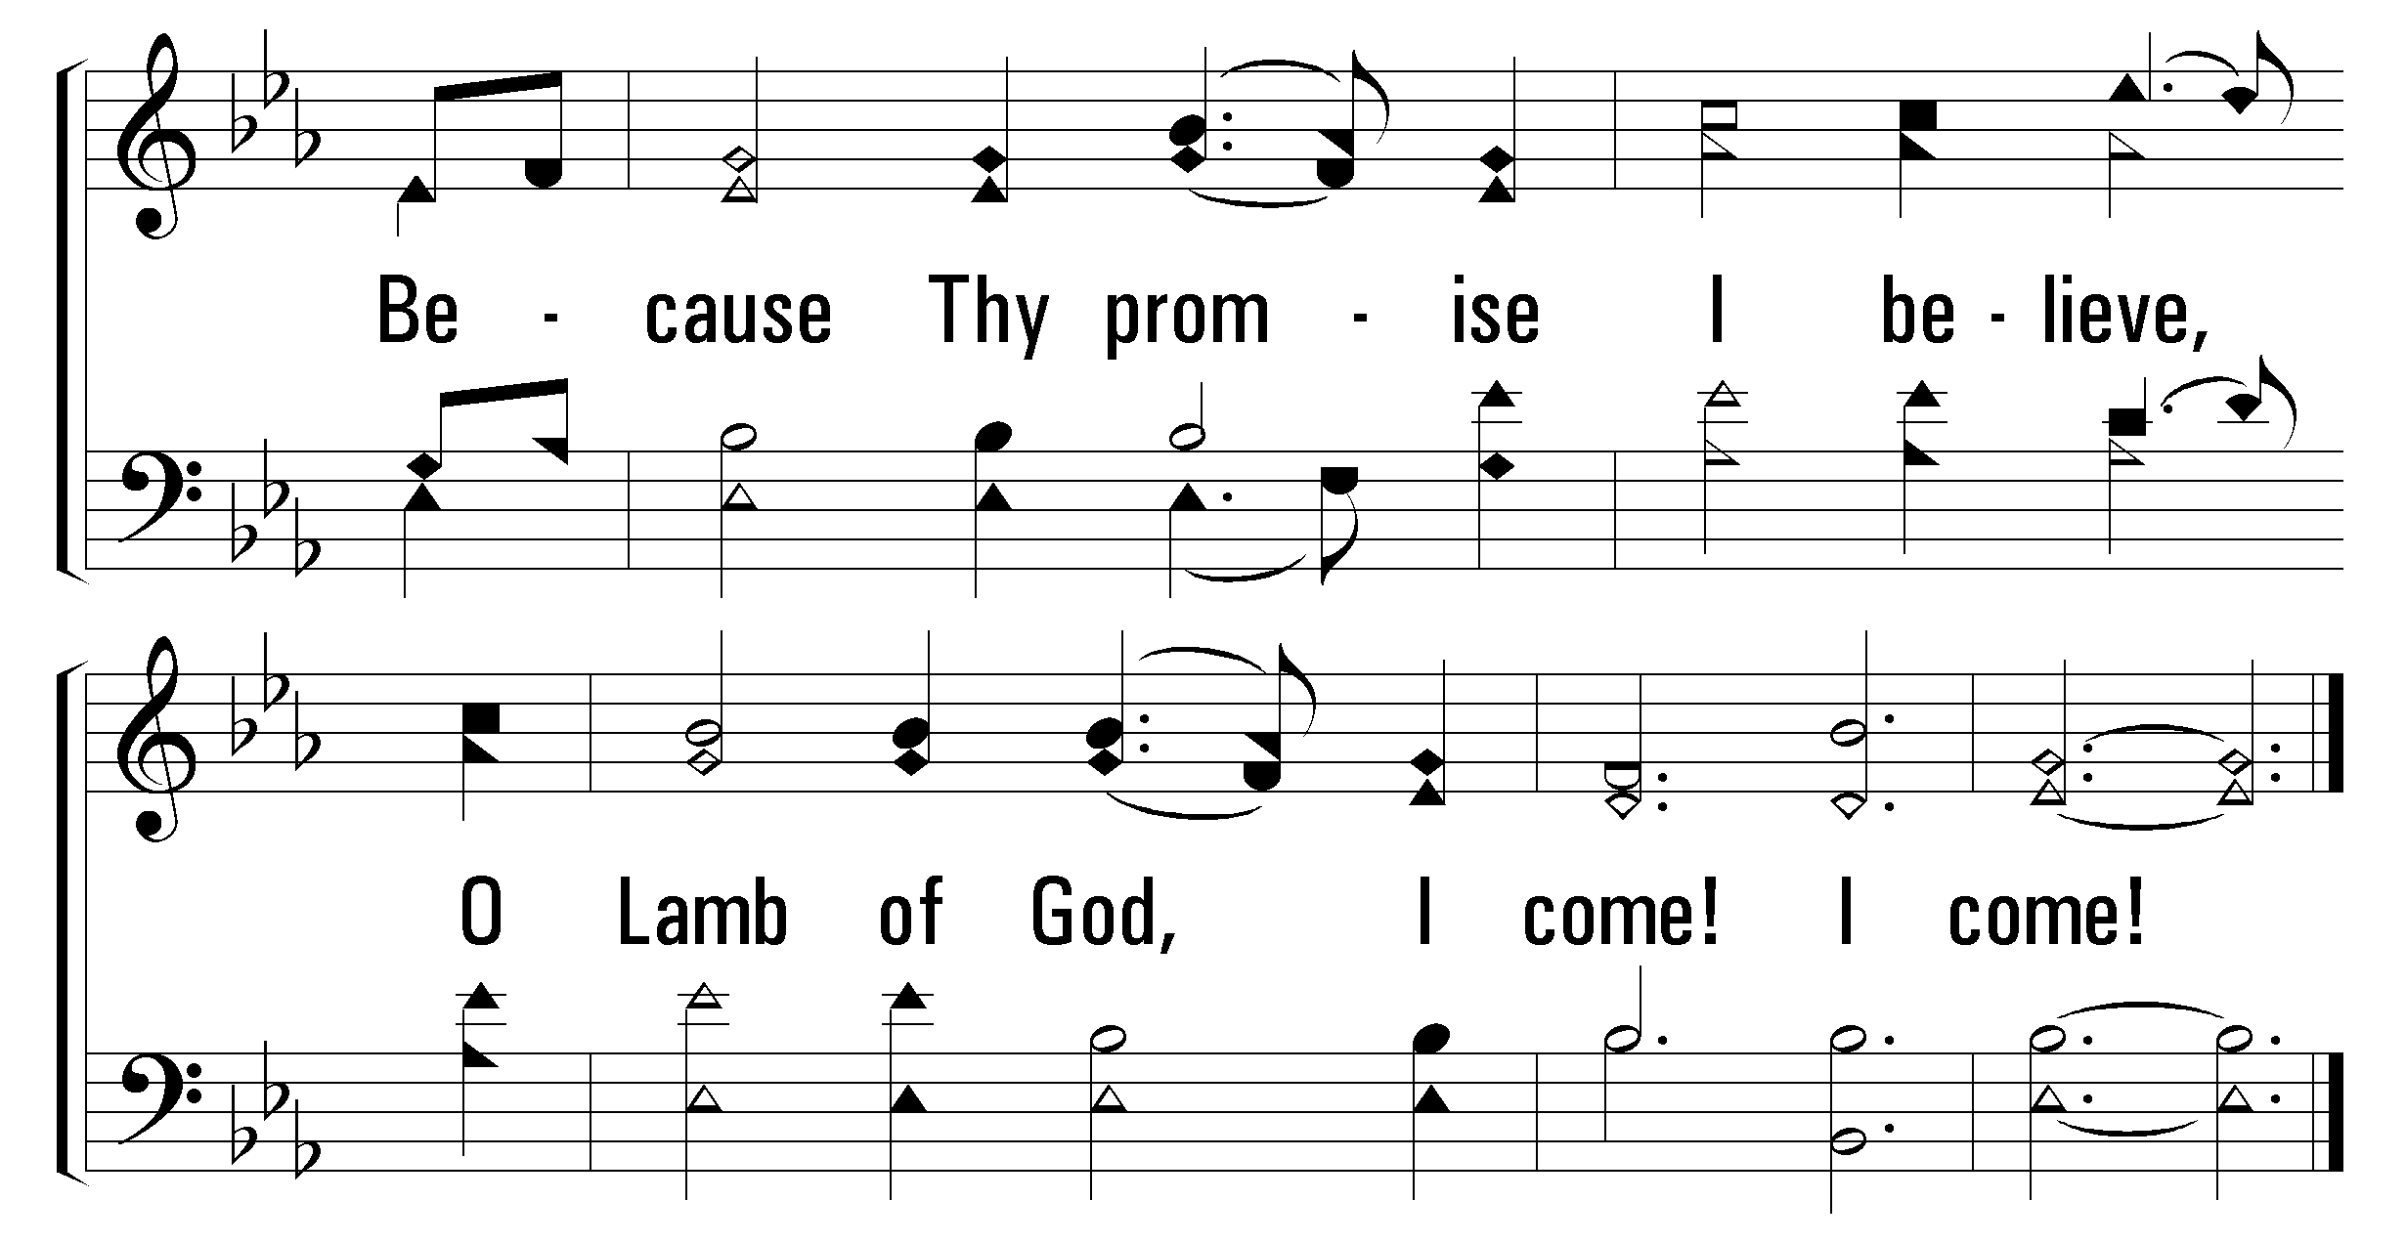
1
2
3
4
5
6
380
JUST AS I AM
© 2001 The Paperless Hymnal™

Slide 12
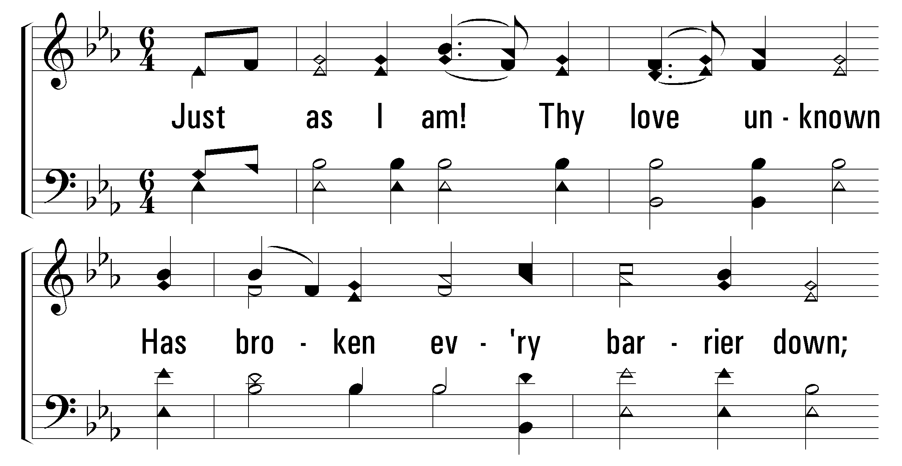
1
2
3
4
5
6
380
JUST AS I AM
© 2001 The Paperless Hymnal™

Slide 13
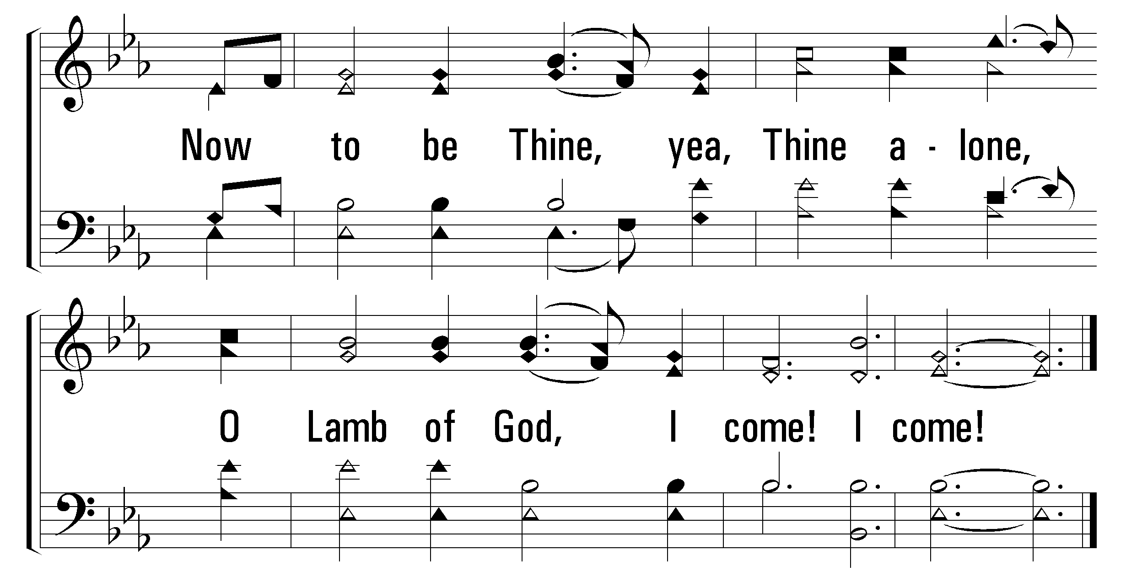
1
2
3
4
5
6
380
JUST AS I AM
© 2001 The Paperless Hymnal™

