Slide 1
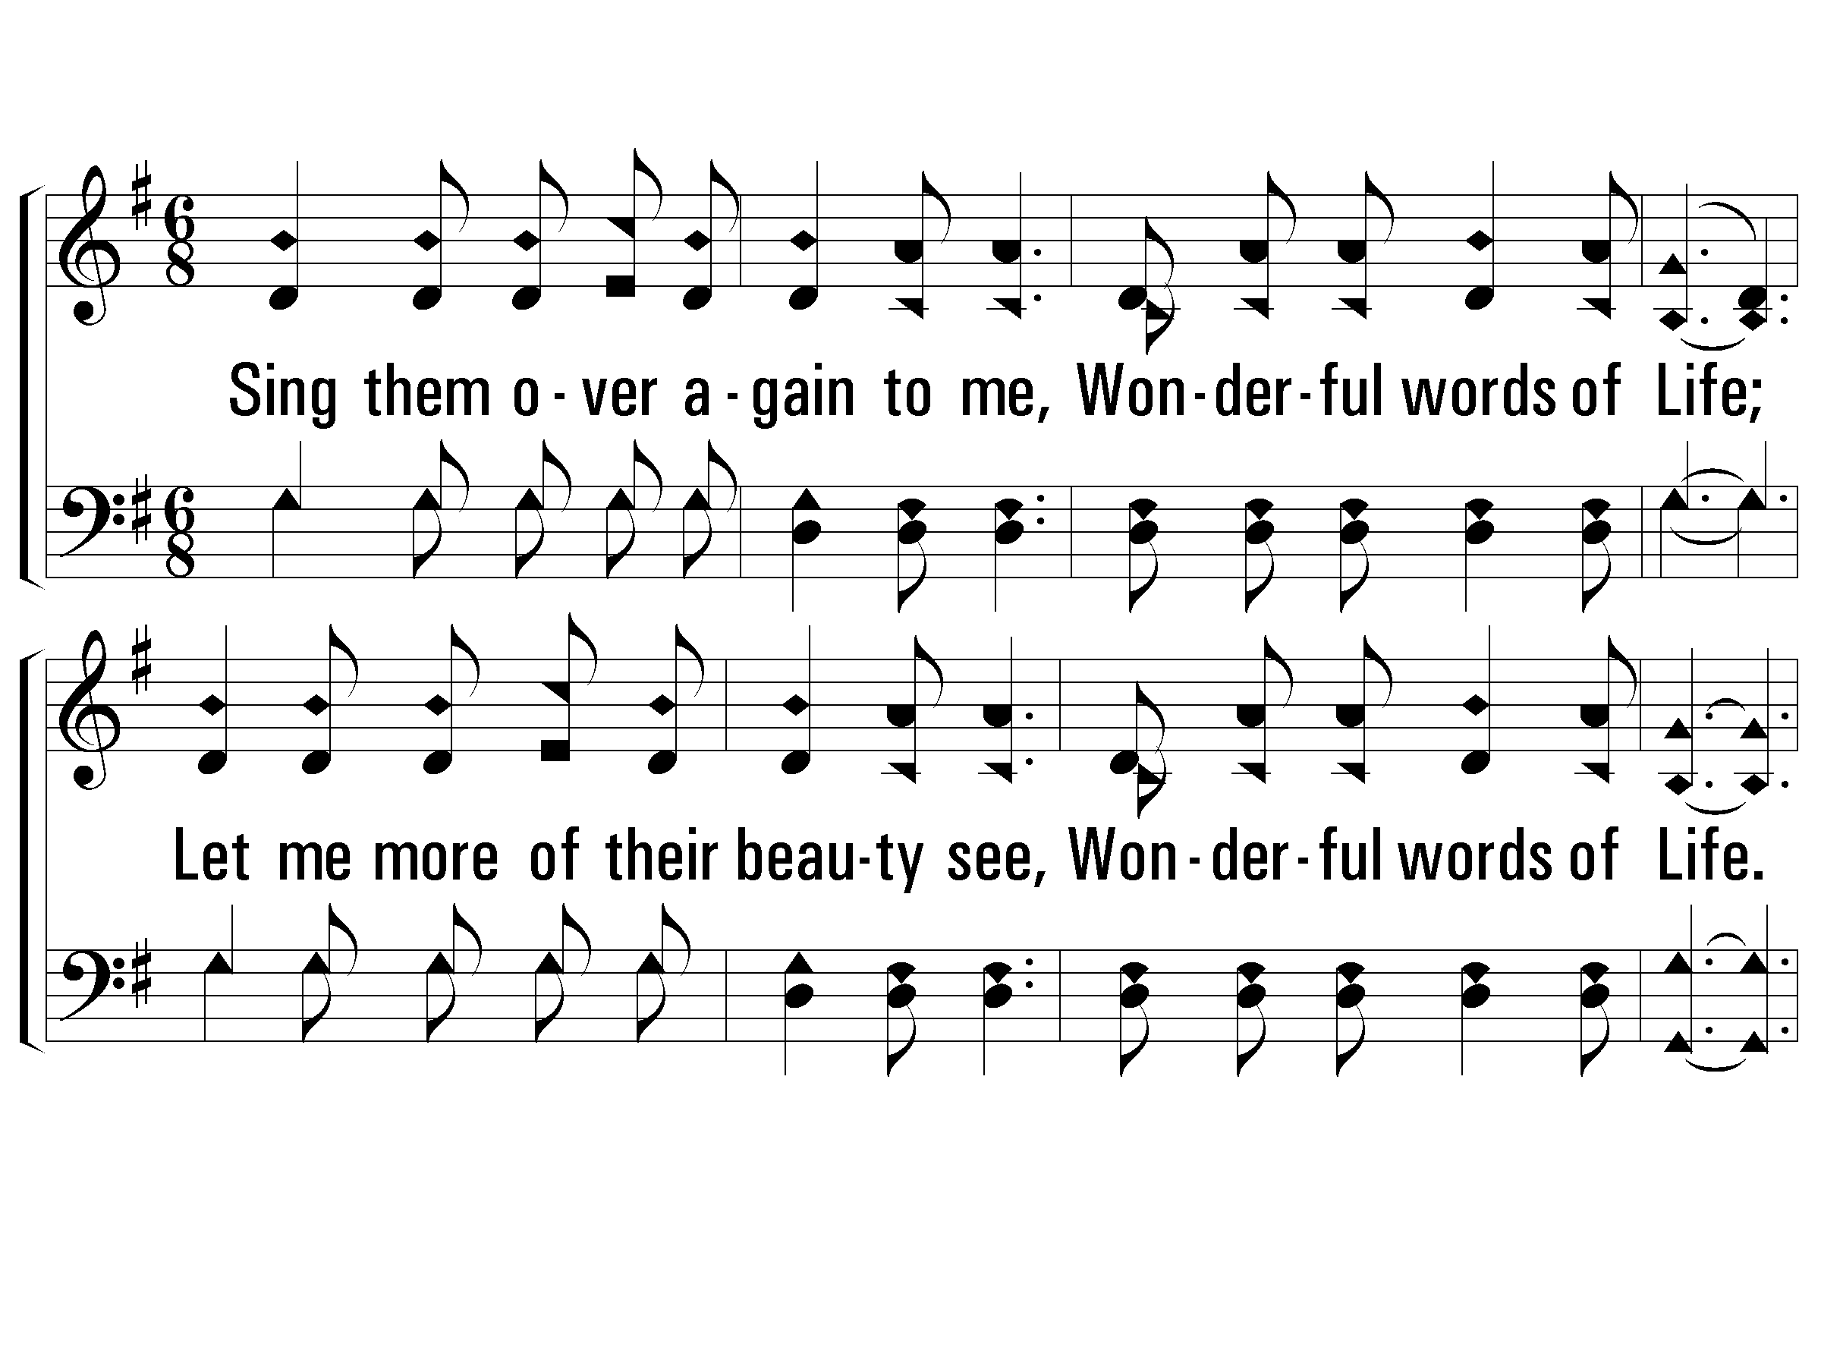
1 – Wonderful Words of Life
788
1.
Sing them over again to me,
Wonderful words of Life;
Let me more of their beauty see,
Wonderful words of Life.
Words of life and beauty,
Teach me faith and duty;
Words and Music by: P. P. Bliss
© 2001 The Paperless Hymnal™

Slide 2
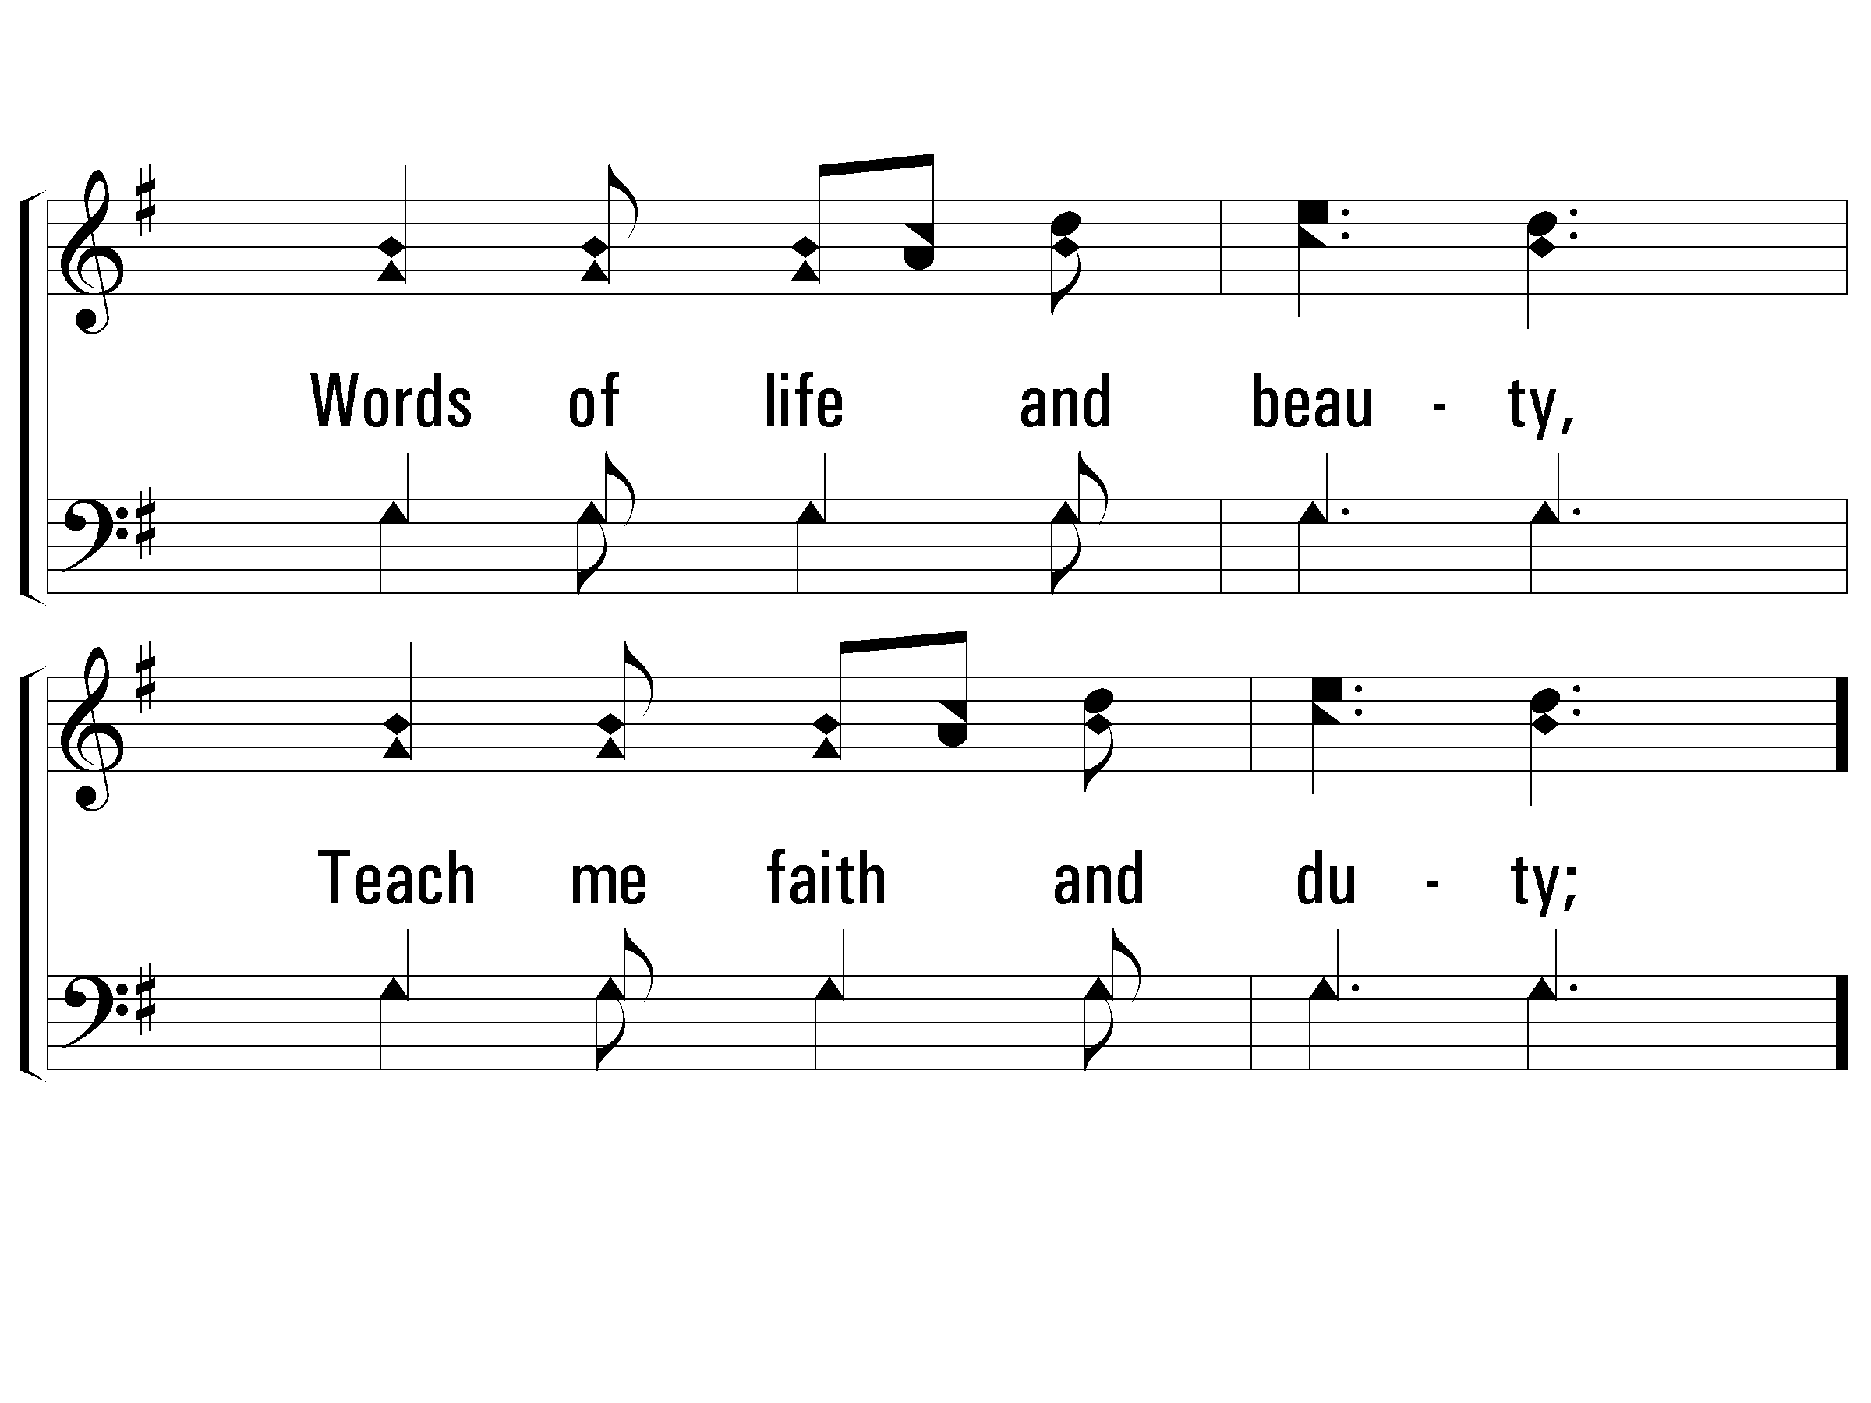
1 – Wonderful Words of Life
788
© 2001 The Paperless Hymnal™

Slide 3
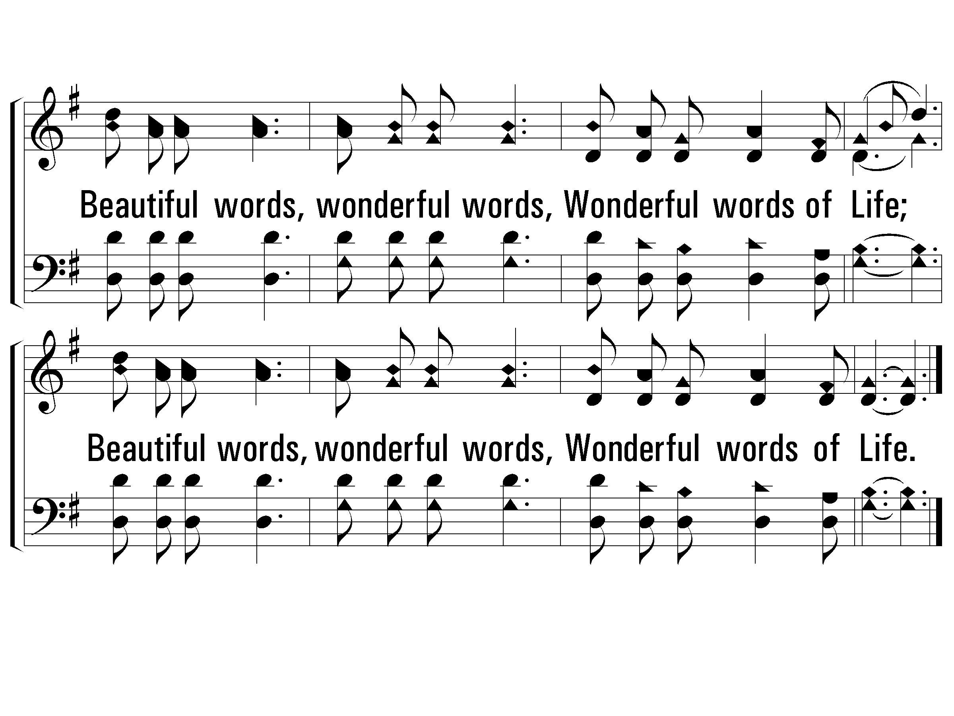
c – Wonderful Words of Life
788
Beautiful words, wonderful words,
Wonderful words of Life;
Beautiful words, wonderful words,
Wonderful words of Life.
© 2001 The Paperless Hymnal™

Slide 4
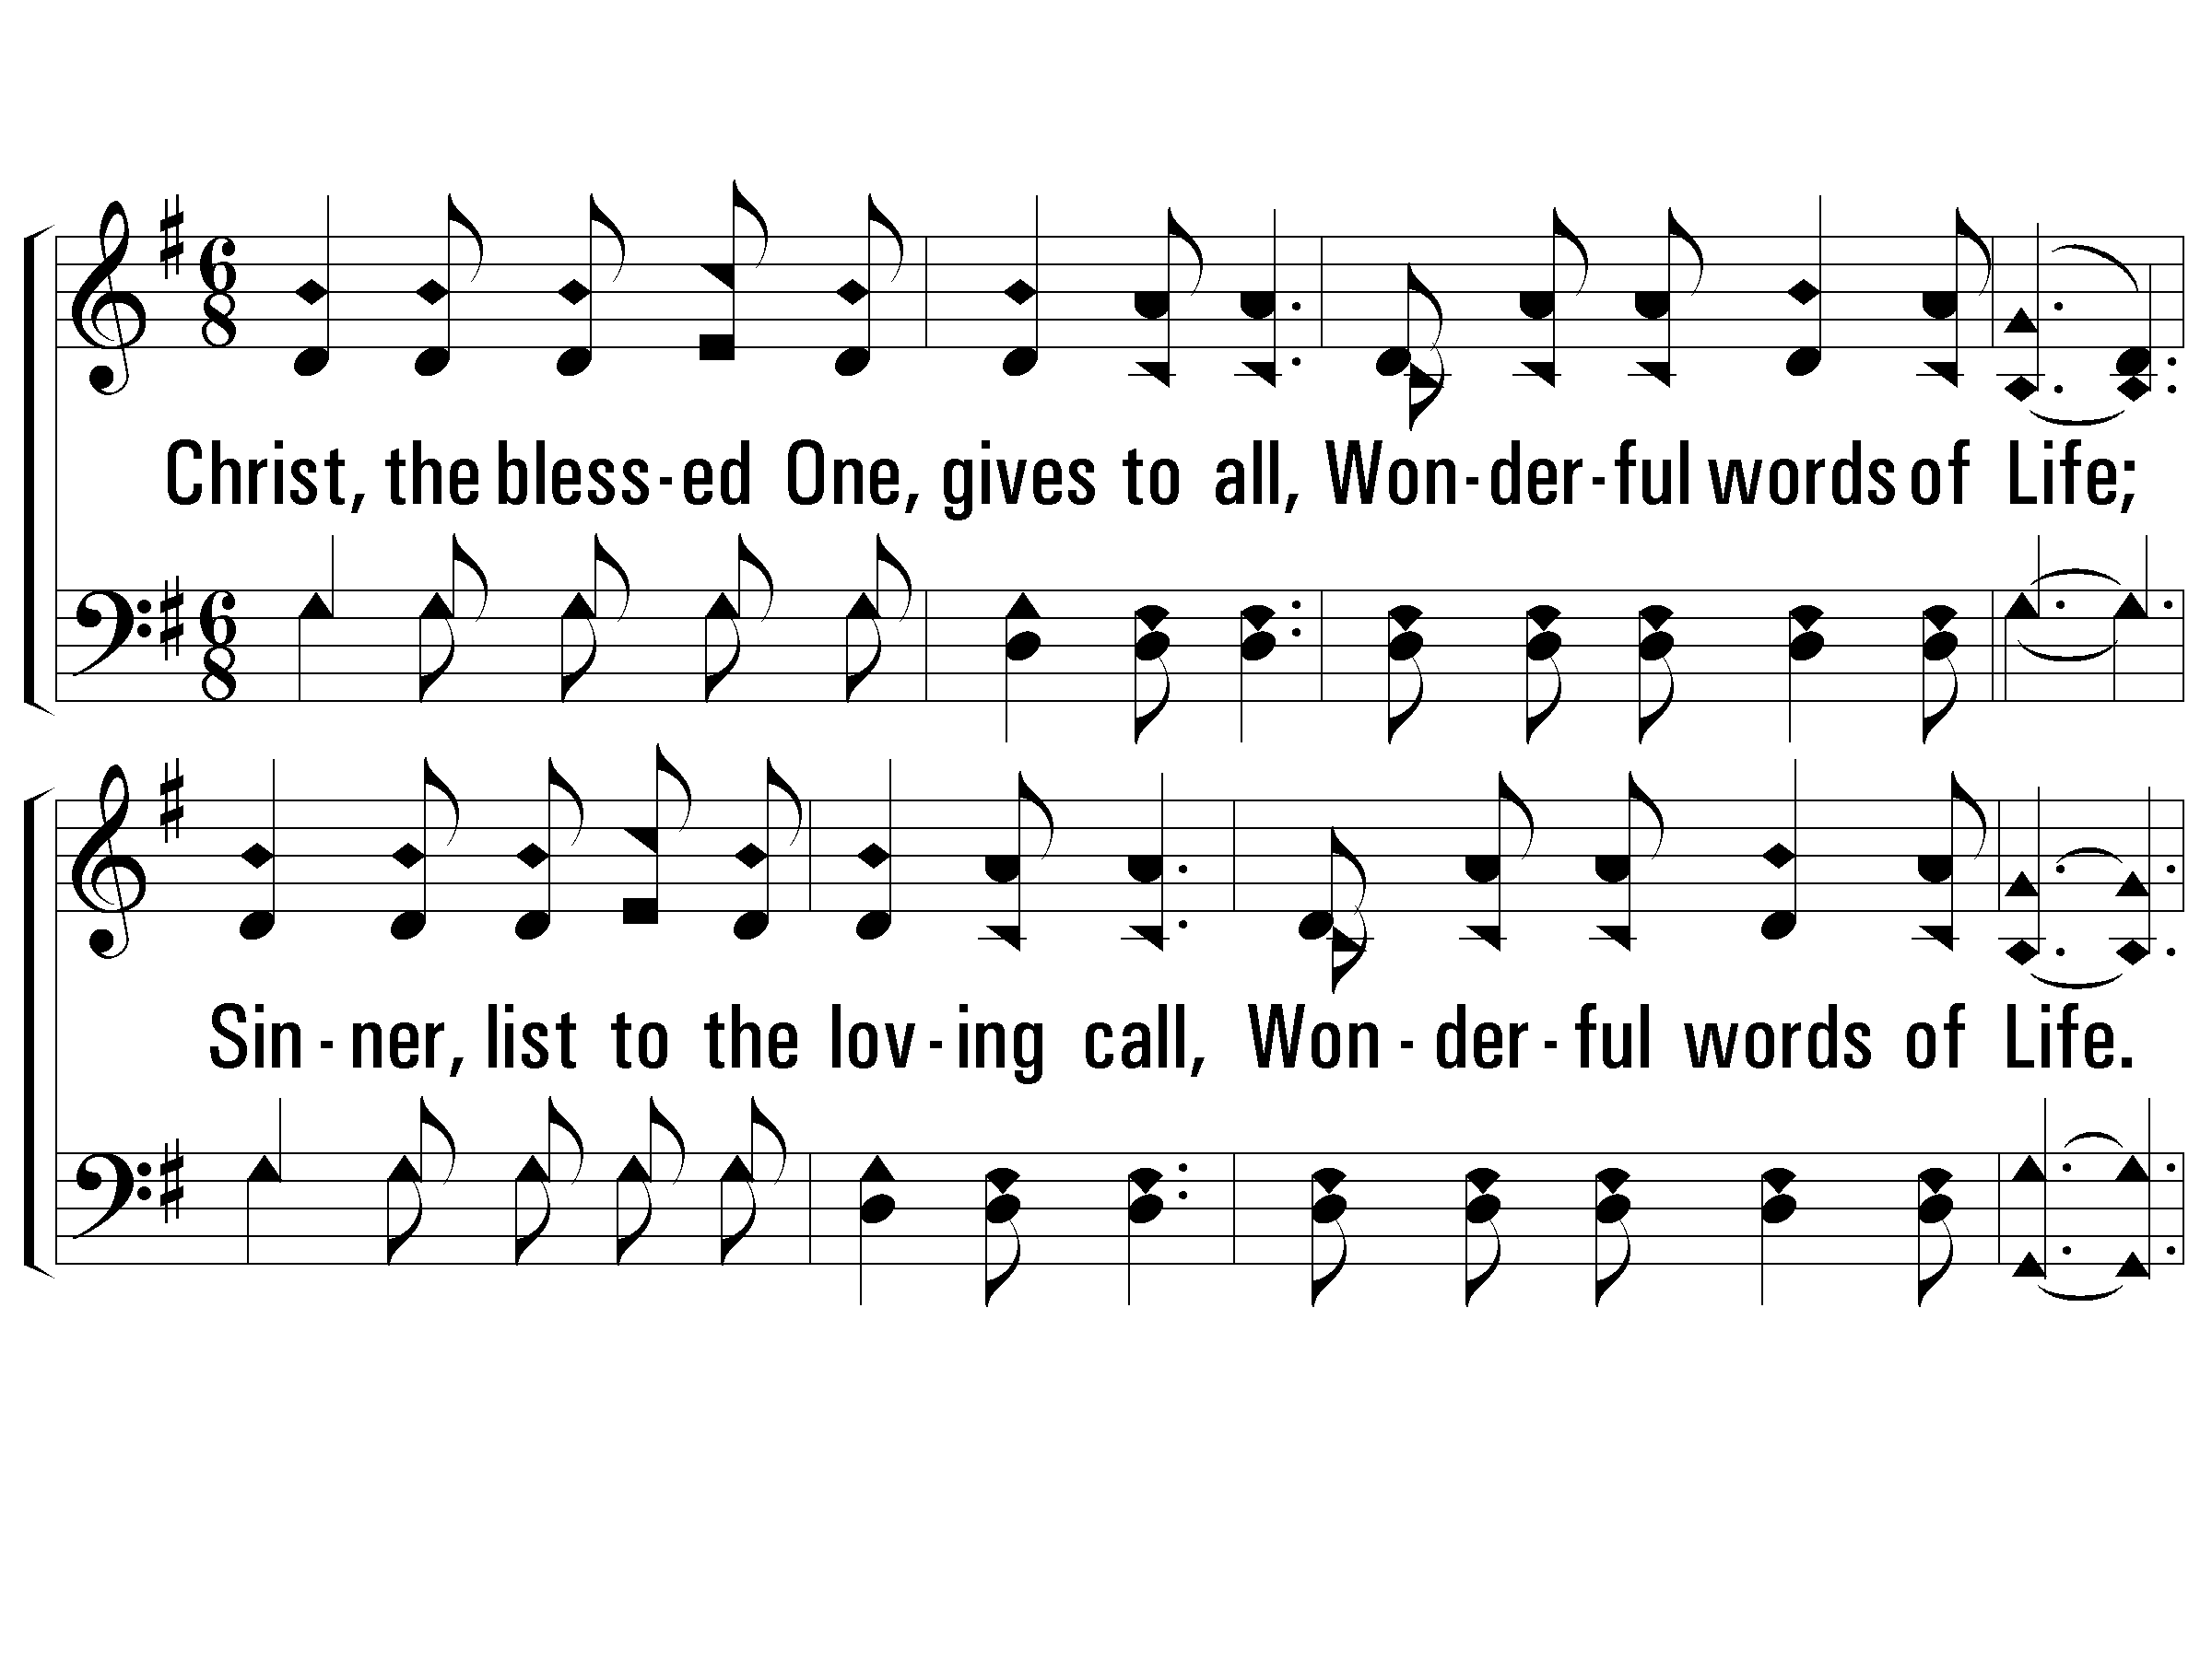
2 – Wonderful Words of Life
788
2.
Christ, the blessed One, gives to all,
Wonderful words of Life;
Sinner, list to the loving call,
Wonderful words of Life.
All so freely given,
Wooing us to heaven;
Words and Music by: P. P. Bliss
© 2001 The Paperless Hymnal™

Slide 5
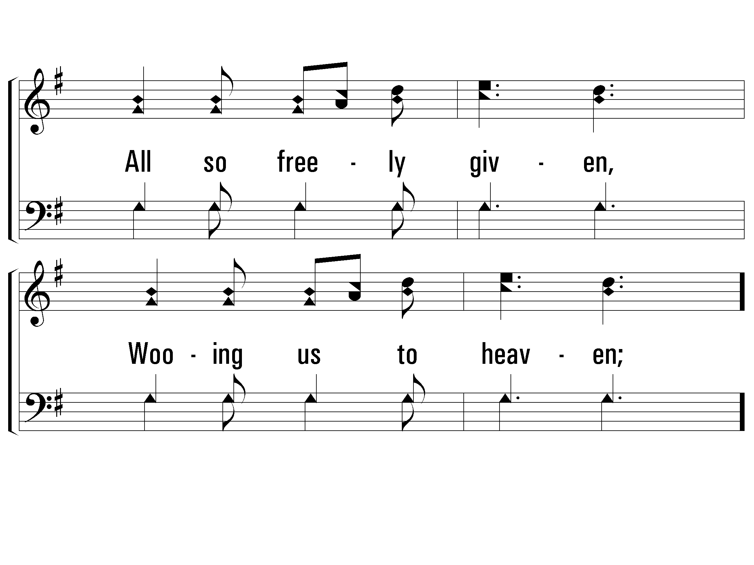
2 – Wonderful Words of Life
788
© 2001 The Paperless Hymnal™

Slide 6
c – Wonderful Words of Life
788
Beautiful words, wonderful words,
Wonderful words of Life;
Beautiful words, wonderful words,
Wonderful words of Life.
© 2001 The Paperless Hymnal™

Slide 7
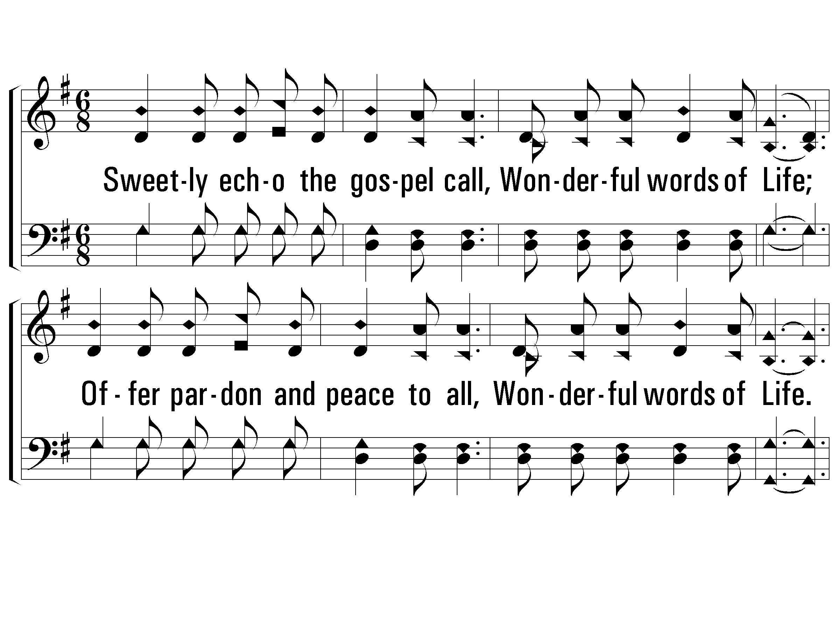
3 – Wonderful Words of Life
788
3.
Sweetly echo the gospel call,
Wonderful words of Life;
Offer pardon and peace to all,
Wonderful words of Life.
Jesus, only Savior,
Sanctify for ever;
Words and Music by: P. P. Bliss
© 2001 The Paperless Hymnal™

Slide 8
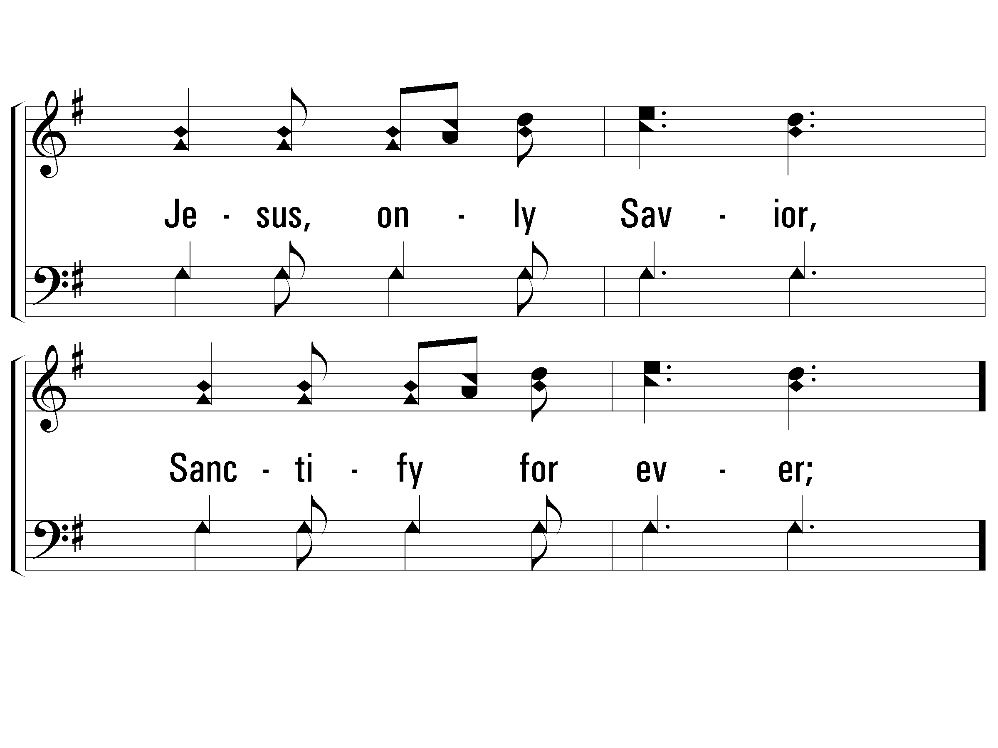
3 – Wonderful Words of Life
788
© 2001 The Paperless Hymnal™

Slide 9
c – Wonderful Words of Life
788
Beautiful words, wonderful words,
Wonderful words of Life;
Beautiful words, wonderful words,
Wonderful words of Life.
© 2001 The Paperless Hymnal™

