Slide 1
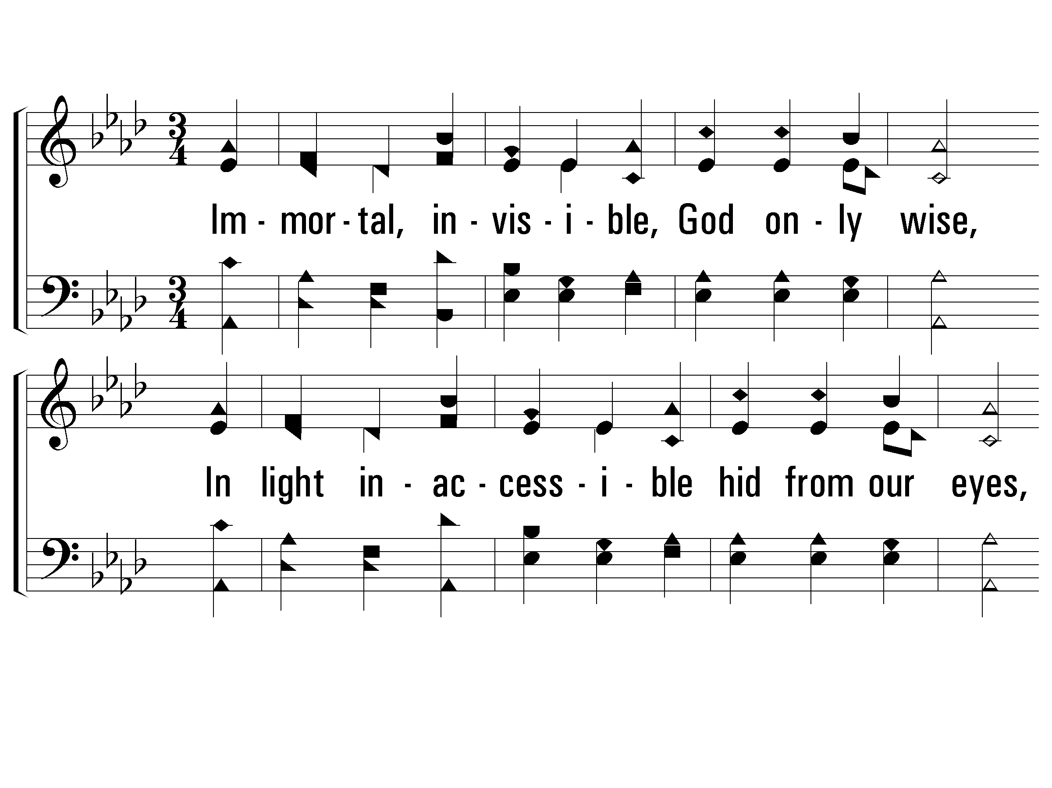
1 - Immortal, Invisible, God Only Wise
945
1.
Immortal, invisible, God only wise,
In light inaccessible hid from our eyes.
Most bless-ed, most glorious, the Ancient of Days,
Al-might-y, victorious, Thy great name we praise.
Words by: Walter Chalmers Smith
Music by: Welsh melody / Roberts’s Caniadau y Cyssegr
© 2001 The Paperless Hymnal™

Slide 2
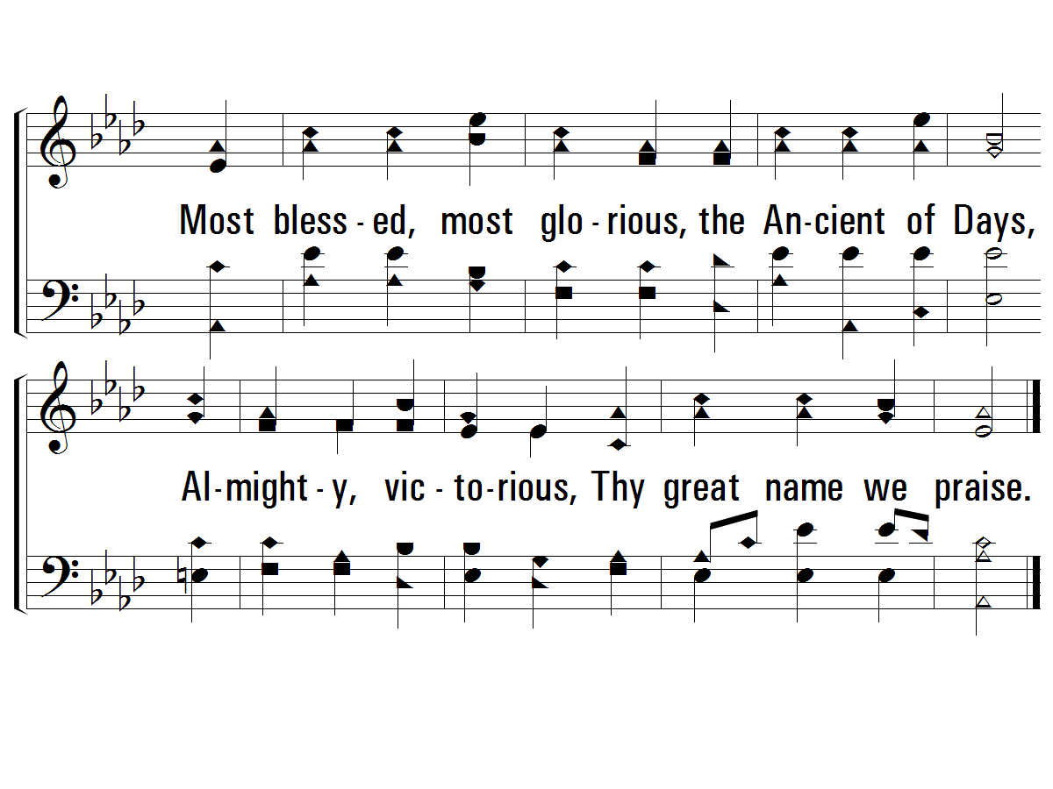
1 - Immortal, Invisible, God Only Wise
945
© 2001 The Paperless Hymnal™

Slide 3
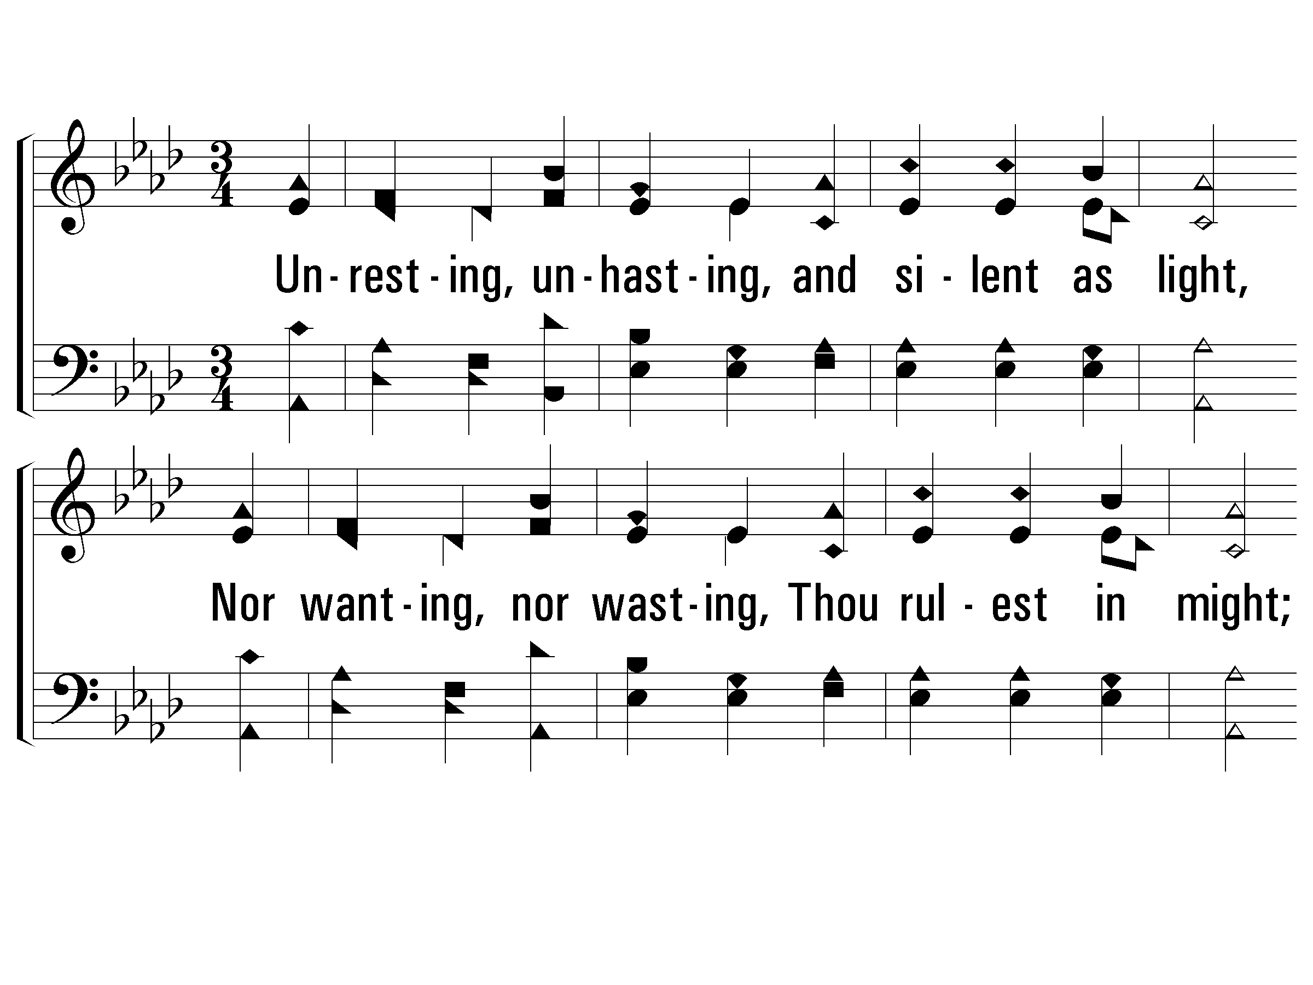
2 - Immortal, Invisible, God Only Wise
945
2.
Unresting, unhasting, and silent as light,
Nor wanting, nor wasting, Thou rulest in might;
Thy justice, like mountains, high soaring above
Thy clouds, which are fountains of good-ness and love.
Words by: Walter Chalmers Smith
Music by: Welsh melody / Roberts’s Caniadau y Cyssegr
© 2001 The Paperless Hymnal™

Slide 4
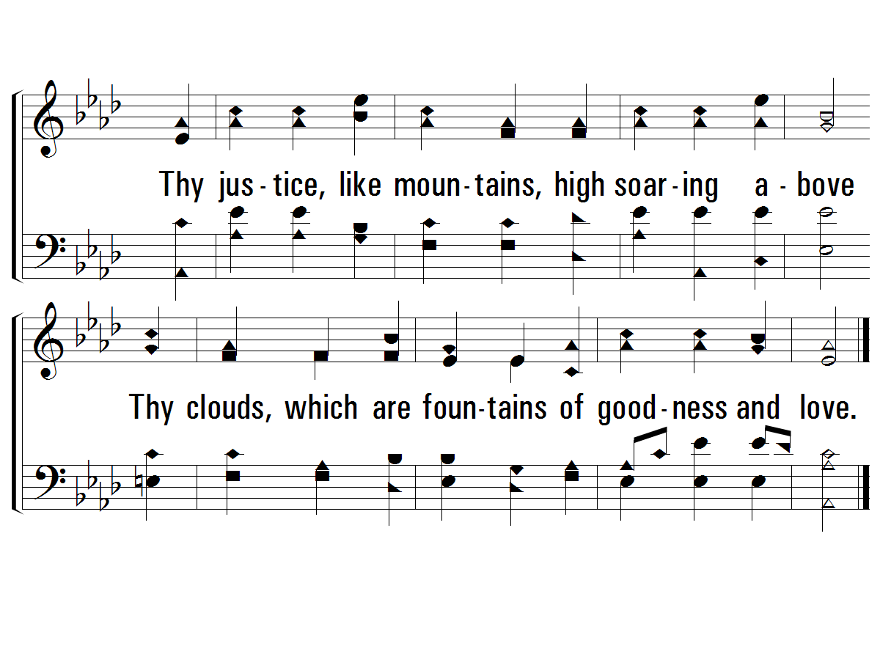
2 - Immortal, Invisible, God Only Wise
945
© 2001 The Paperless Hymnal™

Slide 5
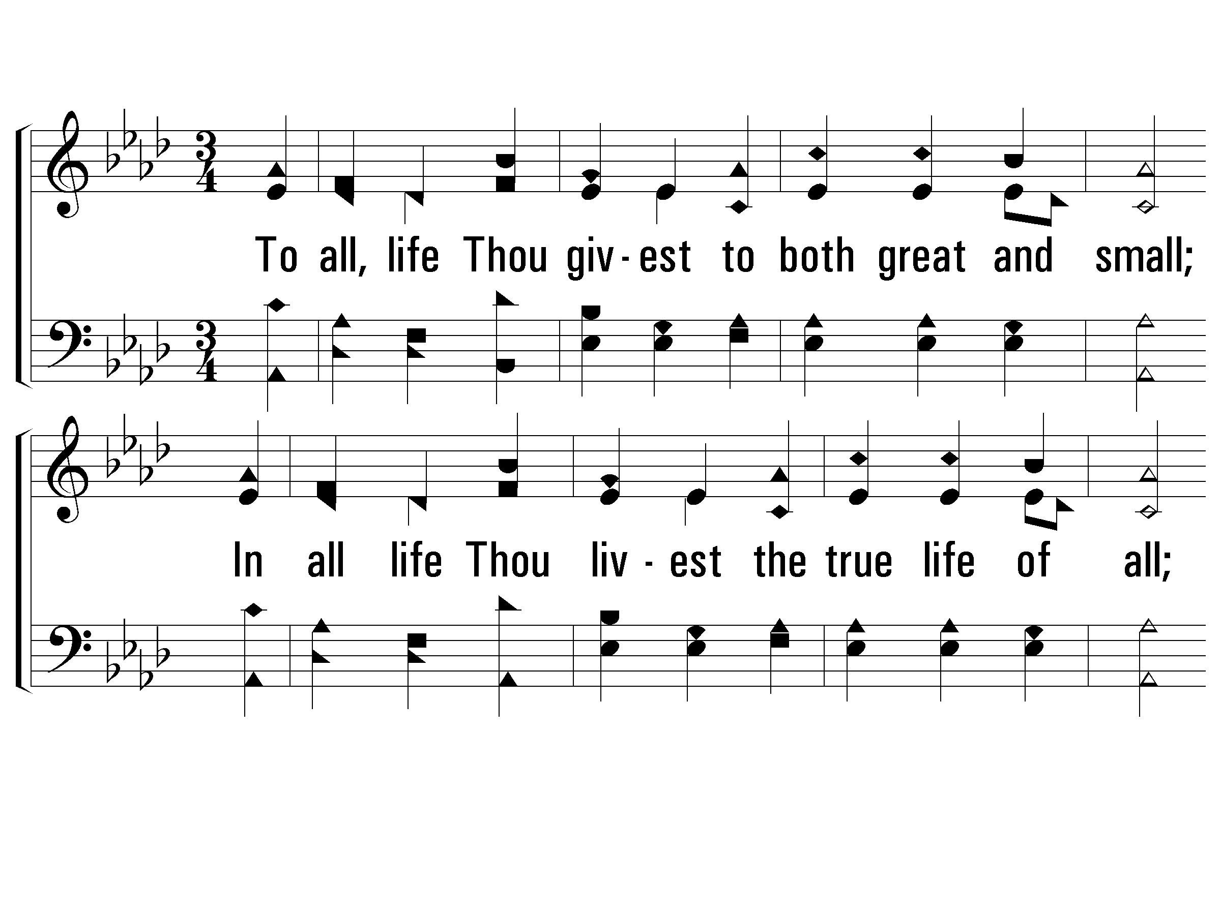
3 - Immortal, Invisible, God Only Wise
945
3.
To all, life Thou givest to both great and small,
In all life Thou livest the true life of all.
We blossom and flourish as leaves on the tree,
And wither and perish but naught changeth Thee.
Words by: Walter Chalmers Smith / Alt.: W. Garrett Horder
Music by: Welsh melody / Roberts’s Caniadau y Cyssegr
© 2001 The Paperless Hymnal™

Slide 6
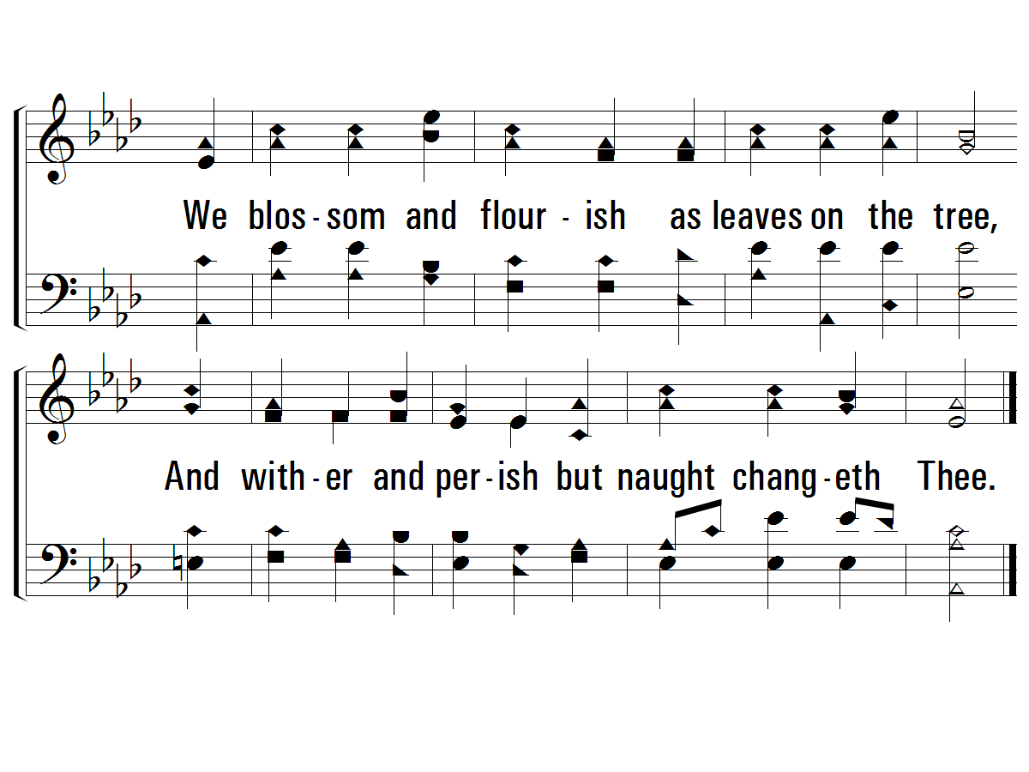
3 - Immortal, Invisible, God Only Wise
945
© 2001 The Paperless Hymnal™

Slide 7
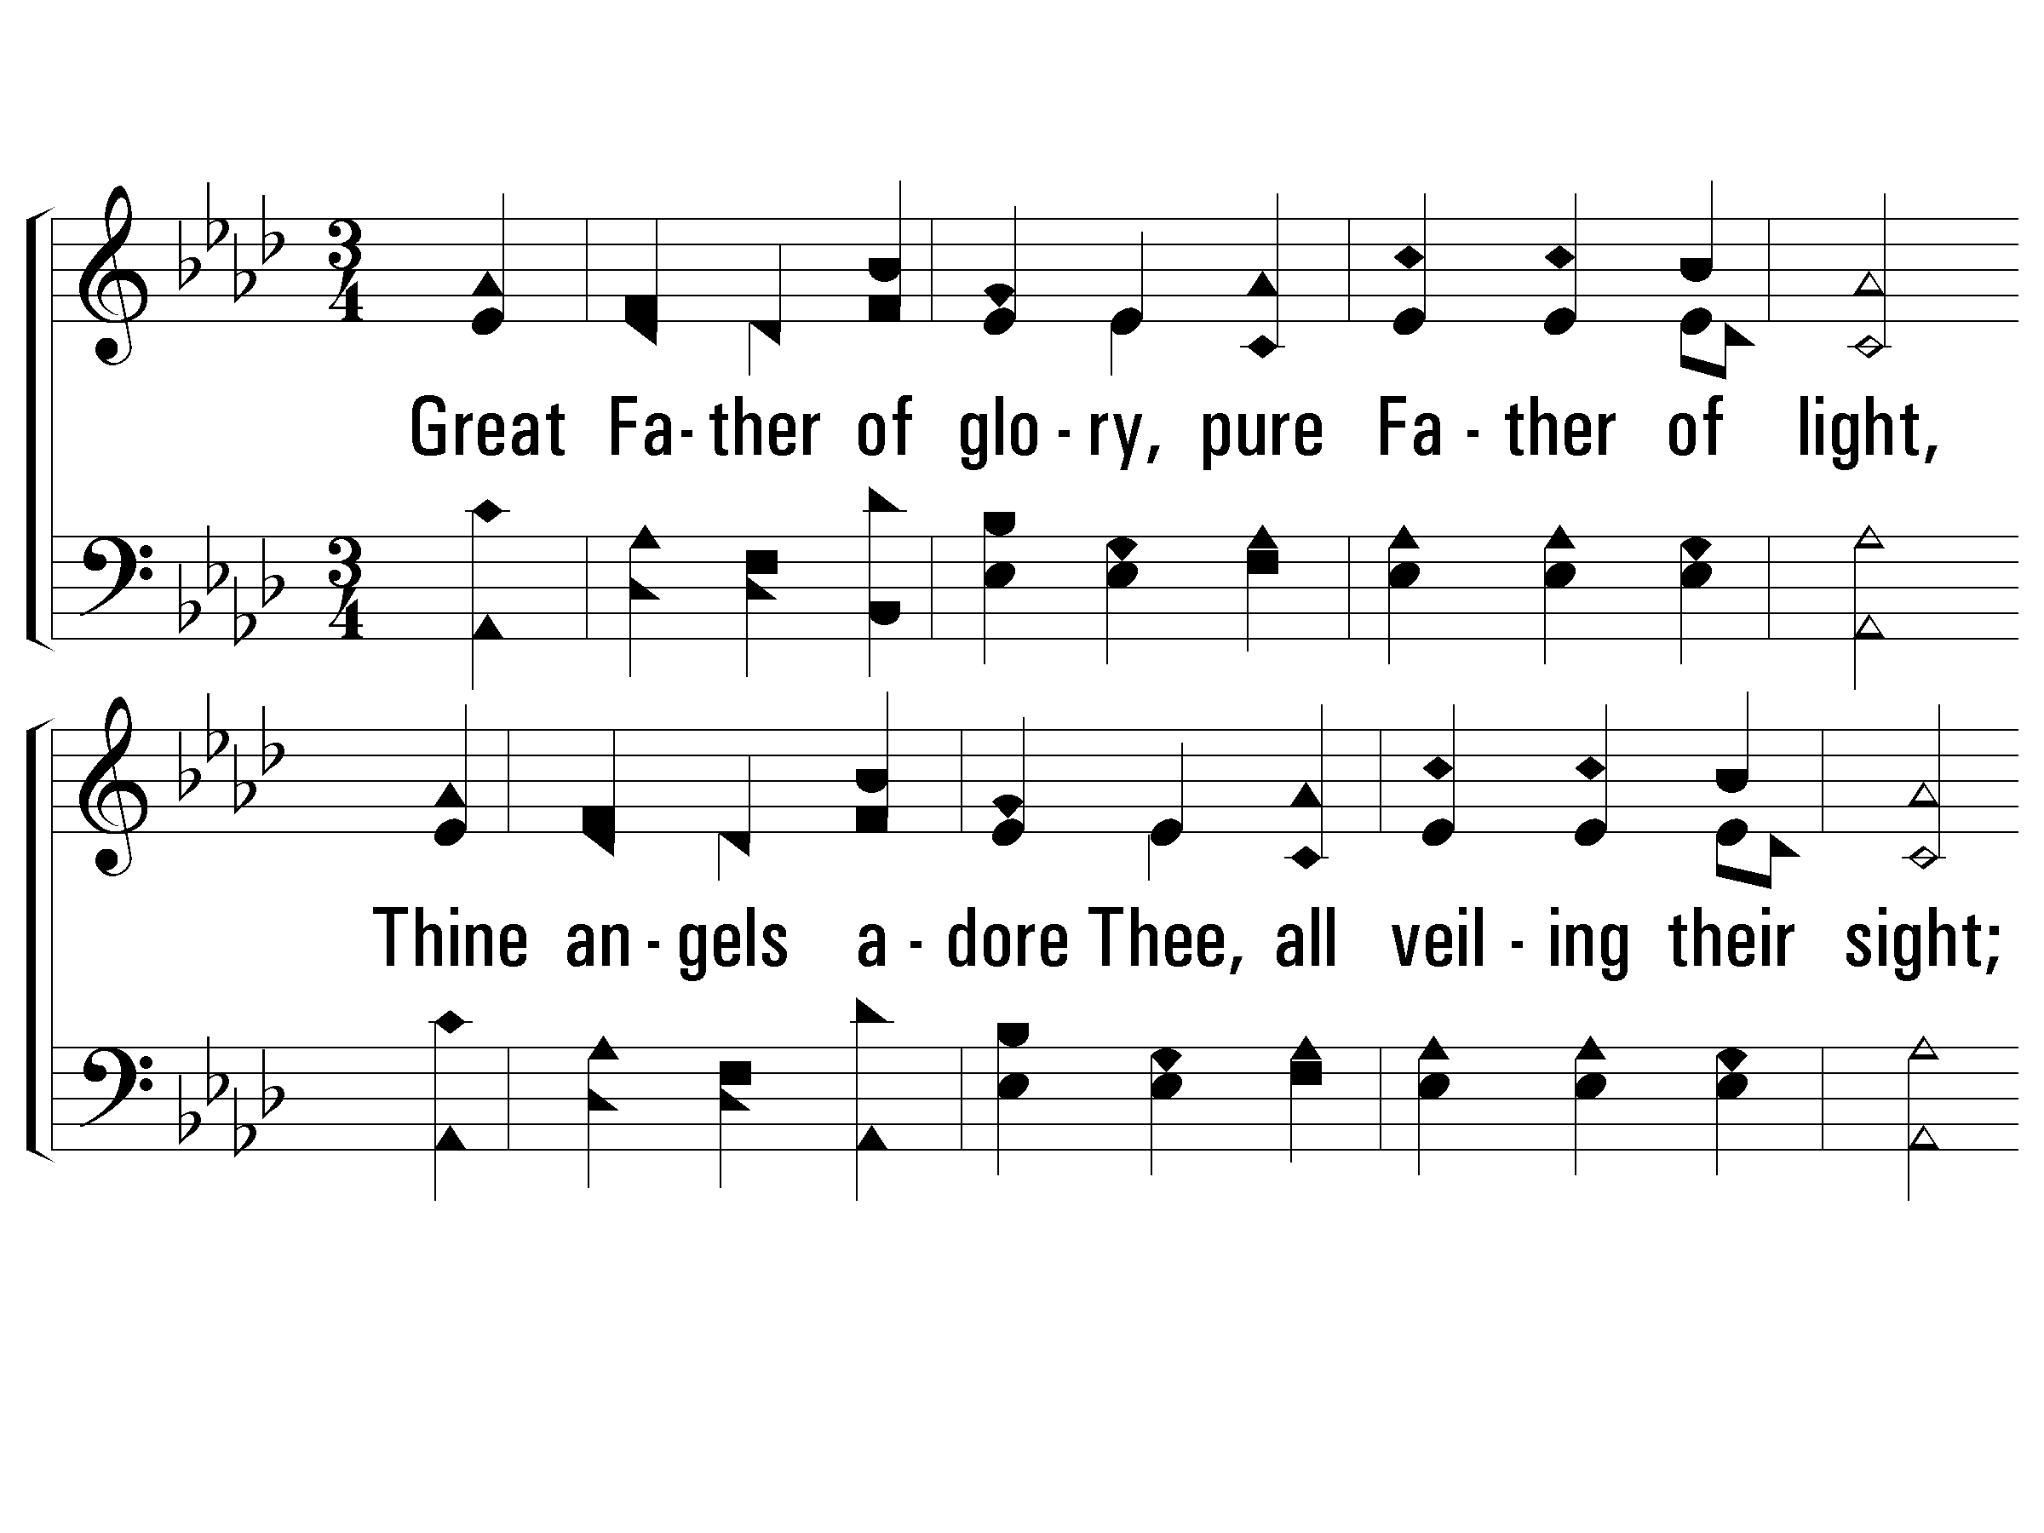
4 - Immortal, Invisible, God Only Wise
945
4.
Great Father of glory, pure Father of light,
Thine angels adore Thee, all veiling their sight;
All praise we would render O help us to see
'Tis only the splendor of light hid-eth Thee!
Words by: Walter Chalmers Smith
Music by: Welsh melody / Roberts’s Caniadau y Cyssegr
© 2001 The Paperless Hymnal™

Slide 8
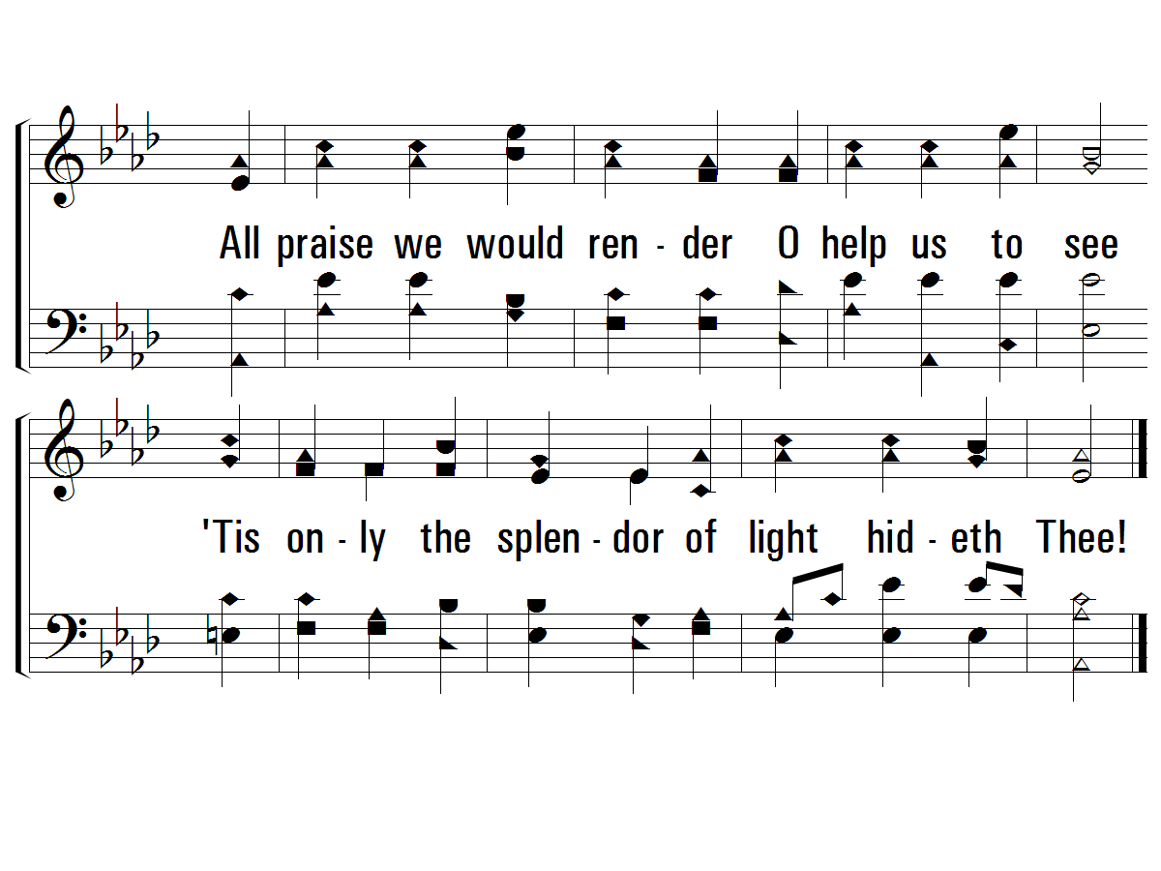
4 - Immortal, Invisible, God Only Wise
945
© 2001 The Paperless Hymnal™

