Slide 1
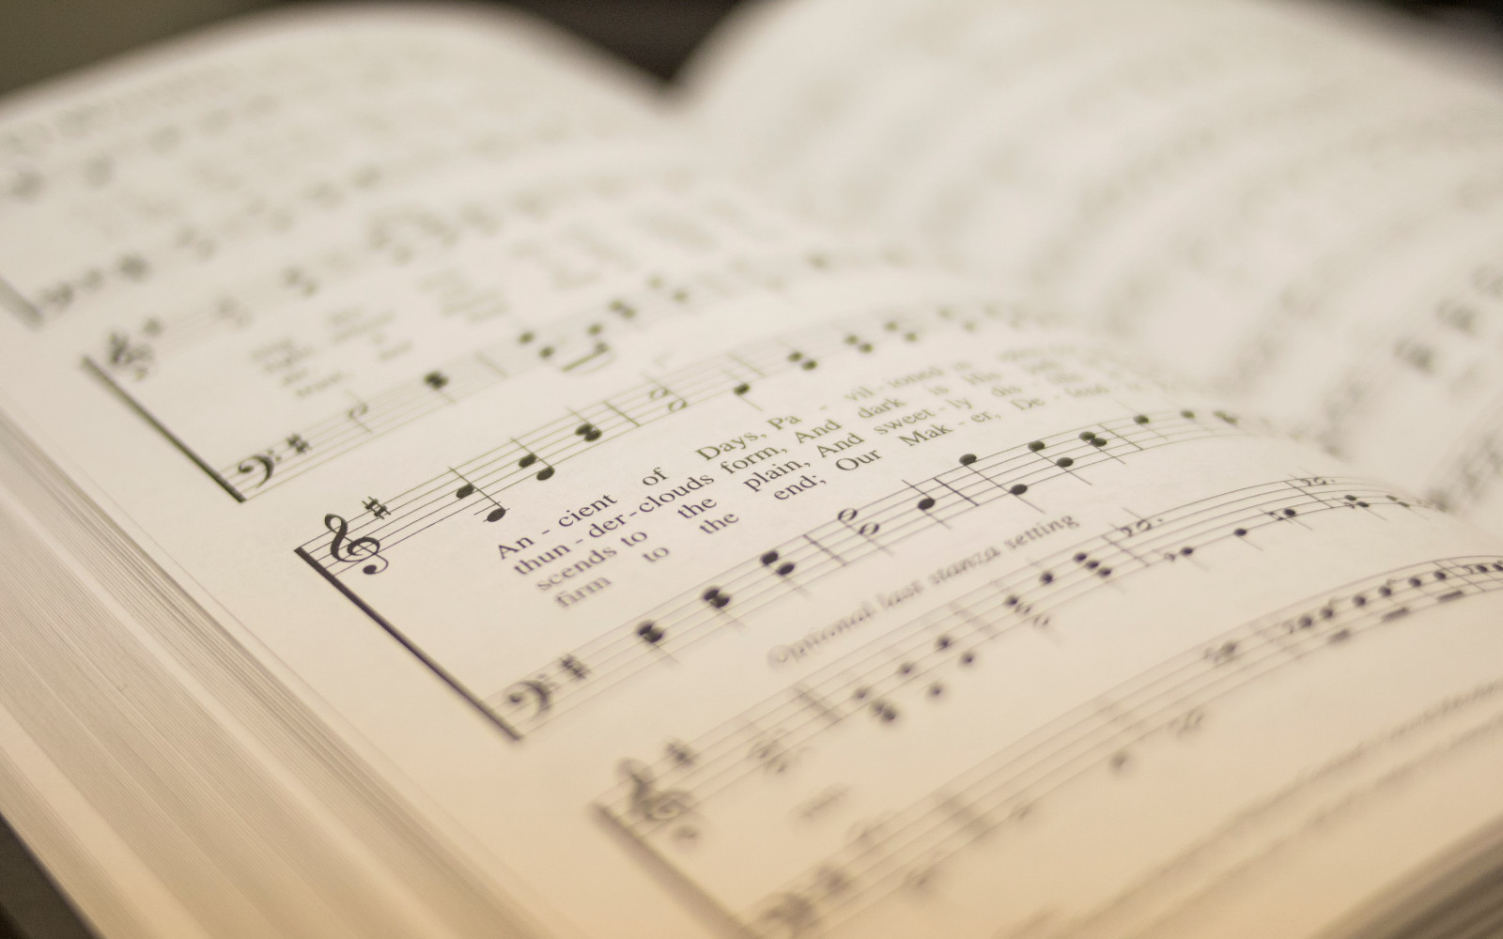

112
ABBA, FATHER!
1
2
3
4
“SINGING...TO THE LORD” COLOSSIANS 3:16
Words & Music: C. E. Couchman All rights reserved. Used by permission.

Slide 2
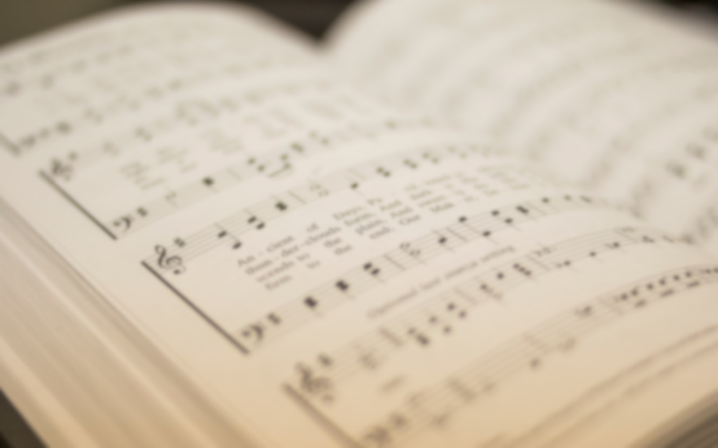
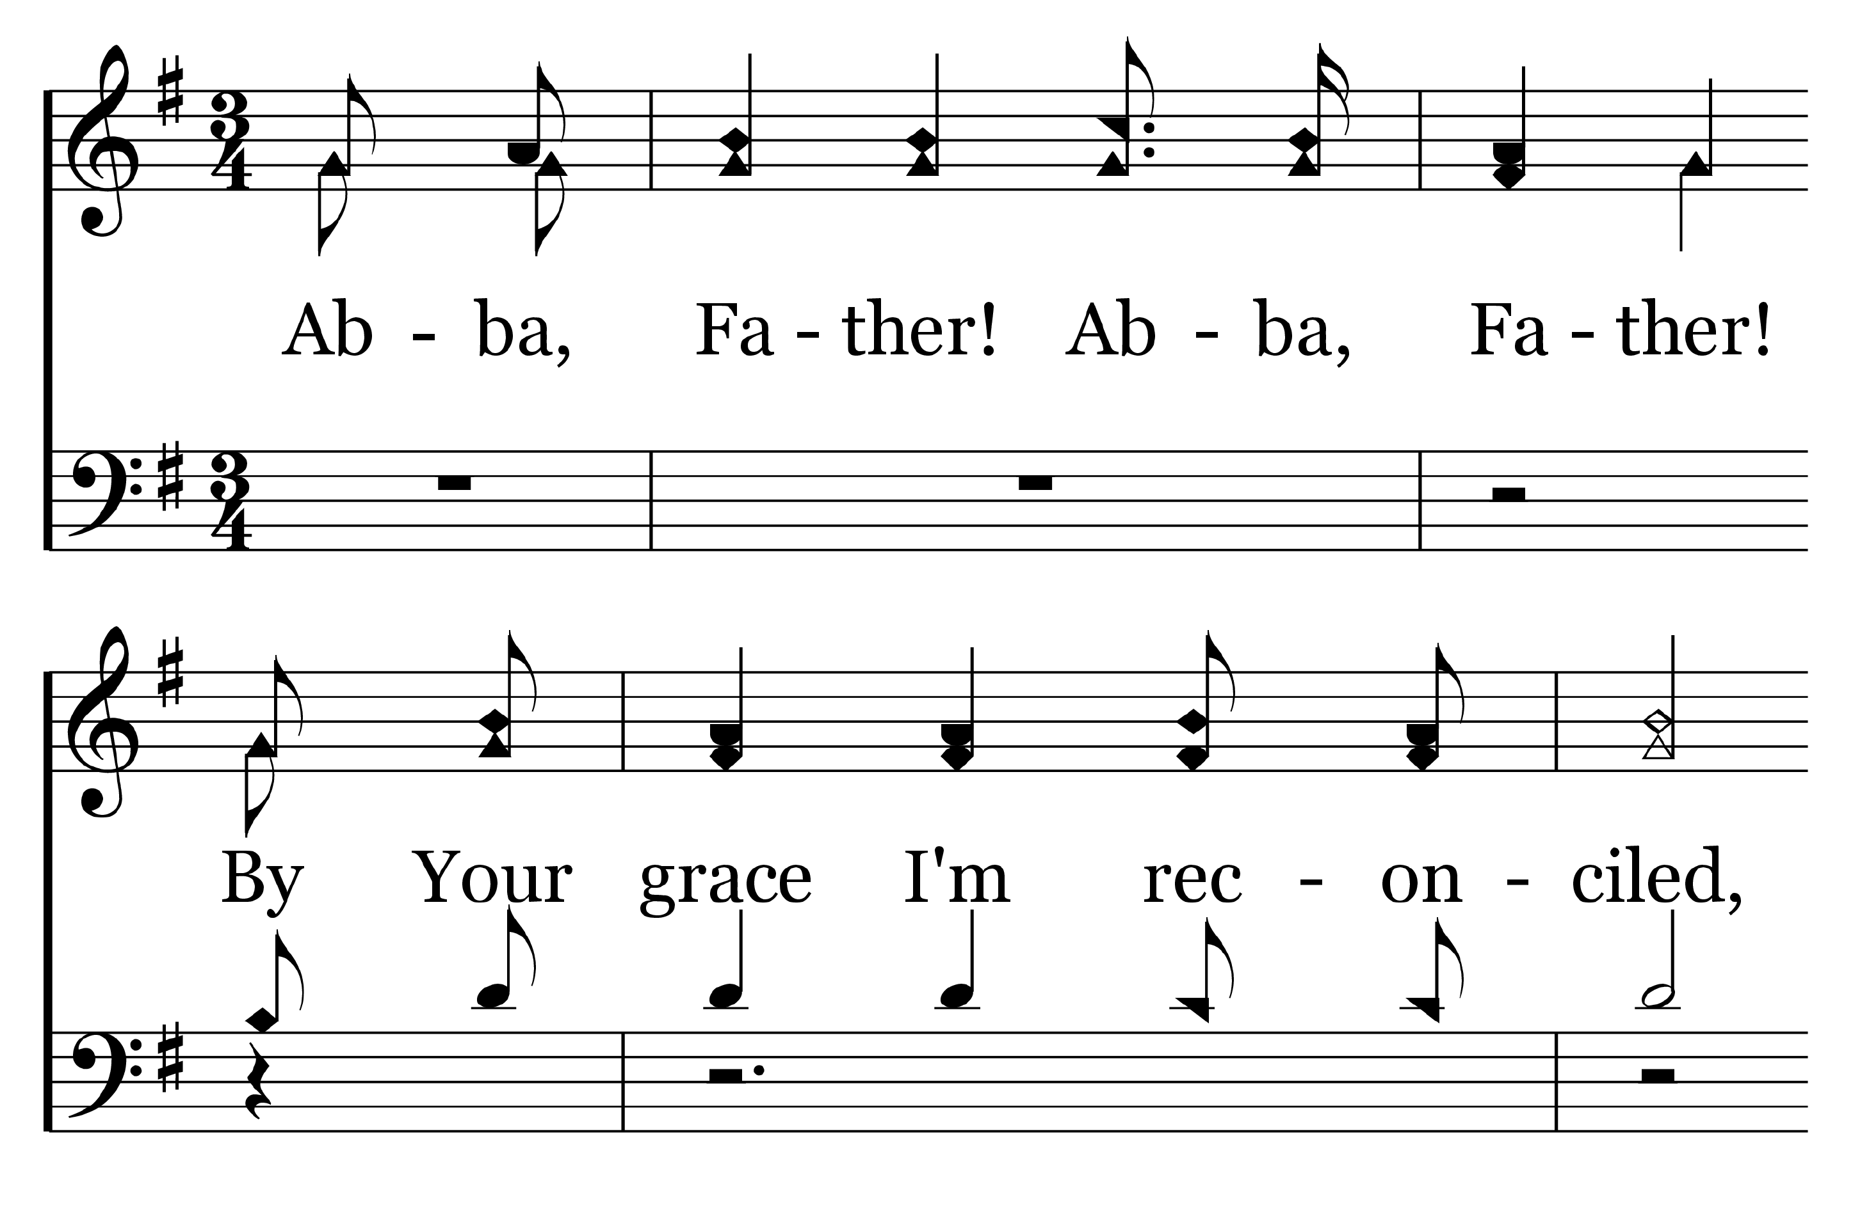

1
C
2
C
3
C
4
C
112
ABBA, FATHER!
© Copyright 2016 by C. E. Couchman

Slide 3
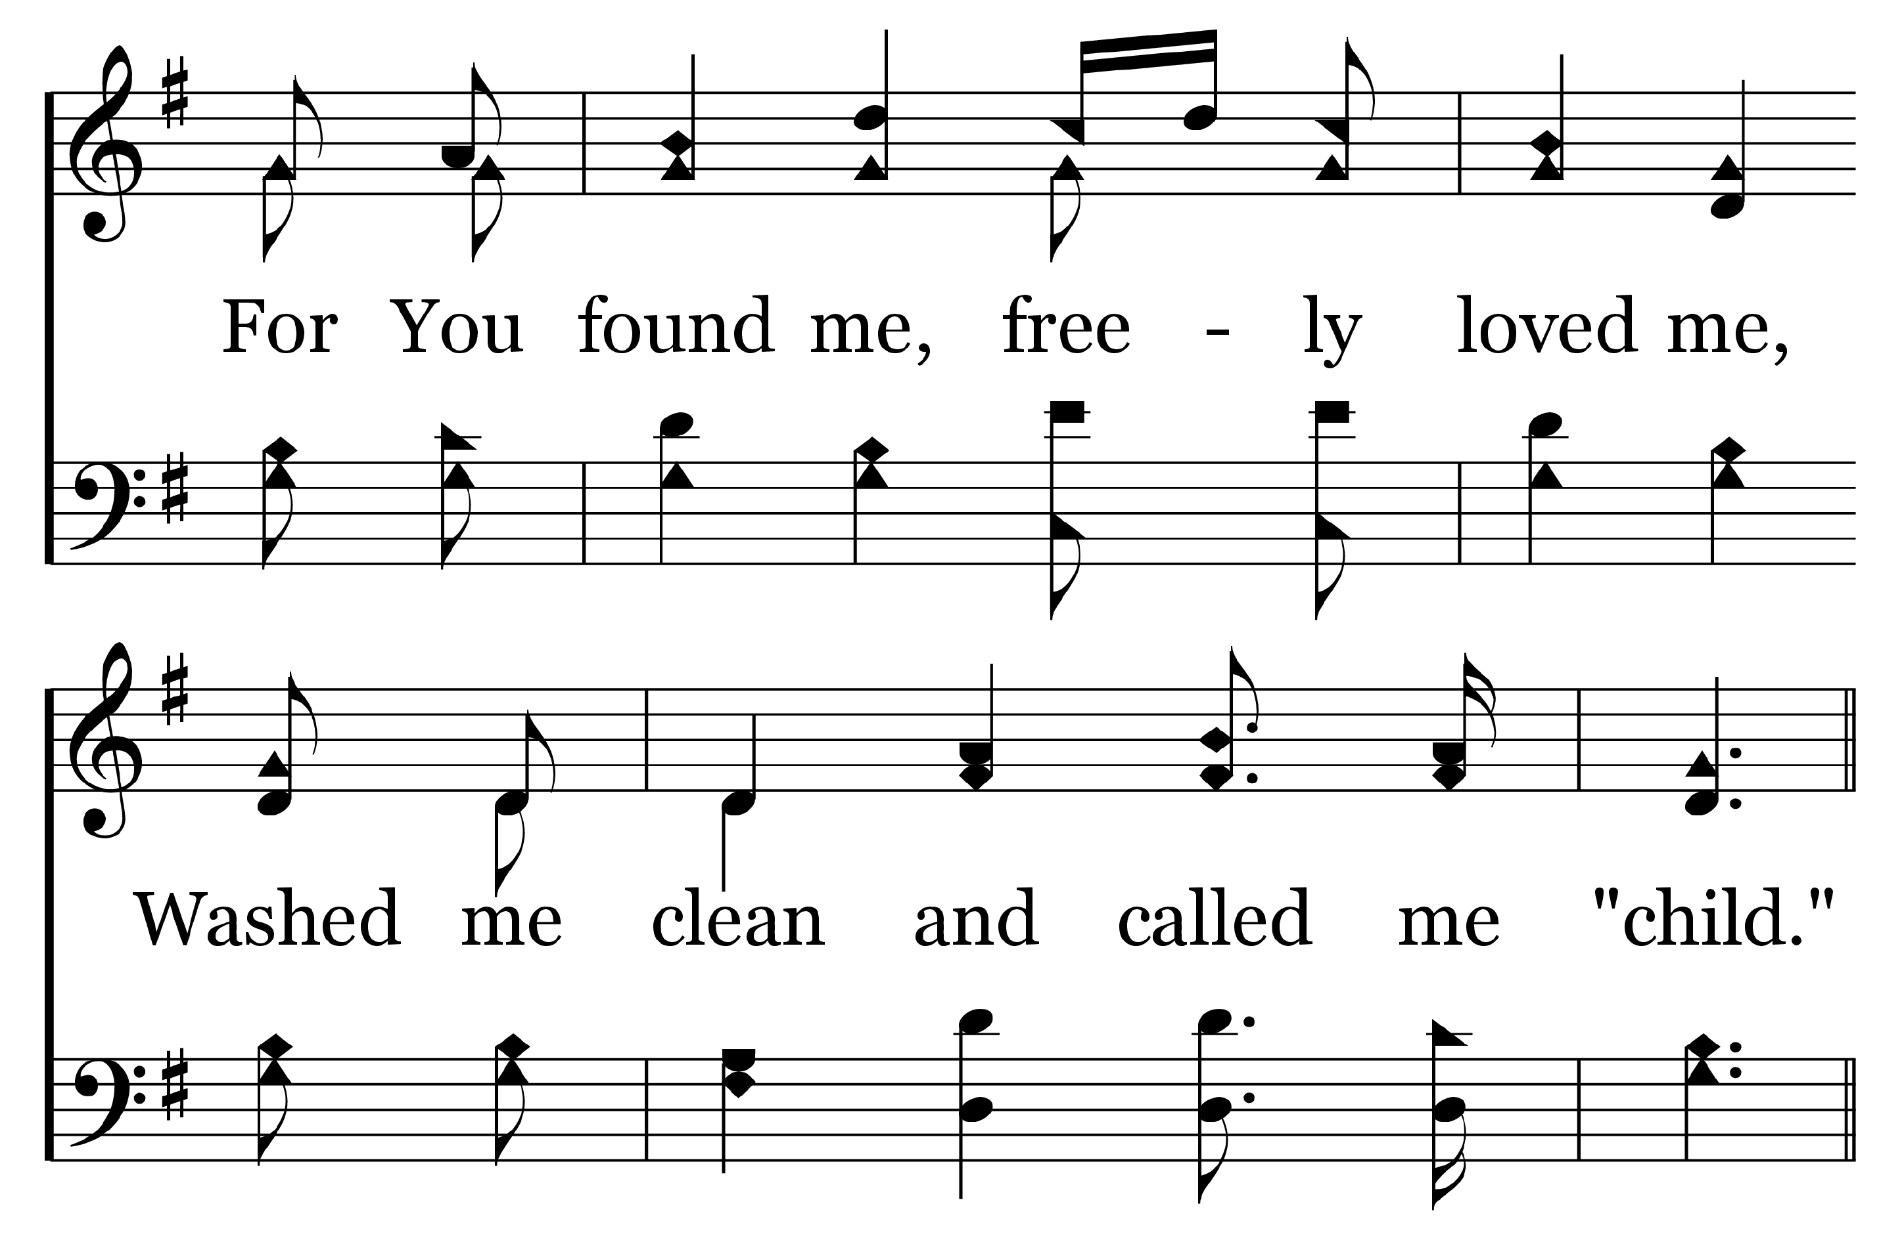
1
C
2
C
3
C
4
C
112
ABBA, FATHER!
© Copyright 2016 by C. E. Couchman

Slide 4
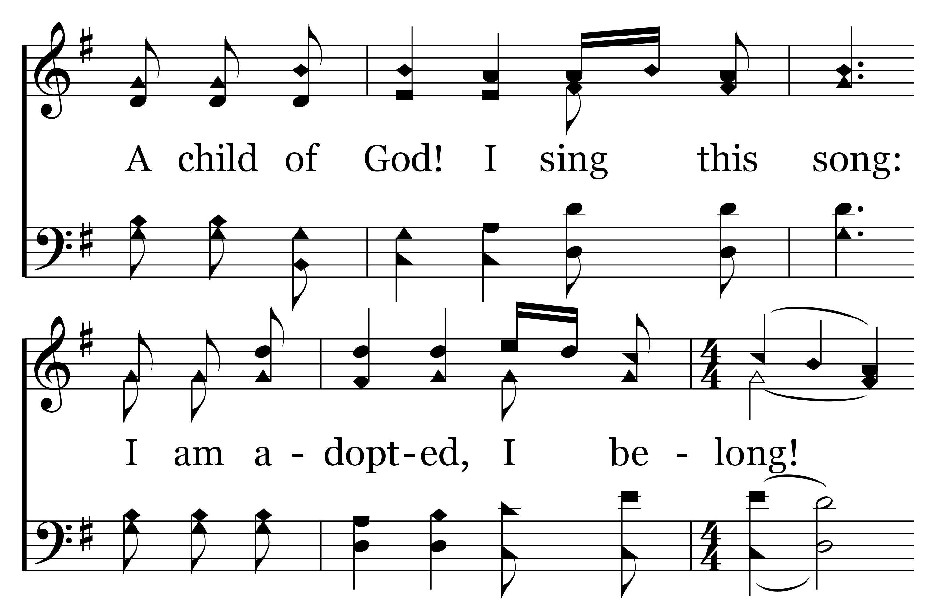
1
C
2
C
3
C
4
C
112
ABBA, FATHER!
© Copyright 2016 by C. E. Couchman

Slide 5
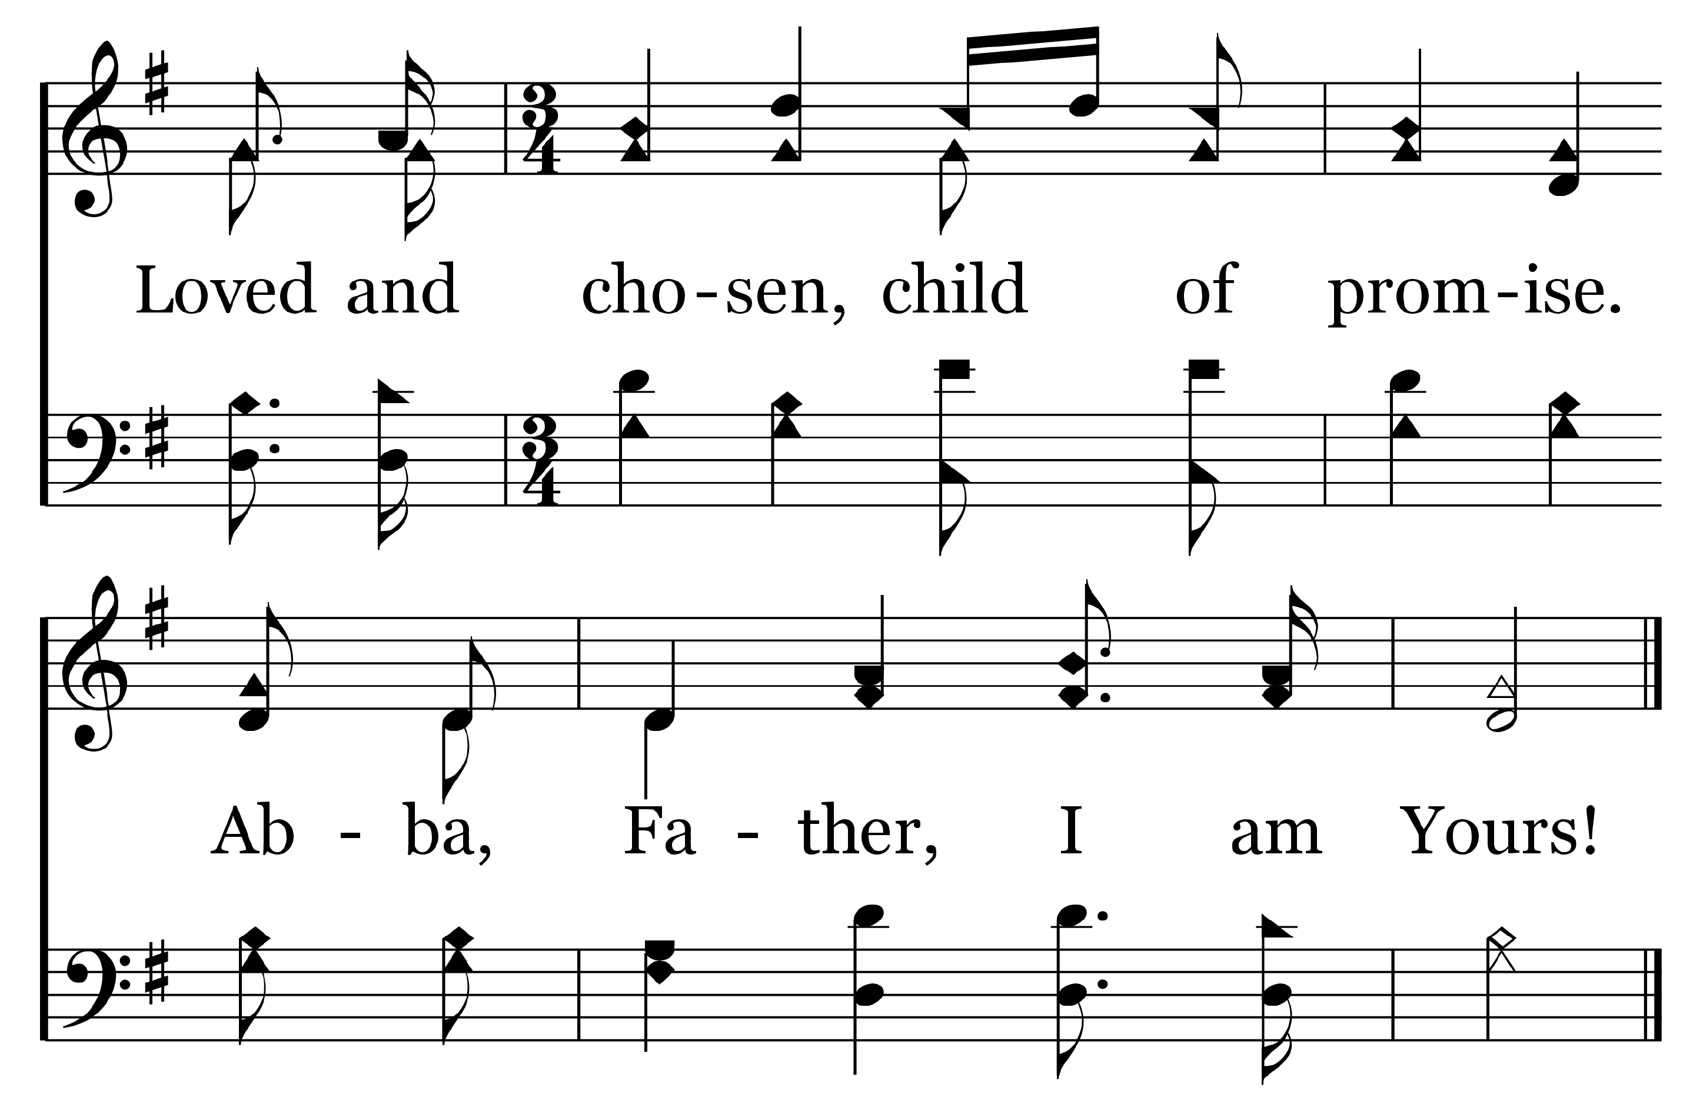
1
C
2
C
3
C
4
C
112
ABBA, FATHER!
© Copyright 2016 by C. E. Couchman

Slide 6
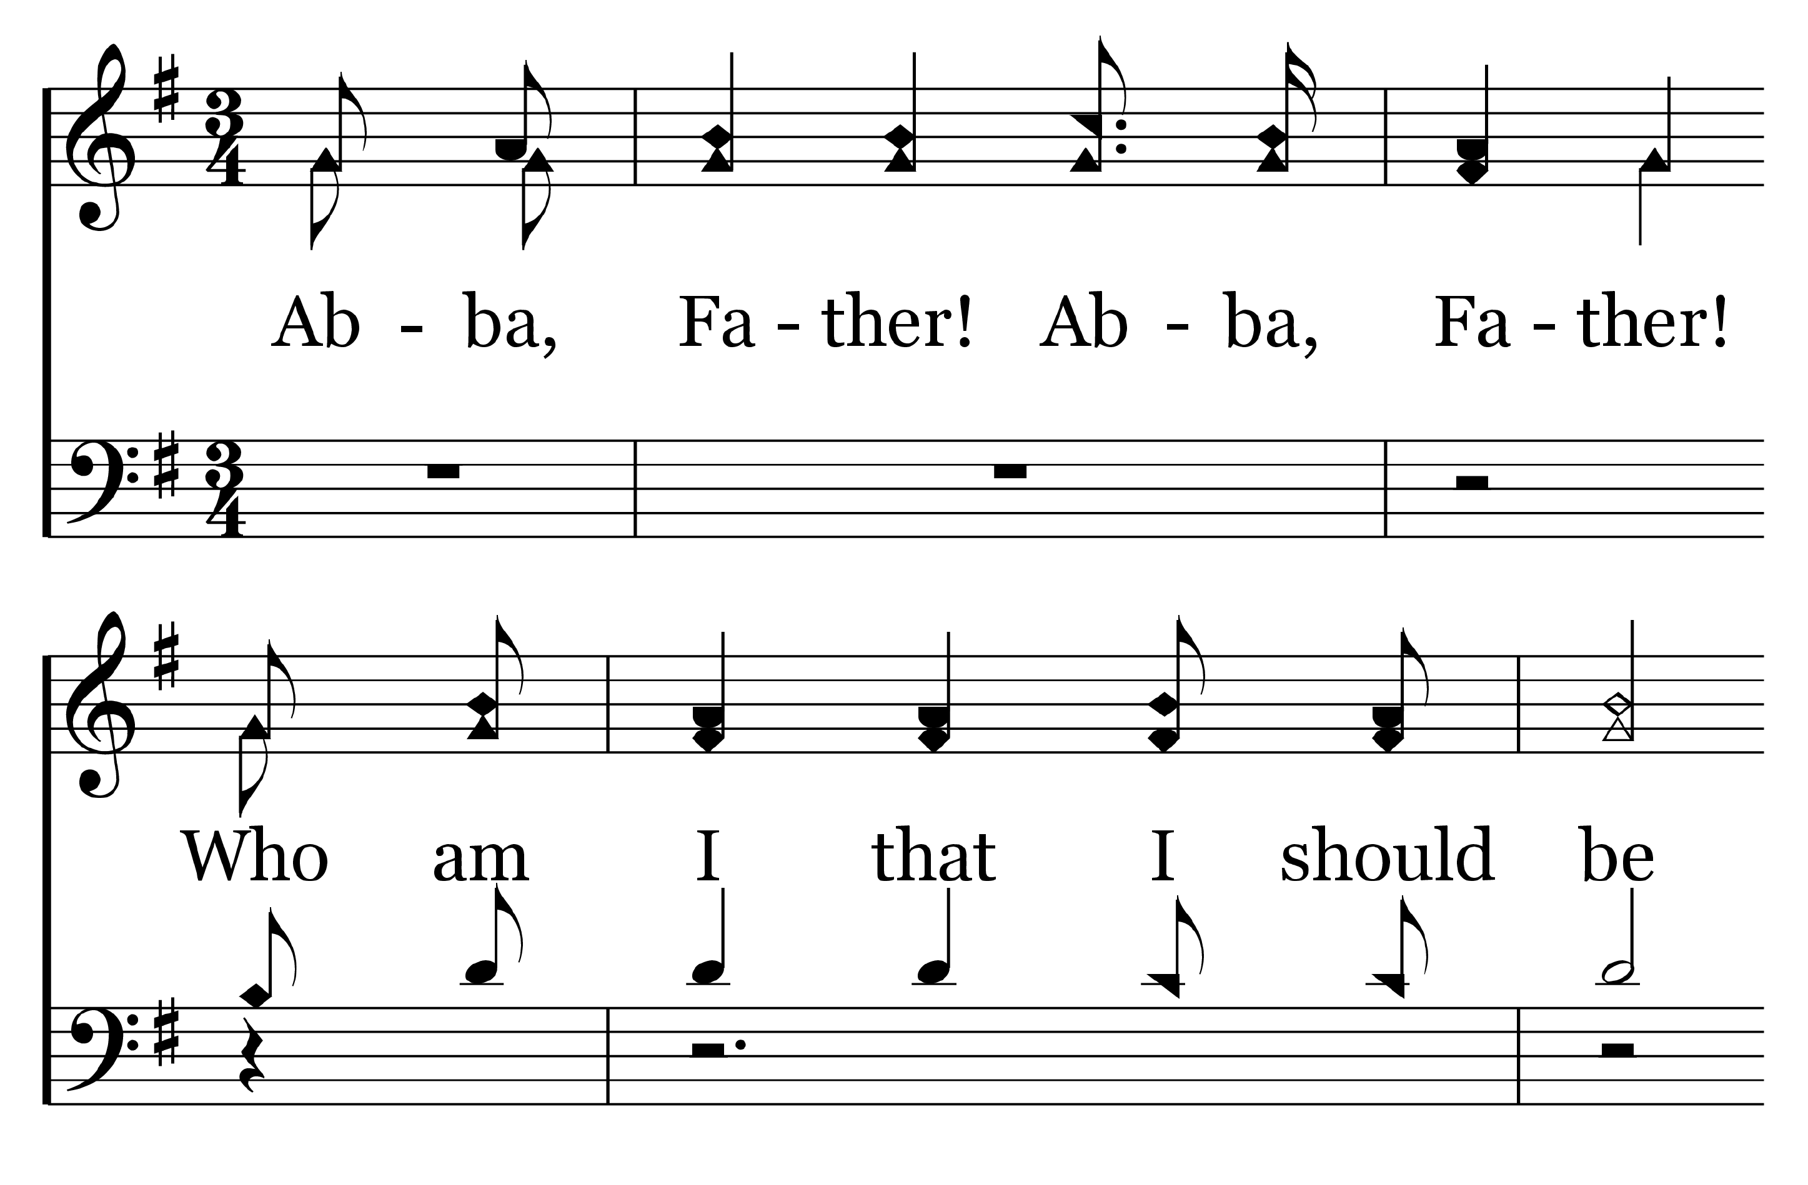
1
C
2
C
3
C
4
C
112
ABBA, FATHER!
© Copyright 2016 by C. E. Couchman

Slide 7
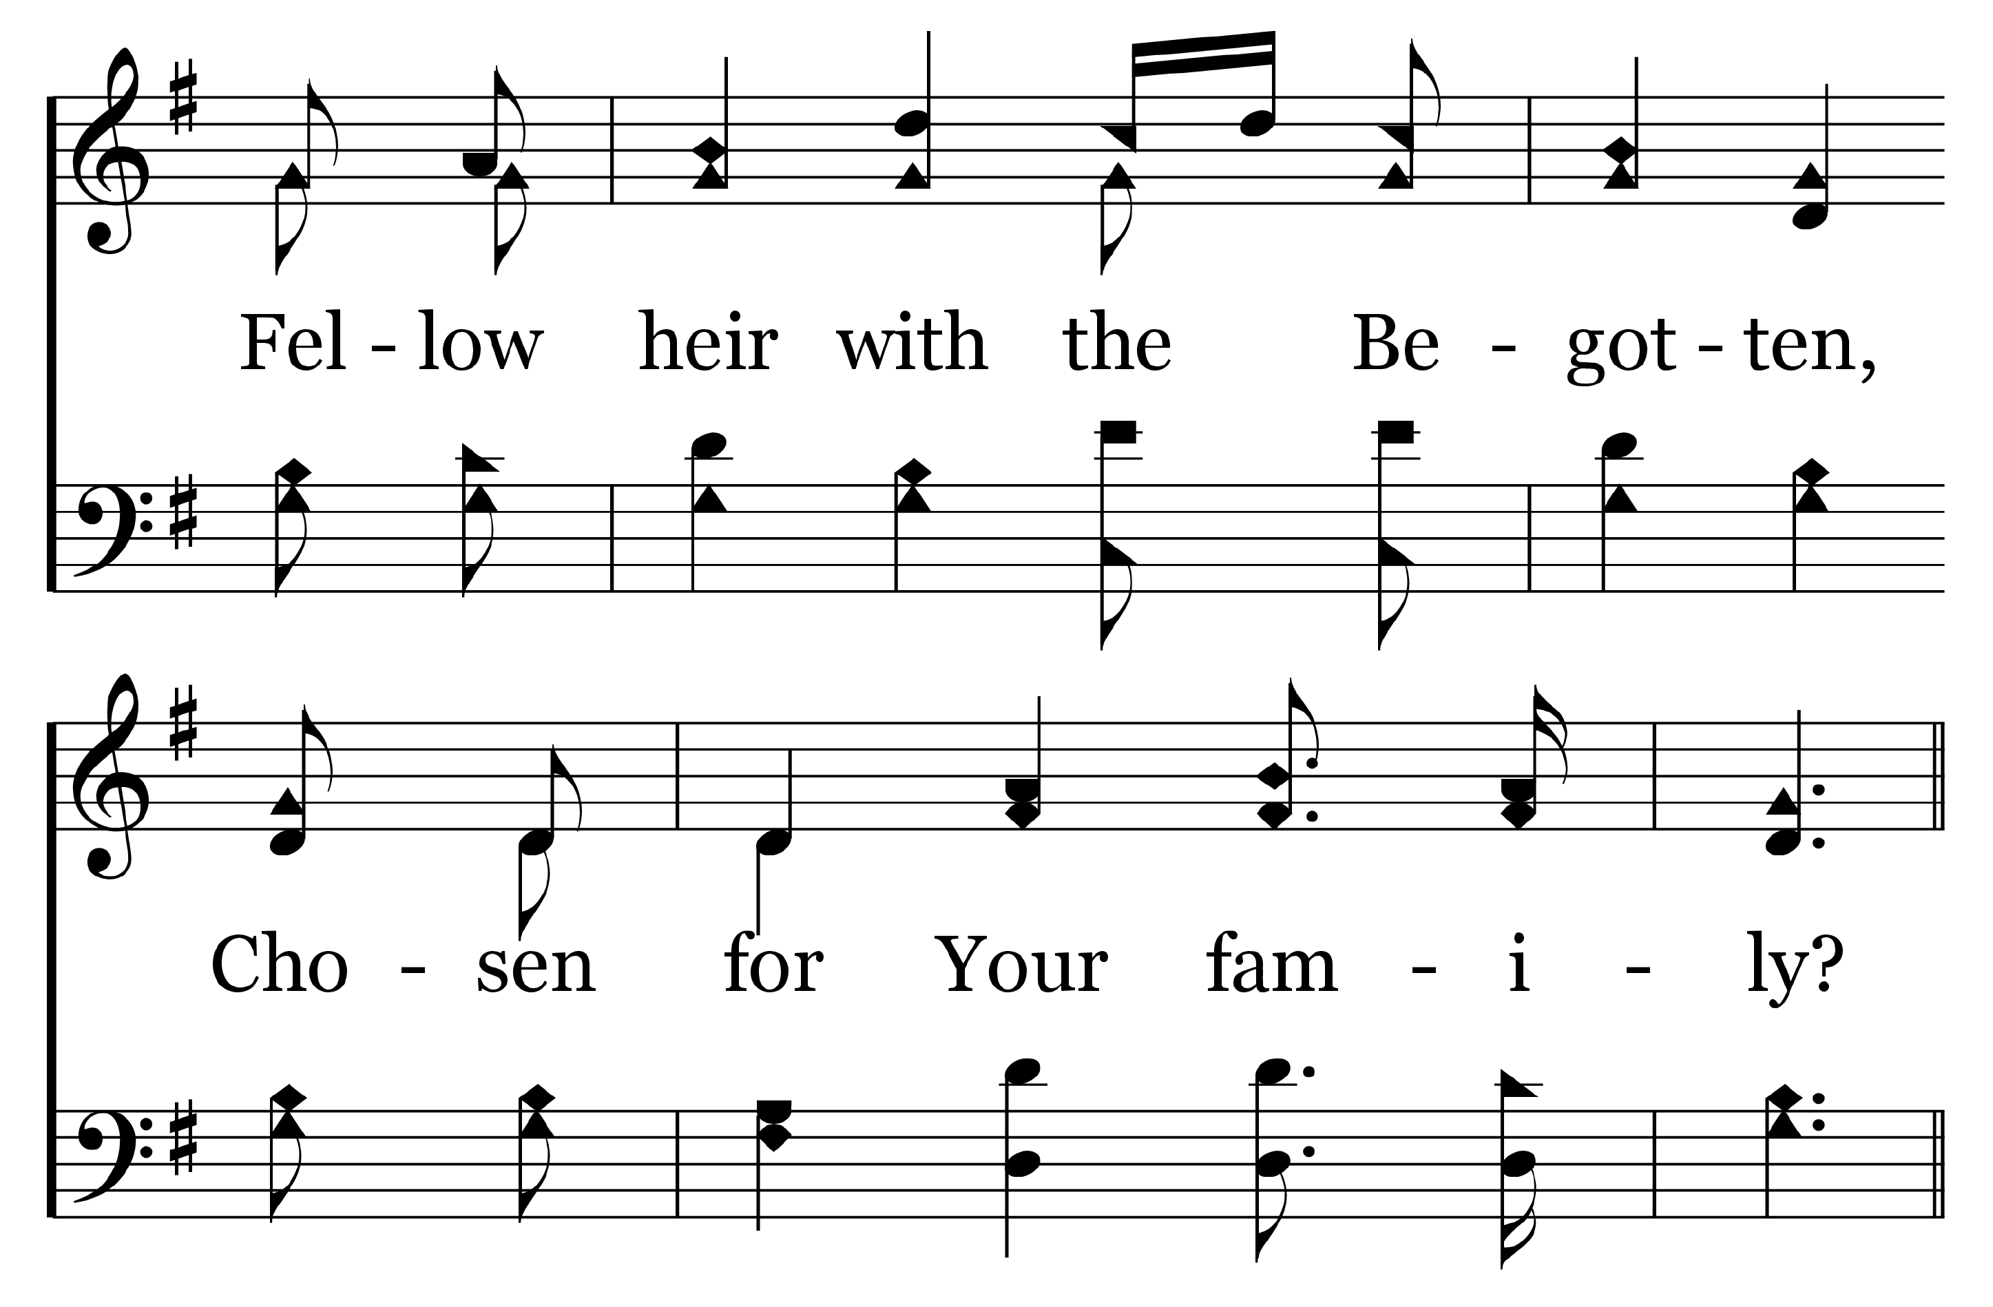
1
C
2
C
3
C
4
C
112
ABBA, FATHER!
© Copyright 2016 by C. E. Couchman

Slide 8
1
C
2
C
3
C
4
C
112
ABBA, FATHER!
© Copyright 2016 by C. E. Couchman

Slide 9
1
C
2
C
3
C
4
C
112
ABBA, FATHER!
© Copyright 2016 by C. E. Couchman

Slide 10
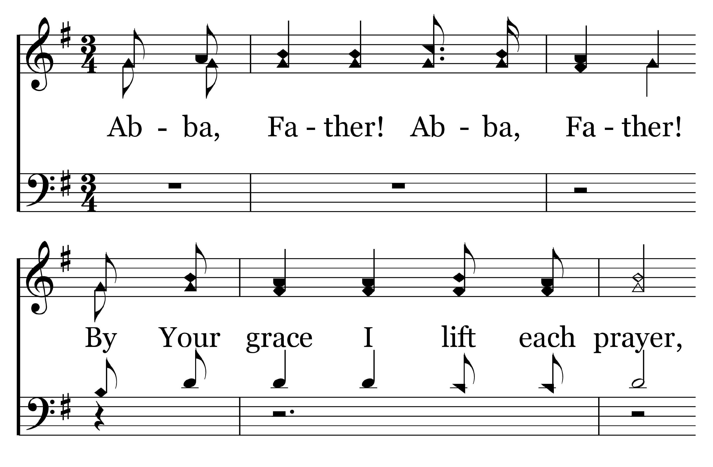
1
C
2
C
3
C
4
C
112
ABBA, FATHER!
© Copyright 2016 by C. E. Couchman

Slide 11
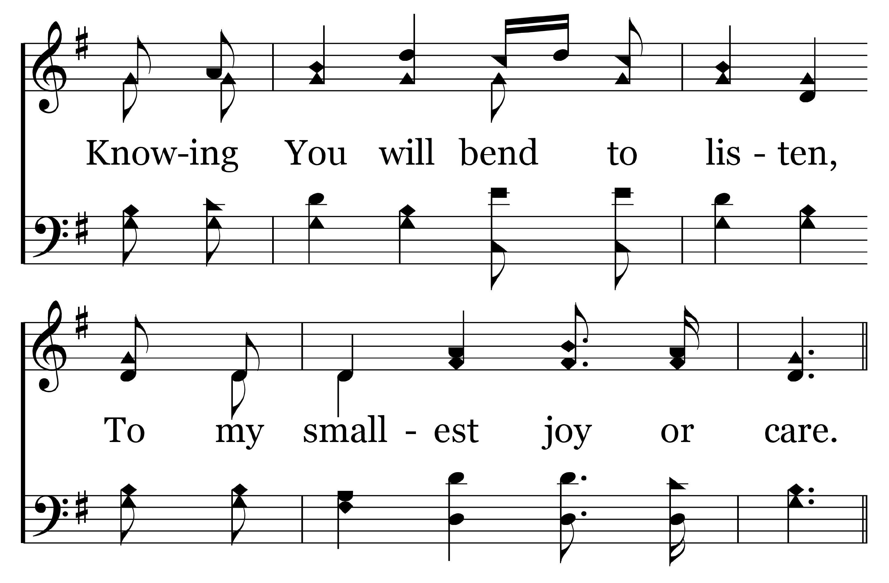
1
C
2
C
3
C
4
C
112
ABBA, FATHER!
© Copyright 2016 by C. E. Couchman

Slide 12
1
C
2
C
3
C
4
C
112
ABBA, FATHER!
© Copyright 2016 by C. E. Couchman

Slide 13
1
C
2
C
3
C
4
C
112
ABBA, FATHER!
© Copyright 2016 by C. E. Couchman

Slide 14
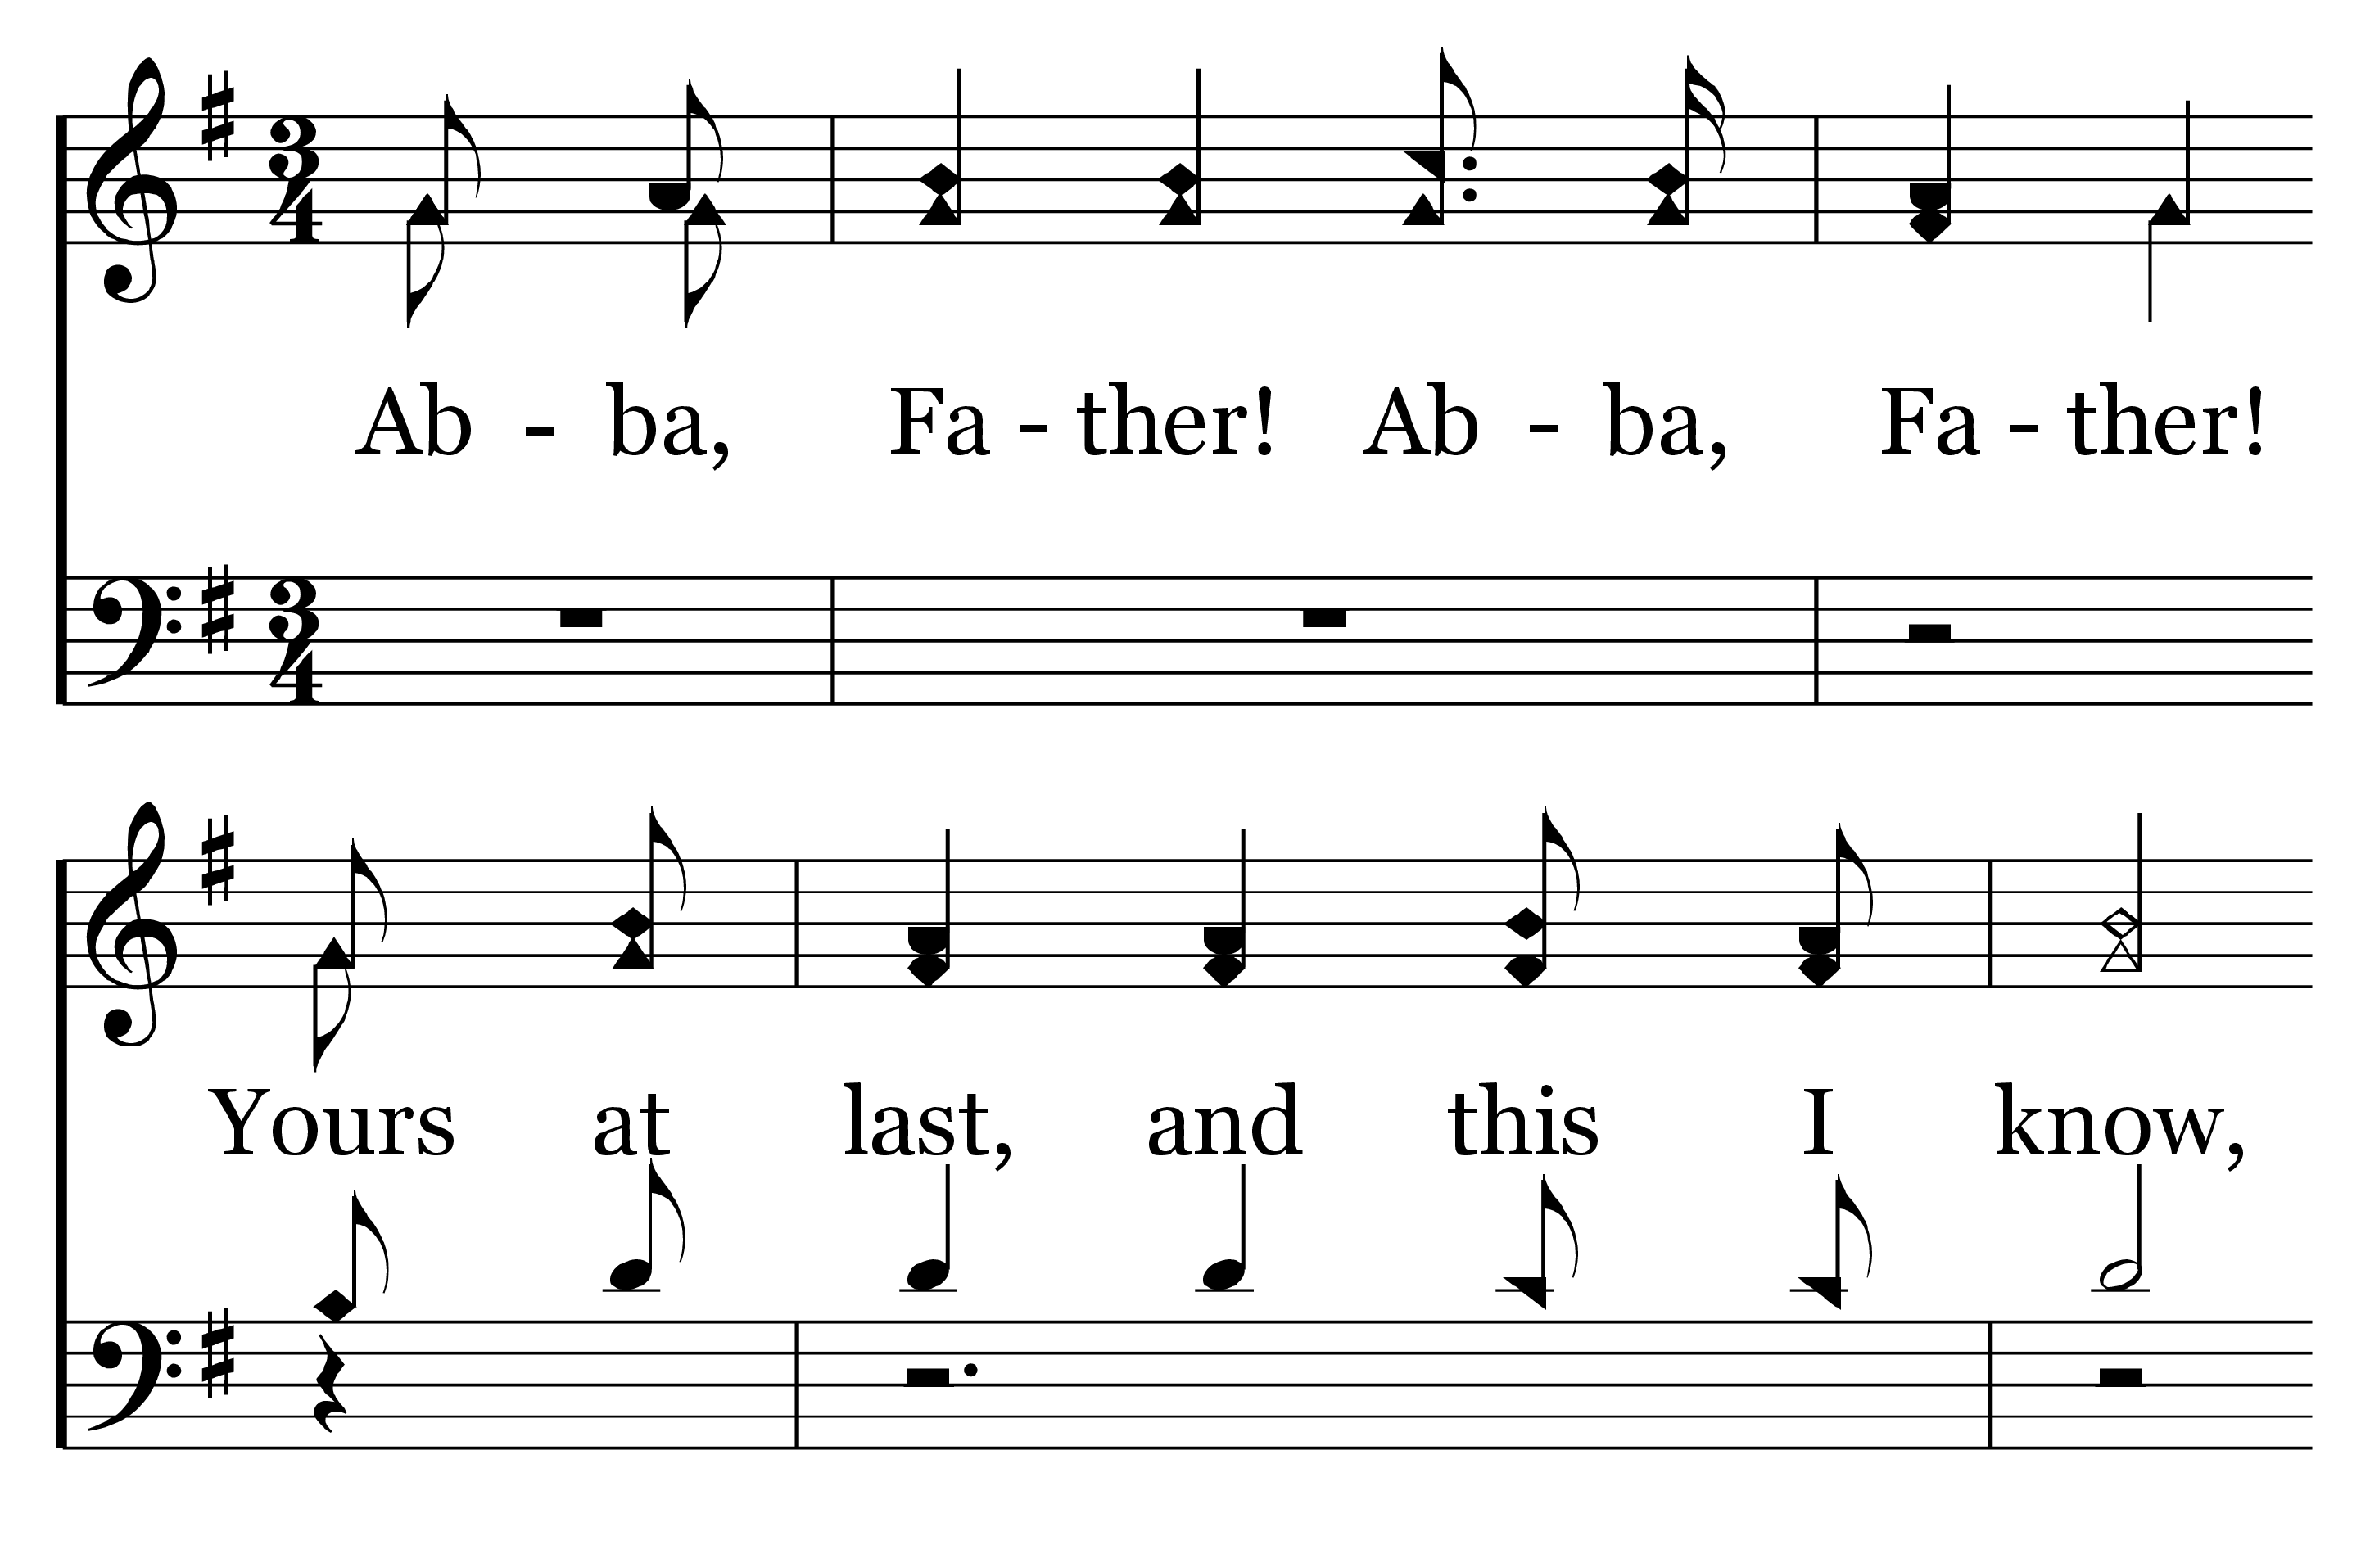
1
C
2
C
3
C
4
C
112
ABBA, FATHER!
© Copyright 2016 by C. E. Couchman

Slide 15
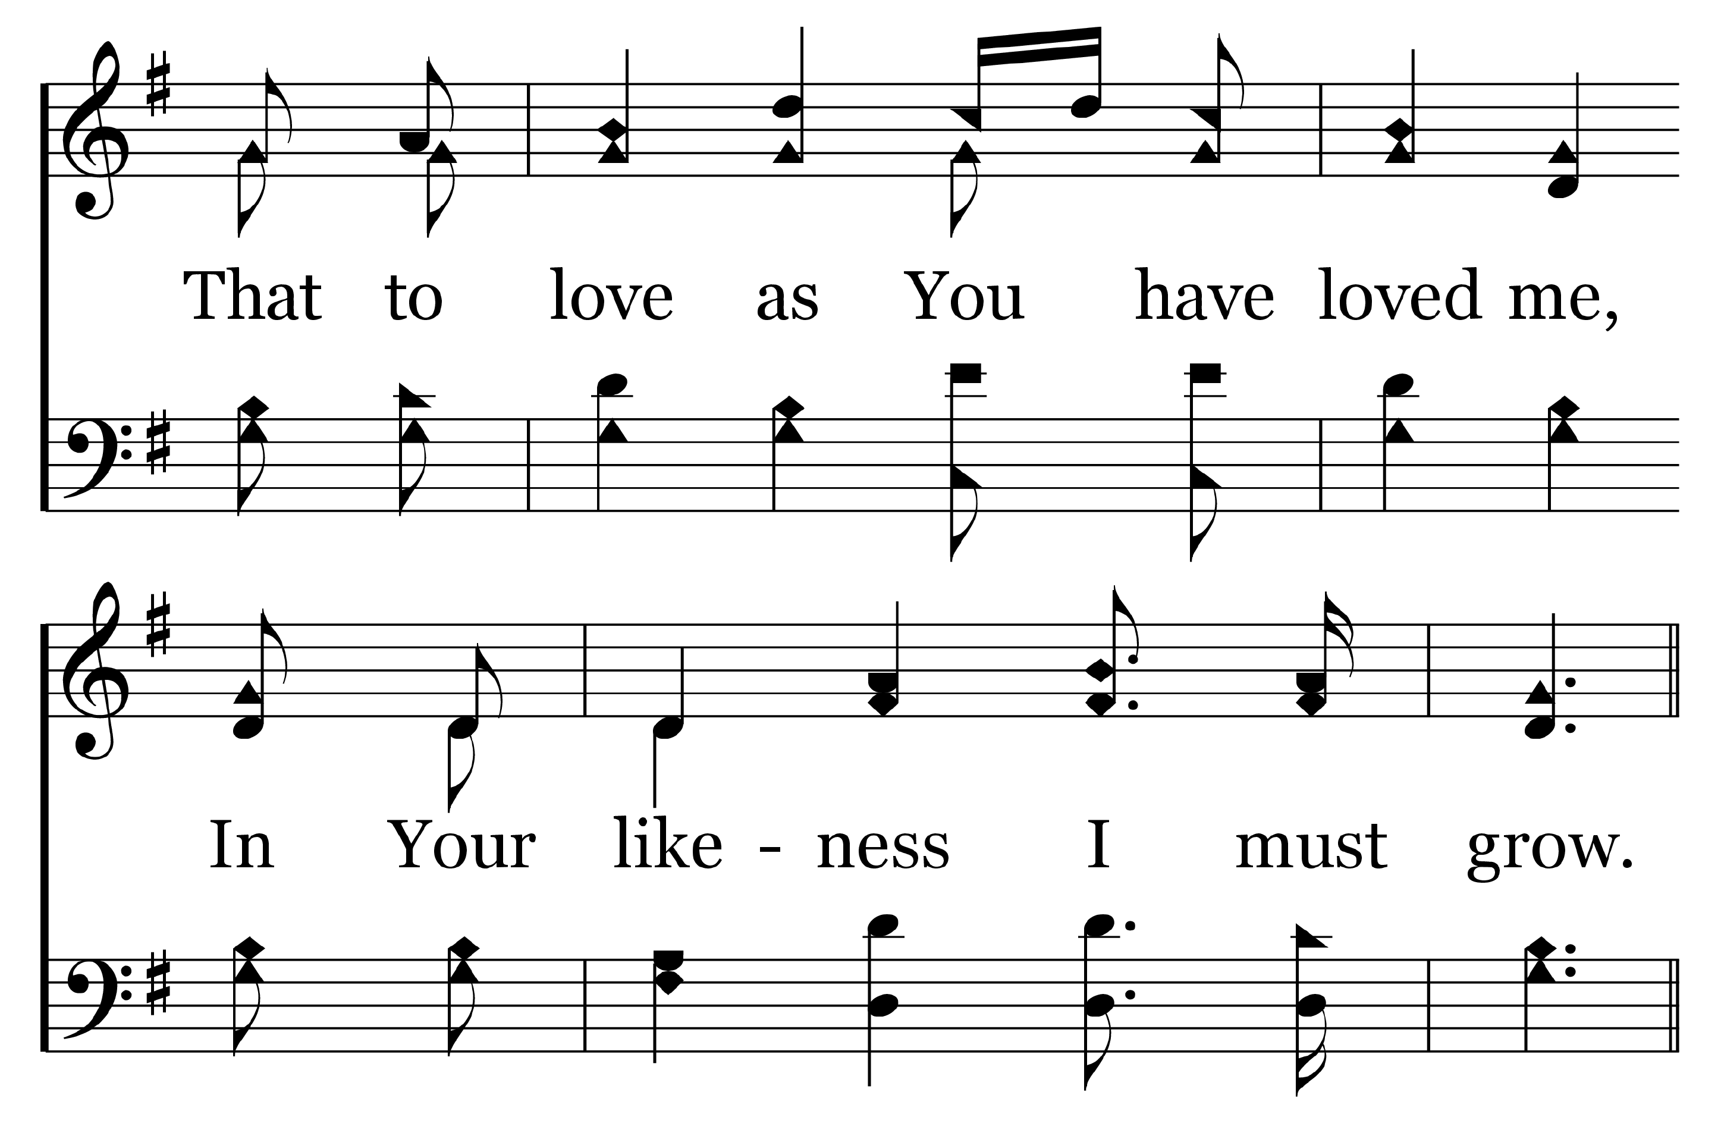
1
C
2
C
3
C
4
C
112
ABBA, FATHER!
© Copyright 2016 by C. E. Couchman

Slide 16
1
C
2
C
3
C
4
C
112
ABBA, FATHER!
© Copyright 2016 by C. E. Couchman

Slide 17
1
C
2
C
3
C
4
C
112
ABBA, FATHER!
© Copyright 2016 by C. E. Couchman

