Slide 1
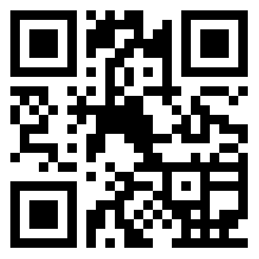
Welcome, visitors!
Please scan or visit
embryhills.com/hello
to fill out a
digital visitor’s card.
Thanks for visiting Embry Hills.

