Slide 1
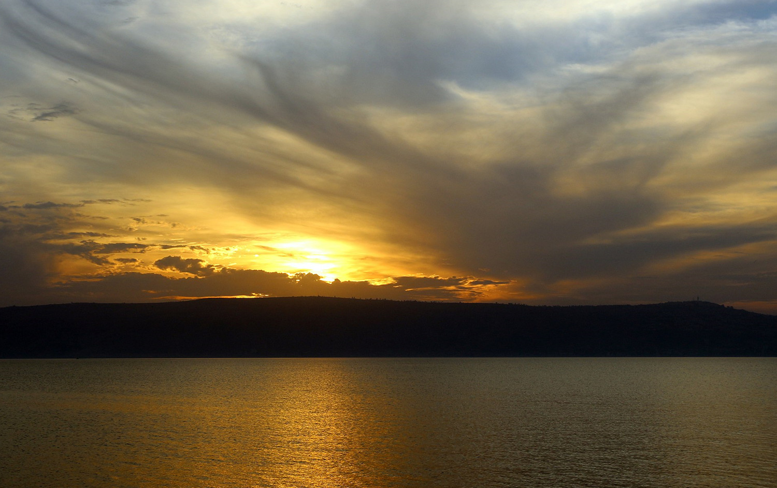

56
AT EVEN, WHEN THE SUN WAS SET
1
2
3
4
5
6
7
8
“SINGING...TO THE LORD” COLOSSIANS 3:16
Words: Henry Twells, 1868 Music: EDEN, Timothy B. Mason, 1836

Slide 2
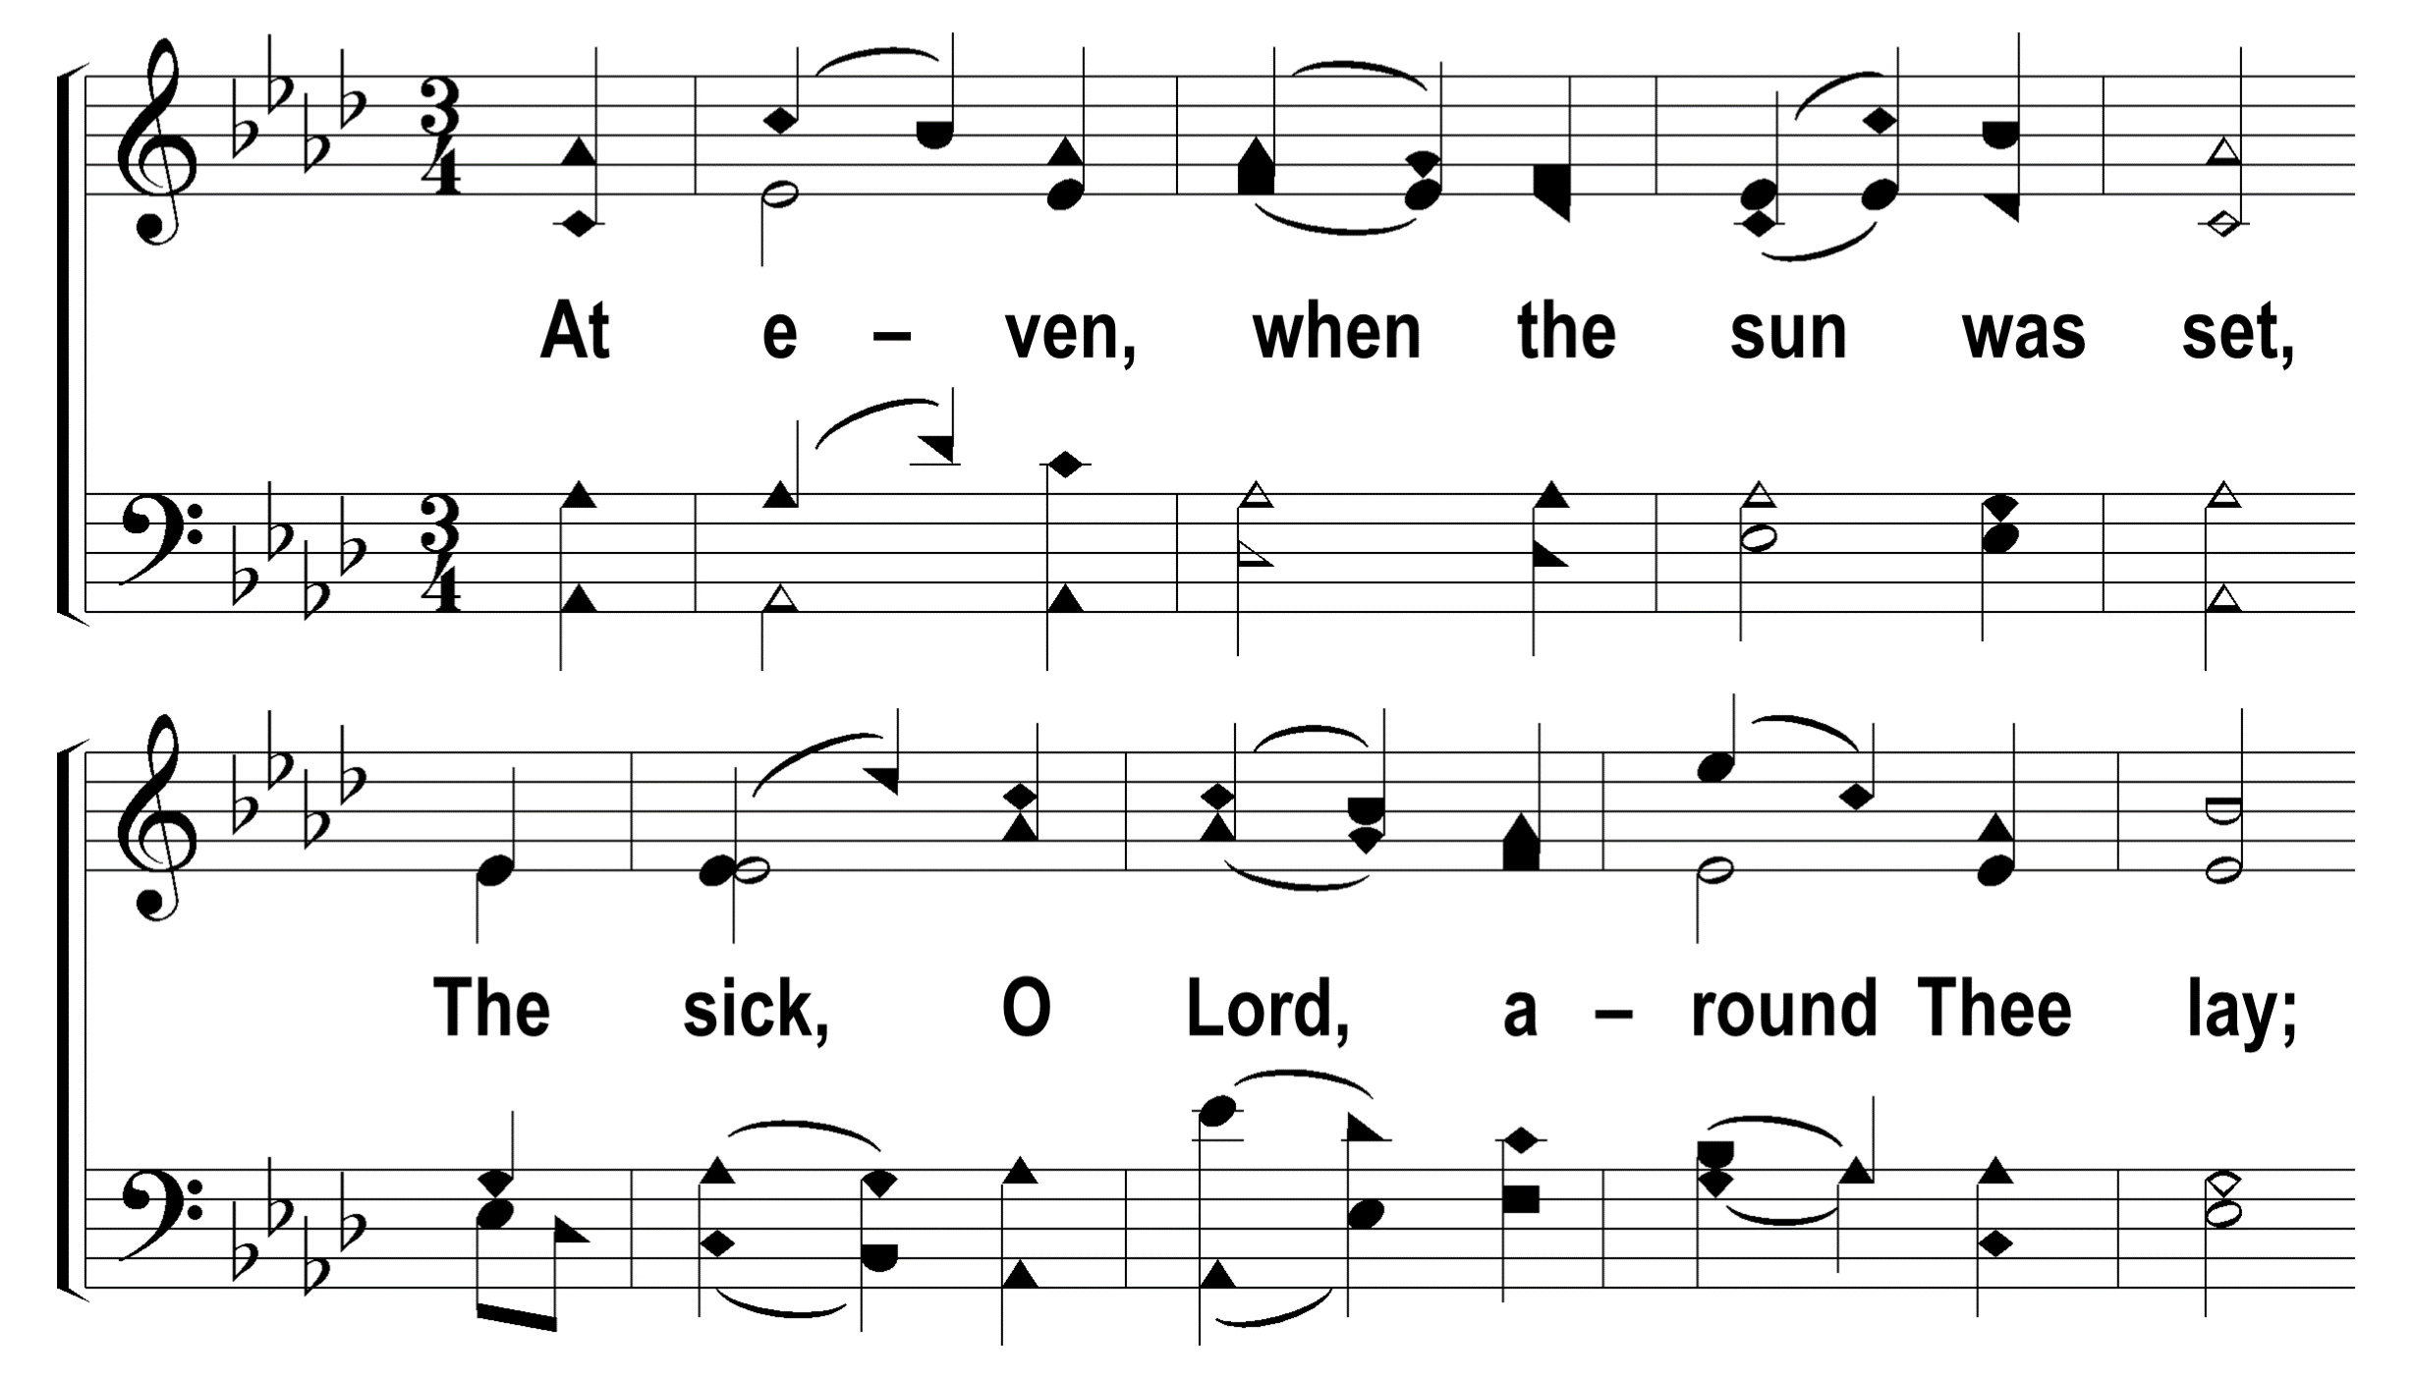

1
2
3
4
5
6
7
8
56
AT EVEN, WHEN THE SUN WAS SET
© 2009 The Paperless Hymnal®

Slide 3
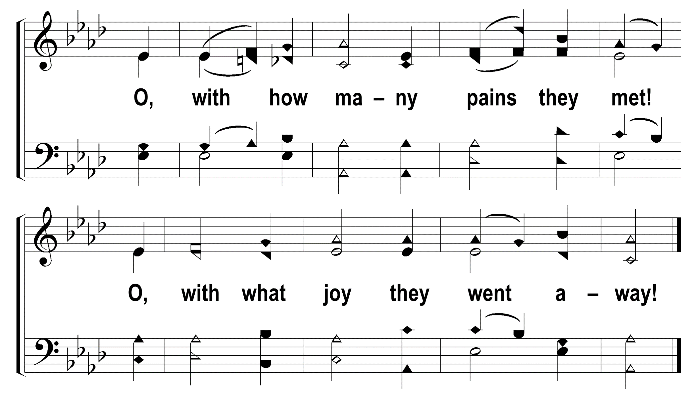
1
2
3
4
5
6
7
8
56
AT EVEN, WHEN THE SUN WAS SET
© 2009 The Paperless Hymnal®

Slide 4
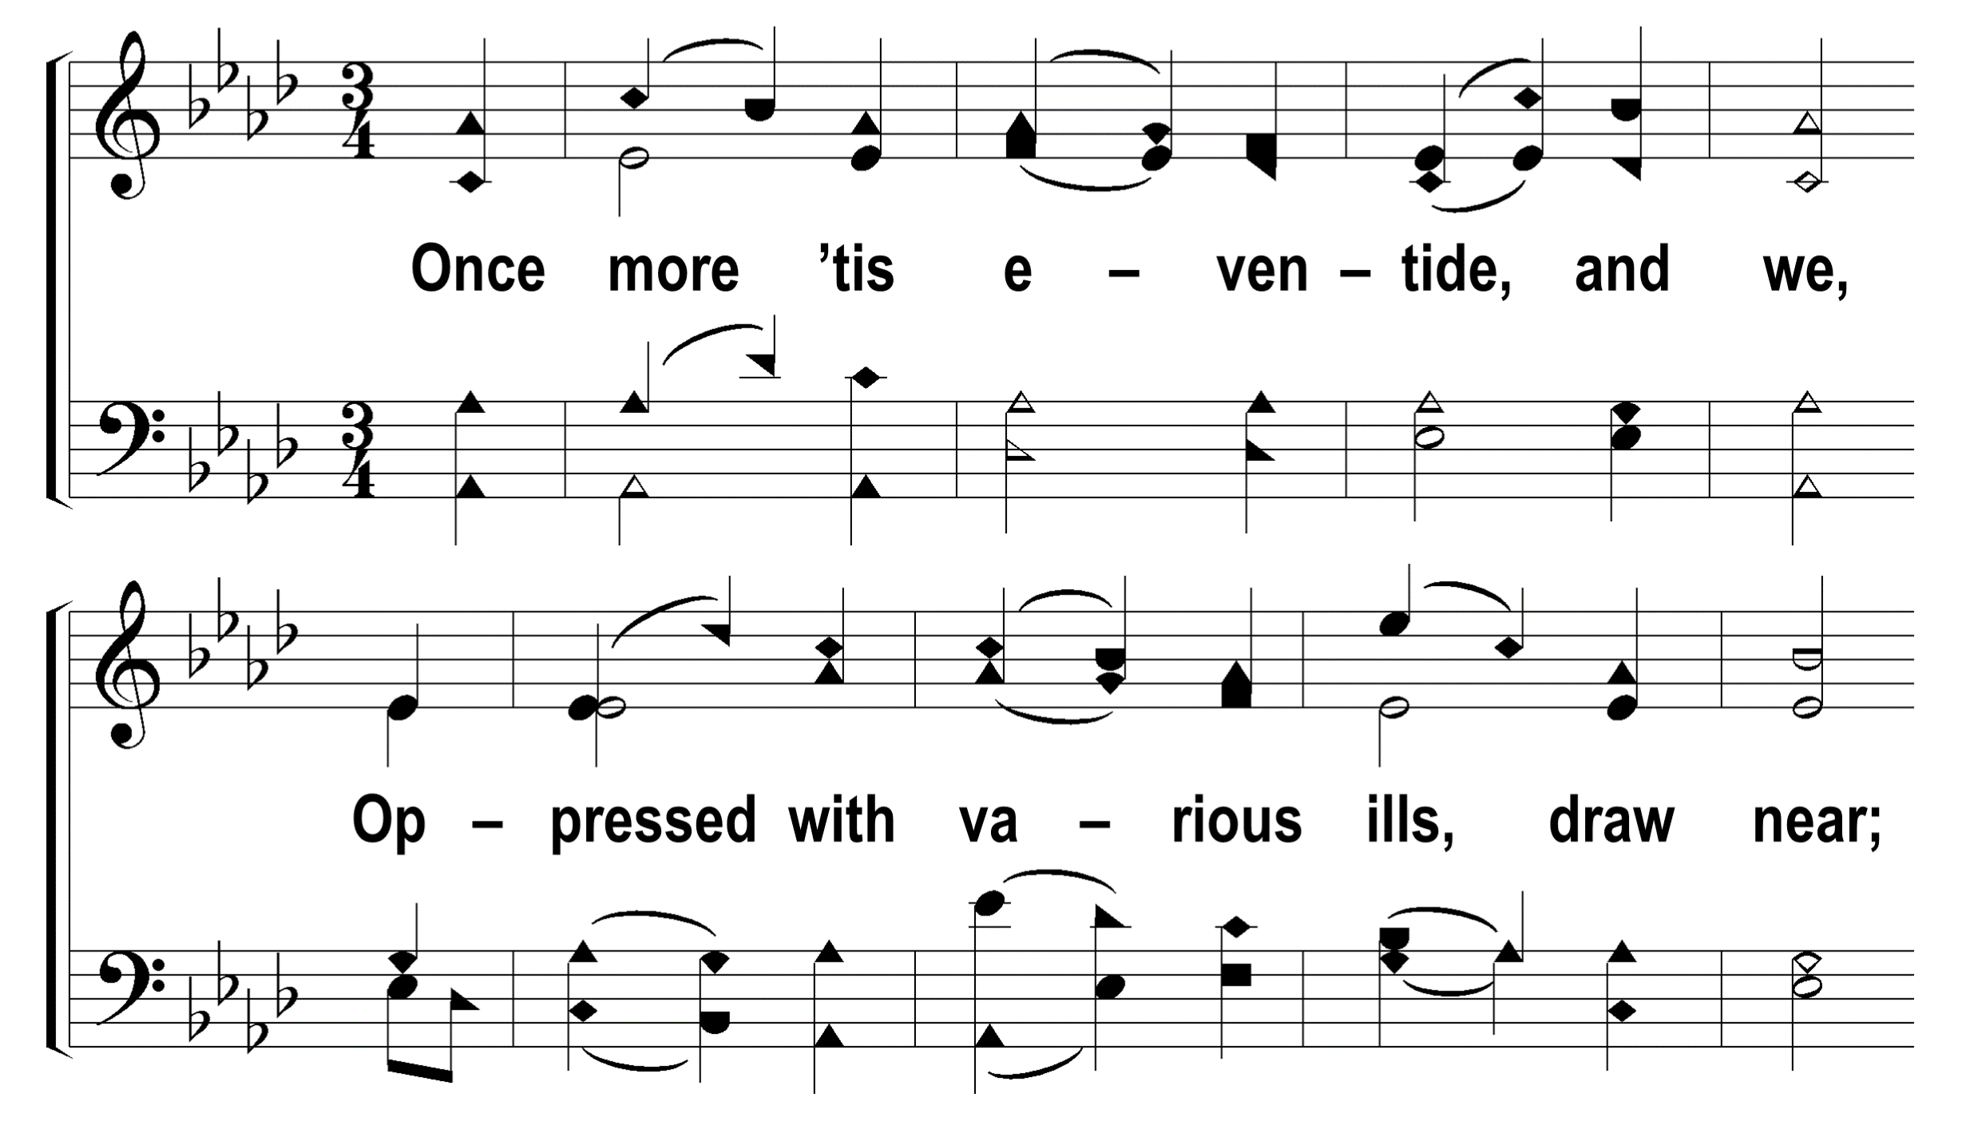
1
2
3
4
5
6
7
8
56
AT EVEN, WHEN THE SUN WAS SET
© 2009 The Paperless Hymnal®

Slide 5
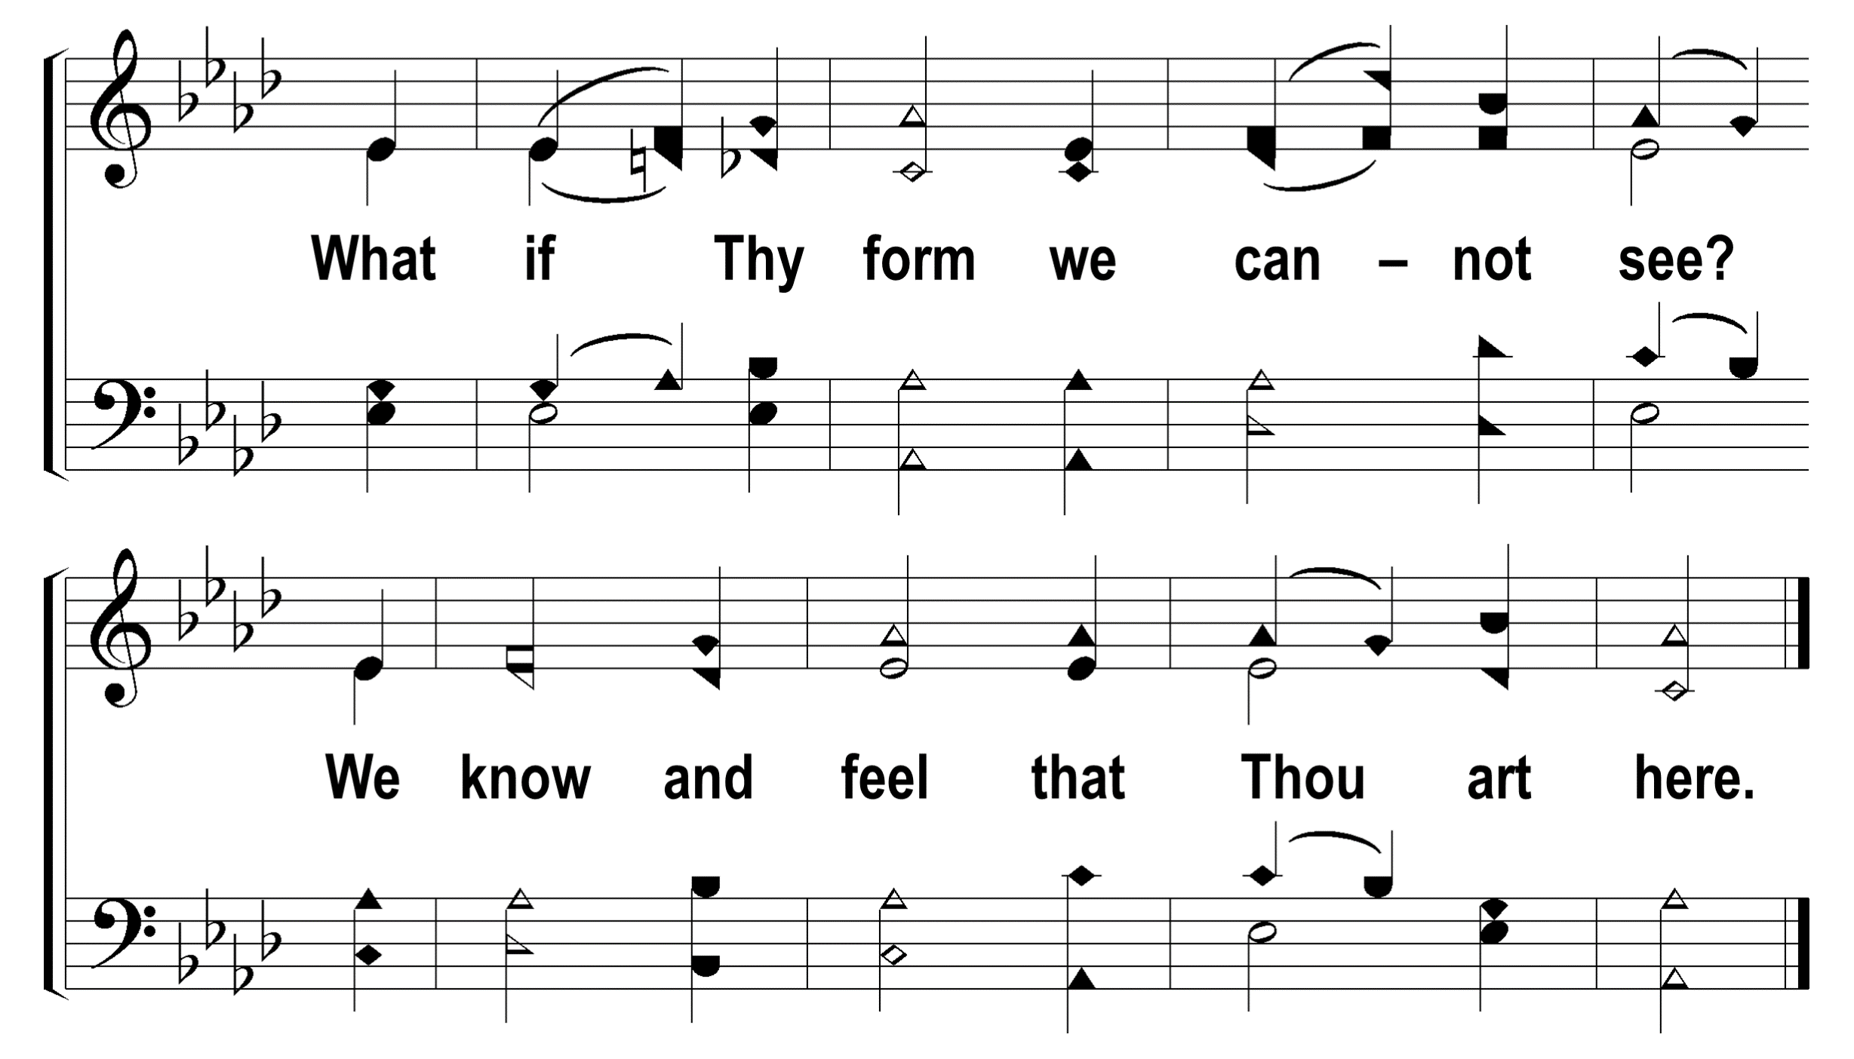
1
2
3
4
5
6
7
8
56
AT EVEN, WHEN THE SUN WAS SET
© 2009 The Paperless Hymnal®

Slide 6
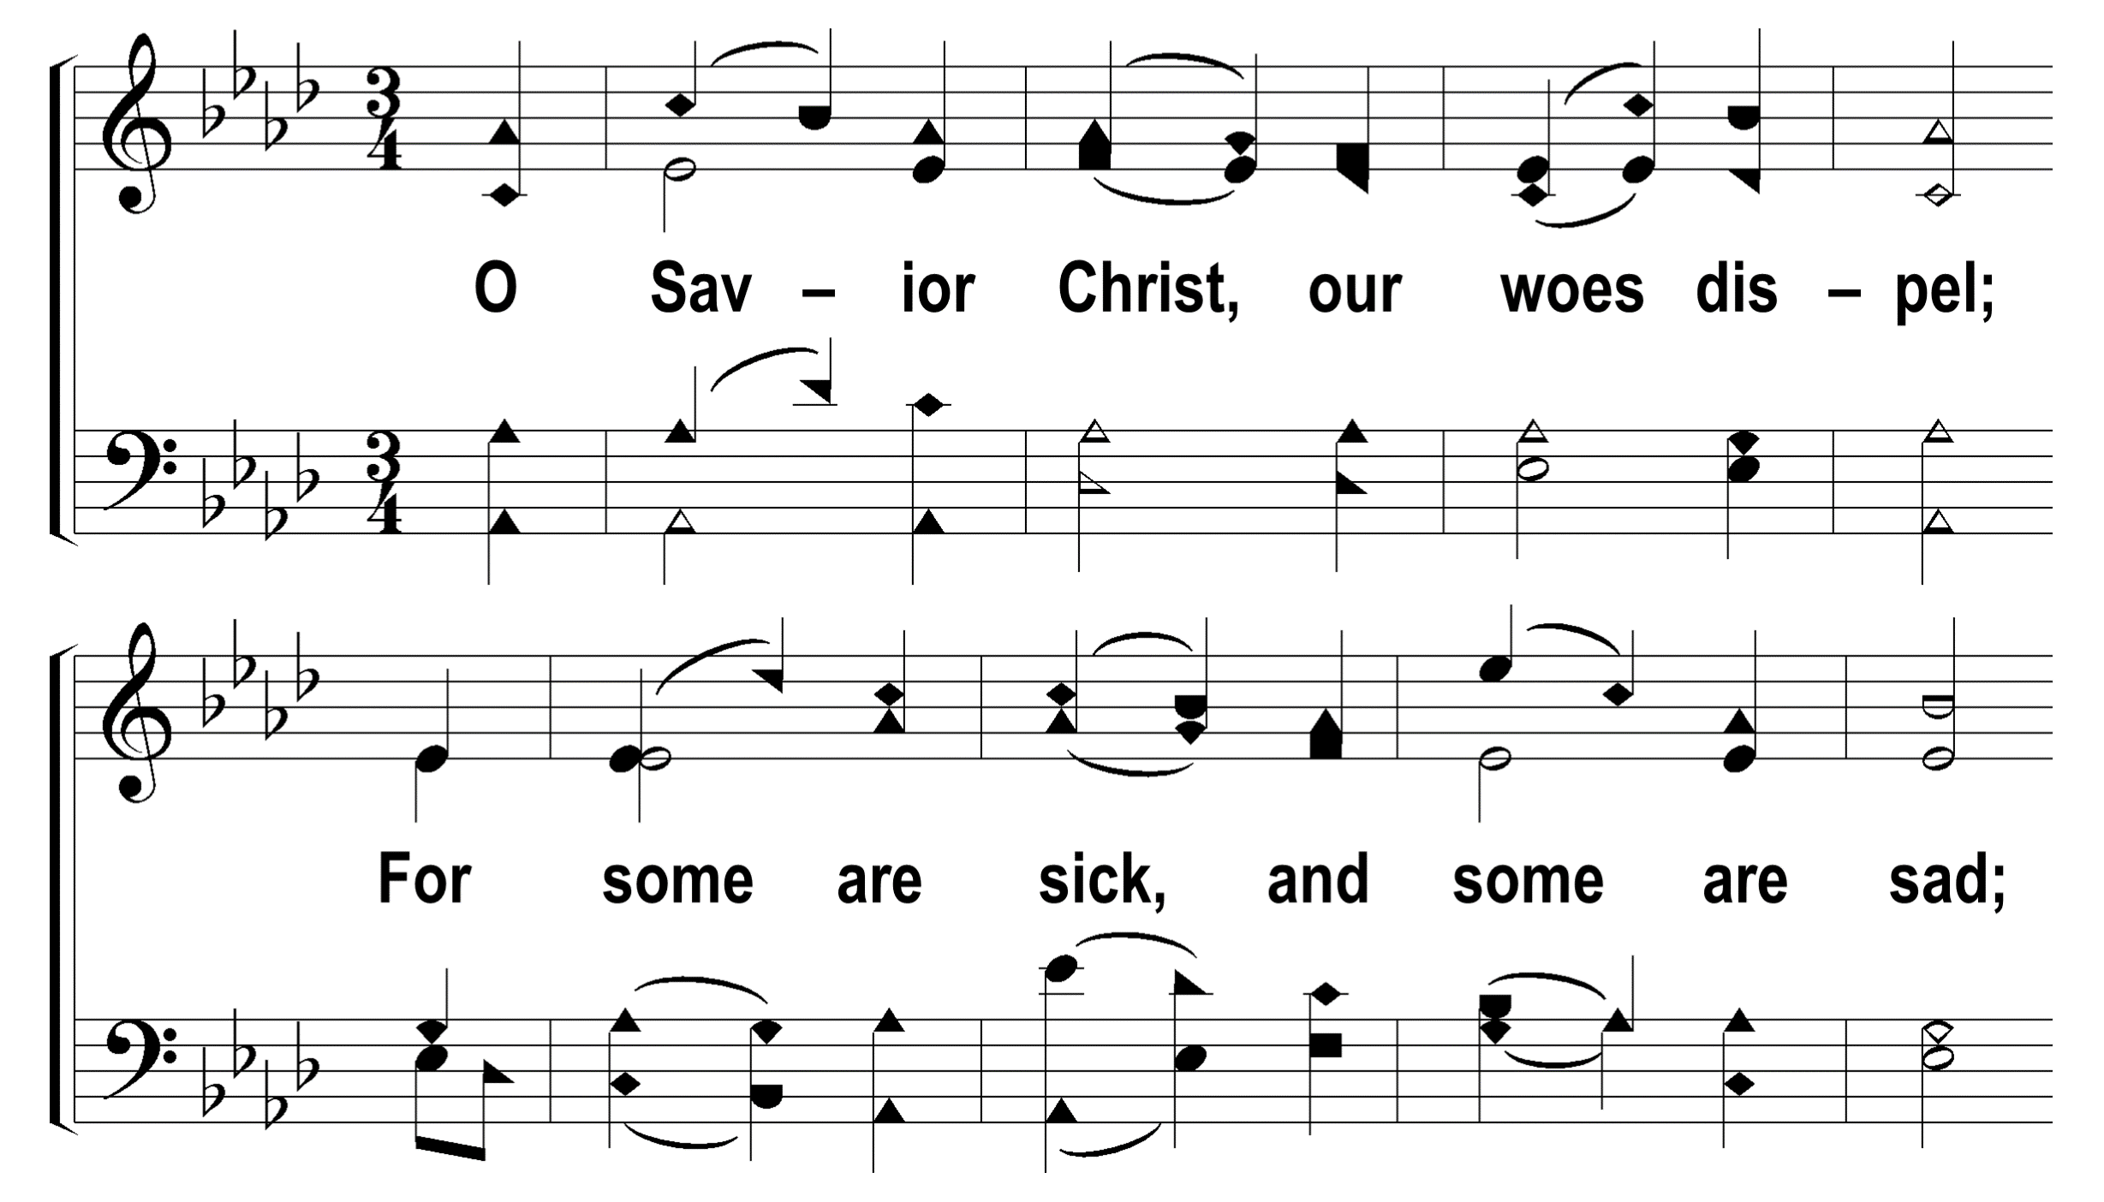
1
2
3
4
5
6
7
8
56
AT EVEN, WHEN THE SUN WAS SET
© 2009 The Paperless Hymnal®

Slide 7
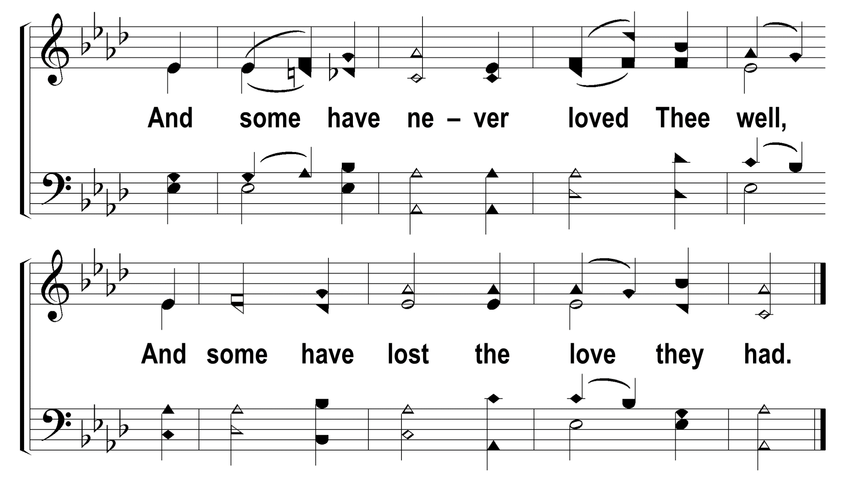
1
2
3
4
5
6
7
8
56
AT EVEN, WHEN THE SUN WAS SET
© 2009 The Paperless Hymnal®

Slide 8
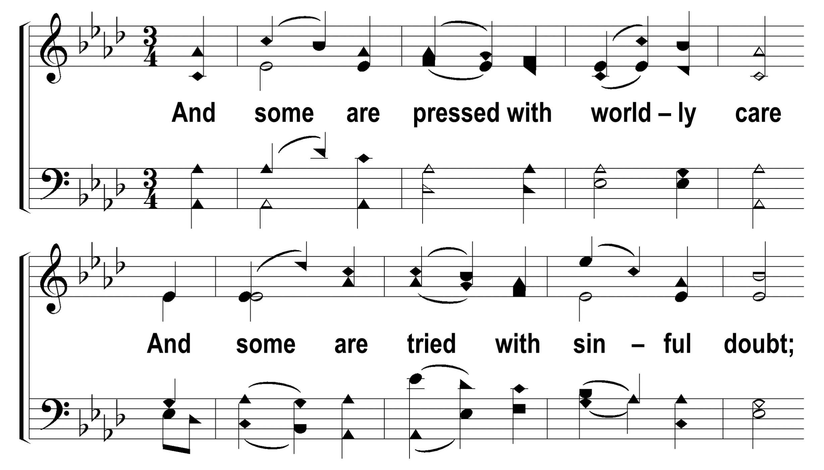
1
2
3
4
5
6
7
8
56
AT EVEN, WHEN THE SUN WAS SET
© 2009 The Paperless Hymnal®

Slide 9
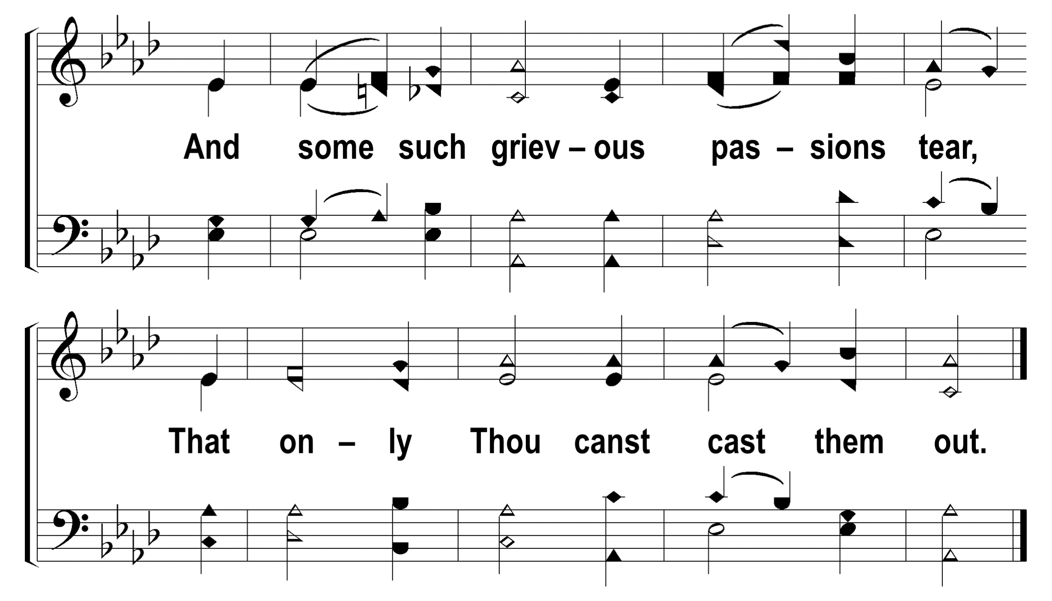
1
2
3
4
5
6
7
8
56
AT EVEN, WHEN THE SUN WAS SET
© 2009 The Paperless Hymnal®

Slide 10
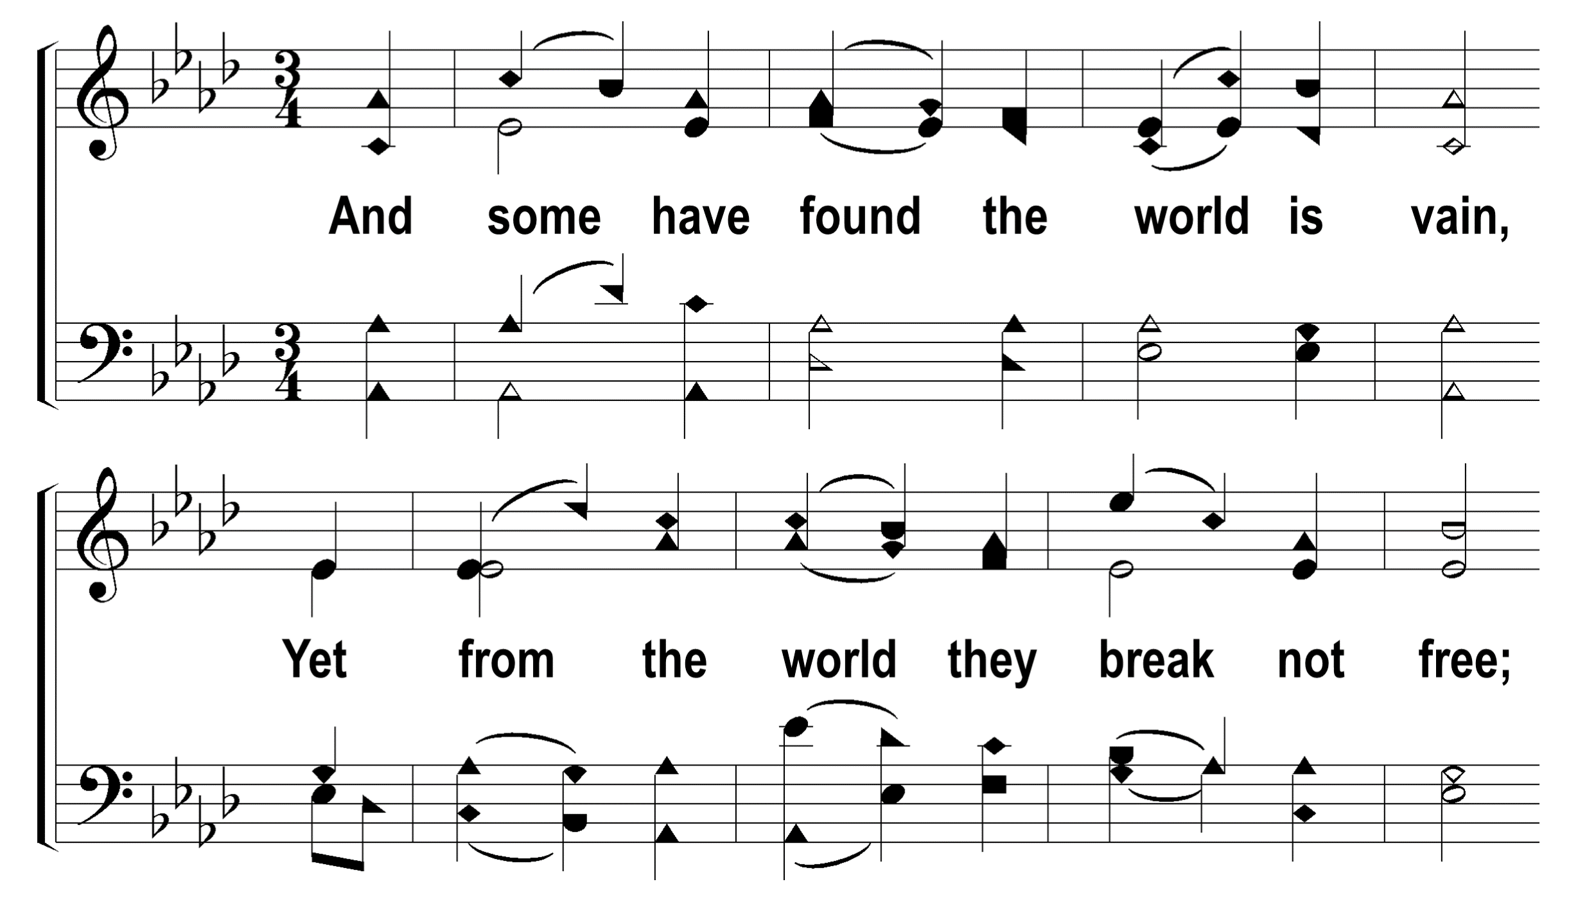
1
2
3
4
5
6
7
8
56
AT EVEN, WHEN THE SUN WAS SET
© 2009 The Paperless Hymnal®

Slide 11
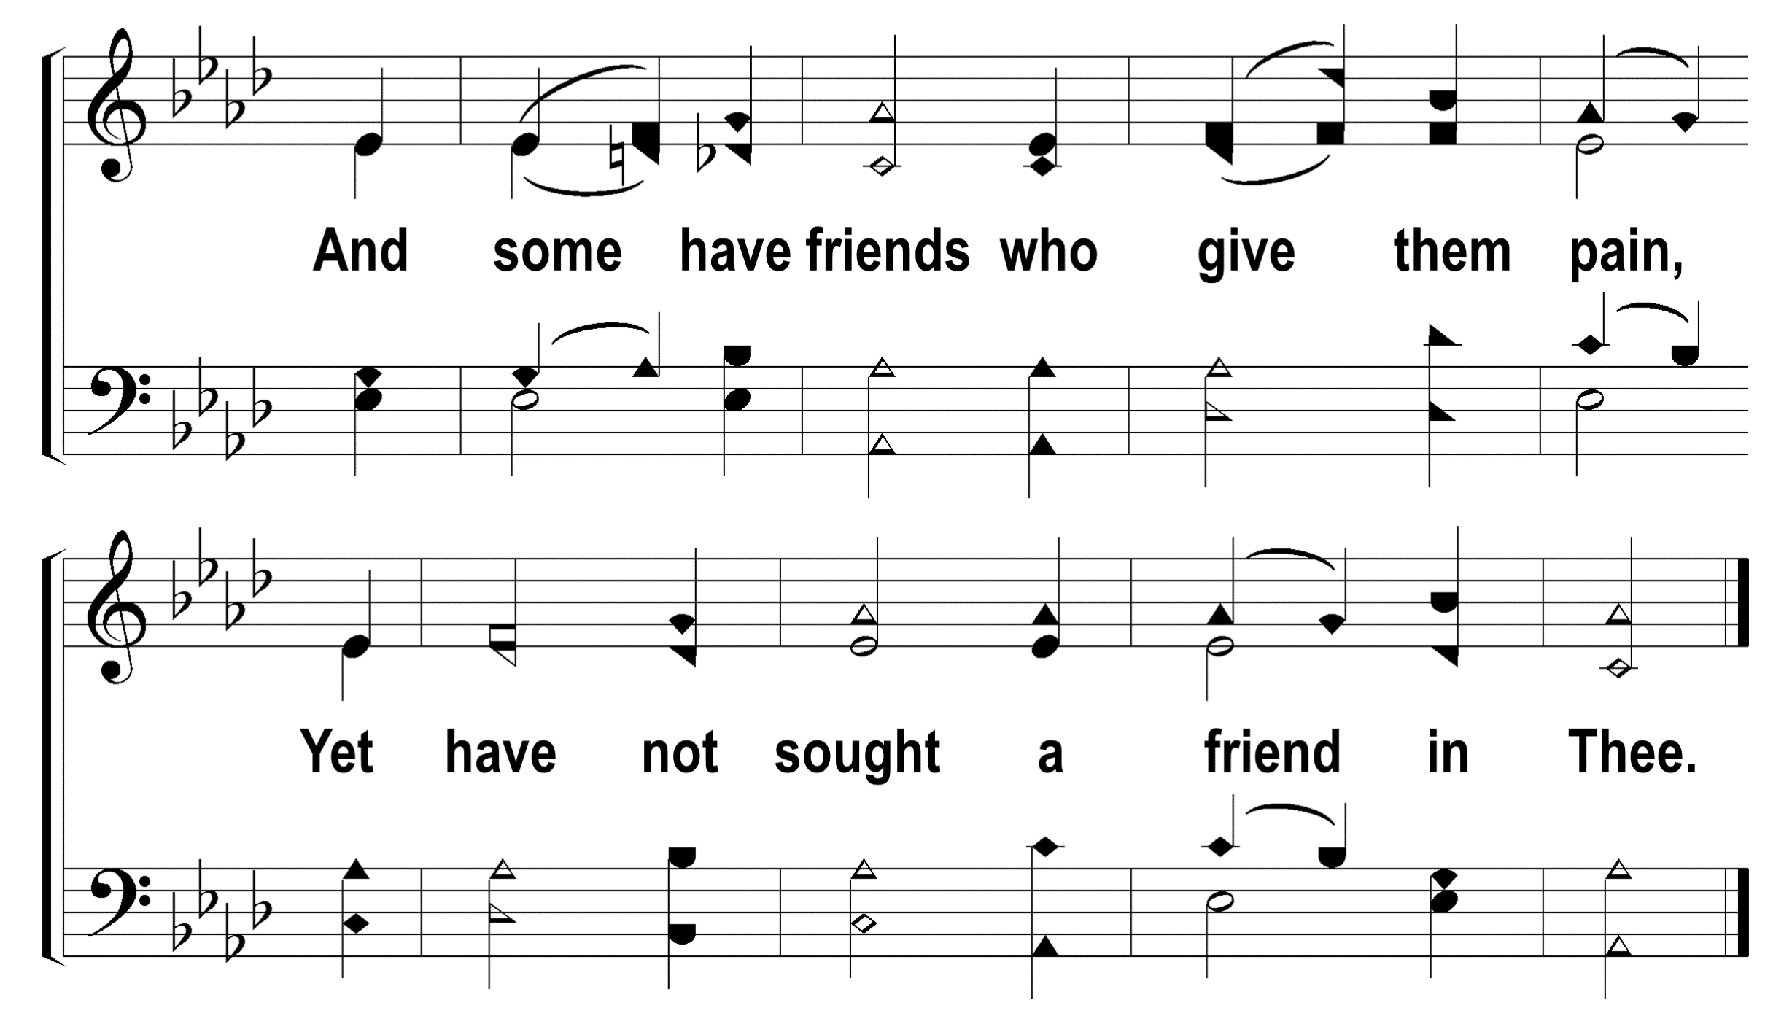
1
2
3
4
5
6
7
8
56
AT EVEN, WHEN THE SUN WAS SET
© 2009 The Paperless Hymnal®

Slide 12
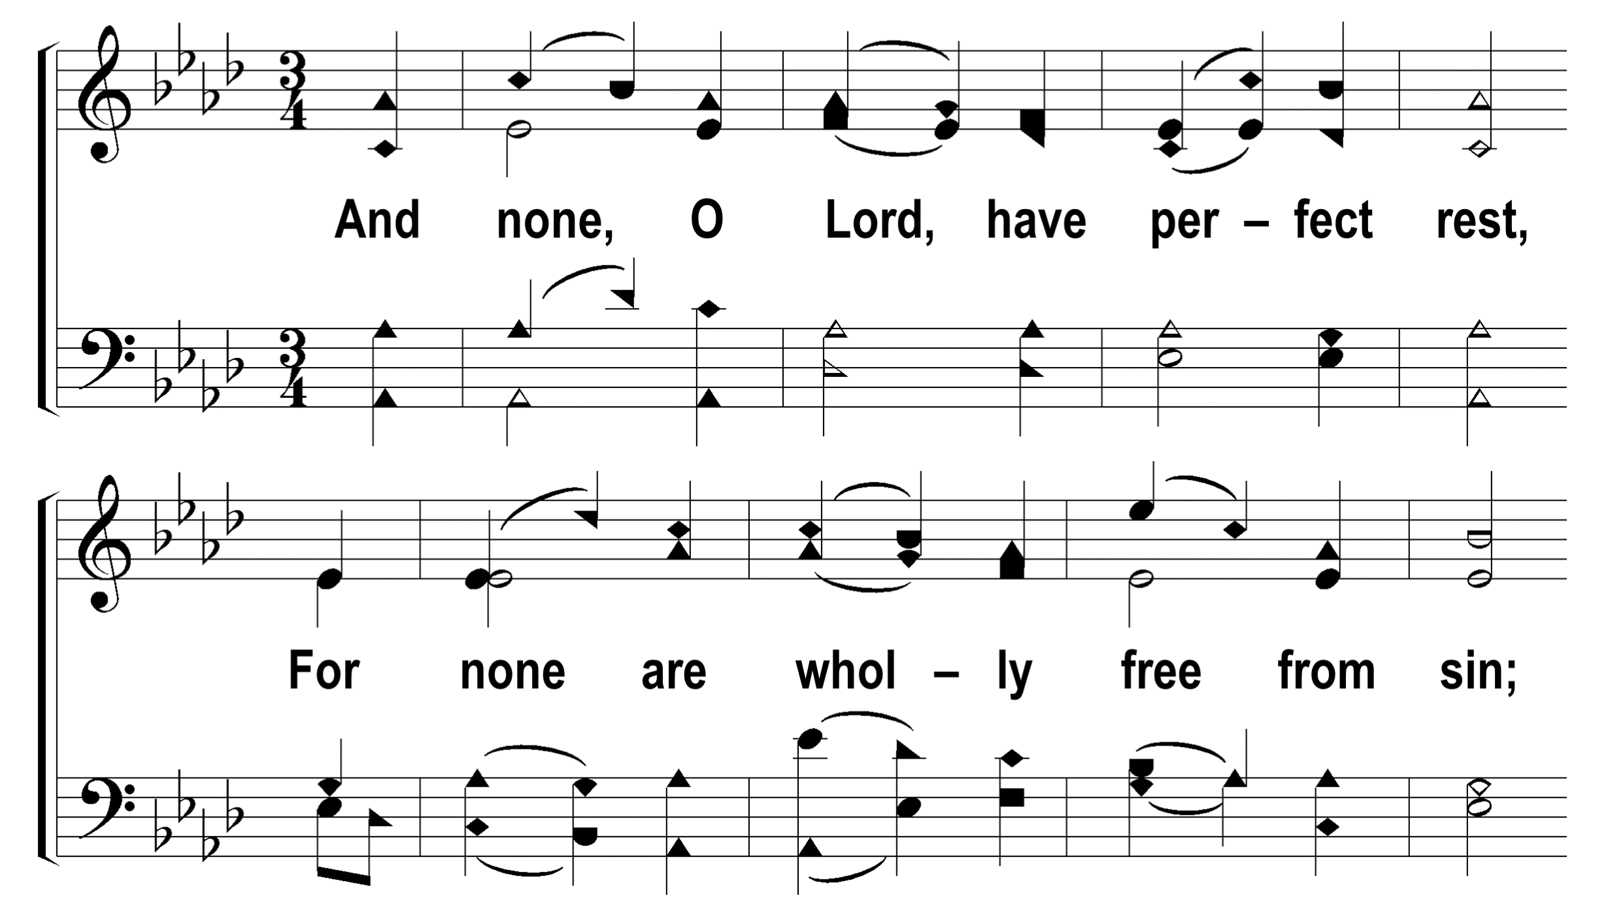
1
2
3
4
5
6
7
8
56
AT EVEN, WHEN THE SUN WAS SET
© 2009 The Paperless Hymnal®

Slide 13
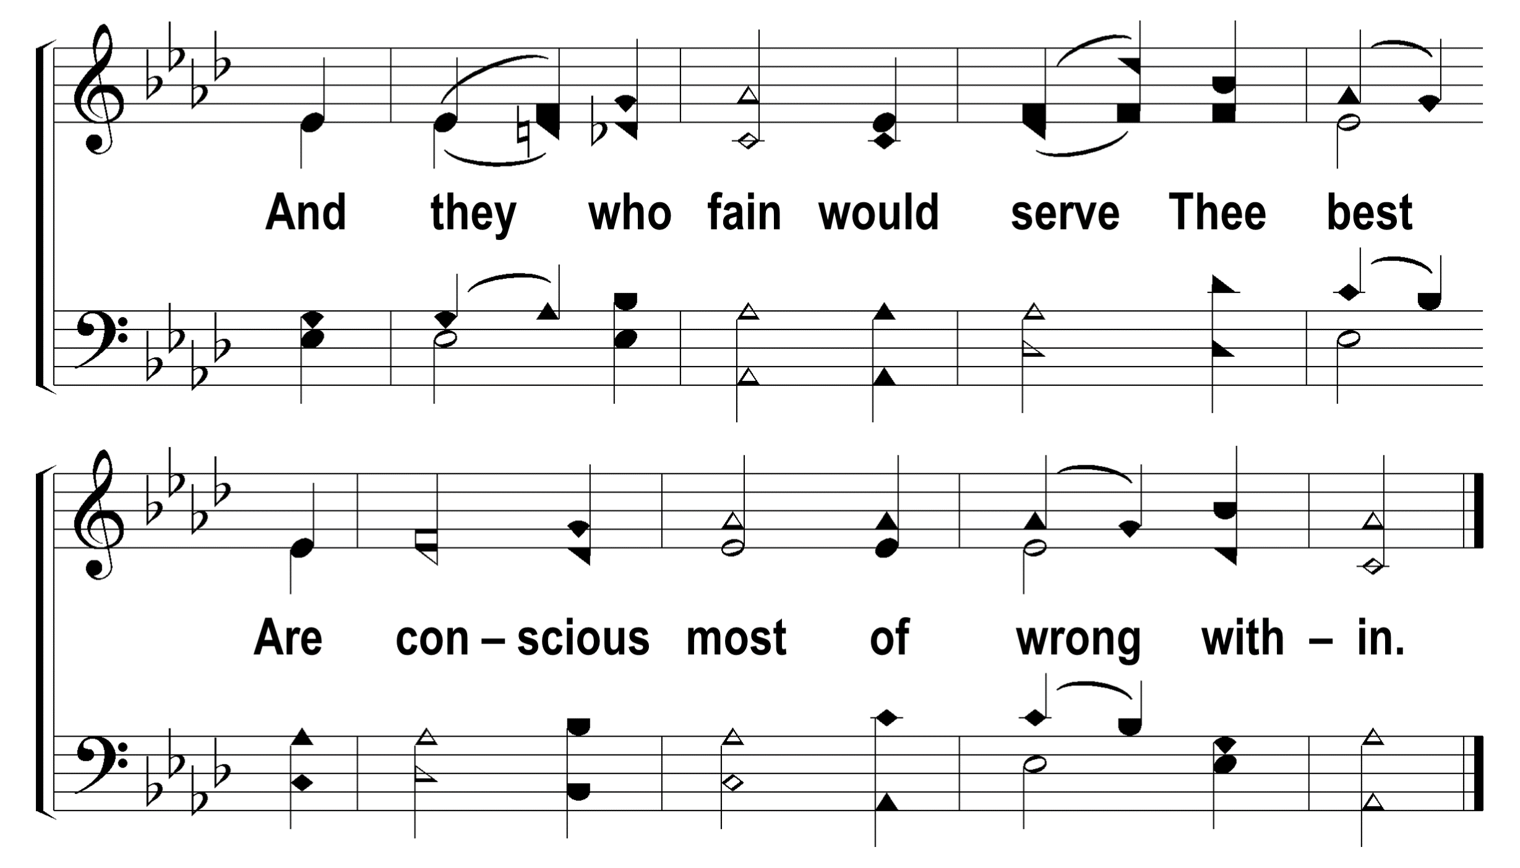
1
2
3
4
5
6
7
8
56
AT EVEN, WHEN THE SUN WAS SET
© 2009 The Paperless Hymnal®

Slide 14
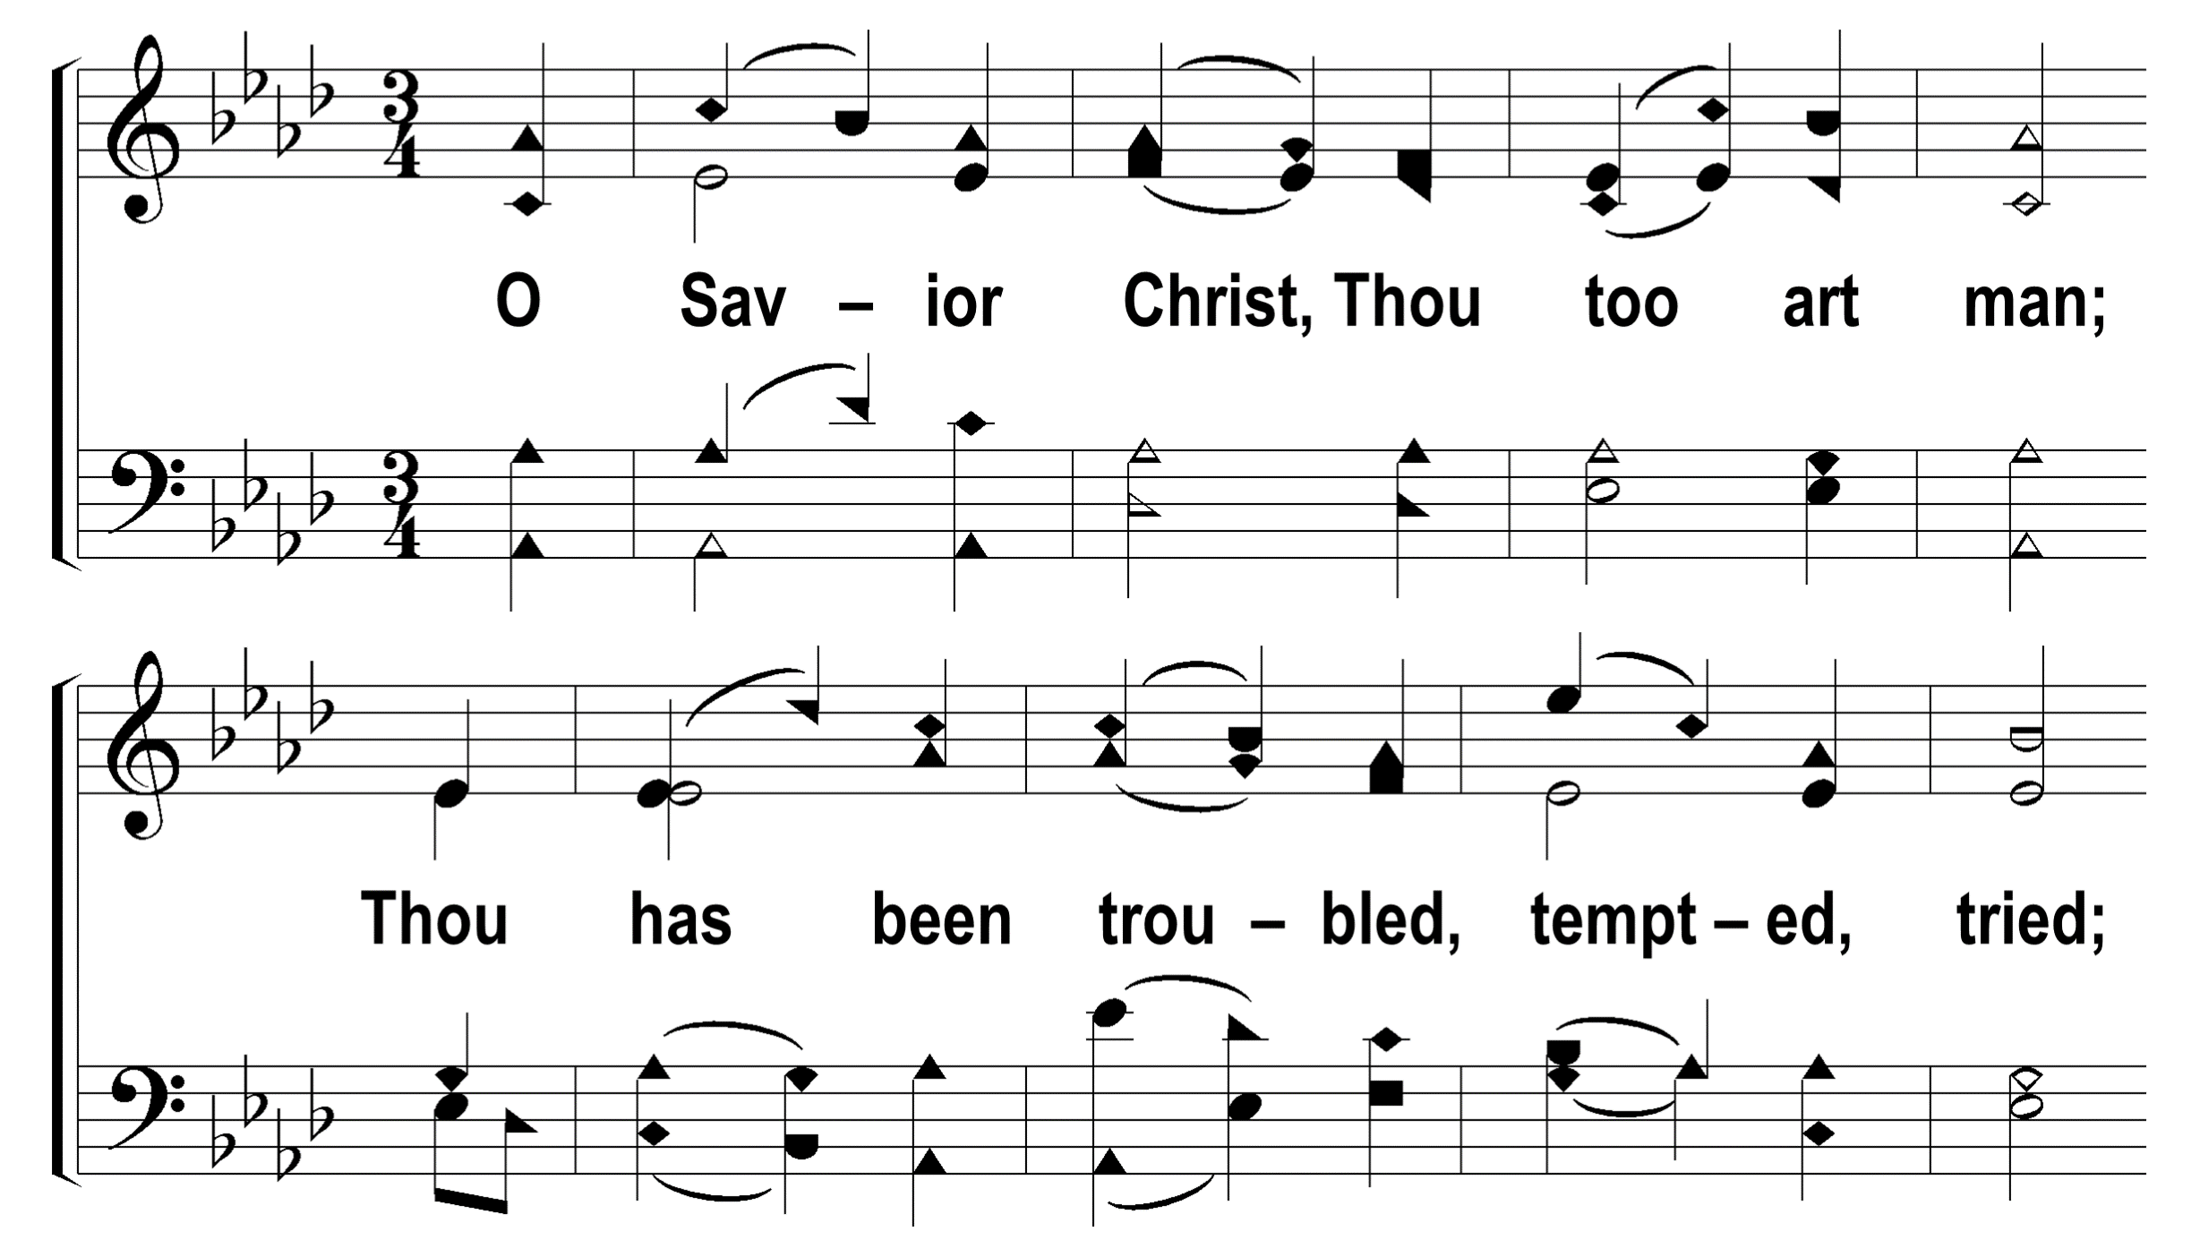
1
2
3
4
5
6
7
8
56
AT EVEN, WHEN THE SUN WAS SET
© 2009 The Paperless Hymnal®

Slide 15
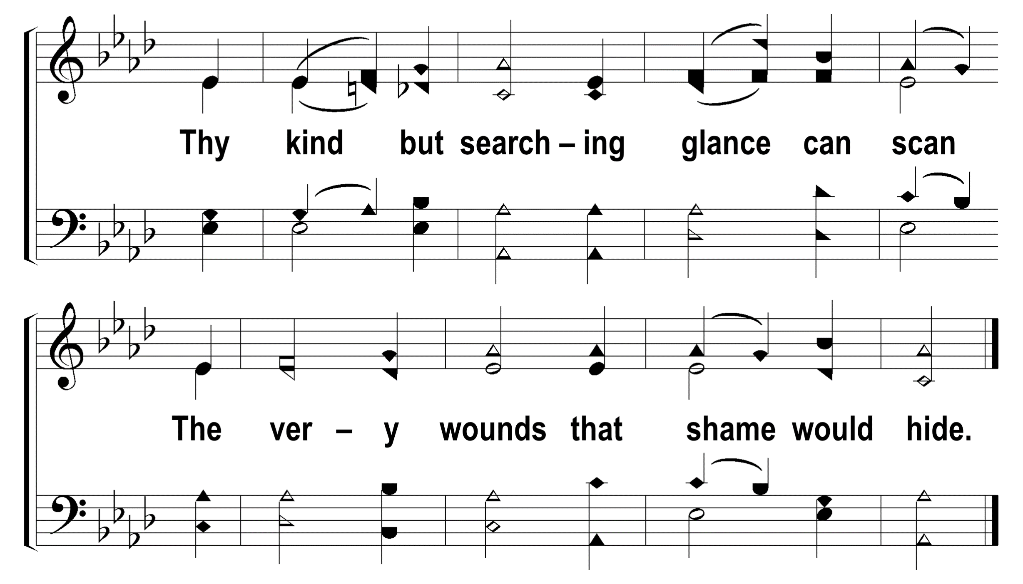
1
2
3
4
5
6
7
8
56
AT EVEN, WHEN THE SUN WAS SET
© 2009 The Paperless Hymnal®

Slide 16
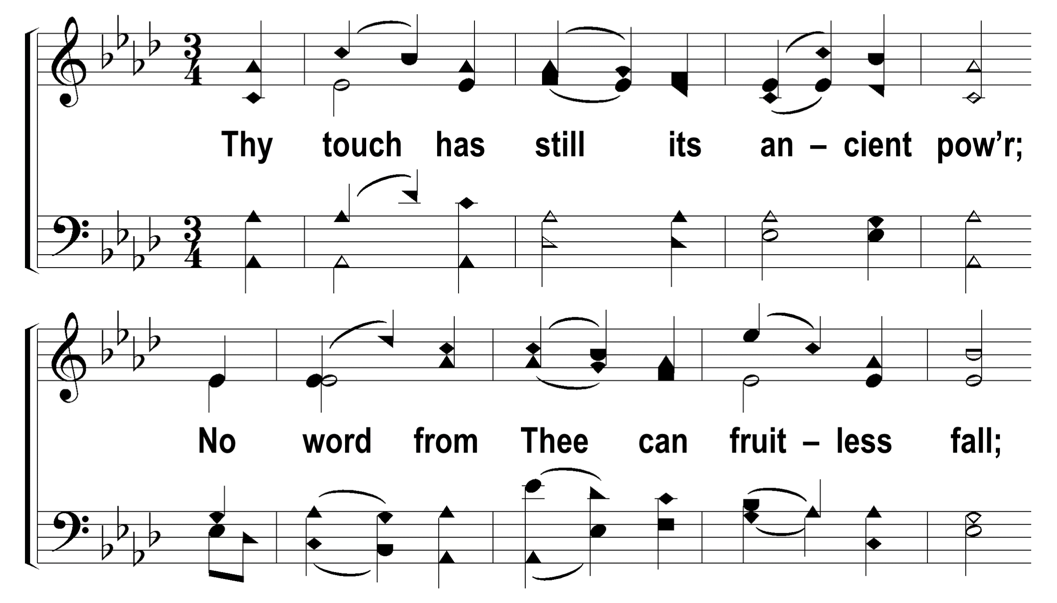
1
2
3
4
5
6
7
8
56
AT EVEN, WHEN THE SUN WAS SET
© 2009 The Paperless Hymnal®

Slide 17
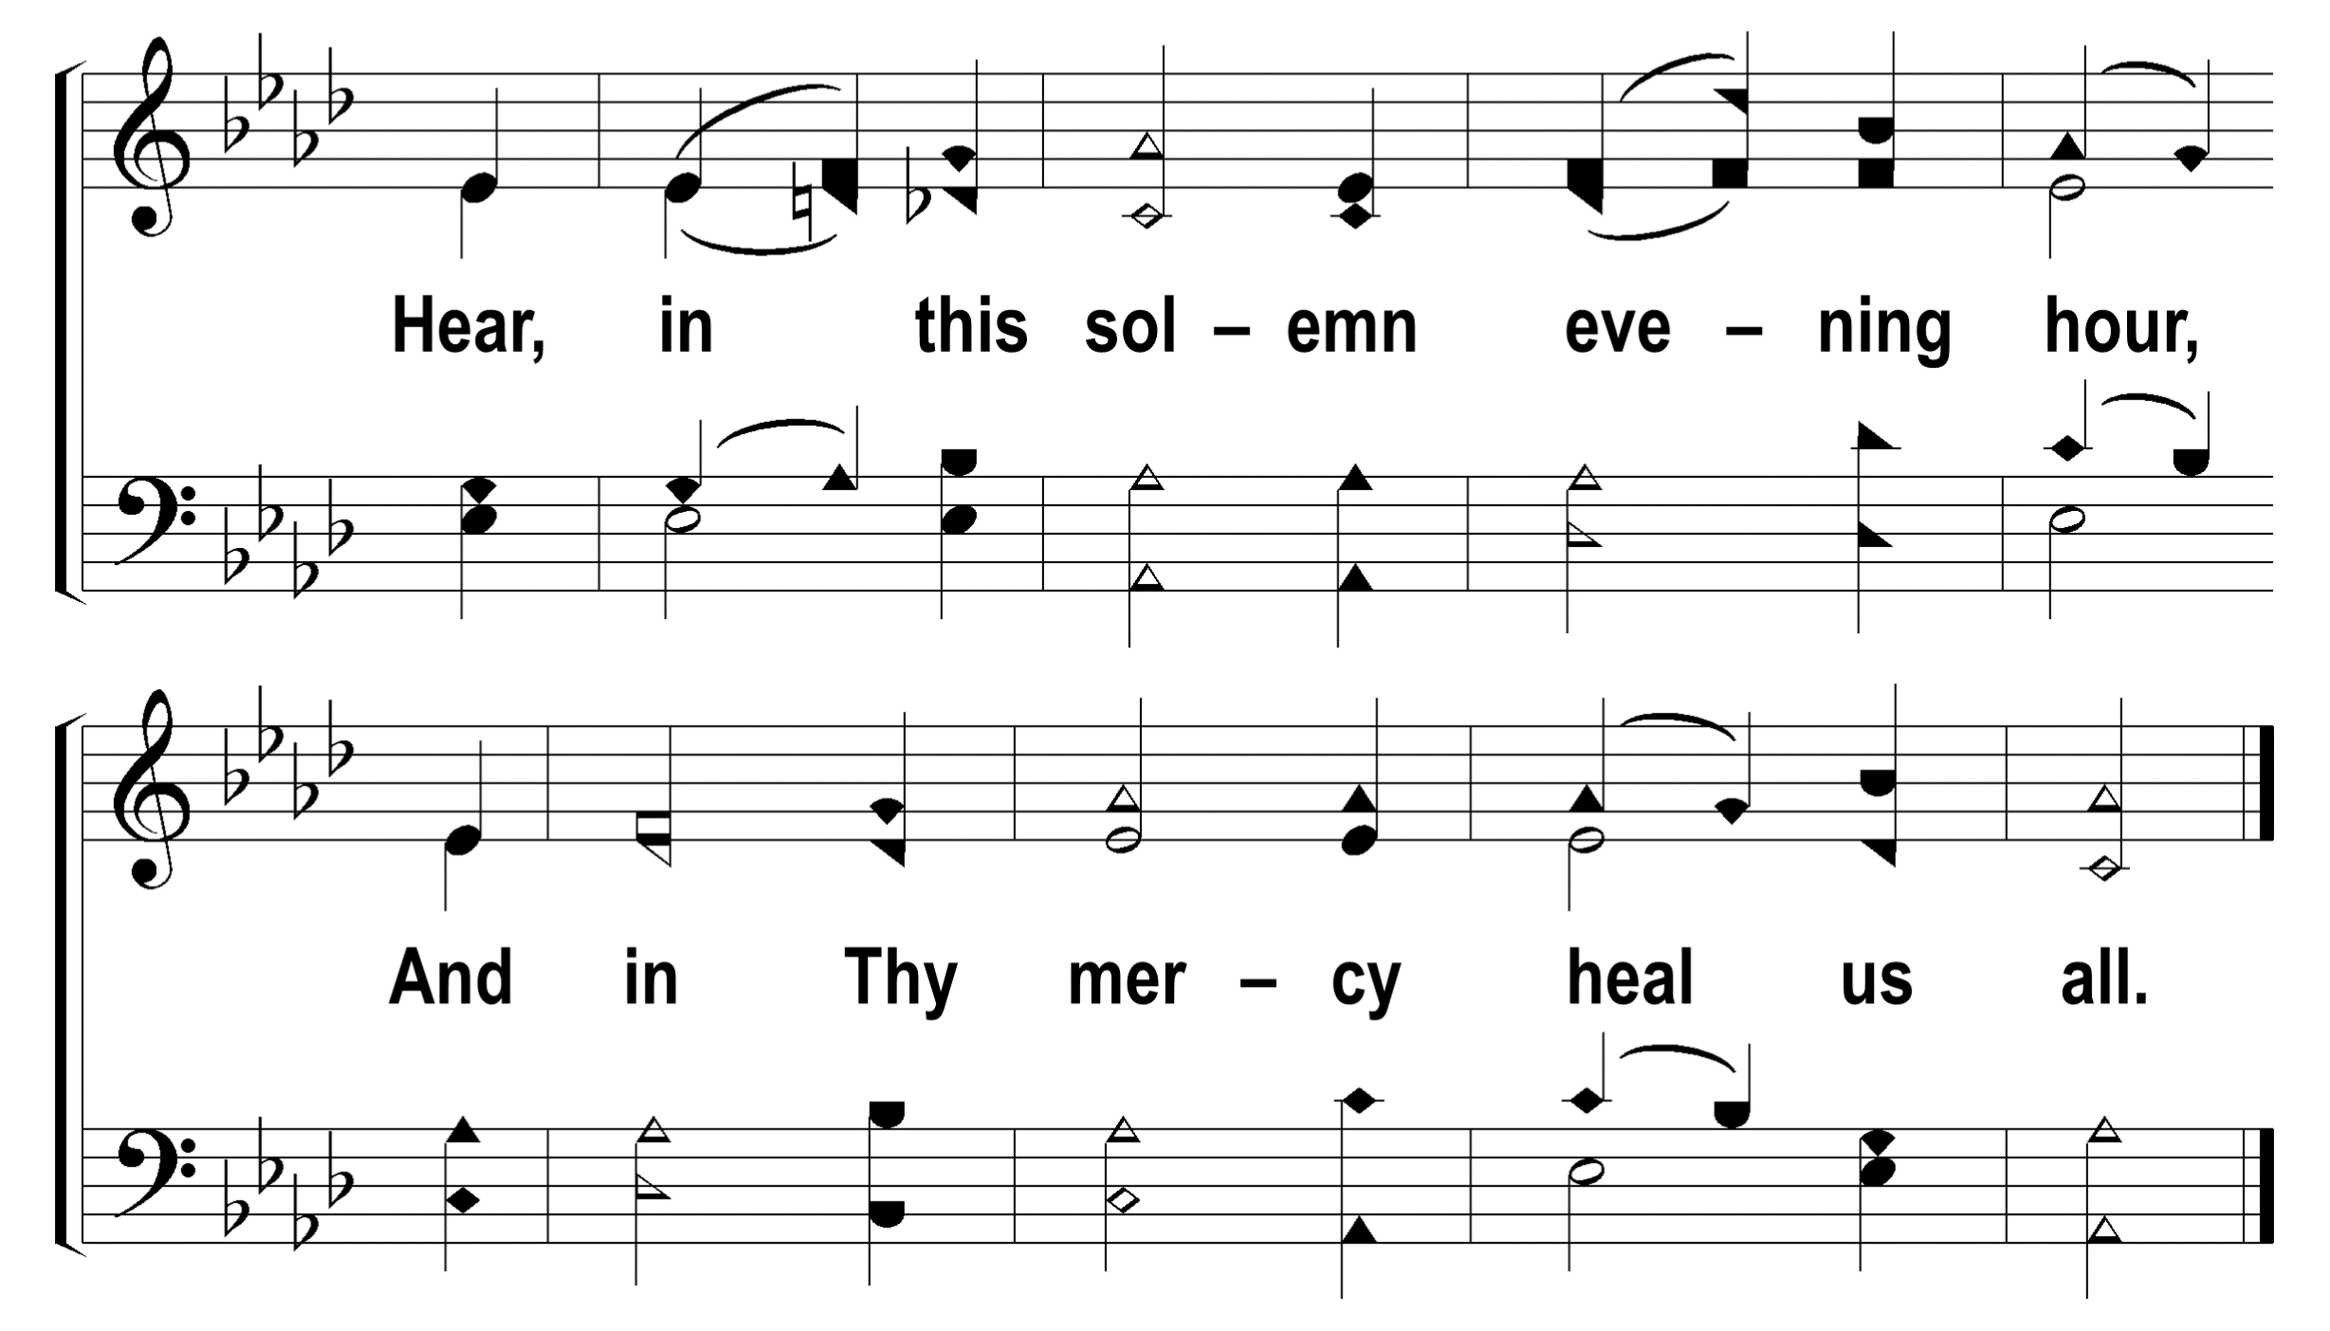
1
2
3
4
5
6
7
8
56
AT EVEN, WHEN THE SUN WAS SET
© 2009 The Paperless Hymnal®

