Slide 1
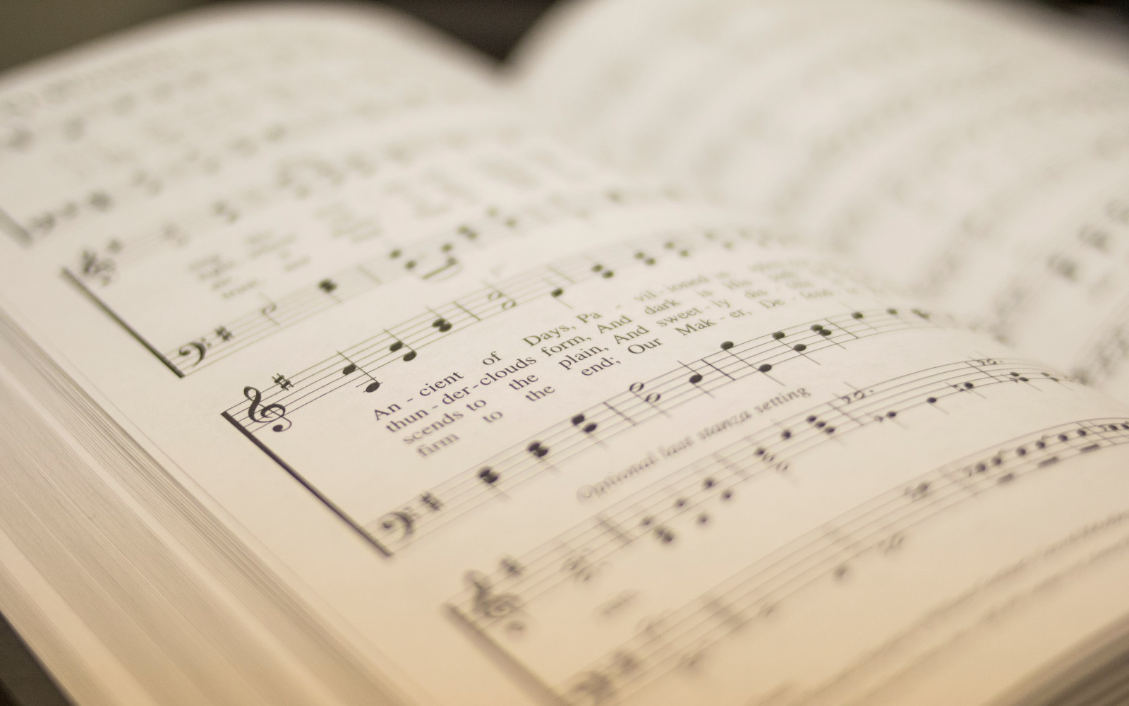

106
LET EVERY TONGUE AND TRIBE AND LAND
1
2
3
“SINGING...TO THE LORD” COLOSSIANS 3:16
Words: S. E. Rouse Music: William B. Bradbury SWEET HOUR

Slide 2
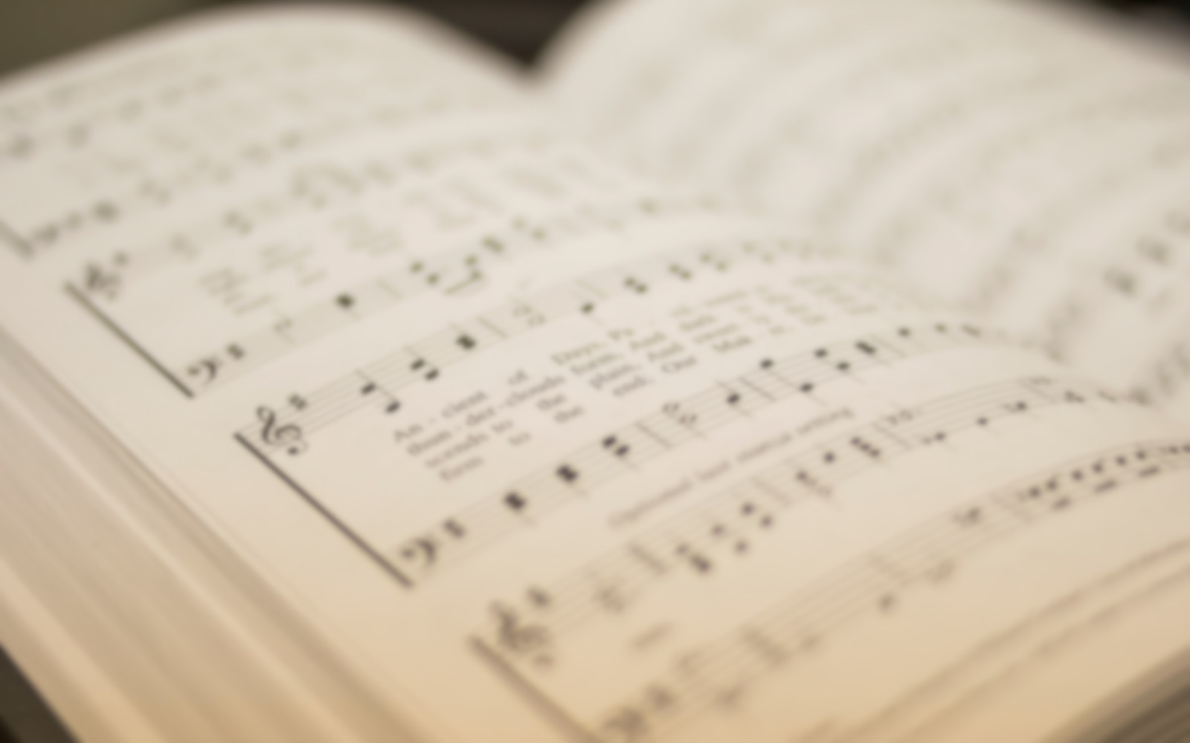
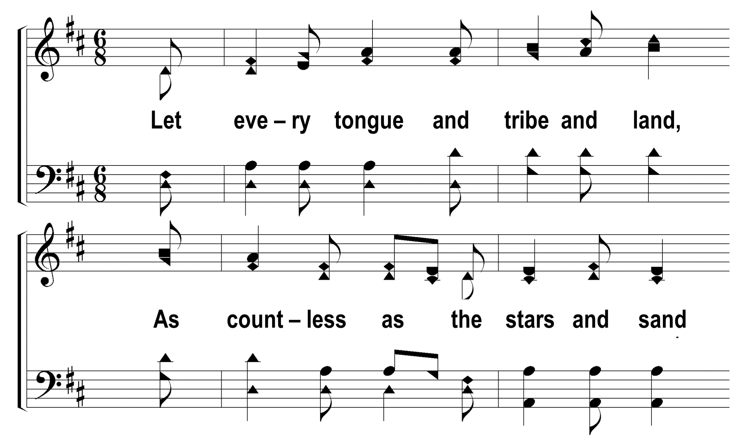

1
C
2
C
3
C
106
LET EVERY TONGUE AND TRIBE AND LAND
© 2014 S. E. Rouse

Slide 3
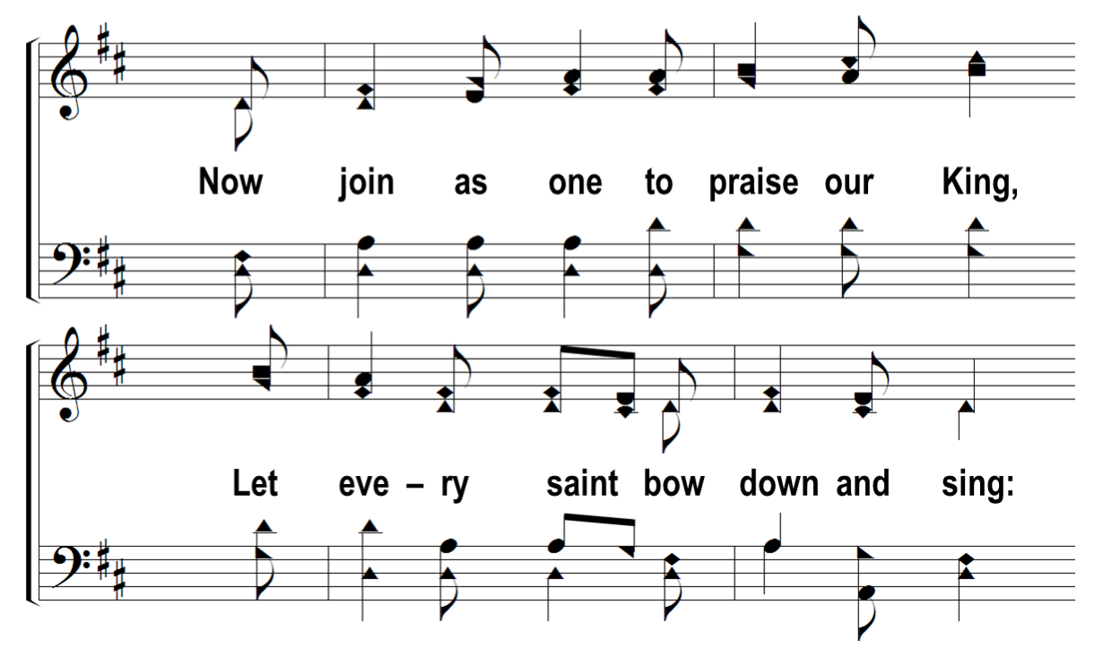
1
C
2
C
3
C
106
LET EVERY TONGUE AND TRIBE AND LAND
© 2014 S. E. Rouse

Slide 4
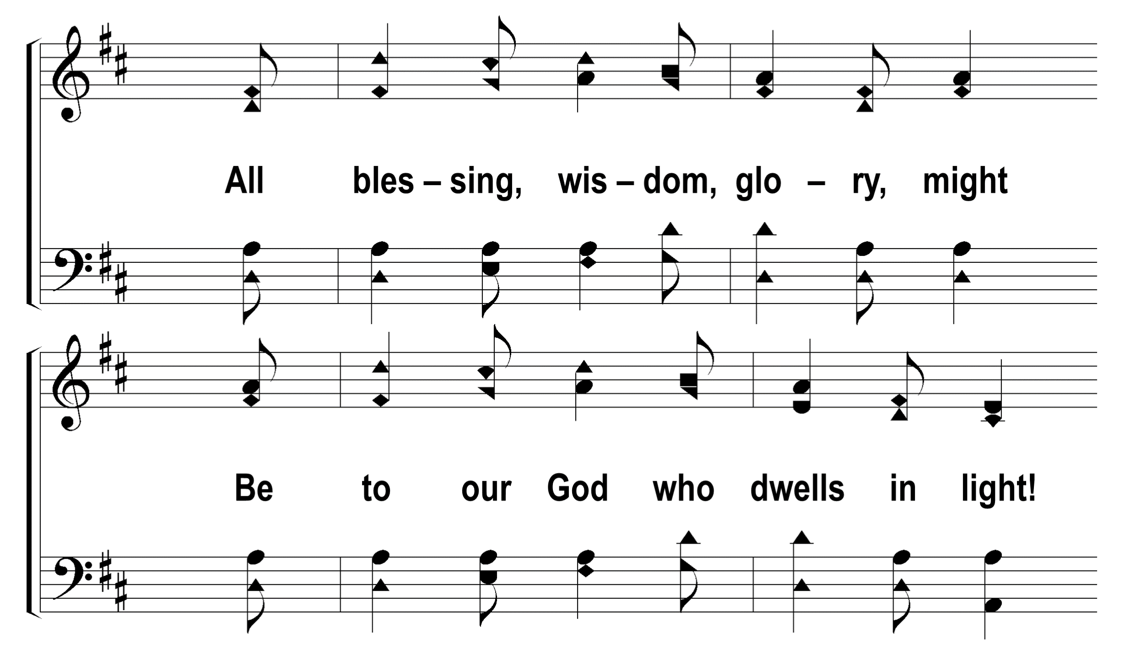
1
C
2
C
3
C
106
LET EVERY TONGUE AND TRIBE AND LAND
© 2014 S. E. Rouse

Slide 5
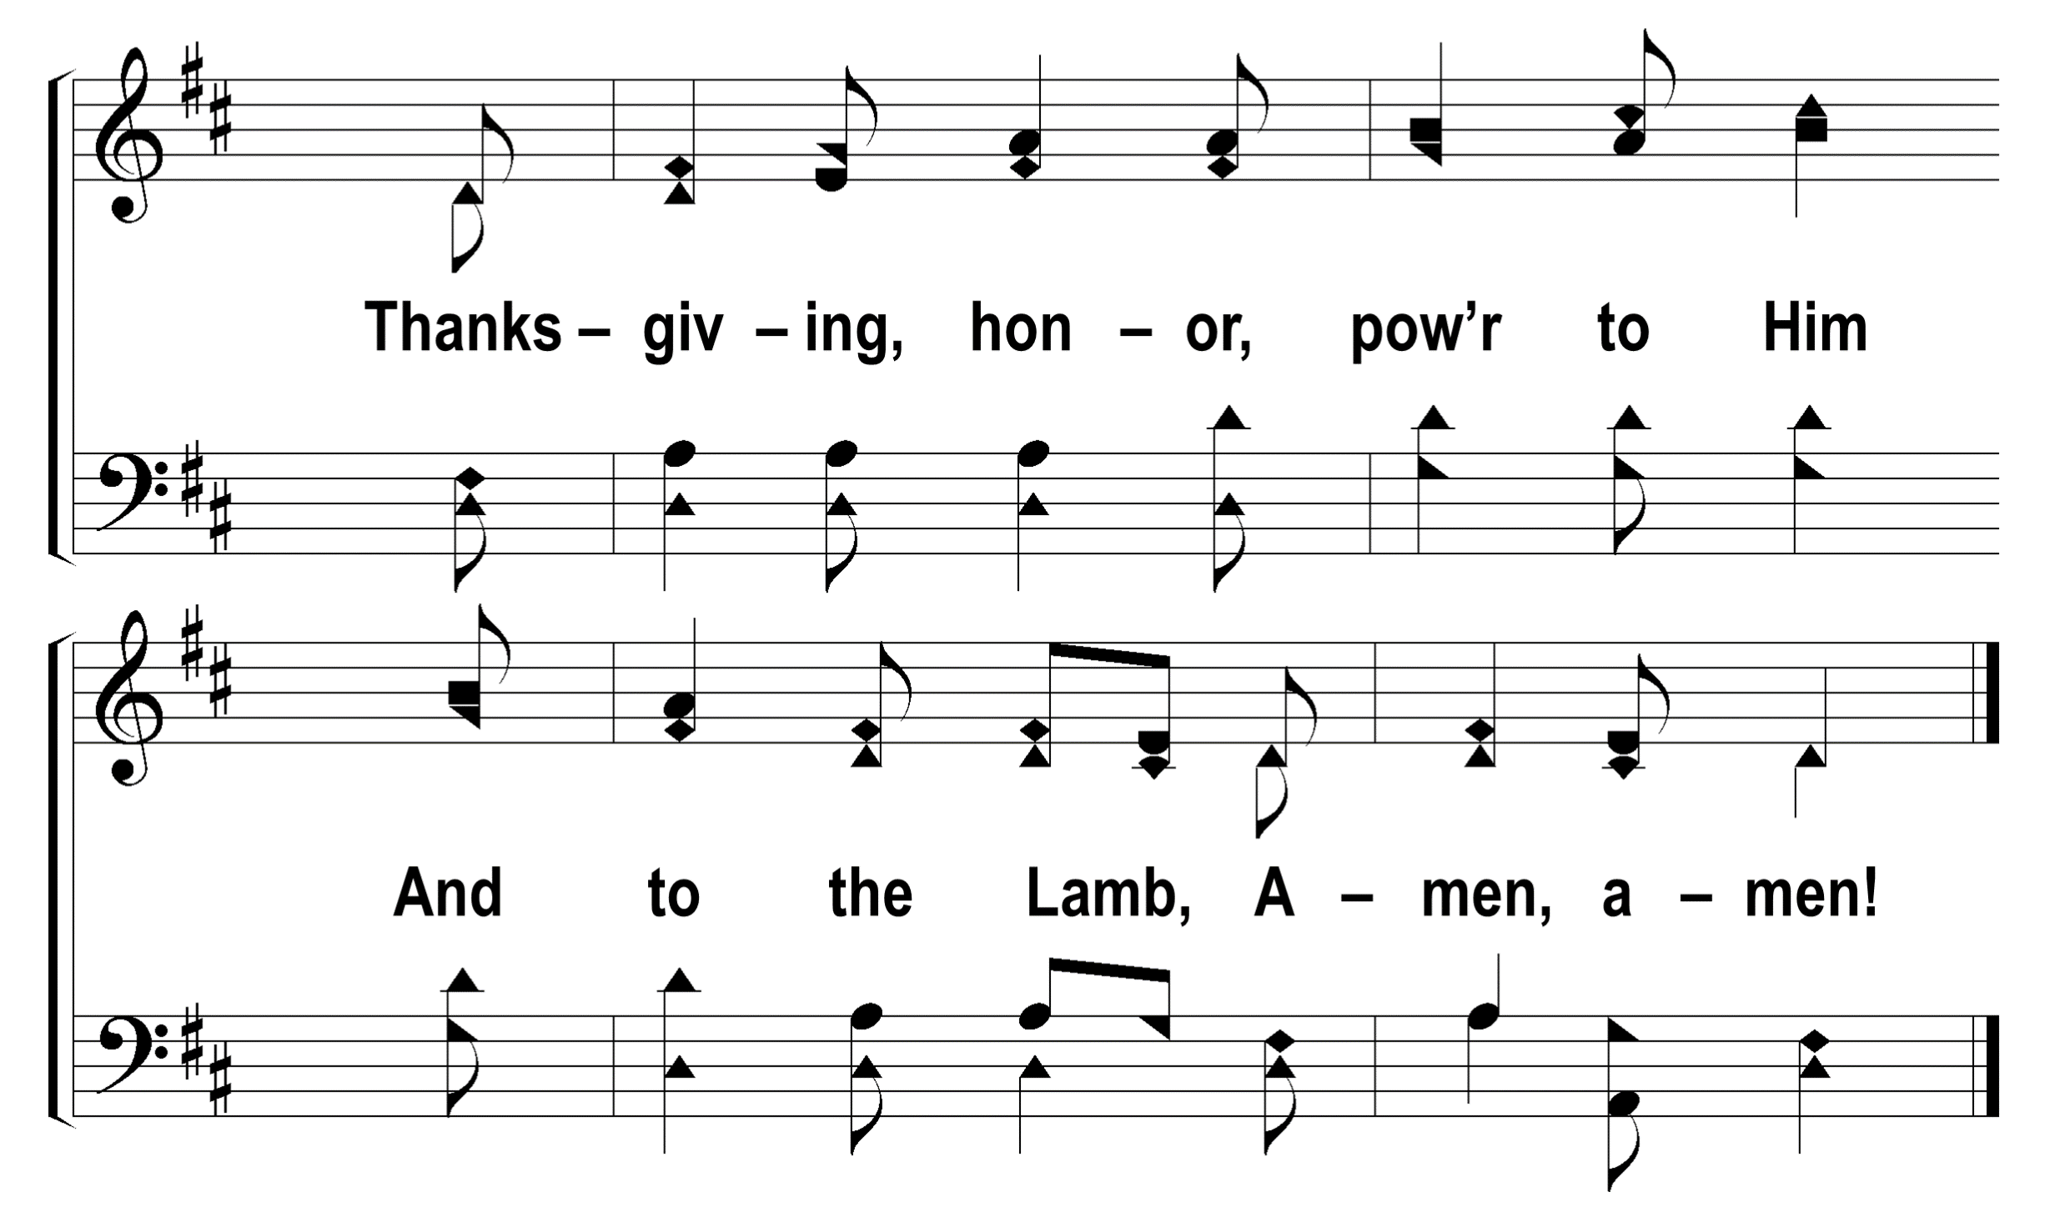
1
C
2
C
3
C
106
LET EVERY TONGUE AND TRIBE AND LAND
© 2014 S. E. Rouse

Slide 6
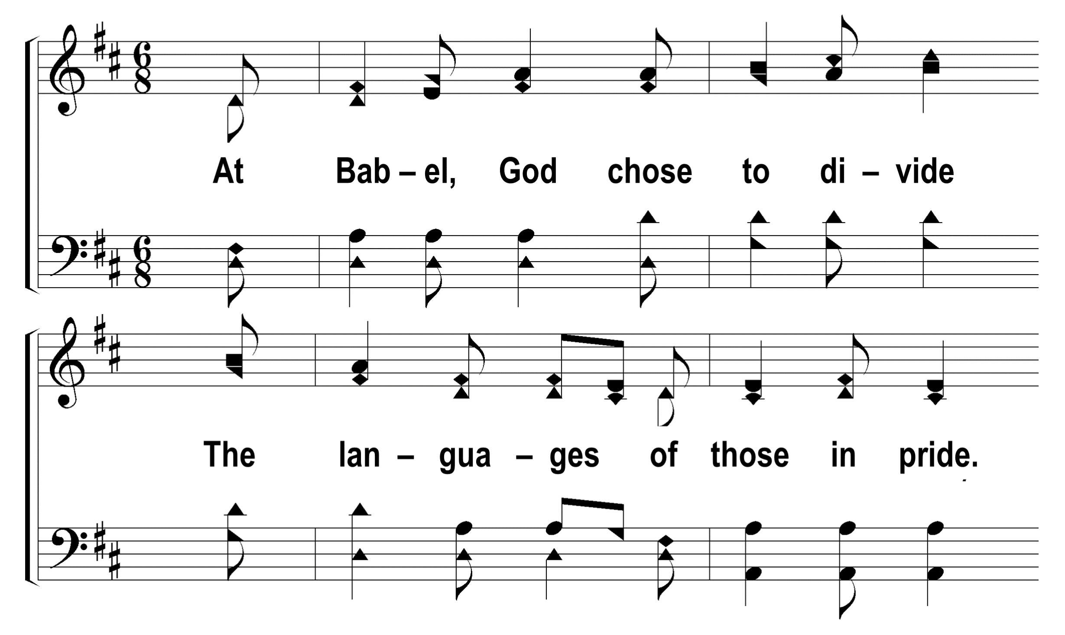
1
C
2
C
3
C
106
LET EVERY TONGUE AND TRIBE AND LAND
© 2014 S. E. Rouse

Slide 7
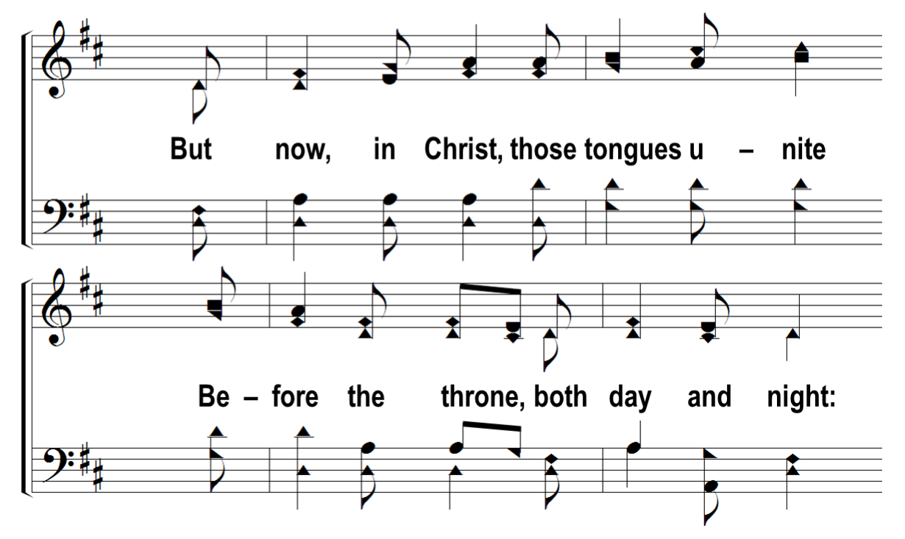
1
C
2
C
3
C
106
LET EVERY TONGUE AND TRIBE AND LAND
© 2014 S. E. Rouse

Slide 8
1
C
2
C
3
C
106
LET EVERY TONGUE AND TRIBE AND LAND
© 2014 S. E. Rouse

Slide 9
1
C
2
C
3
C
106
LET EVERY TONGUE AND TRIBE AND LAND
© 2014 S. E. Rouse

Slide 10
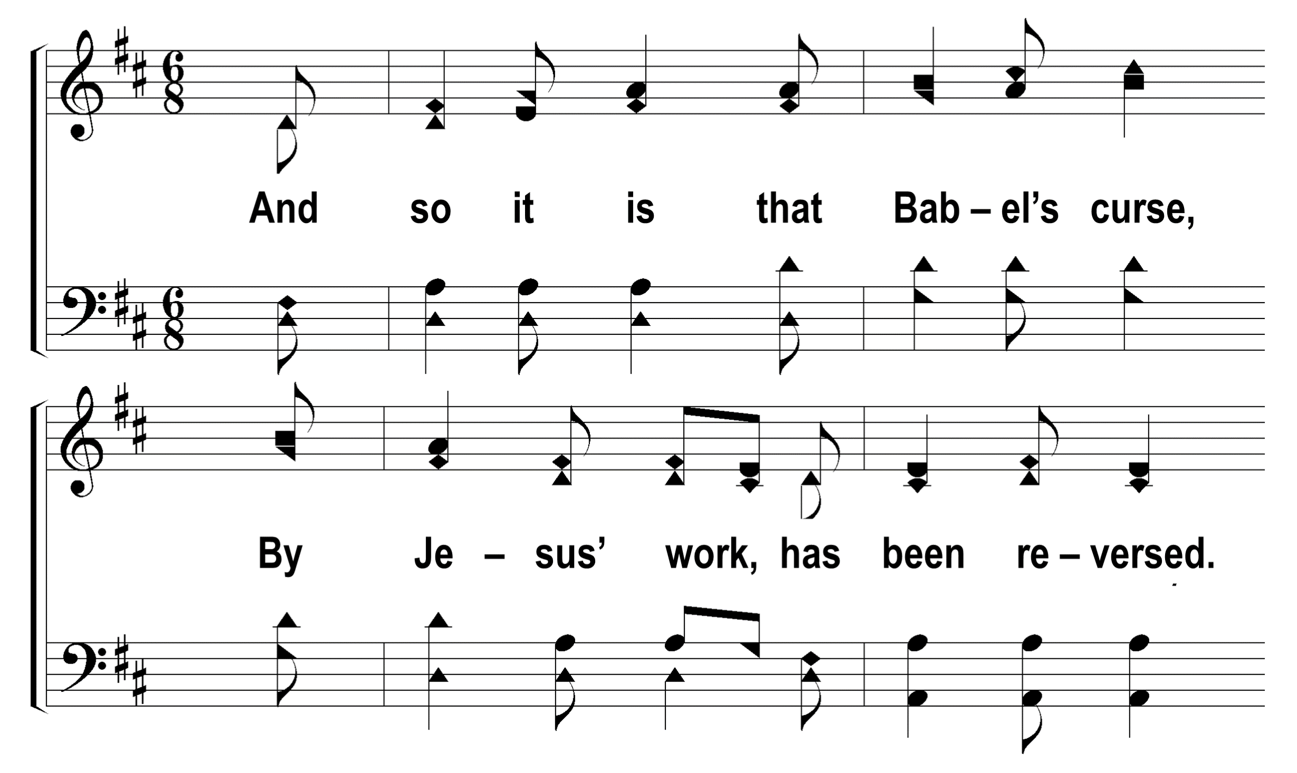
1
C
2
C
3
C
106
LET EVERY TONGUE AND TRIBE AND LAND
© 2014 S. E. Rouse

Slide 11
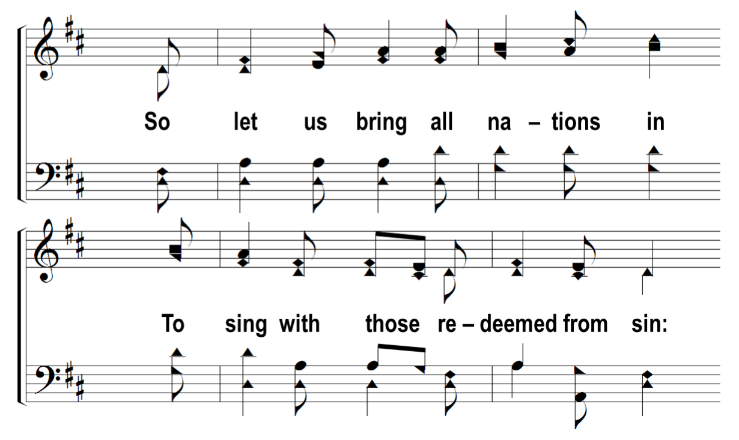
1
C
2
C
3
C
106
LET EVERY TONGUE AND TRIBE AND LAND
© 2014 S. E. Rouse

Slide 12
1
C
2
C
3
C
106
LET EVERY TONGUE AND TRIBE AND LAND
© 2014 S. E. Rouse

Slide 13
1
C
2
C
3
C
106
LET EVERY TONGUE AND TRIBE AND LAND
© 2014 S. E. Rouse

