Slide 1
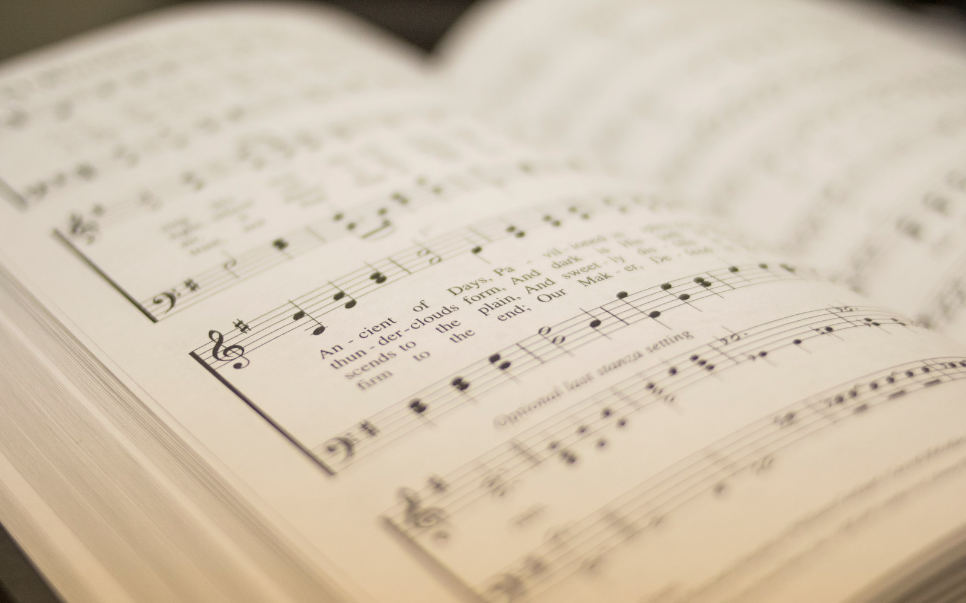

107
LET EVERY LANGUAGE
1
2
3
“SINGING...TO THE LORD” COLOSSIANS 3:16
Hymn: S. E. Rouse Tune: Traditional African Melody Arr. S. E. Rouse and Joshua McKinsey

Slide 2

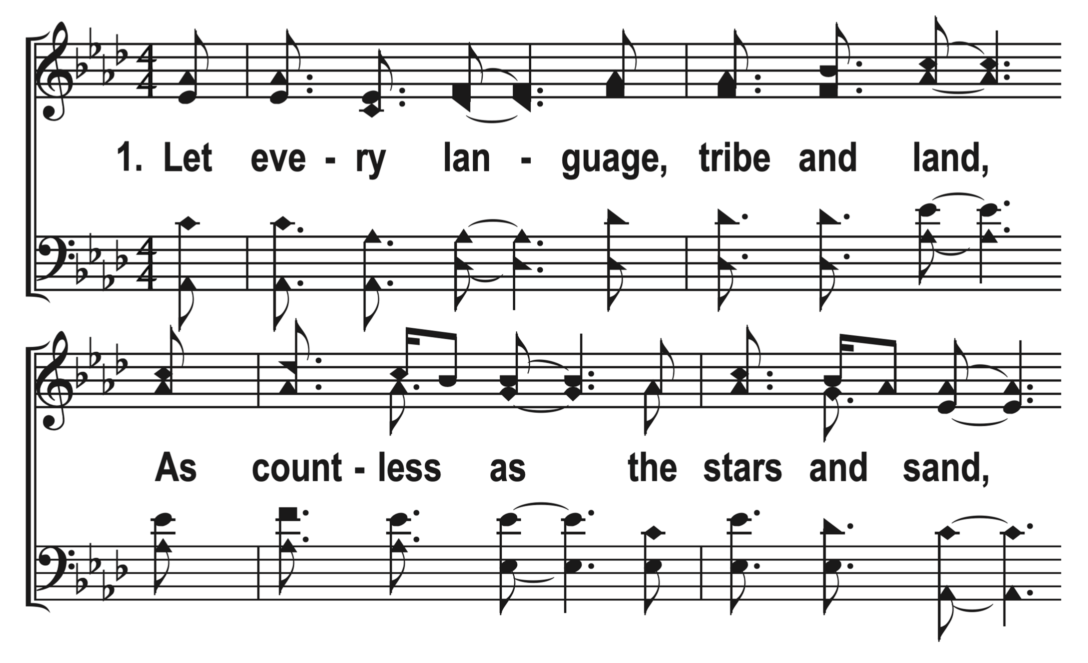

1
C
2
C
3
C
107
LET EVERY LANGUAGE
© 2014 S. E. Rouse

Slide 3
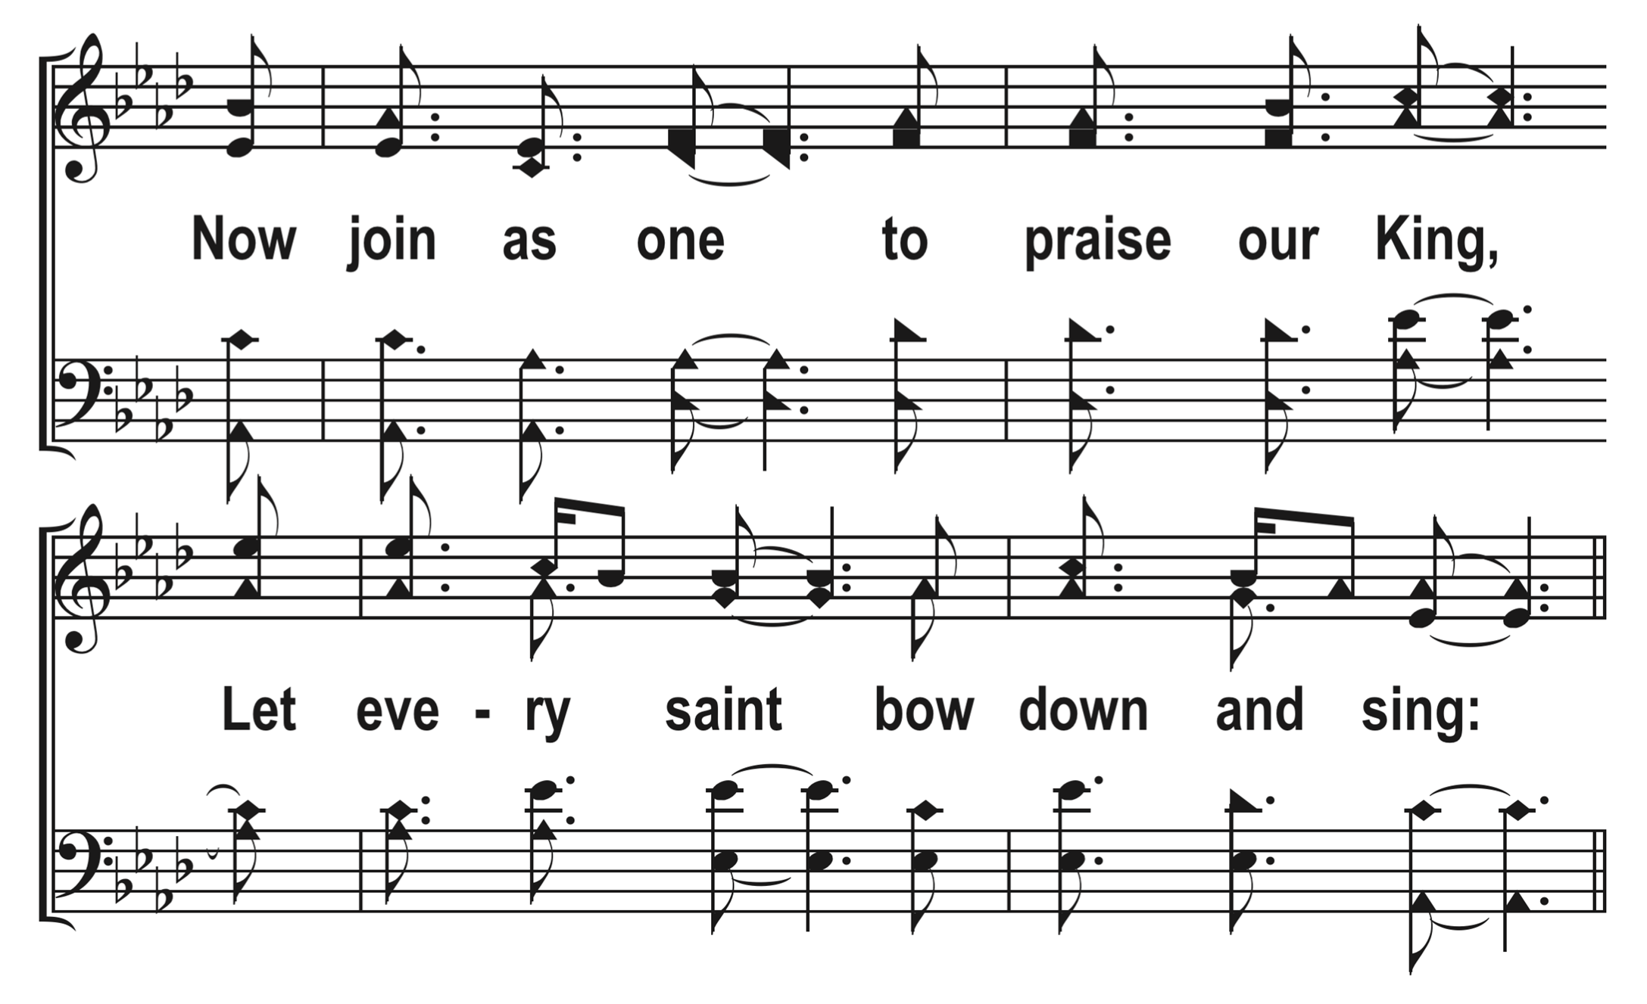
1
C
2
C
3
C
107
LET EVERY LANGUAGE
© 2014 S. E. Rouse

Slide 4
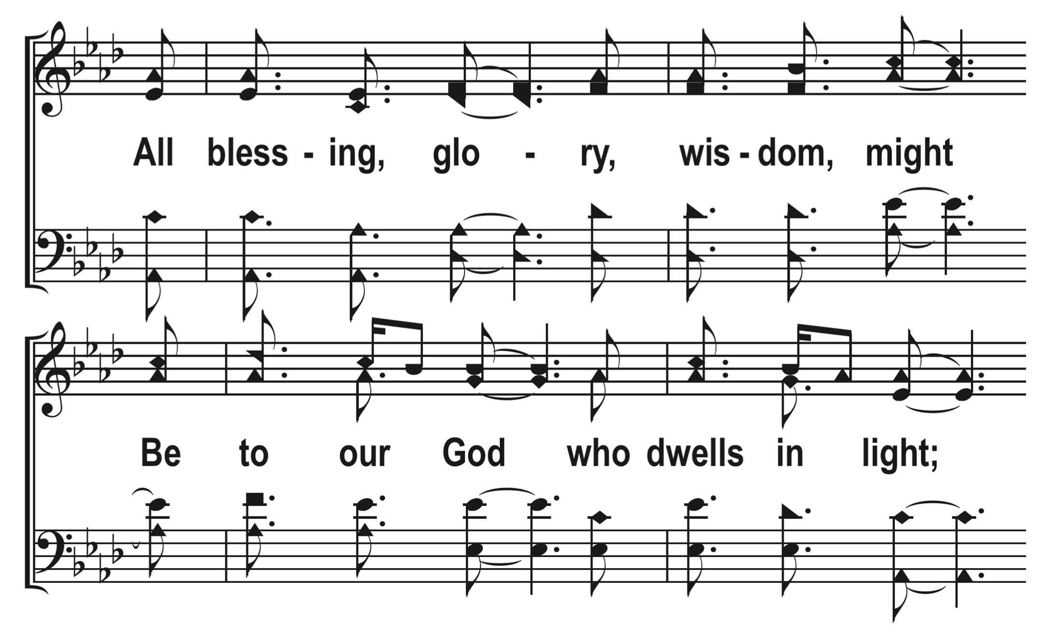
1
C
2
C
3
C
107
LET EVERY LANGUAGE
© 2014 S. E. Rouse

Slide 5
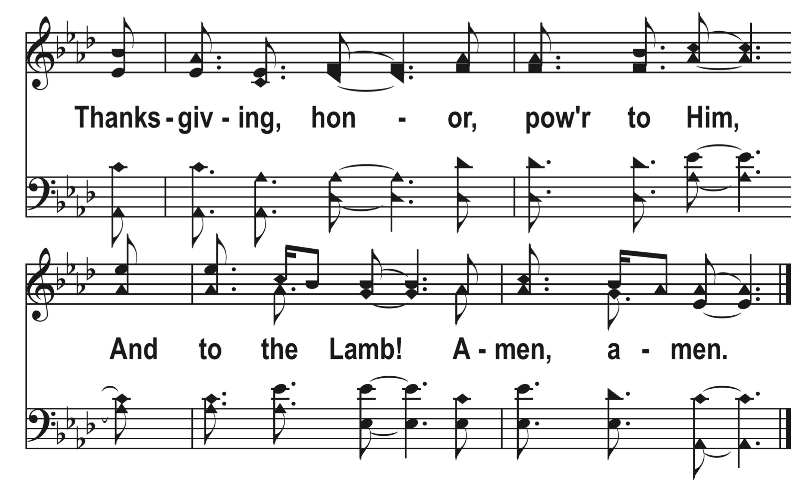
1
C
2
C
3
C
107
LET EVERY LANGUAGE
© 2014 S. E. Rouse

Slide 6
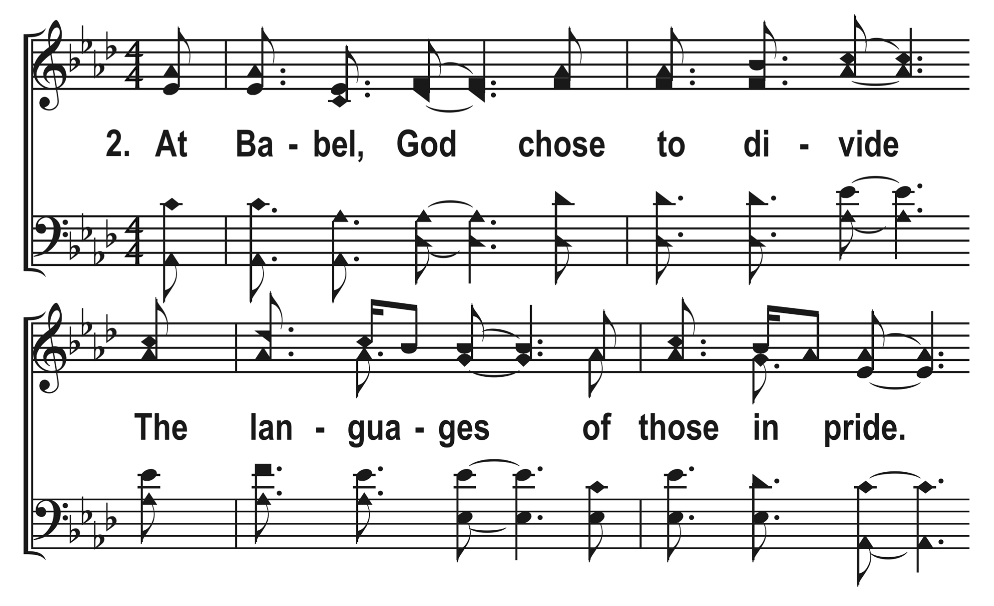
1
C
2
C
3
C
107
LET EVERY LANGUAGE
© 2014 S. E. Rouse

Slide 7
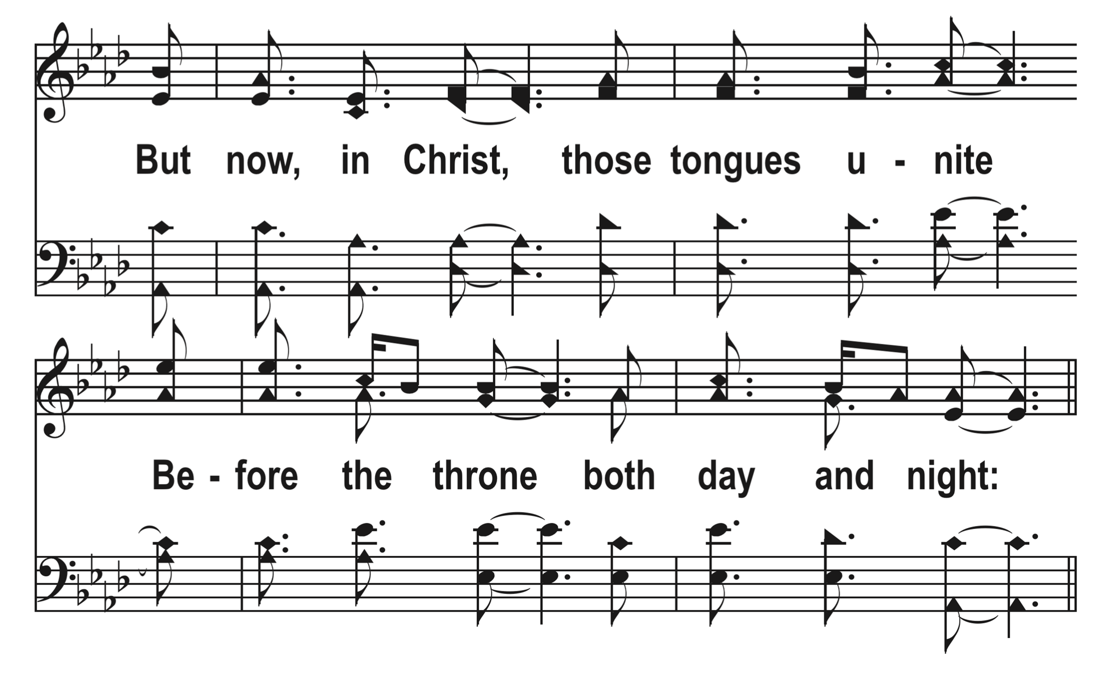
1
C
2
C
3
C
107
LET EVERY LANGUAGE
© 2014 S. E. Rouse

Slide 8
1
C
2
C
3
C
107
LET EVERY LANGUAGE
© 2014 S. E. Rouse

Slide 9
1
C
2
C
3
C
107
LET EVERY LANGUAGE
© 2014 S. E. Rouse

Slide 10
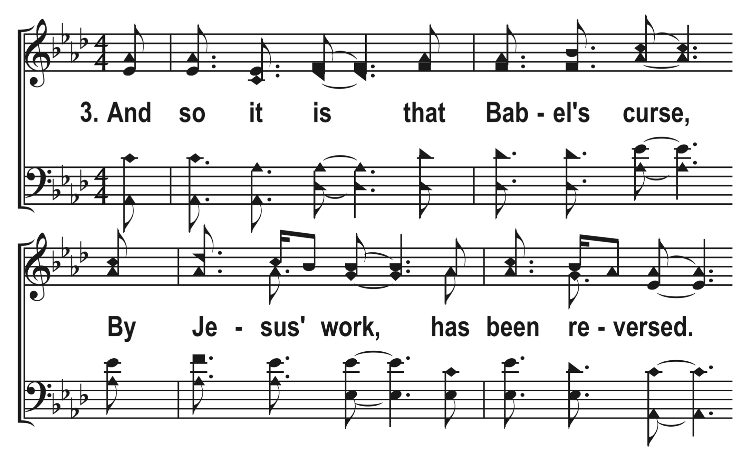
1
C
2
C
3
C
107
LET EVERY LANGUAGE
© 2014 S. E. Rouse

Slide 11
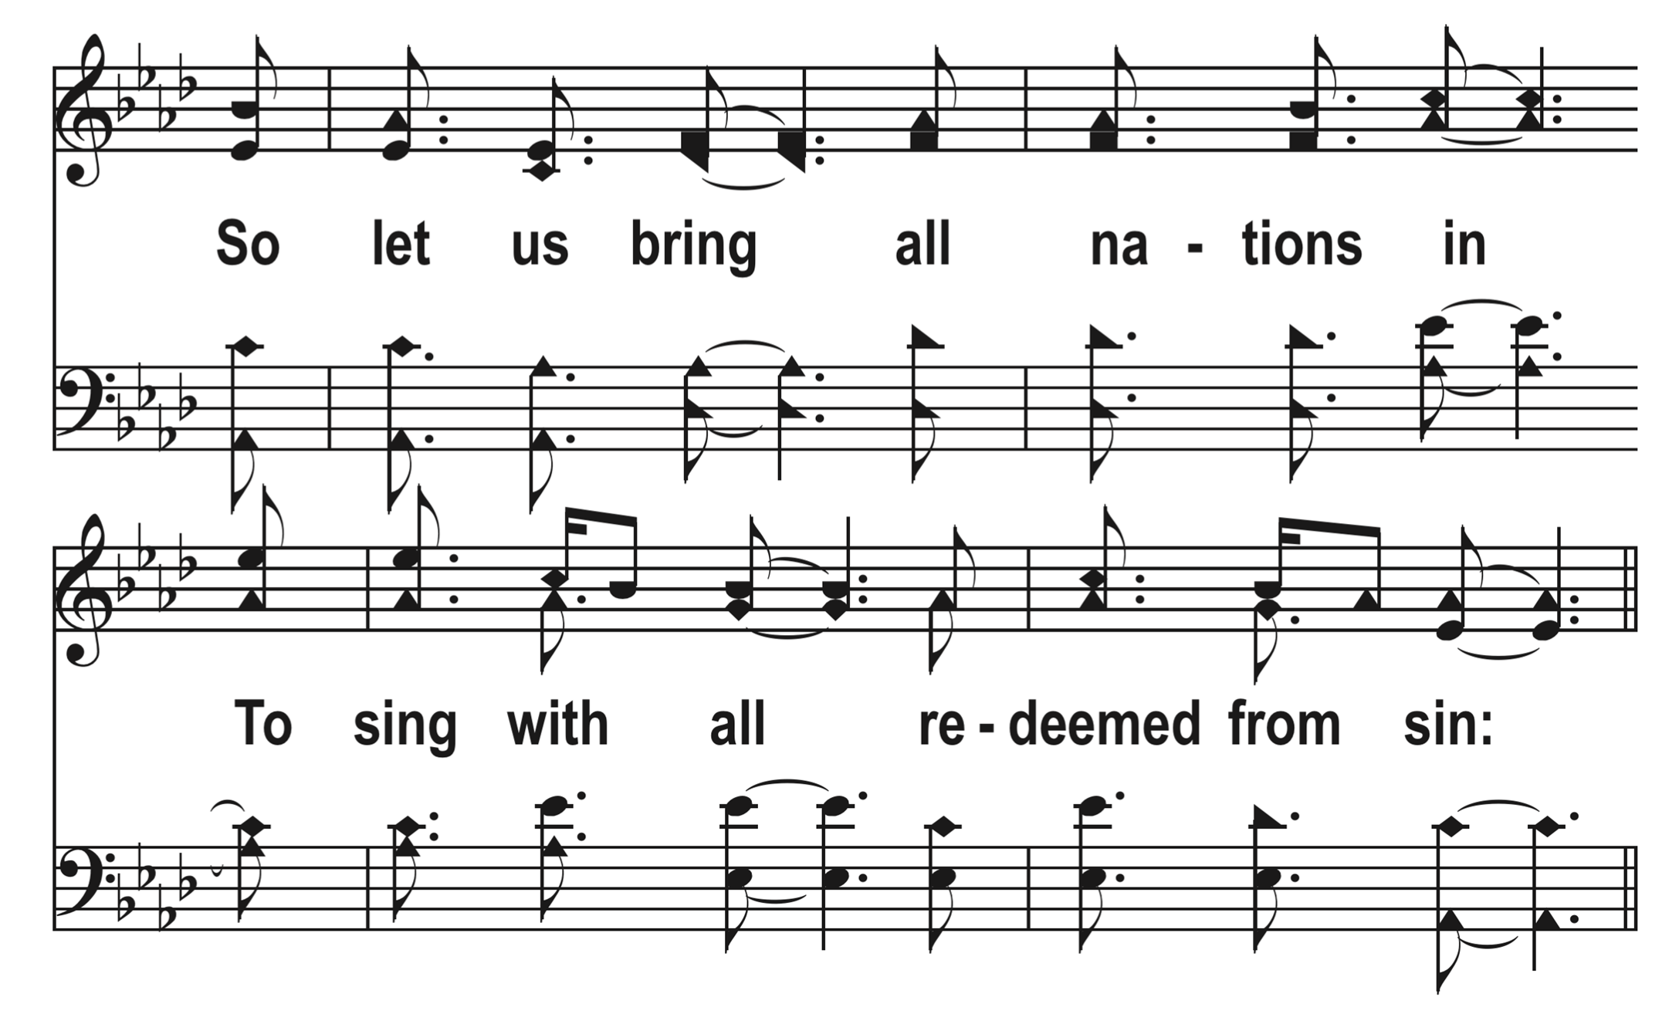
1
C
2
C
3
C
107
LET EVERY LANGUAGE
© 2014 S. E. Rouse

Slide 12
1
C
2
C
3
C
107
LET EVERY LANGUAGE
© 2014 S. E. Rouse

Slide 13
1
C
2
C
3
C
107
LET EVERY LANGUAGE
© 2014 S. E. Rouse

