Slide 1
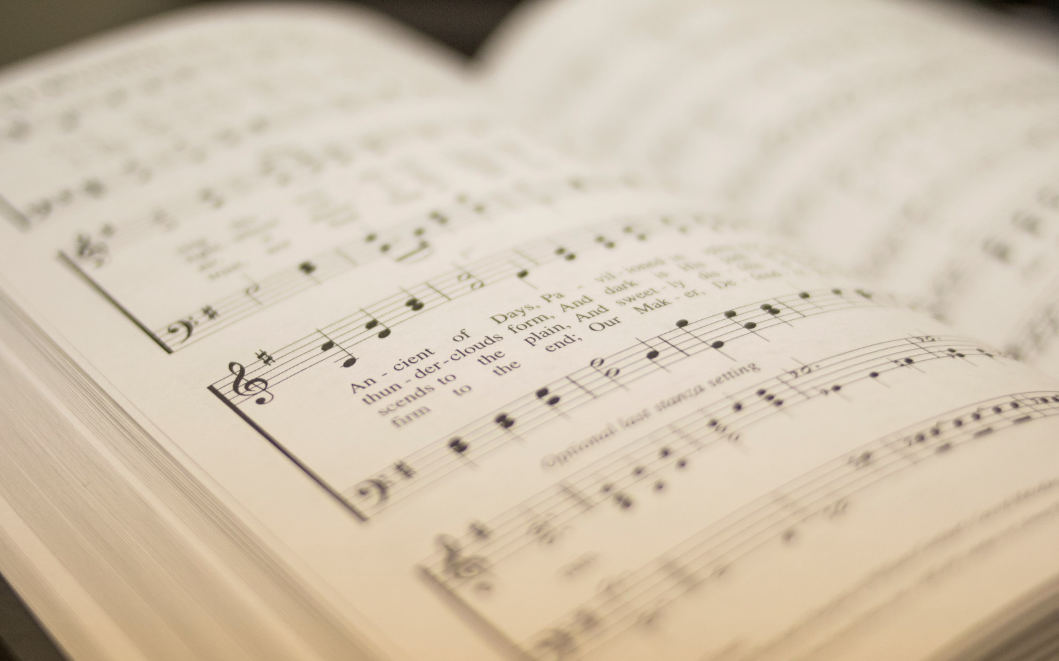

114
HEAL US ALL
1
2
3
4
“SINGING...TO THE LORD” COLOSSIANS 3:16
Hymn: LMD with refrain • Henry Twells (1868), alt. Tune: TWELLS • S. E. Rouse (2023) Music © 2023 S. E. Rouse

Slide 2
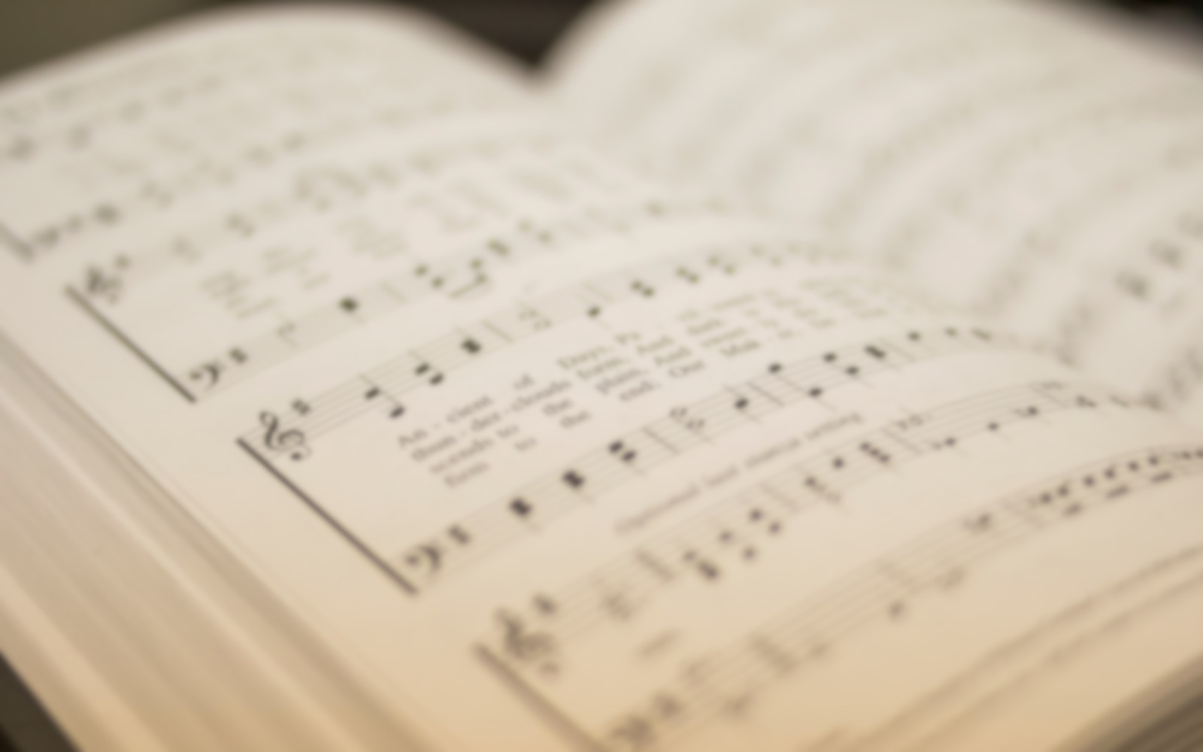
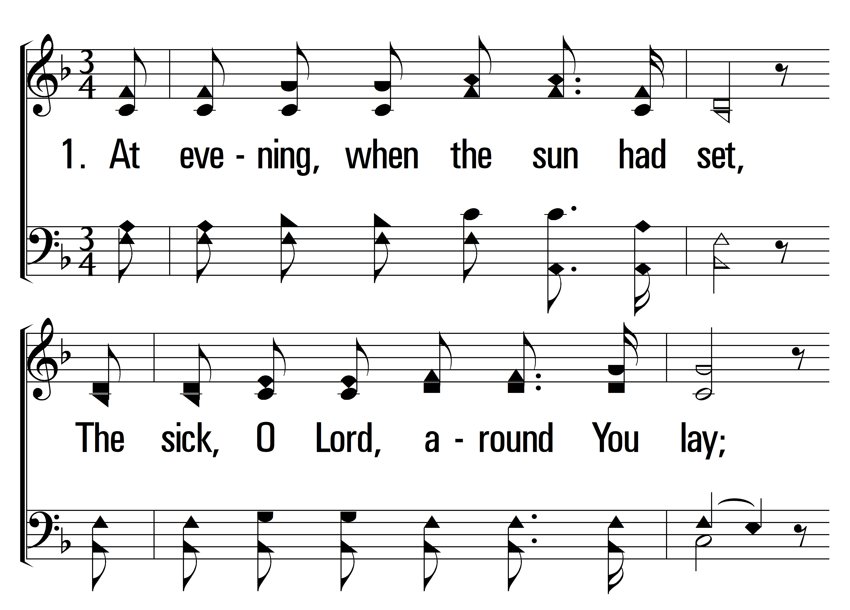

1
C
2
C
3
C
4
C
114
HEAL US ALL
© 2024 Sumphonia Productions, LLC

Slide 3
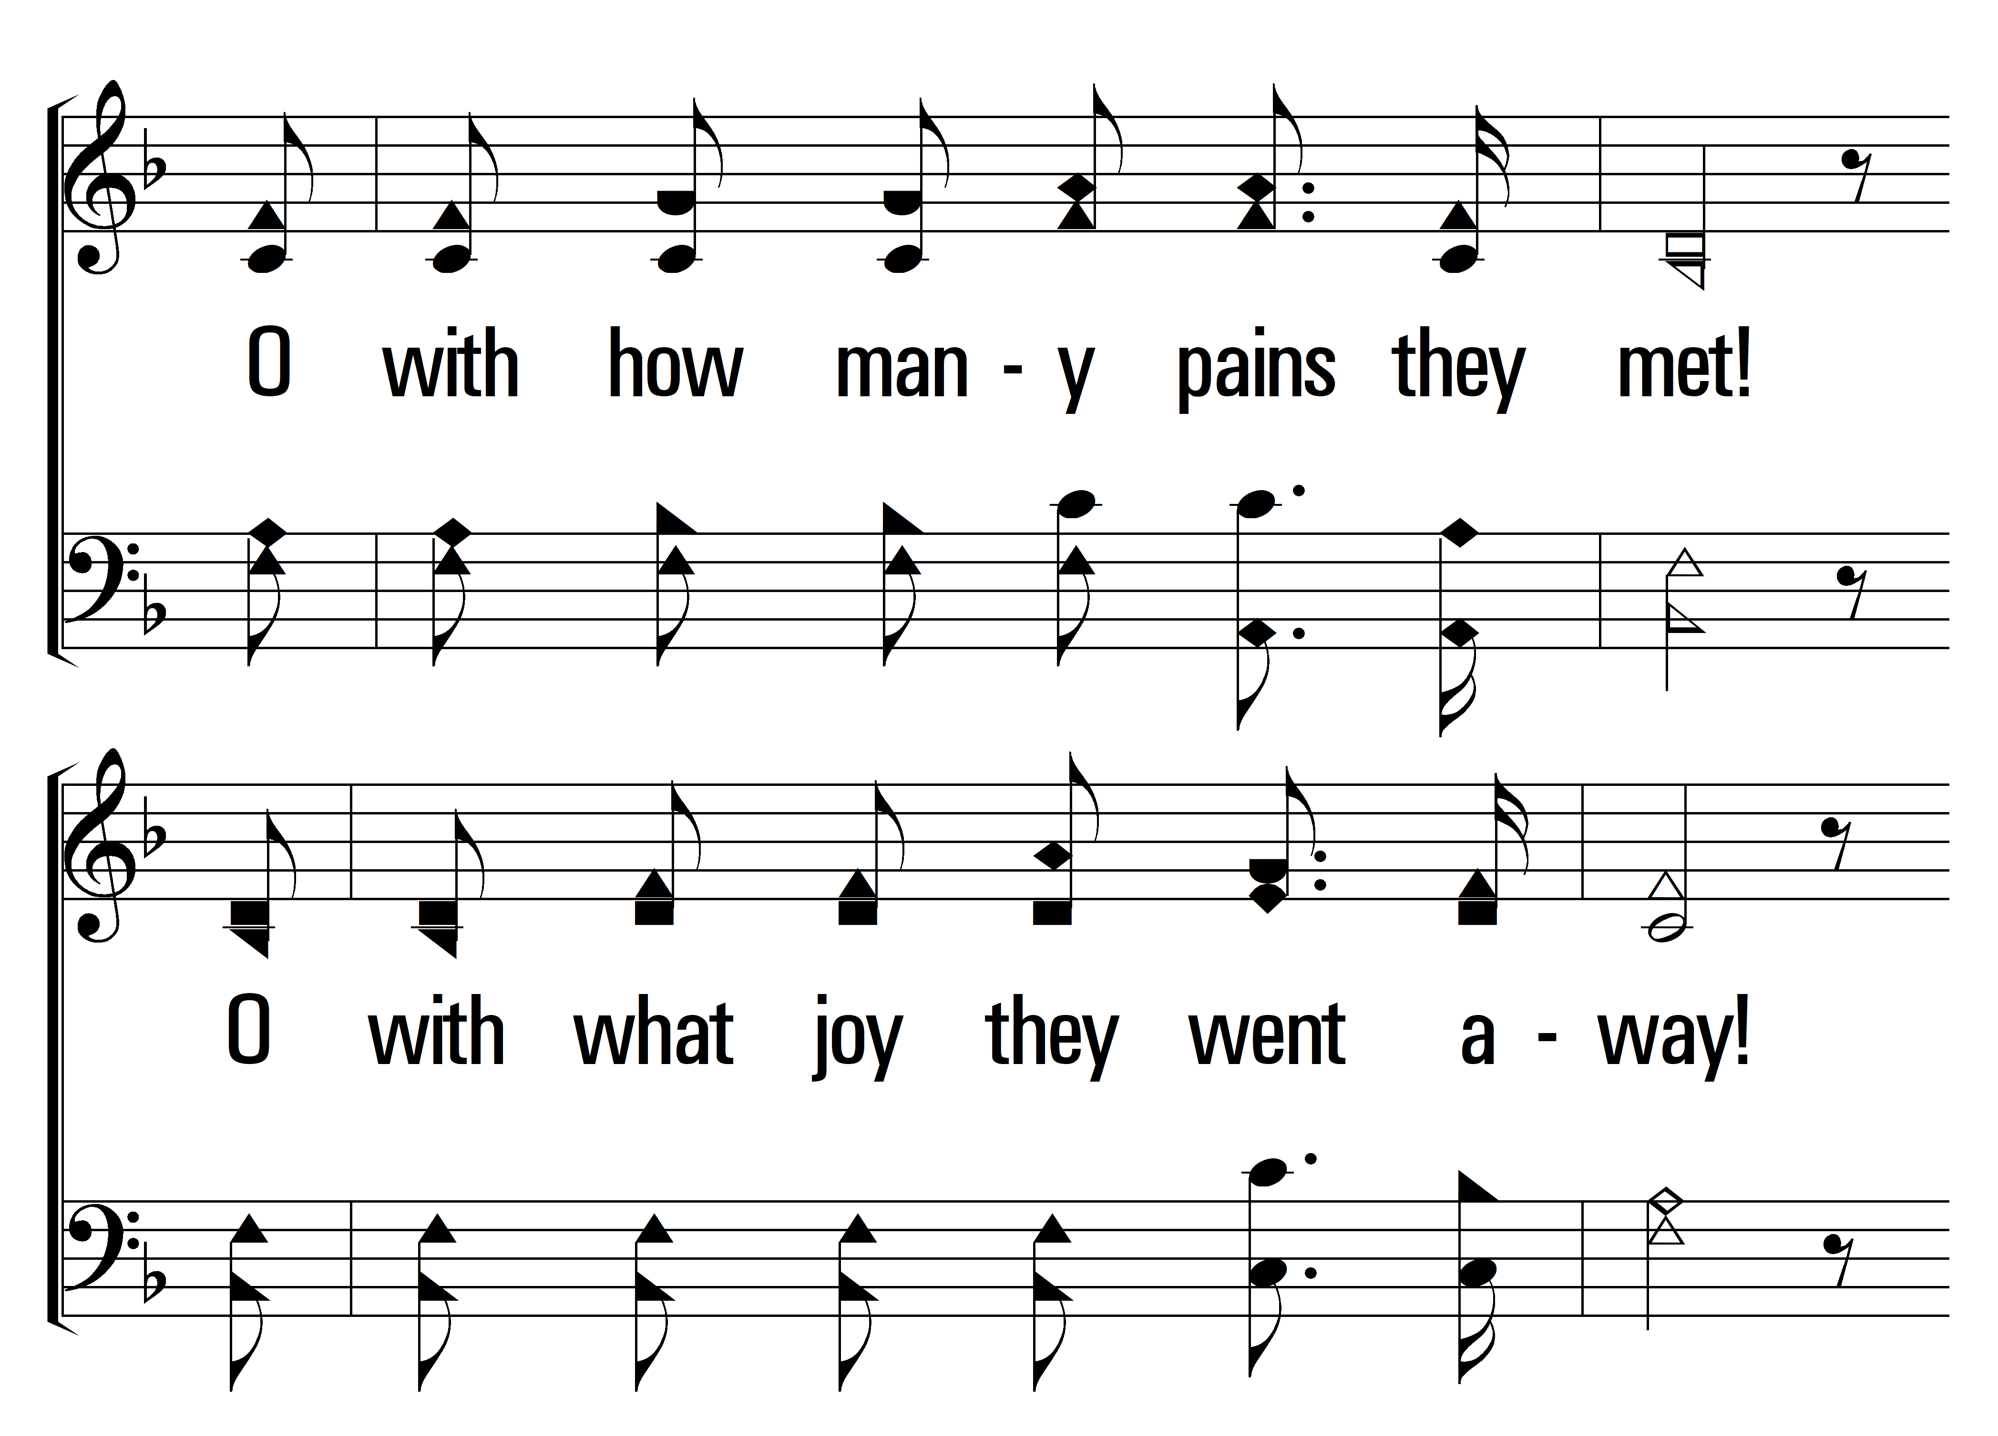
1
C
2
C
3
C
4
C
114
HEAL US ALL
© 2024 Sumphonia Productions, LLC

Slide 4
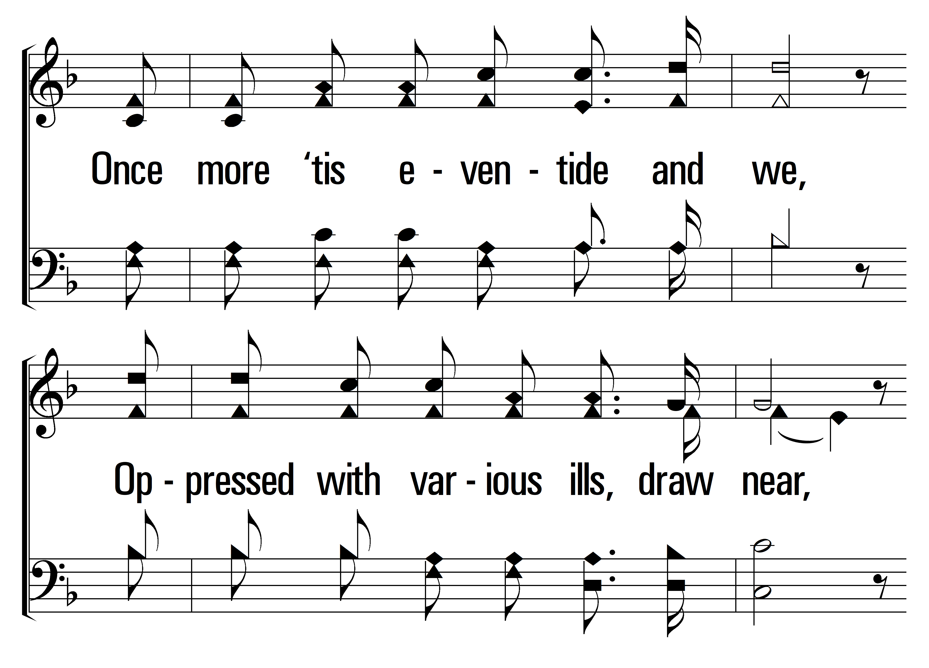
1
C
2
C
3
C
4
C
114
HEAL US ALL
© 2024 Sumphonia Productions, LLC

Slide 5
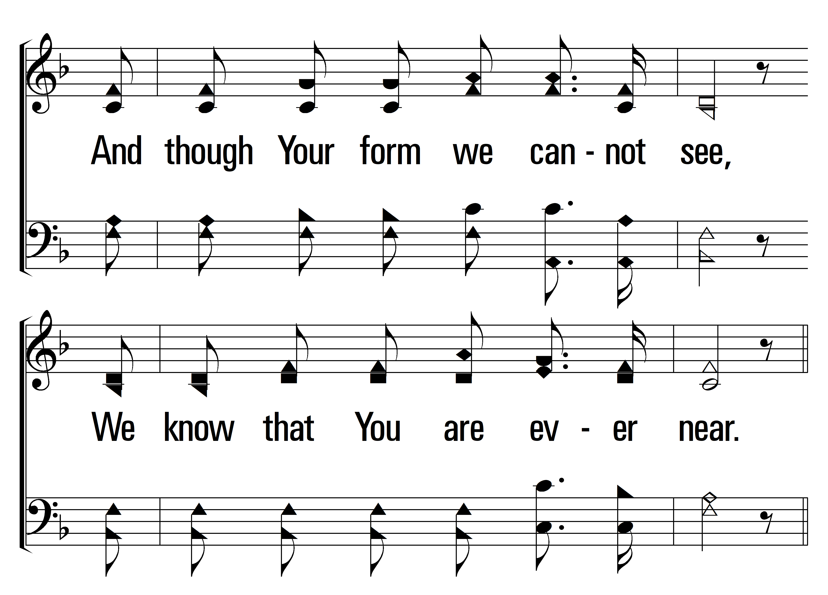
1
C
2
C
3
C
4
C
114
HEAL US ALL
© 2024 Sumphonia Productions, LLC

Slide 6
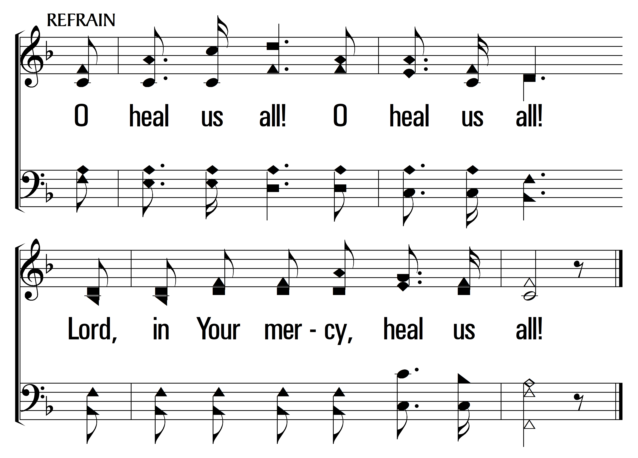
1
C
2
C
3
C
4
C
114
HEAL US ALL
© 2024 Sumphonia Productions, LLC

Slide 7
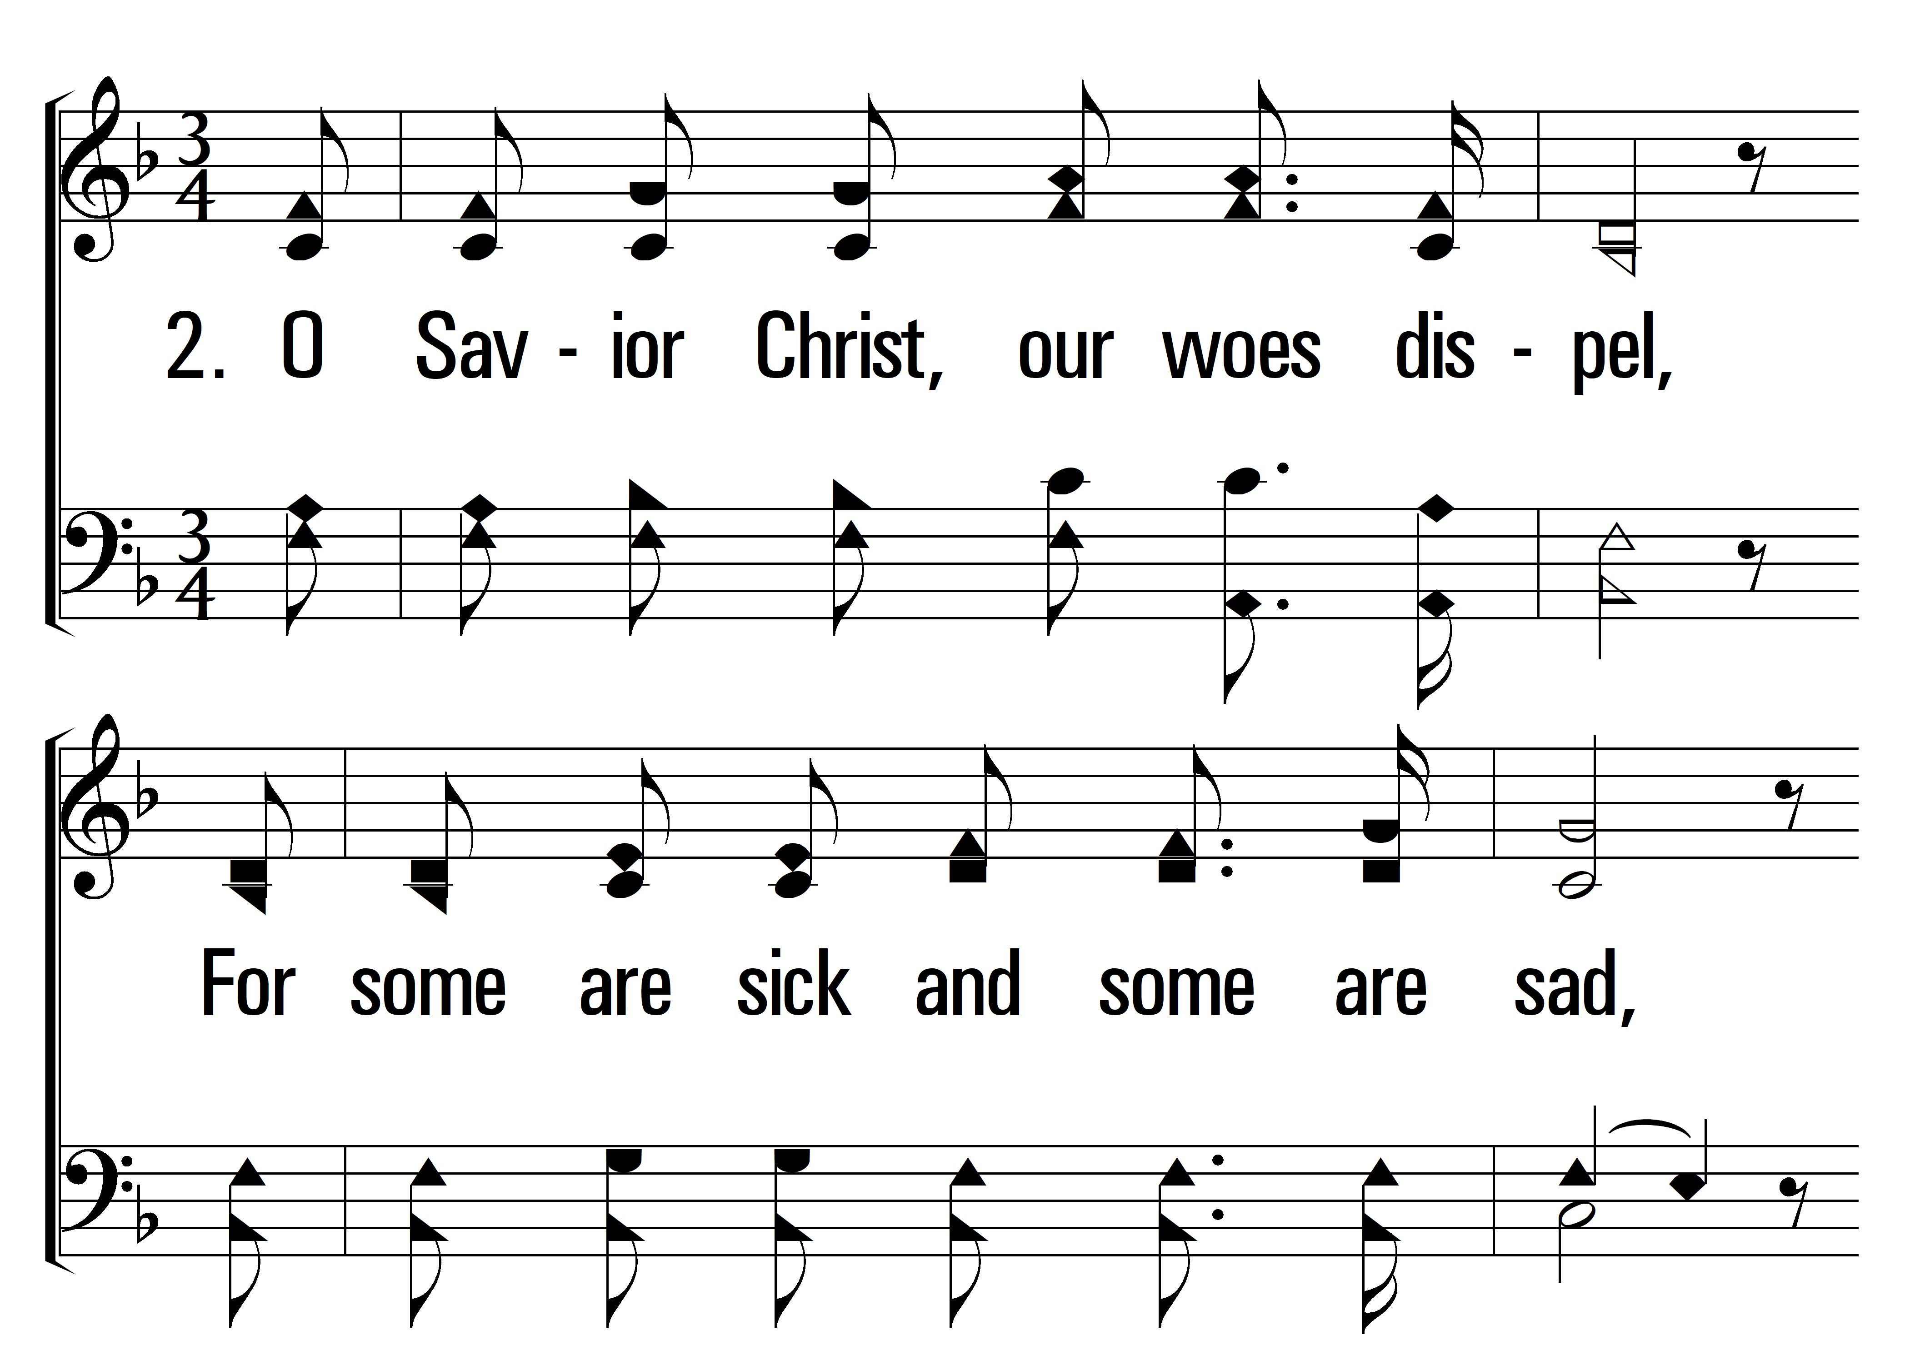
1
C
2
C
3
C
4
C
114
HEAL US ALL
© 2024 Sumphonia Productions, LLC

Slide 8
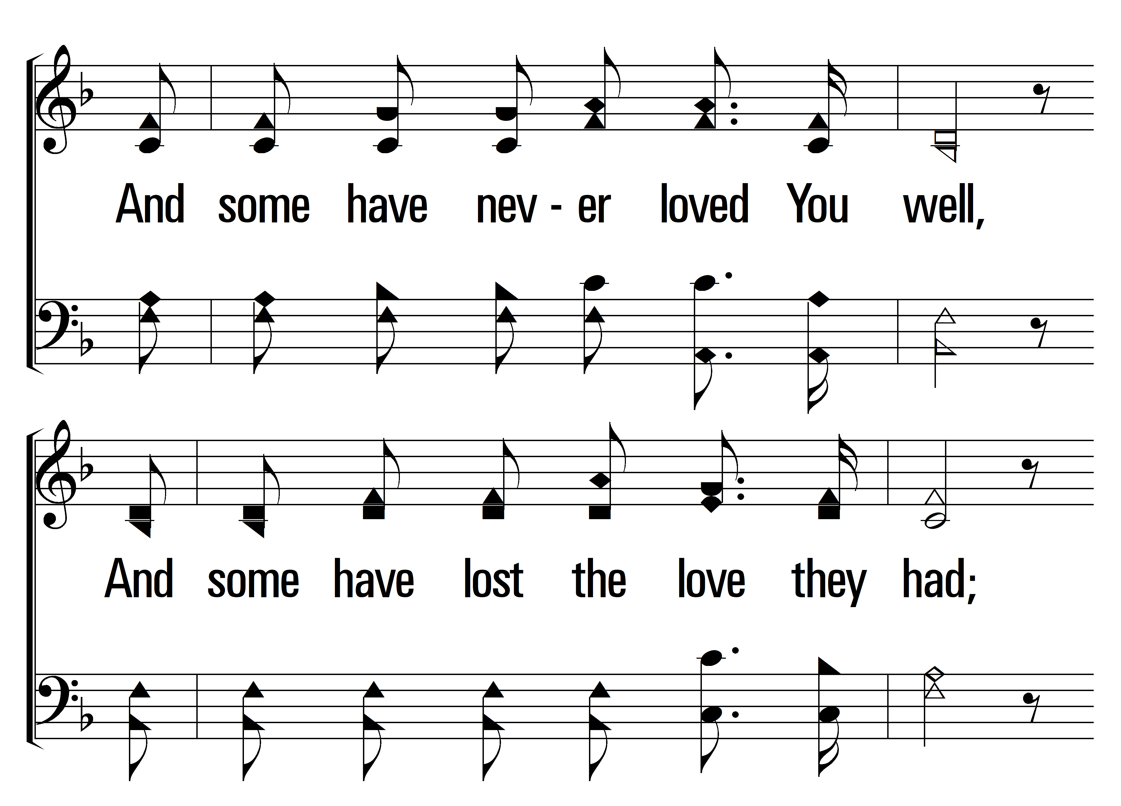
1
C
2
C
3
C
4
C
114
HEAL US ALL
© 2024 Sumphonia Productions, LLC

Slide 9
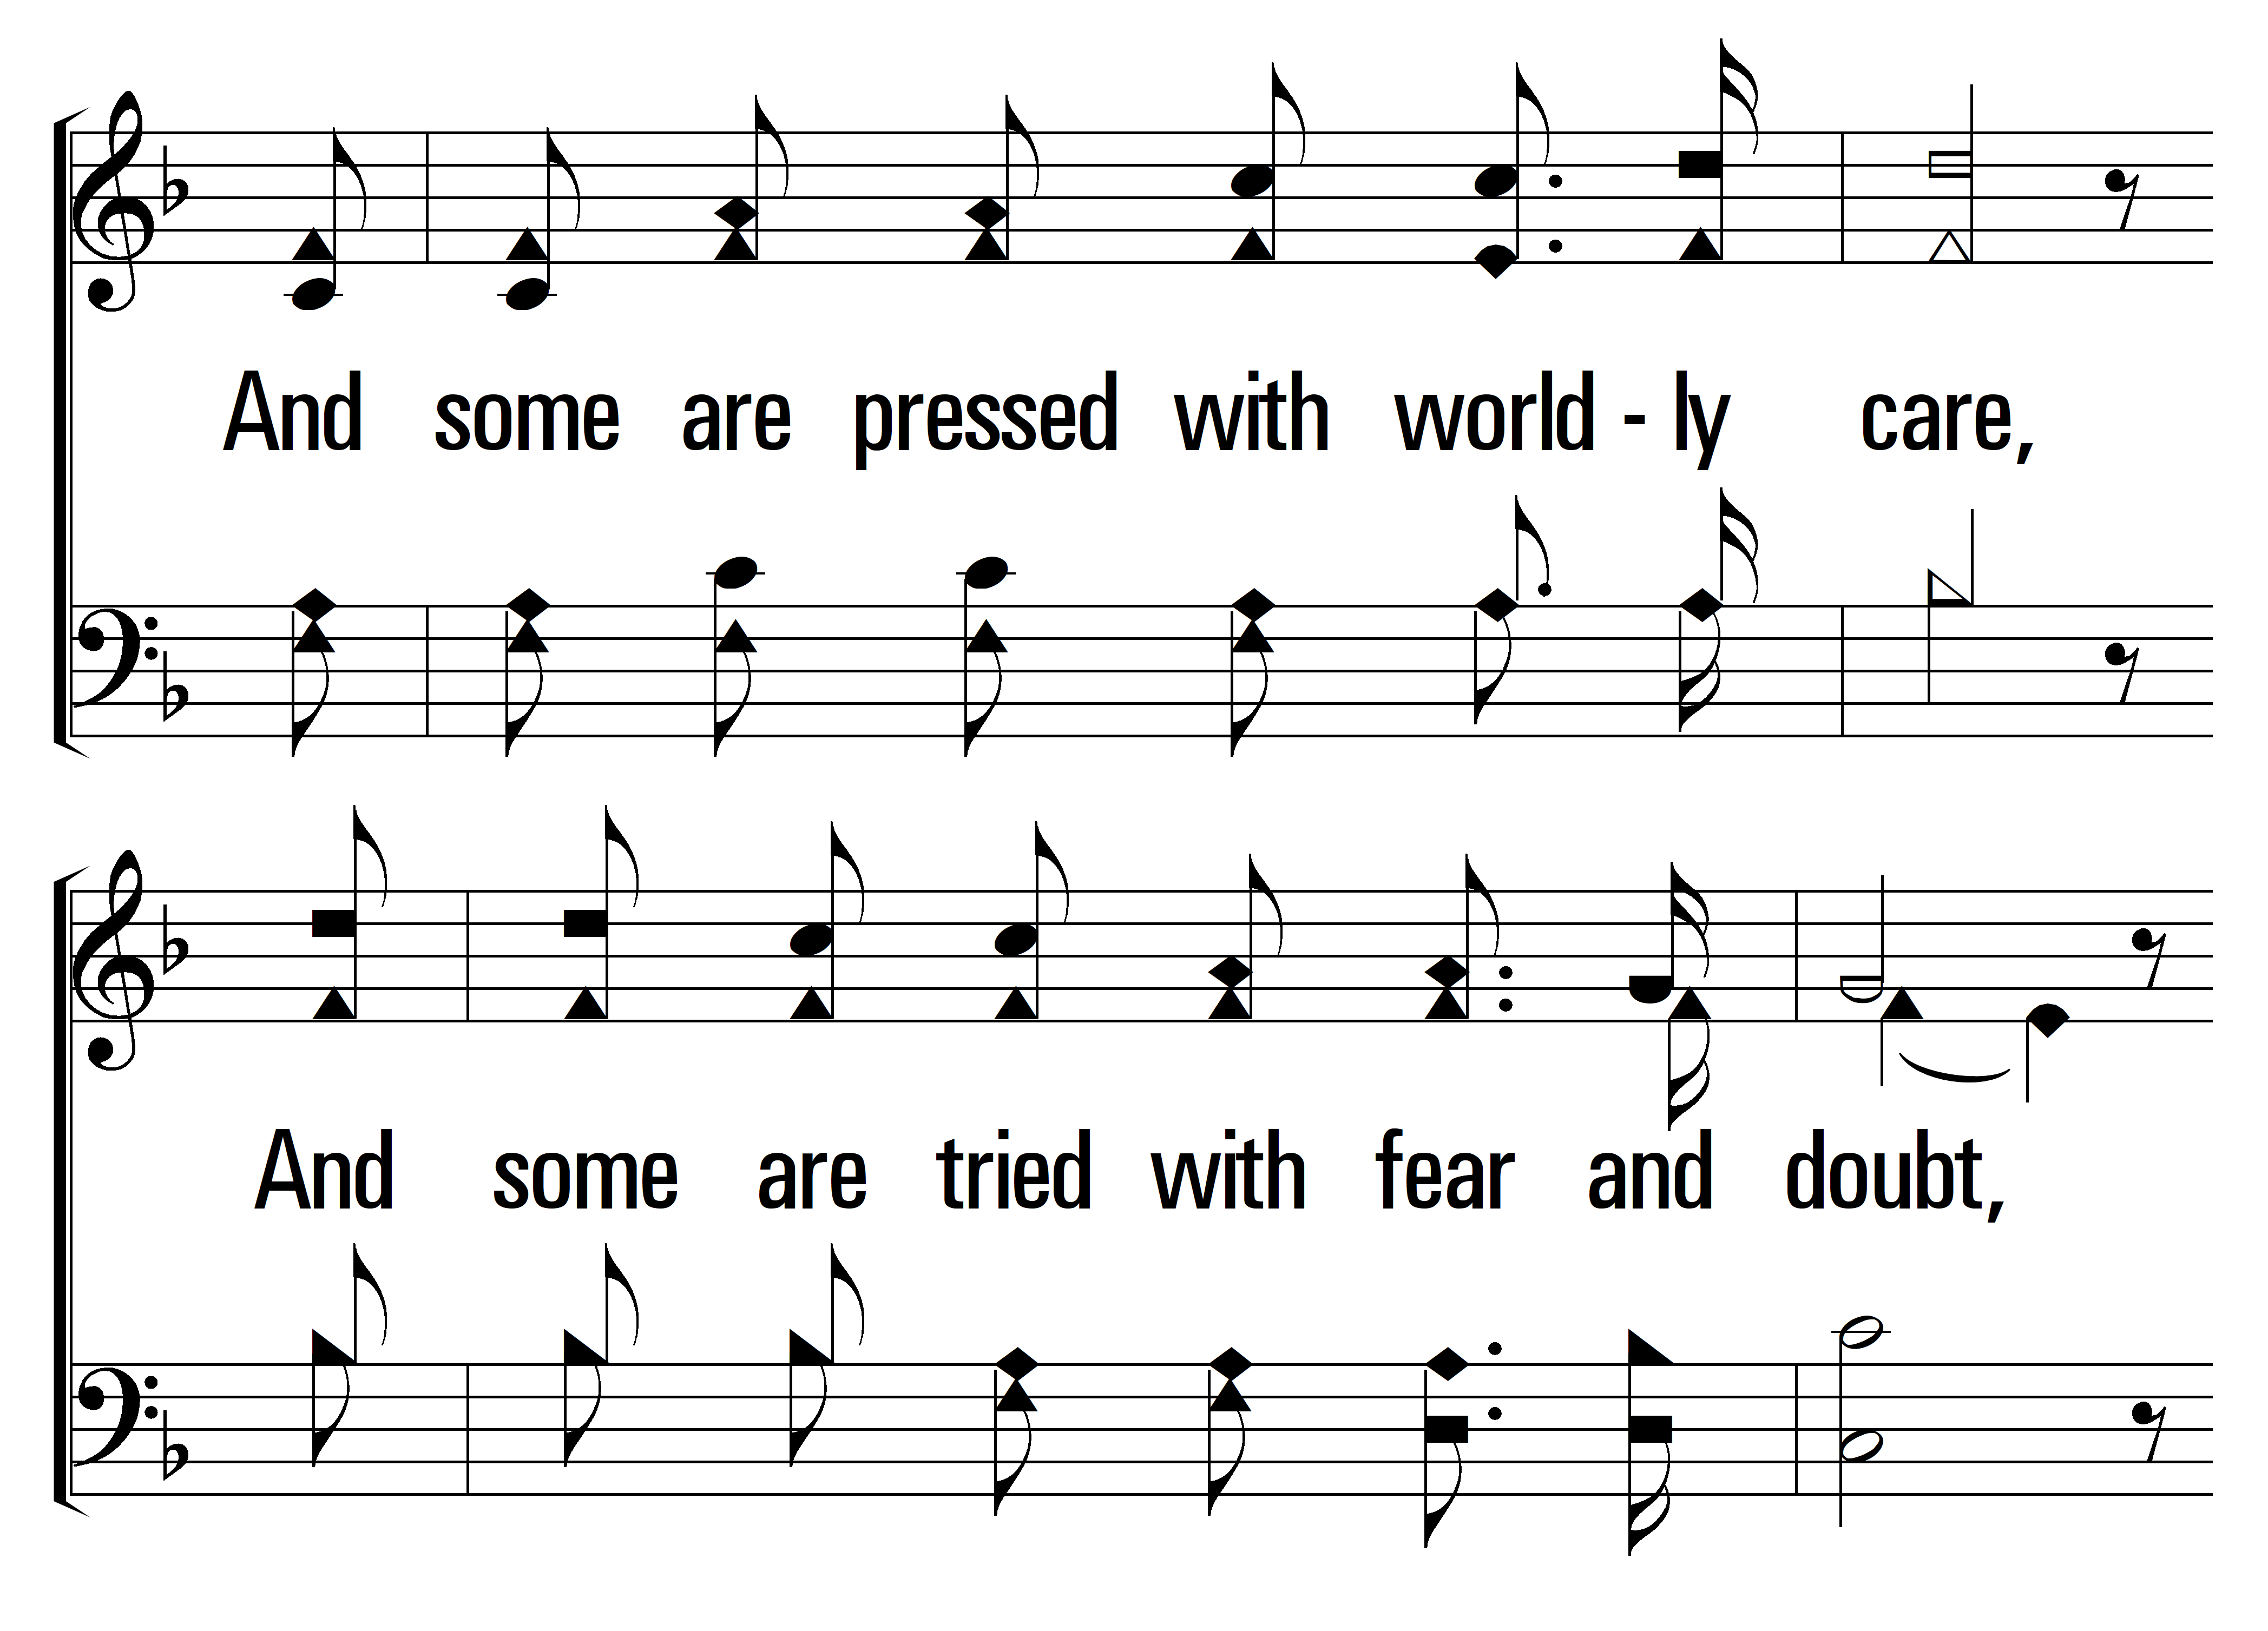
1
C
2
C
3
C
4
C
114
HEAL US ALL
© 2024 Sumphonia Productions, LLC

Slide 10
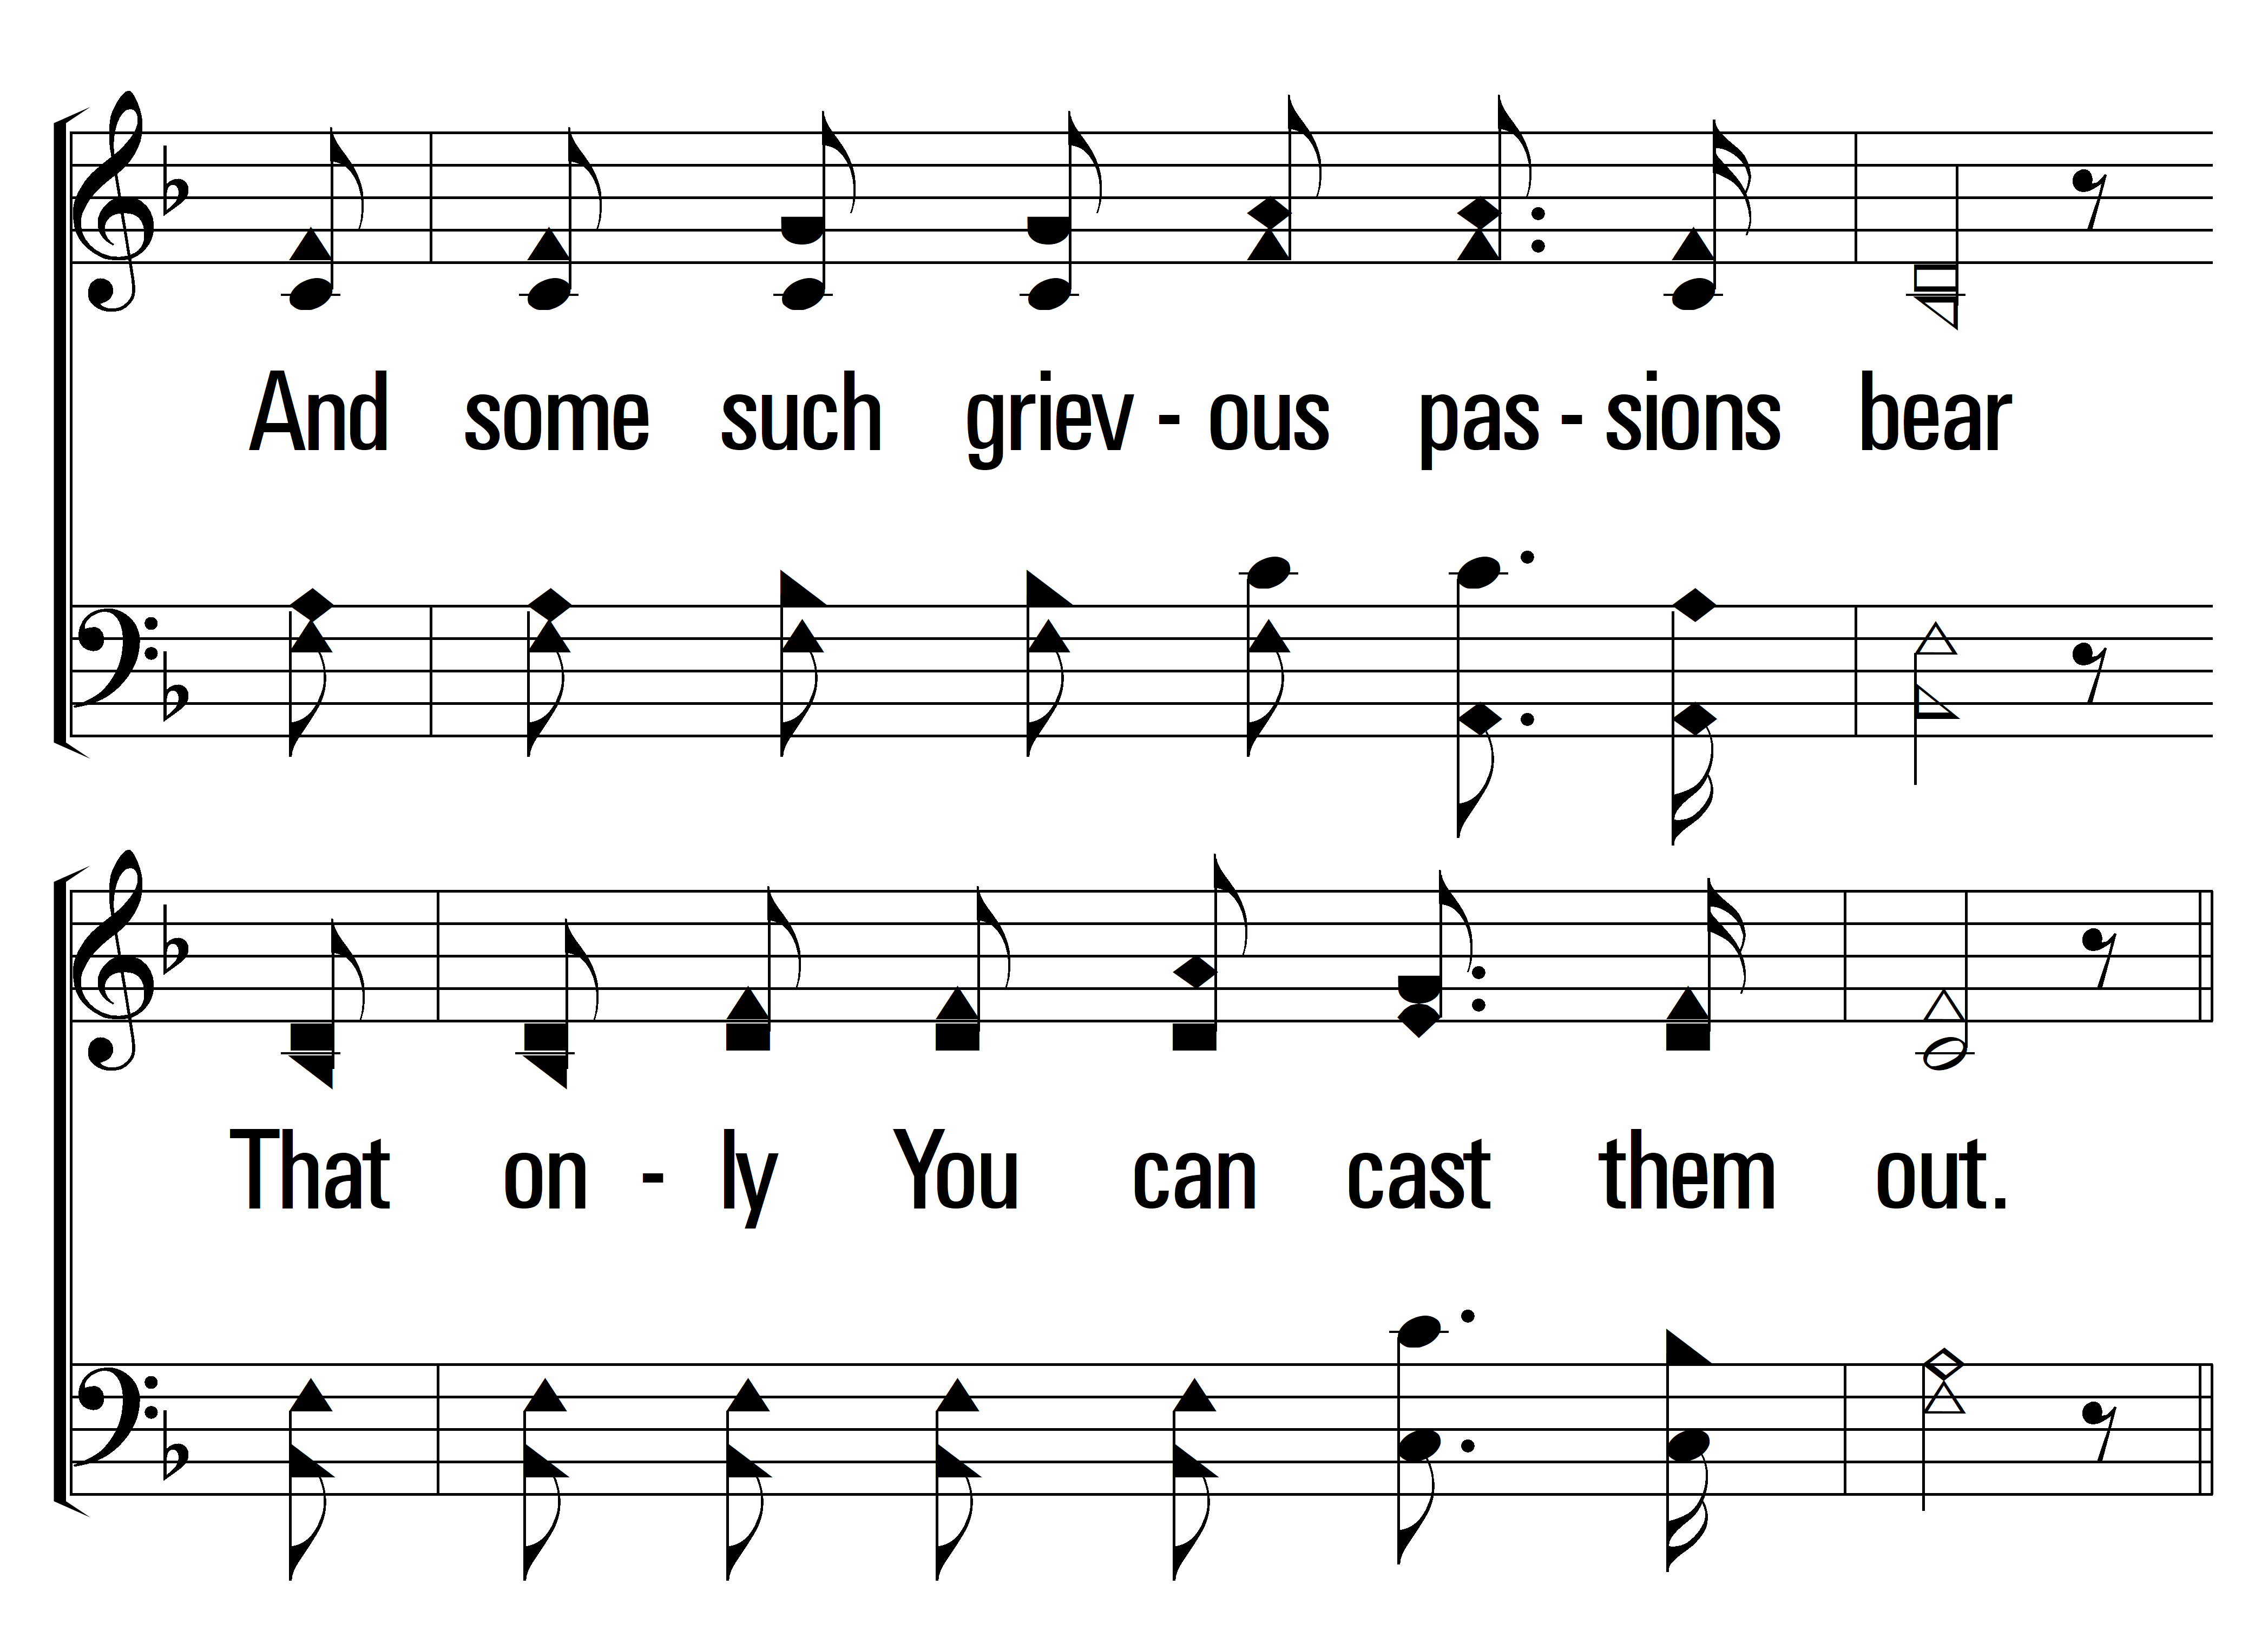
1
C
2
C
3
C
4
C
114
HEAL US ALL
© 2024 Sumphonia Productions, LLC

Slide 11
1
C
2
C
3
C
4
C
114
HEAL US ALL
© 2024 Sumphonia Productions, LLC

Slide 12
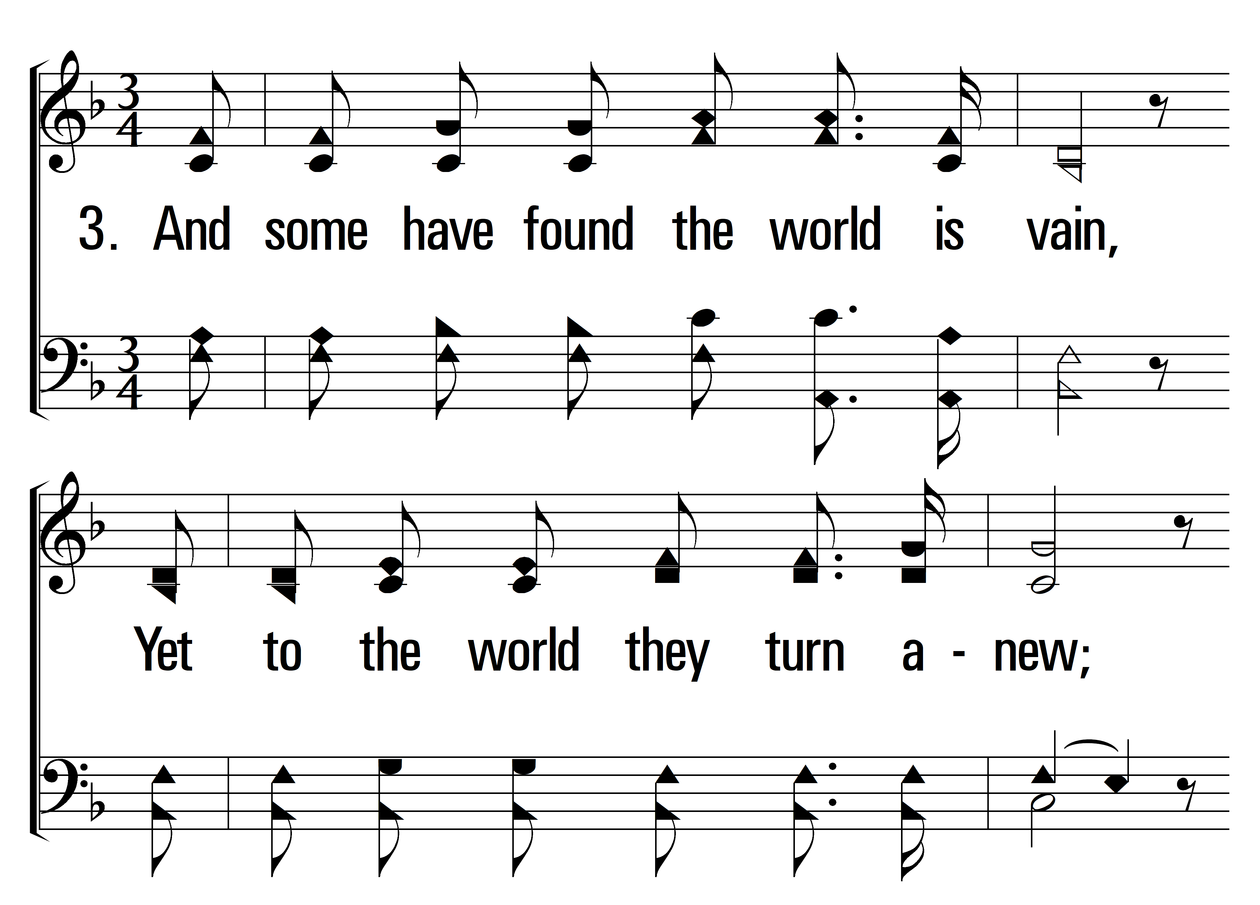
1
C
2
C
3
C
4
C
114
HEAL US ALL
© 2024 Sumphonia Productions, LLC

Slide 13
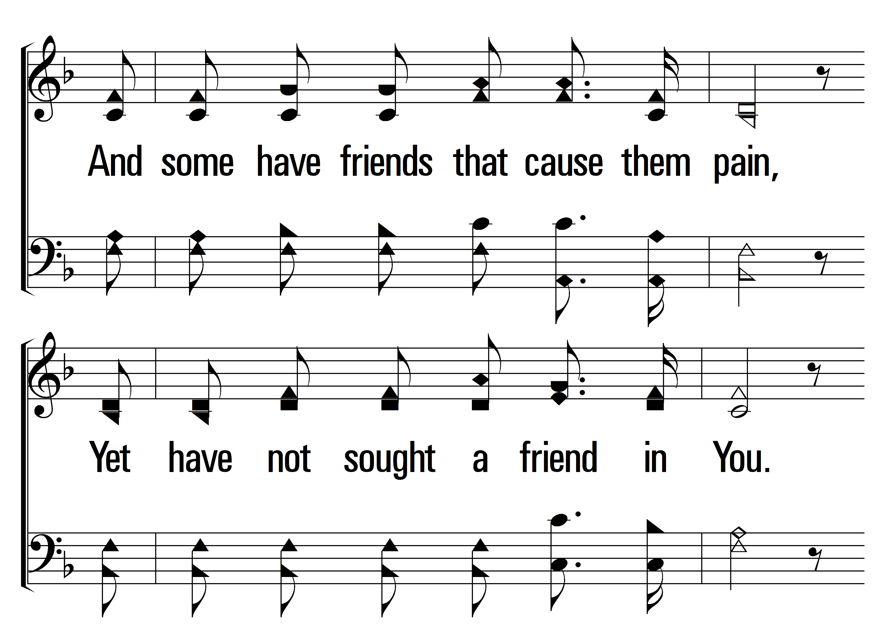
1
C
2
C
3
C
4
C
114
HEAL US ALL
© 2024 Sumphonia Productions, LLC

Slide 14
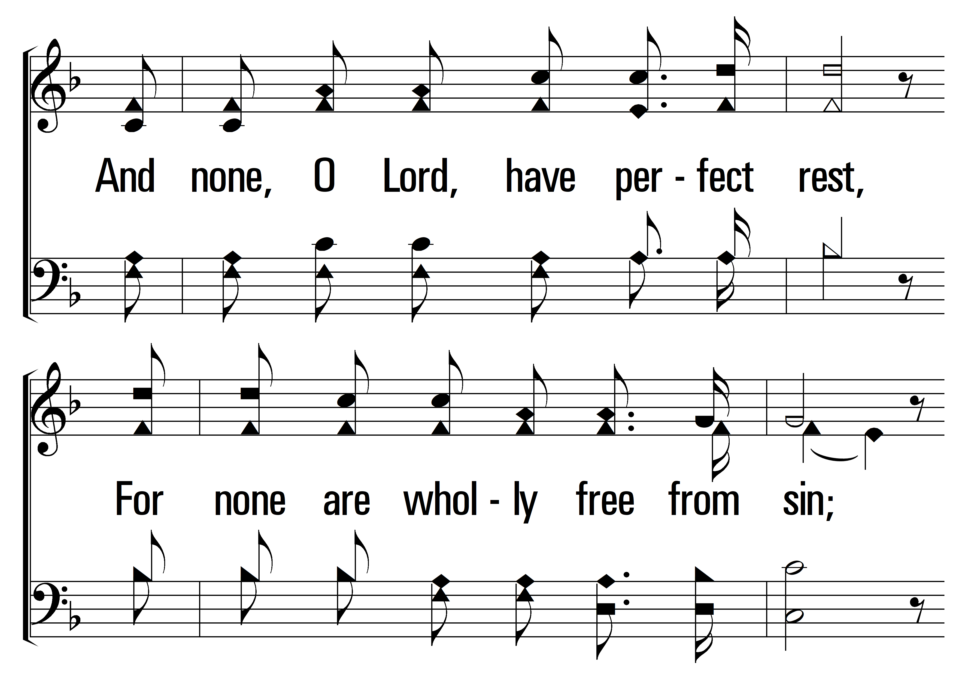
1
C
2
C
3
C
4
C
114
HEAL US ALL
© 2024 Sumphonia Productions, LLC

Slide 15
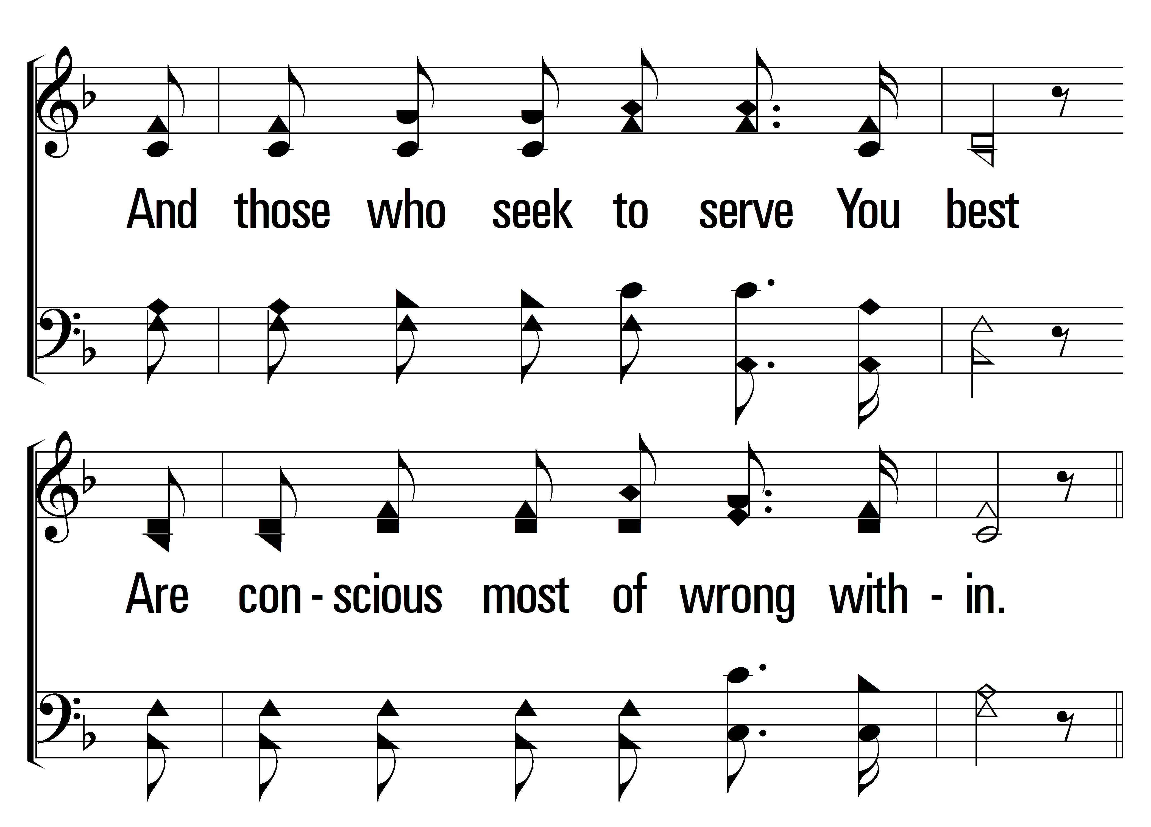
1
C
2
C
3
C
4
C
114
HEAL US ALL
© 2024 Sumphonia Productions, LLC

Slide 16
1
C
2
C
3
C
4
C
114
HEAL US ALL
© 2024 Sumphonia Productions, LLC

Slide 17
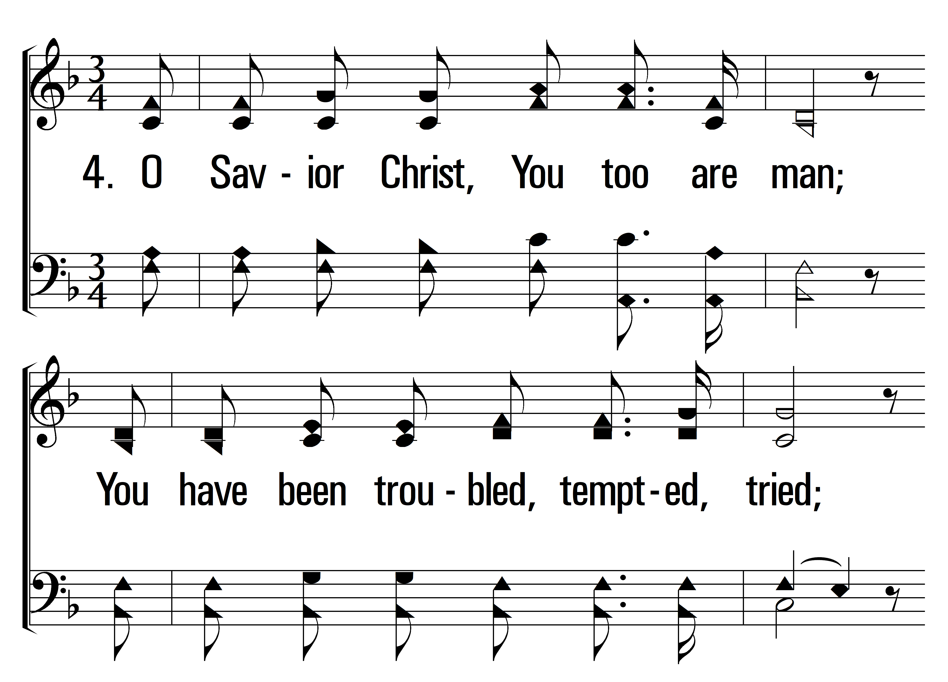
1
C
2
C
3
C
4
C
114
HEAL US ALL
© 2024 Sumphonia Productions, LLC

Slide 18
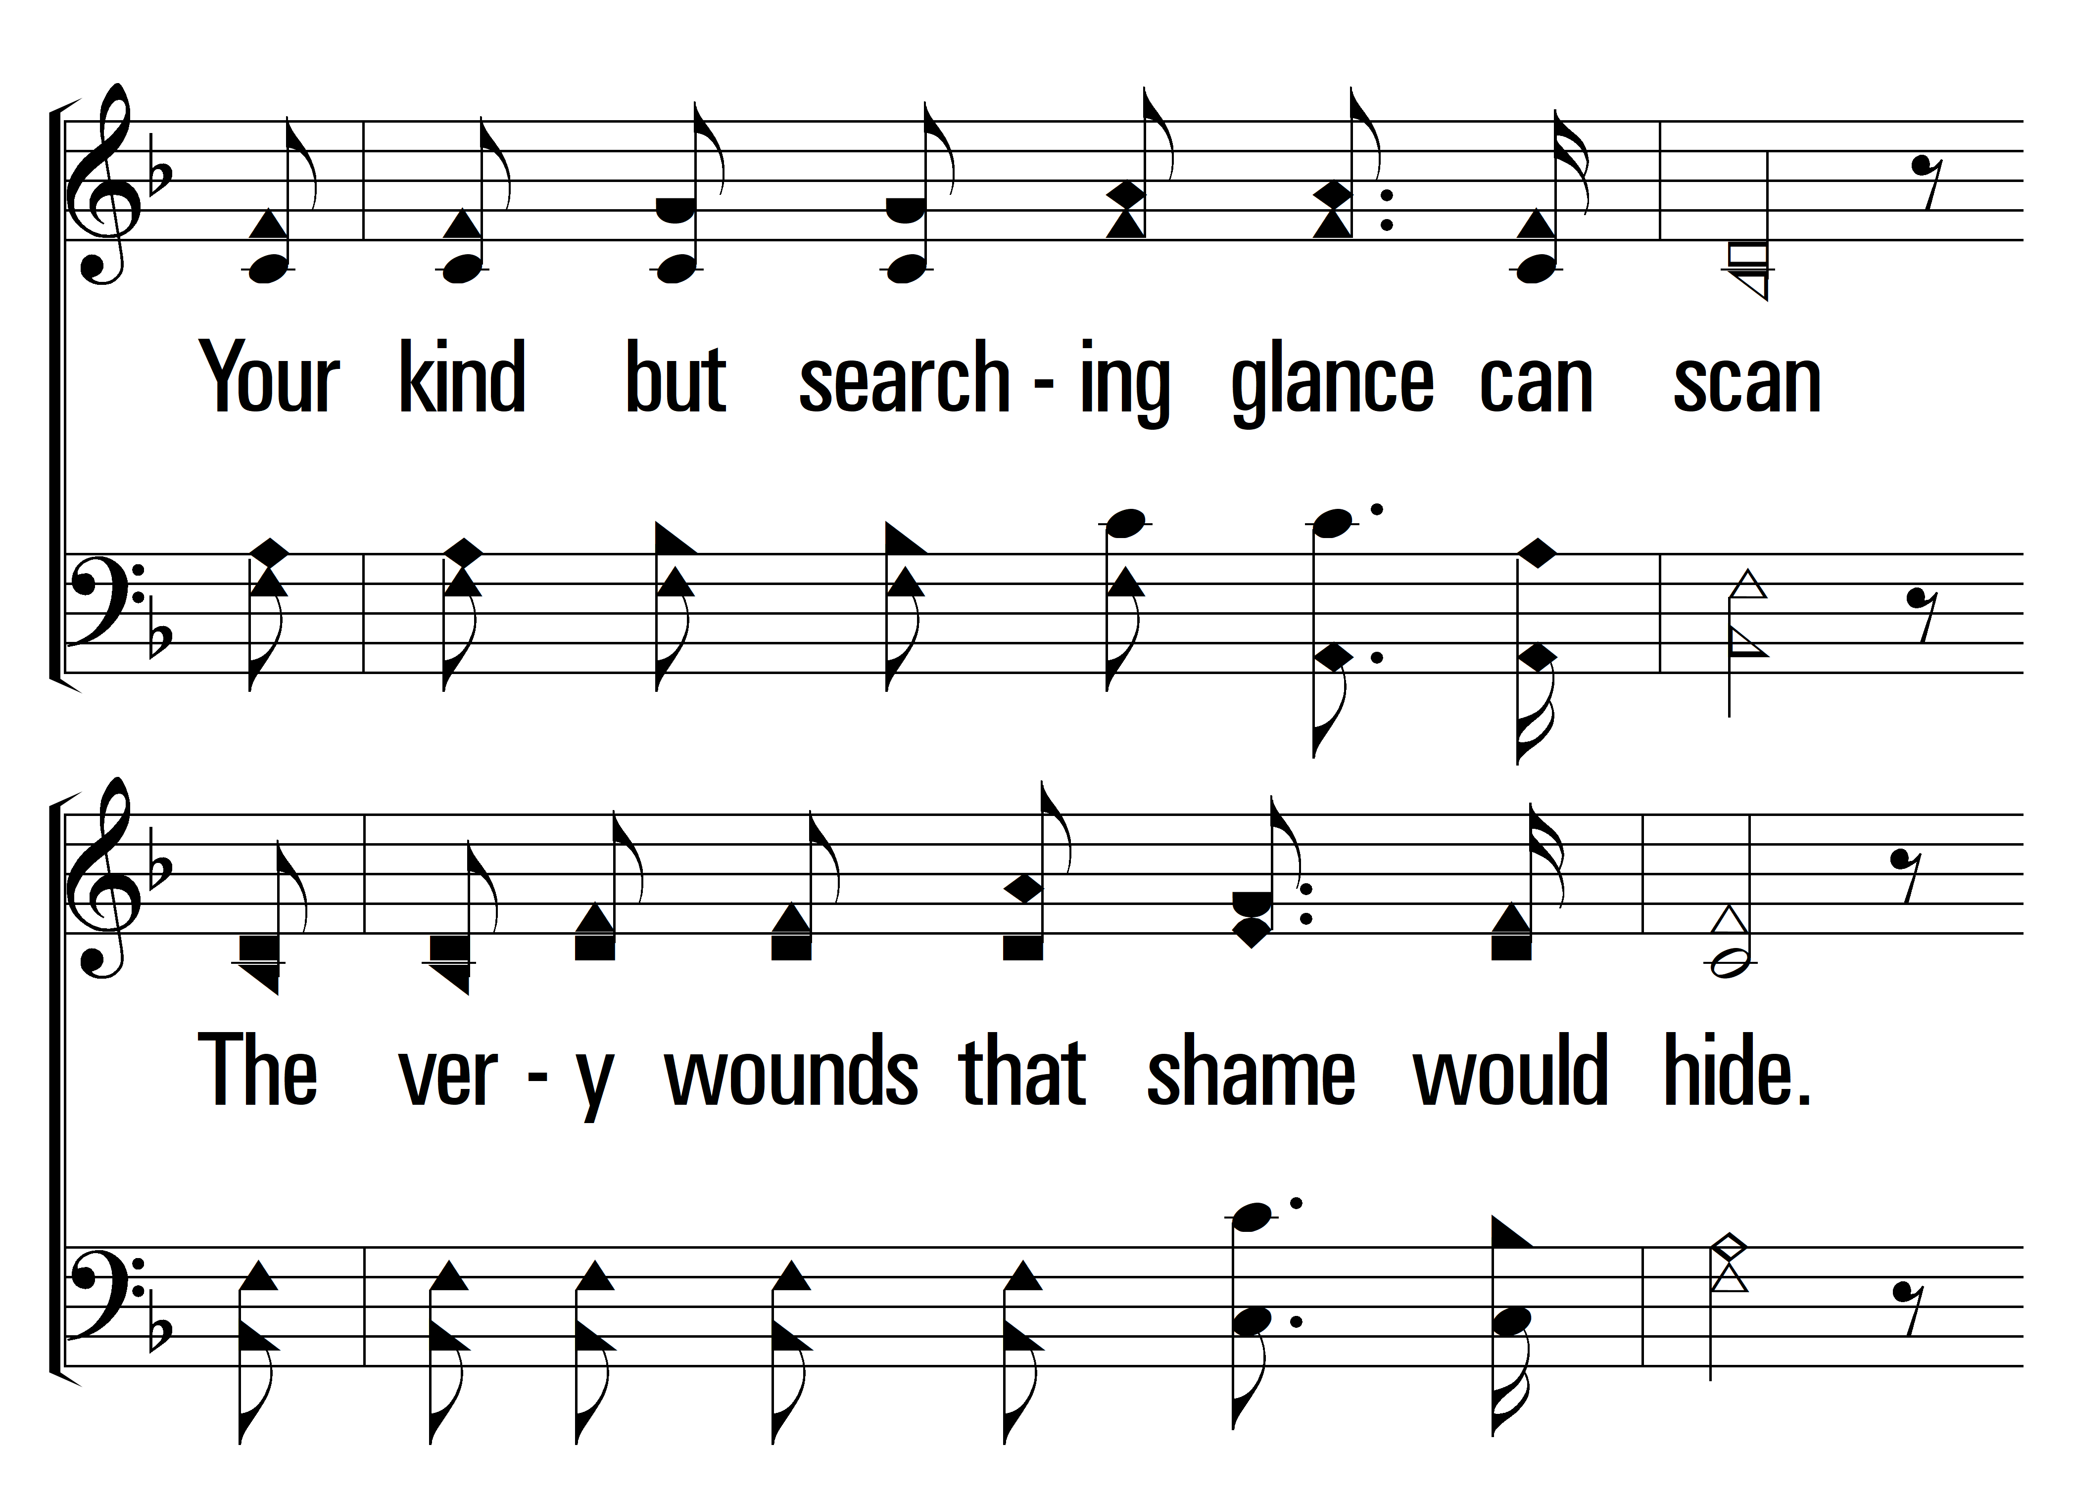
1
C
2
C
3
C
4
C
114
HEAL US ALL
© 2024 Sumphonia Productions, LLC

Slide 19
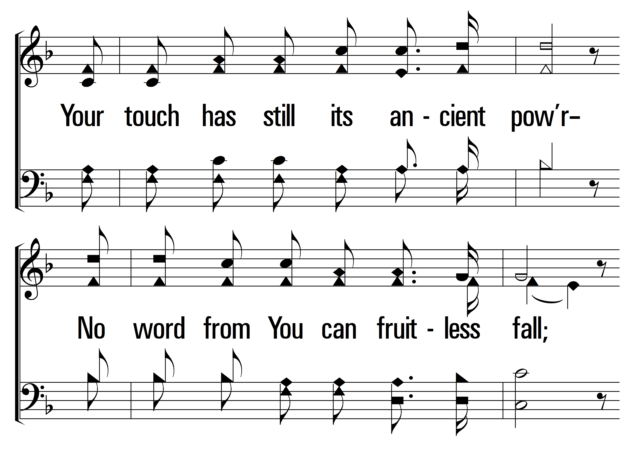
1
C
2
C
3
C
4
C
114
HEAL US ALL
© 2024 Sumphonia Productions, LLC

Slide 20
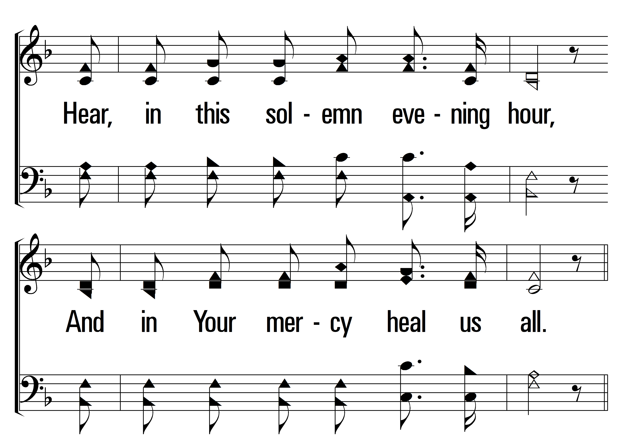
1
C
2
C
3
C
4
C
114
HEAL US ALL
© 2024 Sumphonia Productions, LLC

Slide 21
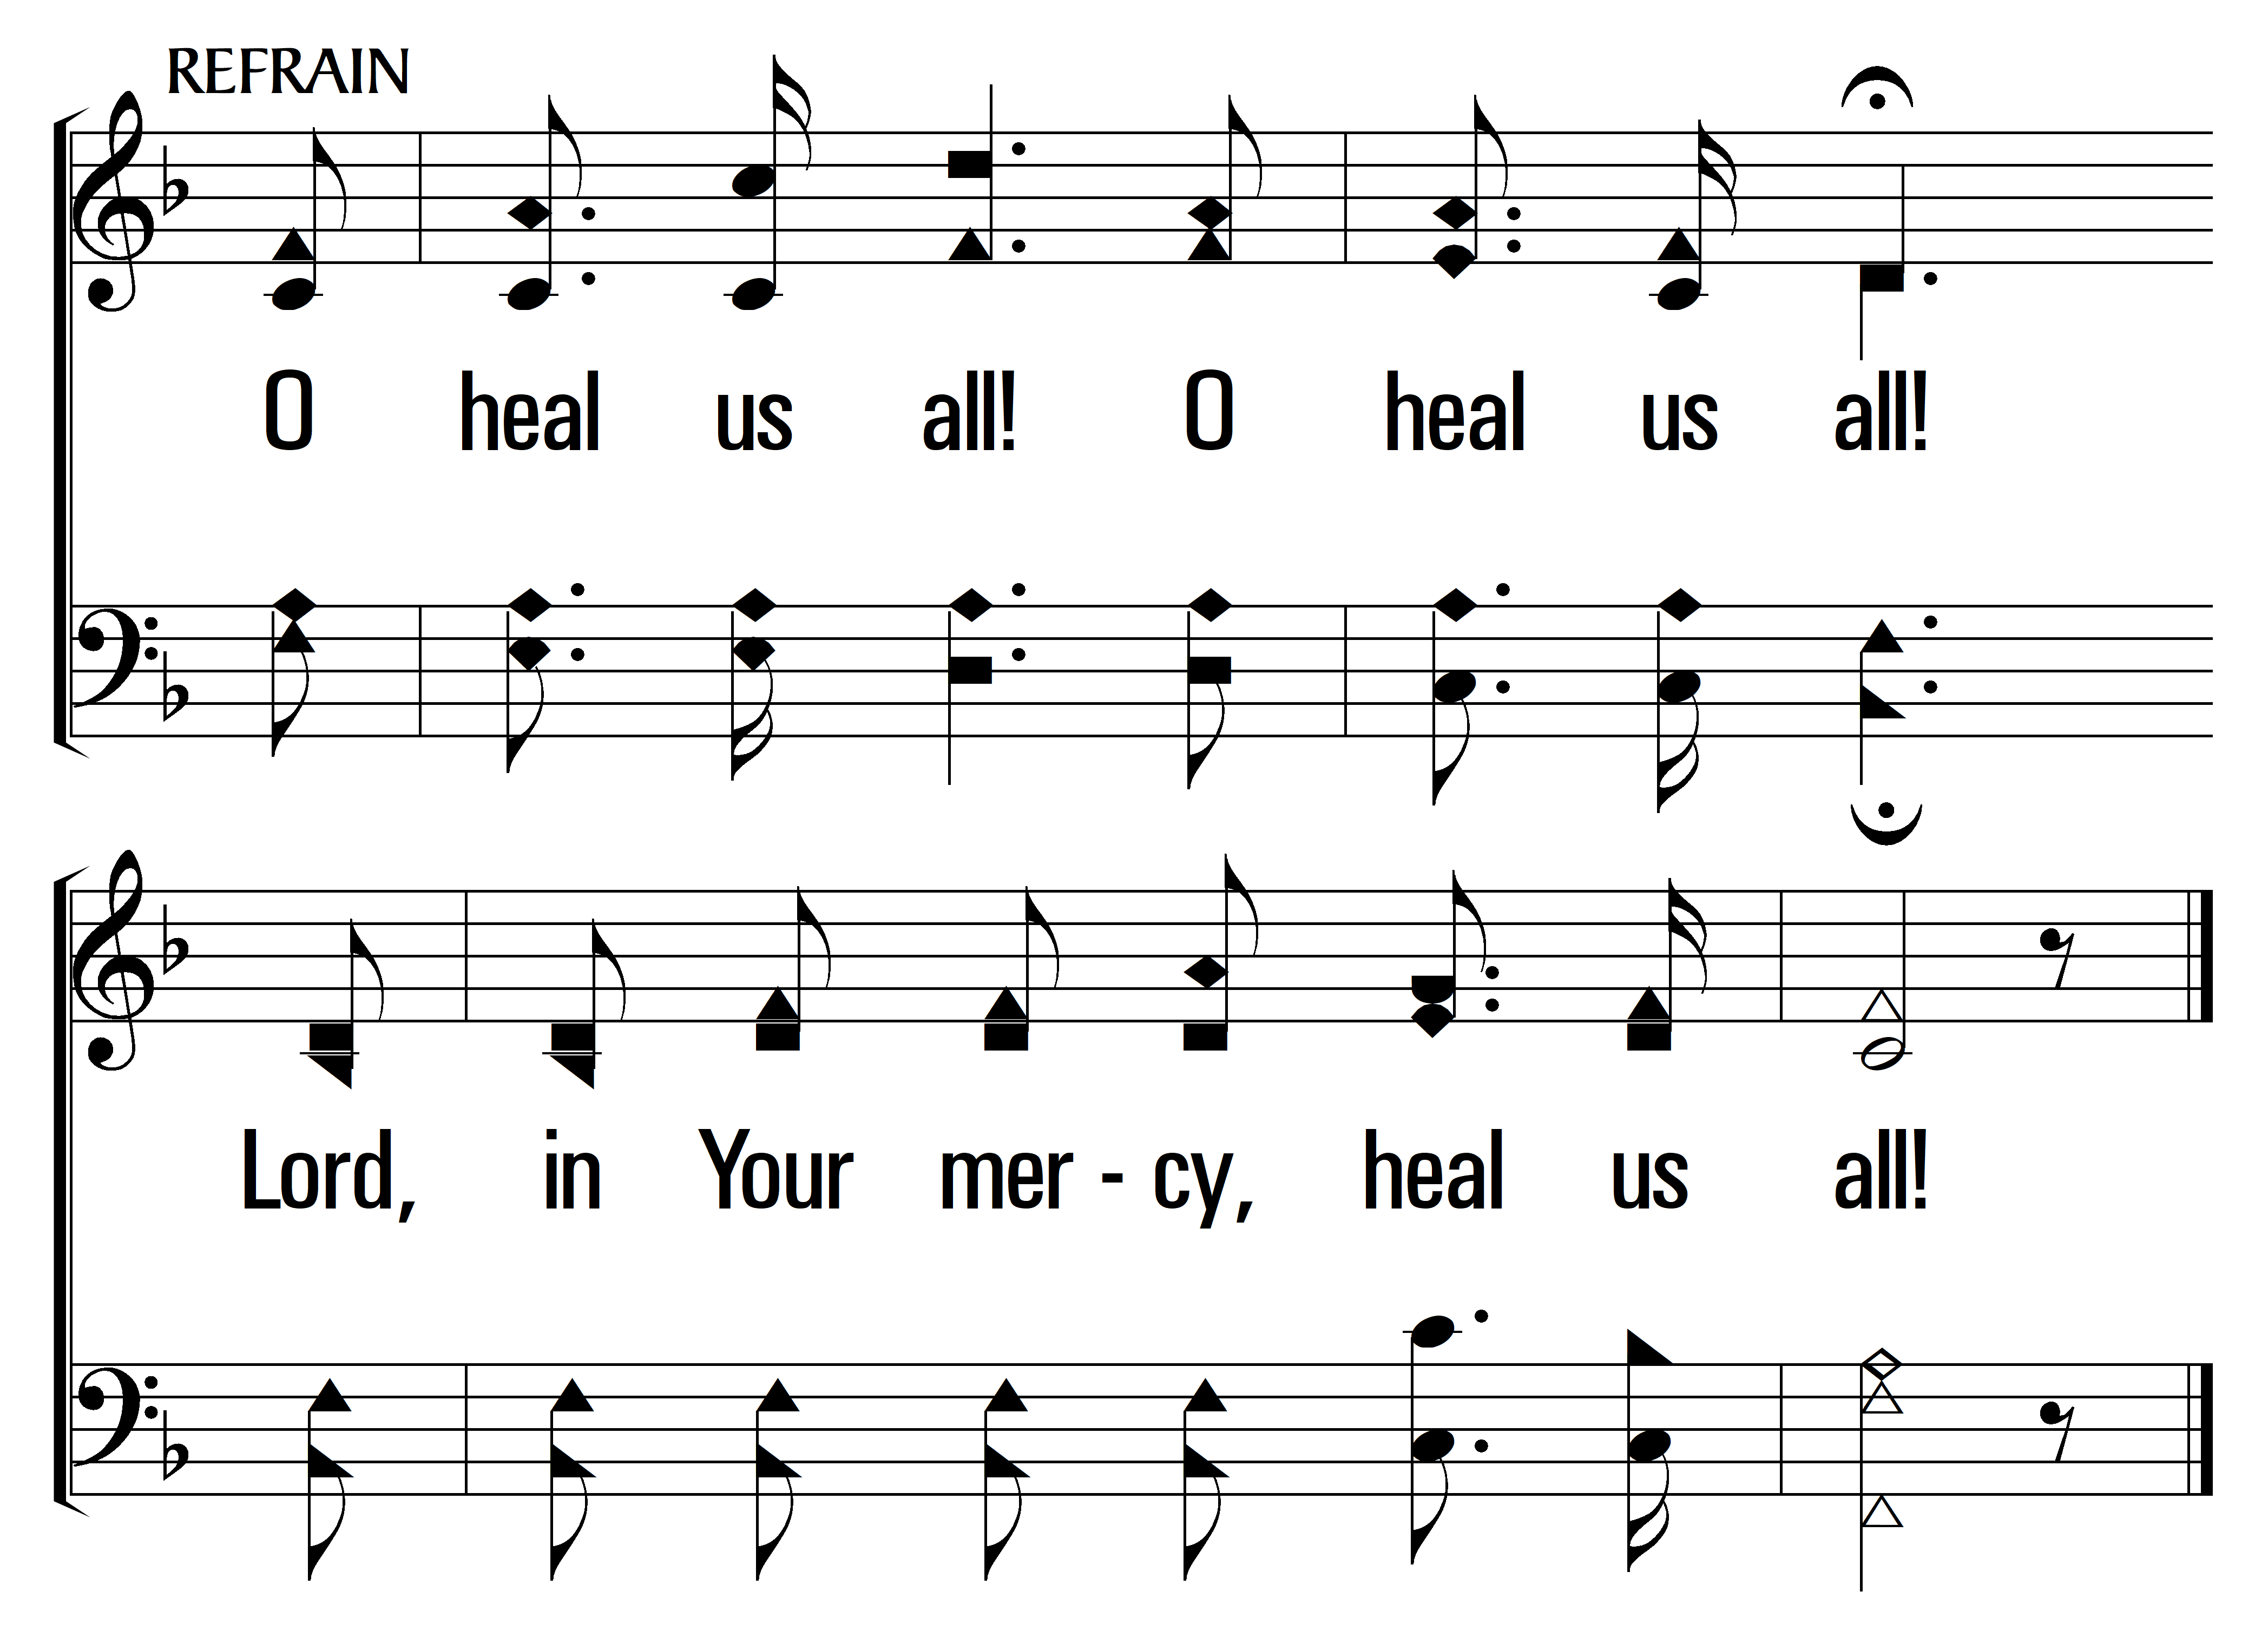
1
C
2
C
3
C
4
C
114
HEAL US ALL
© 2024 Sumphonia Productions, LLC

