Slide 1
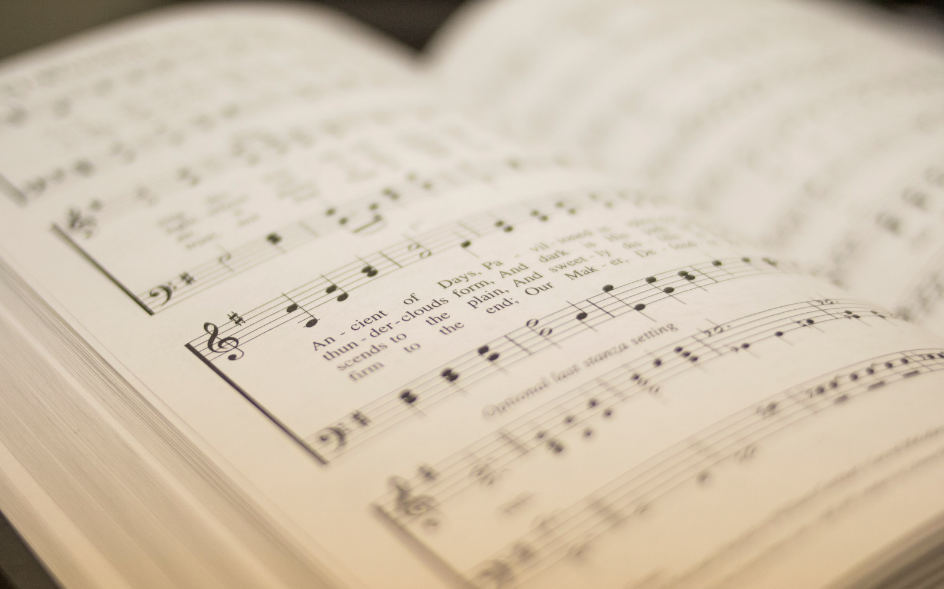

116
IN NEED
1
2
“SINGING...TO THE LORD” COLOSSIANS 3:16
Words & Music: Ross King Arr. Shane Coffman © 1996 Reliance Music. All Rights Reserved

Slide 2

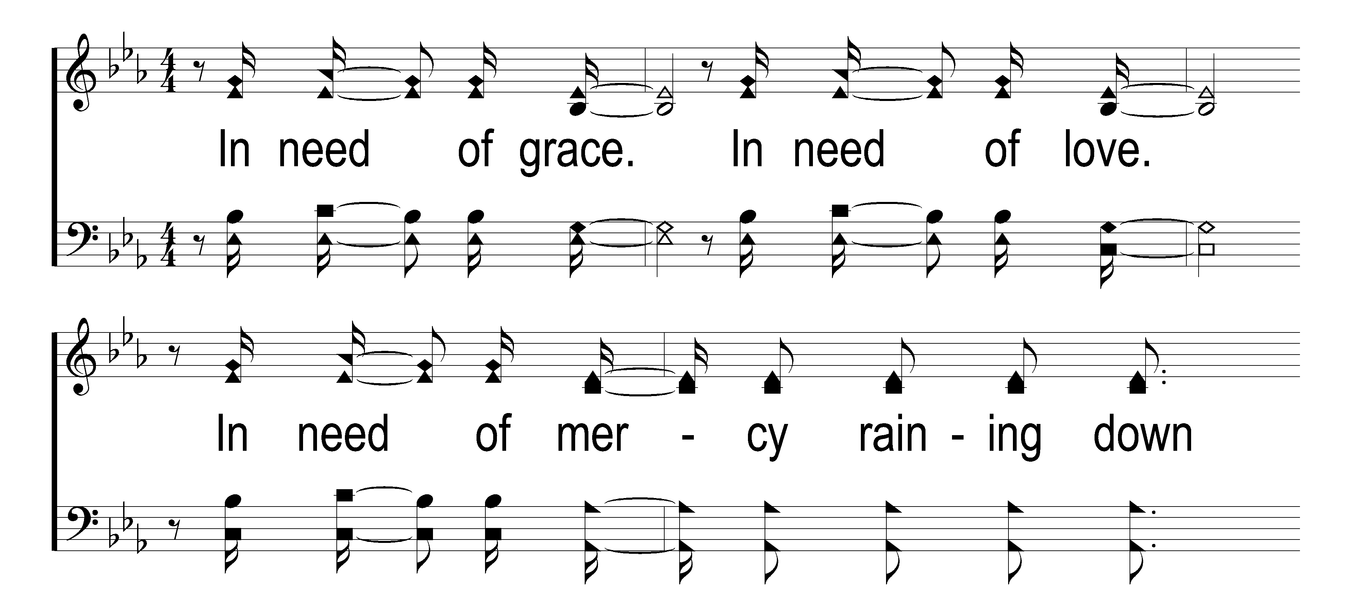

1
C
2
C
116
IN NEED
© 2018 Taylor Publications LLC

Slide 3
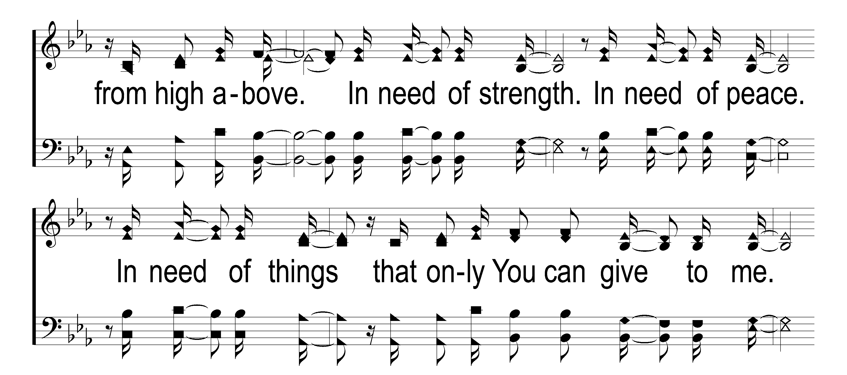
1
C
2
C
116
IN NEED
© 2018 Taylor Publications LLC

Slide 4
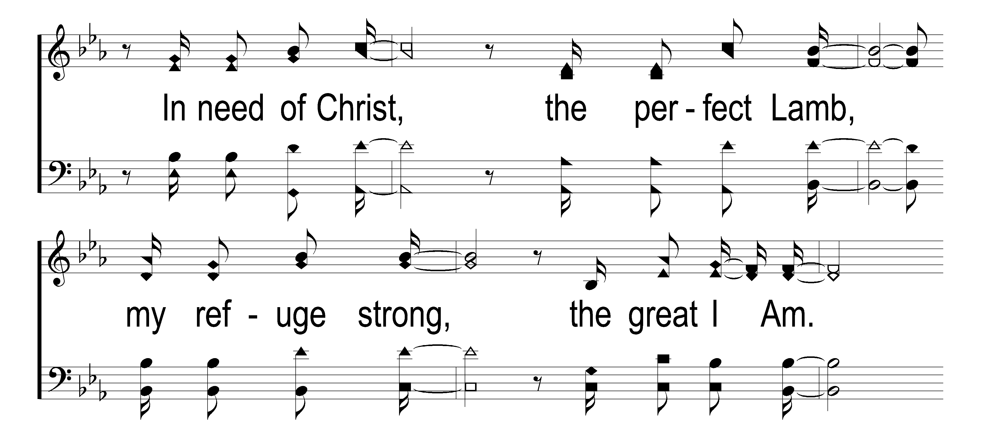
1
C
2
C
116
IN NEED
© 2018 Taylor Publications LLC

Slide 5
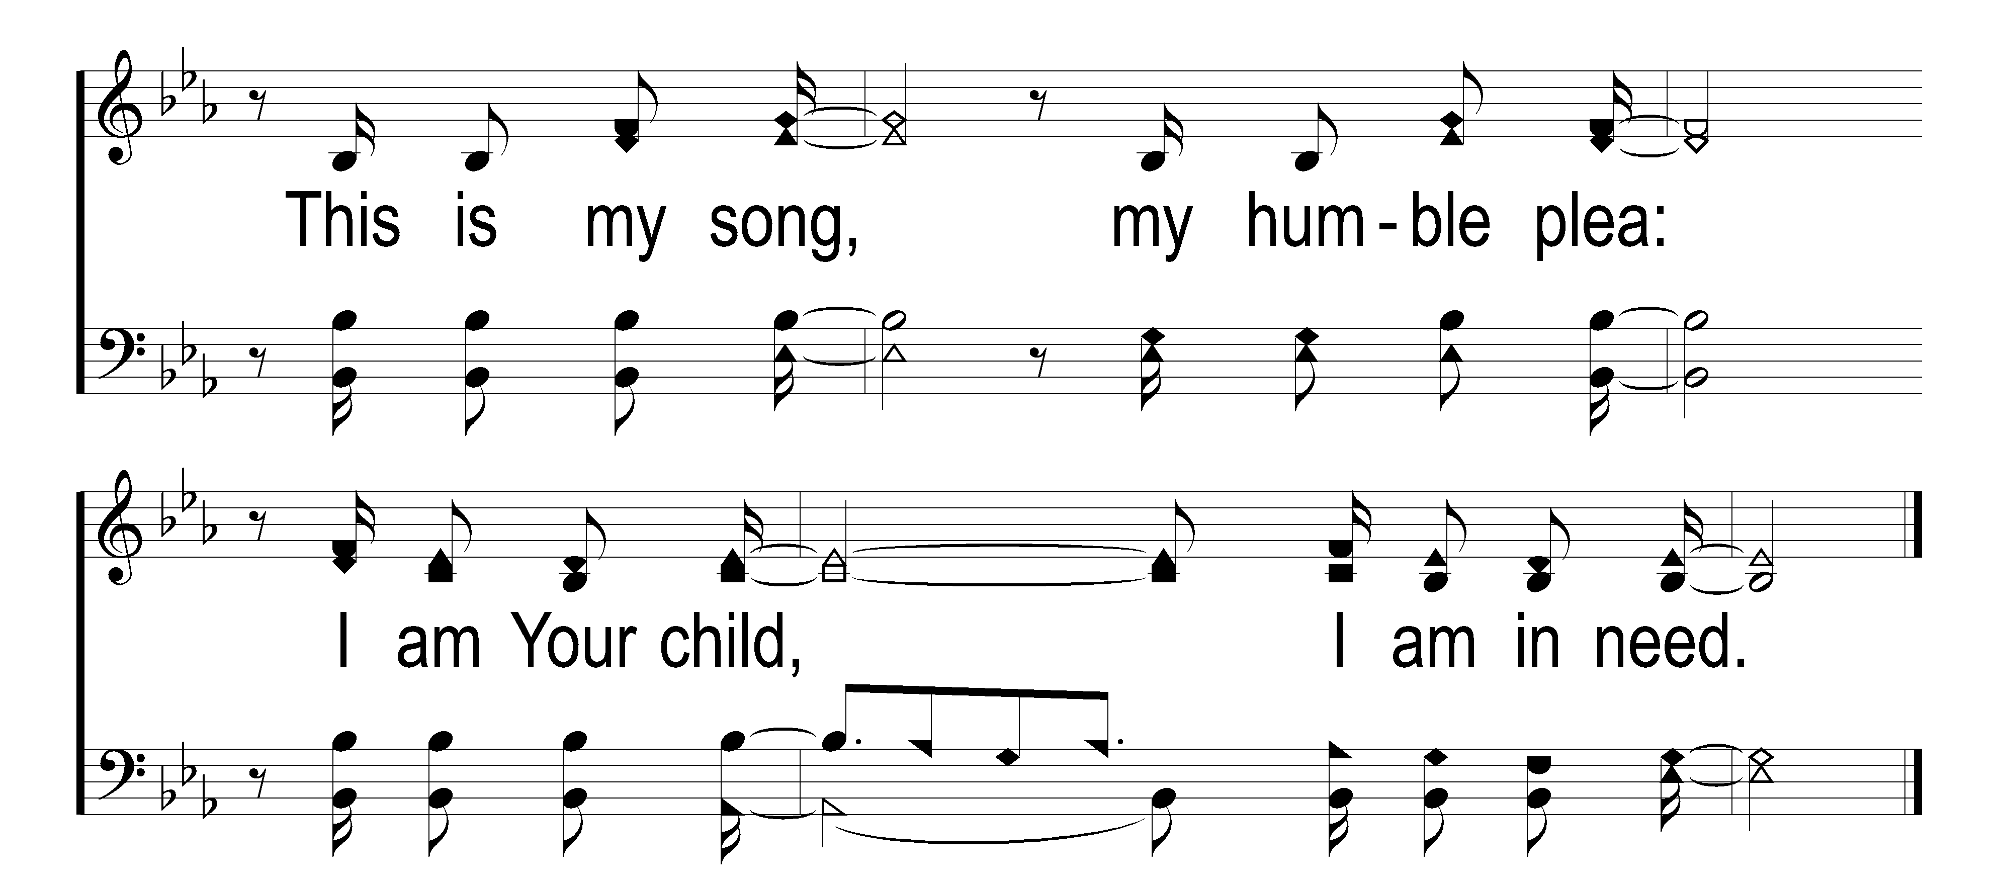
1
C
2
C
116
IN NEED
© 2018 Taylor Publications LLC

Slide 6
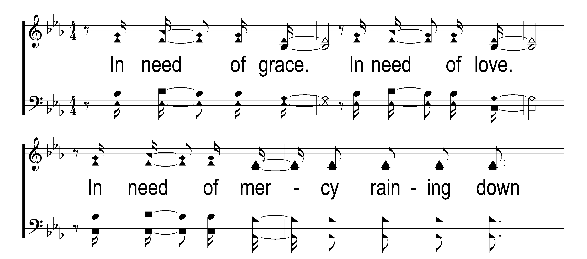
1
C
2
C
116
IN NEED
© 2018 Taylor Publications LLC

Slide 7
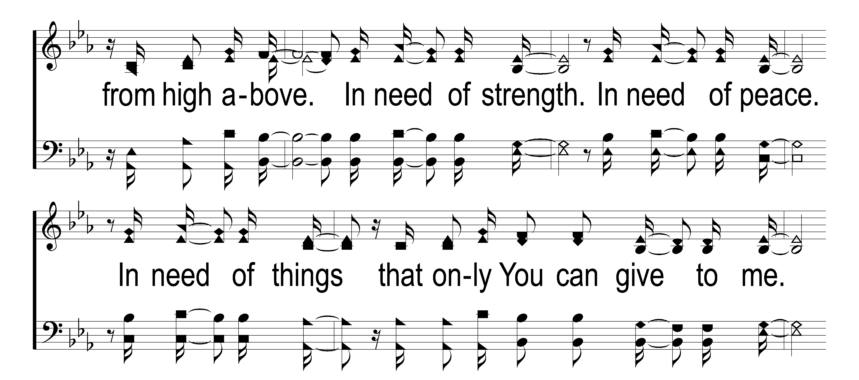
1
C
2
C
116
IN NEED
© 2018 Taylor Publications LLC

Slide 8
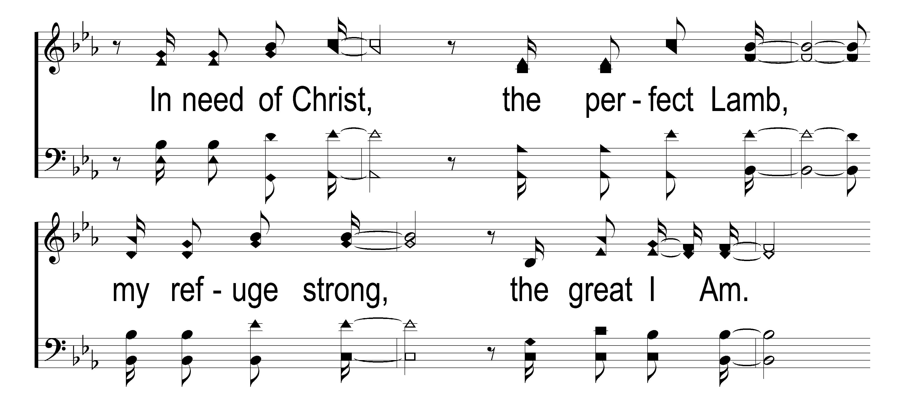
1
C
2
C
116
IN NEED
© 2018 Taylor Publications LLC

Slide 9
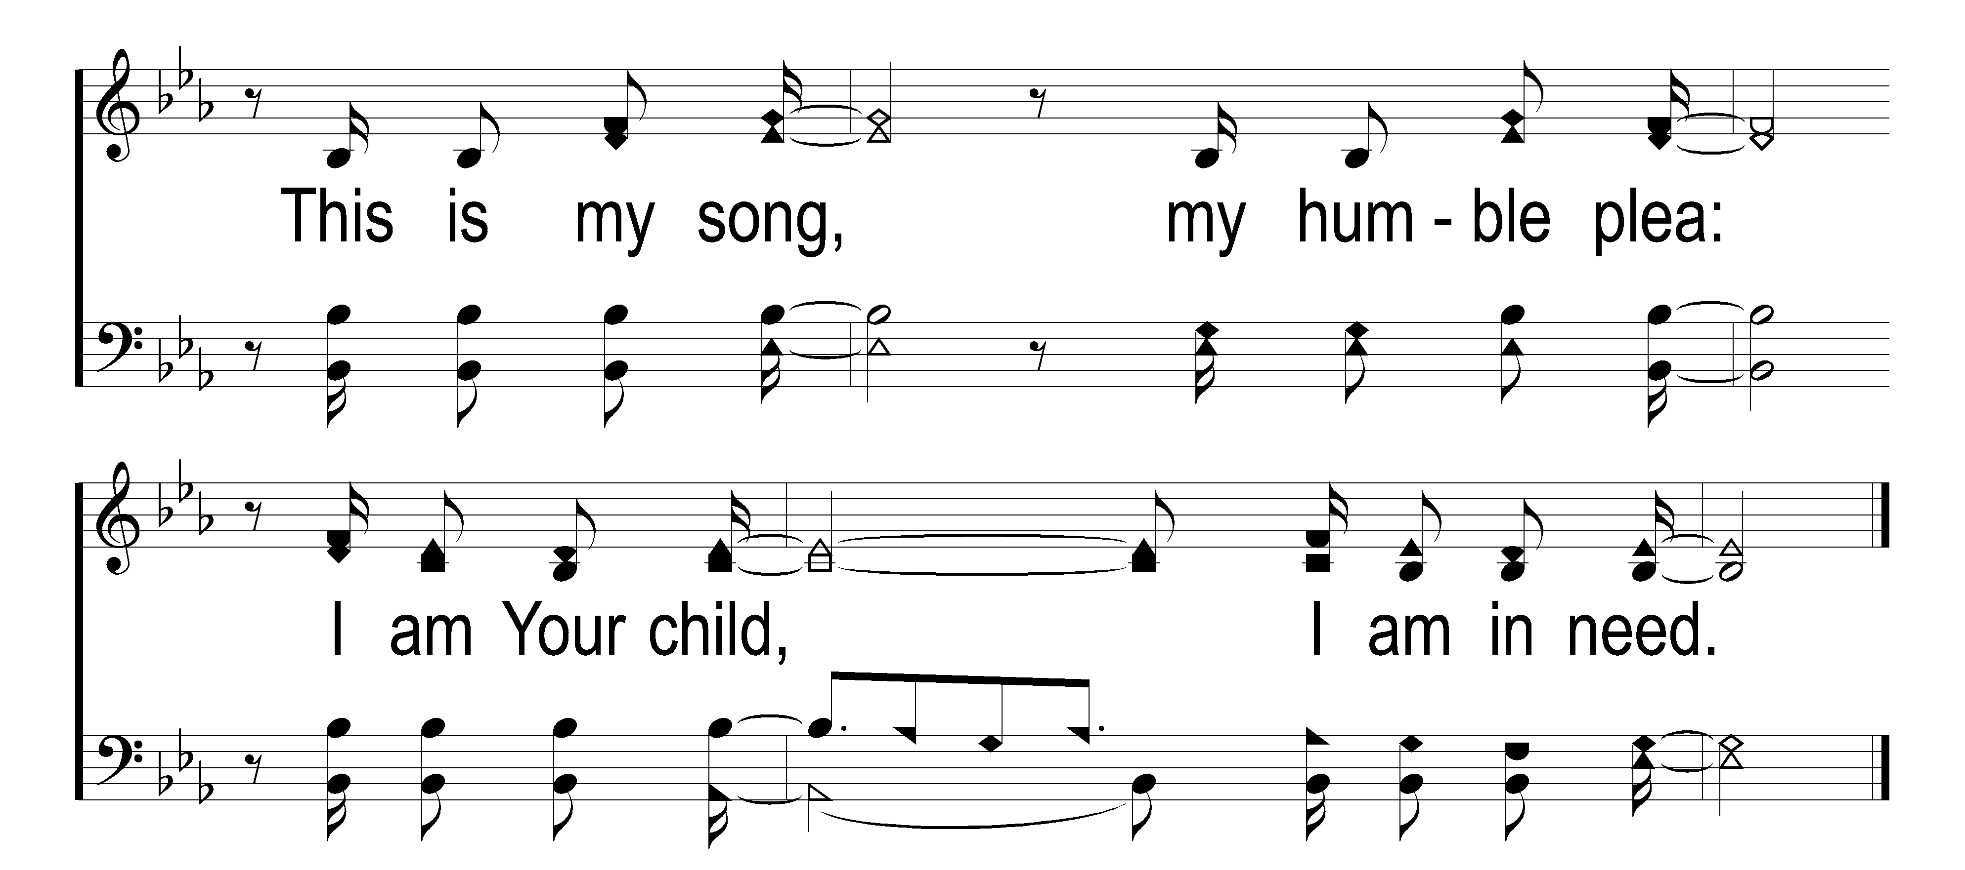
1
C
2
C
116
IN NEED
© 2018 Taylor Publications LLC

Slide 10
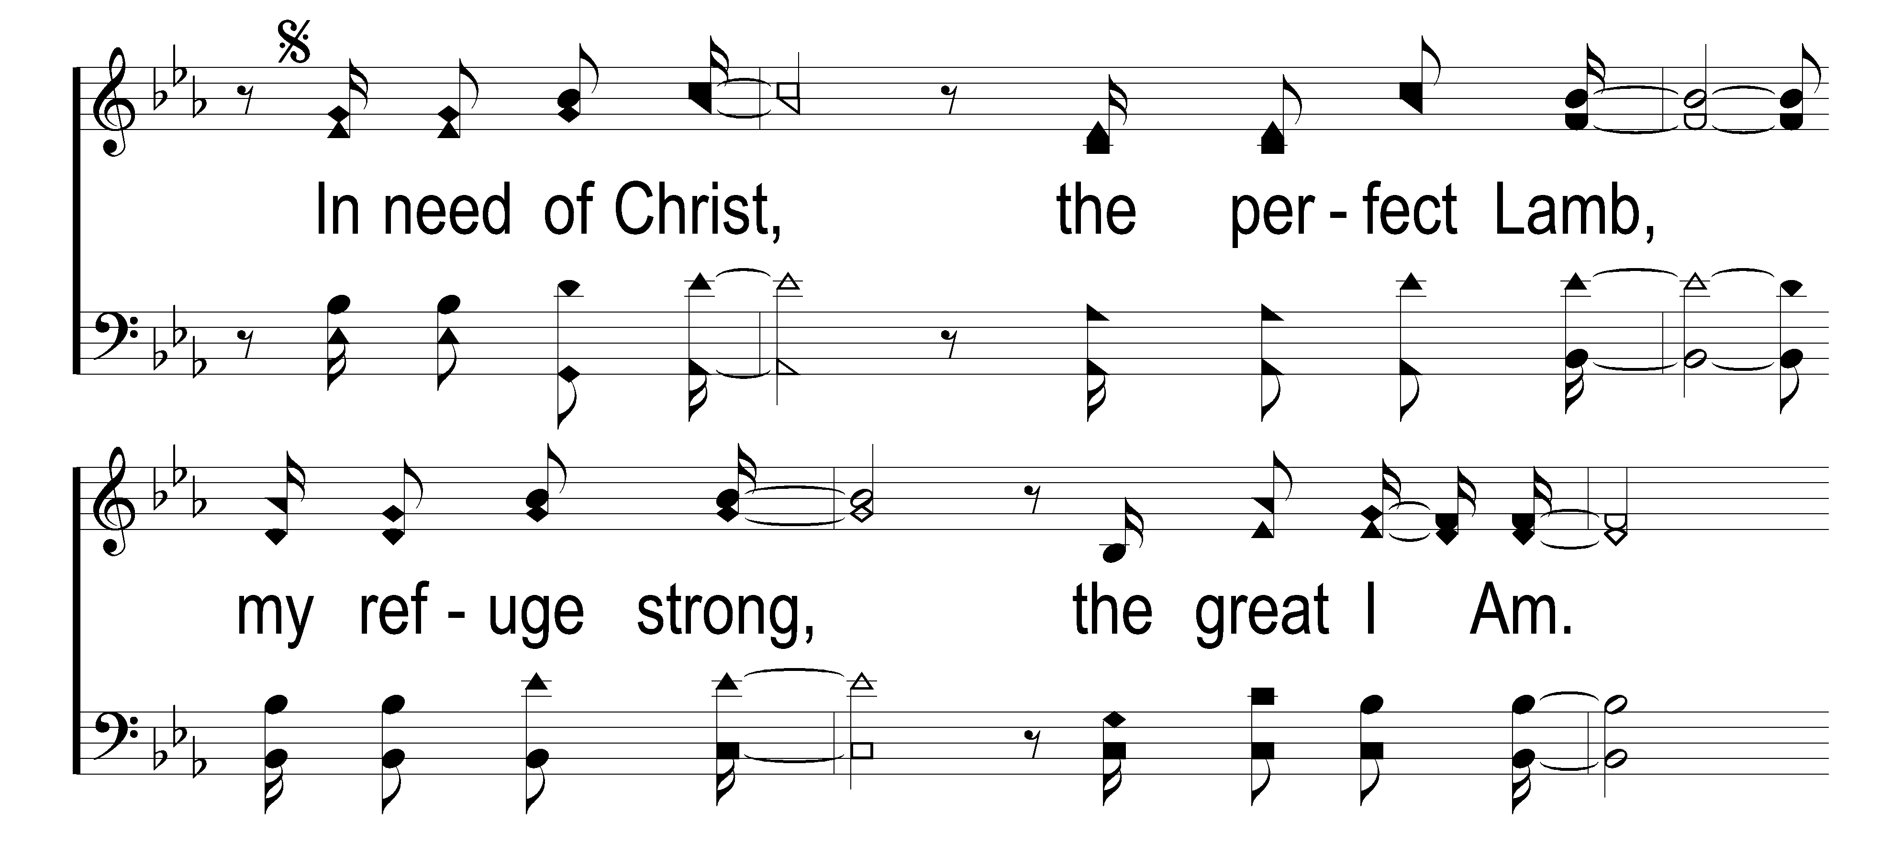
1
C
2
C
116
IN NEED
© 2018 Taylor Publications LLC

Slide 11
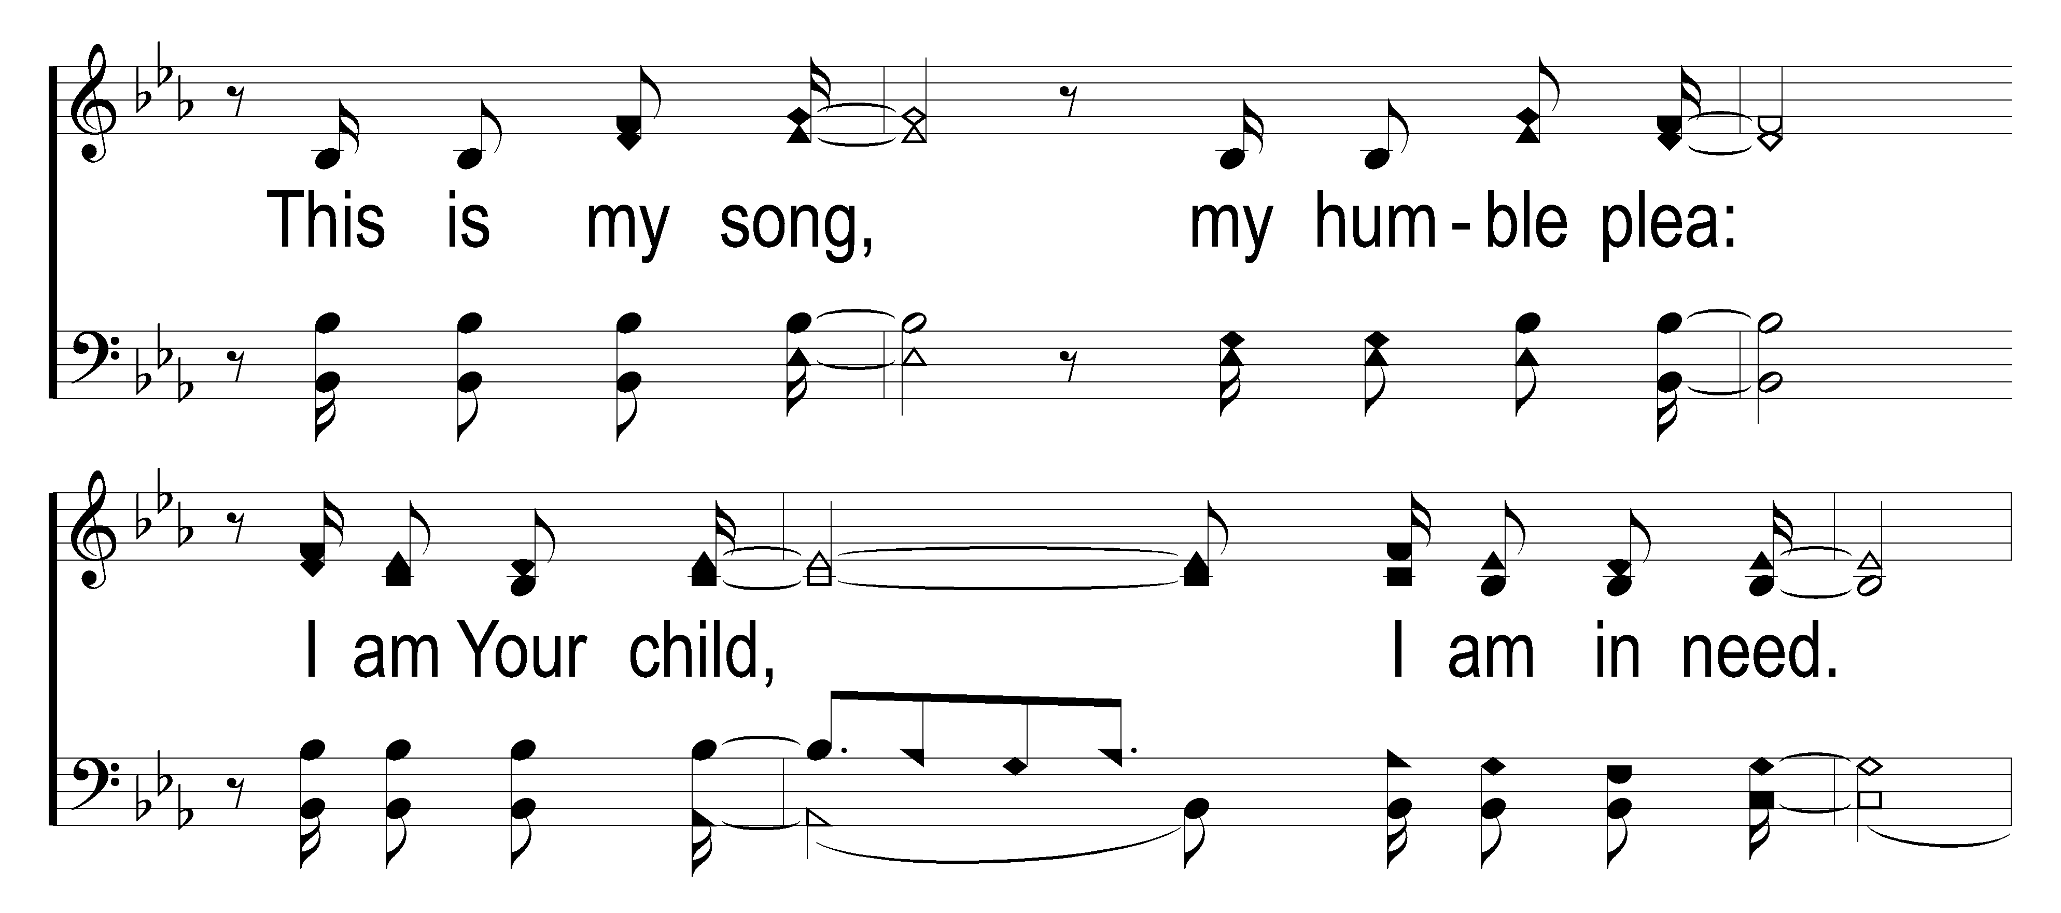
1
C
2
C
116
IN NEED
© 2018 Taylor Publications LLC

Slide 12
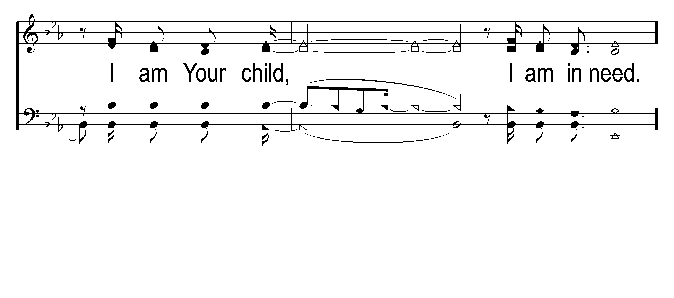
1
C
2
C
116
IN NEED
© 2018 Taylor Publications LLC

