Slide 1


200
LIVING HOPE
1
2
3
“SINGING...TO THE LORD” COLOSSIANS 3:16
Â© Copyright 2018 by Phil Wickham/Simply Global Songs/Sing My Songs/Bethel Music Publishing. All Rights Reserved. Used by Permission. CCLI Song #7106807 Words & Music: Phil Wickham & Brian Johnson Arr. Aneva Peirce

Slide 2

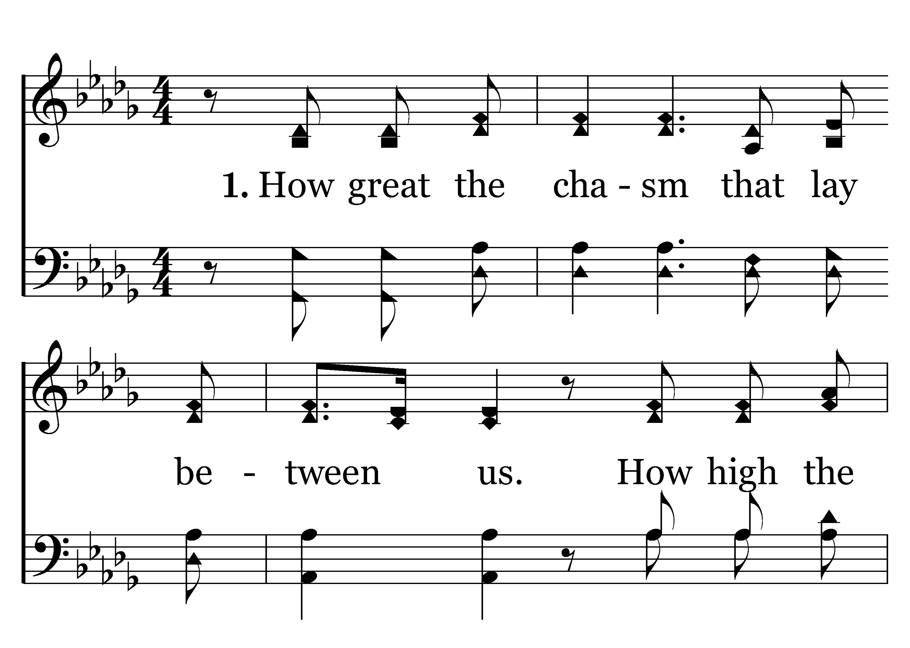

1
2
C
3
C
200
LIVING HOPE
Typeset R. J. Stevens Music

Slide 3
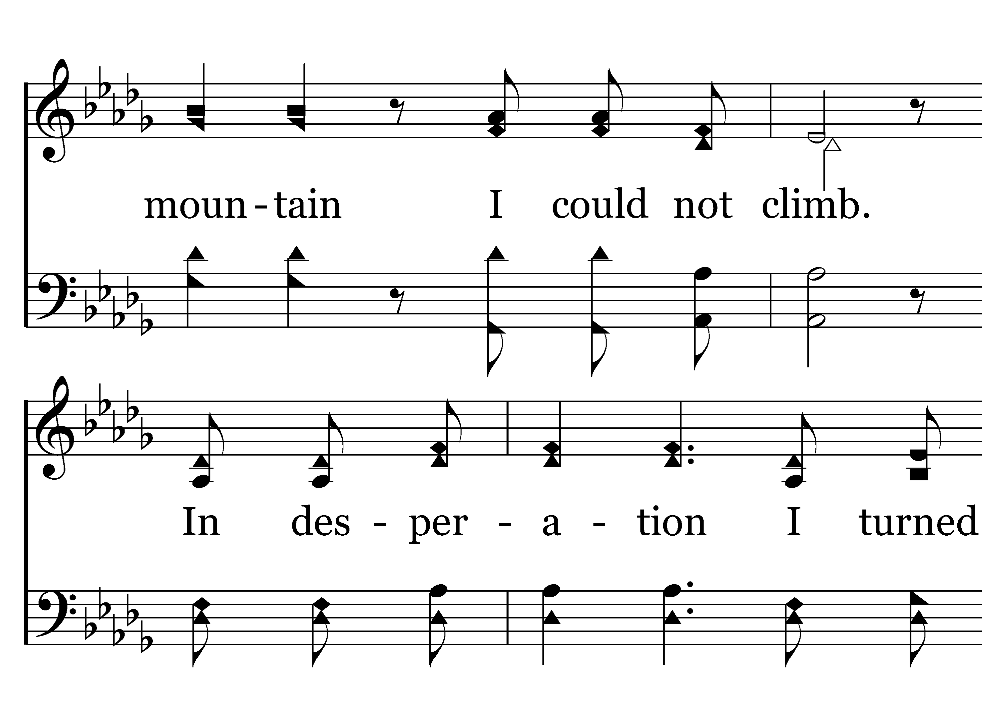
1
2
C
3
C
200
LIVING HOPE
Typeset R. J. Stevens Music

Slide 4
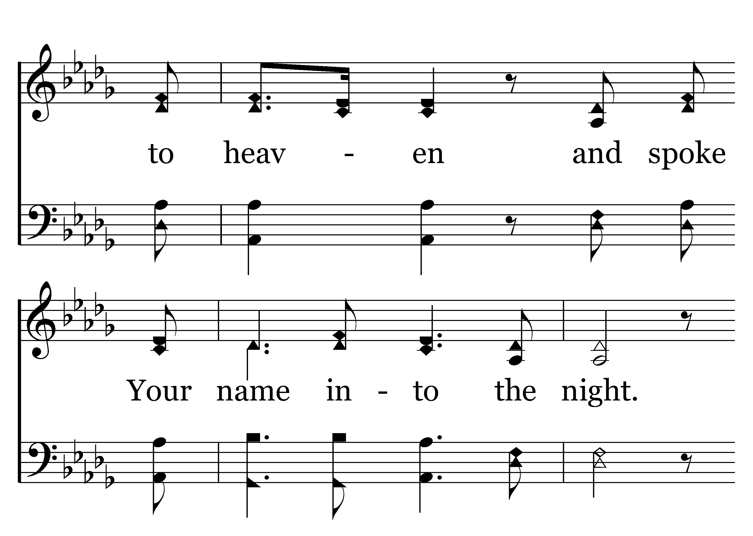
1
2
C
3
C
200
LIVING HOPE
Typeset R. J. Stevens Music

Slide 5
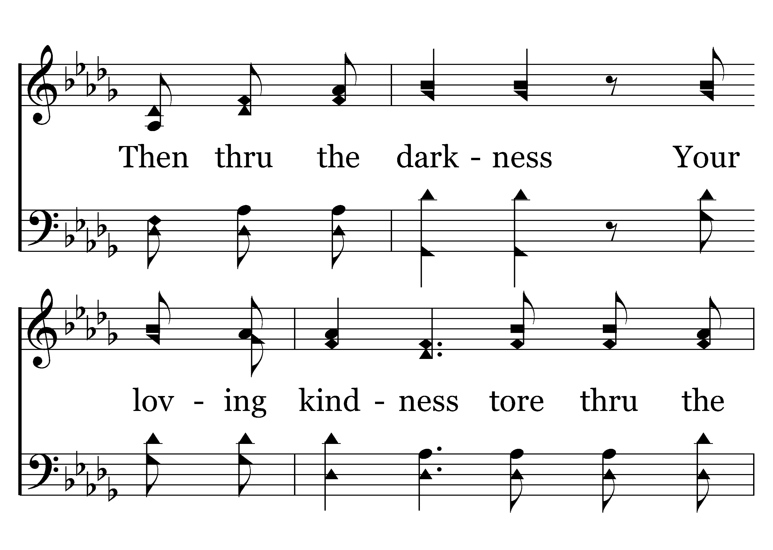
1
2
C
3
C
200
LIVING HOPE
Typeset R. J. Stevens Music

Slide 6
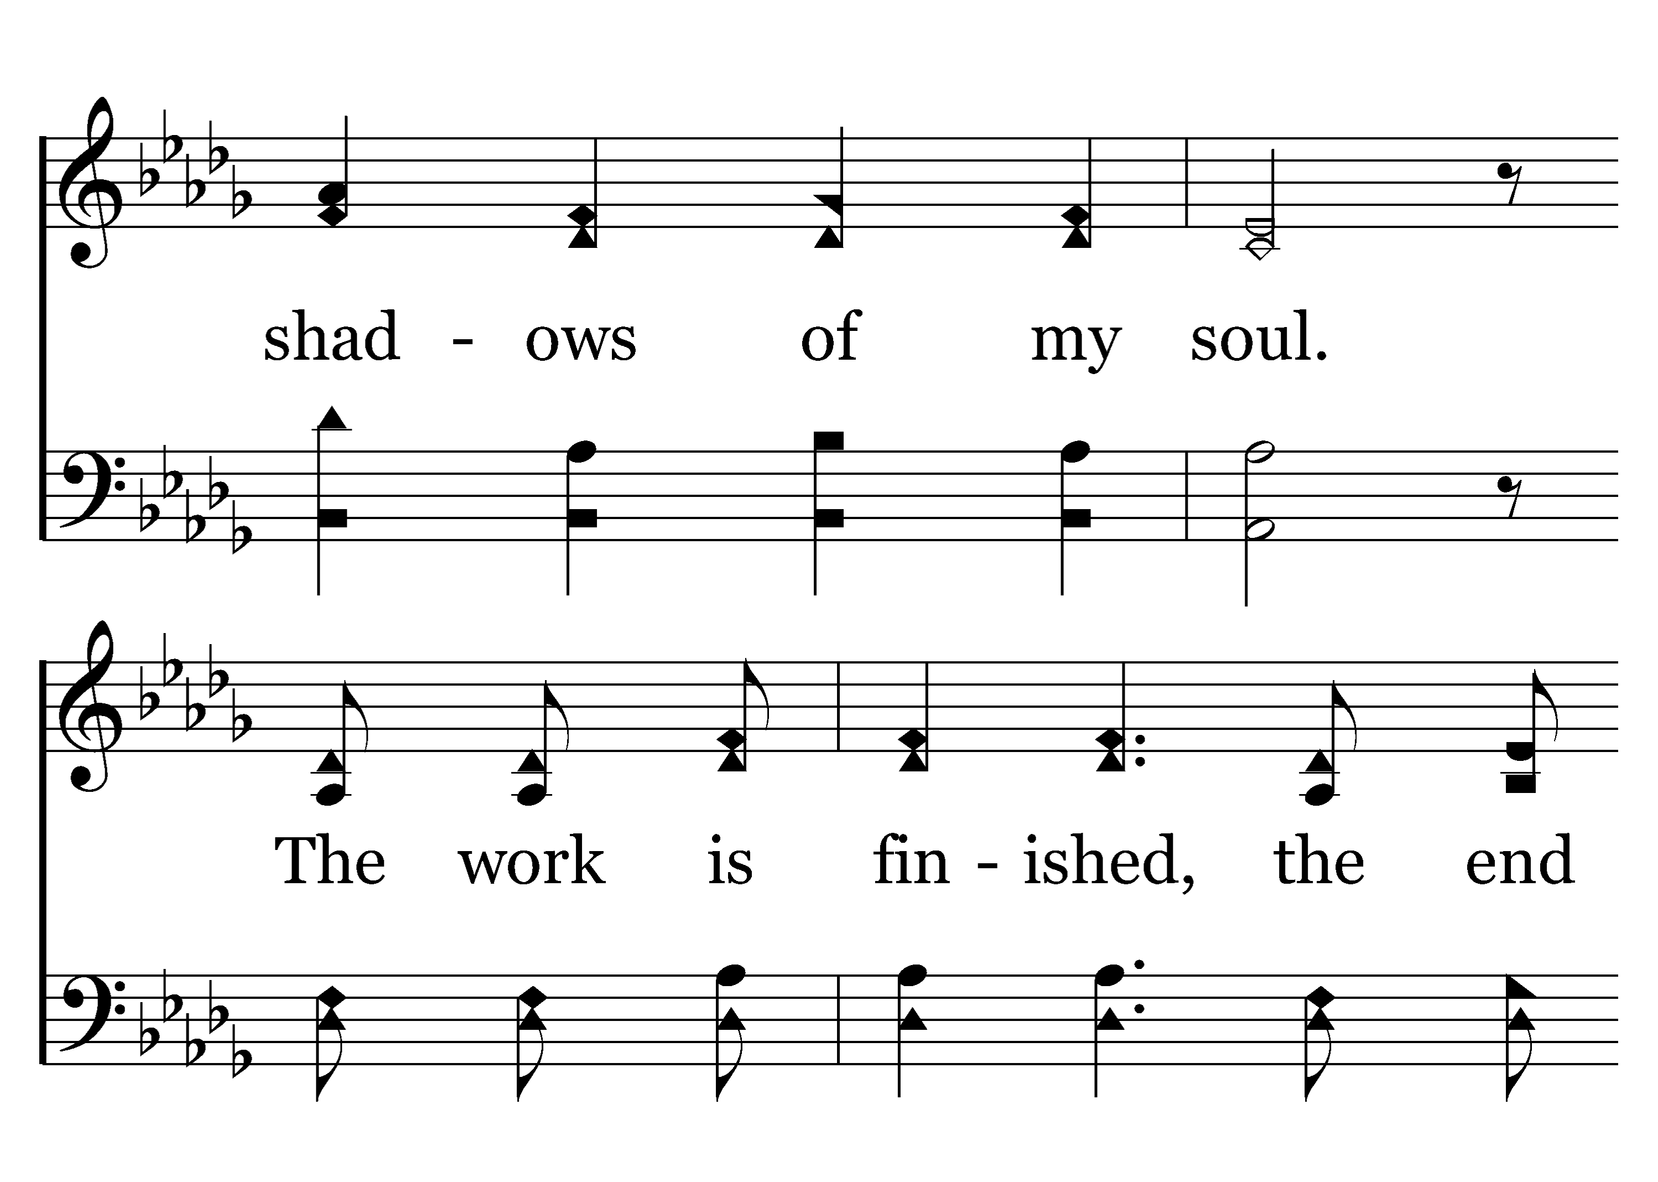
1
2
C
3
C
200
LIVING HOPE
Typeset R. J. Stevens Music

Slide 7
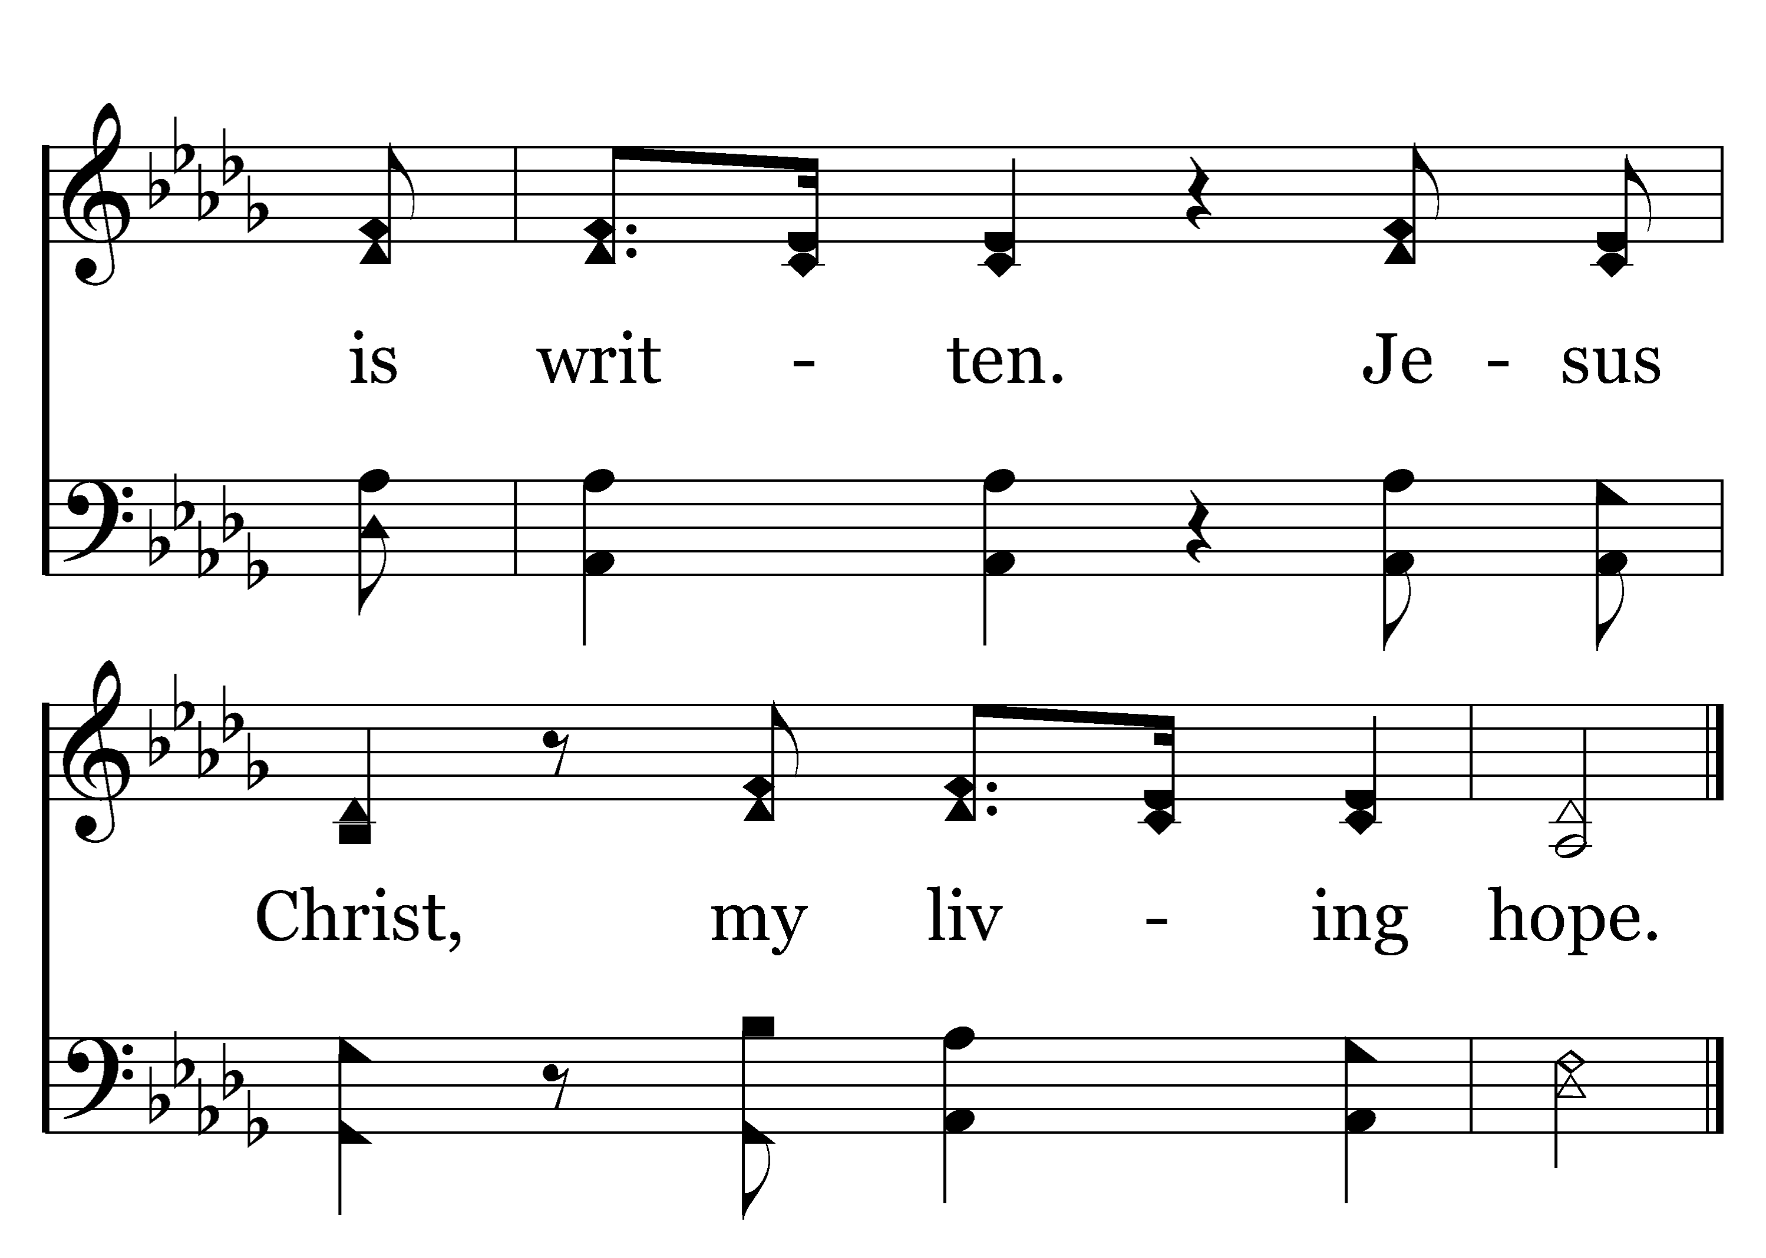
1
2
C
3
C
200
LIVING HOPE
Typeset R. J. Stevens Music

Slide 8
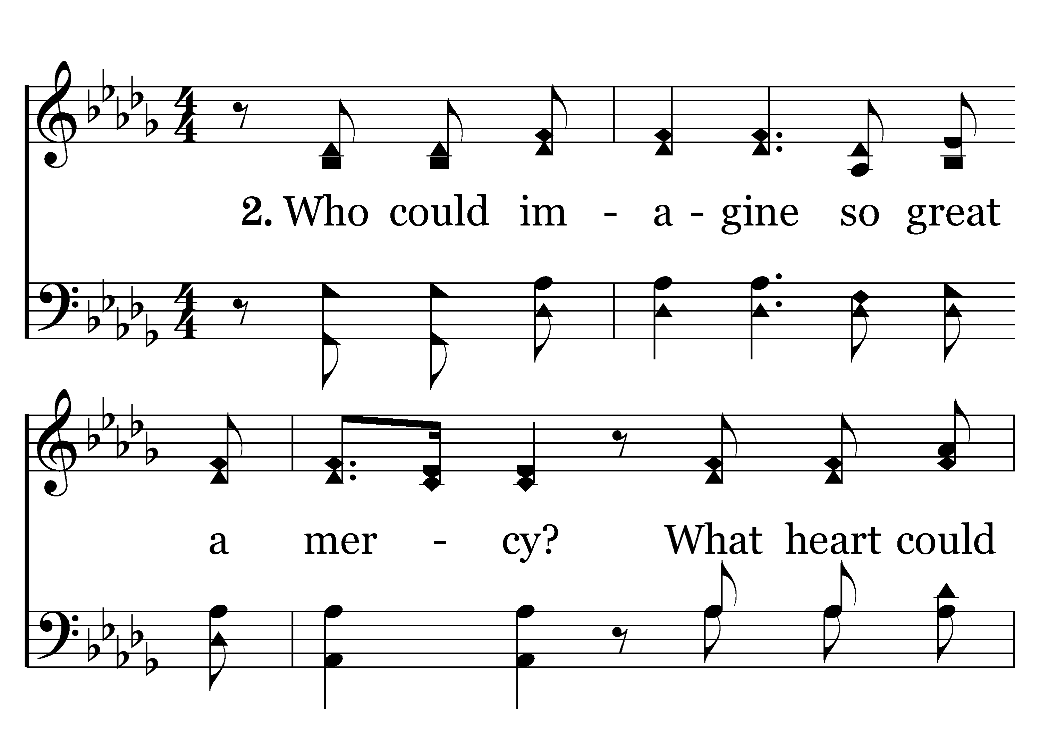
1
2
C
3
C
200
LIVING HOPE
Typeset R. J. Stevens Music

Slide 9
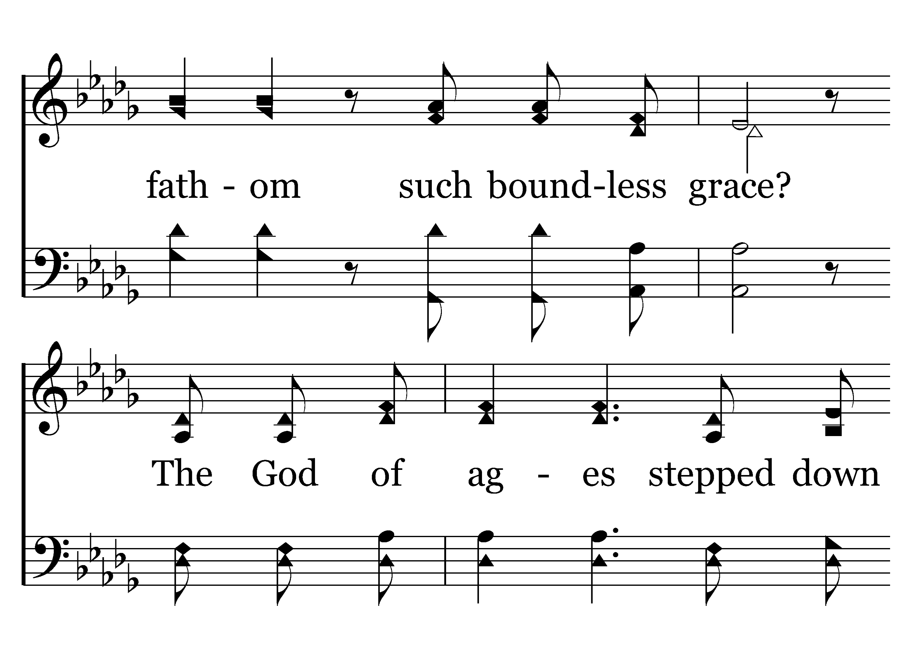
1
2
C
3
C
200
LIVING HOPE
Typeset R. J. Stevens Music

Slide 10
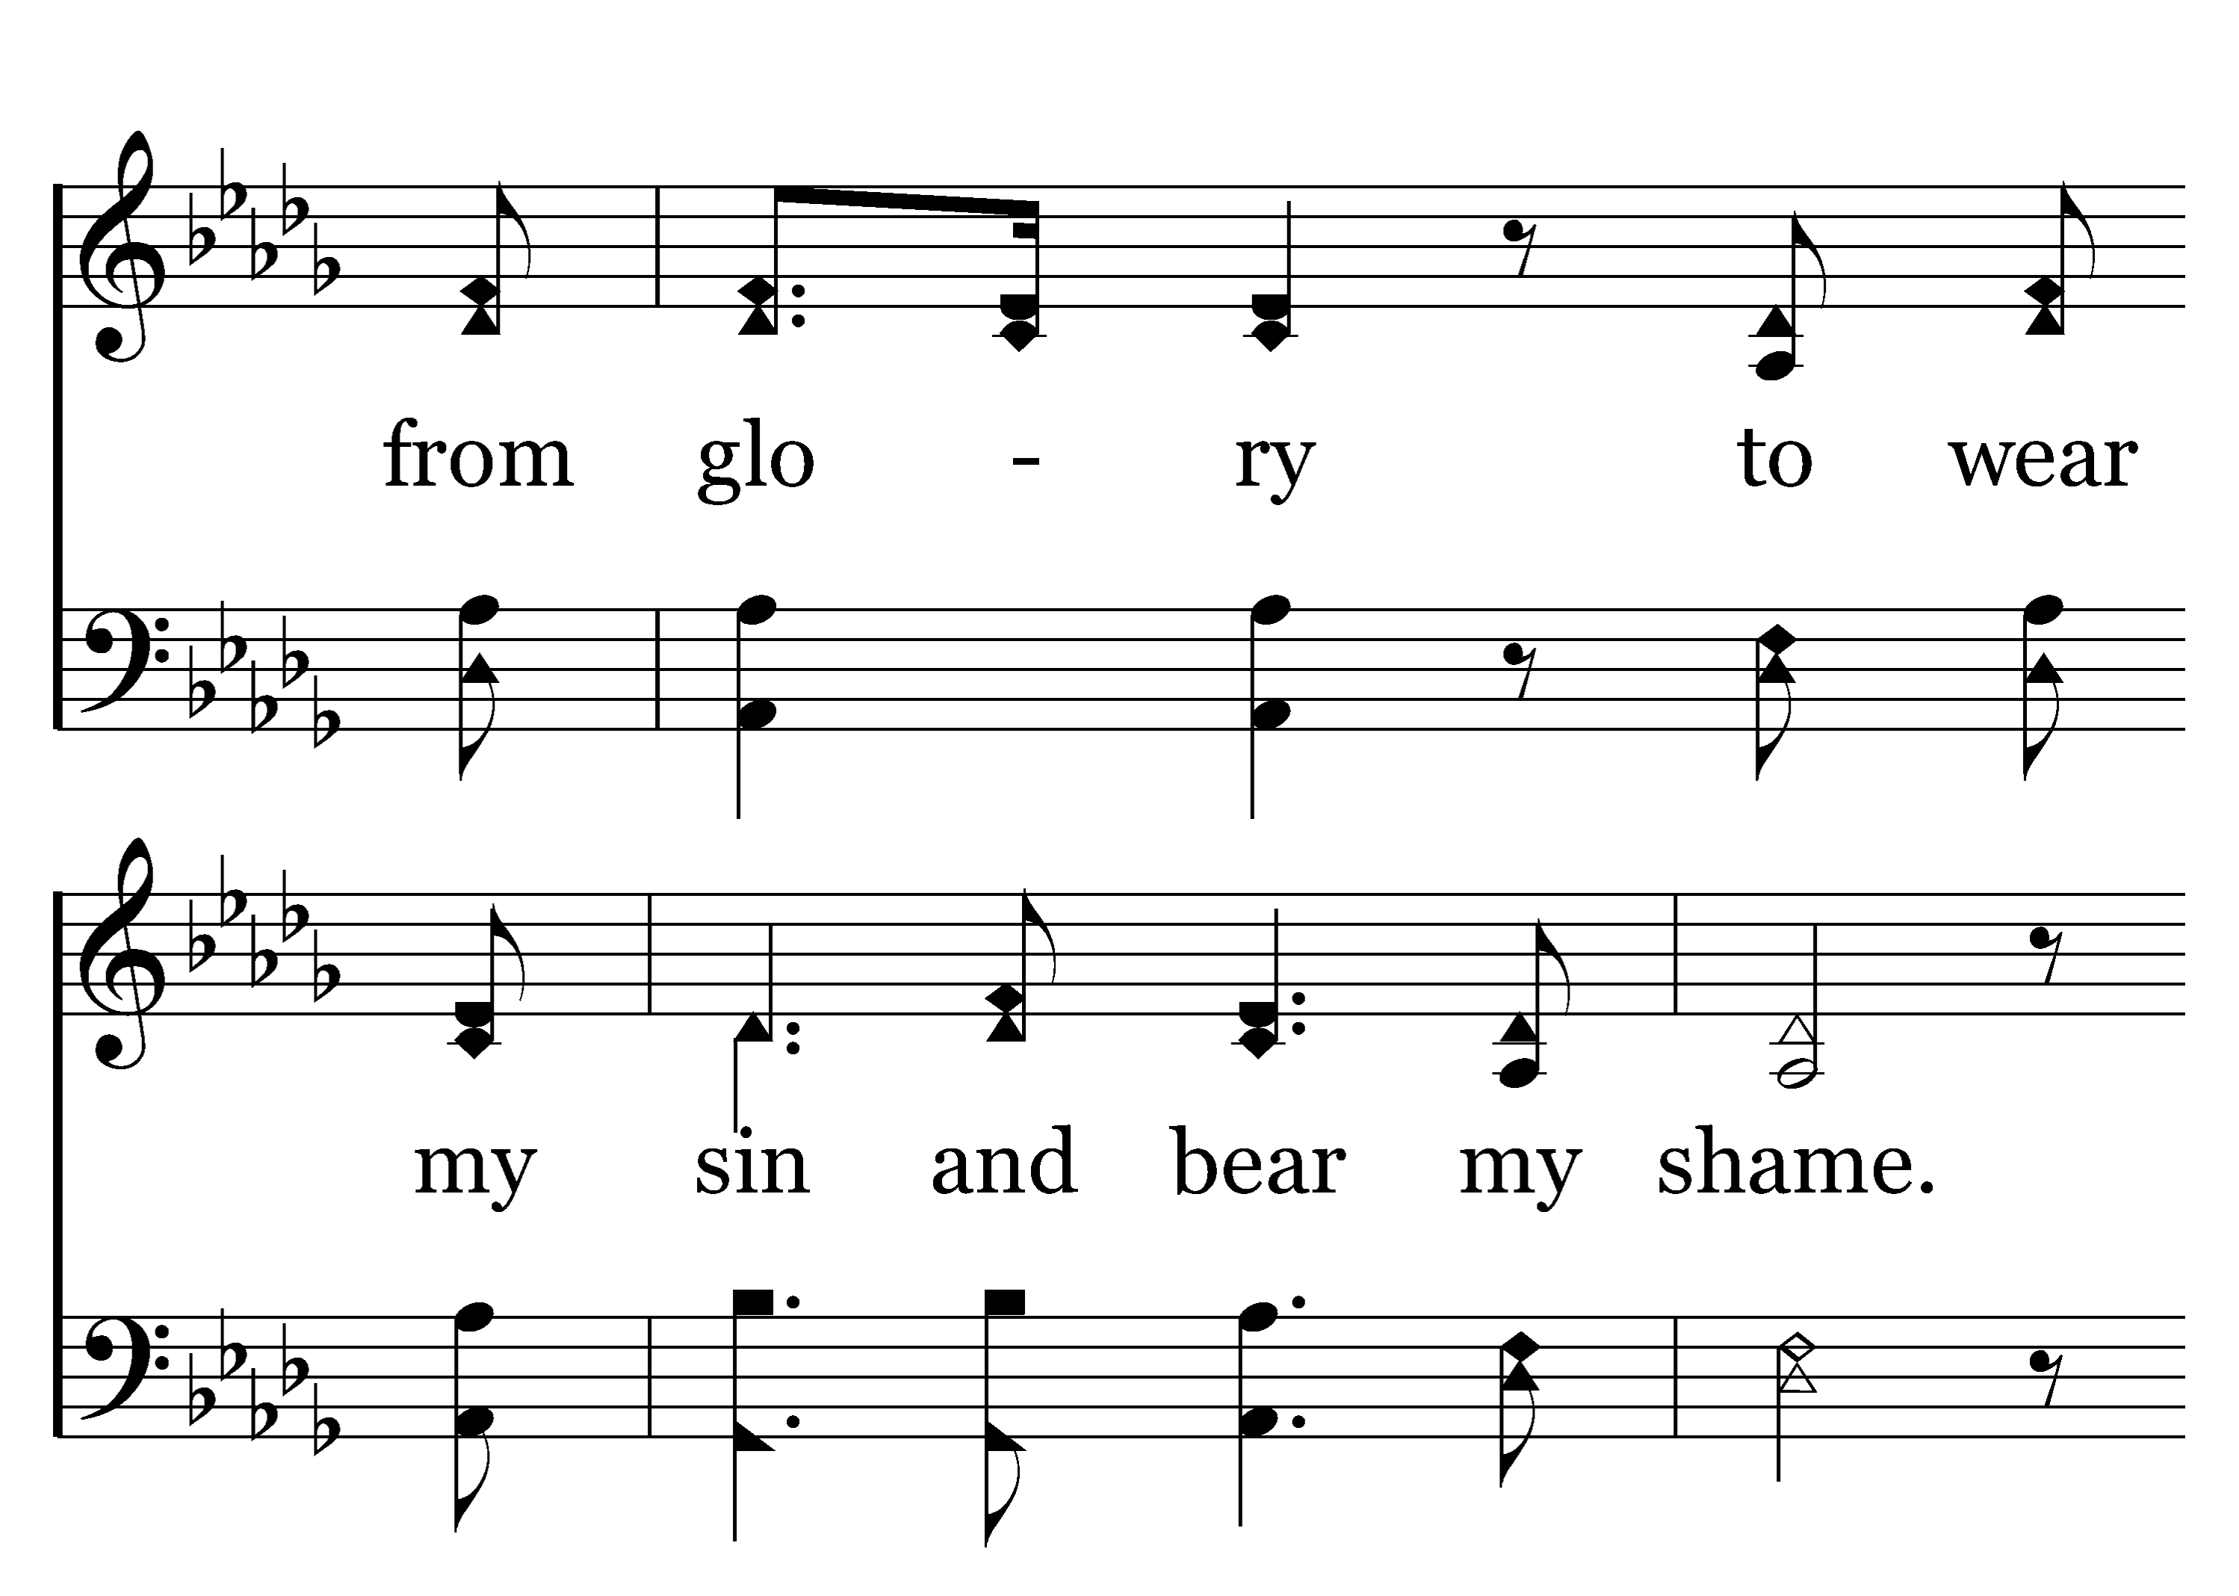
1
2
C
3
C
200
LIVING HOPE
Typeset R. J. Stevens Music

Slide 11
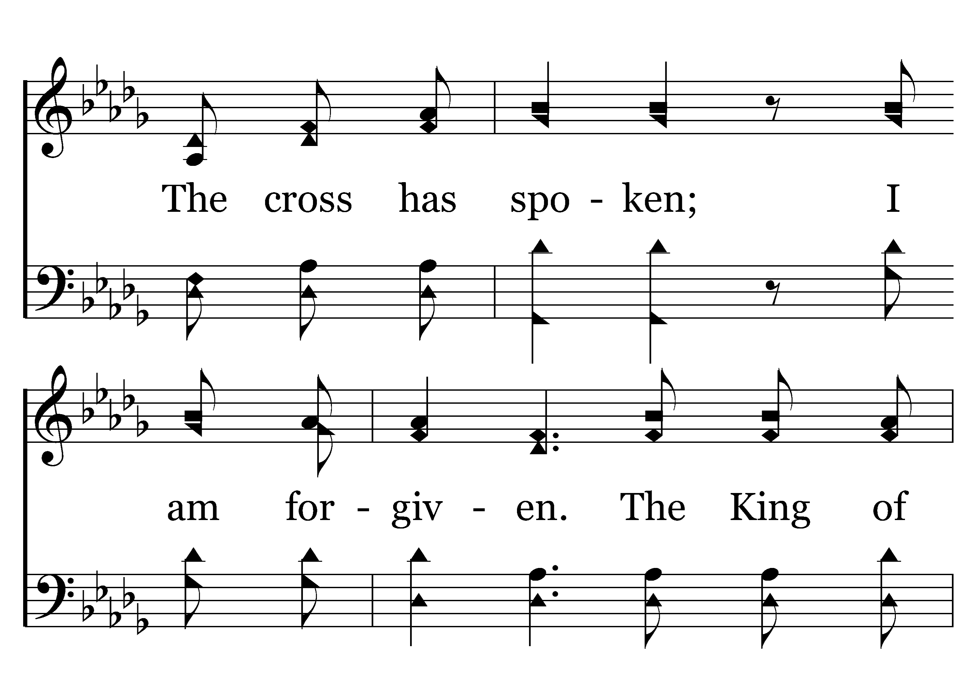
1
2
C
3
C
200
LIVING HOPE
Typeset R. J. Stevens Music

Slide 12
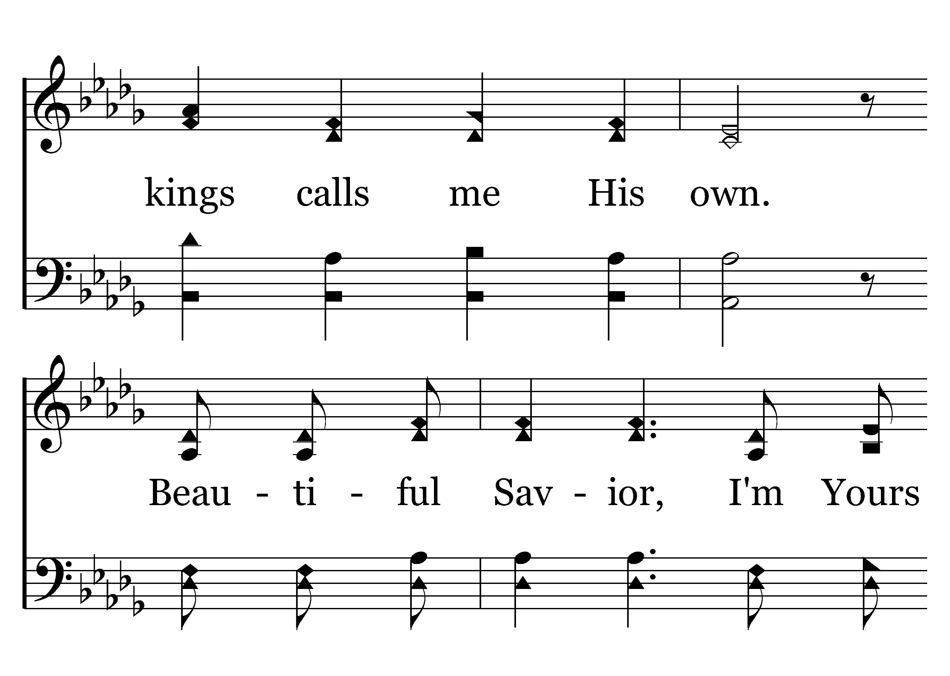
1
2
C
3
C
200
LIVING HOPE
Typeset R. J. Stevens Music

Slide 13
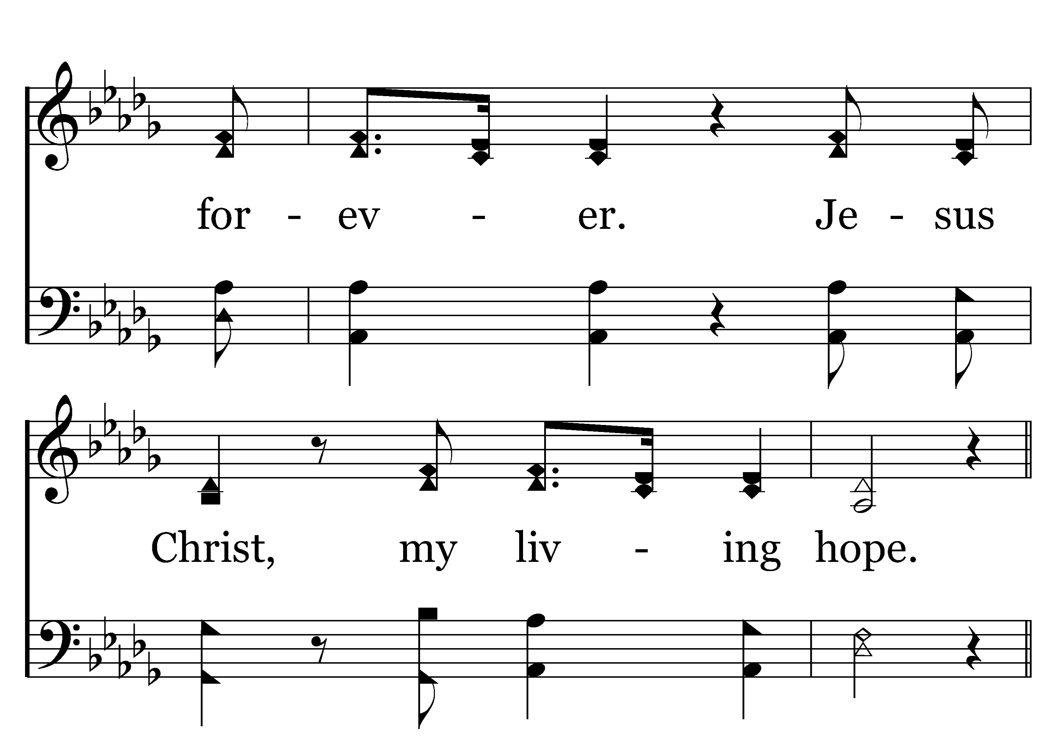
1
2
C
3
C
200
LIVING HOPE
Typeset R. J. Stevens Music

Slide 14
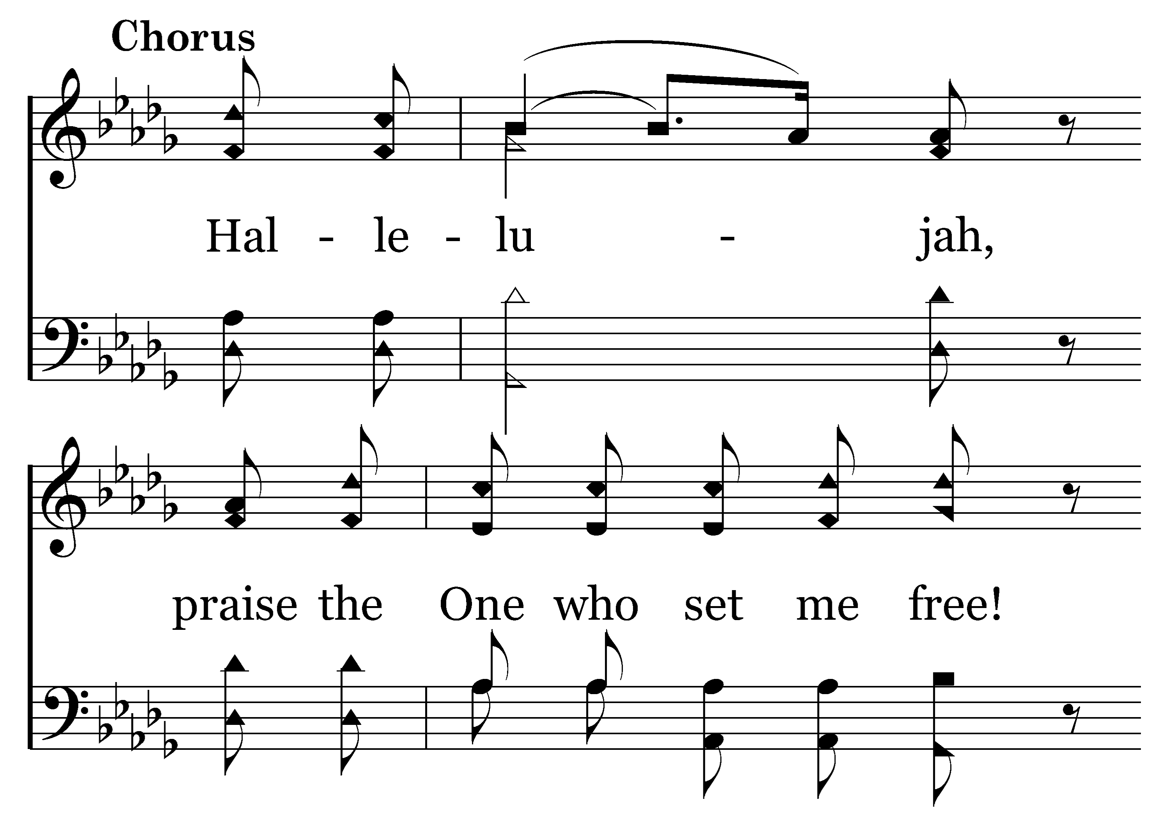
1
2
C
3
C
200
LIVING HOPE
Typeset R. J. Stevens Music

Slide 15
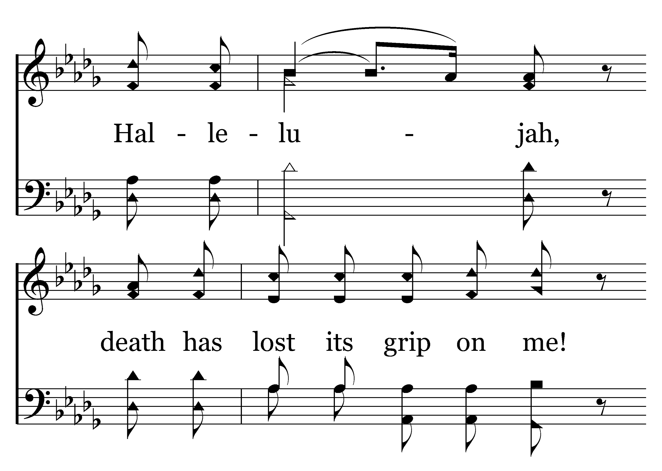
1
2
C
3
C
200
LIVING HOPE
Typeset R. J. Stevens Music

Slide 16
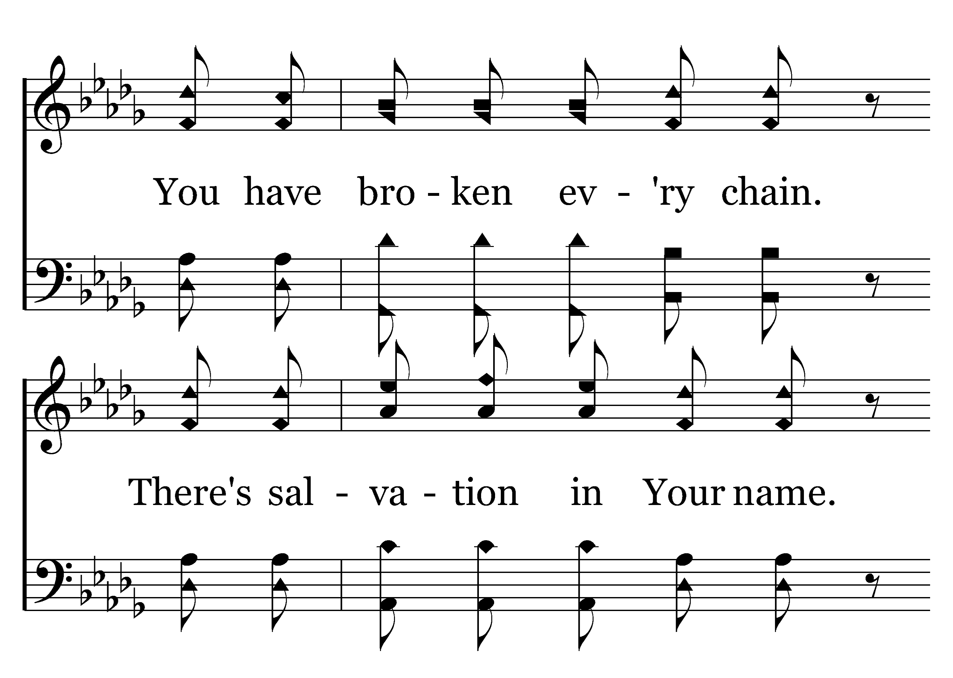
1
2
C
3
C
200
LIVING HOPE
Typeset R. J. Stevens Music

Slide 17
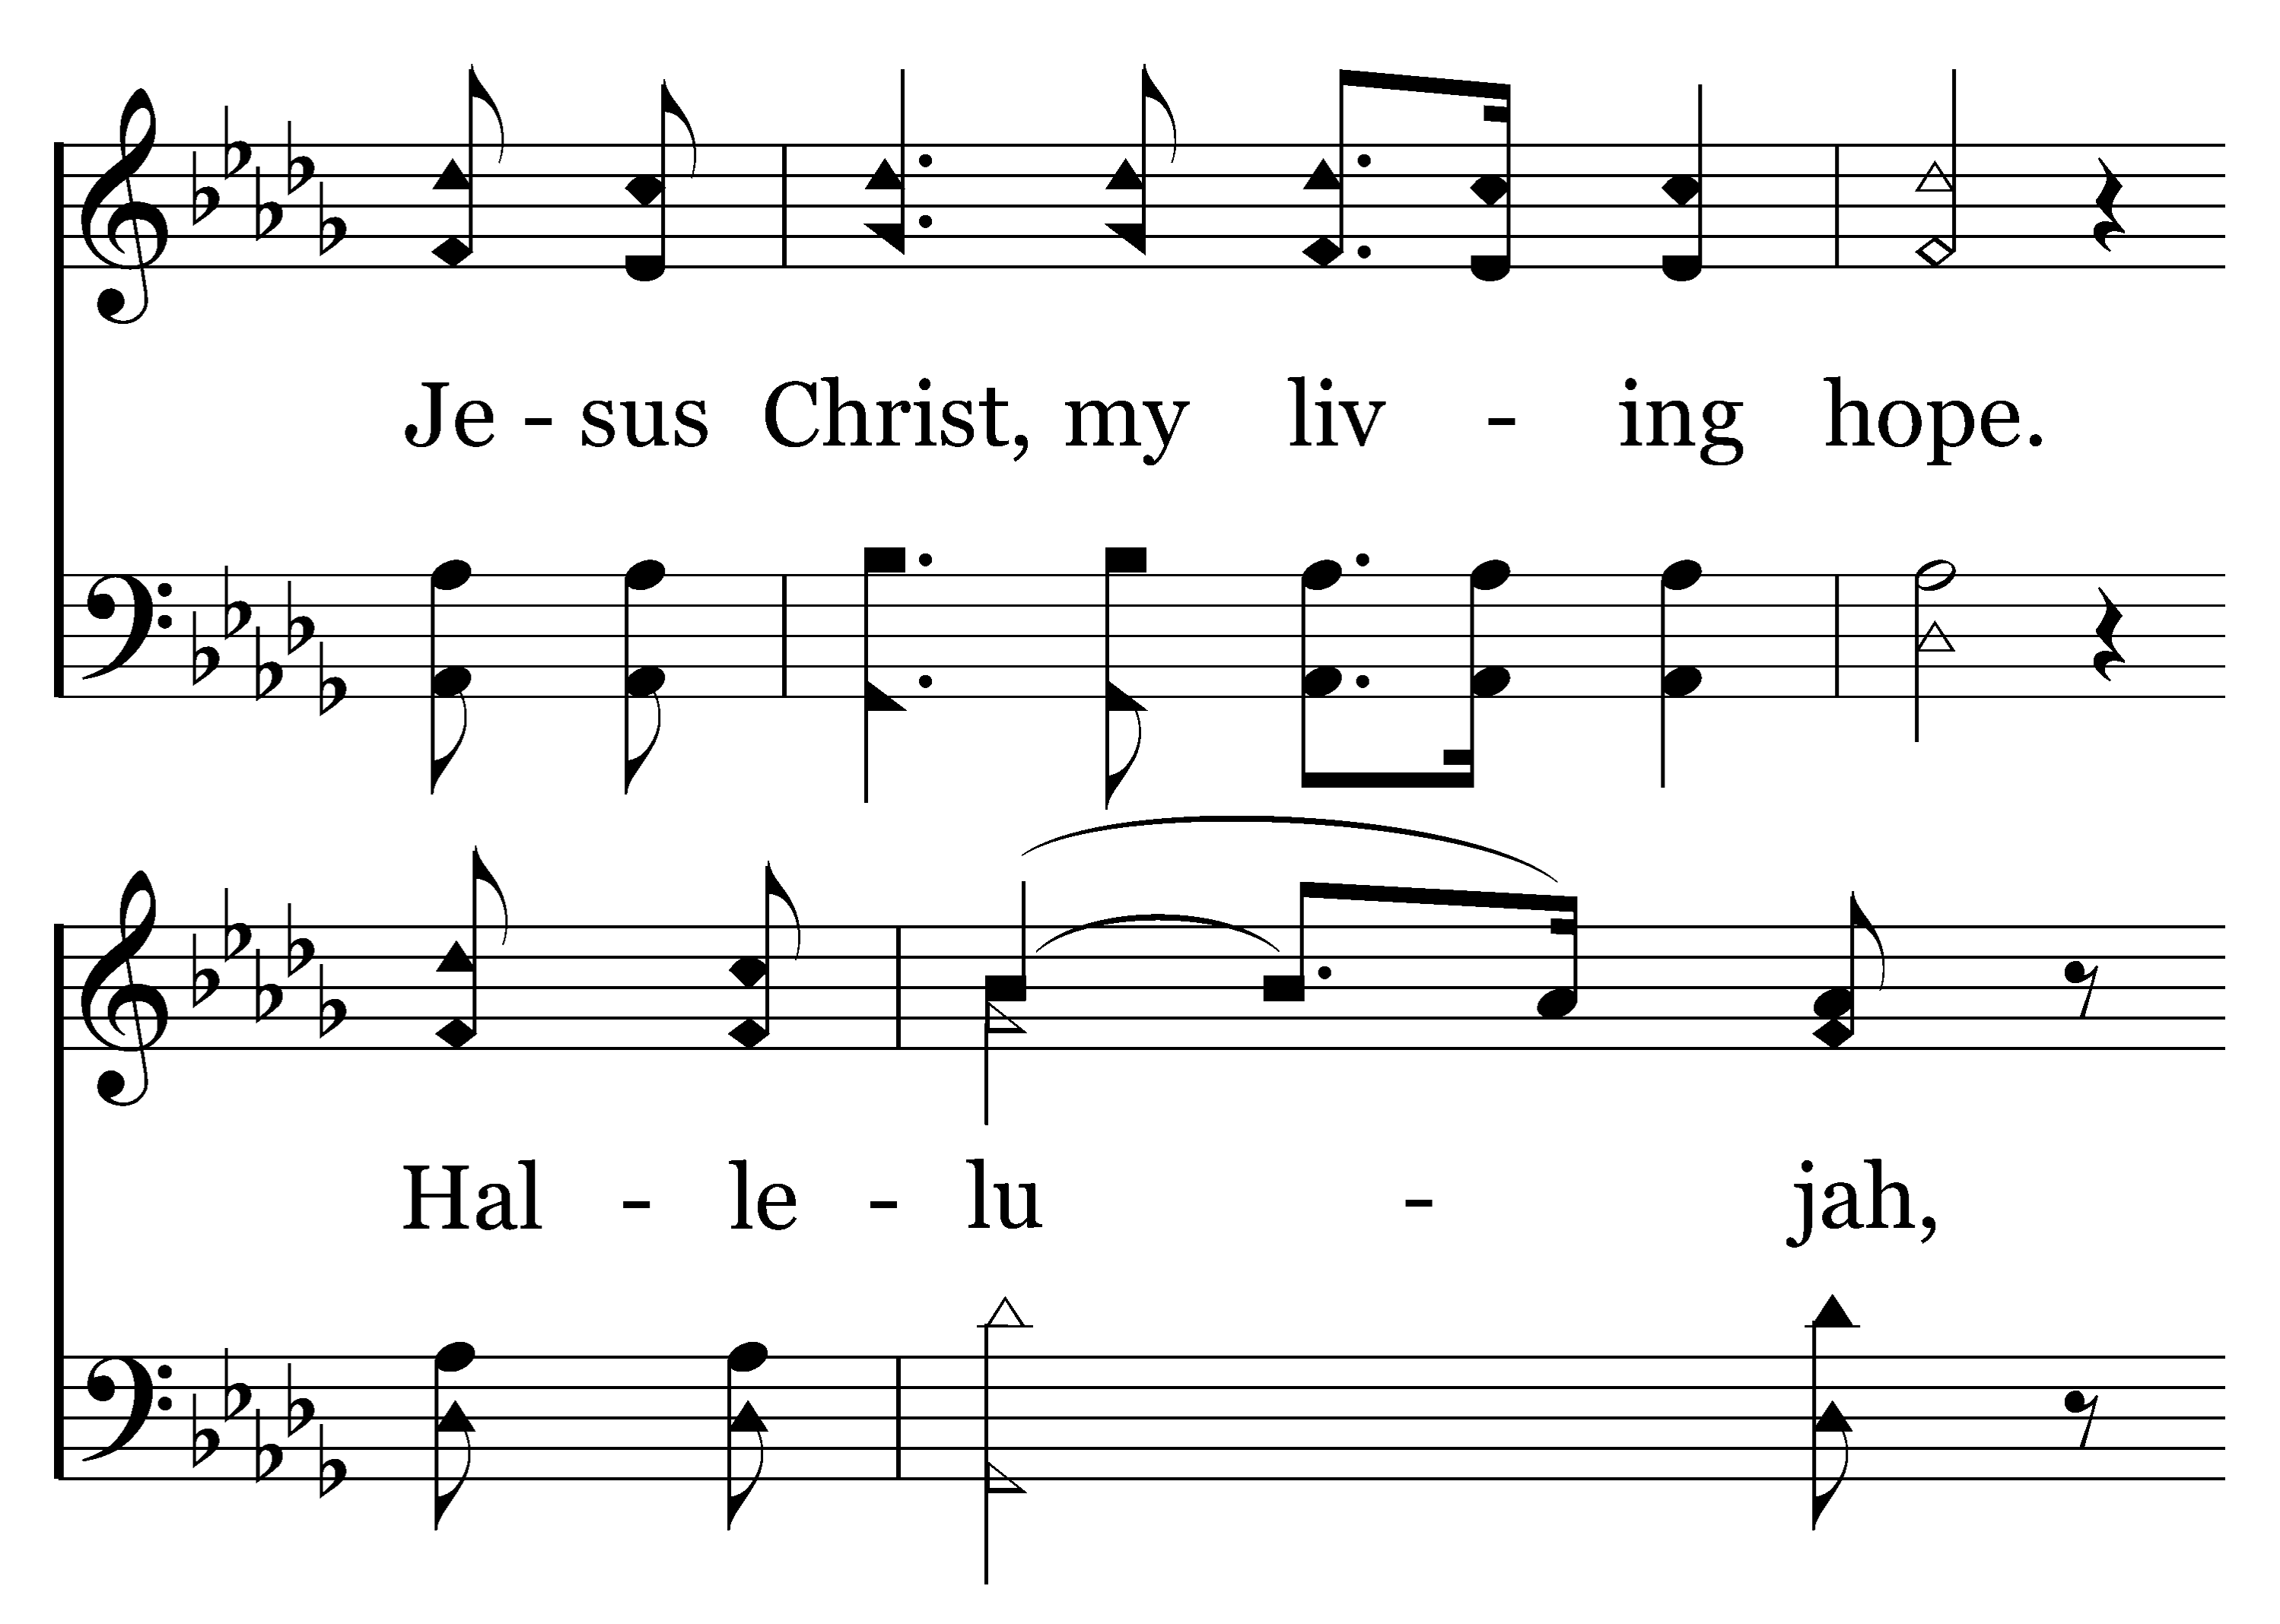
1
2
C
3
C
200
LIVING HOPE
Typeset R. J. Stevens Music

Slide 18
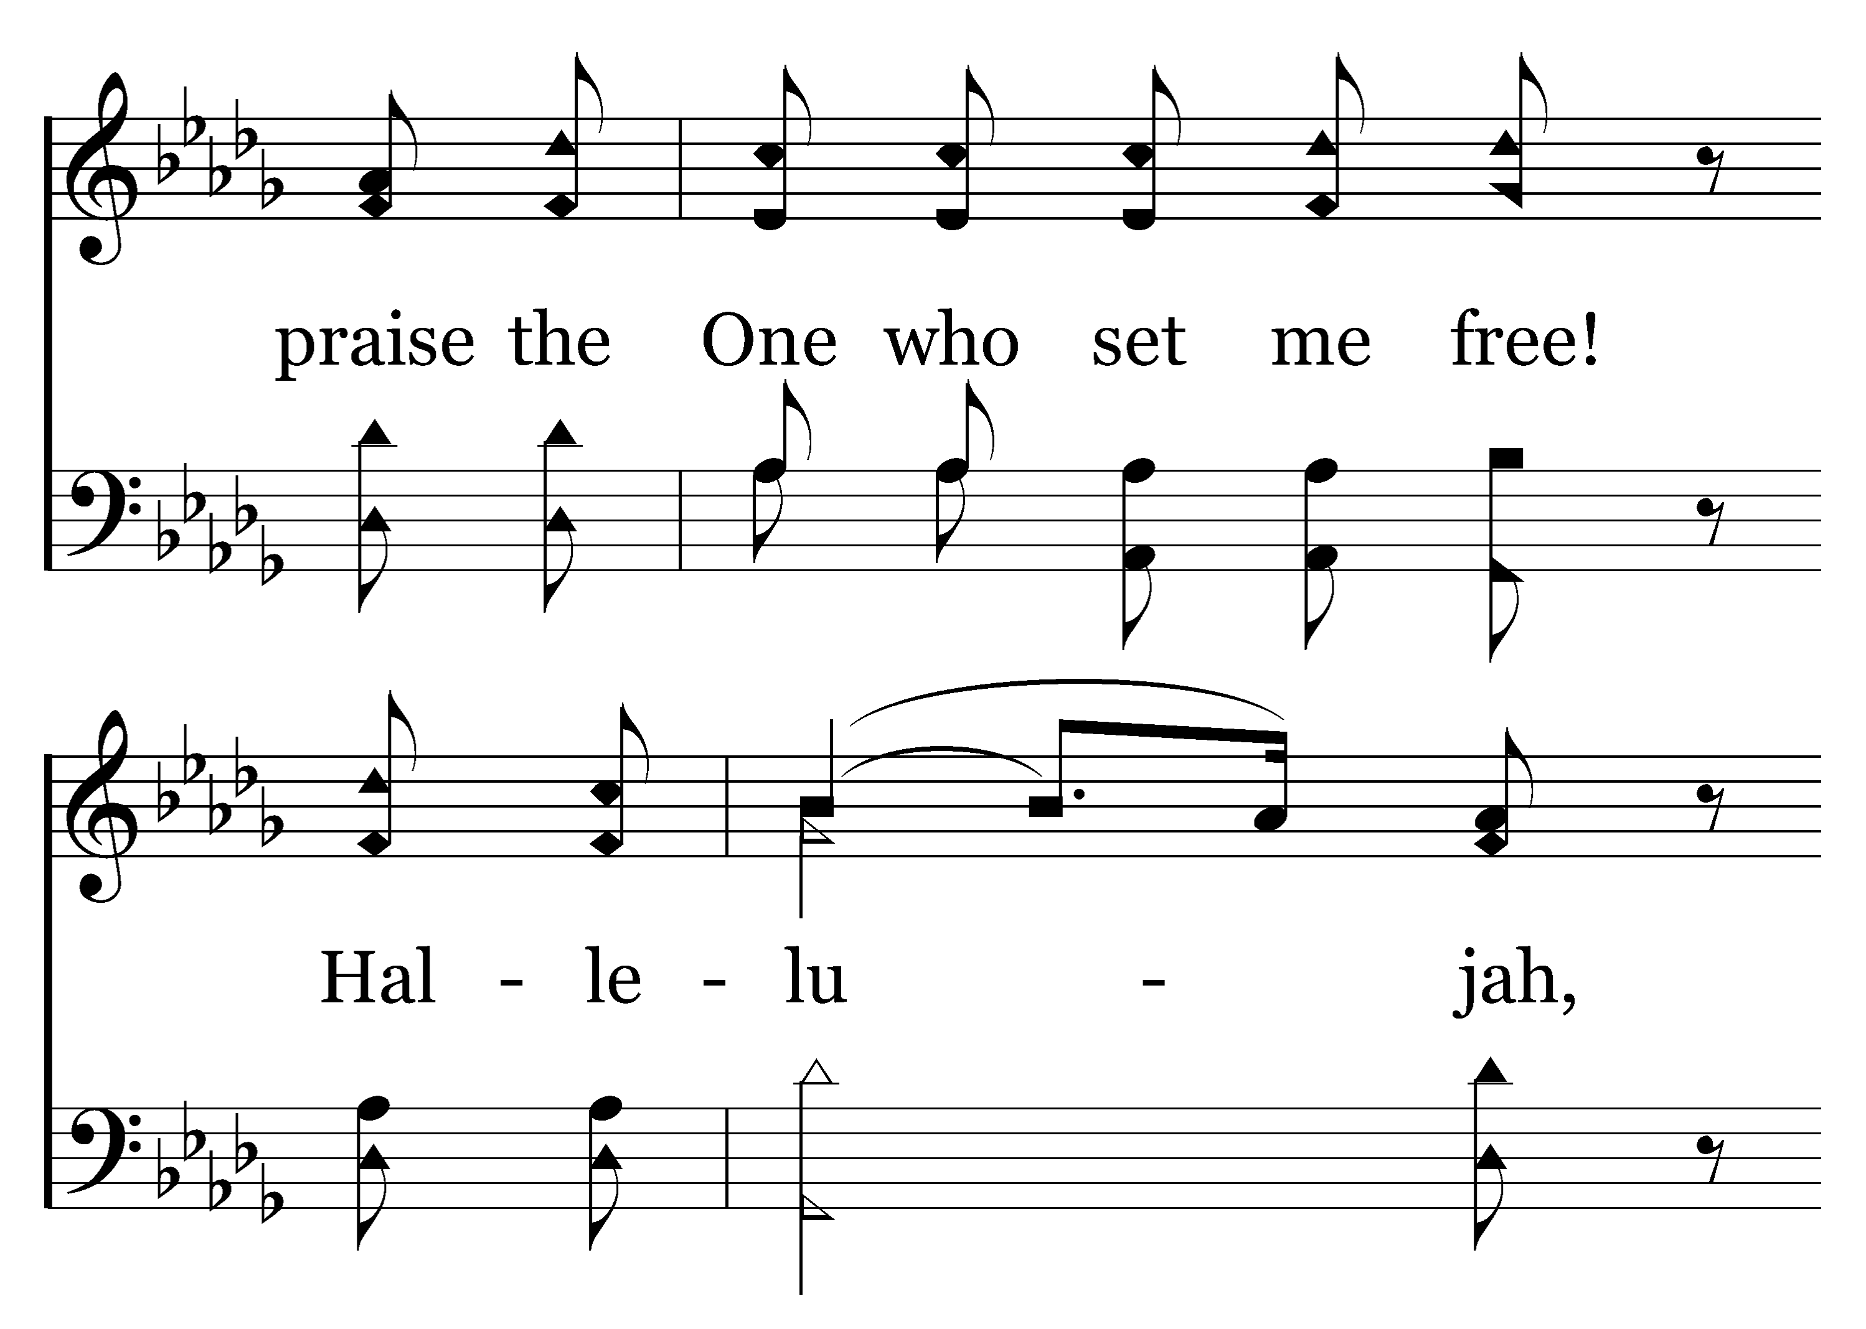
1
2
C
3
C
200
LIVING HOPE
Typeset R. J. Stevens Music

Slide 19
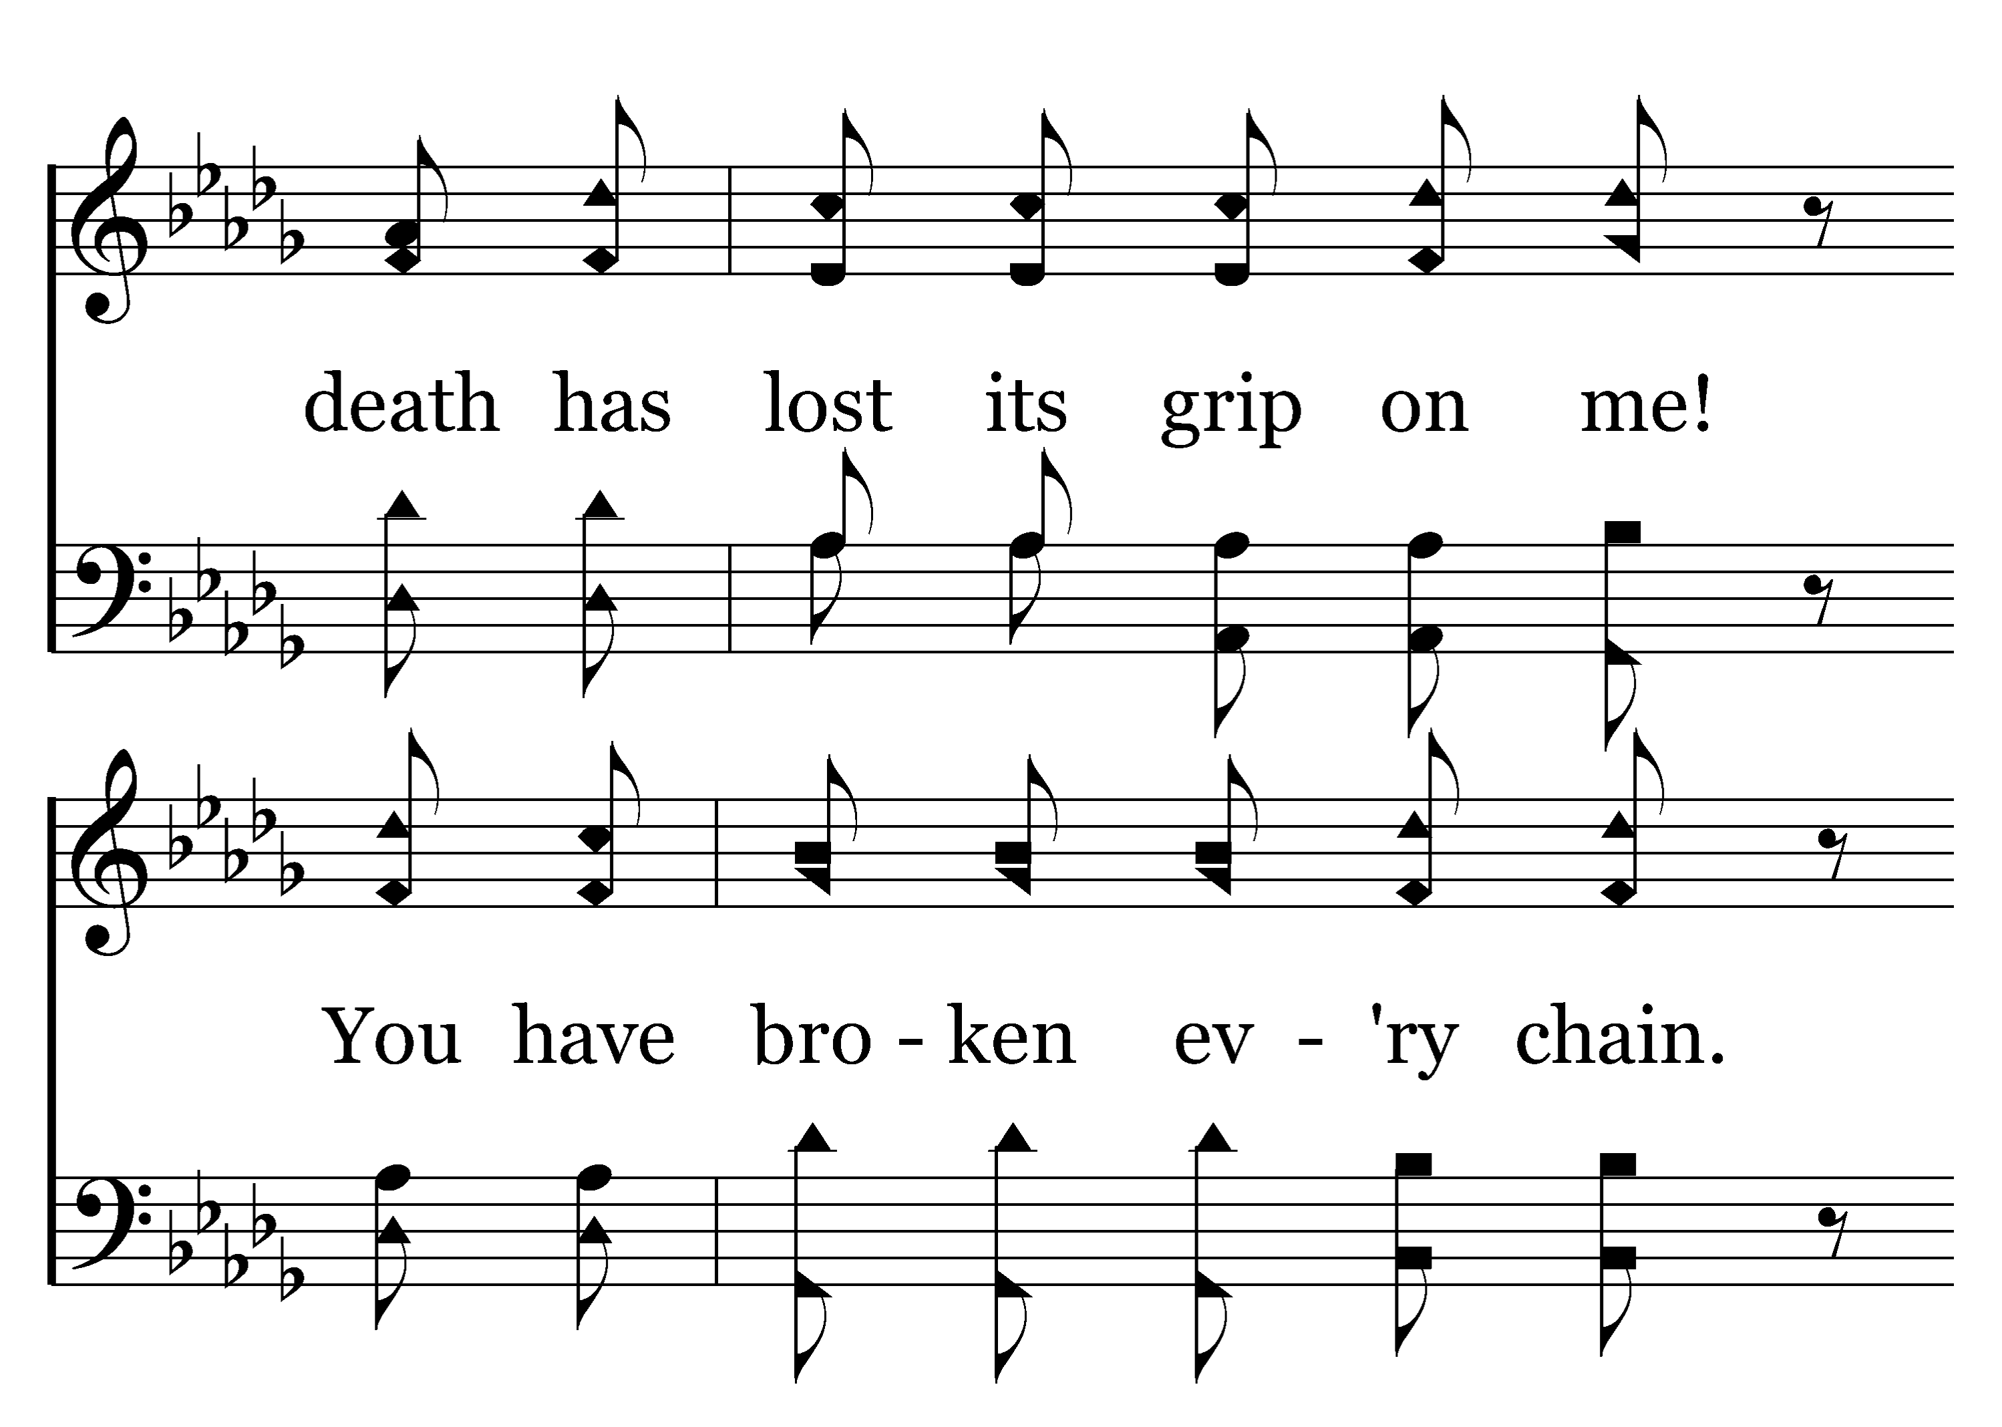
1
2
C
3
C
200
LIVING HOPE
Typeset R. J. Stevens Music

Slide 20
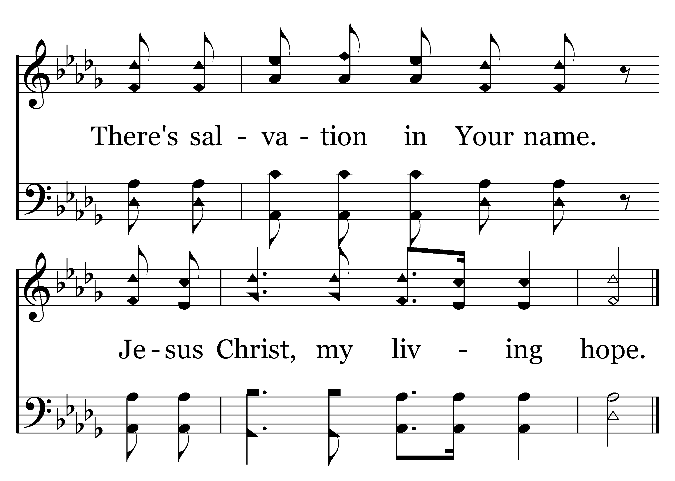
1
2
C
3
C
200
LIVING HOPE
Typeset R. J. Stevens Music

Slide 21
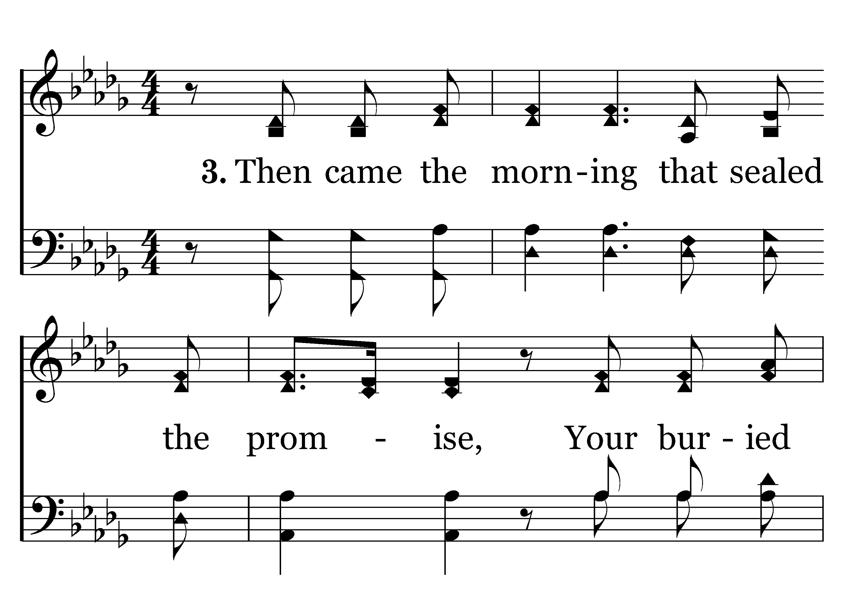
1
2
C
3
C
200
LIVING HOPE
Typeset R. J. Stevens Music

Slide 22
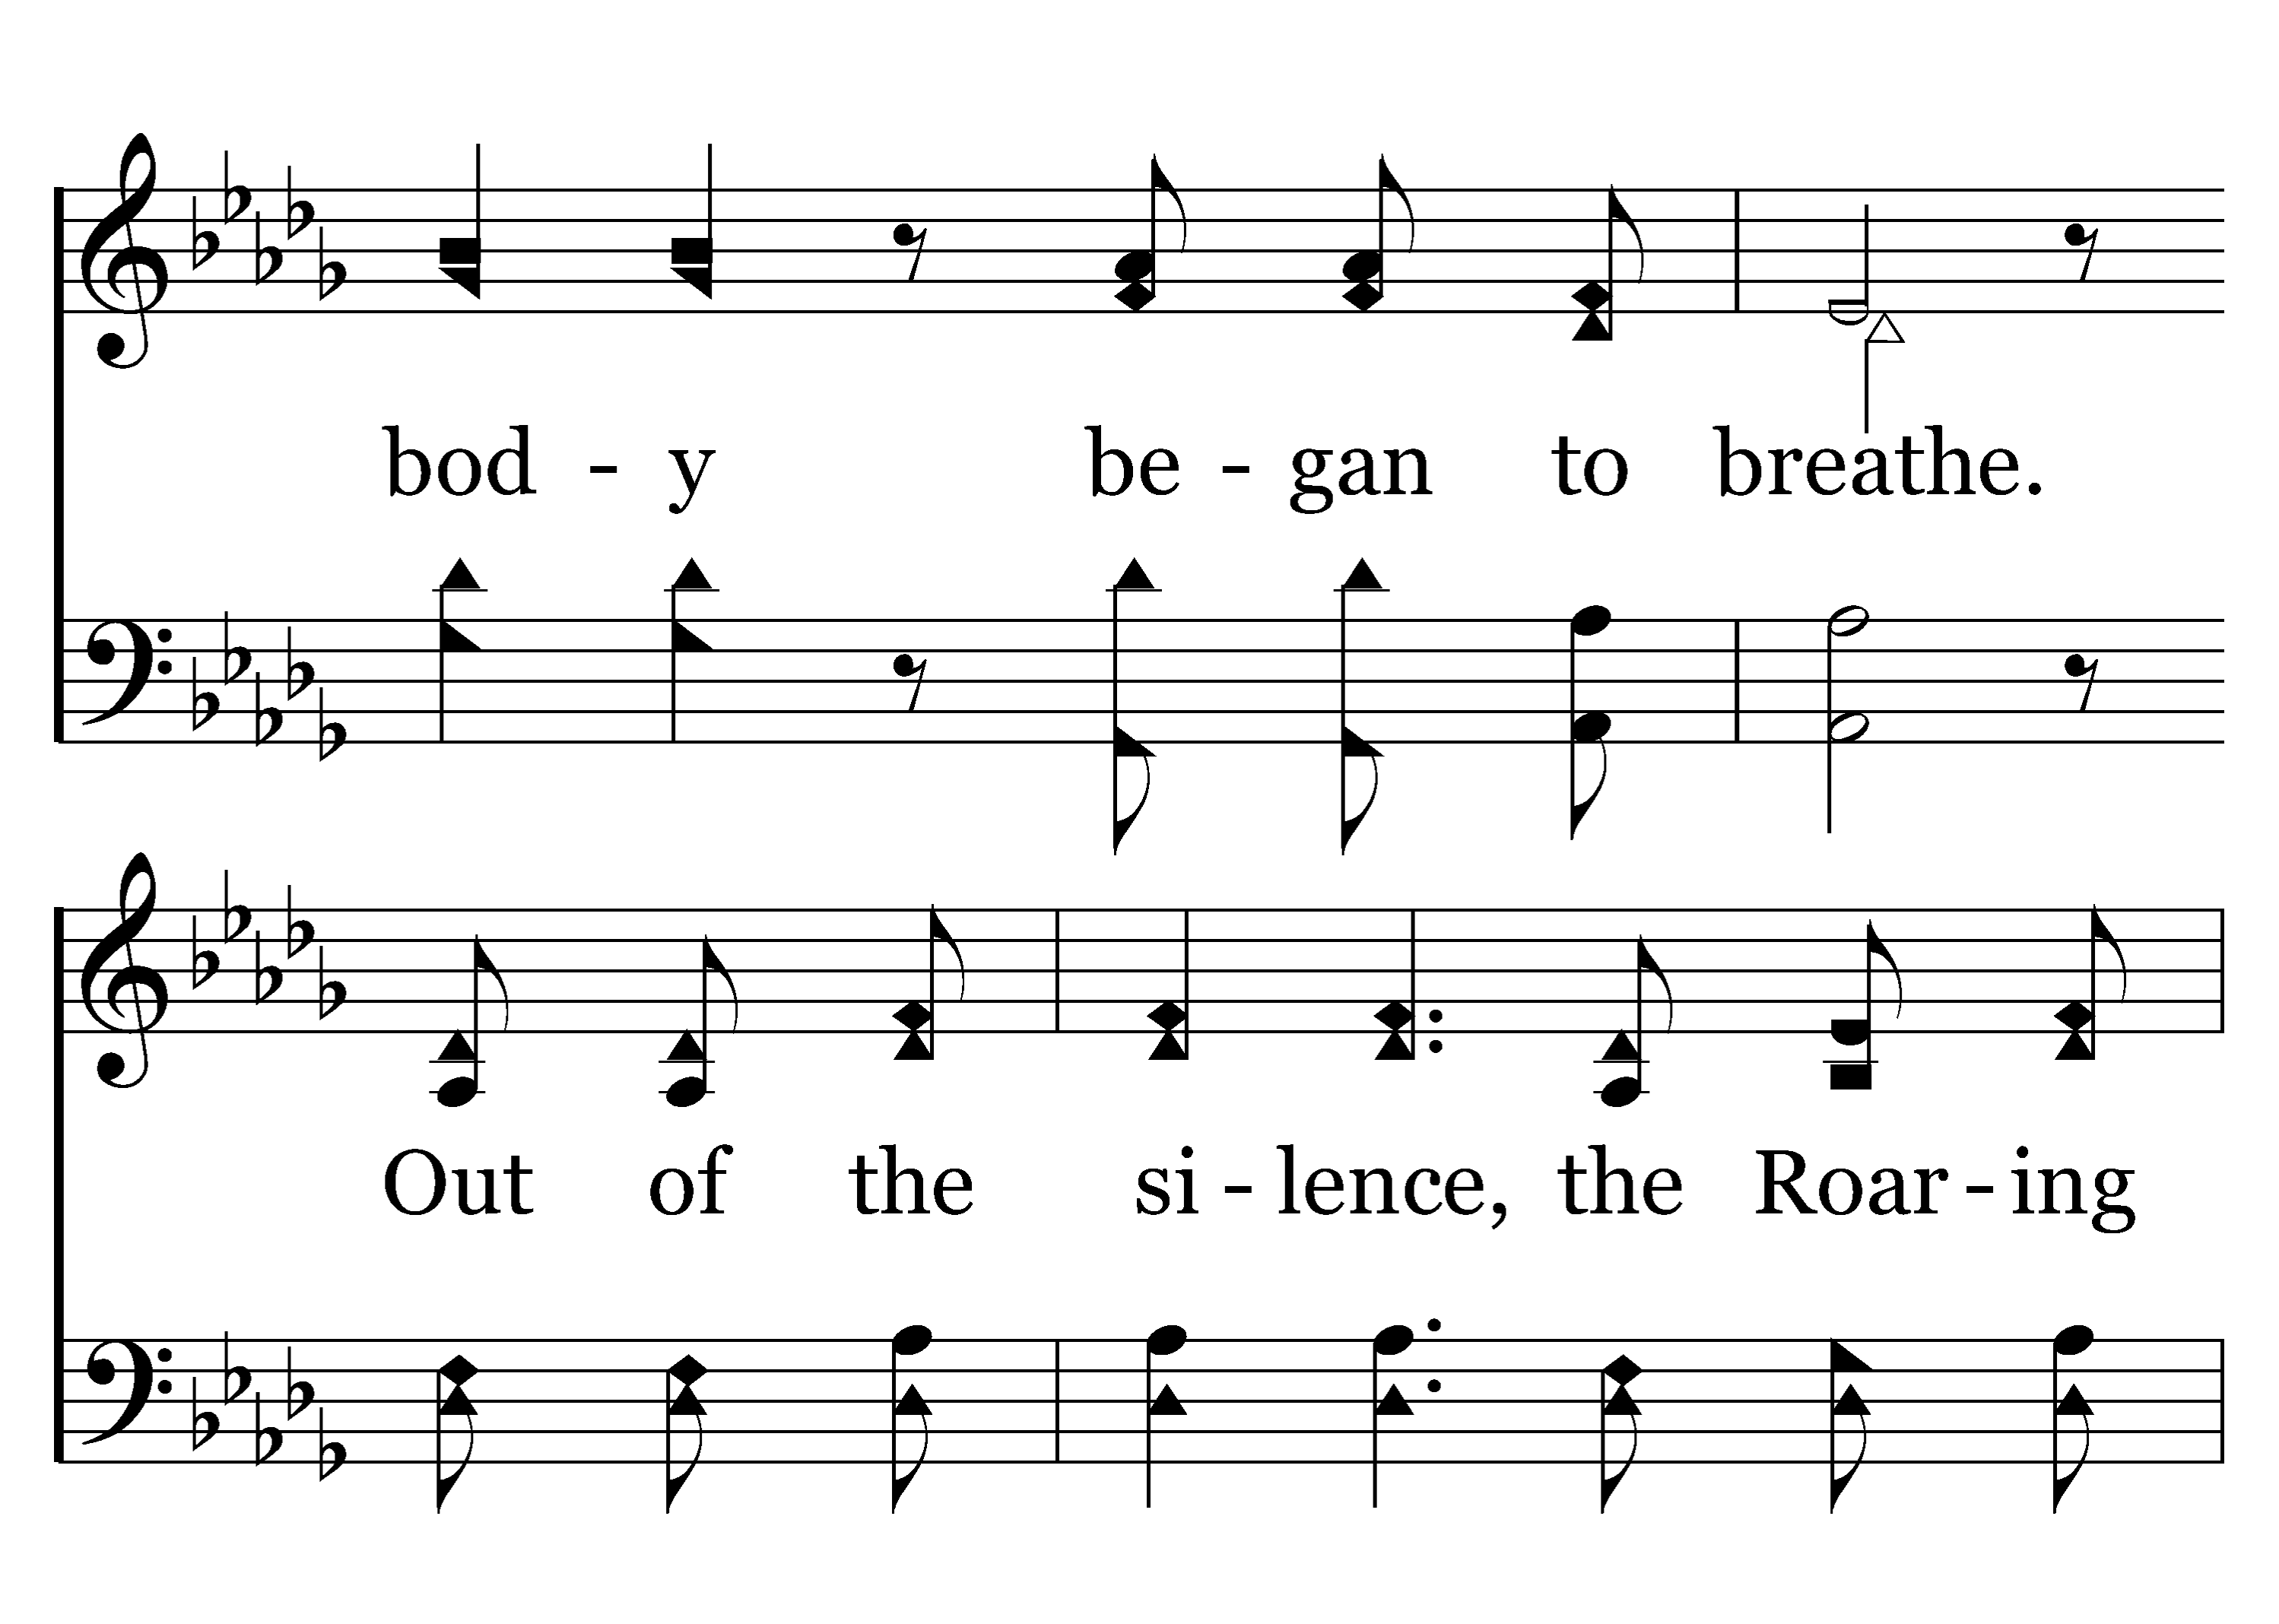
1
2
C
3
C
200
LIVING HOPE
Typeset R. J. Stevens Music

Slide 23
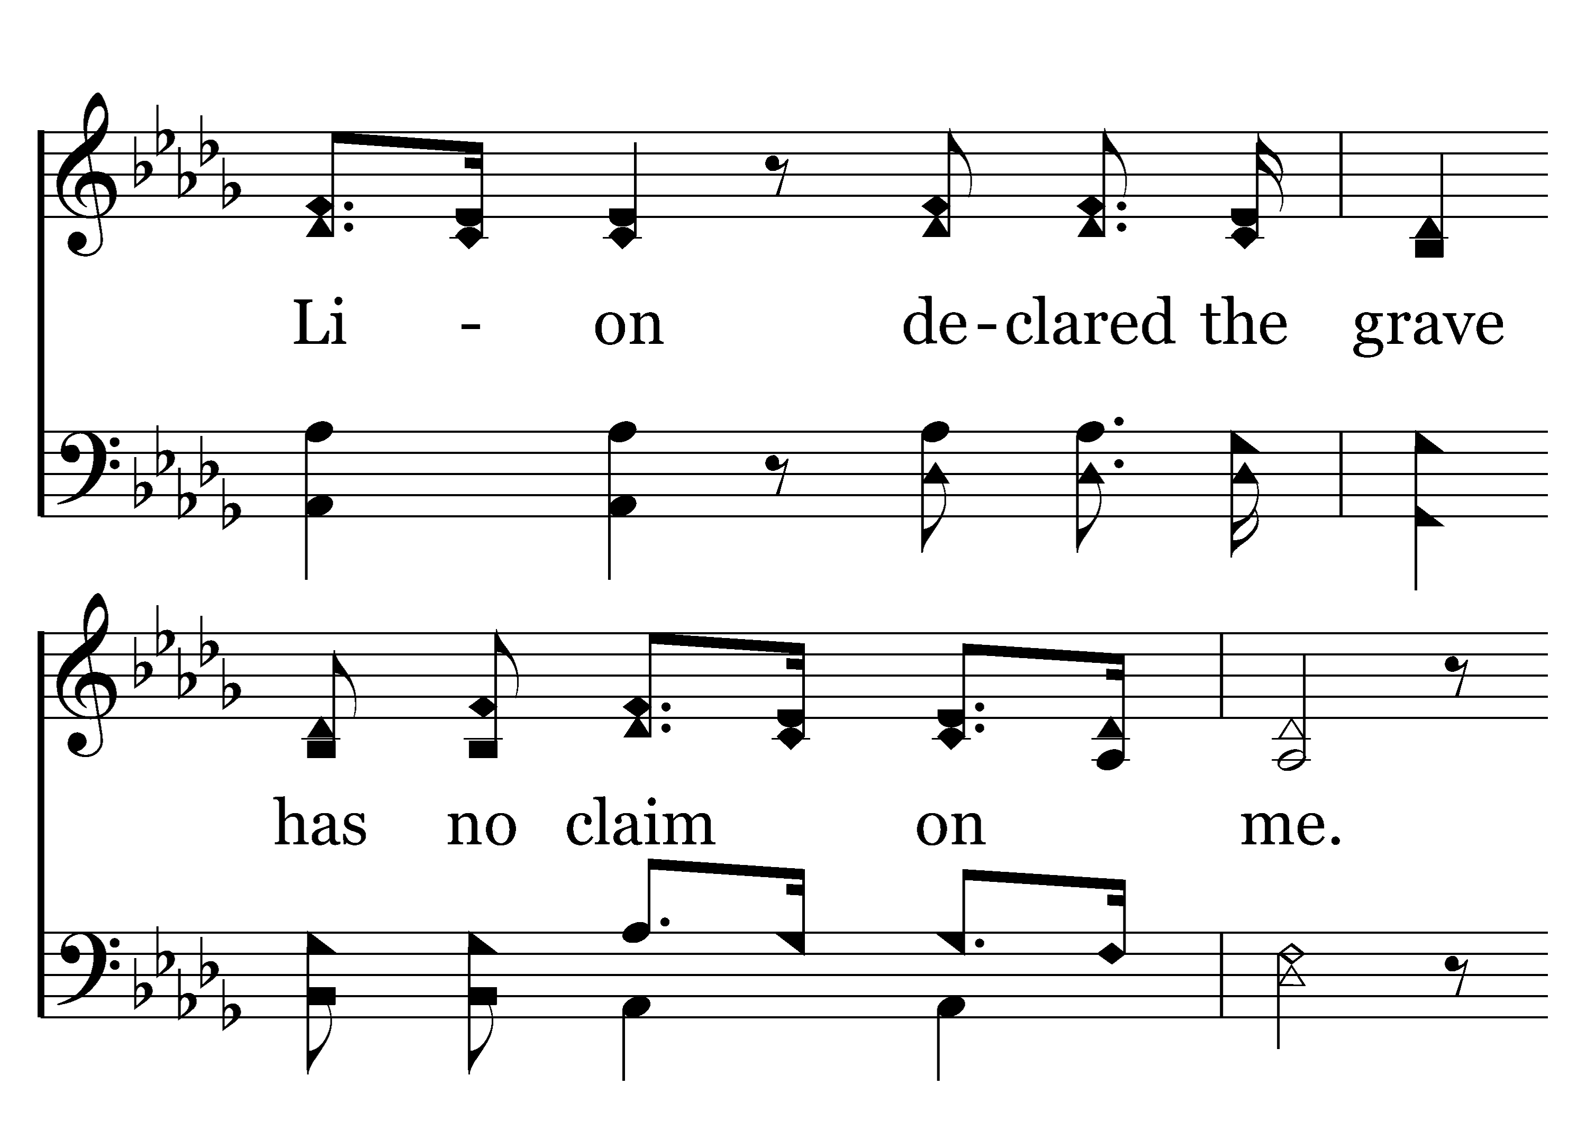
1
2
C
3
C
200
LIVING HOPE
Typeset R. J. Stevens Music

Slide 24
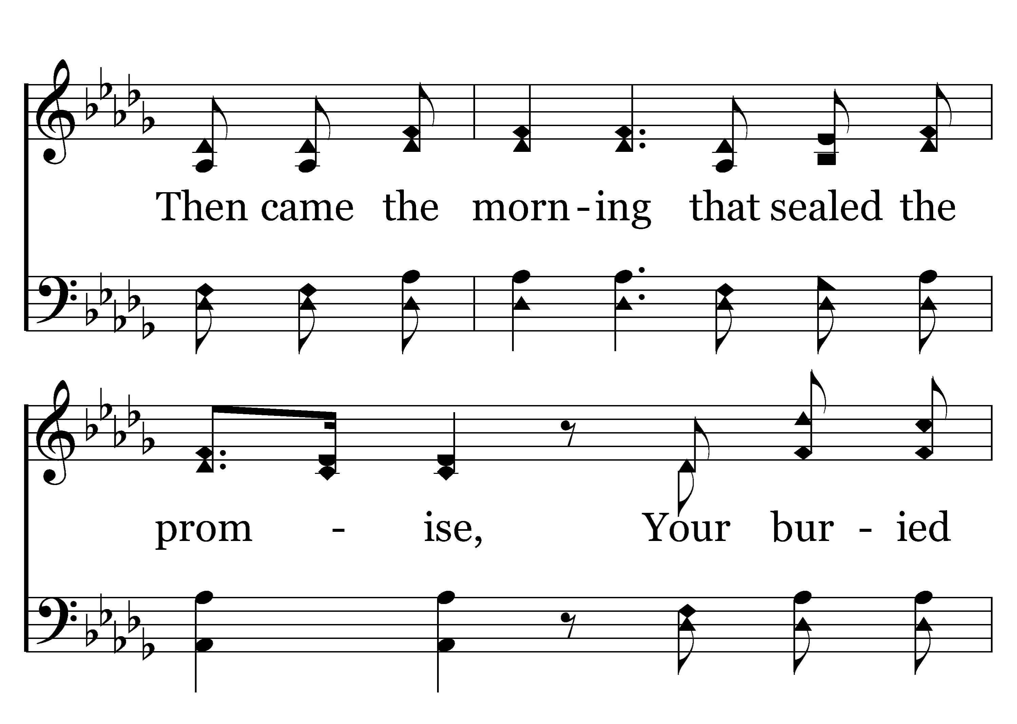
1
2
C
3
C
200
LIVING HOPE
Typeset R. J. Stevens Music

Slide 25
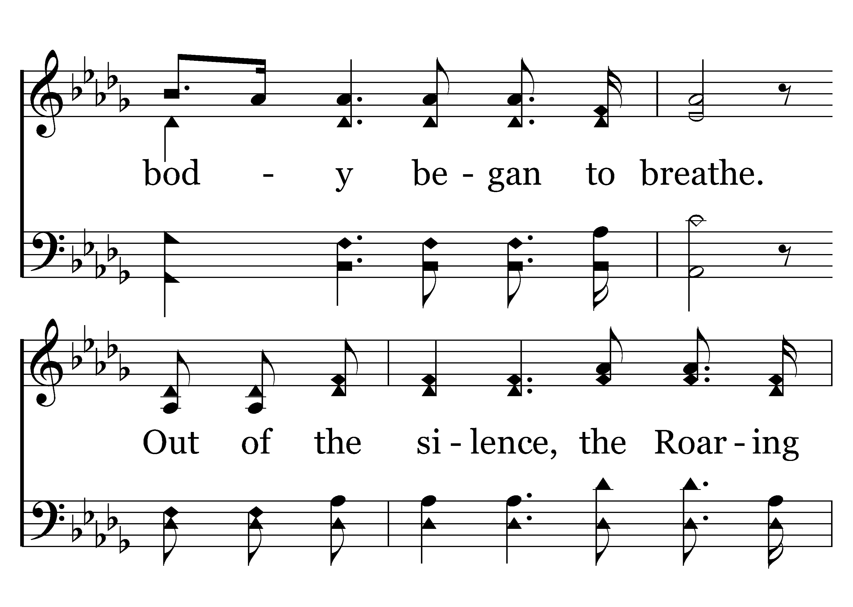
1
2
C
3
C
200
LIVING HOPE
Typeset R. J. Stevens Music

Slide 26
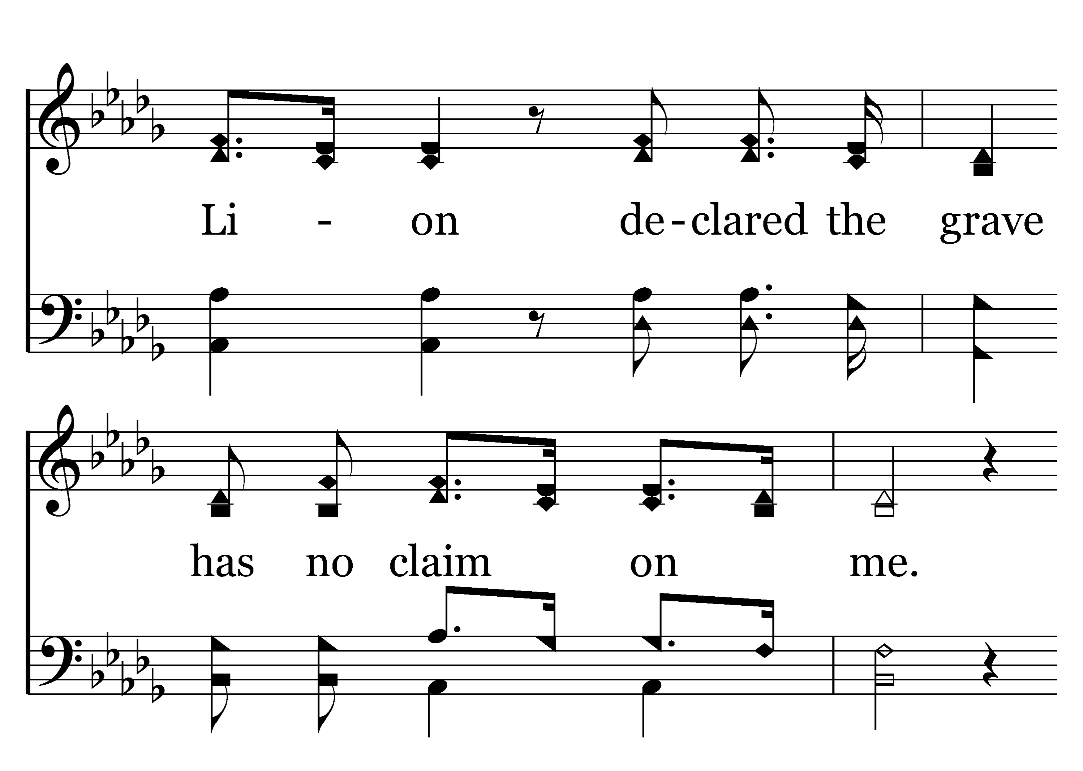
1
2
C
3
C
200
LIVING HOPE
Typeset R. J. Stevens Music

Slide 27
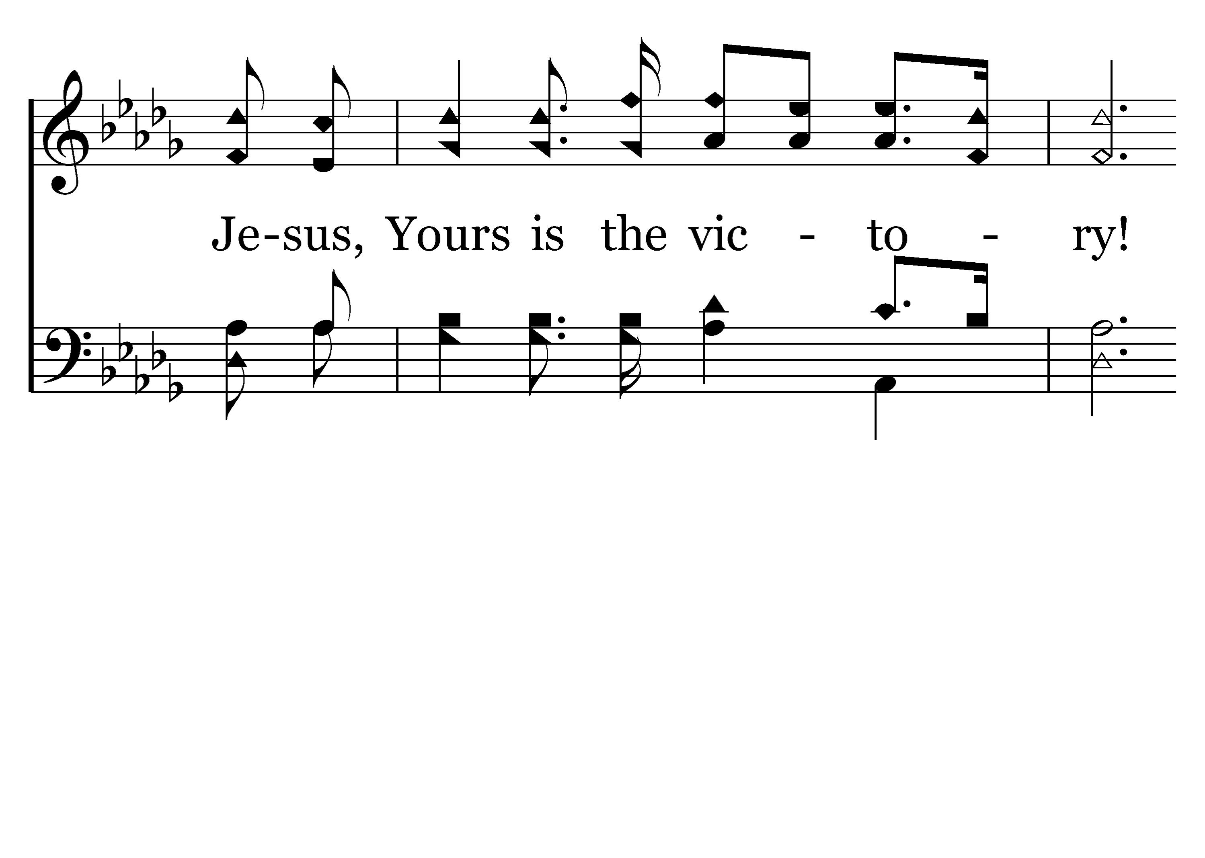
1
2
C
3
C
200
LIVING HOPE
Typeset R. J. Stevens Music

Slide 28
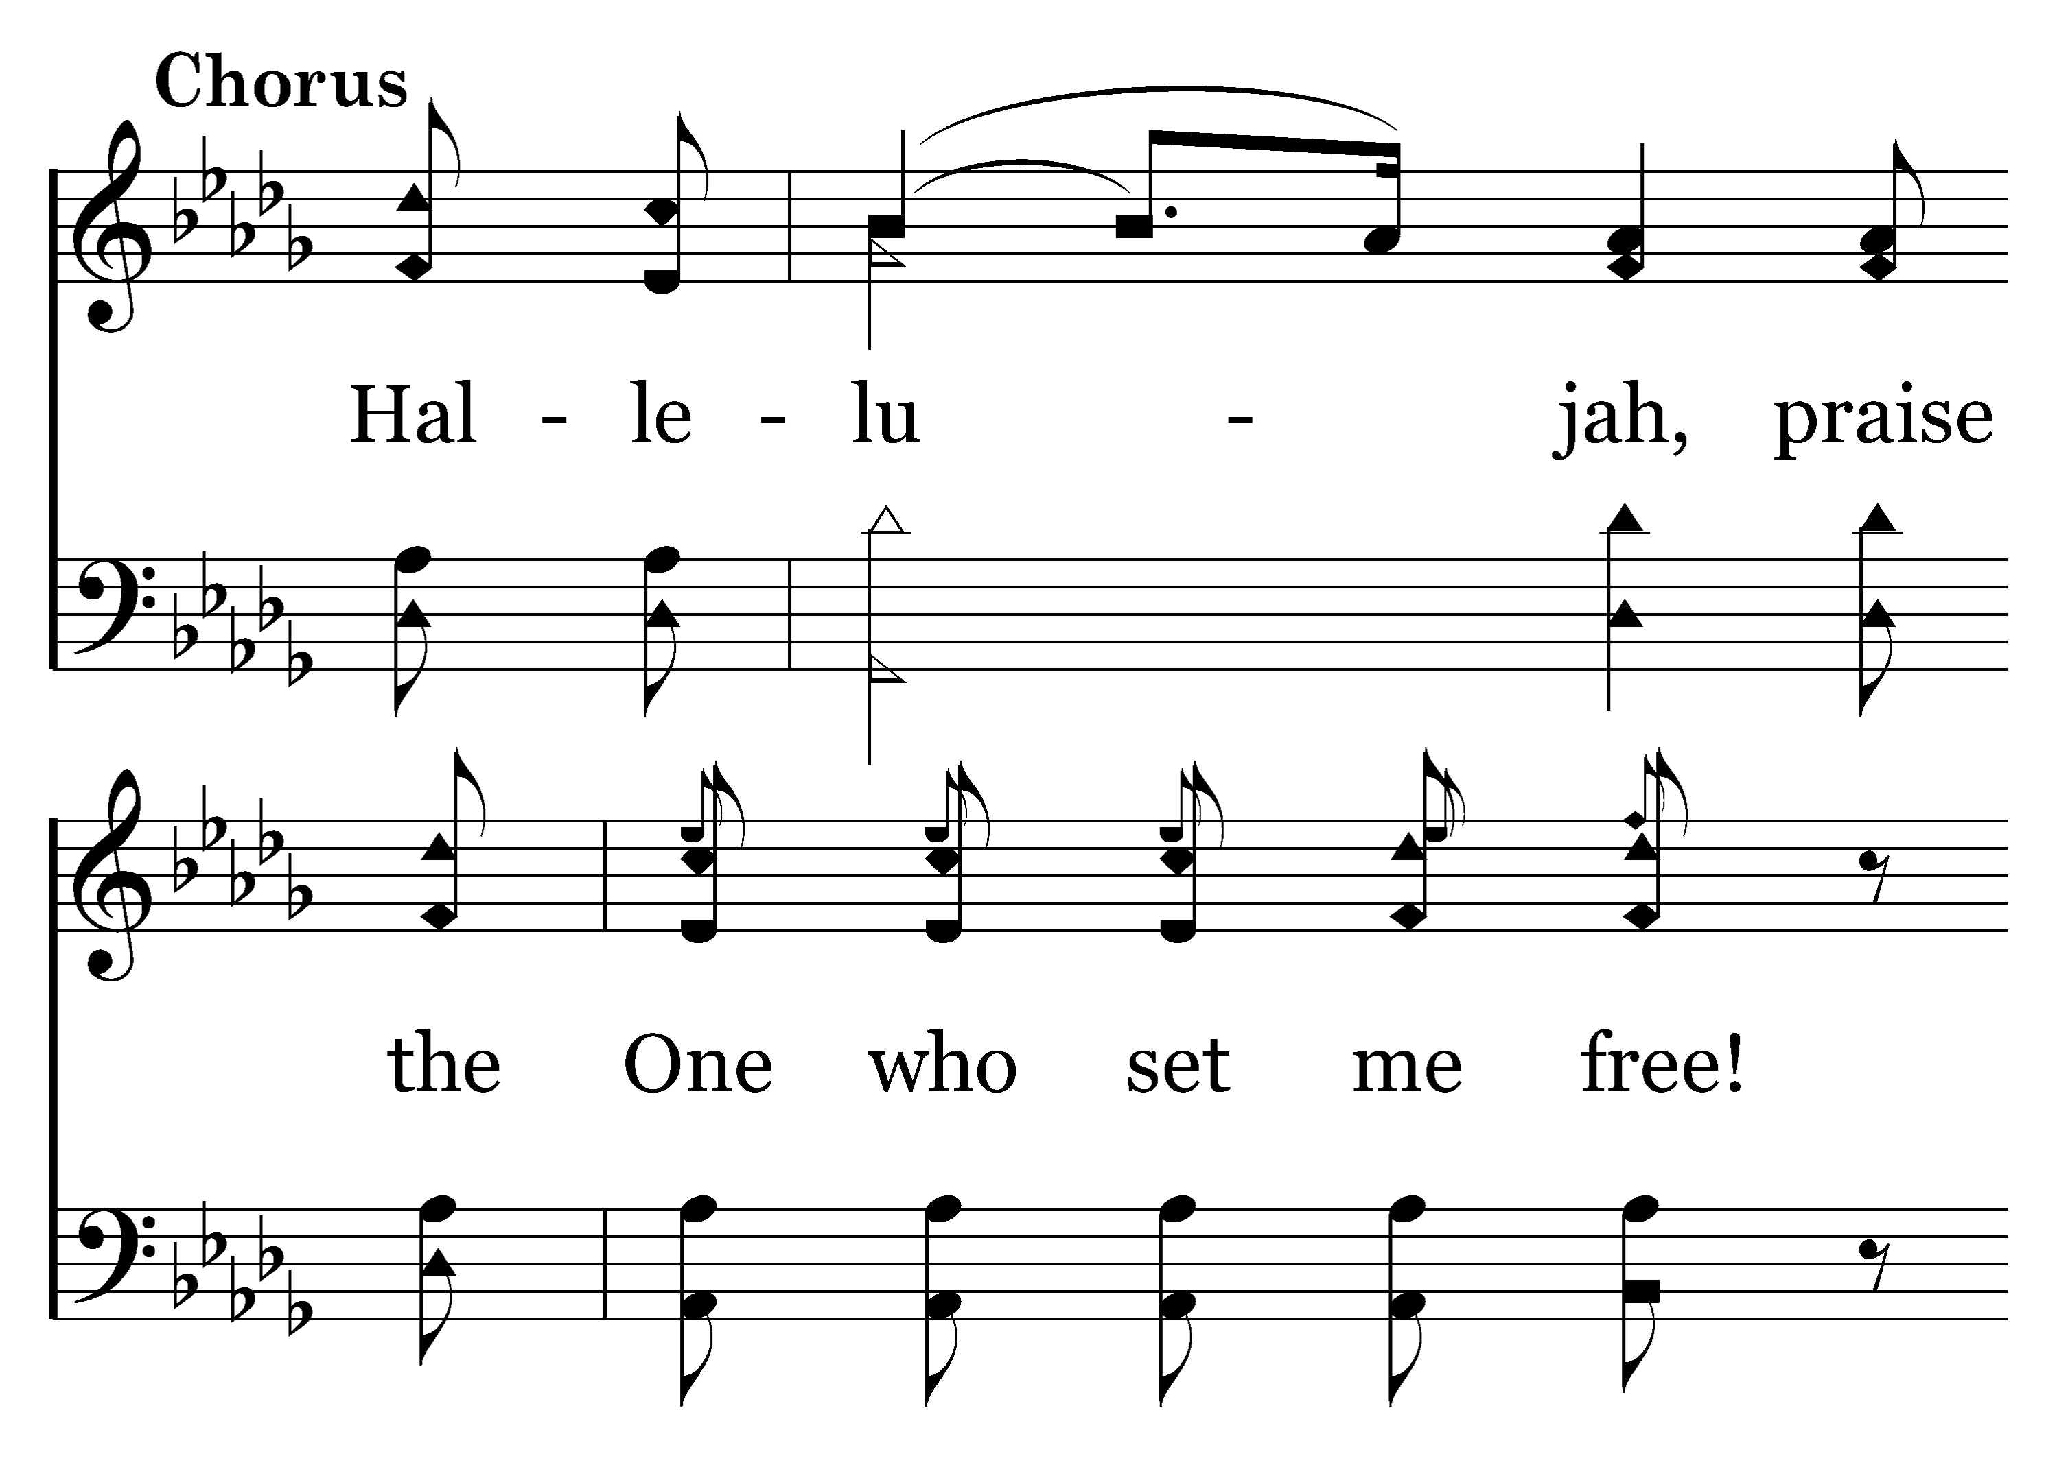
1
2
C
3
C
200
LIVING HOPE
Typeset R. J. Stevens Music

Slide 29
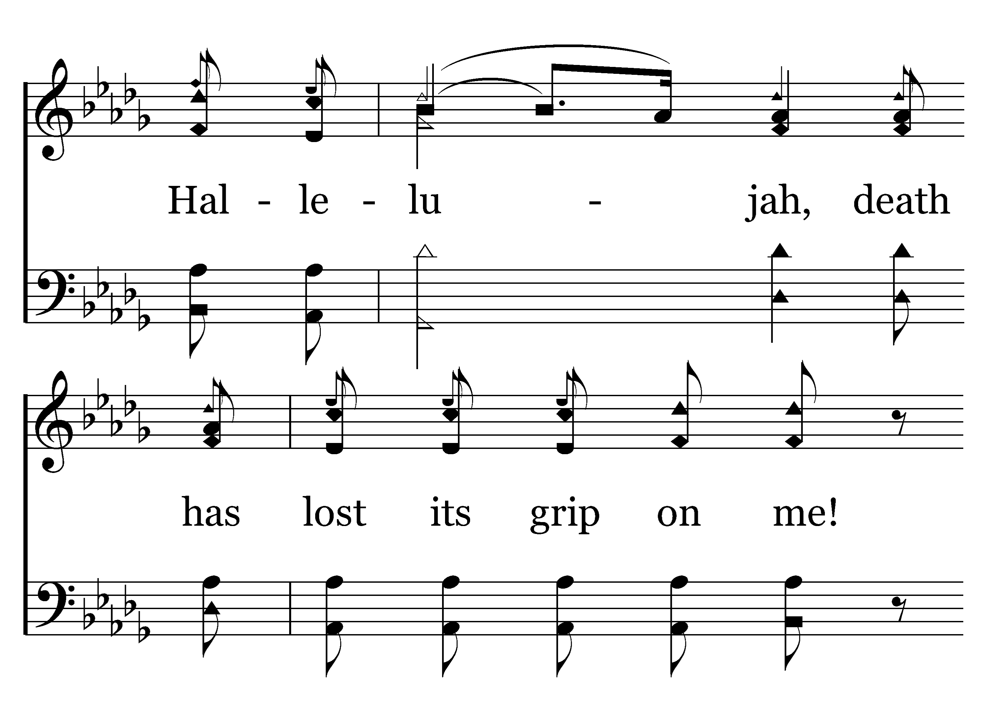
1
2
C
3
C
200
LIVING HOPE
Typeset R. J. Stevens Music

Slide 30
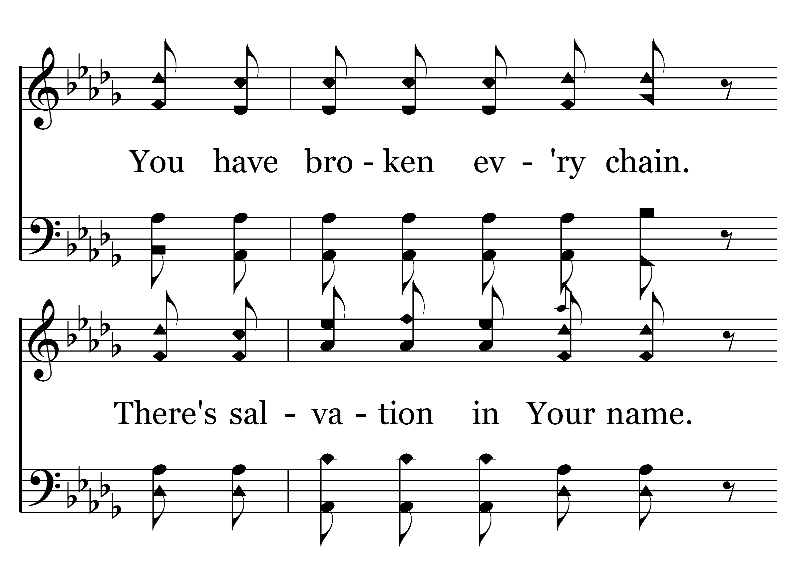
1
2
C
3
C
200
LIVING HOPE
Typeset R. J. Stevens Music

Slide 31
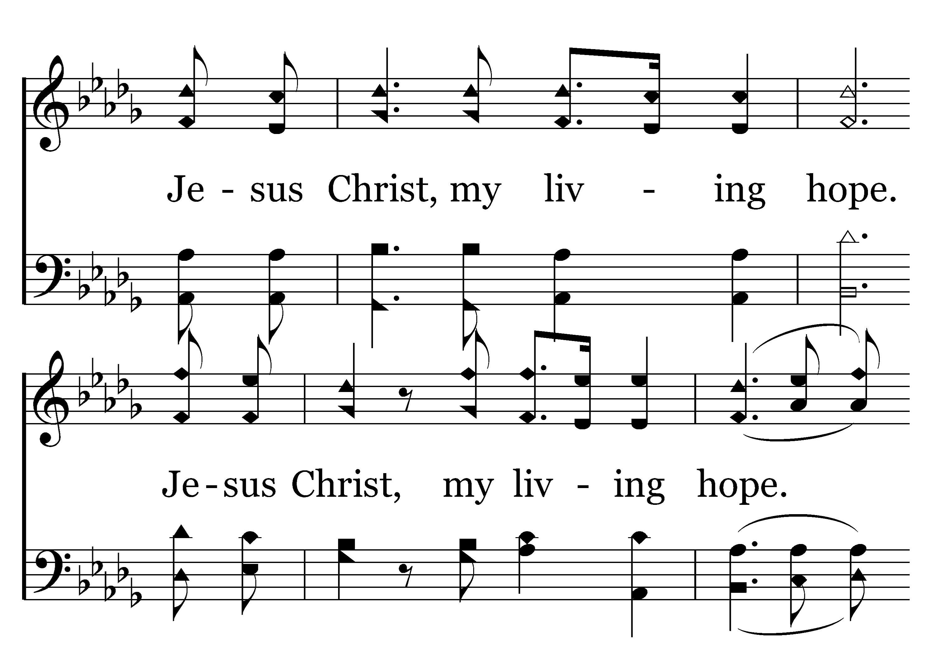
1
2
C
3
C
200
LIVING HOPE
Typeset R. J. Stevens Music

