Slide 1
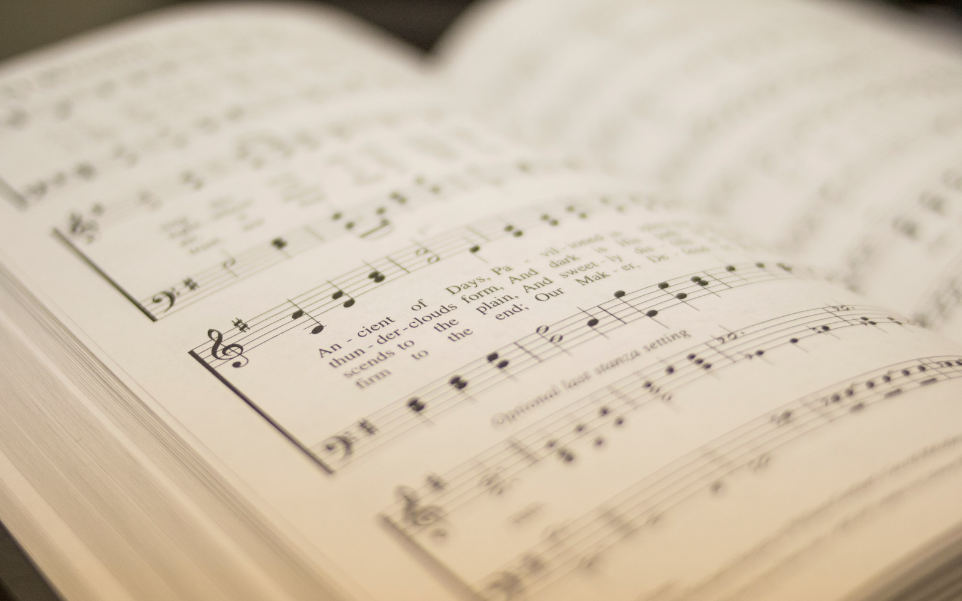

201
NEVER ONCE
1
2
3
“SINGING...TO THE LORD” COLOSSIANS 3:16
Words and Music by: Jason Ingram, Matt Redman, and Tim Wanstall Arr: Randy Gill

Slide 2

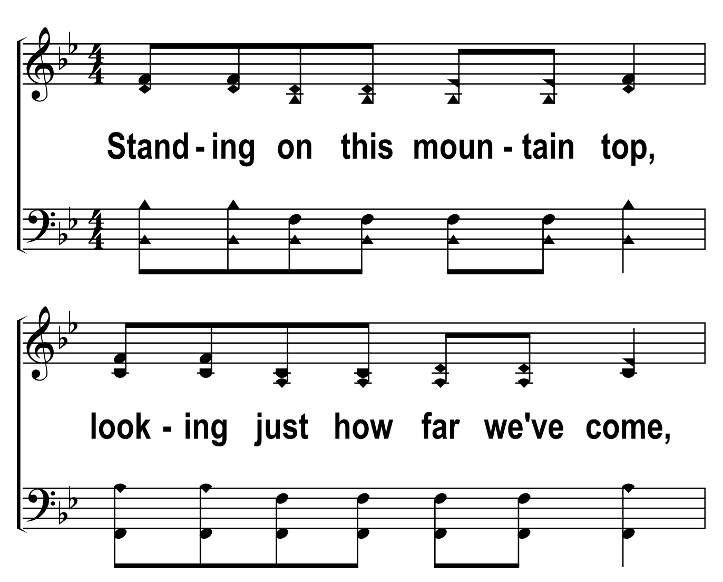

201
1
NEVER ONCE
C
2
C
3
C
Â© 2018 The Acapella Company

Slide 3
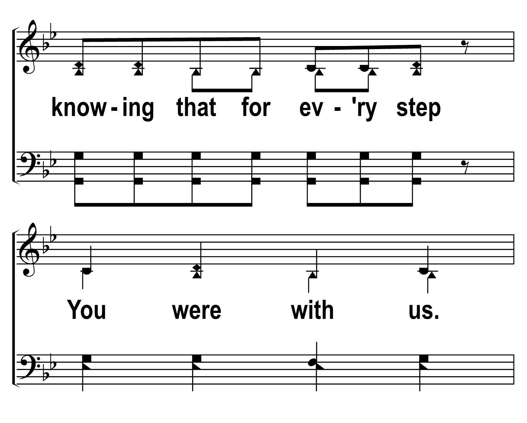
201
1
NEVER ONCE
C
2
C
3
C
Â© 2018 The Acapella Company

Slide 4
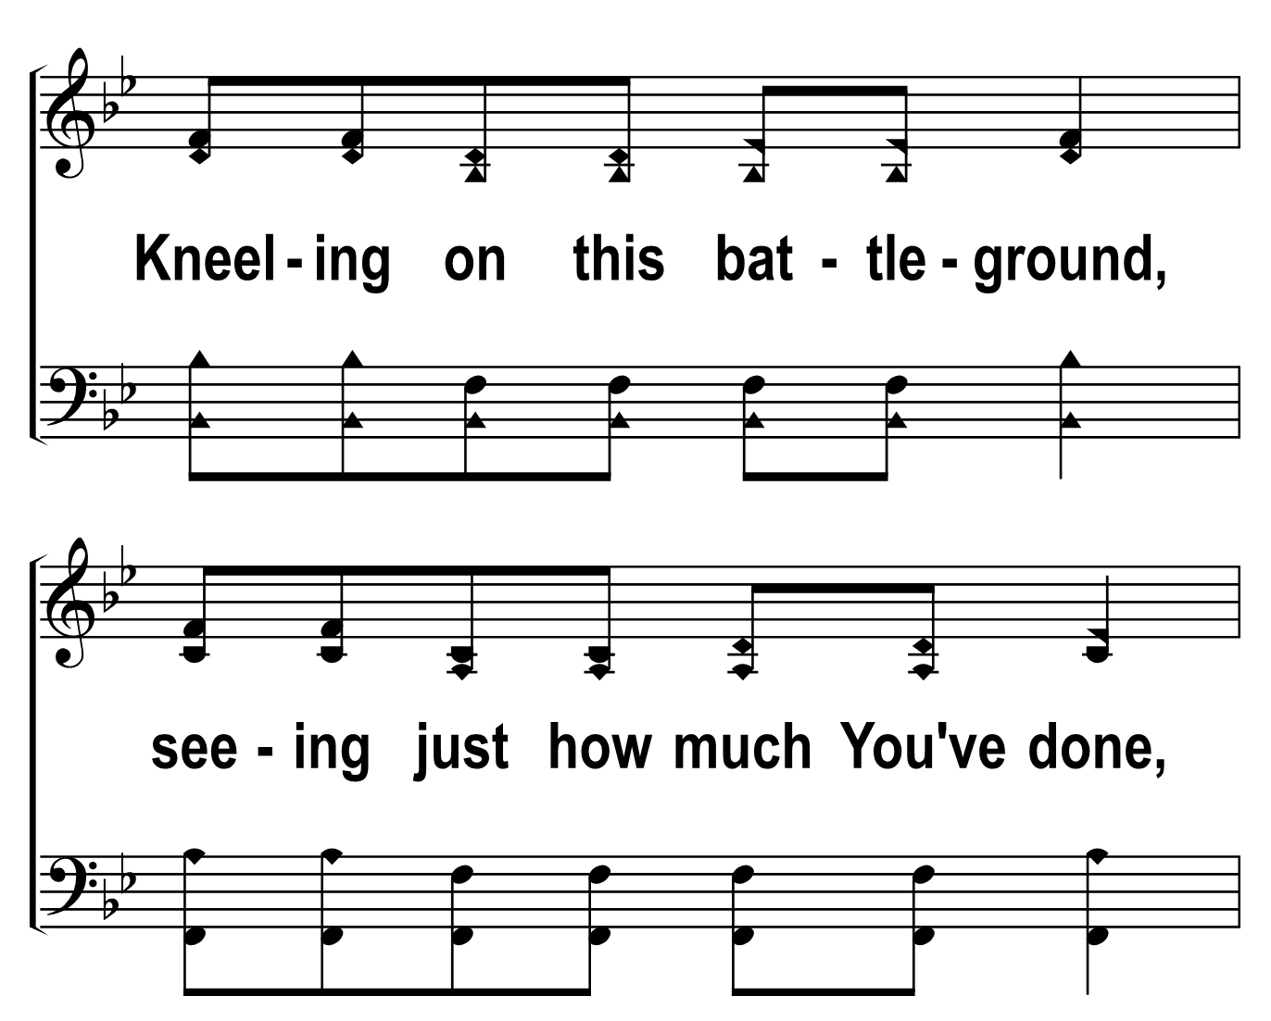
201
1
NEVER ONCE
C
2
C
3
C
Â© 2018 The Acapella Company

Slide 5
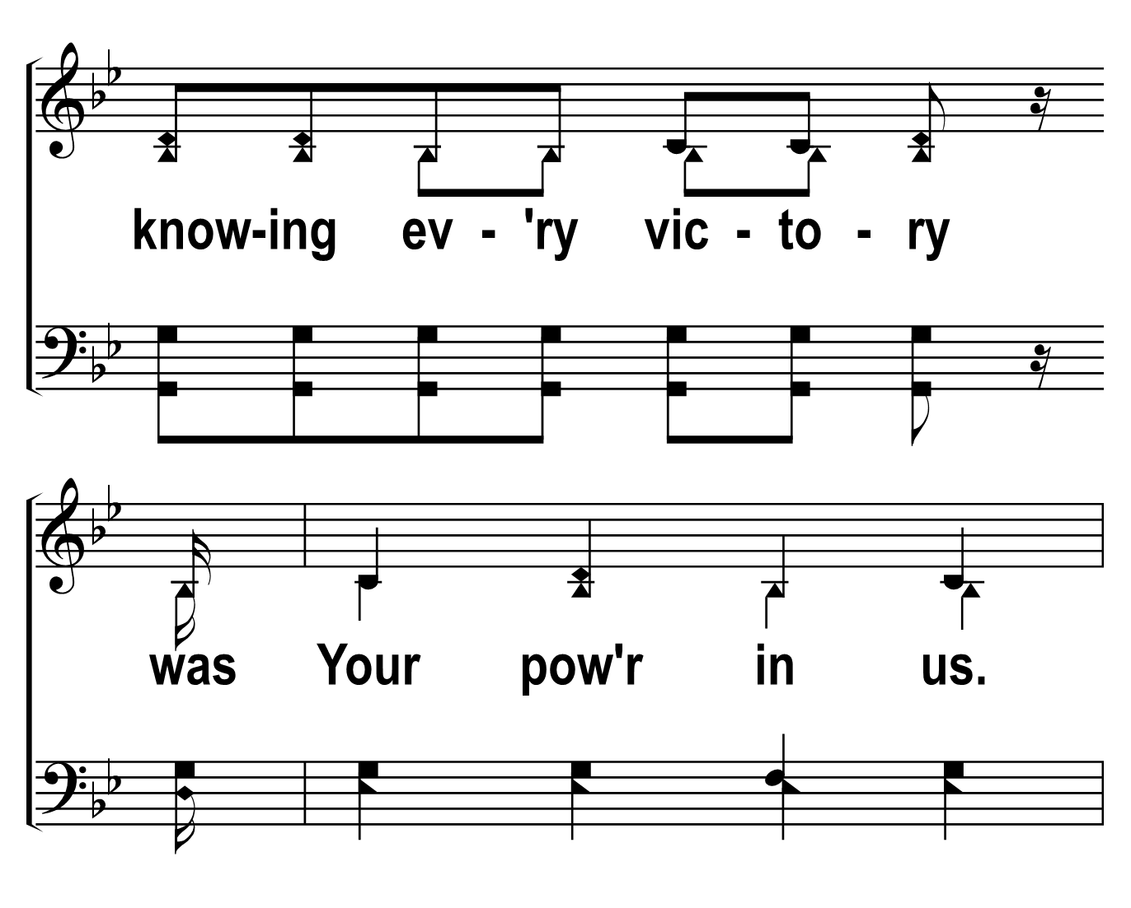
201
1
NEVER ONCE
C
2
C
3
C
Â© 2018 The Acapella Company

Slide 6
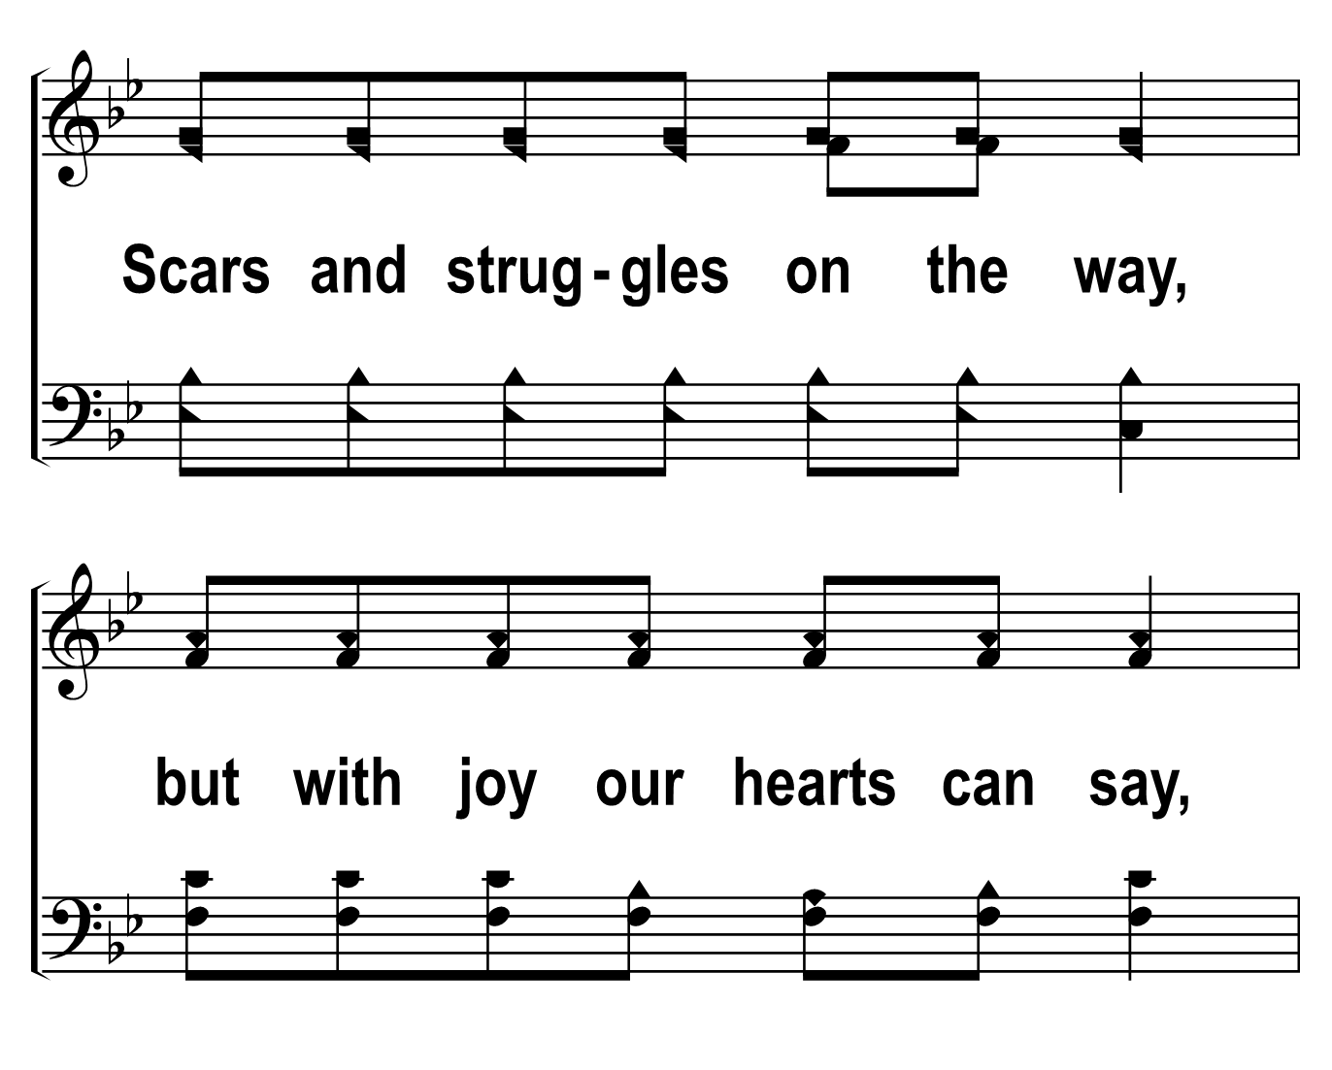
201
1
NEVER ONCE
C
2
C
3
C
Â© 2018 The Acapella Company

Slide 7
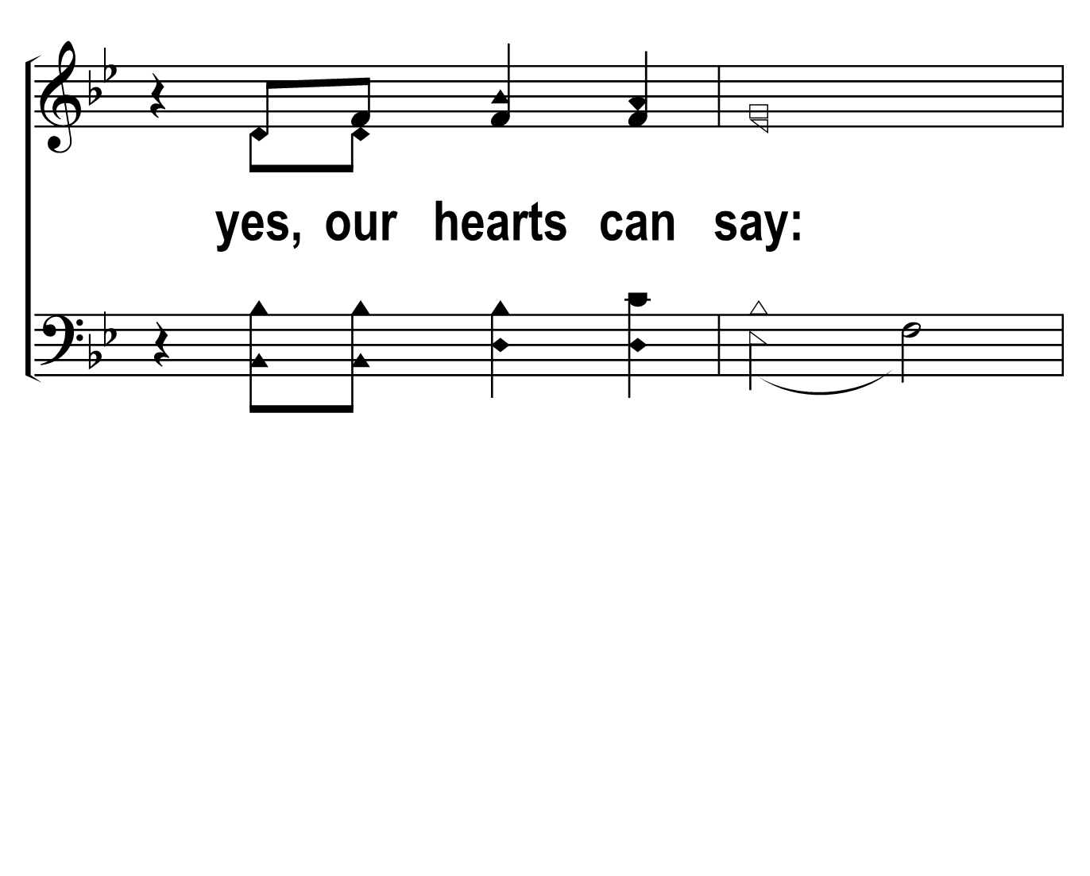
201
1
NEVER ONCE
C
2
C
3
C
Â© 2018 The Acapella Company

Slide 8
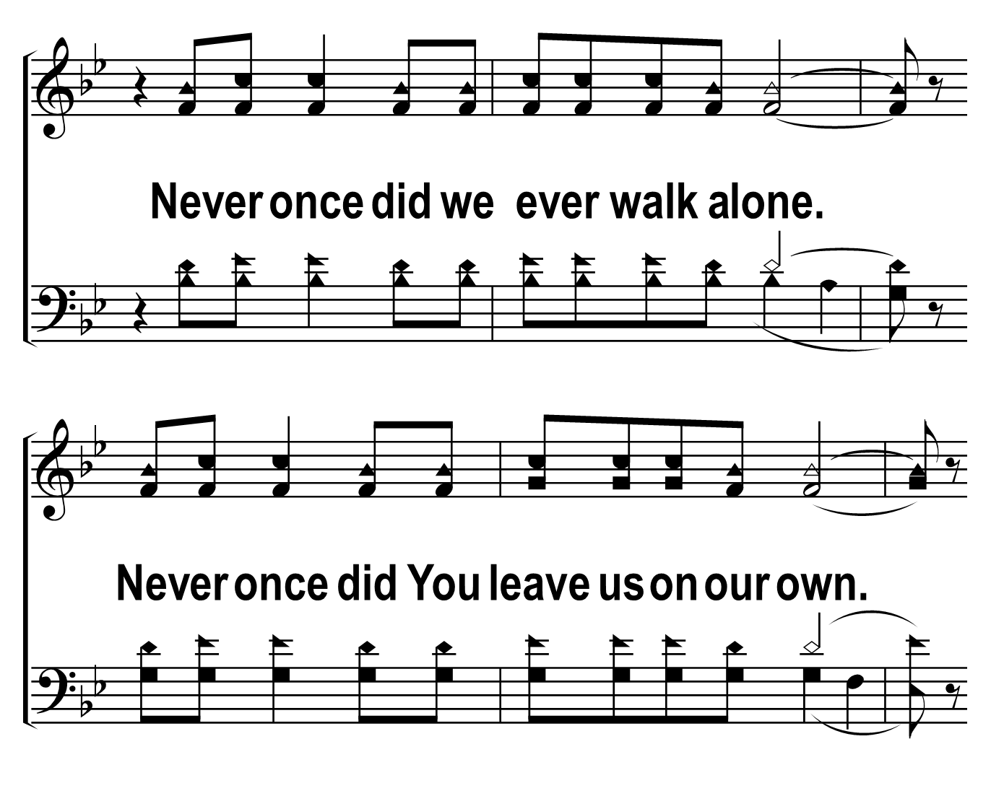
201
1
NEVER ONCE
C
2
C
3
C
Â© 2018 The Acapella Company

Slide 9
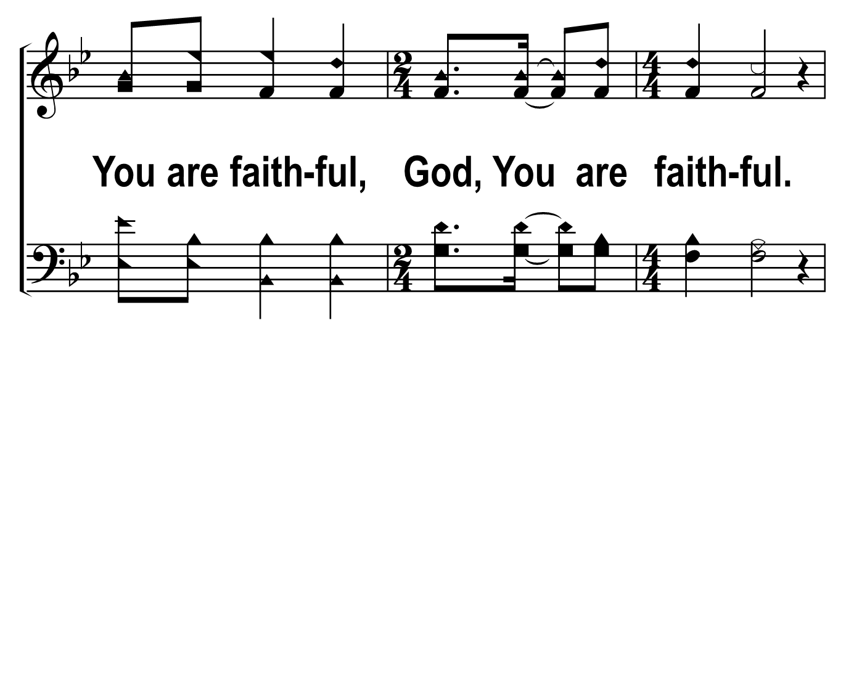
201
1
NEVER ONCE
C
2
C
3
C
Â© 2018 The Acapella Company

Slide 10
201
1
NEVER ONCE
C
2
C
3
C
Â© 2018 The Acapella Company

Slide 11
201
1
NEVER ONCE
C
2
C
3
C
Â© 2018 The Acapella Company

Slide 12
201
1
NEVER ONCE
C
2
C
3
C
Â© 2018 The Acapella Company

Slide 13
201
1
NEVER ONCE
C
2
C
3
C
Â© 2018 The Acapella Company

Slide 14
201
1
NEVER ONCE
C
2
C
3
C
Â© 2018 The Acapella Company

Slide 15
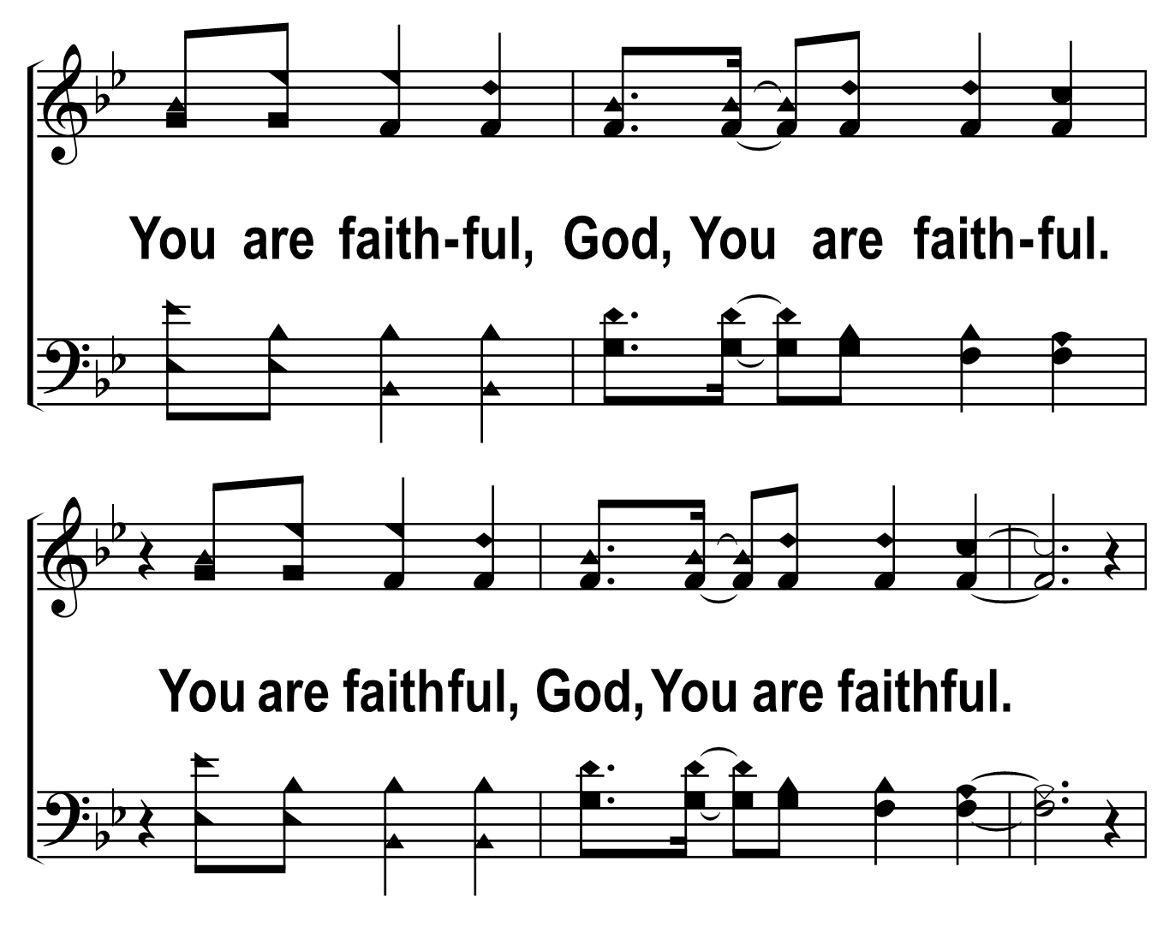
201
1
NEVER ONCE
C
2
C
3
C
Â© 2018 The Acapella Company

Slide 16
201
1
NEVER ONCE
C
2
C
3
C
Â© 2018 The Acapella Company

Slide 17
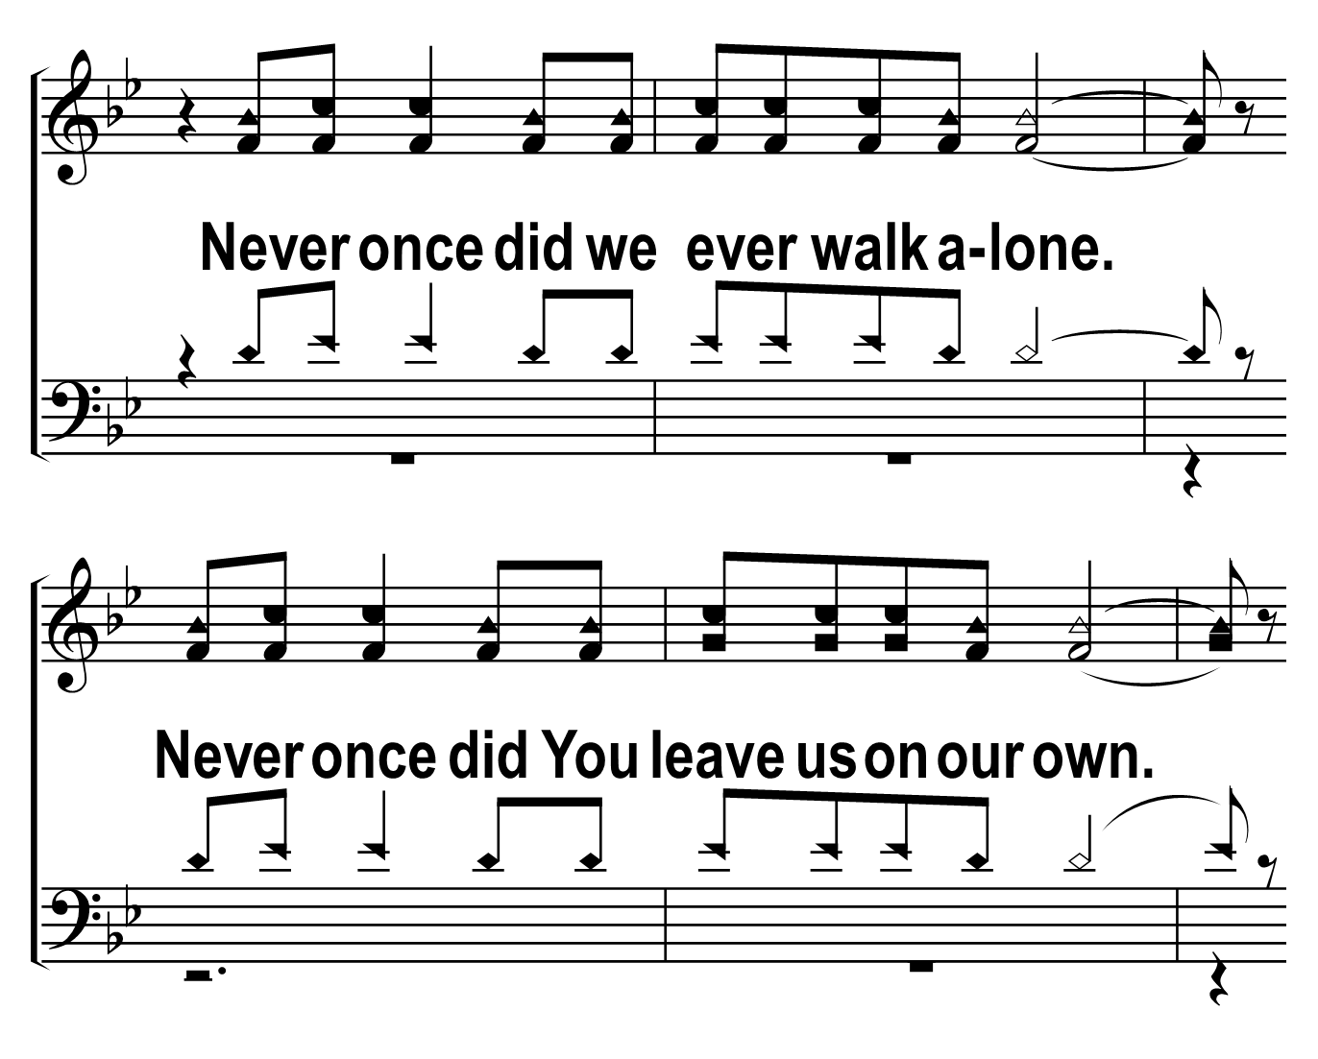
201
1
NEVER ONCE
C
2
C
3
C
Â© 2018 The Acapella Company

Slide 18
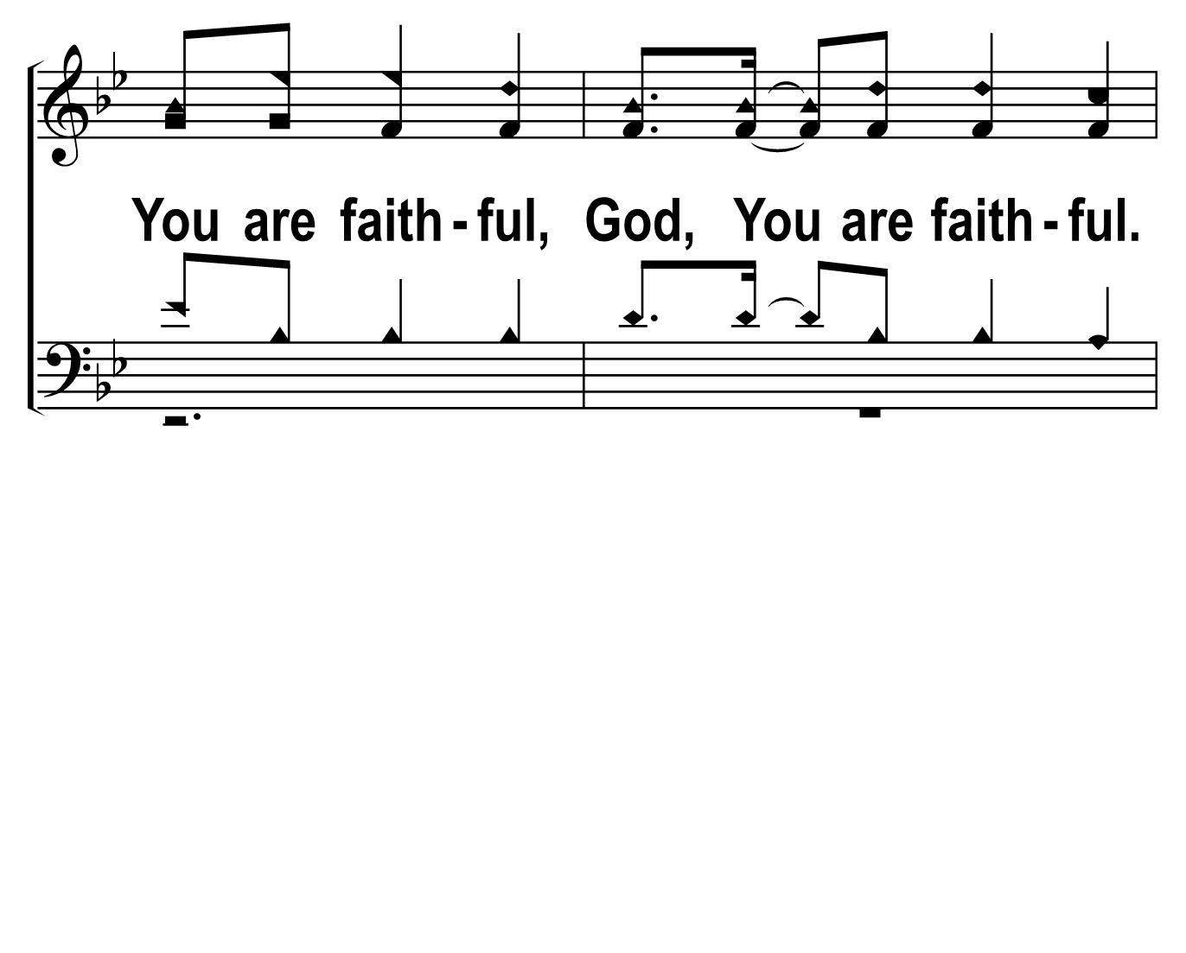
201
1
NEVER ONCE
C
2
C
3
C
Â© 2018 The Acapella Company

Slide 19
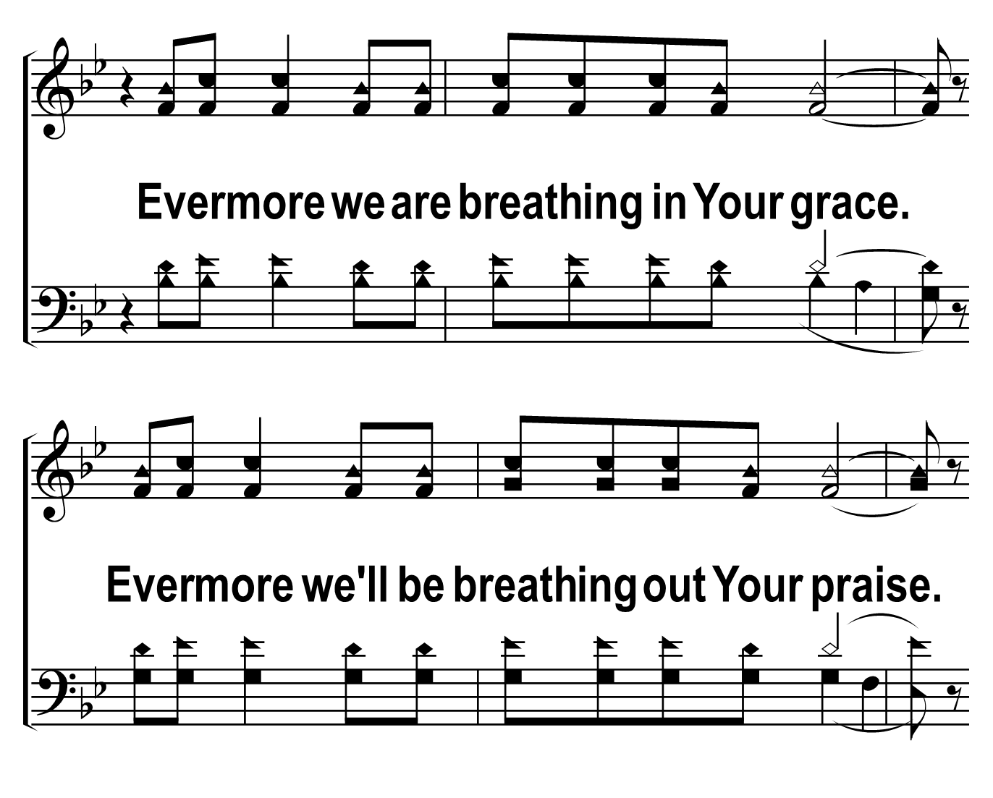
201
1
NEVER ONCE
C
2
C
3
C
Â© 2018 The Acapella Company

Slide 20
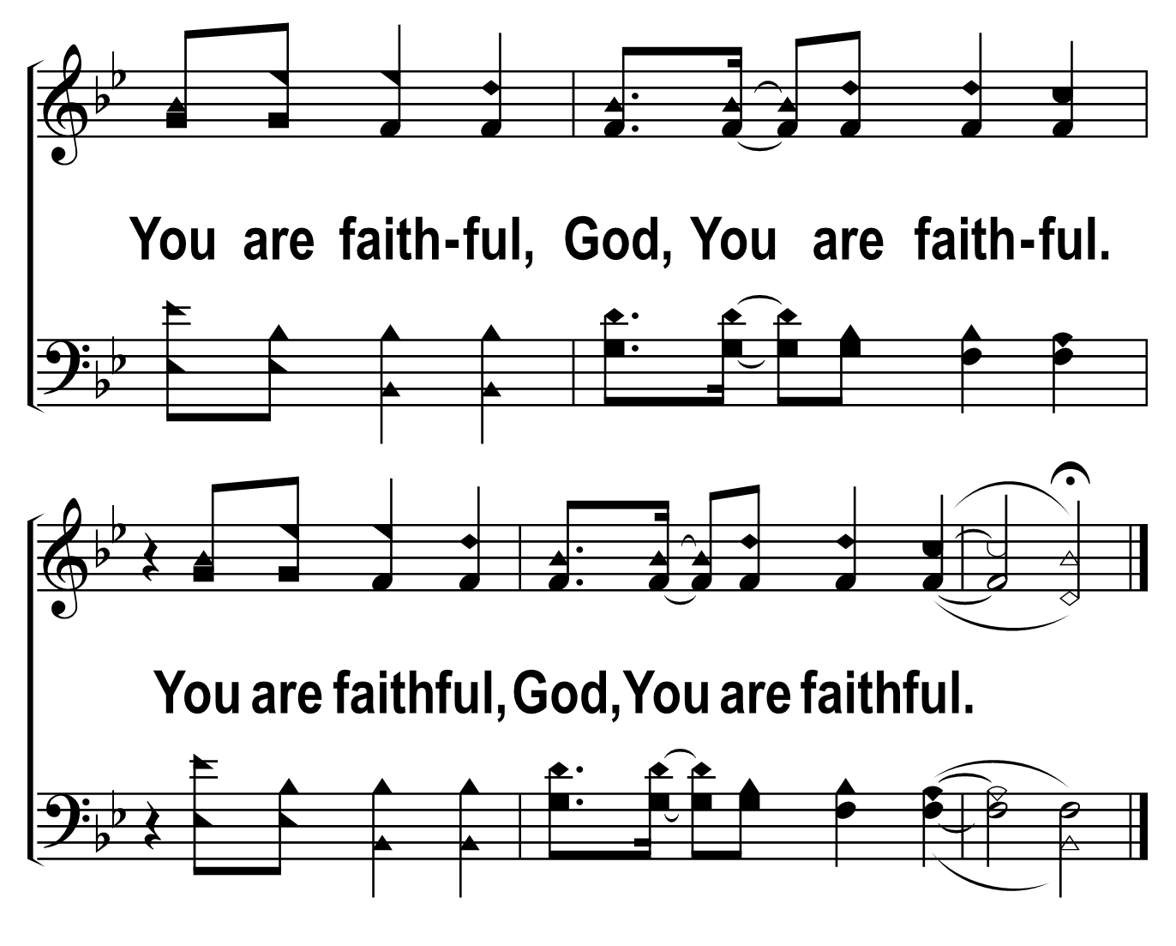
201
1
NEVER ONCE
C
2
C
3
C
Â© 2018 The Acapella Company

