Slide 1
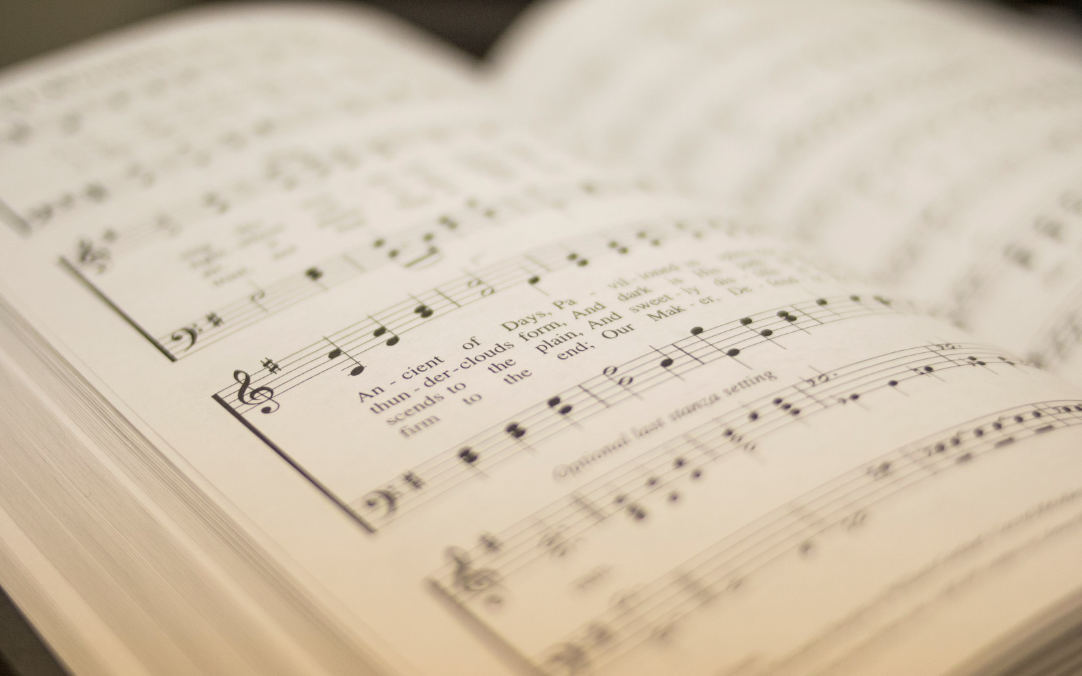

202
GOODNESS OF GOD
1
2
“SINGING...TO THE LORD” COLOSSIANS 3:16
Words and Music by: Jenn Johnson, Ed Cash, Jason Ingram, Ben Fielding, Brian Johnson Arr. Mark Simons, Shane Coffman, Aneva Peirce © Copyright 2019 Fellowship Music. (Admin. by Capitol CMG Publishing.) All Rights Reserved. Used by Permission.

Slide 2
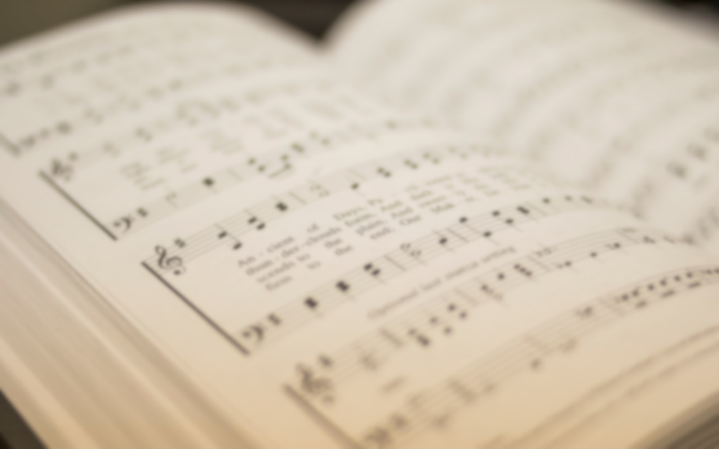
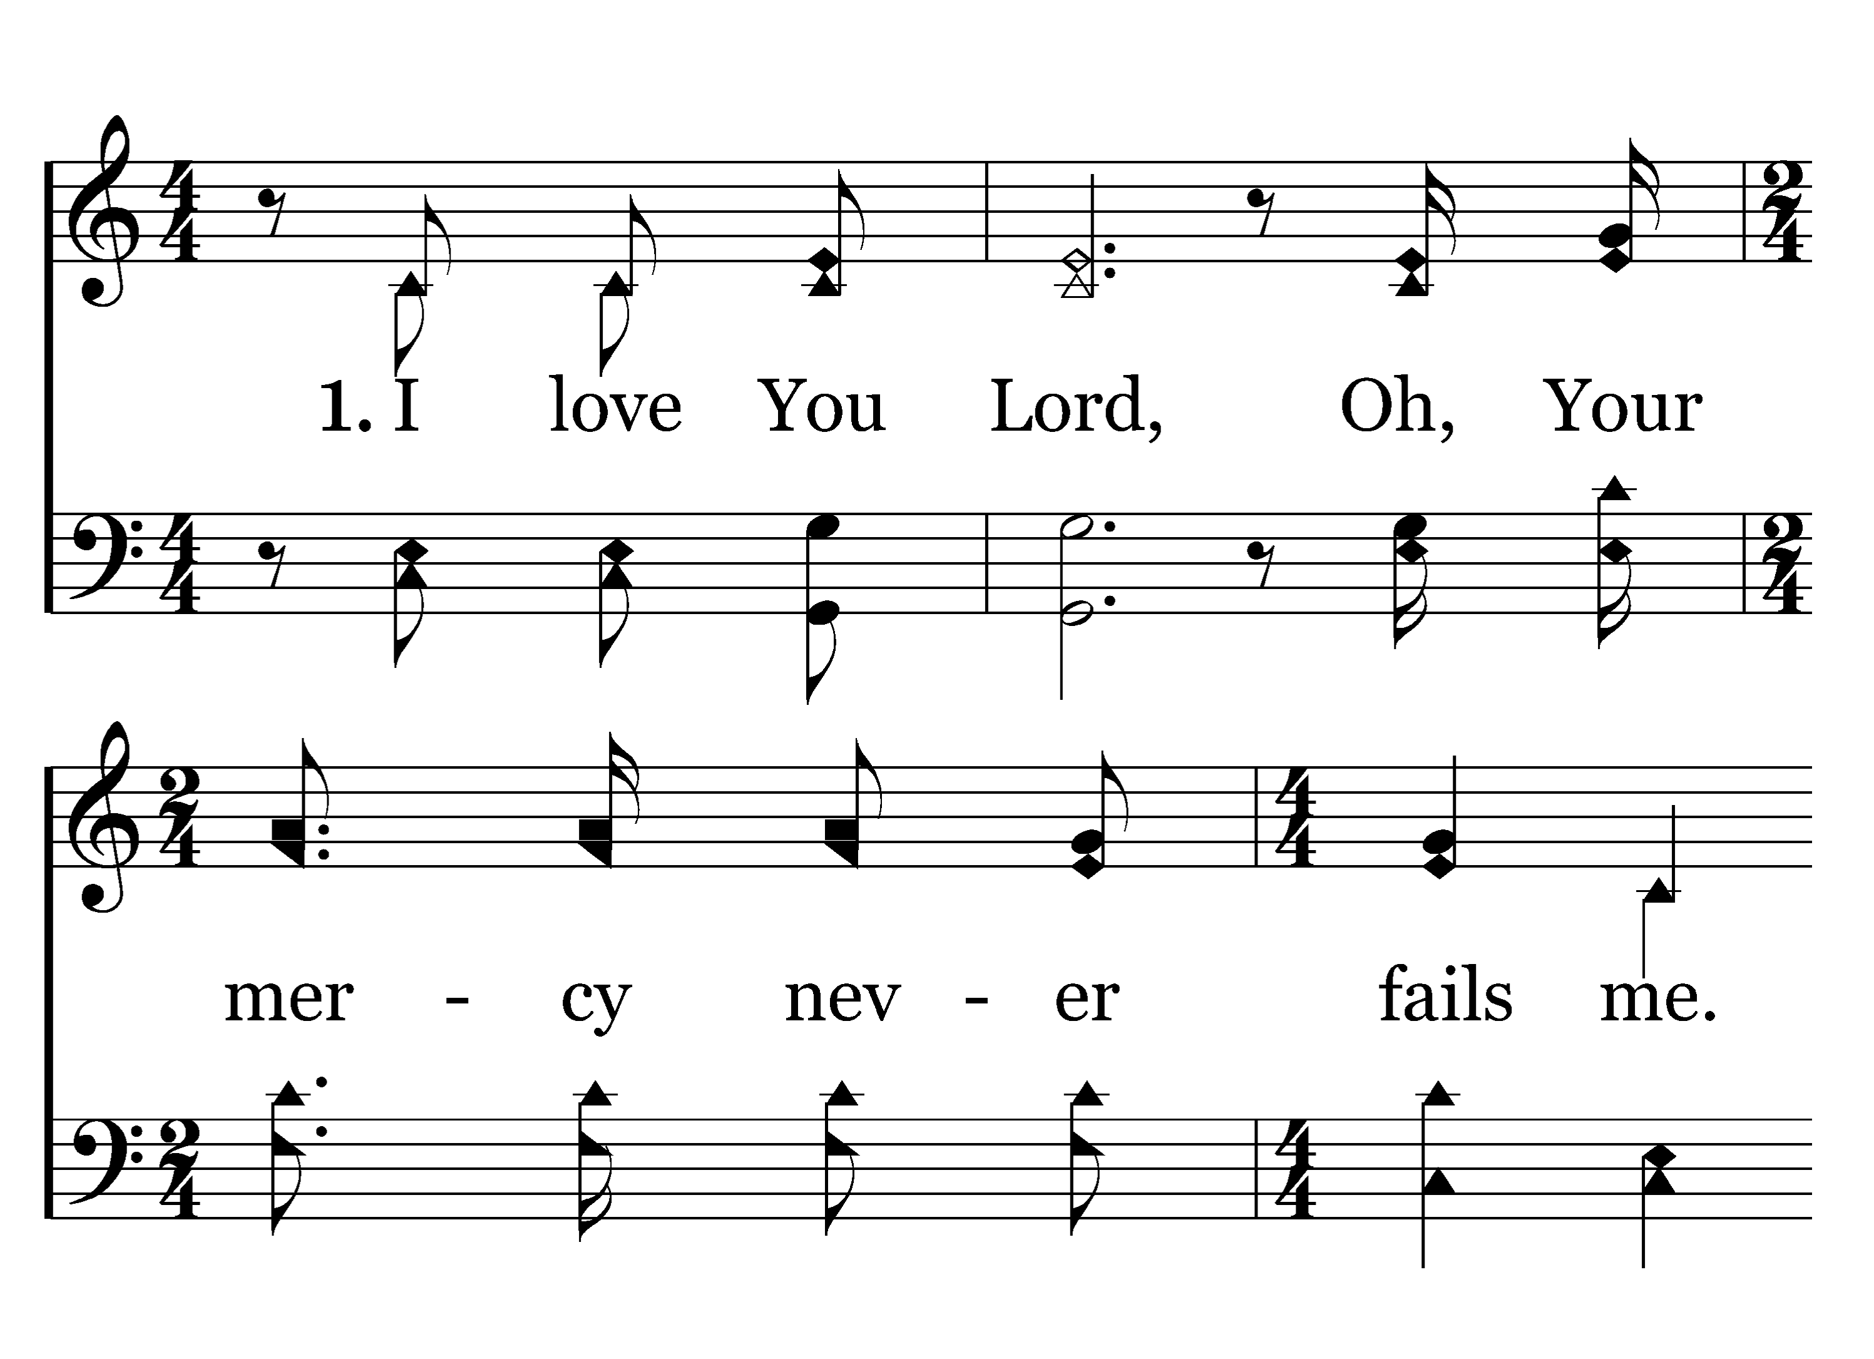

202
1
GOODNESS OF GOD
C
2
C
Typeset R. J. Stevens Music

Slide 3
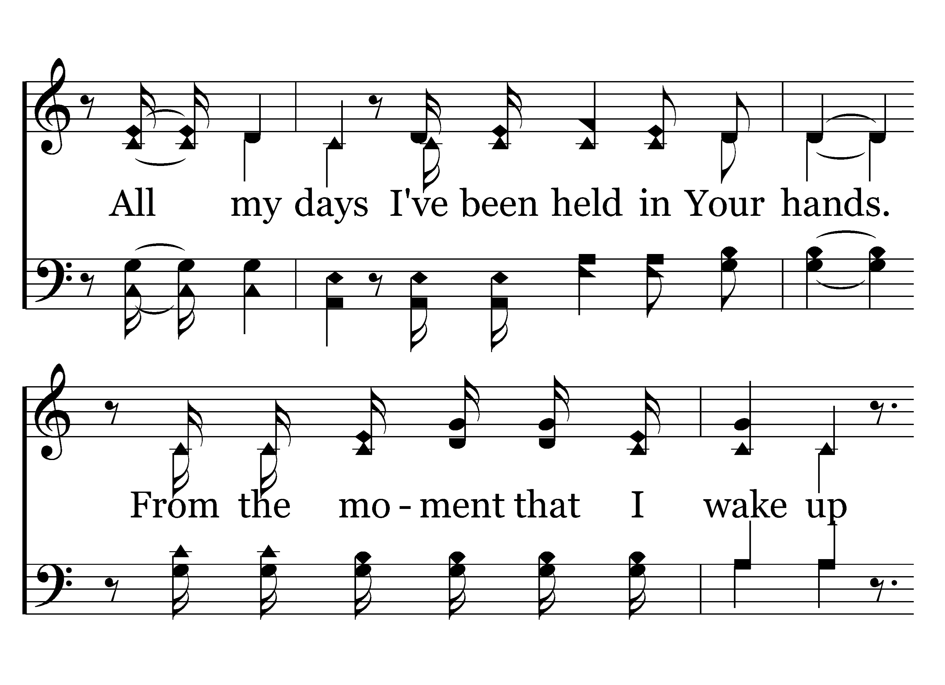
202
1
GOODNESS OF GOD
C
2
C
Typeset R. J. Stevens Music

Slide 4
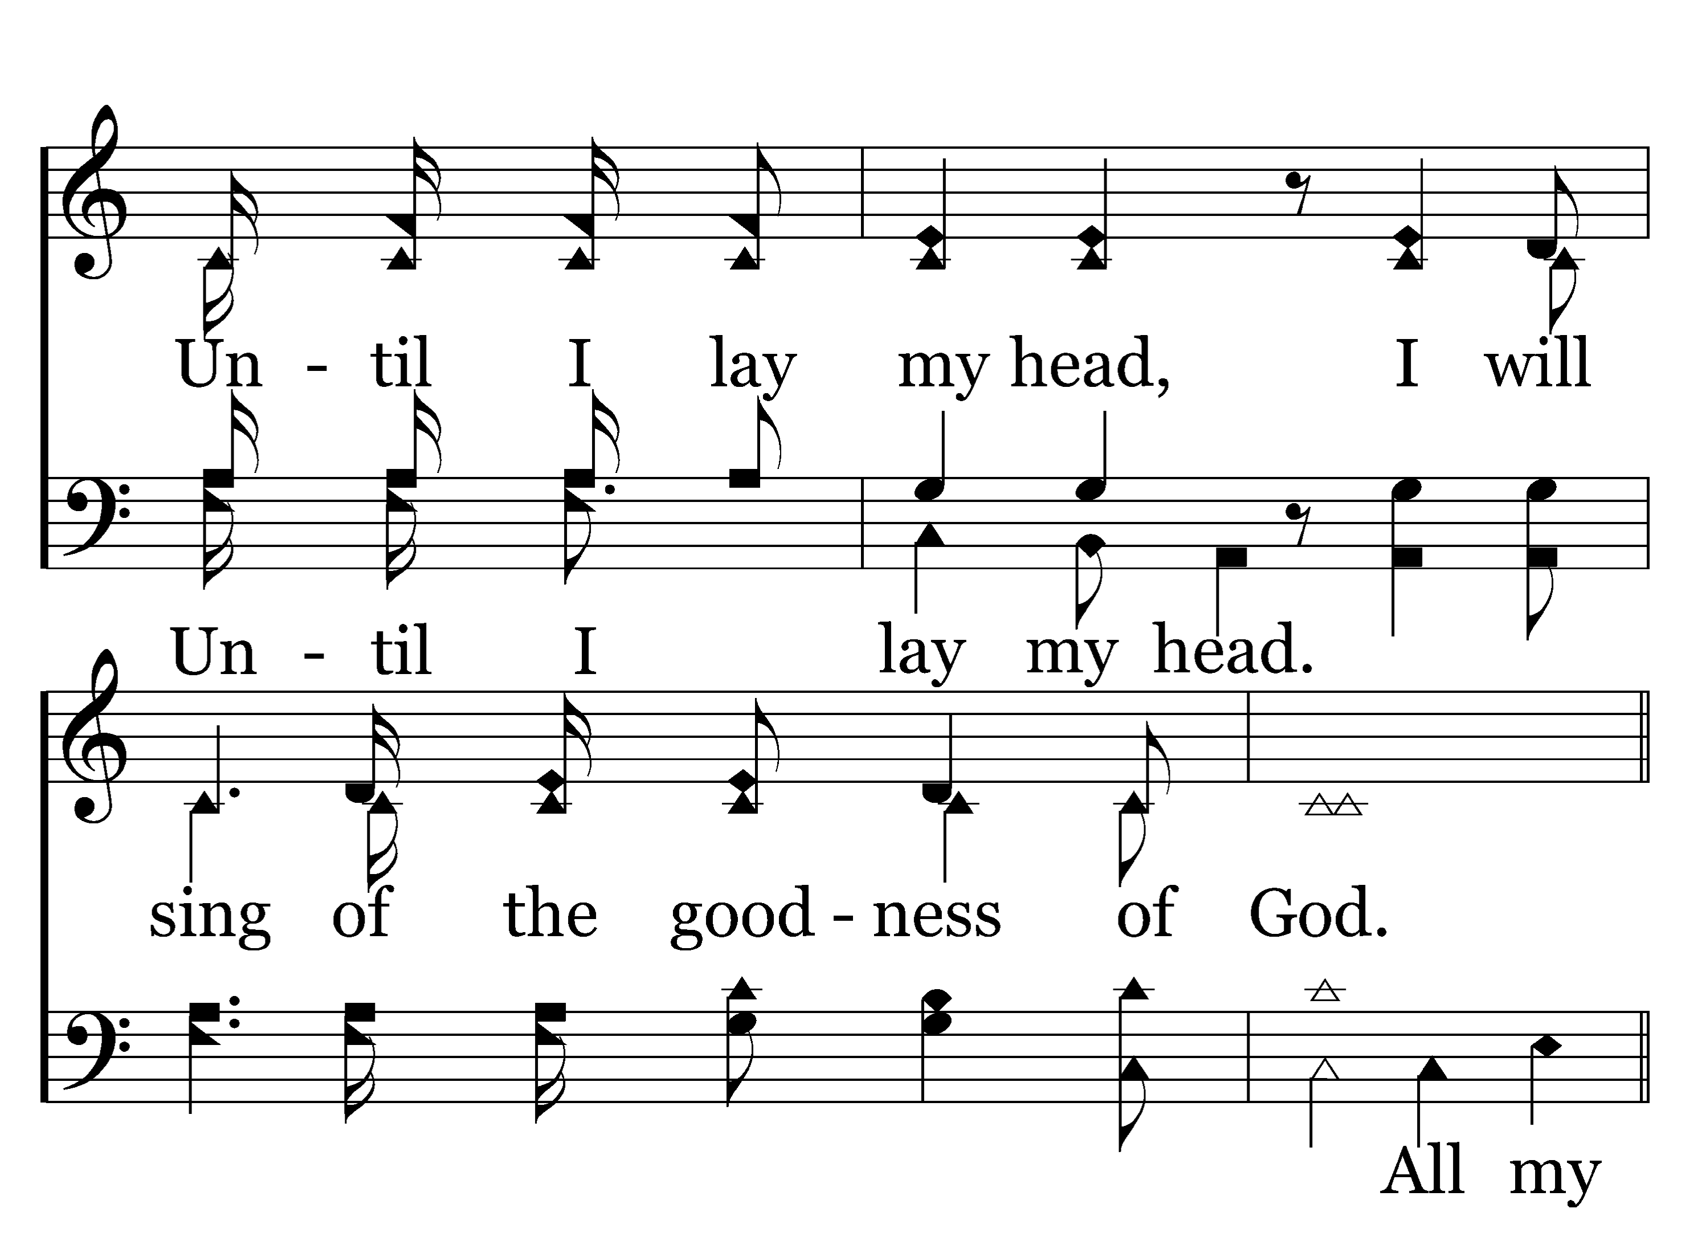
202
1
GOODNESS OF GOD
C
2
C
Typeset R. J. Stevens Music

Slide 5
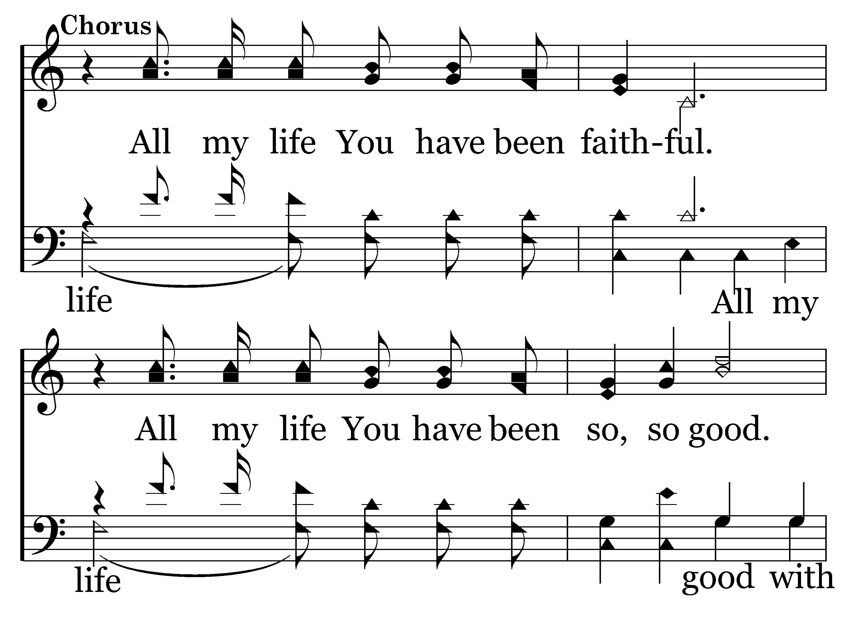
202
1
GOODNESS OF GOD
C
2
C
Typeset R. J. Stevens Music

Slide 6
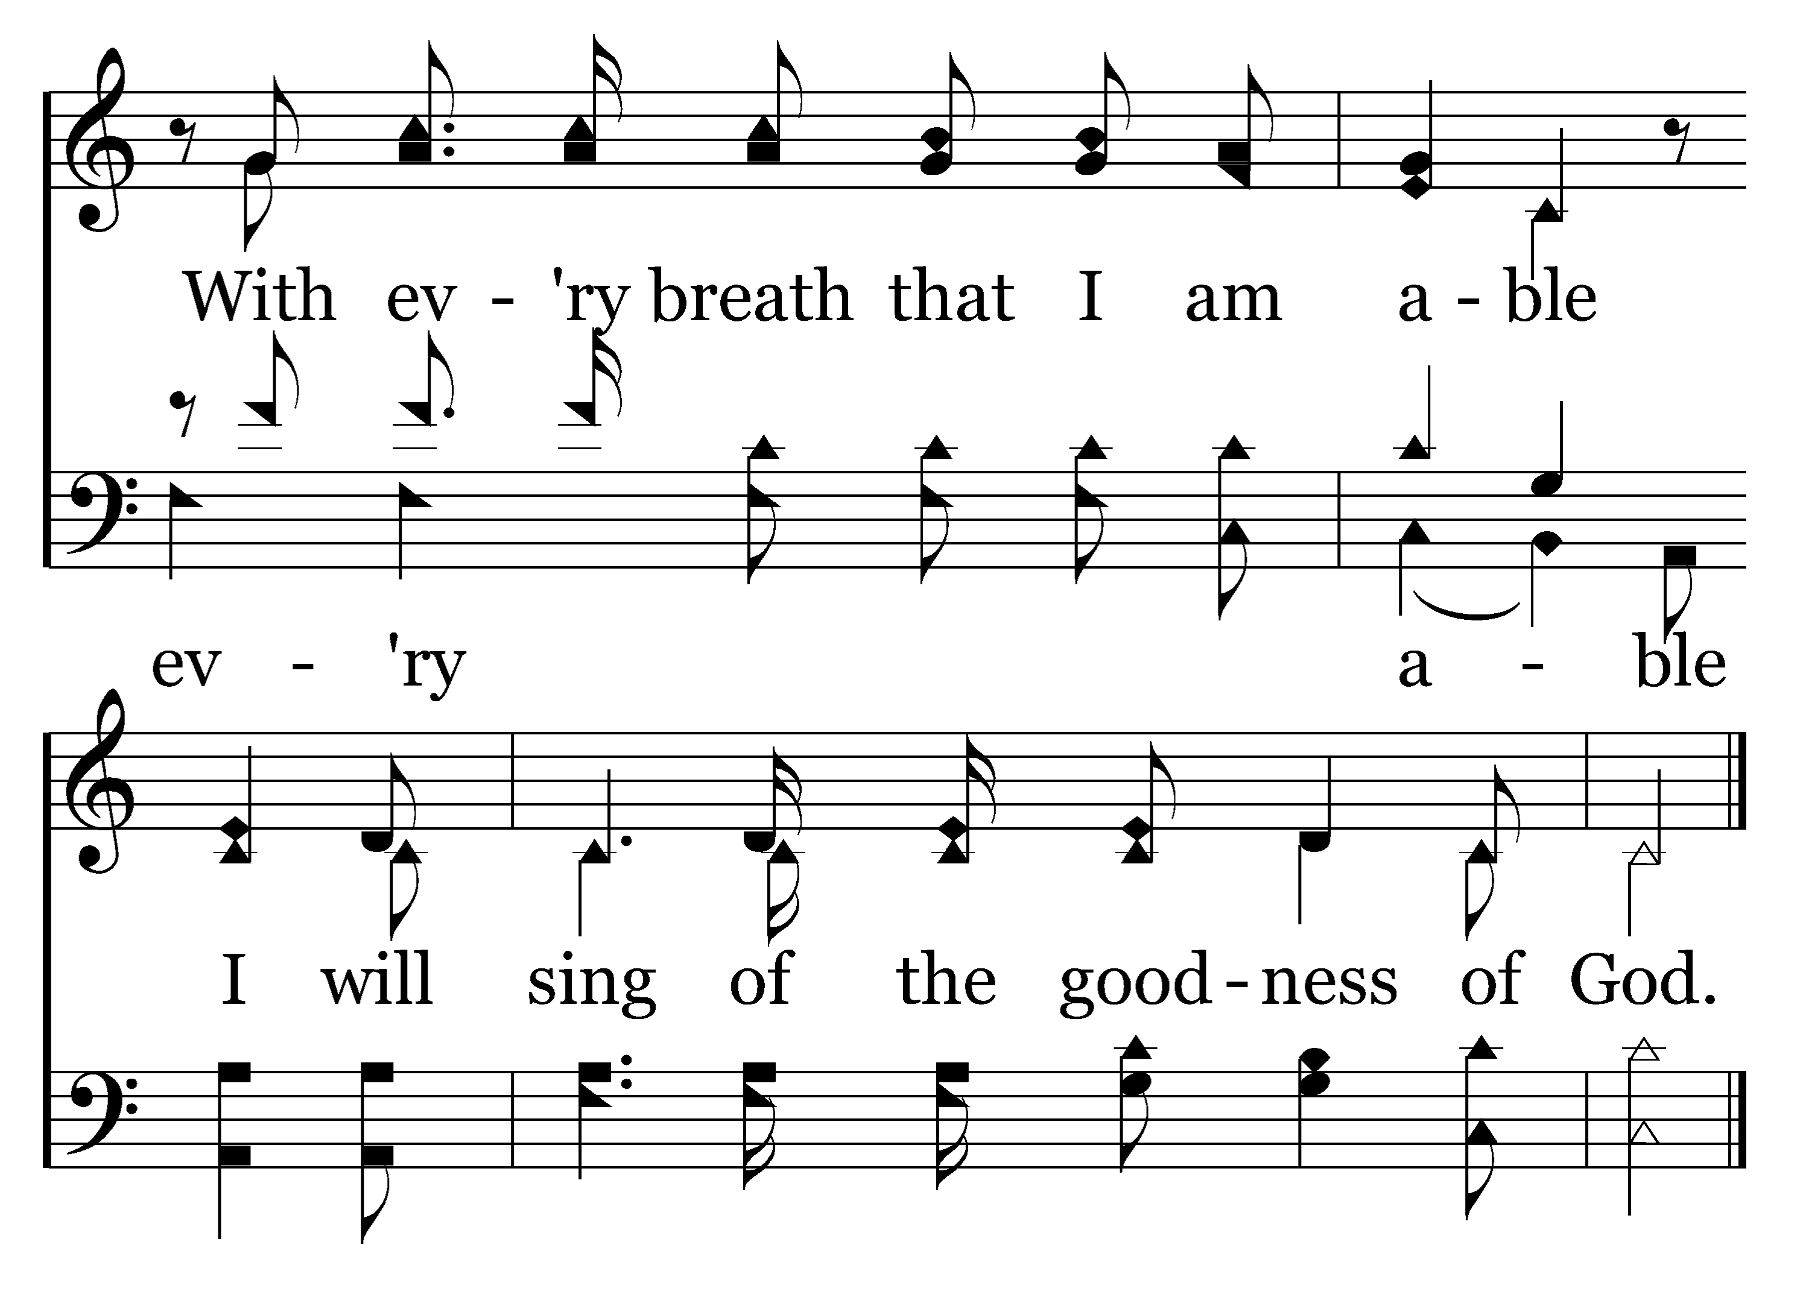
202
1
GOODNESS OF GOD
C
2
C
Typeset R. J. Stevens Music

Slide 7
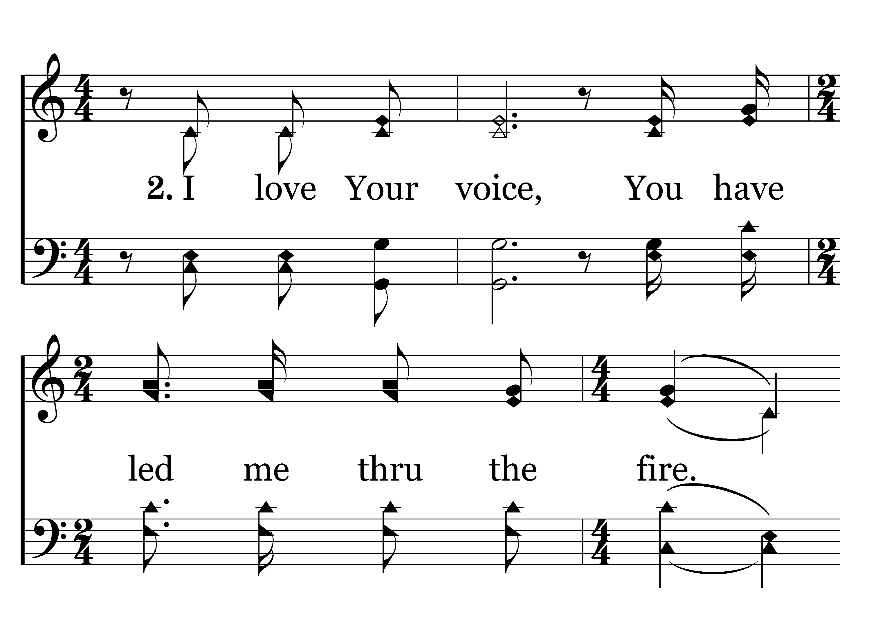
202
1
GOODNESS OF GOD
C
2
C
Typeset R. J. Stevens Music

Slide 8
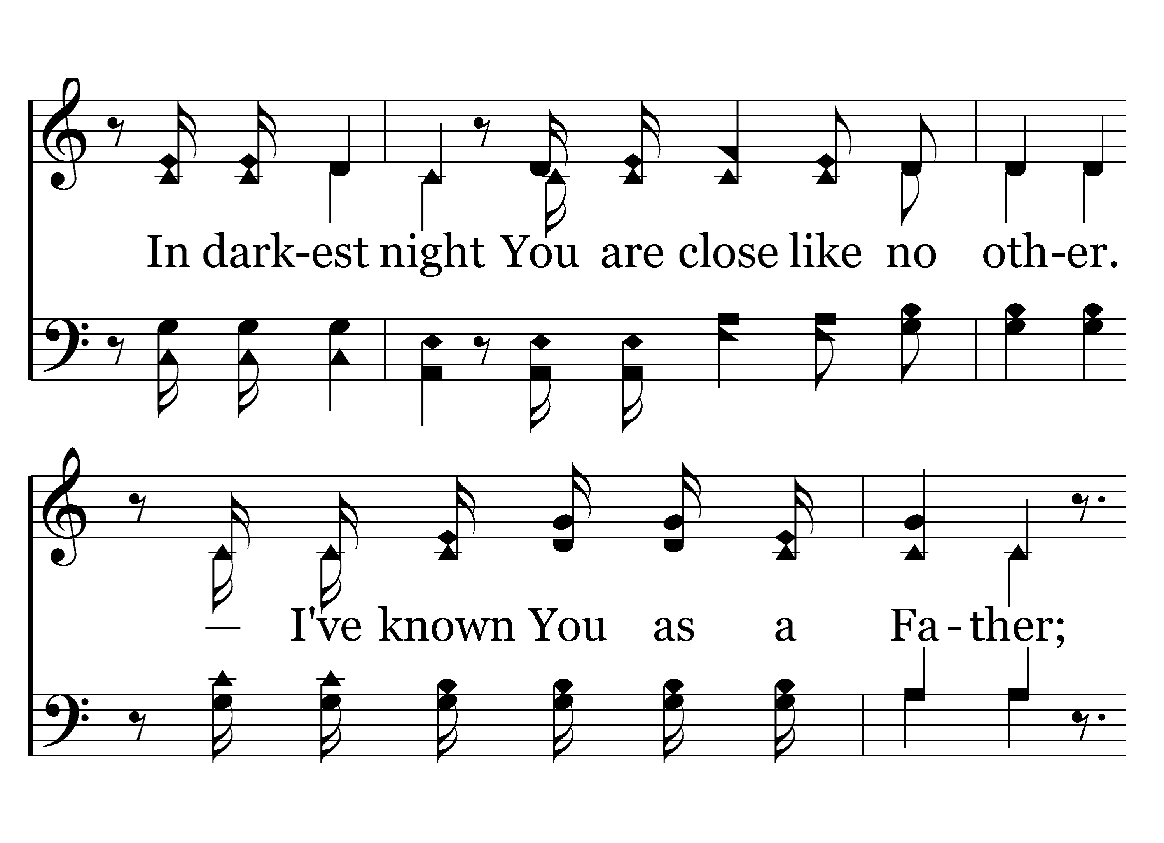
202
1
GOODNESS OF GOD
C
2
C
Typeset R. J. Stevens Music

Slide 9
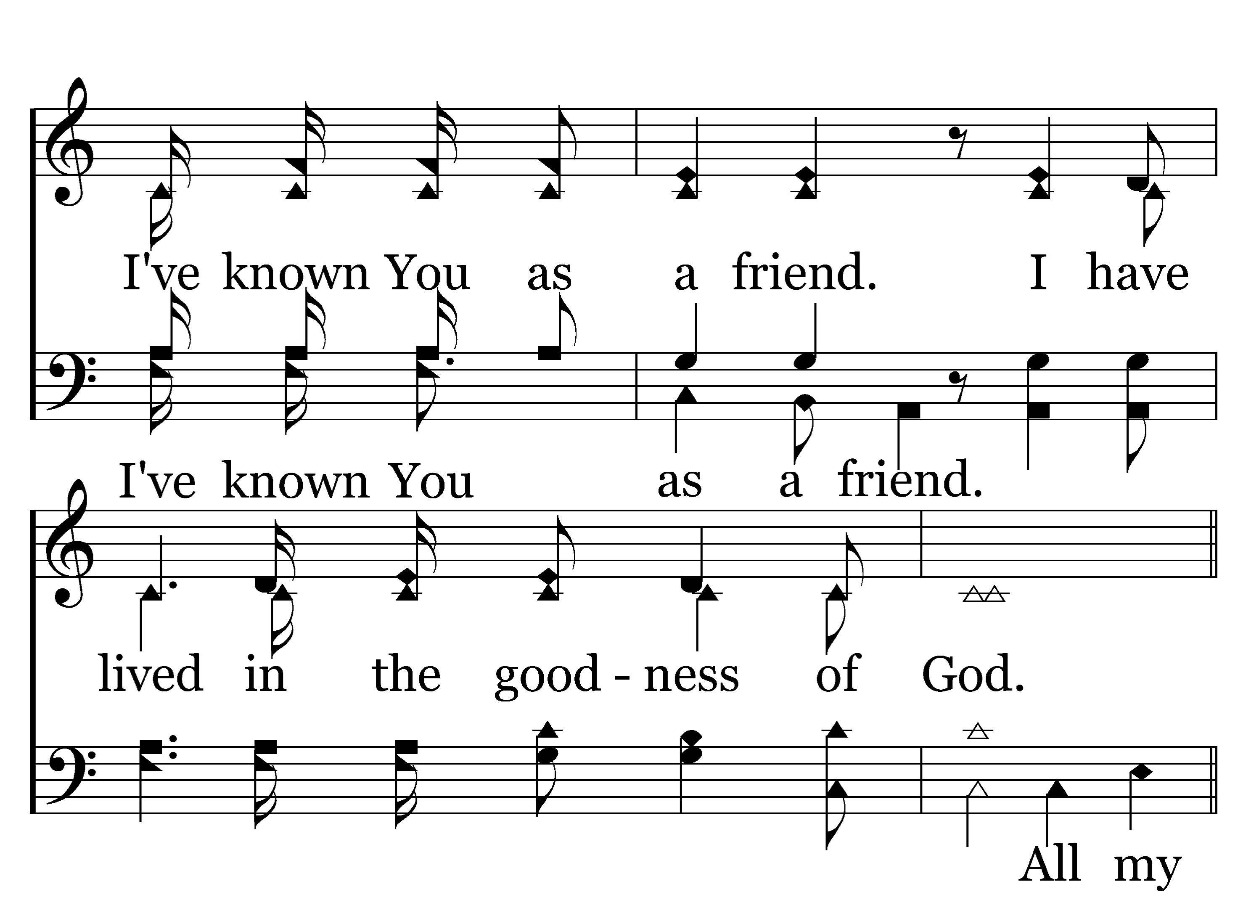
202
1
GOODNESS OF GOD
C
2
C
Typeset R. J. Stevens Music

Slide 10
202
1
GOODNESS OF GOD
C
2
C
Typeset R. J. Stevens Music

Slide 11
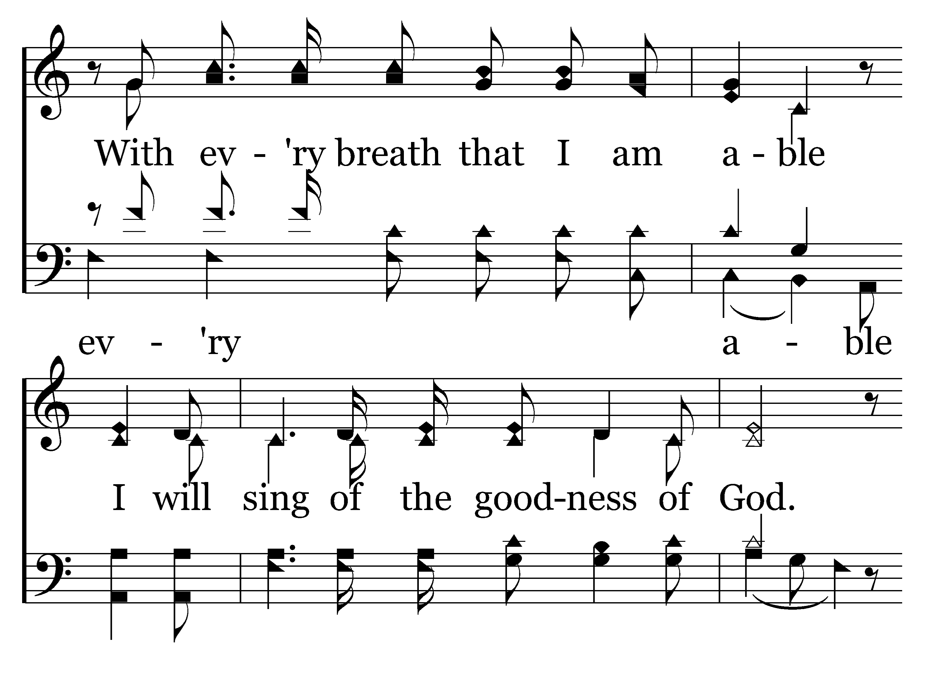
202
1
GOODNESS OF GOD
C
2
C
Typeset R. J. Stevens Music

Slide 12
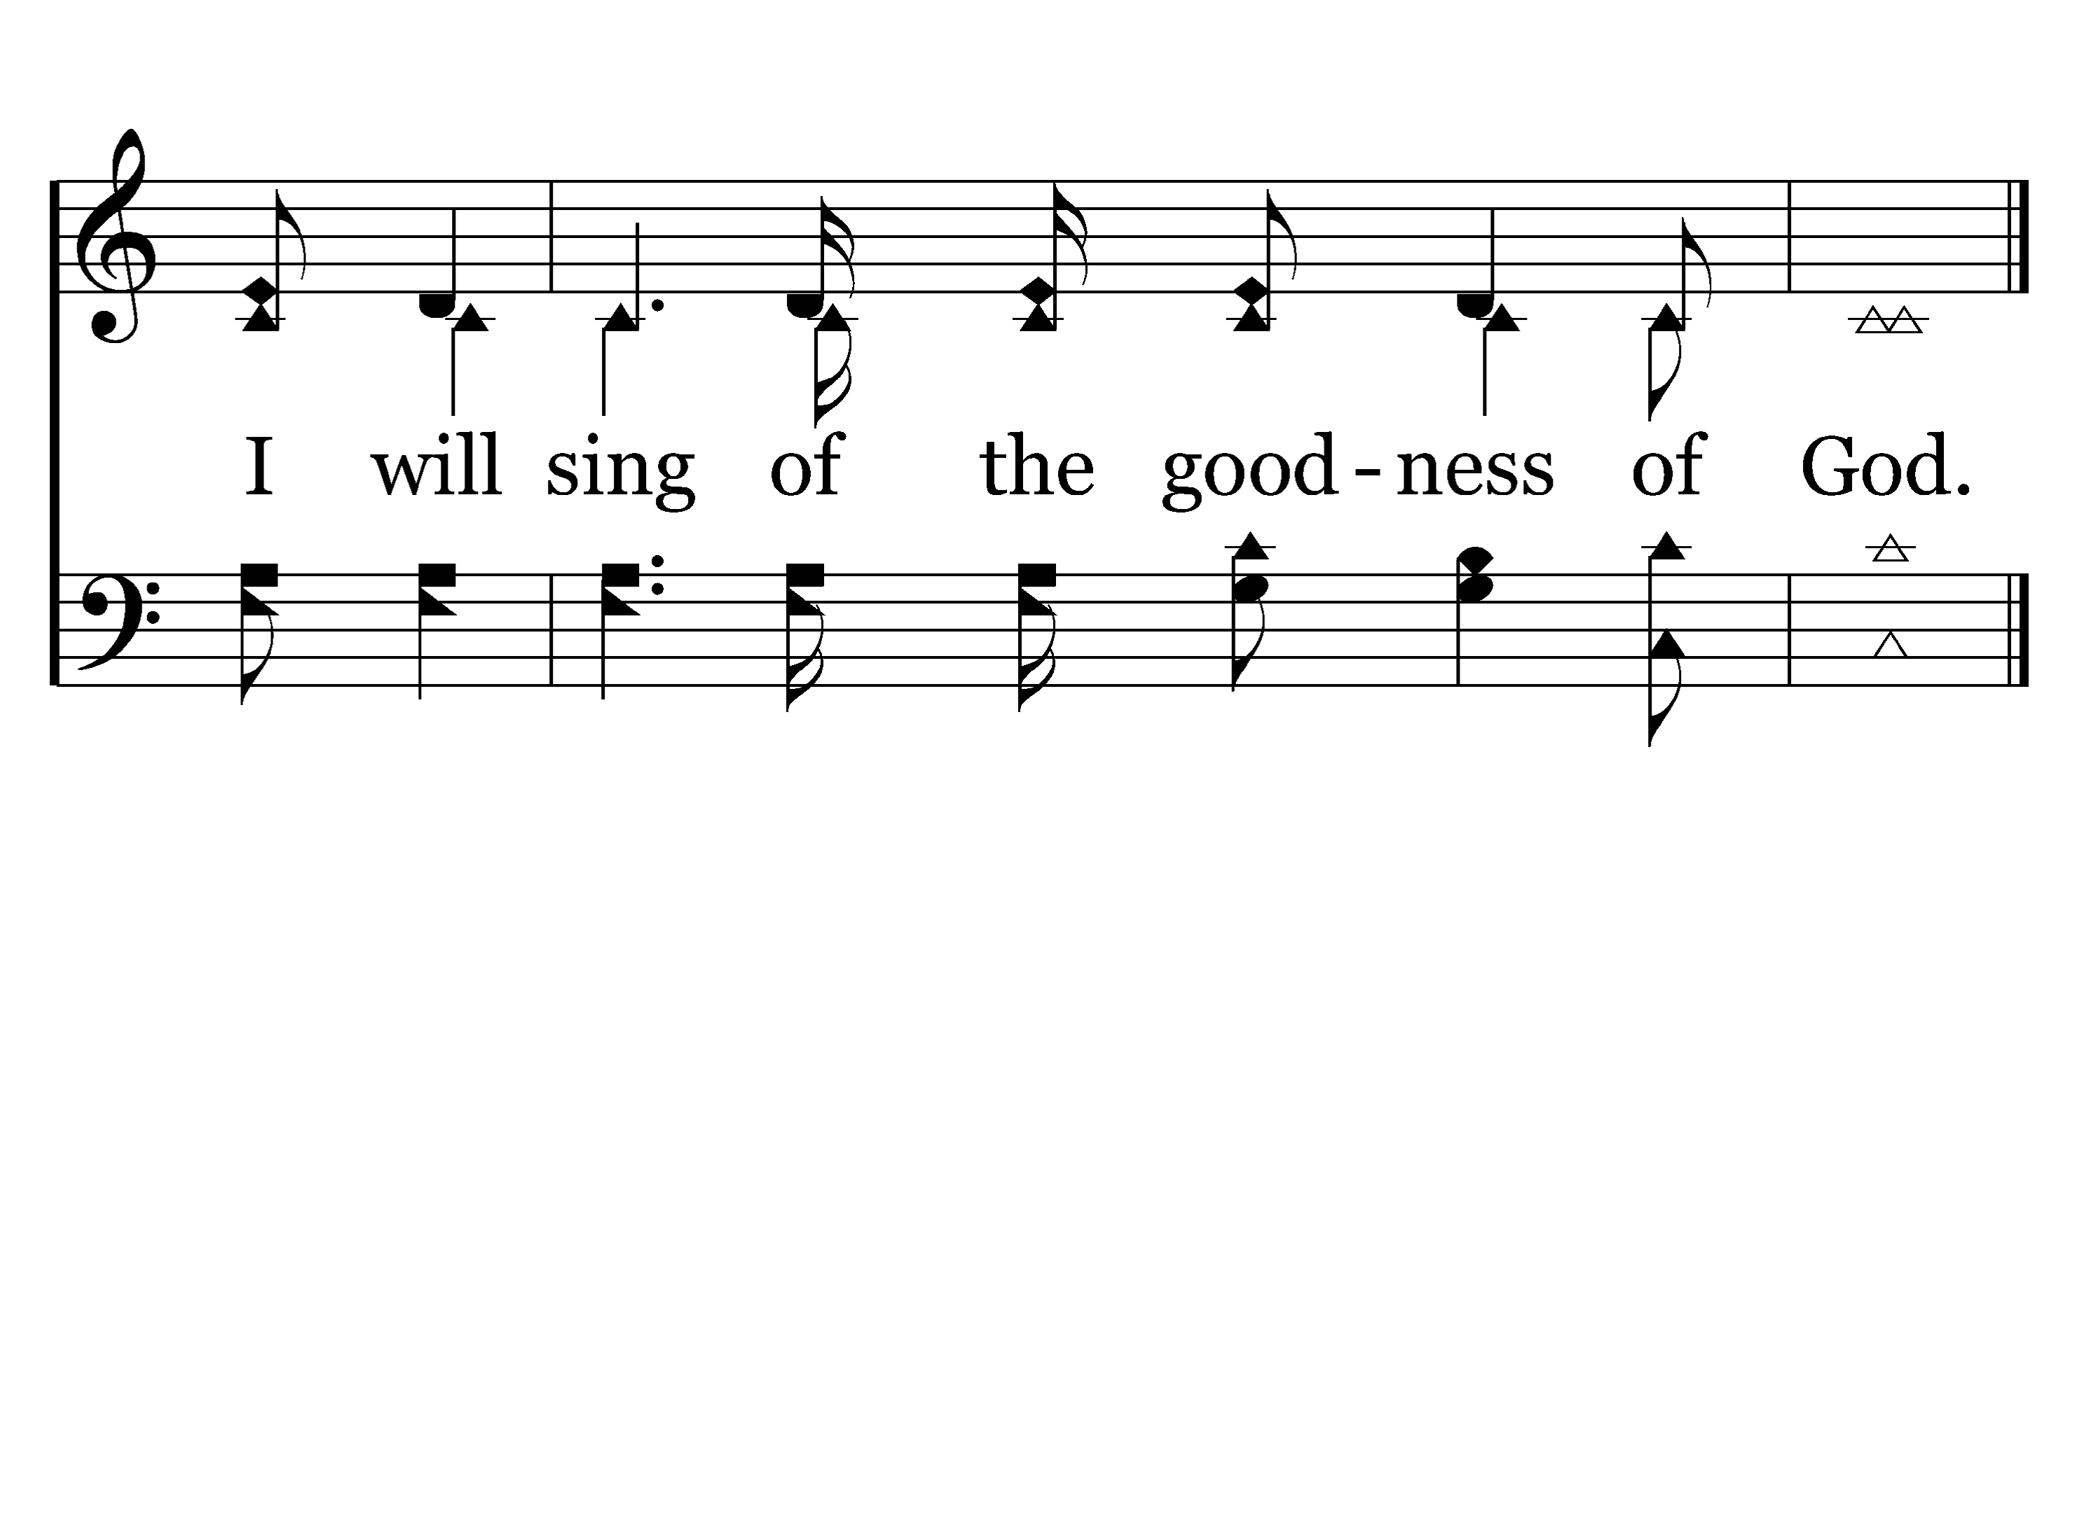
202
1
GOODNESS OF GOD
C
2
C
Typeset R. J. Stevens Music

