Slide 1
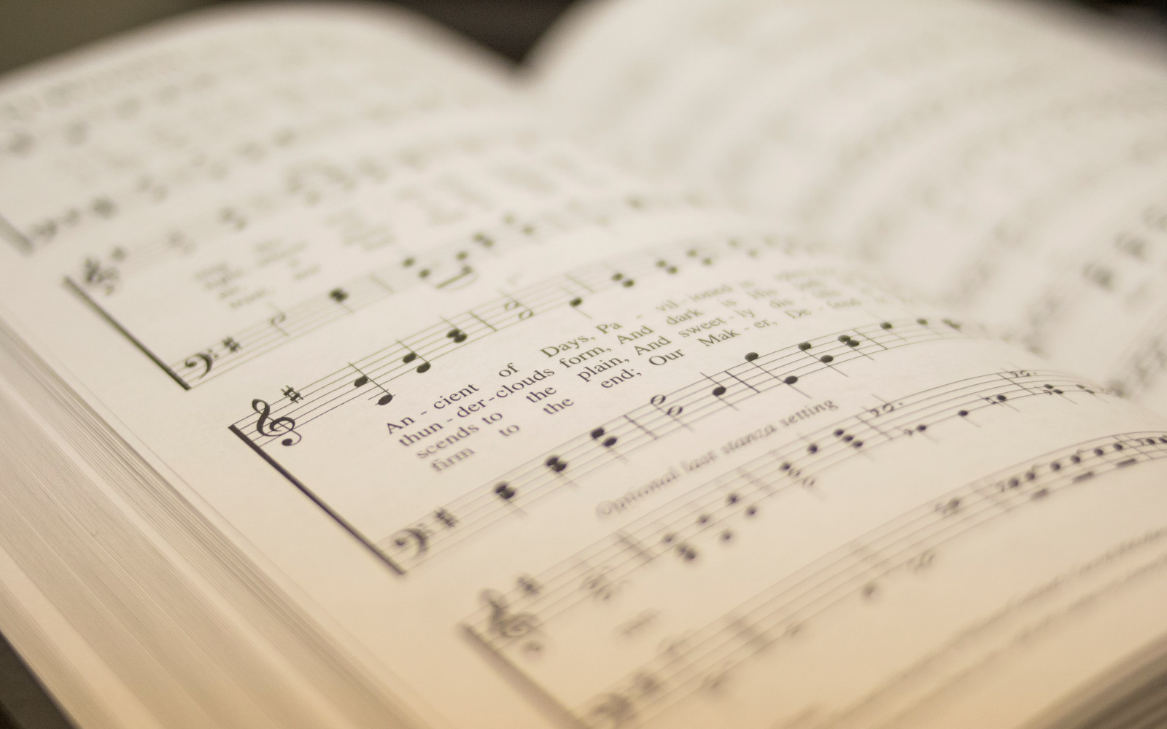

203
ONLY A HOLY GOD
1
2
3
4
“SINGING...TO THE LORD” COLOSSIANS 3:16
Arr: Mark Sullivan, Shane Coffman and Mike Rogers Words and Music by: Michael Farren, Jonny Robinson, Dustin Smith and Rich Thompson

Slide 2
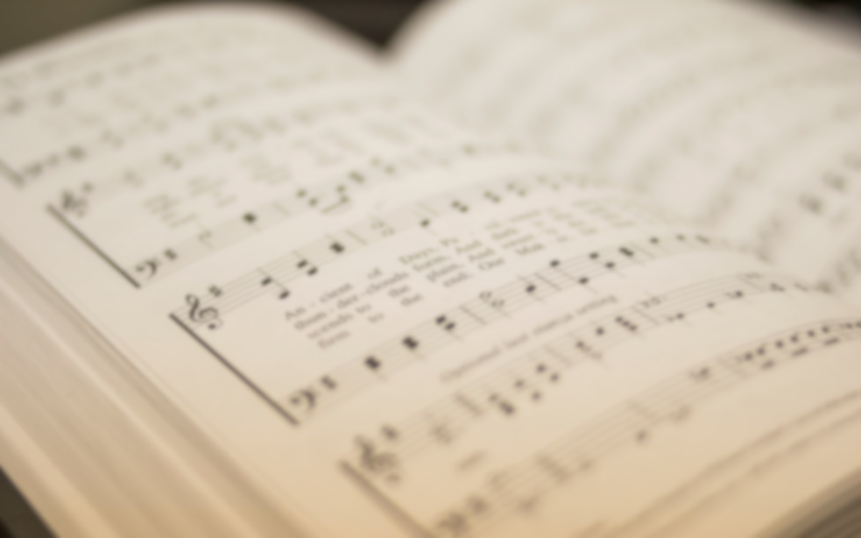
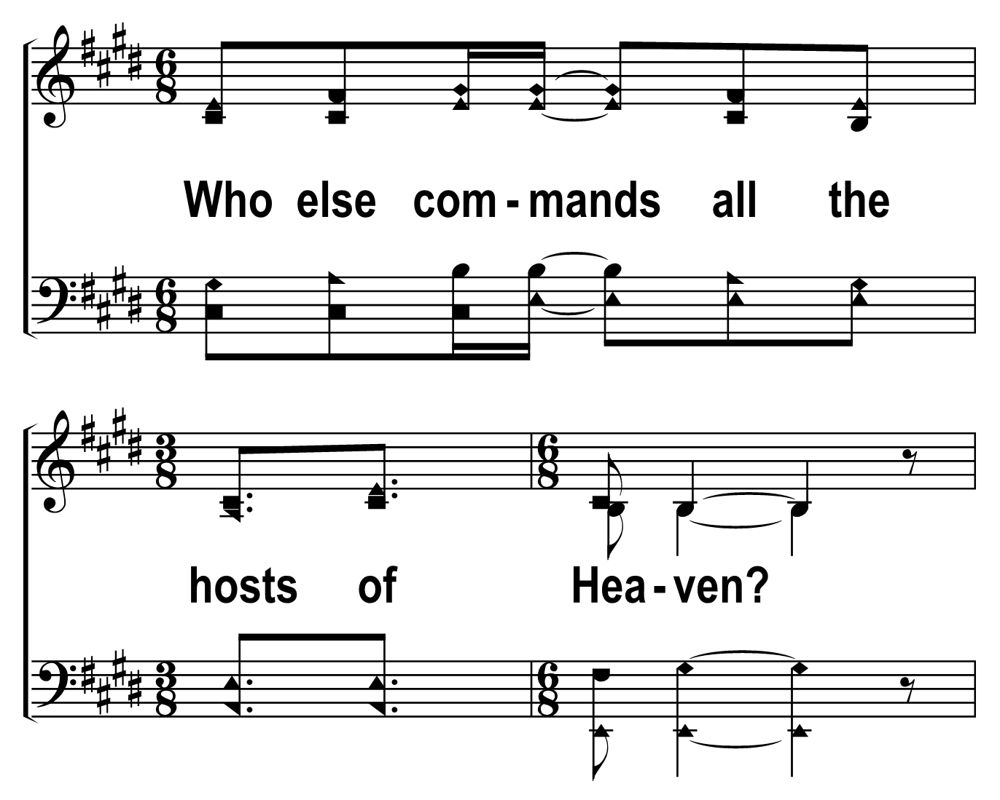

203
1
ONLY A HOLY GOD
C
2
C
3
C
4
C
© 2019 The Acapella Company

Slide 3
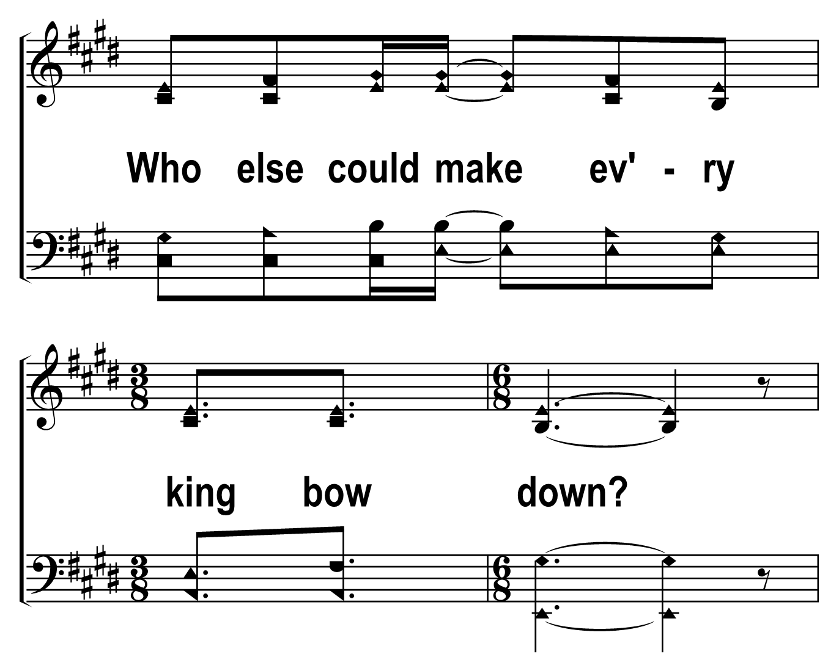
203
1
ONLY A HOLY GOD
C
2
C
3
C
4
C
© 2019 The Acapella Company

Slide 4
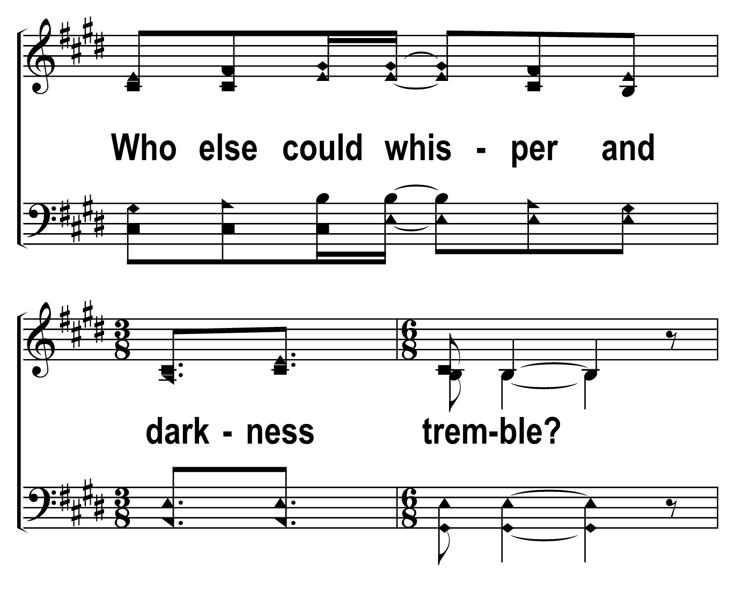
203
1
ONLY A HOLY GOD
C
2
C
3
C
4
C
© 2019 The Acapella Company

Slide 5
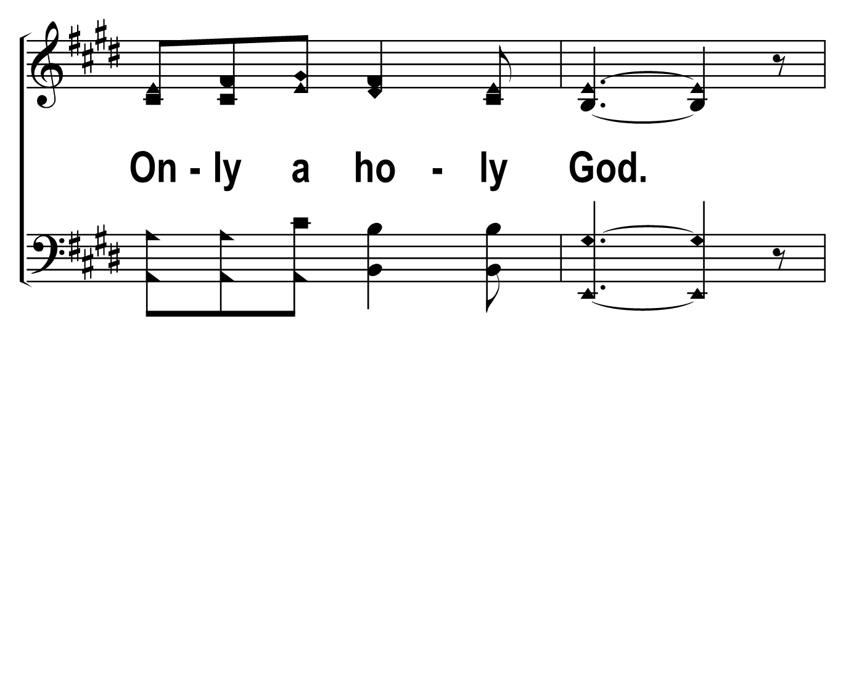
203
1
ONLY A HOLY GOD
C
2
C
3
C
4
C
© 2019 The Acapella Company

Slide 6
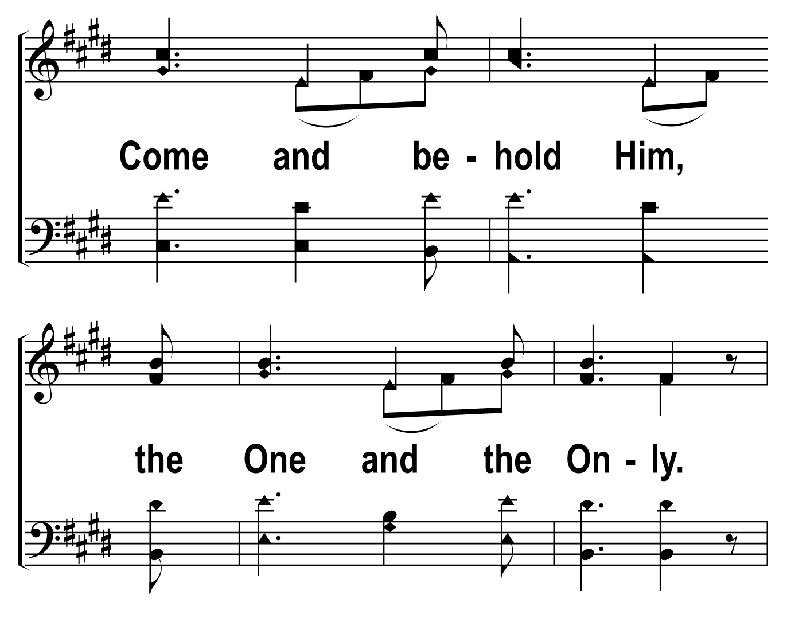
203
1
ONLY A HOLY GOD
C
2
C
3
C
4
C
© 2019 The Acapella Company

Slide 7
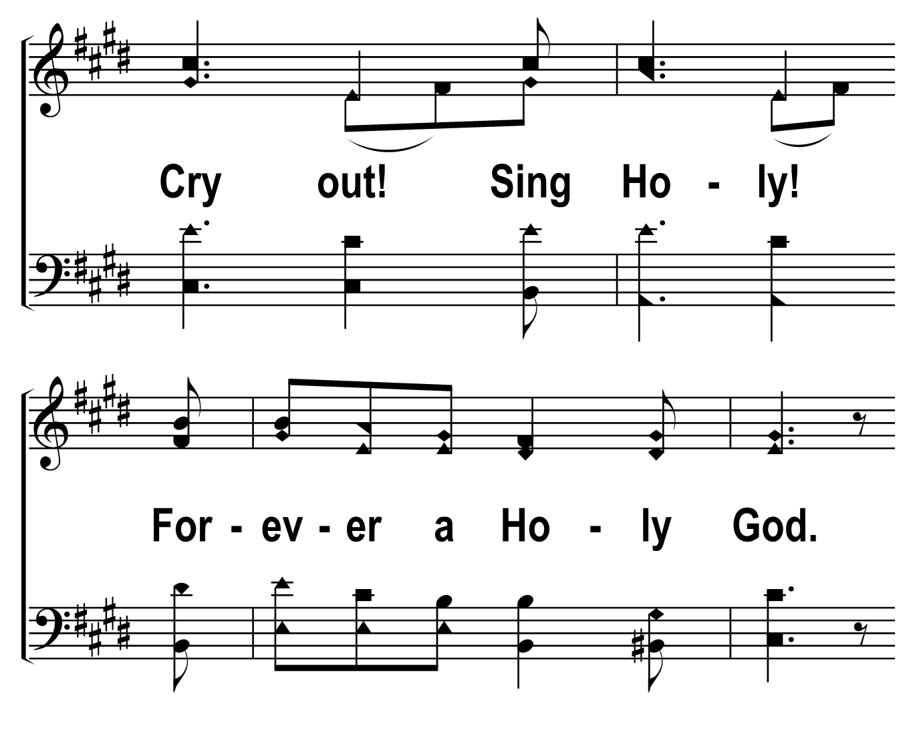
203
1
ONLY A HOLY GOD
C
2
C
3
C
4
C
© 2019 The Acapella Company

Slide 8
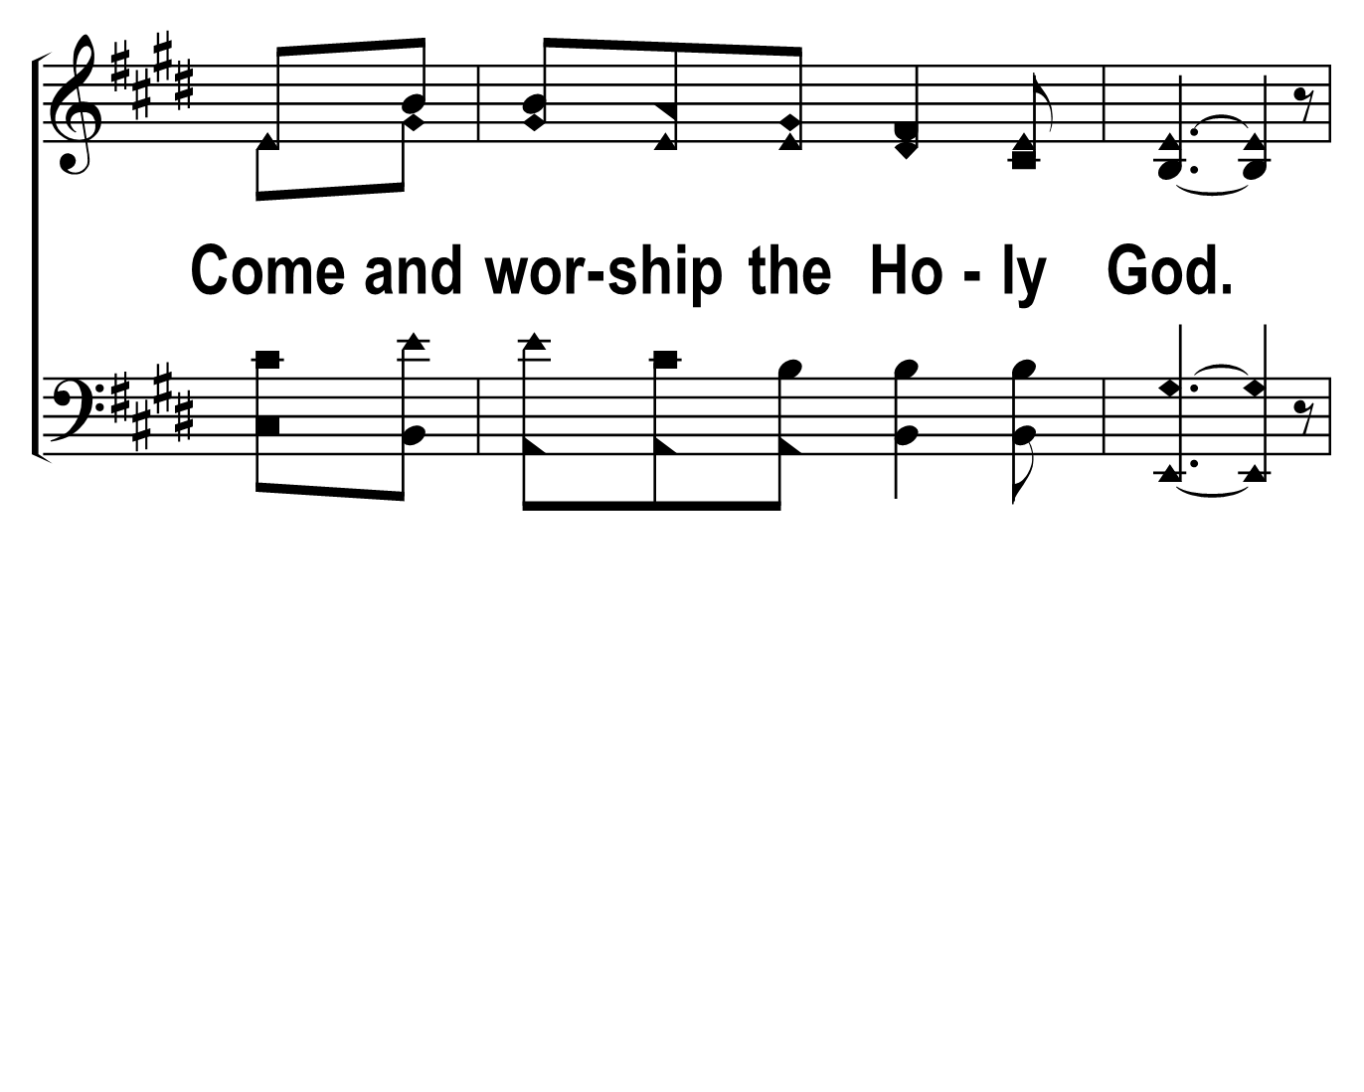
203
1
ONLY A HOLY GOD
C
2
C
3
C
4
C
© 2019 The Acapella Company

Slide 9
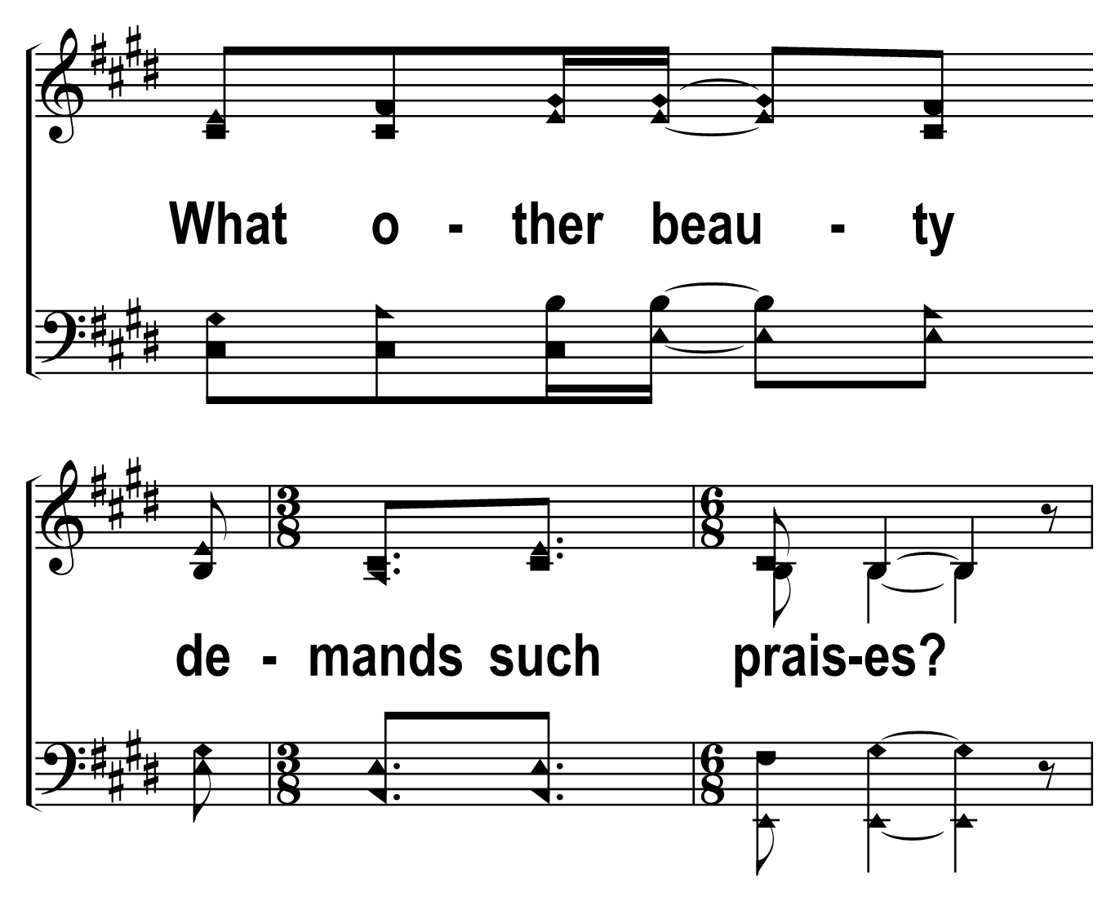
203
1
ONLY A HOLY GOD
C
2
C
3
C
4
C
© 2019 The Acapella Company

Slide 10
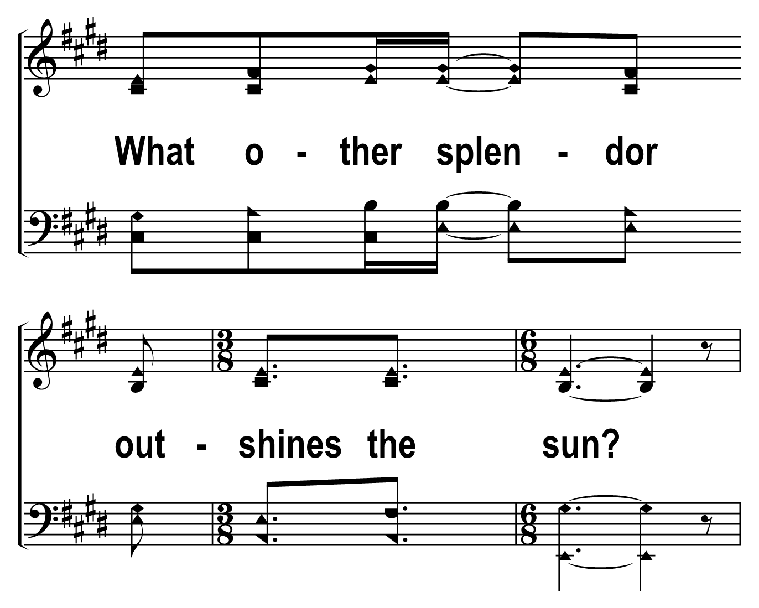
203
1
ONLY A HOLY GOD
C
2
C
3
C
4
C
© 2019 The Acapella Company

Slide 11
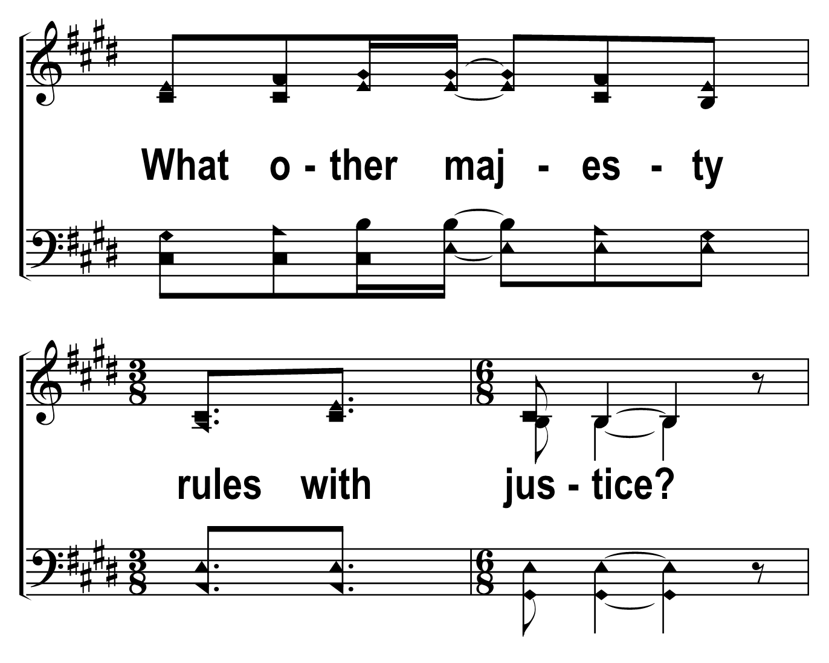
203
1
ONLY A HOLY GOD
C
2
C
3
C
4
C
© 2019 The Acapella Company

Slide 12
203
1
ONLY A HOLY GOD
C
2
C
3
C
4
C
© 2019 The Acapella Company

Slide 13
203
1
ONLY A HOLY GOD
C
2
C
3
C
4
C
© 2019 The Acapella Company

Slide 14
203
1
ONLY A HOLY GOD
C
2
C
3
C
4
C
© 2019 The Acapella Company

Slide 15
203
1
ONLY A HOLY GOD
C
2
C
3
C
4
C
© 2019 The Acapella Company

Slide 16
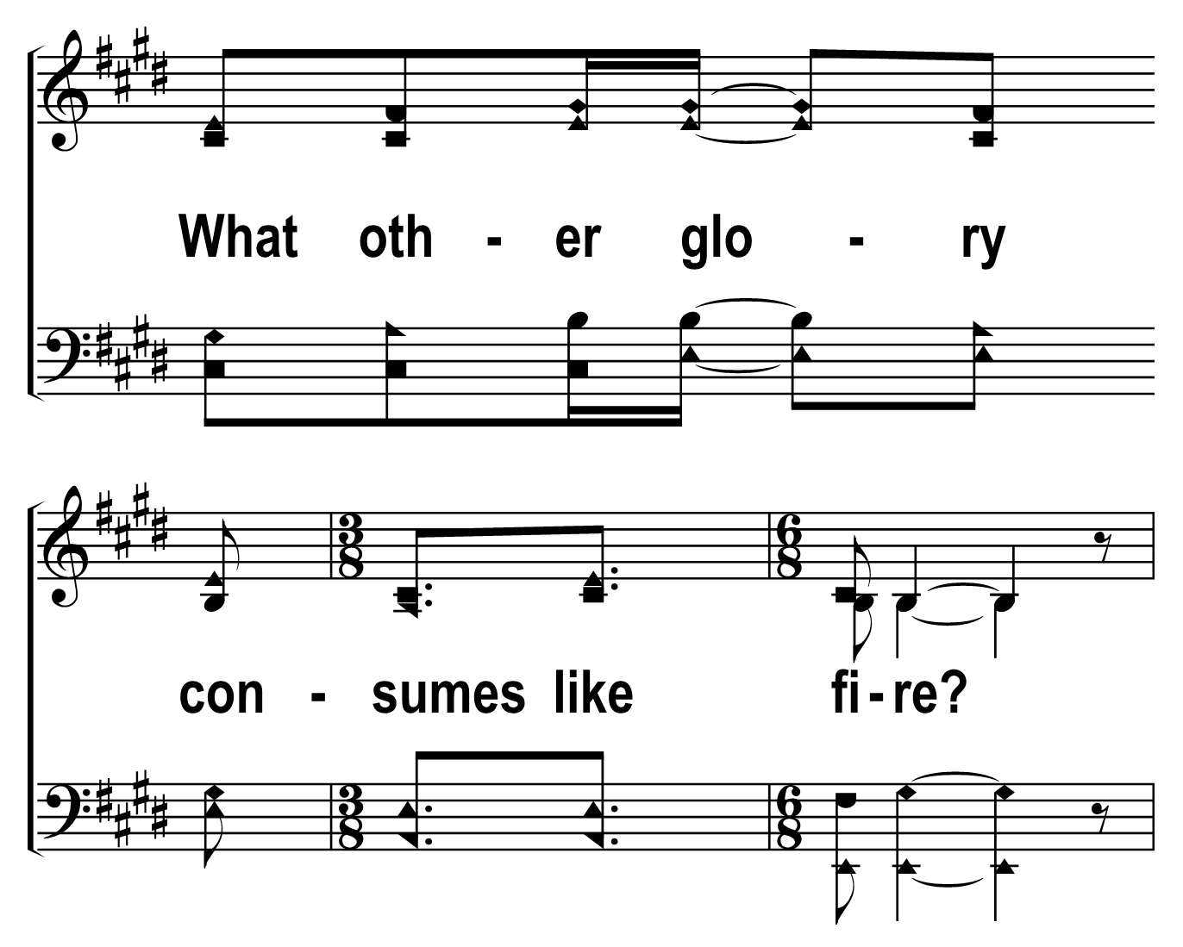
203
1
ONLY A HOLY GOD
C
2
C
3
C
4
C
© 2019 The Acapella Company

Slide 17
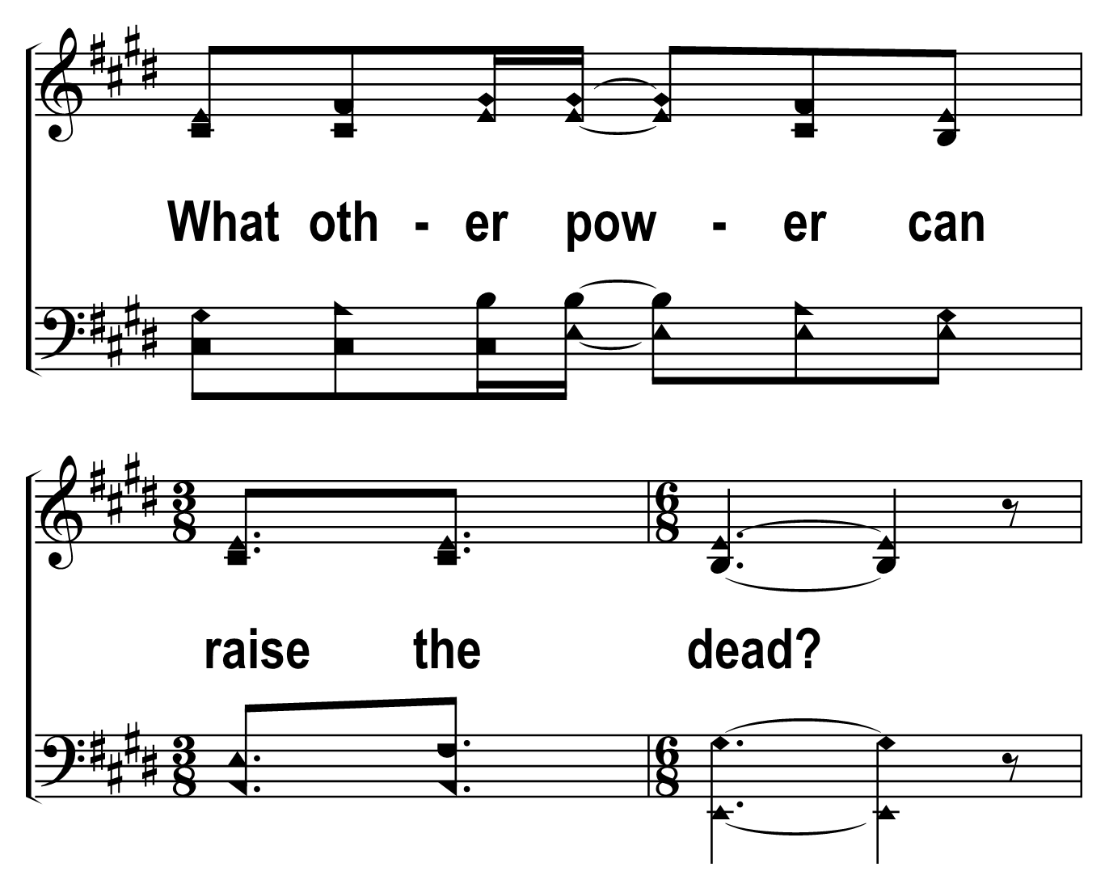
203
1
ONLY A HOLY GOD
C
2
C
3
C
4
C
© 2019 The Acapella Company

Slide 18
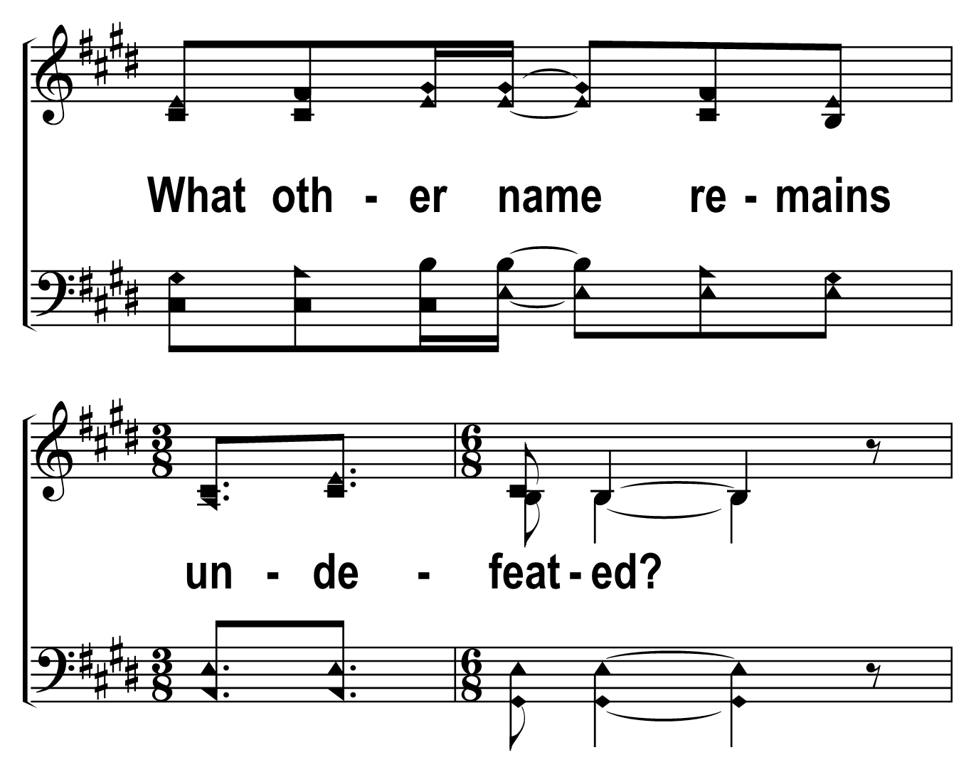
203
1
ONLY A HOLY GOD
C
2
C
3
C
4
C
© 2019 The Acapella Company

Slide 19
203
1
ONLY A HOLY GOD
C
2
C
3
C
4
C
© 2019 The Acapella Company

Slide 20
203
1
ONLY A HOLY GOD
C
2
C
3
C
4
C
© 2019 The Acapella Company

Slide 21
203
1
ONLY A HOLY GOD
C
2
C
3
C
4
C
© 2019 The Acapella Company

Slide 22
203
1
ONLY A HOLY GOD
C
2
C
3
C
4
C
© 2019 The Acapella Company

Slide 23
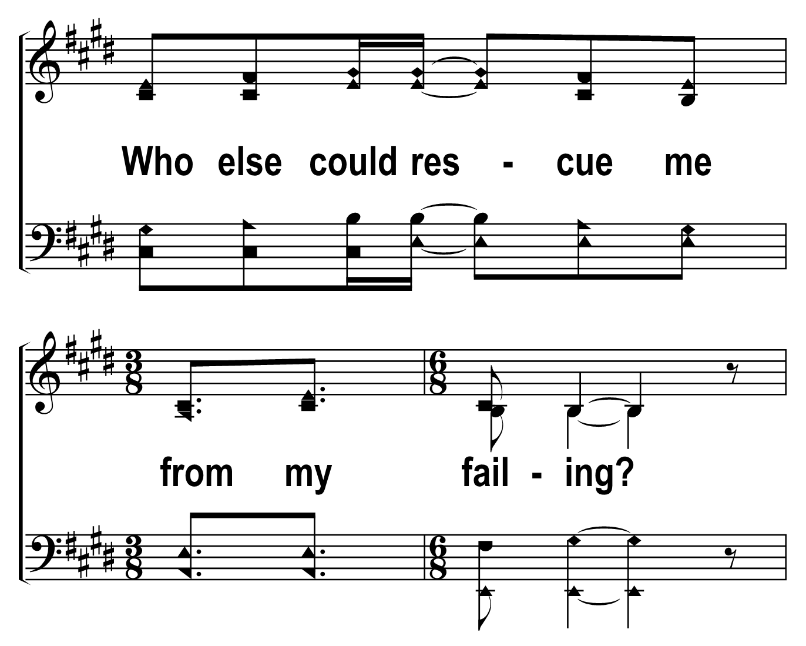
203
1
ONLY A HOLY GOD
C
2
C
3
C
4
C
© 2019 The Acapella Company

Slide 24
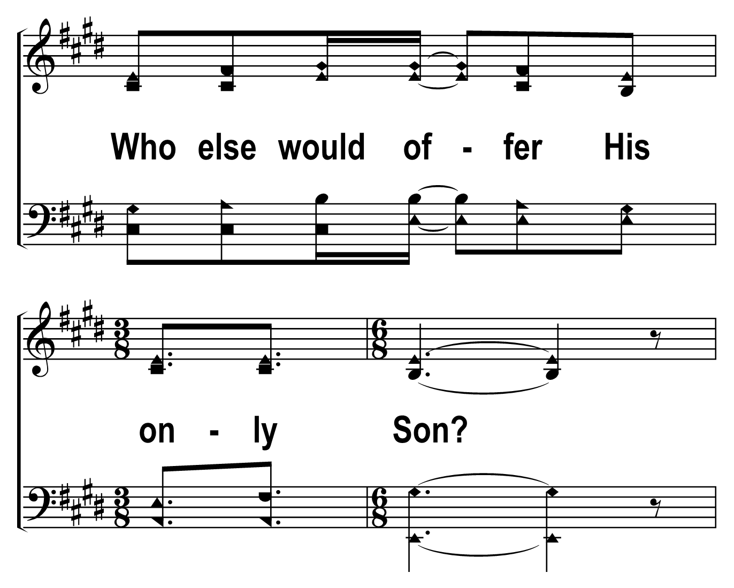
203
1
ONLY A HOLY GOD
C
2
C
3
C
4
C
© 2019 The Acapella Company

Slide 25
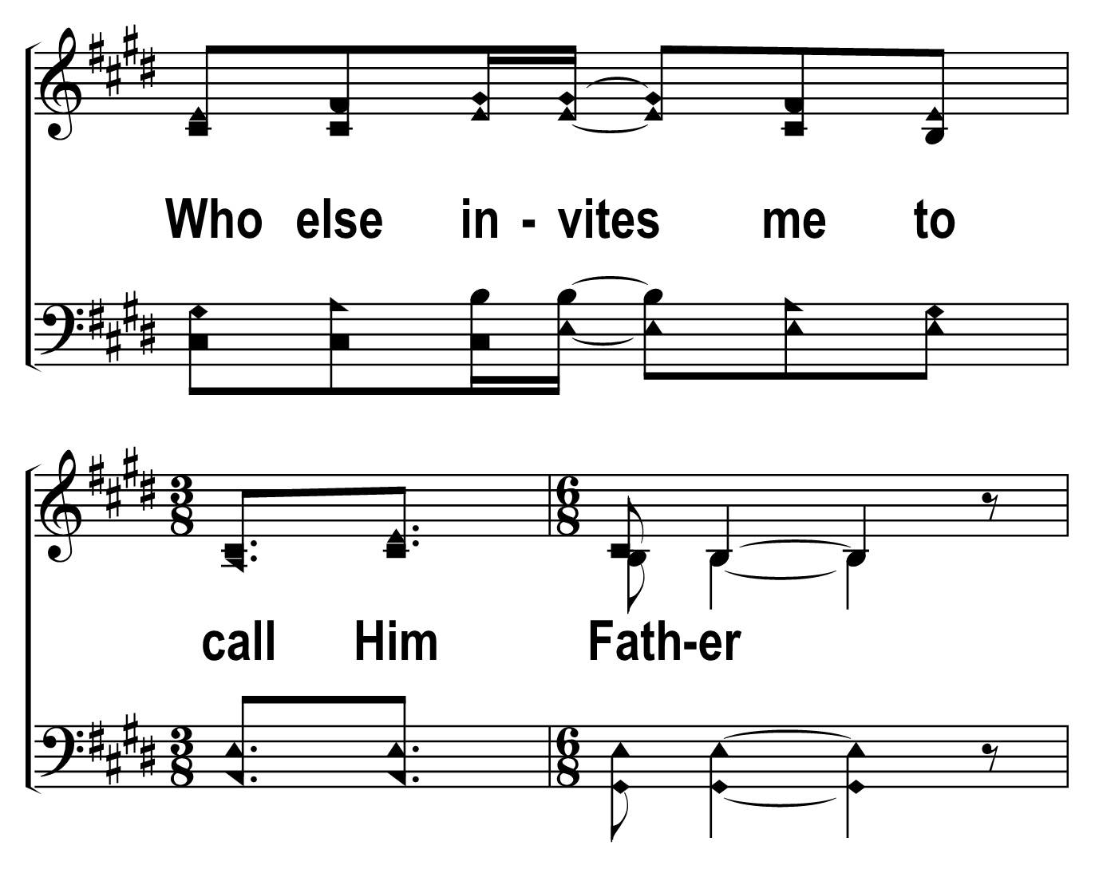
203
1
ONLY A HOLY GOD
C
2
C
3
C
4
C
© 2019 The Acapella Company

Slide 26
203
1
ONLY A HOLY GOD
C
2
C
3
C
4
C
© 2019 The Acapella Company

Slide 27
203
1
ONLY A HOLY GOD
C
2
C
3
C
4
C
© 2019 The Acapella Company

Slide 28
203
1
ONLY A HOLY GOD
C
2
C
3
C
4
C
© 2019 The Acapella Company

Slide 29
203
1
ONLY A HOLY GOD
C
2
C
3
C
4
C
© 2019 The Acapella Company

Slide 30
203
1
ONLY A HOLY GOD
C
2
C
3
C
4
C
© 2019 The Acapella Company

Slide 31
203
1
ONLY A HOLY GOD
C
2
C
3
C
4
C
© 2019 The Acapella Company

Slide 32
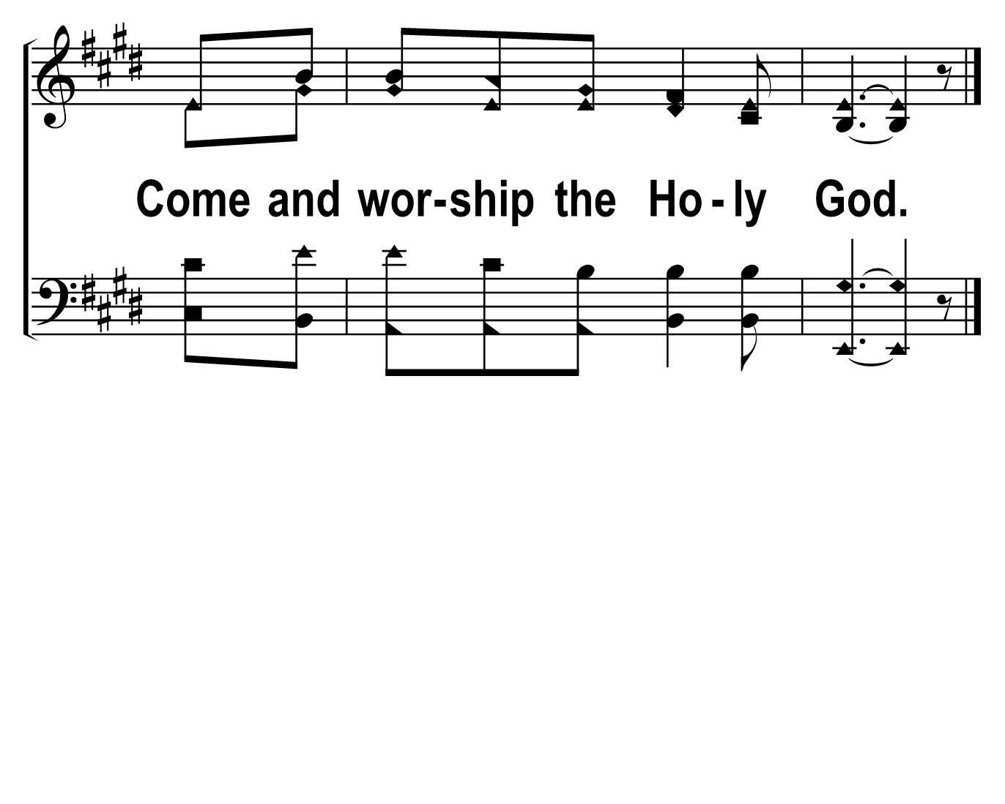
203
1
ONLY A HOLY GOD
C
2
C
3
C
4
C
© 2019 The Acapella Company

