Slide 1
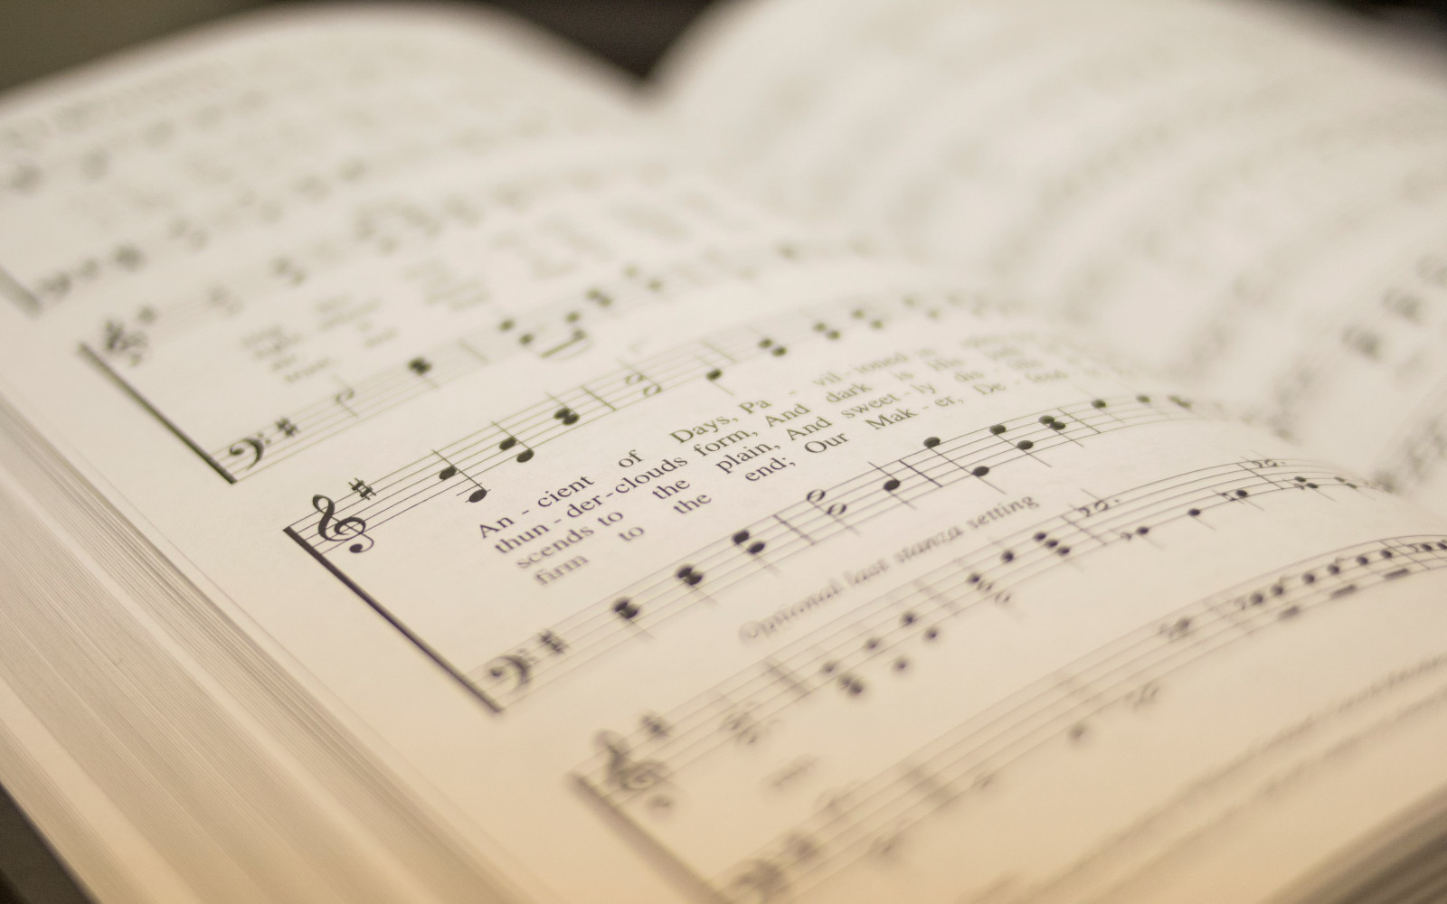

204
HYMN OF HEAVEN
1
2
3
“SINGING...TO THE LORD” COLOSSIANS 3:16
Words and Music: Phil Wickham, Bill Johnson, Brian Johnson and Chris Davenport Arr: Mike Rogers © 2021 Be Essential Songs o/b/o Simply Global Songs, Capitol Cmg Paragon o/b/o Songs for Tim, Be Essential Songs o/b/o Phil Wickham Music, Capitol Cmg Paragon o/b/o Cdaves

Slide 2
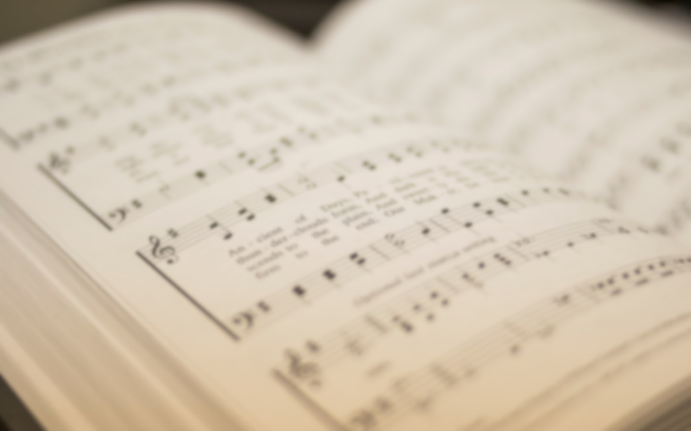
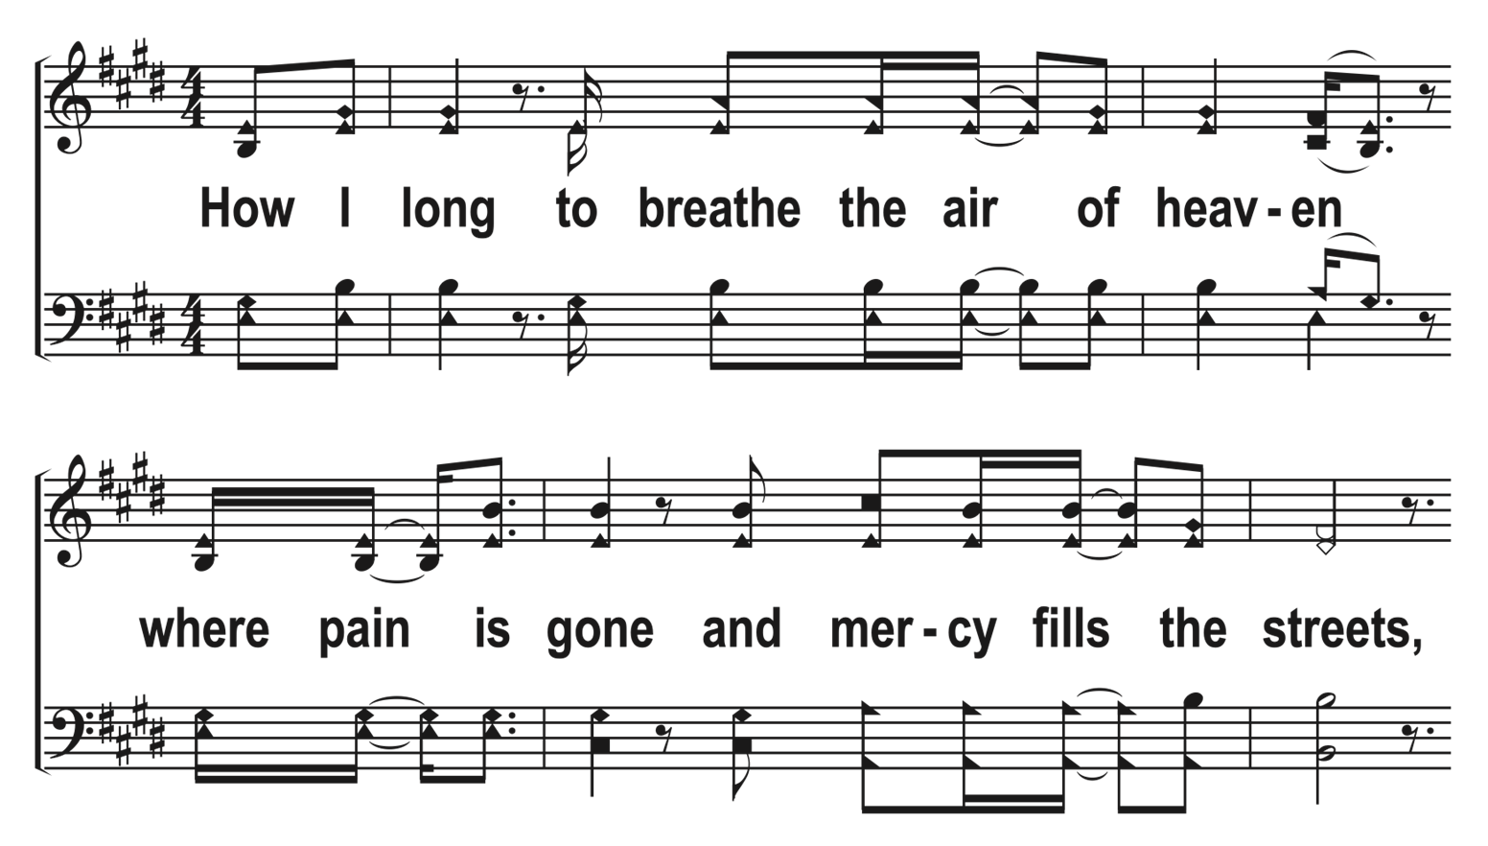

1
C
2
C
3
C
204
HYMN OF HEAVEN
© 2023 The Acapella Company

Slide 3
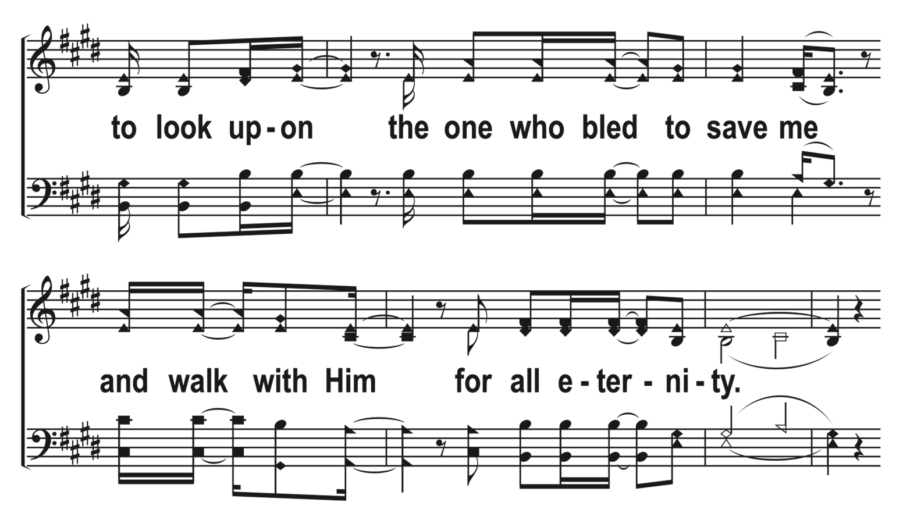
1
C
2
C
3
C
204
HYMN OF HEAVEN
© 2023 The Acapella Company

Slide 4
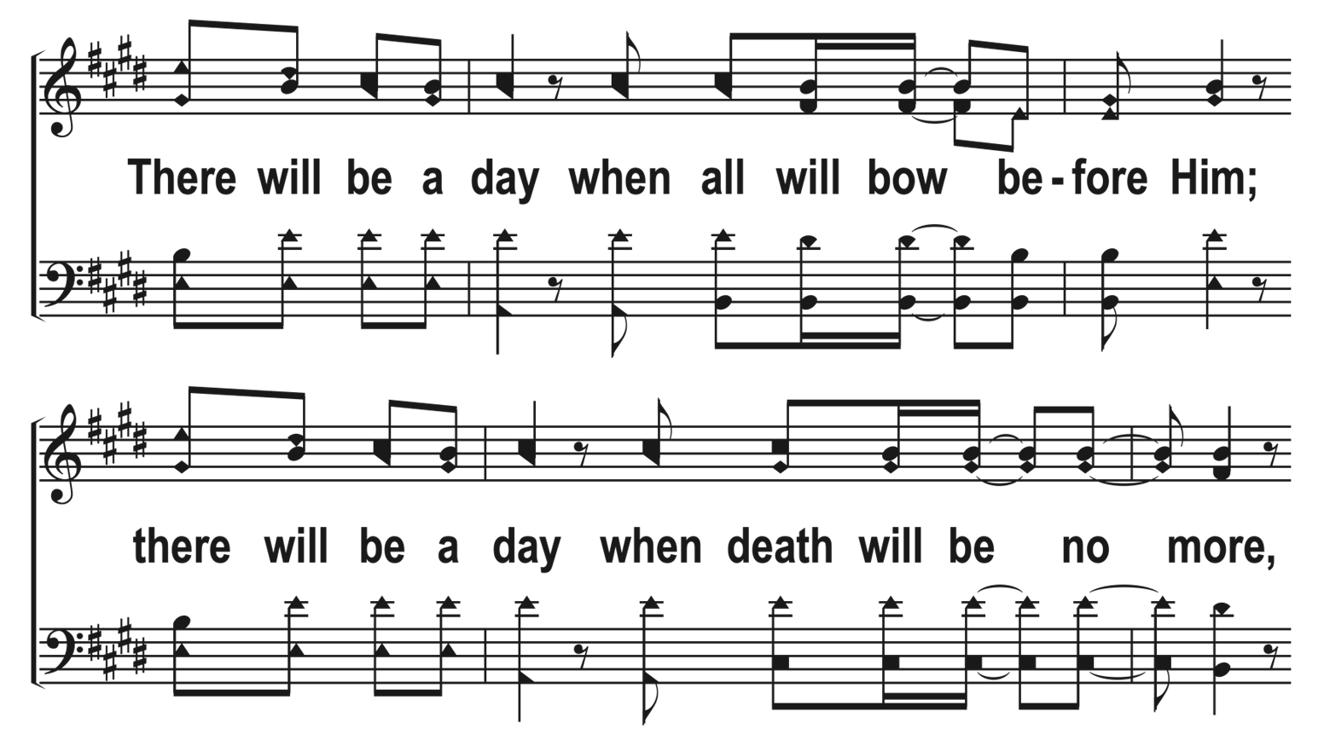
1
C
2
C
3
C
204
HYMN OF HEAVEN
© 2023 The Acapella Company

Slide 5
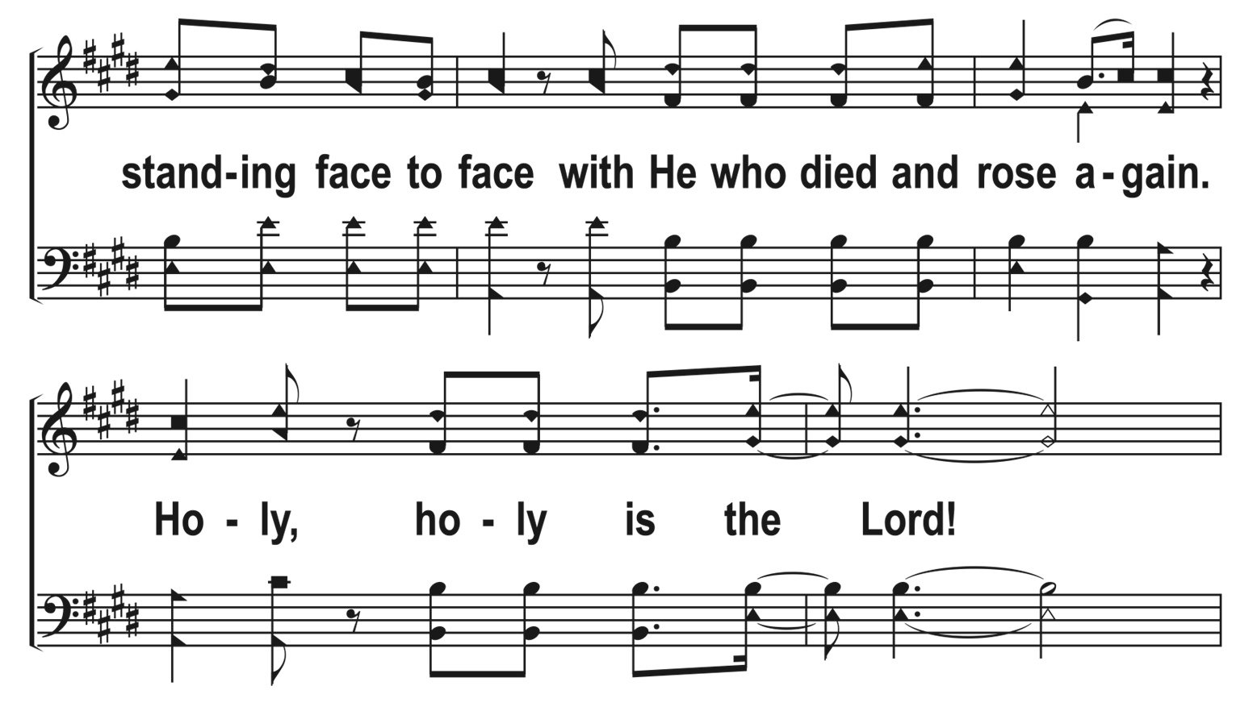
1
C
2
C
3
C
204
HYMN OF HEAVEN
© 2023 The Acapella Company

Slide 6
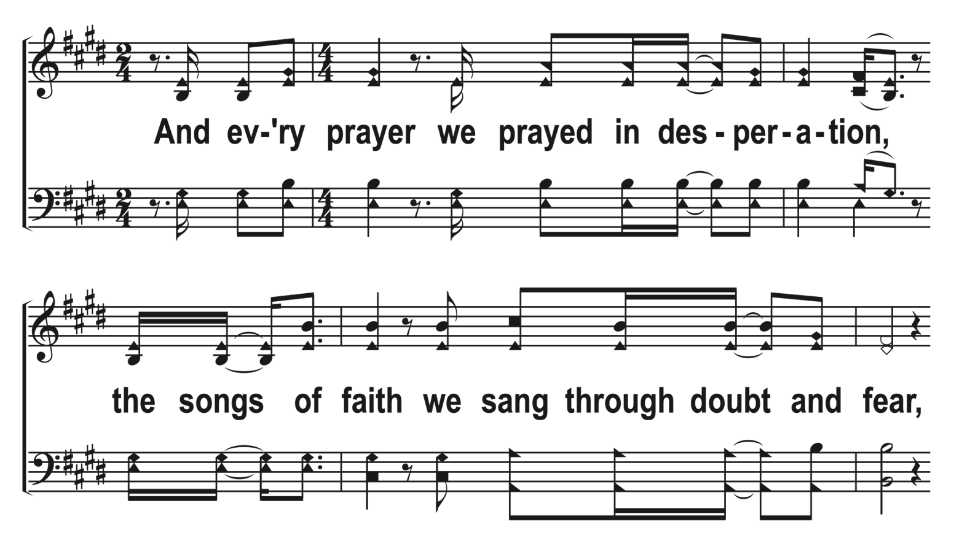
1
C
2
C
3
C
204
HYMN OF HEAVEN
© 2023 The Acapella Company

Slide 7
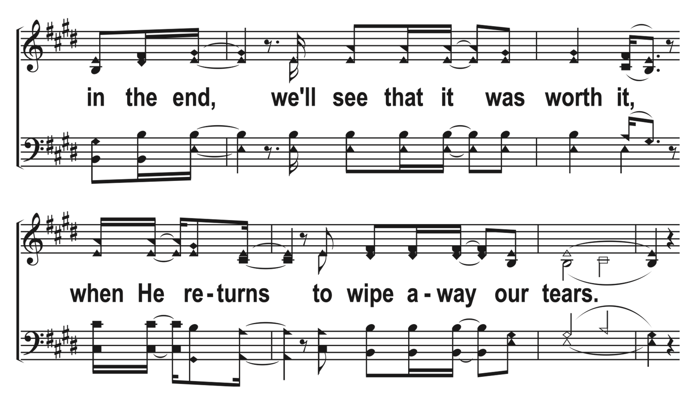
1
C
2
C
3
C
204
HYMN OF HEAVEN
© 2023 The Acapella Company

Slide 8
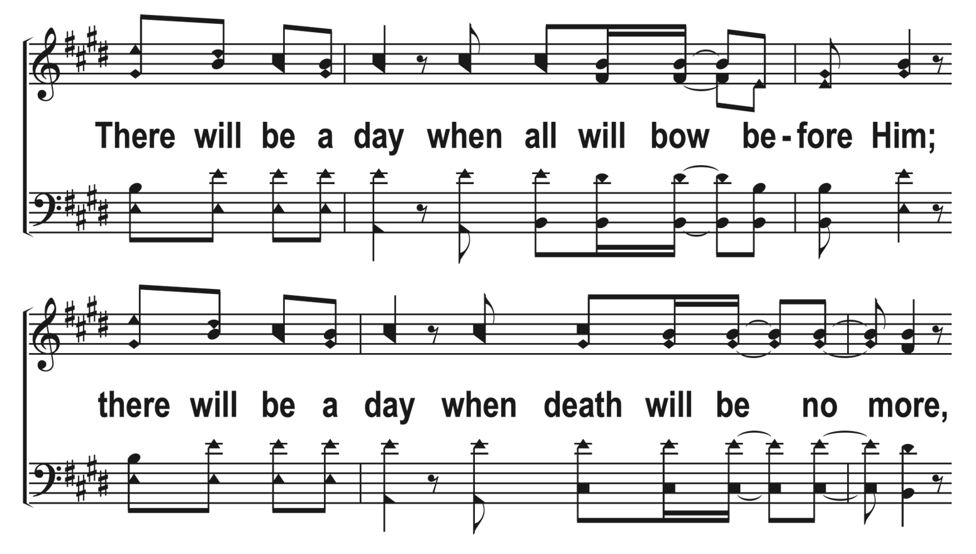
1
C
2
C
3
C
204
HYMN OF HEAVEN
© 2023 The Acapella Company

Slide 9
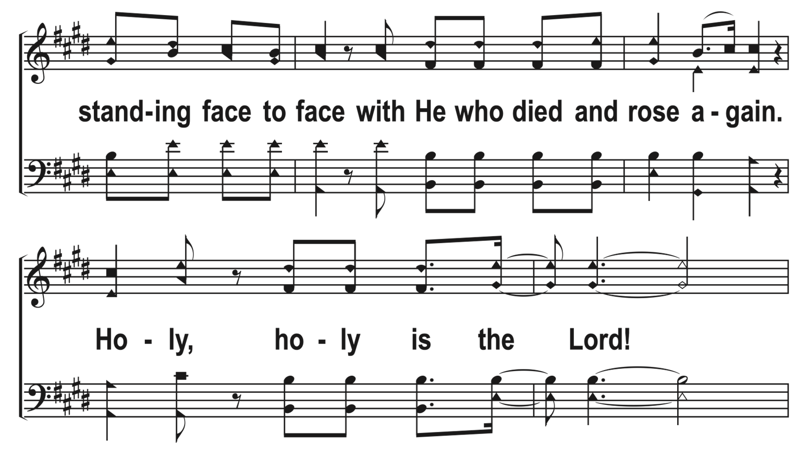
1
C
2
C
3
C
204
HYMN OF HEAVEN
© 2023 The Acapella Company

Slide 10
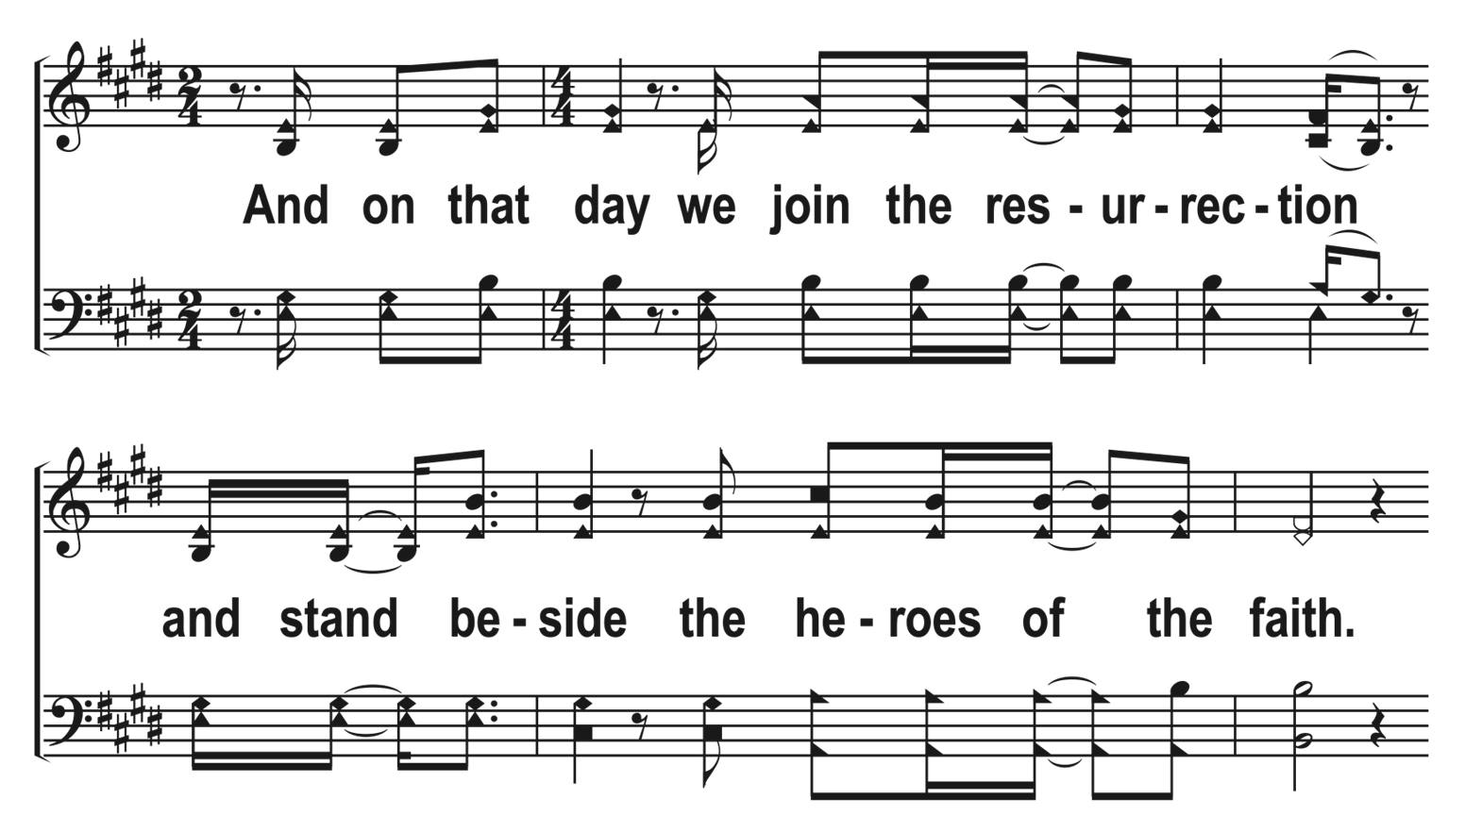
1
C
2
C
3
C
204
HYMN OF HEAVEN
© 2023 The Acapella Company

Slide 11
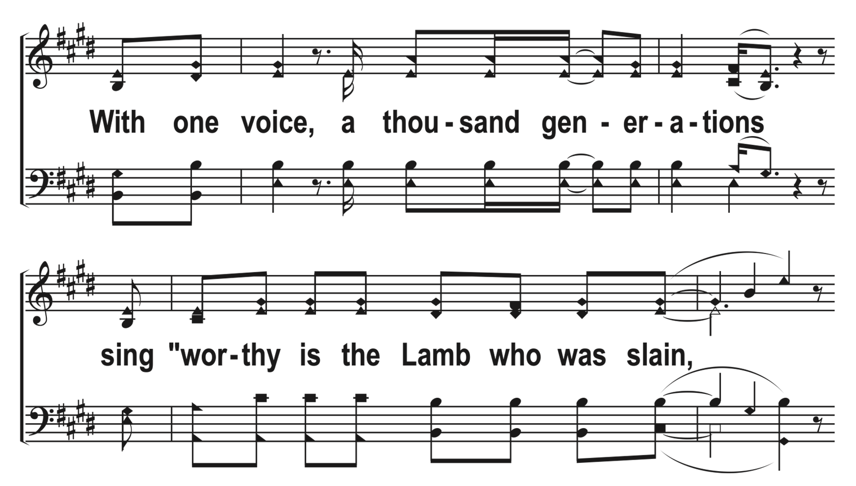
1
C
2
C
3
C
204
HYMN OF HEAVEN
© 2023 The Acapella Company

Slide 12
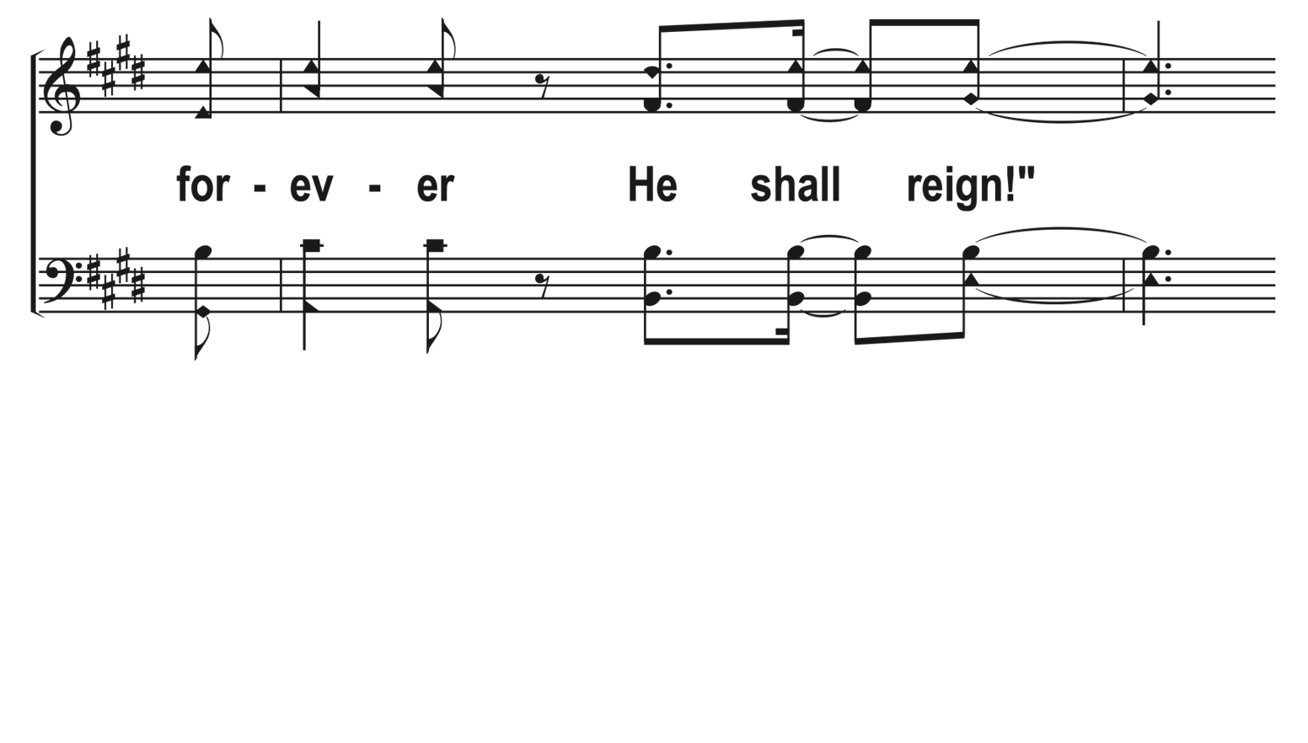
1
C
2
C
3
C
204
HYMN OF HEAVEN
© 2023 The Acapella Company

Slide 13
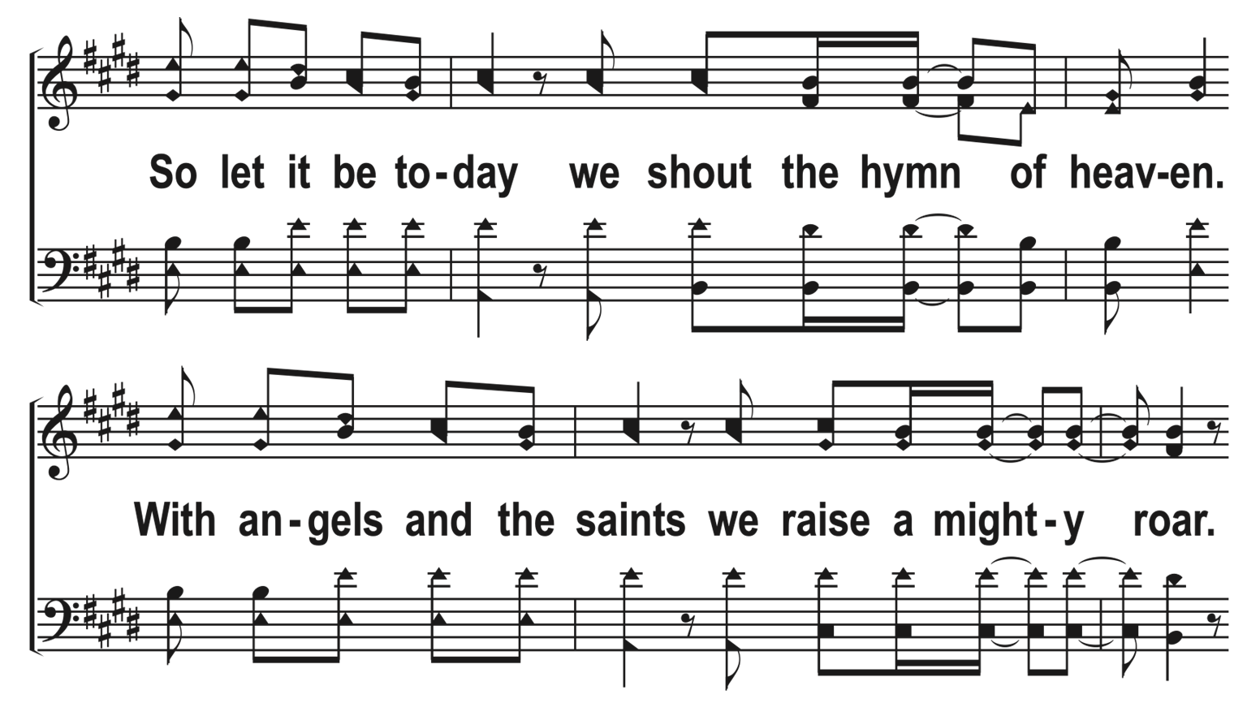
1
C
2
C
3
C
204
HYMN OF HEAVEN
© 2023 The Acapella Company

Slide 14
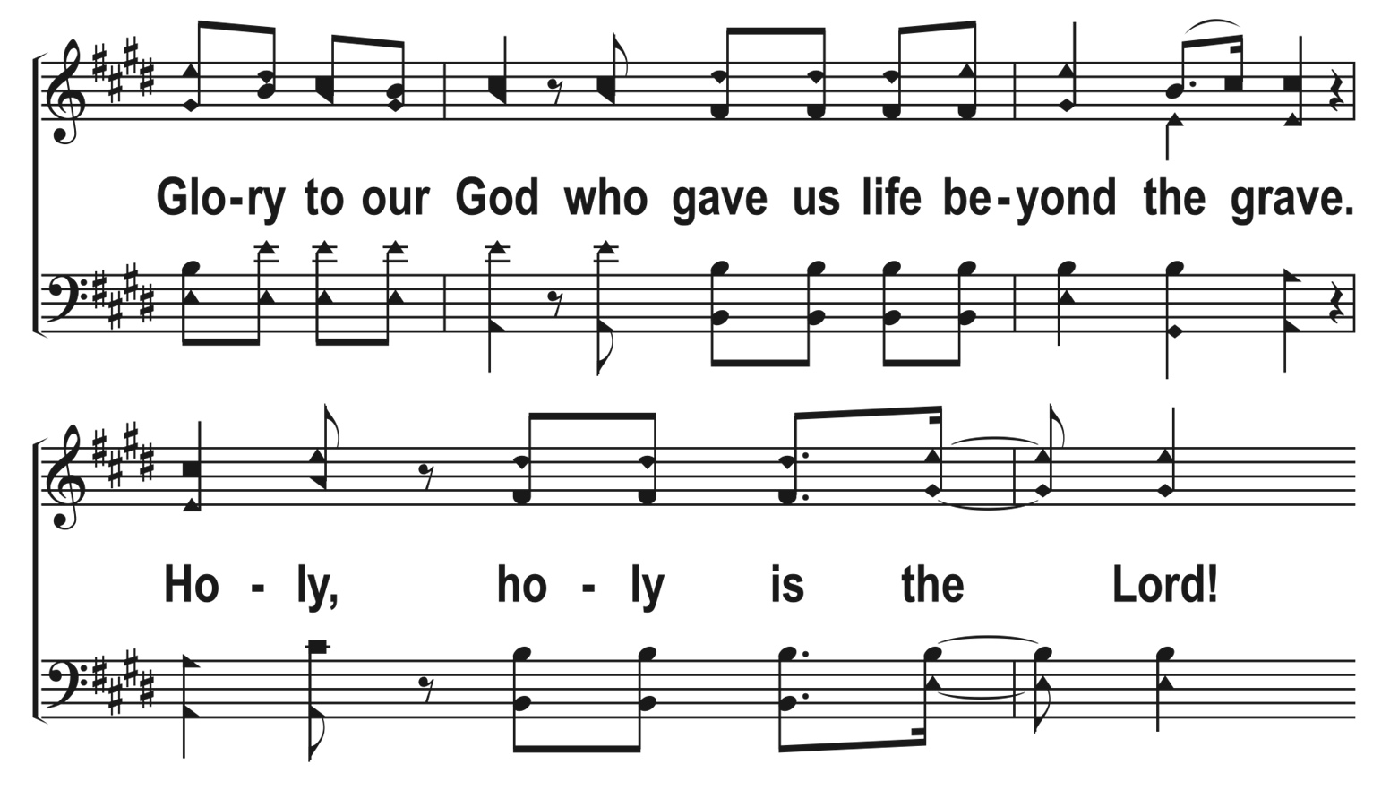
1
C
2
C
3
C
204
HYMN OF HEAVEN
© 2023 The Acapella Company

Slide 15
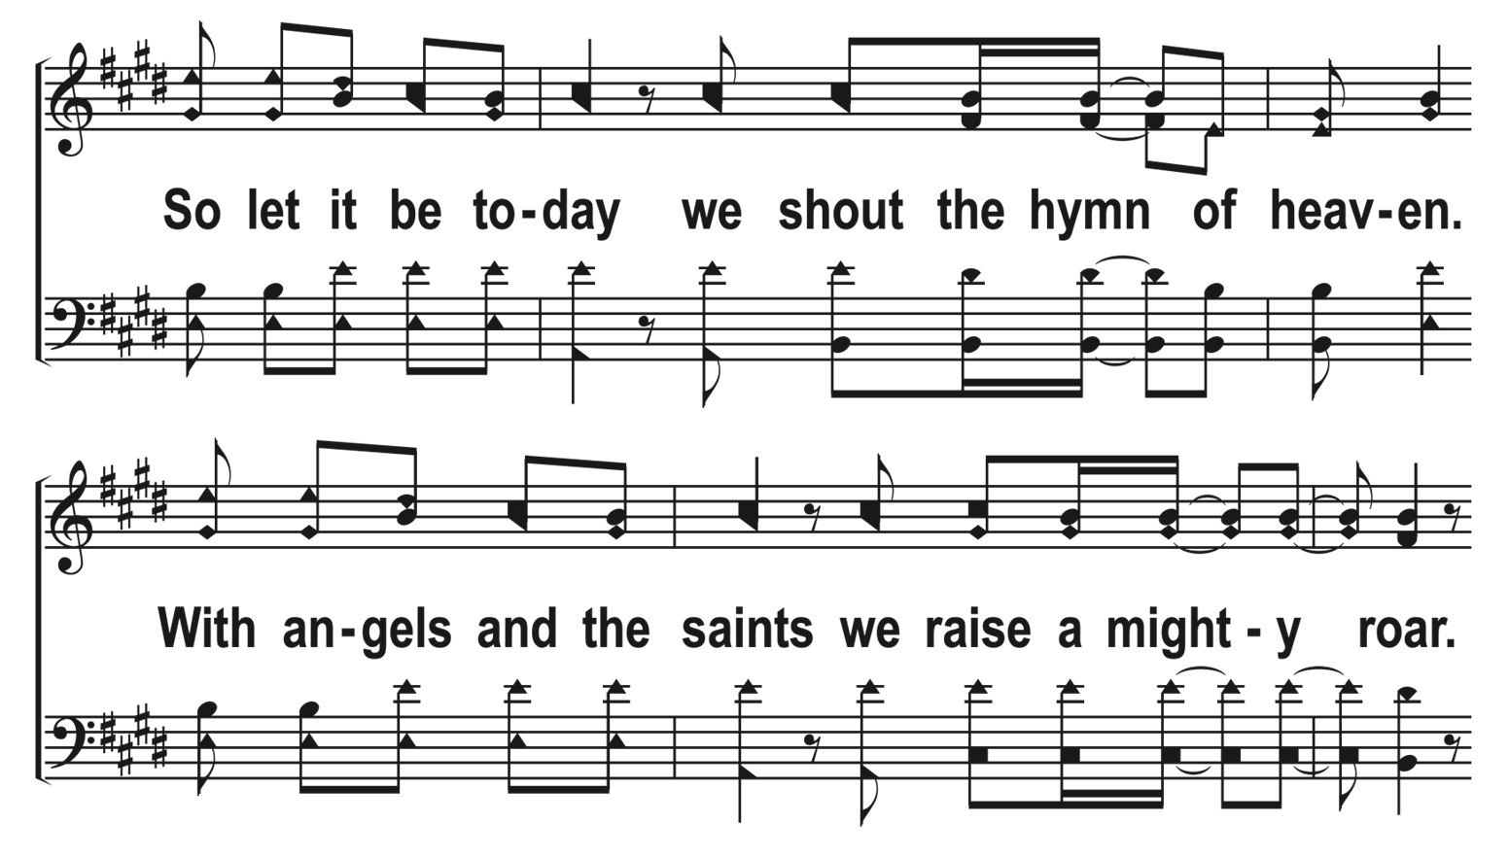
1
C
2
C
3
C
204
HYMN OF HEAVEN
© 2023 The Acapella Company

Slide 16
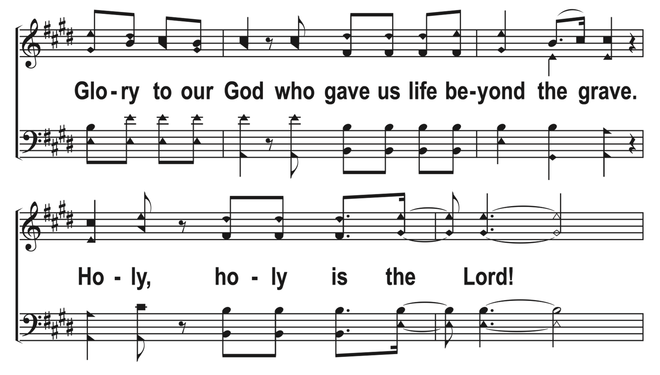
1
C
2
C
3
C
204
HYMN OF HEAVEN
© 2023 The Acapella Company

Slide 17
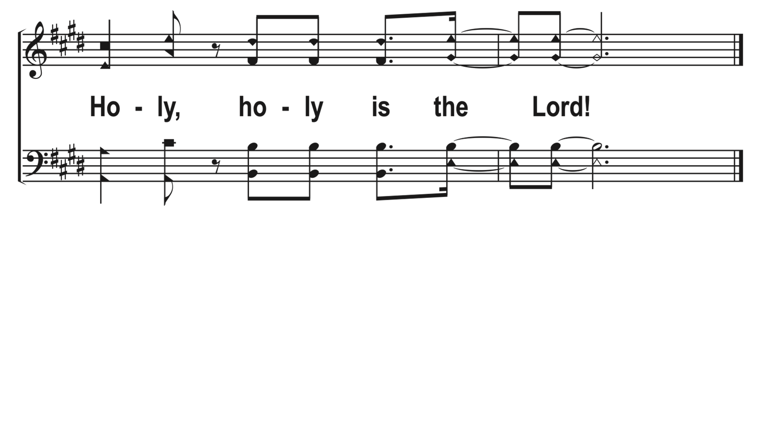
1
C
2
C
3
C
204
HYMN OF HEAVEN
© 2023 The Acapella Company

