Slide 1
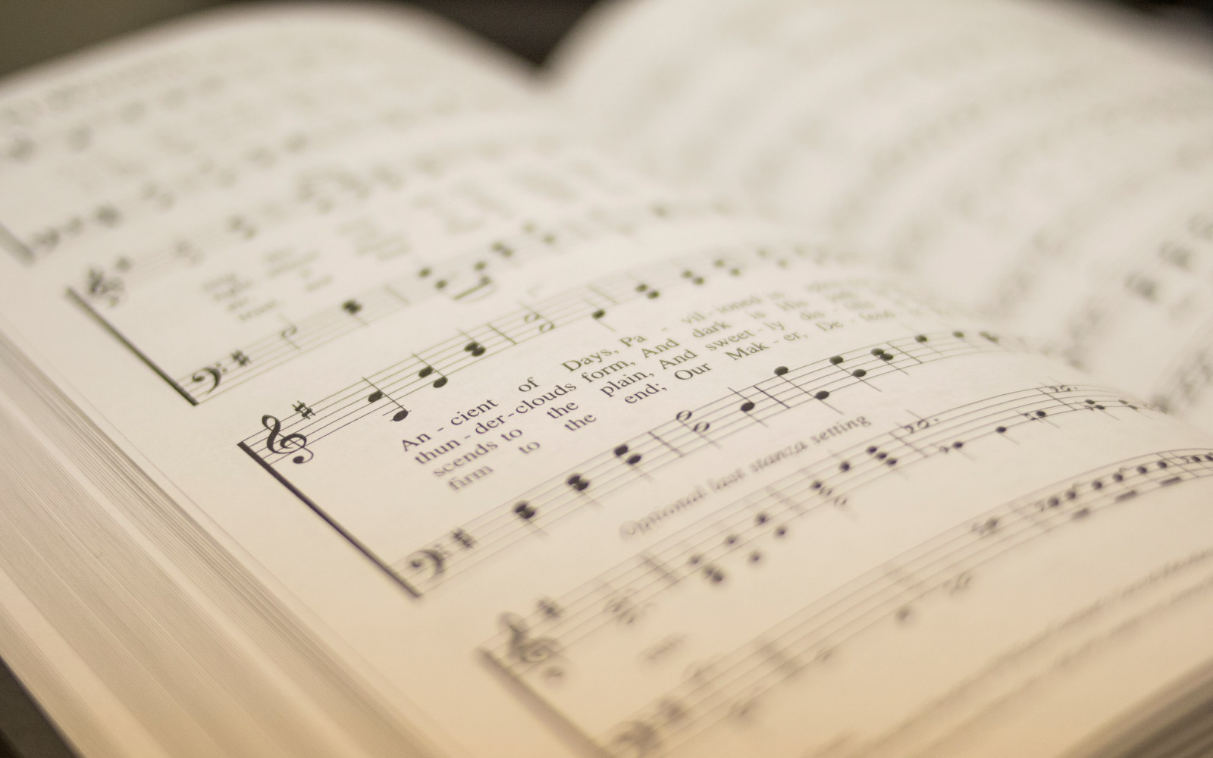

205
GREAT I AM
1
2
3
4
“SINGING...TO THE LORD” COLOSSIANS 3:16
Words and Music by: Jared Anderson, Arr: Mike Rogers and Ryan Smith Â© 2011 Integrity Worship Music

Slide 2
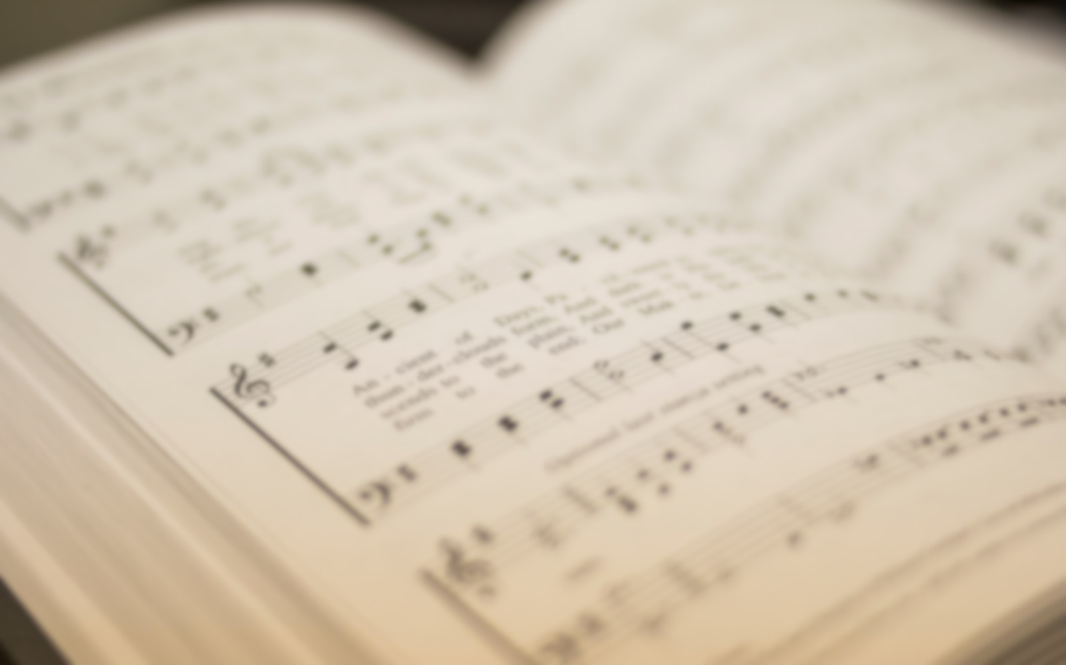
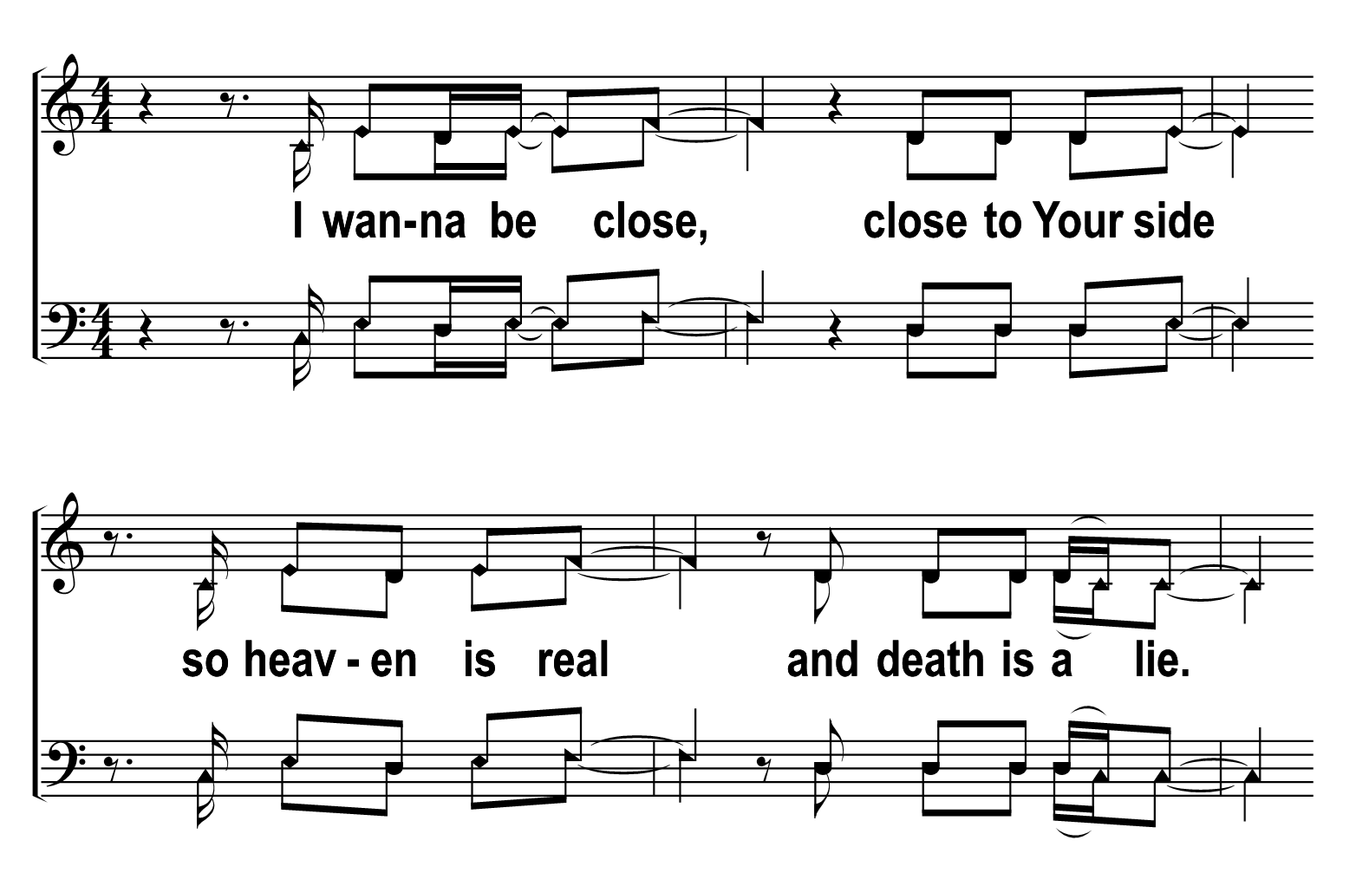

1
2
3
4
205
GREAT I AM
Â© 2022 The Acapella Company

Slide 3
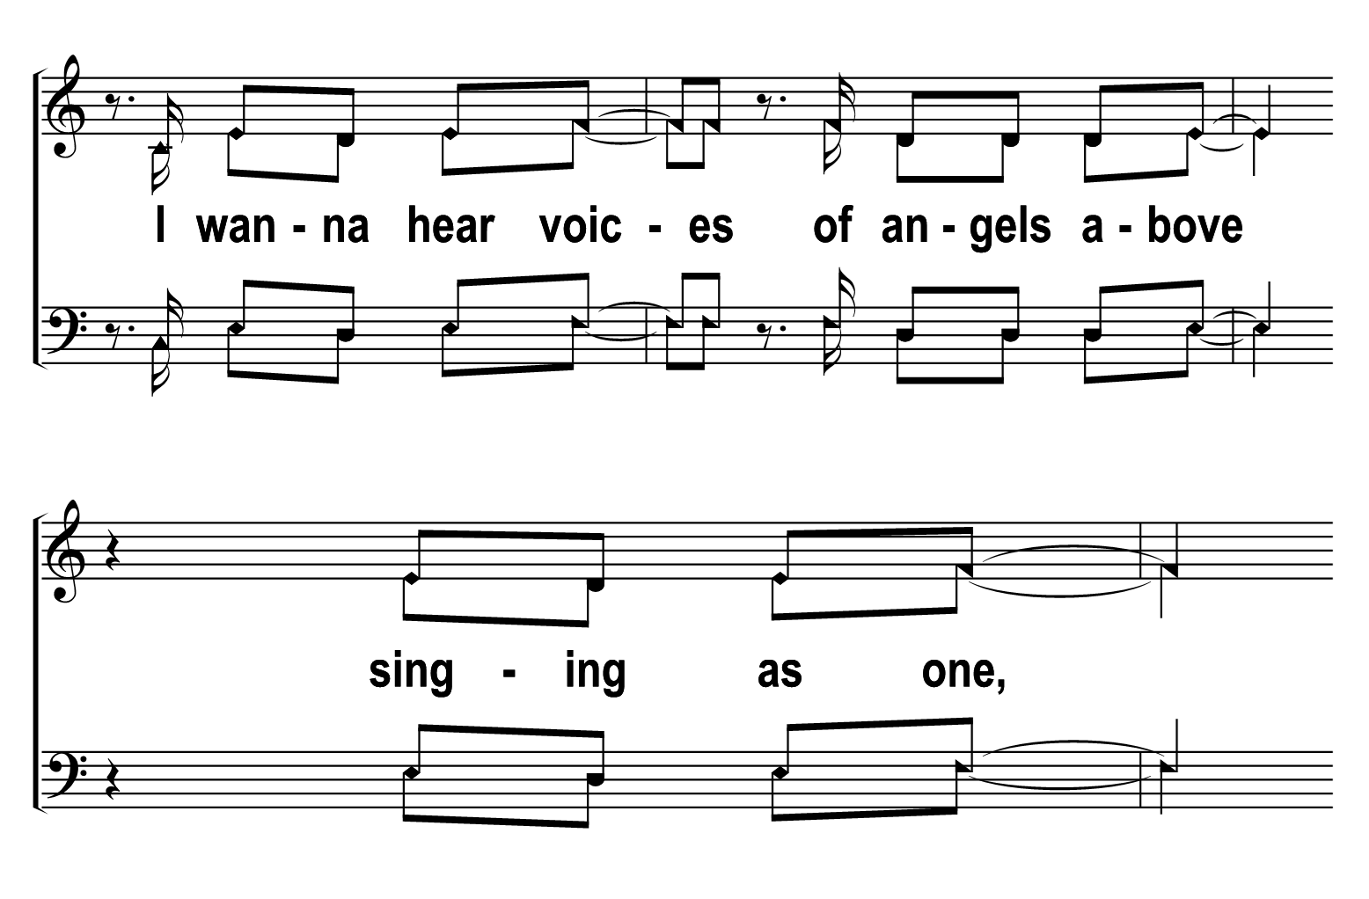
1
2
3
4
205
GREAT I AM
Â© 2022 The Acapella Company

Slide 4
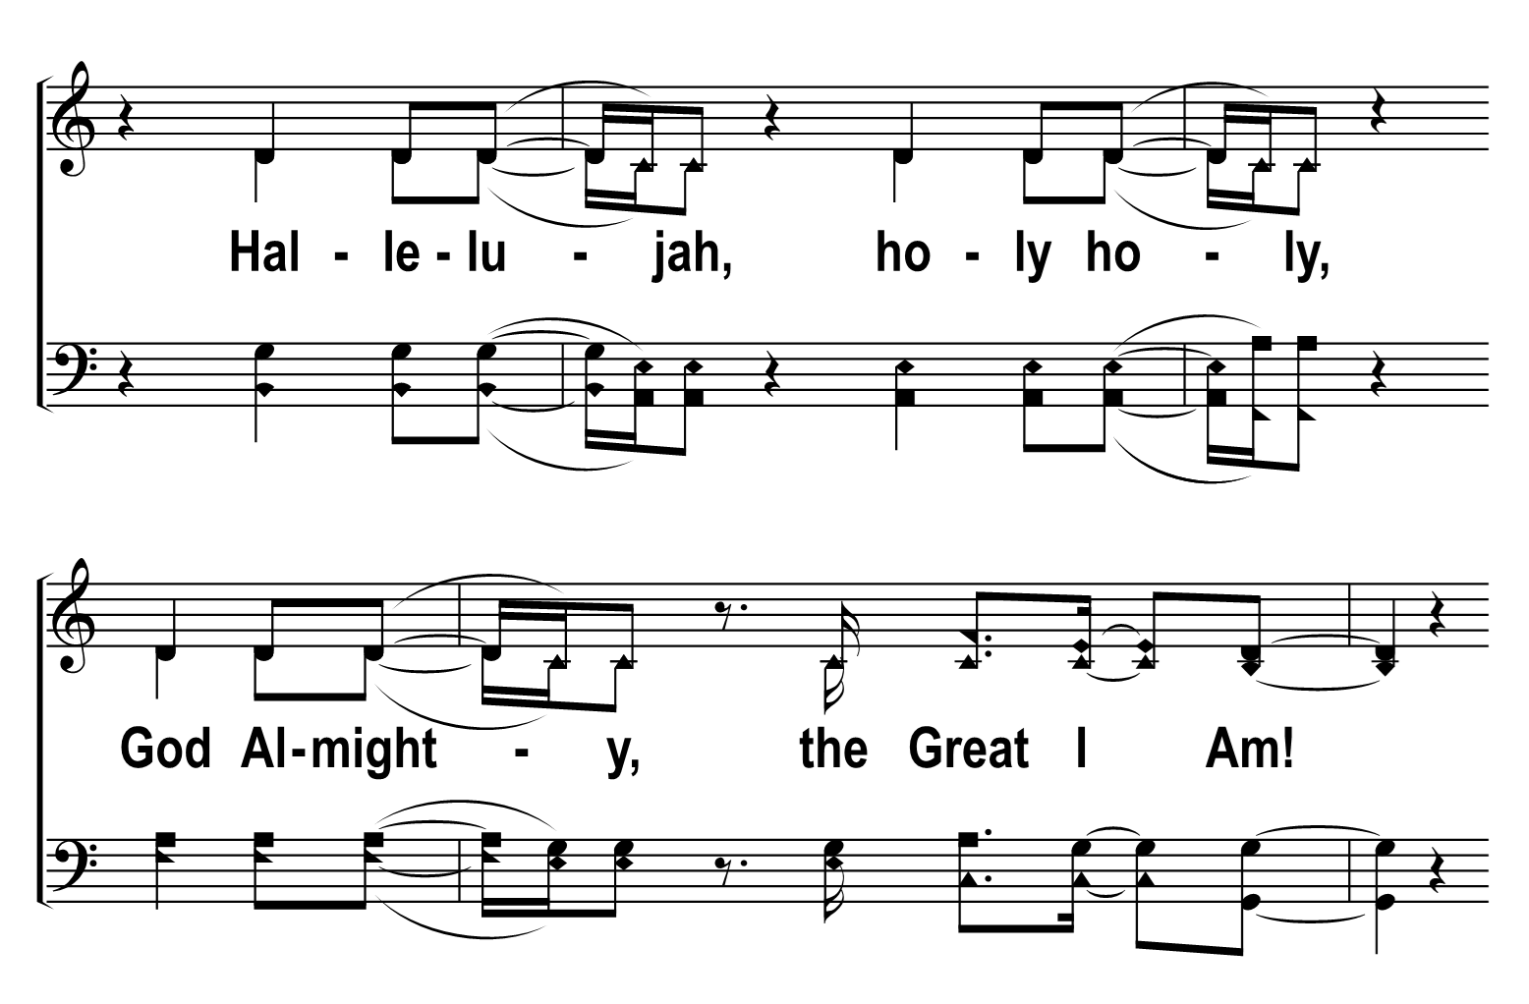
1
2
3
4
205
GREAT I AM
Â© 2022 The Acapella Company

Slide 5
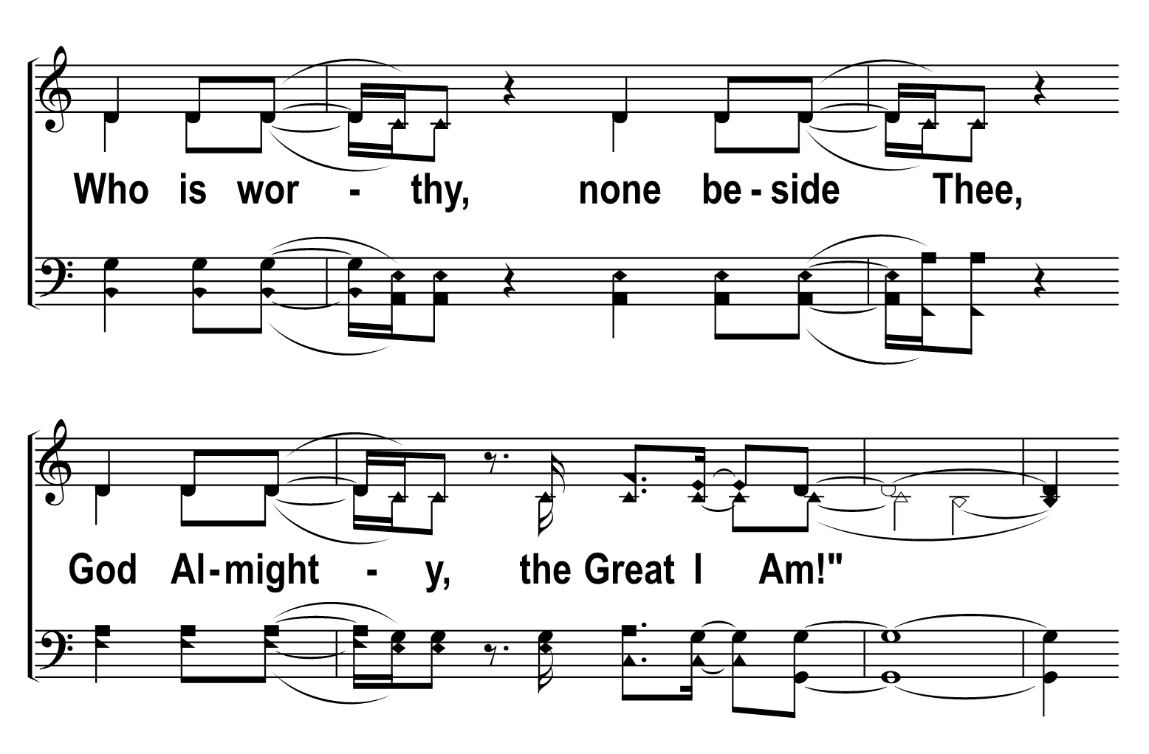
1
2
3
4
205
GREAT I AM
Â© 2022 The Acapella Company

Slide 6
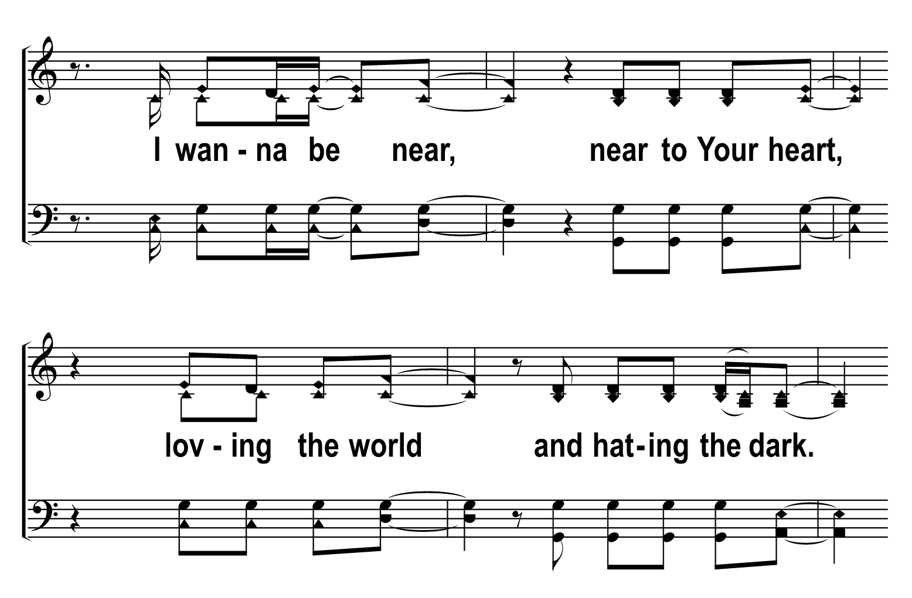
1
2
3
4
205
GREAT I AM
Â© 2022 The Acapella Company

Slide 7
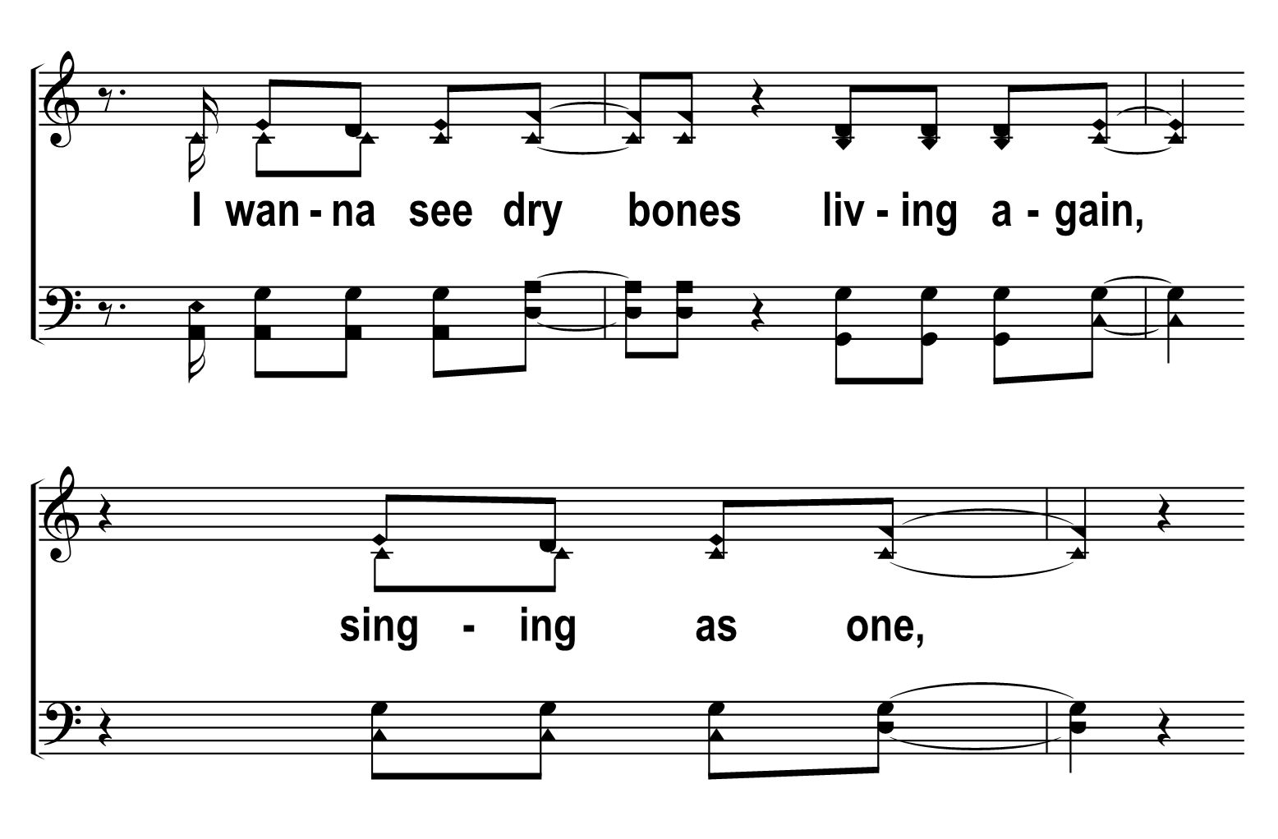
1
2
3
4
205
GREAT I AM
Â© 2022 The Acapella Company

Slide 8
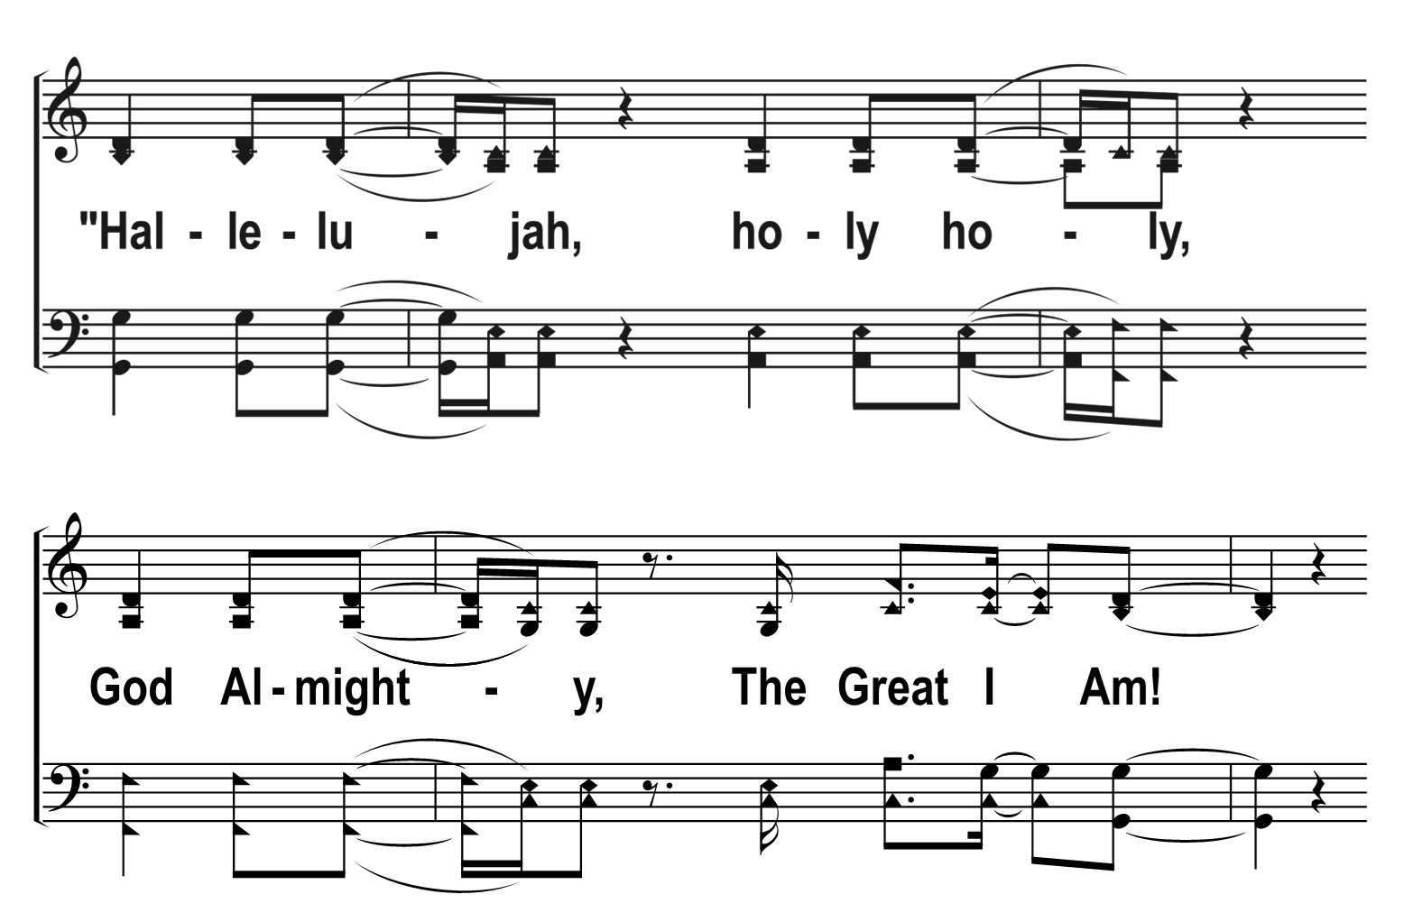
1
2
3
4
205
GREAT I AM
Â© 2022 The Acapella Company

Slide 9
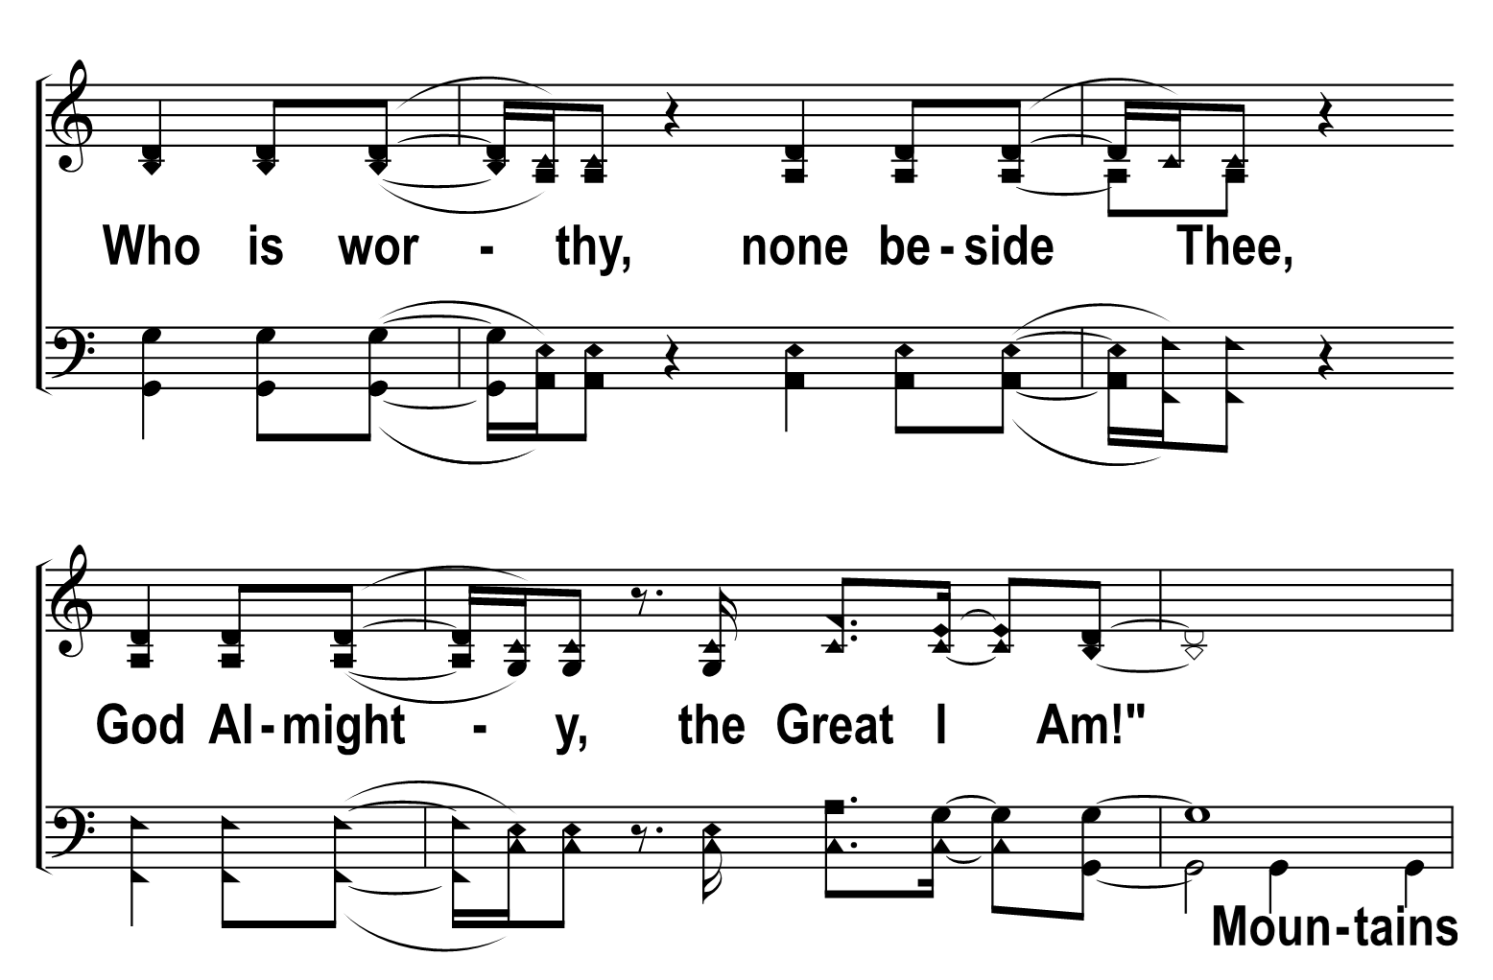
1
2
3
4
205
GREAT I AM
Â© 2022 The Acapella Company

Slide 10
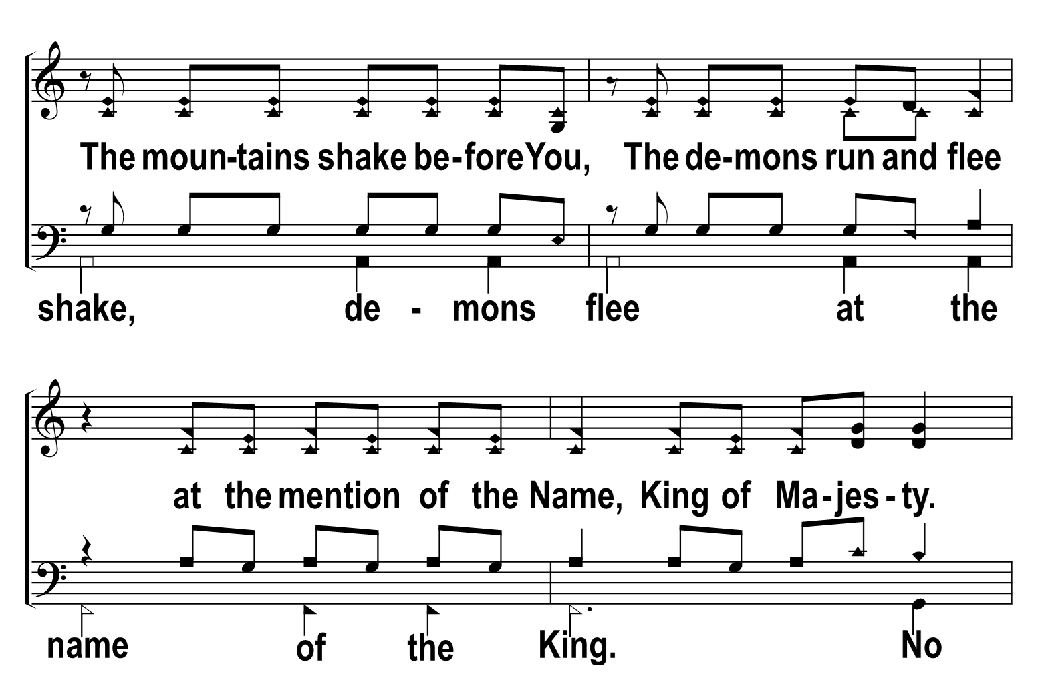
1
2
3
4
205
GREAT I AM
Â© 2022 The Acapella Company

Slide 11
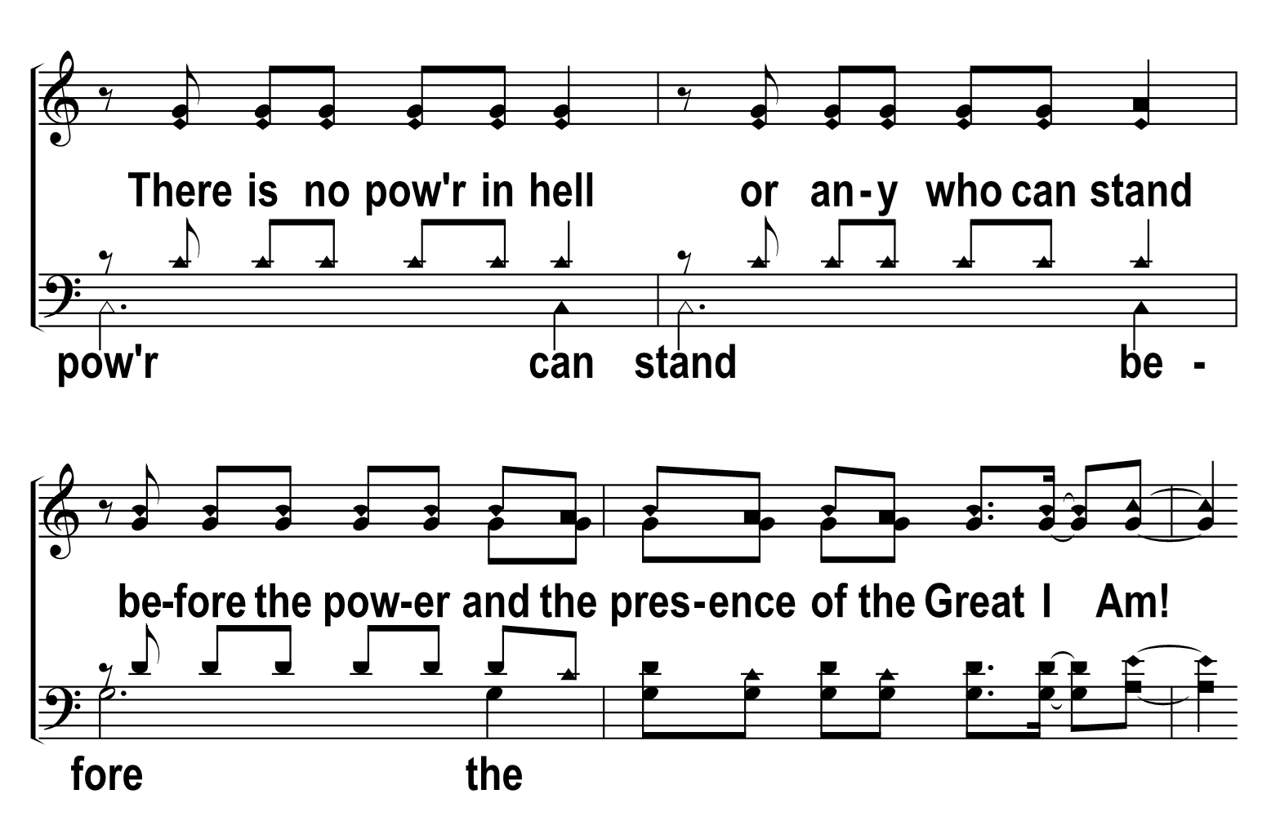
1
2
3
4
205
GREAT I AM
Â© 2022 The Acapella Company

Slide 12
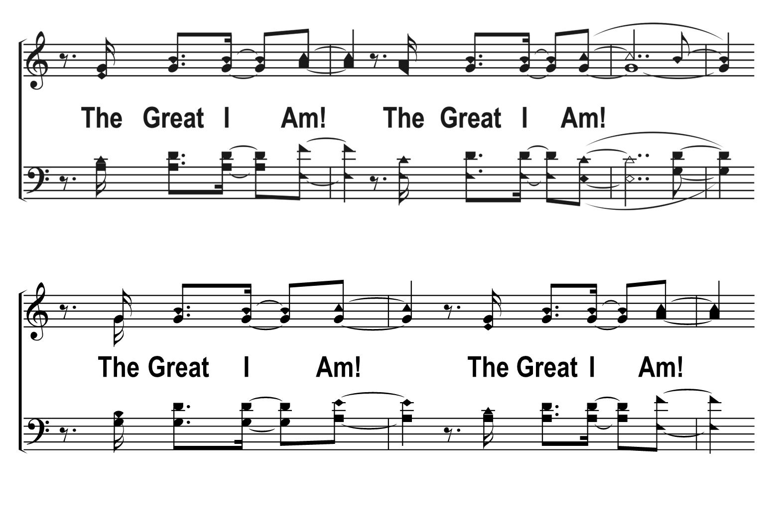
1
2
3
4
205
GREAT I AM
Â© 2022 The Acapella Company

Slide 13
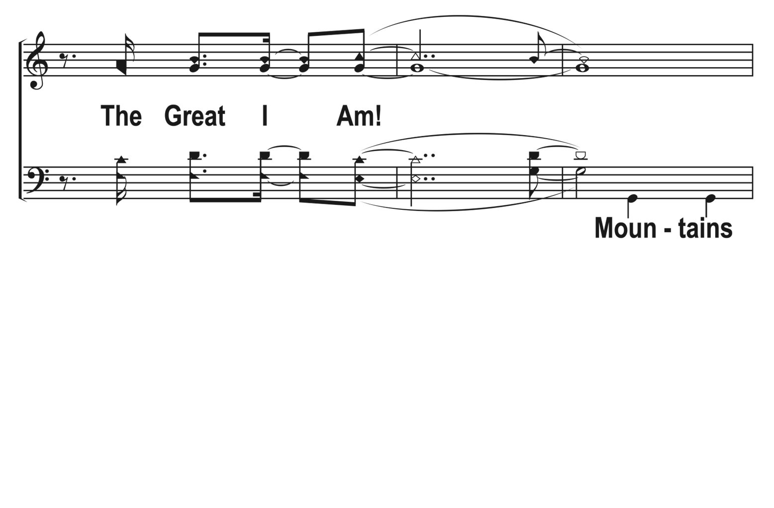
1
2
3
4
205
GREAT I AM
Â© 2022 The Acapella Company

Slide 14
1
2
3
4
205
GREAT I AM
Â© 2022 The Acapella Company

Slide 15
1
2
3
4
205
GREAT I AM
Â© 2022 The Acapella Company

Slide 16
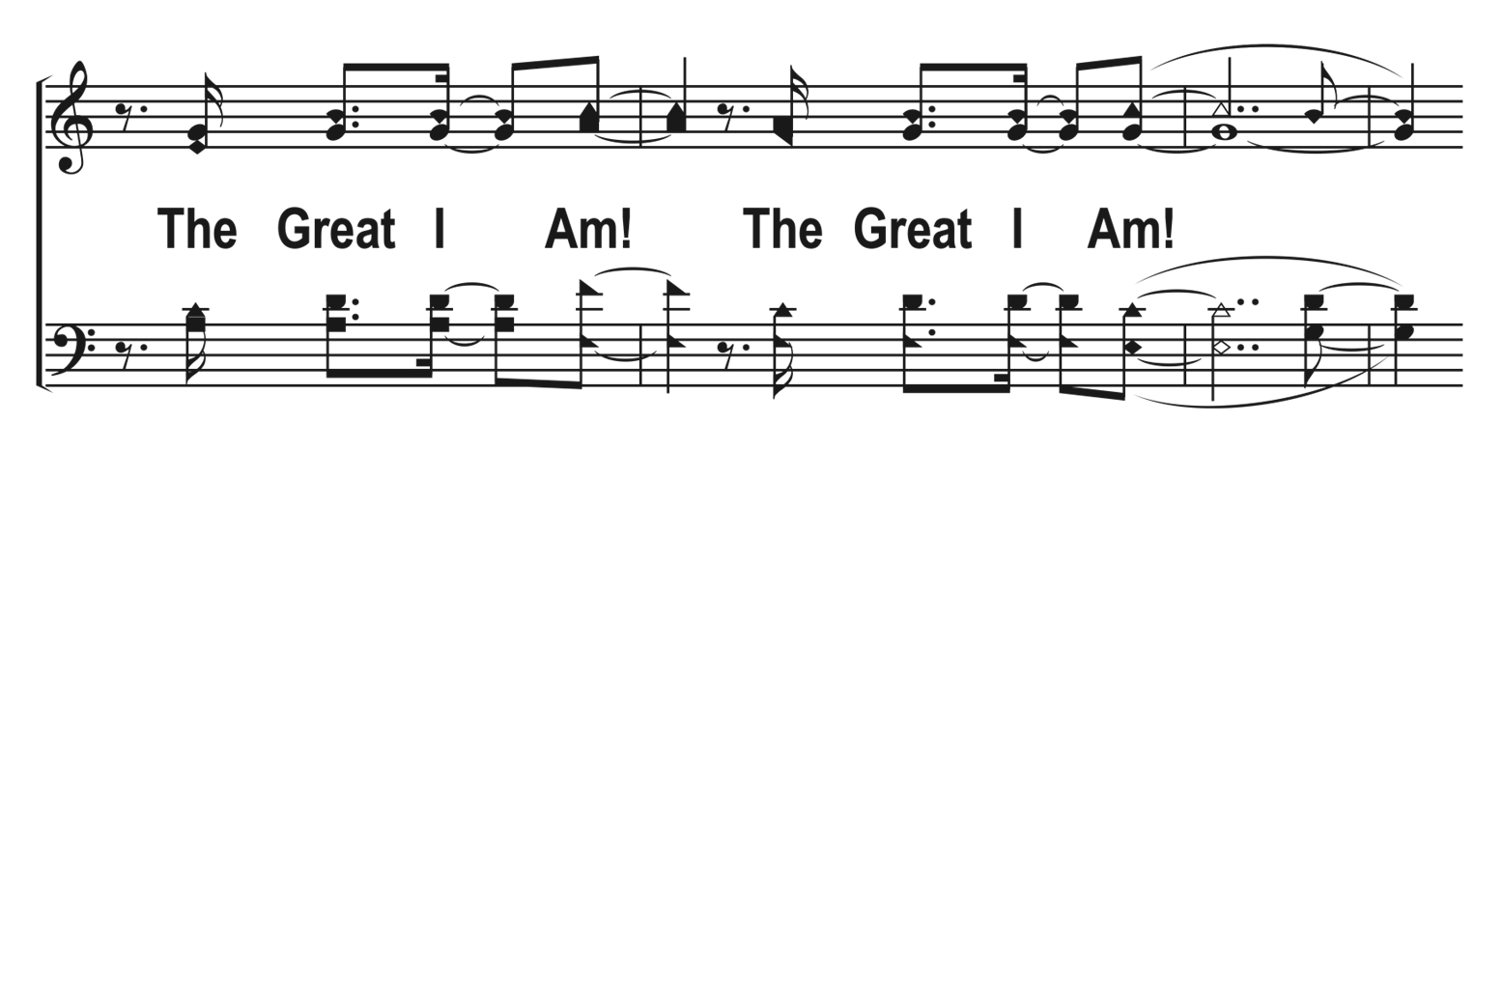
1
2
3
4
205
GREAT I AM
Â© 2022 The Acapella Company

Slide 17
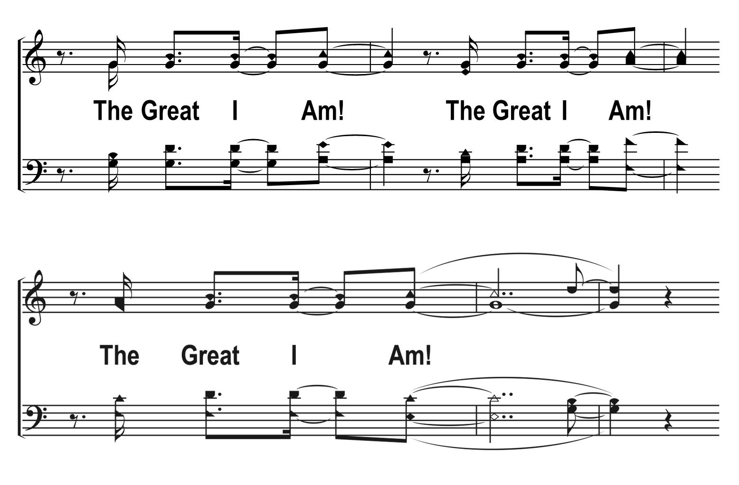
1
2
3
4
205
GREAT I AM
Â© 2022 The Acapella Company

Slide 18
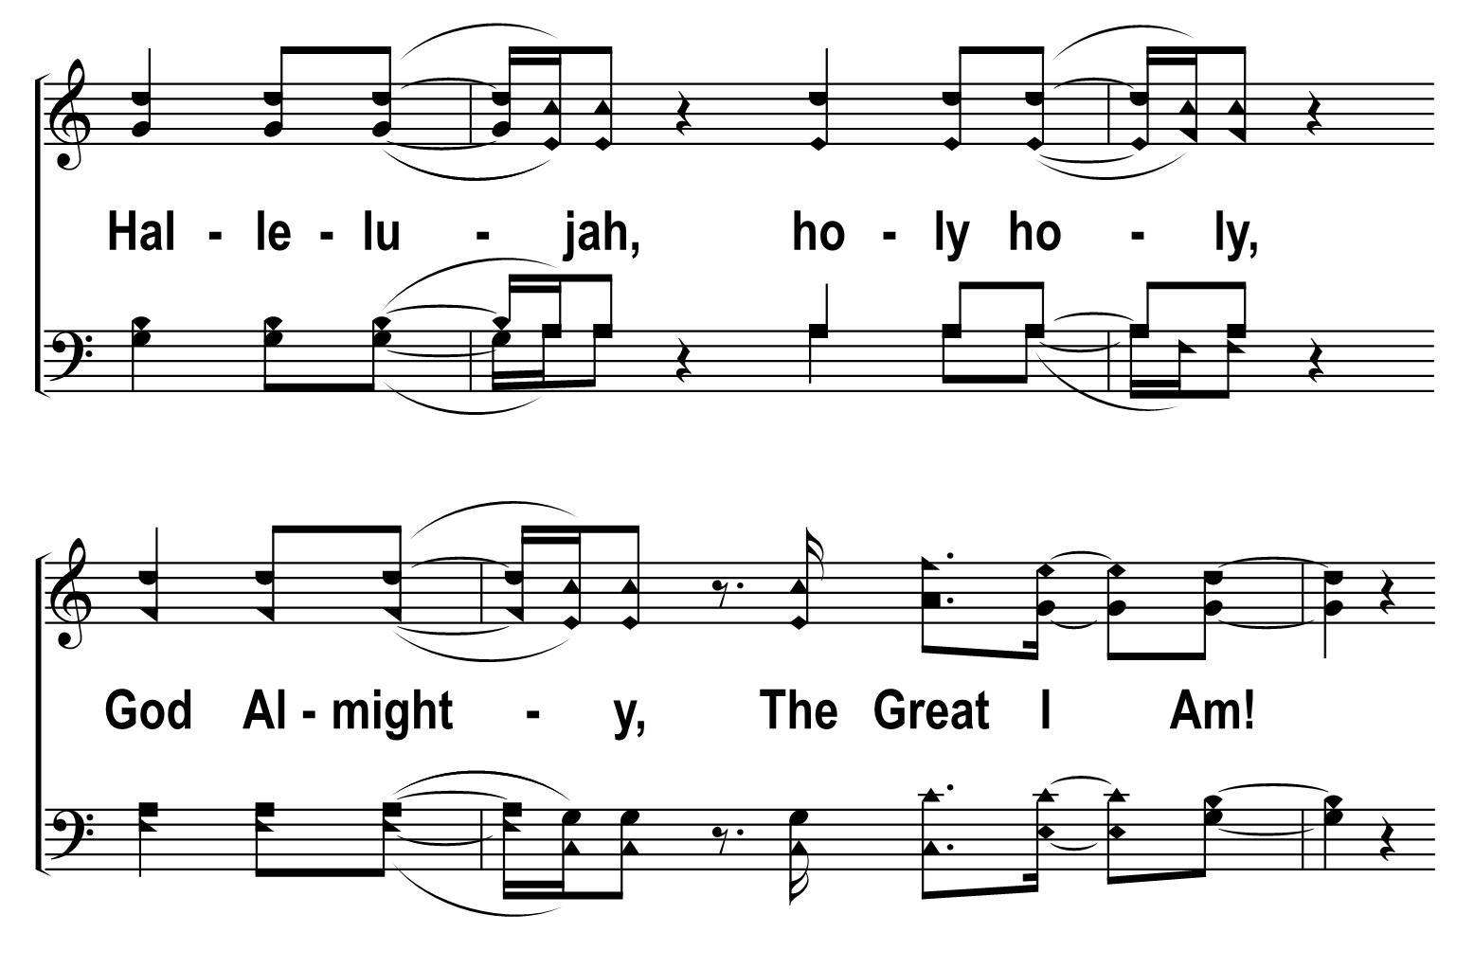
1
2
3
4
205
GREAT I AM
Â© 2022 The Acapella Company

Slide 19
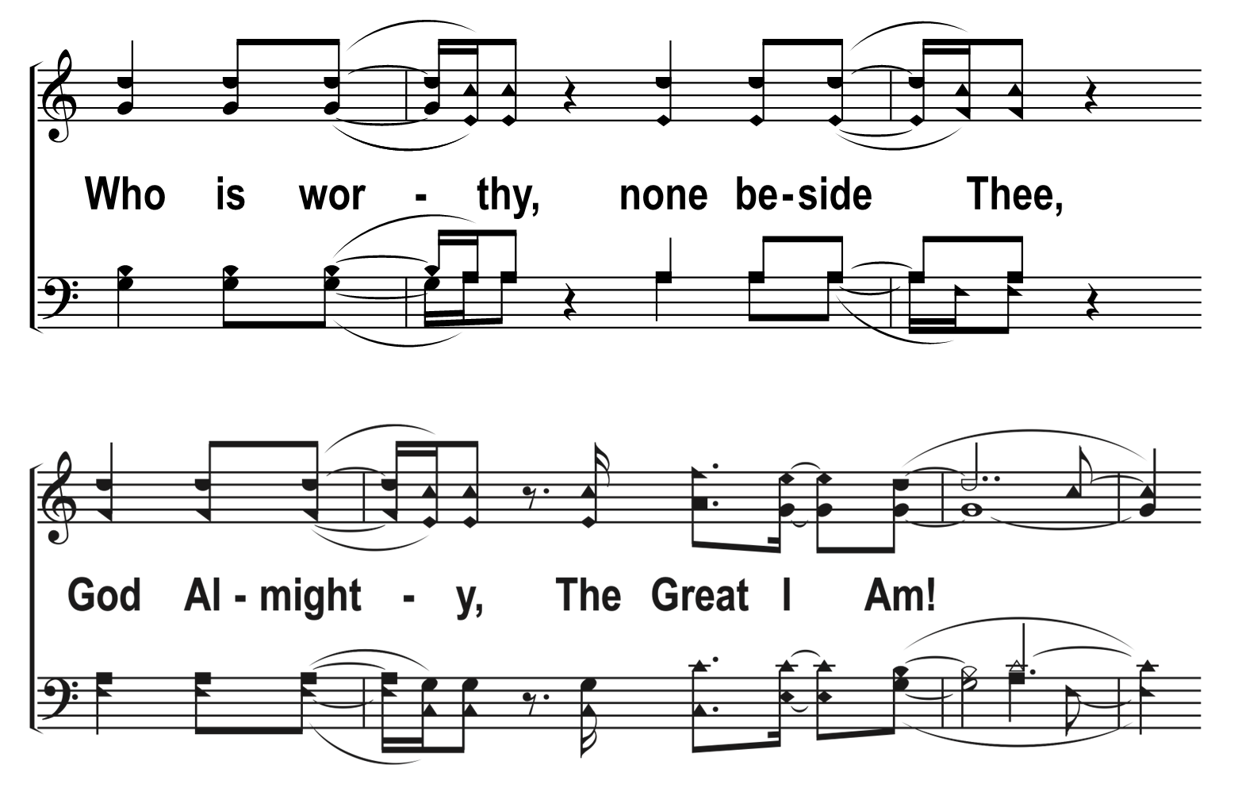
1
2
3
4
205
GREAT I AM
Â© 2022 The Acapella Company

Slide 20
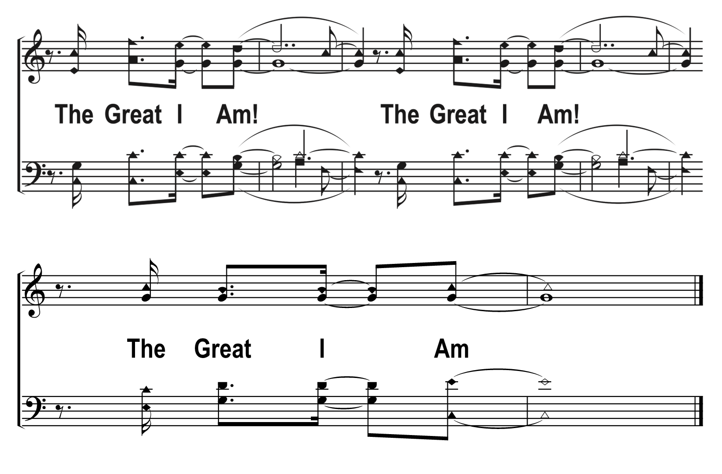
1
2
3
4
205
GREAT I AM
Â© 2022 The Acapella Company

