Slide 1
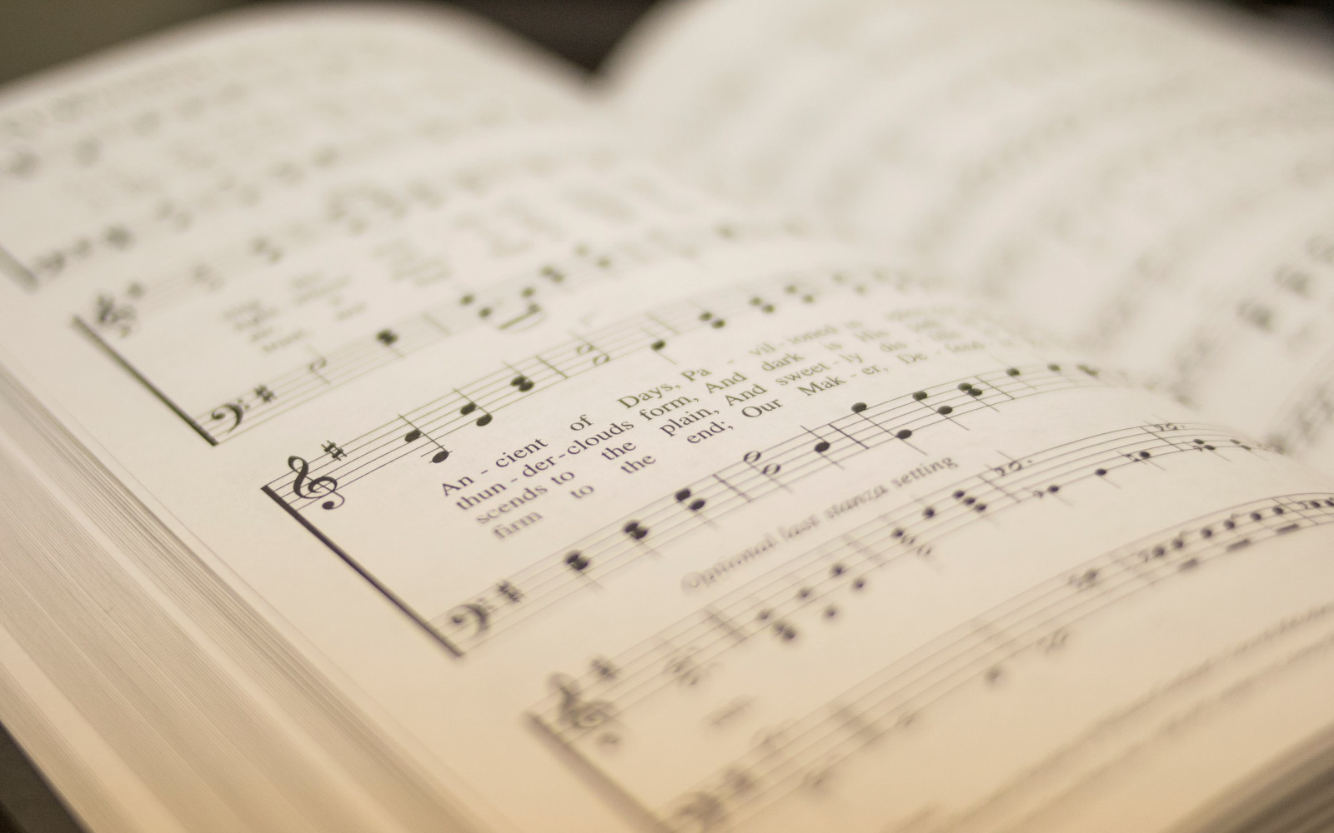

206
BEAUTIFUL LAMB
1
2
3
“SINGING...TO THE LORD” COLOSSIANS 3:16
Words and Music by: Gary Miller © 1996 by Anthony K. Music/ASCAP. All rights reserved. Used by permission.

Slide 2
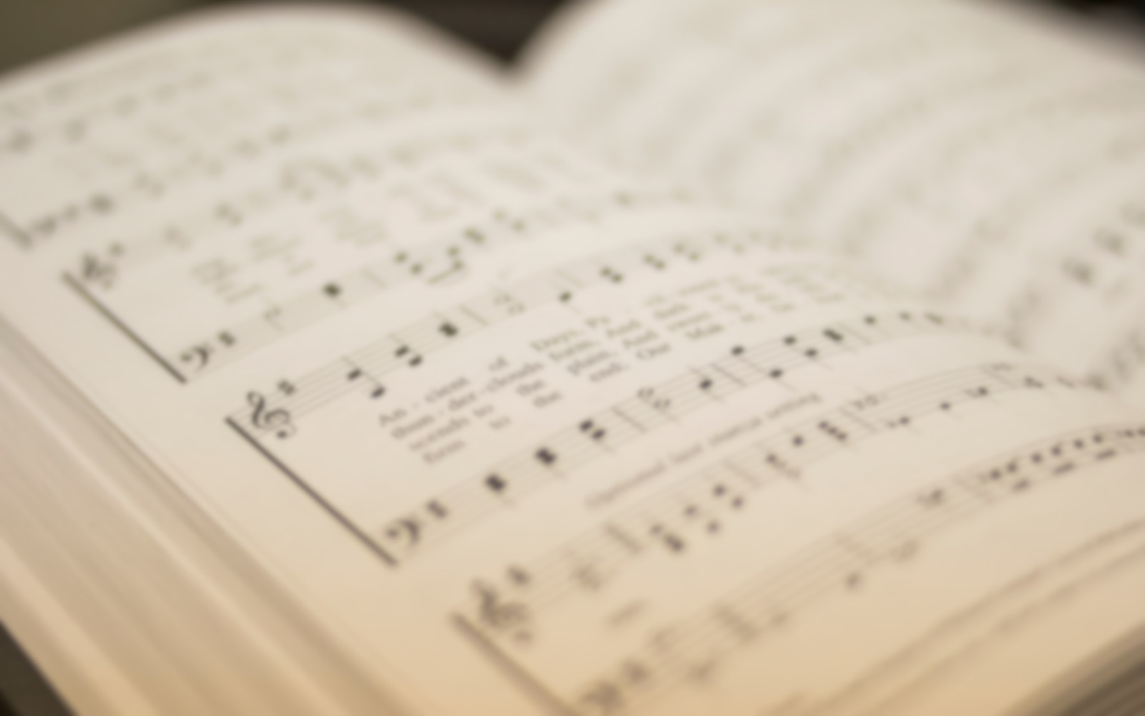
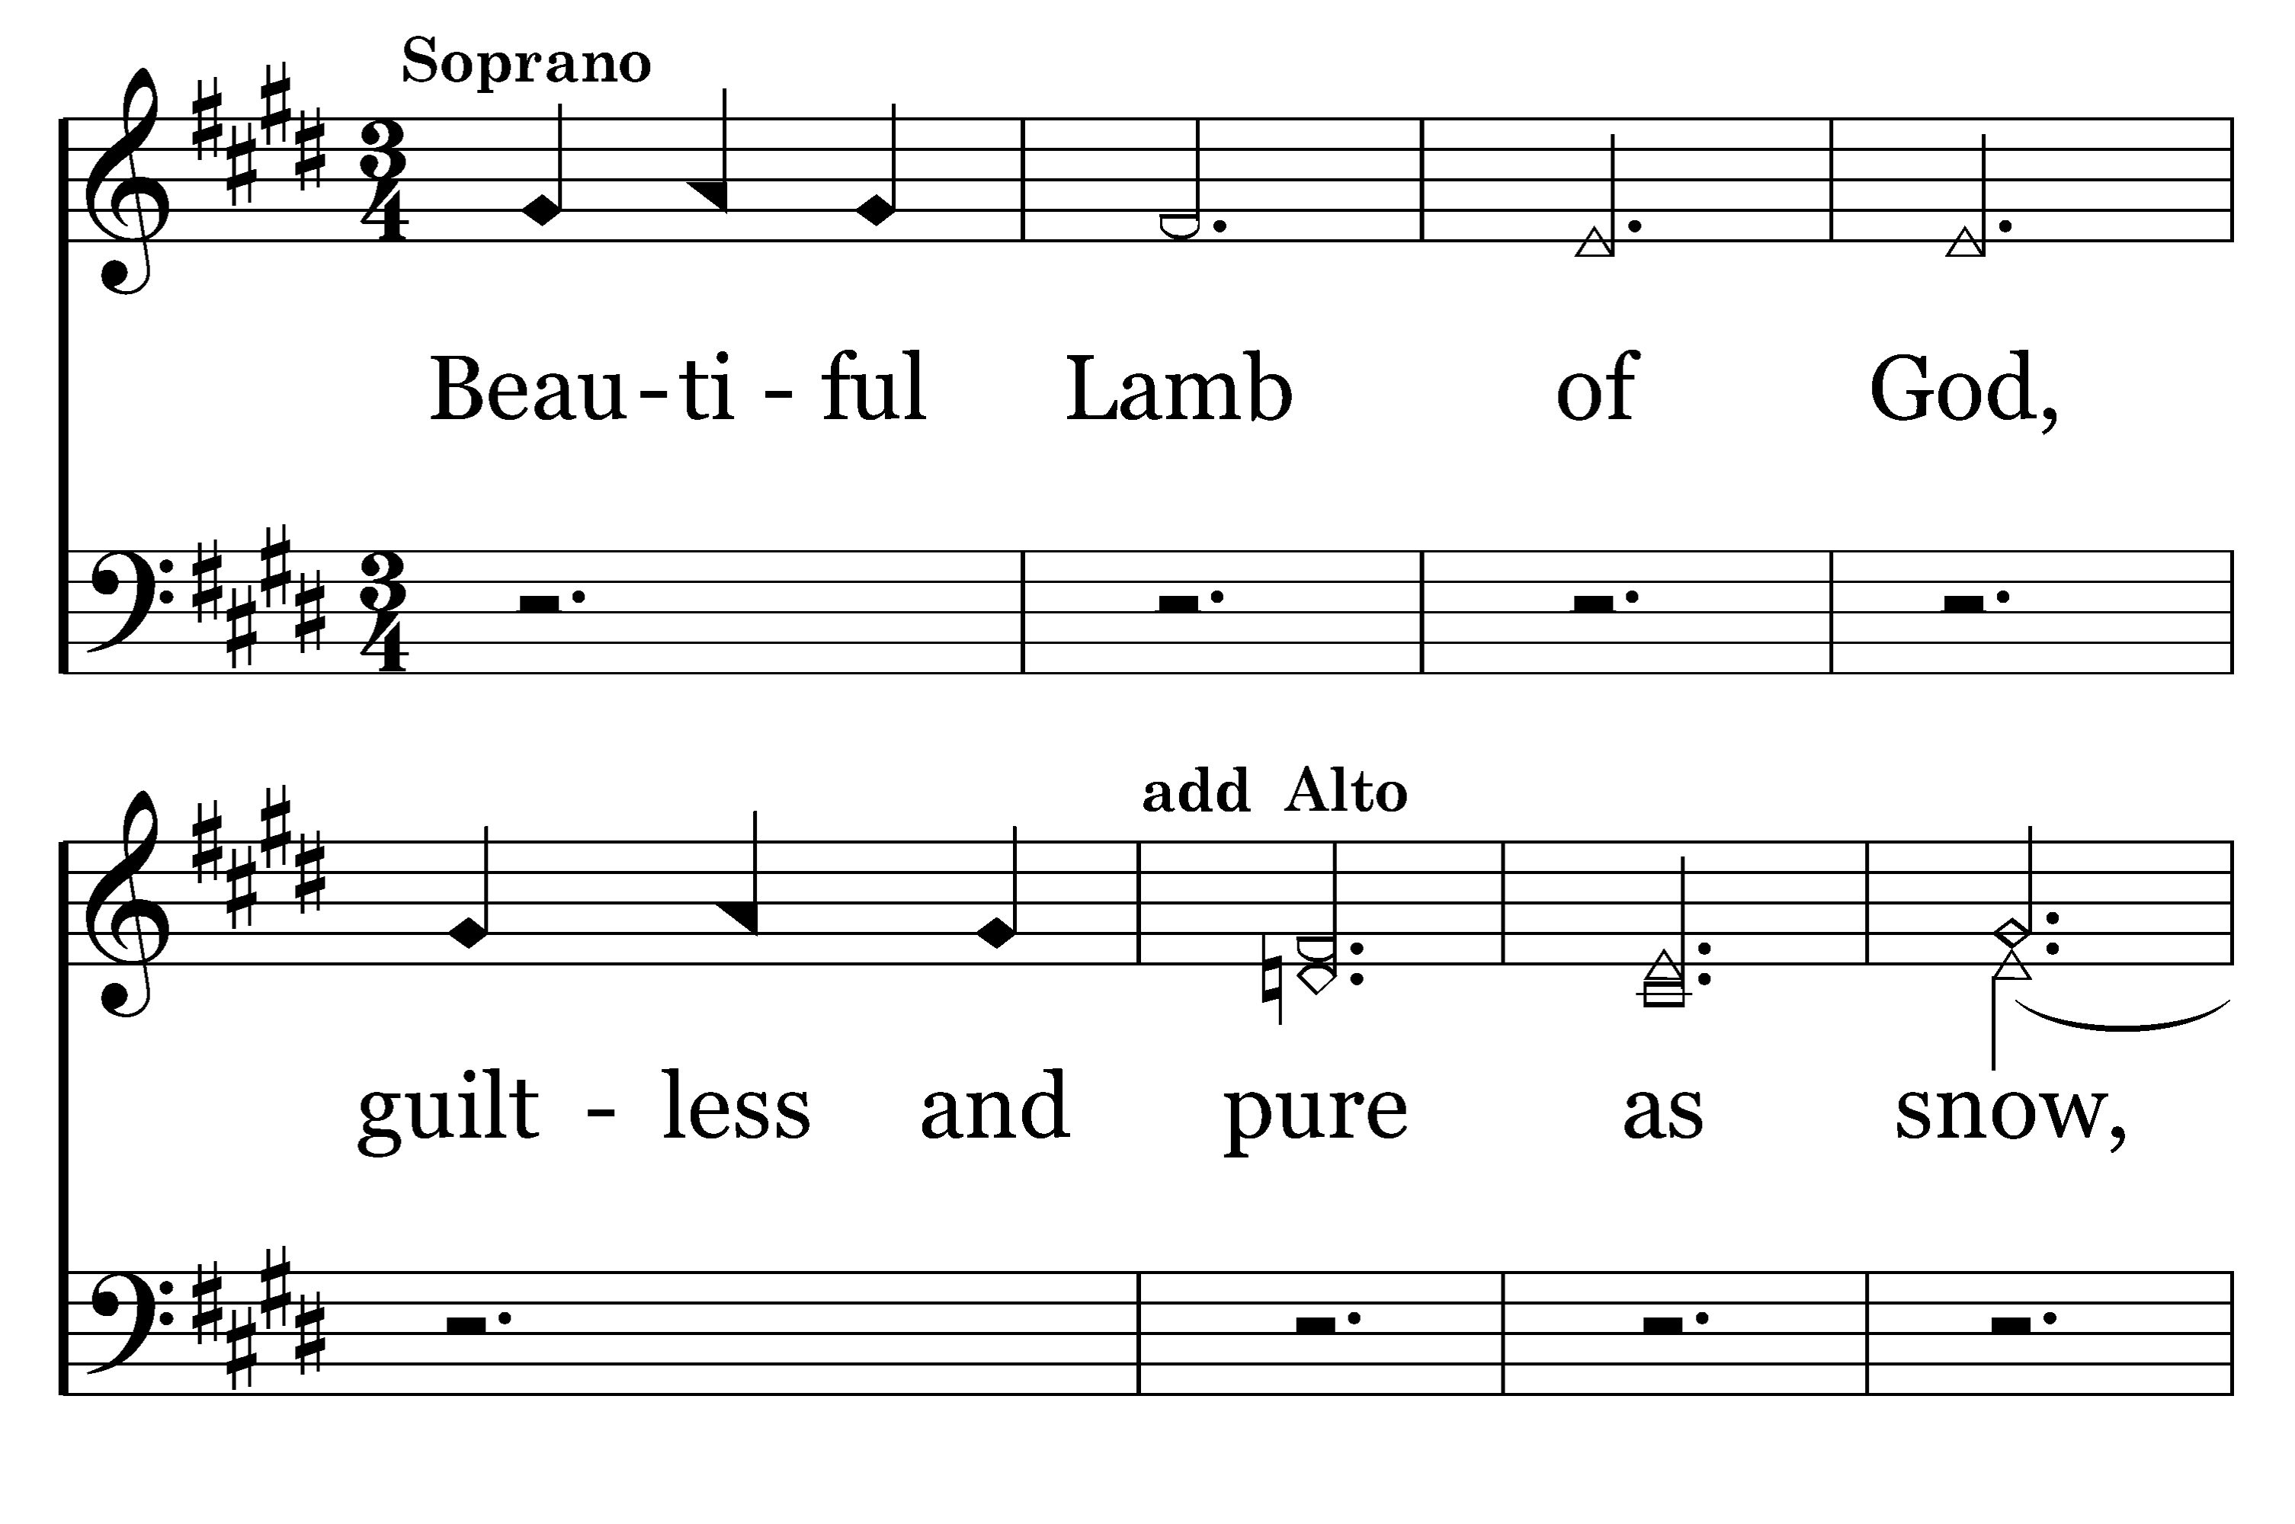

1
2
3
206
BEAUTIFUL LAMB
Typeset by R. J. Stevens Music

Slide 3
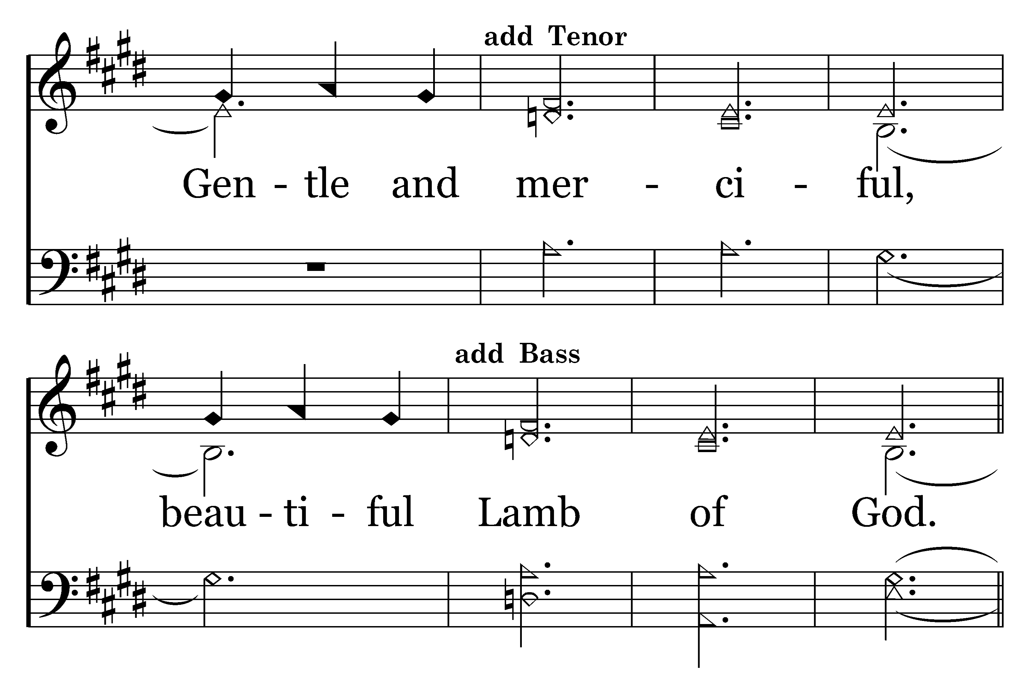
1
2
3
206
BEAUTIFUL LAMB
Typeset by R. J. Stevens Music

Slide 4
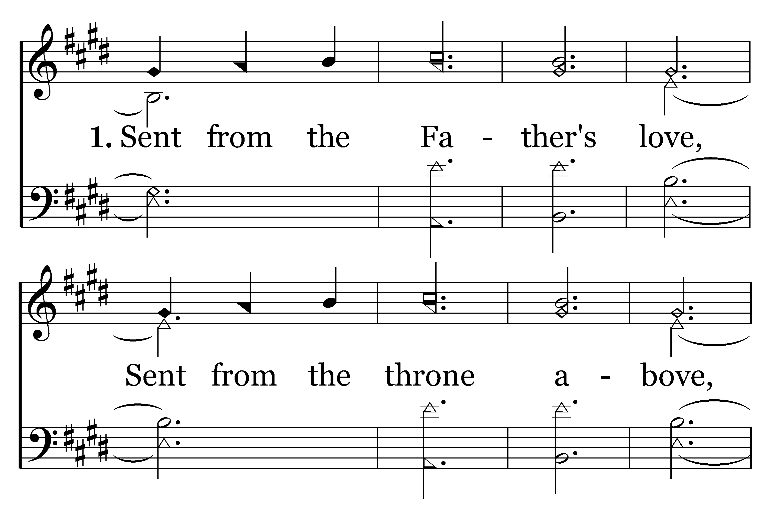
1
2
3
206
BEAUTIFUL LAMB
Typeset by R. J. Stevens Music

Slide 5
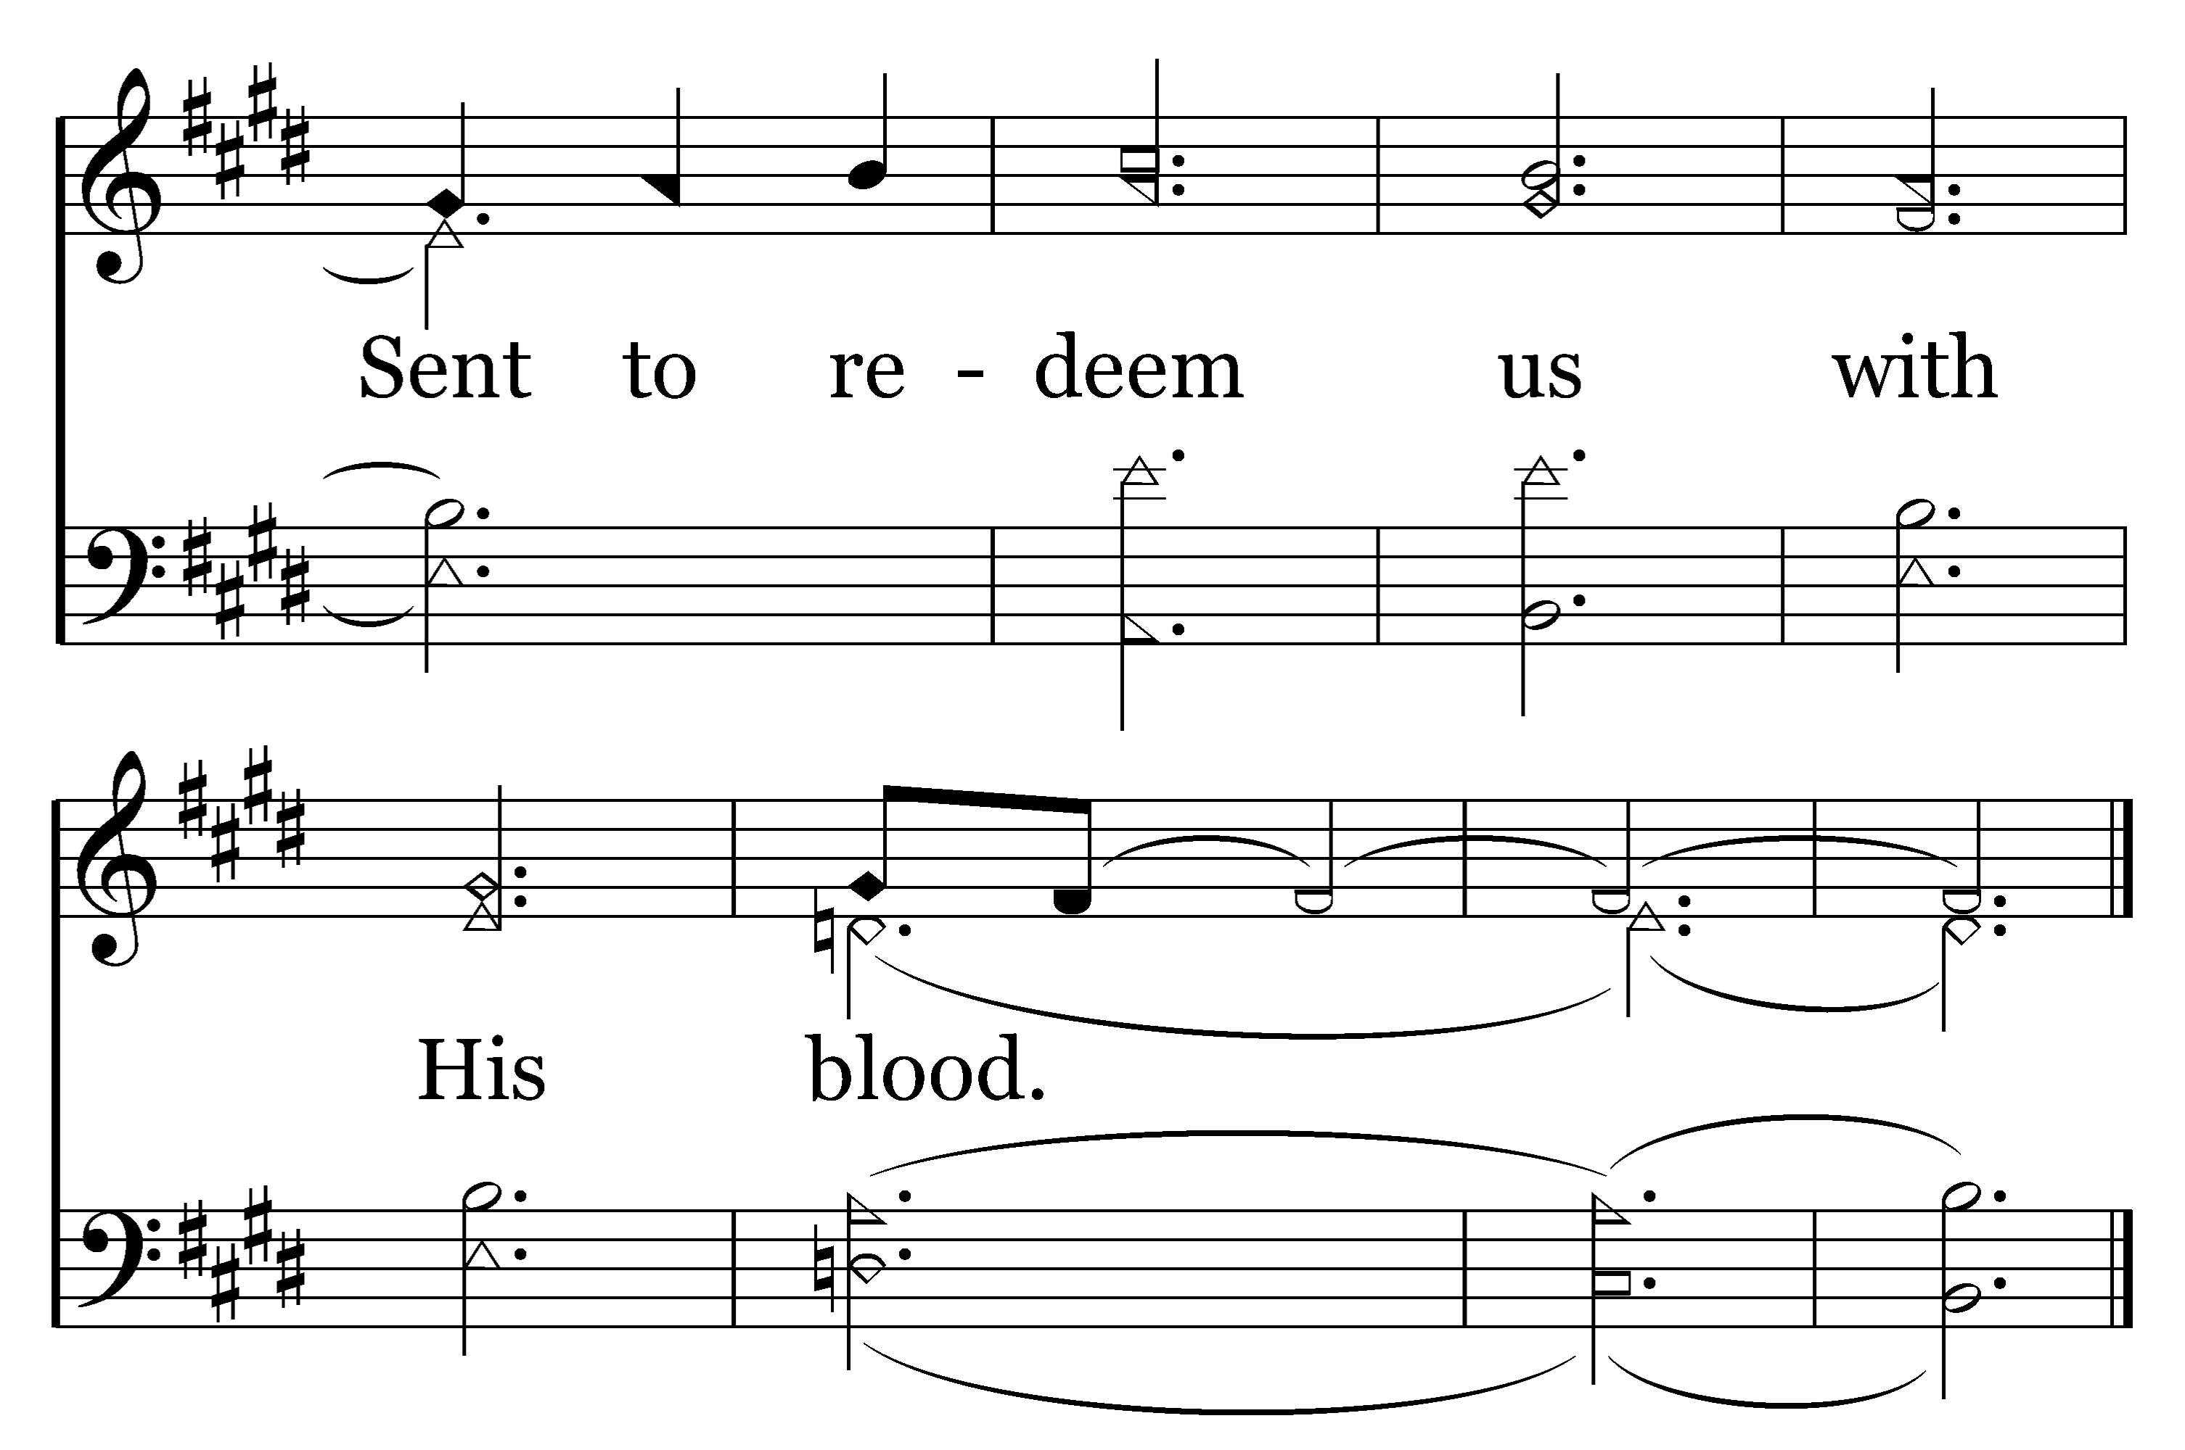
1
2
3
206
BEAUTIFUL LAMB
Typeset by R. J. Stevens Music

Slide 6
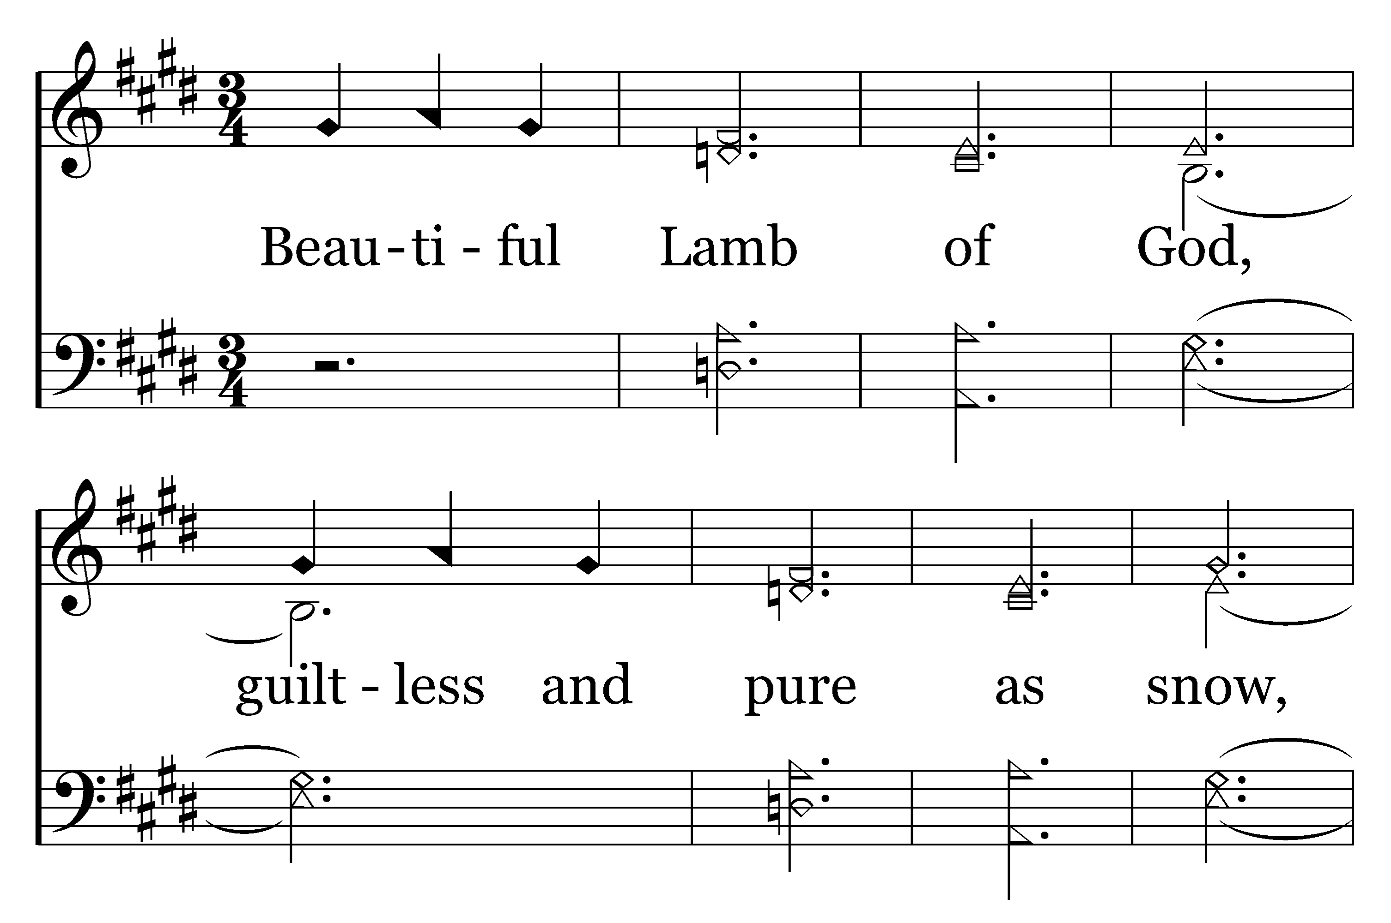
1
2
3
206
BEAUTIFUL LAMB
Typeset by R. J. Stevens Music

Slide 7
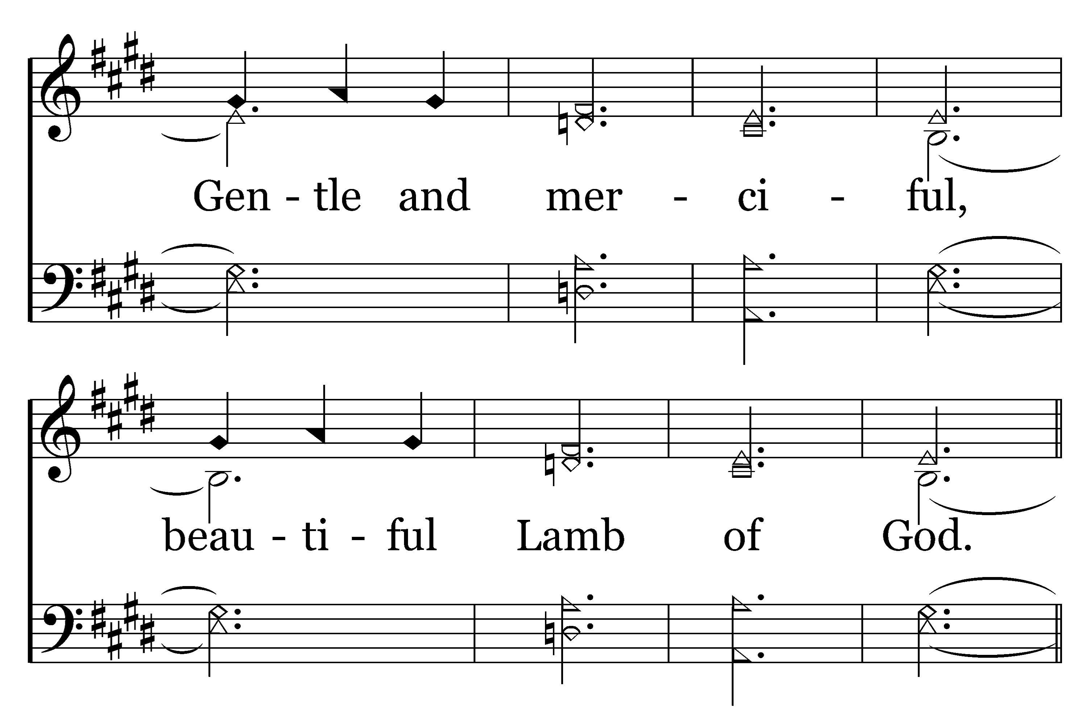
1
2
3
206
BEAUTIFUL LAMB
Typeset by R. J. Stevens Music

Slide 8
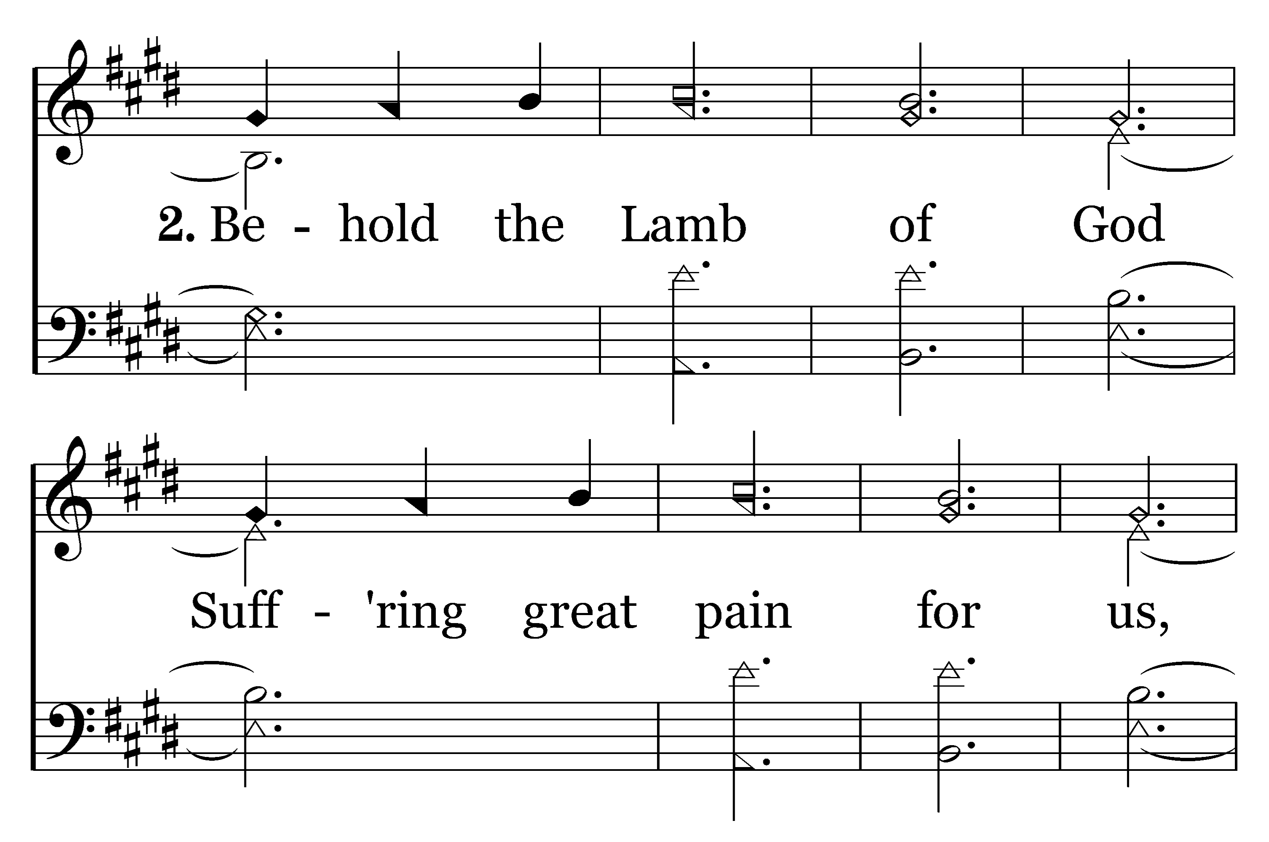
1
2
3
206
BEAUTIFUL LAMB
Typeset by R. J. Stevens Music

Slide 9
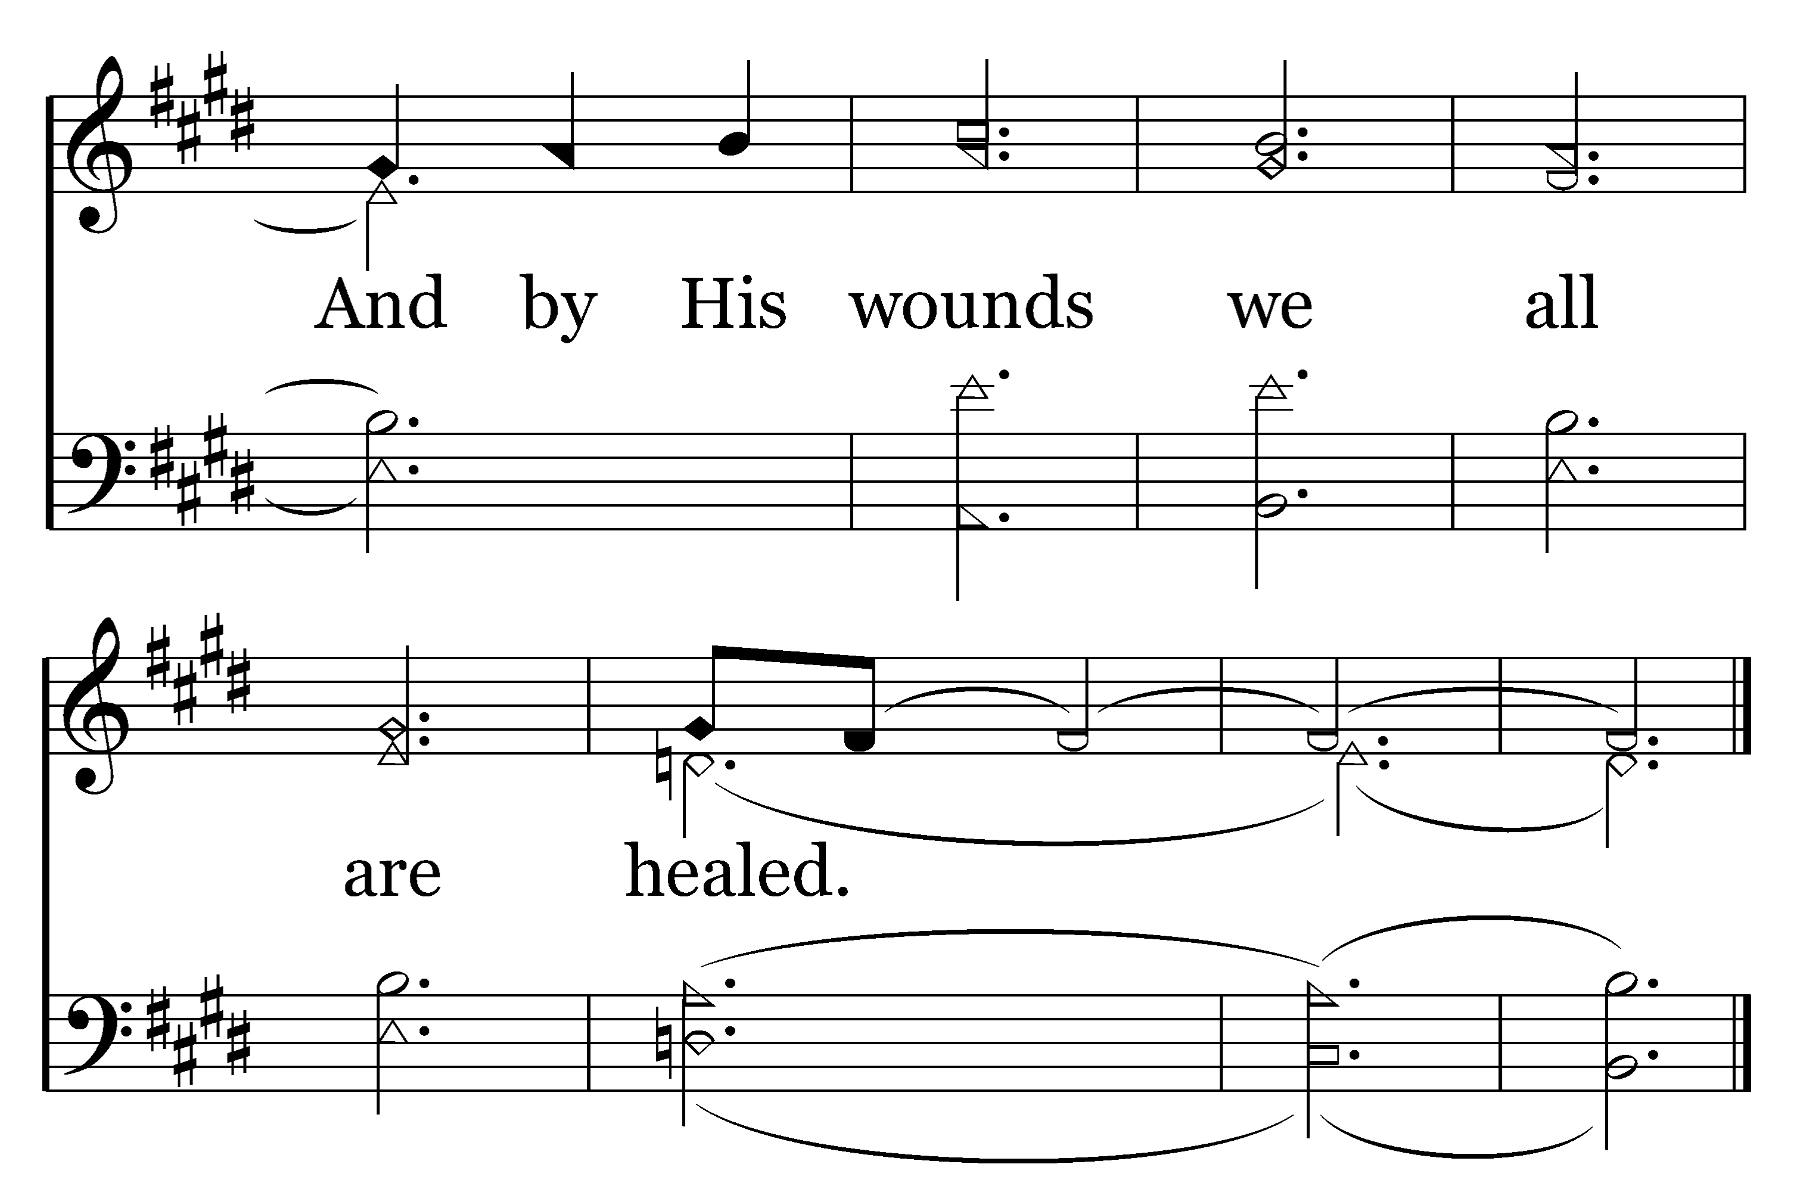
1
2
3
206
BEAUTIFUL LAMB
Typeset by R. J. Stevens Music

Slide 10
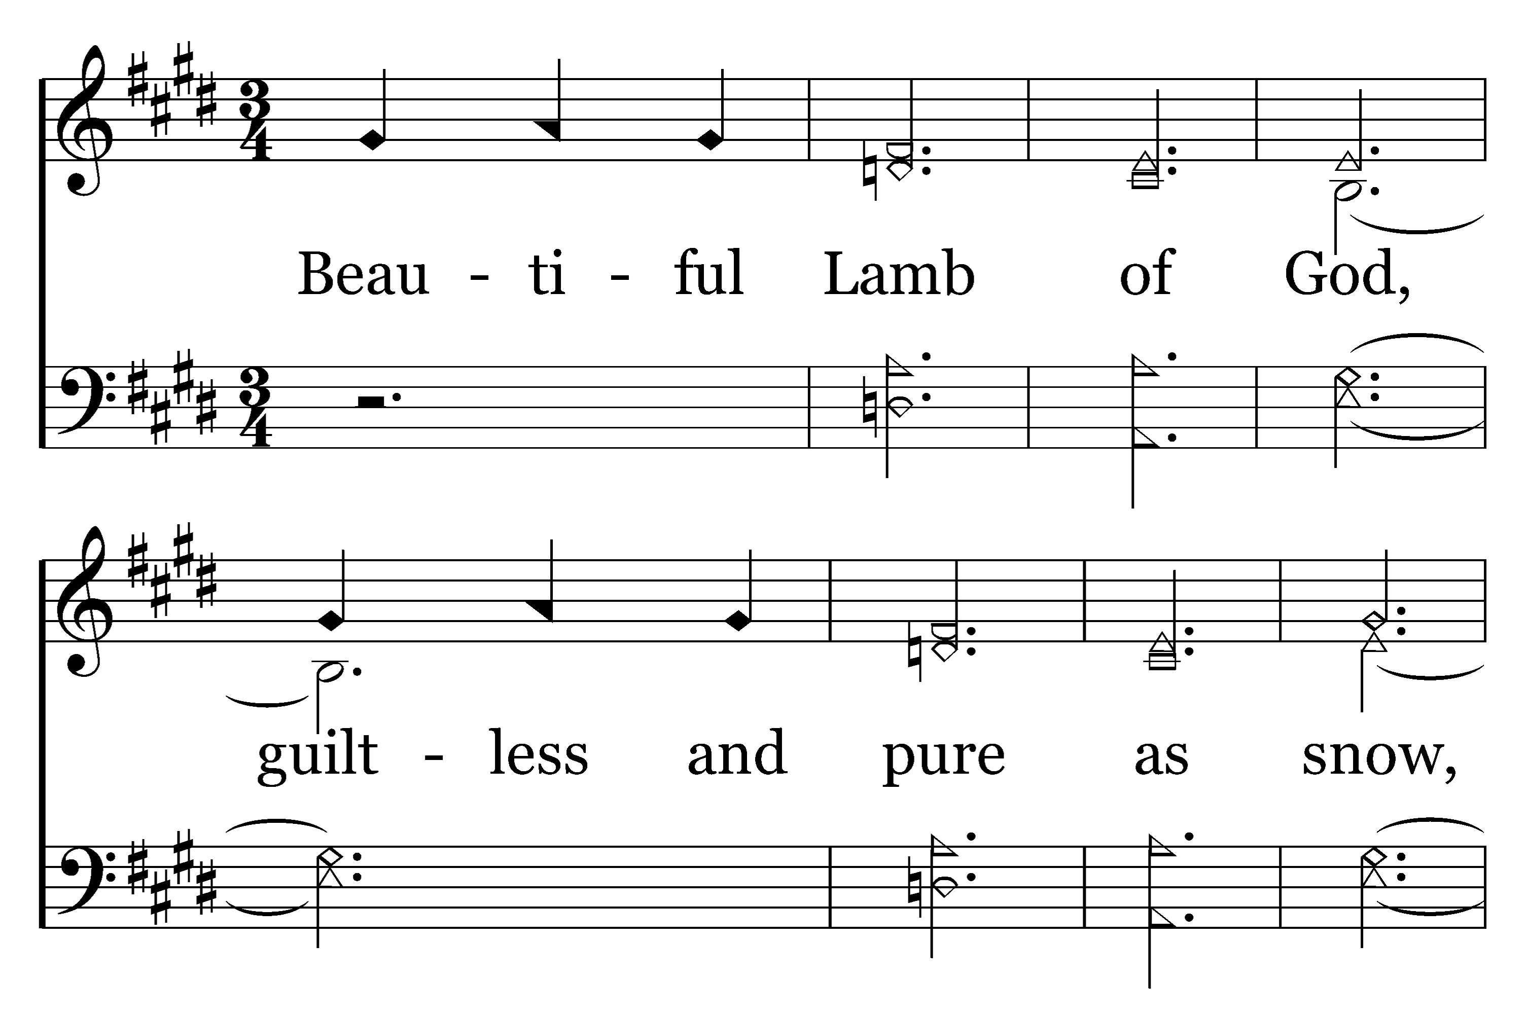
1
2
3
206
BEAUTIFUL LAMB
Typeset by R. J. Stevens Music

Slide 11
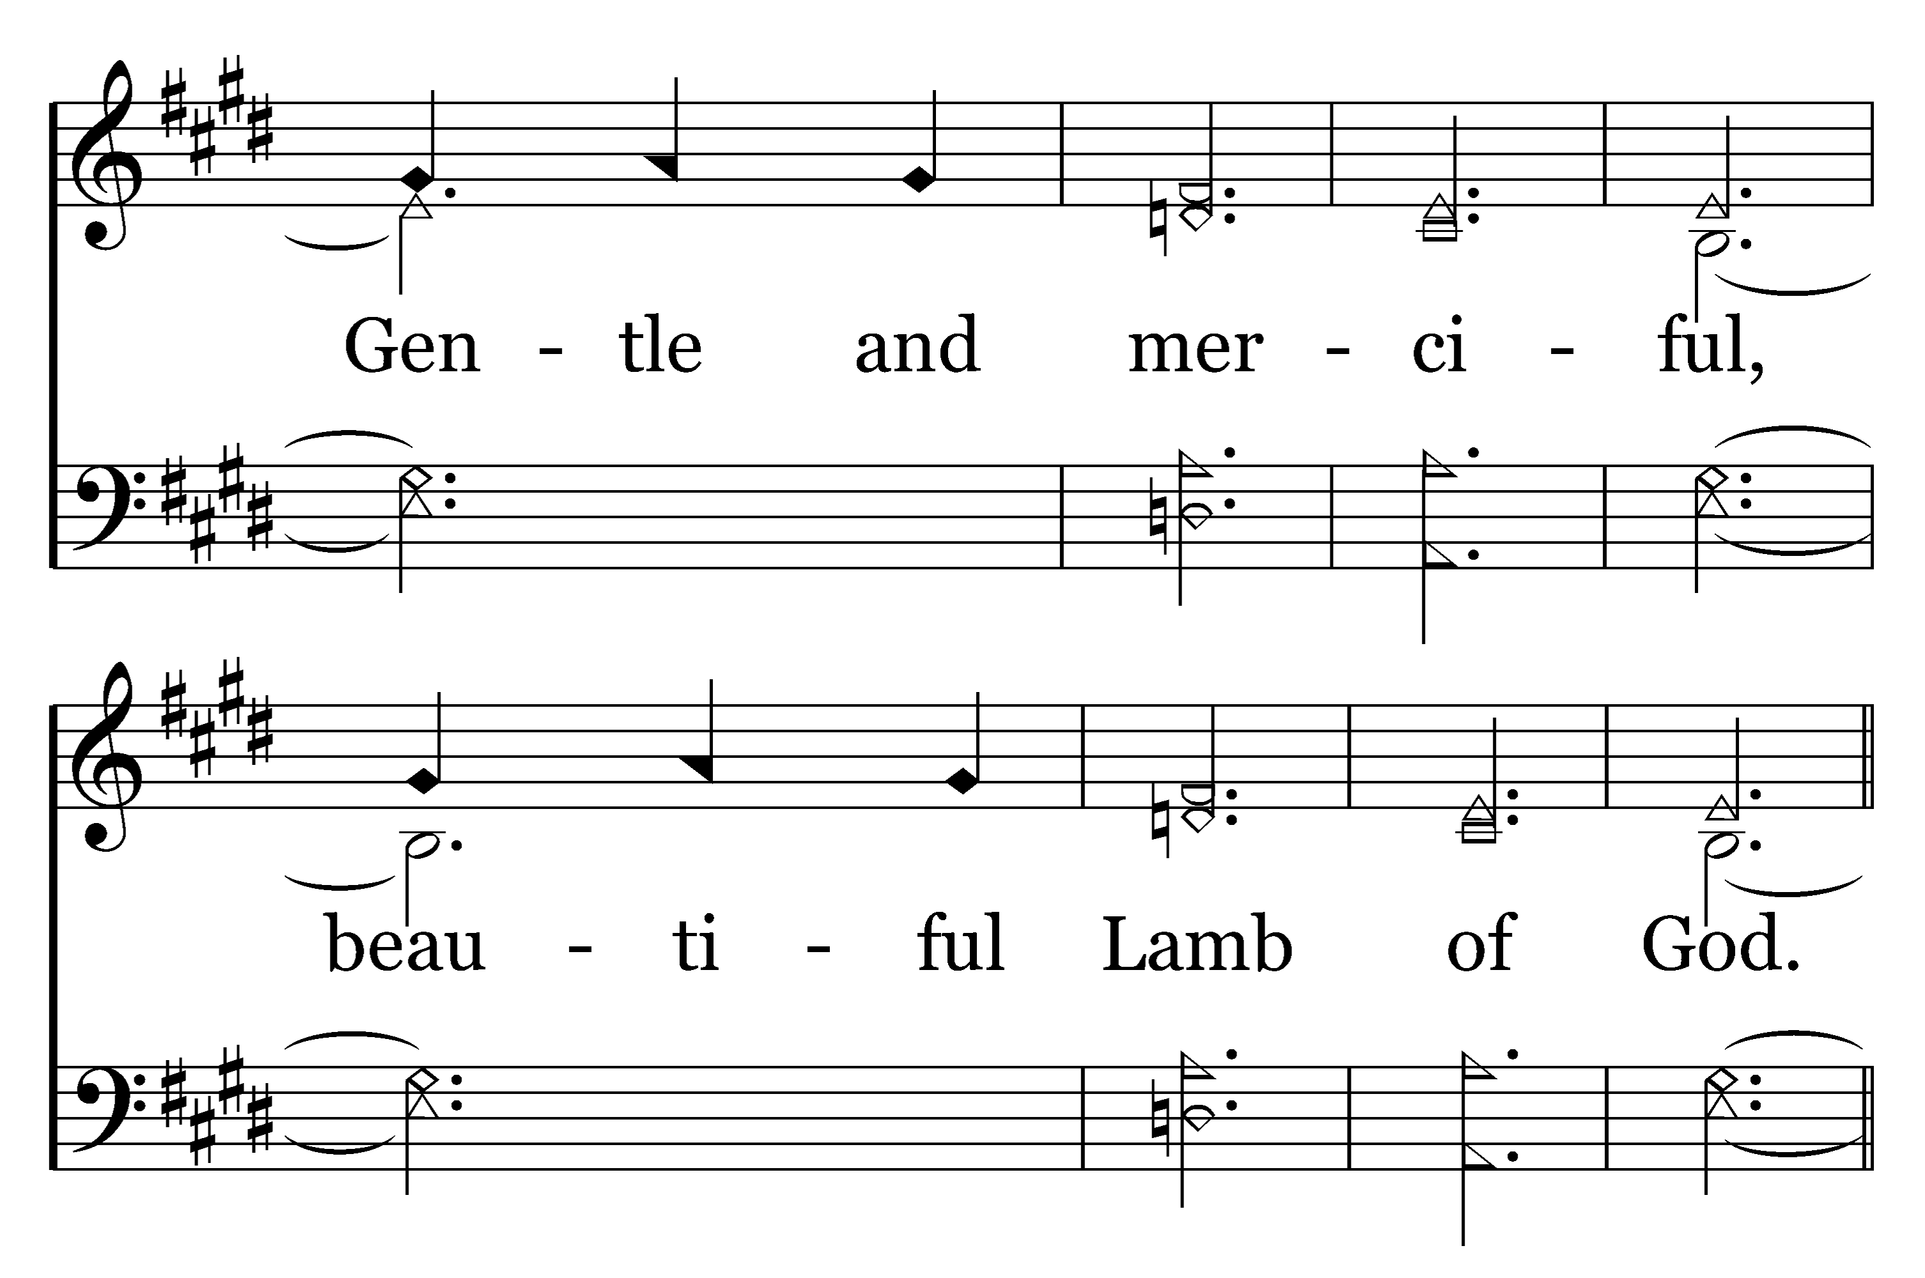
1
2
3
206
BEAUTIFUL LAMB
Typeset by R. J. Stevens Music

Slide 12
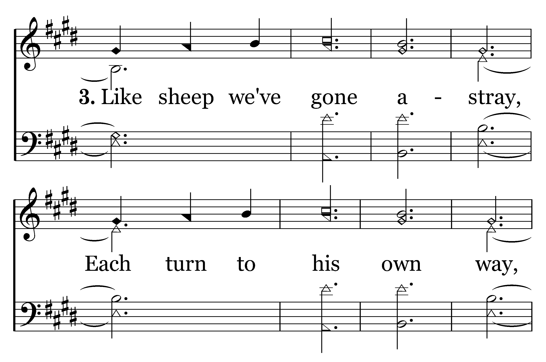
1
2
3
206
BEAUTIFUL LAMB
Typeset by R. J. Stevens Music

Slide 13
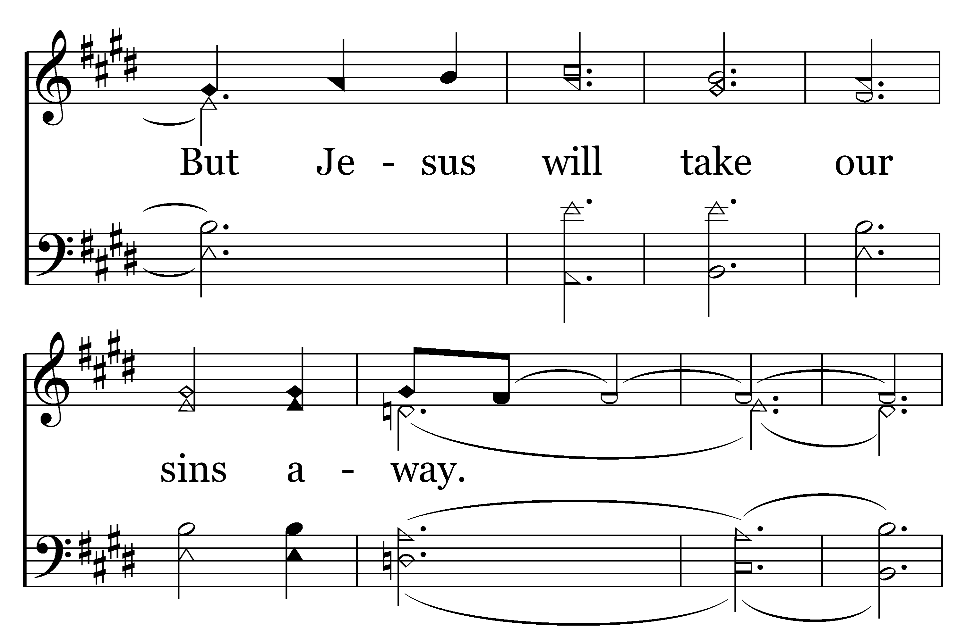
1
2
3
206
BEAUTIFUL LAMB
Typeset by R. J. Stevens Music

Slide 14
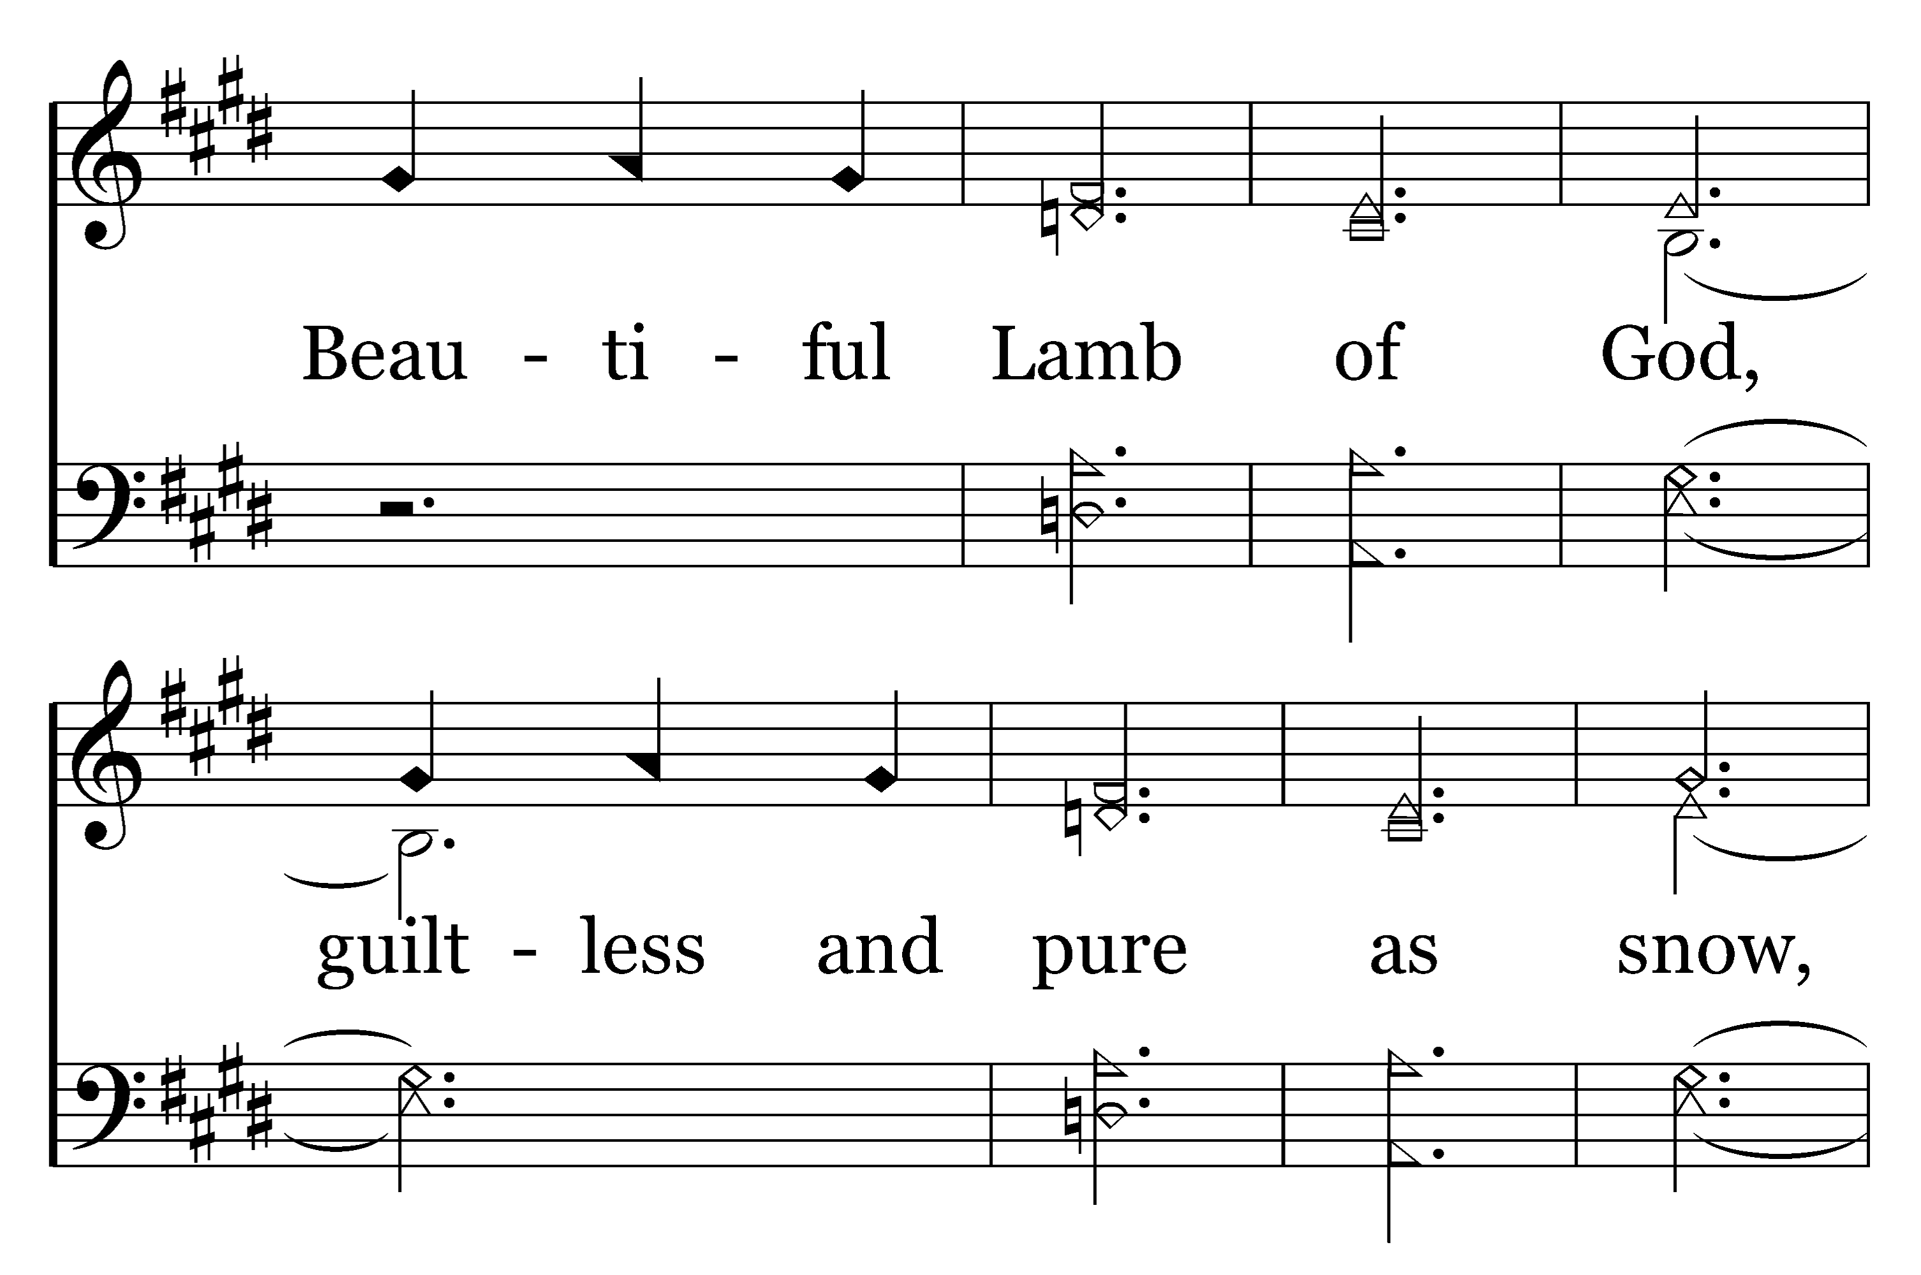
1
2
3
206
BEAUTIFUL LAMB
Typeset by R. J. Stevens Music

Slide 15
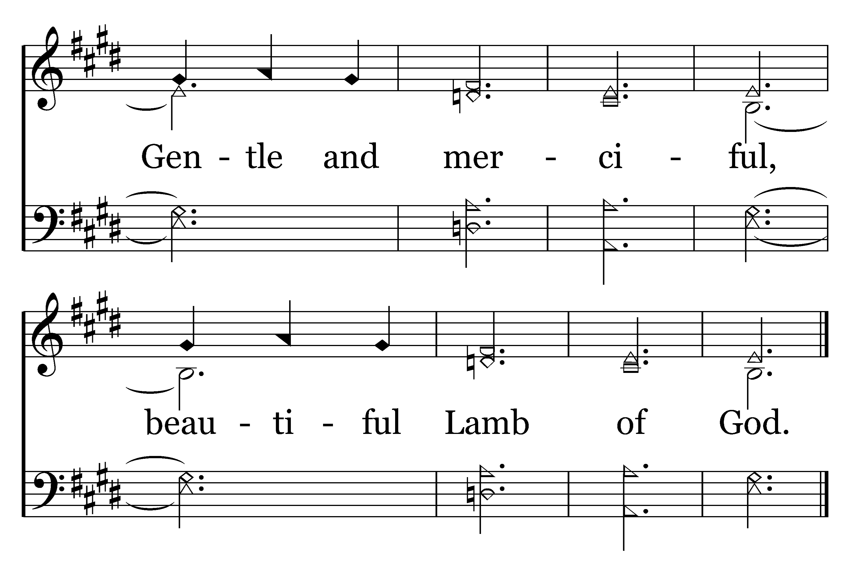
1
2
3
206
BEAUTIFUL LAMB
Typeset by R. J. Stevens Music

