Slide 1
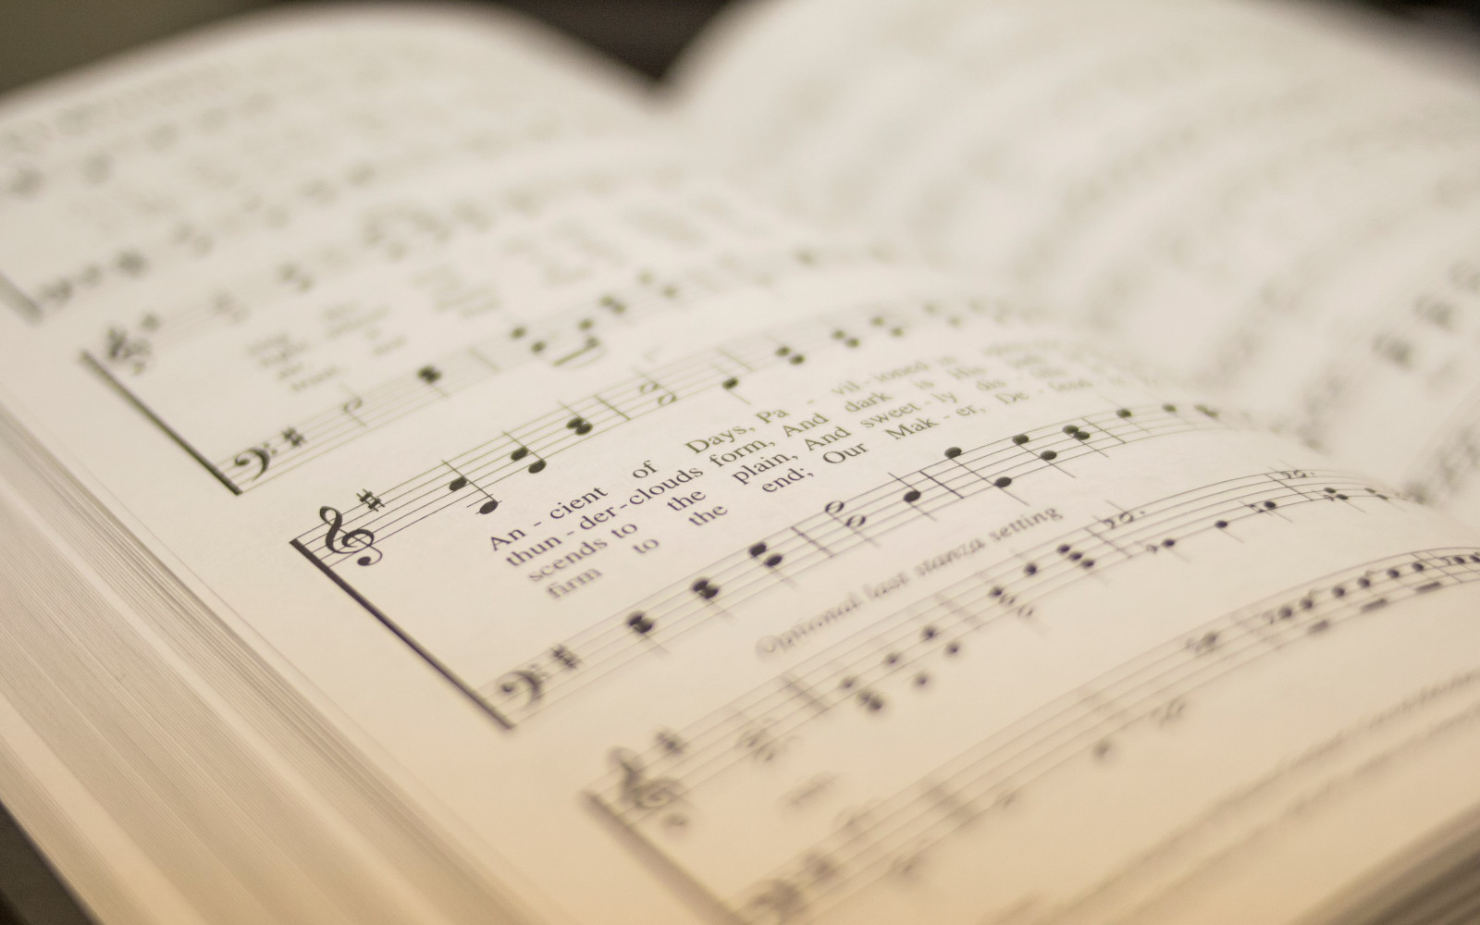

207
HIGHLY EXALTED
1
2
3
“SINGING...TO THE LORD” COLOSSIANS 3:16
Words and Music by: Robin Mark & Paul Baloche, Arr. by Aneva Peirce © 2007 Integrity Hosanna! Music. All rights reserved. Used by permission.

Slide 2
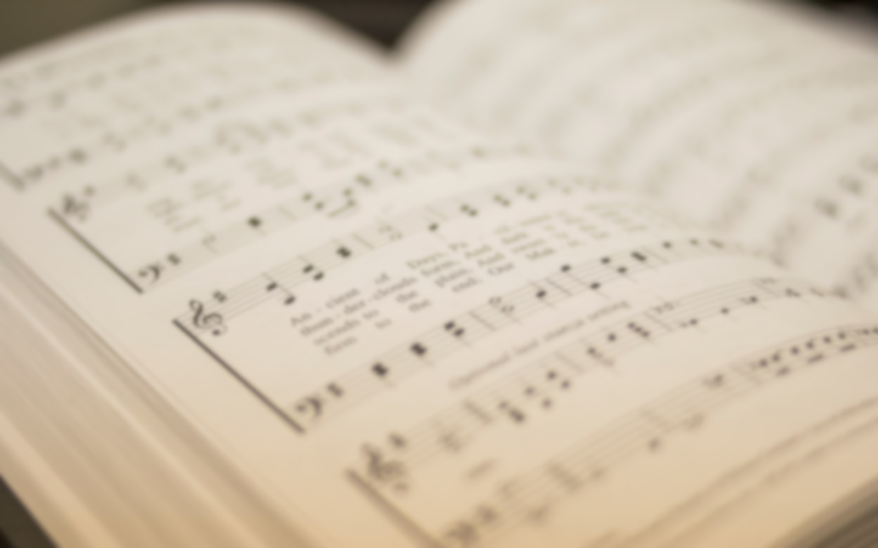
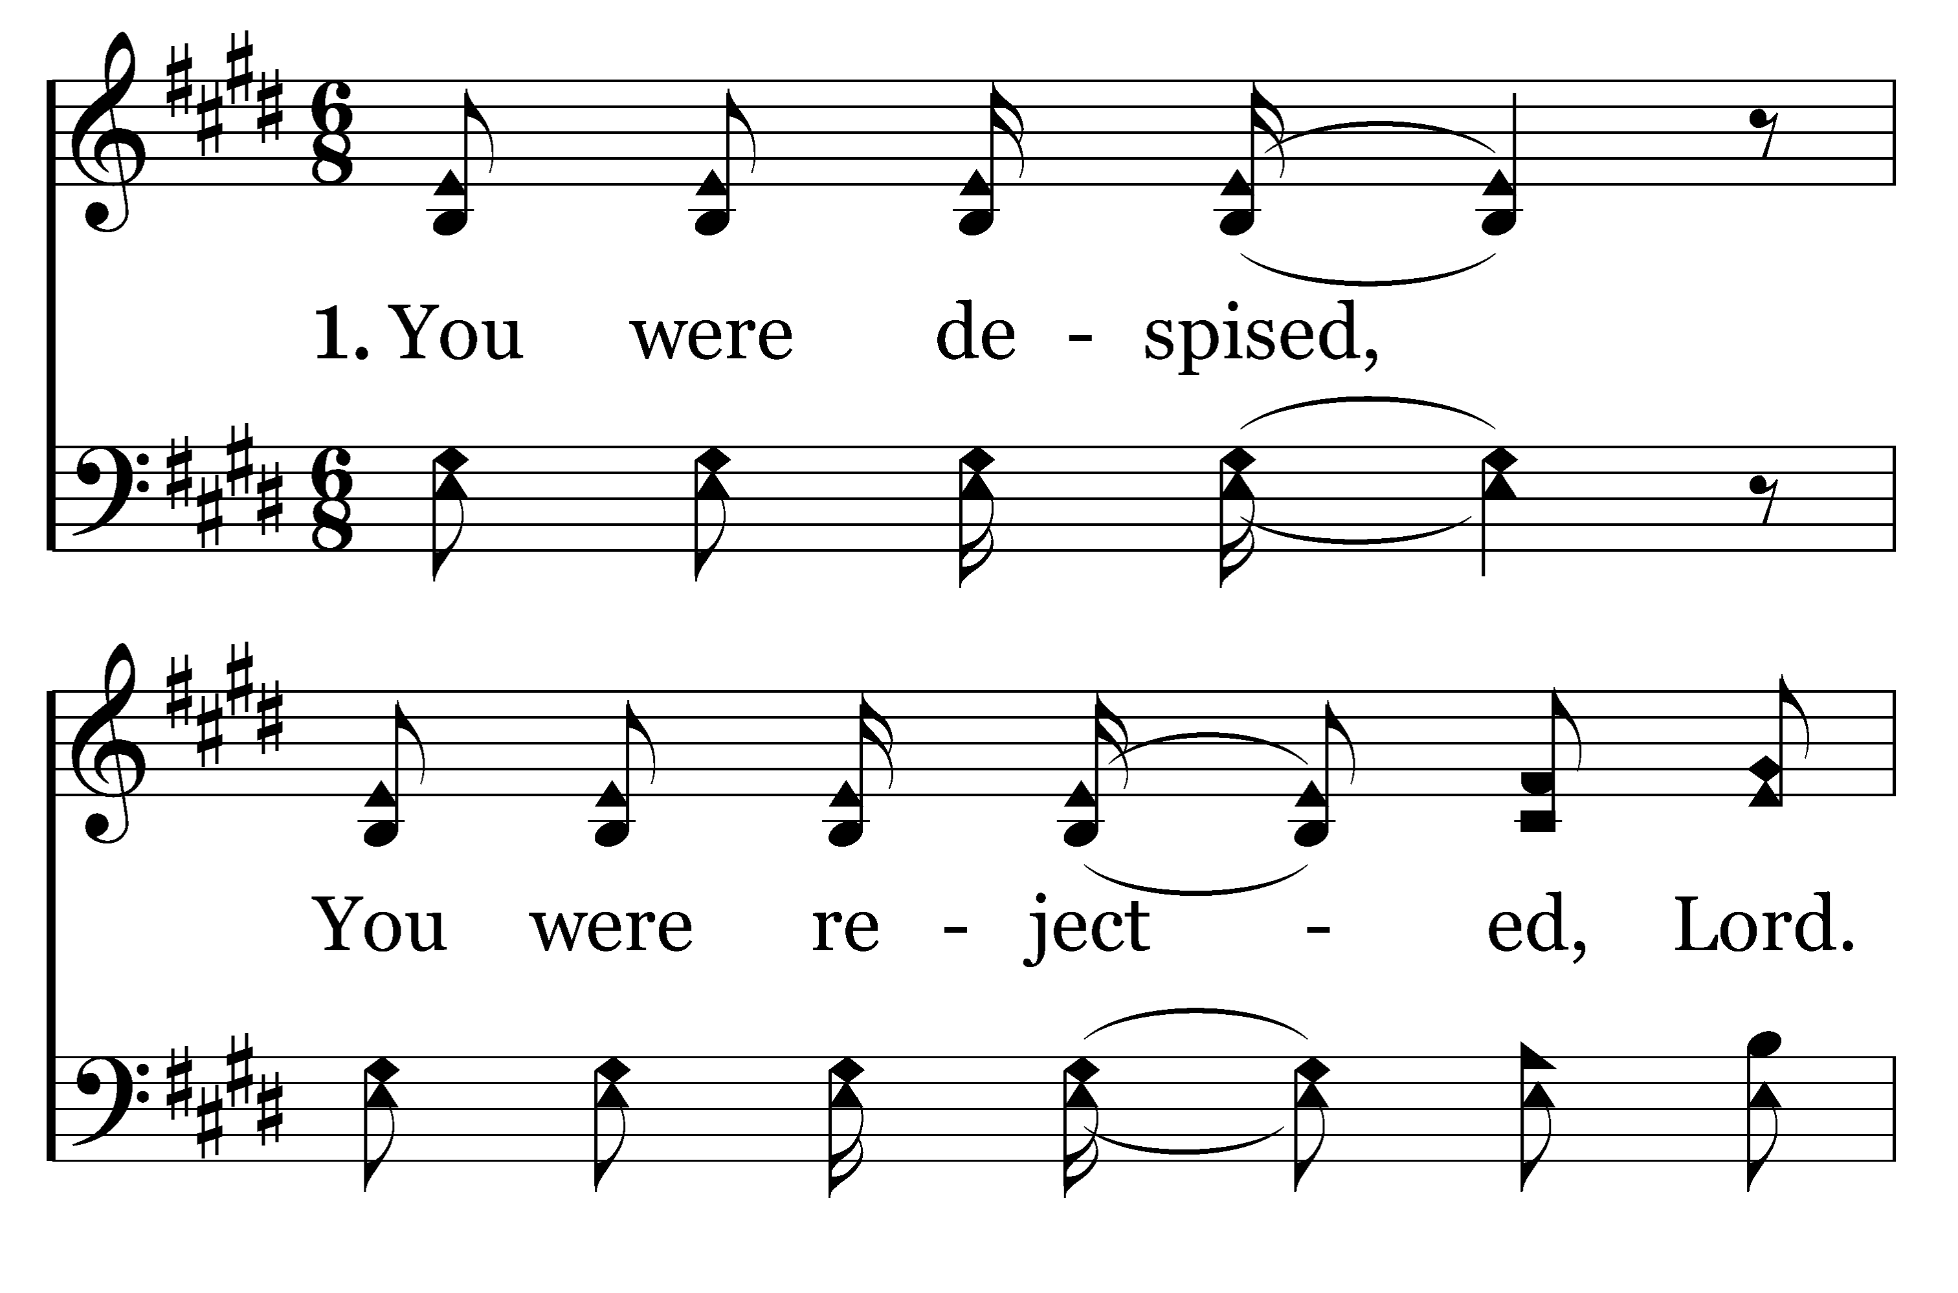

1
2
3
207
HIGHLY EXALTED
Typeset by R. J. Stevens Music

Slide 3
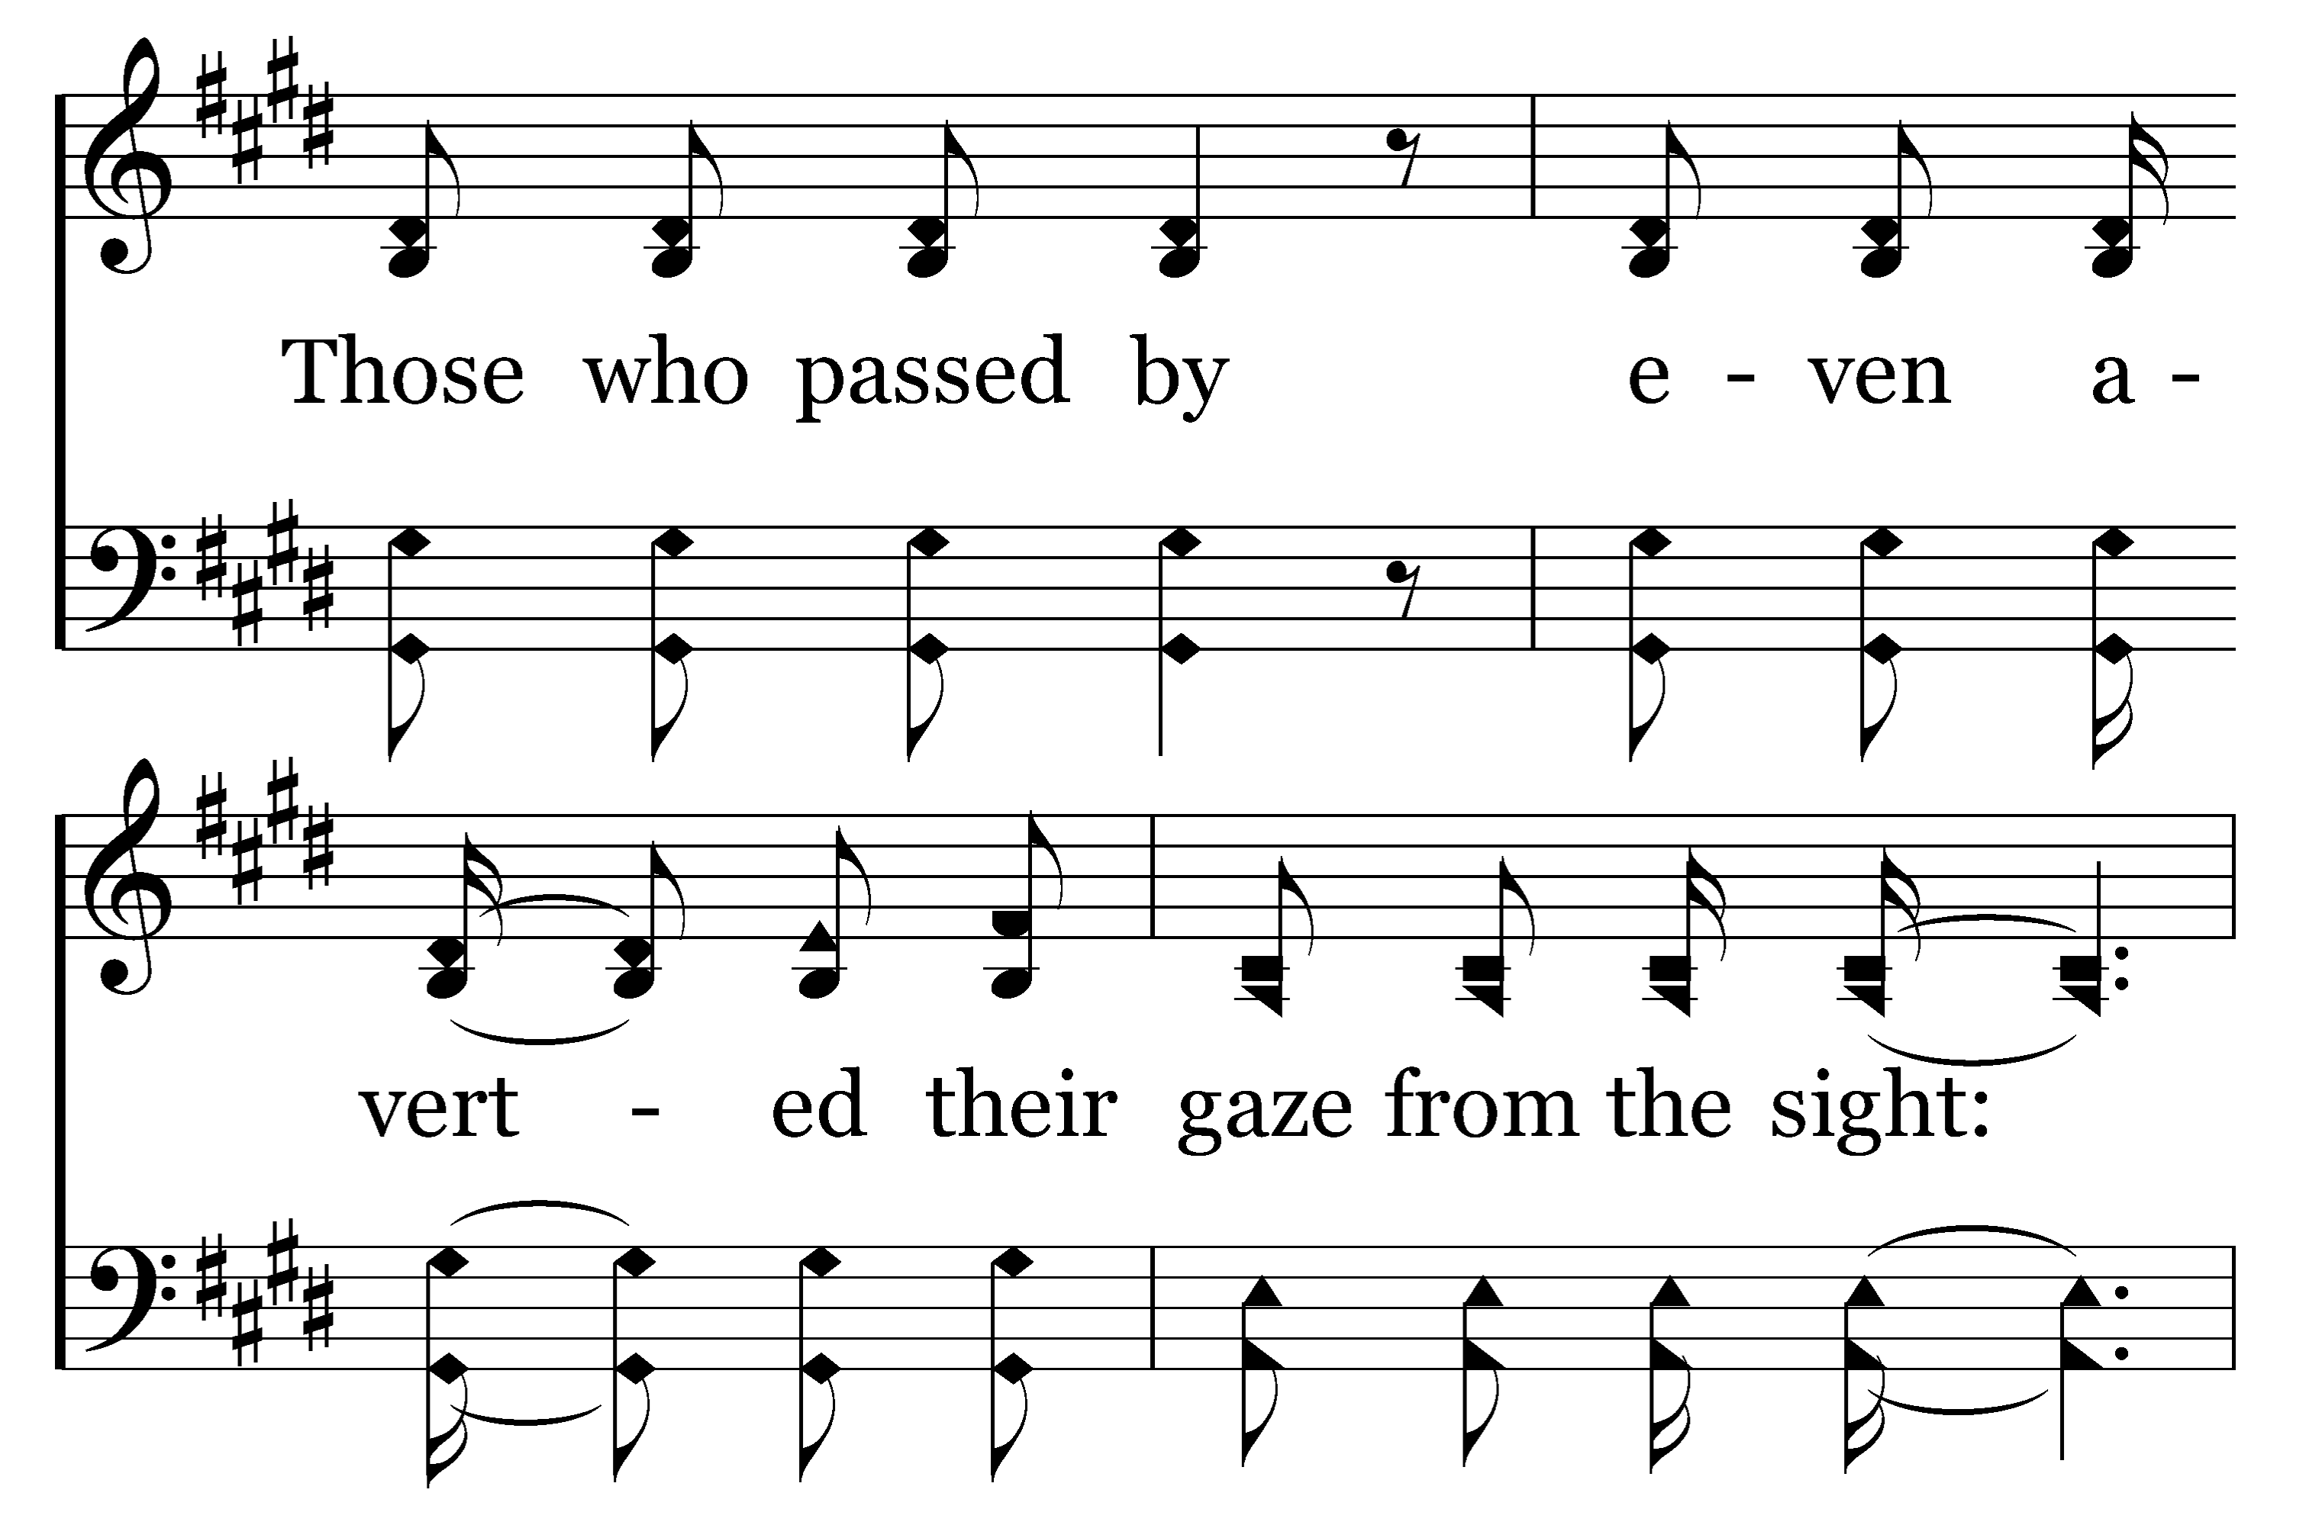
1
2
3
207
HIGHLY EXALTED
Typeset by R. J. Stevens Music

Slide 4
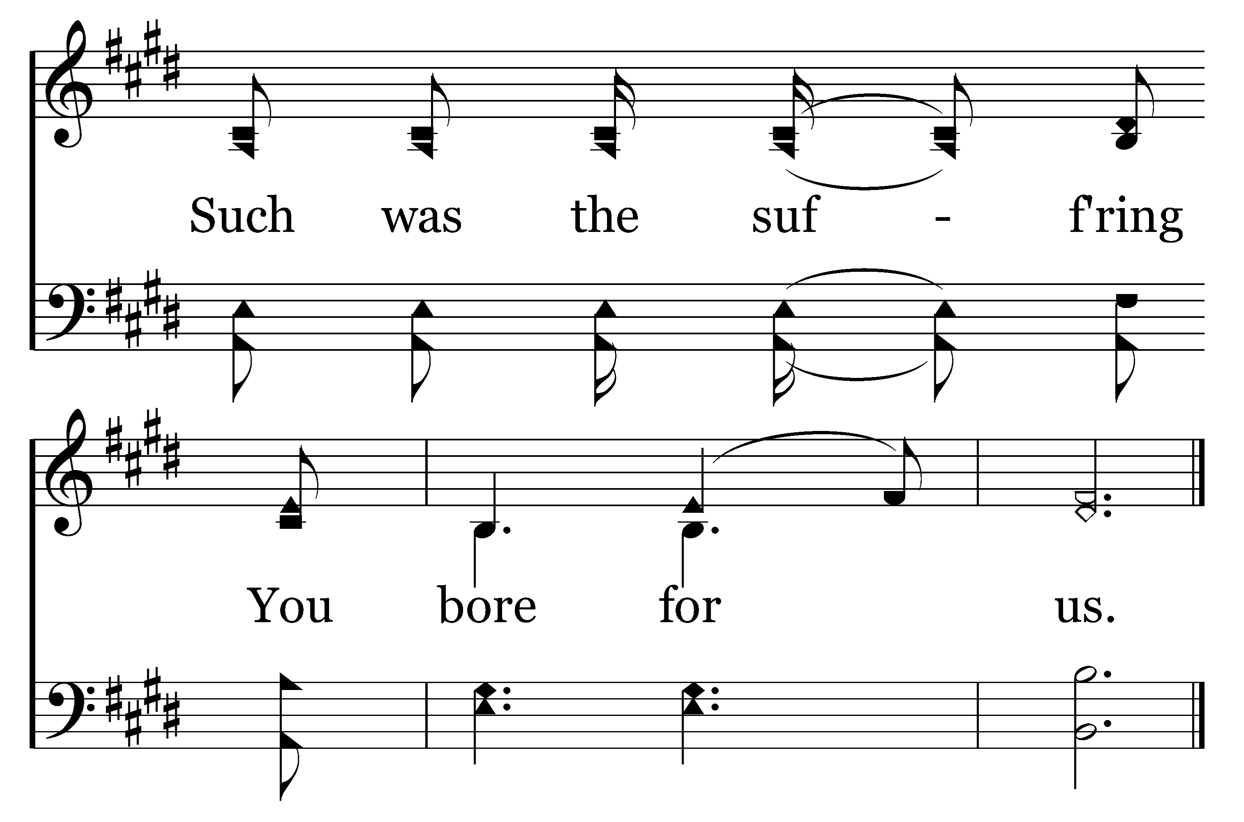
1
2
3
207
HIGHLY EXALTED
Typeset by R. J. Stevens Music

Slide 5
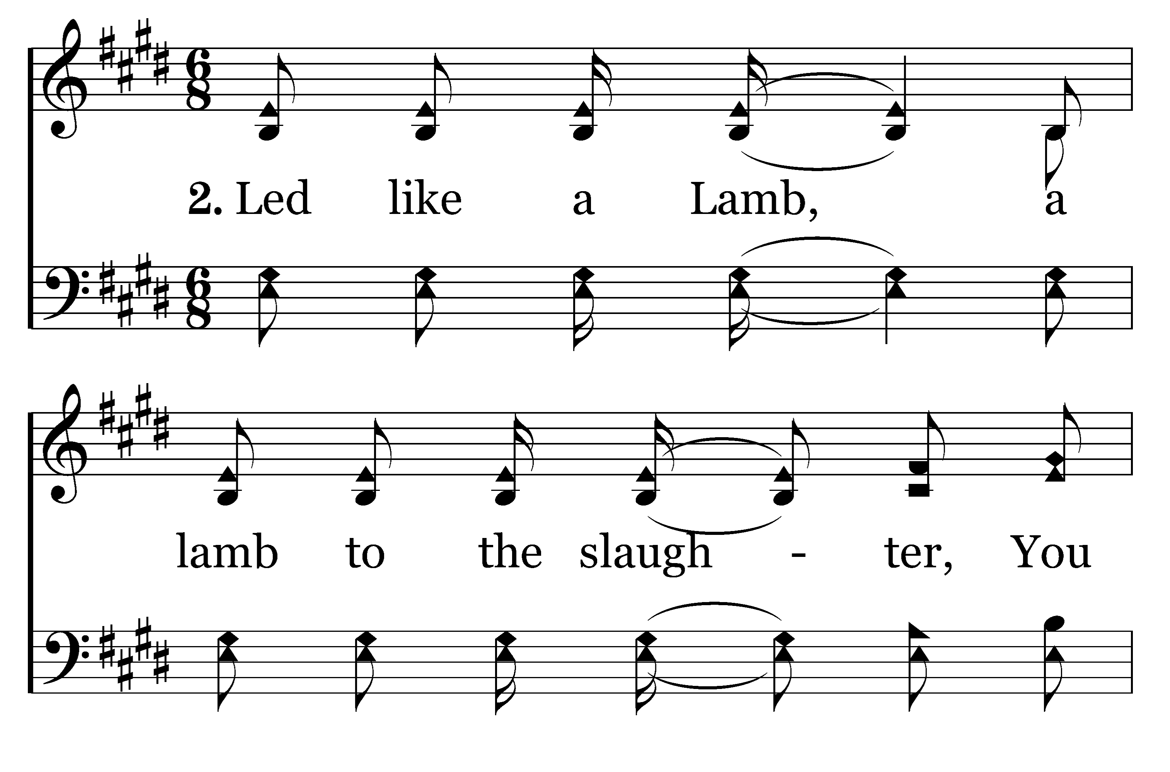
1
2
3
207
HIGHLY EXALTED
Typeset by R. J. Stevens Music

Slide 6
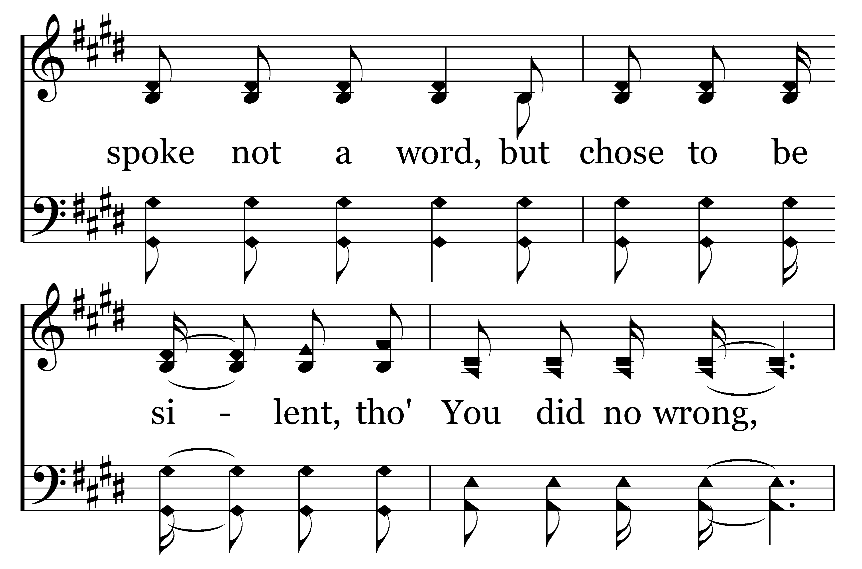
1
2
3
207
HIGHLY EXALTED
Typeset by R. J. Stevens Music

Slide 7
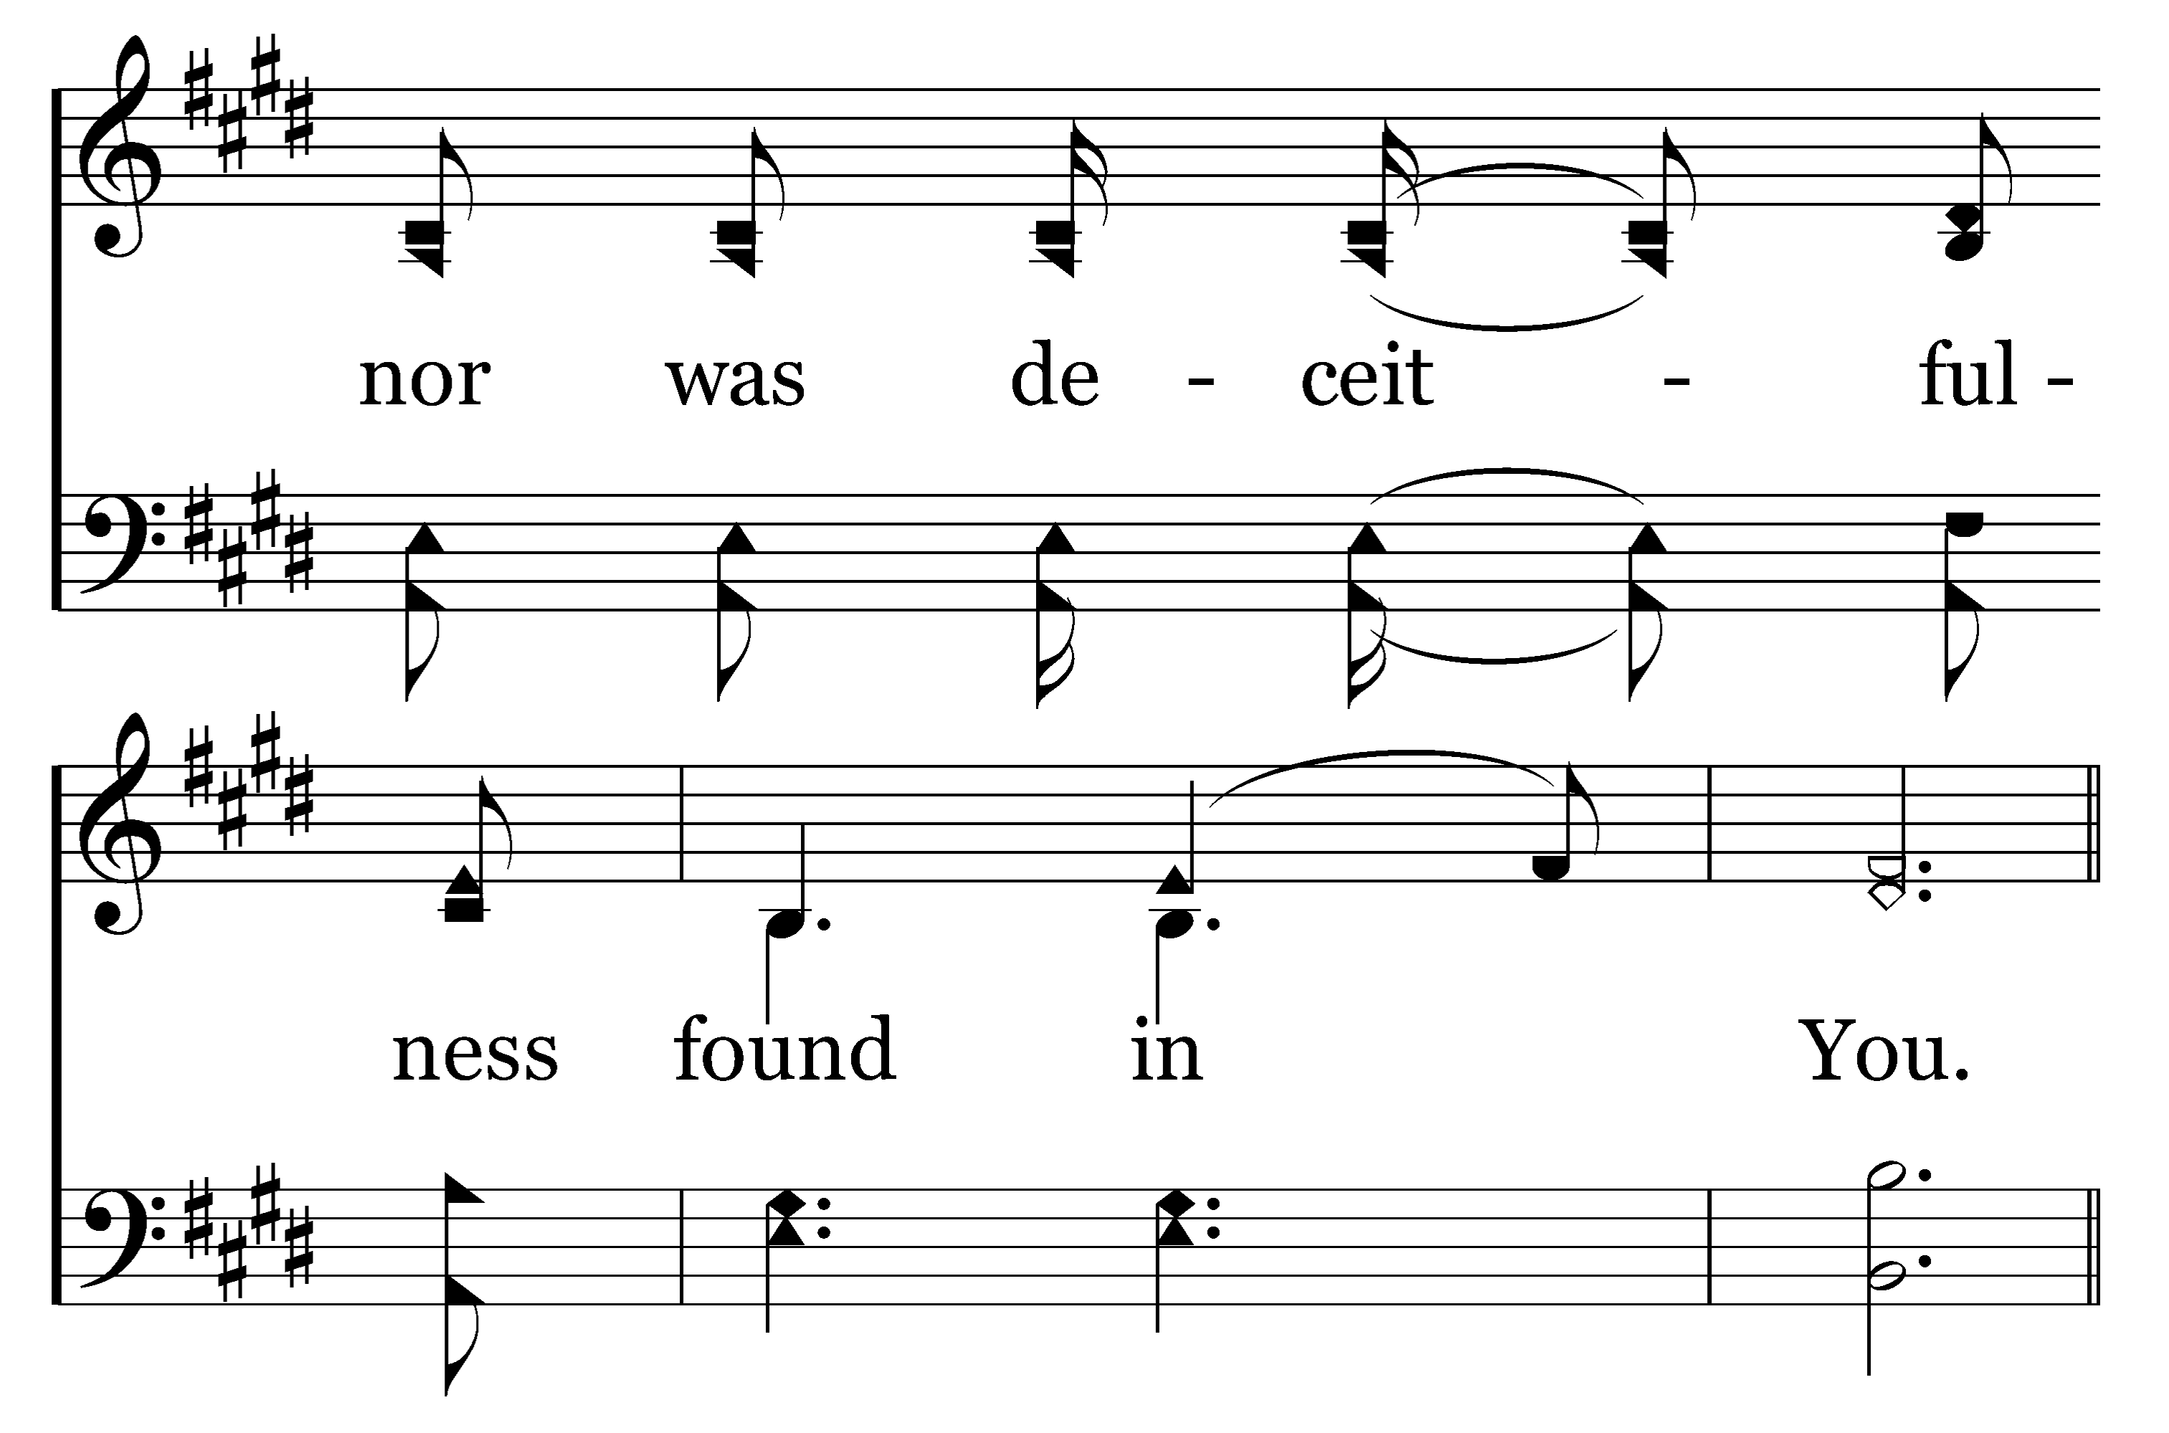
1
2
3
207
HIGHLY EXALTED
Typeset by R. J. Stevens Music

Slide 8
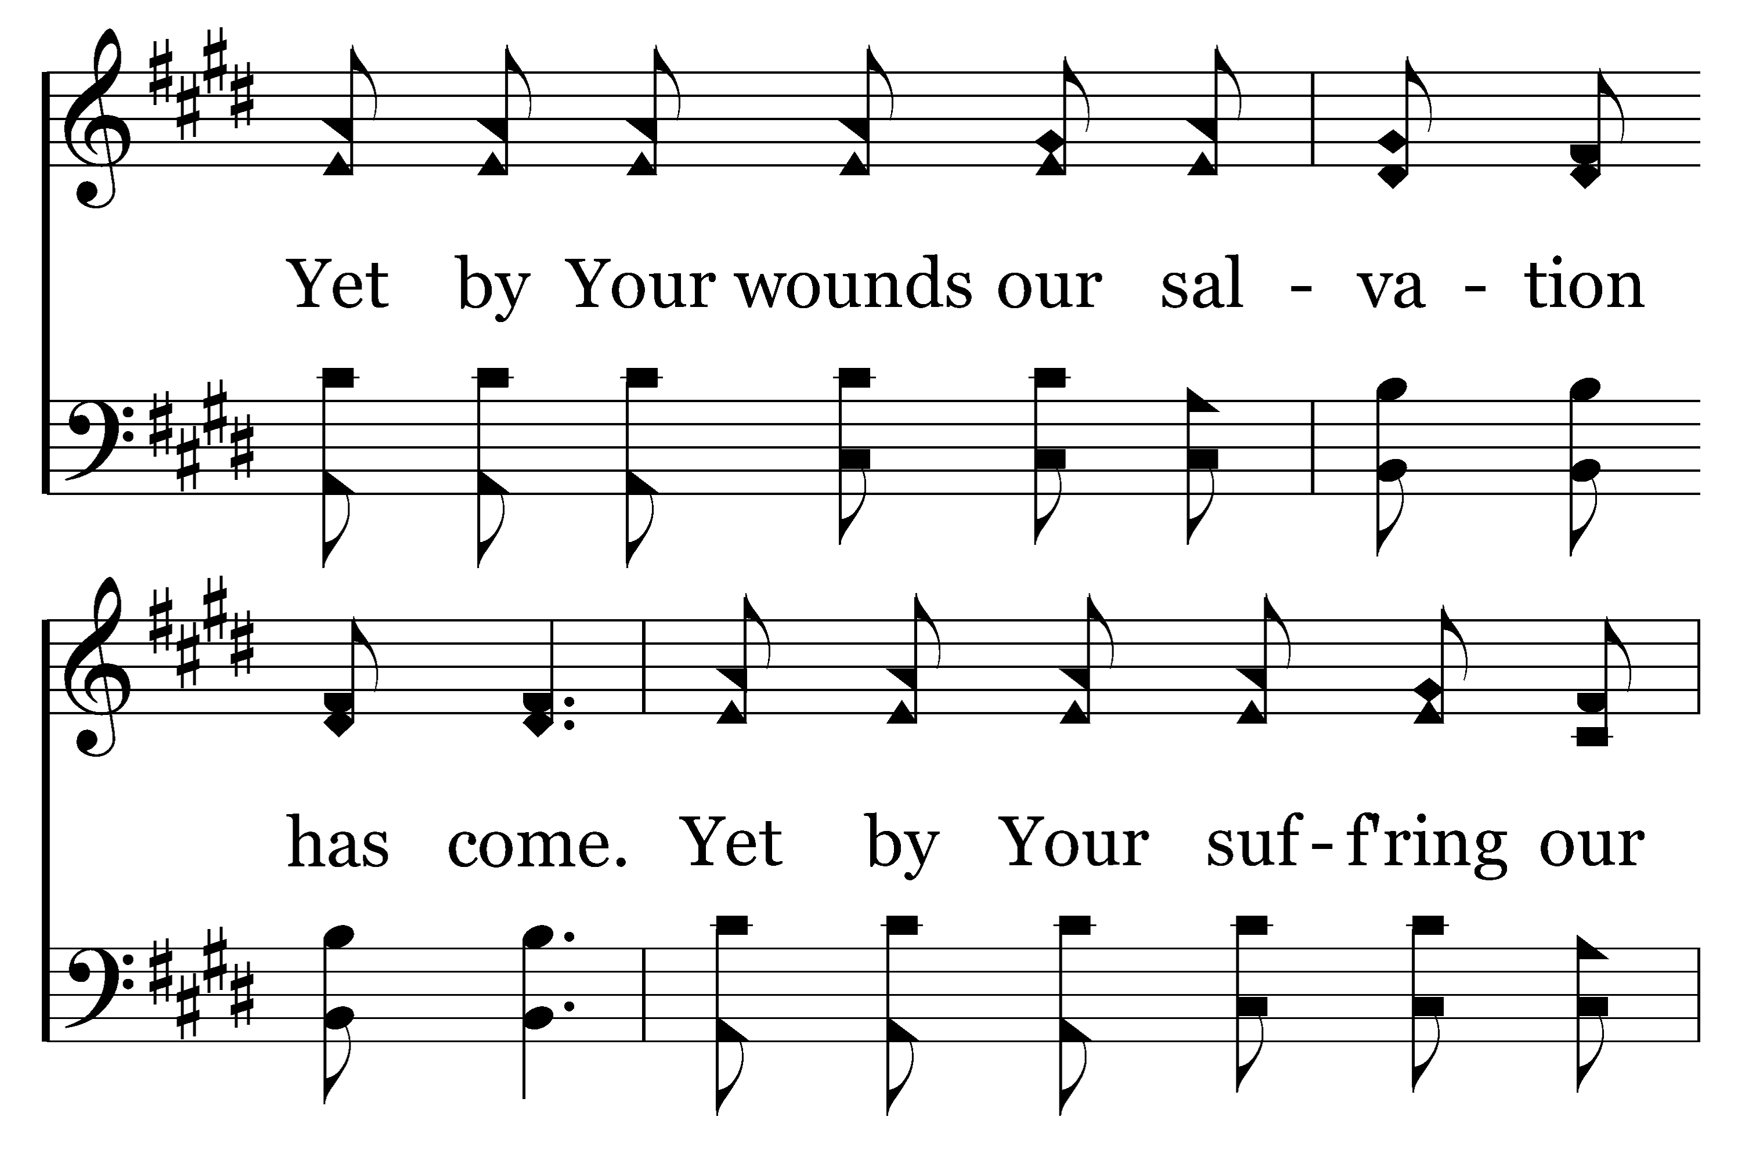
1
2
3
207
HIGHLY EXALTED
Typeset by R. J. Stevens Music

Slide 9
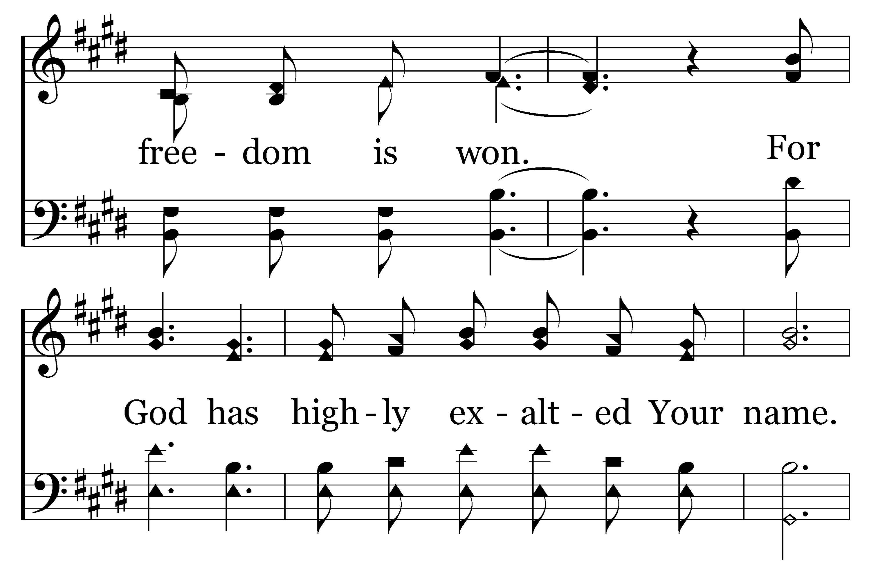
1
2
3
207
HIGHLY EXALTED
Typeset by R. J. Stevens Music

Slide 10
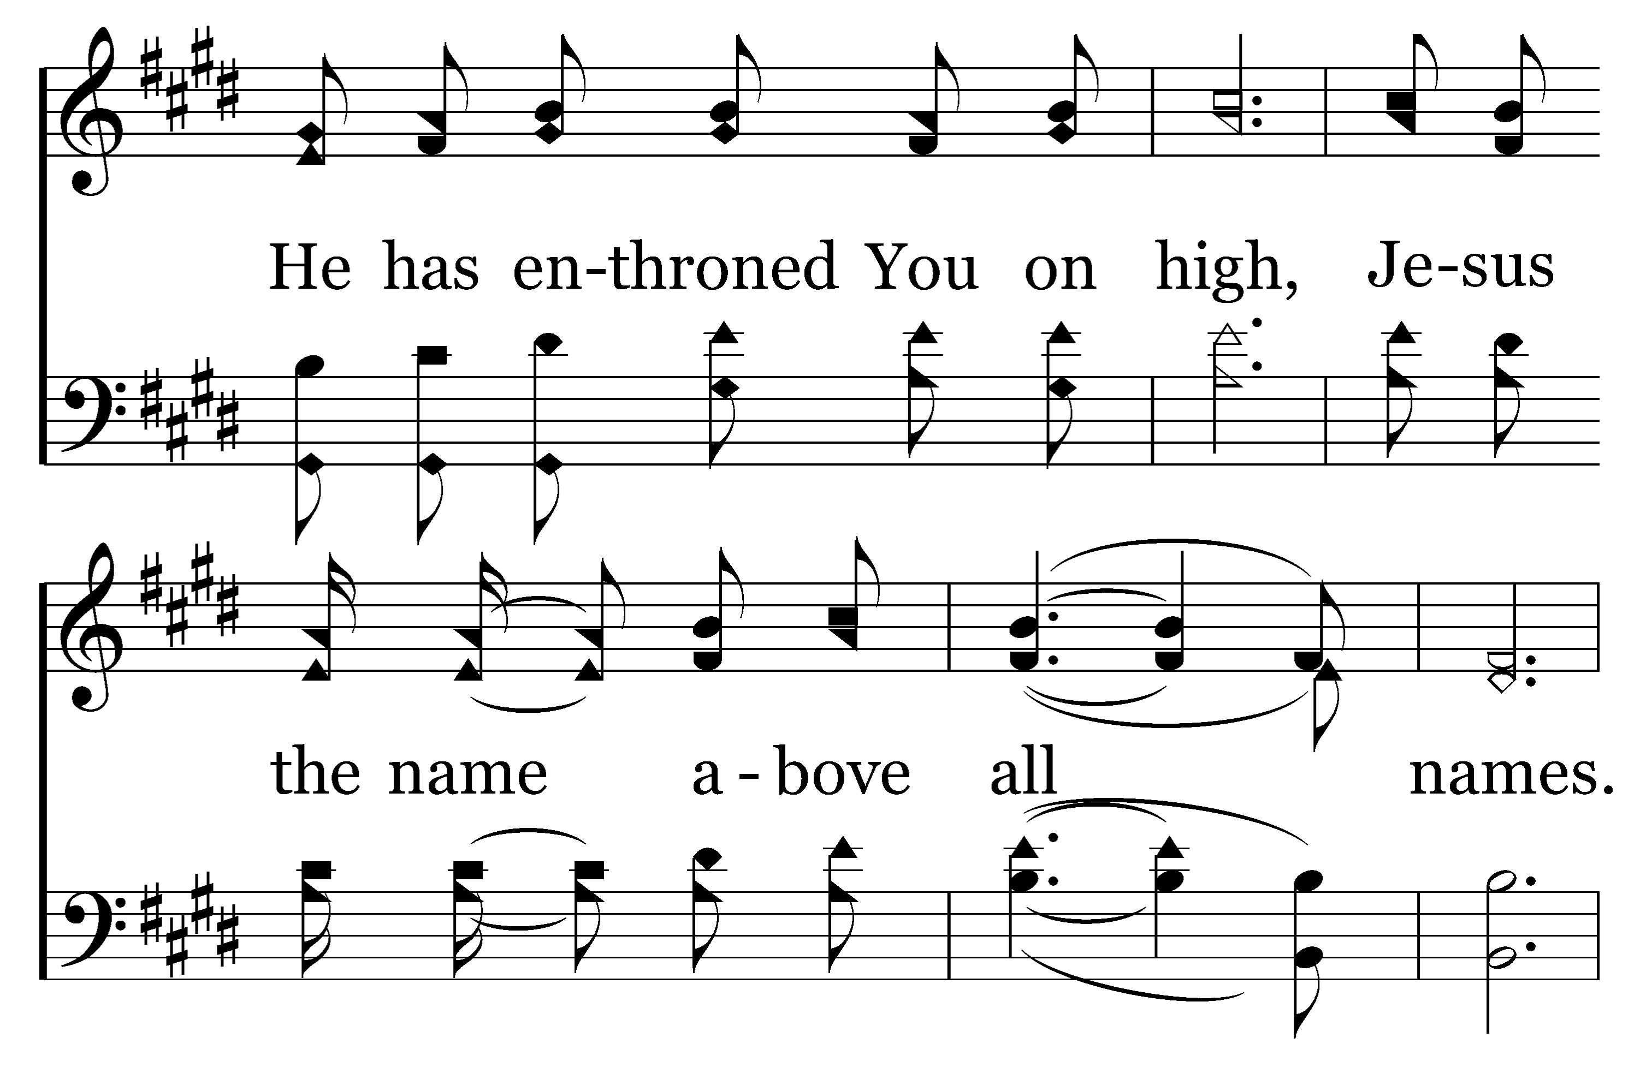
1
2
3
207
HIGHLY EXALTED
Typeset by R. J. Stevens Music

Slide 11
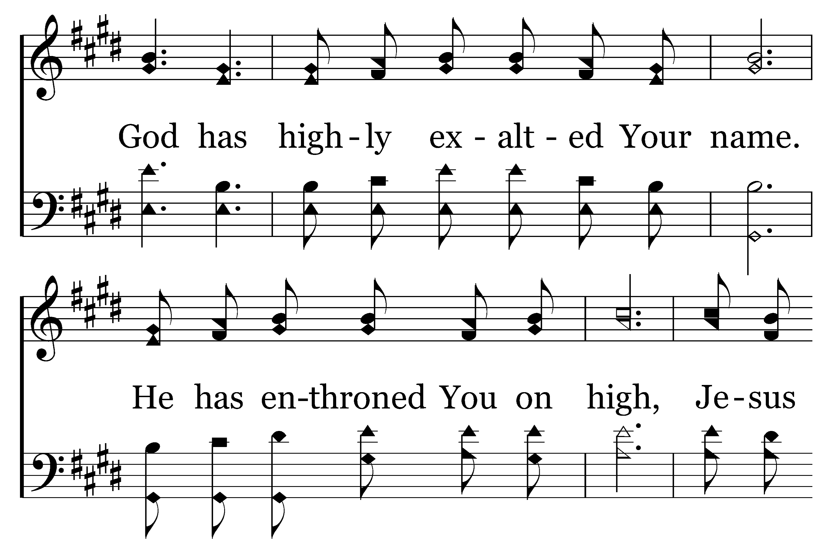
1
2
3
207
HIGHLY EXALTED
Typeset by R. J. Stevens Music

Slide 12
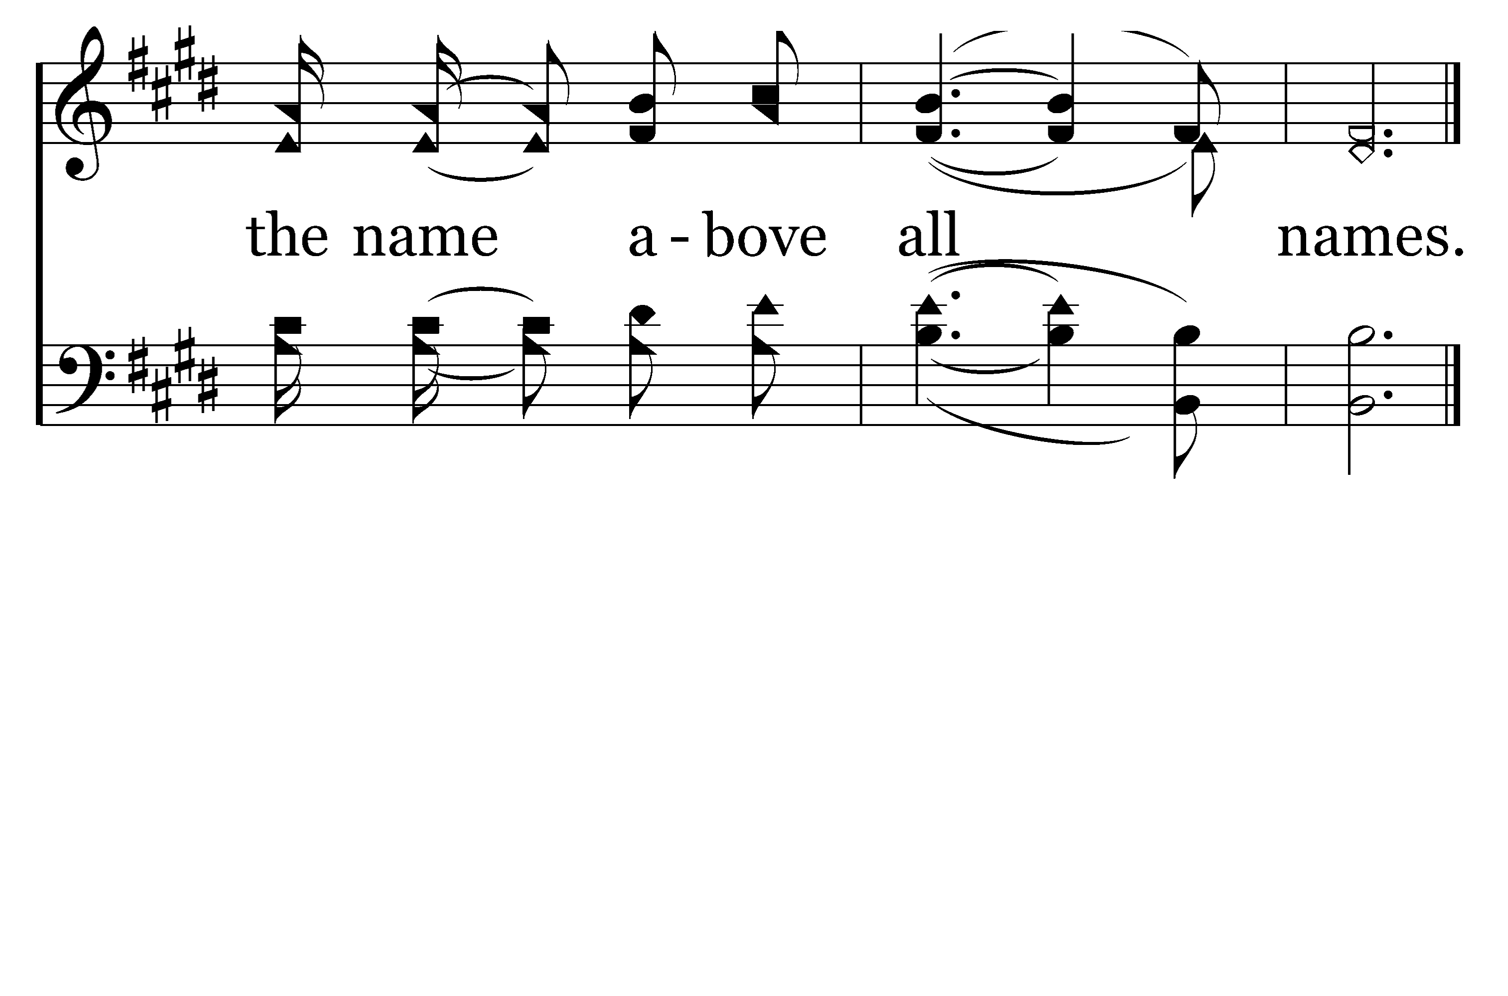
1
2
3
207
HIGHLY EXALTED
Typeset by R. J. Stevens Music

Slide 13
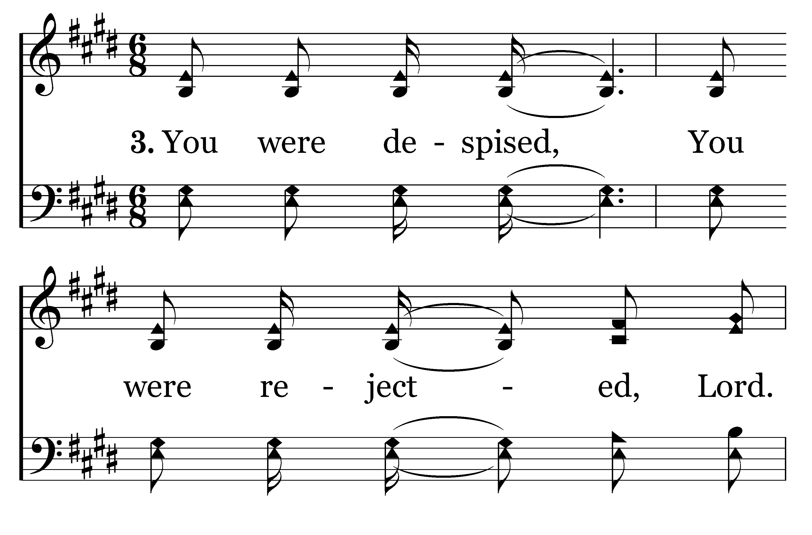
1
2
3
207
HIGHLY EXALTED
Typeset by R. J. Stevens Music

Slide 14
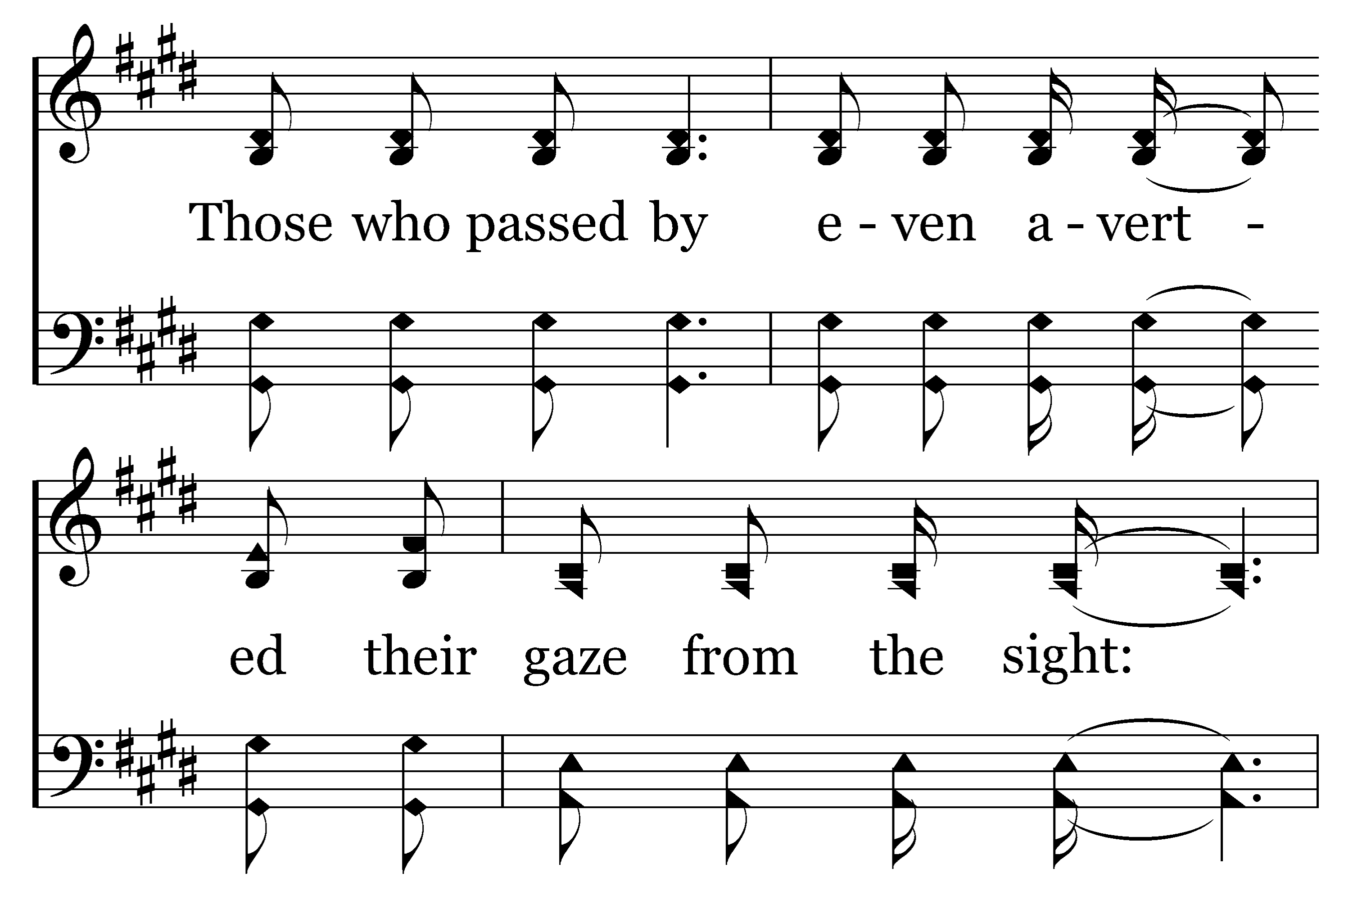
1
2
3
207
HIGHLY EXALTED
Typeset by R. J. Stevens Music

Slide 15
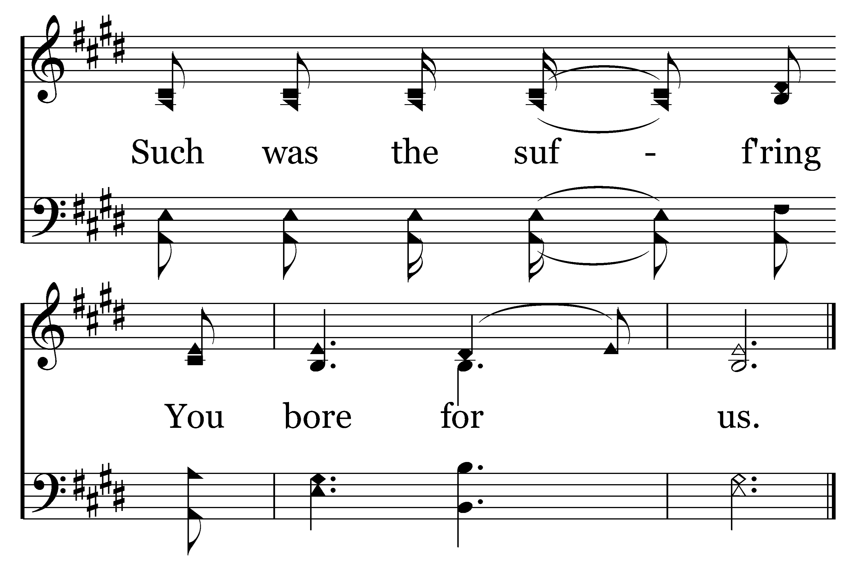
1
2
3
207
HIGHLY EXALTED
Typeset by R. J. Stevens Music

