Slide 1


208
CHRIST OUR GLORY
1
2
3
“SINGING...TO THE LORD” COLOSSIANS 3:16
Words and Music by: Nathan Stiff, David Zimmer, Arr. Mike Rogers © Copyright 2019 by Sovereign Grace Praise/BMI. All rights reserved.

Slide 2

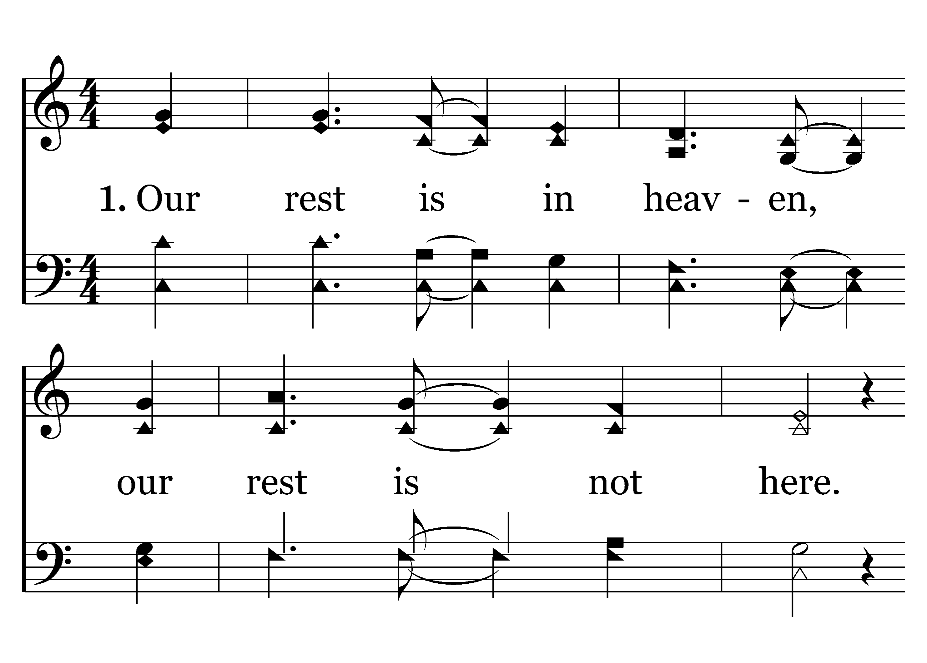

1
C
2
C
3
C
208
CHRIST OUR GLORY
Typeset by R. J. Stevens Music

Slide 3
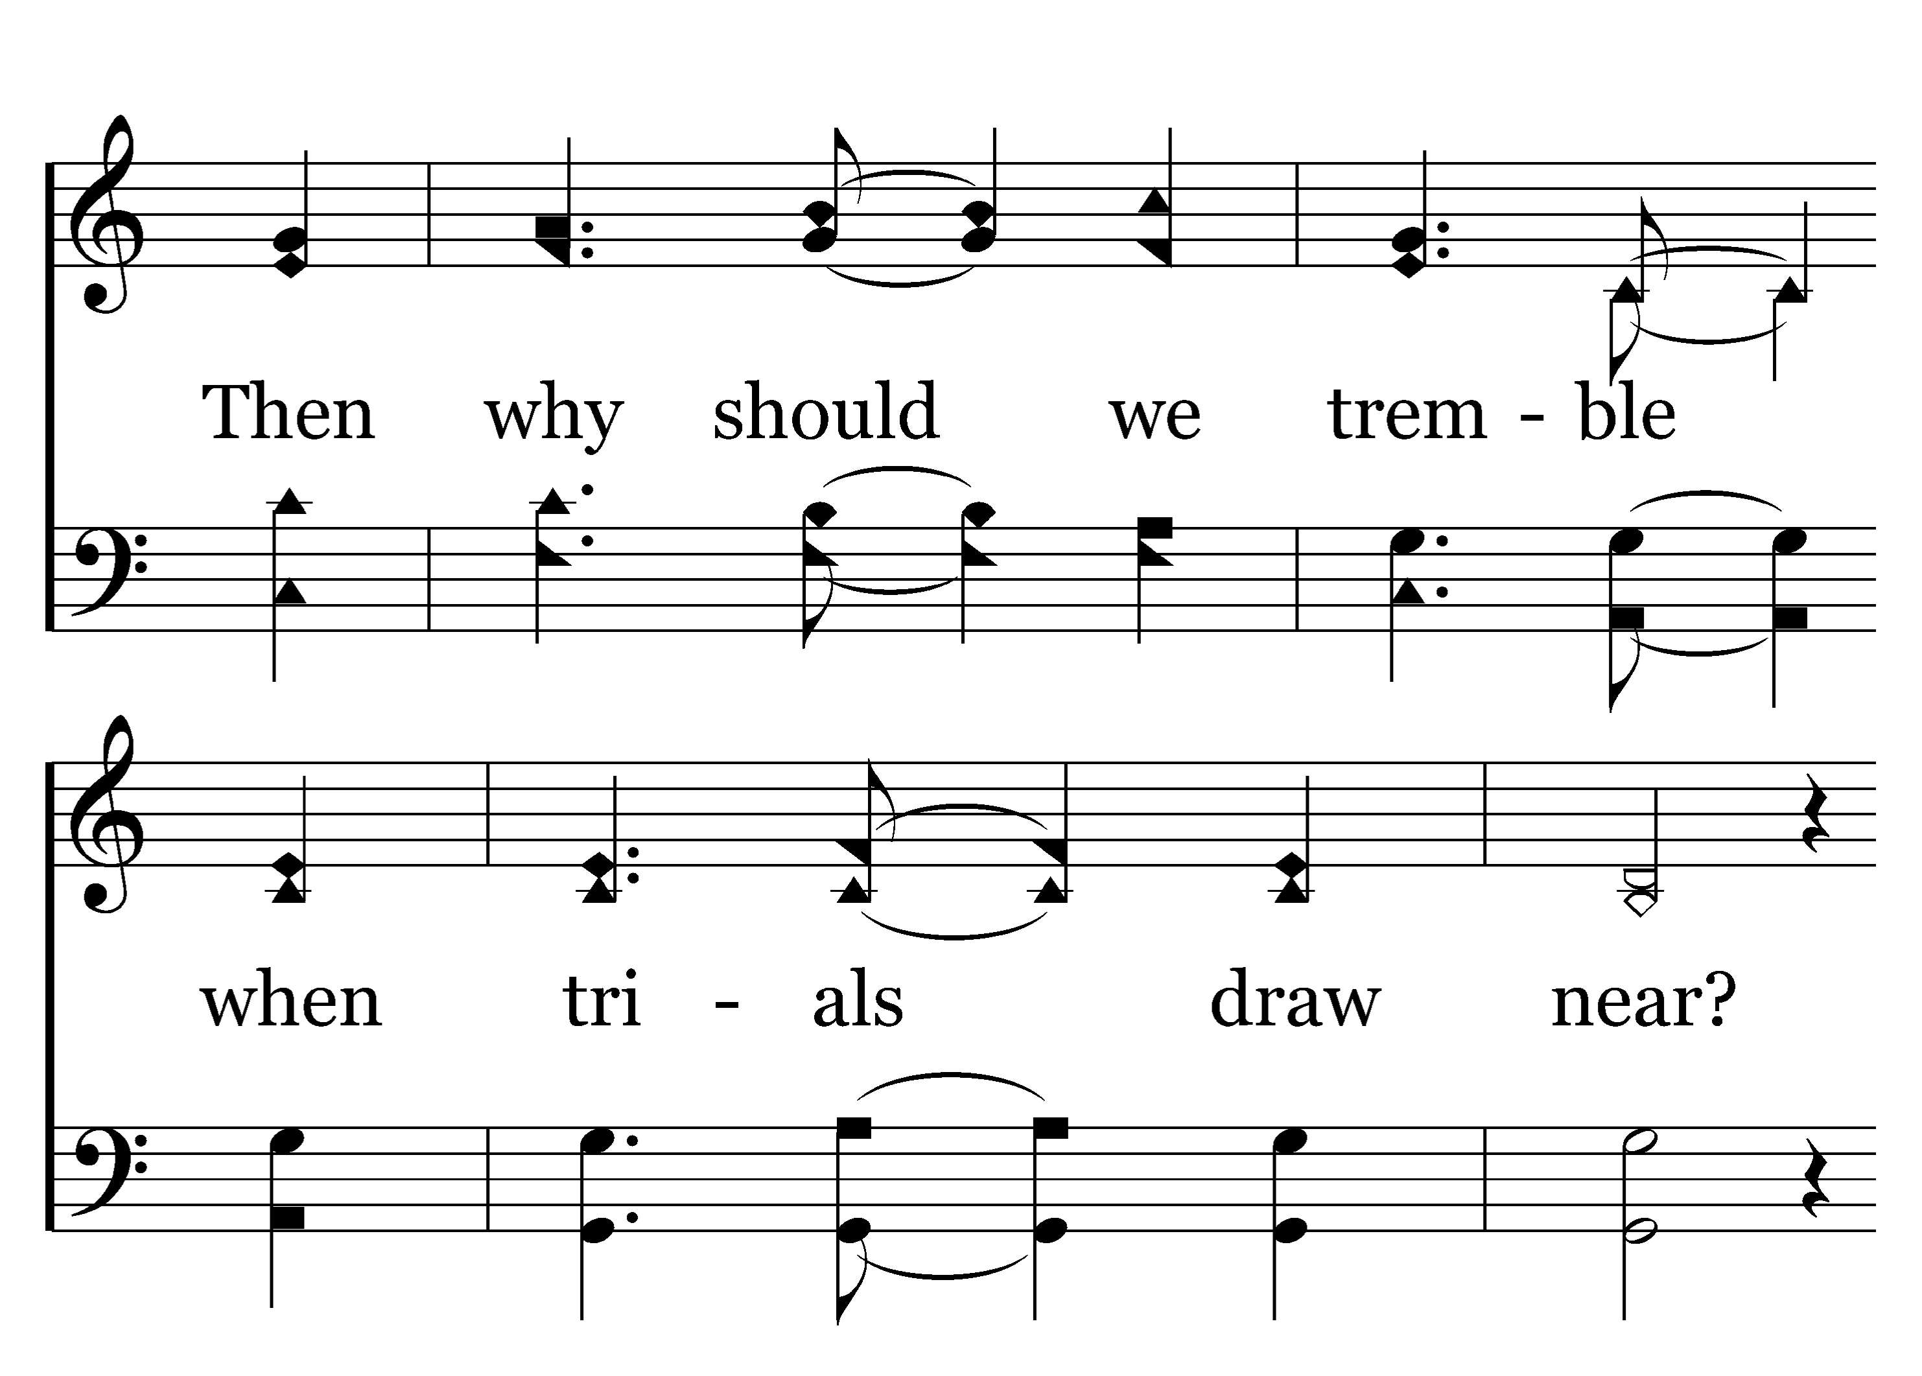
1
C
2
C
3
C
208
CHRIST OUR GLORY
Typeset by R. J. Stevens Music

Slide 4
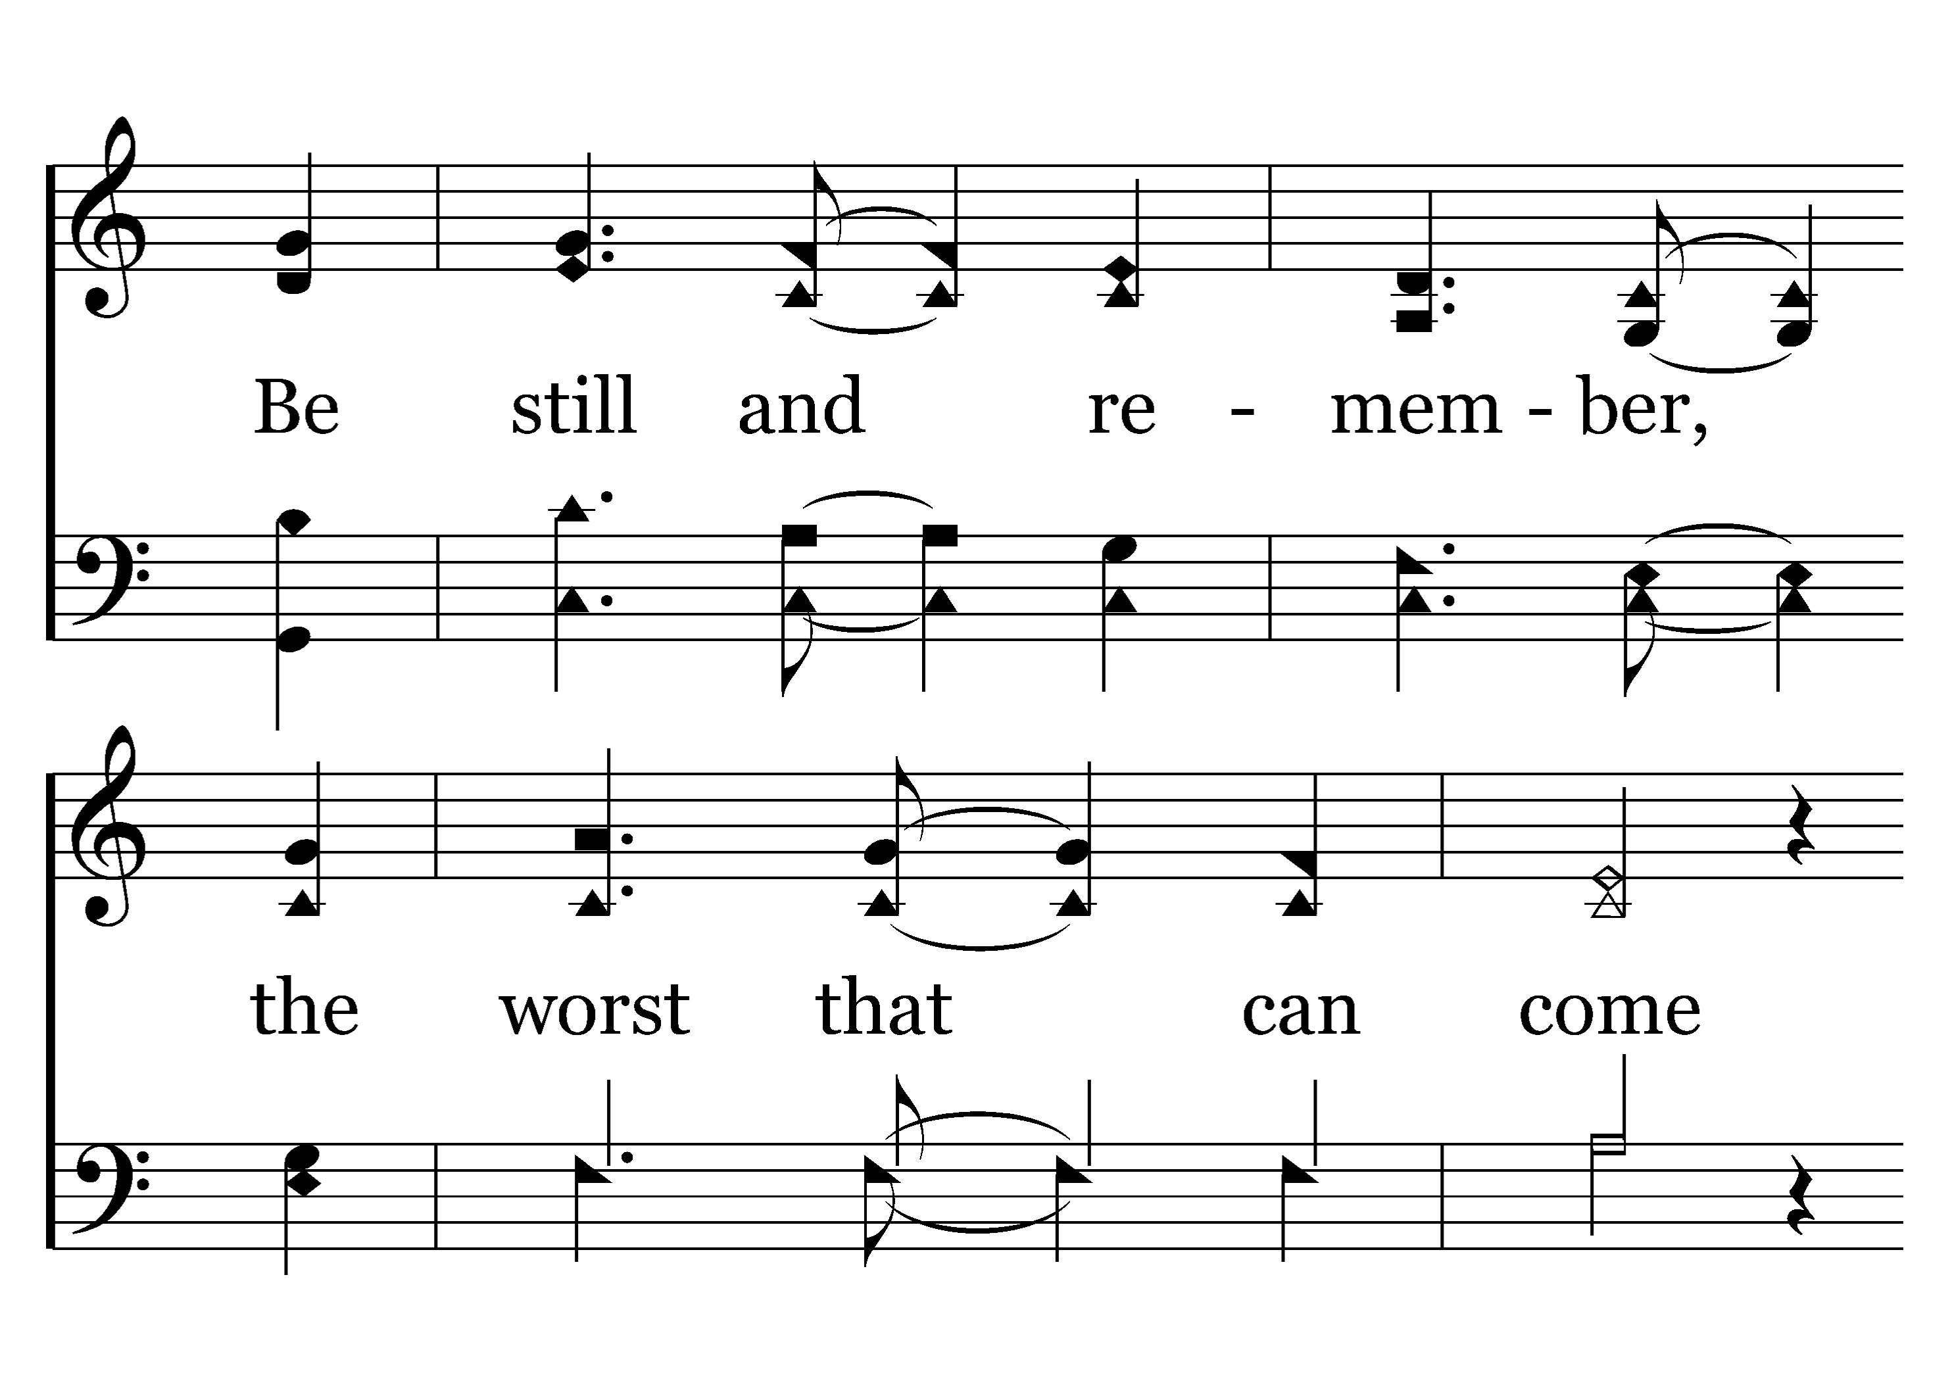
1
C
2
C
3
C
208
CHRIST OUR GLORY
Typeset by R. J. Stevens Music

Slide 5
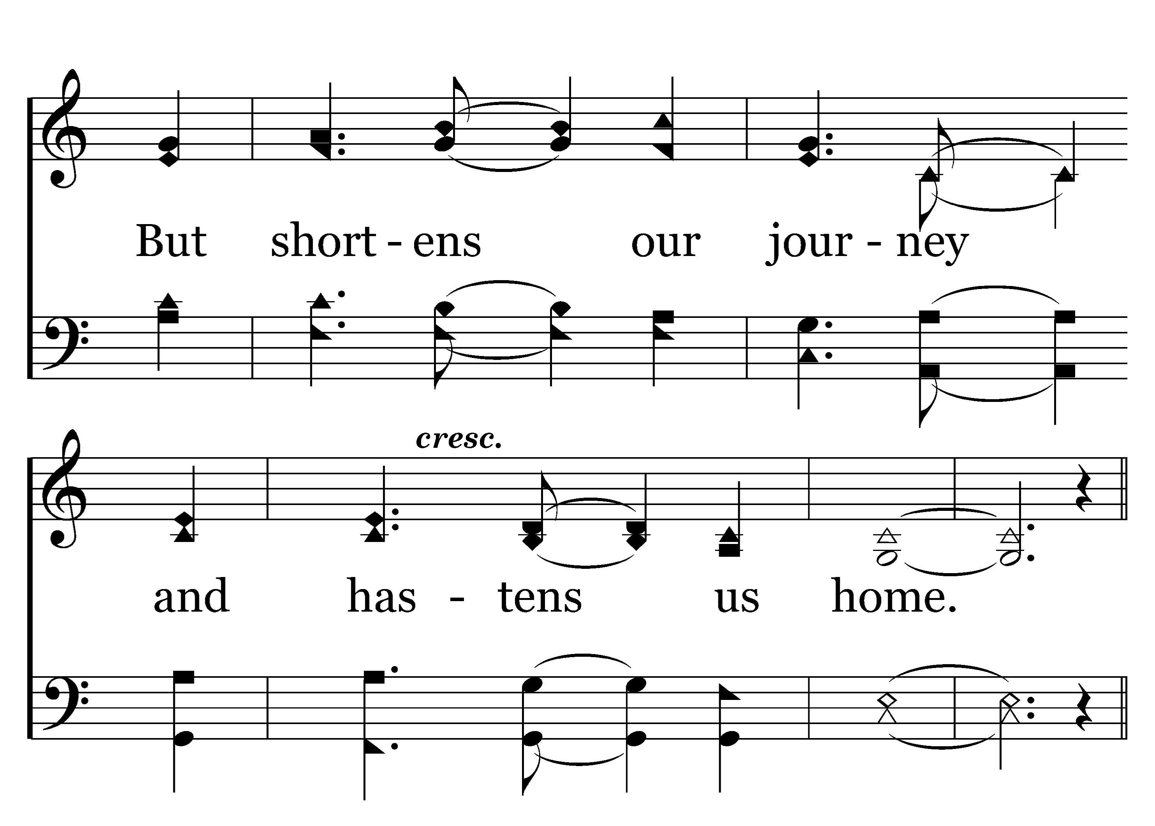
1
C
2
C
3
C
208
CHRIST OUR GLORY
Typeset by R. J. Stevens Music

Slide 6
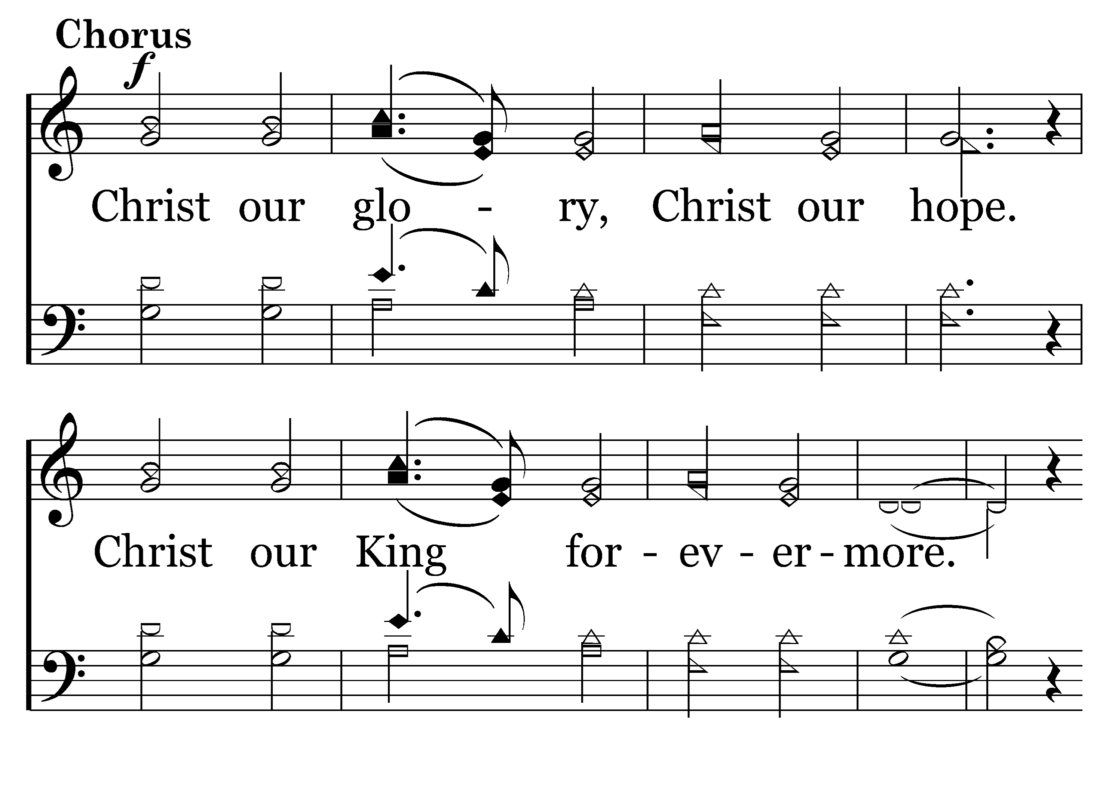
1
C
2
C
3
C
208
CHRIST OUR GLORY
Typeset by R. J. Stevens Music

Slide 7
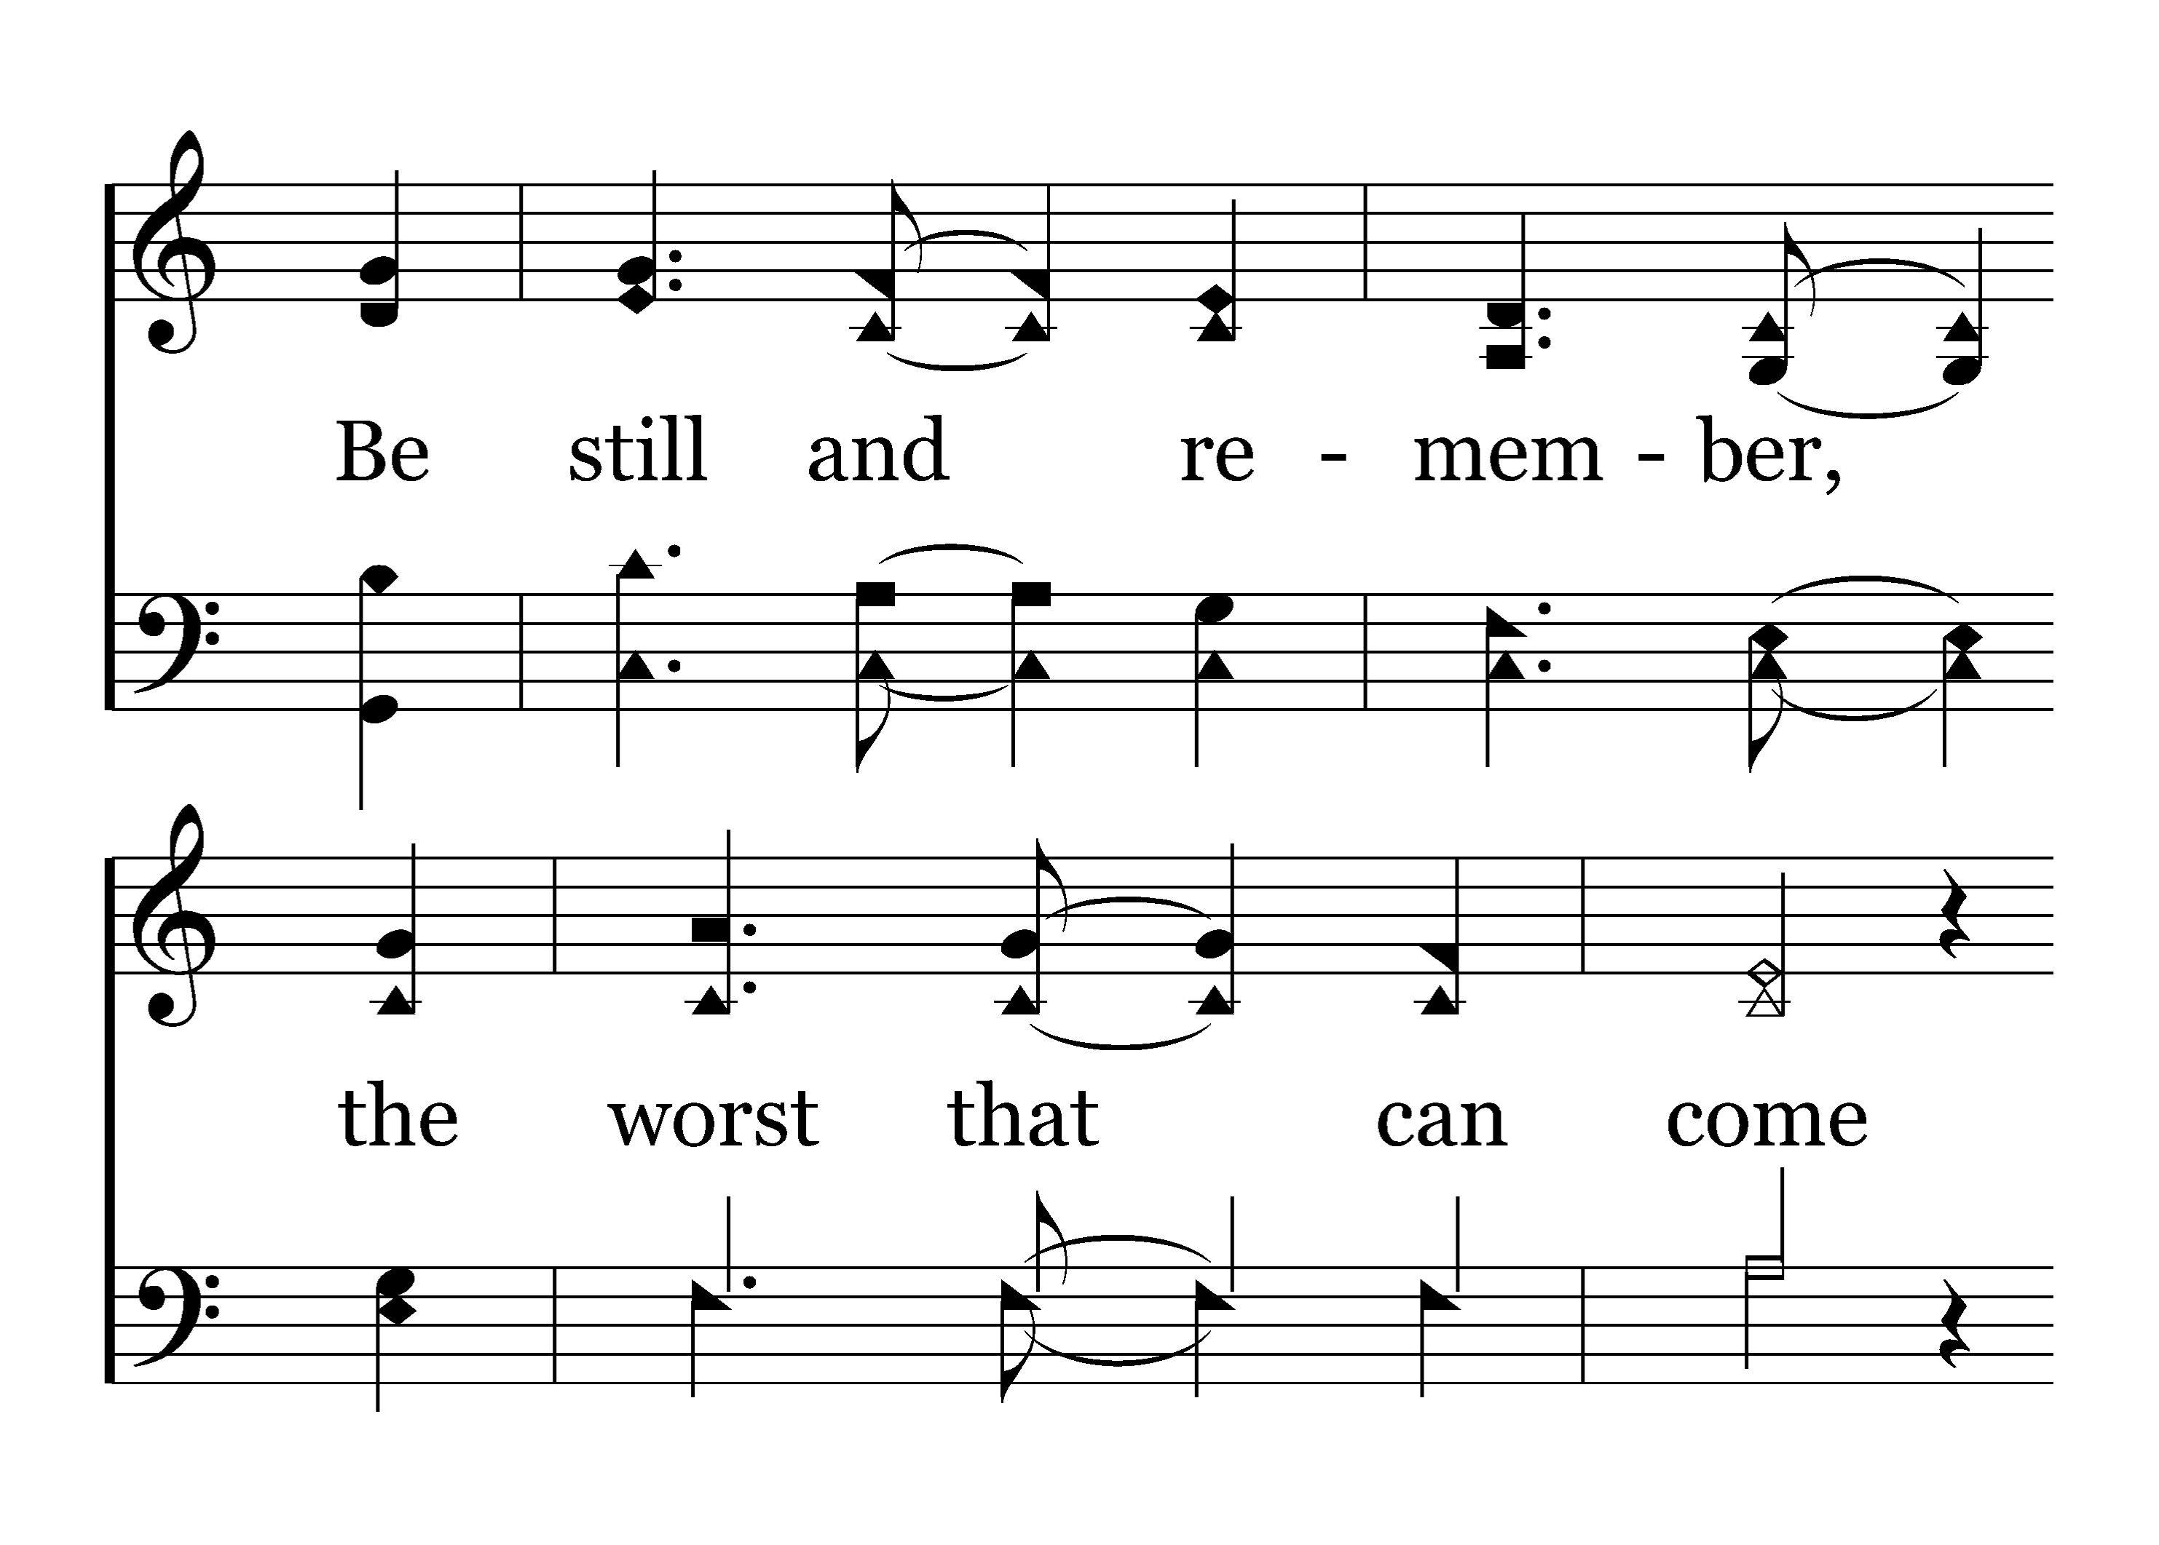
1
C
2
C
3
C
208
CHRIST OUR GLORY
Typeset by R. J. Stevens Music

Slide 8
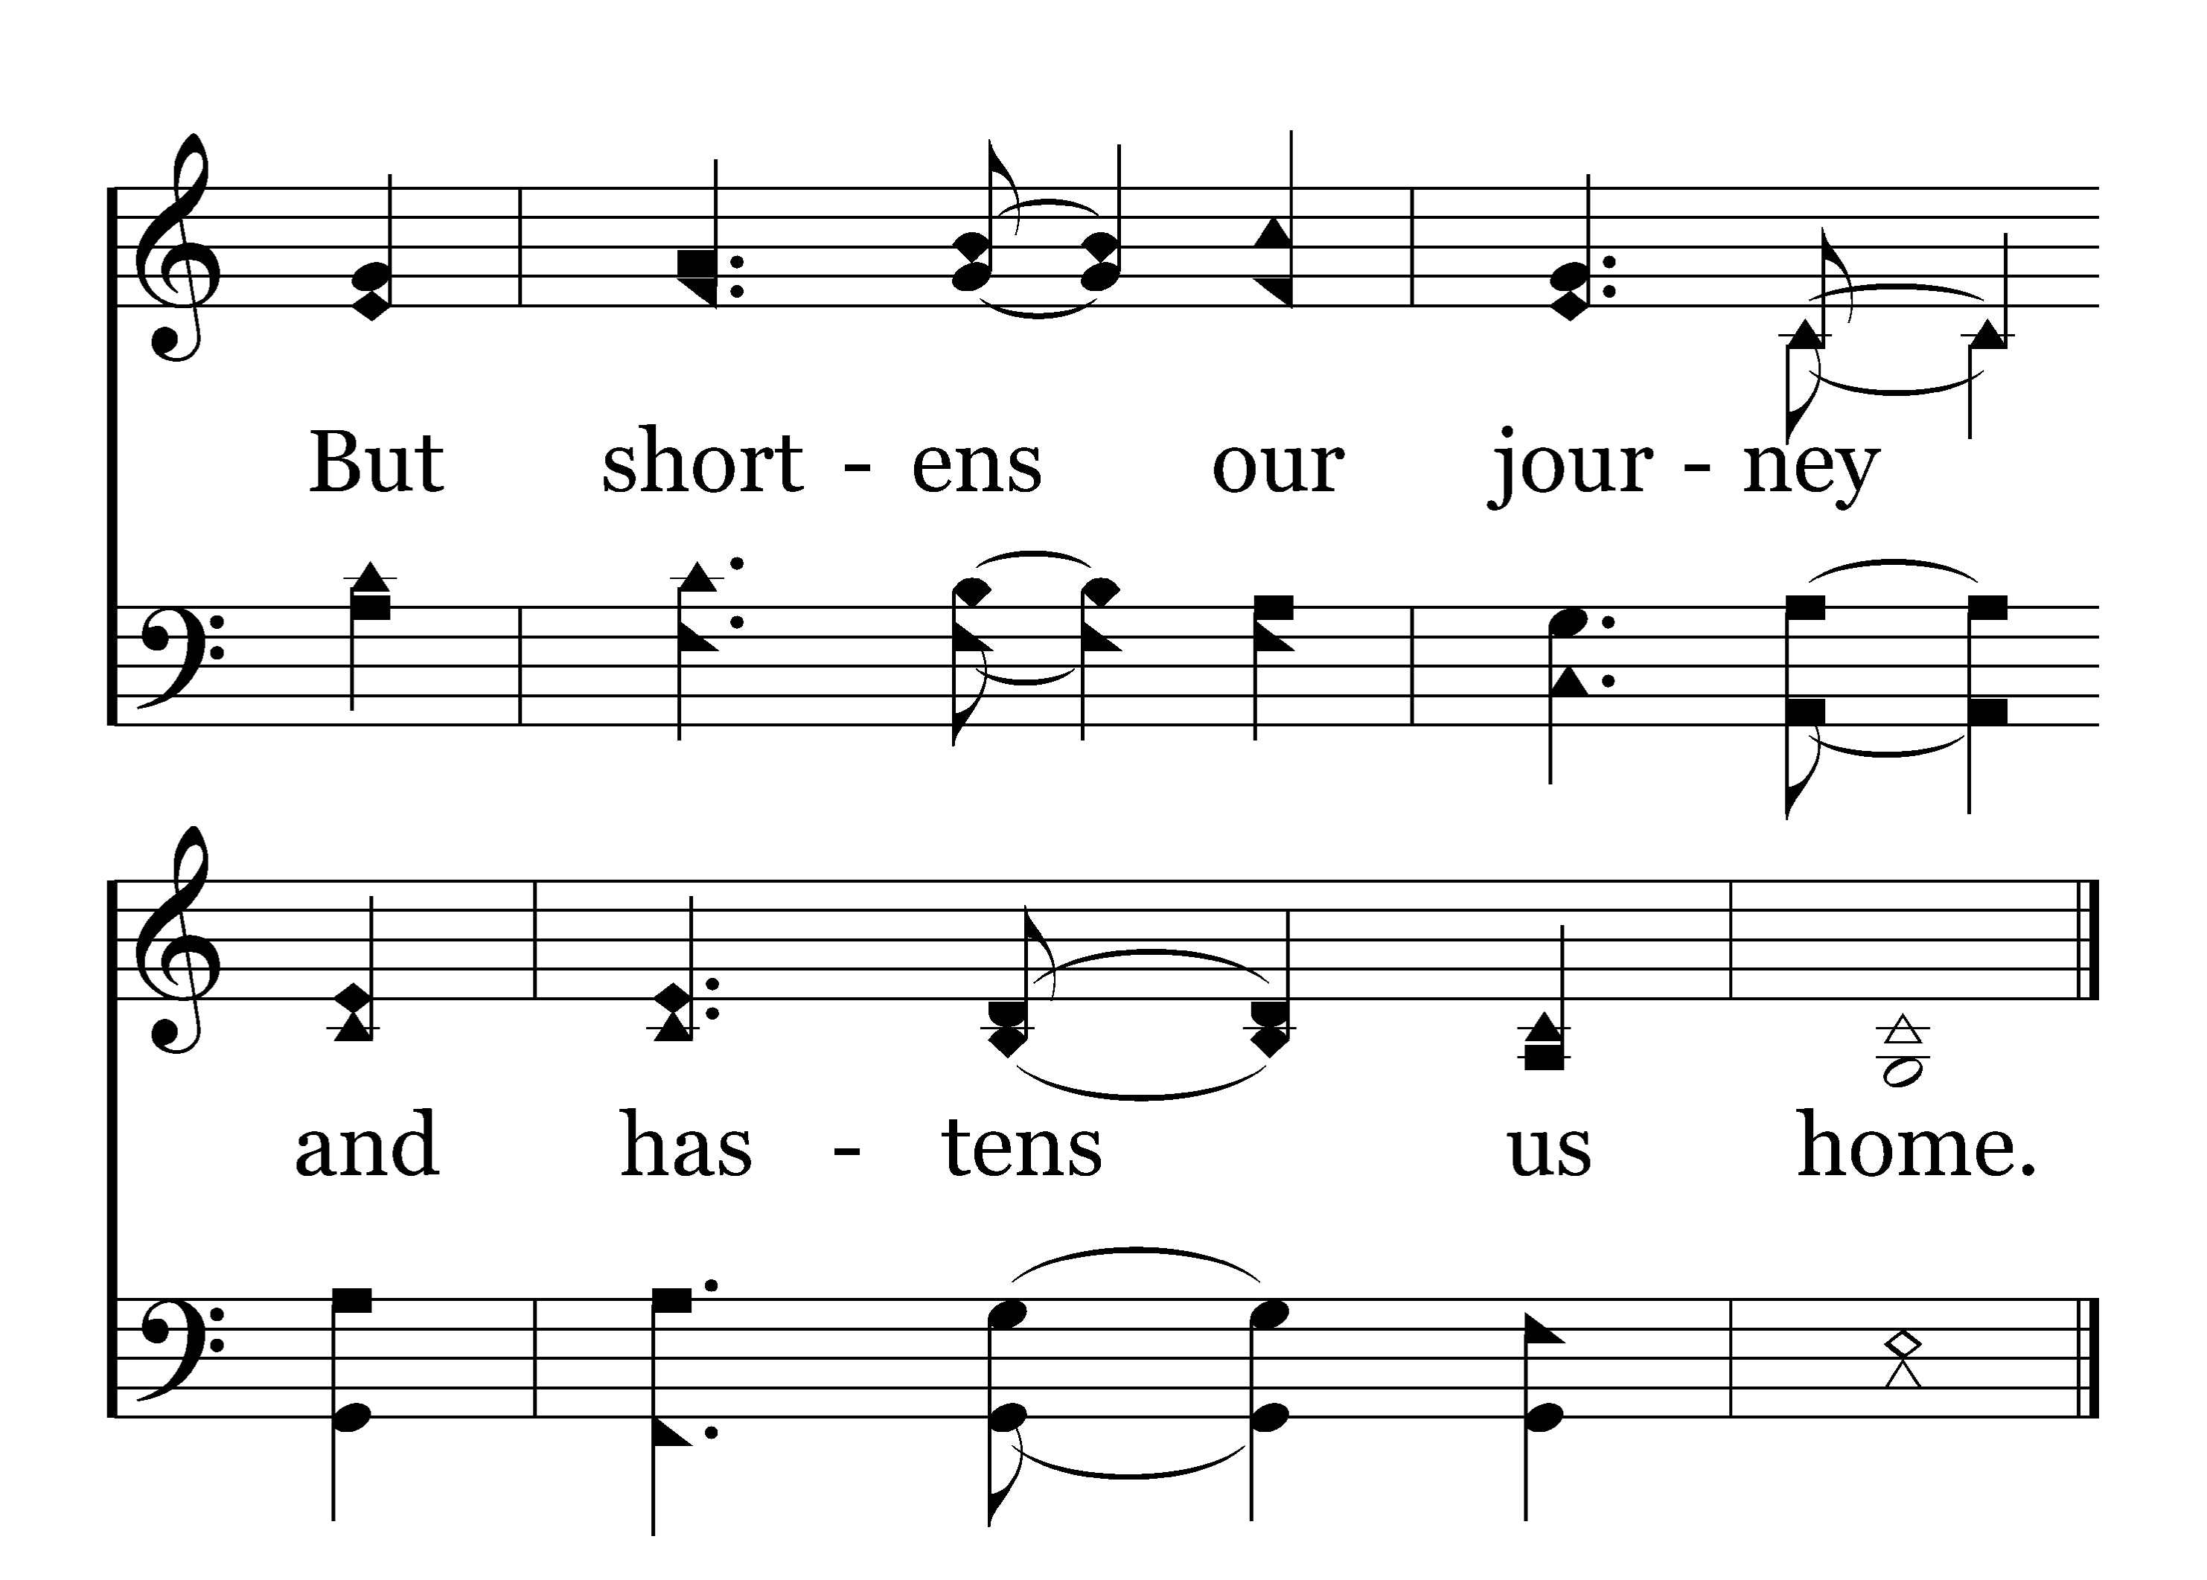
1
C
2
C
3
C
208
CHRIST OUR GLORY
Typeset by R. J. Stevens Music

Slide 9
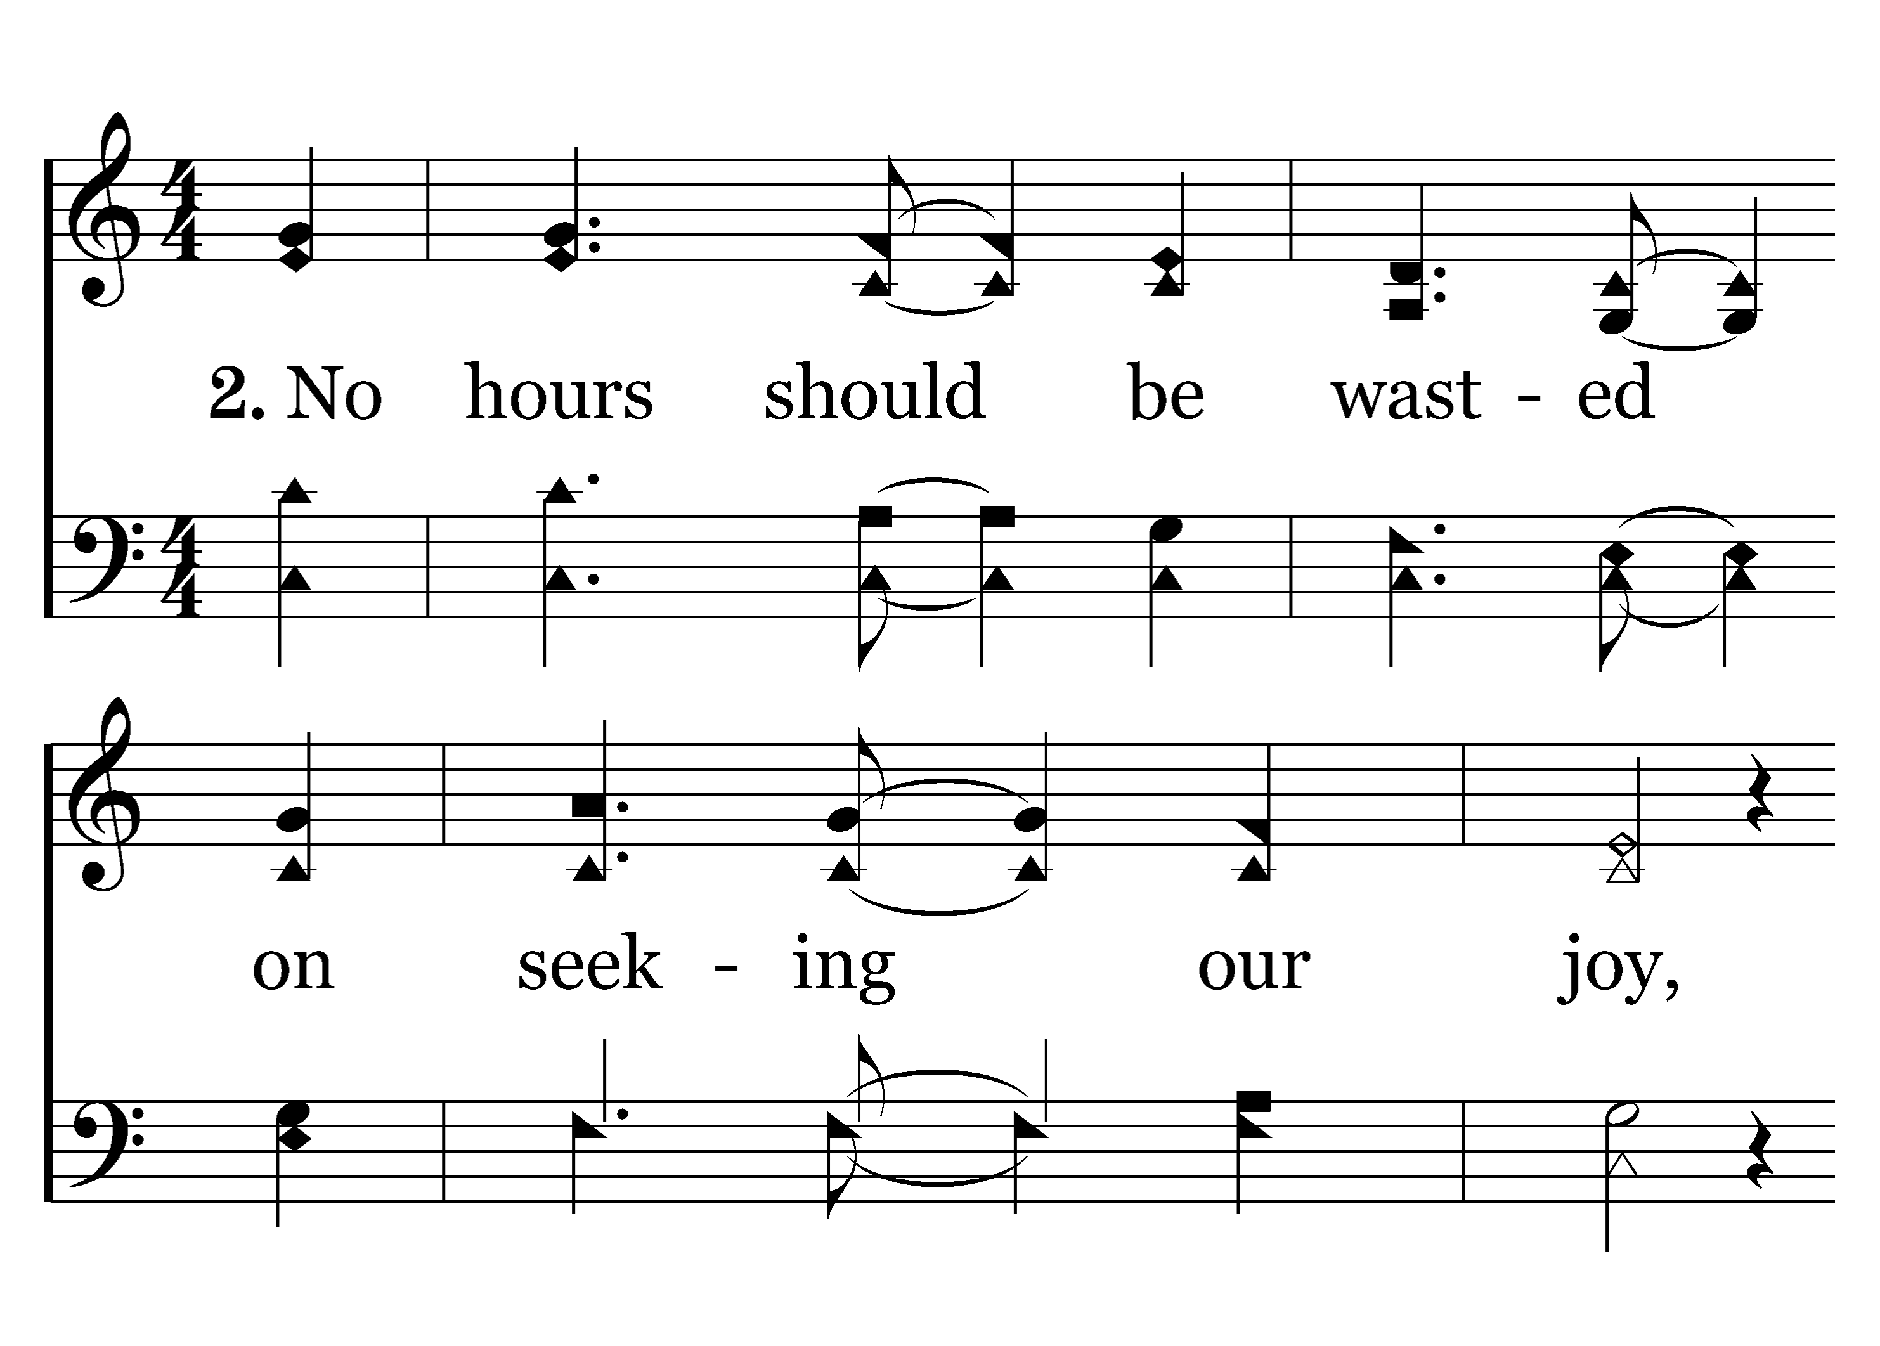
1
C
2
C
3
C
208
CHRIST OUR GLORY
Typeset by R. J. Stevens Music

Slide 10
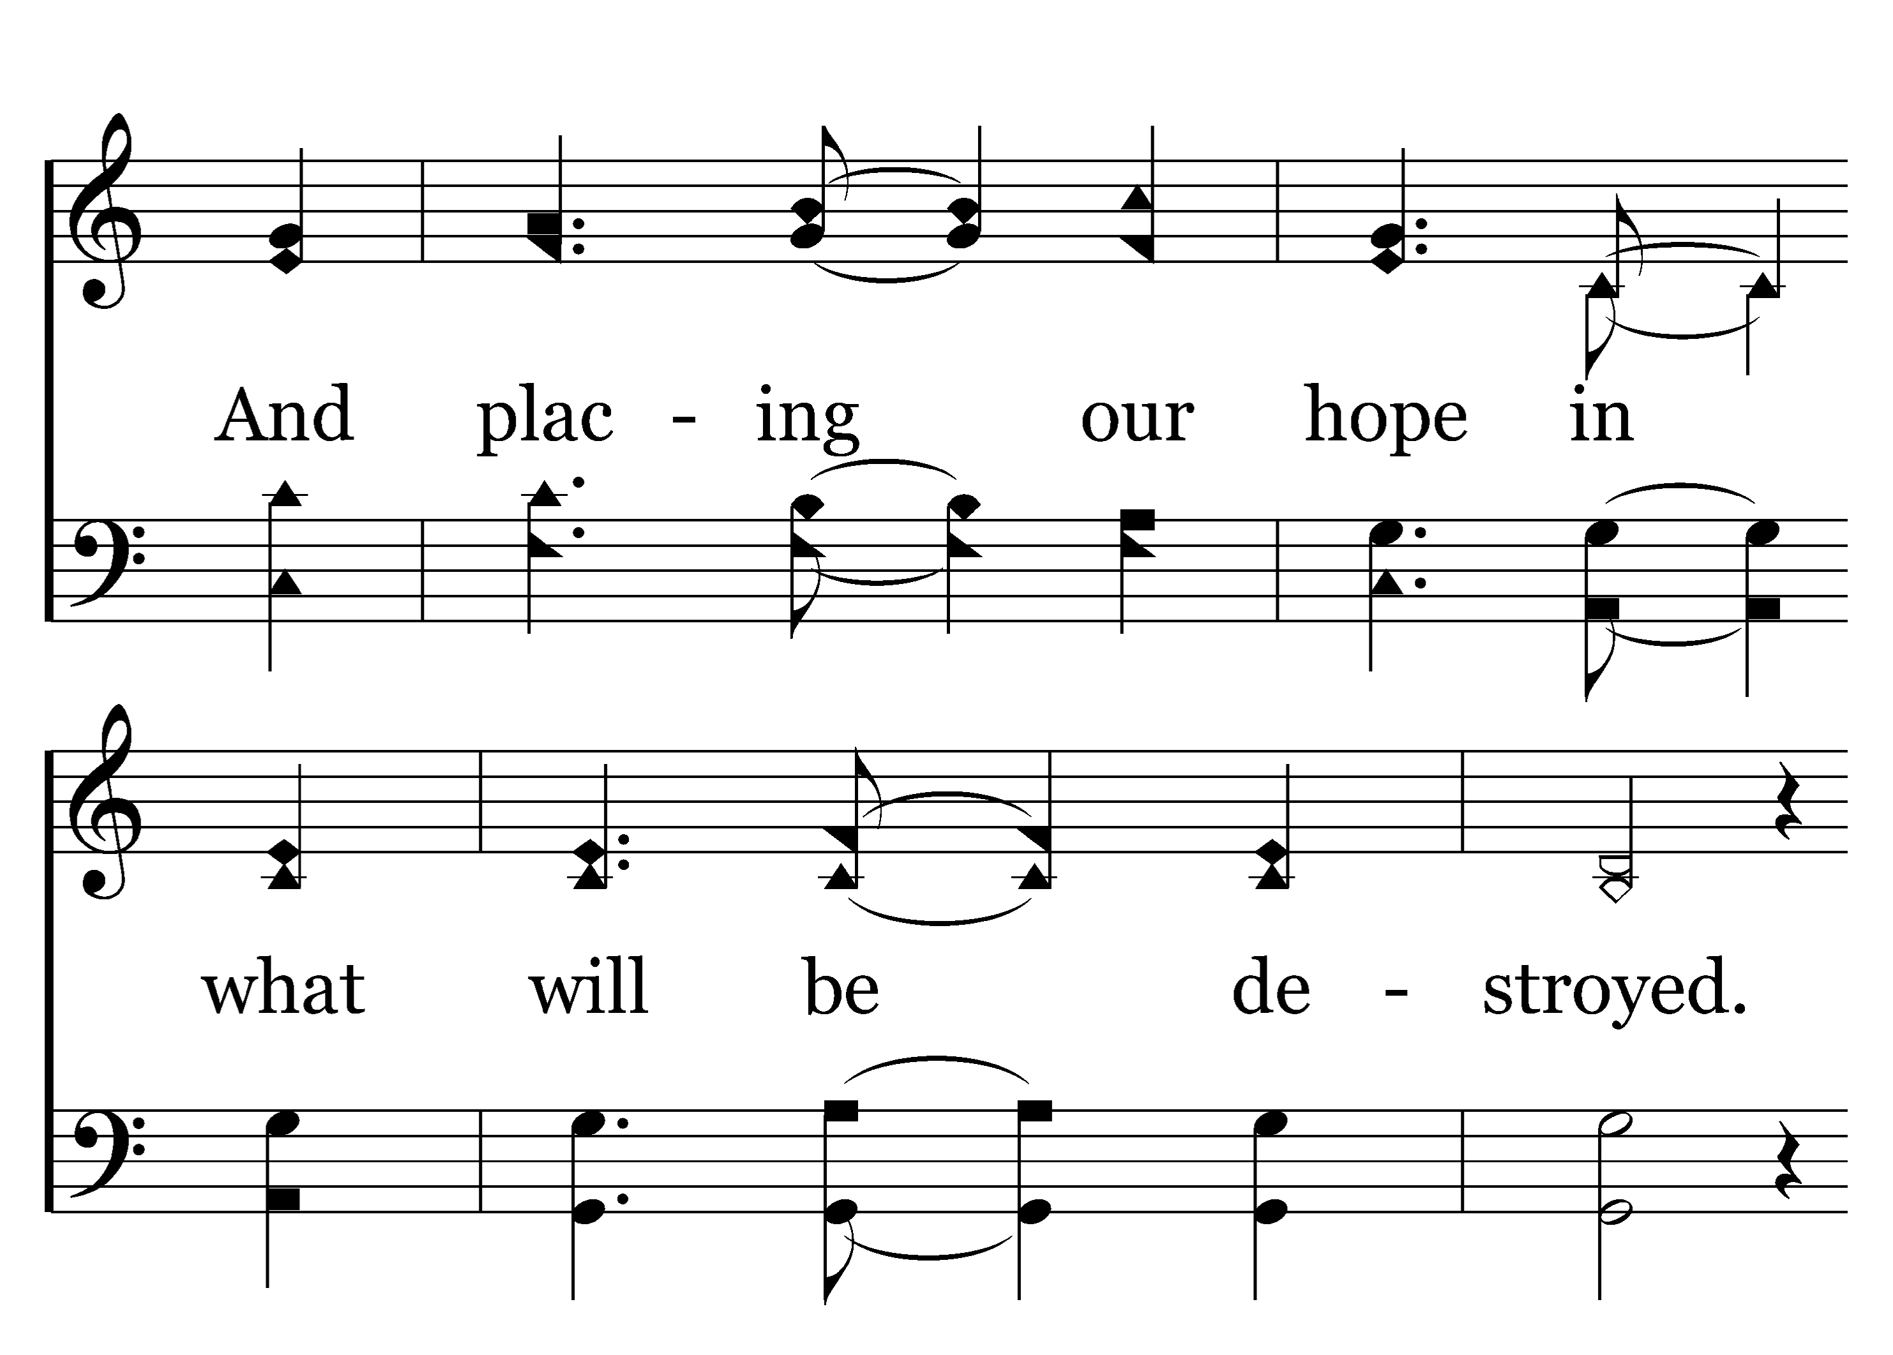
1
C
2
C
3
C
208
CHRIST OUR GLORY
Typeset by R. J. Stevens Music

Slide 11
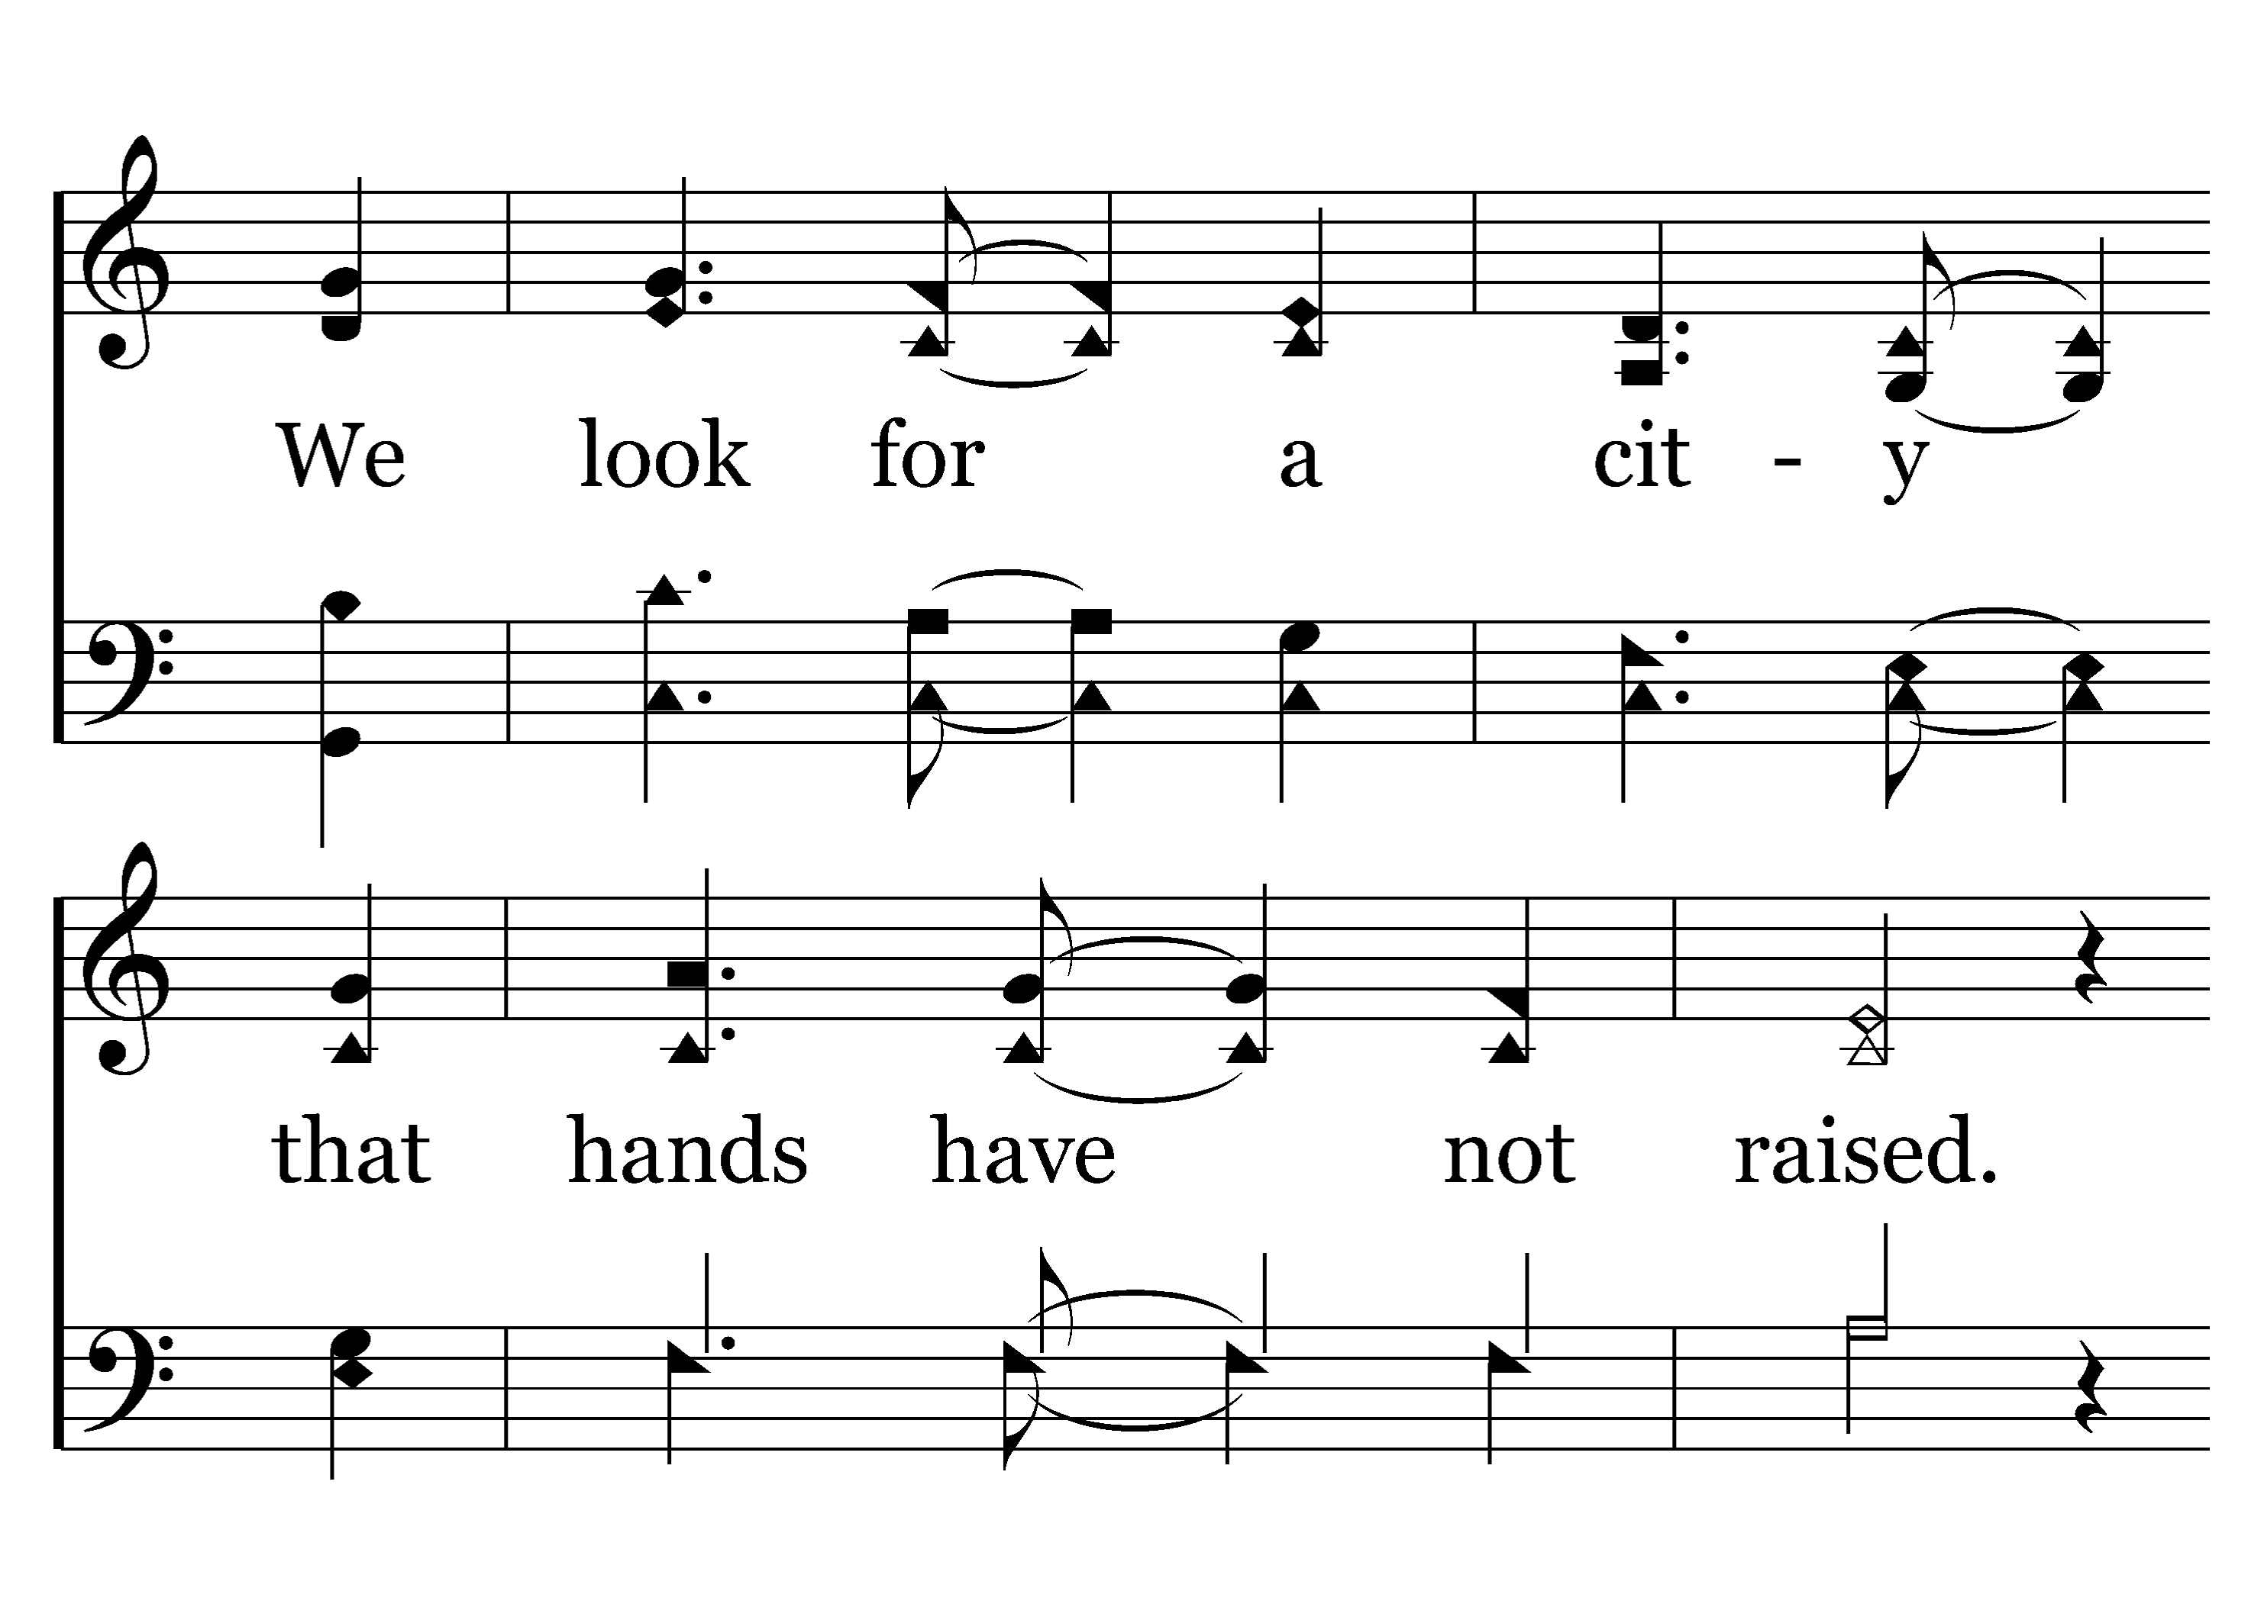
1
C
2
C
3
C
208
CHRIST OUR GLORY
Typeset by R. J. Stevens Music

Slide 12
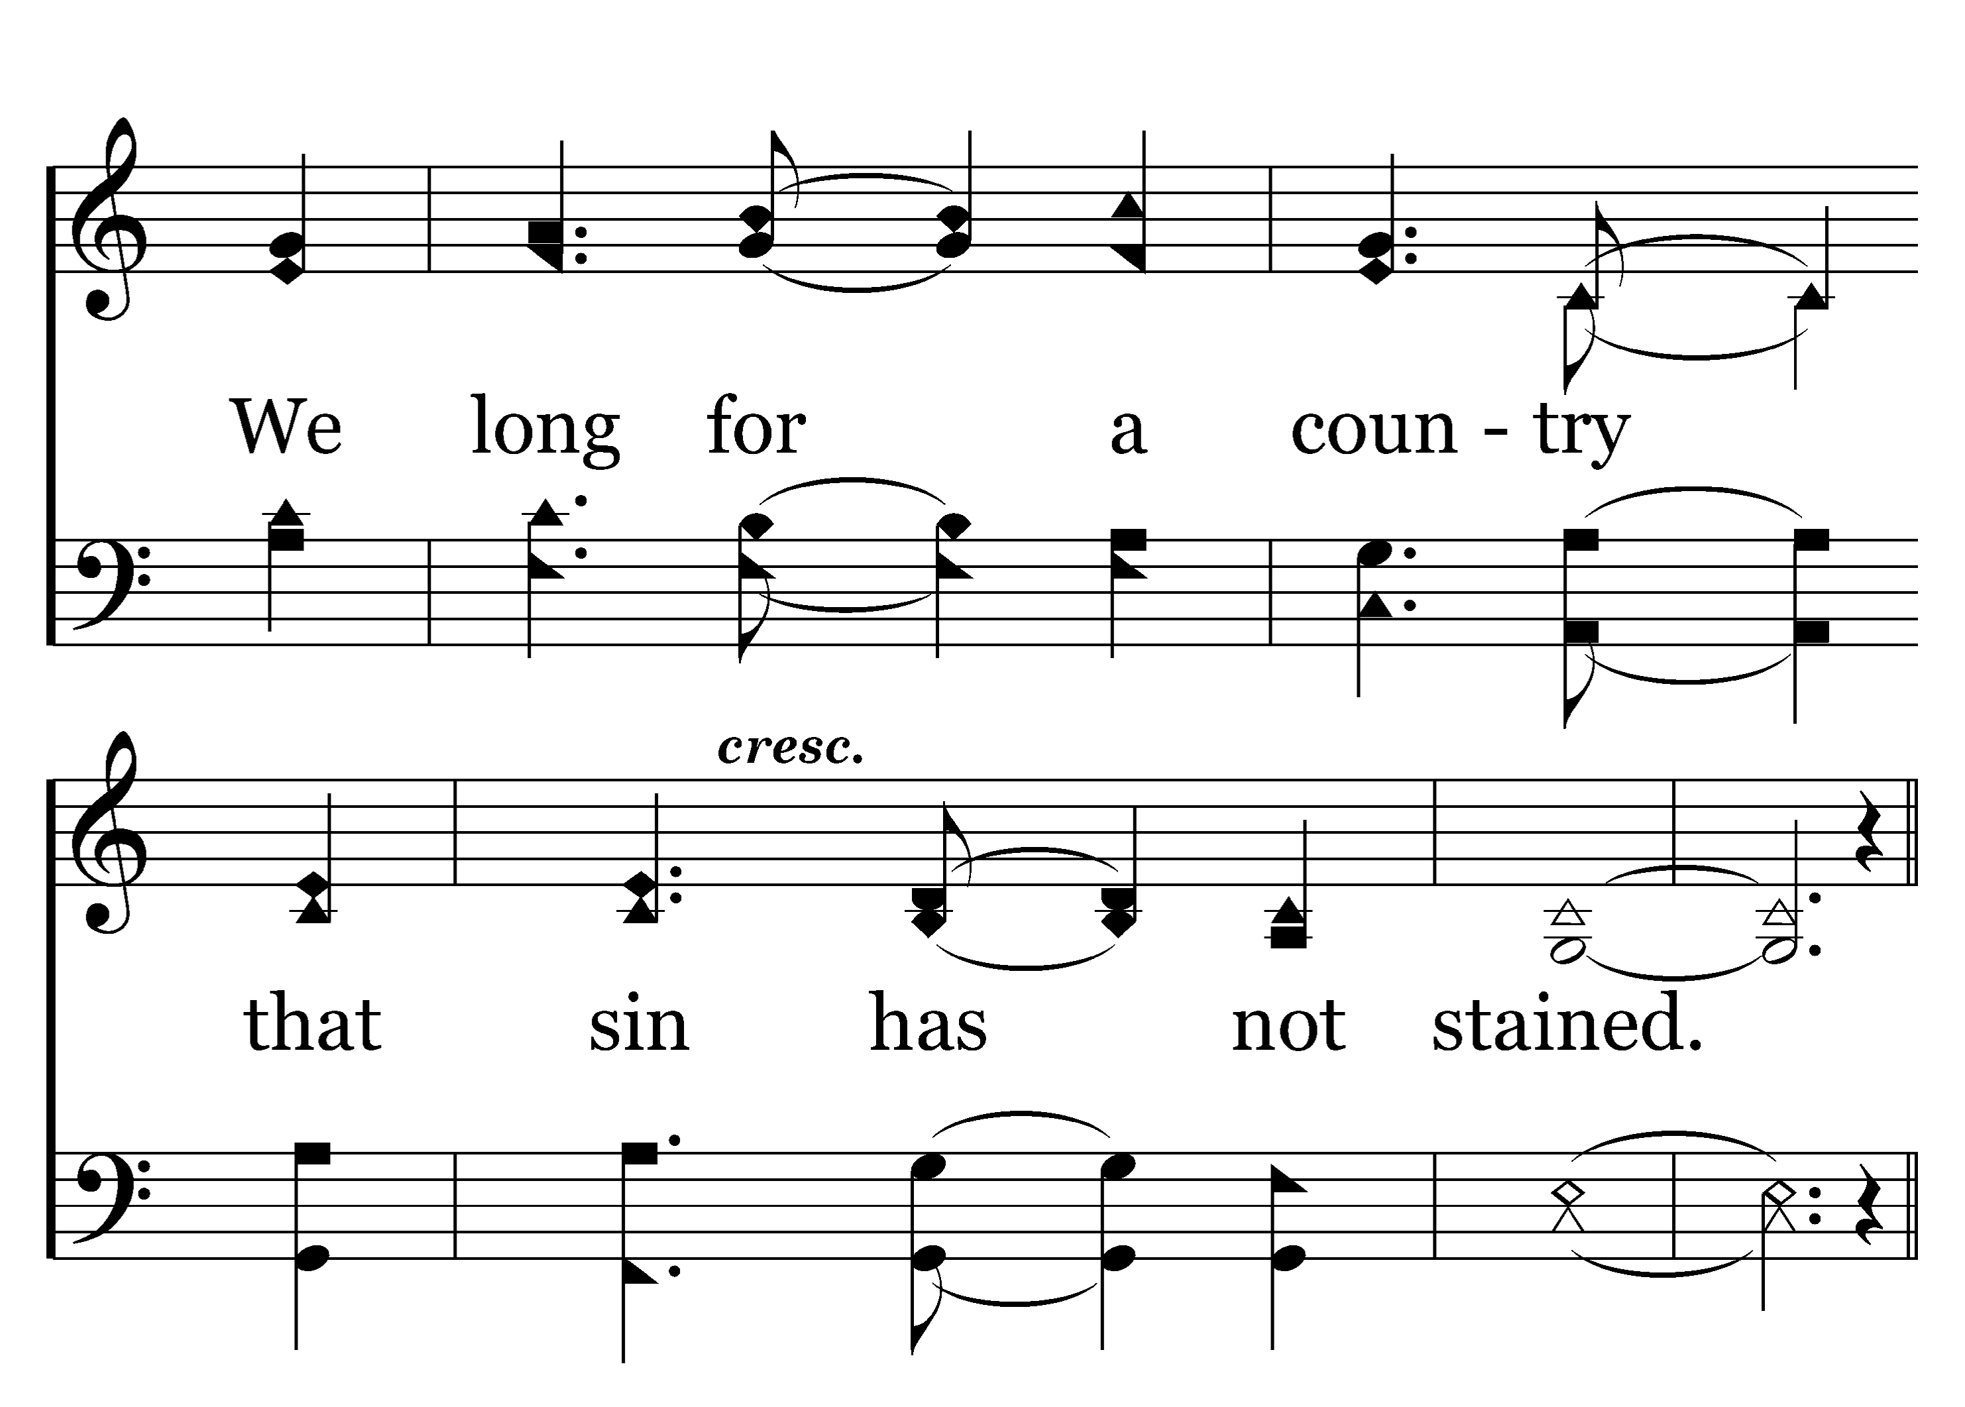
1
C
2
C
3
C
208
CHRIST OUR GLORY
Typeset by R. J. Stevens Music

Slide 13
1
C
2
C
3
C
208
CHRIST OUR GLORY
Typeset by R. J. Stevens Music

Slide 14
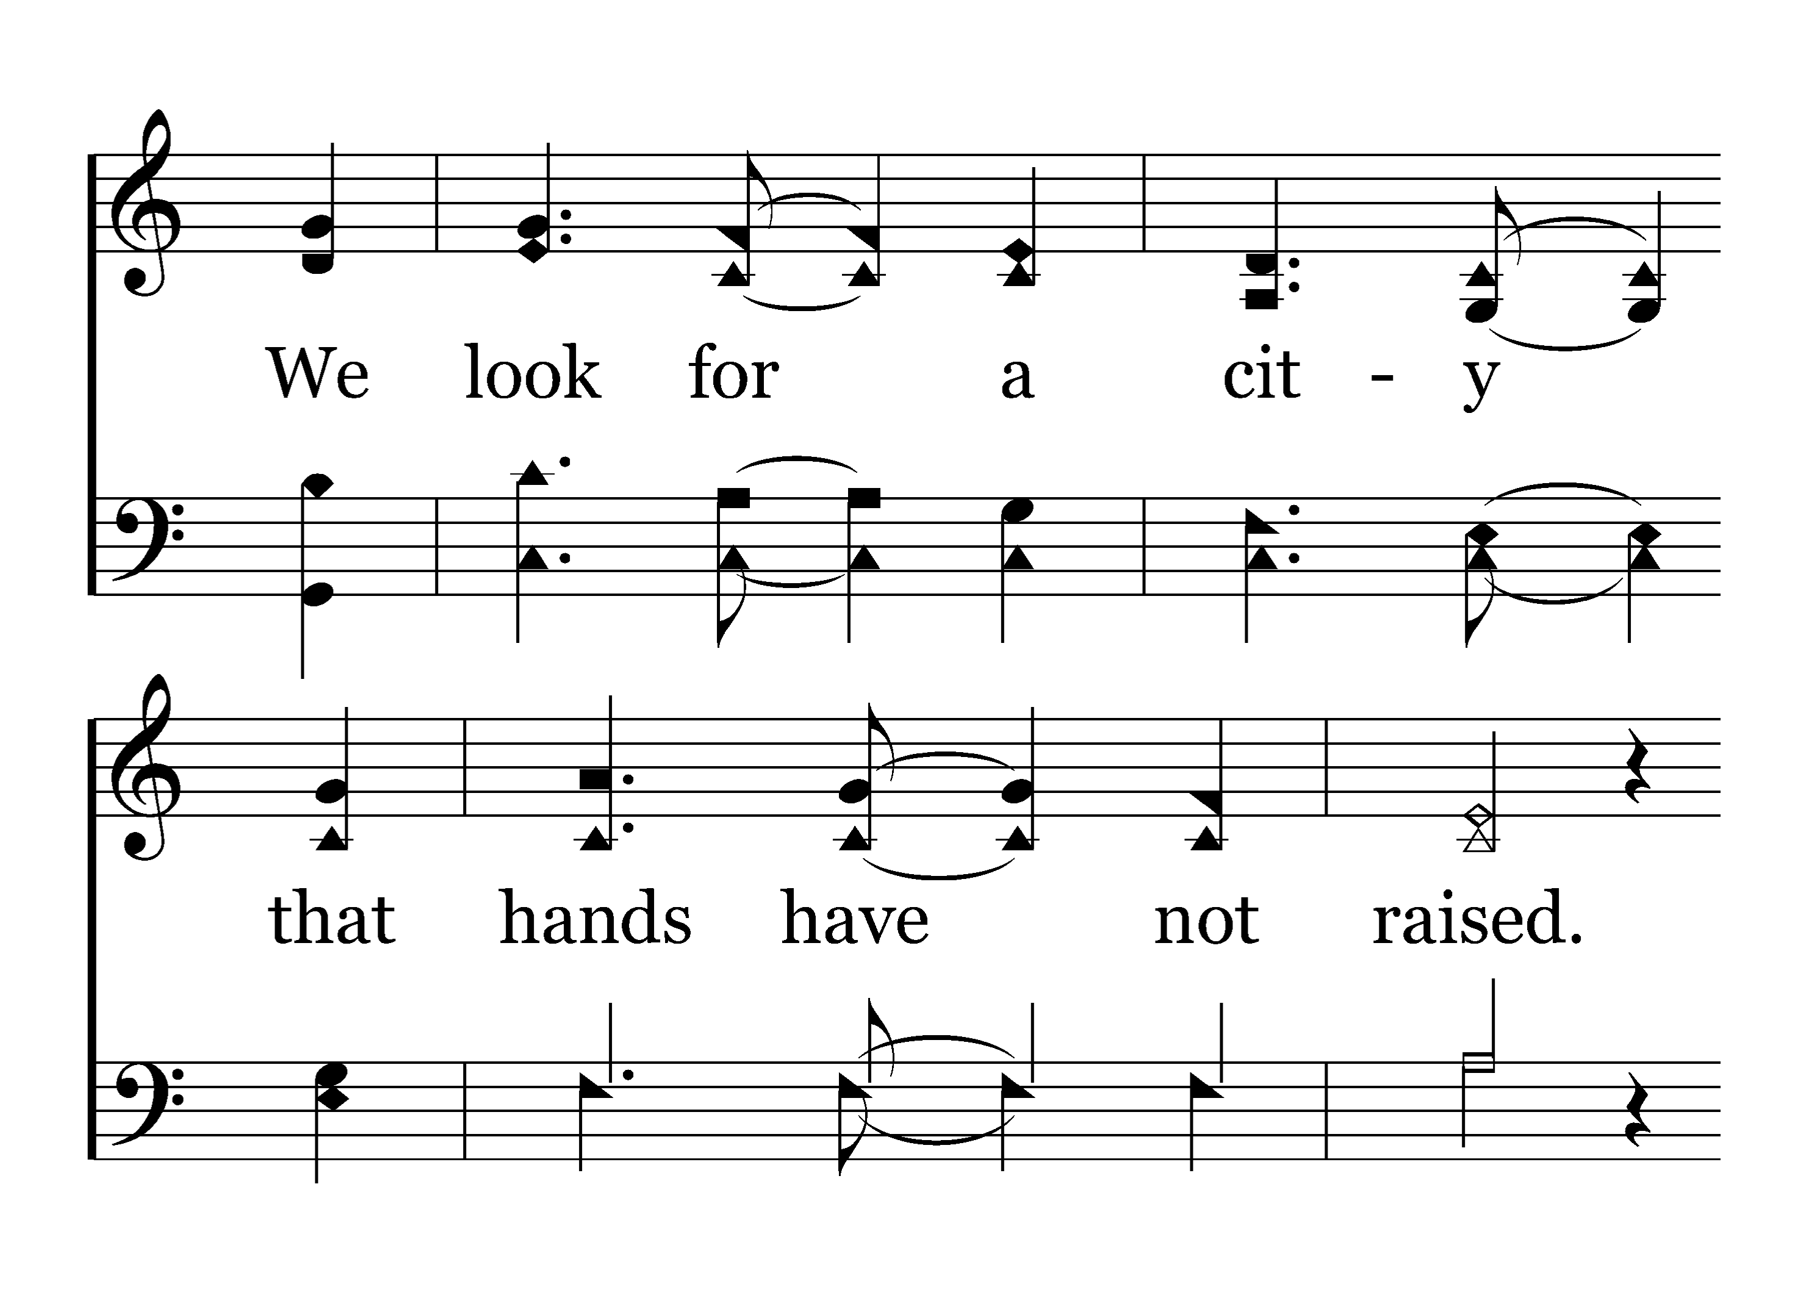
1
C
2
C
3
C
208
CHRIST OUR GLORY
Typeset by R. J. Stevens Music

Slide 15
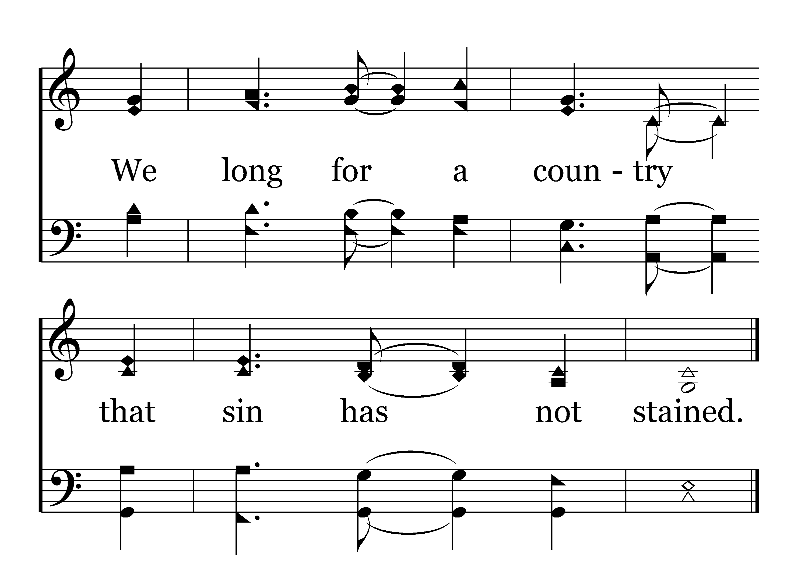
1
C
2
C
3
C
208
CHRIST OUR GLORY
Typeset by R. J. Stevens Music

Slide 16
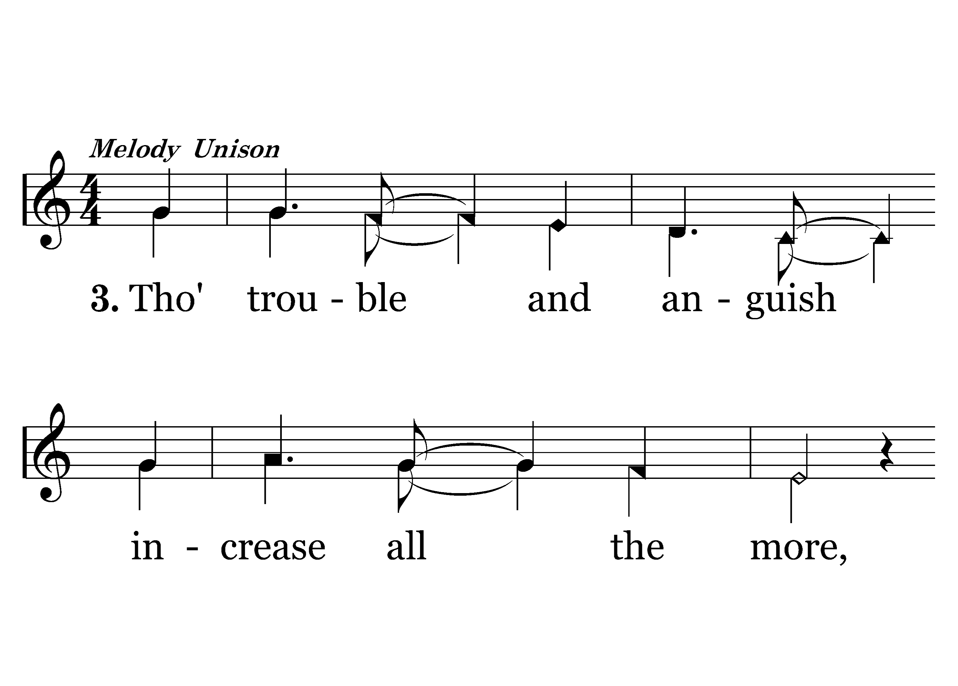
1
C
2
C
3
C
208
CHRIST OUR GLORY
Typeset by R. J. Stevens Music

Slide 17
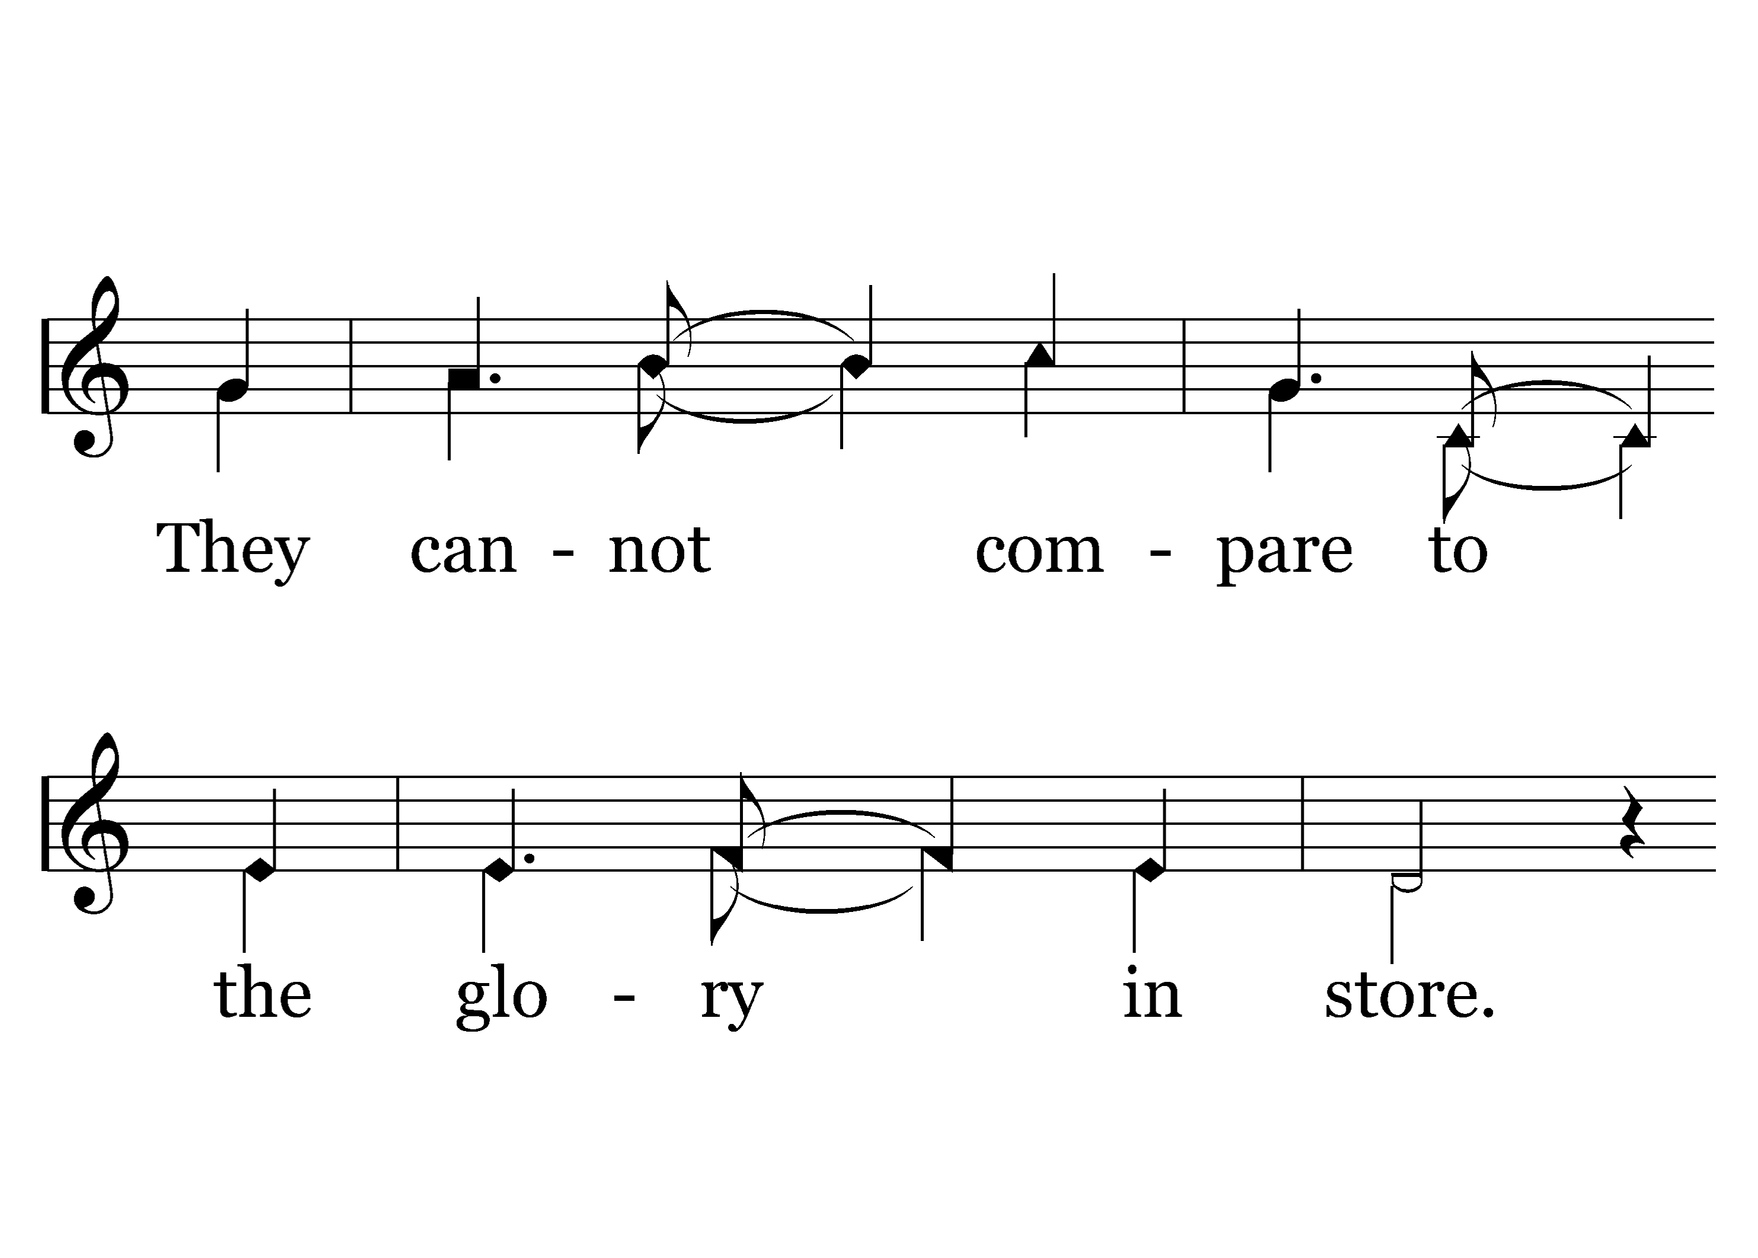
1
C
2
C
3
C
208
CHRIST OUR GLORY
Typeset by R. J. Stevens Music

Slide 18
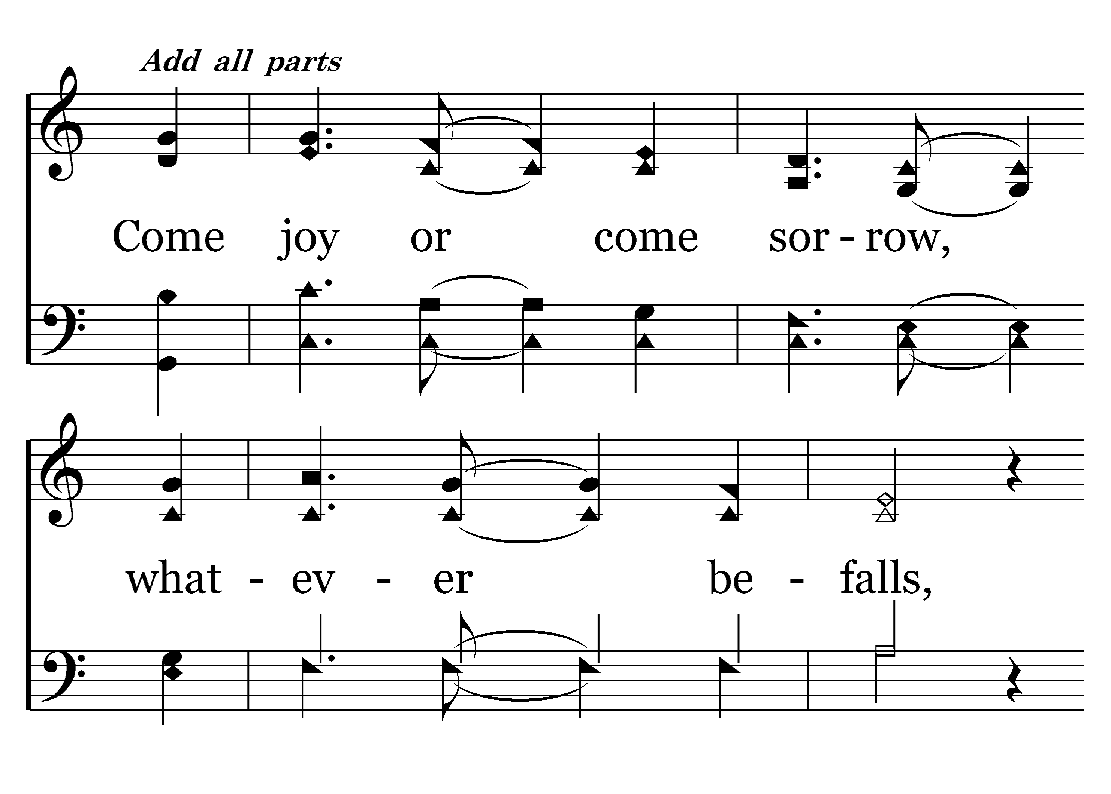
1
C
2
C
3
C
208
CHRIST OUR GLORY
Typeset by R. J. Stevens Music

Slide 19
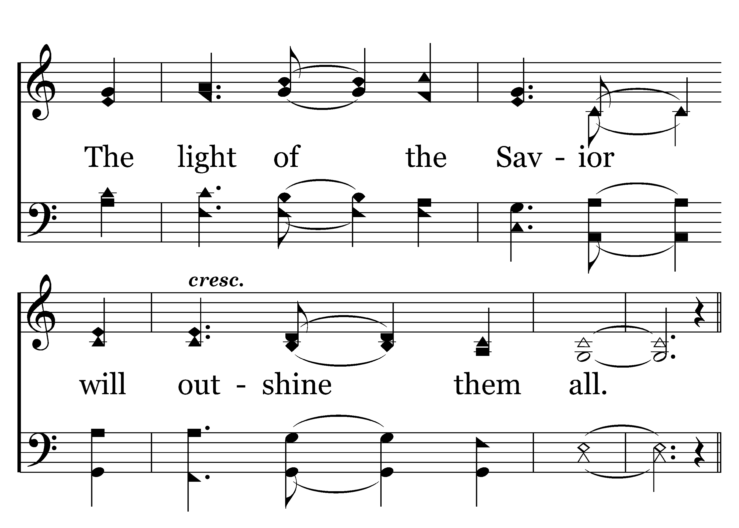
1
C
2
C
3
C
208
CHRIST OUR GLORY
Typeset by R. J. Stevens Music

Slide 20
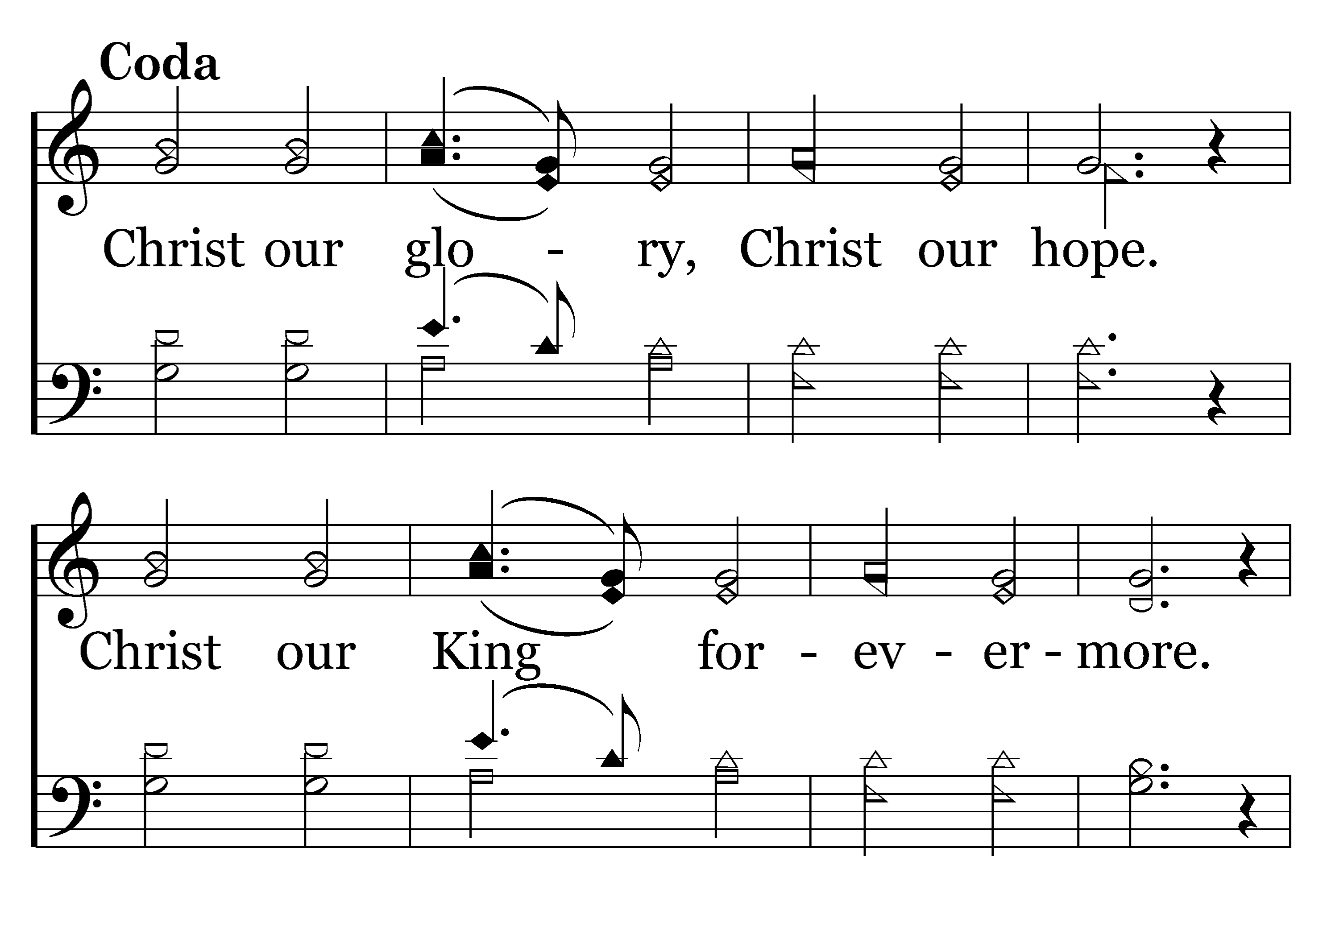
1
C
2
C
3
C
208
CHRIST OUR GLORY
Typeset by R. J. Stevens Music

Slide 21
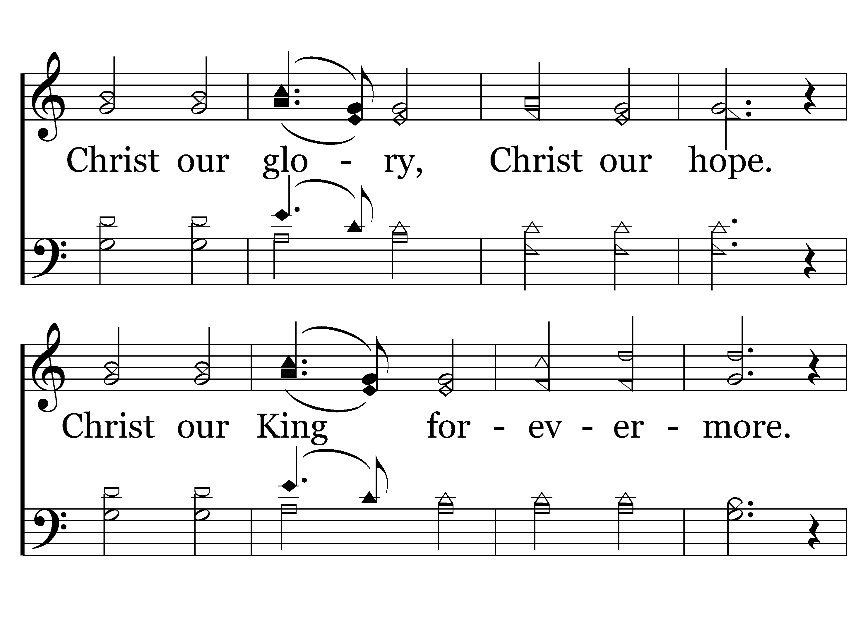
1
C
2
C
3
C
208
CHRIST OUR GLORY
Typeset by R. J. Stevens Music

Slide 22
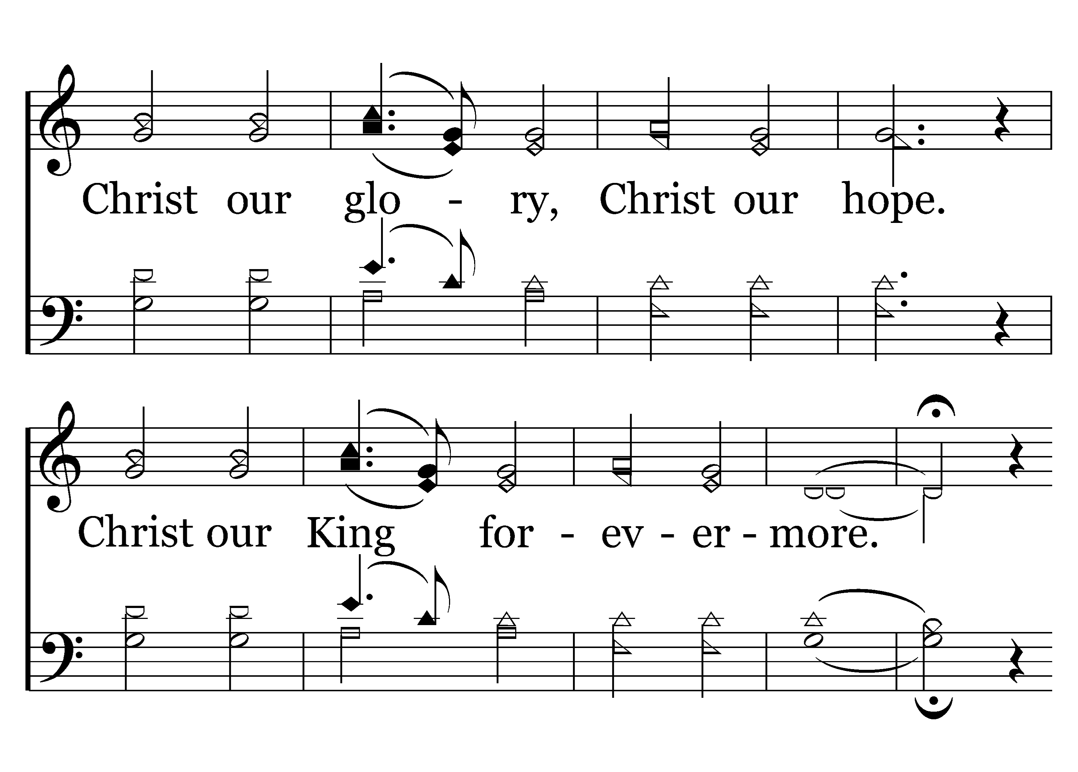
1
C
2
C
3
C
208
CHRIST OUR GLORY
Typeset by R. J. Stevens Music

Slide 23
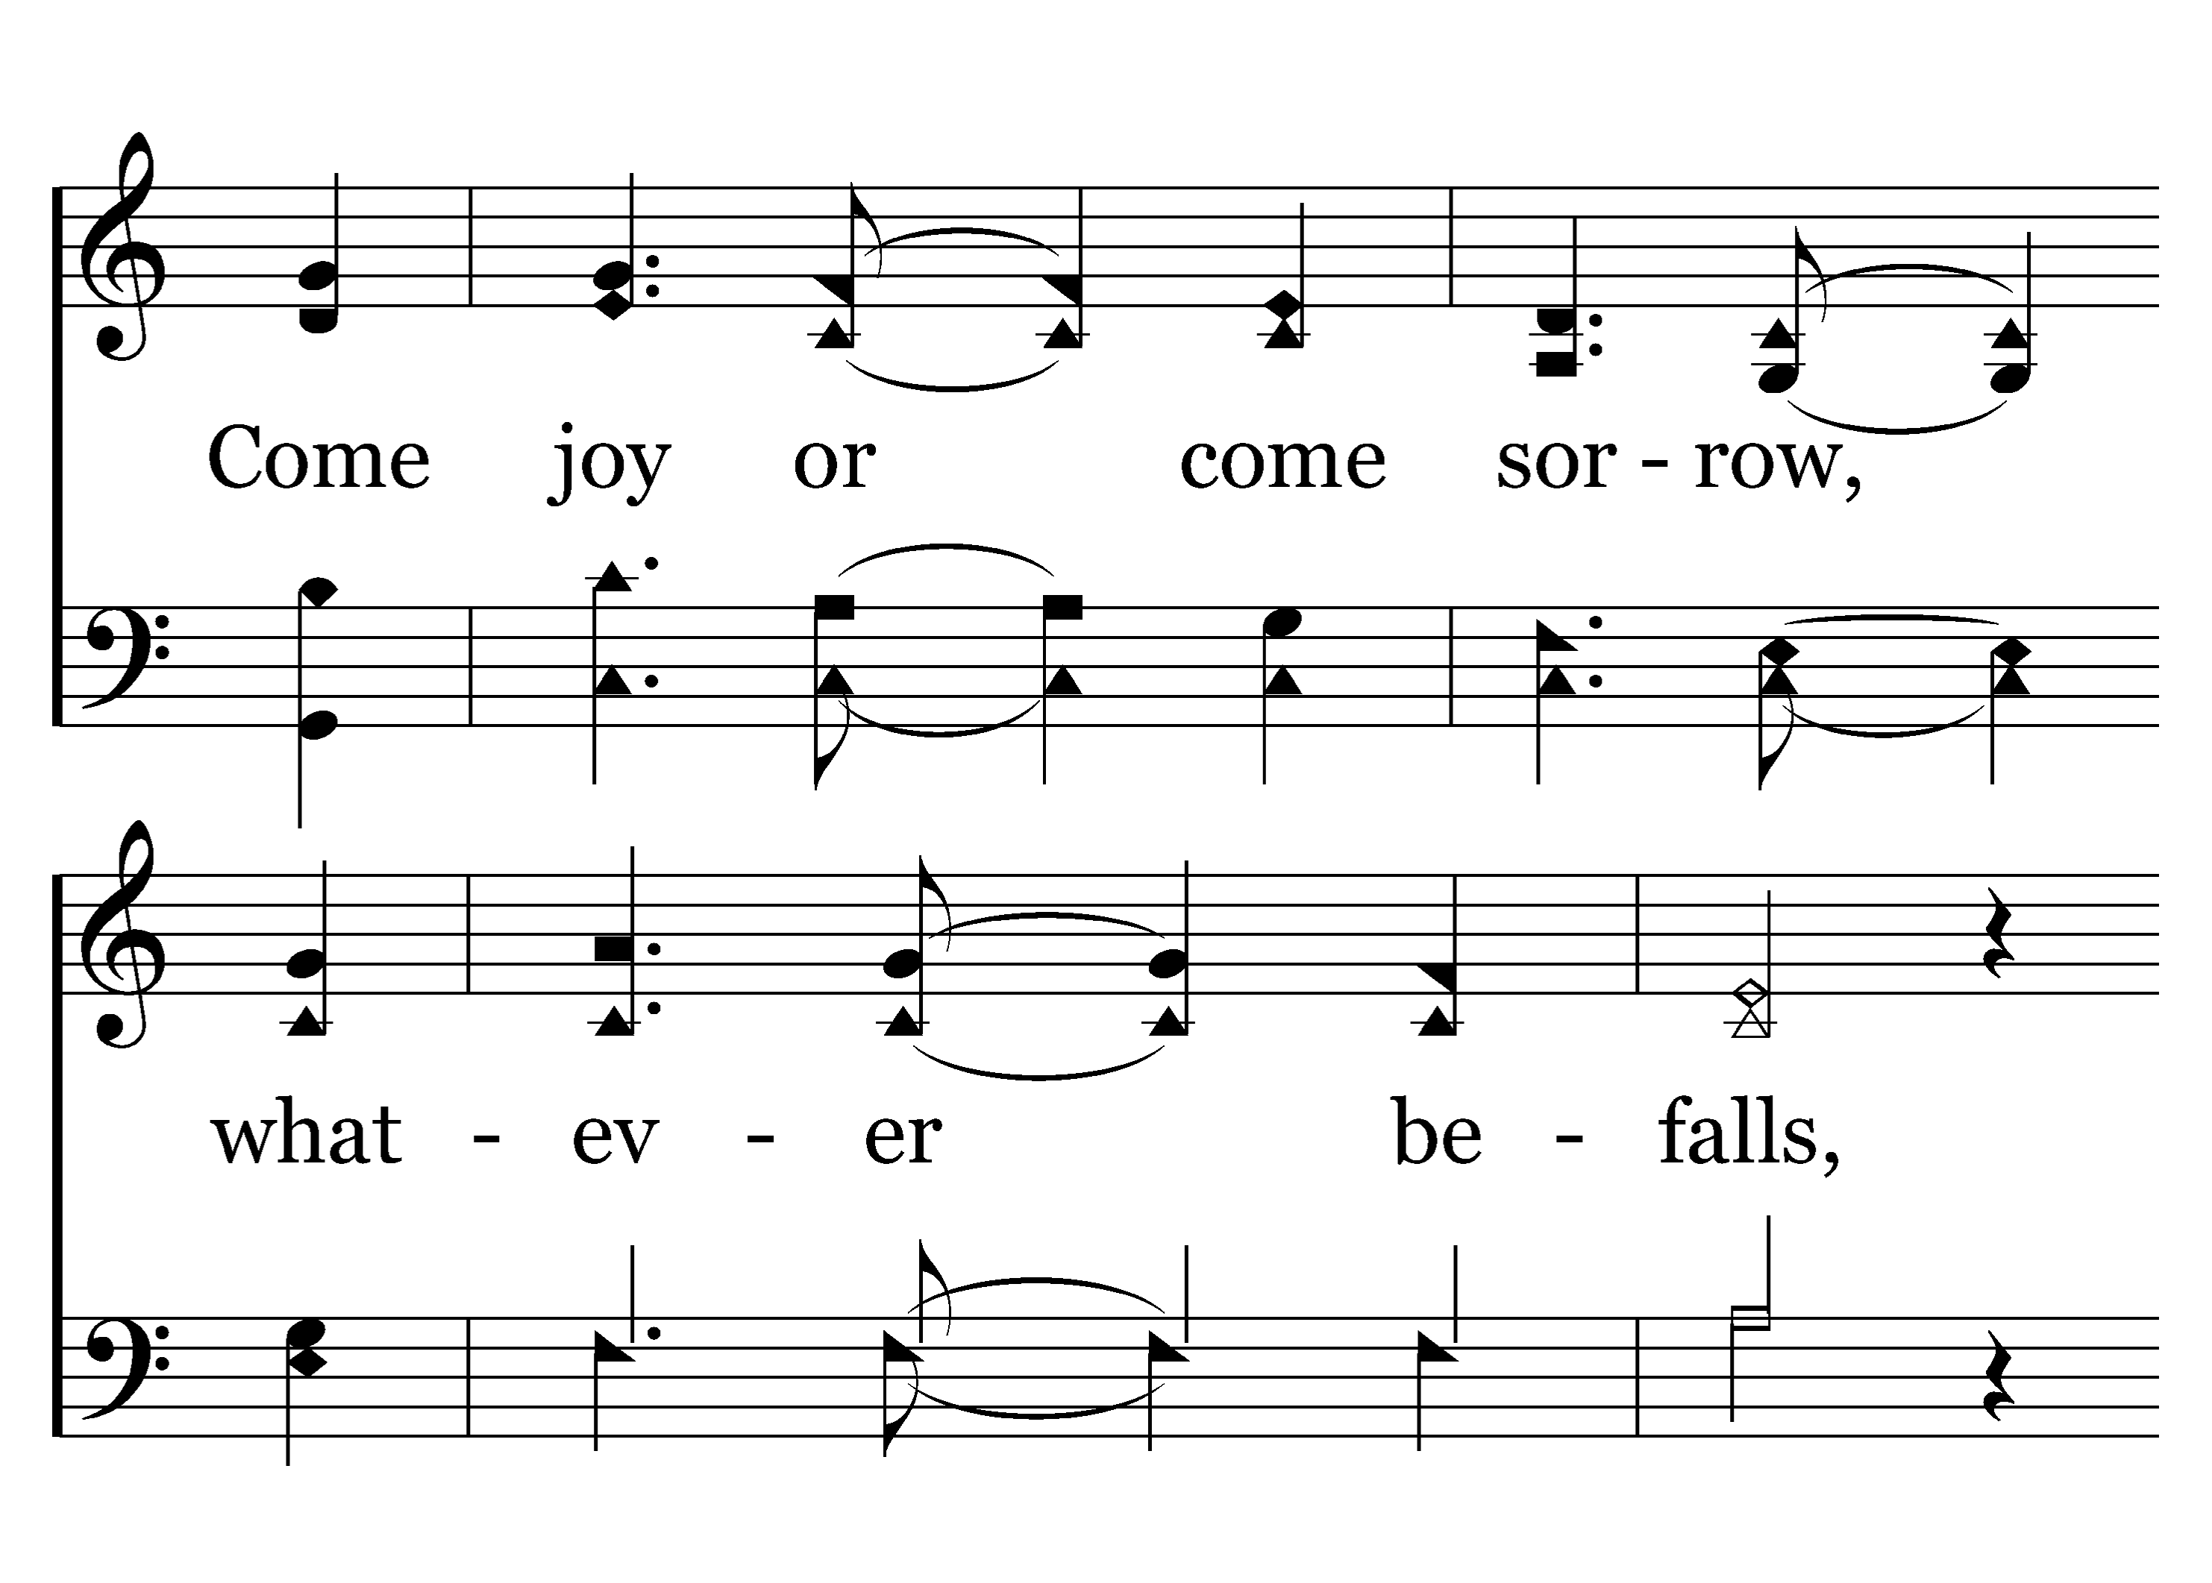
1
C
2
C
3
C
208
CHRIST OUR GLORY
Typeset by R. J. Stevens Music

Slide 24
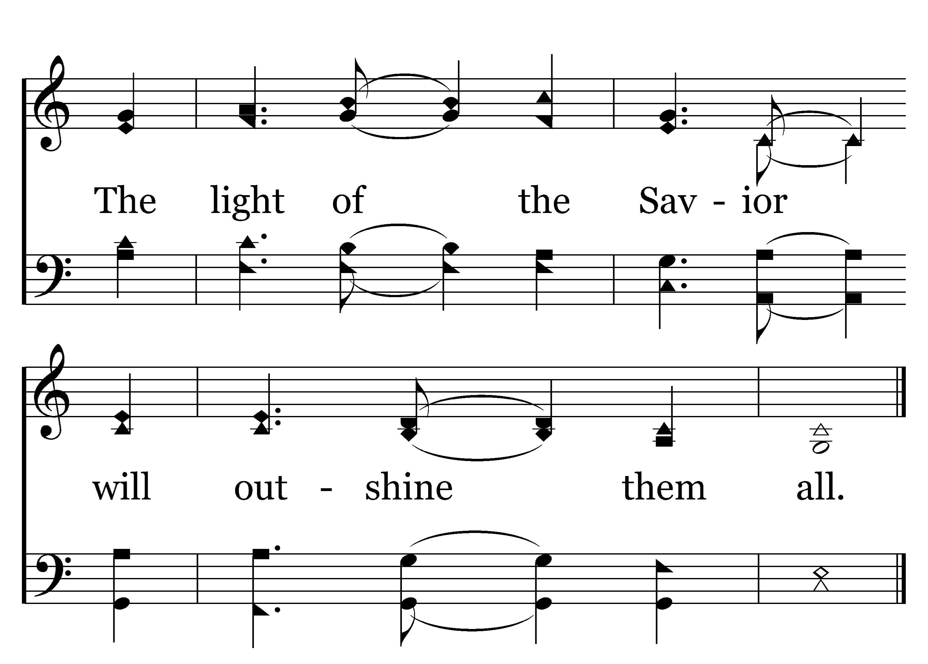
1
C
2
C
3
C
208
CHRIST OUR GLORY
Typeset by R. J. Stevens Music

