Slide 1
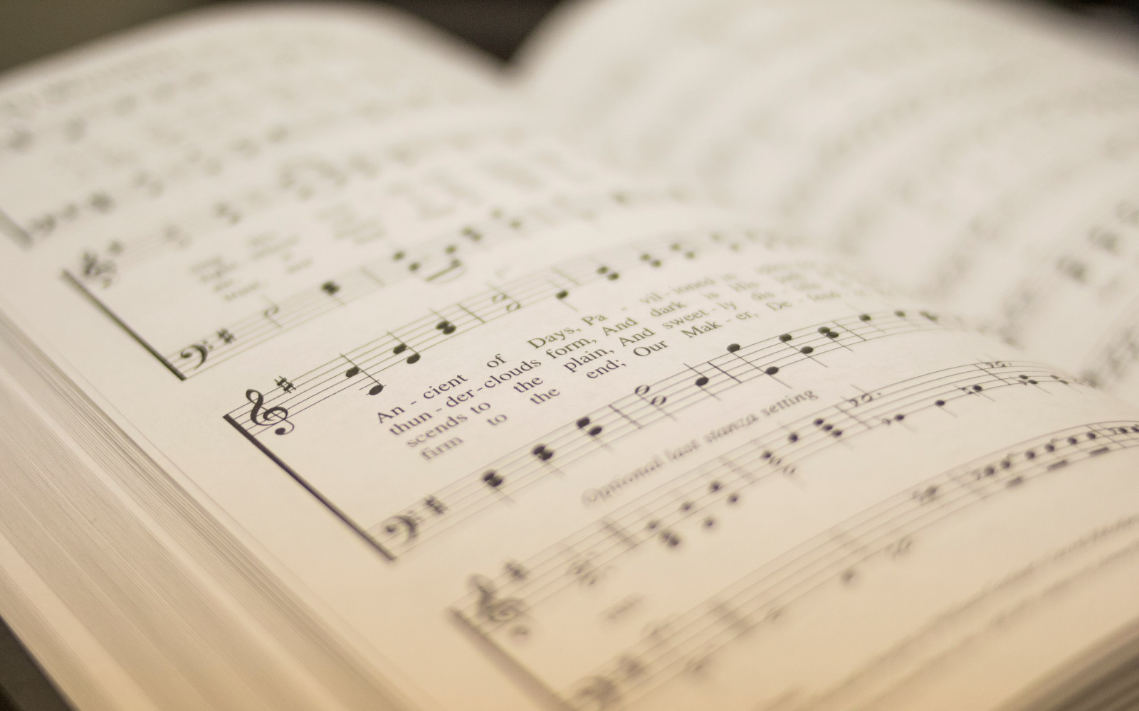

209
BE UNTO YOUR NAME
1
2
“SINGING...TO THE LORD” COLOSSIANS 3:16
Words and Music by: Gary Sadler & Lynn DeShazo © Copyright 1998 by Integrity's Hosanna! Music. All rights reserved. Used by Permission

Slide 2

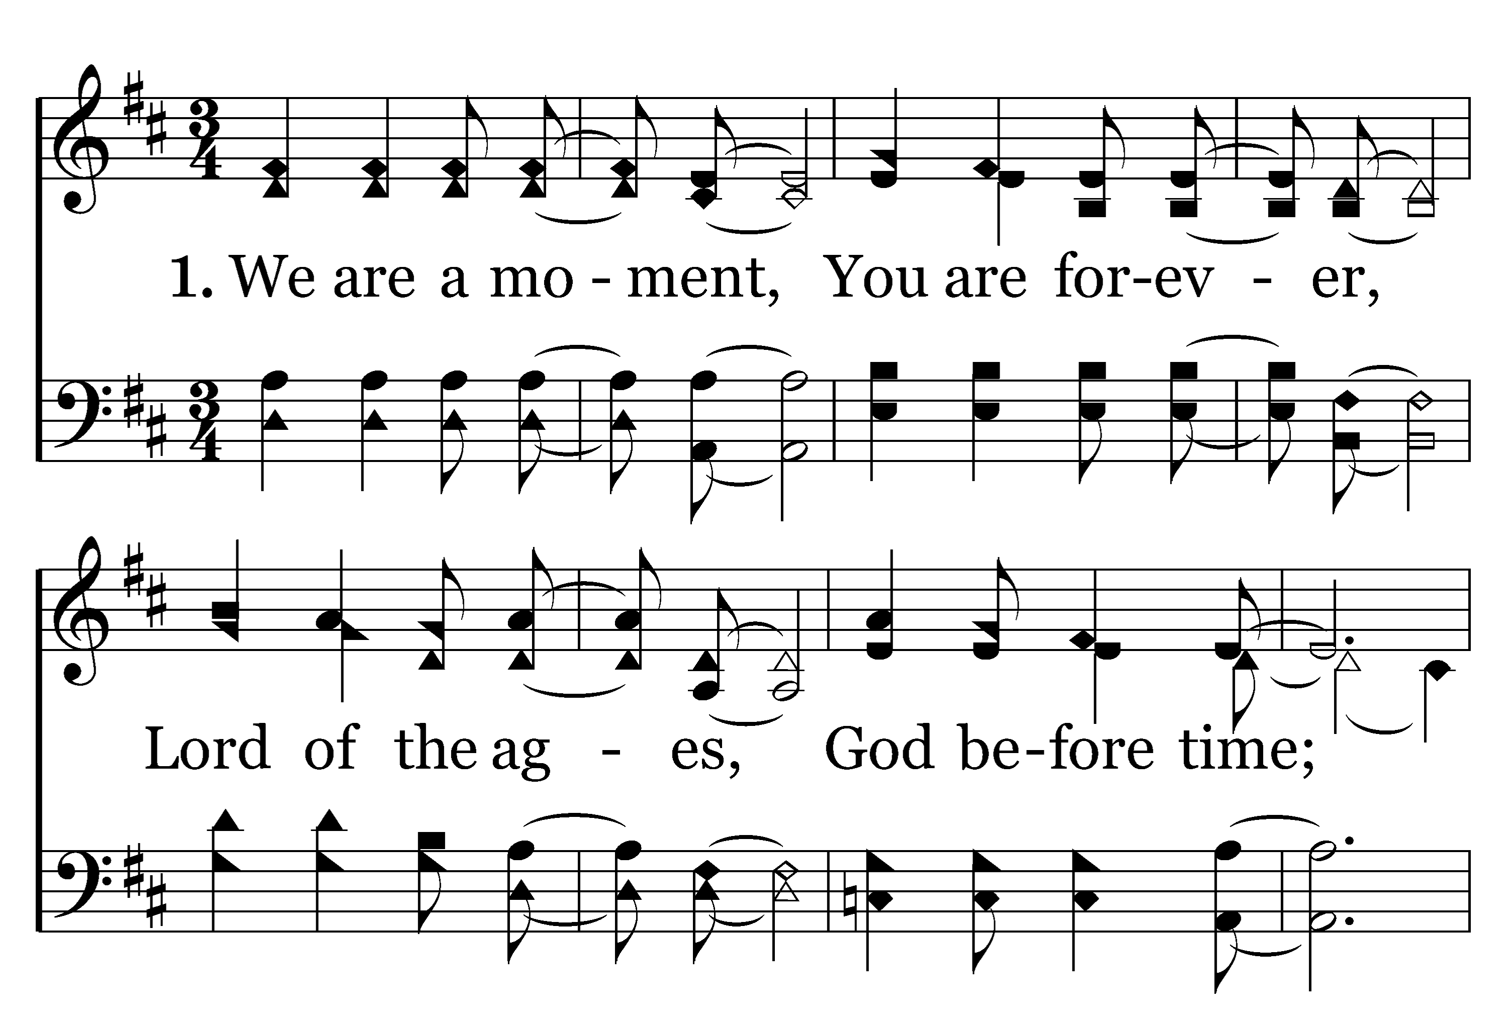

1
C
2
C
209
BE UNTO YOUR NAME
Typeset by R. J. Stevens Music

Slide 3
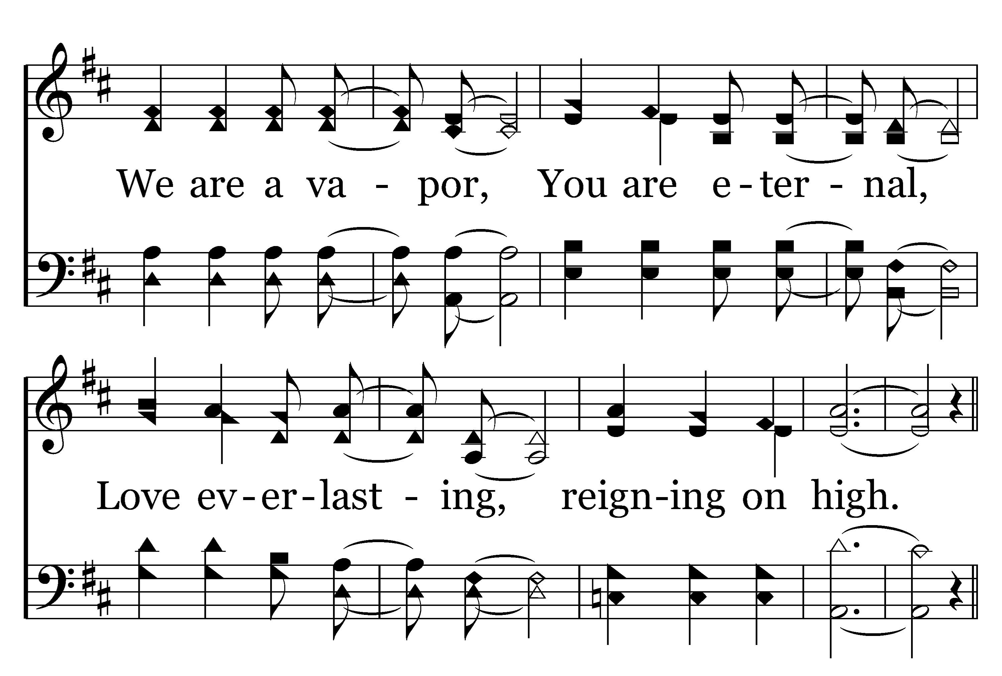
1
C
2
C
209
BE UNTO YOUR NAME
Typeset by R. J. Stevens Music

Slide 4
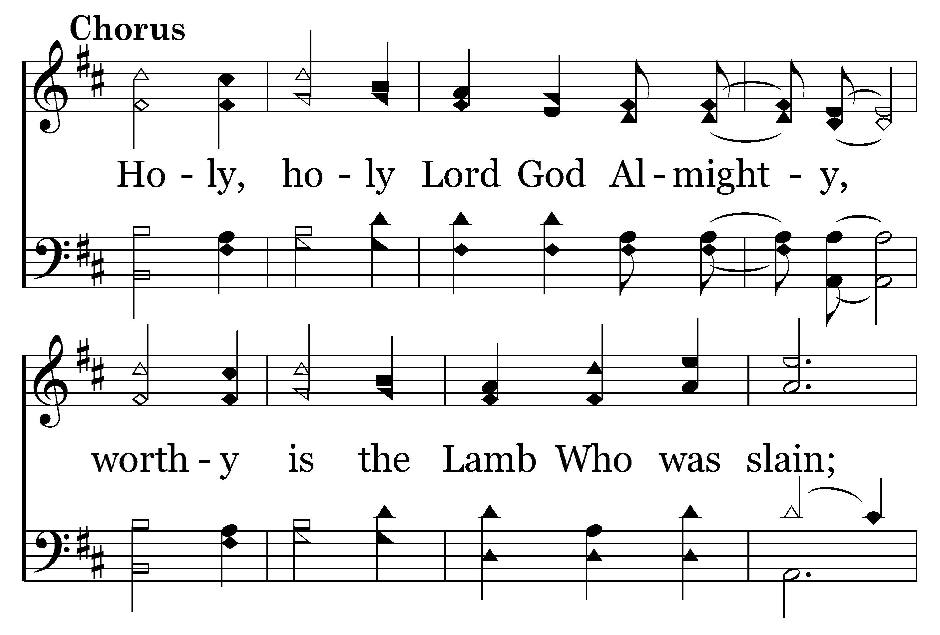
1
C
2
C
209
BE UNTO YOUR NAME
Typeset by R. J. Stevens Music

Slide 5
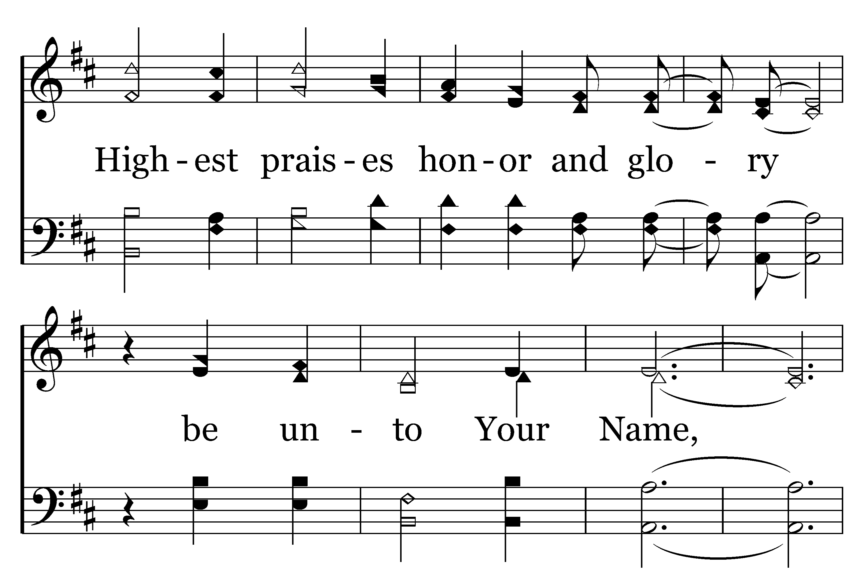
1
C
2
C
209
BE UNTO YOUR NAME
Typeset by R. J. Stevens Music

Slide 6
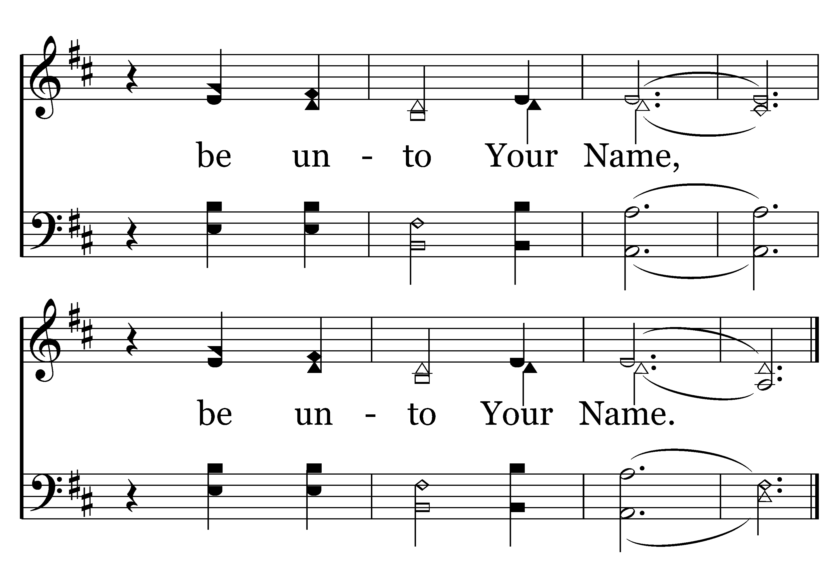
1
C
2
C
209
BE UNTO YOUR NAME
Typeset by R. J. Stevens Music

Slide 7
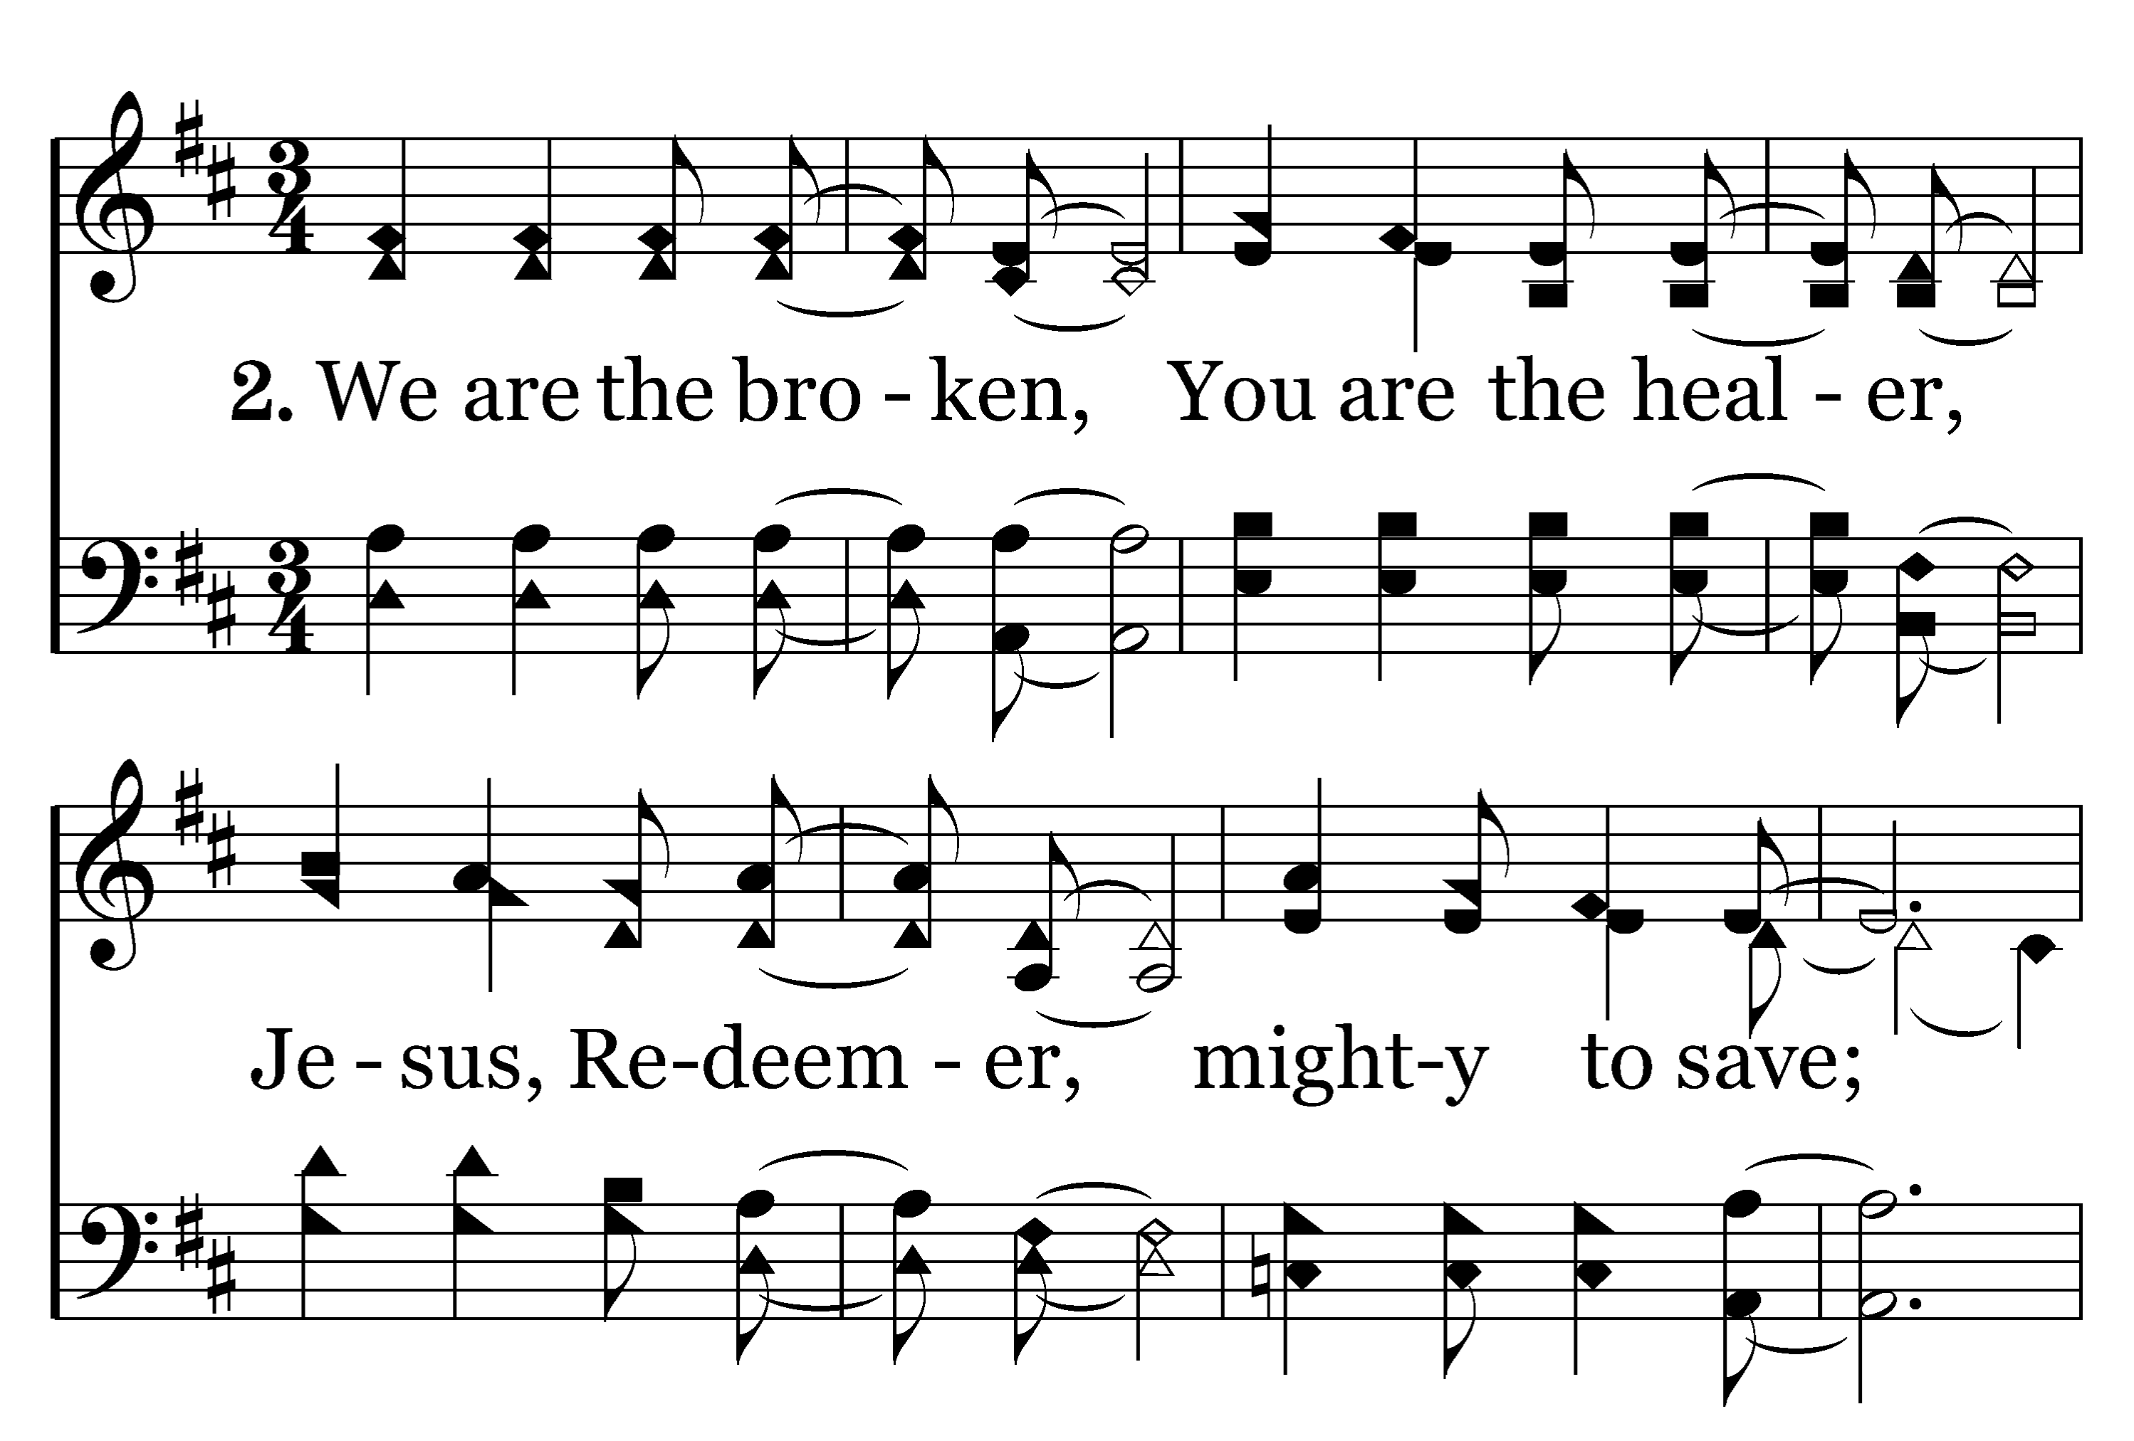
1
C
2
C
209
BE UNTO YOUR NAME
Typeset by R. J. Stevens Music

Slide 8
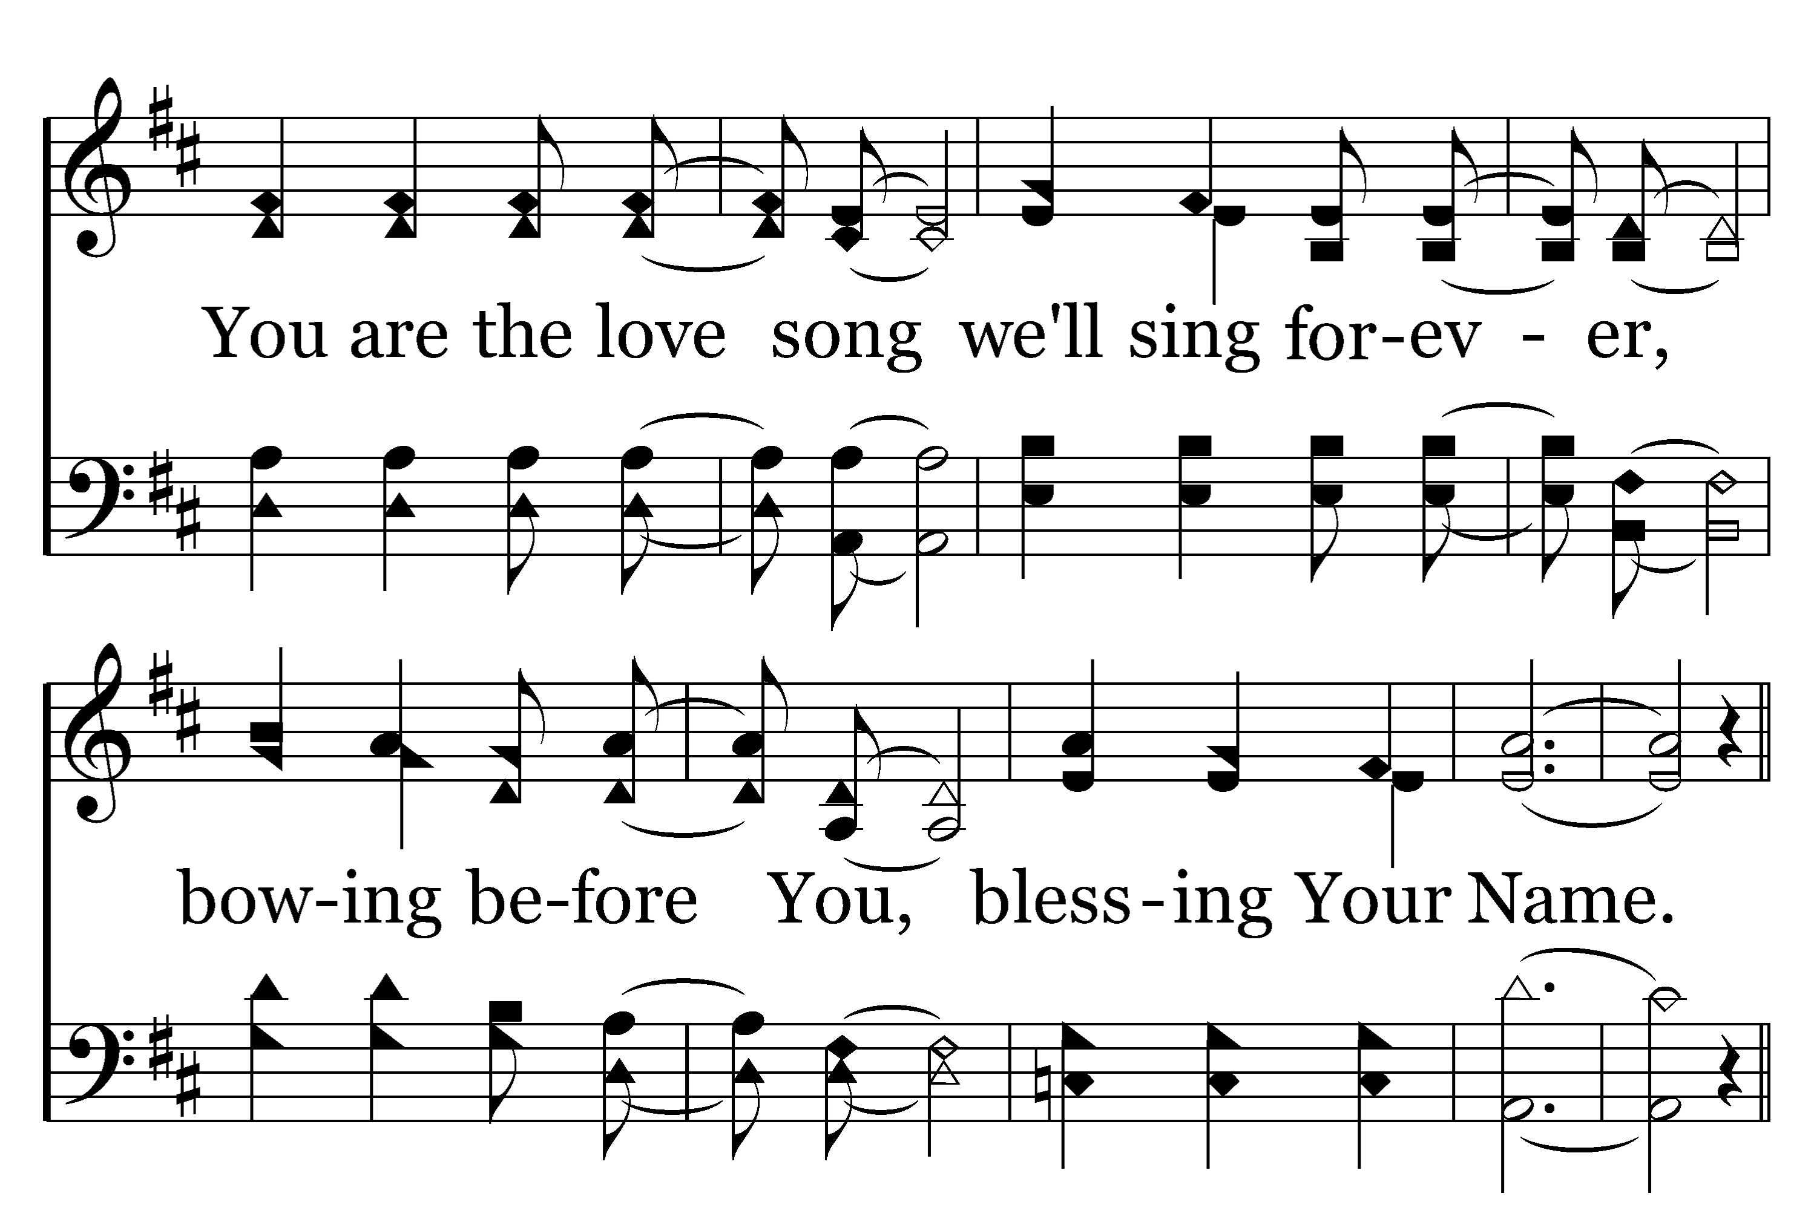
1
C
2
C
209
BE UNTO YOUR NAME
Typeset by R. J. Stevens Music

Slide 9
1
C
2
C
209
BE UNTO YOUR NAME
Typeset by R. J. Stevens Music

Slide 10
1
C
2
C
209
BE UNTO YOUR NAME
Typeset by R. J. Stevens Music

Slide 11
1
C
2
C
209
BE UNTO YOUR NAME
Typeset by R. J. Stevens Music

