Slide 1



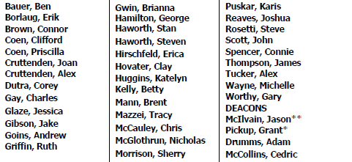
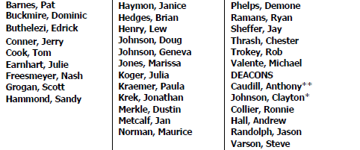
BASEMENT
Group Meetings
2A
12
7
Resource Room
Nursery
2B
Supply & Copy Center
AUDITORIUM

